Slide 1

Machine operation monitoring system for Spiral line TNF. Made for : THAI NIPPON FOODS CO.,LTD.
TOMAS TECH CO., LTD.

Slide 2
Proposal Overview

Slide 3
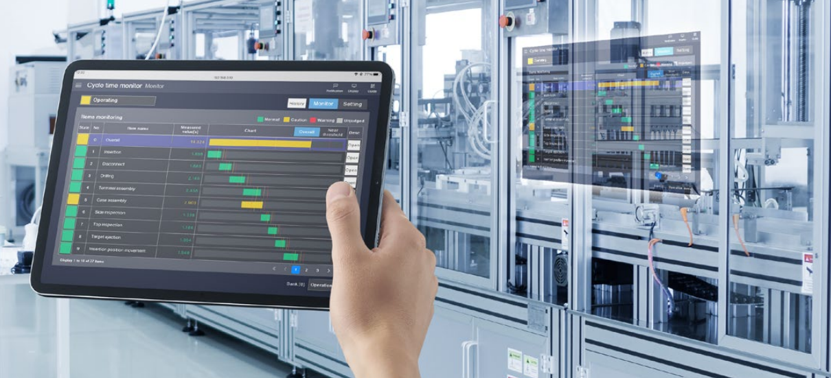
What is Machine operation monitoring system?
Machine Operation Monitoring systems is the process of using technology and systems to inspect and track the operations of machinery or equipment in manufacturing or service processes. It involves measuring and analyzing data to enhance efficiency and control the workflow for improved performance and safety. Real-time monitoring and control of events allow for the reduction of damages and risks in operations while increasing the overall efficiency of the organization.

Slide 4
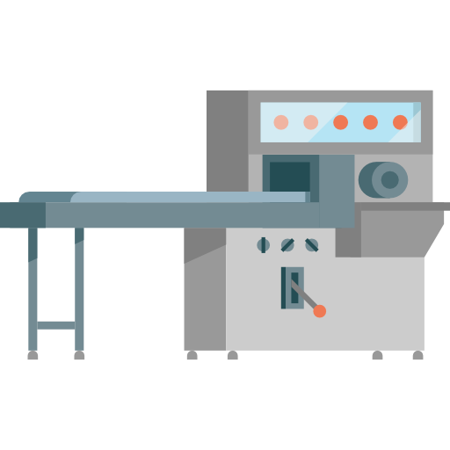
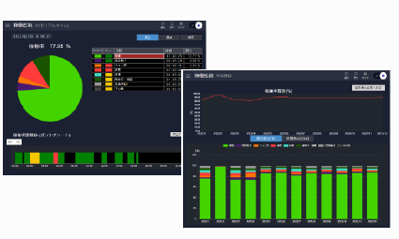
| Benefit of Machine operation monitoring system
The benefits of a Machine Operation Monitoring system are numerous and crucial in improving the performance and efficiency of an organization. Here are some key advantages:
Increased Efficiency: Machine Operation Monitoring systems analyze and track the operations of machinery closely, enabling the identification of issues and opportunities for process improvement. This results in enhanced operational efficiency.
Reduced Downtime: The system can detect abnormalities and provide real-time alerts when there are deviations in machine performance. This helps minimize unplanned downtime and increases overall machine uptime.
Minimized Damage and Risk: By continuously monitoring and detecting potential issues, the system aids in preventing accidents and minimizing damage or risk that could arise during operations.
Analysis and Performance Improvement: The system provides valuable data on machine and equipment performance, facilitating continuous testing and fine-tuning to optimize their capabilities.
Resource Savings: Machine Operation Monitoring helps organizations use resources efficiently by reducing non-essential usage and waste, leading to cost savings.
Informed Business Planning: The system provides valuable data for business managers and teams to make informed decisions and strategic planning based on the analysis of machine performance.
A well-implemented Machine Operation Monitoring system enhances an organization's ability to ensure safety, minimize disruptions, improve production processes, and ultimately deliver high-quality products or services to customers, fostering long-term success and customer satisfaction.

Slide 5

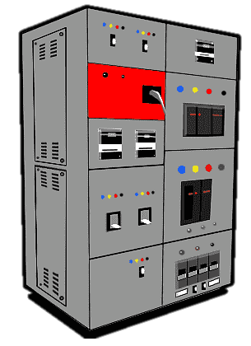
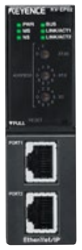
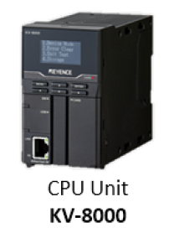
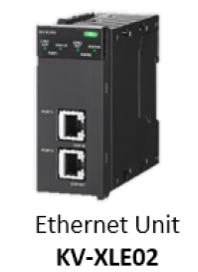
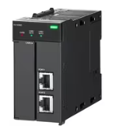

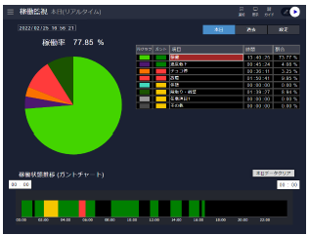

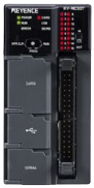


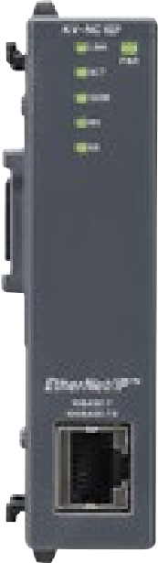
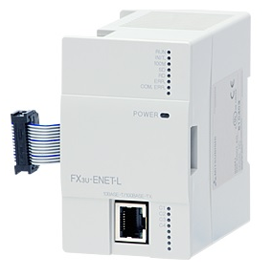
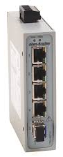
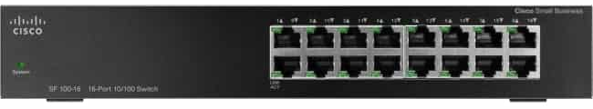
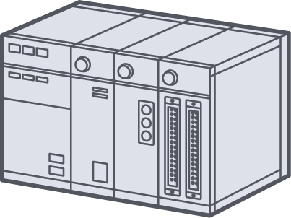
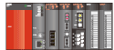
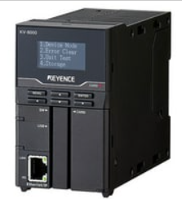
Main system outline
Monitoring system
Machine Link Ethernet
Hard wire control
I/O Link
Master PLC KV8000 + KV-XLE02 + KV-XD02
Data base
Machine Link I/O
Monitoring system
Realtime Monitoring
Data utilization Unit
KV-XD02
Ethernet
ADD MODULE FX3U-ENET-L
FX3U-ENET-ADP
HUB
HUB
Water treatment system
PLC FX3U
PLC-FX3G
Q03UDV
KV-7500

Slide 6

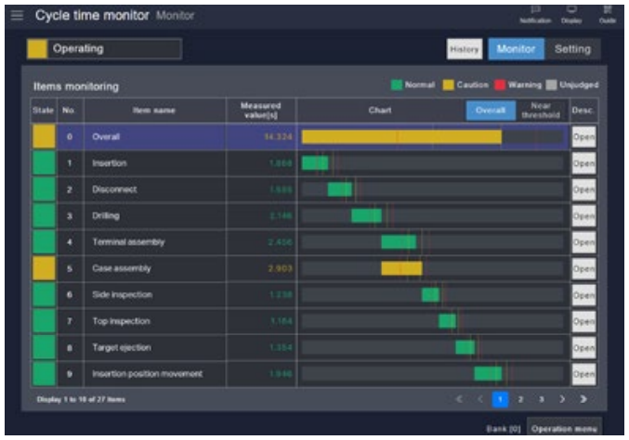









System Outline
Retrieving data from I/O machines will be able to access information about the machine's operation while the machine is running, stopped working, internal equipment, alarm, or damaged, which can monitor the problem and fix it immediately. to make the work possible smoothly
Machine I/O Link
PHASE 2
SERVER
Data Base
Dashboard
Marinate
PLC
Collect data
Access
point
WIFI-I/O
Module
Machine
Operation PC
Maintenance Tablet

Slide 7
System Outline
Extracting data from the machine in the form of accessing parameters in the PLC will be able to access the data and know all the details of the production. such as production model, production number, machine operation status Production model parameters and can record production data to be stored as well
Ethernet Link
PHASE 4
SERVER
Data Base
Dashboard
Cleanroom
PLC
Collect data
Operation PC
Maintenance Tablet

Slide 8
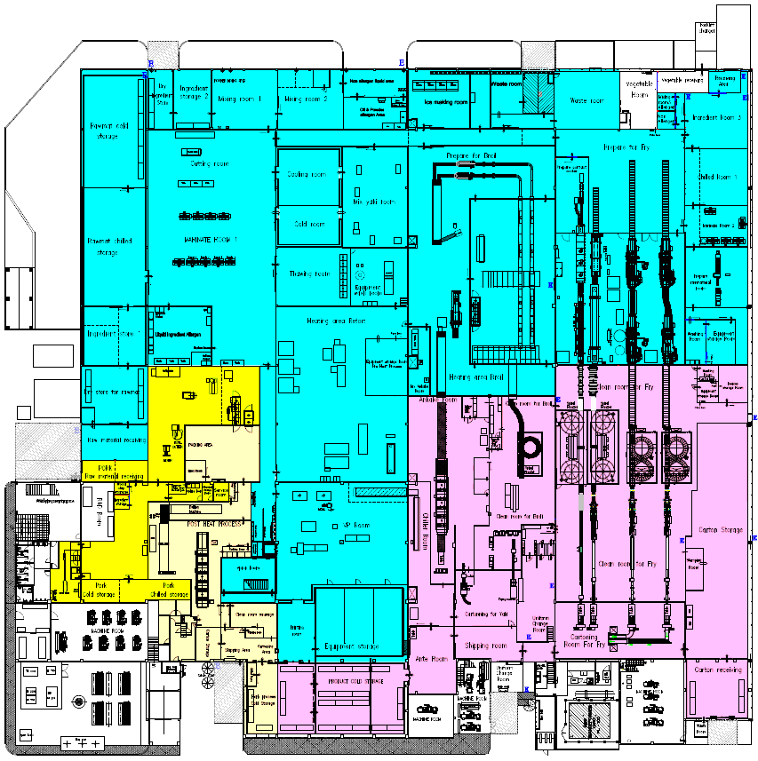

Machine survey in plant A ( 14 Machine )
Prepare for fry
( 7 Machine )
Clean room for fry
( Spiral room 4 Machine )
Clean room for fry
( Poly star 3 Machine)

Slide 9
| System outline ( Prepare for Fry room 7 Machine )
Plant A
Main switch hub plant A
Cable Lan
Cable core 32 ( 220V )
Box Main 2
STEAM COOK
Sun max
High-Cook 1
High-Cook New 1
Slave Box
2-1
KOPPEN FRYER
High-Cook 2
High-Cook New 2
Slave Box
2-1

Slide 10
| System outline ( Spiral room 4 Machine )
Plant A
Main switch hub plant A
Cable Lan
Cable core 32 ( 220V )
Box Main 3
Spiral No.7
Spiral No.6
Spiral No.3
Spiral No.2

Slide 11
| System outline ( Polystar room 3 Machine )
Plant A
Main switch hub plant A
Cable Lan
Cable core 32 ( 220V )
Box Main 4
Poly star 3
Poly star 2
Poly star 1

Slide 12
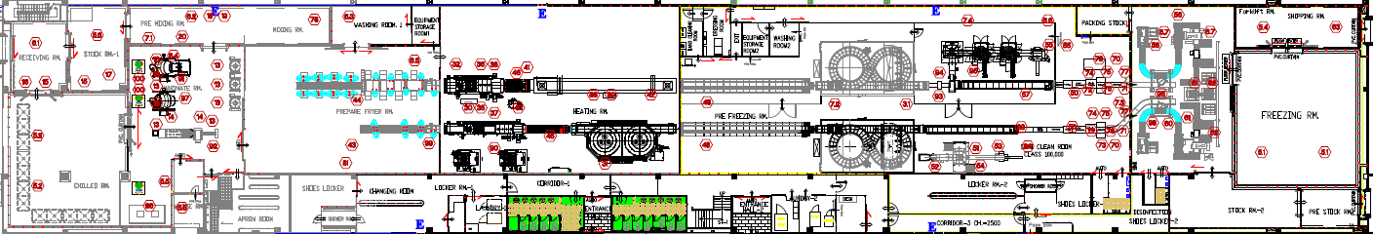
Machine survey in plant B ( 10 Machine )
Fry Fry
( 4 Machine )
Clean room 4
( 4 Machine )
Spiral room
( 2 Machine )

Slide 13
| System outline ( Fry Fry room 4 Machine )
Plant B
Main switch hub plant B
Cable Lan
Cable core 32 ( 220V )
Stream Oven 4
Fryer 1
Box Main 2
Clean room
Koppen Fryer
Fryer 2

Slide 14
| System outline ( Clean room 6 Machine )
Plant B
Main switch hub plant B
Cable Lan
Cable core 32 ( 220V )
Box Main 3
Vertical Packing 1
Vertical Packing 2
Spiral No.4
Packing room
Box Main 4
General Packer 2
General Packer 1
Spiral No.5

Slide 15
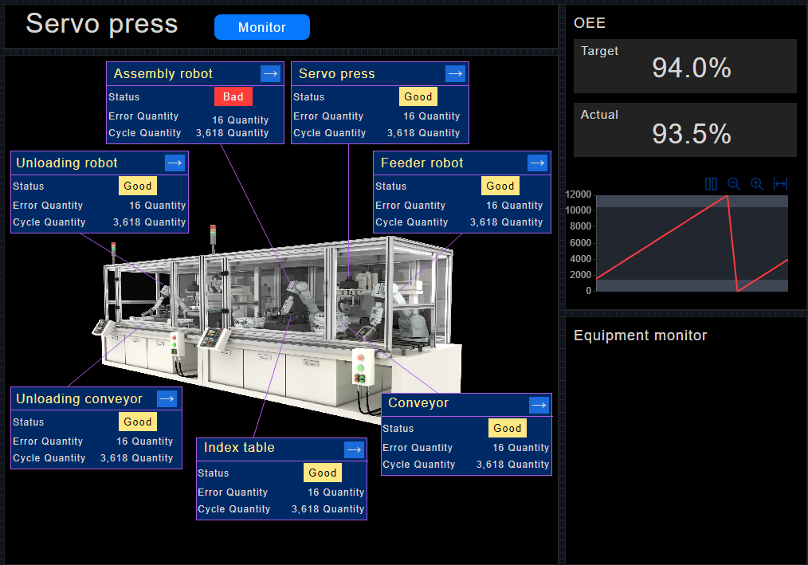
| Benefit of Machine operation monitoring system
Monitoring function
Machine Operation Monitoring systems analyze and track the operations of machinery closely, enabling the identification of issues and opportunities for process improvement. This results in enhanced operational efficiency.

Slide 16
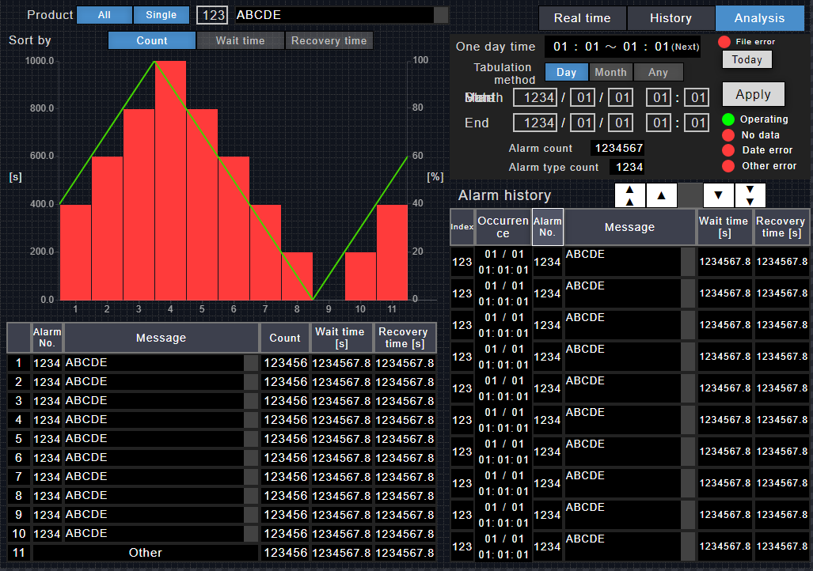
| Benefit of Machine operation monitoring system
Monitoring Reduced Downtime function
The system can detect abnormalities and provide real-time alerts when there are deviations in machine performance. This helps minimize unplanned downtime and increases overall machine uptime.

Slide 17
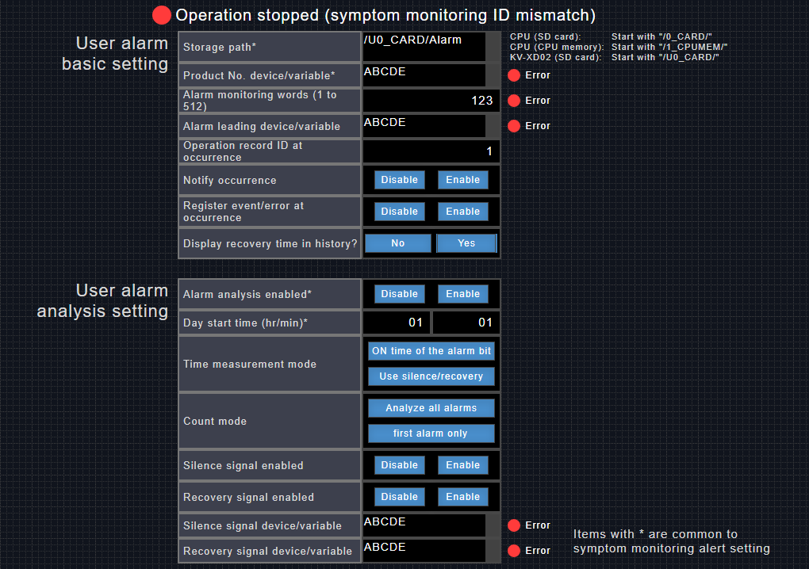
| Benefit of Machine operation monitoring system
Analysis and Performance Improvement
Analysis and Performance Improvement: The system provides valuable data on machine and equipment performance, facilitating continuous testing and fine-tuning to optimize their capabilities.

Slide 18
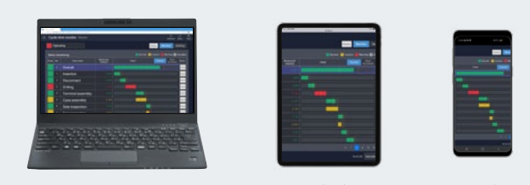
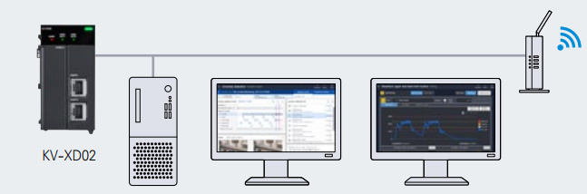
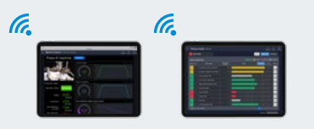
| Benefit of Machine operation monitoring system
Web server function
The web server functionality allows users to check device status from any device with a versatile web browser, including PCs, tablets, smartphones.
PC
Tablet
Smart phone
Up to 8 simultaneous connections
Remote connections from multiple browsers are possible. Each device can display a different screen.
at the site to check the status of current equipment while office equipment can be used to diagnose the latest problems.
Display 1
Display 2
Tablet 1
Tablet 2

Slide 19
