Slide 1
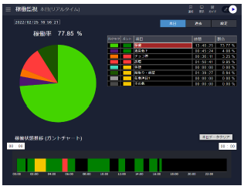
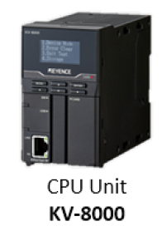
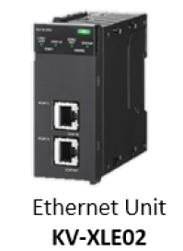
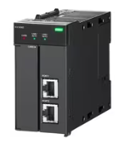
System Outline water treatment project
TNF server
( Backup once a day )
Master PLC
CSV file 2023/06
***.csv
Data utilization Unit
KV-XD02
CSV file 2023/07
***.csv
SD card version R1
CSV file 2023/08
***.csv
FTP communication
CSV file 2023/06
***.csv
1
CSV file 2023/07
***.csv
R1 SD card corruption
Change to R2 SD card
CSV file 2023/08
***.csv
SD card version R2
2
CSV file 2023/06
***.csv
Manual file transfer
CSV file 2023/07
***.csv
Please allow me to confirm your understanding of the content of today's discussion.
Is it correct to say that if we store the CSV backup file on the server and move the SD, we can check the data if we transfer the CSV file to the SD?
CSV file 2023/08
***.csv

