Slide 1

Version 04/Nov2025
Confidential
IoT Pokayoke Jig Project
for AH Brake (Thailand)
By : TOMAS TECH CO.,LTD AH Brake (Thailand) CO.,LTD

Slide 2
Pokayoke Jig Installation report 14/11/2025
Installation service Report
Cylinder #2 Line – OP for installation and quantity of proximity
1.OP10 - 8 Pcs.
- Model No.1 4 Pcs.
- Model No.2 4 Pcs.
2. OP20 - 8 Pcs.
OP20 -1 4 Pcs.
- Model No.1 2 Pcs
- Model No.2 2 Pcs
OP20 -2 4 Pcs
- Model No.1 2 Pcs.
- Model No.2 2 Pcs.
3. OP30 - 72 Pcs. And add Card Remote I/O
OP30 -1 24 Pcs.
- Model No.1 8 Pcs. (for Jig) and 16 Pcs. (for Tooling)
- Model No.2 8 Pcs. (for Jig) and 16 Pcs. (for Tooling)
OP30 -2 24 Pcs.
- Model No.1 8 Pcs. (for Jig) and 16 Pcs. (for Tooling)
- Model No.2 8 Pcs. (for Jig) and 16 Pcs. (for Tooling)
OP30 -1 24 Pcs.
- Model No.1 8 Pcs. (for Jig) and 16 Pcs. (for Tooling)
- Model No.2 8 Pcs. (for Jig) and 16 Pcs. (for Tooling)
4. OP40 - 24 Pcs. add Card Remote I/O
OP40 -1 12 Pcs
- Model No.1 6 Pcs.
- Model No.2 6 Pcs.
OP40 -2 12 Pcs
- Model No.1 6 Pcs.
- Model No.2 6 Pcs.
5. OP50 - 12 Pcs.
OP50 -1 4 Pcs
- Model No.1 2 Pcs.
- Model No.2 2 Pcs.
OP50 -2 4 Pcs
- Model No.1 2 Pcs.
- Model No.2 2 Pcs

Slide 3
Pokayoke Jig Installation report 14/11/2025
Installation service Report
Cylinder #2 Line – OP for installation and quantity of proximity
OP50 -3 4 Pcs
- Model No.1 2 Pcs.
- Model No.2 2 Pcs
Mounting #2 Line – OP for installation and quantity of proximity
1. OP10 - 8 Pcs.
OP10 -1 4 Pcs
- Model No.1 2 Pcs.
- Model No.2 2 Pcs
OP10 -2 4 Pcs
- Model No.1 2 Pcs.
- Model No.2 2 Pcs
2. OP20 - 4 Pcs.
- Model No.1 2 Pcs.
- Model No.2 2 Pcs

Slide 4
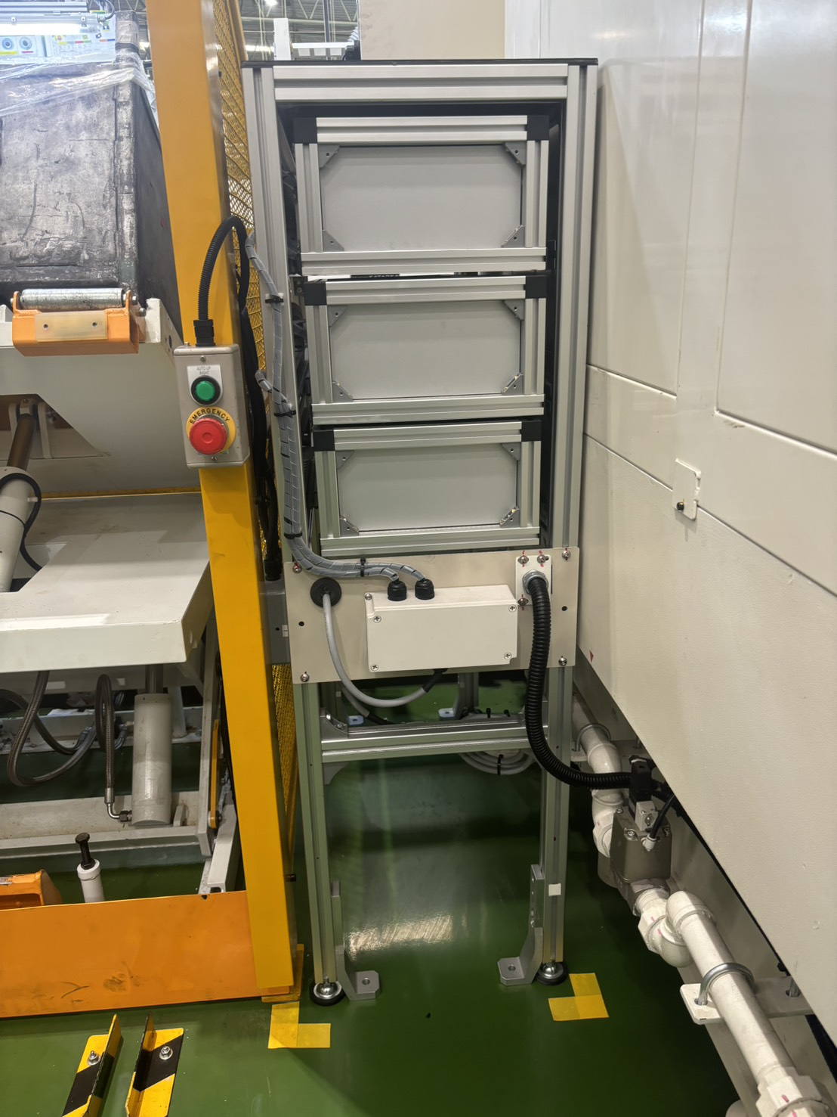
IoT Pokayoke Jig report 14/11/2025
Installation Relay Box and wiring
Line - Cylinder #2 OP10

Slide 5
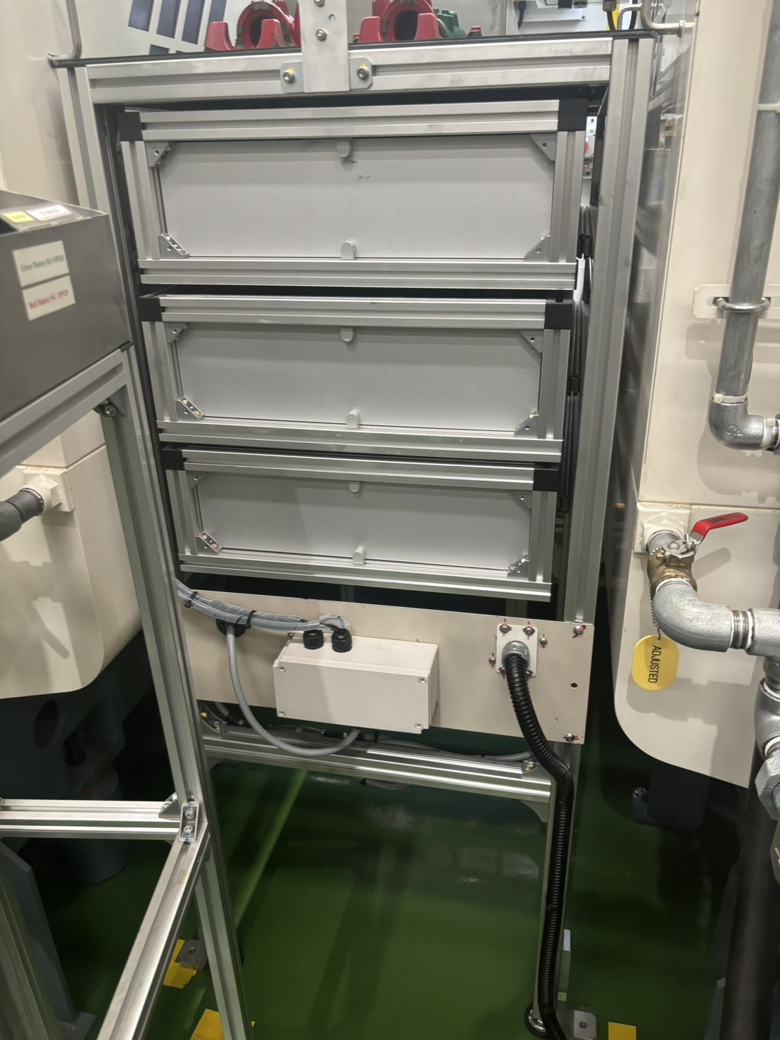
IoT Pokayoke Jig report 14/11/2025
Installation Relay Box and wiring
Line - Cylinder #2 OP20

Slide 6
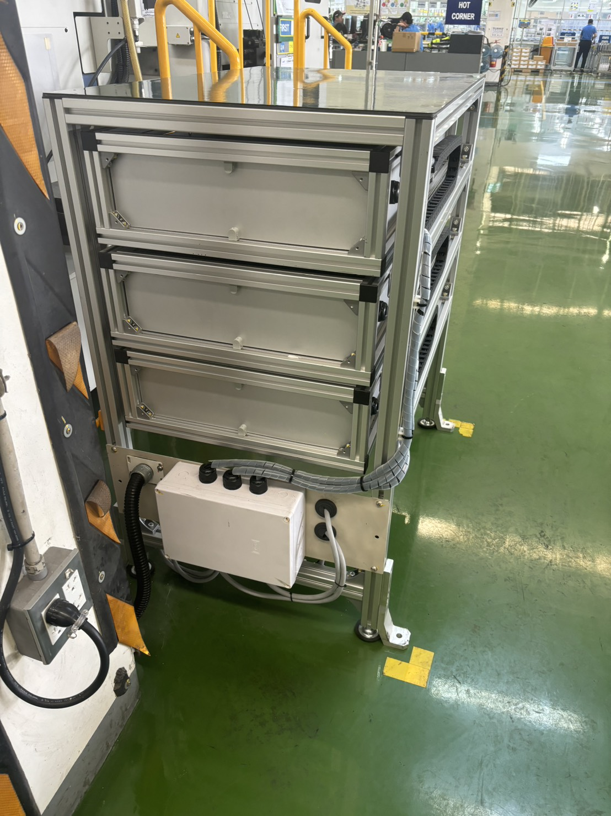
IoT Pokayoke Jig report 14/11/2025
Installation Relay Box and wiring
Line - Cylinder #2 OP30 (for Jig)

Slide 7
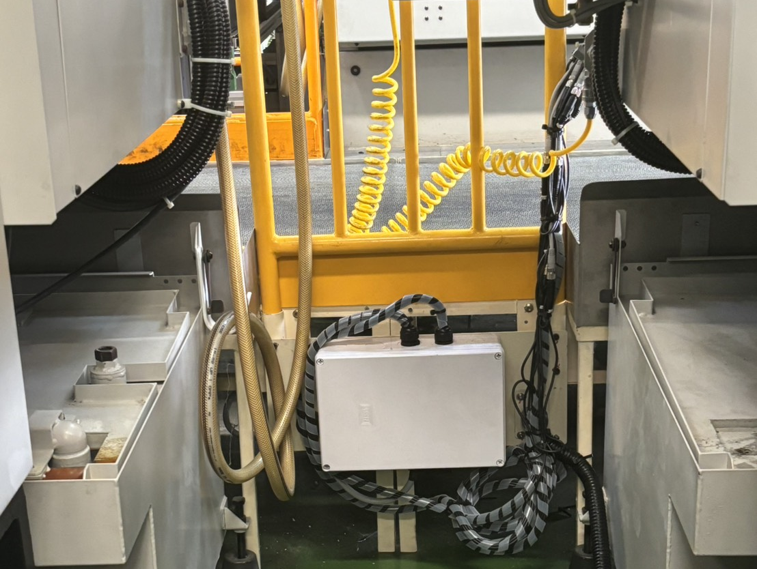
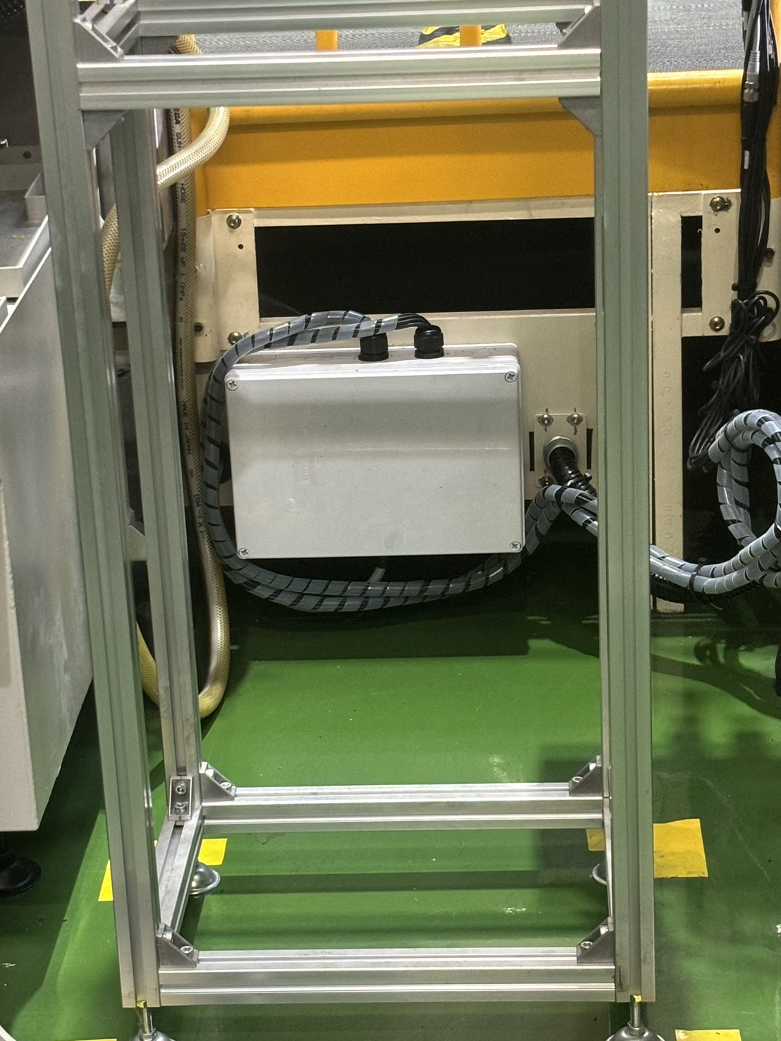
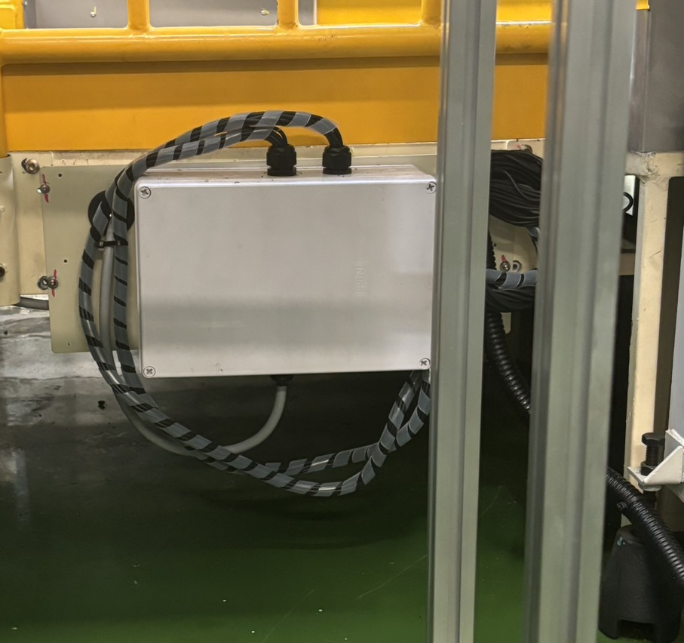
IoT Pokayoke Jig report 14/11/2025
Installation Relay Box and wiring
Line - Cylinder #2 OP30 (for Tooling)

Slide 8
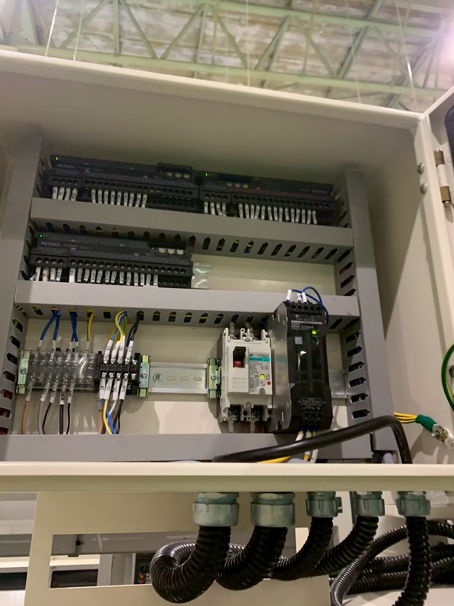
IoT Pokayoke Jig report 14/11/2025
Installation Relay Box and wiring
Line - Cylinder #2 OP30 (Add Card Remote I/O)

Slide 9
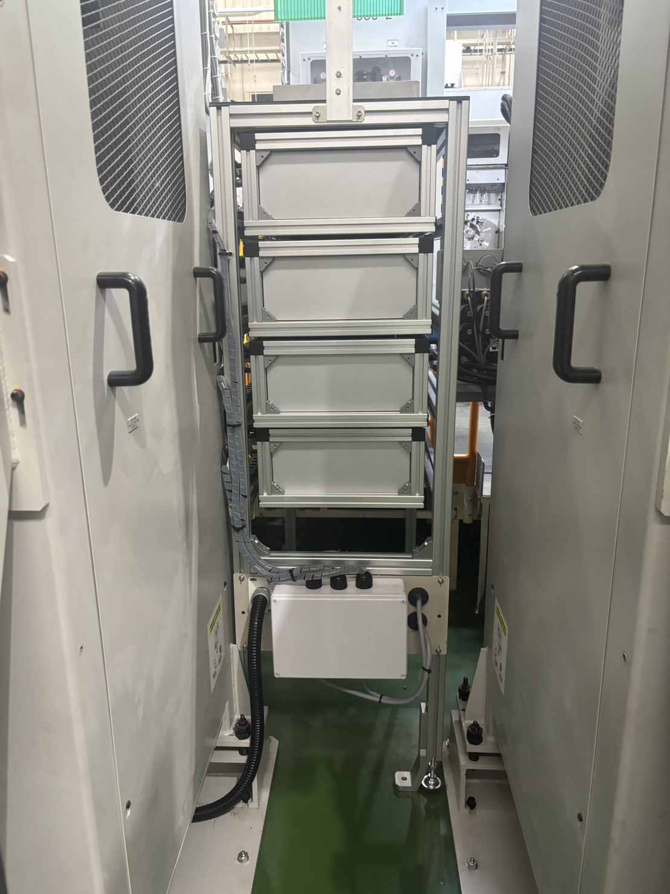
IoT Pokayoke Jig report 14/11/2025
Installation Relay Box and wiring
Line - Cylinder #2 OP40

Slide 10
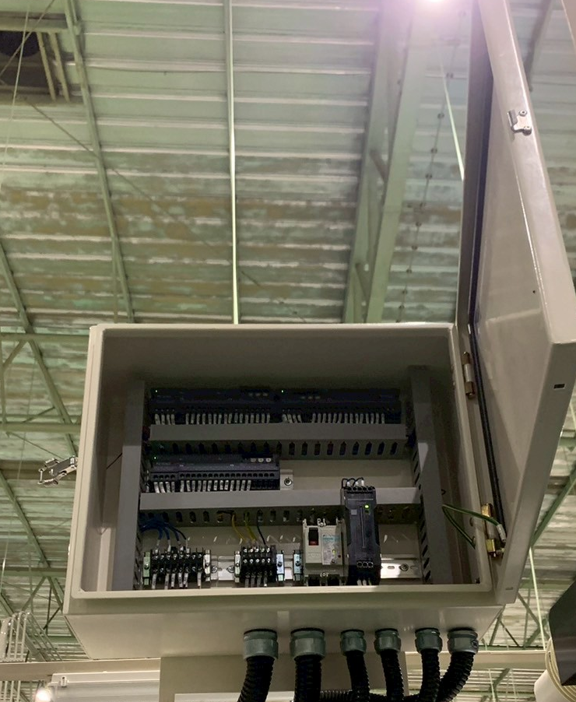
IoT Pokayoke Jig report 14/11/2025
Installation Relay Box and wiring
Line - Cylinder #2 OP40 (Add Card Remote I/O)

Slide 11
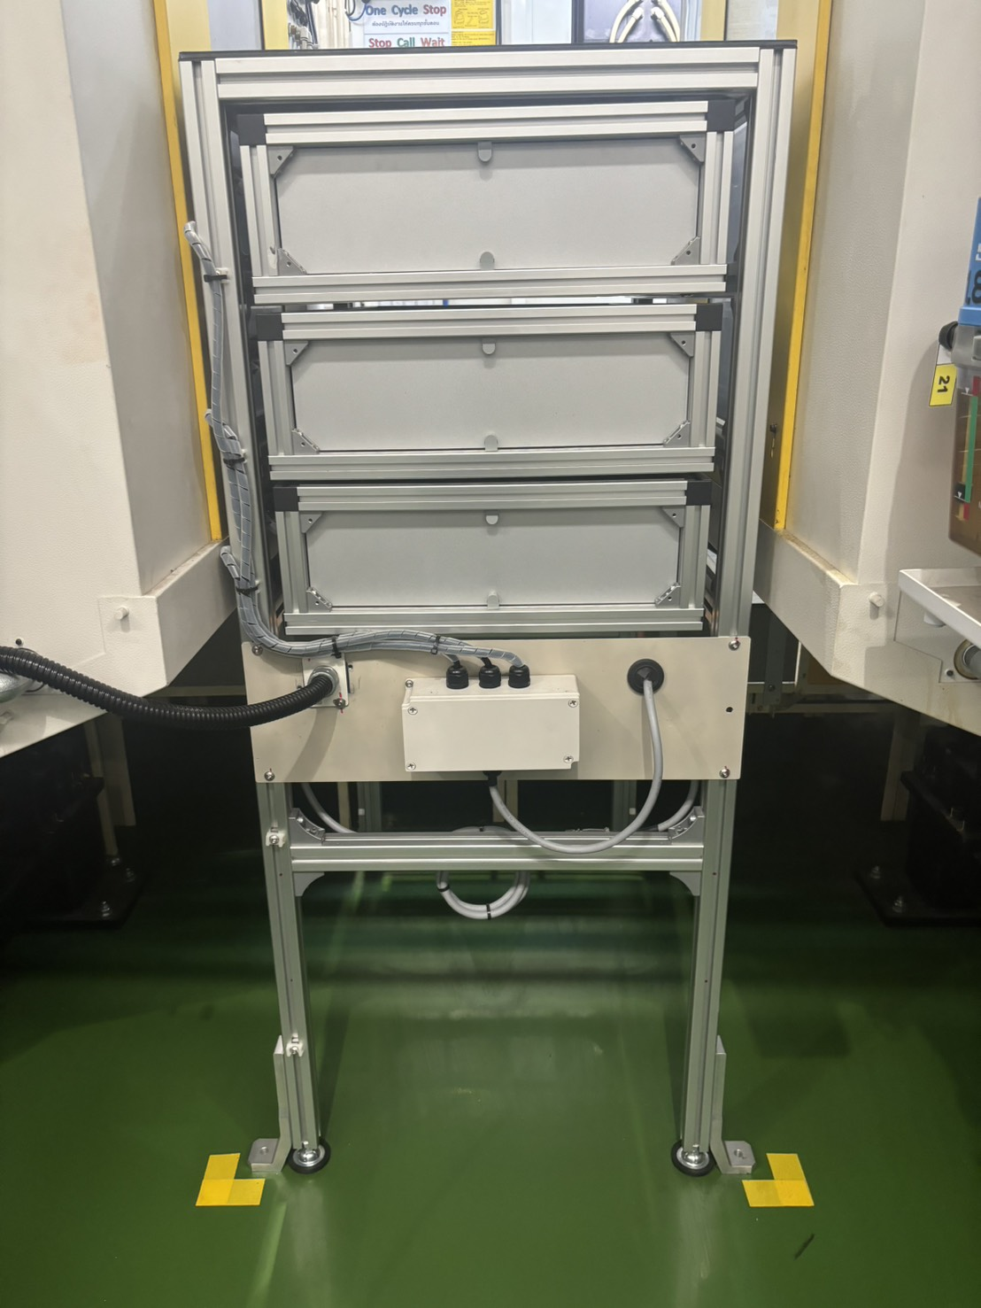
IoT Pokayoke Jig report 14/11/2025
Installation Relay Box and wiring
Line - Cylinder #2 OP50

Slide 12
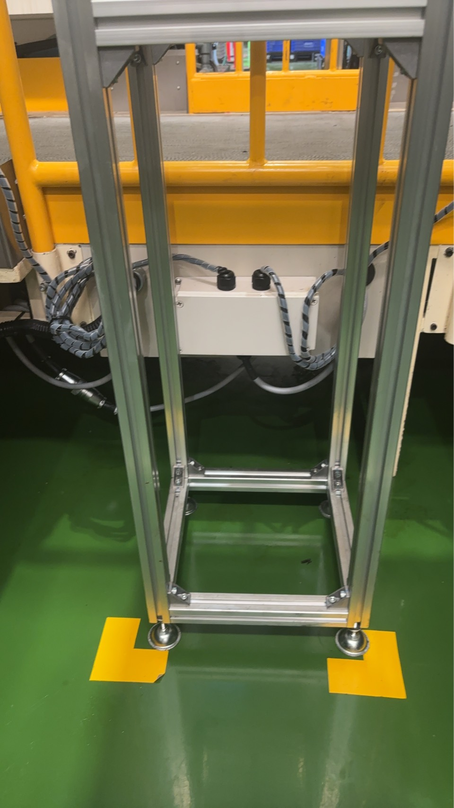
IoT Pokayoke Jig report 14/11/2025
Installation Relay Box and wiring
Line - Mounting #2 OP10

Slide 13
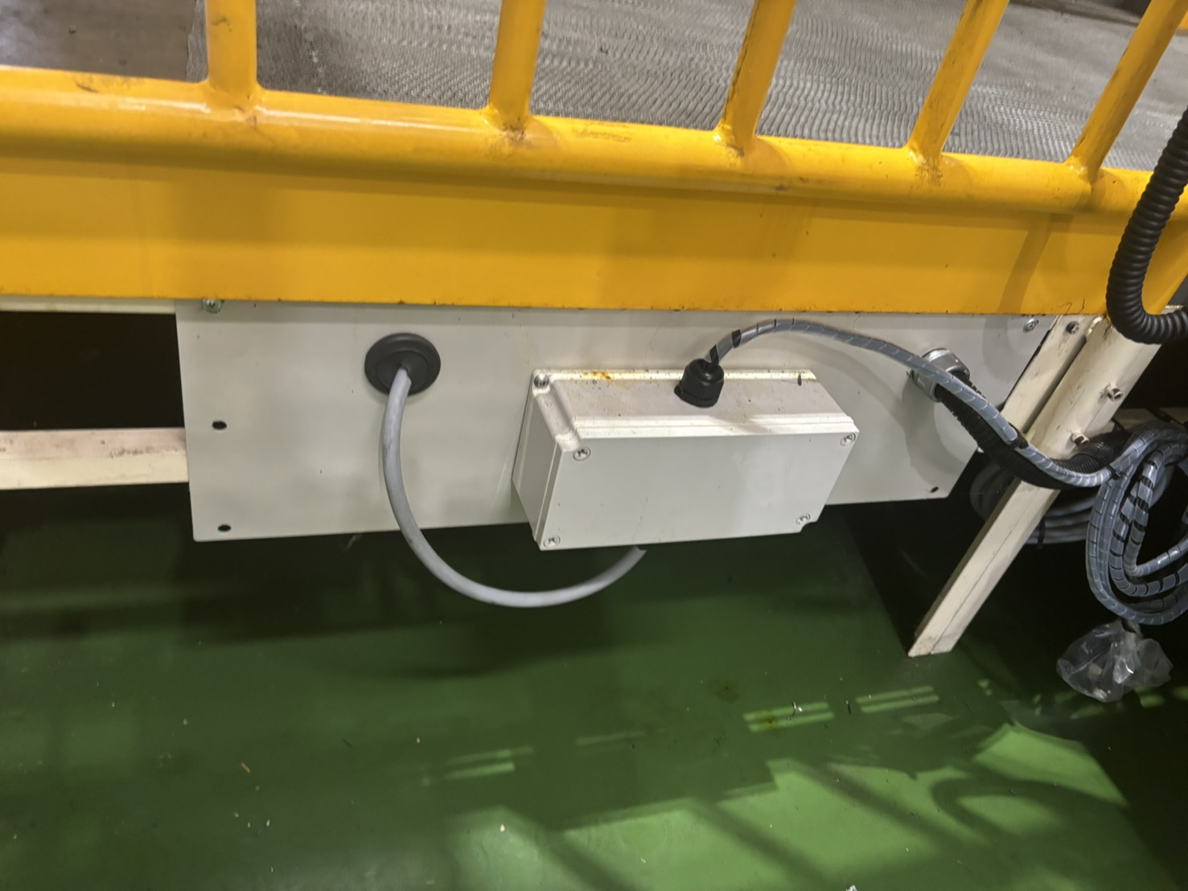
IoT Pokayoke Jig report 14/11/2025
Installation Relay Box and wiring
Line - Mounting #2 OP20

Slide 14
Sign off
With all these documents, this is part of the installation report and it is all the information of the project.
AH Brake (Thailand) CO., LTD.
Sign:
Name:
Title:
Date:
TOMAS TECH CO.,LTD.
Sign:
Name:
Title:
Date:
## END OF BLUEPRINT##

