Slide 1
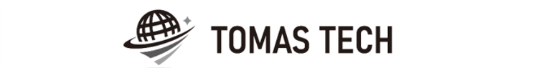
Version 14/Nov/2025
Confidential
CKD process system phase6 specifications
Documentation EN Blueprint for ANI
Blueprint
R8
Made for : A.N.I. LOGISTICS, LTD.
By : TOMAS TECH CO.,LTD.
TOMAS TECH CO.,LTD.
No.1 MD Tower 16Fl, Unit C1, Soi Bangna-Trad 25, Debaratna Rd., Khwaeng Bang Na Nuea
, Khet Bang Na, Bangkok 10260 Thailand
Tel :+66-98-271-9741 E-mail : Info@tomastc.com

Slide 2
Revision History
Date | Version | File name | Details
13/Aug/2025 | R1 | CKD process system phase6 specifications Documentation EN Blueprint for ANI Blueprint | First edition
20/Aug/2025 | R2 | CKD process system phase6 specifications Documentation EN Blueprint for ANI Blueprint | Second edition
27/Aug/2025 | R3 | CKD process system phase6 specifications Documentation EN Blueprint for ANI Blueprint | Third edition
4/Sep/2025 | R4 | CKD process system phase6 specifications Documentation EN Blueprint for ANI Blueprint | Fourth edition
6/Sep/2025 | R5 | CKD process system phase6 specifications Documentation EN Blueprint for ANI Blueprint | Fifth edition
18/Sep/2025 | R6 | CKD process system phase6 specifications Documentation EN Blueprint for ANI Blueprint | Sixth edition
8/Oct/2025 | R7 | CKD process system phase6 specifications Documentation EN Blueprint for ANI Blueprint | Seventh edition
14/Nov/2025 | R7 | CKD process system phase6 specifications Documentation EN Blueprint for ANI Blueprint | Eighth edition
2
3
4
5
6
7
8

Slide 3
■Contents
1. Overview
2. Overall configuration diagram
3. Document information
4. Operation flow
5. System functional specifications
6. Q&A
7. Sign off

Slide 4
1. Overview
Proposal of Process Management System to A.N.I.
By systematizing the CKD work process, we will realize “Improvement of quality", “Improvement of work efficiency", “Visualization of work", “Paperless" and “Traceability management".
Advantages of introducing the system
By scanning and verifying the visual confirmation work with a handy terminal, it is possible to prevent check mistakes by workers and expect "improvement of quality".
By acquiring the cycle time of the packing work, it becomes possible to analyze by process, worker, and control number, and "improvement of work efficiency" can be expected.
By creating a system, on-site managers, office managers, and people in charge of other processes will be able to grasp the work status, realizing "visualization of work". By visualizing the on-site situation, it is possible to manage the progress of the Material Stock process, which can be expected to improve work efficiency.
By enabling the necessary information to be viewed on PCs, handy terminals, tablets, and TV displays, it is possible to realize "paperless" by digitizing forms.
"Traceability management" can be realized because it is possible to take pictures of the actual product and the product as well as the result of verification by the handy terminal.

Slide 5
2. Overall configuration diagram
Regarding the CKD process system, consider the following system configuration.
Overall configuration diagram image
Server Room
Fiber optic communication
ANI CKD process server BK
ANI CKD process server
LAN communication
WIFI communication
HATC schedule data
HATC schedule data
System unit
Printing label (New)
Using label (Old)
UPS
UPS
Show document
TV 75” for monitor *2
S/W Hub
A/P *9
Receiving area
Stock & Staging area
Inner packing area
Outer Packing area
Handy terminal *3
Tablet *3
Label printer for Tag receive *1
Handy terminal * 21
Tablet *21
Label printer for Content label *7
Parts contents tag receive
Parts contents tag receive
Parts contents tag receive
Contents label
Meiji card for Tablet
Meiji card for Tablet
Contents label
Packing check sheet
Meiji card for Tablet
Case mark
Bolt area
Small area
Handy terminal *4
Tablet *4
Label printer for Content label *4
Handy terminal *6
Tablet *6
Label printer for Content label *6
Packing method for Tablet
Inner panel area
Vanning area
Re finish area
Handy terminal *5
Tablet *5
Label printer for Content label *5
Handy terminal *4
Tablet *4
Handy terminal *1
Tablet *1

Slide 6
2. Overall configuration diagram
Network diagram
ANI office
Lan cable
Pegasus
server
Wi-Fi
Client pc
Switching hub
Access Point
IM
IV
WS
Handy terminal#1
Handy terminal#N
TMNS Warehouse

Slide 7
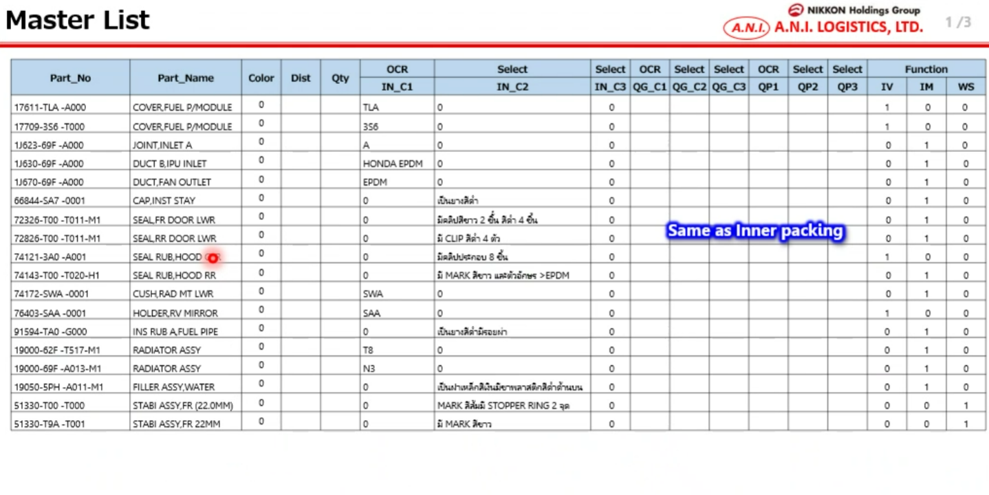
3. Document information
5
3. Document information
3.1. OCR Master
Get data from HATC

Slide 8
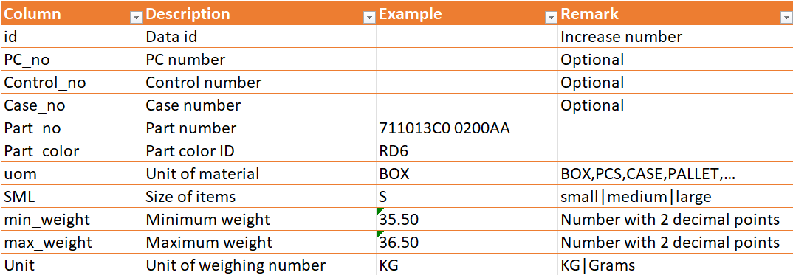
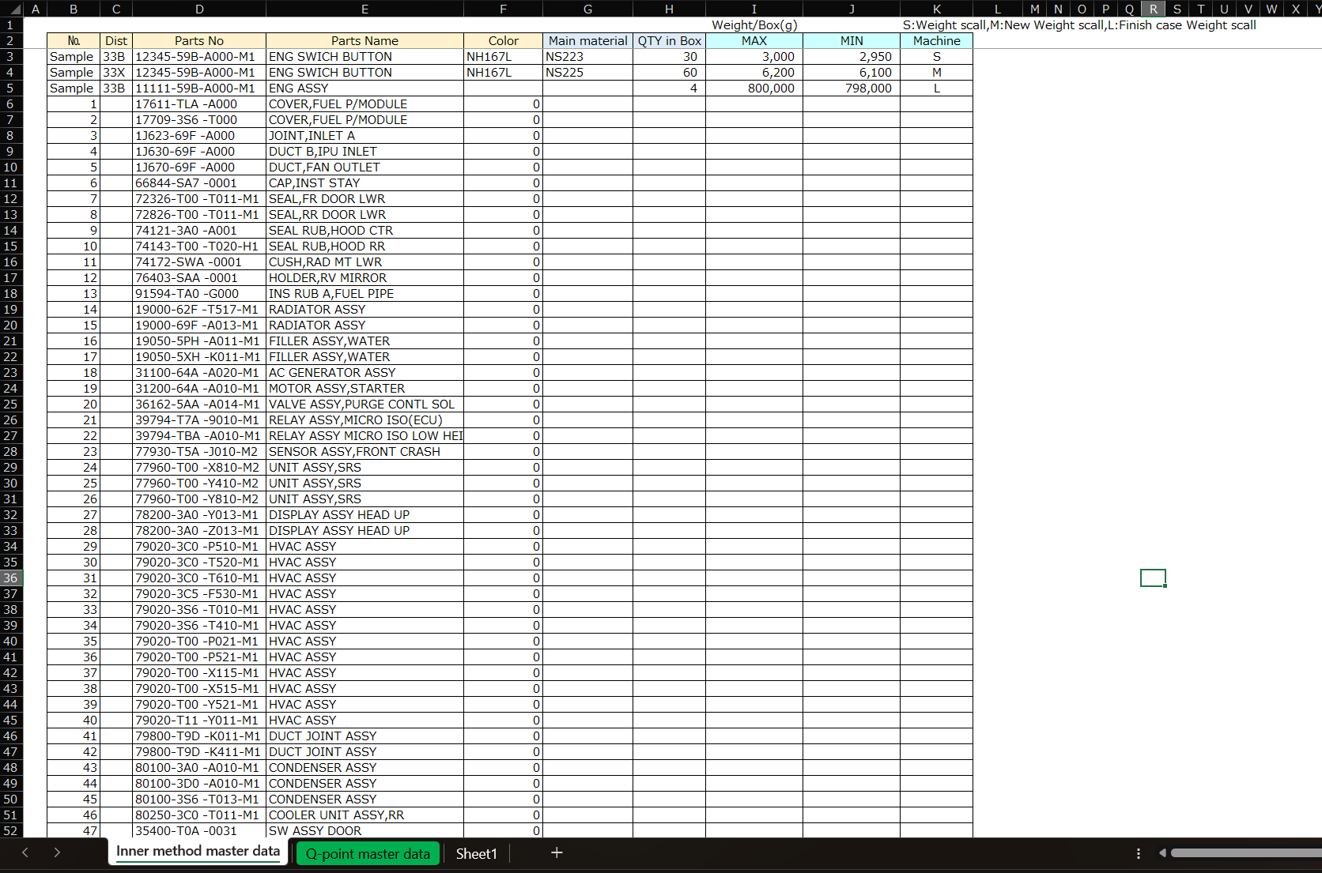
3. Document information
3
3. Document information
3.2 Weight Scale Master

Slide 9
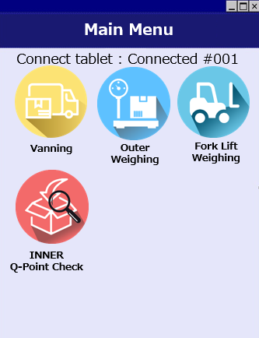
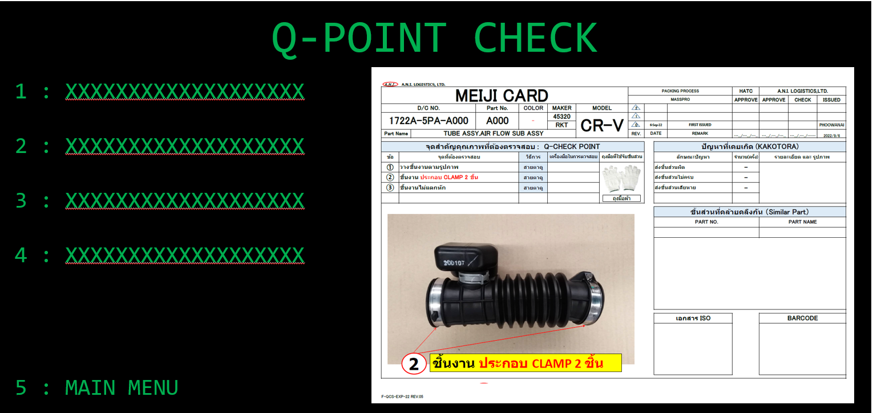
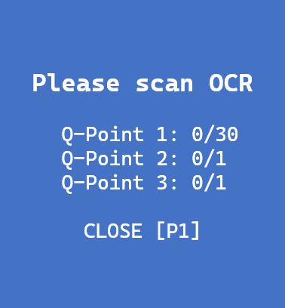
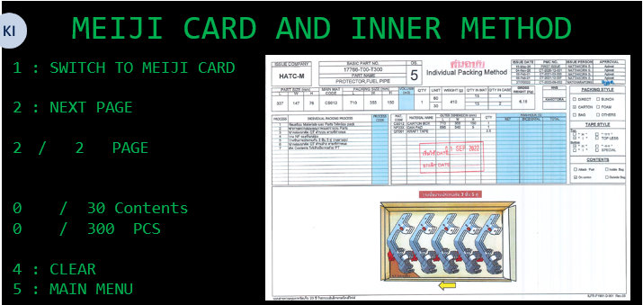
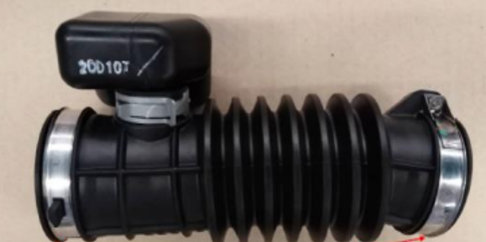

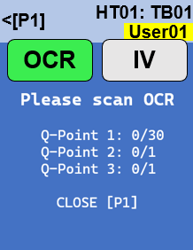
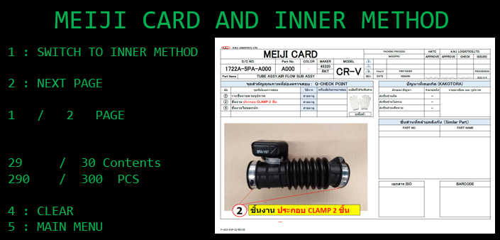
4. Operation flow
5
4. Operation flow
4-1. OCR - PC & Handy – TRIM INNER PACKING
Trim area
HT01: TB01
<[P1]
User01
Standby
Waiting for process
HT01: TB01
<[P1]
OCR
User01
IV
Able to performed at the same time
The last contents scan process can be performed only after the OCR & IV have been completed.
OCR & IV
Completed
The OCR&IV must be finished!!
1: Close
OK[P4]
HT01: TB01
<[P1]
User01
Standby
Waiting for process
Instructions
1. Add the OCR scan by handy
1.1 Adding new function that able to use handy to scan OCR
1.2 Create OCR checking master
1.2.1 Web page for master
1.2.2 Able to set the multiple scan for 3 conditions
1.3 Prioritize the OCR and able to make decision if failed on scan. It needs to unlock by leader(keep history)
1.4 PC INNER has been changed to ask n time(Count)
- Show number of actual/total_count
1.5 PC INNER acts as the old operation if the OCR master hasn't provided
1.6 History & transactions report

Slide 10
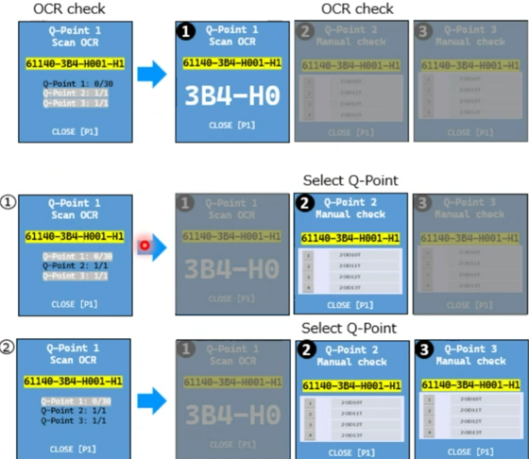
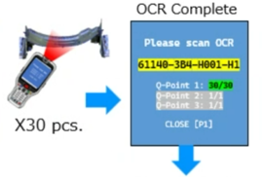
4. Operation flow
5
4. Operation flow
4-1. OCR - PC & Handy – TRIM INNER PACKING (Handy)
Trim area
HT01: TB01
<[P1]
User01
Standby
Waiting for process
OCR & IV
Completed
OK[P4]
HT01: TB01
<[P1]
User01
Standby
Waiting for process
Instructions
1. Add the OCR scan by handy
1.1 Adding new function that able to use handy to scan OCR
1.2 Create OCR checking master
1.2.1 Web page for master
1.2.2 Able to set the multiple scan for 3 conditions
1.3 Prioritize the OCR and able to make decision if failed on scan. It needs to unlock by leader(keep history)
1.4 PC INNER has been changed to ask n time(Count)
- Show number of actual/total_count
1.5 PC INNER acts as the old operation if the OCR master hasn't provided
1.6 History & transactions report

Slide 11
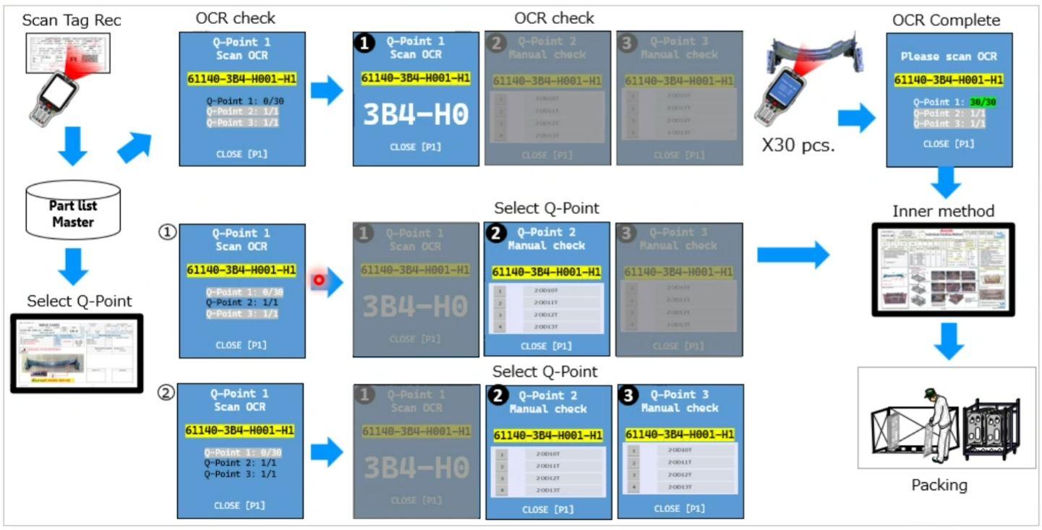
4. Operation flow
2
4. Operation flow
4-1. OCR - PC & Handy – TRIM INNER PACKING
Trim area
Checking Master / OCR Master
Master data not available!!
Instructions
1. Add the OCR scan by handy
1.1 Adding new function that able to use handy to scan OCR
1.2 Create OCR checking master
1.2.1 Web page for master
1.2.2 Able to set the multiple scan for 3 conditions
1.3 Prioritize the OCR and able to make decision if failed on scan. It needs to unlock by leader(keep history)
1.4 PC INNER has been changed to ask n time(Count)
- Show number of actual/total_count
1.5 PC INNER acts as the old operation if the OCR master hasn't provided
1.6 History & transactions report

Slide 12
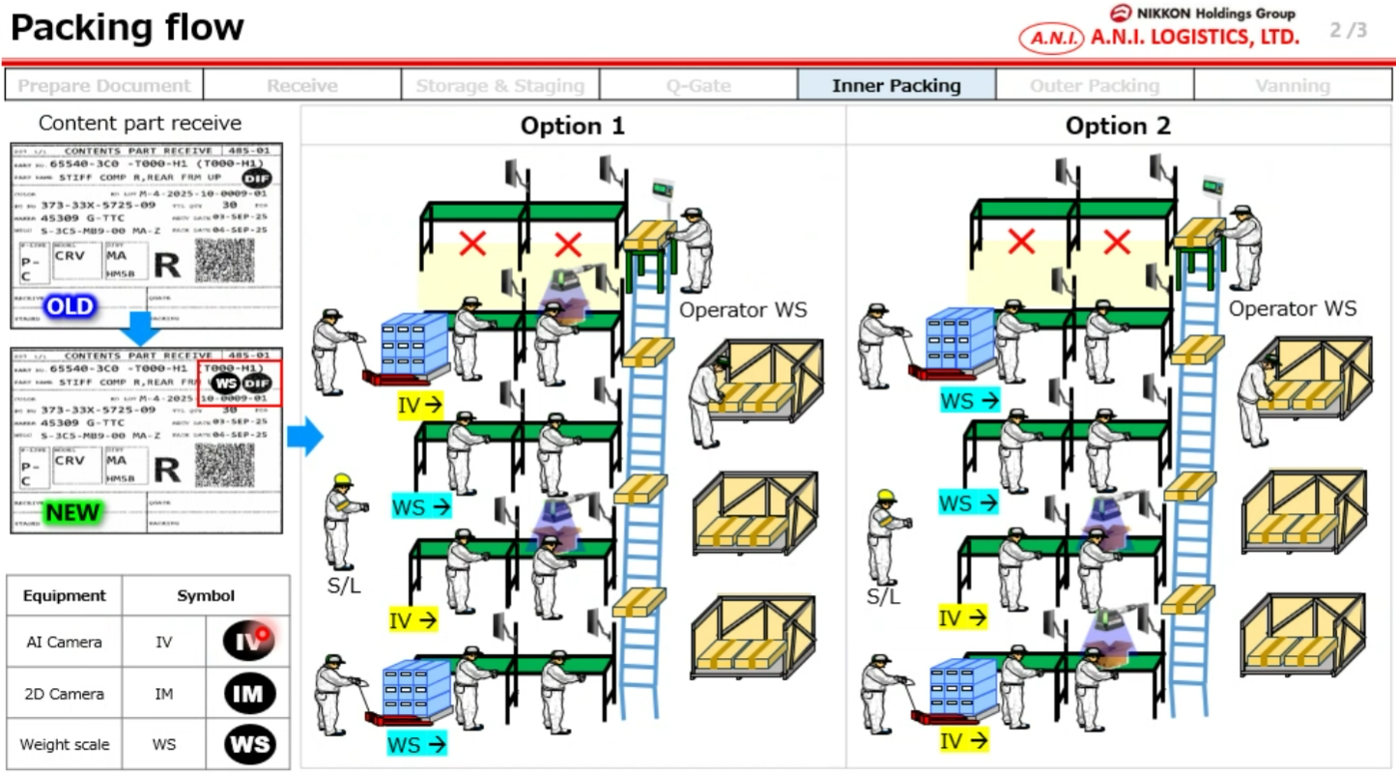
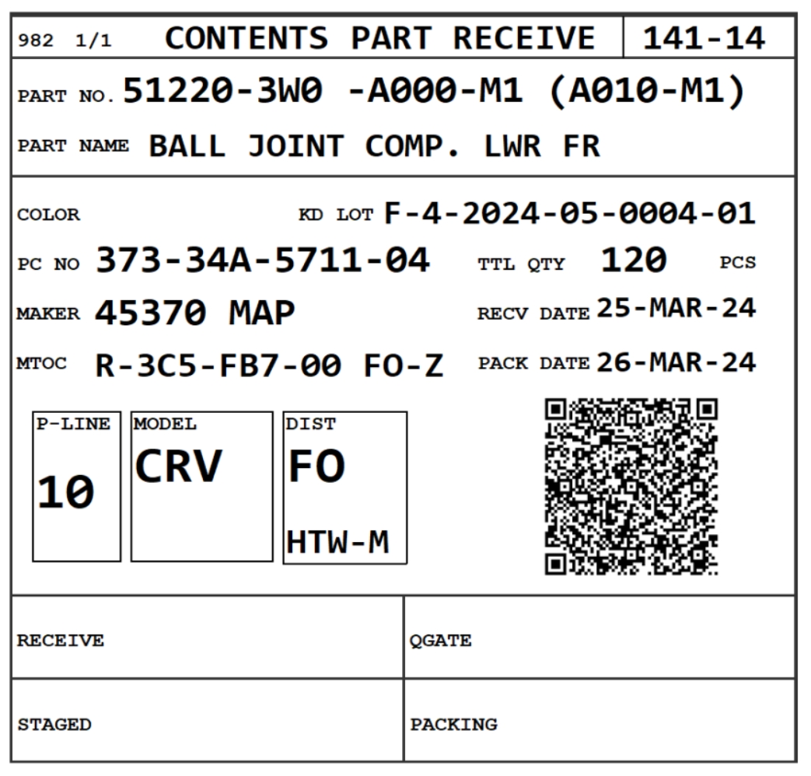
4. Operation flow
5
4. Operation flow
4-1. OCR - PC & Handy – TRIM INNER PACKING
Add “IV”, “IM”, “WS” icon to tag receive label regarding each flag column equals to 1 from OCR master and ProductionScheduleTagReceive.
(Fixed position)
DIF
R
IV
IV
IM
WS

Slide 13

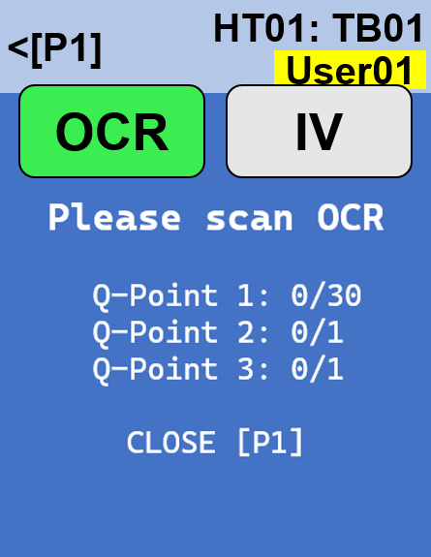

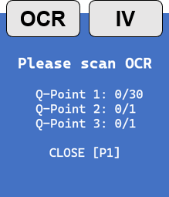
4. Operation flow
8
4. Operation flow
4-1. OCR - PC & Handy – Work table side switching
Working on TB01
TB02
QR Code
TB02
3
Change table?
YES[P3]
NO[P4]
Click “YES” to confirm switch to another table
Handy will get the current production data of another job.
The worker is able to packing another production line.
Handy will reload the saved production data and continue the job.
TB01
QR Code
TB02
Change table?
3
YES[P3]
NO[P4]

Slide 14
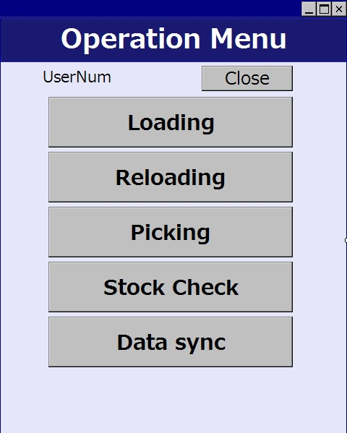
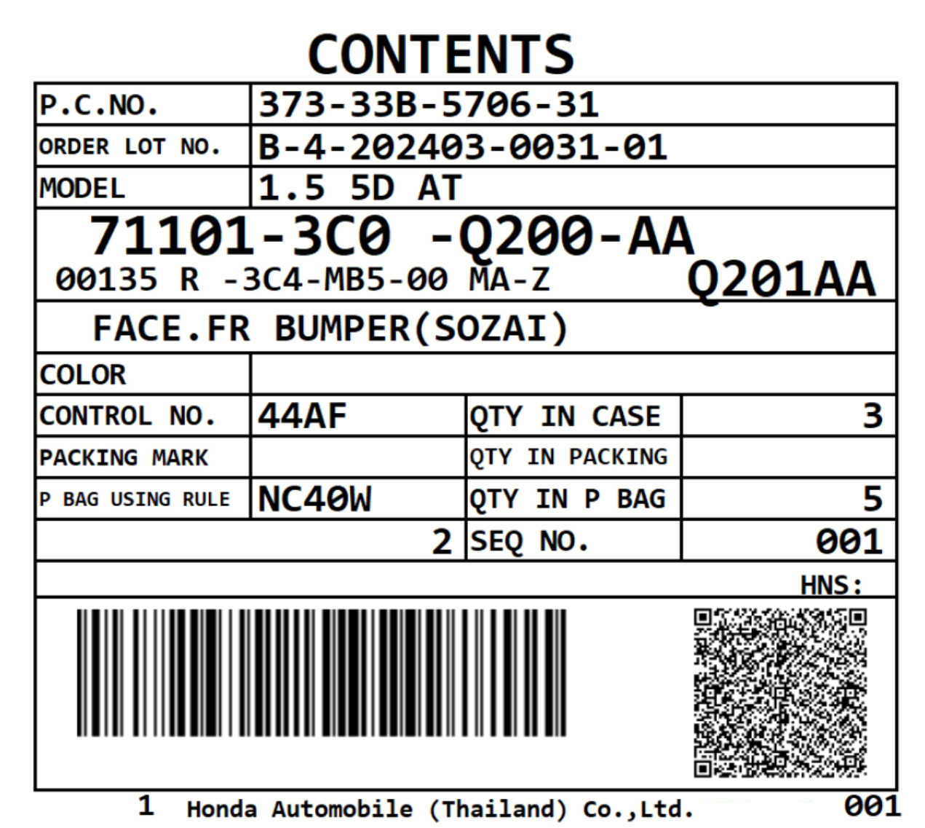




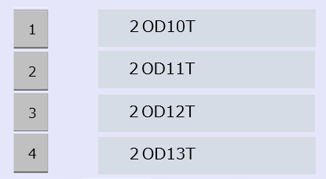
4. Operation flow
3
4. Operation flow
4-2. OCR - Handy – PANEL INNER PACKING
Panel area
Inner Packing area
Inner Packing area
Connect tablet : Connected #001
Connect tablet : Connected #001
Color
-
Qty
30
PC No
37A-33S-5122-01
Case no
22
Control
311F
TTL Seq no
2
12
Control
312F
Packing
TTL Qty
36
TTL Qty
9
27
240
Please select the number that matches the marking no.
NO | PART NO | OCR | QTY in Case
1 | 711013C0 0200AA | W | 27/30
2 | 71234555 0923BB | - | 0/10
3 | 172115YA Z500 | W | 0/1
4 | 82871671 0003 | W | 0/40
1
２OD10T
2
２OD11T
３
２OD12T
The last contents scan process can be performed only after the OCR have been completed.
4
２OD13T
F1
Menu
F1
Menu
F1
Menu
F1
Menu
F1
Menu
F1
Menu
F1
Menu
F1
Menu
Main
Menu [P1]
Clear
[P2]
Pending
[P3]
NG
[P4]
Main
Menu [P1]
Clear
[P2]
Pending
[P3]
NG
[P4]
Q-Point 3
Manual check
711013C0 0200AA
CLOSE [P1]
Q-Point 1
Scan OCR
711013C0 0200AA
Q-Point 1: 0/30
Q-Point 2: 1/1
Q-Point 3: 1/1
CLOSE [P1]
Q-Point 1
Scan OCR
711013C0 0200AA
TA
CLOSE [P1]
Q-Point 2
Manual check
711013C0 0200AA
CLOSE [P1]
Inner Packing area
Connect tablet : Connected #001
PC No
37A-33S-5122-01
Case no
22
OCR
Completed
Please scan OCR
711013C0 0200AA
Q-Point 1: 30/30
Q-Point 2: 1/1
Q-Point 3: 1/1
CLOSE [P1]
Control
311F
TTL Seq no
2
12
Packing
TTL Qty
36
TTL Qty
10
30
240
NO | PART NO | OCR | QTY in Case
1 | 711013C0 0200AA | OK | 30/30
2 | 71234555 0923BB | - | 0/10
3 | 172115YA Z500 | W | 0/1
4 | 82871671 0003 | W | 0/40
OK[P4]
F1
Menu
F1
Menu
F1
Menu
F1
Menu
Main
Menu [P1]
Clear
[P2]
Pending
[P3]
NG
[P4]

Slide 15
4. Operation flow
2
4. Operation flow
4-2. OCR - Handy – PANEL INNER PACKING
Panel area
Checking Master / OCR Master
Master data not available!!
Inner Packing area
Inner Packing area
Connect tablet : Connected #001
Connect tablet : Connected #001
Color
-
Qty
30
PC No
37A-33S-5122-01
Case no
22
Control
Control
311F
TTL Seq no
2
12
312F
Packing
TTL Qty
36
TTL Qty
Please select the number that matches the marking no.
9
27
240
1
２OD10T
NO | PART NO | OCR | QTY in Case
1 | 711013C0 0200AA | W | 27/30
2 | 71234555 0923BB | - | 0/10
3 | 172115YA Z500 | W | 0/1
4 | 82871671 0003 | W | 0/40
2
２OD11T
The screen will display a hyphen (-) for items that do not require OCR processing
３
２OD12T
4
２OD13T
F1
Menu
F1
Menu
F1
Menu
F1
Menu
F1
Menu
F1
Menu
F1
Menu
F1
Menu
Main
Menu [P1]
Clear
[P2]
Pending
[P3]
NG
[P4]
Main
Menu [P1]
Clear
[P2]
Pending
[P3]
NG
[P4]
Instructions
1. Add the OCR scan by handy
1.1 Adding new function that able to use handy to scan OCR
1.2 Create OCR checking master
1.2.1 Web page for master
1.2.2 Able to set the multiple scan for 3 conditions
1.3 Prioritize the OCR and able to make decision if failed on scan. It needs to unlock by leader(keep history)
1.4 PC INNER has been changed to ask n time(Count)
- Show number of actual/total_count
1.5 PC INNER acts as the old operation if the OCR master hasn't provided
1.6 History & transactions report

Slide 16

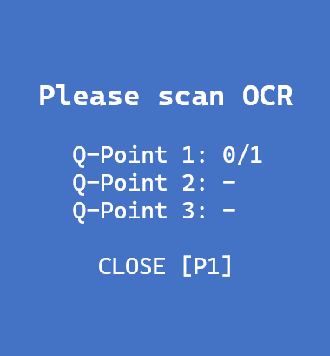
4. Operation flow
2
4. Operation flow
4-3. OCR - Handy – Q-Gate Check
Q-Gate checking process
Please scan OCR
63240-T00-T000-H01
Q-Point 1: 0/1
Q-Point 2: -
Q-Point 3: -
CLOSE [P1]
Q-Gate Check
Connect tablet : Connected #001
PC No
37A-33S-5122-01
Control
311F
Parts no
63240-T00-T000-H01
Color
-
TTL Qty
240
120
BOX NO | PART NO / OCR | OCR | IM | QTY in Case
1 | 63240-T00-T000-H01 | W | W | 60
2 | 63240-T00-T000-H01 | - | W | 60
3 | 63240-T00-T000-H01 | W | - | 60
4 | 63240-T00-T000-H01 | W | - | 60
F1
Menu
F1
Menu
F1
Menu
F1
Menu
Main
Menu [P1]
Clear
[P2]
Recheck
[P3]
Confirm
[P4]
Q-Gate Check
Connect tablet : Connected #001
PC No
37A-33S-5122-01
Control
311F
OCR
Completed
Please scan OCR
63240-T00-T000-H01
Q-Point 1: 1/1
Q-Point 2: -
Q-Point 3: -
CLOSE [P1]
Parts no
63240-T00-T000-H01
Color
-
TTL Qty
240
120
BOX NO | PART NO / OCR | OCR | IM | QTY in Case
1 | 63240-T00-T000-H01 | OK | W | 60
2 | 63240-T00-T000-H01 | - | W | 60
3 | 63240-T00-T000-H01 | W | - | 60
4 | 63240-T00-T000-H01 | W | - | 60
OK[P4]
F1
Menu
F1
Menu
F1
Menu
F1
Menu
Main
Menu [P1]
Clear
[P2]
Recheck
[P3]
Confirm
[P4]
Instructions
2.QGATE - Q-Point check
Use the same OCR checking master data
Area Count
Trim/Panel 1
Bolt --- IM8000
+-- Manual

Slide 17
4. Operation flow
2
4. Operation flow
4-3. OCR - Handy – Q-Gate Check
TRIM/Panel area
Checking Master / OCR Master
Master data not available!!
Q-Gate Check
Connect tablet : Connected #001
PC No
37A-33S-5122-01
Control
311F
Parts no
63240-T00-T000-H01
Color
-
TTL Qty
240
120
BOX NO | PART NO / OCR | OCR | QTY in Case
1 | 63240-T00-T000-H01 | W | 60
2 | 63240-T00-T000-H01 | - | 60
2 | 63240-T00-T000-H01 | W | 60
2 | 63240-T00-T000-H01 | W | 60
F1
Menu
F1
Menu
F1
Menu
F1
Menu
Main
Menu [P1]
Clear
[P2]
Recheck
[P3]
Confirm
[P4]
Instructions
2.QGATE - Q-Point check
Use the same OCR checking master data
Area Count
Trim/Panel 1
Bolt --- IM8000
+-- Manual

Slide 18
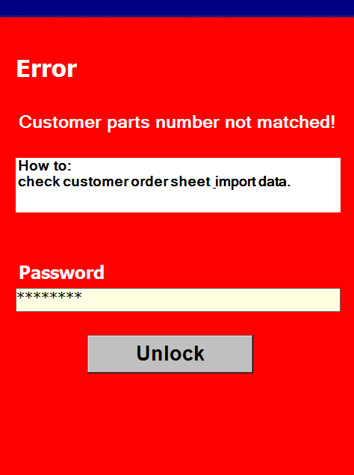
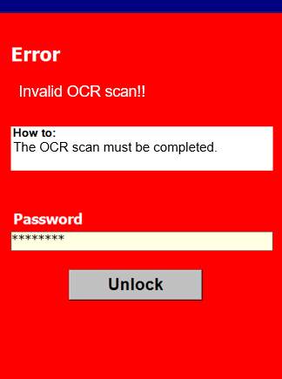
4. Operation flow
2
4. Operation flow
4-4. OCR - Handy – TRIM / PANEL / Q-GATE
Trim area / Panel area / Q-Gate
OCR Scan result NG!!
Invalid OCR scan!!
The OCR scan must be completed.
Instructions
1. Add the OCR scan by handy
1.1 Adding new function that able to use handy to scan OCR
1.2 Create OCR checking master
1.2.1 Web page for master
1.2.2 Able to set the multiple scan for 3 conditions
1.3 Prioritize the OCR and able to make decision if failed on scan. It needs to unlock by leader(keep history)
1.4 PC INNER has been changed to ask n time(Count)
- Show number of actual/total_count
1.5 PC INNER acts as the old operation if the OCR master hasn't provided
1.6 History & transactions report

Slide 19
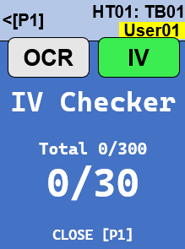

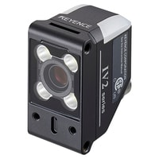

4. Operation flow
7
4. Operation flow
4-5. IV (Vision Sensor) – SD card choosing
Show the popup dialog while clicked at the IV button
OCR
IV
Scan & insert
SD Card
TFA01
Reset
Reset all
TTL: 0/300
No | Plan | Act | Status
BACK[P4]
TF CARD
COVER
The IV controller will send the incorrect information to handy while installed an incorrect SD card.
Reset
Reset all
TTL: 0/300
Pattern not found!
No | Plan | Act | Status
Check the SD Card number.

Slide 20
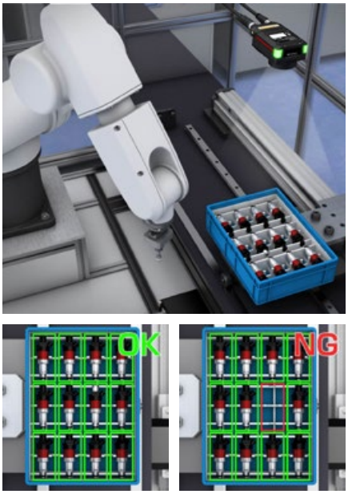
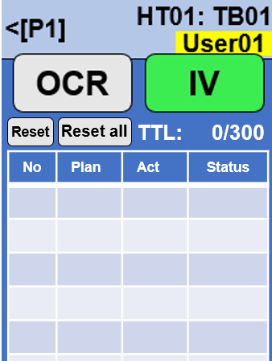
4. Operation flow
5
4. Operation flow
4-5. IV (Vision Sensor) – Trim INNER PACKING (Handy)
Instructions
4. IV
- Add qty check by camera after scan contents label
- Able to multiple capture
- Display the dialog that shows the total of item in content scan and actual number from camera
- Keep picture filename mapped to job
…
Reset
Reset all
TTL: 0/300
No | Plan | Act | Status
Reset : Reject the last data
Reset All : Remove all data
*Need to confirmation
Result OK
Reset
Reset all
TTL: 0/300
Reset
Reset all
TTL: 60/300
No | Plan | Act | Status
No | Plan | Act | Status
2 | 30 | 30 | OK
1 | 30 | 30 | OK
Show the last at top most
Result OK
Reset
Reset all
Reset
IV
Completed
TTL: 270/300
Reset all
TTL: 0/300
No | Plan | Act | Status
9 | 30 | 30 | OK
8 | 30 | 30 | OK
7 | 30 | 30 | OK
6 | 30 | 30 | OK
5 | 30 | 30 | OK
No | Plan | Act | Status
10 | 30 | 30 | OK
9 | 30 | 30 | OK
8 | 30 | 30 | OK
7 | 30 | 30 | OK
6 | 30 | 30 | OK
Able to scroll
OK[P4]

Slide 21
4. Operation flow
5
4. Operation flow
4-5. IV (Vision Sensor) – Trim INNER PACKING (Handy)
Cut part
Result NG
Reset
Reset all
TTL: 60/300
Reset
Reset all
TTL: 75/300
No | Plan | Act | Status
2 | 30 | 30 | OK
1 | 30 | 30 | OK
IV Result
QTY : 15 / 30
Continue?
No | Plan | Act | Status
3 | 30 | 15 | CUT
2 | 30 | 30 | OK
1 | 30 | 30 | OK
YES[P3]
NO[P4]
NG
Result NG
Reset
Reset all
TTL: 60/300
Reset
Reset all
TTL: 60/300
No | Plan | Act | Status
2 | 30 | 30 | OK
1 | 30 | 30 | OK
IV Result
QTY : 15 / 30
Continue?
No | Plan | Act | Status
3 | 30 | 15 | NG
2 | 30 | 30 | OK
1 | 30 | 30 | OK
YES[P3]
NO[P4]
Reset
Reset
Reset all
TTL: 60/300
Reset
Reset all
TTL: 30/300
No | Plan | Act | Status
3 | 30 | 15 | NG
2 | 30 | 30 | OK
1 | 30 | 30 | OK
Reset the last OK data?
No | Plan | Act | Status
3 | 30 | 15 | NG
2 | 30 | 30 | REM
1 | 30 | 30 | OK
YES[P3]
NO[P4]

Slide 22
4. Operation flow
5
4. Operation flow
4-5. IV (Vision Sensor) – Trim INNER PACKING (Handy)
Reset All
Reset
Reset all
TTL: 60/300
Reset
Reset all
TTL: 0/300
No | Plan | Act | Status
2 | 30 | 30 | OK
1 | 30 | 30 | OK
Remove all data?
No | Plan | Act | Status
YES[P3]
NO[P4]
Over plan
Invalid IV result!!
Reset
Reset all
TTL: 60/300
Result NG
Over plan 31/30
The IV result doesn’t matched.
No | Plan | Act | Status
2 | 30 | 30 | OK
1 | 30 | 30 | OK
Reset
Reset all
TTL: 60/300
No | Plan | Act | Status
3 | 30 | 31 | NG
2 | 30 | 30 | OK
1 | 30 | 30 | OK

Slide 23
4. Operation flow
8
4. Operation flow
4-5. IV (Vision Sensor) – Work table side switching
Working on TB01
TB02
QR Code
TB02
Reset
Reset all
TTL: 60/300
Reset
Reset all
TTL: 0/80
No | Plan | Act | Status
2 | 30 | 30 | OK
1 | 30 | 30 | OK
Change table?
No | Plan | Act | Status
YES[P3]
NO[P4]
Click “YES” to confirm switch to another table
The worker is able to packing another production line.
Handy will reload the saved production data and continue the job.
TB02
TB01
QR Code
Reset
Reset all
TTL: 0/80
Change table?
Reset
Reset all
TTL: 60/300
No | Plan | Act | Status
No | Plan | Act | Status
2 | 30 | 30 | OK
1 | 30 | 30 | OK
YES[P3]
NO[P4]

Slide 24
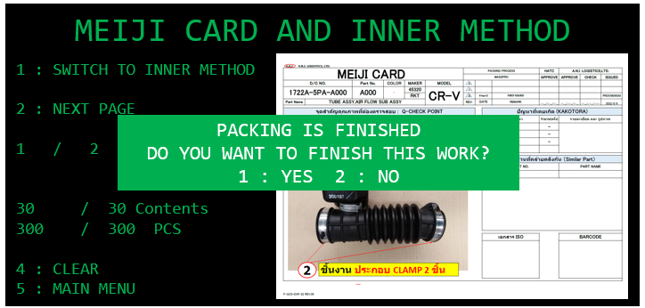
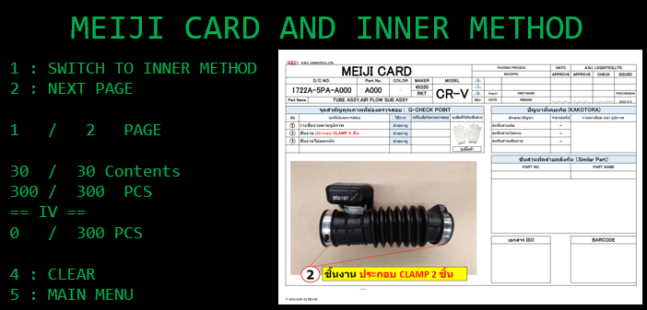
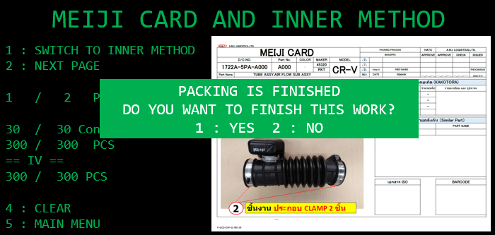
4. Operation flow
4. Operation flow
4-5. IV (Vision Sensor) – Trim INNER PACKING
Before
After

Slide 25
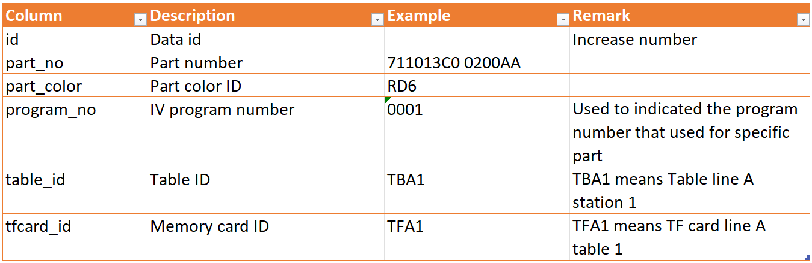
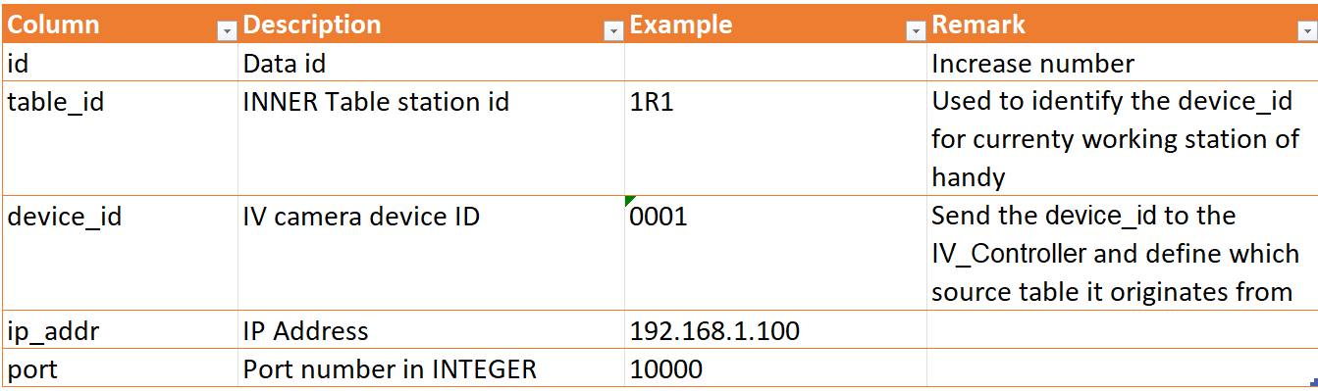
4. Operation flow
8
4. Operation flow
4-5. IV (Vision Sensor) – Master data
IV_camera_program
IV_camera_device
Instructions
4. IV
- Add qty check by camera after scan contents label
- Able to multiple capture
- Display the dialog that shows the total of item in content scan and actual number from camera
- Keep picture filename mapped to job
- Add master
IV_camera_program
- Capture Qty count (use for IV validate OK/NG)
- Program Number mapped to part_no,part_color
- Positions, etc...
IV_camera_device
- Program + Camera + PC table ID
- Use for finding camera that mapped to table and program_id (part_no+color)
- Send program number to IV
- Result table
- Job id
- Qty
- Revision (Count)

Slide 26
4. Operation flow
8
4. Operation flow
4-5. IV (Vision Sensor) – Data Communications
Handy
Pegasus
IV Controller
HT_IV_OPEN
Data attributes
handy_id
job_id
device_id
program_no
table_id
HT_IV_OPEN_SUCCESS
WS_IV_OPEN
WS_IV_OPEN_SUCCESS
Data attributes
job_id
device_id
program_no
table_id
expected_qty
Data attributes
job_id
program_no
table_id
n times depend on jobs
IV_DATA_READ
IV_DATA_READ_SUCCESS
Data attributes
job_id
device_id
program_no
table_id
actual_qty
count_read
WS_DATA_READ
WS_DATA_READ_SUCCESS
Data attributes
job_id
device_id
program_no
table_id
actual_qty
count_read
Instructions
4. IV
…
- Send program number to IV
- Result table
- Job id
- Qty
- Revision (Count)

Slide 27
4. Operation flow
8
4. Operation flow
4-5. IV (Vision Sensor) – Incorrect SD card
Handy
Pegasus
IV Controller
HT_IV_OPEN
Data attributes
handy_id
job_id
device_id
program_no
table_id
HT_IV_OPEN_SUCCESS
WS_IV_OPEN
WS_IV_OPEN_SUCCESS
Data attributes
job_id
device_id
program_no
table_id
expected_qty
Data attributes
job_id
program_no
table_id
n times depend on jobs
IV_DATA_READ_FAILED
IV_DATA_READ_FAILED_ACK
Data attributes
job_id
device_id
program_no
table_id
WS_DATA_READ_FAILED
WS_DATA_READ_FAILED_ACK
Data attributes
job_id
device_id
program_no
table_id

Slide 28
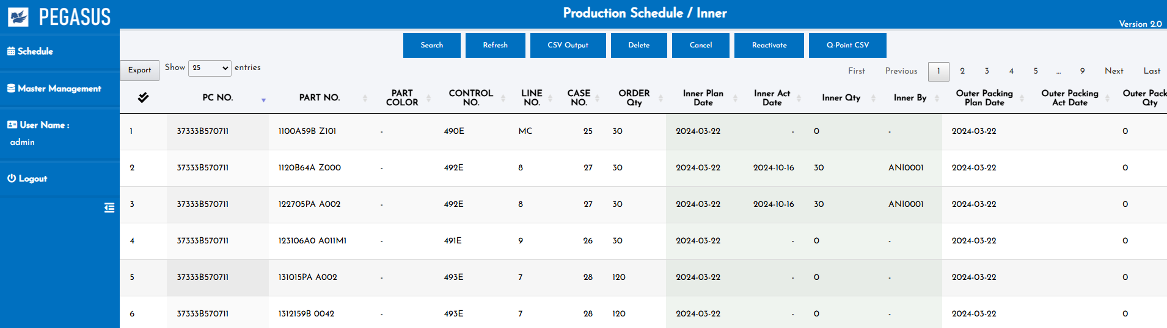
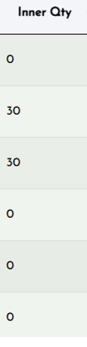
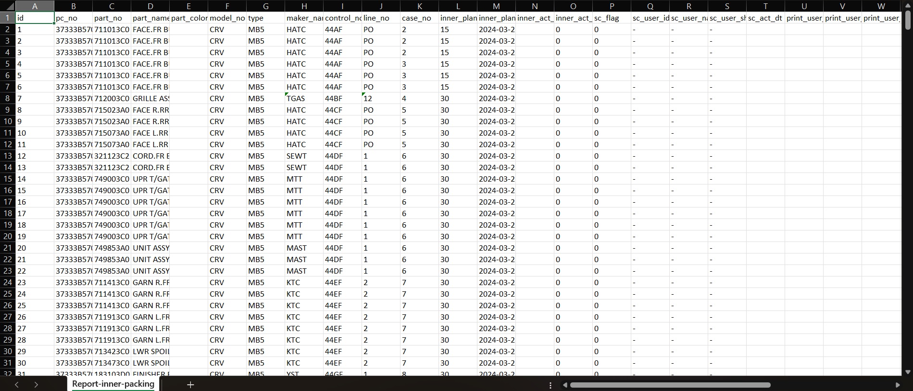
4. Operation flow
4. Operation flow
4-5. IV (Vision Sensor) – Web report
Insert IV result to INNER PACKING report
IV Qty
Able to view entire history of IV transactions including cancel
Also Insert IV result to INNER PACKING CSV export
Instructions
4. IV
- Add qty check by camera after scan contents label
- Able to multiple capture
- Display the dialog that shows the total of item in content scan and actual number from camera
- Keep picture filename mapped to job
- Add master
IV_camera_program
- Capture Qty count (use for IV validate OK/NG)
- Program Number mapped to part_no,part_color
- Positions, etc...
IV_camera_device
- Program + Camera + PC table ID
- Use for finding camera that mapped to table and program_id (part_no+color)
- Send program number to IV
- Result table
- Job id
- Qty
- Revision (Count)

Slide 29
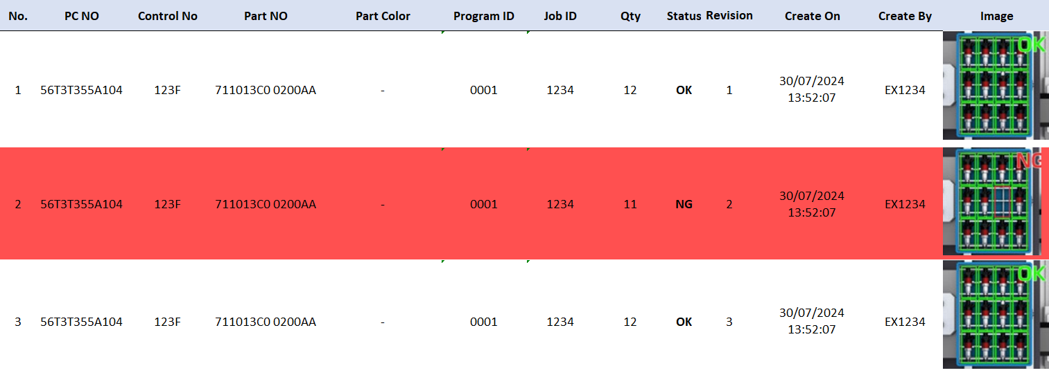
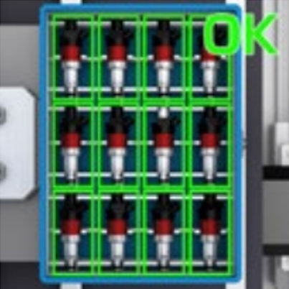
4. Operation flow
4. Operation flow
4-5. IV (Vision Sensor) – Web report details
IV Qty
Able to click the icon
To preview the captured image from IV
- IV Report details
Able to click the icon
To maximize the preview image
Instructions
4. IV
- Add qty check by camera after scan contents label
- Able to multiple capture
- Display the dialog that shows the total of item in content scan and actual number from camera
- Keep picture filename mapped to job
- Add master
IV_camera_program
- Capture Qty count (use for IV validate OK/NG)
- Program Number mapped to part_no,part_color
- Positions, etc...
IV_camera_device
- Program + Camera + PC table ID
- Use for finding camera that mapped to table and program_id (part_no+color)
- Send program number to IV
- Result table
- Job id
- Qty
- Revision (Count)

Slide 30
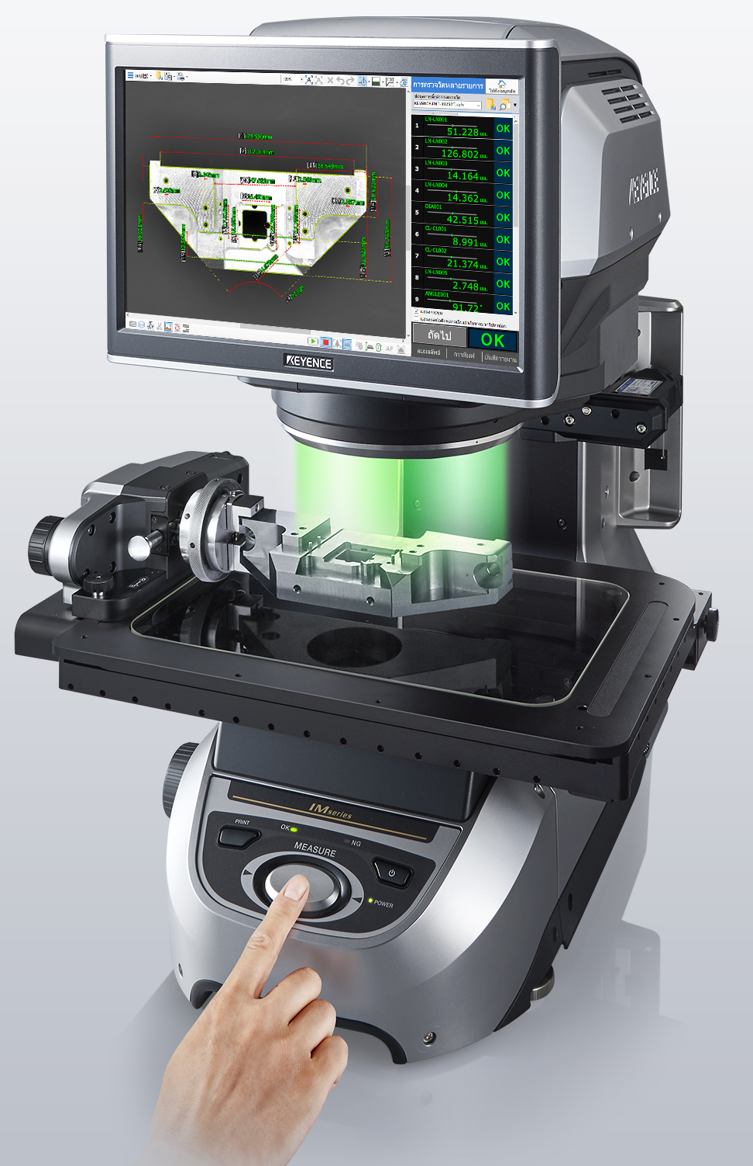
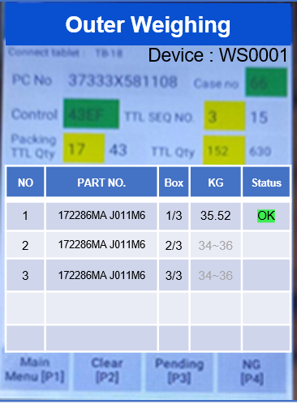
4. Operation flow
5
4. Operation flow
4-6. IM (Image Dimension Measurement) – Device QR code
Q-Gate Check
Device’s QR code
Able to scan the measurement device QR code
for pairing at any time.
Handy will permanent keep the measurement device ID that means there is no need to pairing at every time.
Format
<QR Type>|<Device Type>|<Device ID>
For example
DV|IM|IM8000#01
Tablet: #001 IM: IM8000#01
PC No
37A-33S-5122-01
Control
311F
Parts no
63240-T00-T000-H01
Color
-
TTL Qty
240
120
BOX NO | PART NO / OCR | OCR | IM | QTY in Case
1 | 63240-T00-T000-H01 | - | W | 60
2 | 63240-T00-T000-H01 | - | W | 60
3 | 63240-T00-T000-H01 | W | - | 60
4 | 63240-T00-T000-H01 | W | - | 60
F1
Menu
F1
Menu
F1
Menu
F1
Menu
Main
Menu [P1]
Clear
[P2]
Recheck
[P3]
Confirm
[P4]
IM8000
Instructions
6. WS
…
Operations - Small/Medium
1. Move item to weight scale after scan contents label
2. Check OK/NG
3. Display dialog on handy for notification of weighing before packing
4. Insert weighting check process in outer packing
5. Able to select weight scale liked as printer
Operations - Large
1. Add new weighing check menu for fork lift
2. Able to select weight scale liked as printer
Data connections to ws program
1. WS machine no
2. Weight range
3. Job ID

Slide 31
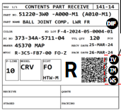
4. Operation flow
3
4. Operation flow
4-6. IM (Image Dimension Measurement) – Overview Flow – Result OK
Bolt/Small parts
Q-Gate Check
Q-Gate Check
Tablet: #001 IM: IM8000#01
Connect tablet : Connected #001
Data checking
IM8000
[PREVIEW DATA]
CLOSE [P1]
PC No
37A-33S-5122-01
Control
311F
Will display the QR code automatic while scan tag receive
PC No
37A-33S-5122-01
Control
311F
Parts no
63240-T00-T000-H01
Parts no
63240-T00-T000-H01
Color
-
TTL Qty
Color
-
TTL Qty
240
120
240
120
BOX NO | PART NO / OCR | OCR | IM | QTY in Case
1 | 63240-T00-T000-H01 | - | W | 60
2 | 63240-T00-T000-H01 | - | W | 60
3 | 63240-T00-T000-H01 | W | - | 60
4 | 63240-T00-T000-H01 | W | - | 60
BOX NO | PART NO / OCR | OCR | IM | QTY in Case
1 | 63240-T00-T000-H01 | W | W | 60
2 | 63240-T00-T000-H01 | - | W | 60
3 | 63240-T00-T000-H01 | W | - | 60
4 | 63240-T00-T000-H01 | W | - | 60
QR code format:
<FULL_PATH_FILENAME>
F1
Menu
F1
Menu
F1
Menu
F1
Menu
F1
Menu
F1
Menu
Clear
[P2]
F1
Menu
F1
Menu
Main
Menu [P1]
Clear
[P2]
Recheck
[P3]
Confirm
[P4]
Main
Menu [P1]
Recheck
[P3]
Confirm
[P4]
Q-Gate Check
Tablet: #001 IM: IM8000#01
Result OK
PC No
37A-33S-5122-01
Control
311F
Parts no
63240-T00-T000-H01
Color
-
TTL Qty
240
120
BOX NO | PART NO / OCR | OCR | IM | QTY in Case
1 | 63240-T00-T000-H01 | - | OK | 60
2 | 63240-T00-T000-H01 | - | W | 60
3 | 63240-T00-T000-H01 | W | - | 60
4 | 63240-T00-T000-H01 | W | - | 60
F1
Menu
F1
Menu
F1
Menu
F1
Menu
Main
Menu [P1]
Clear
[P2]
Recheck
[P3]
Confirm
[P4]
IM8000
Instructions
5. IM
- Small parts - Q-Gate
- Process IM after q-point check
- Keep picture filename result
- Add master
IM_camera_program
- Capture Qty count (use for IV validate OK/NG)
- Program Number mapped to part_no,part_color
- Positions, etc...
IM_camera_device
- Program + Camera + PC table ID
- Use for finding camera that mapped to table and program_id (part_no+color)
- Send program number to IM
- Result table
- Job id
- Qty
- Revision (Count)

Slide 32
4. Operation flow
3
4. Operation flow
4-6. IM (Image Dimension Measurement) – Overview Flow – Result NG
Bolt/Small parts
Q-Gate Check
Q-Gate Check
Tablet: #001 IM: IM8000#01
Connect tablet : Connected #001
Data checking
IM8000
[PREVIEW DATA]
CLOSE [P1]
PC No
37A-33S-5122-01
Control
311F
Will display the QR code automatic while scan tag receive
PC No
37A-33S-5122-01
Control
311F
Parts no
63240-T00-T000-H01
Parts no
63240-T00-T000-H01
Color
-
TTL Qty
Color
-
TTL Qty
240
120
240
120
BOX NO | PART NO / OCR | OCR | IM | QTY in Case
1 | 63240-T00-T000-H01 | - | W | 60
2 | 63240-T00-T000-H01 | - | W | 60
3 | 63240-T00-T000-H01 | W | - | 60
4 | 63240-T00-T000-H01 | W | - | 60
BOX NO | PART NO / OCR | OCR | IM | QTY in Case
1 | 63240-T00-T000-H01 | W | W | 60
2 | 63240-T00-T000-H01 | - | W | 60
3 | 63240-T00-T000-H01 | W | - | 60
4 | 63240-T00-T000-H01 | W | - | 60
F1
Menu
F1
Menu
F1
Menu
F1
Menu
F1
Menu
F1
Menu
Clear
[P2]
F1
Menu
F1
Menu
Main
Menu [P1]
Clear
[P2]
Recheck
[P3]
Confirm
[P4]
Main
Menu [P1]
Recheck
[P3]
Confirm
[P4]
Q-Gate Check
IM result NG!!
Tablet: #001 IM: IM8000#01
Result NG
PC No
37A-33S-5122-01
Control
311F
Parts no
63240-T00-T000-H01
Color
-
TTL Qty
240
120
Invalid IM result!!
BOX NO | PART NO / OCR | OCR | IM | QTY in Case
1 | 63240-T00-T000-H01 | - | NG | 60
2 | 63240-T00-T000-H01 | - | W | 60
3 | 63240-T00-T000-H01 | W | - | 60
4 | 63240-T00-T000-H01 | W | - | 60
The IM result doesn’t matched.
F1
Menu
F1
Menu
F1
Menu
F1
Menu
Main
Menu [P1]
Clear
[P2]
Recheck
[P3]
Confirm
[P4]
Instructions
5. IM
- Small parts - Q-Gate
- Process IM after q-point check
- Keep picture filename result
- Add master
IM_camera_program
- Capture Qty count (use for IV validate OK/NG)
- Program Number mapped to part_no,part_color
- Positions, etc...
IM_camera_device
- Program + Camera + PC table ID
- Use for finding camera that mapped to table and program_id (part_no+color)
- Send program number to IM
- Result table
- Job id
- Qty
- Revision (Count)

Slide 33
4. Operation flow
3
4. Operation flow
4-6. IM (Image Dimension Measurement) – Overview Flow – Incompleted NG
Bolt/Small parts
Q-Gate Check
Q-Gate Check
Tablet: #001 IM: IM8000#01
Connect tablet : Connected #001
Data checking
IM8000
[PREVIEW DATA]
CLOSE [P1]
PC No
37A-33S-5122-01
Control
311F
PC No
37A-33S-5122-01
Control
311F
Parts no
63240-T00-T000-H01
Parts no
63240-T00-T000-H01
Color
-
TTL Qty
Color
-
TTL Qty
240
120
240
120
BOX NO | PART NO / OCR | OCR | IM | QTY in Case
1 | 63240-T00-T000-H01 | - | W | 60
2 | 63240-T00-T000-H01 | - | W | 60
3 | 63240-T00-T000-H01 | W | - | 60
4 | 63240-T00-T000-H01 | W | - | 60
BOX NO | PART NO / OCR | OCR | IM | QTY in Case
1 | 63240-T00-T000-H01 | W | W | 60
2 | 63240-T00-T000-H01 | - | W | 60
3 | 63240-T00-T000-H01 | W | - | 60
4 | 63240-T00-T000-H01 | W | - | 60
F1
Menu
F1
Menu
F1
Menu
F1
Menu
F1
Menu
F1
Menu
Clear
[P2]
F1
Menu
F1
Menu
Main
Menu [P1]
Clear
[P2]
Recheck
[P3]
Confirm
[P4]
Main
Menu [P1]
Recheck
[P3]
Confirm
[P4]
In case of no response from IM controller. User is able to stop by click the “CLOSE [P1]”.
Q-Gate Check
IM result NG!!
Tablet: #001 IM: IM8000#01
Result NG
PC No
37A-33S-5122-01
Control
311F
Parts no
63240-T00-T000-H01
Color
-
TTL Qty
240
120
Incompleted IM step
BOX NO | PART NO / OCR | OCR | IM | QTY in Case
1 | 63240-T00-T000-H01 | - | NG | 60
2 | 63240-T00-T000-H01 | - | W | 60
3 | 63240-T00-T000-H01 | W | - | 60
4 | 63240-T00-T000-H01 | W | - | 60
Redo the IM process.
F1
Menu
F1
Menu
F1
Menu
F1
Menu
Main
Menu [P1]
Clear
[P2]
Recheck
[P3]
Confirm
[P4]
Instructions
5. IM
- Small parts - Q-Gate
- Process IM after q-point check
- Keep picture filename result
- Add master
IM_camera_program
- Capture Qty count (use for IV validate OK/NG)
- Program Number mapped to part_no,part_color
- Positions, etc...
IM_camera_device
- Program + Camera + PC table ID
- Use for finding camera that mapped to table and program_id (part_no+color)
- Send program number to IM
- Result table
- Job id
- Qty
- Revision (Count)

Slide 34
4. Operation flow
2
4. Operation flow
4-6. IM (Image Dimension Measurement) – Q-Gate Bolt/Small parts
Bolt/Small parts
Checking Master / OCR Master
Master data not available!!
Q-Gate Check
Connect tablet : Connected #001
PC No
37A-33S-5122-01
Control
311F
Parts no
63240-T00-T000-H01
Color
-
TTL Qty
240
120
BOX NO | PART NO / OCR | OCR | IM | QTY in Case
1 | 63240-T00-T000-H01 | - | W | 60
2 | 63240-T00-T000-H01 | - | W | 60
3 | 63240-T00-T000-H01 | W | - | 60
4 | 63240-T00-T000-H01 | W | - | 60
F1
Menu
F1
Menu
F1
Menu
F1
Menu
Main
Menu [P1]
Clear
[P2]
Recheck
[P3]
Confirm
[P4]
Instructions
5. IM
- Small parts - Q-Gate
- Process IM after q-point check
- Keep picture filename result
- Add master
IM_camera_program
- Capture Qty count (use for IV validate OK/NG)
- Program Number mapped to part_no,part_color
- Positions, etc...
IM_camera_device
- Program + Camera + PC table ID
- Use for finding camera that mapped to table and program_id (part_no+color)
- Send program number to IM
- Result table
- Job id
- Qty
- Revision (Count)

Slide 35
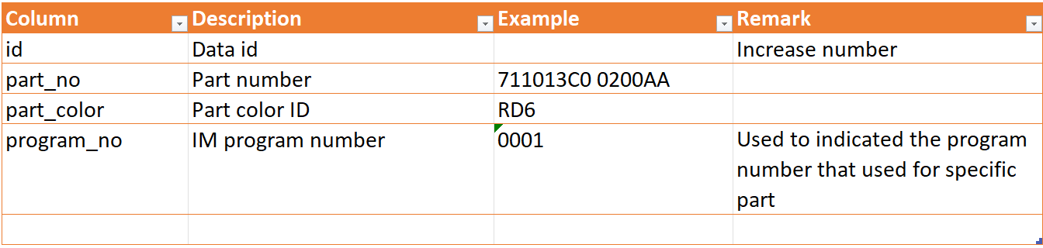
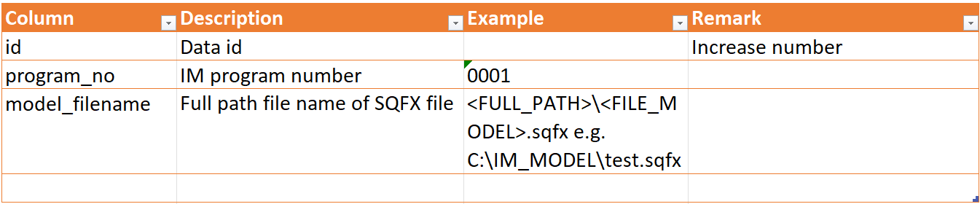
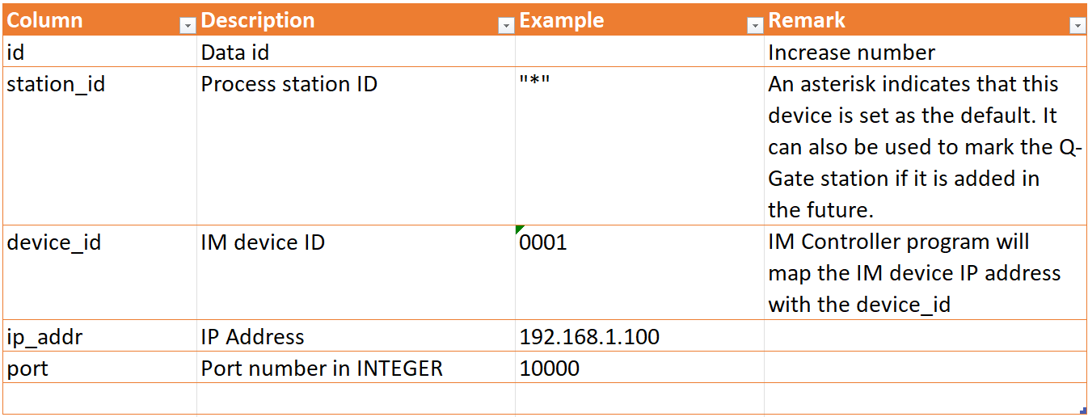
4. Operation flow
4. Operation flow
4-6. IM (Image Dimension Measurement) – Master data
IM_program
IM_model_file
IM_device
Instructions
5. IM
…
IM_camera_program
- Capture Qty count (use for IV validate OK/NG)
- Program Number mapped to part_no,part_color
- Positions, etc...
IM_camera_device
- Program + Camera + PC table ID
- Use for finding camera that mapped to table and program_id (part_no+color)

Slide 36
4. Operation flow
5
4. Operation flow
4-6. IM (Image Dimension Measurement) – Data Communications
Handy
Pegasus
IM Controller
HT_IM_STEP1
Data attributes
handy_id
device_id (IM)
program_no
HT_IM_STEP1_SUCCESS
HT_IM_STEP1_SUCCESS
Data attributes
handy_id
device_id
program_no
job_id
IM_STEP2
IM_STEP2_SUCCESS
Data attributes
job_id
program_no
status (OK/NG)
IM_STEP2_SUCCESS
Data attributes
job_id
program_no
status (OK/NG)
IM_STEP3
IM_STEP3_SUCCESS
Data attributes
job_id
program_no
image_filename
IM_STEP3_SUCCESS
Data attributes
job_id
program_no
status (OK/NG)
Instructions
5. IM
…
- Send program number to IM
- Result table
- Job id
- Qty
- Revision (Count)
20250904:
Need to confirm with Gong regarding the WS API for client
Need to confirm the IM flow
Must create the windows app for get the information and image from exported excel

Slide 37

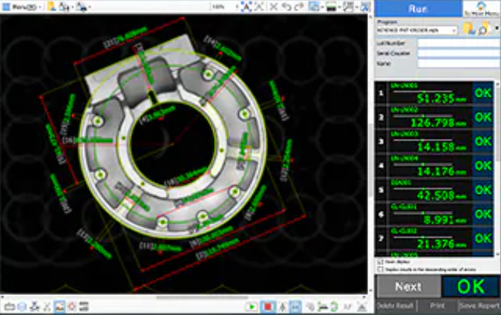


4. Operation flow
6
4. Operation flow
4-6. IM (Image Dimension Measurement) – Overall
17Sep 13:30pm – Training with Keyence
18Sep 10:30am Meeting at online
25Sep 11:00am – Meeting update progress
Q-Gate Check
Q-Gate Check
20250904:
Need to confirm with Gong regarding the WS API for client
Need to confirm the IM flow
Must create the windows app for get the information and image from exported excel
Connect tablet : Connected #001
Connect tablet : Connected #001
Data checking
IM8000
CLOSE [P1]
Data checking
IM8000
CLOSE [P1]
PC No
37A-33S-5122-01
Control
311F
PC No
37A-33S-5122-01
Control
311F
Parts no
63240-T00-T000-H01
Parts no
63240-T00-T000-H01
Color
-
TTL Qty
Color
-
TTL Qty
240
120
240
120
1
BOX NO | PART NO / OCR | OCR | IM | QTY in Case
1 | 63240-T00-T000-H01 | W | W | 60
2 | 63240-T00-T000-H01 | - | W | 60
3 | 63240-T00-T000-H01 | W | - | 60
4 | 63240-T00-T000-H01 | W | - | 60
BOX NO | PART NO / OCR | OCR | IM | QTY in Case
1 | 63240-T00-T000-H01 | W | W | 60
2 | 63240-T00-T000-H01 | - | W | 60
3 | 63240-T00-T000-H01 | W | - | 60
4 | 63240-T00-T000-H01 | W | - | 60
2
SCAN QR CODE
WORKING 1/3…
F1
Menu
F1
Menu
F1
Menu
F1
Menu
F1
Menu
F1
Menu
F1
Menu
F1
Menu
Main
Menu [P1]
Clear
[P2]
Recheck
[P3]
Confirm
[P4]
Main
Menu [P1]
Clear
[P2]
Recheck
[P3]
Confirm
[P4]
Data checking
IM8000
CLOSE [P1]
Export image
4
3
WORKING 2/3…
Start IM Process
image
Data checking
IM8000
CLOSE [P1]
Process image
IM Controller
Network Share Directory
STATUS : OK
5

Slide 38
4. Operation flow
6
4. Operation flow
4-6. IM (Image Dimension Measurement) – Export image
1
Export image
image
Save file to shared folder
IM8000#1
Folder
IM8000#1
IM Station ID => IM8000#1
Get the new image from specific folder mapped by IM station ID and work job ID
2
3
WS push command
IM_STEP3
- job_id
- program_no
- image_name
Pegasus
IM Controller
Pegasus web image folder
4
Move and backup file
IM
Controller backup folder

Slide 39
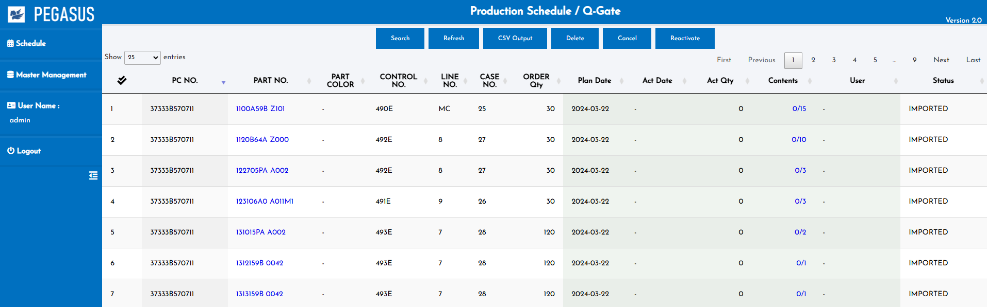
4. Operation flow
4. Operation flow
4-6. IM (Image Dimension Measurement) – Web report
Insert IM result to
Q-GATE report
IM Result
-
OK
OK
NG
OK
OK
Also Insert IM result to Q-GATE CSV export
Instructions
5. IM
- Small parts - Q-Gate
- Process IM after q-point check
- Keep picture filename result
- Add master
IM_camera_program
- Capture Qty count (use for IV validate OK/NG)
- Program Number mapped to part_no,part_color
- Positions, etc...
IM_camera_device
- Program + Camera + PC table ID
- Use for finding camera that mapped to table and program_id (part_no+color)
- Send program number to IM
- Result table
- Job id
- Qty
- Revision (Count)

Slide 40
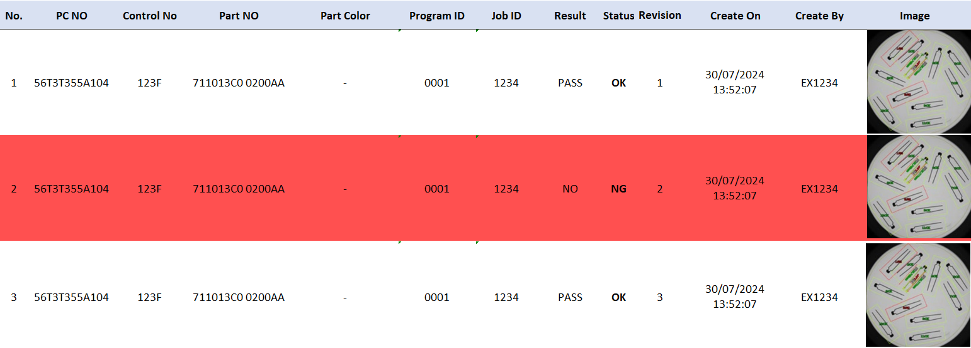
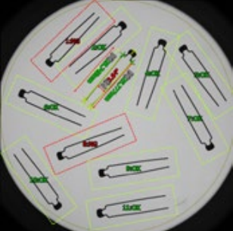
4. Operation flow
4. Operation flow
4-6. IM (Image Dimension Measurement)– Web report details
IM Result
Able to click the icon
To preview the captured image from IM
-
OK
OK
NG
OK
OK
- IM Report details
Able to click the icon
To maximize the preview image
Instructions
5. IM
- Small parts - Q-Gate
- Process IM after q-point check
- Keep picture filename result
- Add master
IM_camera_program
- Capture Qty count (use for IV validate OK/NG)
- Program Number mapped to part_no,part_color
- Positions, etc...
IM_camera_device
- Program + Camera + PC table ID
- Use for finding camera that mapped to table and program_id (part_no+color)
- Send program number to IM
- Result table
- Job id
- Qty
- Revision (Count)

Slide 41
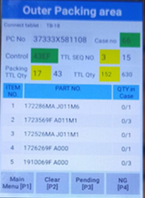
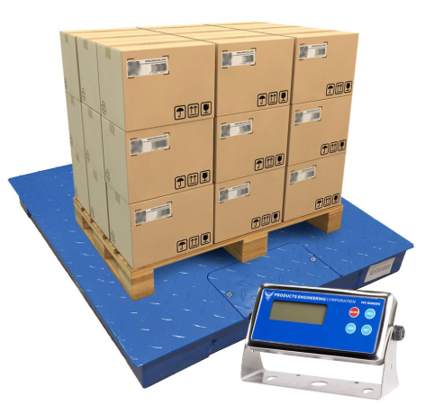

4. Operation flow
5
4. Operation flow
4-7. WS (Weight Scale) – Small/Medium parts
Small/Medium parts – Outer Packing area
Outer Weighing
WS : WSNAME01
1
NO | PART NO. | Box | KG | Status
1 | 172286MA J011M6 | 1/3 | 35.52 | OK
2 | 172286MA J011M6 | 2/3 | 34~36
3 | 172286MA J011M6 | 3/3 | 34~36
Device’s QR code
Able to scan the measurement device QR code
for pairing at any time.
Handy will permanent keep the measurement device ID that means there is no need to pairing at every time.
Format
<QR Type>|<Device Type>|<Device ID>
For example
DV|WS|WSNAME01
Instructions
6. WS
…
Operations - Small/Medium
1. Move item to weight scale after scan contents label
2. Check OK/NG
3. Display dialog on handy for notification of weighing before packing
4. Insert weighting check process in outer packing
5. Able to select weight scale liked as printer
Operations - Large
1. Add new weighing check menu for fork lift
2. Able to select weight scale liked as printer
Data connections to ws program
1. WS machine no
2. Weight range
3. Job ID

Slide 42
4. Operation flow
3
4. Operation flow
4-7. WS (Weight Scale) – Small/Medium parts
Small/Medium parts – Outer Packing area
1
Outer Weighing
2
NO | PART NO. | Box | KG | Status
1 | 172286MA J011M6 | 1/3 | 35.52 | OK
2 | 172286MA J011M6 | 2/3 | 34~36
3 | 172286MA J011M6 | 3/3 | 34~36
Result OK
3
Outer Weighing
Continue process outer packing
NO | PART NO. | Box | KG | Status
1 | 172286MA J011M6 | 1/3 | 35.52 | OK
2 | 172286MA J011M6 | 2/3 | 35.00 | OK
3 | 172286MA J011M6 | 3/3 | 34~36
Instructions
6. WS
- Add master
WS_weigth
- Part_no/Part_color
- Min_weight
- Max_weight
- Small/Medium (use weight master) -> Scan contents -> weighing
- Panel area -> Large
- Control no, Case no
- Scan case mask only => ชั่ง case
Operations - Small/Medium
1. Move item to weight scale after scan contents label
2. Check OK/NG
3. Display dialog on handy for notification of weighing before packing
4. Insert weighting check process in outer packing
5. Able to select weight scale liked as printer
Operations - Large
1. Add new weighing check menu for fork lift
2. Able to select weight scale liked as printer
Data connections to ws program
1. WS machine no
2. Weight range
3. Job ID

Slide 43
4. Operation flow
3
4. Operation flow
4-7. WS (Weight Scale) – Small/Medium parts
Small/Medium parts – Outer Packing area
1
Outer Weighing
2
NO | PART NO. | Box | KG | Status
1 | 172286MA J011M6 | 1/3 | 35.52 | OK
2 | 172286MA J011M6 | 2/3 | 30.00 | NG
3 | 172286MA J011M6 | 3/3 | 34~36
WS result NG!!
Result NG
3
Invalid WS result!!
Check
and reweigh
Weight amount is out of range!!.
Weight
Out of Range!!
30 KG
Reason: [ Cut part v]
Continue?
Outer Weighing
NO | PART NO. | Box | KG | Status
1 | 172286MA J011M6 | 1/3 | 35.52 | OK
2 | 172286MA J011M6 | 2/3 | 30.00 | CUT
3 | 172286MA J011M6 | 3/3 | 34~36
YES[P3]
NO[P4]
YES

Slide 44
4. Operation flow
5
4. Operation flow
4-7. WS (Weight Scale) – Big parts
Big parts
<[P1] ForkLift - Weighing
Tablet: #001 WS: WSNAME01
PC | Ctrl | C/No. | KG | Status
1
Device’s QR code
Able to scan the measurement device QR code
for pairing at any time.
Handy will permanent keep the measurement device ID that means there is no need to pairing at every time.
Format
<QR Type>|<Device Type>|<Device ID>
For example
DV|WS|WSNAME01
Instructions
6. WS
…
Operations - Large
1. Add new weighing check menu for fork lift
2. Able to select weight scale liked as printer
Data connections to ws program
1. WS machine no
2. Weight range
3. Job ID

Slide 45


4. Operation flow
3
4. Operation flow
4-7. WS (Weight Scale) – Big parts
Big parts – Fork Lift
<[P1] ForkLift - Weighing
Instructions
6. WS
…
Operations - Large
1. Add new weighing check menu for fork lift
2. Able to select weight scale liked as printer
Data connections to ws program
1. WS machine no
2. Weight range
3. Job ID
Tablet: #001 WS: WSNAME01
PC | Ctrl | C/No. | KG | Status
1
<[P1] ForkLift - Weighing
<[P1] ForkLift - Weighing
Tablet: #001 WS: WSNAME01
Tablet: #001 WS: WSNAME01
PC | Ctrl | C/No. | KG | Status
2
PC | Ctrl | C/No. | KG | Status
5710-02 | 310F | 1 | 0/500 | W
3
<[P1] ForkLift - Weighing
Result OK
<[P1] ForkLift - Weighing
Tablet: #001 WS: WSNAME01
4
Tablet: #001 WS: WSNAME01
PC | Ctrl | C/No. | KG | Status
5710-02 | 310F | 1 | 500/500 | OK
Weight Scale
5710-02/310F
Case no : 1
0/500 KG
CLOSE [P1]
PC | Ctrl | C/No. | KG | Status
5710-02 | 310F | 1 | 0/500 | W
5710-02 | 311F | 2 | 0/400 | W
5710-02 | 312F | 3 | 0/100 | W
5710-03 | 314F | 1 | 0/200 | W
5710-04 | 315F | 2 | 0/300 | W

Slide 46
4. Operation flow
3
4. Operation flow
4-7. WS (Weight Scale) – Big parts
Big parts – Fork Lift
<[P1] ForkLift - Weighing
<[P1] ForkLift - Weighing
Tablet: #001 WS: WSNAME01
Tablet: #001 WS: WSNAME01
PC | Ctrl | C/No. | KG | Status
1
PC | Ctrl | C/No. | KG | Status
5710-02 | 310F | 1 | 0/500 | W
2
Result NG
3
<[P1] ForkLift - Weighing
Invalid WS result!!
Tablet: #001 WS: WSNAME01
Weight Scale
5710-02/310F
Case no : 1
0/500 KG
CLOSE [P1]
Weight amount is out of range!!.
PC | Ctrl | C/No. | KG | Status
5710-02 | 310F | 1 | 0/500 | W
5710-02 | 311F | 2 | 0/400 | W
5710-02 | 312F | 3 | 0/100 | W
5710-03 | 314F | 1 | 0/200 | W
5710-04 | 315F | 2 | 0/300 | W
<[P1] ForkLift - Weighing
Instructions
6. WS
…
Operations - Large
1. Add new weighing check menu for fork lift
2. Able to select weight scale liked as printer
Data connections to ws program
1. WS machine no
2. Weight range
3. Job ID
Tablet: #001 WS: WSNAME01
PC | Ctrl | C/No. | KG | Status
5710-02 | 310F | 1 | 400/500 | NG

Slide 47


4. Operation flow
4. Operation flow
4-7. WS (Weight Scale) – Master data
WS_master
WS_device
Instructions
6. WS
- Add master
WS_weight
- Part_no/Part_color
- Min_weight
- Max_weight
- Small/Medium (use weight master) -> Scan contents -> weighing
- Panel area -> Large
- Control no, Case no
- Scan case mask only => ชั่ง case
…

Slide 48
4. Operation flow
4
4. Operation flow
4-7. WS (Weight Scale) – Data Communications – Weight Outer
Handy
Pegasus
WS Controller
Sending request data
{ ‘CMD’ : ‘WS_DATA_REQUEST’
, ‘Program_no’ : ‘0001’
, ‘Job_id’ : 1234
, ‘min_weight’ : 35.50
, ‘max_weight’ : 36.50
, ‘unit’ : ‘KG’
}
20250904:
Need to confirm with Gong regarding the WS API for client
HT_WEIGHT_OUTER_STEP1
Data attributes
handy_id
pc_no
control_no
case_no
HT_WEIGHT_OUTER_STEP1_SUCCESS
Data attributes
List of case
Weight details
Jobs ID
20250905:
No need
Use WS client instead due to trigger by WS controller
n times depend on jobs
HT_WEIGHT_OUTER_DATA_REQUEST
Data attributes
job_id
device_id
min/max weight,unit
WS_WEIGHT_OUTER_OPEN
Data attributes
job_id
device_id
Min/max weight/Unit
WS_WEIGHT_OUTER_OPEN_SUCCESS
Data attributes
job_id
device_id
weight/unit (actual)
status (OK/NG)
HT_WEIGHT_OUTER_DATA_REQUEST_SUCCESS
HT_WEIGHT_OUTER_DATA_REQUEST_FAILED
Data attributes
job_id
device_id
weight/unit (actual)
status (OK/NG)
Instructions
6. WS
…
Data connections to ws program
1. WS machine no
2. Weight range
3. Job ID

Slide 49
4. Operation flow
4
4. Operation flow
4-7. WS (Weight Scale) – Data Communications – Weight Forklift
Handy
Pegasus
WS Controller
Sending request data
{ ‘CMD’ : ‘WS_DATA_REQUEST’
, ‘Program_no’ : ‘0001’
, ‘Job_id’ : 1234
, ‘min_weight’ : 35.50
, ‘max_weight’ : 36.50
, ‘unit’ : ‘KG’
}
20250904:
Need to confirm with Gong regarding the WS API for client
HT_WEIGHT_FORKLIFT_STEP1
Data attributes
handy_id
pc_no
control_no
case_no
HT_WEIGHT_FORKLIFT_STEP1_SUCCESS
Data attributes
List of case
Weight details
Jobs ID
20250905:
No need
Use WS client instead due to trigger by WS controller
n times depend on jobs
HT_WEIGHT_FORKLIFT_DATA_REQUEST
Data attributes
job_id
device_id
min/max weight,unit
WS_WEIGHT_FORKLIFT_OPEN
Data attributes
job_id
device_id
Min/max weight/Unit
WS_WEIGHT_FORKLIFT_OPEN_SUCCESS
Data attributes
job_id
device_id
weight/unit (actual)
status (OK/NG)
HT_WEIGHT_FORKLIFT_DATA_REQUEST_SUCCESS
HT_WEIGHT_FORKLIFT_DATA_REQUEST_FAILED
Data attributes
job_id
device_id
weight/unit (actual)
status (OK/NG)
Instructions
6. WS
…
Data connections to ws program
1. WS machine no
2. Weight range
3. Job ID

Slide 50
4. Operation flow
4. Operation flow
4-7. WS (Weight Scale) – Web report
Production Schedule / Outer Packing
Insert WS result to
OUTER PACKING report
Weighing(KG)
Also Insert WS result to OUTER PACKING CSV export
Instructions
6. WS
- Add master
WS_weight
- Part_no/Part_color
- Min_weight
- Max_weight
- Small/Medium (use weight master) -> Scan contents -> weighing
- Panel area -> Large
- Control no, Case no
- Scan case mask only => ชั่ง case
Operations - Small/Medium
1. Move item to weight scale after scan contents label
2. Check OK/NG
3. Display dialog on handy for notification of weighing before packing
4. Insert weighting check process in outer packing
5. Able to select weight scale liked as printer
Operations - Large
1. Add new weighing check menu for fork lift
2. Able to select weight scale liked as printer
Data connections to ws program
1. WS machine no
2. Weight range
3. Job ID

Slide 51




4. Operation flow
3
4. Operation flow
4-8. Checking history transaction
Checking History Report

Slide 52













5. System functional specifications
5
5-1. Handy terminal screen image
Handy terminal function / screen image
1.User Login
2.Main Menu
3.INNER Standby
Main Menu
Inner Q-Point Check
User code
Connect tablet : Connected #001
Table ID
Vanning
Outer
Weighing
Fork Lift
Weighing
INNER
Q-Point Check
Login
4.Inner Q-Point Check
5.Inner Q-Point OCR
5.Inner Q-Point Manual
Inner Q-Point Check
Inner Q-Point Check
Inner Q-Point Check
6. Inner IV Checker
7. Q-Gate Check
8. Q-Gate OCR Checker
Q-Gate Check
Q-Gate Check
Connect tablet : Connected #001
PC No
37A-33S-5122-01
Control
311F
Parts no
63240-T00-T000-H01
Color
-
TTL Qty
240
120
BOX NO | PART NO / OCR | OCR | IM | QTY in Case
1 | 63240-T00-T000-H01 | W | W | 60
2 | 63240-T00-T000-H01 | - | W | 60
3 | 63240-T00-T000-H01 | W | - | 60
4 | 63240-T00-T000-H01 | W | - | 60
F1
Menu
F1
Menu
F1
Menu
F1
Menu
Main
Menu [P1]
Clear
[P2]
Recheck
[P3]
Confirm
[P4]

Slide 53




5. System functional specifications
5
5-1. Handy terminal screen image
Handy terminal function / screen image
10.Q-Gate IM Checker
11.Outer Weighing
12.Forklift Weighing
13.ForkLift Weighing Result
14.Error Locked Screen

Slide 54
6. Q&A

Slide 55
7. Sign off
We hereby acknowledge and agree the above-mentioned blueprint requirements.
Any changes required after the sign off for this blueprint will be addressed through the change request process.
A.N.I. LOGISTICS, LTD.
Sign:
Name:
Title:
Date:
TOMAS TECH CO.,LTD.
Sign:
Name:
Title:
Date:
## END OF BLUEPRINT##

