Slide 1

Version 19/ August /2025
Confidential
MECHANICAL GROUP STANDARD
DRAWING AND PARTS LIST
R.1
Prepare by Warit Chunlaka

Slide 2
Revision History
Date | Version | File name | Details
 | Rev.1
 | Rev.2
 | Rev.3
 | Rev.4

Slide 3
■Contents
Overview
How to configuration Drawing No.
  2-1. Assembly Unit Drawing
  2-2. Parts Drawing
Drawing No. Index
3-1. Category Type : A
3-2. Category Type : B – E
3-3. Category Type : F – K
3-4. Category Type : K – N
3-5. Category Type : N – Z
3-6. Category Type : Z

Slide 4
1. Overview
To setting ME standard drawing template and parts list format
To making the manual

Slide 5
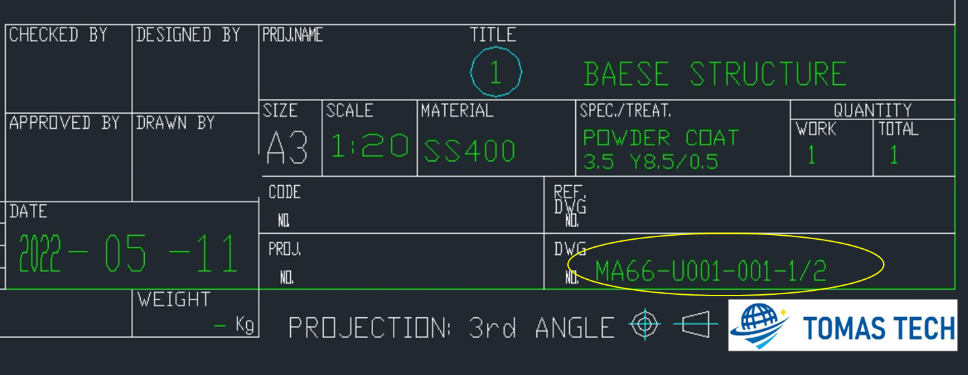
2. How to Configuration Drawing No.
2-1. Assembly Unit Drawing
Example
M | A | 2 | 2 | - | U | 0 | 0 | 1 | - | 1 | / | 2
 |  |  |  |  |  |  |  |  |  | Page
 |  |  |  |  |  |  | Assy Unit No.
 |  |  |  | No.22 : Description (Belt CV)
Category Type (A=Conveyor)
M : Mechanical / E : Electrical |  | M

Slide 6
2. How to Configuration Drawing No.
2-2. Parts Drawing
Example
M | A | 2 | 2 | - | U | 0 | 0 | 1 | - | 0 | 0 | 1 | - | 1 | / | 2
 |  |  |  |  |  |  |  |  |  |  |  |  |  | Page
 |  |  |  |  |  |  |  |  |  | Parts Drawing No.
 |  |  |  |  |  |  | Assy Unit No.
 |  |  |  | No.22 : Description (Belt CV)
Category Type (A=Conveyor)
M : Mechanical / E : Electrical |  | M

Slide 7
3. Drawing No. Index
3-1. Category Type : A
Category | Type | No. | Description
Conveyor | A | 00 | Pallet
 |  | 01 | Diverter
 |  | 02 | Turnover
 |  | 03 | Rotating
 |  | 04 | Direction Change
 |  | 05 | Diverging
 |  | 06 | Converging
 |  | 07 | Palletizer / De-Palletizer
 |  | 08 | Revolving CV
 |  | 09 | Belt CV
 |  | 10 | Chain CV
 |  | 11 | Roller CV
 |  | 12 | Slat CV
 |  | 13 | Overhead CV
 |  | 14 | Insertion CV
 |  | 15 | Free Roller CV
 |  | 16 | Tilt CV
 |  | 17 | AGV
 |  | 18 | RGV
 |  | 19 | Automatic Storage / Retrieval System
 |  | 20 | Stocker
 |  | 21 | Lifter
 |  | 22 | Lifter CV
 |  | 23 | Pusher
 |  | 24 | Stopper
 |  | 25 | Table Lifter
 |  | 26 | Trolley Unit
 |  | 27 | Drive Unit
 |  | 28 | Take-Up (Tail)
 |  | 29 | Anti Back
 |  | 30 | Sensor
 |  | 31 | Lift Up
 |  | 32 | Rapid Feed
 |  | 33 | Chute
 |  | 34 | Pinch Roll
 |  | 35 | Idler
 |  | 36 | Roller
 |  | 37 | Counterweight
 |  | 38 | Special CV

Slide 8
3. Drawing No. Index
3-2. Category Type : B - E
Category | Type | No. | Description
Transfer (Machine Unit) | B | 00 | Transfer Machine
 |  | 01 | Lifter & Carrier
 |  | 02 | Loop Machine
 |  | 03 | Index Table
 |  | 04 | Carrier Head
 |  | 05 | Loader / Unloader
 |  | 06 | Opening / Closing Machine
 |  | 07 | Tilt Angle Changer
Transfer | C | 00 | Cable Carrier
 |  | 01 | Elevator
 |  | 02 | Slider
 |  | 03 | Transfer
 |  | 04 | Traverser
Robot | D | 00 | Robot
 |  | 01 | Horizontal Articulated Robot (SCARA)
 |  | 02 | Vertical Articulated Robot
 |  | 03 | Cartesian Robot
 |  | 04 | Horizontal (X,Y) Axis
 |  | 05 | Vertical (Z) Axis
Robot | D | 06 | Rotational Axis
 |  | 07 | Robot Controller
 |  | 08 | Electrical Cylinder / Actuator
 |  | 09 | Electrical positioner
 |  | 10 | Micro Stage
 |  | 11 | Elevating Axis
 |  | 12 | Rotating Axis
 |  | 13 | Elastic Axis
 |  | 14 | Inversion Axis
 |  | 15 | Wrist Axis
 |  | 16 | Hand Holder Unit
 |  | 17 | End Effector Unit
 |  | 18 | Travelling Axis
Tools | E | 00 | Chuck (Gripper)
 |  | 01 | Vacuum
 |  | 02 | Floating (Compensating)
 |  | 03 | ATC (Automatic Tool Change)
Tools | E | 04 | Vibration (Vibrator) Head
 |  | 05 | Transfer Head
 |  | 06 | Multiple Head

Slide 9
3. Drawing No. Index
3-3. Category Type : F - K
Category | Type | No. | Description
Installation and Dismantle Support | F | 00 | Installation and Removal
 |  | 01 | Exposure
 |  | 02 | Installation
 |  | 03 | Removal
Positioning | G | 00 | Positioner
 |  | 01 | Pallet Positioning
 |  | 02 | Part Positioning
 |  | 03 | Correction
 |  | 04 | Back Up
 |  | 05 | Tilt Positioning
 |  | 06 | Centering
 |  | 07 | Holder
 |  | 08 | Lift Pin
 |  | 09 | Alignment
Inspection | H | 00 | Judgment
 |  | 01 | Vision
 |  | 02 | Detection
Applying | J | 00 | Applicator
 |  | 01 | Injection
 |  | 02 | Filling
 |  | 03 | Printer
 |  | 04 | Screen Printing
Process (1) | K | 00 | Processing
 |  | 01 | Drier
 |  | 02 | Washer
 |  | 03 | Heater
 |  | 04 | Static Eliminator
 |  | 05 | Demagnetizer
 |  | 06 | Cleaner
 |  | 07 | Peripheral Processing Machine
 |  | 08 | Laminating
Tools | E | 09 | Vulcanizer
 |  | 10 | Spray
 |  | 11 | Cooler
 |  | 12 | Irradiating
 |  | 13 | Re-Colleting
 |  | 14 | Vacuum
 |  | 15 | Blower
 |  | 16 | Ventilation

Slide 10
3. Drawing No. Index
3-4. Category Type : K - N
Category | Type | No. | Description
Process (2) | K | 17 | Development
 |  | 18 | Etching
 |  | 19 | Heater
 |  | 20 | Edge Removal
 |  | 21 | Vacuum Chamber
 |  | 22 | Chemical Vapor Deposition (CVD)
 |  | 23 | Physical Vapor Deposition (PVD)
 |  | 24 | Surface Modification
Machining Process | L | 00 | Machining
 |  | 01 | Thin Slice System
 |  | 02 | Cutting
 |  | 03 | Grinding
 |  | 04 | Punching
 |  | 05 | Pressing
 |  | 06 | Cut and Clinch
 |  | 07 | Twisting
 |  | 08 | Clinch
Test Inspector | M | 00 | Gage
 |  | 01 | Leak Tester
 |  | 02 | Circuit Tester
 |  | 03 | Adjustor
 |  | 04 | Measuring
 |  | 05 | Optics
 |  | 06 | Vision Check
 |  | 07 | Torque Check
 |  | 08 | Backlash Measuring
 |  | 09 | Testing
Supply (1) | N | 00 | Feeder
 |  | 01 | Discharging
 |  | 02 | Tray Feeder
 |  | 03 | Magazine Stocker
 |  | 04 | Magazine Feeder
 |  | 05 | Pitch Driving (Feeder)
 |  | 06 | Bowl Feeder
 |  | 07 | Escapement
 |  | 08 | Magazine
 |  | 09 | Hopper
 |  | 10 | Rack

Slide 11
3. Drawing No. Index
3-5. Category Type : N - Z
Category | Type | No. | Description
Supply (2) | N | 11 | Tape Feeder
 |  | 12 | Stick Feeder
 |  | 13 | Tray Feeder
Connecting Processing | P | 00 | Fastening
 |  | 01 | Calking
 |  | 02 | Soldering
 |  | 03 | Press Fit
 |  | 04 | Welder
 |  | 05 | Fastening (Screw Tightening)
 |  | 06 | Gluing
Inserting Processing | Q | 00 | Insert
 |  | 01 | Mounting
 |  | 02 | Mounter / Handler
Marking | R | 00 | Stamping
 |  | 01 | Labeling
 |  | 02 | Marking (Etching)
Packing | S | 00 | Packing
 |  | 01 | Sealing
 |  | 02 | Carton Former
 |  | 03 | Packaging
 |  | 04 | Taping
 |  | 05 | Covering
 |  | 06 | Folding
 |  | 07 | Binding
Piping | T | 00 | Container
 |  | 01 | Tank
 |  | 02 | Piping
 |  | 03 | Nozzle
 |  | 04 | Exhaust
 |  | 05 | Pump
Handling | U | 00 | Cargo Handling
 |  | 01 | Air Table
 |  | 02 | Hoist
Transfer | W | 00 | Bucket CV
 |  | 01 | Vibrating CV
 |  | 02 | Screw CV
Other (1) | Z | 00 | Bracket
 |  | 01 | Duct
 |  | 02 | Guide

Slide 12
3. Drawing No. Index
3-6. Category Type : Z
Category | Type | No. | Description
Other (2) | Z | 04 | Stay
 |  | 05 | Solenoid Valve
 |  | 06 | Power Collector
 |  | 07 | Safety Guard
 |  | 08 | Handrail
 |  | 09 | Stairs
 |  | 10 | Walkway
 |  | 11 | Fall Prevention
 |  | 12 | Ladder
 |  | 13 | Hanger
 |  | 14 | Cover (Safety Cover)
 |  | 15 | Rack
 |  | 16 | Leg
 |  | 17 | Table
 |  | 18 | Base
 |  | 19 | Incidental
 |  | 20 | Shutter
 |  | 21 | Hydraulic
 |  | 22 | Jig
 |  | 23 | Molding / Die
 |  | 24 | Table Unit
 |  | 25 | Enclosure
 |  | 26 | Door unit
 |  | 27 | Escape Movement Unit
 |  | 28 | External Cable Unit
 |  | 29 | Option Unit

