Slide 1
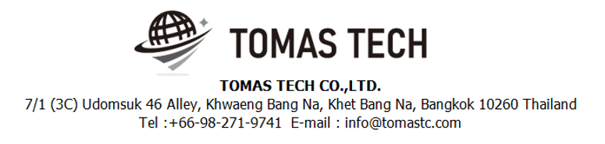
Version 20/Jul/2025
Confidential
Power Visualization System manual document
Documentation EN Manual
Made for: NTN Manufacturing(Thailand) Co., Ltd.
By: TOMAS TECH CO.,LTD.

Slide 2

Introduction
This manual explains each handy terminal, how to set it up with a PC, how to check the operation, and how to communicate with a PC.
Please read before starting work.
For safe use of this device
To use this device correctly and safely, be sure to observe the following safety precautions when operating this device. TOMAS TECH cannot be held responsible or warranted for any damage caused by using the product in violation of these precautions.
◆How to read the symbols
In this manual, the items to be observed in order to use the device safely are classified as follows.
Danger
If you ignore the information on this label and handle it incorrectly, there is a risk of death or serious injury.
Warning
This indicates the contents that may cause injury if the contents of this display are ignored and the product is handled improperly.
Caution
It indicates that property damage may occur if the product is handled improperly, ignoring the contents of this display.
The symbol represents a "caution" that it should be aware of.
The symbol represents an "instruction" that it must execute.
The symbol represents a "prohibition" that must not be done.
The symbols represent the "information" needed to deepen your understanding of this book.
The symbol represents "prohibited handling" by anyone other than a service person.
The symbol indicates that grounding is required during installation.
Reference
Indicates chapters to refer to and other manual references.

Slide 3
For safe use
◆General caution
In the unlikely event that this device breaks down, take sufficient safety measures to prevent various damages before use.
Please note that we cannot guarantee the function and performance of products that are used or modified outside the specifications shown in the specifications.
Do not disassemble this device unnecessarily. There is a risk of failure or damage.
Do not allow the device to get wet with water. It may lead to damage to this device.
Please use within the environmental conditions of this device. In addition, even within environmental conditions, equipment may be damaged in an environment where condensation forms due to sudden temperature changes.
Do not drop the device or hit it with strong force. Also, if the wiring from this device is likely to be subject to excessive impact, consider how to protect the wiring. It may lead to damage to this device and other devices.
Do not operate the device in a place with flammable or explosive gas or vapor. It is very dangerous to use this device in such an environment.
When using this device in combination with other devices, the functions and performance may not be satisfactory depending on the usage conditions and environment, so please consider carefully before using.
Caution
◆For proper use
When installing this device, turn off the power of the device. Do not short-circuit each wiring or terminal.
When installing this device, be sure to perform protective grounding to prevent electric shock.
Be sure to check that the power supply voltage of the device matches the voltage of the power supply before turning on the device.
Only our customer service or equivalent handlers should install this equipment.
To supply power to this device, connect it via a protection circuit such as a switchboard breaker or an earth leakage breaker.
Since this device is an electronic device, when installing various devices, investigate the installation environment (primary power supply system noise, drive device system noise, electrostatic discharge noise, etc.) and take countermeasures. It may cause system malfunction or damage to various devices.
Caution

Slide 4
Revision History
Date | Version | File name | Details
20/Jul/2025 | R1 | Power Visualization System manual document_EN_R1 | First edition

Slide 5
■Contents
Overview
Web Functions
2.1 Electric Summary Dashboard
2.2 Menu List
2.3 Basic Unit
2.4 Meter Compare
2.5 Meter Detail
2.6 Data Export
2.7 Consumption Export
2.8 Manage Peak Rate
2.9 Manage Target
2.10 Manage Calendar
2.11 Manage Meter
2.12 Manage User
2.13 Manage Authority
2.14 Manage Menus
Q&A Contact
Information

Slide 6
1. Overview
Proposal: Power Visualization System For NTN Manufacturing (Thailand) Co., Ltd.
Objective
The objective of this proposal is to develop a Power Visualization System that enables NTN Manufacturing (Thailand) Co., Ltd. to effectively monitor and manage energy consumption throughout the factory.
Scope
The system will provide monitoring capabilities for daily, monthly, and yearly energy usage, offering a comprehensive overview of power consumption for each area of the facility.

Slide 7
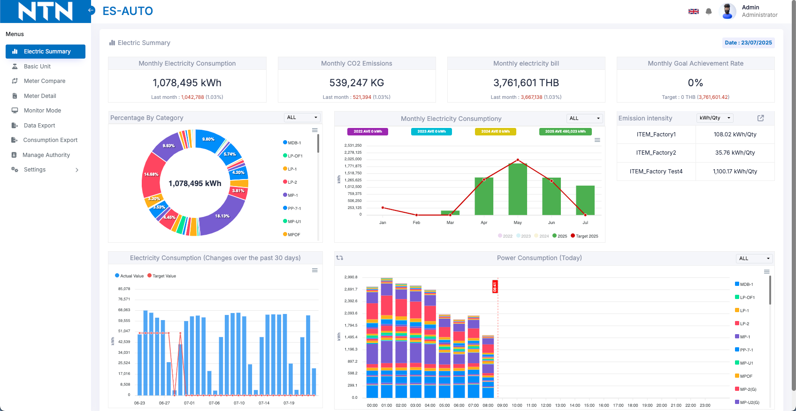
2. Web Functions
2.1 Electric Summary Dashboard
The Electric Summary Dashboard provides a comprehensive overview of the factory’s electricity consumption and key performance metrics. This page is designed to help users quickly understand energy usage patterns, track progress toward goals, and identify areas for improvement. Key features include:
2.1.1 Monthly Electricity Consumption: Displays the total energy used in the current month, along with a comparison to the previous month.
2.1.2 Monthly CO2 Emissions: Shows the total carbon emissions associated with energy use for the current month.
2.1.1
2.1.2
7

Slide 8
2. Web Functions
2.1.3 Monthly Electricity Bill: Summarizes the total electricity costs for the month.
2.1.4 Monthly Goal Achievement Rate: Indicates the current progress toward monthly energy-saving targets.
2.1.3
2.1.4
2.1.5 Percentage by Category: A donut chart that visualizes the proportion of energy usage by each area or section.
2.1.6 Monthly Electricity Consumption Trend: A bar and line chart that shows monthly consumption across multiple years, including the target line for comparison.
2.1.7 Emission Intensity Table: Lists the energy intensity (kWh/Qty) for each major unit or section.
2.1.5
2.1.6
2.1.7

Slide 9
2. Web Functions
2.1.8 Electricity Consumption (Changes over the past 30 days): A bar chart displaying daily actual and target electricity usage.
2.1.9 Power Consumption (Today): A stacked bar chart illustrating today’s power consumption, broken down by area and hour.

Slide 10
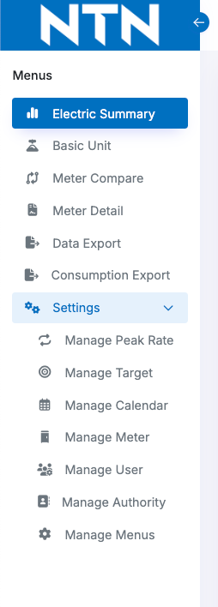
2. Web Functions
2.2 Menu List
Section 1 focuses on displaying data in various formats.
Section 1
Section 2 is for configuration and management of master data in the system, such as peak rate settings, user management, factory holiday settings, and monthly energy consumption targets.
Section 2

Slide 11
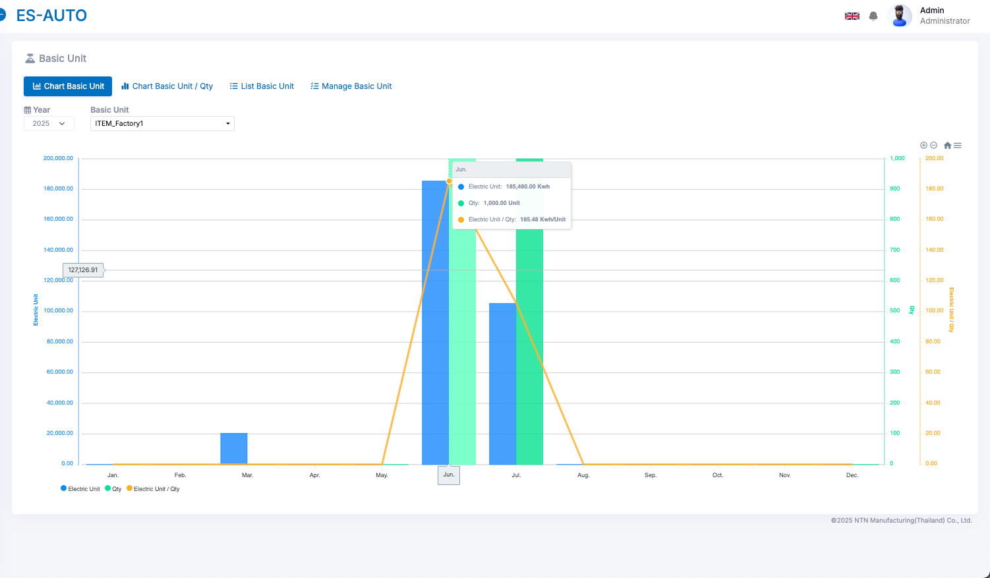
2. Web Functions
2.3 Basic Unit
The Basic Unit section displays information on the total number of equipment units in the factory compared with the energy consumption of each group. This section consists of four parts:
Chart Basic Unit
Shows the total number of equipment units compared with their energy consumption, including the average values.
Chart Basic Unit / Qty
Compares the number of equipment units with energy consumption in three formats:
1. Unit/Qty
2. kWh/Qty
3. CO2/Qty
List Basic Unit
Displays the list of Basic Units that have been set up for each month.
Manage Basic Unit
The management page for adding or editing Basic Unit records.
2.3.1 Chart: Basic Unit
Electric Unit
Basic Unit
Avg Electric Unit / Basic Unit

Slide 12
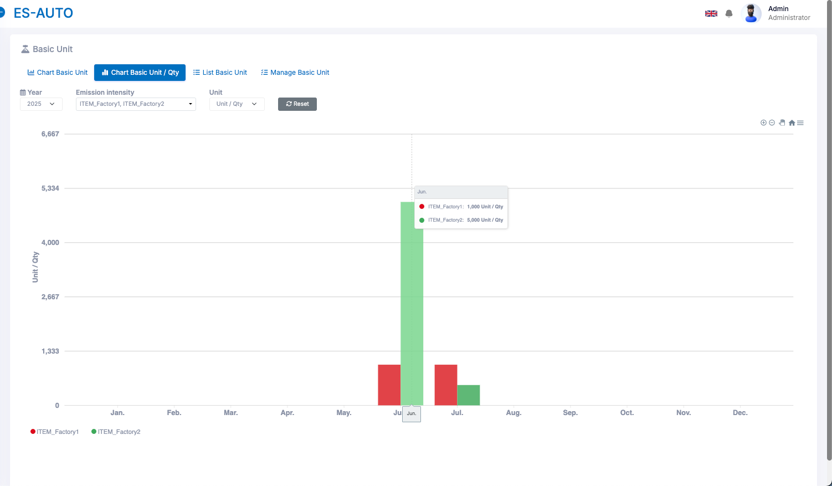
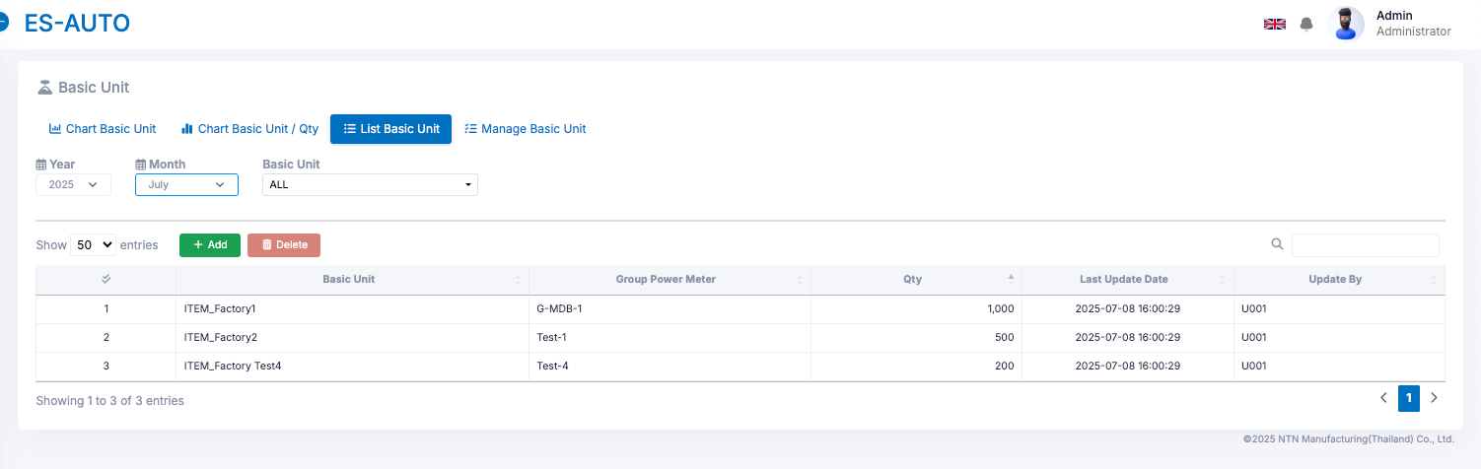
2. Web Functions
2.3.2 Chart: Basic Unit / Qty
Avg Electric Unit / Basic Unit
2.3.3 List Basic Unit: This page is used for managing the monthly Basic Unit reports. Users can add new records or edit the number of each Basic Unit for any given month.

Slide 13
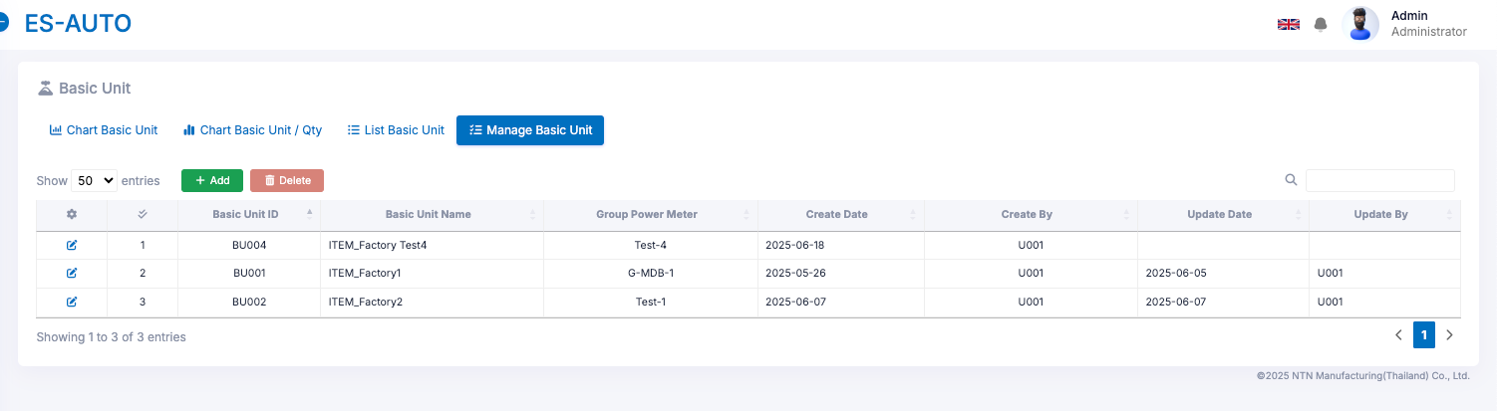
2. Web Functions
2.3.4 Manage Basic Unit: This page is used for managing all Basic Unit records within the factory. Users can add, delete, and edit Basic Units as needed.

Slide 14
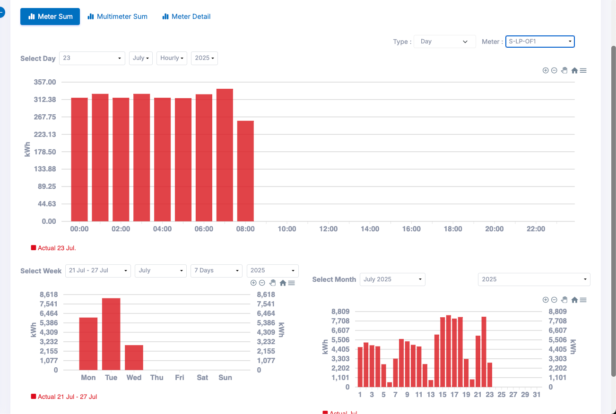
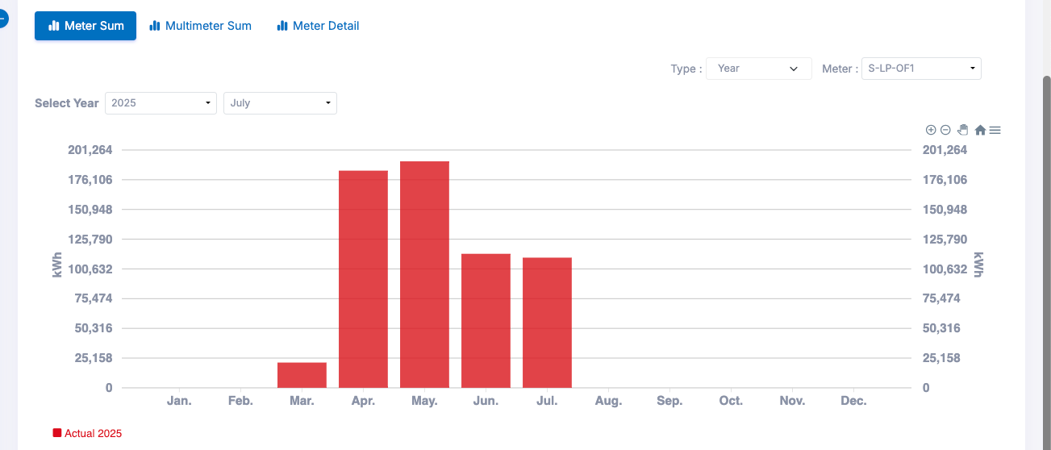
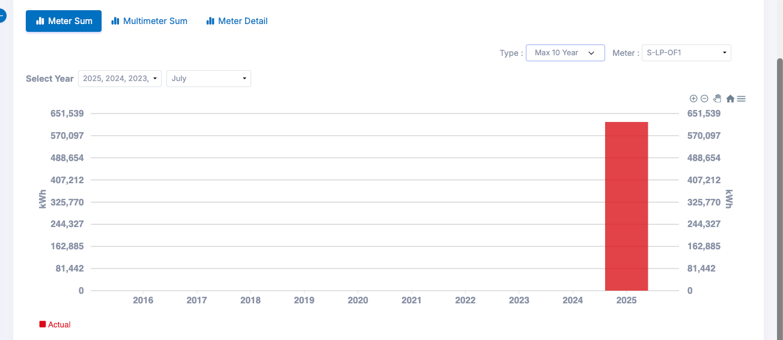
2. Web Functions
2.4 Meter Compare
The Meter Compare section displays energy consumption data in various chart formats. It includes three different types of charts for comparison.
2.4.1 Meter Sum: This section displays energy consumption data on a daily, weekly, monthly, yearly, and 10-year basis. Users can filter and view the data for specific dates or months as needed.

Slide 15
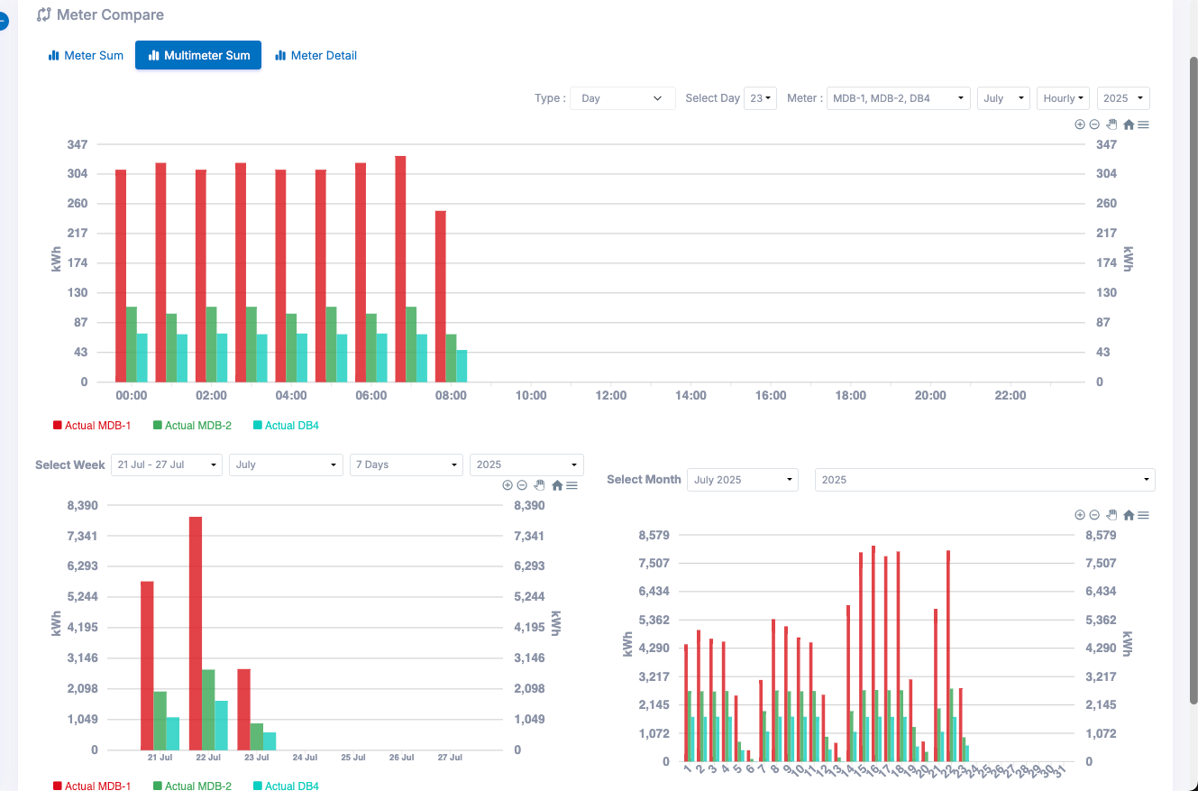
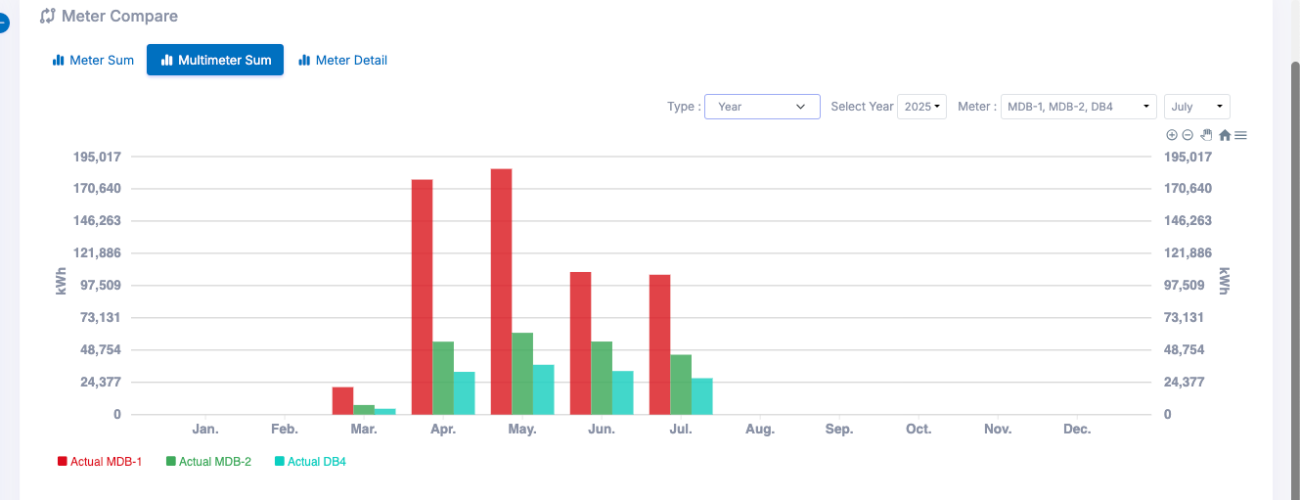
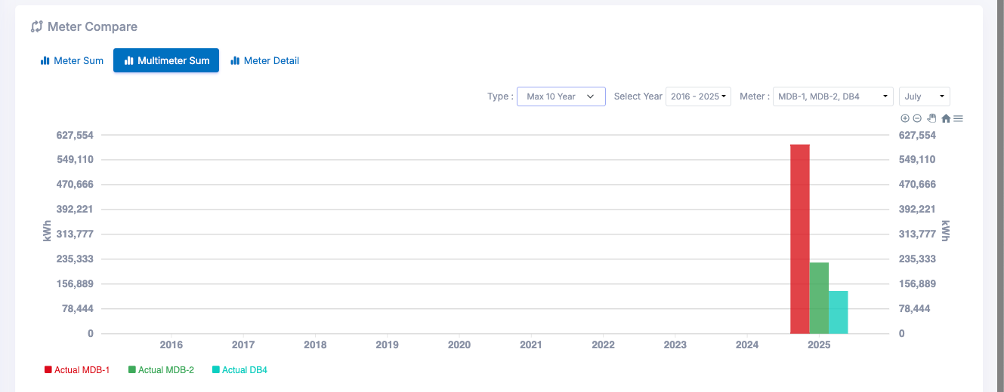
2. Web Functions
2.4.2 Multimeter Sum: This section displays energy consumption data on a daily, weekly, monthly, yearly, and 10-year basis. Users can filter and view the data for specific dates or months as needed, and can also select multiple meters to compare their data side by side.

Slide 16
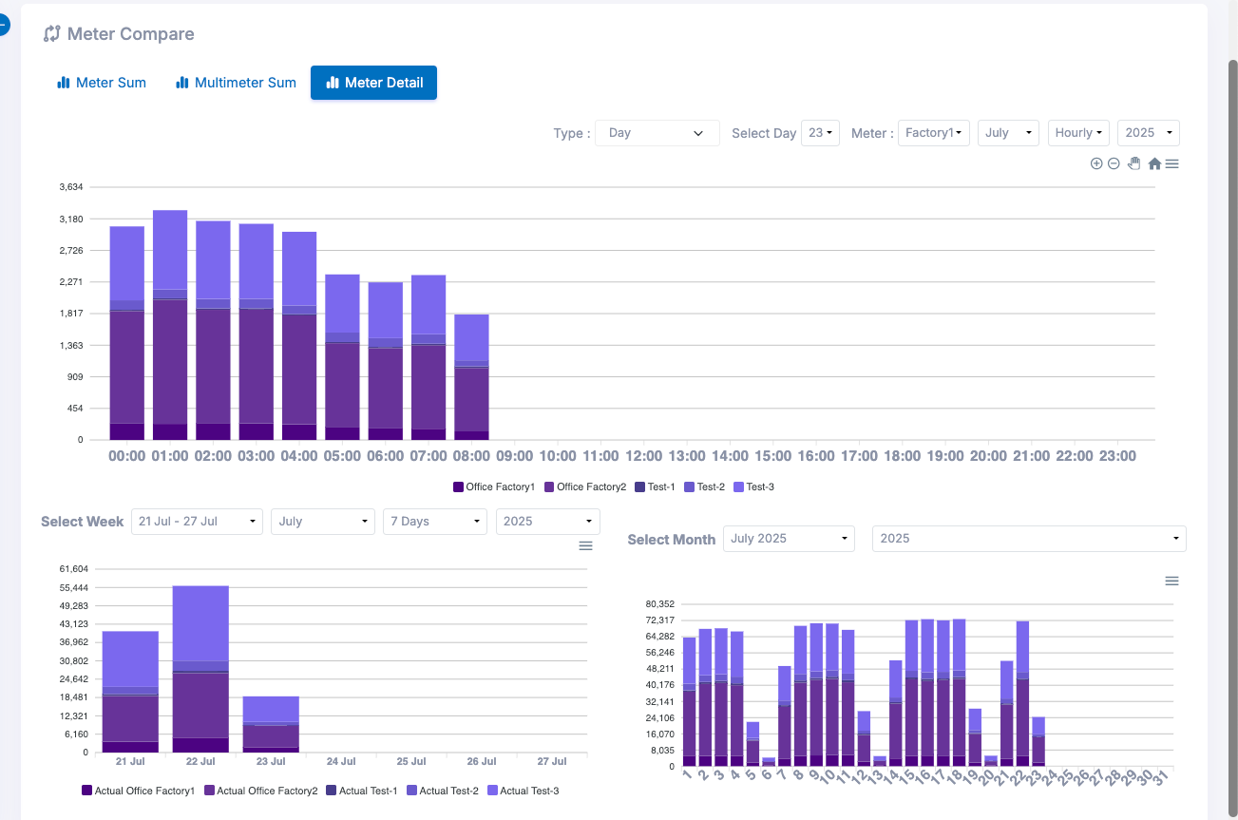
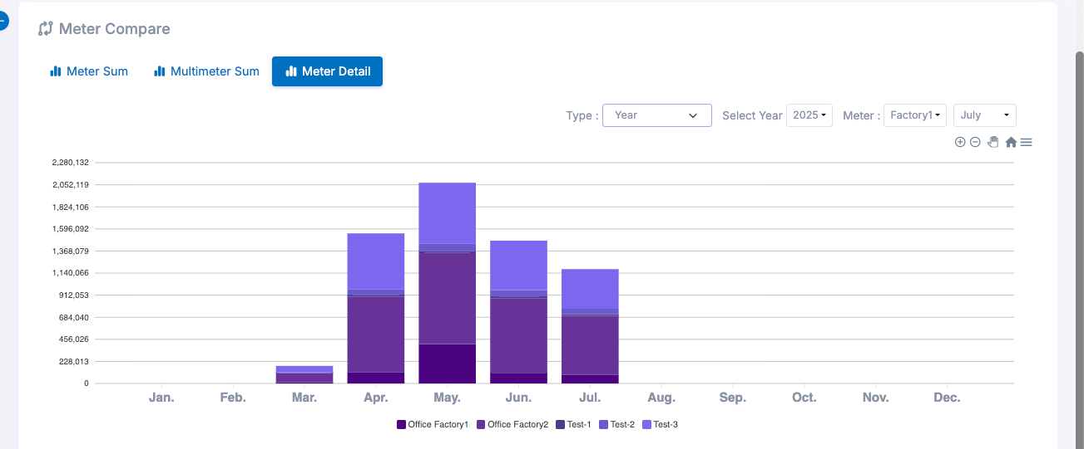
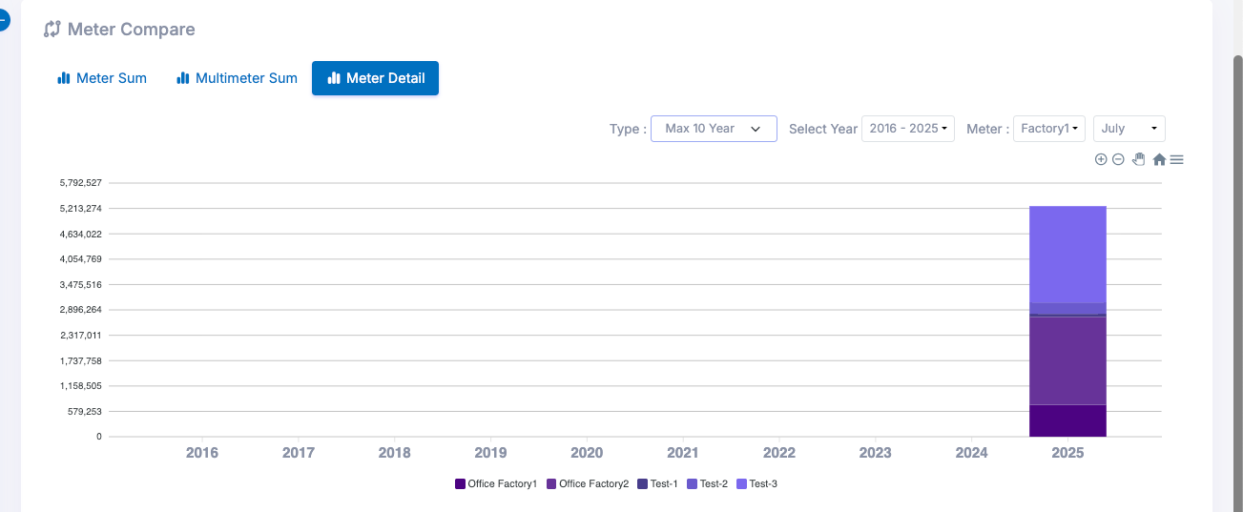
2. Web Functions
2.4.3 Meter Detail: This section displays energy consumption data on a daily, weekly, monthly, yearly, and 10-year basis. Users can filter and view the data for specific dates or months as needed, and can also select multiple meters to compare their data side by side. The results are shown in a stacked chart format, making it easy to clearly see the differences in energy usage.

Slide 17
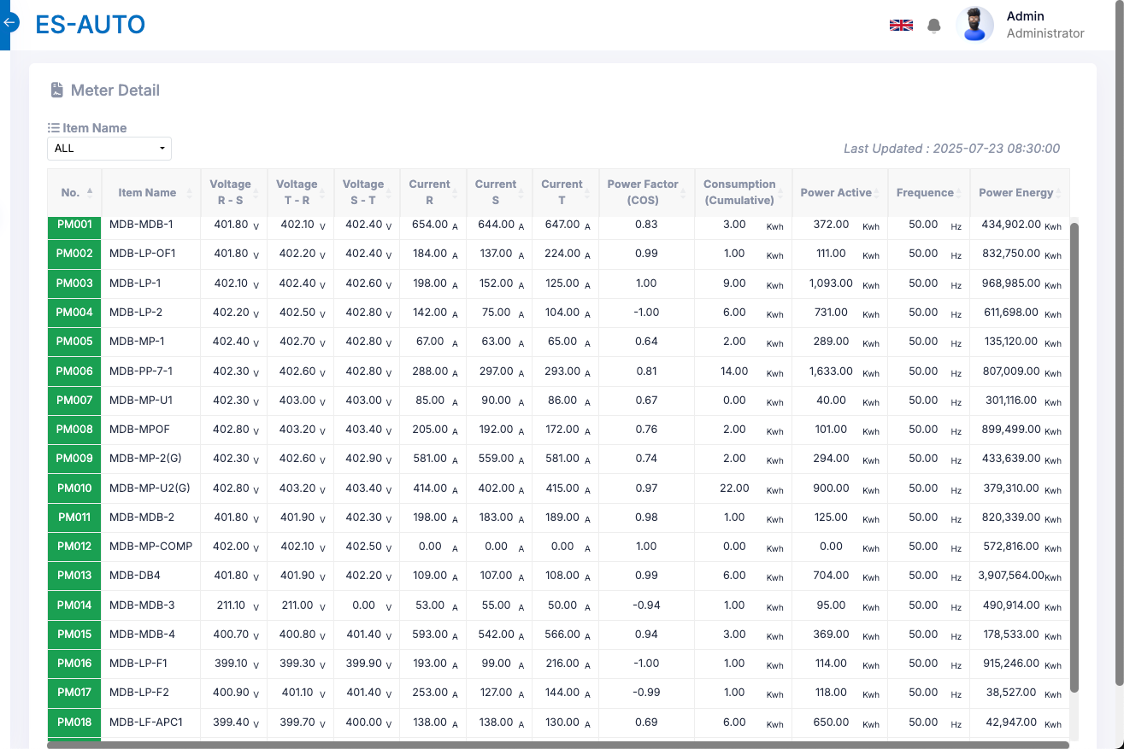
2. Web Functions
2.5 Meter Detail
The Meter Detail section displays the raw energy consumption data collected from every power meter installed in the factory.
Note: This page only displays the current data available in the database.
It is not possible to view historical data on this page.

Slide 18
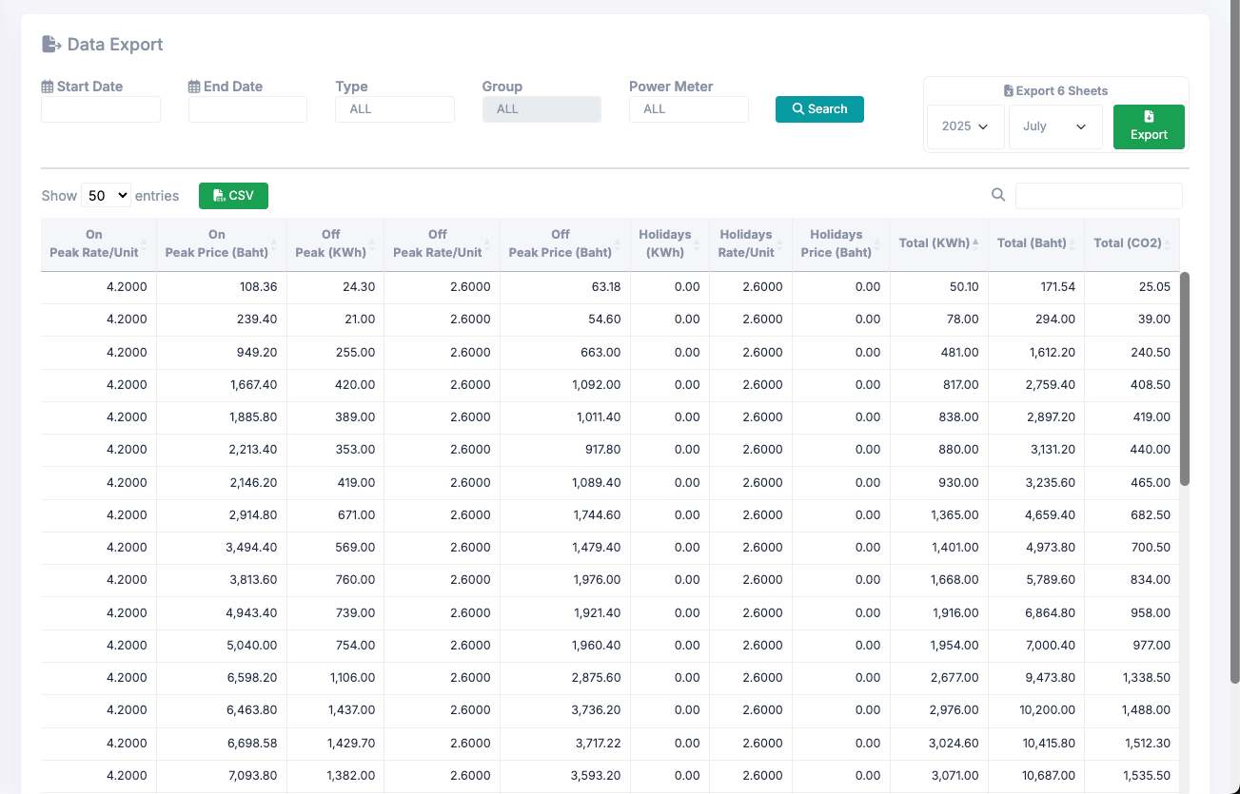
2. Web Functions
2.6 Data Export
The Data Export page displays the total kWh used during the selected date range. By default, it shows data for the current month upon entering the page. Users can export the filtered data as a CSV file, or export monthly data into 6 separate sheets, each containing the following information:
1. DemandData – Shows energy usage data recorded every 15 minutes.
2. Demand – Shows the maximum daily energy demand for each Power Meter.
3. Kwhr – Shows the total daily kWh usage for each Power Meter.
4. Energy by Period (TOD) – Displays energy usage separated into time periods: 08:00–18:30, 18:30–21:30, and 21:30–08:00 (next day).
5. Energy by Period (TOU) – Displays energy usage separated into four periods:
  ONPEAK (09:00–22:00)
  OFFPEAK1 (00:00–09:00)
  OFFPEAK2 (22:00–24:00)
  HOLIDAY (00:00–24:00)
6. Energy Cost by Period (TOU) – Shows the energy cost separated into the same four periods above, calculated based on the ONPEAK RATE and OFFPEAK RATE configured in the system.
Excel 6 Sheet

Slide 19
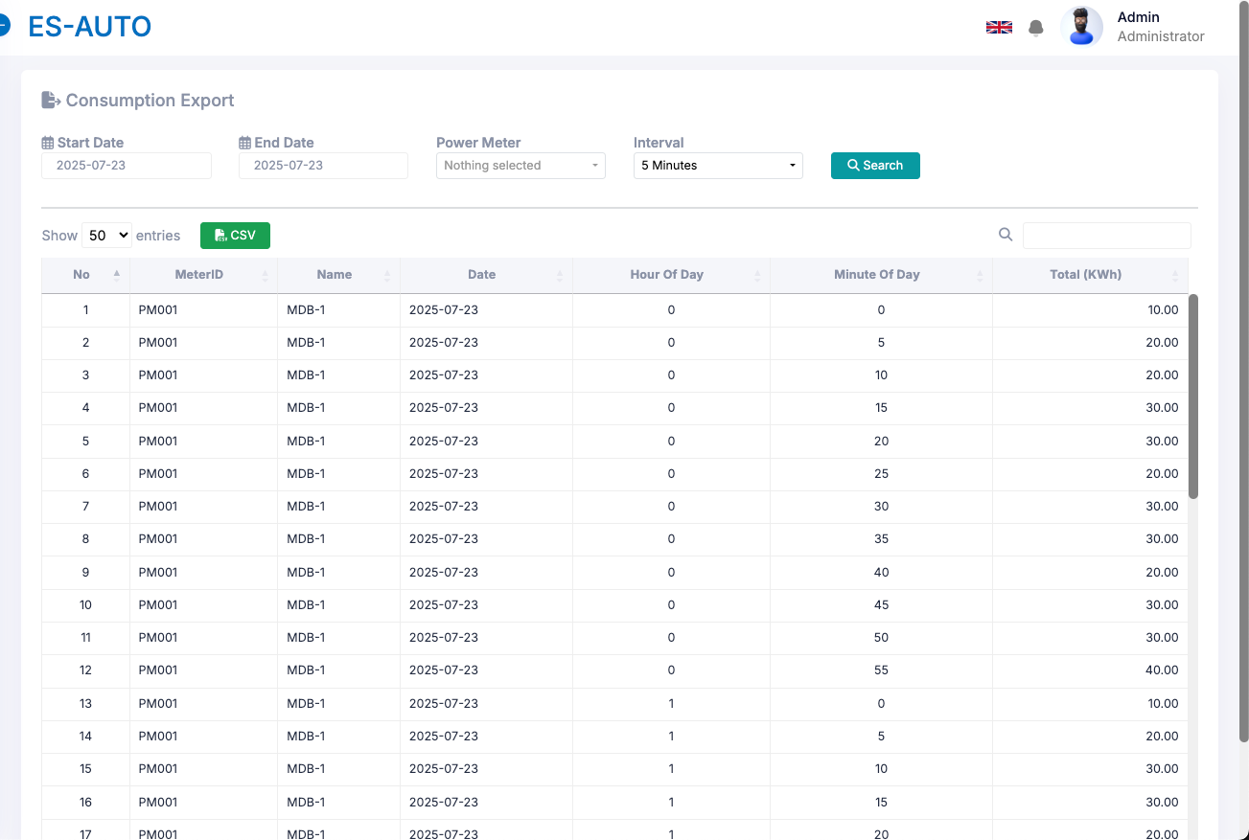
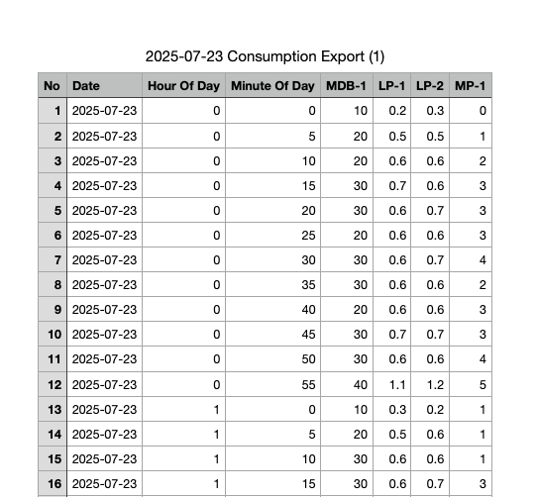
2. Web Functions
2.7 Consumption Export
The Consumption Export page displays energy consumption data at 5-minute, 15-minute, or hourly intervals, based on the user's selection. Users can also select multiple power meters to view and export data for more than one meter at a time.
CSV Export

Slide 20
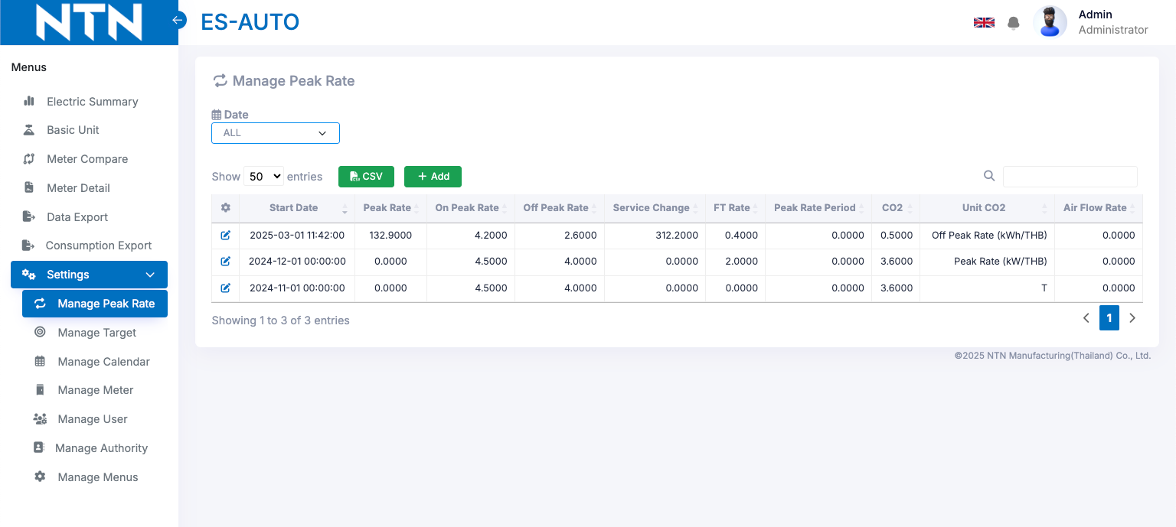
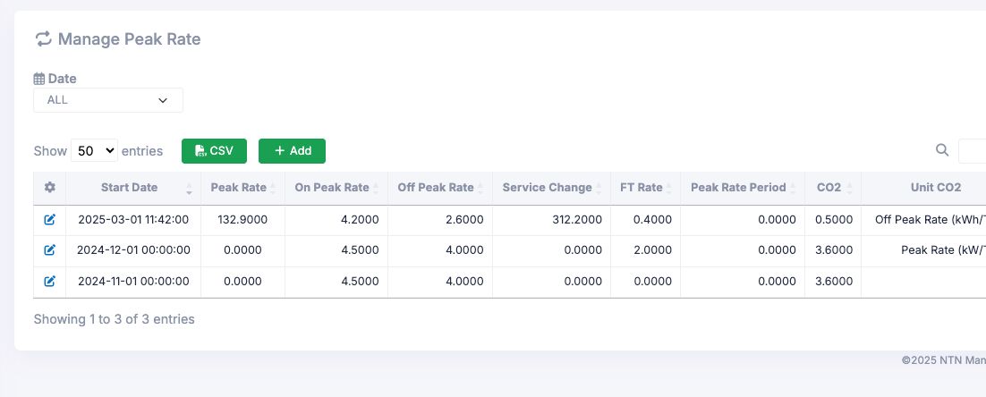
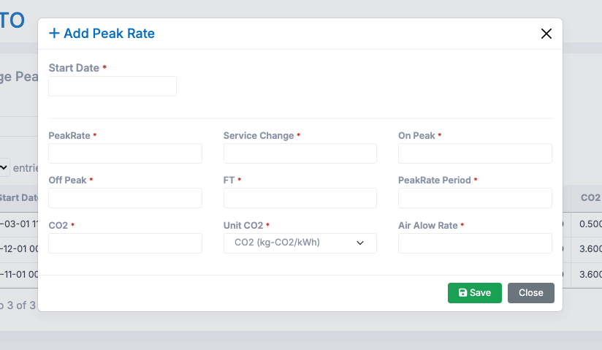
2. Web Functions
2.8 Manage Peak Rate
The Manage Peak Rate page is used to manage the cost settings for ONPEAK and OFFPEAK periods. These rates are used to calculate the monthly energy costs.
2.8.1 Add: if you want to add a new Peak Rate setting, click the "Add" button. After entering all required information, click "Save" to store the data. The new rate will be applied starting from the Start Date you specified.
20

Slide 21
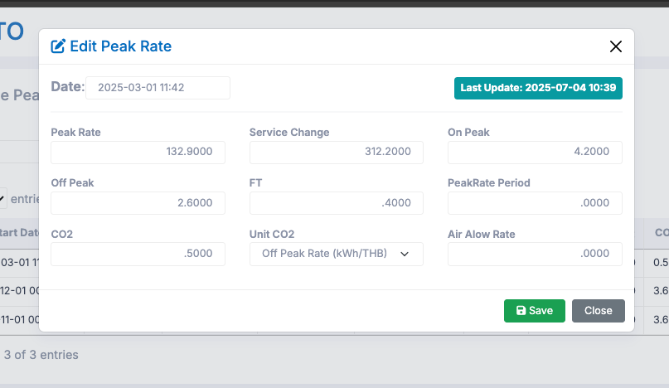
2. Web Functions
2.8.2 Edit: If you want to edit the details of a Peak Rate, click the "pencil" icon next to the rate you wish to modify. After updating the necessary information, click "Save" to save your changes.
21

Slide 22
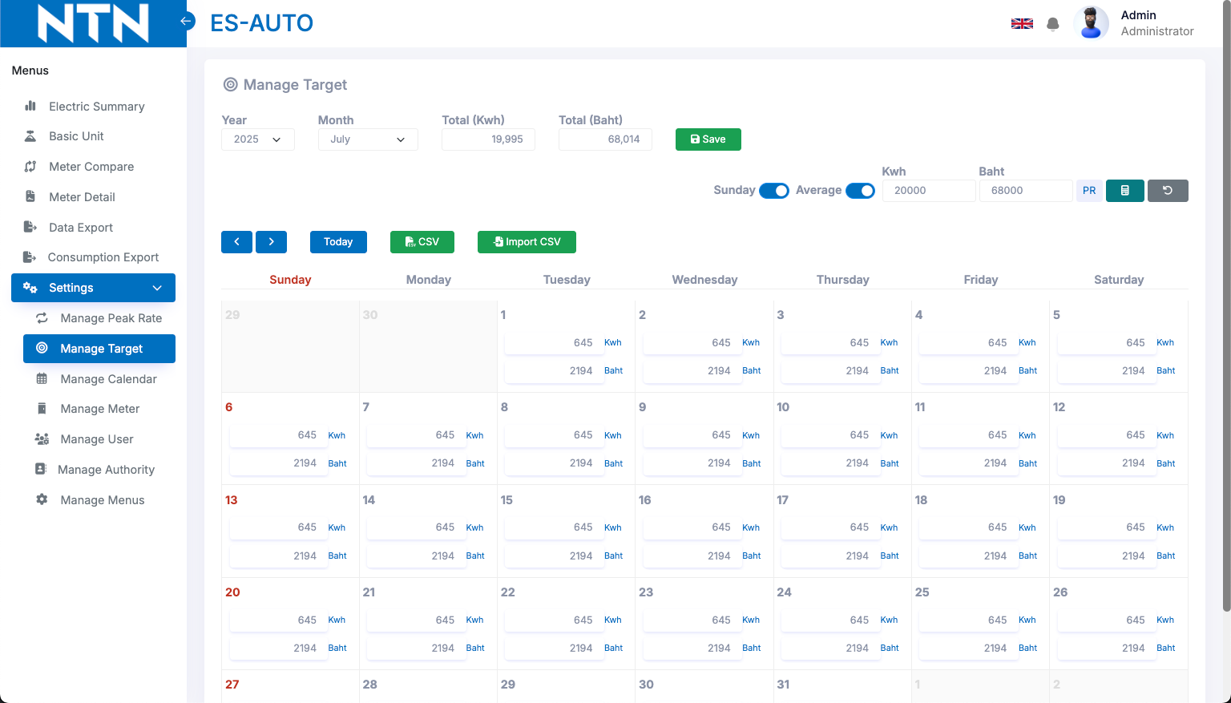
2. Web Functions
2.9 Manage Target
The Manage Target page is used to set energy consumption targets for each day and month, which serve as benchmarks for various data displays throughout the system. You can also set target costs for each day and month on this page.
You can specify the dates for which you want to set targets and choose to exclude Sundays if needed. The system also allows you to enter a total kWh value, which will be automatically averaged and distributed as daily targets. After entering all required information, click the "Save" button to save your settings.
22

Slide 23
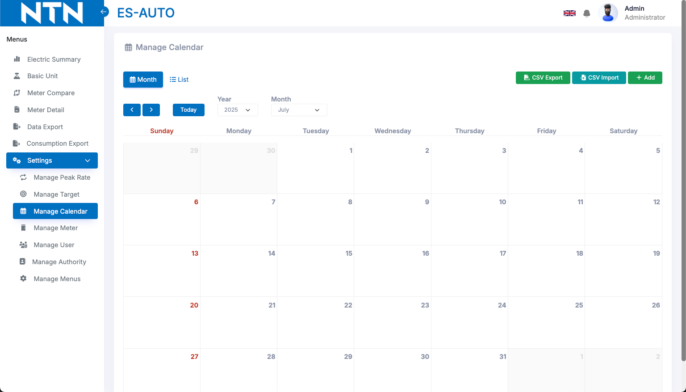
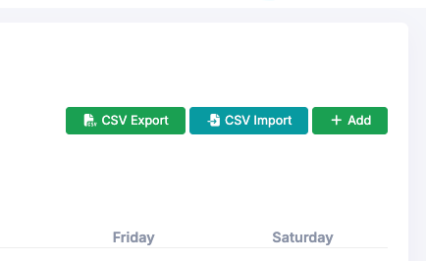
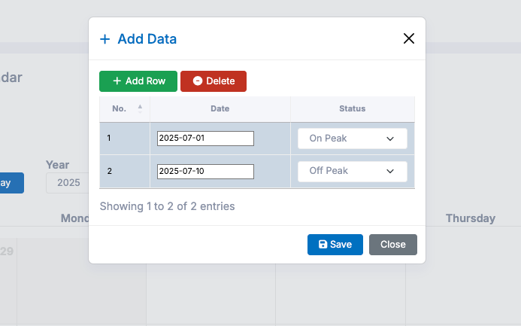
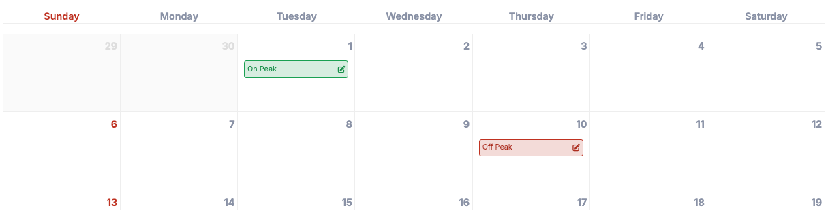
2. Web Functions
2.10 Manage Calendar
The Manage Calendar page is used to configure ONPEAK and OFFPEAK days for each day and month. This ensures that monthly energy costs are calculated accurately based on the correct peak and off-peak periods.
2.10.1 Add: To set ONPEAK or OFFPEAK days, click the "Add" button. Then, select the dates and choose the type (ONPEAK or OFFPEAK). You can add multiple entries at once. After completing your selections, click the "Save" button to save the settings.
23

Slide 24
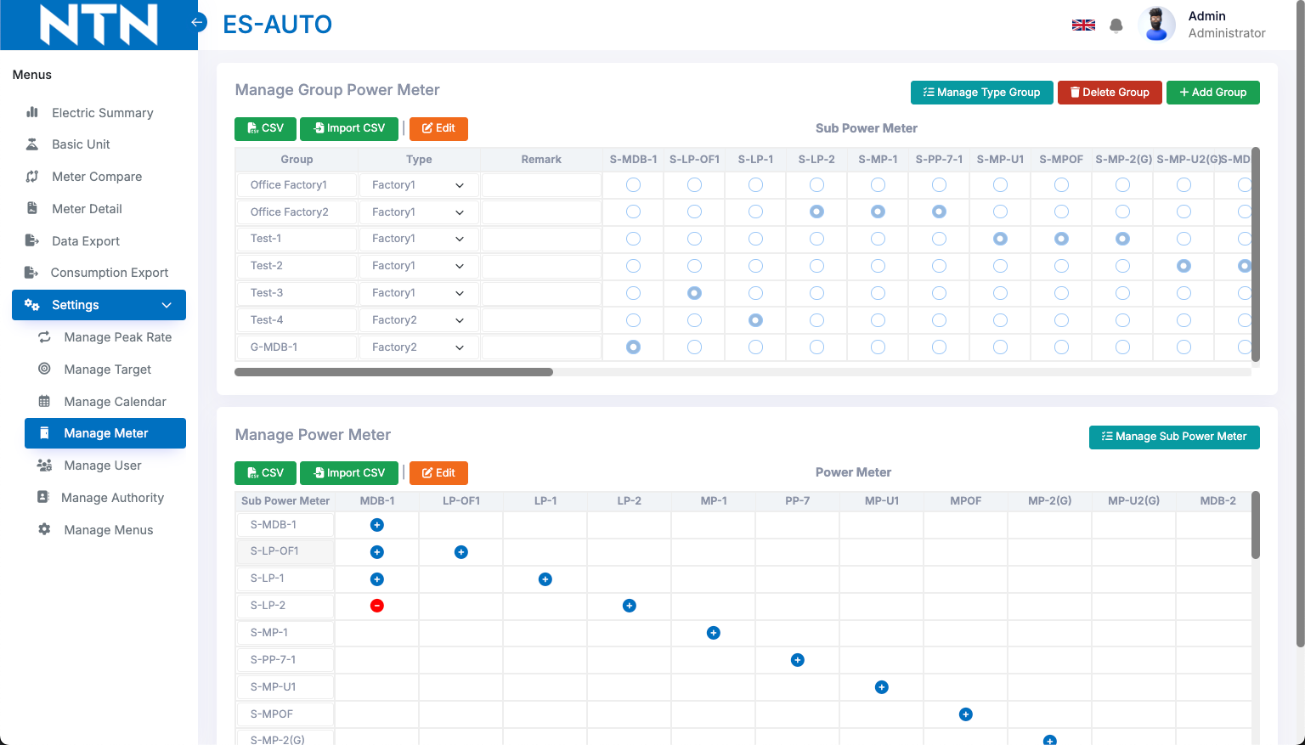
2. Web Functions
2.11 Manage Meter
The Manage Meter page is used to group Power Meters for data display on the Dashboard. The grouping is organized in the following order:
Type
Factory 1
GROUP | Office 1 | Plant 1 |  | Plant 2
Sub Power Meter | SMDB1 | SMDB2 | SMDB3 | SMDB4
Power Meter | MDB-1 | MDB-2 | MDB-3 | MDB-4
 | MP-U1 | LP-OF | PP-7 | PP-1
 |  | MPOF |  | PP-200-4
Group
Sub Power Meter
Power Meter
Factory 1 is provided as an example to illustrate how grouping works. Users can customize the groups they want to view as needed. To edit a group, click the "Edit" button.
24

Slide 25
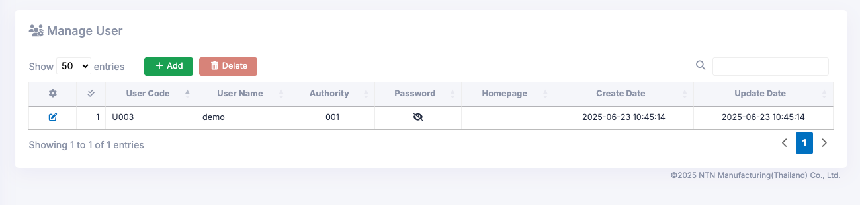
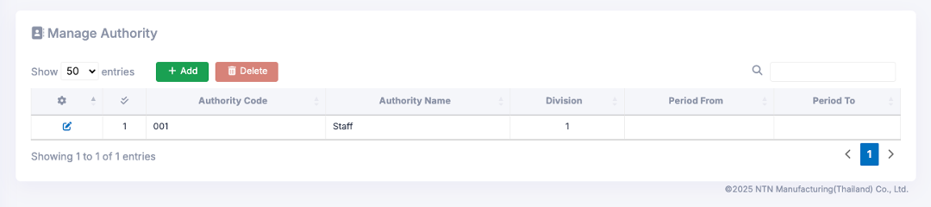
2. Web Functions
2.12 Manage User
The Manage User page is used to manage system users, allowing you to add, delete, and edit user accounts, as well as reset passwords.
2.13 Manage Authority
The Manage Authority page is used to manage user groups within the system. You can add, delete, and edit groups as needed. Once access rights have been set, they will be applied in the Manage User menu.
25

Slide 26
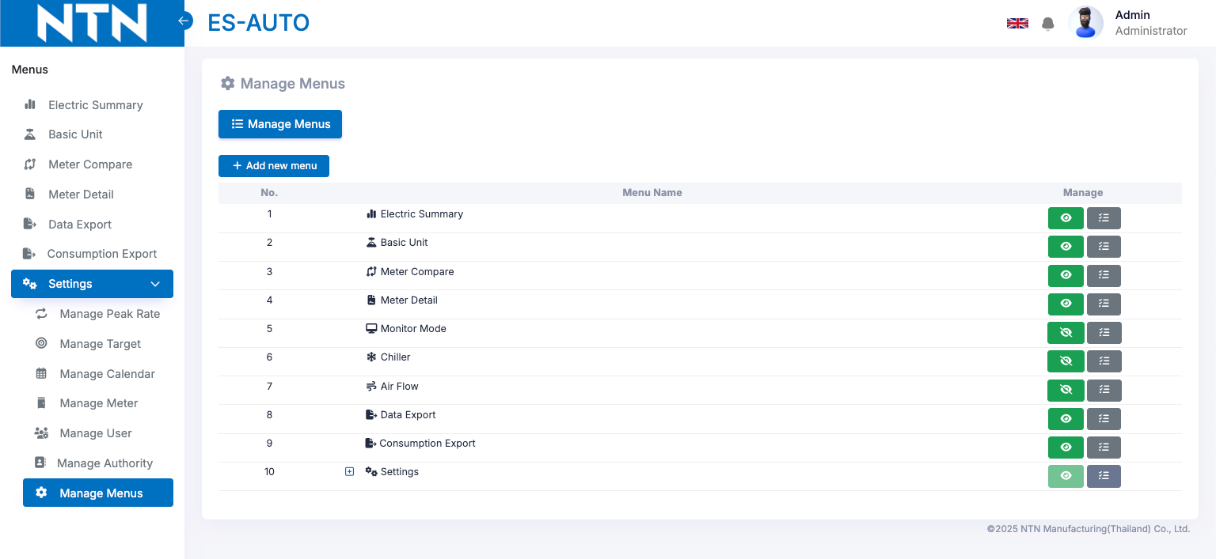
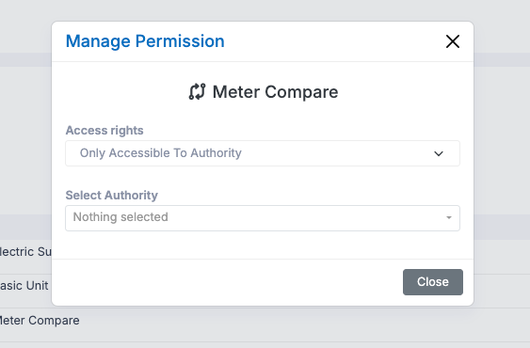
2. Web Functions
2.14 Manage Menus
The Manage Menus page is used to manage the menus within the system. You can show, hide, or control user access to specific menus as needed.
Users can configure which users have access to view specific pages within the system.
26

Slide 27
3. Q&A
# | Date | Question | By | Date | Answer | By
1
2
3
4
5

Slide 28
4. Contact information
The contents of this specification and manual are subject to change without notice. Copying or copying part or all of the manual without the written permission of TOMAS TECH is prohibited, regardless of its form.
If you have any questions, concerns, or questions regarding the specifications of this system and the contents of the manual, please contact us by phone or e-mail. Tel: +66 (0) 2 336 0574 E-mail: info@tomastc.com
Item | Description
1. Service time | 8 hours x 5 days (8:00 -17:00 Monday to Friday)
2. Onsite Hardware Maintenance | -
3. Onsite System Maintenance | -
4. Response after receive a call | On-line support within 24 hours / On-site support within 48 hours
5. Remote service | Yes
6. Phone service | Yes
7. Email service | Yes

