Slide 1
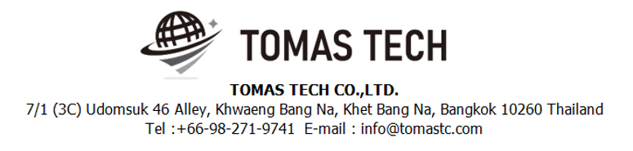
Version 23/May/2025
Confidential
Production management system specifications
Documentation EN Blueprint for YAMATO
Blueprint
R9
Made for: Yamato Electric (Thailand) Co., Ltd.
By: TOMAS TECH CO.,LTD.

Slide 2
Revision History
Date | Version | File name | Details
15/Jun/2024 | R1 | Production management system specifications Documentation EN Blueprint for YAMATO Blueprint | First edition
15/Jul/2024 | R2 | Production management system specifications Documentation EN Blueprint for YAMATO Blueprint | Second edition
4/Aug/2024 | R3 | Production management system specifications Documentation EN Blueprint for YAMATO Blueprint | Third edition
14/Aug/2024 | R4 | Production management system specifications Documentation EN Blueprint for YAMATO Blueprint | Fourth edition
21/Aug/2024 | R5 | Production management system specifications Documentation EN Blueprint for YAMATO Blueprint | Fifth edition
7/Sep/2024 | R6 | Production management system specifications Documentation EN Blueprint for YAMATO Blueprint | Sixth edition
12/Dec/2024 | R7 | Production management system specifications Documentation EN Blueprint for YAMATO Blueprint | Seven edition
12/May/2025 | R8 | Production management system specifications Documentation EN Blueprint for YAMATO Blueprint | Eighth edition
23/May/2025 | R9 | Production management system specifications Documentation EN Blueprint for YAMATO Blueprint | Ninth edition
2
3
4
5
6
7
8
9

Slide 3
■Contents
1. Overview
2. Overall configuration diagram
3. Document image
3-1. Importing Files
3-1-1. BOM (Sample)
3-1-2. Delivery Schedule (Shipment plan)
3-1-3. Forecast Monthly
3-1-4. Remain PO
3-1-5. Master plan (Production plan)
3-2. Print label information
3-3. Location Tag
3-4. Labeling
4. Schedule
4-1. Work Flow Chart
4-1-1. CSV file import process
4-1-2. Warehouse Inbound/Incoming process
4-1-3. Goods Receive Process
4-1-4 QC Process
4-1-5. Picking Process (Part Store)
4-2. Stock management
4-3. Outbound
4-4. Master management
5. System functional specifications
5-1. Handy terminal function
5-2. Handy terminal function Inbound
5-3. Handy terminal function Outbound
5-4. Handy terminal function Stock Management
5-5. PC operation flow Basic
5-6. PC operation flow Schedule
5-7. PC operation flow Inbound
5-8. PC operation flow Outbound
5-9. PC operation flow Stock management
5-10. PC operation flow Master management
6. Q&A
7. Sign off

Slide 4
1. Overview
Introduced Production management system to YAMATO.
The system specifications for introduction are described in this document.

Slide 5

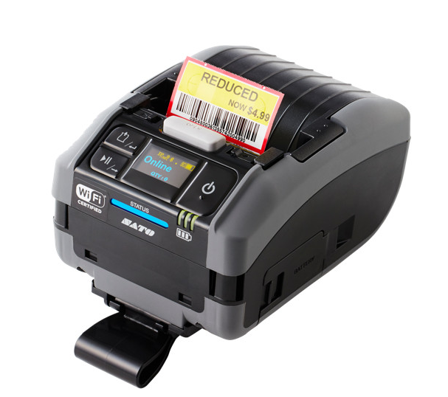

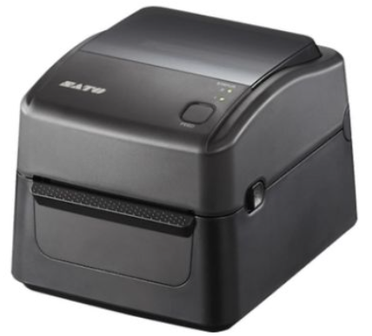

2. Overall configuration diagram
Represents a configuration diagram of the stock management system. It is a configuration image of hardware and documents.
Overall configuration diagram image
Inbound
Stock management
Outbound
Inbound label
Mobile printer × 1
PW2NX (WH)
WIFI
Handy terminal× 10
LAN cable
4
WIFI
Label printer × 1
WS412 (WH)
Label printer × 1
WS412 (Injection&Press& Molding&Remain)
Pegasus Server
Label printer × 1
WS412 (ASSY)
5
Able to import the materials data in format of CSV file.
Purchase order (30 days advanced)
Forecast
Production plan
Input Data
Plan data (IN/OUT)
PO
Forecast

Slide 6
2. Overall configuration diagram
Network diagram
YAMATO office
Lan cable
Pegasus
server
Wi-Fi
Client pc
Bluetooth
Switching hub
Access Point
Handy terminal#1
Handy terminal#10
4
Mobile printer #1
Label printer #1
Label printer #2
Label printer #3
YAMATO Warehouse

Slide 7
2. Overall configuration diagram
Hardware diagram
YAMATO office
Lan cable
Pegasus
server
Wi-Fi
Client pc
Bluetooth
AC220V*1
Switching hub
Access Point
AC220V*1
Handy terminal#1
Handy terminal#10
Charger #1
Charger #10
AC220V*10
4
Mobile printer#1
Label printer #1
Label printer #2
Label printer #3
Charger #1
AC220V*1
AC220V*1
AC220V*1
AC220V*1
YAMATO Warehouse

Slide 8
3. Document image
4
3-1. Importing Files
Item | File name | Type | Remarks
Inbound / Material Receive | Remain PO.xls | Purchase Order | Import to Pegasus (p.12)
Outbound / Delivery / Production plan | HOSODA & LOCAL DELIVERY SCHEDULE OF JUNE'2024.xls | Delivery Plan | Shipment Plan Import to Pegasus (p.10)
 | Plan_Assy_Inj_Press.xlsx | Production Plan | Production plan Import to Pegasus (p.13)
Master / Report / Other | BOM Sample.xlsx | BOM | * Must be change format (p.9)
 | Japan shipment Request.xlsx | Forecast Monthly | Use this format for Forecast Monthly (p.11)

Slide 9
3. Document image
3-1-1. BOM (Sample)
YAMATO ⇒Pegasus
6
*Must be change format below table
2
L0/L1
L2
L3
No | Product | FG Code | Part code | Part name | Material code | Material grade/size | Usage | BOM | Com | Unit price | Supplier
1 | KYUHAI | FG7173 | FP190910090001 | PL COVER | M12220137S | FP994 | 0.00366 | 1 | 3
2 | KYUHAI | FG7173 | FP190965040000 | CASE | M720965010001 | UREA CU6600Y70LT (GREEN) | 0.02850 | 1 | 3
3 | KYUHAI | FG7173 | FP190965050000 | CAM | M720965010001 | UREA CU6600Y70LT (GREEN) | 0.00350 | 1 | 3
4 | KYUHAI | FG7173 | FP190965070000 | HIKIDAMA | M12220136S | PP COMPOUND E701G | 0.00101 | 1 | 3
5 | KYUHAI | FG7173 | FP190965080000 | NAME RING | M12210563S | ABS COMPOUND QF-N | 0.00471 | 1 | 3
6 | KYUHAI | FG7173 | P190910050000 | LEVER |  |  |  | 1 | 3
7 | KYUHAI | FG7173 | P190910060000 | CAME PLATE |  |  |  | 1 | 3
8 | KYUHAI | FG7173 | P190910070000 | HIKITE |  |  |  | 1 | 3
9 | KYUHAI | FG7173 | P190910120000 | KOTEIHEN A |  |  |  | 1 | 3
10 | KYUHAI | FG7173 | P190910130000 | KOTEIHEN B |  |  |  | 2 | 3
11 | KYUHAI | FG7173 | P190910160000 | FLAT SPRING |  |  |  | 1 | 3
12 | KYUHAI | FG7173 | P190910170000 | SPRING A S91017 |  |  |  | 1 | 3
13 | KYUHAI | FG7173 | P190910180000 | SPRING B S91018 |  |  |  | 1 | 3
14 | KYUHAI | FG7173 | P190911020000 | C RING |  |  |  | 1 | 3
15 | KYUHAI | FG7173 | P190965020000 | SPL REVET |  |  |  | 1 | 3
16 | KYUHAI | FG7173 | P190965060000T | (KYUHAI SW KADOHEN) | MP11526004S | C5210R-EH 0.4 X 28 | 0.00248 | 1 | 2
17 | KYUHAI | FG7173 | P190965070000 | SHAFT |  |  |  | 1 | 3
18 | KYUHAI | FG7173 | P190965100000 | STEEL COVER |  |  |  | 1 | 3
19 | KYUHAI | FG7173 | P190965120000 | STRING A 1.6*910 |  |  |  | 1 | 3
20 | KYUHAI | FG7173 | P190965140000 | NAME PLATE |  |  |  | 1 | 1
21 | KYUHAI | FG7173 | P300015010000 | HATOME 1.8*4 |  |  |  | 4 | 1
22 | KYUHAI | FG7173 | P300015540000 | SCREW TP 3*8(THAI) |  |  |  | 2 | 3
23 | KYUHAI | FG7173 | PK081000000000 | BOX KYUHAI SWITCH ( SET ) |  |  |  | 0.005 | 3
24 | KYUHAI | FG7173 | W190910230000 | LEAD WIRE A |  |  |  | 1 | 3
25 | KYUHAI | FG7173 | W190910240000 | LEAD WIRE B |  |  |  | 1 | 3
Example of BOM file
2
No | FG Code | Ref part | Part no | Part name | Usage | Unit | Level | Supplier Code | Supplier Name
1 | FG7173 | FG7173 | FP190910090001 | PL COVER | 1 | Pcs | 1
2 | FG7173 | FP190910090001 | M12220137S | FP994 | 0.00366 | Kgs | 2
3 | FG7173 | FG7173 | FP190965040000 | CASE | 1 | Pcs | 1
4 | FG7173 | FG7173 | M720965010001 | UREA CU6600Y70LT (GREEN) | 0.02850 | Kgs | 2

Slide 10

3. Document image
3-1-2. Delivery Schedule (Shipment plan)
YAMATO ⇒Pegasus
2
*Create the delivery outbound schedule only. It can be outbound the items from any store location.
YAMATO ELECTRIC (THAILAND) CO., LTD.
HOSODA & LOCAL DELIVERY SCHEDULE OF JUNE'2024
RV_00 |  |  |  |  |  |  |  |  | UPDATE: | 13-May-24
Sum of PO Q'TY |  |  |  |  |  | YDT REPLY
CUS'T | Material No. | FG Code | Product Name | Inv. No. | PO. NO. # | 5-Jun-24 | 6-Jun-24 | 7-Jun-24 | 17-Jun-24 | TTL
TPT | 6233002003 | FG-8275 | MS-27ET | 2400067 | 10000583658 |  |  | 12000 |  | 20000
 | 17438000014366@MD |  |  | 2400067 | 10000586969 |  |  | 8000
TTEI | NEBI10830000000 | FG-2932 | POWER PUMP PLK-BA,10V | 2400065 | 2202402174 |  | 2000 |  |  | 3000
 | NEMI10000000001 | FG-2932 | POWER PUMP PLK-BA,10V | 2400066 | 2202402174 |  | 1000
 | PCBI6236019401T | FG-8172 | SDD | 2400063 | 2202406926 | 1500 |  |  |  | 1500
 | PCBI6236033501T | FG-8102 | GDD | 2400063 | 2202403916 | 3900 |  |  |  | 21000
 |  |  |  | 2400063 | 2202405785 | 6600
 |  |  |  |  | 2202405785 |  |  |  | 8400
 |  |  |  |  | 2202407555 |  |  |  | 2100
 | PCBI6343177901T | FG-8103 | SENSOR CASE GDD | 2400064 | 2202403916 | 2000 |  |  |  | 14000
 |  |  |  | 2400064 | 2202405785 | 4000
 |  |  |  | 2400064 | 2202407555 | 2000
 |  |  |  |  | 2202407555 |  |  |  | 6000
 | PCBI6343198201T | FG-8104 | 3 SENSOR CASE GDD | 2400064 | 2202405785 | 8000 |  |  |  | 14000
 |  |  |  |  | 2202405785 |  |  |  | 4000
 |  |  |  |  | 2202407555 |  |  |  | 2000
*User will add the Japanese customer to this file.
2
Noted on 23May2024
1. User can search the items by Inv no/Po no.
2. Update invoice no instructions (might not included when import)
2.1 Manual edit or enter the invoice no on Pegasus
2.2 Import the invoice no map with po no and material
3. It can’t be delivery outbound if there has no invoice number.
4. There are multiple invoice numbers with the same PO no.
Customer
TPT
TTEI
HOSODA
Forecast / PO plan
Customer | Forecast | PO
Japan | 4 months | 3 months
Thai | 2 weeks – 1 month | 2 weeks – 1 month
8

Slide 11
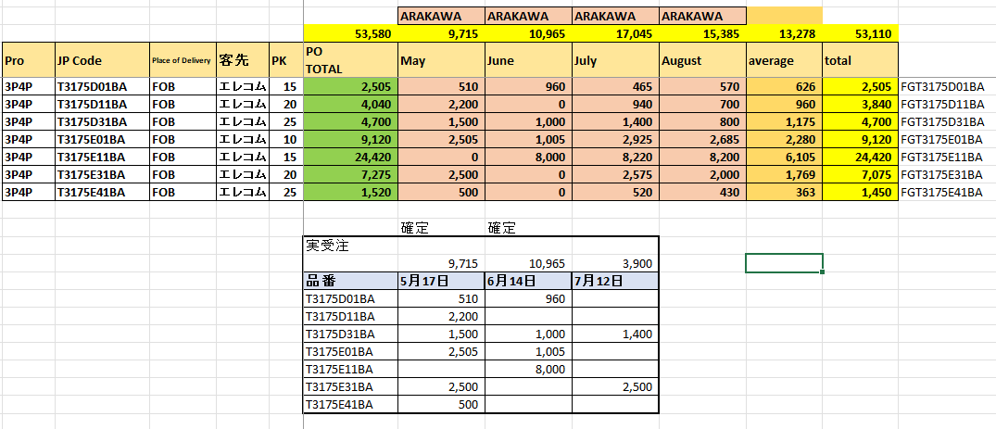
3. Document image
3-1-3. Forecast Monthly
4
YAMATO ⇒Pegasus
*May including all shipment requests with this format

Slide 12
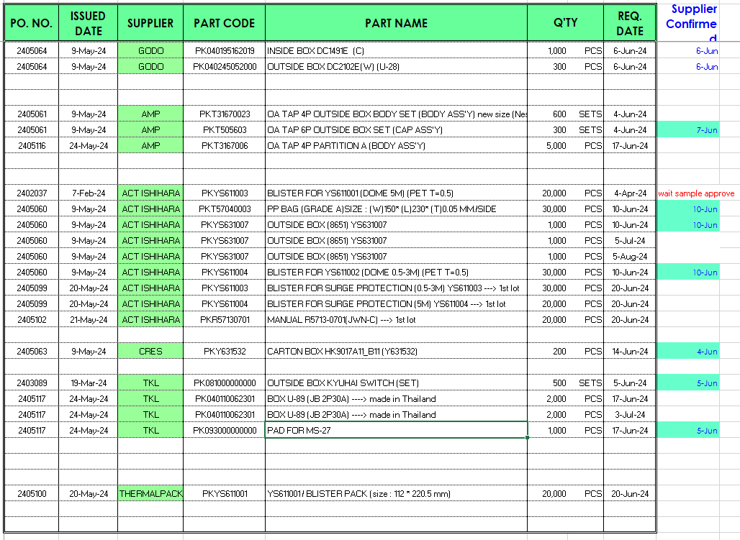
3. Document image
3-1-4. Remain PO
YAMATO ⇒Pegasus
2
*Used to create Material Inbound
2
*An item can be received from vary suppliers.

Slide 13
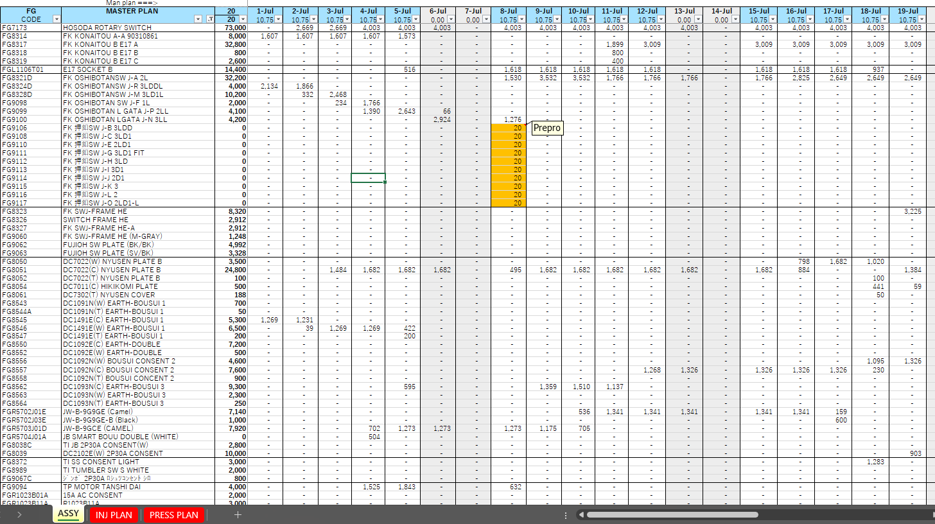
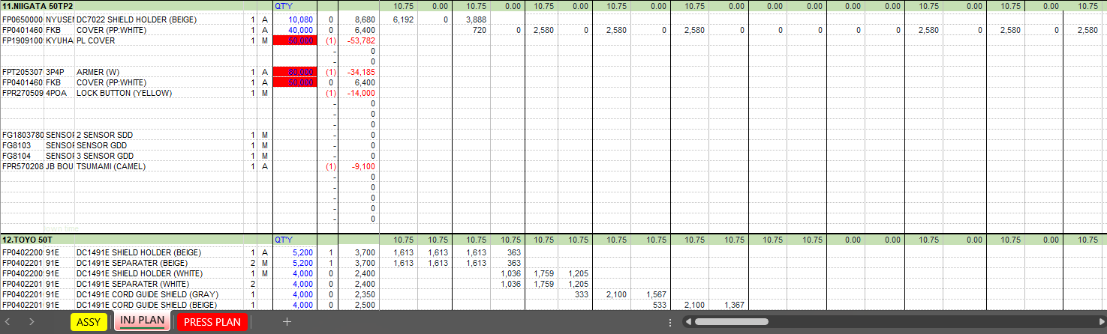
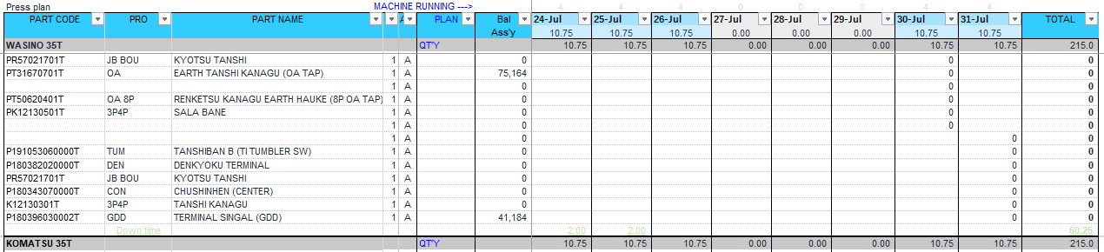
3. Document image
3-1-5. Master plan (Production plan)
YAMATO ⇒Pegasus
*Import this file to generate the material outbound and inbound work job for production.
** The jobs will be created before one shift time or one day earlier than the actual production time.
2
Process time generate
- Day shift (-1 day)
- Night shift (same day)
8
Assy plan should be separate the Qty column to DAY and NIGHT shift.

Slide 14

3. Document image
3-2. Print label information (Warehouse)
Font : Consolas
6
YDT
DATE : 6-Jun-23
TIME: 08:30 SEC: PC
SUPPLIER : AMP USER ID : EX1234
PART CODE : FPT20530101
PART NAME : BODY 3P (WH) Injection
QUANTITY : 1,500 PCS. LOT: 20231231
123456789001
QC/QA : CHECK
INSPEC ID: QC0001 PASS
REMARK : REJECT
SPECIAL USE
55mm
5
* There are 2 types background color Black/White. For solving the swap problem while repack the package
8
2
85mm
**QC inspection results
PASS : When all quantities have passed
REJECT : When the quantity is NG
SPECIAL USE : When some quantity passes
Item definition
DATE : Date of print label
TIME : Time of print label
USER ID : Printing user
SEC : Department user
SUPPLIER : Supplier No
PART CODE : Part No
PART NAME : Part Name
QUANTITY : Current part stock number
Unit : Unit of label quantity e.g. PCS
LOT : Lot number
LABEL ID : Label ID number
QR information
[PART CODE] │[LOT] | [SERIAL NO] | [LABEL ID]
PART CODE : Part No
LOT : Lot number
SERIAL NO : Serial no (box no)
LABEL ID : Label ID number
2

Slide 15
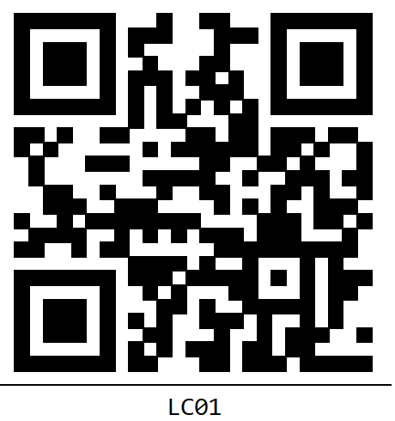
3. Document image
3-3. Location Tag
6
Font : Consolas
60mm
55mm
Item definition
LOCATION CODE : Location ID
QR information
[LOCATION CODE] │[ITEM CODE1],[ITEM CODE2],…
LOCATION CODE : Location ID
ITEM CODE 1…n : Item code that allows placement of items (leave blank
for a free location).

Slide 16
3. Document image
3-4. Labeling
2
A : Automatic print / M : Manual print
Process | Area | Remaining Label | New Label
Repack | - | M | M
Sale | - | M | -
Inbound Material * | WH | - | A/M
Inbound FG/NG ** | Production | - | M
Schedule Picking Warehouse | WH | A | A
Schedule Picking Production | Production | A | -
Crusher *** | Injection | - | M
* Use the receive item qty from plan and should be adjustable
** Manual print and enter the qty by lot size(produce QTY plan) and should be adjustable
*** Create crusher label regarding the user can control the crusher stock

Slide 17
4. Operation flow
4-1. Schedule
YAMATO
Production Management System Pegasus
Purchasing Instruction (P.24)
FG production plan
Material/WIP qty check
Notification if not enough
Check in process PO
NG Report
Handy function
Pegasus report
HT : NG Report
Stock check
HT : Stock Check

Slide 18
4. Operation flow
4-1. Inbound
8
Manage inbound status using the following 3 steps or 4 steps.
Schedule registered
Schedule registered
Inbound working
QC process
Inbound QC
Inbound working
Cancel
Inbound Completed
Inbound Completed
Inbound material
Inbound production

Slide 19

4. Operation flow
4-1. Work Flow Chart
4-1-1. CSV file import process
YAMATO
Production Management System Pegasus
Planning the production
Schedule from Purchase Order
Import the planning on Pegasus
CSV
Verify and Confirm
Finish

Slide 20
4. Operation flow
4-1. Work Flow Chart
4-1-2. Warehouse Inbound/Incoming process
YAMATO
Production Management System Pegasus
Start
8
No
QC Check?
Yes
Return?
Yes / No
No
Yes
Return to supplier
Finish
4-1-3.Material receive
process

Slide 21
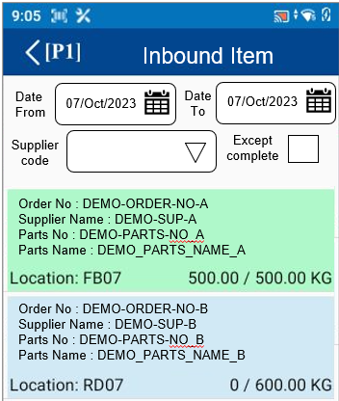

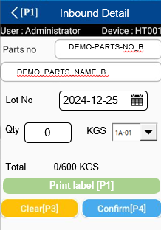
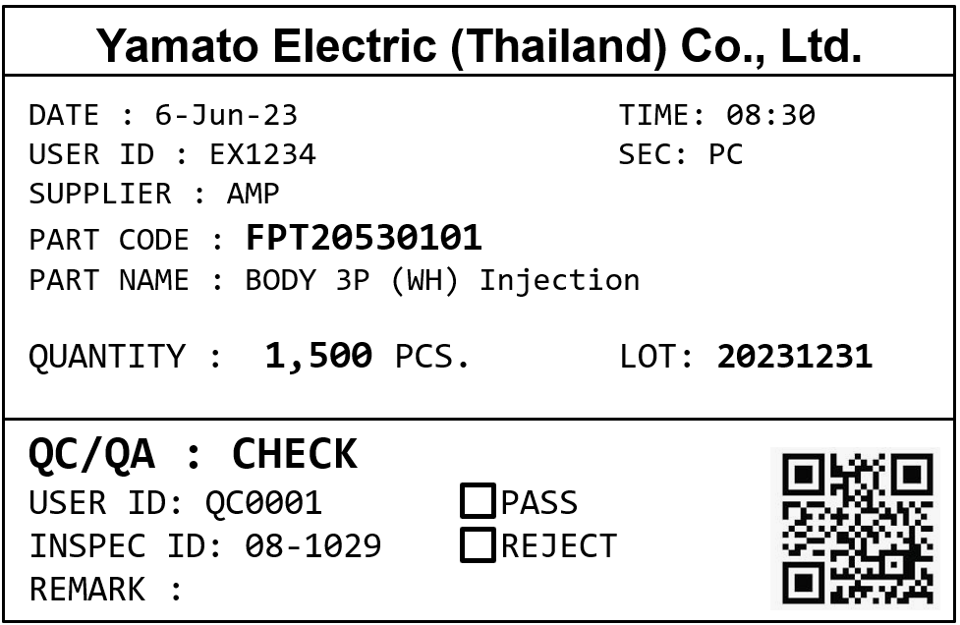

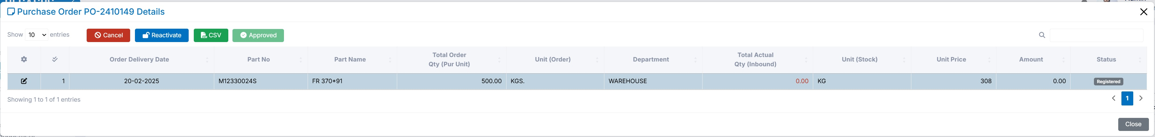

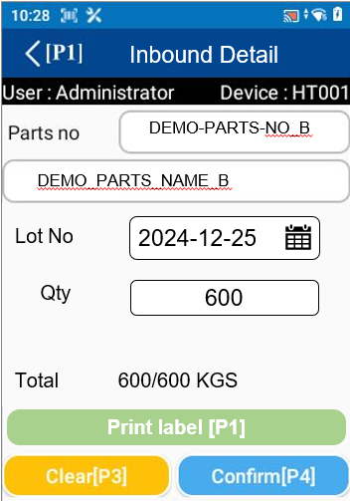


4. Operation flow
4-1. Work Flow Chart
4-1-3. Material Receive Process (process by WH)
YAMATO
Production Management System Pegasus
Start
1
8
Check daily job?
No
Yes
2
Check Qty
&
Prepare part label
600
Put label to items.
QC Check?
No
8
Return?
Yes / No
Yes
3
9
9
Inbound process scan label by handy
Yes
Qty
KGS
NG
500
KGS
Return to supplier
100
Place the items to WH Location
Finish
7
Finish

Slide 22
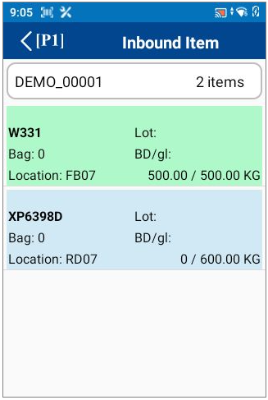


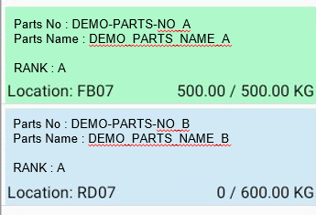
4. Operation flow
4-1. Work Flow Chart
4-1-4. Production issue FG to WH (Process by Assy)
8
YAMATO
Production Management System Pegasus
Start
1
Inbound Item
Date
From
07/Oct/2023
Date
To
07/Oct/2023
Supplier
code
Except complete
Order No : DEMO-ORDER-NO-A
Supplier Name : DEMO-SUP-A
Parts No : DEMO-PARTS-NO_A
Parts Name : DEMO_PARTS_NAME_A
Check daily job?
No
2
Order No : DEMO-ORDER-NO-B
Supplier Name : DEMO-SUP-B
Parts No : DEMO-PARTS-NO_B
Parts Name : DEMO_PARTS_NAME_B
Yes
Input the quantity of items produced.
600
Quality inspection by QC.
3
Print labels based on QC results
via Handy
Qty
600
KGS
NG
0
KGS
Put label to items.
Inbound process scan by handy
4
9
Store in the area of ​​ASSY
Qty
600
KGS
NG
0
KGS
Finish

Slide 23
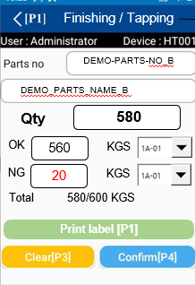
4. Operation flow
4-1. Work Flow Chart
4-1-5. Production issue WIP to WH (Process by Injection & Press)
8
YAMATO
Production Management System Pegasus
Start
1
Inbound Item
Date
From
07/Oct/2023
Date
To
07/Oct/2023
Supplier
code
Except complete
Check daily job?
No
Order No : DEMO-ORDER-NO-A
Supplier Name : DEMO-SUP-A
Parts No : DEMO-PARTS-NO_A
Parts Name : DEMO_PARTS_NAME_A
2
Yes
Order No : DEMO-ORDER-NO-B
Supplier Name : DEMO-SUP-B
Parts No : DEMO-PARTS-NO_B
Parts Name : DEMO_PARTS_NAME_B
Input the quantity of items produced.
8
Finishing or Tapping
Select the next process
Qty
580
KGS
NG
20
KGS
9
Input the quantity of items after Finishing or Tapping.
QC
3
Quality inspection by QC.
4
Print labels according to QC results
Put label to items.
Qty
500
KGS
NG
60
KGS
Inbound process scan by handy
4
No
All done?
Yes
Qty
500
KGS
Store in the area of ​​Injection / Press
NG
60
KGS
Finish

Slide 24
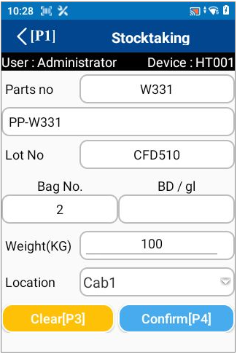


4. Operation flow
7
4-1. Work Flow Chart
4-1-6. Confirm schedule
(Confirm FG/WIP Receive by WH & Confirm Material Receive by PD)
YAMATO
Production Management System Pegasus
Start
1
Confirm Inbound
8
Date
From
07/Oct/2023
Date
To
07/Oct/2023
Supplier
code
Except complete
Production issue FG to WH?
Order No : DEMO-ORDER-NO-A
Supplier Name : DEMO-SUP-A
Parts No : DEMO-PARTS-NO_A
Parts Name : DEMO_PARTS_NAME_A
No
Order No : DEMO-ORDER-NO-B
Supplier Name : DEMO-SUP-B
Parts No : DEMO-PARTS-NO_B
Parts Name : DEMO_PARTS_NAME_B
Yes
Confirm inbound by handy
2
Confirm Detail
8
No
DEMO-PARTS-NO_B
DEMO_PARTS_NAME_B
2023-09-28
Lot No
2024-12-25
Qty
0
/ 600 PCS
Qty
200
Qty
All done?
Act Qty
Act Qty
Location : 1A-01
Yes
Move to location fix ID that displays on HT
Finish

Slide 25
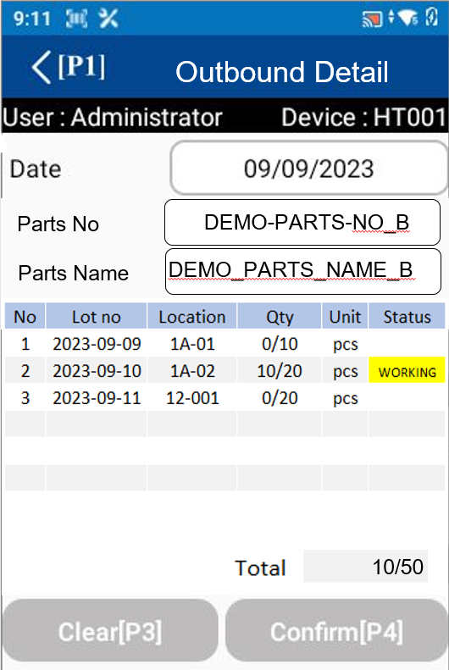
4. Operation flow
4-1. Work Flow Chart
4-1-7. Picking Process (Part Store)
YAMATO
Production Management System Pegasus
Start
1
Outbound item
Date
From
07/Oct/2023
Date
To
07/Oct/2023
Except complete
Order No : DEMO-ORDER-NO-A
Supplier : DEMO-SUP-A
Parts No : DEMO-PARTS-NO_A
Parts Name : DEMO_PARTS_NAME_A
Check daily job?
No
Order No : DEMO-ORDER-NO-B
Supplier Name : DEMO-SUP-B
Parts No : DEMO-PARTS-NO_B
Parts Name : DEMO_PARTS_NAME_B
Yes
Outbound process scan by handy
2
Print the remaining label and picking label
Paste the new label
- Display suggest FIFO
All done?
9
No
The printed label here will have the QC inspection results.
Yes
Place the items to production order store
Finish

Slide 26
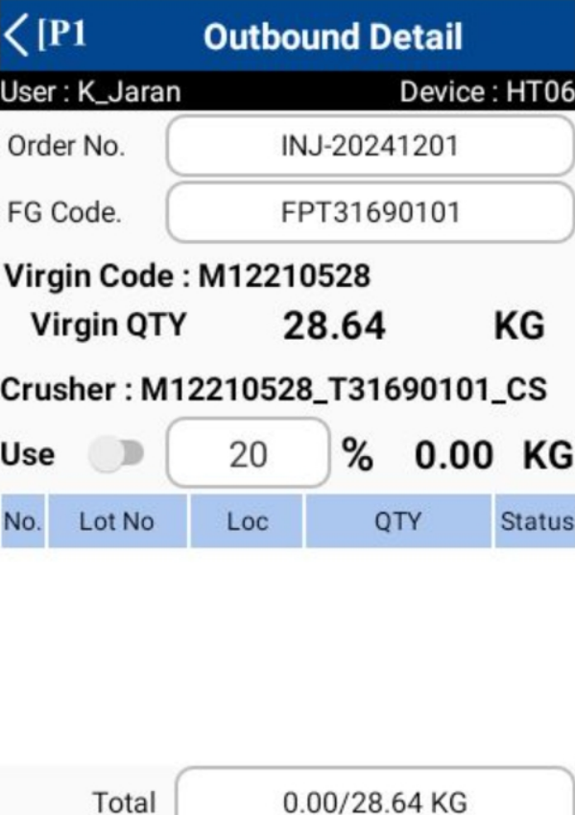

4. Operation flow
4-1. Work Flow Chart
4-1-8. Crusher Picking Process (Injection Store)
YAMATO
Production Management System Pegasus
Start
1
Outbound item
Date
From
07/Oct/2023
Date
To
07/Oct/2023
Except complete
Need to use the crusher?
Order No : DEMO-ORDER-NO-A
Supplier : DEMO-SUP-A
Parts No : DEMO-PARTS-NO_A
Parts Name : DEMO_PARTS_NAME_A
No
Order No : DEMO-ORDER-NO-B
Supplier Name : DEMO-SUP-B
Parts No : DEMO-PARTS-NO_B
Parts Name : DEMO_PARTS_NAME_B
Yes
Crusher Outbound process scan by handy from production store
2
Print the remaining label and picking label
Paste the new label
No
All done?
Yes
Feed the outbound material to the machine
Finish

Slide 27
4. Operation flow
4-1. Work Flow Chart
4-1-8. Crusher Picking Process (Injection Store)
YAMATO
Production Management System Pegasus
Start
1
Outbound item
Date
From
07/Oct/2023
Date
To
07/Oct/2023
Except complete
Need to use the crusher?
Order No : DEMO-ORDER-NO-A
Supplier : DEMO-SUP-A
Parts No : DEMO-PARTS-NO_A
Parts Name : DEMO_PARTS_NAME_A
No
Order No : DEMO-ORDER-NO-B
Supplier Name : DEMO-SUP-B
Parts No : DEMO-PARTS-NO_B
Parts Name : DEMO_PARTS_NAME_B
Yes
Virgin 100 use25
Crusher Outbound process scan by handy from production store
2
Print the remaining label and picking label
Paste the new label
WH 75 INJ 25
crusher 100 use 5
95 5
All done?
No
Yes
Feed the outbound material to the machine
Finish

Slide 28
4. Operation flow
4-1. Work Flow Chart
4-1-9. Mix material(Injection Store)
Warehouse
Injection
9
Start
Start
Outbound virgin
Page 25
Inbound manual crusher
Inbound Confirm virgin
Page 24
Store in the ​​Injection area
Take out raw materials for production
Yes
Need to use the crusher?
No
Define Virgin and Crusher Material Ratio
Page26
use Virgin only
Mix
Virgin & Crusher
Enter the production process
Production completed
Inbound WIP
Page 23
Inbound Confirm WIP
Page 24
Store in
the Injection area
Store WIP in Warehouse location.
Move WIP to WH

Slide 29
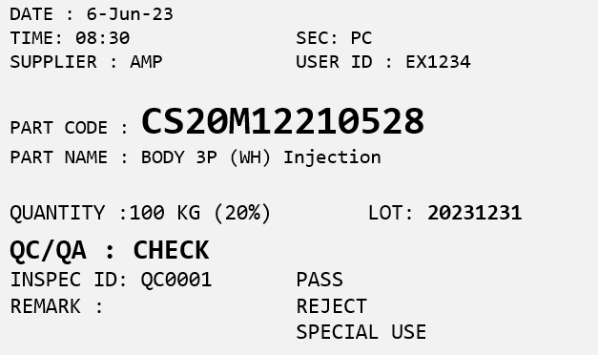
4. Operation flow
4-1. Work Flow Chart
4-1-9. Injection Work Process (Injection Store)
Warehouse
Injection
9
Start
Start
Outbound virgin
Page 25
Inbound manual crusher
Inbound Confirm virgin
Page 24
Store in the ​​Injection area
Take out raw materials for production
Virgin
M12210528
Crusher
MIX
Virgin & Crusher
Print label
Inbound to store Injection
Format : part code
CS + percent crusher + virgin

Slide 30


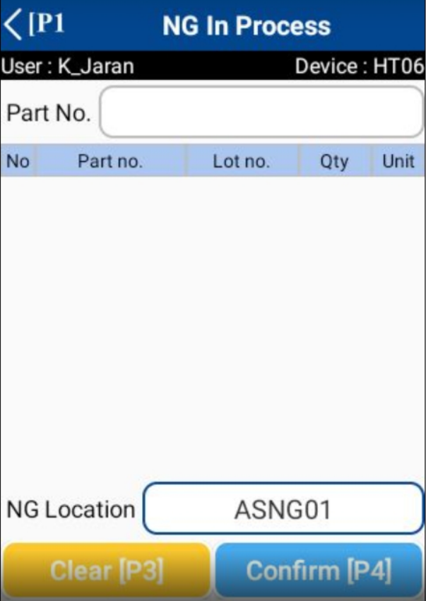

4. Operation flow
4-1. Work Flow Chart
4-1-10. NG In Process (Assembly Store)
YAMATO
Production Management System Pegasus
Start
Record NG In Process?
No
Yes
Scan the parts NG
1
Confirm will outbound the parts from PD store
No
All done?
Yes
Collect and move to waste area
Finish

Slide 31

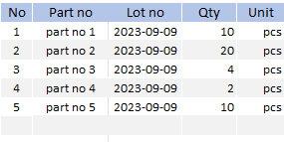
4. Operation flow
4-1. Work Flow Chart
4-1-11. Rework process (Return FG from customer/Defected FG at the end of ASSY line)
YAMATO
Production Management System Pegasus
Start
Receive defected FG?
No
Yes
1
Inbound Rework
Scan the parts FG
FG-PART-01
Qty
2
PCS
Adjust Qty and Confirm
Automatic outbound the FG label and inbound rework parts
No
All done?
Yes
Able to use the rework parts in production
Finish

Slide 32
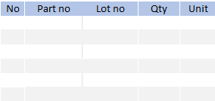
4. Operation flow
4-1. Work Flow Chart
4-1-12. Rework NG process (Return FG from customer/Defected FG at the end of ASSY line)
YAMATO
Production Management System Pegasus
Start
Receive defected FG?
No
Yes
1
Inbound Rework NG
Scan the parts FG
Qty
PCS
Adjust Qty and Confirm
Automatic outbound the FG label and inbound NG parts
No
All done?
Yes
Collect and move to waste area
Finish

Slide 33
4. Operation flow
4-2. Stock management
YAMATO
Production Management System Pegasus
Change Location
HT : Change Location
Stock taking
HT : Stock taking
Stock check
HT : Stock Check

Slide 34
4. Operation flow
4-3. Outbound
Manage inbound status using the following 3 steps.
Schedule registered
Outbound working
Outbound Completed
Cancel

Slide 35
4. Operation flow
4-4. Master management
YAMATO
Production Management System Pegasus
Item master
PC : Item master
Location master
PC : Location master
User master
PC : User master
User credential master
PC : User Credential
Authority master
PC : Authority Master
Name master
PC : Name Master
Packing Standard master
PC : Packing Standard
BOM master
8
PC : Package Type
Defect master
PC : Defect master

Slide 36


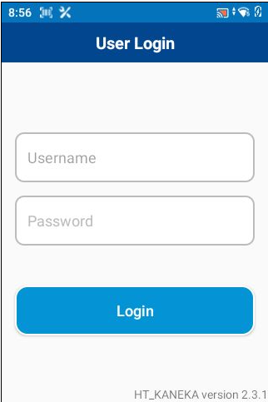
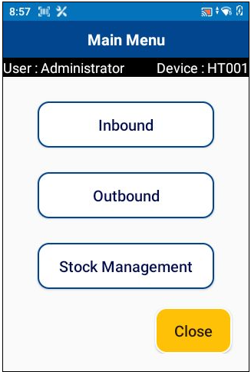
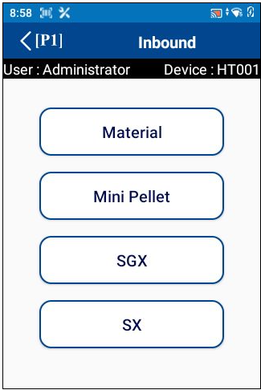
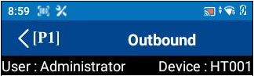





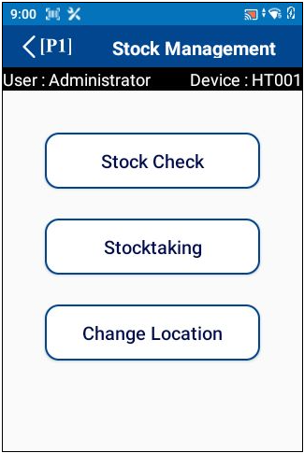
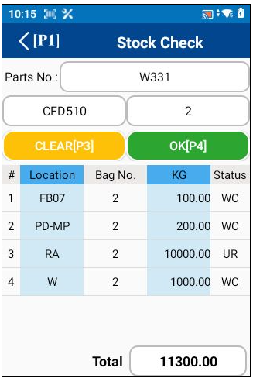
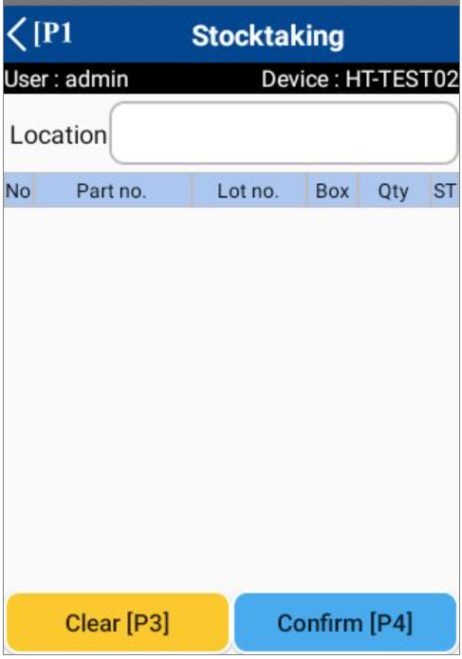
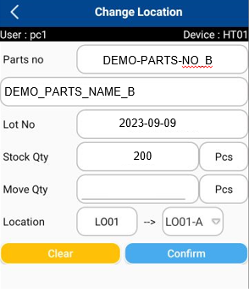
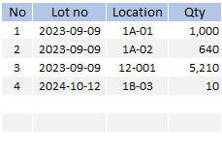
5. System functional specifications
5-1. Handy terminal function
1. User Login
2. Main menu
3. Inbound menu
4. Outbound menu
SCHEDULE
MANUAL
Schedule Label
Work Outbound
Inbound Schedule
SCHEDULE
MANUAL
Label Manual
Delivery Outbound
Inbound Schedule
Outbound Manual
QC Check
PHOTO
Inbound Rework
3
Inbound Schedule
Inbound Rework NG
Inbound
Inbound Manual
Confirm Inbound
8
5. Stock management menu
6. Inbound Item
7. Inbound Detail
8. Work Outbound
Inbound Item
Inbound Detail
Work Outbound
Date
From
07/Oct/2023
Date
To
07/Oct/2023
DEMO-PARTS-NO_B
Date
From
07/Oct/2023
Date
To
07/Oct/2023
Supplier
code
Except complete
DEMO_PARTS_NAME_B
Except complete
Order No : DEMO-ORDER-NO-A
Supplier Name : DEMO-SUP-A
Parts No : DEMO-PARTS-NO_A
Parts Name : DEMO_PARTS_NAME_A
Lot No
2023-09-28
3
Order No : DEMO-ORDER-NO-A
Parts No : DEMO-PARTS-NO_A
Parts Name : DEMO_PARTS_NAME_A
Lot no : 20231225, 20240118
Qty
2024-12-25
Qty
0
KGS
Order No : DEMO-ORDER-NO-B
Supplier Name : DEMO-SUP-B
Parts No : DEMO-PARTS-NO_B
Parts Name : DEMO_PARTS_NAME_B
Qty
200
Order No : DEMO-ORDER-NO-B
Parts No : DEMO-PARTS-NO_B
Parts Name : DEMO_PARTS_NAME_B
Lot no : 20231225, 20240118
NG
0
KGS
Act Qty
Act Qty
Total 0/600 KGS
8
Label For Return
Print label [P1]
9. Outbound Detail
10. Stock check
11. Stock taking
12. Change location
Lot No:
DEMO-PARTS-NO_B
6,860

Slide 37
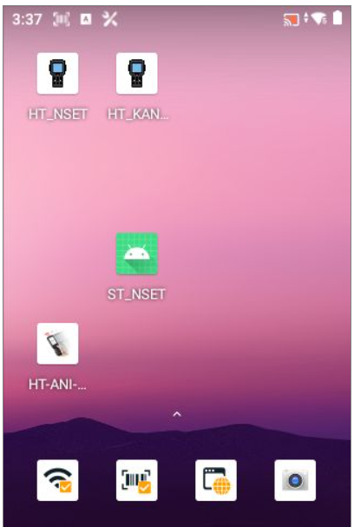
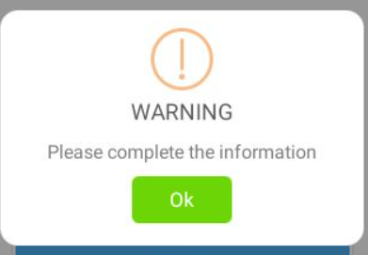
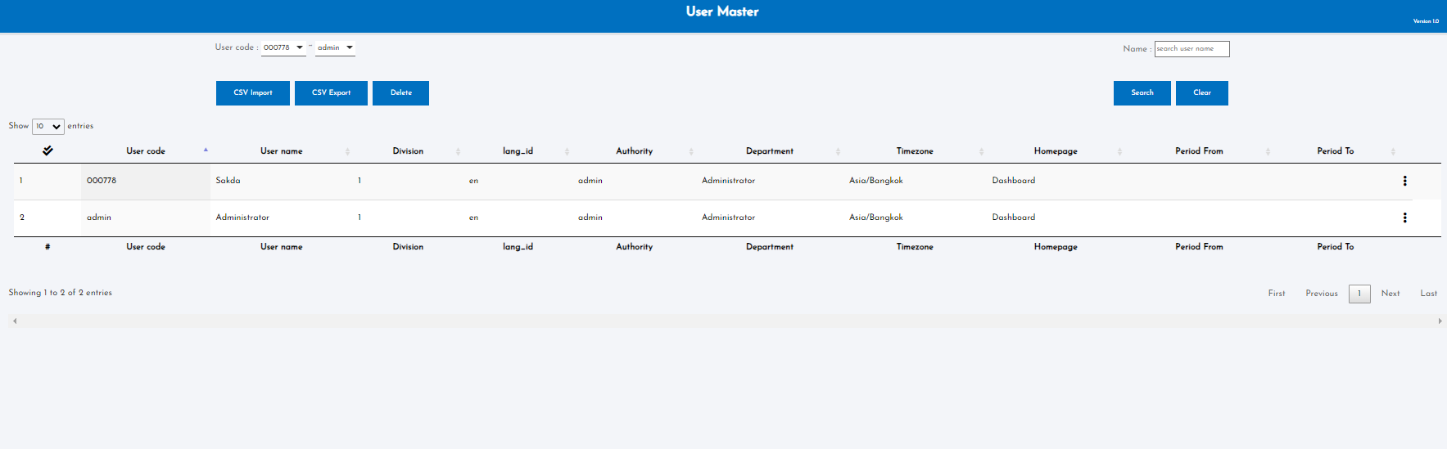
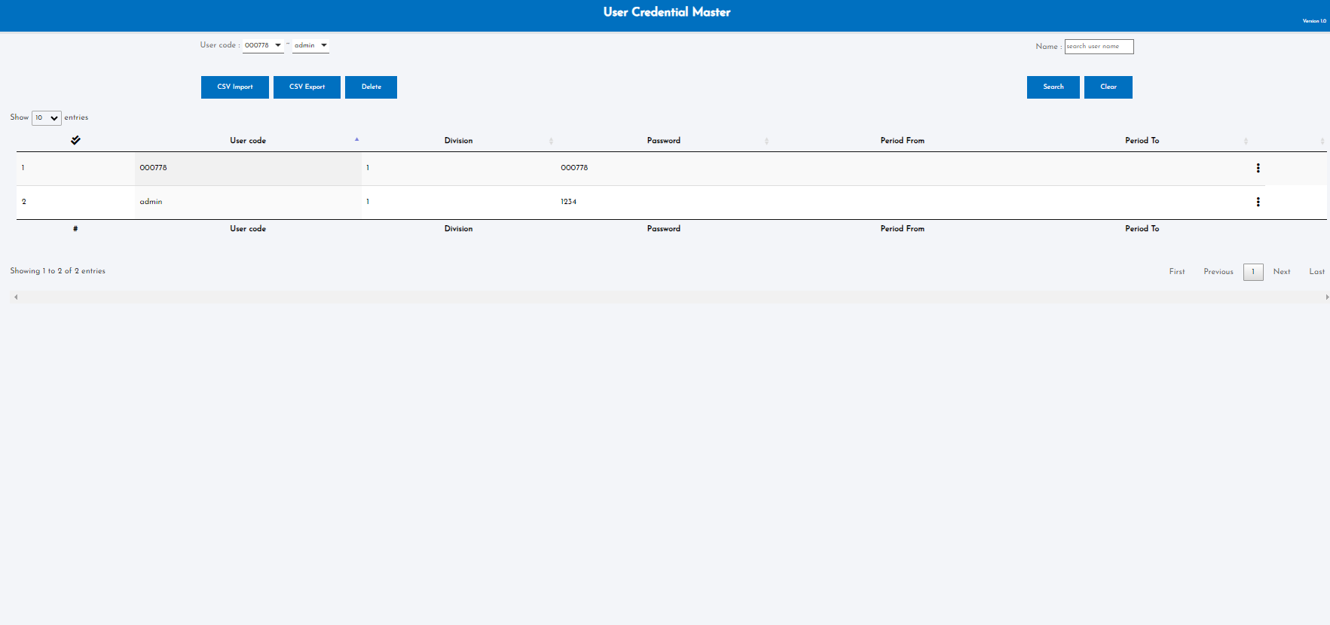
5. System functional specifications
5-1. Handy terminal function
5-1-1. User Login
This is the screen that transitions after icon app click from home screen.
User name: Information is referenced from the User master.
Enter the User code of User master.
If it enter a code that does not exist, an error screen will be displayed. *1
Pass word: Information is referenced from the User credential master.
The User code of User master is linked to the User code of User credential master. User credential Enter the master password.
If it enter a code that does not exist, an error screen will be displayed. *1
Login button: If the information is correct, it will be redirected to the Main menu.
*1: Display screen when information is incorrect
OK button: Close this screen. Return to the previous process.
User master
User credential master

Slide 38
5. System functional specifications
5-1. Handy terminal function
5-1-2. Main menu
This is the screen that transitions after logging in from User Login.
Inbound button: Transitions to the Inbound screen.
Outbound button: Transitions to the Outbound screen.
Stock Management button: Transitions to the Stock Management screen.
Close button: Closes the application.
admin
1234

Slide 39
5. System functional specifications
5-2. Handy terminal function Inbound
5-2-1. Inbound
This is the screen that transitions after select inbound from Main menu.
Inbound Schedule button: Transitions to the Inbound Schedule screen.
Inbound Manual button: Transitions to the Inbound screen.
Inbound Rework button: Transitions to the Inbound Rework screen.
< (P1): Back to Main menu
Schedule Label
Inbound Schedule
Label Manual
Inbound Schedule
Inbound Rework
Inbound Schedule
3
Inbound Schedule
Inbound Rework NG
Inbound Manual
Inbound Schedule
7
QC schedule

Slide 40
5. System functional specifications
5-2. Handy terminal function Inbound
5-2-2. Inbound Item
Inbound item
This is the screen that transitions after select Inbound Schedule from Inbound.
Date from: Select the start of the target date. Default is today's date. Search ORDER DELIVERY DATE
Date to: Select the end of the target date. Default is today's date. Search ORDER DELIVERY DATE
Supplier code: Select supplier code. Or do a scan. Default is blank. Search SUPPLIER CODE
Except complete: If checked, the completed status Item list will not be displayed from the Item list. Default is unchecked.
Order list : Display a list that matches the condition.
Order no : ORDER NO
Supplier name : SUPPLIER CODE
Part No.: PART NUMBER
Part Name: PART NAME
Location: Fixed location of each Item linked to Item master
Item quantity: Number of items that have been processed
Status color: Green - Completed, Dark Blue - Working, Light Blue - Not Started.
< (P1): Back to Main menu
Date
From
07/Oct/2023
Date
To
07/Oct/2023
Schedule Label
Supplier
code
Except complete
Inbound Schedule
Order No : DEMO-ORDER-NO-A
Supplier Name : DEMO-SUP-A
Parts No : DEMO-PARTS-NO_A
Parts Name : DEMO_PARTS_NAME_A
Label Manual
Inbound Schedule
Order No : DEMO-ORDER-NO-B
Supplier Name : DEMO-SUP-B
Parts No : DEMO-PARTS-NO_B
Parts Name : DEMO_PARTS_NAME_B
Inbound Rework
Inbound Schedule
3
Inbound Schedule
Inbound Rework NG
Inbound Manual
QC schedule

Slide 41




5. System functional specifications
5-2. Handy terminal function Inbound
5-2-3. Inbound Detail [for Inbound material to WH]
Inbound item
Inbound Detail
This is the screen that transitions after select order information from Inbound screen.
Part No.: Part number
Part Name :PART NAME
Lot No: Today date YYYY-MM-DD will be default
Qty: Quantity of received item
Unit: Receive unit will be loaded from schedule
Total Qty: Will be loaded from schedule
Location : The allowed location and free location will be loaded from the Location master. No initial value information.* The location control will be identified in QR Code
Clear[P3]: Clear input contents
Confirm[P4]: Confirmation processing. Normal end: Completion of registration *1. Warning: Warning screen display *2
< (P1): Back to Main menu
Date
From
07/Oct/2023
Date
To
07/Oct/2023
9
DEMO-PARTS-NO_B
Supplier
code
status
DEMO_PARTS_NAME_B
Order No : DEMO-ORDER-NO-A
Supplier Name : DEMO-SUP-A
Parts No : DEMO-PARTS-NO_A
Parts Name : DEMO_PARTS_NAME_A
Lot No
2023-09-28
2024-12-25
8
Qty
200
Qty
Order No : DEMO-ORDER-NO-B
Supplier Name : DEMO-SUP-B
Parts No : DEMO-PARTS-NO_B
Parts Name : DEMO_PARTS_NAME_B
Qty
0
KGS
Act Qty
Act Qty
Total 0/600 KGS
QC
Print label [P2]
Order No : DEMO-ORDER-NO-A
Supplier Name : DEMO-SUP-A
Parts No : DEMO-PARTS-NO_A
Parts Name : DEMO_PARTS_NAME_A
8
8
Inbound Detail
Inbound Detail
DEMO-PARTS-NO_B
8
DEMO-PARTS-NO_B
DEMO_PARTS_NAME_B
DEMO_PARTS_NAME_B
Lot No
Lot No
2023-09-28
2024-12-25
2024-12-25
Qty
2023-09-28
Qty
500
KGS
KGS
Qty
200
Qty
600
200
Qty
Qty
QC records inspection results on the web page.
NG
100
KGS
Act Qty
Act Qty
Act Qty
Act Qty
Total 600/600 KGS
Total 600/600 KGS
Print label [P2]
Show results
of each type
Print label [P2]
(Step.1) Print Label
Select schedule
Enter the quantity then
press the print label button.
(Step.2) QC Result
Select a Schedule that has passed QC. The system will show the QC inspection results in the inbound detail page.
9
Inbound Detail
9
The system will inbound into
the QC location.
LOCATION QC = IQC (incoming QC)
*Every time you have to do QC*
DEMO-PARTS-NO_B
DEMO_PARTS_NAME_B
Lot No
2023-09-28
Qty
2024-12-25
(Step.3) Inbound
Scan labels and
scan storage locations
Qty
500
KGS
Qty
200
NG
100
Act Qty
Act Qty
After scan label
change background color to green (GOOD/NG)
Total 600/600 KGS
Print label [P1]
9
(Step.4) confirm
press the confirm button
Qty OK : Inbound to selected location
Qty NG : Outbound from IQC location

Slide 42
5. System functional specifications
5-2. Handy terminal function Inbound
5-2.4-. Inbound Detail [for Assy Inbound FG to WH]
8
Inbound item
Inbound Detail
This is the screen that transitions after select order information from Inbound screen.
Part No.: Part number
Part Name :PART NAME
Lot No: Today date YYYY-MM-DD will be default
Qty: Quantity of received item
Unit: Receive unit will be loaded from schedule
Total Qty: Will be loaded from schedule
Location : The allowed location and free location will be loaded from the Location master. No initial value information.* The location control will be identified in QR Code
Clear[P3]: Clear input contents
Confirm[P4]: Confirmation processing. Normal end: Completion of registration *1. Warning: Warning screen display *2
< (P1): Back to Main menu
Date
From
07/Oct/2023
Date
To
07/Oct/2023
9
DEMO-PARTS-NO_B
Supplier
code
status
DEMO_PARTS_NAME_B
Order No : DEMO-ORDER-NO-A
Supplier Name : DEMO-SUP-A
Parts No : DEMO-PARTS-NO_A
Parts Name : DEMO_PARTS_NAME_A
Lot No
2023-09-28
2024-12-25
Qty
200
Qty
Order No : DEMO-ORDER-NO-B
Supplier Name : DEMO-SUP-B
Parts No : DEMO-PARTS-NO_B
Parts Name : DEMO_PARTS_NAME_B
Qty
0
KGS
Act Qty
Act Qty
Total 0/600 KGS
QC
Print label [P2]
Order No : DEMO-ORDER-NO-A
Supplier Name : DEMO-SUP-A
Parts No : DEMO-PARTS-NO_A
Parts Name : DEMO_PARTS_NAME_A
Inbound Detail
(Step.3) Print Label
Click the print label button
For printing label.
Inbound Detail
Show results
of each type
DEMO-PARTS-NO_B
DEMO-PARTS-NO_B
DEMO_PARTS_NAME_B
DEMO_PARTS_NAME_B
(Step.2)
Select the Schedule again that has been verified.
Lot No
2023-09-28
Lot No
2024-12-25
2024-12-25
2023-09-28
Qty
600
KGS
Qty
200
Qty
600
KGS
Qty
Qty
200
Qty
NG
0
KGS
Act Qty
Act Qty
Act Qty
Total /600 KGS
Act Qty
Total 600/600 KGS
Print label [P2]
Print label [P2]
(Step.1)
Select schedule
Enter the quantity then
press the confirm button
QC records inspection results on the web page.
8
Inbound Detail
9
Inbound Production to WH
DEMO-PARTS-NO_B
When you press Confirm, the system will automatically outbound the material used by
the calculation according to the BOM.
*If the material is at L3, it must be possible to
add an additional Outbound quantity.
DEMO_PARTS_NAME_B
Lot No
2023-09-28
Qty
2024-12-25
Qty
600
KGS
After scan label
change background color to green (GOOD/NG)
Qty
200
NG
0
KGS
Act Qty
Act Qty
9
Total 600/600 KGS
Outbound
Purge / Set up
*If no data is entered or zero is entered, the system will outbound as initially calculated.
Print label [P1]
Show Part name.
System : 5 KG
The system must outbound
this item by 8 KG.
(Step.4) Inbound
Scan labels and scan storage locations
After that press the confirm button
8
KG
OK
Default : As calculated by the system

Slide 43


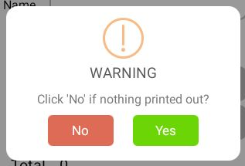
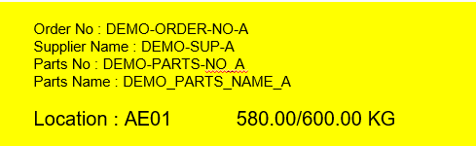
5. System functional specifications
5-2. Handy terminal function Inbound
5-2.5-. Inbound Detail [for Injection or Press Inbound WIP to WH]
Inbound item
Inbound Detail
Inbound Detail
8
Date
From
07/Oct/2023
Date
To
07/Oct/2023
9
DEMO-PARTS-NO_B
DEMO-PARTS-NO_B
Supplier
code
status
DEMO_PARTS_NAME_B
DEMO_PARTS_NAME_B
Order No : DEMO-ORDER-NO-A
Supplier Name : DEMO-SUP-A
Parts No : DEMO-PARTS-NO_A
Parts Name : DEMO_PARTS_NAME_A
Location : AE01 600.00/600.00 KG
Lot No
2024-12-25
Lot No
2023-09-28
2023-09-28
Qty
2024-12-25
Qty
580
KGS
KGS
Qty
200
Qty
0
200
Qty
Order No : DEMO-ORDER-NO-A
Supplier Name : DEMO-SUP-A
Parts No : DEMO-PARTS-NO_A
Parts Name : DEMO_PARTS_NAME_A
Location : AE01 0.00/600.00 KG
Qty
NG
Order No : DEMO-ORDER-NO-B
Supplier Name : DEMO-SUP-B
Parts No : DEMO-PARTS-NO_B
Parts Name : DEMO_PARTS_NAME_B
NG
0
KGS
20
KGS
Act Qty
Act Qty
Act Qty
Act Qty
Total 0/600 KGS
QC
Total 0/600 KGS
Order No : DEMO-ORDER-NO-A
Supplier Name : DEMO-SUP-A
Parts No : DEMO-PARTS-NO_A
Parts Name : DEMO_PARTS_NAME_A
Location : AE01 0.00/600.00 KG
Print label [P1]
Print label [P1]
Order No : DEMO-ORDER-NO-A
Supplier Name : DEMO-SUP-A
Parts No : DEMO-PARTS-NO_A
Parts Name : DEMO_PARTS_NAME_A
Location : AE01 560.00/600.00 KG
(Step.1) Enter Qty
Select schedule
Enter the quantity then
press the confirm button
Yellow background for finishing or Tapping work.
Condition Outbound
Same as page 39
8
How to input defect details
9
Inbound Detail
Please select the next process.
1
QC
Finishing
2
Please select defect.
DEMO-PARTS-NO_B
Defect1
X
DEMO_PARTS_NAME_B
5
Defect2
5
(Step.2) Select next process
After press the confirm button.
The system will prompt you to select the next process.
Lot No
2024-12-25
Qty
2023-09-28
Qty
600
KGS
Qty
200
Defect3
10
NG
0
KGS
(Name button or page)
Finishing : for Injection.
Tapping : for Press.
Act Qty
Act Qty
Total 600/600 KGS
Add
Print label [P1]
Finishing / Tapping
DEMO-PARTS-NO_B
DEMO_PARTS_NAME_B
9
Lot No
2024-12-25
OK
2023-09-28
Qty
200
KGS
Next page
Qty
200
NG
80
KGS
Act Qty
Act Qty
Total 0 / 580 KGS
1
QC records inspection results from a total of 580 products on the web page.
Print label [P1]
2
QC records inspection results from a total of 280 products on the web page.
(Step.3) If selected Finishing or Tapping
Select the Schedule again
then enter the quantity
After that press the confirm button.
*At this process, the quantity can be split into multiple transactions.
9

Slide 44

5. System functional specifications
5-2. Handy terminal function Inbound
5-2.5-. Inbound Detail [for Injection or Press Inbound WIP to WH]
9
Inbound item
Finishing / Tapping
QC Result
Date
From
07/Oct/2023
Date
To
07/Oct/2023
DEMO-PARTS-NO_B
DEMO-PARTS-NO_B
2
Supplier
code
status
DEMO_PARTS_NAME_B
DEMO_PARTS_NAME_B
Order No : DEMO-ORDER-NO-A
Supplier Name : DEMO-SUP-A
Parts No : DEMO-PARTS-NO_A
Parts Name : DEMO_PARTS_NAME_A
Location : AE01 600.00/600.00 KG
Lot No
2024-12-25
2023-09-28
Lot No
2023-09-28
For work need to do in finishing / tapping process
OK
KGS
Qty
2024-12-25
Qty
200
Qty
560
KGS
QC
Qty
Qty
200
Order No : DEMO-ORDER-NO-A
Supplier Name : DEMO-SUP-A
Parts No : DEMO-PARTS-NO_A
Parts Name : DEMO_PARTS_NAME_A
Location : AE01 380.00/600.00 KG
Order No : DEMO-ORDER-NO-B
Supplier Name : DEMO-SUP-B
Parts No : DEMO-PARTS-NO_B
Parts Name : DEMO_PARTS_NAME_B
NG
KGS
NG
0
KGS
Act Qty
Act Qty
Act Qty
Act Qty
QC
Total 580 / 580 KGS
Total 560/600 KGS
Order No : DEMO-ORDER-NO-A
Supplier Name : DEMO-SUP-A
Parts No : DEMO-PARTS-NO_A
Parts Name : DEMO_PARTS_NAME_A
Location : AE01 0.00/600.00 KG
Print label [P1]
Print label [P1]
Only items with QC inspection results and have not been inbound can be selected.
Order No : DEMO-ORDER-NO-A
Supplier Name : DEMO-SUP-A
Parts No : DEMO-PARTS-NO_A
Parts Name : DEMO_PARTS_NAME_A
Location : AE01 560.00/600.00 KG
(Step.4)
Select the Schedule again.
Then click print label button.
Then select the item want to print label
Inbound Detail
Inbound Detail
DEMO-PARTS-NO_B
Show results
of each type
DEMO-PARTS-NO_B
DEMO_PARTS_NAME_B
DEMO_PARTS_NAME_B
Lot No
2023-09-28
Lot No
2023-09-28
2024-12-25
2024-12-25
Qty
100
KGS
Qty
200
After scan label
change background color to green (GOOD/NG)
Qty
100
KGS
Qty
Qty
200
Qty
NG
50
KGS
NG
KGS
Act Qty
50
Act Qty
Act Qty
Total 380/600 KGS
Act Qty
Total 380/600 KGS
Print label [P1]
1
Print label [P1]
(Step.6) Inbound
Scan labels and scan storage locations
After that press the confirm button
(Step.5) Print label
click print label button.
Inbound item
Show results
of each type
Inbound Detail
Date
From
07/Oct/2023
Date
To
07/Oct/2023
DEMO-PARTS-NO_B
Supplier
code
status
DEMO_PARTS_NAME_B
1
Order No : DEMO-ORDER-NO-A
Supplier Name : DEMO-SUP-A
Parts No : DEMO-PARTS-NO_A
Parts Name : DEMO_PARTS_NAME_A
Location : AE01 600.00/600.00 KG
Lot No
2023-09-28
For work not need to do in finishing / tapping process
Qty
2024-12-25
Qty
580
KGS
QC
Qty
200
Order No : DEMO-ORDER-NO-A
Supplier Name : DEMO-SUP-A
Parts No : DEMO-PARTS-NO_A
Parts Name : DEMO_PARTS_NAME_A
Location : AE01 380.00/600.00 KG
Order No : DEMO-ORDER-NO-B
Supplier Name : DEMO-SUP-B
Parts No : DEMO-PARTS-NO_B
Parts Name : DEMO_PARTS_NAME_B
NG
0
KGS
Act Qty
Act Qty
QC
Total /600 KGS
Order No : DEMO-ORDER-NO-A
Supplier Name : DEMO-SUP-A
Parts No : DEMO-PARTS-NO_A
Parts Name : DEMO_PARTS_NAME_A
Location : AE01 0.00/600.00 KG
Print label [P1]
Order No : DEMO-ORDER-NO-A
Supplier Name : DEMO-SUP-A
Parts No : DEMO-PARTS-NO_A
Parts Name : DEMO_PARTS_NAME_A
Location : AE01 560.00/600.00 KG
(Step.) Print label
click print label button.

Slide 45

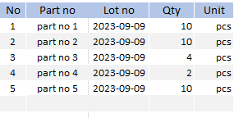
5. System functional specifications
5-2. Handy terminal function Inbound
5-2-6. Inbound Rework
Inbound Rework
This is the screen that transitions after select order information from Inbound screen.
Part No.: Part number
Qty: Quantity of total NG items for rework.
Unit: Unit of NG items qty.
Location : The allowed location and free location will be loaded from the Location master. No initial value information.* The location control will be identified in QR Code
Clear[P3]: Clear input contents
Confirm[P4]: Confirmation processing. Normal end: Completion of registration *1. Warning: Warning screen display *2
< (P1): Back to Main menu
Qty
PCS
Inbound Rework
Inbound Rework
FG-PART-01
INFORMATION
Qty
PCS
Qty
2
PCS
Operation completed
Inbound Rework
* Able to enter 0 to discard some items
Inbound Rework
FG-PART-01
Part no 2
FG-PART-01
5
Qty
2
PCS
QTY
10
PCS
Qty
2
PCS
LOT NO
2023-09-09
OK
Cancel

Slide 46
5. System functional specifications
5-2. Handy terminal function Inbound
5-2-7. Inbound Rework NG
3
Inbound Rework NG
This is the screen that transitions after select order information from Inbound screen.
Part No.: Part number
Qty: Quantity of total NG items for rework.
Unit: Unit of NG items qty.
Location : The NG locations will be loaded from the Location master. No initial value information.* The location control will be identified in QR Code
Clear[P3]: Clear input contents
Confirm[P4]: Confirmation processing. Normal end: Completion of registration *1. Warning: Warning screen display *2
< (P1): Back to Main menu
Qty
PCS
NG Locations will be loaded.
Inbound Rework NG
Inbound Rework NG
FG-PART-01
INFORMATION
Qty
PCS
Qty
2
PCS
Operation completed
Inbound Rework NG
* Able to enter 0 to discard some items
Inbound Rework NG
FG-PART-01
Part no 2
FG-PART-01
5
Qty
2
PCS
QTY
10
PCS
Qty
2
PCS
LOT NO
2023-09-09
OK
Cancel

Slide 47
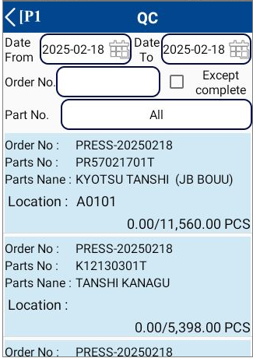
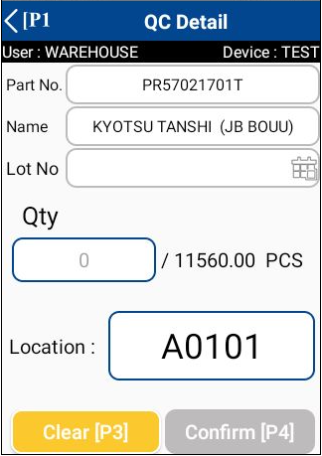
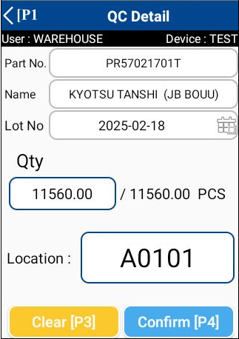


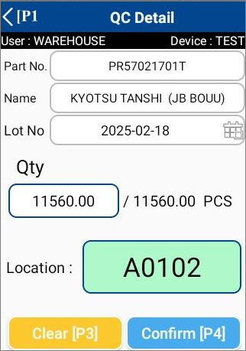
5. System functional specifications
5-2. Handy terminal function Inbound
5-2-8. Confirm Inbound schedule
8
Confirm Inbound
Confirm Inbound
This is the screen that transitions after select order information from Qc screen.
Part No.: Part number
Part Name :PART NAME
Lot No: Today date YYYY-MM-DD will be default
Qty: Quantity of received item
Unit: Receive unit will be loaded from schedule
Total Qty: Will be loaded from schedule
Location : The allowed location and free location will be loaded from the Location master. No initial value information.* The location control will be identified in QR Code
Clear[P3]: Clear input contents
Confirm[P4]: Confirmation processing. Normal end: Completion of registration *1. Warning: Warning screen display *2
< (P1): Back to Main menu
Confirm Inbound
Confirm Inbound
(Step.2)
Scan the location you want to store.
(Step.1)
Scan all of the label to confirm the detail
Location : A0102
Confirm Detail
*Recommended location
for storing in warehouse
By Item Master
Confirm Inbound
Change background color to green
INFORMATION
(Step.4)
Click the Confirm[P4] to complete the operation
Operation completed

Slide 48
5. System functional specifications
5-3. Handy terminal function Outbound
5-3-1. Outbound
This is the screen that transitions after select outbound from Main menu.
Work Outbound: Transitions to the Work Outbound screen.
Production Outbound: Transitions to the Production Outbound screen.
Outbound Manual button: Transitions to the Outbound manual screen.
< (P1): Back to Main menu
Work Outbound
Delivery Outbound
Outbound Manual
Inbound

Slide 49
5. System functional specifications
5-3. Handy terminal function Outbound
5-3-2. Work Outbound
Date
From
Work Outbound
This is the screen that transitions after select outbound schedule from Outbound menu.
Target items: For outbound items feed to the production line.
Date from: Select the start of the target date. Default is today's date. Search ORDER DELIVERY DATE
Date to: Select the end of the target date. Default is advance 7 days date. Search ORDER DELIVERY DATE
Except complete: If checked, the completed status Item list will not be displayed from the Item list. Default is unchecked.
Order list : Display a list that matches the condition.
Order no : ORDER NO
Part No.: PART NUMBER
Part Name : PART NAME
Lot No: *Displays a list of Lot no that are recommended for picking after reservation. If there are multiple items, display multiple items.
Location: *Display assigned location information. If there are multiple items, display multiple items.
Item quantity: Number of items that have been processed "/" ORDER QTY(PER UNIT)
Status color: Green - Completed, Dark Blue - Working, Light Blue - Not Started.
< (P1): Back to Main menu
07/Oct/2023
Date
To
07/Oct/2023
Work Outbound
Except complete
Delivery Outbound
Order No : DEMO-ORDER-NO-A
Parts No : DEMO-PARTS-NO_A
Parts Name : DEMO_PARTS_NAME_A
Lot No : 20230910
Location code : RD07/RD08 500.00/500.00PCS
Outbound Manual
Order No : DEMO-ORDER-NO-B
Parts No : DEMO-PARTS-NO_B
Parts Name : DEMO_PARTS_NAME_B
Lot No : 20230910 / 20230911
Location code : RD05/RD06 0.00/600.00PCS
Inbound

Slide 50
5. System functional specifications
5-3. Handy terminal function Outbound
5-3-3. Delivery Outbound
Date
From
Delivery Outbound
This is the screen that transitions after select outbound schedule from Outbound menu.
Target items: For delivery order items
Date from: Select the start of the target date. Default is today's date. Search ORDER DELIVERY DATE
Date to: Select the end of the target date. Default is advance 7 days date. Search ORDER DELIVERY DATE
Except complete: If checked, the completed status Item list will not be displayed from the Item list. Default is unchecked.
Order list : Display a list that matches the condition.
Order no : ORDER NO
Part No.: PART NUMBER
Part Name : PART NAME
Lot No: *Displays a list of Lot no that are recommended for picking after reservation. If there are multiple items, display multiple items.
Location: *Display assigned location information. If there are multiple items, display multiple items.
Item quantity: Number of items that have been processed "/" ORDER QTY(PER UNIT)
Status color: Green - Completed, Dark Blue - Working, Light Blue - Not Started.
< (P1): Back to Main menu
07/Oct/2023
Date
To
07/Oct/2023
Work Outbound
Except complete
Delivery Outbound
Order No : DEMO-ORDER-NO-A
Parts No : DEMO-PARTS-NO_A
Parts Name : DEMO_PARTS_NAME_A
Lot No : 20230910
Location code : RD07/RD08 500.00/500.00PCS
Outbound Manual
Order No : DEMO-ORDER-NO-B
Parts No : DEMO-PARTS-NO_B
Parts Name : DEMO_PARTS_NAME_B
Lot No : 20230910 / 20230911
Location code : RD05/RD06 0.00/600.00PCS
Inbound

Slide 51
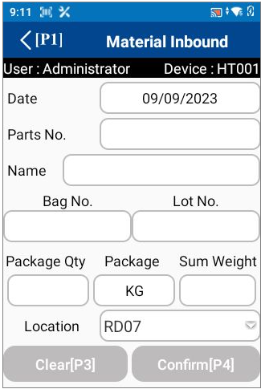
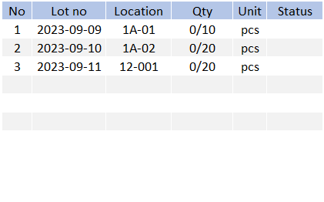

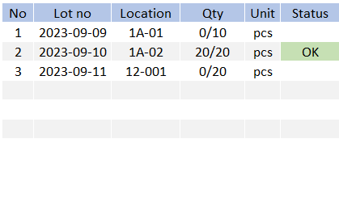
5. System functional specifications
5-3. Handy terminal function Outbound
5-3-4. Outbound Detail for Work Outbound * Same as Delivery Outbound
This is the screen that transitions after select order information from Outbound item.
Date : Today’s date
Part No.: PART NUMBER
Part Name : PART NAME
Location Plan :*Display assigned location information. If there are multiple items, display multiple items.
Lot Plan :*Displays a list of Lot no that are recommended for picking after reservation. If there are multiple items, display multiple items.
Lot No: No initial value information * Scan QR data or Can be changed manually
Package Qty: No initial value information * Scan QR data or Can be changed manually
Package: No initial value information * Scan QR data or Can be changed manually
Sum Qty: No initial value information * Scan QR data or Can be changed manually
Location: The initial value is referenced from the Location master. No initial value information. If there is no link, display blank.* Scan QR data or Can be changed manually
Clear[P3]: Reset to the initial data
Confirm[P4]: Confirmation processing. Normal end: Completion of registration *1. Warning: Warning screen display *2
< (P1): Back to Main menu
Date
From
Work Outbound
Outbound Detail
07/Oct/2023
Date
To
07/Oct/2023
Except complete
Parts No
DEMO-PARTS-NO_B
Order No : DEMO-ORDER-NO-A
Parts No : DEMO-PARTS-NO_A
Parts Name : DEMO_PARTS_NAME_A
Lot No : 20230910
Location code : RD07/RD08 500.00/500.00PCS
Parts Name
DEMO_PARTS_NAME_B
220(Outbound QTY)
100 → SCAN (use an old label)
120
100 → SCAN (use an old label)
20
100 → REPACK
PRINT
LABEL 1 → 80pcs (Force print)
LABEL 2 → 20pcs (YES/NO)
Location
Plan
RD05
RD06
Lot No
Plan
2023-09-10
2023-09-11
Order No : DEMO-ORDER-NO-B
Parts No : DEMO-PARTS-NO_B
Parts Name : DEMO_PARTS_NAME_B
Lot No : 20230910 / 20230911
Location code : RD05/RD06 0.00/600.00PCS
Box No
Lot No
Box no
Qty
0/50
Operation completed
Outbound Detail
Outbound Detail
Parts No
DEMO-PARTS-NO_B
OUTBOUND QTY
DEMO-PARTS-NO_B
DEMO-PARTS-NO_B
QTY
20
/20 PCS
DEMO-PARTS-NO_B
Parts No does not match Plan
Parts Name
DEMO_PARTS_NAME_B
Parts Name
DEMO_PARTS_NAME_B
Location
Plan
RD05
RD06
Lot No
Plan
2023-09-10
2023-09-11
DEMO-PARTS-NO_B
Enter QTY = 20pcs
Label 1 piece
Lot 2023-09-10
RD05
RD06
Lot No
Plan
2023-09-10
2023-09-11
Box No
Lot No
Box No
Lot No
Box no
Qty
0001
2023-09-10
PCS
Qty
INFORMATION
2
20
0/50
Operation completed!
20/50
Confirm[P4]
Parts No does not match Plan
Outbound Detail
*3: When Parts No does not match the Plan.
OK button: Close this screen. Return to the previous process.
OUTBOUND QTY
Cannot enter the EXCEED qty!
Parts No
DEMO-PARTS-NO_B
QTY
30
/20 PCS
DEMO-PARTS-NO_B
NG
Parts Name
DEMO_PARTS_NAME_B
Location
Plan
RD05
RD06
Lot No
Plan
2023-09-10
2023-09-11
DEMO-PARTS-NO_B
Qty per box = 10pcs
Label 1 piece
Lot 2023-09-10
Box No
Lot No
Box no
Qty
NG :
1. Exceed the total plan
2. Exceed the suggest FIFO
3. Enter zero/blank
OUTBOUND QTY
Cannot enter the ZERO qty!
0/50
QTY
0
/20 PCS
NG

Slide 52
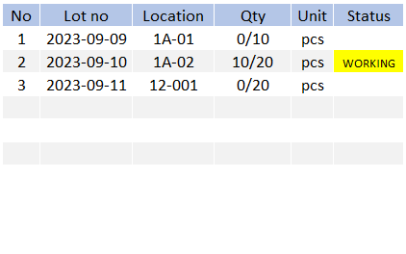
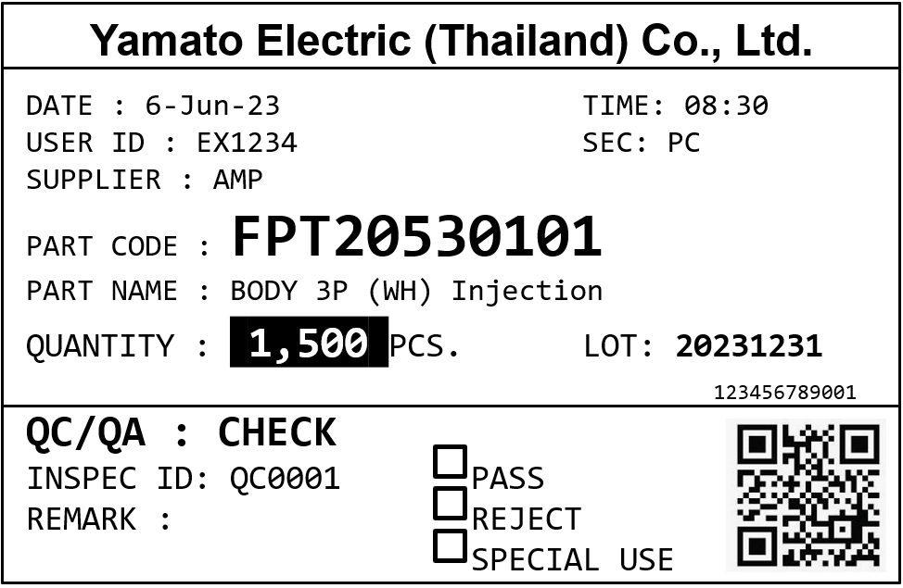
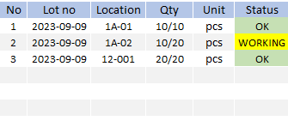

5. System functional specifications
5-3. Handy terminal function Outbound
5-3-4. Outbound Detail for Work Outbound * Same as Delivery Outbound
Outbound Detail
Outbound Detail
Parts No
DEMO-PARTS-NO_B
OUTBOUND QTY
Parts No
DEMO-PARTS-NO_B
DEMO-PARTS-NO_B
QTY
10
/20 PCS
DEMO-PARTS-NO_B
220(Outbound QTY)
100 → SCAN (use an old label)
120
100 → SCAN (use an old label)
20
100 → REPACK
PRINT
LABEL 1 → 80pcs (Force print)
LABEL 2 → 20pcs (YES/NO)
Parts Name
DEMO_PARTS_NAME_B
Parts Name
DEMO_PARTS_NAME_B
Location
Plan
RD05
RD06
Lot No
Plan
2023-09-10
2023-09-11
DEMO-PARTS-NO_B
Enter QTY = 10pcs
Label 1 piece
Lot 2023-09-10
Location
Plan
RD05
RD06
Lot No
Plan
2023-09-10
2023-09-11
Box No
Lot No
Box No
Lot No
Box no
0001
2023-09-10
Qty
Box no
Qty
5
PRINT LABEL
2023-09-10
PCS
10
0/20
Print all remaining labels?
10/50
YES
NO
Confirm[P4]
2 Types printed label
New (black color)
Remaining/Old (white color)
INFORMATION
Operation completed!
Operation completed
Outbound Detail
Outbound Detail
Parts No
DEMO-PARTS-NO_B
OUTBOUND QTY
DEMO-PARTS-NO_B
DEMO-PARTS-NO_B
QTY
10
/10 PCS
DEMO-PARTS-NO_B
Parts No does not match Plan
Parts Name
DEMO_PARTS_NAME_B
Parts Name
DEMO_PARTS_NAME_B
Location
Plan
RD05
RD06
Lot No
Plan
2023-09-10
2023-09-11
DEMO-PARTS-NO_B
Enter QTY = 10pcs
Label 1 piece
Lot 2023-09-10
RD05
RD06
Lot No
Plan
2023-09-10
2023-09-11
Box No
Lot No
Box No
Lot No
Box no
Qty
0001
2023-09-10
PCS
Qty
PRINT LABEL
2
20
40/50
Print all remaining labels?
50/50
YES
NO
Confirm[P4]
Parts No does not match Plan
*3: When Parts No does not match the Plan.
OK button: Close this screen. Return to the previous process.
Qty (inside FIFO)
Label Qty < FIFO remaining Qty ➔ Label Qty
Otherwise ➔ FIFO remaining Qty
INFORMATION
All items completed!

Slide 53

5. System functional specifications
5-3. Handy terminal function Outbound
5-3-4. Outbound Detail for Work Outbound * Same as Delivery Outbound
* Scan the other items not included in the FIFO plan
* Show total of label qty in case of manual outbound
Outbound Detail
Outbound Detail
Parts No
DEMO-PARTS-NO_B
OUTBOUND QTY
DEMO-PARTS-NO_B
220(Outbound QTY)
100 → SCAN (use an old label)
120
100 → SCAN (use an old label)
20
100 → REPACK
PRINT
LABEL 1 → 80pcs (Force print)
LABEL 2 → 20pcs (YES/NO)
DEMO-PARTS-NO_B
QTY
10
/10 PCS
DEMO-PARTS-NO_B
Parts Name
DEMO_PARTS_NAME_B
Parts Name
DEMO_PARTS_NAME_B
Location
Plan
RD05
RD06
Lot No
Plan
2023-09-10
2023-09-11
DEMO-PARTS-NO_B
Enter QTY = 10pcs
Label 1 piece
Lot 2024-10-12
RD05
RD06
Lot No
Plan
2023-09-10
2023-09-11
Box No
Lot No
Box No
Lot No
Box no
Qty
0001
2023-09-10
PCS
Qty
PRINT LABEL
2
20
40/50
Print all remaining labels?
50/50
YES
NO
Confirm[P4]
5
* All status should be changed to OK while the outbound items have already completed
Qty (outside FIFO)
Label Qty < Total remaining Qty ➔ Label Qty
Otherwise ➔ Total remaining Qty
INFORMATION
All items completed!
Operation completed
Parts No does not match Plan
Parts No does not match Plan
*3: When Parts No does not match the Plan.
OK button: Close this screen. Return to the previous process.

Slide 54







5. System functional specifications
5-3. Handy terminal function Outbound
5-3-5. Outbound Detail for INJECTION Work Outbound
2
This is the screen that transitions after select order information from Outbound item.
Date : Today’s date
Part No.: PART NUMBER
Part Name : PART NAME
Use Crusher : Enable/Disable to picking the crusher as percentage.
Location Plan :*Display assigned location information. If there are multiple items, display multiple items.
Lot Plan :*Displays a list of Lot no that are recommended for picking after reservation. If there are multiple items, display multiple items.
Lot No: No initial value information * Scan QR data or Can be changed manually
Package Qty: No initial value information * Scan QR data or Can be changed manually
Package: No initial value information * Scan QR data or Can be changed manually
Sum Qty: No initial value information * Scan QR data or Can be changed manually
Location: The initial value is referenced from the Location master. No initial value information. If there is no link, display blank.* Scan QR data or Can be changed manually
Clear[P3]: Reset to the initial data
Confirm[P4]: Confirmation processing. Normal end: Completion of registration *1. Warning: Warning screen display *2
< (P1): Back to Main menu
Date
From
Work Outbound
Outbound Detail
07/Oct/2023
Date
To
07/Oct/2023
Except complete
Parts No
DEMO-PARTS-NO_B
Order No : DEMO-ORDER-NO-A
Parts No : DEMO-PARTS-NO_A
Parts Name : DEMO_PARTS_NAME_A
Lot No : 20230910
Location code : RD07/RD08 500.00/500.00PCS
DEMO-PARTS-NO_B
Parts Name
DEMO_PARTS_NAME_B
220(Outbound QTY)
100 → SCAN (use an old label)
120
100 → SCAN (use an old label)
20
100 → REPACK
PRINT
LABEL 1 → 80pcs (Force print)
LABEL 2 → 20pcs (YES/NO)
Use Crusher
20%
Crusher-parts-no-xx
Order No : DEMO-ORDER-NO-B
Parts No : DEMO-PARTS-NO_B
Parts Name : DEMO_PARTS_NAME_B
Lot No : 20230910 / 20230911
Location code : RD05/RD06 0.00/600.00PCS
Box No
Lot No
Box no
Qty
Total 0/45
OUTBOUND QTY
QTY
20
/20 KGS
Operation completed
Outbound Detail
Outbound Detail
The FIFO and outbound details will recalculate while user uses the crusher.
Swipe up the screen to process the crusher outbound list items.
Outbound Detail
Parts No
DEMO-PARTS-NO_B
Parts No
DEMO-PARTS-NO_B
Total 0/45
DEMO-PARTS-NO_B
DEMO-PARTS-NO_B
Parts No does not match Plan
Parts Name
DEMO_PARTS_NAME_B
Parts Name
DEMO_PARTS_NAME_B
Crusher P/No
Crusher-part-no-xxx
Use Crusher
20%
Use Crusher
20%
Crusher-parts-no-xx
Crusher-parts-no-xx
Box No
Lot No
Box No
Lot No
Box no
Qty
Box no
Qty
Outbound Detail
Total 0/50
Total 0/45
Total 0/5
DEMO-PARTS-NO_B
Parts Name
DEMO-PARTS-NO_B
5
RD05
RD06
DEMO_PARTS_NAME_B
Parts No does not match Plan
Show confirmation dialog about Reset all data if user change the ratio percentage or disable/enable.
It can be 5/10/15/20/25 which set in config file.
Referred to page 64.
Box No
Lot No
Plan
2023-09-10
2023-09-11
Outbound Detail
Outbound Detail
Lot No
0001
2023-09-10
PCS
Qty
*3: When Parts No does not match the Plan.
OK button: Close this screen. Return to the previous process.
Parts No
DEMO-PARTS-NO_B
Total 45/45
2
20
DEMO-PARTS-NO_B
20/50
Parts Name
DEMO_PARTS_NAME_B
Crusher P/No
Crusher-part-no-xxx
It need to be process an outbound.
The Handy will allow to confirm only when the crusher item has been picked.
Confirm[P4]
Use Crusher
20%
CRUSHER changed detect
Crusher-parts-no-xx
Box No
Lot No
Click “YES” to clear all data?
Box no
Qty
YES
NO
Total 45/45
Total 5/5
INFORMATION
Confirm[P4]
Operation completed!
DEMO-PARTS-NO_B
Enter QTY = 20pcs
Label 1 piece
Lot 2023-09-10

Slide 55
5. System functional specifications
5-4. Handy terminal function Stock Management
5-4-1. Stock management
This is the screen that transitions after select Stock management from Main menu.
Stock Check button: Transitions to the Stock Check screen.
Stocktaking button: Transitions to the Stocktaking screen.
Change Location button: Transitions to the Change Location screen.
< (P1): Back to Main menu
8
8
Label For Return
Label For Return

Slide 56

5. System functional specifications
5-4. Handy terminal function Stock Management
5-4-2. Stock Check
This is the screen that transitions after select Stock check from Stock management menu.
Parts No: No initial value information, List selection from Item master* Can be changed manually or scan label
Lot No: No initial value information.* Can be changed manually or scan label
Location : No initial value information
Qty Box : No initial value information
Qty : No initial value information
Total : No initial value information
Clear[P3]: Clear input contents
OK[P4]: Confirmation processing. Search data.
< (P1): Back to Main menu
3
Lot No
Qty
8
Label For Return
*2: Display screen when information is incorrect
OK button: Close this screen. Return to the previous process.
Qty
DEMO-PARTS-NO_B
DEMO-PARTS-NO_B
DEMO-PARTS-NO_B
Qty per box = 10pcs
Label 1 piece
Lot 2023-09-09
6,850
6,860

Slide 57




5. System functional specifications
5-4. Handy terminal function Stock Management
5-4-3. Stocktaking
5
This is the screen that transitions after select Stocktaking from Stock management menu.
Parts No: No initial value information, List selection from Item master* Can be changed manually or scan label
Lot No: No initial value information.* Can be changed manually or scan label
Location : No initial value information .* Can be changed manually or scan label
Qty : System quantity, No initial value information *The quantity in the system will be displayed.
Act ถty : Actual quantity, No initial value information
Clear[P3]: Clear input contents
Confirm[P4]: Confirmation processing.
< (P1): Back to Main menu
8
Label For Return
808-0210031-00
Label 1 piece
Lot 2024-02-03
Instructions
Scan location
Scan label
Current stock information will be shown on screen.
Click “Confirm” to apply the information.
In the case of NG, the item was rescanned.
Success dialog will show if the data saving completed.

Slide 58


5. System functional specifications
5-4. Handy terminal function Stock Management
5-4-4. Change Location
This is the screen that transitions after select Change Location from Stock management menu.
Parts No: No initial value information, List selection from Item master* Can be changed manually or scan label
Lot No: No initial value information.* Can be changed manually or scan label
Qty : No initial value information Can be changed manually or scan label
Old Location : No initial value information .* Can be changed scan label
New Location : No initial value information .* Can be changed manually or scan label
Clear[P3]: Clear input contents
Confirm[P4]: Confirmation processing.
< (P1): Back to Main menu
8
Label For Return
1
All pack change location
DEMO-PARTS-NO_B
DEMO-PARTS-NO_B
DEMO_PARTS_NAME_B
DEMO_PARTS_NAME_B
2023-09-09
2023-09-09
200
200
DEMO-PARTS-NO_B
Label 1 piece
Lot 2023-09-09
DEMO-PARTS-NO_B
Label 1 piece
Lot 2023-09-09
* Scan the same label
200
2
Partial change location
DEMO-PARTS-NO_B
DEMO-PARTS-NO_B
DEMO_PARTS_NAME_B
DEMO_PARTS_NAME_B
2023-09-09
2023-09-09
200
200
DEMO-PARTS-NO_B
Label 1 piece
Lot 2023-09-09
Serial 0001
120
DEMO-PARTS-NO_B
Label 1 piece
Lot 2023-09-09
Location: LO01
Serial 0002(new serial)
DEMO-PARTS-NO_B
Label 1 piece
Lot 2023-09-09
Location: LO01-A
Serial 0003(new serial)

Slide 59




5. System functional specifications
5-4. Handy terminal function Stock Management
5-4-5. Label For Return
8
Label For Return
This is the screen that transitions after select Label For Return
from Stock management menu.
Parts No: No initial value information, List selection from Item master* Can be changed manually or scan label
Lot No: No initial value information. Location : No initial value information
Qty Box : No initial value information
Qty : No initial value information
Total : No initial value information
Clear[P3]: Clear input contents
OK[P4]: Confirmation processing. Search data.
< (P1): Back to Main menu
Name :
Lot No
Qty
Label For Return
Print label [P2]
*2: Display screen when information is incorrect
OK button: Close this screen. Return to the previous process.
Name :
Can edit lot number
Name :
30-002863-00-00
Name :
CONTACT TREATMENT OIL...
6,850
*Show only items in
your own department.
Location
A001
Scan or select
6,850

Slide 60

5. System functional specifications
5-5. PC operation flow basic
5-5-1. Login-Menu
Prepare user ID and password for YAMATO.
Please log in with YAMATO user ID and password.
Username: admin
Pass: 1234

Slide 61

5. System functional specifications
5-5. PC operation flow basic
5-5-2. Main-Menu
1
[Schedule]
[Inbound]
[Outbound]
[Stock Management]
[Master Management]
2
3
4
5
Inbound Schedule Material
Inbound Schedule Material
Schedule
Inbound Schedule Production
8
Outbound Schedule Material
Inbound
Outbound Schedule Delivery
Inbound Inquiry Report
Outbound
Outbound Inquiry Report
Stock Inquiry / report
8
Customer master
Packing Standard master
Stock Maintenance
Item master
Supplier master
Stocktaking
8
Supplier master
Customer master
Stock Maintenance Inquiry / Report
Location master
Department master
Purchase Instructions
3
User credential master
Bill Of Material
Stock Inventory
Report
5
User master
Crusher Ratio master
3
Stock Monthly Report
8
8
Calendar Master
Department master
8
Weekly Delivery Report
8
Stock Card Report
8
Stock management
Master management
Delivery Monthly Report
8

Slide 62

5. System functional specifications
5-6. PC operation flow Schedule
5-6-1. Inbound Schedule Material
Show the clicked link if there are already process.
It will open the history preview web page.
Cancel button It can change the status to Cancel.
CSV import button It can import CSV files manually.
Add button It can register as many schedules as it manually select.
Search button Search using the entered conditions.
Clear button Initializes and clears the entered conditions.
Status management
Schedule registered
Inbound working
Inbound Completed
Cancel

Slide 63

5. System functional specifications
5-6. PC operation flow Schedule
5-6-2. Inbound Schedule Production
Show the clicked link if there are already process.
It will open the history preview web page.
Cancel button It can change the status to Cancel.
CSV import button It can import CSV files manually.
Add button It can register as many schedules as it manually select.
Search button Search using the entered conditions.
Clear button Initializes and clears the entered conditions.
Status management
Schedule registered
Inbound working
Inbound Completed
Cancel

Slide 64

5. System functional specifications
5-6. PC operation flow Schedule
5-6-3. Outbound Schedule Material
Show the clicked link if there are already process.
It will open the history preview web page.
Cancel button It can change the status to Cancel.
CSV import button It can import CSV files manually.
Add button It can register as many schedules as it manually select.
Search button Search using the entered conditions.
Clear button Initializes and clears the entered conditions.
Status management
Schedule registered
Outbound working
Outbound Completed
Cancel

Slide 65

5. System functional specifications
5-6. PC operation flow Schedule
5-6-3. Outbound Schedule Delivery
Show the clicked link if there are already process.
It will open the history preview web page.
Cancel button It can change the status to Cancel.
CSV import button It can import CSV files manually.
Add button It can register as many schedules as it manually select.
Search button Search using the entered conditions.
Clear button Initializes and clears the entered conditions.
Status management
Schedule registered
Outbound working
Outbound Completed
Cancel

Slide 66

5. System functional specifications
5-7. PC operation flow Inbound
5-7-1. Inbound
** Standard specifics
CSV Export button Export all recodes for CSV file
PDF Export button Export all recodes for CSV file
Search button Search using the entered conditions.
Clear button Initializes and clears the entered conditions.

Slide 67

5. System functional specifications
5-8. PC operation flow Outbound
5-8-1. Outbound
** Standard specifics
CSV Export button Export all recodes for CSV file
PDF Export button Export all recodes for CSV file
Search button Search using the entered conditions.
Clear button Initializes and clears the entered conditions.

Slide 68

5. System functional specifications
5-9. PC operation flow Stock management
5-9-1. Stock Inquiry Report
** Standard specifics
CSV Export button Export all recodes for CSV file
PDF Export button Export all recodes for CSV file
Search button Search using the entered conditions.
Clear button Initializes and clears the entered conditions.
8

Slide 69

5. System functional specifications
5-9. PC operation flow Stock management
5-9-2. Stock Maintenance
** Standard specifics
Register Register input data.
Remove Zero Qty Remove all zero qty records.
Add Add the blank record for input the new data.
Search button Search using the entered conditions.
Clear button Initializes and clears the entered conditions.

Slide 70

5. System functional specifications
5-9. PC operation flow Stock management
5-9-3. Stocktaking
** Standard specifics
Save button Register input data
Confirm button Confirm the current input data
Delete button Delete selected records
Recheck button Change the status to RECHECK
Start button Initial data for current month (start the new data record)
CSV Output button Export the CSV file
Search button Search using the entered conditions.
Clear button Initializes and clears the entered conditions.

Slide 71

5. System functional specifications
5-9. PC operation flow Stock management
5-9-5. Stock Maintenance Inquiry / Report
** Standard specifics
CSV Export button Export all recodes for CSV file
PDF Export button Export all recodes for CSV file
Search button Search using the entered conditions.
Clear button Initializes and clears the entered conditions.

Slide 72


5. System functional specifications
Link this page to notification dialog at home page
5-9. PC operation flow Stock management
5-9-6. Purchase Instructions
4
Show information for every day in the next 3 months.
5
Show information for every day in the next 4 months.
8
Able to scroll
Must be enter after PO issued
3
2
Sum all need qty in selected date range
100
/Total 200 pcs
Status :
1. Start
2. Temporary PO
3. PO issued - Inbound date not yet
4. PO issued - Inbound date answered
4
Background color :
RED : Start
YELLOW : Temporary PO / PO issued
GREEN : PO issued – date answered
CSV Export button Export all recodes for CSV file
PDF Export button Export all recodes for CSV file
Search button Search using the entered conditions.
Clear button Initializes and clears the entered conditions.
The system will keep the data everyday.
Shipment plan (-)
Remain PO (actual data) (inbound mat) (+)
Item master e.g. RM-Leadtime
Stockcard data (+)
Import PO plan
Will increase the delivery date with lead time
7

Slide 73





5. System functional specifications
5-9. PC operation flow Master management
5-9-7. Stock Inventory Report
5
** Standard specifics
Stock Inventory Report
Show popup menu
- Stock inquiry report
CSV Export button Export all recodes for CSV file
Search button Search using the entered conditions.
Clear button Initializes and clears the entered conditions.
Category: Item category (Item master)
Item name: Item name (Item master)
Item number: Item code (Item master)
Drawing number: Drawing number (Item master)
FG : Average shipping qty per month: Last 1 year
100 100 ;;;;;;;100 = 100
RM : (N-2) – (N-1) – Inbound Qty
100 - (120 -40) = 20 last 1year
Safety stock qty: Safety stock quantity (Item master)
Latest shipping date: Last shipping date (Outbound transactions)
Inventory quantity: Stock quantity
Unit price: Unit price (Item master)
8

Slide 74

5. System functional specifications
5-9. PC operation flow Master management
5-9-8. Stock monthly report (monthly inventory report)
8
** Standard specifics
CSV Import button Import selected CSV file
CSV Export button Export all recodes for CSV file
Delete button Delete selected records
Edit mode button Transitions to edit screen mode
Save button Save data
Search button Search using the entered conditions.
Clear button Initializes and clears the entered conditions.

Slide 75

5. System functional specifications
5-9. PC operation flow Master management
5-9-9. Weekly delivery report(Plan/Actual/Balance stock)
8
** Standard specifics
CSV Import button Import selected CSV file
CSV Export button Export all recodes for CSV file
Delete button Delete selected records
Edit mode button Transitions to edit screen mode
Save button Save data
Search button Search using the entered conditions.
Clear button Initializes and clears the entered conditions.

Slide 76

5. System functional specifications
5-9. PC operation flow Master management
5-9-10. Stock card (Part No., Rec, Issue, Stock)
8
** Standard specifics
CSV Import button Import selected CSV file
CSV Export button Export all recodes for CSV file
Delete button Delete selected records
Edit mode button Transitions to edit screen mode
Save button Save data
Search button Search using the entered conditions.
Clear button Initializes and clears the entered conditions.

Slide 77

5. System functional specifications
** Standard specifics
5-9. PC operation flow Master management
5-9-11. Delivery monthly report (PO No., FG, Name, Qty, Req-date, Delivery date
8
CSV Import button Import selected CSV file
CSV Export button Export all recodes for CSV file
Delete button Delete selected records
Edit mode button Transitions to edit screen mode
Save button Save data
Search button Search using the entered conditions.
Clear button Initializes and clears the entered conditions.

Slide 78

5. System functional specifications
5-10. PC operation flow Master management
5-10-1. Item master
** Standard specifics
5
Add the below columns
Drawing no
Category
CSV Import button Import selected CSV file
CSV Export button Export all recodes for CSV file
Delete button Delete selected records
Search button Search using the entered conditions.
Clear button Initializes and clears the entered conditions.

Slide 79

5. System functional specifications
5-10. PC operation flow Master management
5-10-2. Packing Standard master
** Standard specifics
CSV Import button Import selected CSV file
CSV Export button Export all recodes for CSV file
Delete button Delete selected records
Search button Search using the entered conditions.
Clear button Initializes and clears the entered conditions.

Slide 80

5. System functional specifications
5-10. PC operation flow Master management
5-10-3. Supplier Master
8
** Standard specifics
CSV Import button Import selected CSV file
CSV Export button Export all recodes for CSV file
Delete button Delete selected records
Search button Search using the entered conditions.
Clear button Initializes and clears the entered conditions.

Slide 81

5. System functional specifications
5-10. PC operation flow Master management
5-10-4. Location master
** Standard specifics
CSV Import button Import selected CSV file
CSV Export button Export all recodes for CSV file
Delete button Delete selected records
Search button Search using the entered conditions.
Clear button Initializes and clears the entered conditions.

Slide 82

5. System functional specifications
5-10. PC operation flow Master management
5-10-5. User master
** Standard specifics
CSV Import button Import selected CSV file
CSV Export button Export all recodes for CSV file
Delete button Delete selected records
Search button Search using the entered conditions.
Clear button Initializes and clears the entered conditions.

Slide 83

5. System functional specifications
5-10. PC operation flow Master management
5-10-6. User Credential master
** Standard specifics
CSV Import button Import selected CSV file
CSV Export button Export all recodes for CSV file
Delete button Delete selected records
Search button Search using the entered conditions.
Clear button Initializes and clears the entered conditions.

Slide 84

5. System functional specifications
5-10. PC operation flow Master management
5-10-7. Customer Master
8
** Standard specifics
CSV Import button Import selected CSV file
CSV Export button Export all recodes for CSV file
Delete button Delete selected records
Search button Search using the entered conditions.
Clear button Initializes and clears the entered conditions.

Slide 85

5. System functional specifications
5-10. PC operation flow Master management
5-10-8. Crusher Ratio master
2
** Standard specifics
6
CSV Import button Import selected CSV file
CSV Export button Export all recodes for CSV file
Delete button Delete selected records
Search button Search using the entered conditions.
Clear button Initializes and clears the entered conditions.
6
These values can be further modified which defined in the HT settings config named 'crusher_ratio’.
For example
crusher_ratio=5,10,15,20,25
Crusher details
1. Virgin (Part No.)
2. Crusher (Part No.)
3. Ratio(%) – The default ratio of each item. It can be 5/10/15/20/25 shown in drop down list in handy.
4. Max Rate(%) – The maximum rate of crusher that able to choose in handy.
5. FG (Part No.)
* User must define the crusher information for INJECTION process

Slide 86

5. System functional specifications
5-10. PC operation flow Master management
5-10-9. BOM master
5
** Standard specifics
CSV Import button Import selected CSV file
CSV Export button Export all recodes for CSV file
Delete button Delete selected records
Edit mode button Transitions to edit screen mode
Save button Save data
Search button Search using the entered conditions.
Clear button Initializes and clears the entered conditions.

Slide 87

5. System functional specifications
5-10. PC operation flow Master management
5-10-10. Calendar master
8
** Standard specifics
CSV Import button Import selected CSV file
CSV Export button Export all recodes for CSV file
Delete button Delete selected records
Edit mode button Transitions to edit screen mode
Save button Save data
Search button Search using the entered conditions.
Clear button Initializes and clears the entered conditions.

Slide 88

5. System functional specifications
5-10. PC operation flow Master management
5-10-11. Department master
8
** Standard specifics
CSV Import button Import selected CSV file
CSV Export button Export all recodes for CSV file
Delete button Delete selected records
Edit mode button Transitions to edit screen mode
Save button Save data
Search button Search using the entered conditions.
Clear button Initializes and clears the entered conditions.

Slide 89
6. Q&A

Slide 90
7. Sign off
We hereby acknowledge and agree the above-mentioned blueprint requirements.
Any changes required after the sign off for this blueprint will be addressed through the change request process.
Yamato Electric (Thailand) Co., Ltd.
Sign:
Name:
Title:
Date:
TOMAS TECH CO.,LTD.
Sign:
Name:
Title:
Date:
## END OF BLUEPRINT##

