Slide 1
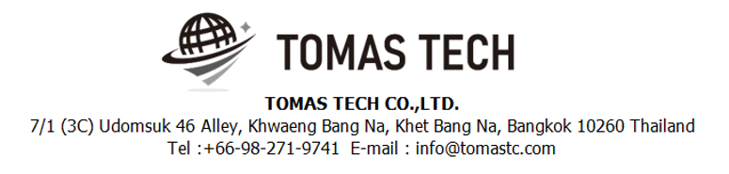
Version 23/Mar/2025
Confidential
Pegasus Web Stock Management System
Manual Document
Documentation EN for NKI
R1
Made for: PT NIPPON KONPO INDONESIA
By: TOMAS TECH CO.,LTD.

Slide 2

Introduction
This manual explains each handy terminal, how to set it up with a PC, how to check the operation, and how to communicate with a PC.
Please read before starting work.
For safe use of this device
To use this device correctly and safely, be sure to observe the following safety precautions when operating this device. TOMAS TECH cannot be held responsible or warranted for any damage caused by using the product in violation of these precautions.
◆How to read the symbols
In this manual, the items to be observed in order to use the device safely are classified as follows.
Danger
If you ignore the information on this label and handle it incorrectly, there is a risk of death or serious injury.
Warning
This indicates the contents that may cause injury if the contents of this display are ignored and the product is handled improperly.
Caution
It indicates that property damage may occur if the product is handled improperly, ignoring the contents of this display.
The symbol represents a "caution" that it should be aware of.
The symbol represents an "instruction" that it must execute.
The symbol represents a "prohibition" that must not be done.
The symbols represent the "information" needed to deepen your understanding of this book.
The symbol represents "prohibited handling" by anyone other than a service person.
The symbol indicates that grounding is required during installation.
Reference
Indicates chapters to refer to and other manual references.

Slide 3
For safe use
◆General caution
In the unlikely event that this device breaks down, take sufficient safety measures to prevent various damages before use.
Please note that we cannot guarantee the function and performance of products that are used or modified outside the specifications shown in the specifications.
Do not disassemble this device unnecessarily. There is a risk of failure or damage.
Do not allow the device to get wet with water. It may lead to damage to this device.
Please use within the environmental conditions of this device. In addition, even within environmental conditions, equipment may be damaged in an environment where condensation forms due to sudden temperature changes.
Do not drop the device or hit it with strong force. Also, if the wiring from this device is likely to be subject to excessive impact, consider how to protect the wiring. It may lead to damage to this device and other devices.
Do not operate the device in a place with flammable or explosive gas or vapor. It is very dangerous to use this device in such an environment.
When using this device in combination with other devices, the functions and performance may not be satisfactory depending on the usage conditions and environment, so please consider carefully before using.
Caution
◆For proper use
When installing this device, turn off the power of the device. Do not short-circuit each wiring or terminal.
When installing this device, be sure to perform protective grounding to prevent electric shock.
Be sure to check that the power supply voltage of the device matches the voltage of the power supply before turning on the device.
Only our customer service or equivalent handlers should install this equipment.
To supply power to this device, connect it via a protection circuit such as a switchboard breaker or an earth leakage breaker.
Since this device is an electronic device, when installing various devices, investigate the installation environment (primary power supply system noise, drive device system noise, electrostatic discharge noise, etc.) and take countermeasures. It may cause system malfunction or damage to various devices.
Caution

Slide 4
Revision History
Date | Version | File name | Details
23/Mar/2025 | R1 | Pegasus Web Stock Management System Manual Document Documentation EN for NKI | First edition

Slide 5
■Contents
Overview
Web Functions
2-1-1. Login Screen
2-1-2. Home Page
2-2-1. Menu Schedule
2-2-2. Inbound Schedule Details
2-2-3. Outbound Schedule
2-2-4. Outbound Schedule Details
2-3-1. Inbound Schedule
2-3-2. Inbound Inquiry/Report
2-4-1. Out Schedule
2-4-2. Outbound Inquiry/Report
2-5-1. Stock Management
2-5-2. Stock Inquiry/Report
2-5-3. Stock Maintenance
2-5-4. Stocktaking
2-5-5. Stock Maintenance Inquiry/Report
2-5-6. Inventory Linkage
2-5-7. Tag Label
2-5-8. NG Inquiry/Report
2-5-9. Traceability Report
2-5-10. Change Location
2-6-1. Add User
2-6-2. Authority Master
2-6-3. User Credentials
2-6-4. User Master
Q&A Contact
Information

Slide 6
1. Overview
Proposal for Stock Management System to PT NIPPON KONPO INDONESIA
In the current operation, the goal is to improve work efficiency and accuracy by replacing the manual management of paper and whiteboards with a comprehensive system.
Expected Effects of Introducing an Inventory Management System:
Improved Work Efficiency and Accuracy
  Support work at the handy terminal during warehousing and storage.
  Real-time inventory status tracking.
Effective Use of Storage Space
  Manage product locations efficiently to optimize space.
  Ensure thorough implementation of FIFO (First In, First Out).
Optimized Inventory Levels
  Manage ordering points to prevent excess inventory and stockouts.
Tracking and Traceability
  Manage materials and goods tracking to trace problematic products, including material lot numbers, suppliers, and processe

Slide 7
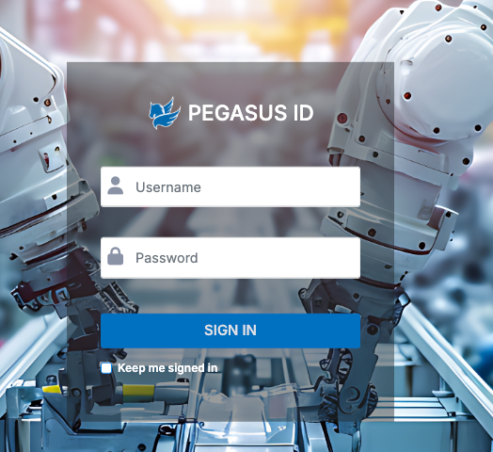
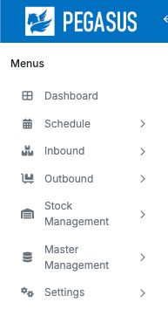
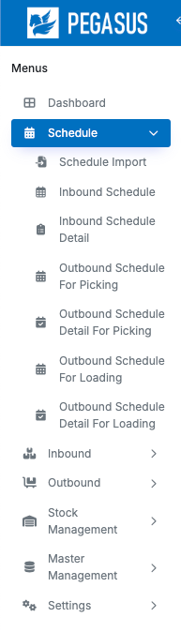
2. Web functions
2-1-1. Login screen
1. Open the browser of the website below on your PC to access
the link to use on the Cloud.
URL : http://13.212.34.168/nki/pegasus/
2. Enter Username and Password.
3. Click Sing In
4. Once logged in successfully You will find a menu on the left-hand side of the system. which will have the main menu and various submenus
Main menu
Sub menu

Slide 8
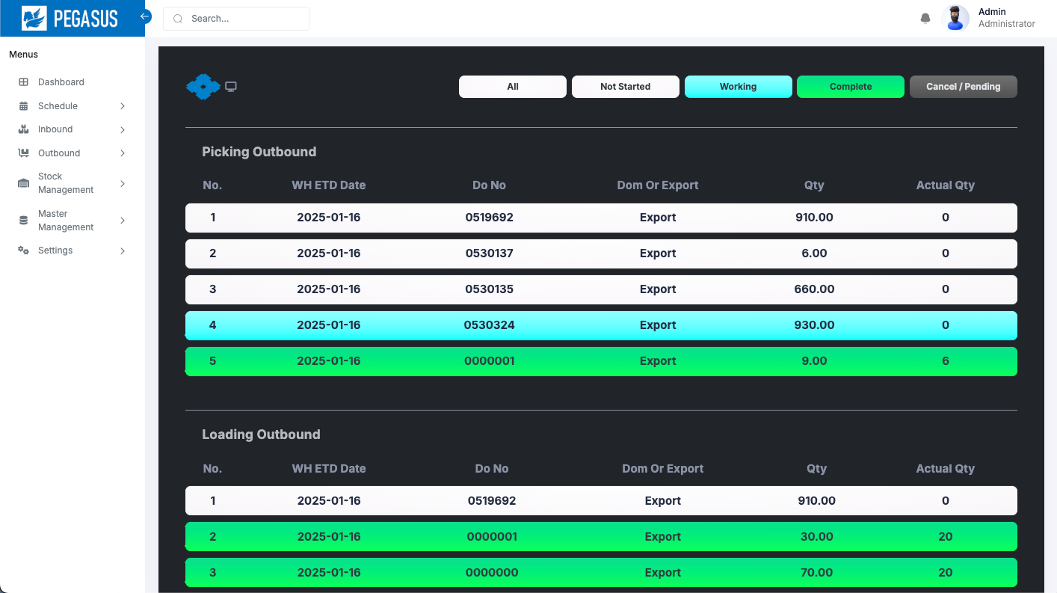
2. Web functions
2-1-2. Home Page
Once logged in successfully You will find a menu on the left-hand side of the system. which will have the main menu and various submenus
1
2
The website content will consist of two main parts
  The menu on the left side.
  The main content of the website.

Slide 9
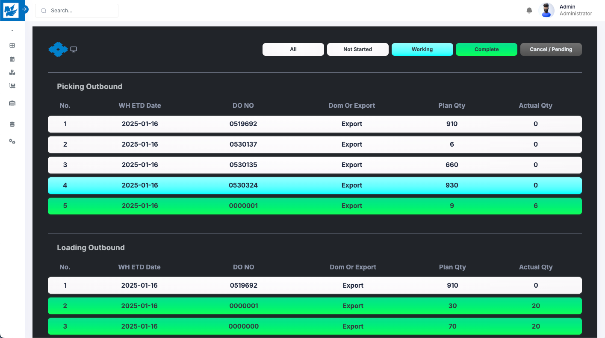
2. Web functions
2-1-3. Dashboard
After you log in to the system, you will see the Dashboard. The Dashboard will display the status of Picking Outbound and Loading Outbound, with the information shown according to the current WH ETD Date and in descending order.
Filter status
1
2
Dashboard page
The Dashboard will consist of two parts
  The section for filtering the status of the data.
  The section displaying the data results.
There are 5 statuses in total
  Display the first 5 records.
  Display data with no status.
  Display data that is currently Outbound.
  Display data that has been successfully Outbound.
  Display data that is Cancelled.
You can click the button at the top to select and view the data for the
status you are interested in.

Slide 10
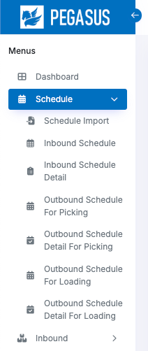
2. Web functions
2-2-1. Menu Schedule
The Schedule menu has 7 submenus
Schedule Import
Inbound Schedule
Inbound Schedule Detail
Outbound Schedule For Picking
Outbound Schedule Detail For Picking
Outbound Schedule For Loading
Outbound Schedule Detail For Loading

Slide 11
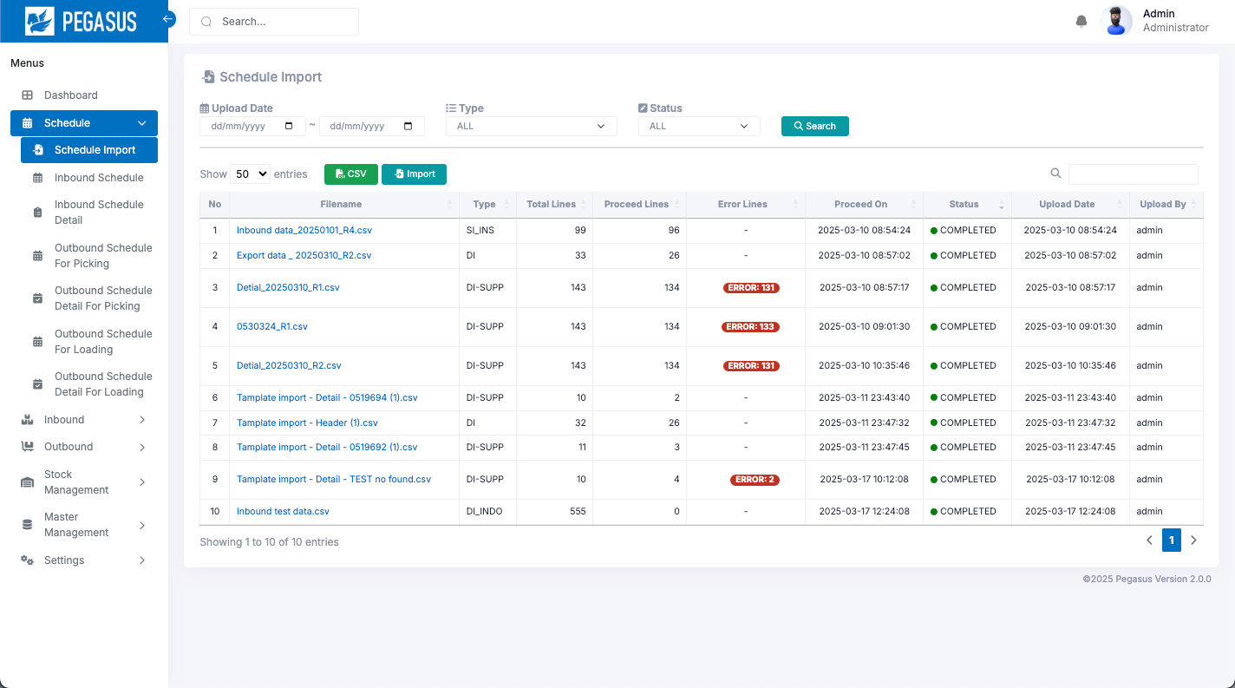
2. Web functions
2-2-2. Schedule Import
For importing schedule data into the system, both Inbound Schedule and Outbound Schedule can be imported.
Schedule Import page
Import function:
The import process will support a total of 4 file types
  Shipping INS
  Delivery Instruction Indonesia
  Delivery Instruction (Header)
  Delivery Instructions (Detail)

Slide 12
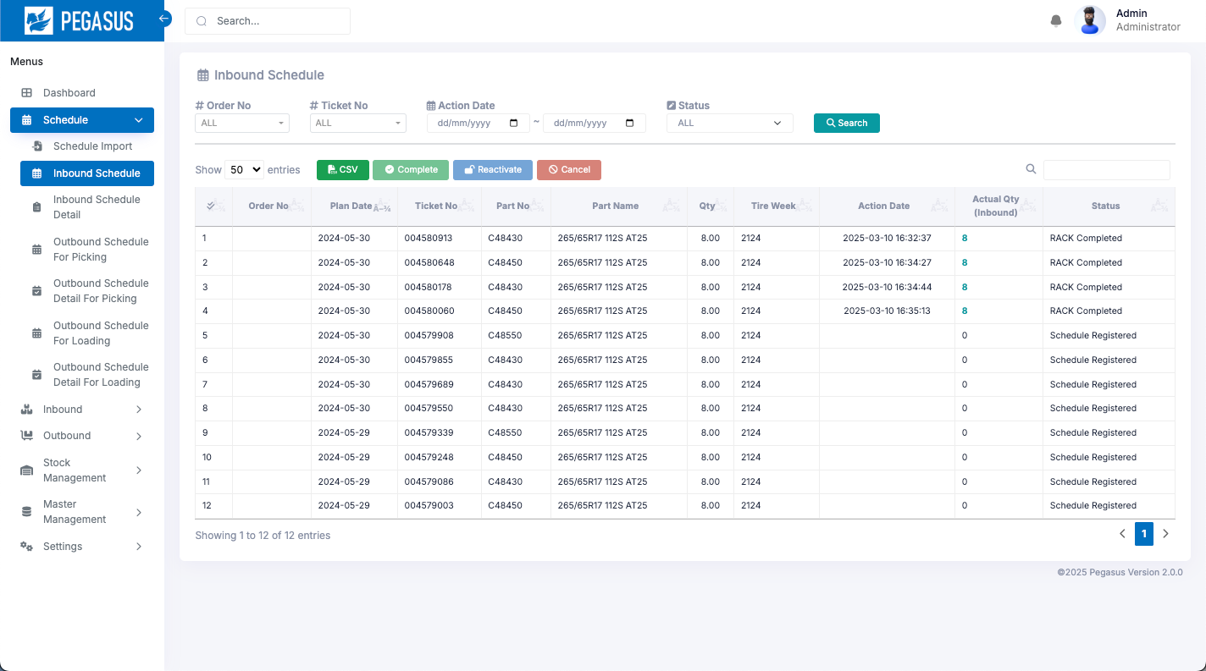
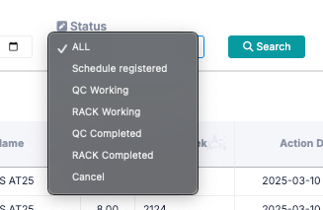
2. Web functions
2-2-3. Inbound Schedule
The Inbound Schedule list will be displayed after import, showing the following information: Plan Date, Quantity, and Status.
Inbound Schedule page
Search: A function for searching for information as specified in each option.
Filter Status
  Schedule registered
  QC Working
  RACK Working
  QC Completed
  Cancel

Slide 13


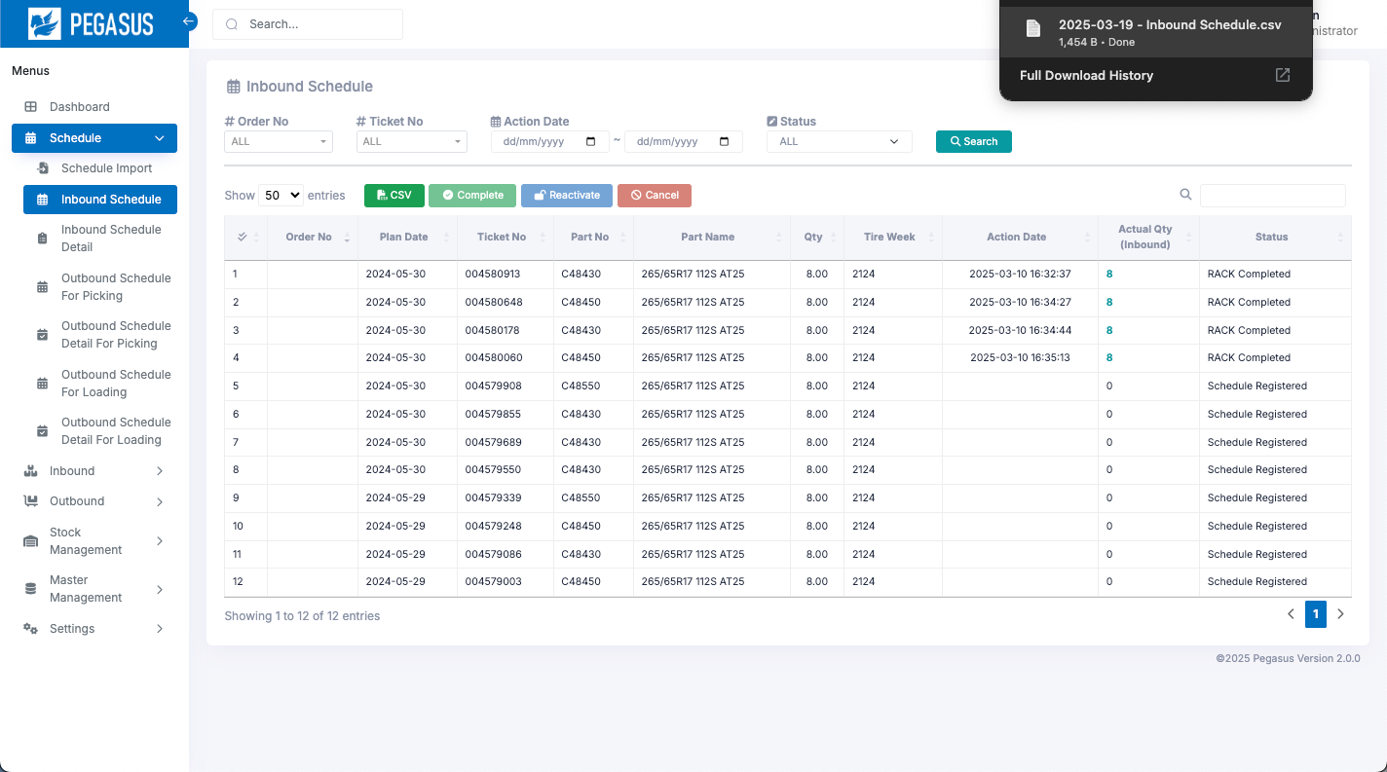
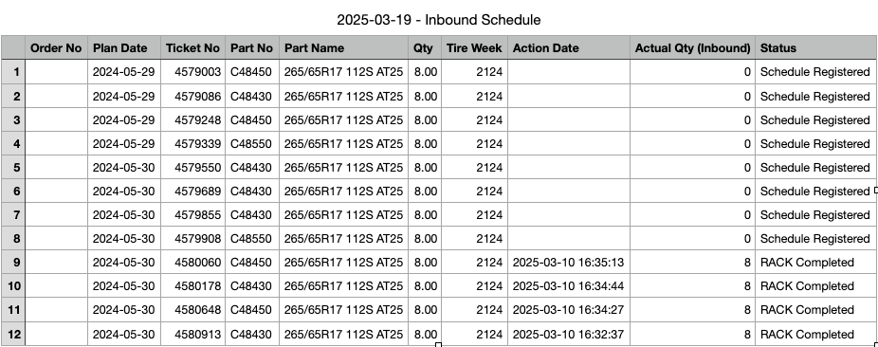

2. Web functions
2-2-3. Inbound Schedule
CSV Output: Export data as a CSV file.
It will export data from the current page.
Cancel: Select an item from the row below. and click “cancel”
to change the status to cancel.
*can change status only: Schedule Registered.
Reactivate: Select an item from the row below. and click “Reactivate”
to change the cancel status to reactivate status.
** You can select each item individually.

Slide 14
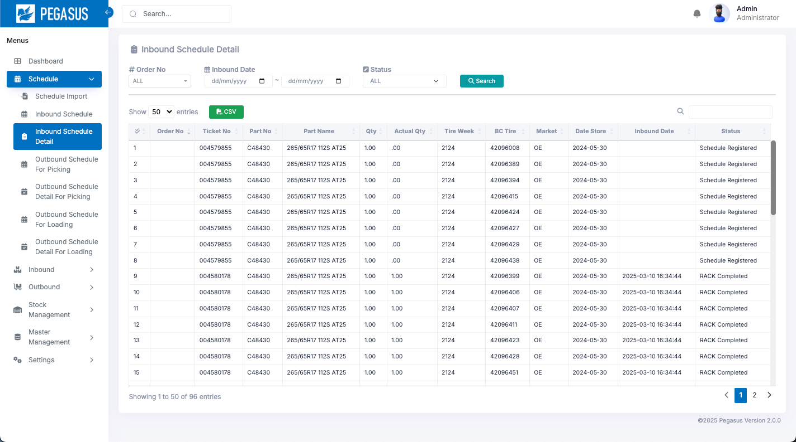

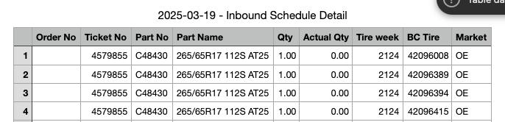
2. Web functions
2-2-4. Inbound Schedule Detail
View data all Inbound Schedule Detail
Inbound Schedule Detail page
When you arrive at this page, Click the “Search” button to search and display the desired information.
Search: A function for searching for information as specified in each option.
CSV Output: Export data as a CSV file.

Slide 15
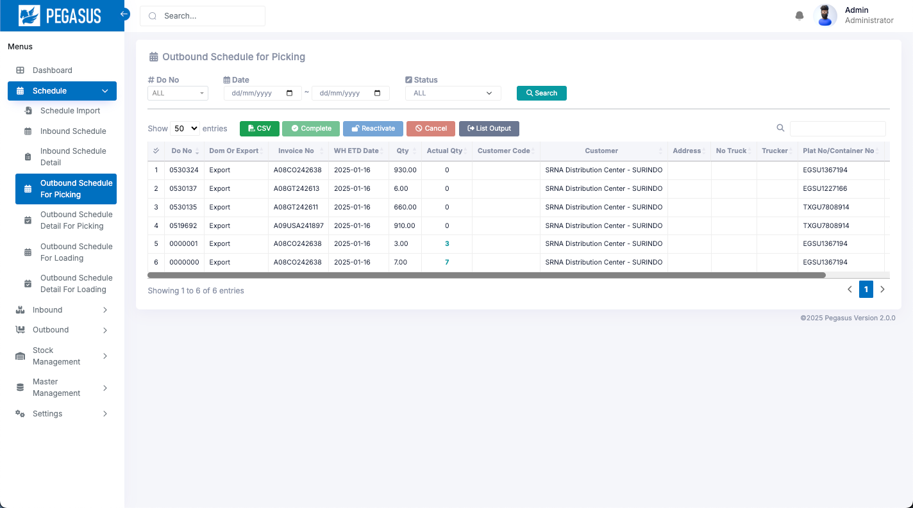
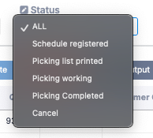
2. Web functions
2-2-5. Outbound Schedule for Picking
The Outbound Schedule list will be displayed after import, showing the following information.
Outbound Schedule for Picking page
Search: A function for searching for information as specified in each option.
Filter Status
  Schedule registered
  Picking list printed
  Picking working
  Picking Completed
  Cancel

Slide 16
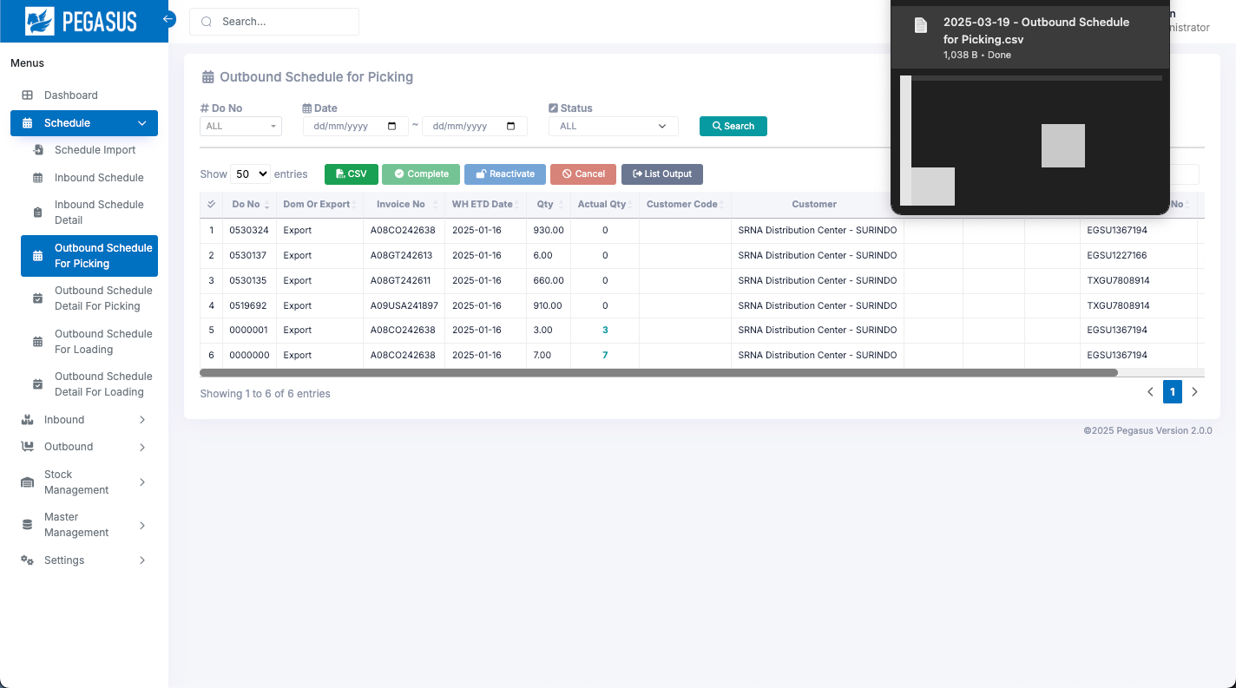
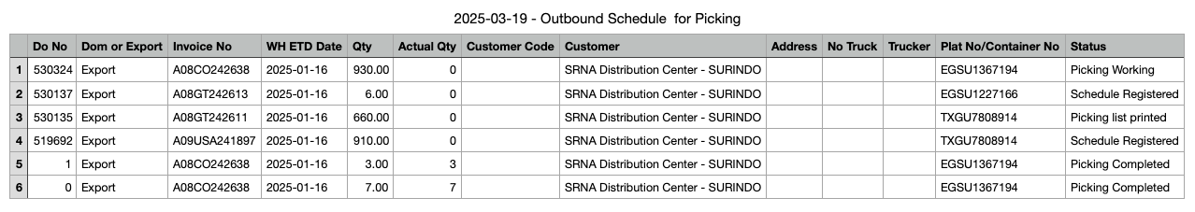
2. Web functions
2-2-5. Outbound Schedule for Picking
CSV Output: Export data as a CSV file.
It will export data from the current page.
Cancel: Select an item from the row below. and click “cancel”
to change the status to cancel.
*can change status only: Schedule Registered.
Reactivate: Select an item from the row below. and click “Reactivate”
to change the cancel status to reactivate status.
** You can select each item individually.

Slide 17
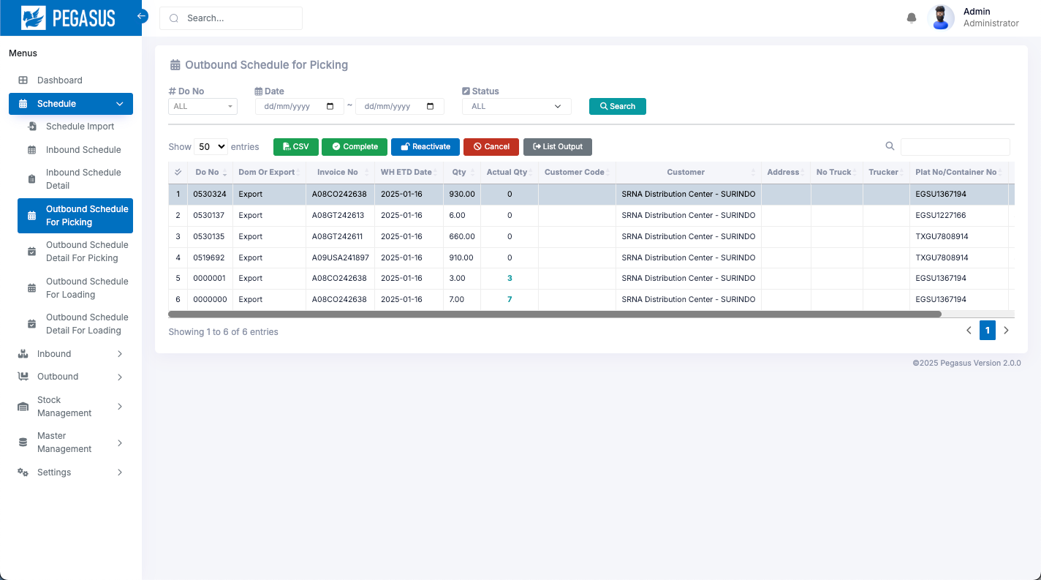
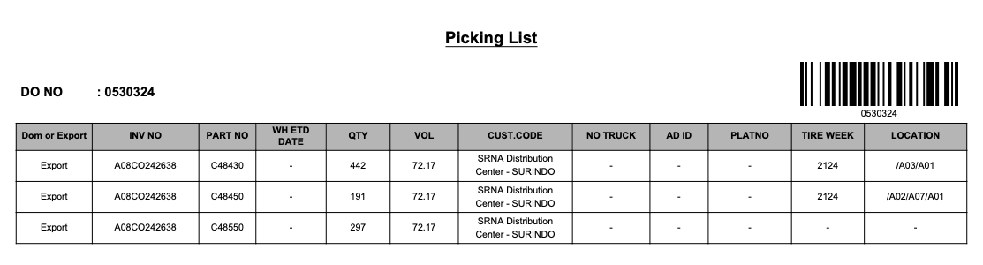
2. Web functions
2-2-5. Outbound Schedule for Picking
List Output: Export data as a PDF file.
2
1
Select the item you want to export to PDF and click the "List Output" button.
The "List Output" is a PDF that includes a QR Code, which is used for Outbound Picking.

Slide 18
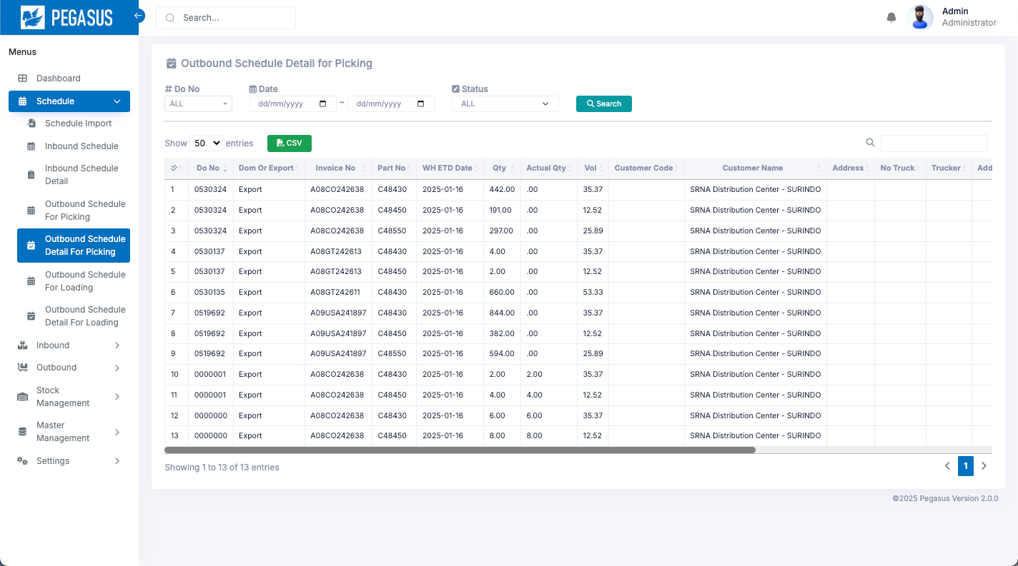
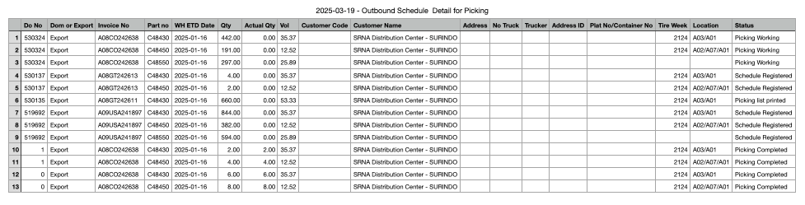
2. Web functions
2-2-6. Outbound Schedule Detail for Picking
View data all Outbound Schedule Detail for Picking
Outbound Schedule Detail for Picking page
When you arrive at this page, Click the “Search” button to search and display the desired information.
Search: A function for searching for information as specified in each option.
CSV Output: Export data as a CSV file.

Slide 19
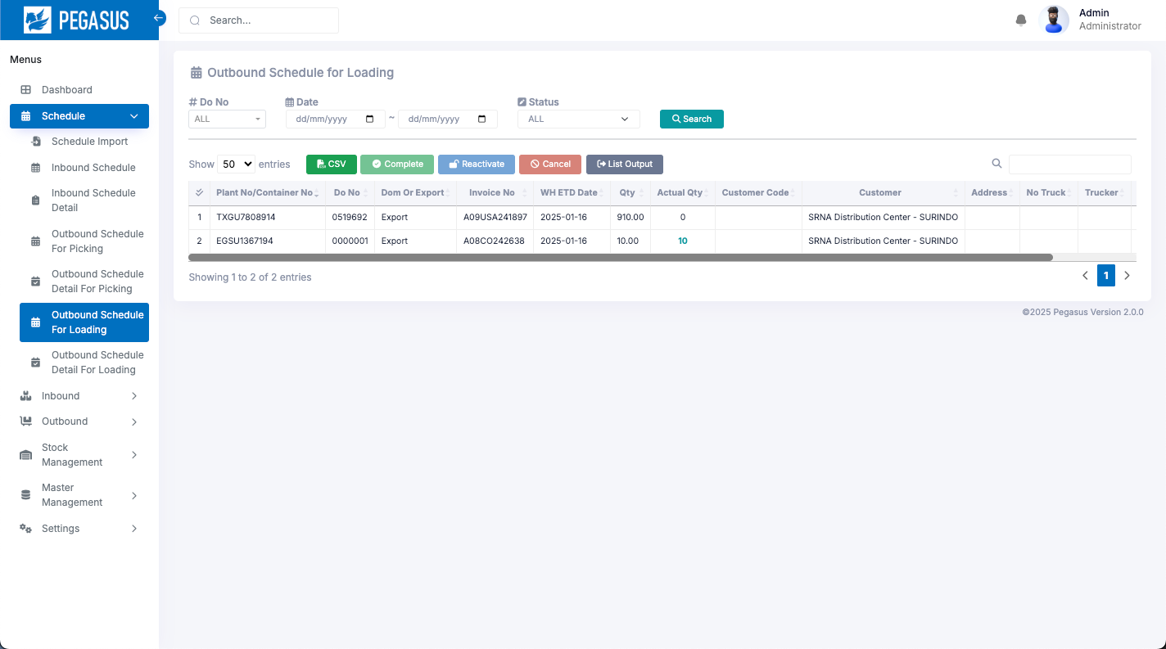

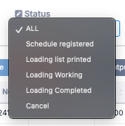
2. Web functions
2-2-7. Outbound Schedule for Loading
The Outbound Schedule list will be displayed after import, showing the following information.
Outbound Schedule for Loading page
Search: A function for searching for information as specified in each option.
Filter Status
  Schedule registered
  Loading list printed
  Loading working
  Loading Completed
  Cancel

Slide 20
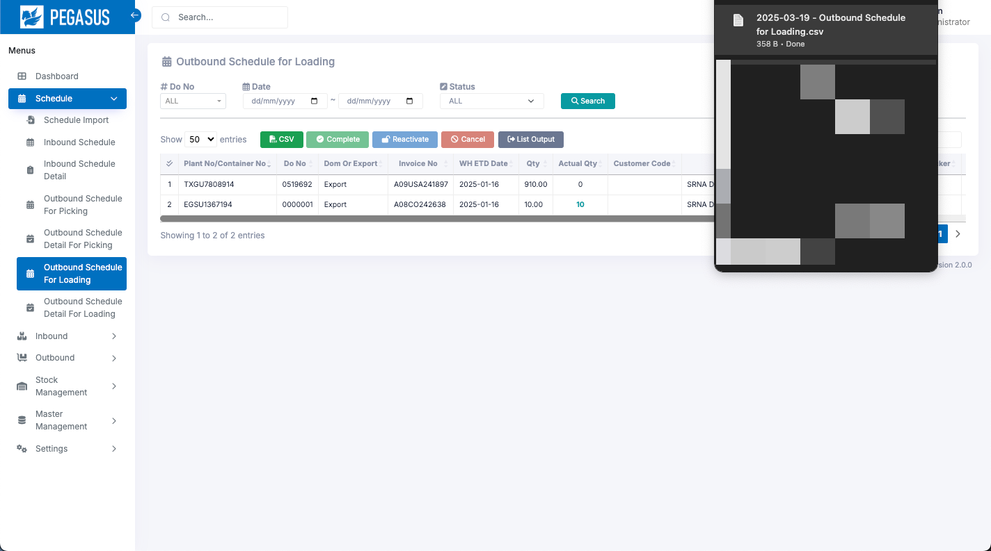
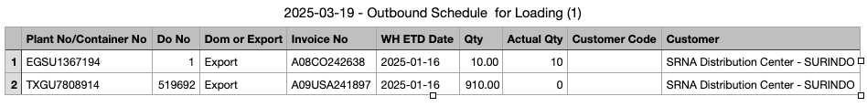
2. Web functions
2-2-7. Outbound Schedule for Loading
CSV Output: Export data as a CSV file.
It will export data from the current page.
Cancel: Select an item from the row below. and click “cancel”
to change the status to cancel.
*can change status only: Schedule Registered.
Reactivate: Select an item from the row below. and click “Reactivate”
to change the cancel status to reactivate status.
** You can select each item individually.

Slide 21
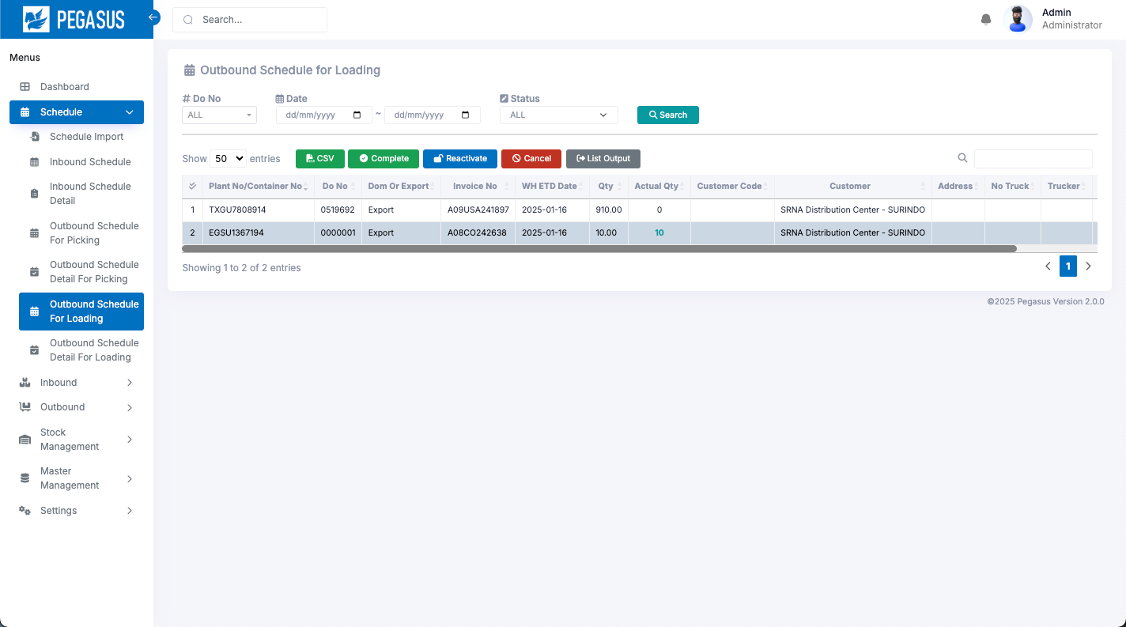
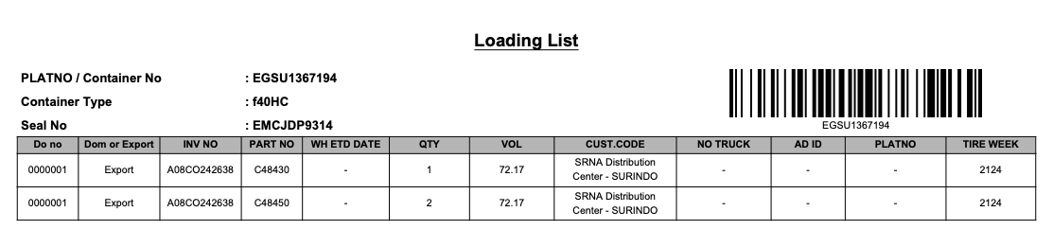
2. Web functions
2-2-7. Outbound Schedule for Loading
List Output: Export data as a PDF file.
2
1
Select the item you want to export to PDF and click the "List Output" button.
The "List Output" is a PDF that includes a QR Code, which is used for Outbound Loading.

Slide 22
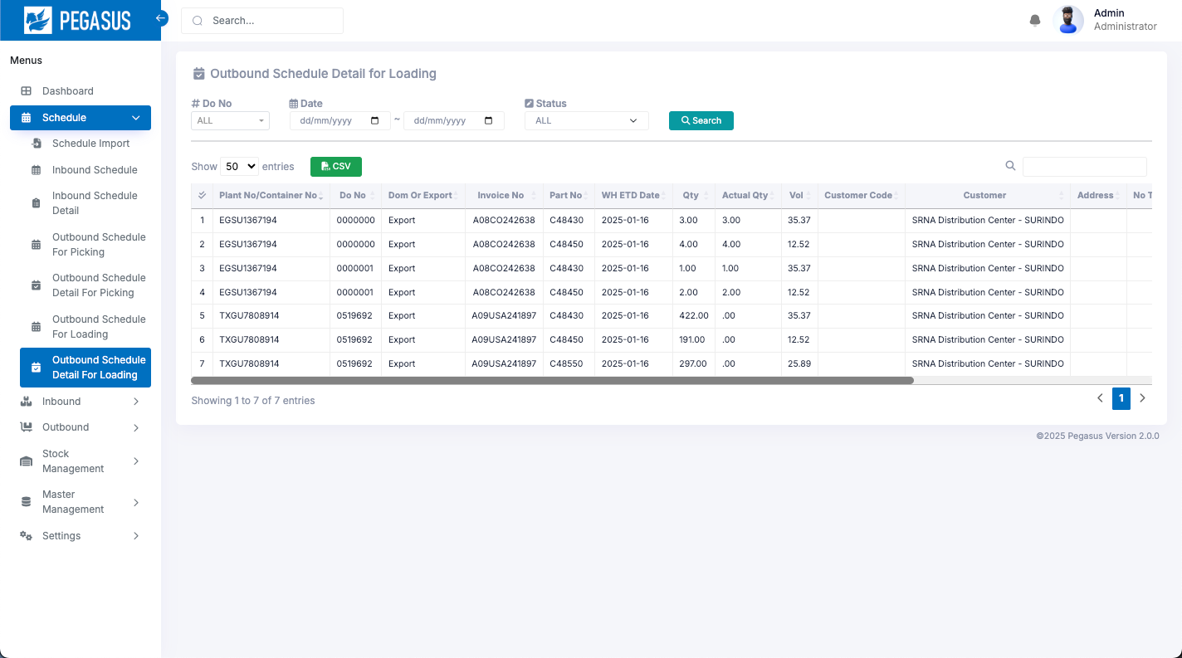
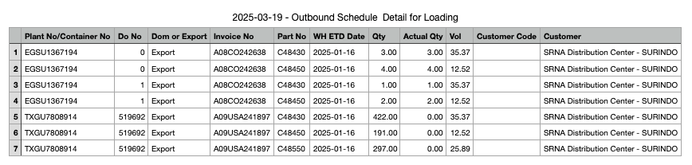
2. Web functions
2-2-8. Outbound Schedule Detail for Loading
View data all Outbound Schedule Detail for Loading
Outbound Schedule Detail for Loading page
When you arrive at this page, Click the “Search” button to search and display the desired information.
Search: A function for searching for information as specified in each option.
CSV Output: Export data as a CSV file.

Slide 23
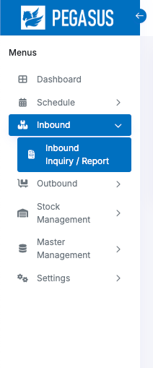
2. Web functions
2-3-1. Menu Inbound
The Inbound menu has 1 submenus
Inbound Inquiry / Report

Slide 24
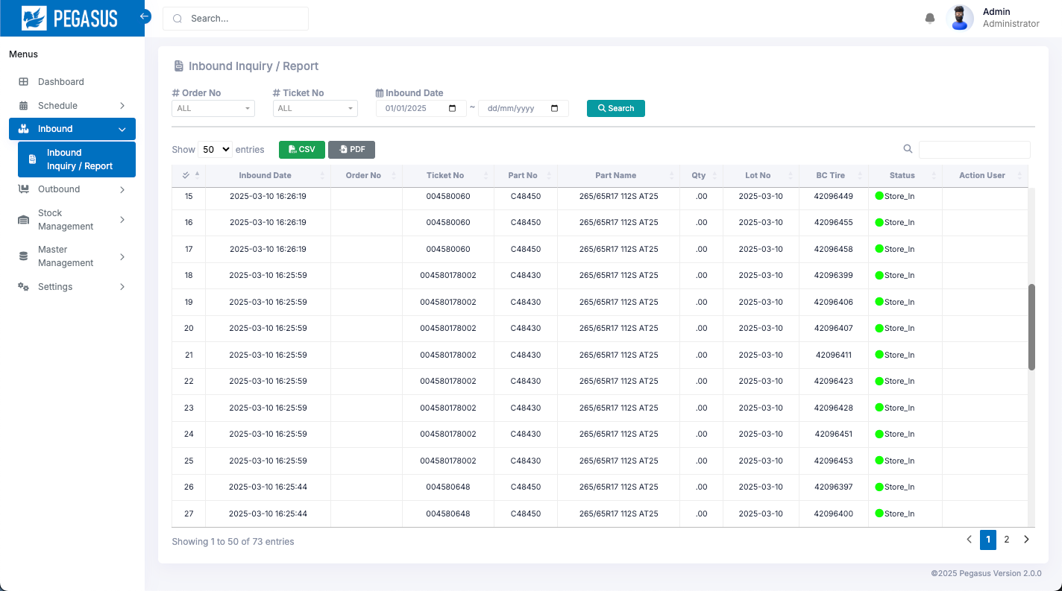


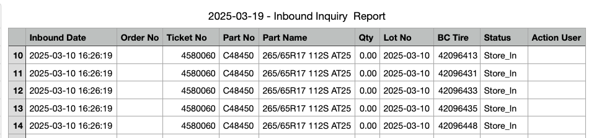
2. Web functions
2-3-2. Inbound Inquiry / Report
View data all Inbound Inquiry / Report
Inbound Inquiry / Report page
When you arrive at this page, Click the “Search” button to search and display the desired information.
Search: A function for searching for information as specified in each option.
CSV Output: Export data as a CSV file, PDF file

Slide 25
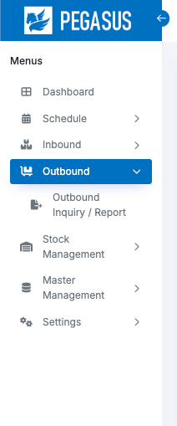
2. Web functions
2-4-1. Menu Outbound
The Outbound menu has 1 submenus
Outbound Inquiry / Report

Slide 26
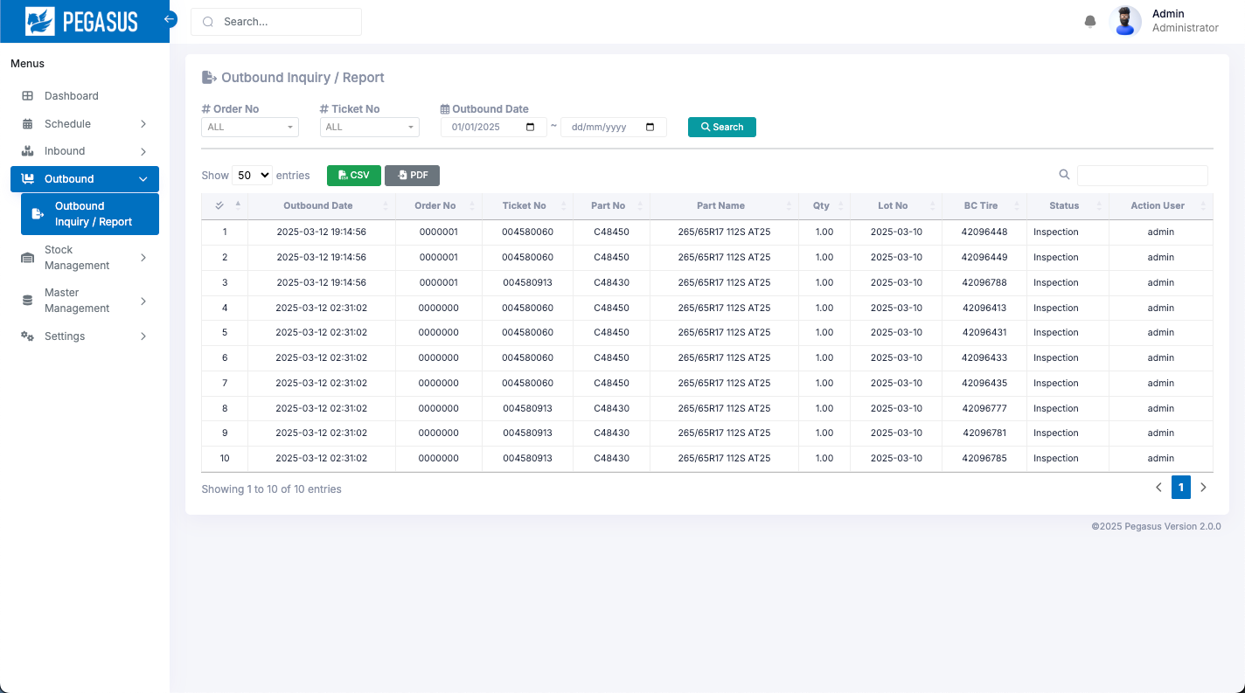
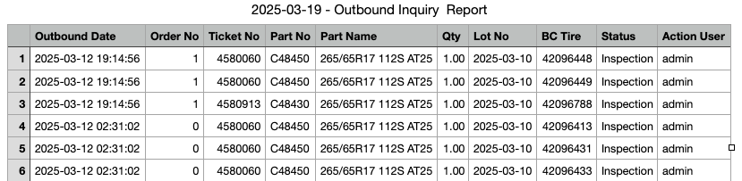
2. Web functions
2-4-2. Outbound Inquiry / Report
View data all Outbound Inquiry / Report
Outbound Inquiry / Report page
When you arrive at this page, Click the “Search” button to search and display the desired information.
Search: A function for searching for information as specified in each option.
CSV Output: Export data as a CSV file, PDF file

Slide 27
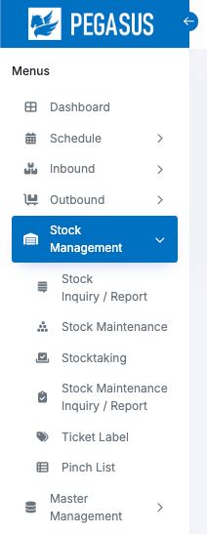
2. Web functions
2-5-1. Menu Stock Management
The Stock Management menu has 6 submenus
Stock Inquiry / Report
Stock Maintenance
Stocktaking
Stock Maintenance Inquiry / Report
Ticket Label
Pinch list

Slide 28
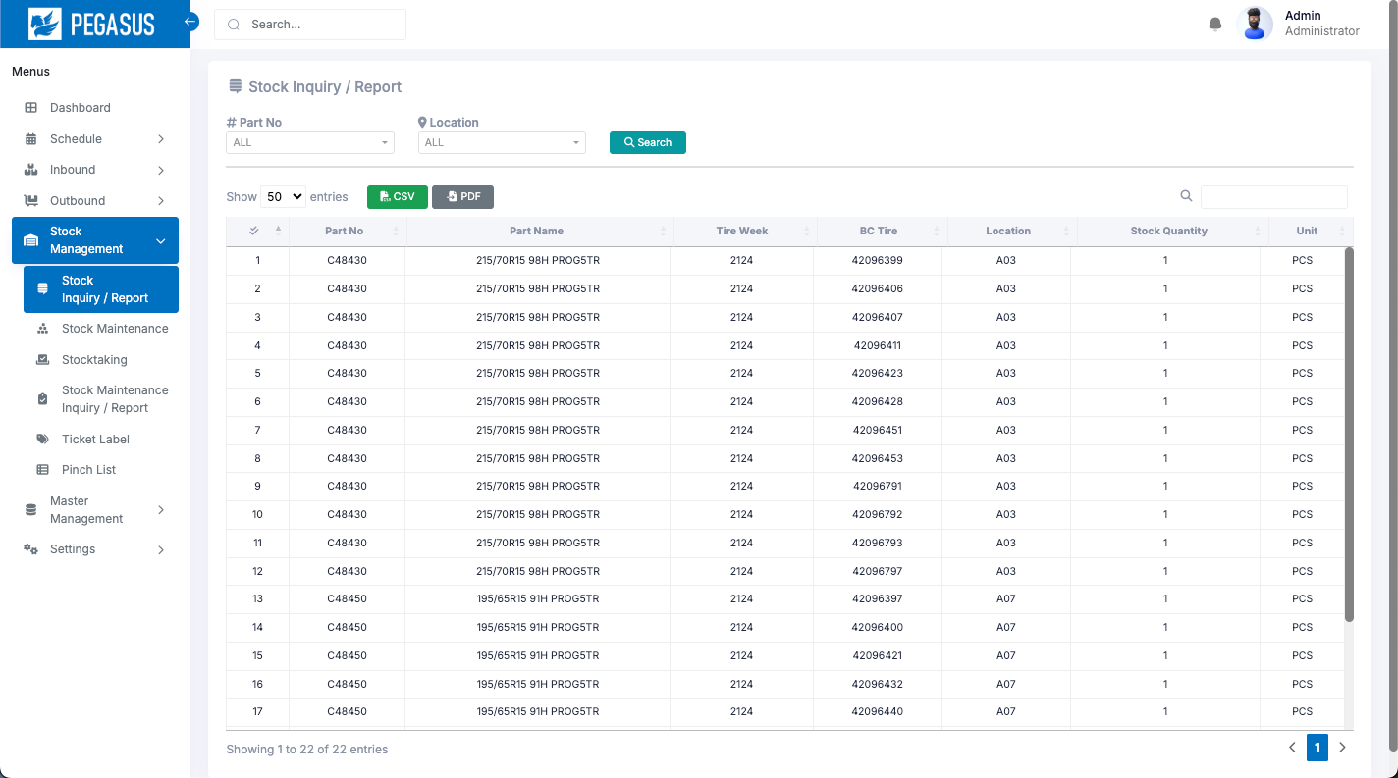

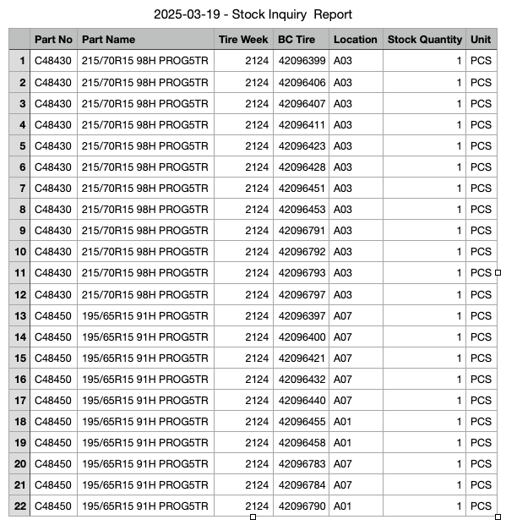
2. Web functions
2-5-2. Stock Inquiry / Report
View data all Stock Inquiry / Report
Stock Inquiry / Report page
When you arrive at this page, Click the “Search” button to search and display the desired information.
Search: A function for searching for information as specified in each option.
CSV Output: Export data as a CSV file, PDF file

Slide 29
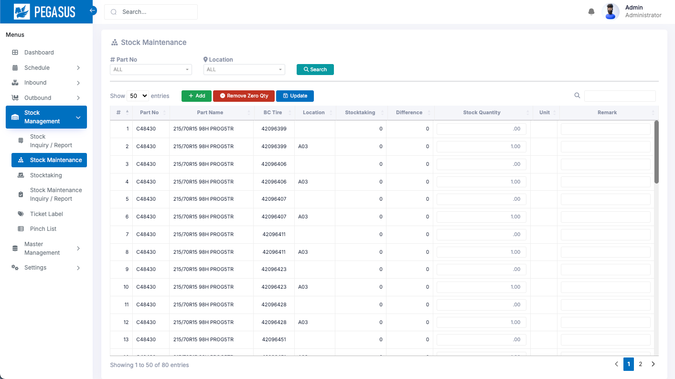
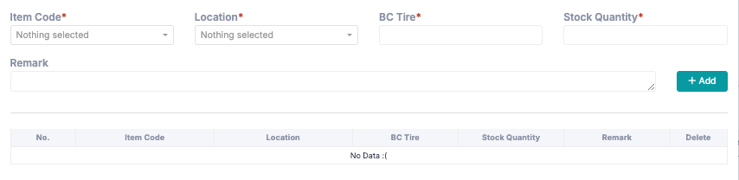
2. Web functions
2-5-3. Stock Maintenance
View data all Stock Maintenance
Stock Maintenance page
When you arrive at this page, Click the “Search” button to search and display the desired information.
Search: A function for searching for information as specified in each option.
Add: Add the item and quantity data into the system

Slide 30
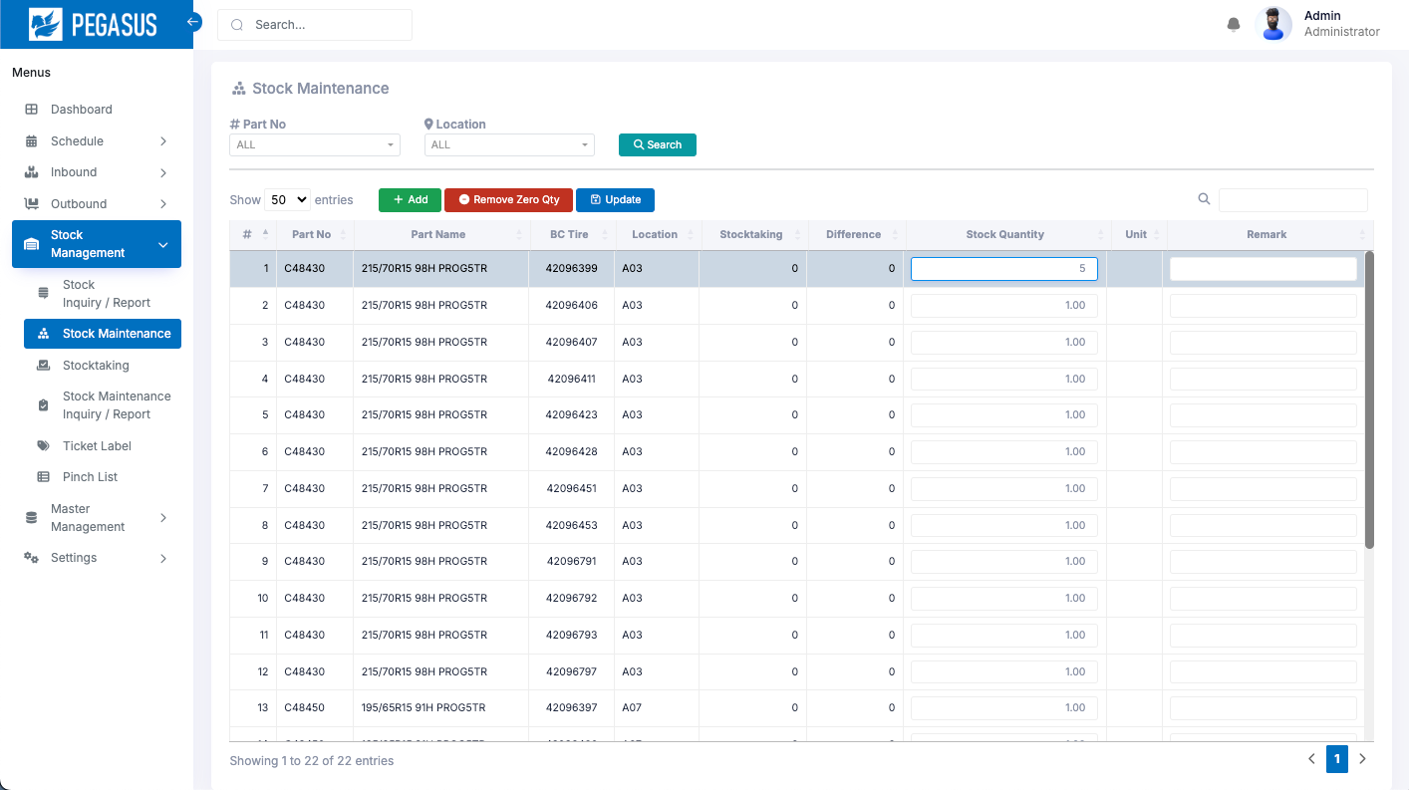
2. Web functions
2-5-3. Stock Maintenance
Remove Zero Qty: This is used to clear data in the stock that has a quantity of 0
Update: This is used to update the quantity of items in stock along with a remark. To update, select the item you want to update, enter the desired quantity and remark, then click "Update."
2
1

Slide 31
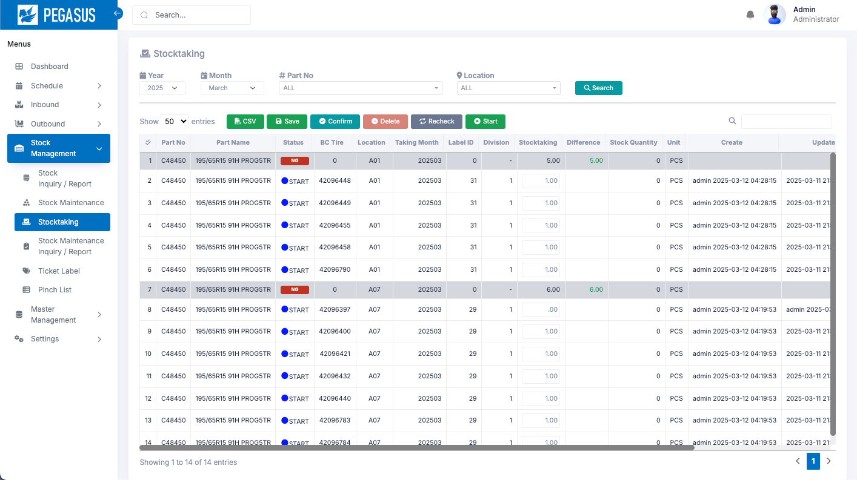
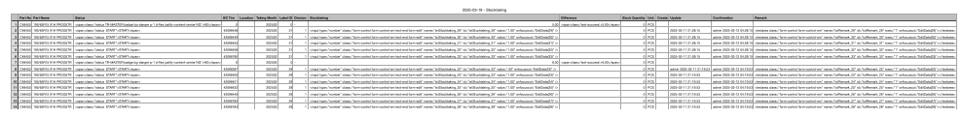
2. Web functions
2-5-4. Stocktaking
View data all Stocktaking
Stocktaking page
When you arrive at this page, Click the “Search” button to search and display the desired information.
Search: A function for searching for information as specified in each option.
CSV Output: Export data as a CSV file.
It will export data from the current page.

Slide 32
2. Web functions
2-5-4. Stocktaking
Start: A function for Start counting the stock of that month according to the month the information was searched.
If after pressing search for the month in which data is searched, there is no data in the table, it means that the month has not yet started counting stock.
Save: This is used to record the stock count of that particular item.
Confirm: This is used to record the "Confirm" status for that particular item to notify the HT equipment.
Delete: This is used to remove the item from the stock count.
Recheck: This is used to update the status to "Recheck" to notify HT and initiate a stock count for that item again.

Slide 33
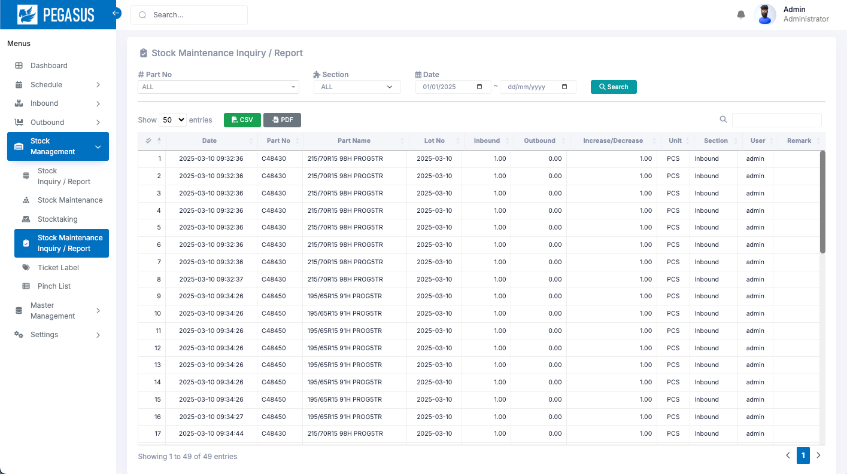
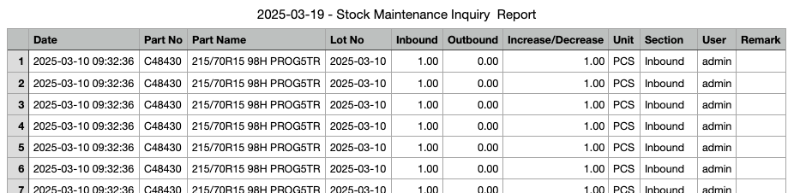
2. Web functions
2-5-5. Stock Maintenance Inquiry / Report
View data all Stock Maintenance Inquiry / Report
Stock Maintenance Inquiry / Report page
When you arrive at this page, Click the “Search” button to search and display the desired information.
Search: A function for searching for information as specified in each option.
CSV Output: Export data as a CSV file, PDF file

Slide 34
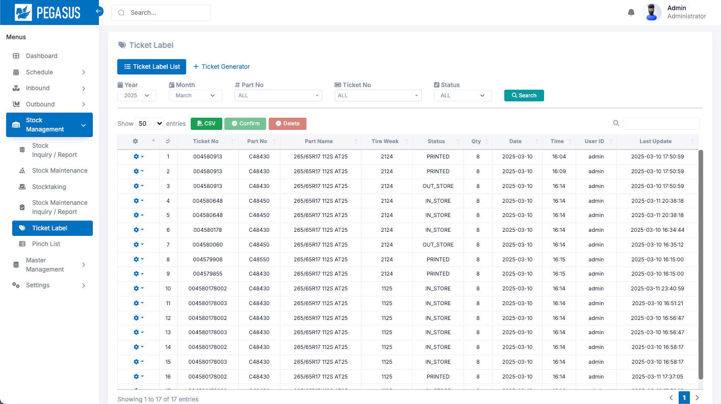
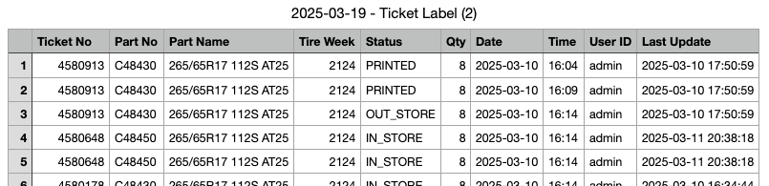
2. Web functions
2-5-6. Ticket Label
View data all Ticket Label
Ticket Label page
When you arrive at this page, Click the “Search” button to search and display the desired information.
Search: A function for searching for information as specified in each option.
CSV Output: Export data as a CSV file, PDF file

Slide 35
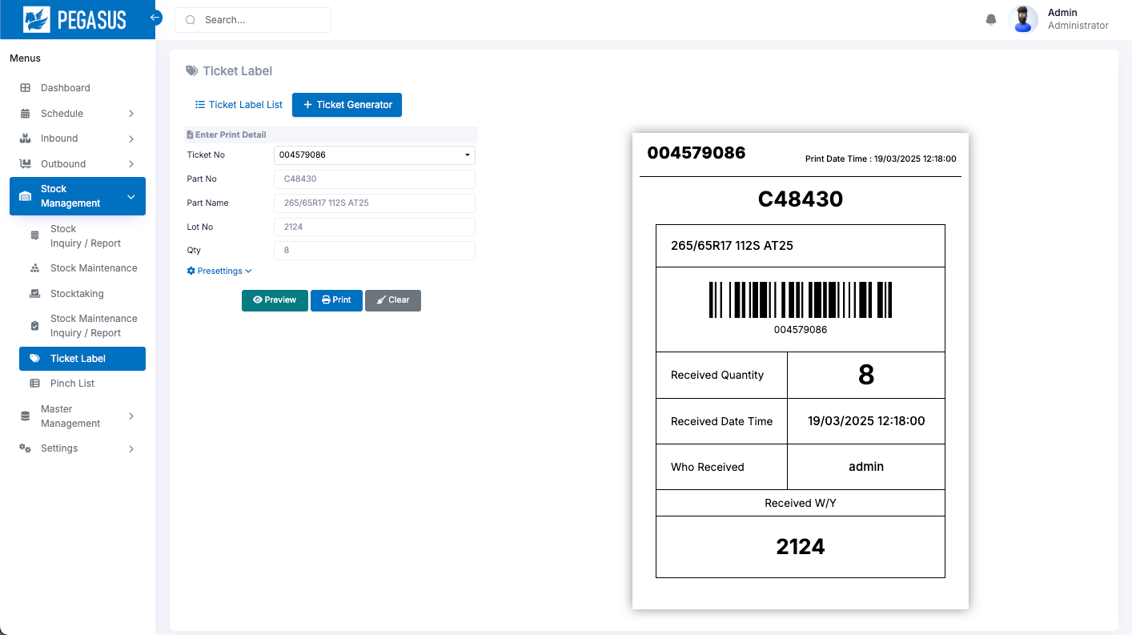
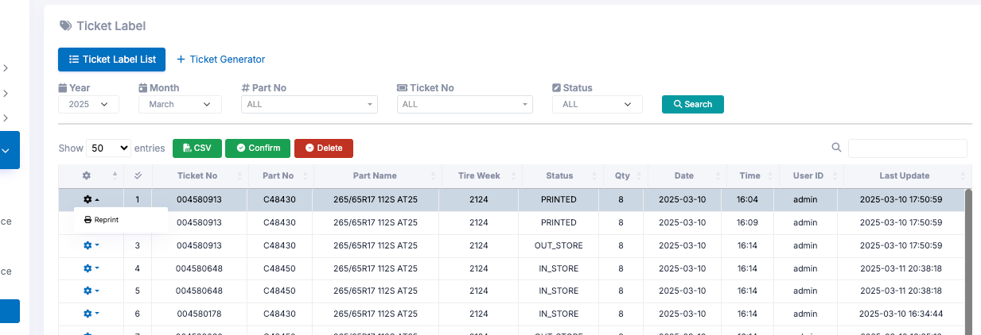
2. Web functions
2-5-6. Ticket Label
Ticket Generator: This is used to generate a ticket label for both Inbound and Outbound processes
1
2
3
To generate the ticket, select the desired Ticket No and then click the "Preview" button followed by the "Print" button in sequence.
If you lose a ticket during operation, you can also come here to reprint the label.

Slide 36



2. Web functions
2-5-7. Pinch list
View data all Pinch list This is the page that displays the list of Inbound and Outbound quantities that do not match the plan.
Pinch list page
When you arrive at this page, Click the “Search” button to search and display the desired information.
Search: A function for searching for information as specified in each option.
CSV Output: Export data as a CSV file, PDF file

Slide 37

2. Web functions
2.6-1. Add User
Add new User to system
Master data related to adding User data has 3 parts
  Authority Master
  User Credential
  User Master
Authority
User Credential
User Master
2-6-2. Authority Master
View data all Authority
Authority Master page
Authority Master can export all data to CSV file and can add data by importing CSV file as well.

Slide 38


2. Web functions
2-6-2. Authority Master
When you arrive at this page, Click the “Search” button to search and display the desired information.
Search: A function for searching for information as specified in each option.
Create: A function for add new Authority
Delete: A function for delete authority

Slide 39



2. Web functions
2-6-3. User Master
View data all User Master
User Master page
When you arrive at this page, Click the “Search” button to search and display the desired information.
Search: A function for searching for information as specified in each option.
CSV Output: Export data as a CSV file

Slide 40

2. Web functions
2-6-3. User Master
Create: A function for add new User
Delete: A function for delete User

Slide 41


2. Web functions
2-6-4. User Credential
View data all User Credential
User Credential page
When you arrive at this page, Click the “Search” button to search and display the desired information.
Search: A function for searching for information as specified in each option.
CSV Output: Export data as a CSV file

Slide 42

2. Web functions
2-6-4. User Credential
Create: A function for add new User
Delete: A function for delete User Credential

Slide 43
4. Q&A
# | Date | Question | By | Date | Answer | By
1
2
3
4
5

Slide 44
5. Contact information
The contents of this specification and manual are subject to change without notice. Copying or copying part or all of the manual without the written permission of TOMAS TECH is prohibited, regardless of its form.
If you have any questions, concerns, or questions regarding the specifications of this system and the contents of the manual, please contact us by phone or e-mail. Tel: +66 (0) 2 336 0574 E-mail: info@tomastc.com
Item | Description
1. Service time | 8 hours x 5 days (8:00 -17:00 Monday to Friday)
2. Onsite Hardware Maintenance | -
3. Onsite System Maintenance | -
4. Response after receive a call | On-line support within 24 hours / On-site support within 48 hours
5. Remote service | Yes
6. Phone service | Yes
7. Email service | Yes

