Slide 1
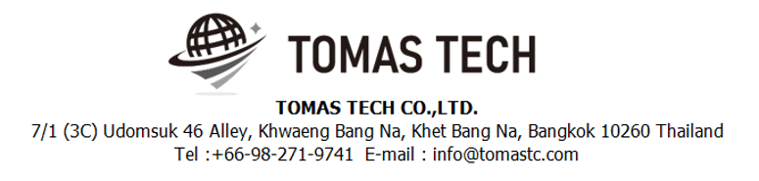
Version 03/Feb/2024
Confidential
Pegasus Web Stock Management System
Manual Document
Documentation EN for MAST
R1
Made for: Minebea AccessSolutions Thai Ltd.
By: TOMAS TECH CO.,LTD.

Slide 2

Introduction
This manual explains each handy terminal, how to set it up with a PC, how to check the operation, and how to communicate with a PC.
Please read before starting work.
For safe use of this device
To use this device correctly and safely, be sure to observe the following safety precautions when operating this device. TOMAS TECH cannot be held responsible or warranted for any damage caused by using the product in violation of these precautions.
◆How to read the symbols
In this manual, the items to be observed in order to use the device safely are classified as follows.
Danger
If you ignore the information on this label and handle it incorrectly, there is a risk of death or serious injury.
Warning
This indicates the contents that may cause injury if the contents of this display are ignored and the product is handled improperly.
Caution
It indicates that property damage may occur if the product is handled improperly, ignoring the contents of this display.
The symbol represents a "caution" that it should be aware of.
The symbol represents an "instruction" that it must execute.
The symbol represents a "prohibition" that must not be done.
The symbols represent the "information" needed to deepen your understanding of this book.
The symbol represents "prohibited handling" by anyone other than a service person.
The symbol indicates that grounding is required during installation.
Reference
Indicates chapters to refer to and other manual references.

Slide 3
For safe use
◆General caution
In the unlikely event that this device breaks down, take sufficient safety measures to prevent various damages before use.
Please note that we cannot guarantee the function and performance of products that are used or modified outside the specifications shown in the specifications.
Do not disassemble this device unnecessarily. There is a risk of failure or damage.
Do not allow the device to get wet with water. It may lead to damage to this device.
Please use within the environmental conditions of this device. In addition, even within environmental conditions, equipment may be damaged in an environment where condensation forms due to sudden temperature changes.
Do not drop the device or hit it with strong force. Also, if the wiring from this device is likely to be subject to excessive impact, consider how to protect the wiring. It may lead to damage to this device and other devices.
Do not operate the device in a place with flammable or explosive gas or vapor. It is very dangerous to use this device in such an environment.
When using this device in combination with other devices, the functions and performance may not be satisfactory depending on the usage conditions and environment, so please consider carefully before using.
Caution
◆For proper use
When installing this device, turn off the power of the device. Do not short-circuit each wiring or terminal.
When installing this device, be sure to perform protective grounding to prevent electric shock.
Be sure to check that the power supply voltage of the device matches the voltage of the power supply before turning on the device.
Only our customer service or equivalent handlers should install this equipment.
To supply power to this device, connect it via a protection circuit such as a switchboard breaker or an earth leakage breaker.
Since this device is an electronic device, when installing various devices, investigate the installation environment (primary power supply system noise, drive device system noise, electrostatic discharge noise, etc.) and take countermeasures. It may cause system malfunction or damage to various devices.
Caution

Slide 4
Revision History
Date | Version | File name | Details
03/Feb/2024 | R1 | Pegasus Web Stock Management System Manual Document Documentation EN for MAST | First edition

Slide 5
■Contents
1. Overview
2. Overall configuration diagram
2-1-1. Login screen
2-2-1. Settings mode
2-2-2. Settings Information
2-3-1. Main menu
2-4-1. Inbound menu
2.4-2. Schedule Label
2.4.3. Schedule Label [ Label Detail Screen ]
2.4.4. Label Manual Menu
2.4.5. Label Manual
2.4.6. Relabeling
2.4.7. Schedule Inbound
2.4.8. Schedule Inbound [ Inbound Detail Screen ]
2.4.9. Inbound Manual
2.4.10. QC Menu
2.4.11. QC Schedule
2.4.12. QC Check Manual
2.4.13. Photo matching
2-5-1. Outbound menu
2-5-2. Outbound Schedule [ Work Outbound & Production Outbound ]
2-5-3. Outbound Manual
2-6-1. Stock management Menu
2-6-2. Stock Check
2-6-3. Stocktaking
2-6-4. Change Location
2-7-1. Printer Setting
3. Configuration file storage
4. Q&A
5. Contact information

Slide 6
1. Overview
We propose a stock management system to Minebea AccessSolutions Thai Ltd.. In the current operation, we aim to improve work efficiency and work accuracy by replacing the work managed by paper and whiteboard with a system. The expected effects of introducing an inventory management system are as follows.
1. Work efficiency and work accuracy can be improved by supporting work at the handy terminal at the time of warehousing and warehousing. In addition, the inventory status can be grasped in real time.
2. By managing the product location, the location can be used effectively. In addition, it is possible to thoroughly implement the FIFO.
3. By managing the ordering points, it is possible to eliminate excess inventory and out of stock.
4. By managing the materials and goods tracking, it is able to trace back to find material lot numbers, suppliers, and processes when found problematic products.

Slide 7
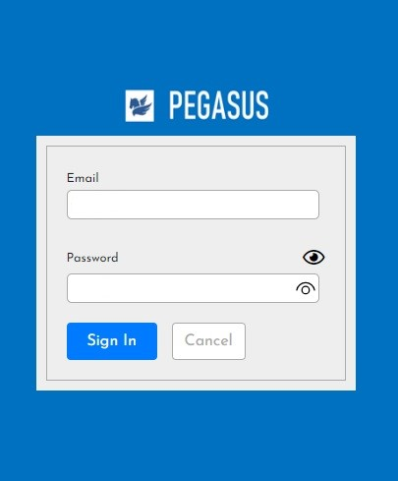
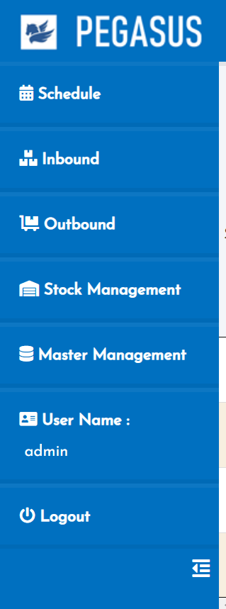
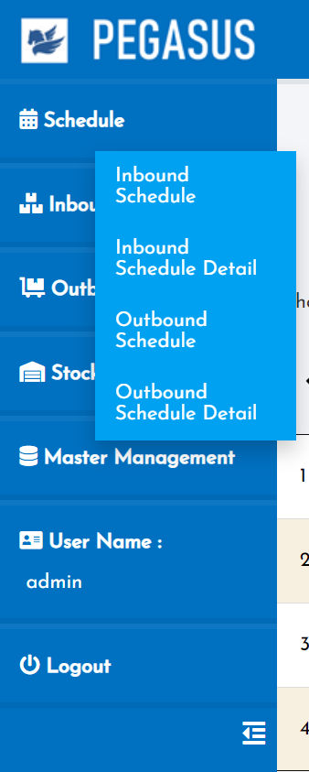
2. Handheld functions
2-1-1. Login screen
1. Open the browser of the website below on your PC to access
the link to use on the Cloud.
URL : https://tom-demo-01.proen.app.ruk-com.cloud/acme/pegasus/
2. Enter Username and Password.
3. Click Sing In
4. Once logged in successfully You will find a menu on the left-hand side of the system. which will have the main menu and various submenus
Main menu
Sub menu

Slide 8
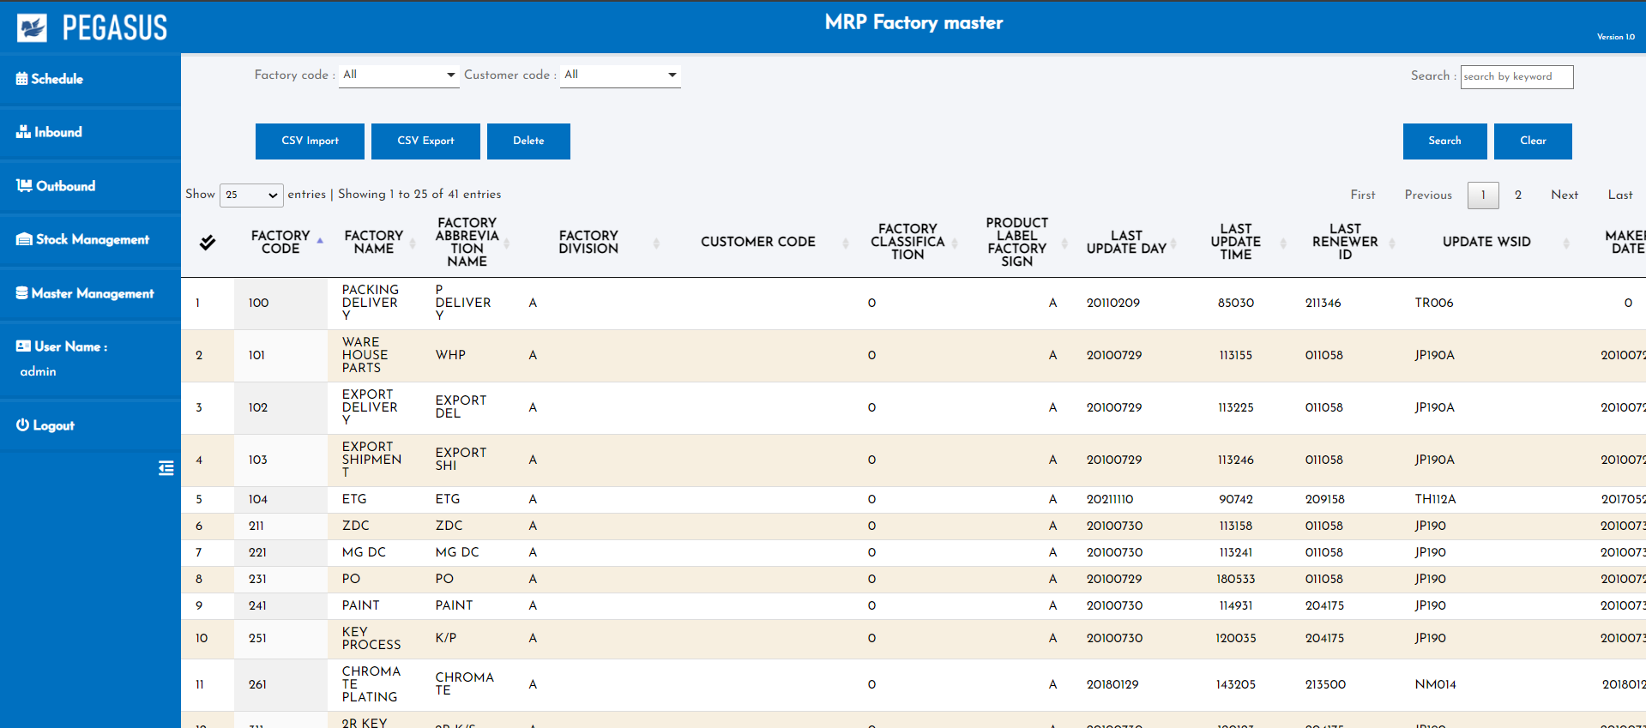
2. Handheld functions
2-1-2. Home Page
Once logged in successfully You will find a menu on the left-hand side of the system. which will have the main menu and various submenus
Home page after this will be logged in
Main menu
Sub menu

Slide 9
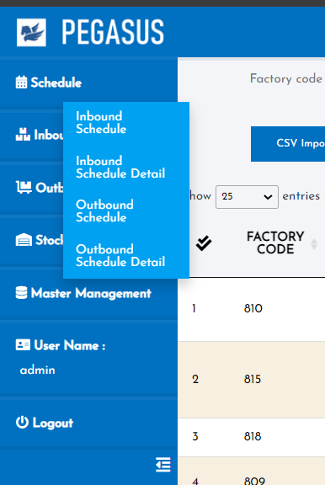
2. Handheld functions
2-1-3. Menu Schedule
The Schedule menu has 4 submenus
- Inbound Schedule.
- Inbound Schedule Detail.
- Outbound Schedule
- Outbound Schedule Detail

Slide 10
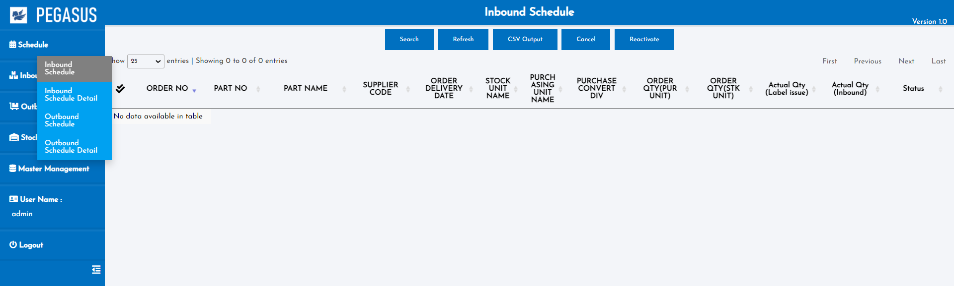

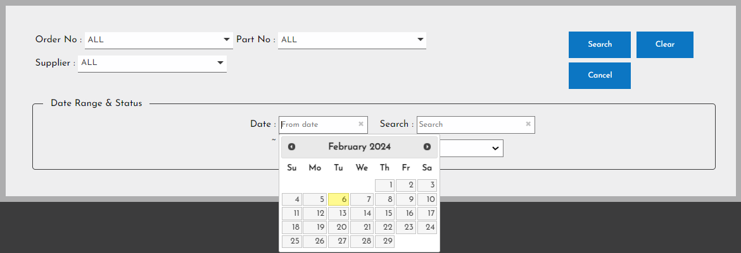
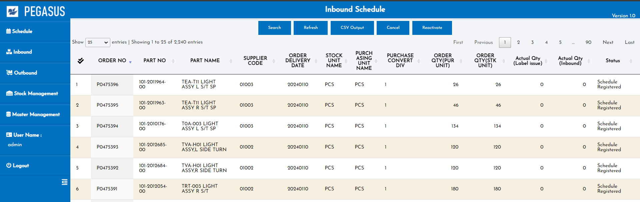
2. Handheld functions
2-2-1. Inbound Schedule
View data and manage all Inbound Schedule
Inbound Schedule page
When you arrive at this page, Click the “Search” button to search and display the desired information.
• Search: A function for searching for information as specified in each option.

Slide 11
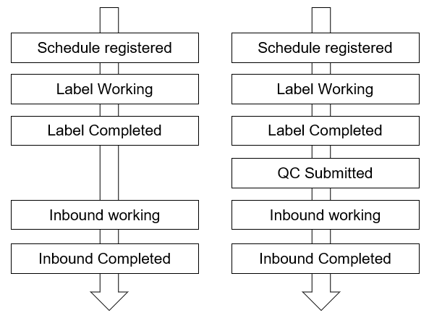
2. Handheld functions
2-2-1. Inbound Schedule
Inbound Schedule page
Status management :
Cancel

Slide 12
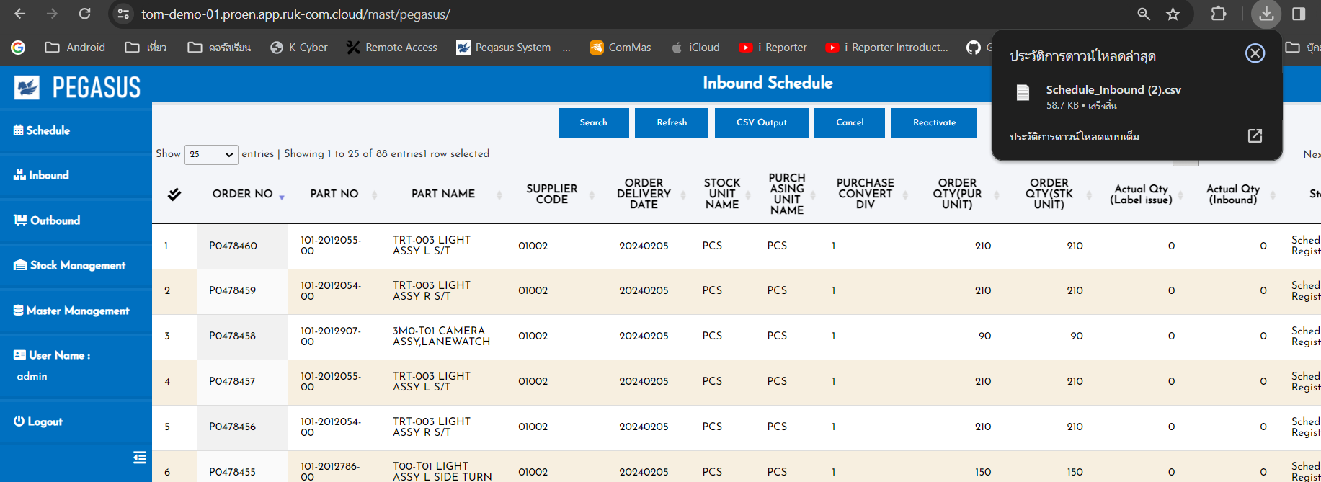
2. Handheld functions
2-2-1. Inbound Schedule
• Refresh: To refresh the information on this page to the latest information.
• CSV Output: Export data as a CSV file.
It will export data from the current page.

Slide 13
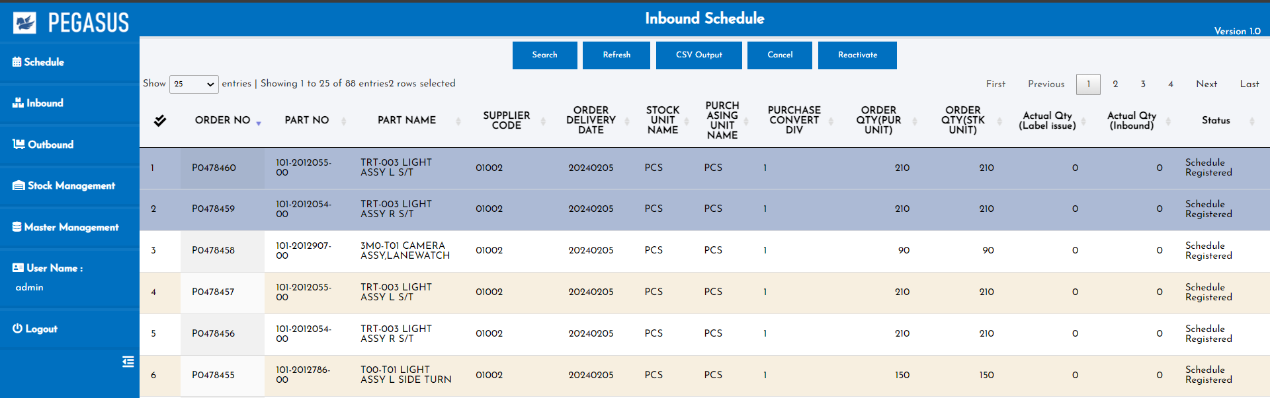
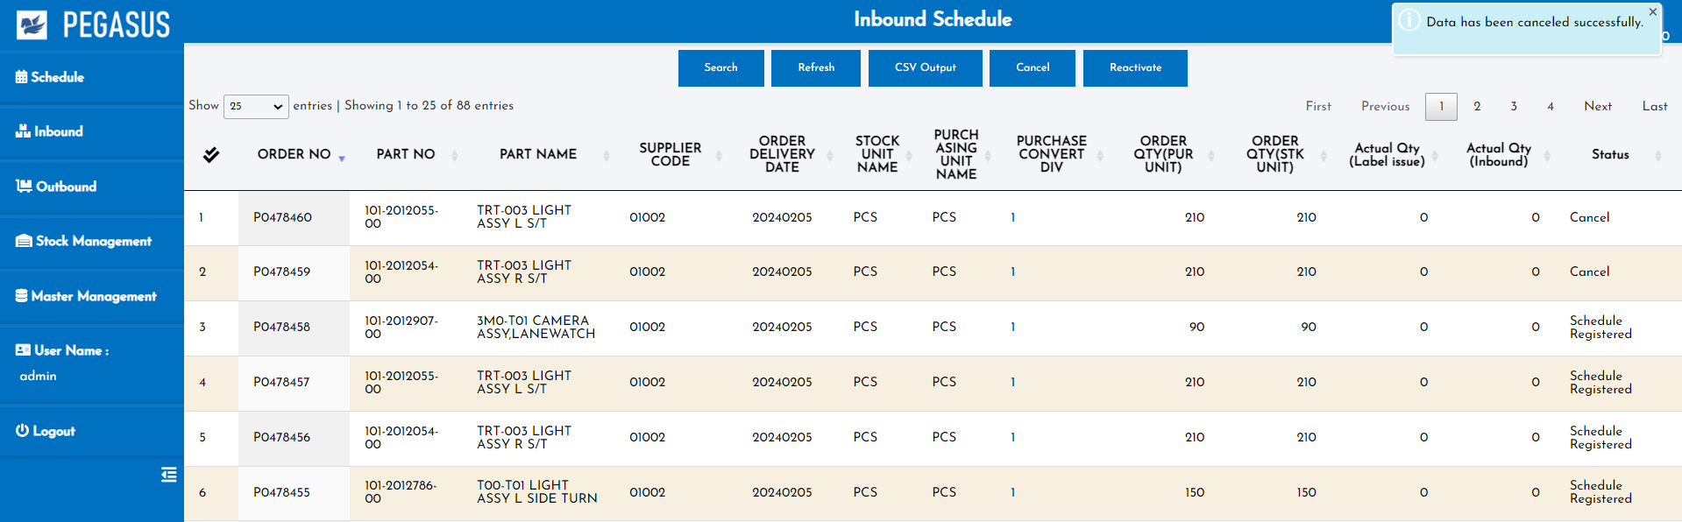
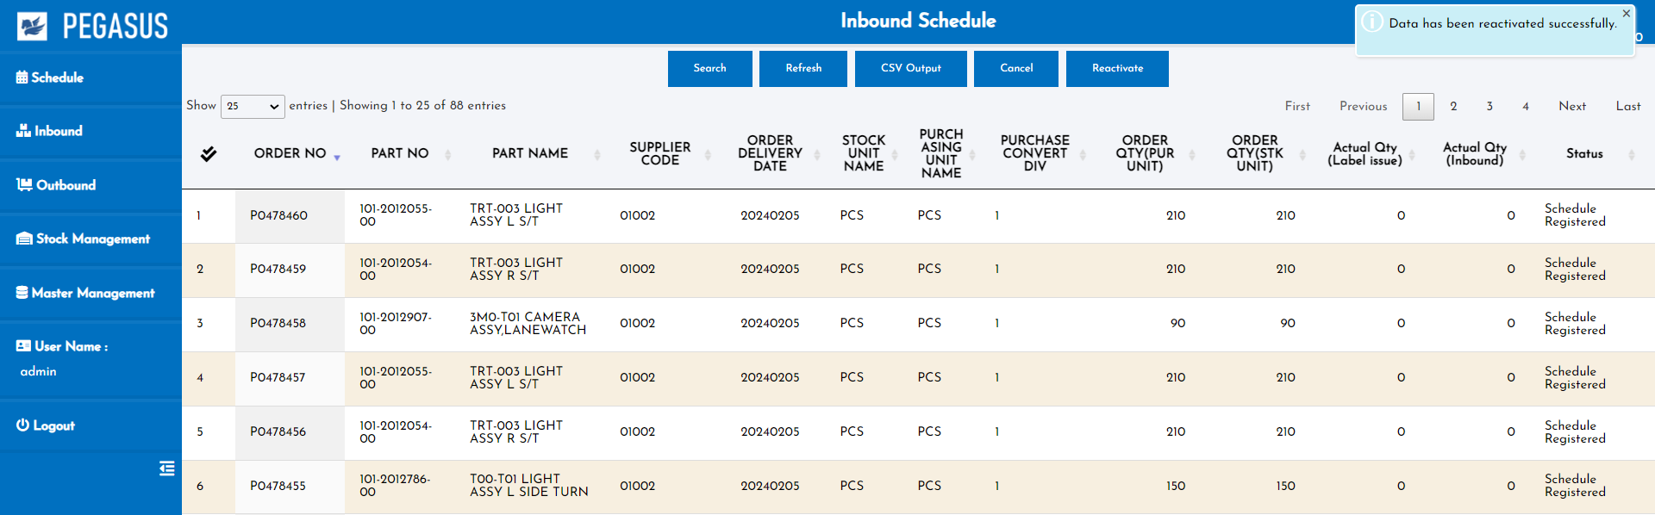
2. Handheld functions
2-2-1. Inbound Schedule
• Cancel: Select an item from the row below. and click “cancel”
to change the status to cancel.
*can change status only: Schedule Registered.
• Reactivate: Select an item from the row below. and click “Reactivate”
to change the cancel status to reactivate status .

Slide 14
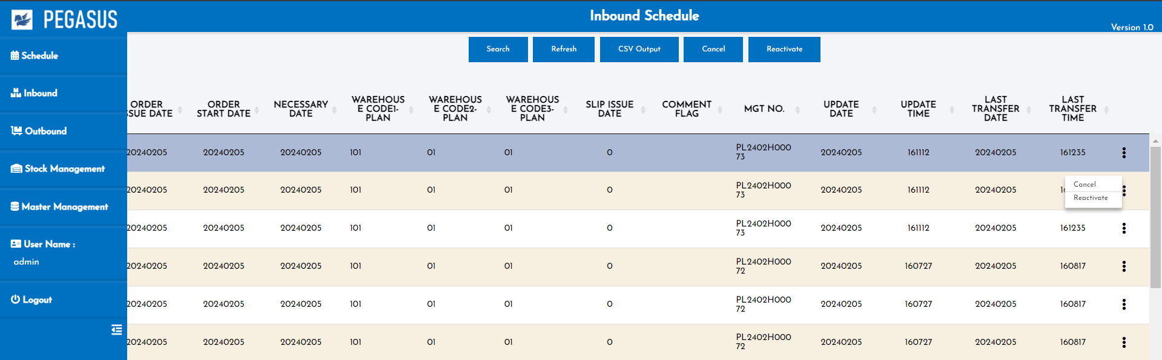
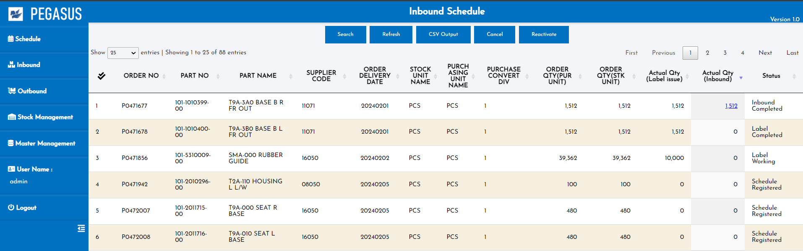
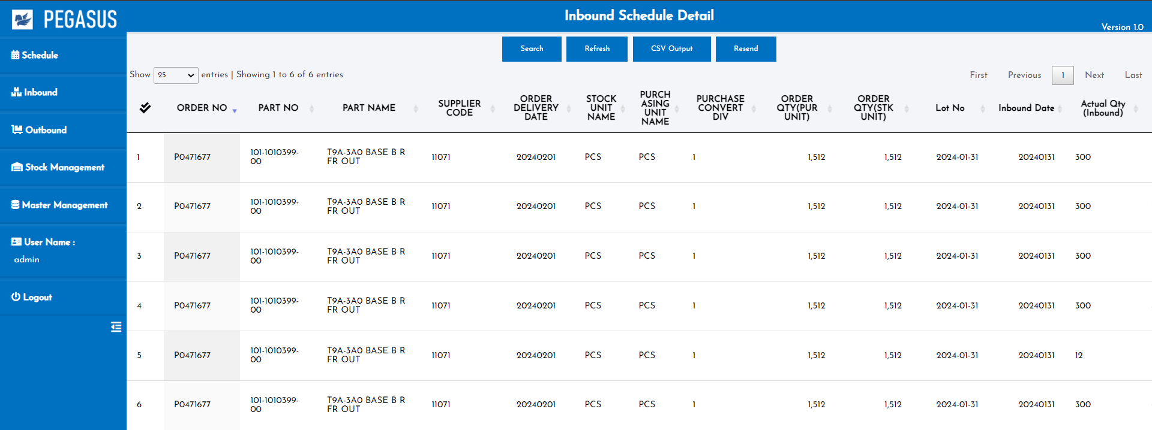
2. Handheld functions
2-2-1. Inbound Schedule
*Status can be changed from the menu symbol. on the back of each item.
If the actual quantity is included, it will be possible to jump to the “Inbound schedule detail” screen.
If there is a quantity, please add a link. If the quantity is not included, do not link.
“Inbound detail schedule” narrows down the conditions by order number and part no.
If actual results are included, Actual Qty can be checked.
Inbound Schedule Detail page

Slide 15
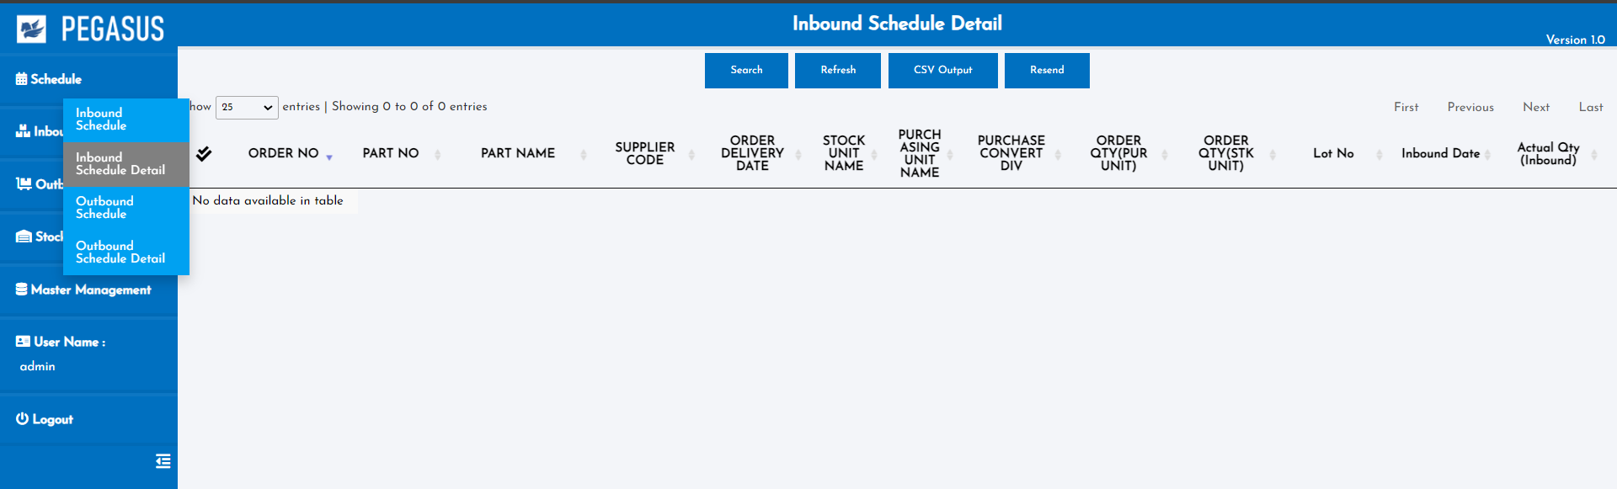
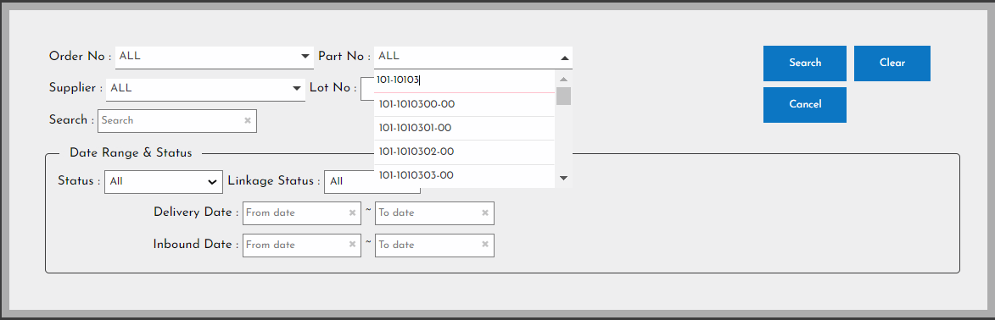
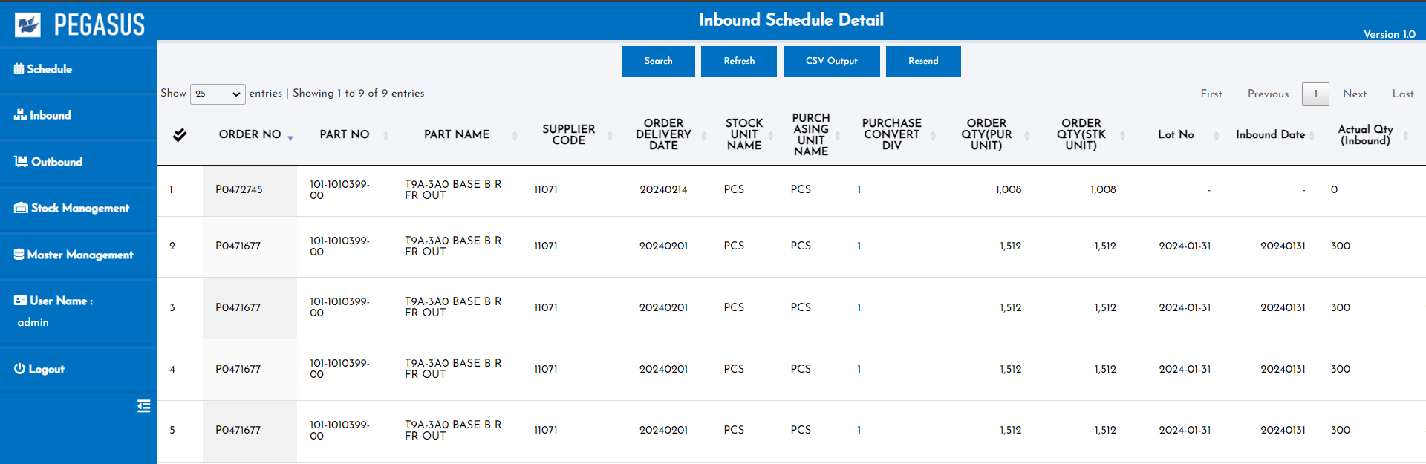
2. Handheld functions
2-2-2. Inbound Schedule Detail
View data all Inbound Schedule Detail
Inbound Schedule Detail page
When you arrive at this page, Click the “Search” button to search and display the desired information.
• Search: A function for searching for information as specified in each option.

Slide 16
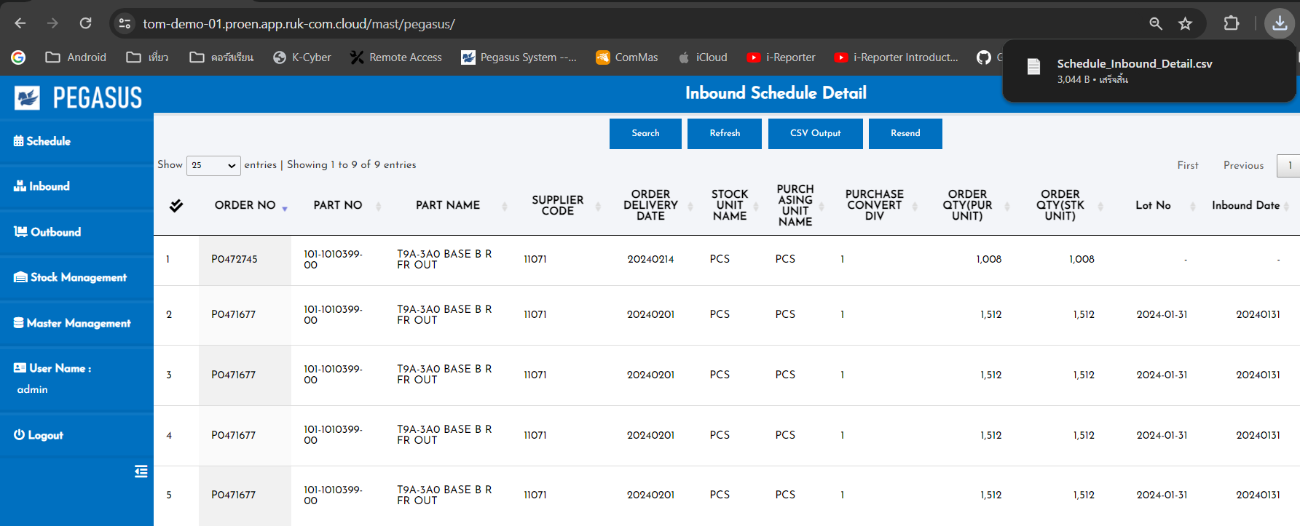
2. Handheld functions
2-2-2. Inbound Schedule Detail
• Refresh: To refresh the information on this page to the latest information.
• CSV Output: Export data as a CSV file.
It will export data from the current page.

Slide 17
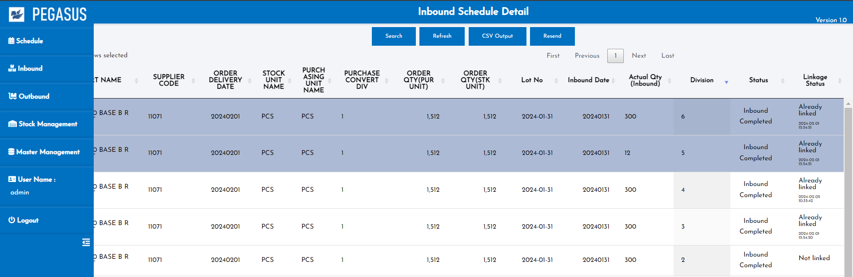
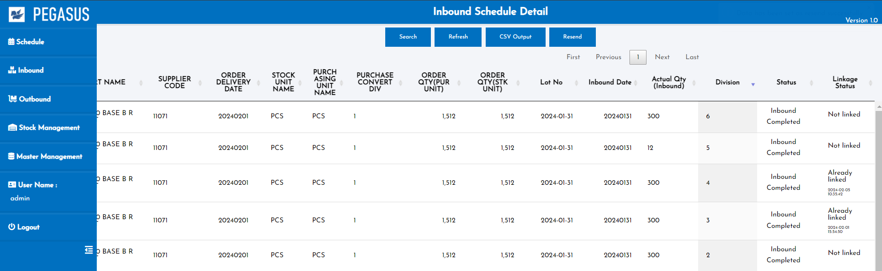
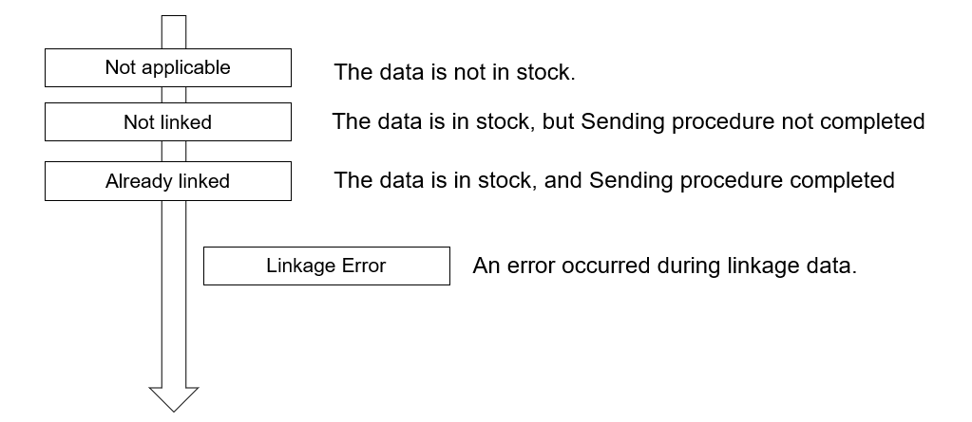
2. Handheld functions
2-2-2. Inbound Schedule Detail
• Resend: If "Linkage Error" occurs in the status, it is possible to create
and resend the CSV again.
Status management :

Slide 18
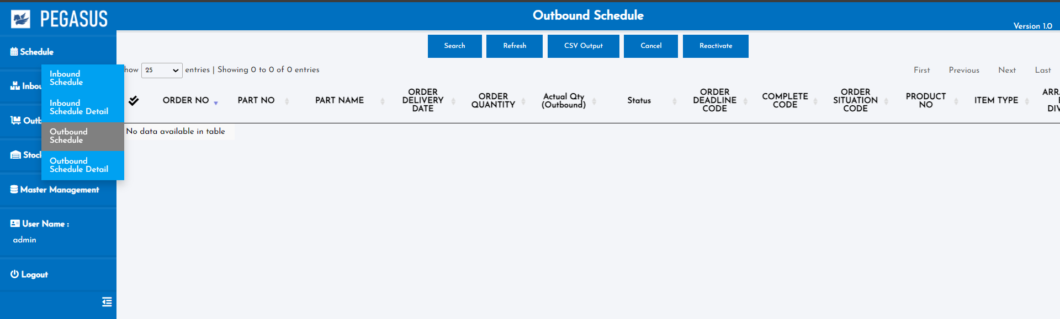
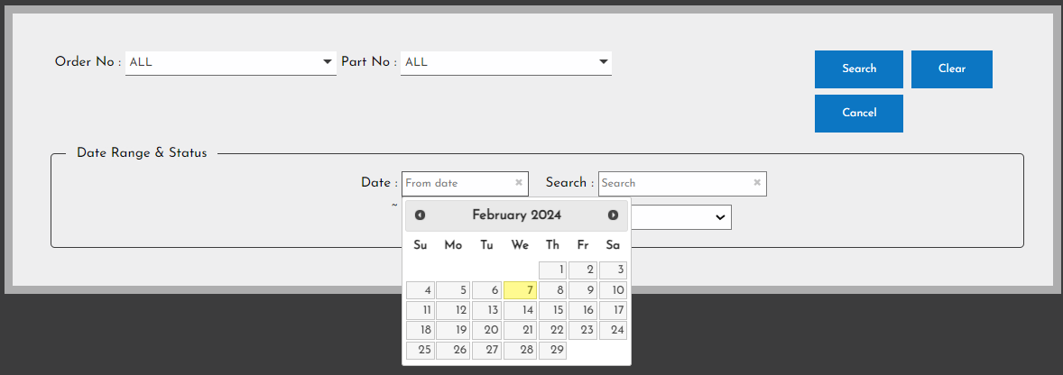
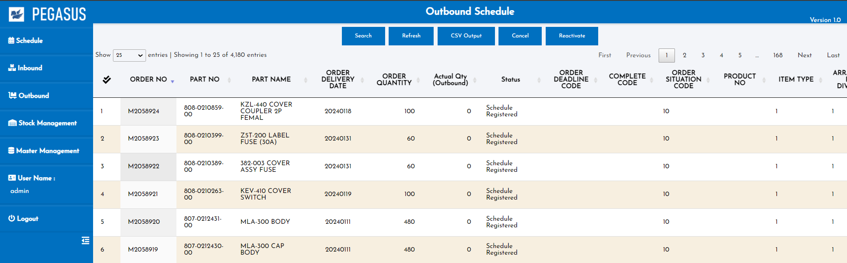
2. Handheld functions
2-2-3. Outbound Schedule
View data and manage all Outbound Schedule
Outbound Schedule page
When you arrive at this page, Click the “Search” button to search and display the desired information.
• Search: A function for searching for information as specified in each option.

Slide 19
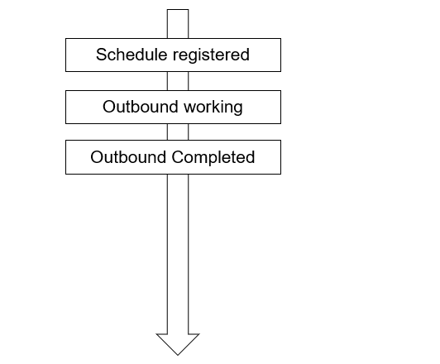
2. Handheld functions
2-2-3. Outbound Schedule
Outbound Schedule page
Status management :
Cancel

Slide 20
2. Handheld functions
2-2-3. Outbound Schedule
• Refresh: To refresh the information on this page to the latest information.
• CSV Output: Export data as a CSV file.
It will export data from the current page.

Slide 21
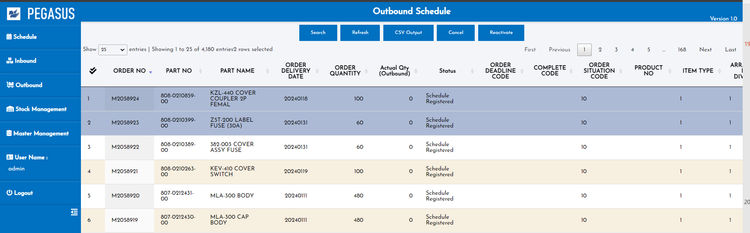
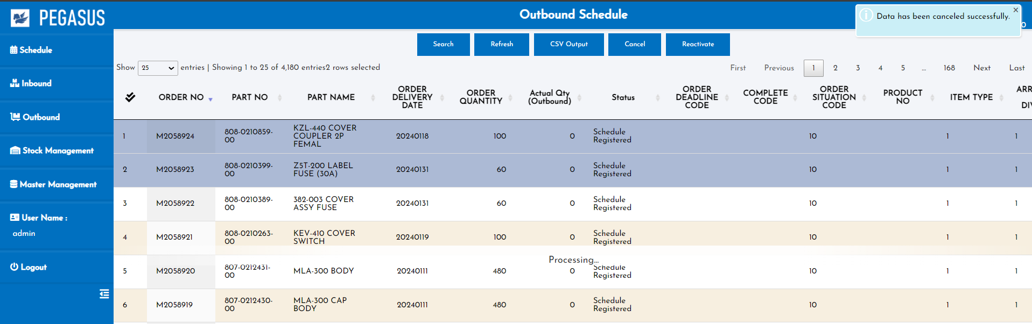
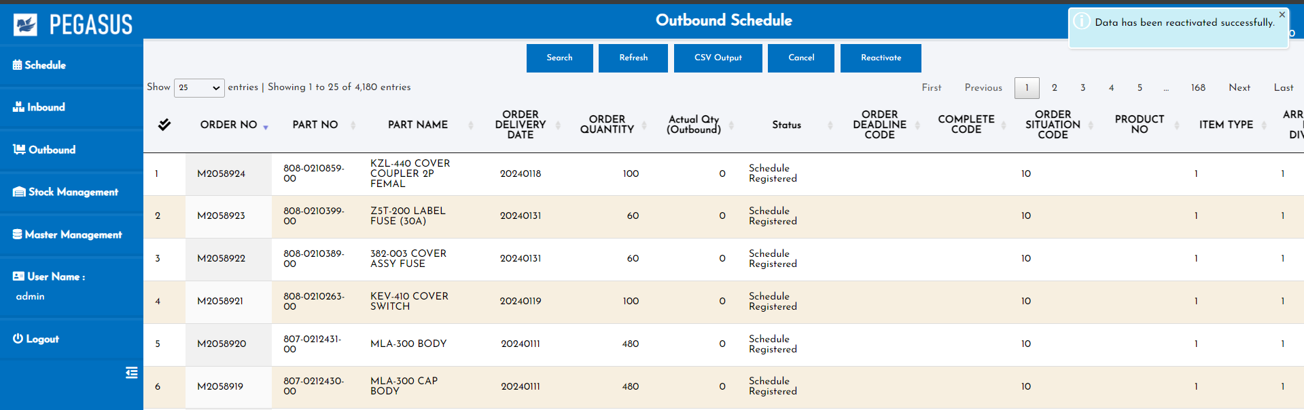
2. Handheld functions
2-2-3. Outbound Schedule
• Cancel: Select an item from the row below. and click “cancel”
to change the status to cancel.
*can change status only: Schedule Registered.
• Reactivate: Select an item from the row below. and click “Reactivate”
to change the cancel status to reactivate status .

Slide 22
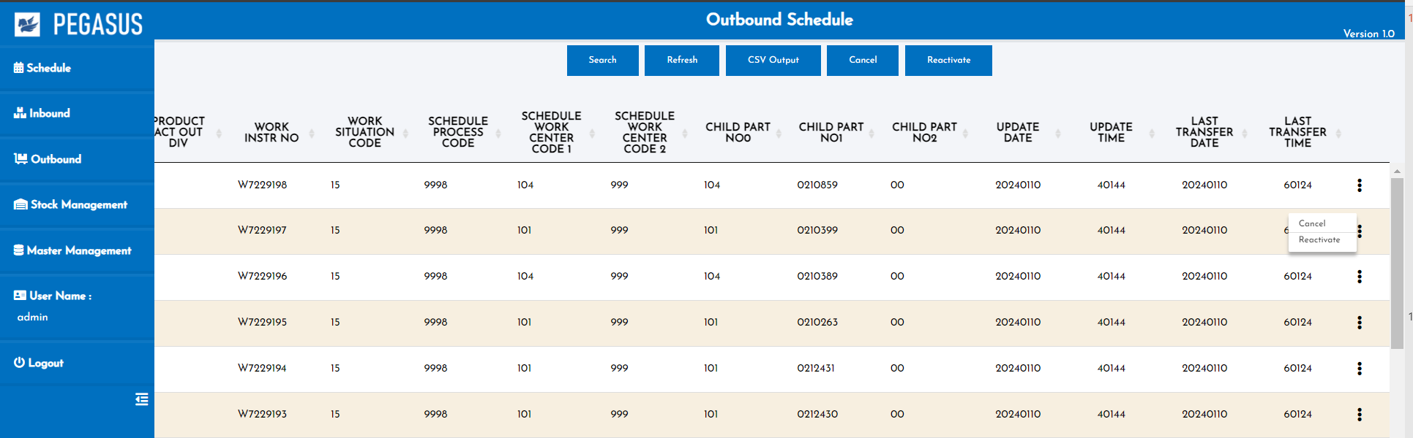
2. Handheld functions
2-2-3. Outbound Schedule
*Status can be changed from the menu symbol. on the back of each item.
If the actual quantity is included, it will be possible to jump to the “Inbound schedule detail” screen.
If there is a quantity, please add a link. If the quantity is not included, do not link.
“Inbound detail schedule” narrows down the conditions by order number and part no.
If actual results are included, Actual Qty can be checked.
Inbound Schedule Detail page

Slide 23
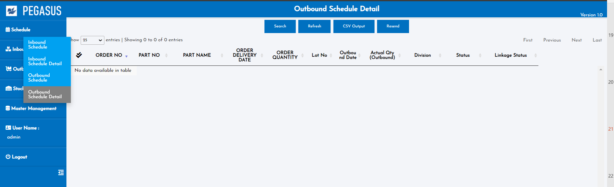
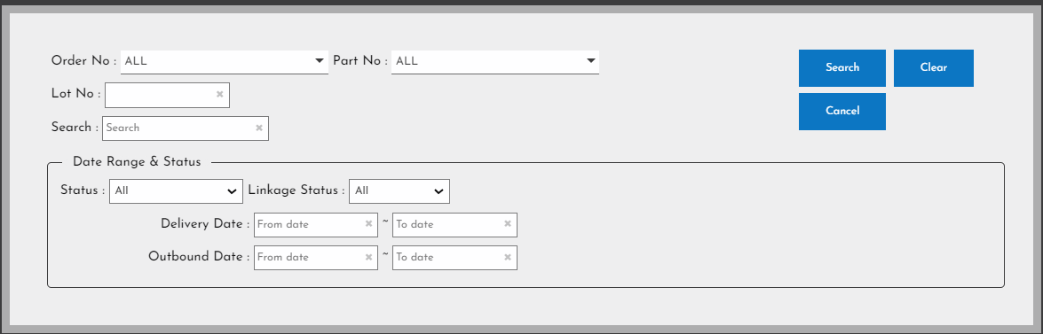
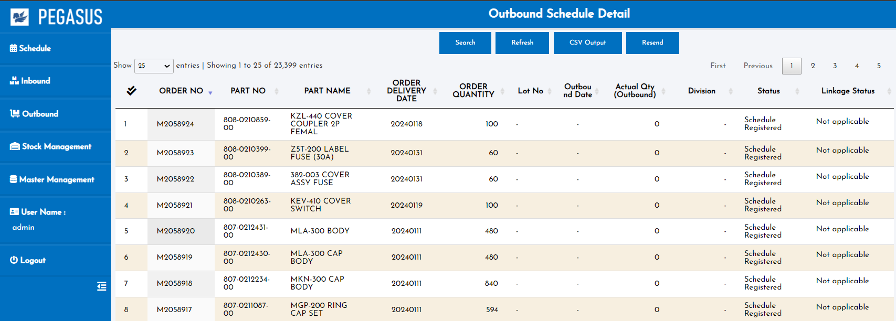
2. Handheld functions
2-2-4. Outbound Schedule Detail
View data all Inbound Schedule Detail
Outbound Schedule Detail page
When you arrive at this page, Click the “Search” button to search and display the desired information.
• Search: A function for searching for information as specified in each option.

Slide 24
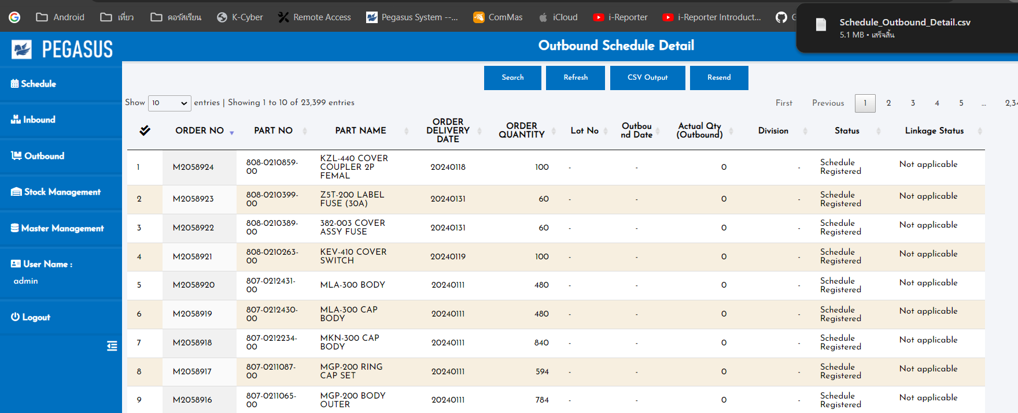
2. Handheld functions
2-2-4. Outbound Schedule Detail
• Refresh: To refresh the information on this page to the latest information.
• CSV Output: Export data as a CSV file.
It will export data from the current page.

Slide 25
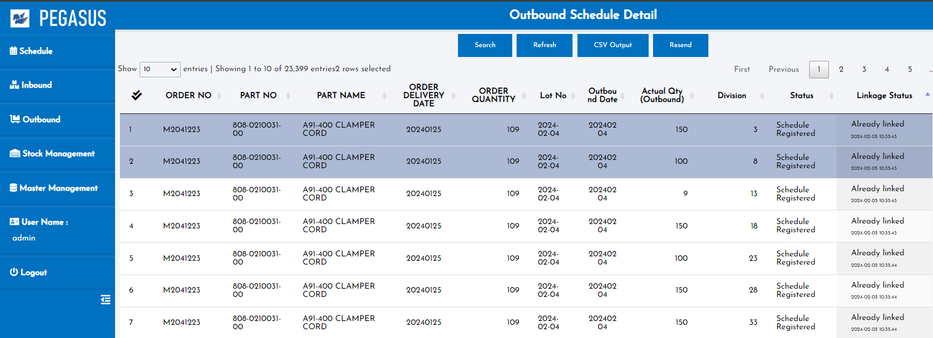
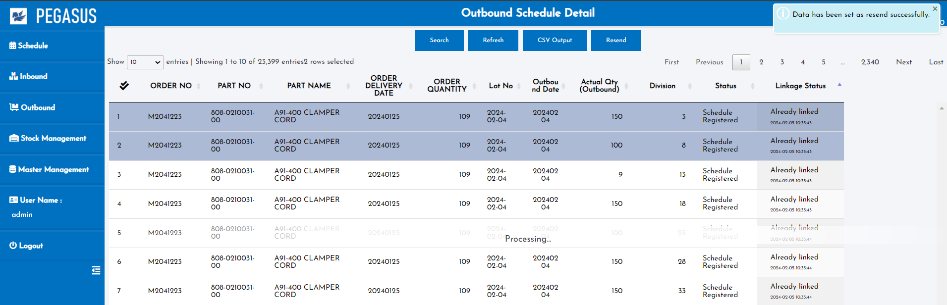
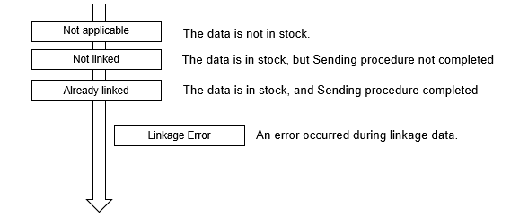
2. Handheld functions
2-2-4. Outbound Schedule Detail
• Resend: If "Linkage Error" occurs in the status, it is possible to create
and resend the CSV again.
Status management :

Slide 26
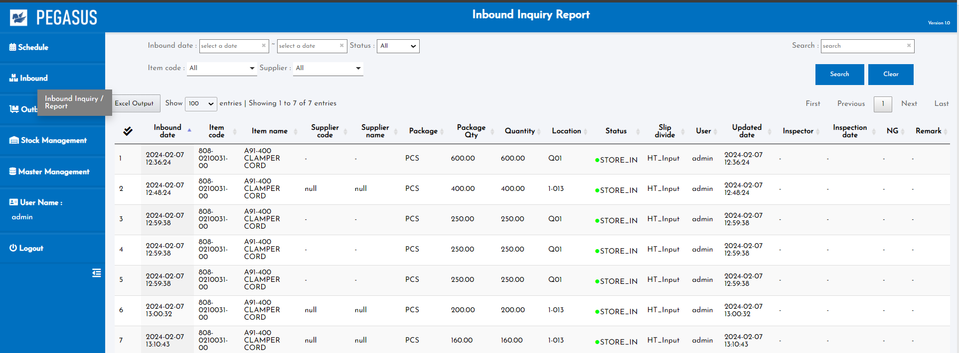
2. Handheld functions
2-3-1. Inbound Inquiry Report
• Resend: If "Linkage Error" occurs in the status, it is possible to create
and resend the CSV again.
Status management :

Slide 27
3. Configuration file storage
Input data:
1. Employee information
2. Product list

Slide 28
4. Q&A
# | Date | Question | By | Date | Answer | By
1
2
3
4
5

Slide 29
5. Contact information
The contents of this specification and manual are subject to change without notice. Copying or copying part or all of the manual without the written permission of TOMAS TECH is prohibited, regardless of its form.
If you have any questions, concerns, or questions regarding the specifications of this system and the contents of the manual, please contact us by phone or e-mail. Tel: +66 (0) 2 336 0574 E-mail: info@tomastc.com
Item | Description
1. Service time | 8 hours x 5 days (8:00 -17:00 Monday to Friday)
2. Onsite Hardware Maintenance | -
3. Onsite System Maintenance | -
4. Response after receive a call | On-line support within 24 hours / On-site support within 48 hours
5. Remote service | Yes
6. Phone service | Yes
7. Email service | Yes

