Slide 1
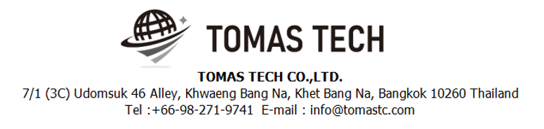
Version 18/Nov/2024
Confidential
Handy Terminal Stock management
Manual Document
Documentation EN Blueprint for YDT
R1
Made for: YAMATO ELECTRIC (THAILAND) CO., LTD.
By: TOMAS TECH CO.,LTD.

Slide 2

Introduction
This manual explains each handy terminal, how to set it up with a PC, how to check the operation, and how to communicate with a PC.
Please read before starting work.
For safe use of this device
To use this device correctly and safely, be sure to observe the following safety precautions when operating this device. TOMAS TECH cannot be held responsible or warranted for any damage caused by using the product in violation of these precautions.
◆How to read the symbols
In this manual, the items to be observed in order to use the device safely are classified as follows.
Danger
If you ignore the information on this label and handle it incorrectly, there is a risk of death or serious injury.
Warning
This indicates the contents that may cause injury if the contents of this display are ignored and the product is handled improperly.
Caution
It indicates that property damage may occur if the product is handled improperly, ignoring the contents of this display.
The symbol represents a "caution" that it should be aware of.
The symbol represents an "instruction" that it must execute.
The symbol represents a "prohibition" that must not be done.
The symbols represent the "information" needed to deepen your understanding of this book.
The symbol represents "prohibited handling" by anyone other than a service person.
The symbol indicates that grounding is required during installation.
Reference
Indicates chapters to refer to and other manual references.

Slide 3
For safe use
◆General caution
In the unlikely event that this device breaks down, take sufficient safety measures to prevent various damages before use.
Please note that we cannot guarantee the function and performance of products that are used or modified outside the specifications shown in the specifications.
Do not disassemble this device unnecessarily. There is a risk of failure or damage.
Do not allow the device to get wet with water. It may lead to damage to this device.
Please use within the environmental conditions of this device. In addition, even within environmental conditions, equipment may be damaged in an environment where condensation forms due to sudden temperature changes.
Do not drop the device or hit it with strong force. Also, if the wiring from this device is likely to be subject to excessive impact, consider how to protect the wiring. It may lead to damage to this device and other devices.
Do not operate the device in a place with flammable or explosive gas or vapor. It is very dangerous to use this device in such an environment.
When using this device in combination with other devices, the functions and performance may not be satisfactory depending on the usage conditions and environment, so please consider carefully before using.
Caution
◆For proper use
When installing this device, turn off the power of the device. Do not short-circuit each wiring or terminal.
When installing this device, be sure to perform protective grounding to prevent electric shock.
Be sure to check that the power supply voltage of the device matches the voltage of the power supply before turning on the device.
Only our customer service or equivalent handlers should install this equipment.
To supply power to this device, connect it via a protection circuit such as a switchboard breaker or an earth leakage breaker.
Since this device is an electronic device, when installing various devices, investigate the installation environment (primary power supply system noise, drive device system noise, electrostatic discharge noise, etc.) and take countermeasures. It may cause system malfunction or damage to various devices.
Caution

Slide 4
Revision History
Date | Version | File name | Details
18/Nov/2024 | R1 | Handy Terminal Stock management Manual Document EN for YDT_R1 | First edition

Slide 5
■Contents
Chapter [Page]
1. Overview 6
2. Handheld functions
2-1-1. Login screen 7
2-2-1. Settings mode 8
2-2-2. Settings Information 9
2-2-2. How to update the program 10
2-3-1. Main menu 11
2-4-1. Inbound menu 12
2-4-2. Inbound Schedule 13
2-4-3. Inbound Schedule [ Inbound Detail Screen ] 16
2-4-4. Inbound Manual 19
2-4-5. Inbound Rework 22
2-4-6. Inbound Rework NG 25
2-4-7. QC Schedule 28
2-5-1. Outbound menu 33
2-5-2. Outbound Schedule [ Work Outbound & Delivery Outbound ] 34
2-5-3. Outbound Manual 40
2-5-4. NG In Process 44
2-6-1. Stock management Menu 48
2-6-2. Stock Check 49
2-6-3. Stocktaking 50
2-6-4. Change Location 53
2-7-1. Printer Setting 55
3. Configuration file storage 56
4. Q&A 57
5. Contact information 52
6. Troubleshooting 59

Slide 6
1. Overview
We propose a stock management system to Minebea AccessSolutions Thai Ltd.. In the current operation, we aim to improve work efficiency and work accuracy by replacing the work managed by paper and whiteboard with a system. The expected effects of introducing an inventory management system are as follows.
1. Work efficiency and work accuracy can be improved by supporting work at the handy terminal at the time of warehousing and warehousing. In addition, the inventory status can be grasped in real time.
2. By managing the product location, the location can be used effectively. In addition, it is possible to thoroughly implement the FIFO.
3. By managing the ordering points, it is possible to eliminate excess inventory and out of stock.
4. By managing the materials and goods tracking, it is able to trace back to find material lot numbers, suppliers, and processes when found problematic products.

Slide 7
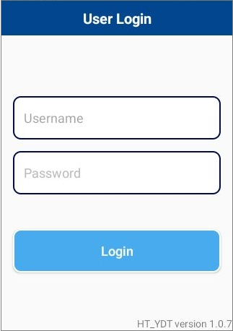
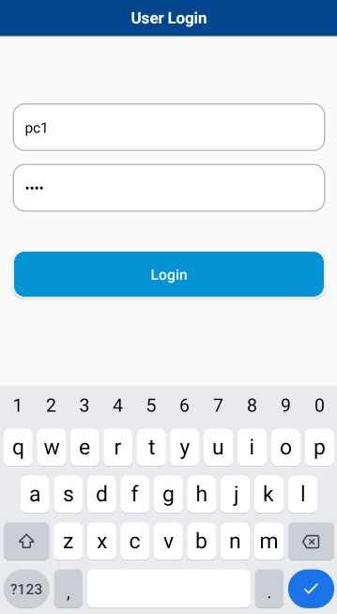
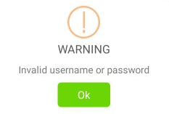
2. Handheld functions
2-1-1. Login screen
Login Instructions
Scan or Click the Username text box.
On-screen keyboard will automatic show up.
Enter the staff ID or Scan the QRcode or Barcode.
Enter the password.
Click “Login”
!
The warning dialog will be shown if login failed.
2.1.2 Example of Staff ID Qrcode or Barcode

Slide 8
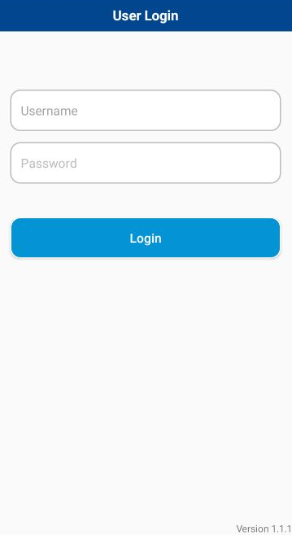

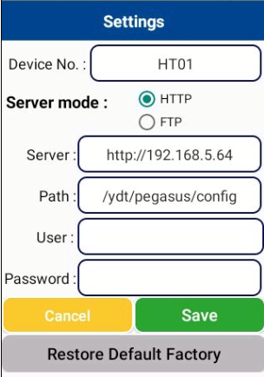
2. Handheld functions
2-2-1. Settings mode
To enter the “Settings” screen.
Tap the upper title “User Login” 7 times.
In case of upgrading new version or restore default settings. User need to enter the information in settings screen.
Instructions
Enter the information to each text box regarding to below table.
Click “Save” to apply the settings and restart the app.
Click “Cancel” to cancel any changed.
Click “Restore Default Factory” to remove all settings.

Slide 9
2. Handheld functions
2.2.2 Settings information
No | Item | Description | Example
1. | Device No. | Device name | HT01
2. | Server mode | Communication protocol | HTTP or FTP
3. | Server | URL link to server instance. | http://192.168.5.64/
4. | Path | Application web configuration path | /ydt/pegasus/config/
5 | User(optional) | Authenticate user account
6 | Password (optional) | Password for login

Slide 10
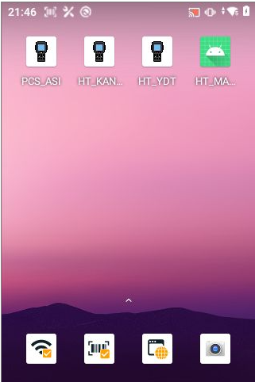
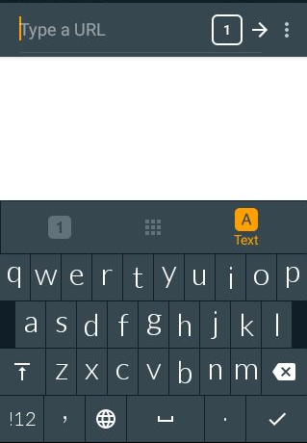
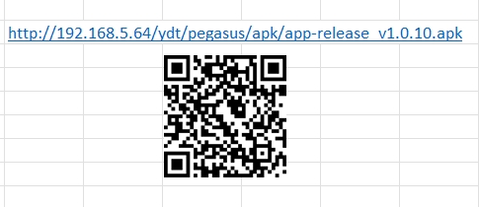

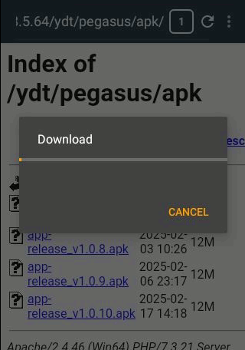
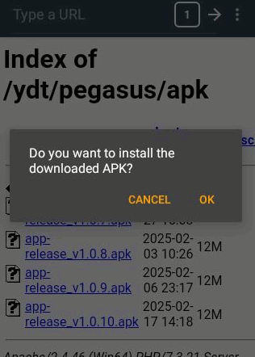
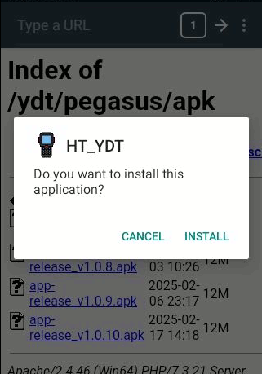
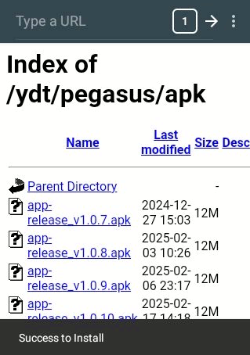
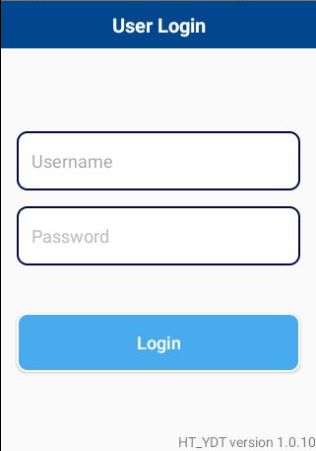
2. Handheld functions
2.2.3 How to update the program.
1
2
Type with keyboard or scan the QR code
received from Thomas Tech.
3
4
5
6
7
8
Check the version number
to make sure it matches the version
Thomas Tech has informed

Slide 11
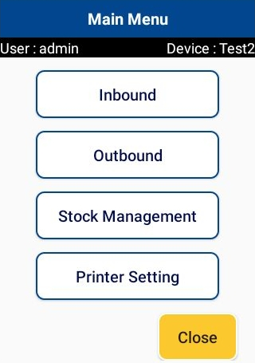
2. Handheld functions
2-3-1. Main menu.
Screen name
Device info.
User name logged in.
1
2
3
4
5
No | Menu | Description
 | Inbound | Click to enter Inbound section.
 | Outbound | Click to enter Outbound section.
 | Stock Management | Click to Stock management functions.
 | Printer Setting | Click to Printer Setting functions.
 | Close | Close the application.
1
2
3
4
5

Slide 12
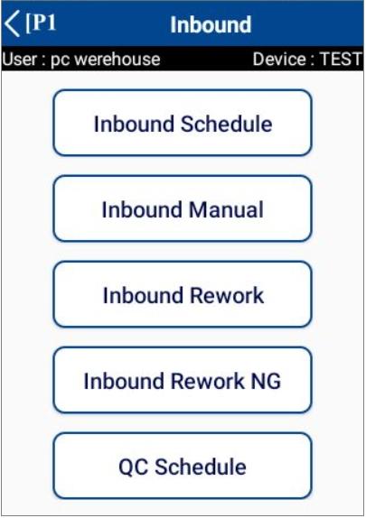
2. Handheld functions
2-4-1. Inbound menu.
Click “<” to exit
to main menu
1
2
3
4
5
No | Menu | Description
 | Inbound Schedule | Click to enter Inbound Schedule. Inbound material, Inbound FG
 | Inbound Manual | Click to enter Inbound Manual.
 | Inbound Rework | Click to enter Inbound Rework.
 | Inbound Rework NG | Click to enter Inbound Rework NG.
 | QC Schedule | Click to enter QC Schedule. Inspect finished goods and put them in store
1
2
3
4
5

Slide 13
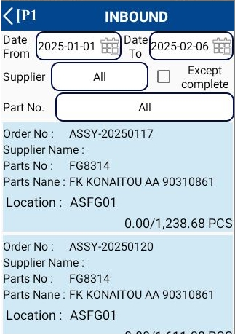
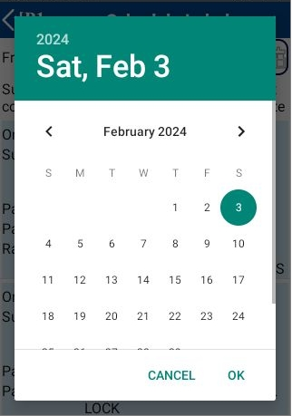

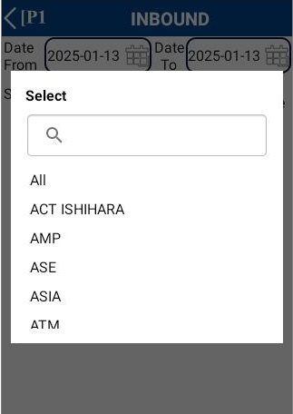



2. Handheld functions
2-4-2. Inbound Schedule.
1. Select the desired information
Date From – To :
Date from: Default today.
Date to: Default today.
* Can be changed manually
----------------------------------------------------------------------------------------------------------
Supplier code :
Select supplier code.
Default is All
----------------------------------------------------------------------------------------------------------
Except complete :
Default : Display all status.
: Display only Working and Imported status.
Color | Description
 | WORKING
 | COMPLETED
 | NEW

Slide 14

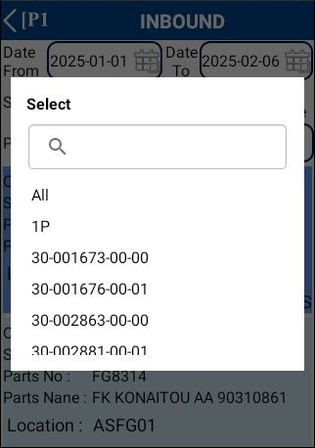
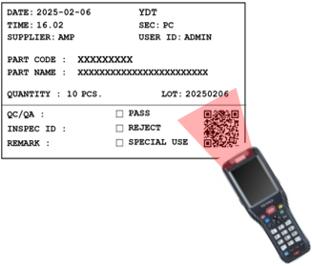
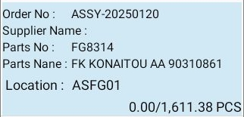
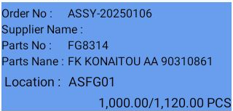
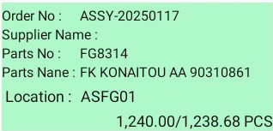
2. Handheld functions
2-4-2. Inbound Schedule.
Parts No. :
Search / Scan
Select part no. or do a scan.
Default is All
----------------------------------------------------------------------------------------------------------
Background Color :
The background color describes the status of the job.
New Working Completed

Slide 15
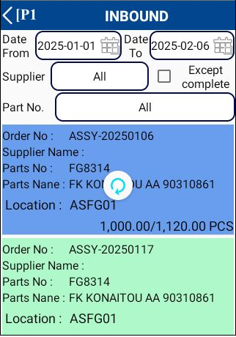
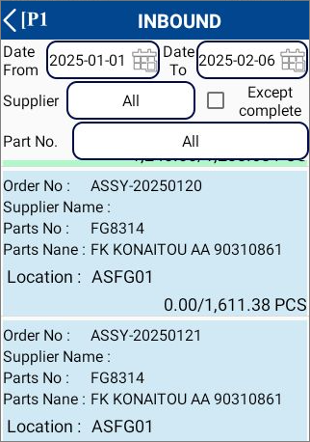
2. Handheld functions
2-4-2. Inbound Schedule
2. Please pull down the screen to refresh the information.
3. Click an item.
Color | Description
 | WORKING
 | COMPLETED
 | NEW

Slide 16
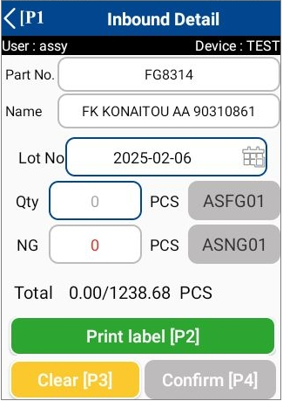
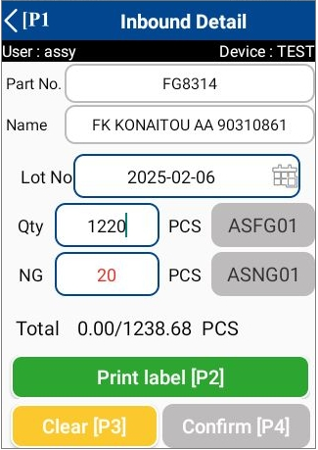
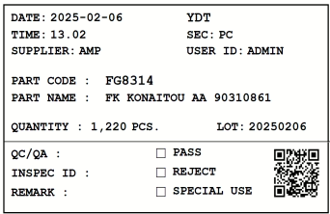
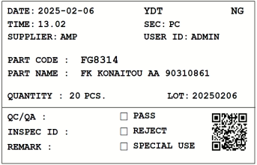
2. Handheld functions
2-4-3. Inbound Schedule [ Inbound Detail Screen ]
1. Click an item from schedule list.
* Can be changed manually
2. Enter the actual quantity and press the print label.
If there is NG quantity, please enter it.
1
2
When click confirm.
The system will print the label.

Slide 17
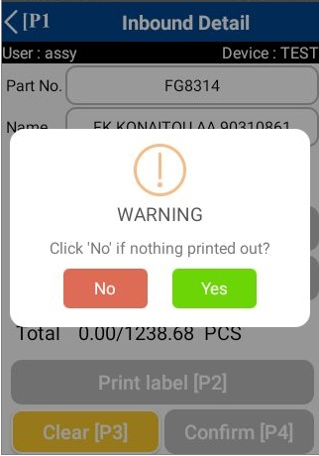
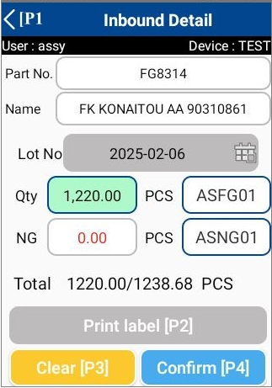
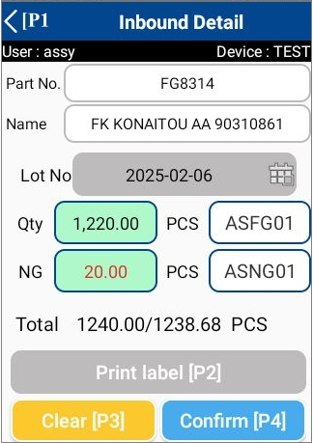
2. Handheld functions
2-4-3. Inbound Schedule [ Inbound Detail Screen ]
3. When the system finishes printing the label will notify you.
Click “Yes” when the label is completely printed.
Click “No” if nothing printing out?
4. Scan label for inbound.
Multiple labels can be scanned if there are multiple labels.

Slide 18
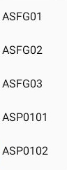
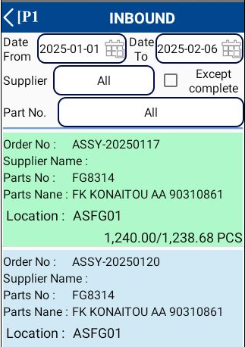
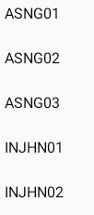
2. Handheld functions
2-4-3. Inbound Schedule [ Inbound Detail Screen ]
5. Scan or select the location you want to store for good work.
For NG work, select locations only from the list.
After that press the confirm.
1
Scan or select from list
Status
=
completed
2
Select from list only
3

Slide 19
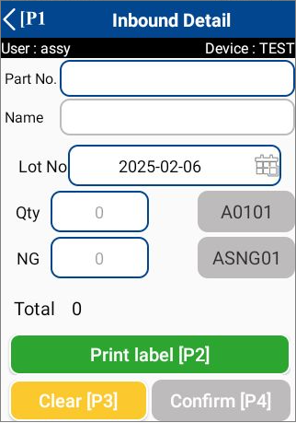
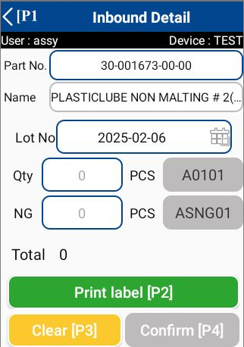
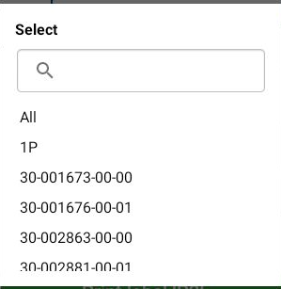
2. Handheld functions
2-4-4. Inbound Manual
1. Select part no from list.
*Can be
changed manually

Slide 20
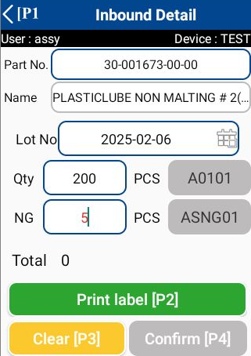
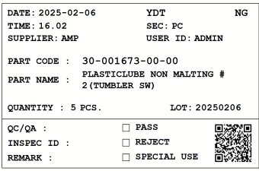
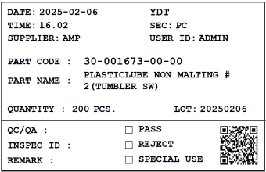
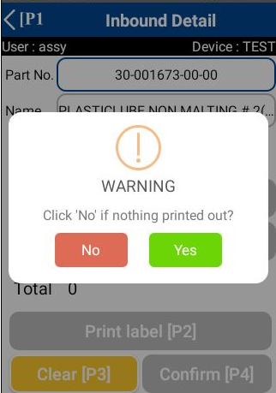
2. Handheld functions
2-4-4. Inbound Manual
2. Enter the actual quantity and press the print label.
If there is NG quantity, please enter it.
1
2
When click confirm.
The system will print the label.
3. When the system finishes printing the label will notify you.
Click “Yes” when the label is completely printed.
Click “No” if nothing printing out?

Slide 21
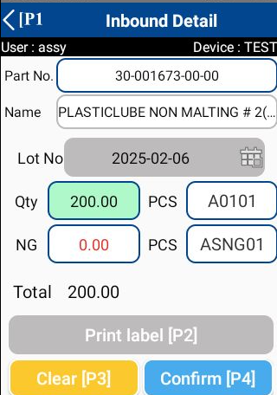
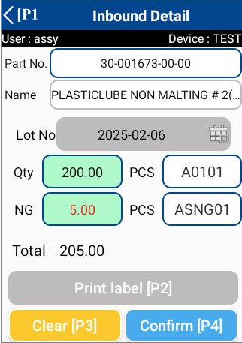
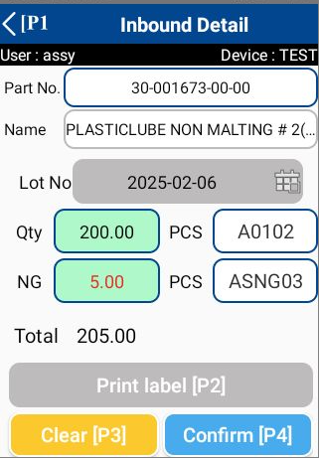
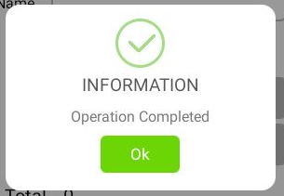
2. Handheld functions
2-4-4. Inbound Manual
4. Scan label for inbound.
Multiple labels can be scanned if there are multiple labels.
5. Scan or select the location you want to store for good work.
For NG work, select locations only from the list.
After that press the confirm.
1
Scan or select from list
2
Select from list only
3

Slide 22
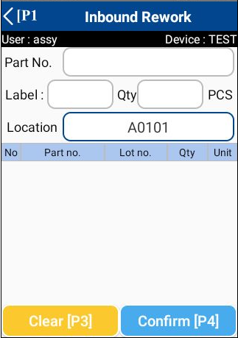
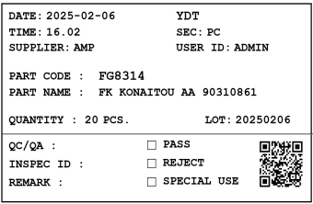
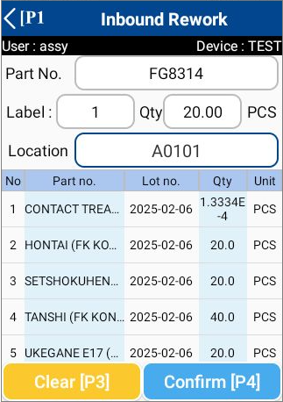
2. Handheld functions
2-4-5. Inbound Rework
1. Scan FG label. (Can scan more than 1 label)
*The system will outbound this FG label.
The system will display a list of BOM
and calculate the material quantity
based on the quantity of finished goods.

Slide 23



2. Handheld functions
2-4-5. Inbound Rework
2. You can edit the quantity of each material by simply clicking on the item.
*Can edit quantity
and lot no.
3. Scan or select the location you want to store.
Edited item

Slide 24



2. Handheld functions
2-4-5. Inbound Rework
4. Press the Confirm button. The system will print out labels with a quantity greater than 0.
*The system will export these labels
according to the selected location.
5. When the system finishes printing the label will notify you.
Click “Yes” when the label is completely printed.
Click “No” if nothing printing out?

Slide 25


2. Handheld functions
2-4-6. Inbound Rework NG
1. Scan FG label. (Can scan more than 1 label)
*The system will outbound this FG label.
The system will display a list of BOM
and Initial value of quantity = 0

Slide 26




2. Handheld functions
2-4-6. Inbound Rework NG
2. You can edit the quantity of each material by simply clicking on the item.
*Can edit quantity
and lot no.
3. Scan or select the location you want to store.
Edited item

Slide 27




2. Handheld functions
2-4-6. Inbound Rework NG
4. Press the Confirm button. The system will ask if you want to print a label.
Press “Yes” if you want to print the label.
Press “No” if you do not want to print the label.
If you choose to print the label.
When the system finishes printing the label will notify you.
Click “Yes” when the label is completely printed.
Click “No” if nothing printing out?

Slide 28



2. Handheld functions
2-4-7. QC Schedule
1. Select the desired information
Date From – To :
Date from: Default today.
Date to: Default today.
* Can be changed manually
----------------------------------------------------------------------------------------------------------
Order No. :
You can search
for partial order no. by typing.
----------------------------------------------------------------------------------------------------------
Except complete :
Default : Display all status.
: Display only Working and Imported status.
Color | Description
 | WORKING
 | COMPLETED
 | NEW

Slide 29

2. Handheld functions
2-4-7. QC Schedule
Parts No. :
Search / Scan
Select part no. or do a scan.
Default is All
----------------------------------------------------------------------------------------------------------
Background Color :
The background color describes the status of the job.
New Working Completed
*Only Warehouse staff can see and use the QC Schedule.
**The Schedule will be visible only after the Production department
has inbounded FG.

Slide 30

2. Handheld functions
2-4-7. QC Schedule
2. Please pull down the screen to refresh the information.
3. Click an item
Color | Description
 | WORKING
 | COMPLETED
 | NEW

Slide 31



2. Handheld functions
2-4-7. QC Schedule
4. Click an item from schedule list.
*Recommended location
for storing in warehouse
By Item Master
5. Scan QR code FG label.
Check the correctness
of the lot and quantity on the label.

Slide 32



2. Handheld functions
2-4-7. QC Schedule
6. Scan the QR code of the location you want to store.
Location : A0102
7. Press the Confirm button.
Status
=
completed

Slide 33

2. Handheld functions
2-5-1. Outbound menu
1
2
3
4
No | Menu | Description
 | Work Outbound | Click to enter Work Outbound. Outbound the items to production process.
 | Delivery Outbound | Click to enter Outbound Production. Outbound the items to delivery process.
 | Outbound Manual | Click to enter Inbound Schedule
 | NG In Process | Click to enter NG In Process. Outbound the NG items
1
2
3
4

Slide 34





2. Handheld functions
2-5-2. Outbound Schedule [ Work Outbound & Delivery Outbound ]
1. Select the desired information
Date From – To :
Date from: Default is previous 7 days.
Date to: Default is advance 7 days.
* Can be changed manually
----------------------------------------------------------------------------------------------------------
Category :
Select supplier code or do a scan.
Default is All
----------------------------------------------------------------------------------------------------------
Except complete :
Default : Display all status.
: Display only Working and Imported status.
Color | Description
 | WORKING
 | COMPLETED
 | NEW

Slide 35

2. Handheld functions
2-5-2. Outbound Schedule [ Work Outbound & Delivery Outbound ]
Parts No. :
Search / Scan
Select part no. or do a scan.
Default is All
----------------------------------------------------------------------------------------------------------
Background Color :
The background color describes the status of the job.
New Working Completed
*There is no item in stock.

Slide 36



2. Handheld functions
2-5-2. Outbound Schedule [ Work Outbound & Delivery Outbound ]
2. Please pull down the screen to refresh the information.
3. Click an item
Color | Description
 | WORKING
 | COMPLETED
 | NEW
 | There is no item in stock

Slide 37


2. Handheld functions
2-5-2. Outbound Schedule [ Work Outbound & Delivery Outbound ]
4. Click an item from schedule list.
*FIFO list
5. Scan QR code label.
Can edit
Qty in stock

Slide 38



2. Handheld functions
2-5-2. Outbound Schedule [ Work Outbound & Delivery Outbound ]
6. Enter the desired quantity and press OK.
1
2
7. Press the Confirm button.
- Press “Yes” if you want to print remaining label.
- Press “No” if you do not want to print remaining label.

Slide 39



2. Handheld functions
2-5-2. Outbound Schedule [ Work Outbound & Delivery Outbound ]
8. If you press to select print remaining labels, the system will print 2 labels.
Kept in storage
Send to production
9. When the system finishes printing the label will notify you.
Click “Yes” when the label is completely printed.
Click “No” if nothing printing out?

Slide 40


2. Handheld functions
2-5-3. Outbound Manual
1. Scan label.
*Can scan more than 1 label in the same parts no.

Slide 41



2. Handheld functions
2-5-3. Outbound Manual
2. Edit the amount of outbound you want.
1
2
3

Slide 42



2. Handheld functions
2-5-3. Outbound Manual
3. Press the Confirm button.
- Press “Yes” if you want to print remaining label.
- Press “No” if you do not want to print remaining label.
4. If you press to select print remaining labels, the system will print 2 labels.
Kept in storage
Send to production

Slide 43


2. Handheld functions
2-5-3. Outbound Manual
5. When the system finishes printing the label will notify you.
Click “Yes” when the label is completely printed.
Click “No” if nothing printing out?

Slide 44


2. Handheld functions
2-5-4. NG In Process
1. Scan label.

Slide 45




2. Handheld functions
2-5-4. NG In Process
2. Enter the amount of material you want to outbound by pressing
on the desired item
Can edit lot number
1
2
3

Slide 46


2. Handheld functions
2-5-4. NG In Process
3. Select the location where you want to store.
2
1

Slide 47


2. Handheld functions
2-5-4. NG In Process
4. Press the Confirm button.
Press “Yes” if you want to print the label.
Press “No” if you do not want to print the label.
If you choose to print the label.
When the system finishes printing the label will notify you.
Click “Yes” when the label is completely printed.
Click “No” if nothing printing out?

Slide 48

2. Handheld functions
2-6-1. Stock management
1
2
3
No | Menu | Description
 | Stock Check | Click to enter Stock Check screen.
 | Stocktaking | Click to enter Stocktaking screen.
 | Change Location | Click to enter Change Location screen. User able to changes or repack the package.
1
2
3

Slide 49


2. Handheld functions
2-6-2. Stock Check
1
Scan the label you want to check stock.

Slide 50



2. Handheld functions
2-6-3. Stocktaking
1
Scan location

Slide 51


2. Handheld functions
2-6-3. Stocktaking
2
Scan the label in that location.
3
Press the Confirm button.

Slide 52


2. Handheld functions
2-6-3. Stocktaking
4
Result.
The data saving completed.
In the case of NG,
The item has been duplicate.

Slide 53

2. Handheld functions
2-6-4. Change Location
No | Menu | Description
Mode 1 | Change location | Scan the tag label twice → Scan the destinate location Label Location
1
2
*same label
*same label

Slide 54




2. Handheld functions
2-6-4. Change Location
No | Menu | Description
Mode 2 | Repack | Scan the label tag once→ Enter the amount you want to move. (move qty < stock qty) → Scan the location
 |  | Two labels will be printed. The first one is to be pasted on the original box in place of the original label. The second one is to put in a new box where the location has been moved.
1
2
3
4
Qty = 200 KG Old location
Qty = 300 KG
New location

Slide 55





2. Handheld functions
2-7-1. Printer Setting
1. Scan QR code Printer.

Slide 56
3. Configuration file storage
Input data:
1. Employee information
2. Product list

Slide 57
4. Q&A
# | Date | Question | By | Date | Answer | By
1
2
3
4
5

Slide 58
5. Contact information
The contents of this specification and manual are subject to change without notice. Copying or copying part or all of the manual without the written permission of TOMAS TECH is prohibited, regardless of its form.
If you have any questions, concerns, or questions regarding the specifications of this system and the contents of the manual, please contact us by phone or e-mail. Tel: +66 (0) 2 336 0574 E-mail: info@tomastc.com
Item | Description
1. Service time | 8 hours x 5 days (8:00 -17:00 Monday to Friday)
2. Onsite Hardware Maintenance | -
3. Onsite System Maintenance | -
4. Response after receive a call | On-line support within 24 hours / On-site support within 48 hours
5. Remote service | Yes
6. Phone service | Yes
7. Email service | Yes

Slide 59

6. Troubleshooting
Problem | Troubleshooting
1. Can't print | Enter the Master Management menu from the pegasus system and press reprint.
2. The printer is not online. | Turn the printer off and on again. Press the Online button.
3. No Schedule | Adjust the search date If you don't have it yet, please notify admin.
4. The label is lost. | Find the label id number from the pegasus system and tag label menu and reprint it.
5. Can't connect to internet | Turn off and then turn on wifi on the device and connect again.
6. Can't login | Turn off the WiFi again . Check whether the username and password are entered correctly or not.
7. Can't print, can't connect to printer. | Scan the qr code of the new printer again. Turn the printer off and on again. and check the printer's internet connection Check that the printer status is online.
8. label can't scan | Check the label status to see if it is in printing status or not. If the status is not yet printed, confirm the item.
9. label damaged | You can scan from the original label or search for the label id from the web menu

