Slide 1
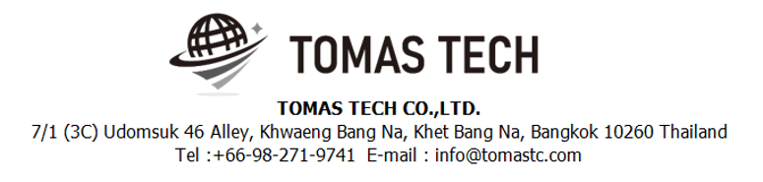
Version 18/Dec/2024
Confidential
i-Reporter system specifications
Documentation EN Blueprint for
Sumitomo Rubber Thailand Co., Ltd.
Blueprint
R8
Made for: Toyota Boshoku Filtration System(Thailand) Co., Ltd.
By: TOMAS TECH CO.,LTD.

Slide 2
Revision History
Date | Version | File name | Details
25/Jul/2024 | R1 | Stock management system specifications Documentation EN Blueprint for TBFST Blueprint | First edition
19/Aug/2024 | R2 | Stock management system specifications Documentation EN Blueprint for TBFST Blueprint | Second edition
2/Sep/2024 | R3 | Stock management system specifications Documentation EN Blueprint for TBFST Blueprint | Third edition
8/Oct/2024 | R4 | Stock management system specifications Documentation EN Blueprint for TBFST Blueprint | Fourth edition
4/Nov/2024 | R5 | Stock management system specifications Documentation EN Blueprint for TBFST Blueprint | Fifth edition
22/Nov/2024 | R6 | Stock management system specifications Documentation EN Blueprint for TBFST Blueprint | Sixth edition
15/Nov/2024 | R7 | Stock management system specifications Documentation EN Blueprint for TBFST Blueprint | Seventh edition
18/Nov/2024 | R8 | Stock management system specifications Documentation EN Blueprint for TBFST Blueprint | Eighth edition
2
3
4
5
6
7
8

Slide 3
■Contents
1. Overview
2. Overall configuration diagram
3. Document image
4. Operation flow
5. System functional specifications
5-1. Setting i-Reporter for Window and i-Pad app., ConMas Designer app.
5-2. Setting users/groups manager (System menu)
5-3. Creating address for forms and documents (Labels menu)
5-4. Creating forms document
5-4-1. Creating forms document on Excel file
5-4-2. Creating forms document on ConMas Designer app.
5-5. Selecting address for forms and documents - Document permission setting, Document
visibility permission (Forms menu)
5.6. Setting approved (System menu)
5.7. Locking signature fields for individuals by group (Forms menu)
5.8. Master Manager menu
5.9. Data Output menu
5.10. Custom menu
5.11. Library menu
5.12. Schedule menu
6. Q&A
7. Sign off

Slide 4
1. Overview
The familiar paper forms and EXCEL forms can be converted into electronic forms with the same laity.
Forms entered in the field are quickly digitized, eliminating the need for data entry after returning to the office.
It can also reduce the management of forms, printing costs, and overtime.
Significantly improve work efficiency and speed by completing reporting and recording work on site and reducing post-processing work.
As soon as a form is uploaded from the site to the server, it is converted into data immediately, and the information is shared in real time between
the site and the office. It is also possible to search and refer to past data.

Slide 5



2. Overall configuration diagram
Represents a configuration diagram of the stock management system. It is a configuration image of hardware and documents.
Overall configuration diagram image
Excel, PDF, TIFF, GIF, Image file document
Create document on ConMas Designer
Organize documents on ConMas Manager
Use document in i-Reporter add on iPad or Computer
Check or export for document storage on ConMas Manager
Computer
i-Pad
WIFI
Schedule information
1. Calibration planning
2.
Sumitomo Rubber

Slide 6
2. Overall configuration diagram
Network diagram
TBFST office
Lan cable
DB
Middle tier
Pegasus
server
Wi-Fi
4
Client pc
Switching hub
Access Point
2
Handy terminal#1
Handy terminal#6
TBFST Warehouse

Slide 7
2. Overall configuration diagram
Hardware diagram
TBFST office
Lan cable
DB
Middle tier
Pegasus
server
Wi-Fi
4
Client pc
AC220V*1
Switching hub
Access Point
2
Handy terminal#1
Handy terminal#6
Charger #1
Charger #6
AC220V*6
TBFST Warehouse

Slide 8
3. Document image
8
3-1. Linkage data
Item | File name/Page no | Remarks
Inbound / Material Receive | Page 12 | 3-1-4. PO/PDS Line
 | Page 9 | 3-1-1. PS – Production Schedule (FG Inbound)
 | Page 24 | 3-1-20. Part Delivery Sheet (used to start process Receipt Material)
 | Page 23 | 3-1-19. RMA Return view table
Outbound / Delivery / Production plan | Page 10 | 3-1-2. CO (used to mapped to loading container)
 | Page 20 | 3-1-12. Loading Container – FG transfer, POKAYOKE
Master / Report / Other | Page 13 | Item master
 | Page 14 | Location master
 | Page 15 | Department master
 | Page 16 | Customer master
 | Page 17 | Supplier master
 | Page 18 | User master
 | Page 19 | Packing standard
 |  | NG Reason
 | Page 11 | BOM
 | Page 22 | Carton master

Slide 9
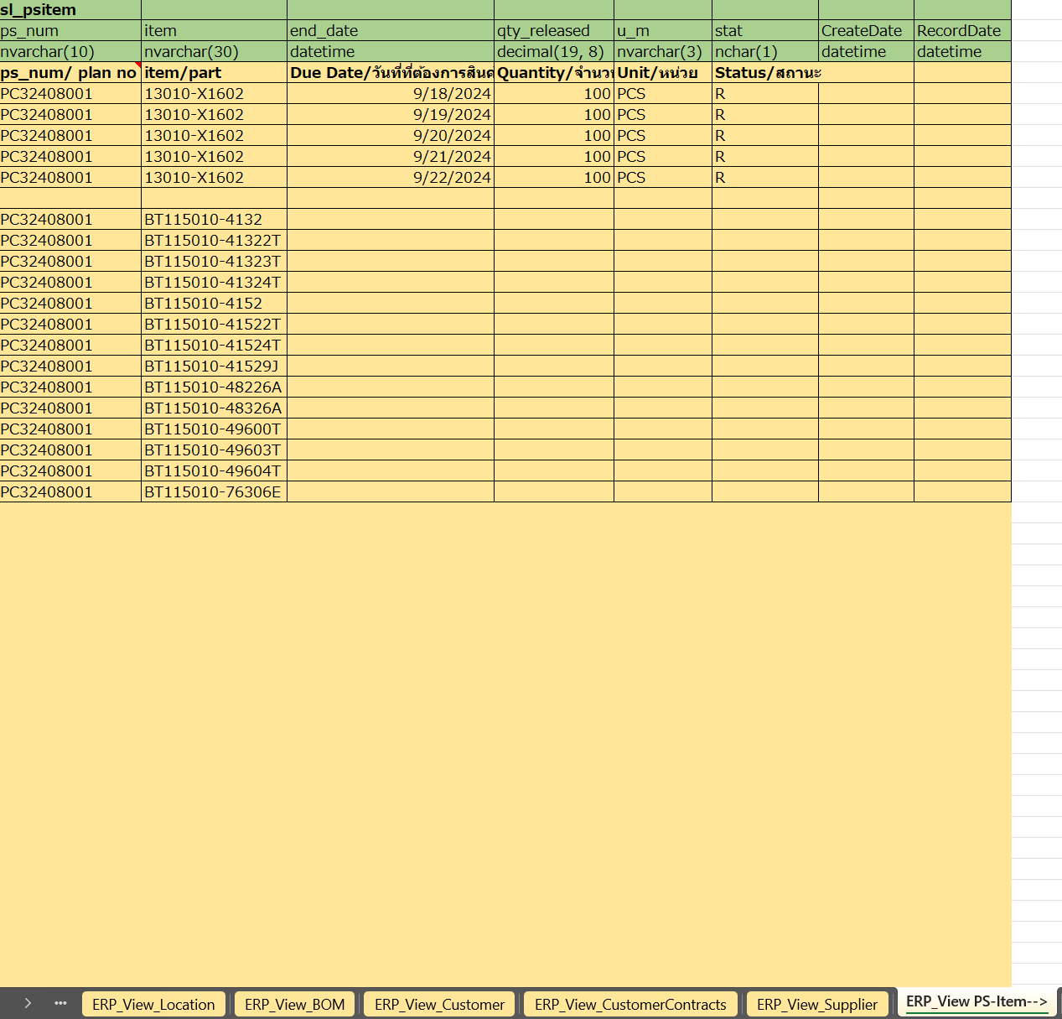
3. Document image
5
3-1-1. Production Schedule - PS
Syteline will create view table on middle DB tier
SYTELINE ⇒Pegasus
PS Item
* Used to generate FG Inbound schedule

Slide 10
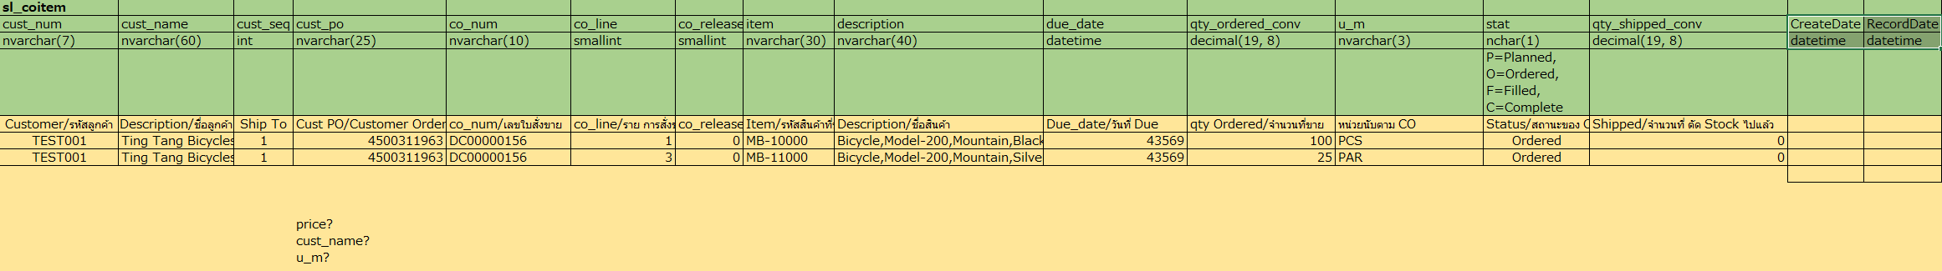
3. Document image
8
3-1-2. CO
Syteline will create view table on middle DB tier
SYTELINE ⇒Pegasus

Slide 11
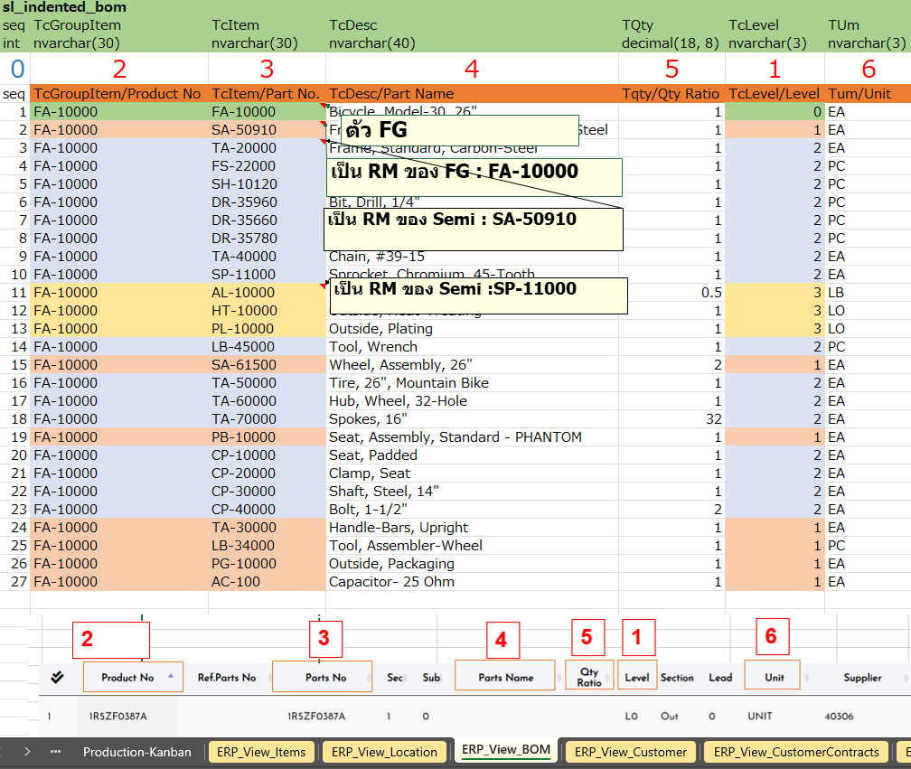
3. Document image
3-1-3. BOM master
Syteline will create view table on middle DB tier
SYTELINE ⇒Pegasus

Slide 12
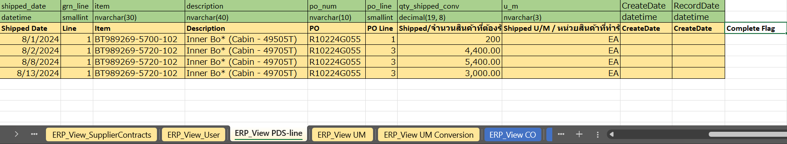
3. Document image
8
3-1-4. PO/PDS Line
Syteline will create view table on middle DB tier
SYTELINE ⇒Pegasus
PO/PDS Line
* Used to generate Material Receive and QC Check schedule
Descriptions
Item | Description | Remarks
Vendor | Vendor ID
Name | Vendor Name
GRN | PDS No
Status | Status of data | “I” (In process) status will be process on WMS
Date | Date created
Shipped Date | Shipped date
Line | Line no
Item | Part no
Description | Part name
PO | PO number
PO Line | PO line
Shipped | Plan qty
Shipped U/M | Unit of material
Complete Flag | Used to set completion of schedule

Slide 13
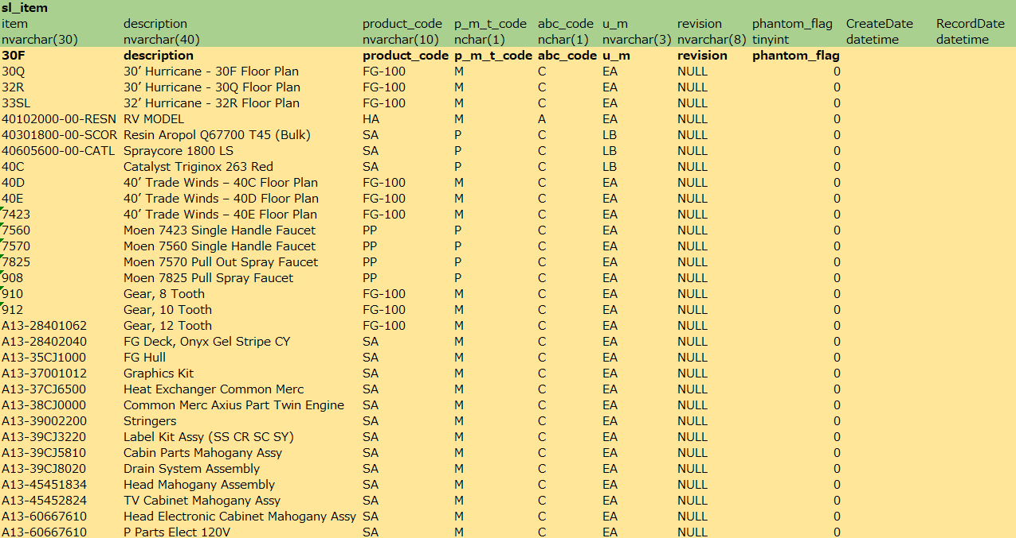
3. Document image
5
3-1-5. Item master
SYTELINE
⇒Pegasus

Slide 14
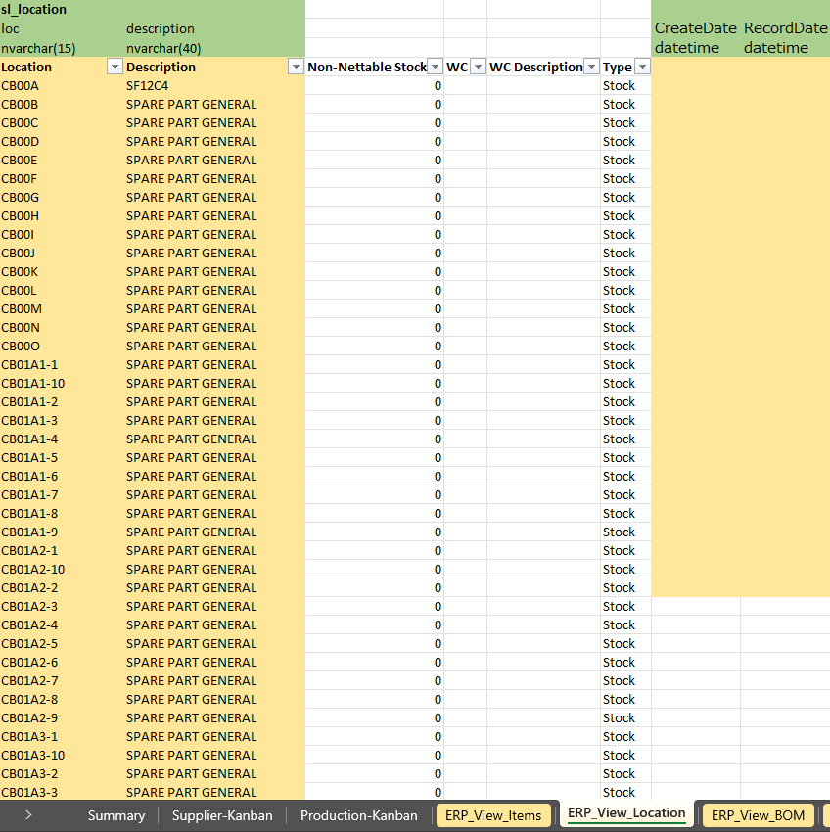
3. Document image
5
3-1-6. Location master
SYTELINE ⇒Pegasus

Slide 15
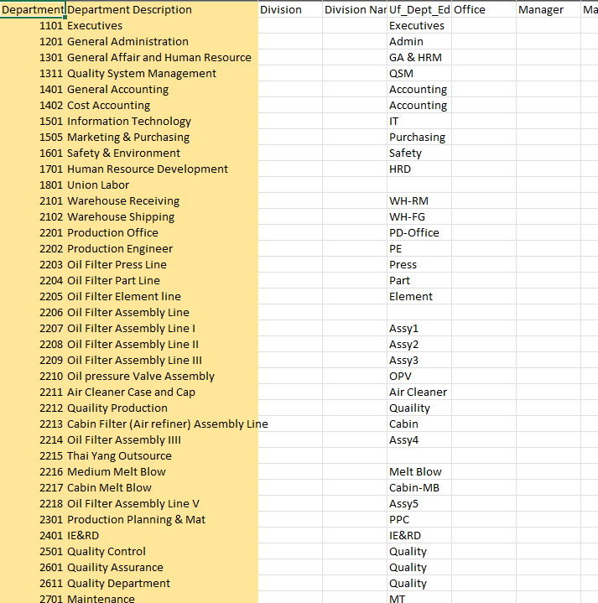
3. Document image
3-1-7. Department master
TBFST ⇒Pegasus

Slide 16
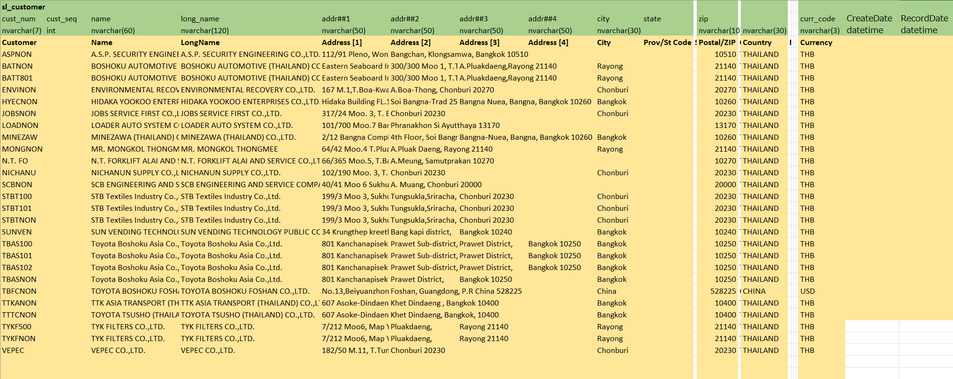
3. Document image
5
3-1-8. Customer master
SYTELINE ⇒Pegasus

Slide 17
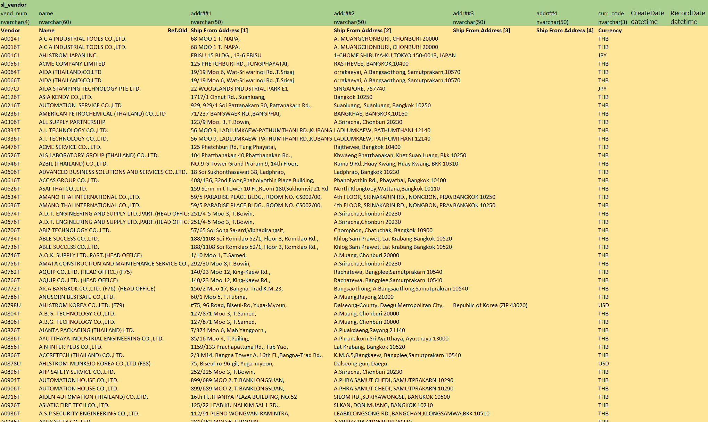
3. Document image
5
3-1-9. Supplier master
SYTELINE ⇒Pegasus

Slide 18
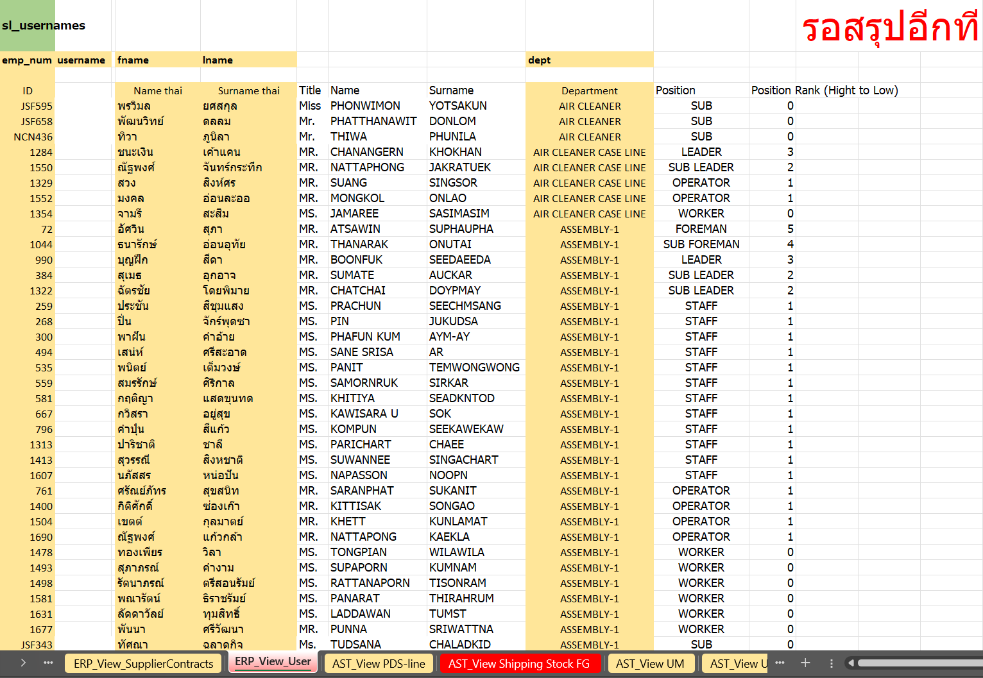
3. Document image
7
3-1-10. User master
SYTELINE ⇒ Pegasus

Slide 19
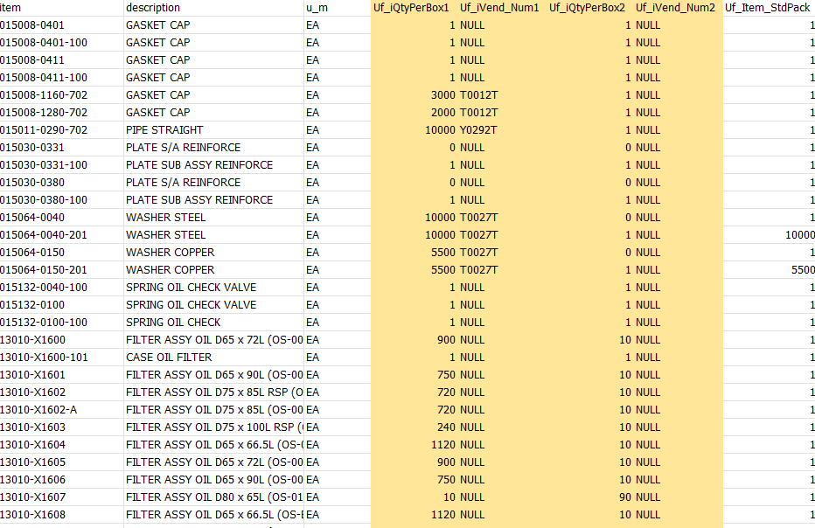
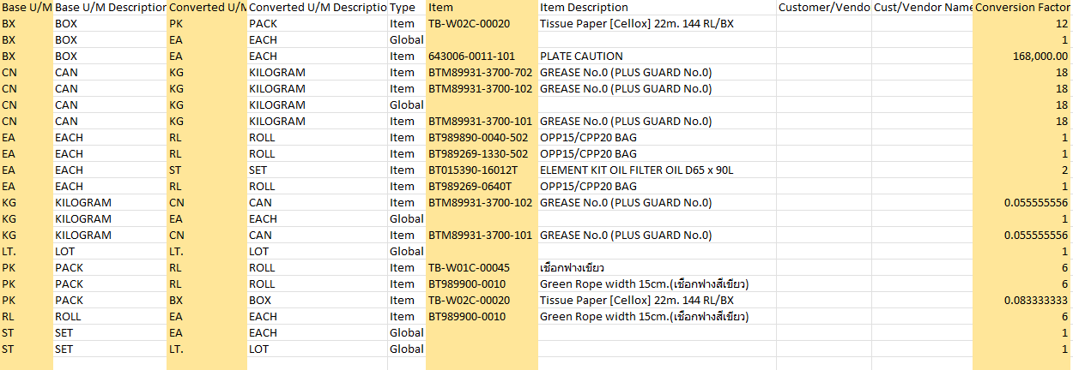
3. Document image
3-1-11. Packing Standard master
SYTELINE ⇒Pegasus
Standard pack
Unit of measure conversion

Slide 20
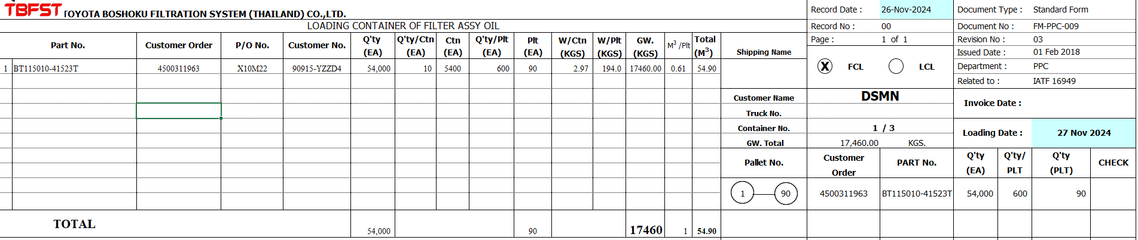
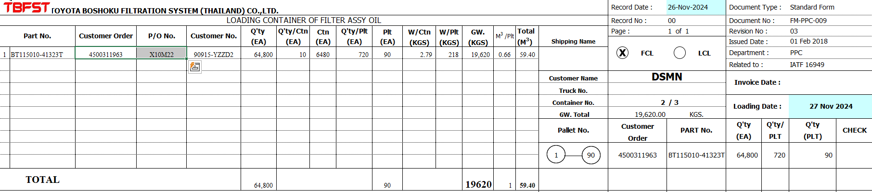
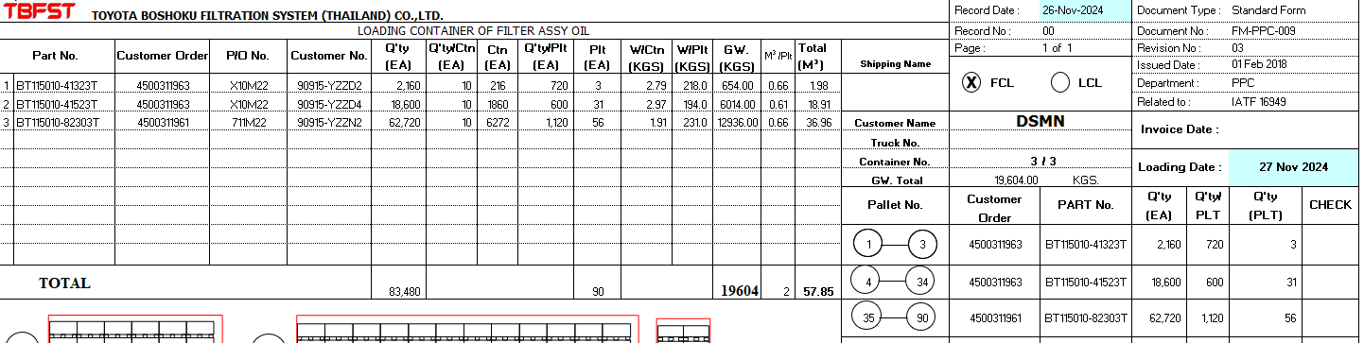
3. Document image
8
3-1-12. Loading Container – FG transfer, POKAYOKE
TBFST ⇒Pegasus
Loading Container
Import loading container to generate the FG transfer to loading area and POKAYOKE
Conditions :
There are linked CO(3-1-2) data and loading container import items which will allowed to create
FG transfers and POKAYOKE schedules only.

Slide 21
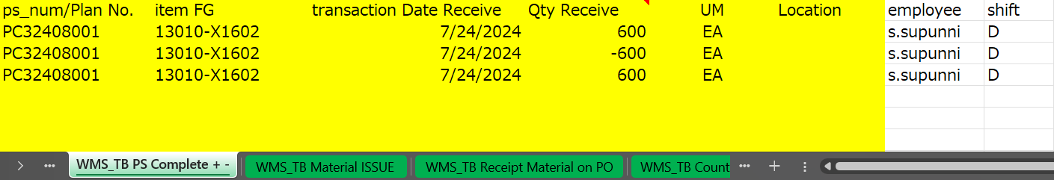
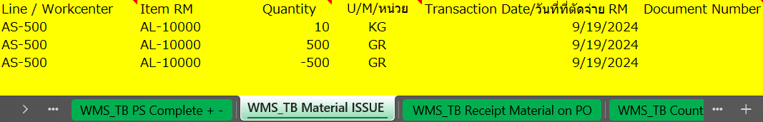
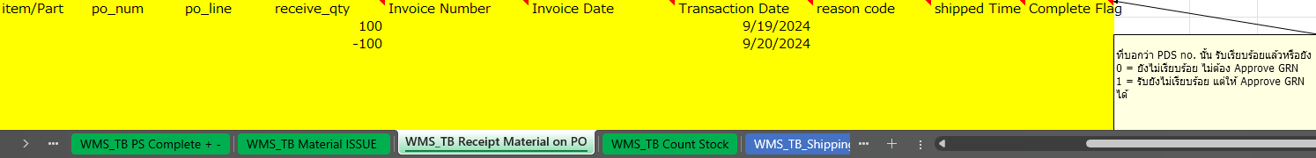
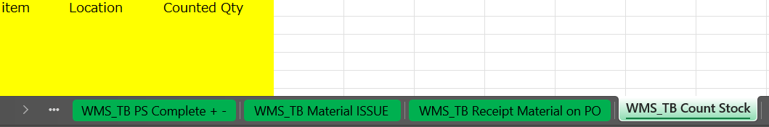
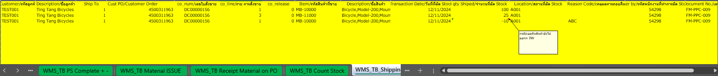
3. Document image
8
3-1-13. PS Complete (FG Inbound) => WMS_TB PS Complete
Pegasus ⇒ SYTELINE
3-1-14. Material Issue => WMS_TB Material ISSUE
Pegasus ⇒ SYTELINE
3-1-15. Receipt Material => WMS_TB Receipt Material on PO
Pegasus ⇒ SYTELINE
3-1-16. Stock count => WMS_TB Count Stock
Pegasus ⇒ SYTELINE
3-1-17. FG Outbound => WMS_TB_Shipping FG
Pegasus ⇒ SYTELINE

Slide 22
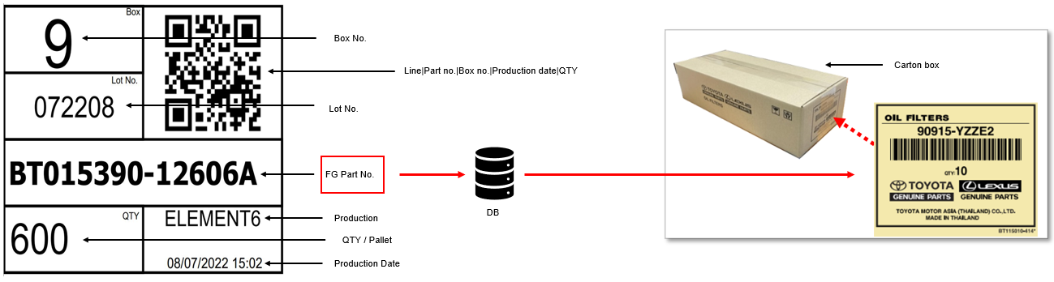
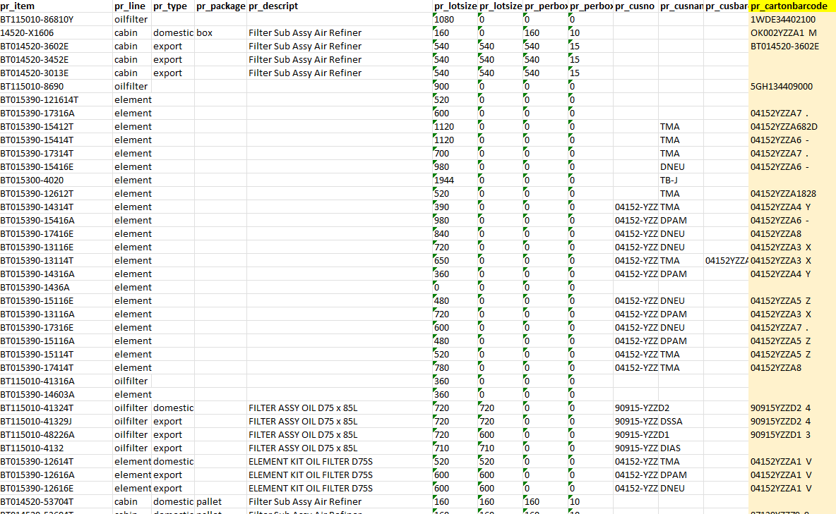
3. Document image
8
3-1-18 Carton barcode master
TBFST ⇒Pegasus
Carton barcode comparison
Carton barcode master data

Slide 23
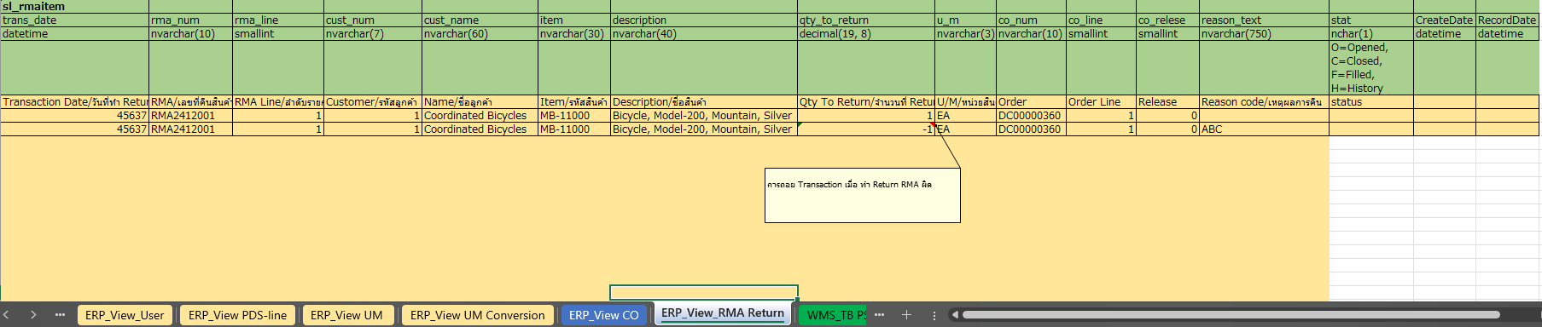
3. Document image
8
3-1-19. RMA Return view table
SYTELINE ⇒Pegasus
RMA Return
Retrieve the RMA return data from ERP to generate the FG inbound schedule,
where items are received into the warehouse (WH).

Slide 24
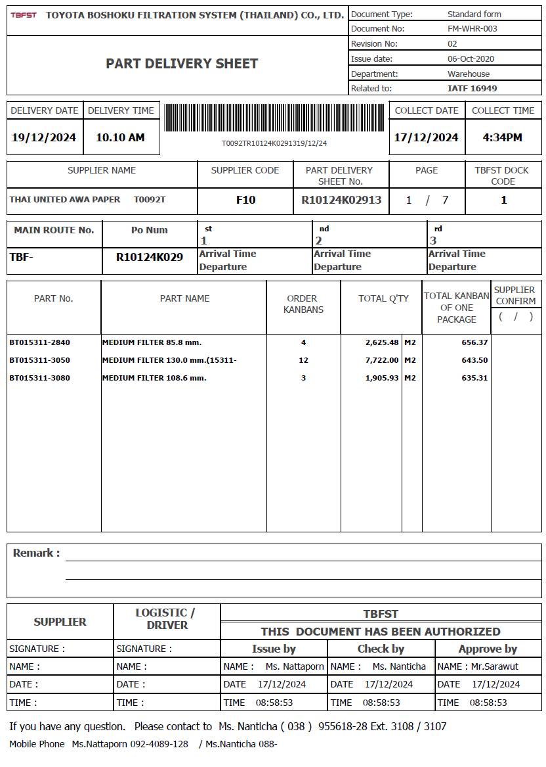
3. Document image
8
3-1-20. Part Delivery Sheet
TBFST ⇒Pegasus

Slide 25
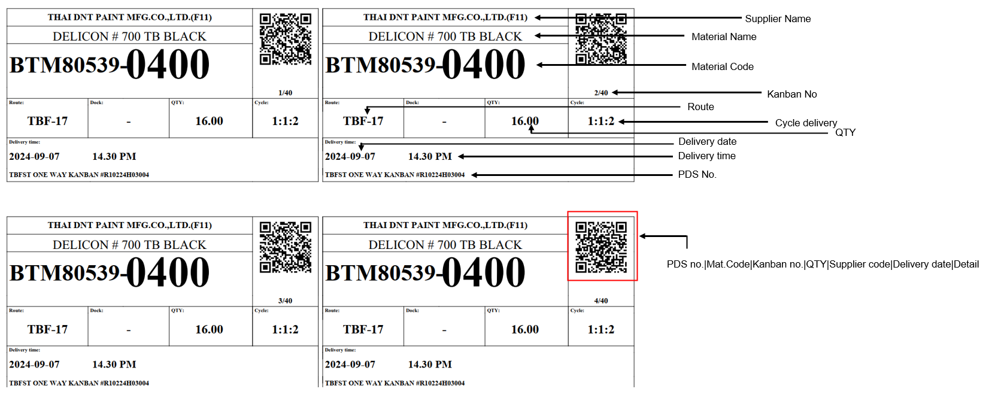

3. Document image
6
3-2-1. Supplier KANBAN
QR Code format:
PDS no.|Mat.Code|Kanban no.|QTY|Supplier code|Delivery date|Detail
Example:
R10224H03004|BTM80539-0400-102|4|16.00|T0102T|2024-09-07|medium

Slide 26
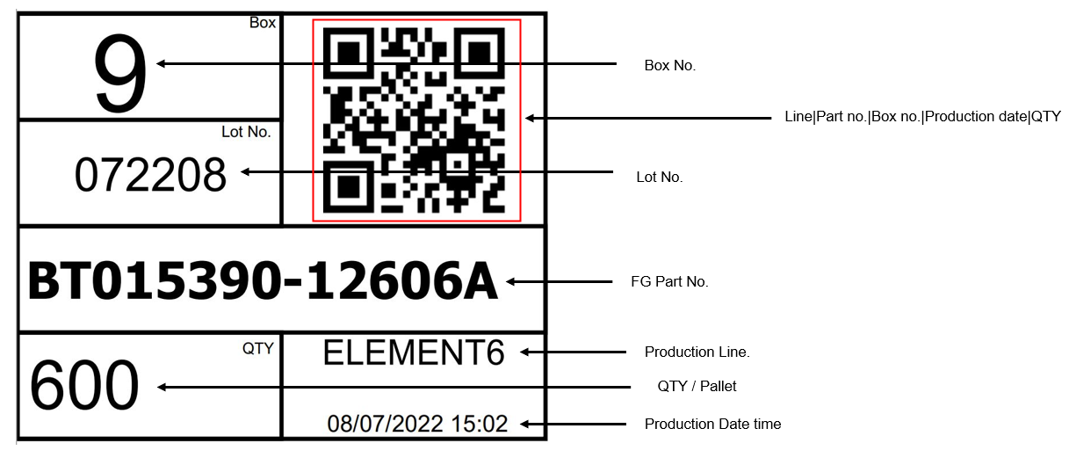
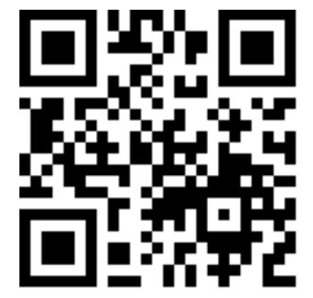
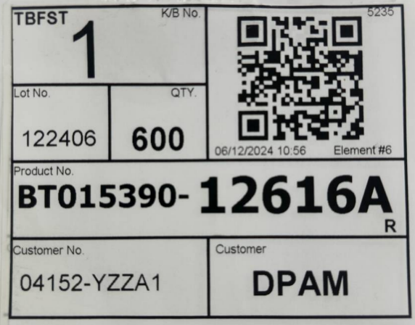
3. Document image
7
3-2-2. Production KANBAN
QR Code format:
Line|Part no.|Box no.|Production date|QTY
Example:
e6|12606A|9|08072022|600
2024-12-15:
New format layout

Slide 27
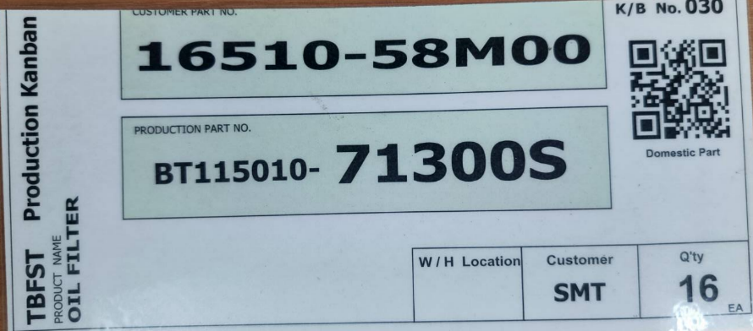

3. Document image
7
3-2-3. Production KANBAN (reused KANBAN)
QR Code format:
[Customer P/N – 11digits][Production P/N – 15digits][Qty]-[K/B No.]
Example:
16510-58M000BT115010-71300S016-030

Slide 28
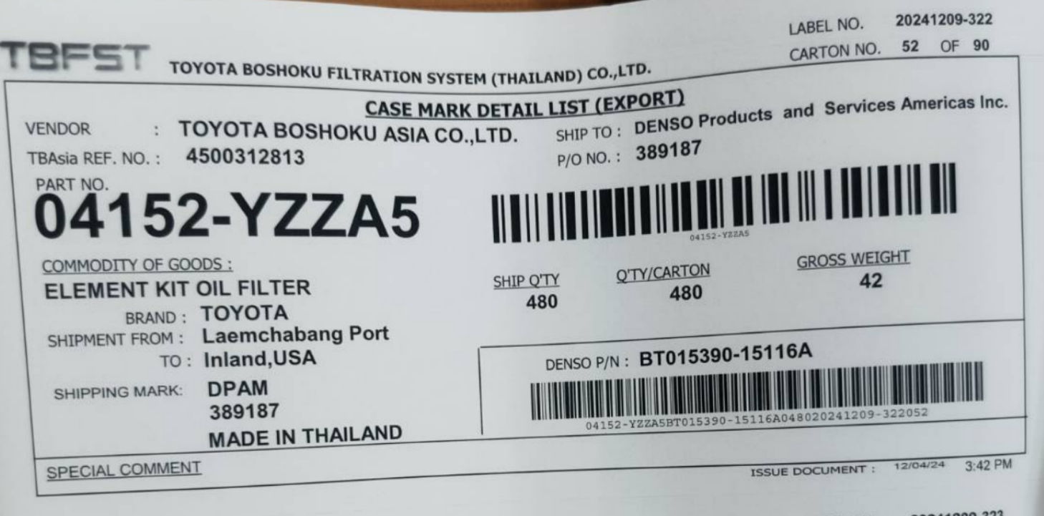
3. Document image
7
3-2-4. Customer KANBAN (Case mark)

Slide 29
4. Operation flow
8
4-1. RM – Materials Receive (PDS Line from ERP)
ERP
Stock Management System Pegasus
Send/Resend PDS Line
Middle Tier
DB
Read PDS Line
Report error details
Data OK?
Yes / No
No
Yes
Acceptance work
/ Create RM schedule
Next #1

Slide 30
4. Operation flow
8
4-1. RM – Materials Receive (Continue)
ERP
Stock Management System Pegasus
Next #1
พี่อ๋อ นันทิชา
Scan PDS sheet to start receiving process
No
Individual scan mode?
Yes/No
Yes
No
Request leader permission?
Yes/No
Scan all
the KANBAN tag.
Confirm and move to QC area
Yes
Scan 1st tag and move to QC area
Enter lot size
and total amount
Confirm and move to QC area
Return Materials
No
QC Inspection
Yes / No
Yes
Confirm RM transactions on web
QC Confirm and move to storage location
Feedback RM result
Get RM result
Middle Tier
DB

Slide 31
4. Operation flow
8
4-2. Temporary FG Inbound
ERP
Stock Management System Pegasus
Start
Scan Production KANBAN
Scan box barcode due to matching the parts no and carton barcode
Is Matched?
Yes / No
No
Yes
Yes
Is more KANBAN?
Yes / No
No
Scan temporary location ID (lane location) & confirm
Finish

Slide 32
4. Operation flow
8
4-3. FG Inbound (Inbound to FG store)
ERP
Stock Management System Pegasus
Start
Check actual part no and FG inbound work
No
Found FG Inbound work?
Yes / No
Yes
Move item to store & Scan FG store location ID
Enter item qty amount
Feedback PS result
Confirm PS transactions on web
Get PS result
Middle Tier
DB
Is more Inbound work?
Yes / No
Yes
No
Finish

Slide 33
4. Operation flow
8
4-3. FG Transfer / POKAYOKE (preparing schedule)
TBFST
Stock Management System Pegasus
Start
Preparing Loading Container Excel(CSV)
Import with Pegasus
Yes
File import error?
Yes / No
Check error details
No
Checking the import detail
No
Confirm work?
Yes
Acceptance work
Finish

Slide 34
4. Operation flow
8
4-4. FG Transfer
TBFST
Stock Management System Pegasus
Start
Check FG transfer work in handy
No
Found FG transfer work?
Yes / No
Yes
Go to location & scan store location ID then move items out
System will choose the oldest package from specific location
Is more transfer work?
Yes / No
Yes
No
Confirm FG transfer schedule on web
Finish

Slide 35
4. Operation flow
8
4-5. POKAYOKE
TBFST
Stock Management System Pegasus
Start
Check POKAYOKE work in handy
No
Found POKAYOKE work?
Yes / No
Yes
Check KANBAN
Scan production KANBAN & customer KANBAN
No
Is matched?
Yes / No
Yes
Yes
Replace production KANBAN with customer KANBAN
Is more POKAYOKE work?
Yes / No
No
Feedback FG Outbound result
Confirm FG Outbound transactions on web
Get FG Outbound result
Middle Tier
DB
Finish

Slide 36
4. Operation flow
8
4-6. Material Issue
TBFST
Stock Management System Pegasus
Start
Receive order to material issue
No
Is KANBAN mode?
Yes / No
Yes
Material Issue Manual mode process
Material Issue KANBAN process
Is more work?
Yes / No
Yes
No
Finish

Slide 37
4. Operation flow
8
4-6. Material Issue – Manual mode
TBFST
Stock Management System Pegasus
Start
Scan parts barcode
Enter the PS No
Enter/Adjust the quantity
System will get the oldest package (FIFO) due to designate quantity
Is more work?
Yes / No
Yes
No
Scan barcode line(destination line)
Confirm & move designate items out
System will generate material issue slip
Finish

Slide 38
4. Operation flow
8
4-6. Material Issue – KANBAN mode
TBFST
Stock Management System Pegasus
Start
Enter the PS No
Scan KANBAN
Is more KANBAN?
Yes / No
Yes
No
Scan barcode line(destination line)
Confirm
System will generate material issue slip
Finish

Slide 39
4. Operation flow
8
4-6. Material Issue – Confirm/Cancel Material Issue Slip
TBFST
Stock Management System Pegasus
Start
Check Material Issue Slip in handy
No
Found waiting to confirm slip?
Yes / No
Yes
Click and visual check the items and slip details
Confirm or Cancel the slip
Is more slip?
Yes / No
Yes
No
Feedback Material Issue result
Confirm Material Issue Slip on web
Get Material Issue result
Middle Tier
DB
Finish

Slide 40
4. Operation flow
8
4-7. RMA Return – Prepare data from ERP
ERP
Stock Management System Pegasus
Start
Send/Resend RMA Return
Middle Tier
DB
ERP_View_RMA Return
Read RMA Return
Report error details
Data OK?
Yes / No
No
Yes
Acceptance work
/ Create Receipt Material schedule
End

Slide 41
4. Operation flow
8
4-8. Return Material
ERP
Stock Management System Pegasus
พี่อ๋อ นันทิชา
Start
Enter “Return Material” and
Scan KANBAN
Yes
Is More KANBAN?
Yes / No
No
Scan barcode line
(source location)
Confirm and move material to WH store
System will automatically create Return Mat schedule
Feedback Material Issue rollback result
Confirm Return Mat schedule on web
Get Material Issue result
Middle Tier
DB
Is more Return material work?
Yes / No
Yes
No
Finish

Slide 42
4. Operation flow
8
4-7. Master management
TBFST
Stock Management System Pegasus
Location master
PC : Location master
User master
PC : User master
User credential master
PC : User Credential
Authority master
PC : Authority Master
Name master
PC : Name Master
Packing Standard master
PC : Packing Standard
Bill of Materials
PC : Bill of Materials
NG Reason master
PC : Name Master
Carton barcode master
PC : Packing Standard
Department master
PC : Bill of Materials

Slide 43
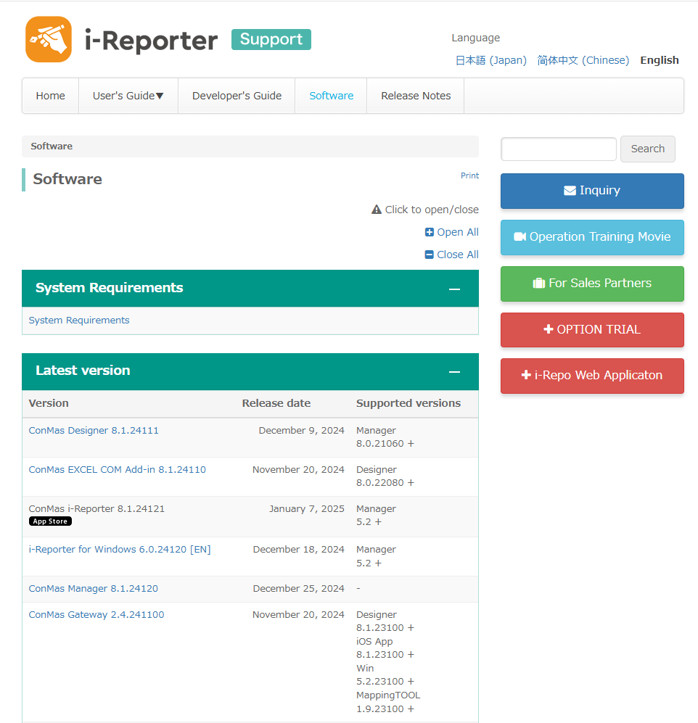
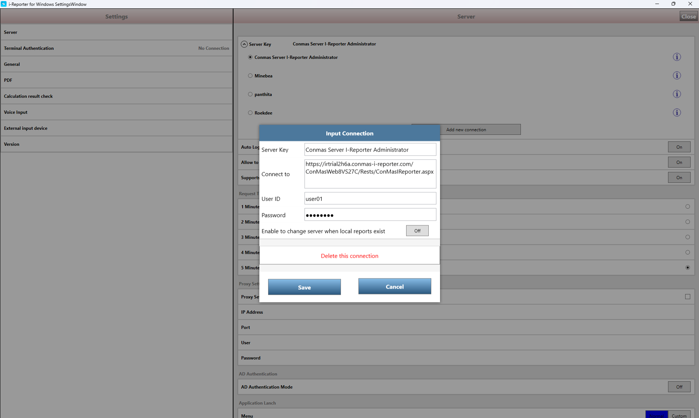
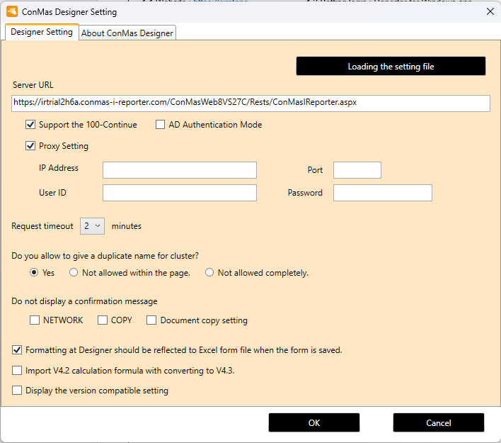
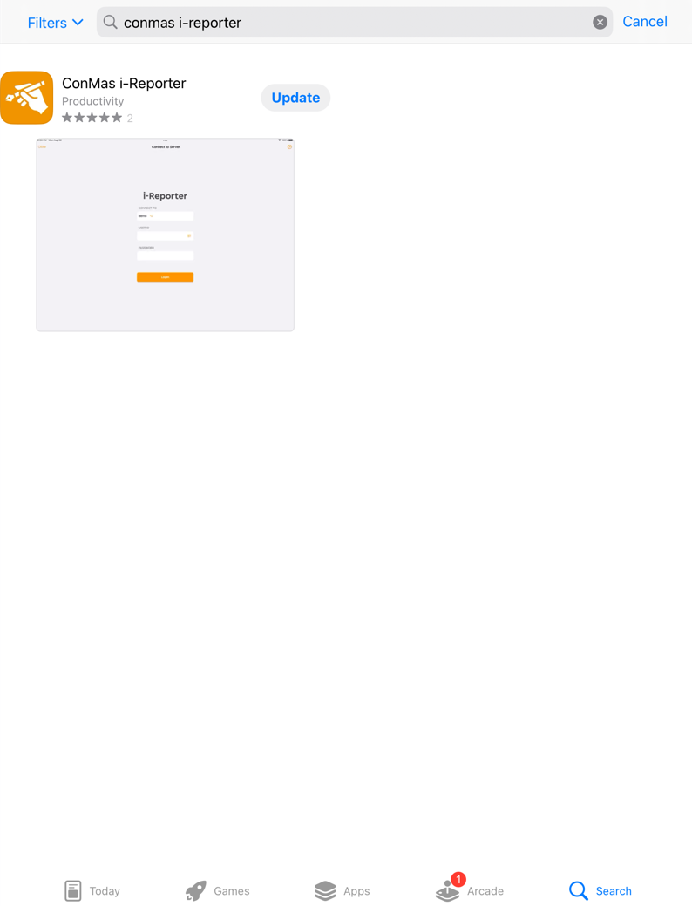
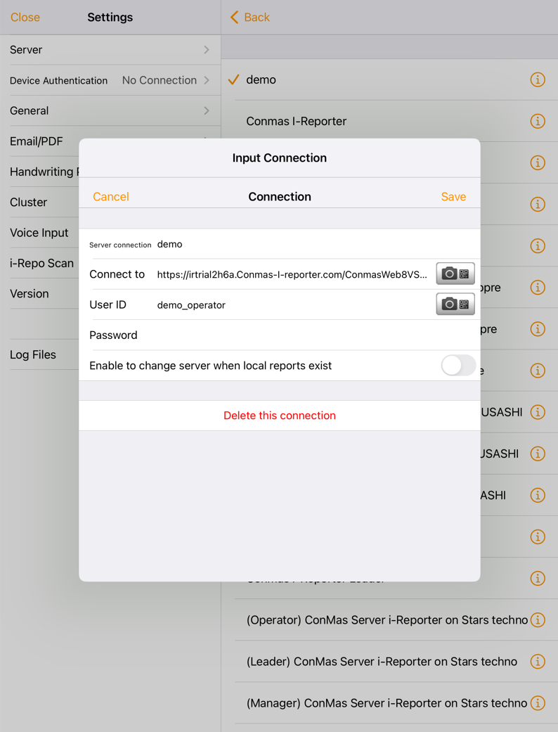
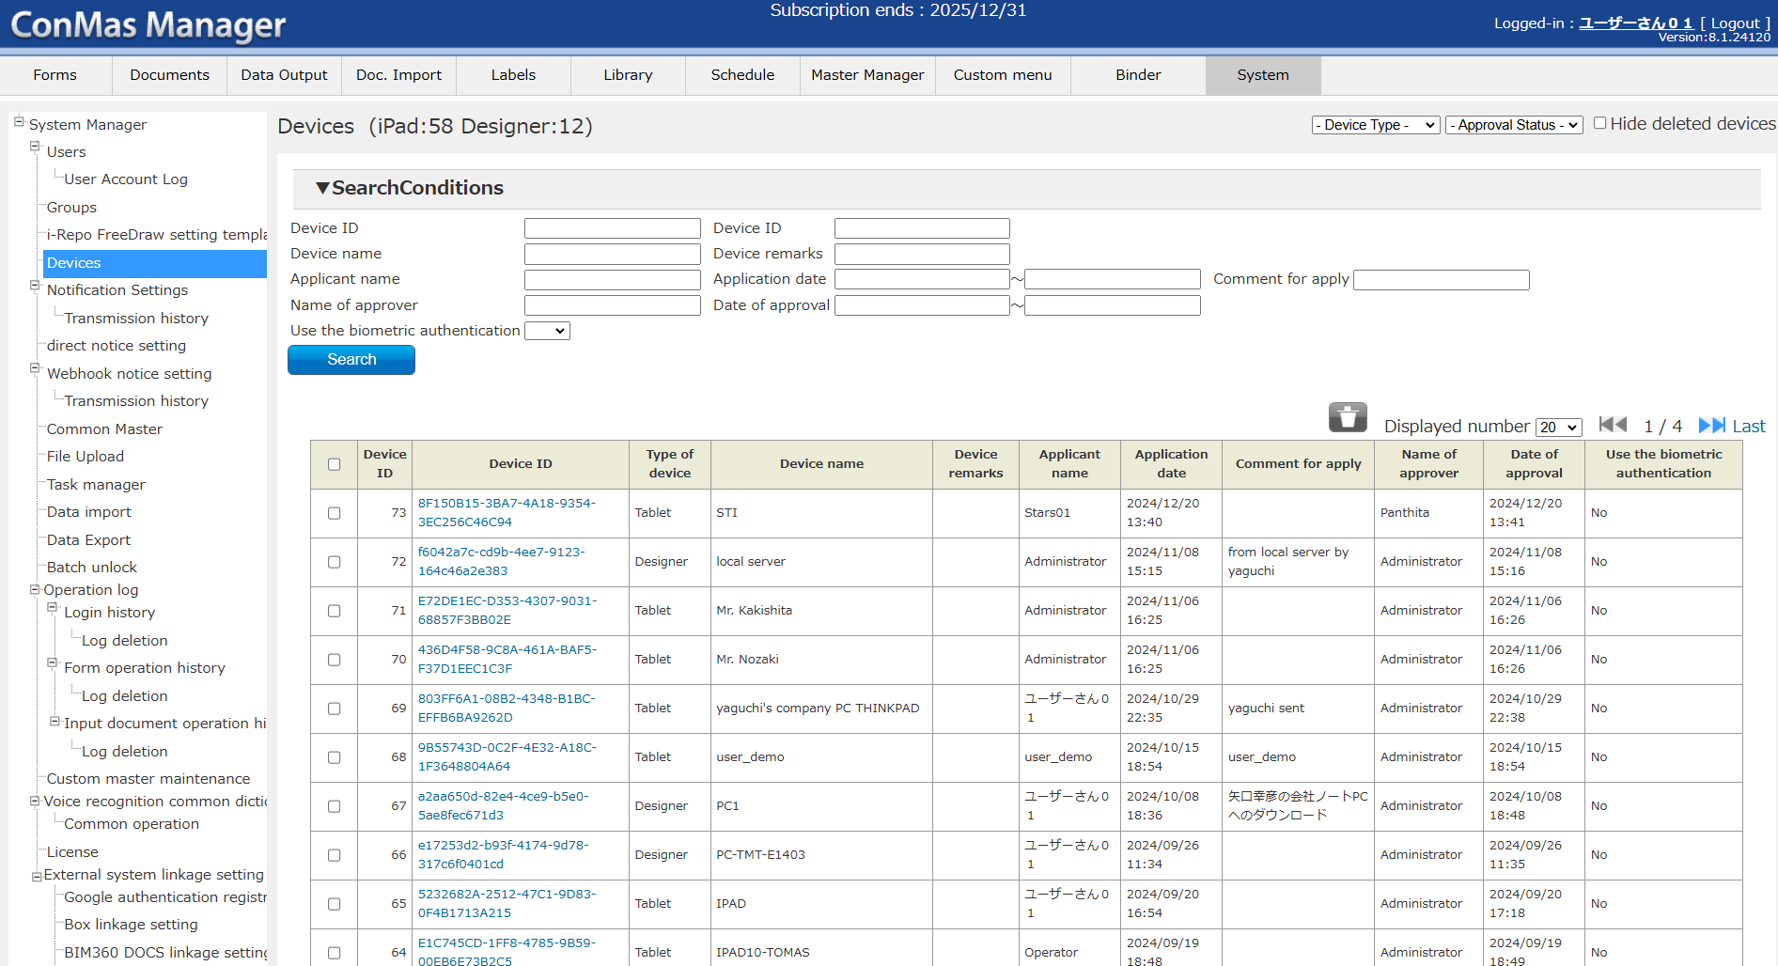
5. System functional specifications
8
5-1. Setting i-Reporter for Window and i-Pad app, ConMas Designer app
1. Download i-Reporter for Windows app. And ConMas Designer app. On Website : https://cimtops-support.com/i-Reporter/en/dl-software-en and login
1.1 Website : https://cimtops-support.com/i-Reporter/en/dl-software-en and login
1.2 Setting login i-Reporter for Windows
app.
1.3 Setting login ConMas Designer
app.
2. Download i-Reporter app. in App Store on i-Pad And and login
2.1 App Store
2.1 Setting login i-Reporter app.
3. Approved the use of the app on ConMas Manager > System menu > Devices

Slide 44
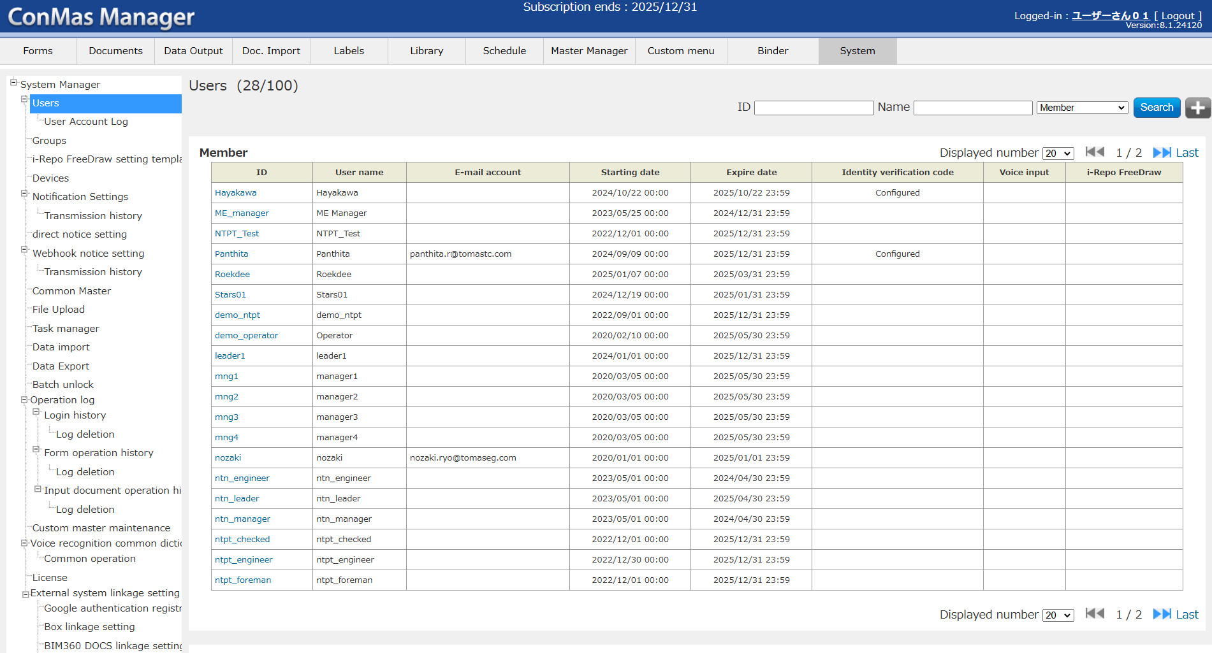
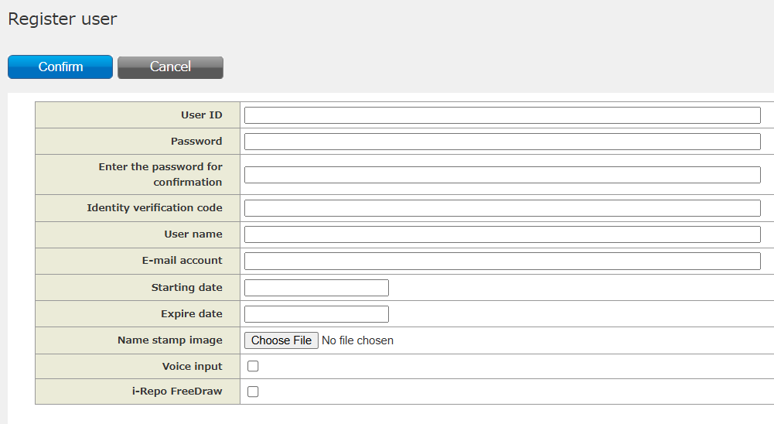
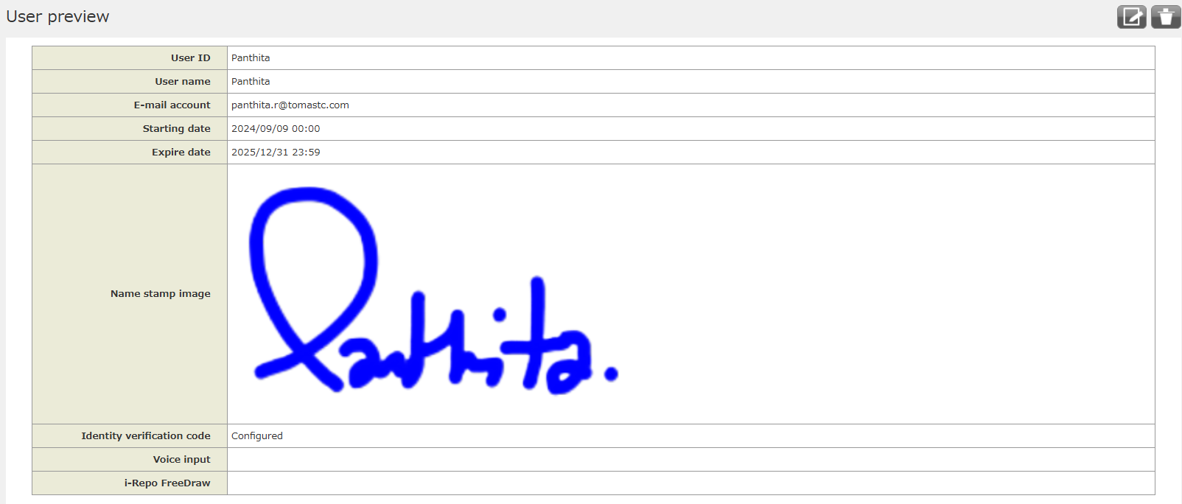
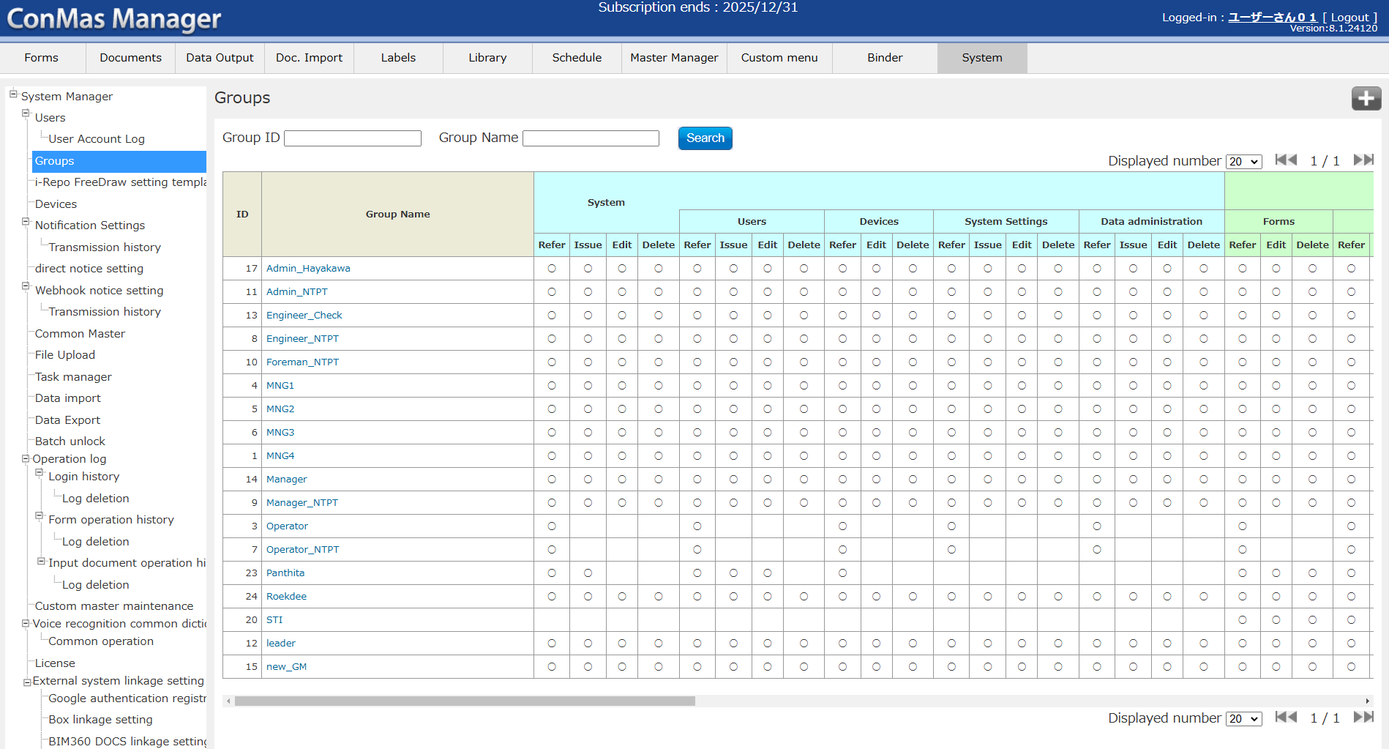
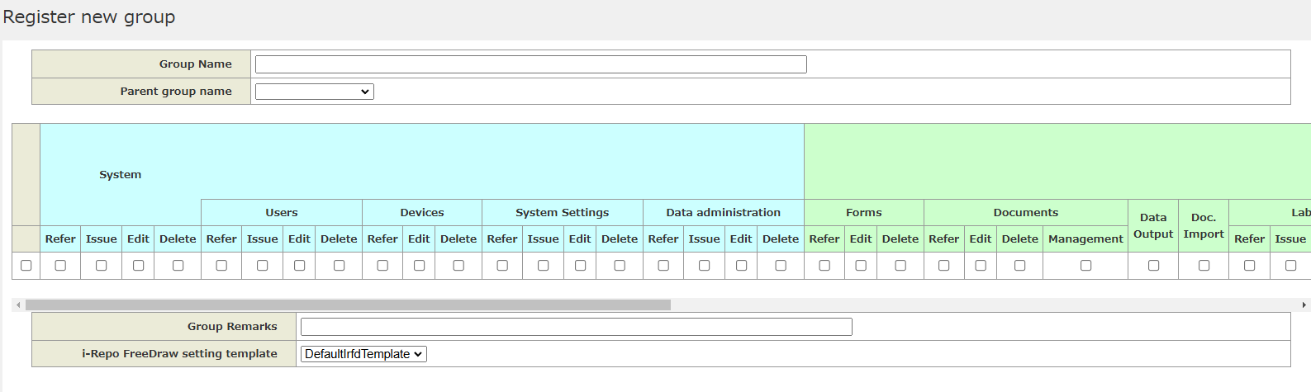
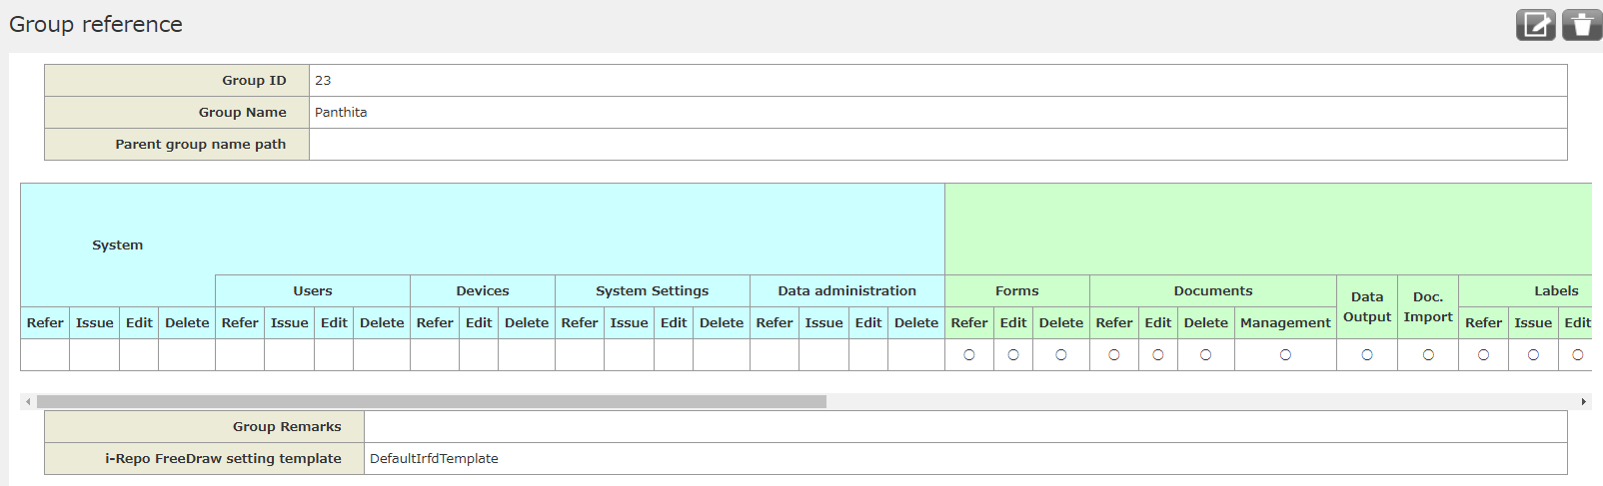
5. System functional specifications
8
5-2. Setting users/groups manager (System menu)
1. Setting user on ConMas Manager > System menu > Users > (add user, edit or delete user)
Example
2. Setting groups on ConMas Manager > System menu > Groups > (add groups, edit or delete groups)
Example

Slide 45
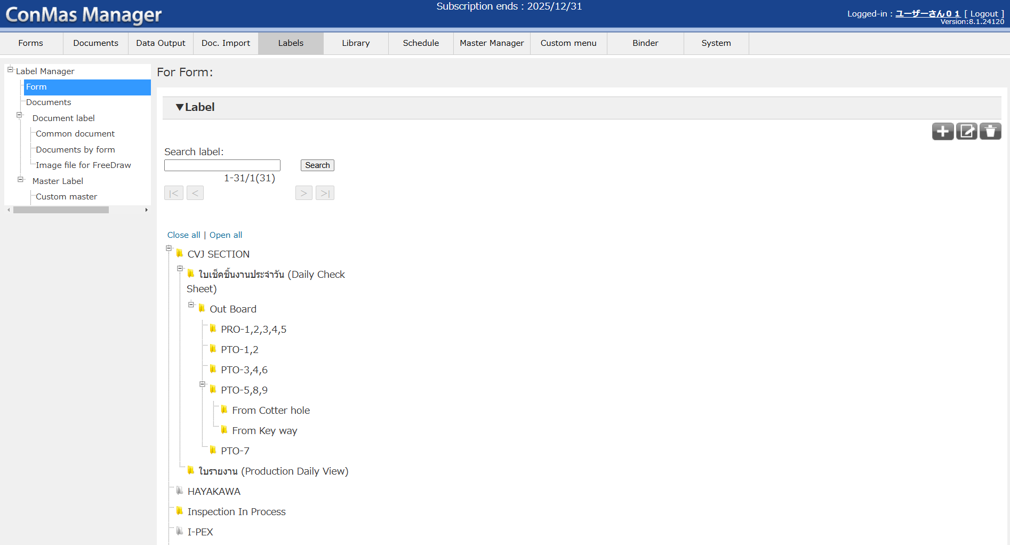
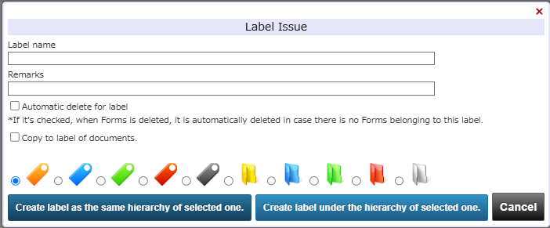
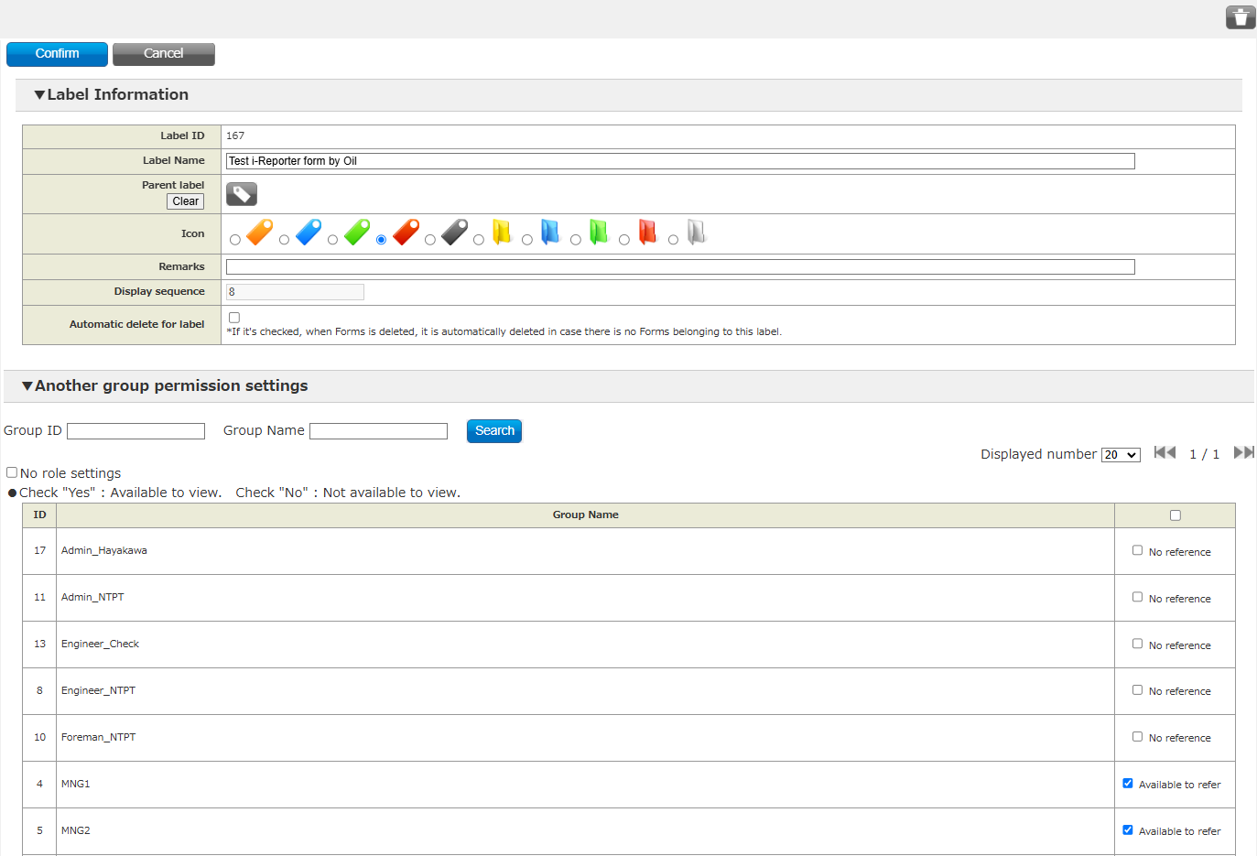
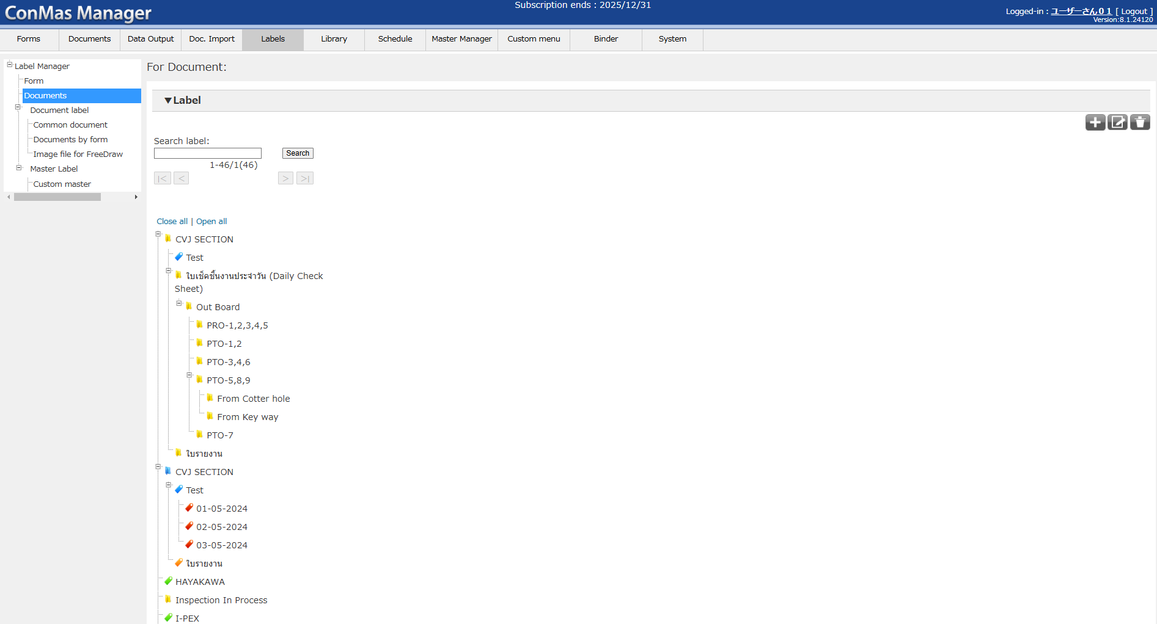
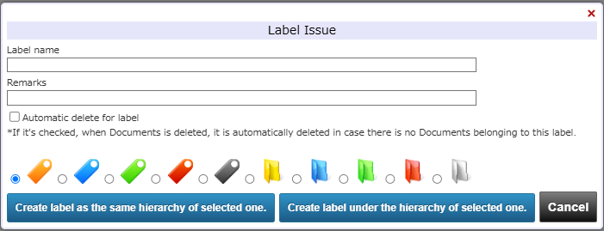
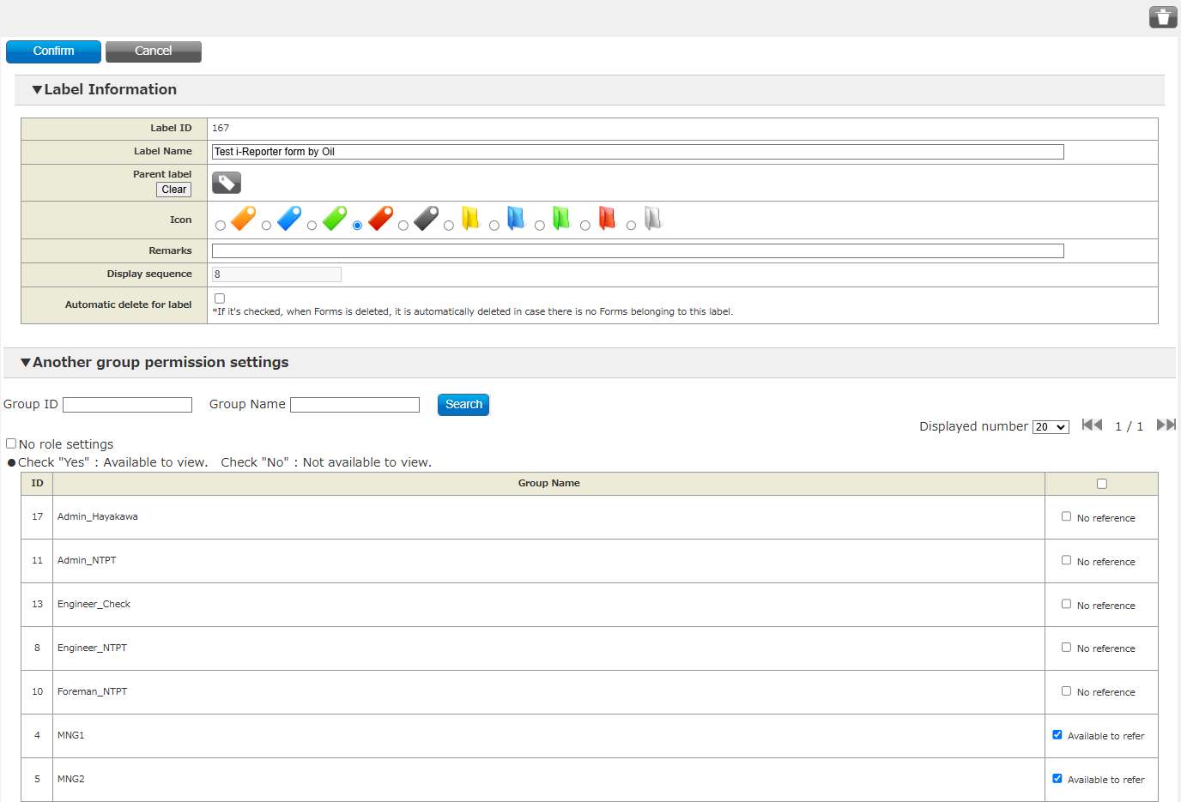
5. System functional specifications
8
5-3. Creating address for forms and documents (Labels menu)
1. Creating address for forms on ConMas Manager > Labels menu > Form (add labels, edit or delete labels)
Example
2. Creating address for documents on ConMas Manager > Labels menu > Document (add labels, edit or delete labels)
Example

Slide 46
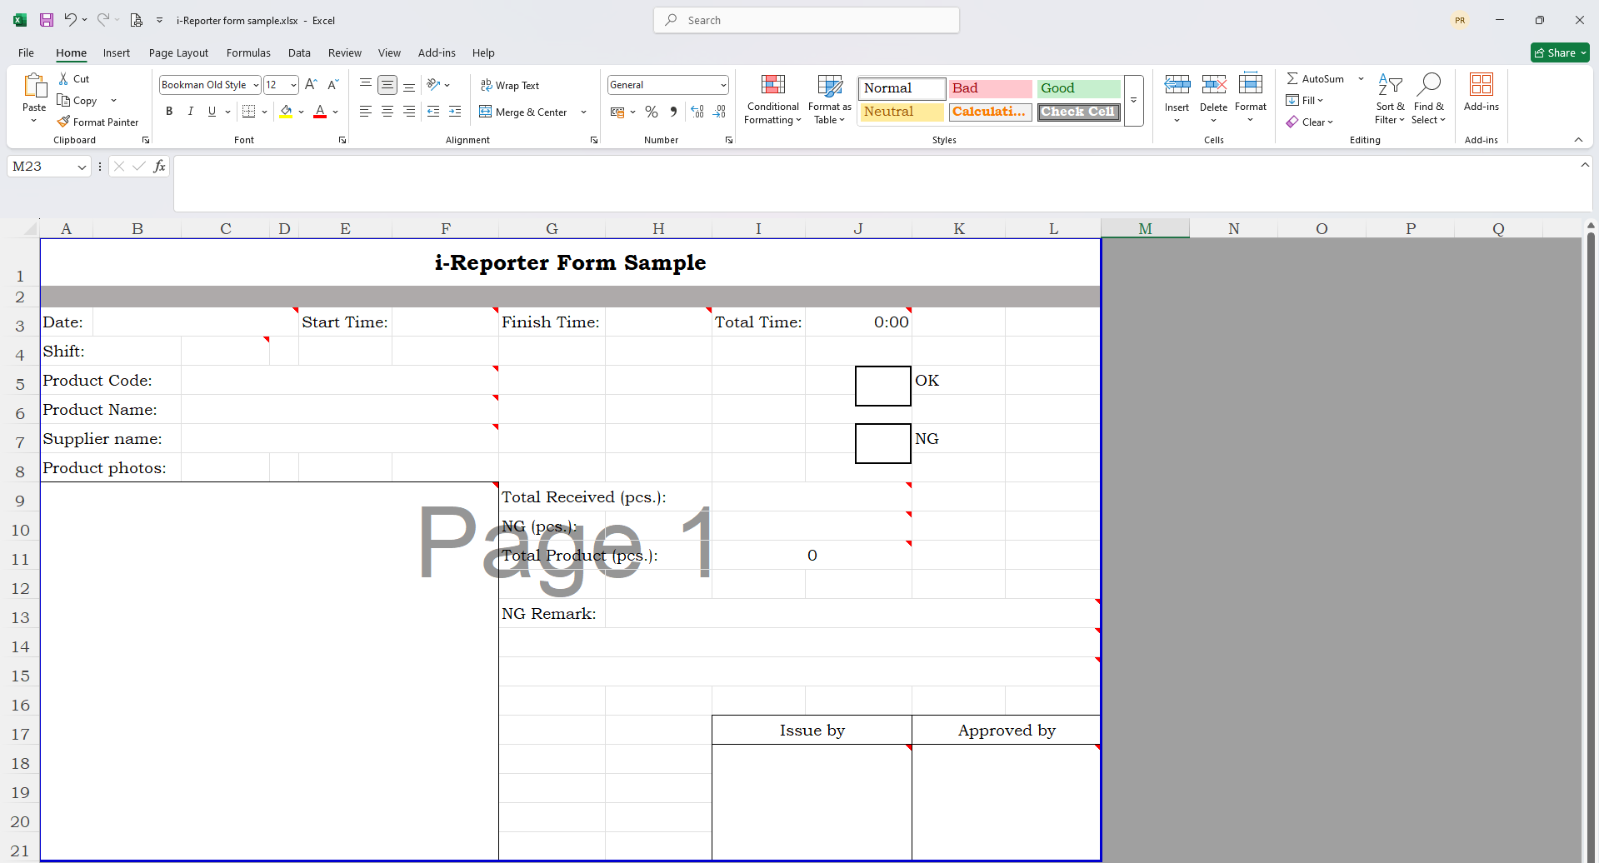



5. System functional specifications
8
5-4. Creating forms document
1. Creating a document forms on Excel file (document page layout and inserting various clusters, including setting up table(some forms document))
Create a document forms.
Add each type of cluster according to its application.
Setting table (some forms document) (The report data is automatically outputted to a dedicated table. (Two types are available)
In case of the form having tabular style, a table data is created for each setting table.
It will make more easy to be referred from external system such as BI tool.
The table data can be referenced via ConMas Manager and API * via the reference view, and also CSV output can be performed.)
Cover the document form area and then select 'Set Print Area’ and save document forms.

Slide 47
5. System functional specifications
8
5-4. Creating forms document
Cluster Type
Keyboard
You can enter characters from the software keyboard of your tablet or an external input device such as a
keyboard or barcode reader. It is a cluster that can be linked with external systems.
Text by handwriting
In order to use the function of this cluster, iPad App. "7notes Pad+WC"(provided by MetaMoji, annual
amount usage 3,000 yen) needs to be installed in iPad.
If "7notes Pad + WC" is installed, start "7notes Pad + WC" by linking between apps, convert handwritten
characters to text, and confirm, the text will be displayed in the corresponding cluster of i-Reporter. It will
be entered.
If "7notes Pad + WC" is not installed, normal keyboard text input will be used.
It is a cluster that can be linked with external systems.
Handwriting note
You can input multiple lines by handwriting. No text conversion is performed, and the entered content is
input as it is as an image.
Free white board
In addition to freehand drawing, you can call the camera and paste the image of the camera roll by pressing and holding the cluster. No text conversion is done and the entry is saved as an image.
It is a cluster that can be linked with external systems.
Free draw
A high-performance drawing tool with a dedicated editing screen.
It is a cluster that can be linked with external systems.
Choice of Numerical number
You can create a list (or counter) of numbers in a specified range at regular intervals.
It is a cluster that can be linked with external systems.
Numerical number keyboard
You can enter numerical values with the numeric keypad. It is a cluster that can be linked with external systems.
Number of hours
Available to input length of time, such as "260 minutes", "36 hours 15 minutes". External system
coordination is possible.
Calculation formula
You can use operations for clusters with numerical values and Excel functions when importing Excel.
Date
You can enter the date from the list. It is a cluster that can be linked with external systems.
Calendar
You can select and enter the date with the calendar-type picker. The parameters are the same as for the
date cluster. It is a cluster that can be linked with external systems.
Time
You can select and enter the time from the list. The format is for time only. It is a cluster that can be linked with external systems.
Time calculation
Specify two time clusters and calculate the elapsed time in minutes for less than 24 hours (1439 minutes
or less). Calculations that span days are also possible. It is a cluster that can be linked with external
systems.
Single check
You can click the "check mark" or "circle" that can be used in checklists. It is a cluster that can be linked
with external systems.
Toggle select
Each time you click multiple character strings, they are switched and displayed. You can set the label character string for display and the numerical value for internal calculation. It is a cluster that can be linked with external systems.
Toggle summary
You can aggregate the Toggle select values on a group-by-group basis. There are two methods of
aggregation: "Calculation of total score" by choice and "Summary count (Full points)" that displays the
perfect score for the entire group.

Slide 48
5. System functional specifications
8
5-4. Creating forms document
Single choice
You can select one item from the list. It is a cluster that can be linked with external systems.
The items in the list consist of a "Label" for display, a "Value" used for system linkage, and a "Default"
specified for the initial display.
Multiple choice
Select multiple items from the list. External system coordination is possible.
The items in the list consist of a "Label" for display, a "Value" used for system linkage, and a "Default"
specified for the initial display. Parameter is same as "Single choice" cluster.
Image
Insert the image taken by the camera or the image in the terminal. The size of the image is reduced to fit
in the cluster frame. It is a cluster that can be linked with external systems.
Issuer
It is mainly used to fill in the Signature Image and Sign of the person in charge.
When you click the Issuer cluster in the app, a pop-up will display the logged-in user information, comment, Signature Image or Sign entry field, and when you register, the Signature Image or Sign will be displayed.
Inspector
It is mainly used to fill in the Signature Image and Sign of the person in charge.
When you click the Inspector cluster in the app, a pop-up will display the logged-in user information,
comment, Signature Image or Sign entry field, and when you register, the Signature Image or Sign will be displayed.
Approver
Applies can be made by workers and approvals can be made by superiors and managers.
When applying, click the cluster to display the logged-in user information, comment entry field, and apply
button. After applying, a user with approval authority can click the cluster to approve or reject. Once
rejected, you will be able to apply again.
Approval authority is set in Manager.
Issuer of document
Create a document and display the user who originally saved it on the server. It is automatically entered
and cannot be edited.
Date of issue
Creates a document and displays the date it was originally saved on the server. It is automatically entered and cannot be edited.
Last update person
Edit the document and display the user who last saved it on the server. It is automatically entered and cannot be edited.
Last update date
Edit the document and display the date it was last saved on the server. It is automatically entered and cannot be edited.
Bar code
Click to scan the barcode (or QR code) using the camera of your iOS device or an external reading device and enter the text. It is a cluster that can be linked with external systems.
Barcode reader
When clicked in the app, the software keyboard is not displayed and only input from external devices is
accepted. It is a cluster that can be linked with external systems.
GPS location
Records the latitude and longitude information of your current location when saving.
To use GPS location information, enable location services and allow it to be used in the app. You can
configure your iOS location services in Settings> Privacy> Location Services.
Action
Action clusters, unlike other clusters, are buttons on your app to perform specific actions.
Action type
1. Jump to Reference document
Opens the specified file. It is necessary to register for Library management in
Manager in advance.

Slide 49

5. System functional specifications
8
5-4. Creating forms document
2. Sheet Jump
When you click the cluster in the app, it will move to the specified sheet. You cannot specify the same sheet as the cluster itself. Also, it cannot be used for document with only one sheet.
3. Server connecting menu
You can specify one item of "Server connecting menu" of the application and place it as a shortcut.
If "Use for Windows app. Version." Is checked, only the menus available for Windows apps will be displayed.
4. Sheet copy
When you click the cluster in the app, the specified number of sheets will be copied. The copy destination is immediately after the sheet where the cluster is located, and the input values can be copied at the same time.
5. Display non-required mark
When you click a cluster in the app, the "no entry required mark" specified in the Forms information settings will be displayed on the target cluster.
6. Open URL
Opens the specified URL. In addition to opening in the safari browser, it also supports custom URL schemes, so you can launch another iOS app.
7. Execute external application
Executes the external program specified by the command.
8. Export data（Text）
The text set in advance on Designer is output to the specified file path. Some cluster values and document information can be output as text. The output destination of the file is fixed and will be in the following folder.
Output destination: C: ¥ Users ¥ (user name) ¥ AppData ¥ Roaming ¥ CIMTOPS ¥ ConMas i- Reporter for Windows ¥ output destination
(“(User name)” is the name of the user logged in to Windows)
(Also, please note that "AppData" is a hidden folder.)
9. Automatic input
The configuration file prepared in advance in the local environment is read, and the value described in the configuration file is automatically input to the specified cluster.
10. Back to main screen
You can do the same thing in the Action cluster as the "Back to main screen" icon.

Slide 50
5. System functional specifications
8
5-4. Creating forms document
11. Gateway linkage
This is the action type used to link the Gateway. Please refer to the attached ConMas Gateway Manual and ConMas IoT Manual for how to link ConMas Gateway / ConMas IoT.
Also, from Ver.8.0.21050, only when the action type is set to Gateway linkage, it is possible to set " Focus on the cluster Start up as input wait state." even if it is an action cluster.
12. Start timer
It is used as a set with the schedule time of the action type "Gateway linkage". When the timer is started, the timer mode is set, and no document editing is possible until the timer mode is canceled. In this state, when the time set in the schedule time of "Gateway linkage" is reached, the corresponding "Gateway linkage" is automatically executed. If the network is set to operate during the timer mode, the operation of the network function is not guaranteed.
13. QR code generation
This is an action type that generates a QR code by using the Calculation formula cluster of the reference destination and the Image cluster of the output destination together. Set the three clusters of Action cluster, Calculation formula cluster, and Image cluster set in "QR code generation" as one set.
14. Biometric authentication
This is an iOS version limited function. Click to ask for biometrics. When used in combination with the network settings, it can be set to allow input of subsequent clusters of the network if biometric authentication is successful.
15. Batch clear
It is a function to clear all the input values of the cluster registered in advance by Clicking the Action cluster.
Select master
You can specify the custom master registered in Manager and the fields to be referenced from it, and enter values for multiple associated clusters at once.
Log-in user
Enter the user name or user ID that is currently logged in to the app.
Stick pins
It will be the area to hit the pin on the app. Only one can be placed in the entire document.
It is a cluster that can be linked with external systems.
Pin No. locating
It works with the pinning cluster and displays the number of the pin hit by the pinning cluster.
Pin No.
The pin No. in the pinning table is displayed.
Audio recording
Click to record up to the specified maximum recording time, and after recording, click to play, delete or rerecord the recorded data.
SCANDIT
SCANDIT cluster is a dedicated cluster for use with i-Repo Scan.
i-Repo Scan is an optional function of i-Reporter and requires a separate i-Reporter contract in addition to the i-Repo Scan license.

Slide 51






5. System functional specifications
8
5-4. Creating forms document
2. Creating forms document on ConMas Designer app.
Select to create a forms document an existing file.
Additional settings in different clusters
Set the document name to identify the data according to the desired cluster.
Set "Yes" when using the table function.
Set "Yes" when using the document copy function and select the 'Method of document copy' menu option.
Save form documents.

Slide 52


5. System functional specifications
8
5-4. Creating forms document
Cluster Mode
Editing Settings

Slide 53


5. System functional specifications
8
5-4. Creating forms document
Network settings
Two clusters can be set as “Prior” and “Successive,” and are connected by network.
- Control the input order and input without errors or omissions
- Automatically require “Successive” input fields depending on the “Prior” selection
- Perform control such as limiting the selection value in the “Successive” based on the selection value of the “Prior” .
Carbon Copy Settings
Use ConMas Designer “Carbon copy setting” in Cluster mode.
- Switch Cluster mode to “Copy” ①
- Click in the order ②cluster (Value to be copied) > ③cluster (Value to be pasted) on the next page
- A confirmation message appears, click “Yes” to complete the setting ④.

Slide 54



5. System functional specifications
8
5-4. Creating forms document
Custom Master
Entering information using master data (registered on the server).
① Tap a “Select Master” cluster (Parent cluster) for master data to appear.
② Select a record from the master data and then values in the record are entered to clusters
(child clusters) accordingly.
By creating master data and linking it with clusters in the template form, data can be input via tablet.

Slide 55



5. System functional specifications
8
5-4. Creating forms document
Barcode Breakup Function
This function allows you to read bar code and QR code (hereinafter referred to as “barcode”), then split the information into multiple clusters at one time.
◆Scan a barcode and breakup to enter the information according to the settings.
Set up a cluster to read barcode and to enter the values after breaking up the read data.
Barcode reading (Cluster Type: Bar code): A cluster that reads a barcode
Entering destination (Cluster Type: Bar code): Barcode data that splits into multiple clusters
* Up to 100 “Entering destinations” can be set from one “Barcode reading.”
Barcode breakup is set in ConMas Designer
① Cluster types should be set as “Bar code(s).”
②.Select “Bar Code Breakup Setting.” from Cluster mode.

Slide 56


5. System functional specifications
8
5-4. Creating forms document
Barcode reading cluster setting
- Click the cluster to be “Barcode reading” and choose the separator type, then click [OK].
- [Device code breakdown information] list appears.

Slide 57


5. System functional specifications
8
5-4. Creating forms document
Document copy settings
Click the " Document copy setting " button from " Cluster mode " on the edit screen to enter the mode to set the input value movement.
First, You can set the Moved from cluster and Move to cluster by selecting the Moved from cluster and then selecting the Move to cluster.
When you set the Moved from and Move to clusters, the settings are added to the " Settings of
document copy function" grid. By double-clicking the "To cluster" item on this grid, you can select the
"Move" and "Copy" settings from the combo box. The default setting is "Move".

Slide 58


5. System functional specifications
8
5-4. Creating forms document
Automatic File (Document) Naming Function
Parameter (Category)-dependent file naming when saving a document.
The following contents can automatically be added to the file name.
Click the “SETTING” button in the “Form Information Setting” Tab.

Slide 59
5. System functional specifications
8
5-4. Creating forms document
Main menu of the Designer editing screen
• Save temporarily
Temporarily saves the file locally. When an error occurs, you can resume from the temporarily saved state.
• Save in process
Store it privately on the server.
• Save in Published
It will be saved to the server as public and can be viewed on the iPad app.
• Save in Test
Save it to the server for testing. You can see it if the iPad app is set to display the test document.
* Please use the document created from the test public definition only for the purpose of testing before operation.
• Output xml of form
Save the Forms locally as an xml file.
• Exit without saving
Discard the edited contents and close the editing window.
• Hide sheet view
Hides the thumbnail list of the sheet.
• Maximize screen size
Hides the window frame and Forms list, and maximizes the editing screen.
• Output Excel of form.
Valid only when the Forms is created from the EXCEL file. Return the Forms information to the EXCEL file and output it again.

Slide 60


5. System functional specifications
8
5-5. Selecting address for forms and documents - Document permission setting, Document visibility permission (Forms menu)
1. Forms - Label
• Labels are separately configured for Forms and Documents. Create a label in advance in “Labels.”
• Documents labels can also be configured later in “Documents.”
2. Forms – Authority
• For the Forms authority, the authority set up in “Groups” at the time of definition creation is set up as
the initial value.
• In the editing screen, the list of groups and check boxes for each authority are displayed. Register the
necessary authority by inserting a check mark.

Slide 61




5. System functional specifications
8
5-5. Selecting address for forms and documents - Document permission setting, Document visibility permission (Forms menu)
• Check box operation at the top of the screen: Check batch operation in a vertical row.
• Check box operation at the right of the screen: Check batch operation in a horizontal row.
• Check box operation in the upper right corner of the screen: All checks are batch operations.
• Set “what group” to which “right” is given for the corresponding template form

Slide 62


5. System functional specifications
8
5.6. Setting approved (System menu)
Enable this function for all forms (common setting)
You can set the applicant edit lock function for the entire system by selecting → Common Master from the menu
"System".
The applicant edit lock function is enabled for all forms.
*If set for the entire system, the form definition settings will be ignored.
1. Select "IPAD_SETTING" from the common key.
2. Change the common item name "USE_APPLICANT_LOCK" from "0" to "1".
“0” : Disabled) No system-wide settings (default)
“1” : Enabled) Enable applicant edit lock for the entire system
Enable applicant edit lock mitigation mode
The settings are enabled in the Common Master of System.
⮚ Common key “IPAD_SETTING”
⮚ Common item name “APPLICANT_LOCK_TYPE”
⮚ Common item value “0”: Normal “1”: mitigation mode
⮚ * The default is "0"

Slide 63

5. System functional specifications
8
5.6. Setting approved (System menu)
Enable automatic network application
In the menu "System" -> "Common Master", enable the automatic network application function for the entire system.
*There is no individual setting for each Forms.
1. Select "AUTO_APPLY_SETTING" from the common key.
2. Change the common item name "MANAGER_ENABLE" from "0" to "1" to make it effective for the
entire system.

Slide 64


5. System functional specifications
8
5.7. Locking signature fields for individuals by group (Forms menu)
Authority for Clusters
The following authority can be set for each cluster
◆ Editable: Enter values in the cluster and check the entered values
◆ Reference only: Cannot enter values in the cluster, but you can check the entered values
◆ No reference : Cannot enter values in the cluster, nor can you confirm the value(s) entered.
* An “approved cluster” cluster type means the following.
* Editable → Can be approved * Reference only → Applicable *No reference → Cannot perform any operations
Authority for Clusters : Setting

Slide 65


5. System functional specifications
8
5.7. Locking signature fields for individuals by group (Forms menu)

Slide 66

5. System functional specifications
8
5.7. Locking signature fields for individuals by group (Forms menu)

Slide 67



5. System functional specifications
8
5.8. Master Manager menu
1. Creating and Registering a Custom Master
Custom masters are registered / updated by CSV.
Create a CSV file using a “Custom Master Input Sheet” for custom master registration and upload the CSV file to the server using ConMas Manager.
* This file contains an Excel macro for reading and writing CSV.
1.1 Download Excel workbook “CustomMasterInputSheet.xlsb” (in the “software” pages of the support web.)
1.2 Start Excel and fill in the required information in the white cells of the input sheet background. (There is a description of the input in the cell comment field of each title.)

Slide 68




5. System functional specifications
8
5.8. Master Manager menu
1.3 Basic Master’s information setting
1.4 Setting up record information to configure a custom master table
1.4.1 Flag/display order/available group settings

Slide 69



5. System functional specifications
8
5.8. Master Manager menu
1.4.2 Header name such as Record KEY/Field name/Field type setting
1.4.3 Setting method for image data
1.5 Output a CSV file reflecting a custom Master import CSV layout

Slide 70


5. System functional specifications
8
5.8. Master Manager menu
1.6 Uploading the created CSV file to ConMas Server
Login to ConMas Manager.
Click the “Master Manager” menu, and click on the upper right button of the screen, “Custom master maintenance,” to display the maintenance screen.
In the case of a custom master with images: ZIP file creation.
When adding images to master data,
① Specify image file names as “Image 01 to Image 05” fields in CustomMasterInputSheet.xlsb.
② Compress the CSV file containing image file names and actual image files into a Zip file
③ Upload the zip file to the server.

Slide 71


5. System functional specifications
8
5.8. Master Manager menu
2. Custom Master Updates
2.1 Downloading the custom master as a CSV file.
① Select the custom master you want to download.
② Click the “CSV” button at the top left of the screen to download the CSV file.
2.2 Load the extracted CSV file into the “CustomMasterInputSheet.xlsb.”

Slide 72


5. System functional specifications
8
5.8. Master Manager menu
2.3 Processing after record updates
- For “Flag,” enter an “M” (Merge) or a “D” (Delete).
M: Adding new records or modifying the current contents.
D: Deleting the current record.
- The subsequent steps are the same as when creating a new CSV file and importing it into the server using ConMas Manager.
3. Custom Master Setting in Template Forms
Configure the following settings using ConMas Designer.
① Select which master table to use and which fields to insert in the “Select Master” cluster.
② Setting “parent-child relationship” between Select Master cluster (parent cluster) and other clusters (child clusters).

Slide 73


5. System functional specifications
8
5.8. Master Manager menu
Linking master table and field selection
Link the master table registered in ConMas Server to the “Select Master” cluster
Master table linkage / field selection
① Click the “Choose master” button on the Select master cluster “Input parameter setting” tab, and
select the master to use for this cluster.
② Click the “Choose field” button, and select the field that is to be the input value for this cluster

Slide 74


5. System functional specifications
8
5.8. Master Manager menu
Each field value of the master data can be automatically inserted to each child cluster.
Set up a “Parent-child relationship” in ConMas Designer.
* The only cluster type that can be a parent is a “Select master” cluster.
Select “Custom Master Settings” mode of ConMas Designer
① Click the “Customer Master Settings” button in “Cluster Mode” on screen.
② Select a parent (Select Master) cluster to be set in a parent-child relationship.
③ Select a child cluster for which the master data value is automatically inserted.

Slide 75


5. System functional specifications
8
5.8. Master Manager menu
Cluster types that can be set as a child cluster
The following 6 cluster types can be set as child clusters.
*Only the same field as the cluster type of the child cluster can be displayed in the list
4. How To Input on a Tablet
On the tablet, operate the “Select master” cluster as follows.

Slide 76


5. System functional specifications
8
5.9. Data Output menu
The type of connection table
There are two types of linkage table as follows.
• Single form (Current one)
A report data registered in one record.
• Tabular format (available since V7.1.20050)
Input document data can be outputted as tabular format according to the table settings. You can set the multiple tables in one document.
Tabular formats are generated per table.
* Requires table setting in EXCEL COM Add in (Ver 7.0.20030 and more)
How to create table data for connection
Table for connection (tabular format) requires to set with EXCEL COM Add-in first.
• Click [Add-in] menu and select [Table setting].
• Select the range of cells to be set for a table.
• Set "Table name” (Table number is set automatically).
• Check on the box “Output to linkage table”.
• Column names and column keys are set automatically.
(available to modify them)
• Click “Save” button.

Slide 77




5. System functional specifications
8
5.9. Data Output menu
A table for connection is automatically generated by setting on each form in ConMas Designer.
• Import Excel template form or open the target form in Designer.
• Click the "Form information and setting".
• Set "Create table for connection" to "Yes ( for all items ) or Yes (select item)".
Single form
Output all the cluster information in the single form style.
Tabular format (available since V7.0.20050)
Output all the cluster information including all tables in the tabular format.
Single form
Output the selected cluster information which is checked on “Adapt to this cluster”
of “Coordination master table” in single form style.
Tabular format (available since V7.0.20050)
Output the selected cluster information including all tables which is checked on “Adapt to this cluster”
of “Coordination master table” in the tabular format.

Slide 78


5. System functional specifications
8
5.9. Data Output menu
Reference view from ConMas Manager
Contents of view can be referred from ConMas Manager
• Previously created single form views are also available to refer
• CSV output available
Select output definition
Select the target form in the Data Output menu.
• Select the target form and click the button “To linkage view".
• Up to 1 form only.

Slide 79


5. System functional specifications
8
5.9. Data Output menu
Selection of connection view
Select a view physical name.
• Click the view physical name.
Type
Single form type is a view in which lists up in one record per document.
Table form is a view with a tabular format.
View physical name
Single form: view_report [original form ID]
Table format: view_report [original form ID] _ [table number]
Table name
Single form: Not displayed.
Table format: Displays the table name.
Linkage view reference / CSV output

Slide 80


5. System functional specifications
8
5.10. Custom menu
This is a business menu that can be set by the user. You can place 6 businesses.
Custom menu is set by the user in the Manager.
It's automatically delivered to iPad and iPhone which has been set to Custom menu.
You can click the menu change icon to switch to the conventional menu (Normal menu).
The user can freely set the Custom Menu panel to be displayed on i-Reporter.
The following actions can be assigned to the Custom Menu button located in the
Custom Menu panel on i-Reporter.
1. Call the Forms and create a new Document (display of Document input screen)
2. Start Documents (display of Document input screen)
3. When the Document is started, the value of the read device code is decomposed and
automatically input to the decomposition destination cluster

Slide 81


5. System functional specifications
8
5.10. Custom menu
Custom menu settings
• Custom menu are created in ConMas Manager.
• The iPad and iPhone apps download and use the setting information.
• The settings for how to decompose the code read by the device into each cluster of Document are
set in the Forms in ConMas Designer.
Custom menu settings Overall flow
The roles, settings, and operations of Manager, Designer, and iPad / iPhone apps are largely performed in the following flow.This section describes"
(1)Registering/editing Custom menu information with Manager".

Slide 82


5. System functional specifications
8
5.10. Custom menu
Custom menu panel setting flow
The Custom Menu panel Layout settings
Layout settings for Custom Menu panel are made in ConMas Manager.
• The screen that displays the Custom menu button is called the custom menu panel.
• In the layout settings of the Custom Menu panel, you can set the following.

Slide 83


5. System functional specifications
8
5.10. Custom menu
Custom menu button settings
Custom menu button is set in ConMas Manager.

Slide 84


5. System functional specifications
8
5.10. Custom menu
1. Custom menu button settings
Set the display of Custom menu buttons.
2. Custom Menu button setting
Set the operation to be assigned to the Custom menu button.
Set whether to call the Forms or the Documents from the Custom menu button.
• When "Forms" is selected, a new Document is created from the Forms and started.
• When “Documents" is selected, the Document is started.

Slide 85


5. System functional specifications
8
5.11. Library menu
Using Library management function
To use Library management function, please execute the following procedures in Manager.
1. Set the group that has authority for Library management.
2. Set the labels for Library management.
3. Register documents in common.
4. Register documents by form.
5. Set the documents to be referenced in the form.
Setting document labels
Labels can be set for Common document or Documents by form.
• Click Labels, and then click Document Label / Common document or Documents by form from the label
tree on the left side of the label management screen.
• To add a label, click the add "+" button at the top right of the screen.
• To add new a label below an existing label, click the "+" button with the label selected.
If no label was selected, then a label will be created at the topmost layer.
Managing Library
To manage library, all operations is executed in Manage.
• Library has two classifications: "Common" and "Document by form".
• Documents can be stored with hierarchical label.
• Authority can be set by group for each label.
• Authority can be set by group for each document.
(You can manage the reference authority in the same way as the Forms and Documents.)

Slide 86


5. System functional specifications
8
5.11. Library menu
Available file format
Following types of files are available.
• MS Office documents in Excel, Word, and PowerPoint
• PDF
• Images (jpg/gif/png)
• Audio (mp3/wma/wav)
• Video (mp4/mov)
• 3D viewer "iXVL" by Lattice Technology Co., Ltd.
• Web page URL
Freedraw image
Register the images that can be used in the FreeDraw in the iOS app.
  Feature of FreeDraw image document
• Images handled by FreeDraw on the iPad can be registered, saved locally like a common library, and saved on the iPad itself.
• Click the dedicated icon on the FreeDraw screen of the iPad to display the list, and you can
register multiple images at once from there.
List of library
List of documents in Manager.
• Click top menu "Library", and display "Library management" screen. (if the user doesn't have an
authority, the menu is not displayed.)

Slide 87


5. System functional specifications
8
5.11. Library menu
Switching between Common and By document
Click on the "Common" / “By document" toggle button at the top left of the screen to switch between common documents and form documents.
• The initial display shows “Common ” list.

Slide 88


5. System functional specifications
8
5.11. Library menu
Displaying a list of images for FreeDraw
Register common / documents by form
Registering documents (Common and by form)
• Click "Library" on the top menu to display "Library management" screen.
• To add a document in library, click "+" button at the upper right of the screen.
• To add a new document with a label, click "+" button with the label selected.
• The label can also be designated on the next step.

Slide 89


5. System functional specifications
8
5.11. Library menu
• In Common library, register three items: "▼Information", "▼Label Information", "▼ Another group permission settings ".
• In "By document", in addition to the above three items, register "▼Document which is linked to this file".
• Enter "▼Information", and select the documents to be uploaded.
• Up to 10 document files can be uploaded at once. When you select a file in File, a list of files is displayed below the file selection. You can delete it by clicking the "x" in front of the file name.
• Upload file name becomes "document name ", and icon is automatically set by extension of the file. Enable to edit the file name after uploading.
Set label.
• Under "▼Label Information", set the label to be put to the file.
* “Common library label” or “By document label” must have been created beforehand in label management.

Slide 90


5. System functional specifications
8
5.11. Library menu
Set viewing authority for each group.
• Set the authority under "▼Another group permission settings".
• If "No role settings" is checked, all groups will be able to view
Register images for FreeDraw
• Click “Library" in the menu to display the “Library" screen, and click the image for FreeDraw.
• To add an image, click the Add [+] button at the top right of the screen.
• When add a new image to the label, select the label and click the Add [+] button.
• It possible to specify the label on the image registration screen.

Slide 91


5. System functional specifications
8
5.11. Library menu
• Register "▼ Information", "▼ Label Information", and "▼ Another group permission settings ".
• First, enter "▼ Information" and select the image to upload.
• Up to 10 image files can be uploaded at once. When you select a file in File, a list of files is displayed below the file selection. You can delete it by clicking the "x" in front of the file name.
• The file name will be "Name" for the first upload. You can change it by editing it after the upload is completed.
Setting label.
• In "▼ Label information", set the label to be given to this image.
* It is necessary to create a label for "image for FreeDraw" in advance by label management.

Slide 92


5. System functional specifications
8
5.11. Library menu
Set viewing authority for each group.
• Set the authority under "▼Another group permission settings".
• If "No role settings" is checked, all groups will be able to view.
Form allocation of documents by form
Documents by form can be registered for each of the Forms and document.

Slide 93


5. System functional specifications
8
5.11. Library menu
• Assign a Forms or Documents that can refer to a document by form.
• If assign a Forms, the Documents created from that Forms inherits the document information that can be referenced.
• To enable only an individual Documents to view the document, assign the individual Documents.
Select the Forms and Documents to view the document
• List of Forms or Documents is displayed.
• Check the Forms or Documents to be assigned from the list, and click the select button.

Slide 94

5. System functional specifications
8
5.11. Library menu
Register the document.
• Click on “Confirm" button to register the document.
*There is *Confirm" button at the bottom of screen, Whichever you click is the same.

Slide 95


5. System functional specifications
8
5.12. Schedule menu
Using Schedule Management function
To use Schedule management function, following procedures on ConMas Manager are required.
Preparation
1. Set the authority groups for schedule management.
2. Register the task in task management.
3. Register public holidays.
Daily operation
1. Use Automatic document creation function to create input documents.
2. Register the schedule.
Registering task
• Select "System management/Task manager".
• "Task list" is displayed. Click "+" button to create new task.
• Enter the information in "Create task" screen. (Task ID is setting automatically. )
Editing and deleting tasks
• On the "Task list" screen, click on a registered task name to open the "Task edit" screen.
• Edit the task on the task editing screen.
• Check the task to be deleted from the list and click delete icon at the upper fight. Or, delete
button at upper right in editing task screen, too.

Slide 96


5. System functional specifications
8
5.12. Schedule menu
Registering public holidays
Setting public holidays
• Public holidays and weekend can be registered to display them on the calendar.
• Click on "To holiday setting" at the lower left of the schedule screen.
Registering public holidays
• On the "Public holiday list" screen, a list of public holidays for the year is displayed for each year.
• To register a public holiday, click on the "+" button.
• Public holidays that are checked on the list can be deleted using the delete button.

Slide 97



5. System functional specifications
8
5.12. Schedule menu
Registering public holidays from CSV
• "Import from CSV" enables public holiday information to be imported in a batch from a CSV file.
Layout for public holiday setting CSV file
• The layout for CSV file for setting public holidays is as follows.
Managing Schedule
Schedule management screen
Schedule management is conducted from "Schedule" on the menu.
• The administrator performs schedule registration for each user (worker).
• Items to be set are user, task, start/end date and time, comments, and relevant input document for this task.
• Registered schedule can be viewed by assigned user on tablet App.

Slide 98


5. System functional specifications
8
5.12. Schedule menu
Searching for worker name and switching the display
Registering schedule from calendar
Register schedule for each worker from the calendar display screen.
• Click "+" button at upper right of the date.
• Schedule registration screen is displayed.

Slide 99


5. System functional specifications
8
5.12. Schedule menu
• Click "+" button at upper right of the date for registering schedule.
• Schedule registration screen is displayed.
• In back of schedule registration screen, input document list screen is displayed. Select the relevant input document.
• From schedule registration screen, setting worker (login User), start/end date and time, task, comments, and relevant input document.

Slide 100


5. System functional specifications
8
5.12. Schedule menu
Registering schedule from input document list
• Schedules can also be registered from the document list.
• Select an input document from the list and click the "Schedule" button with the clock icon at the upper right of screen to open the "Schedule registration" screen.
Editing and deleting schedule
• Click an input document name displayed in each date to open the registration screen for that schedule.
• Click delete icon to delete the schedule.
(Document will not be deleted. )

Slide 101
6. Q&A

Slide 102
7. Sign off
We hereby acknowledge and agree the above-mentioned blueprint requirements.
Any changes required after the sign off for this blueprint will be addressed through the change request process.
Toyota Boshoku Filtration System(Thailand) Co., Ltd.
Sign:
Name:
Title:
Date:
TOMAS TECH CO.,LTD.
Sign:
YN2-TECH (THAILAND) CO.,LTD.
Sign:
Name:
Name:
Title:
Title:
Date:
Date:
## END OF BLUEPRINT##

