Slide 1
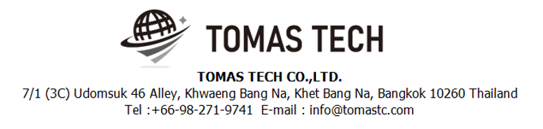
Version 9/Jan/2025
Confidential
IKD process system specifications
Documentation EN Blueprint for ANI
Blueprint
R2
Made for : A.N.I. LOGISTICS, LTD.
By : TOMAS TECH CO.,LTD.

Slide 2
Revision History
Date | Version | File name | Details
21/Dec/2024 | R1 | IKD process system specifications Documentation EN Blueprint for ANI Blueprint | First edition
9/Jan/2025 | R2 | IKD process system specifications Documentation EN Blueprint for ANI Blueprint | Second edition
2

Slide 3
■Contents
1. Overview
2. Overall configuration diagram
3. Document information
4. Operation flow
5. System functional specifications
6. Q&A
7. Sign off

Slide 4
1. Overview
Proposal of Process Management System to A.N.I.
By systematizing the IKD work process, we will realize “Improvement of quality", “Improvement of work efficiency", “Visualization of work", “Paperless" and “Traceability management".
Advantages of introducing the system
By scanning and verifying the visual confirmation work with a handy terminal, it is possible to prevent check mistakes by workers and expect "improvement of quality".
By acquiring the cycle time of the packing work, it becomes possible to analyze by process, worker, and control number, and "improvement of work efficiency" can be expected.
By creating a system, on-site managers, office managers, and people in charge of other processes will be able to grasp the work status, realizing "visualization of work". By visualizing the on-site situation, it is possible to manage the progress of the Material Stock process, which can be expected to improve work efficiency.
By enabling the necessary information to be viewed on PCs, handy terminals, tablets, and TV displays, it is possible to realize "paperless" by digitizing forms.
"Traceability management" can be realized because it is possible to take pictures of the actual product and the product as well as the result of verification by the handy terminal.

Slide 5
2. Overall configuration diagram
2
Regarding the IKD process system, consider the following system configuration.
Overall configuration diagram image
Server Room
Fiber optic communication
ANI IKD process server PB
LAN communication
AS400
WIFI communication
HATC schedule data
System unit
AS400 DB
Printing label (New)
Using label (Old)
UPS
Show document
TV for monitor
S/W Hub
A/P
Receiving area
Case Transfer
Case Picking
Box Unpack
Handy terminal x3
Handy terminal x2
Handy terminal x1
Handy terminal x7
Tablet x5
Mobile Printer x7
Receive Control Sheet
Case mark
Case Transfer list
Picking Case list
Contents label ANI
Existing devices
A500 x15 (buy new 6 items)
A600 x2 (not use)
Honda needs to set GO LIVE on June 2025
ANI requests the spare battery for 21 items.
Battery charger 7 items.
Case List plan
Able to print by officer
Case mark
Case mark
Exporter label
Delivery Bill
Daily Picked Report
Case mark
Staging/Delivery
Handy terminal x7
Fixed Printer(Wifi) x5
Tomas will adjust the design
~ 5,000 contents/shift
Size : 5x7 cm
Meiji card for Tablet
Special Part area
Contents label ANI
Handy terminal x1
Mobile Printer x1
Shipping Note
Mobile printer label length ~ 7,500 mm
1 A4 = 300 mm
1,000 barcode / shift / line
1,000 barcode = 1000/10 = 100 pages A4
100 x 300 mm = 30 meters/shift/line
Shipping Note
Truck Delivery
Special part
Repack
Scan case into special part stock
Unpack case and move part to store
Repack the entire part qty to usage refer from plan (mat lot excel) / Scan exporter label to confirm
Picking
Scan exporter label + location ID
Case mark
10 Contents per page
Size : 80mm
Delivery Bill (A4)
Contents Exporter
(out)
Will receive example label

Slide 6
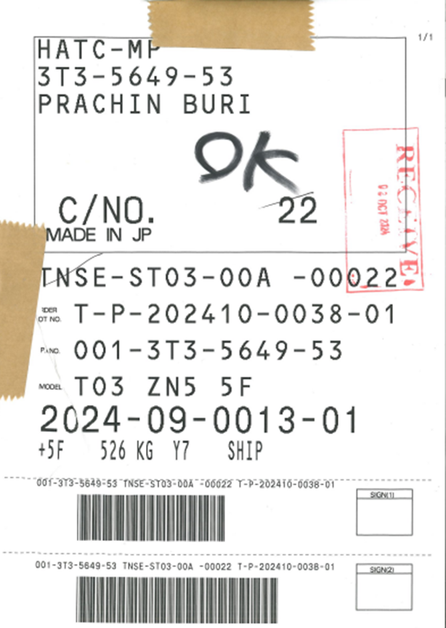
3. Document information
3.2. Case Mark
ออกใหม่ในกรณีที่ tag หาย สามารถใช้ทดแทนกันได้เลยโดยไม่มีการล๊อค Inactive ใบเดิม
Print ที่เครื่อง printer ทั่วไปใน office
คำสั่งการใช้ จาก Honda ยึด KD Lot เป็นหลัก

Slide 7
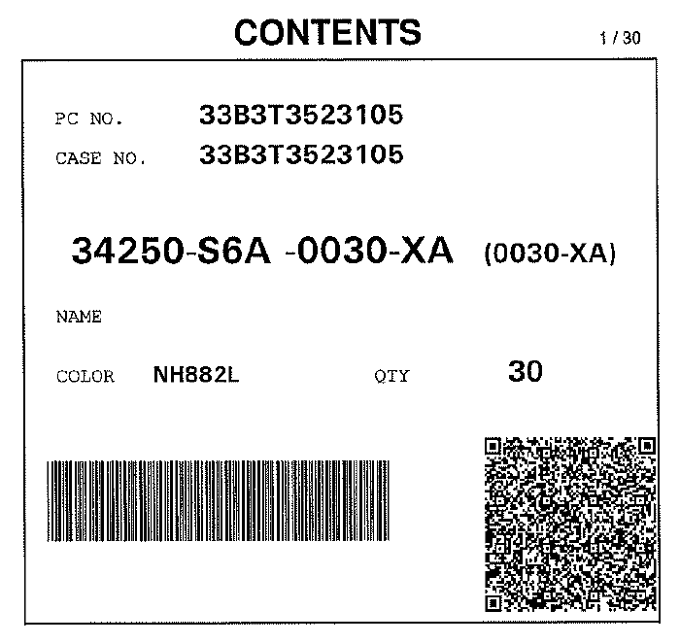
3. Document information
3.3. Contents Exporter Label
- รอ format layout ต้องการให้เป็นรูปแบบเดียว
เพราะมีหลายประเทศที่ไม่เหมือนกัน
- ในกรณีที่ไม่มี label ทาง ANI ต้องทำการออก Contents Exporter
- Print ที่เครื่อง printer ทั่วไปใน office

Slide 8
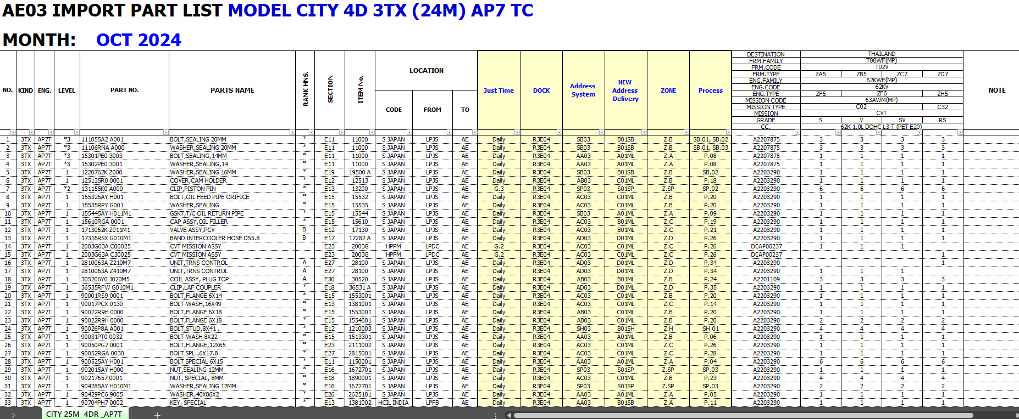
3. Document information
3.4. Import Part List

Slide 9
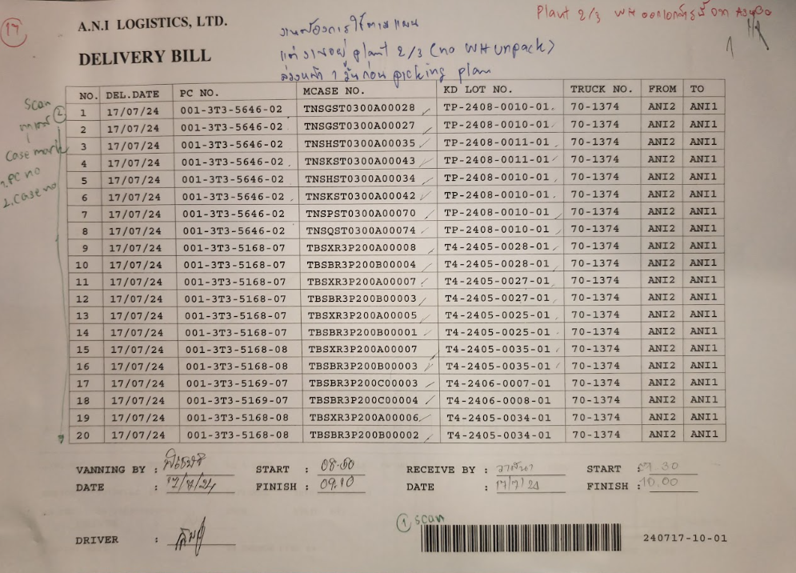
3. Document information
3.6. Delivery Bill
- มี function HT scan แล้วกด print Delivery Bill
- Print ที่เครื่อง printer ทั่วไปที่หน้างาน

Slide 10
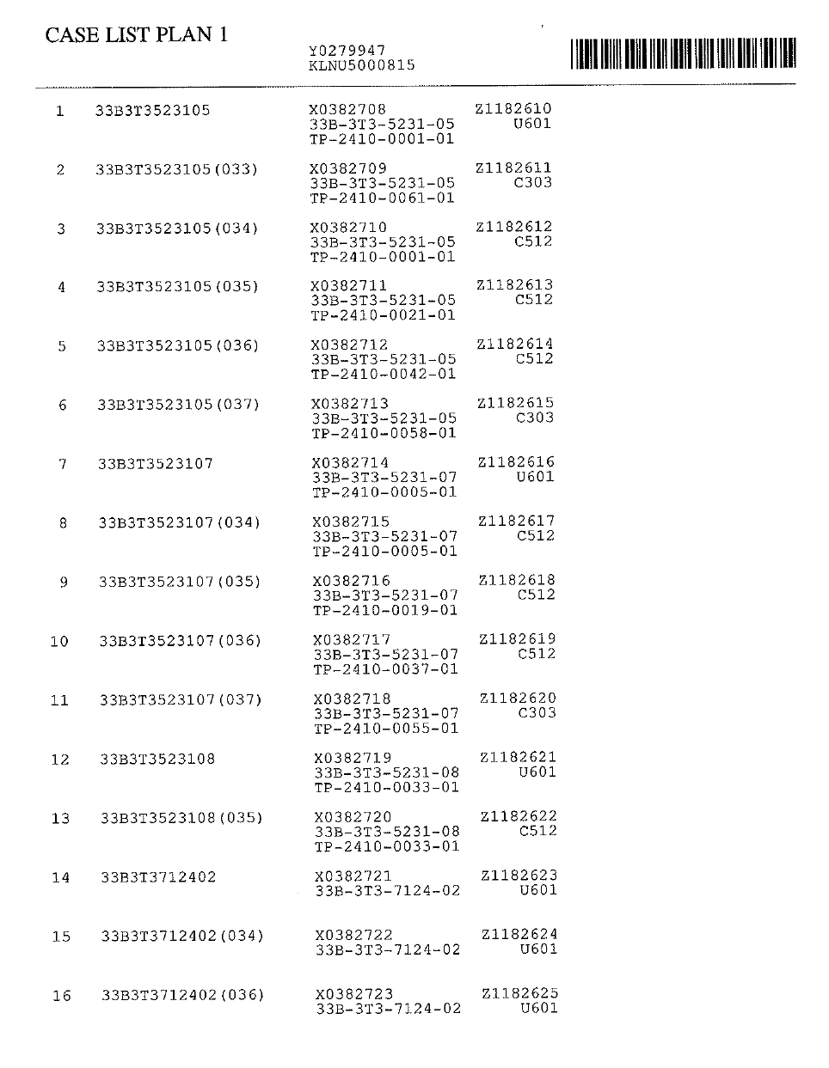
3. Document information
3.7. Case List Plan
ใช้ตอน receive
ระบบใหม่สร้าง Case list plan แต่อยากเปลี่ยนการ print
เฉพาะเลข container เพื่อทำการแสกนหัวเอกสาร
Print จาก office ระบบต้องใส่ QR code เพื่อให้ forklift ยกตามแผน
Handy แสกนรายการตาม container no
มี check box ให้ซ่อนรายการที่ทำเสร็จแล้ว
ใน function receive ต้องเก็บ Case type
Case type (May scan from barcode)
Full case
Half case
One way case * User จะส่งข้อมูลให้อีกที
Export ข้อมูล Report เพื่อทำส่งให้ Honda
*user ส่ง report ตัวอย่างให้ tomas เพื่อจัดทำให้ได้เลย
Stock case report

Slide 11
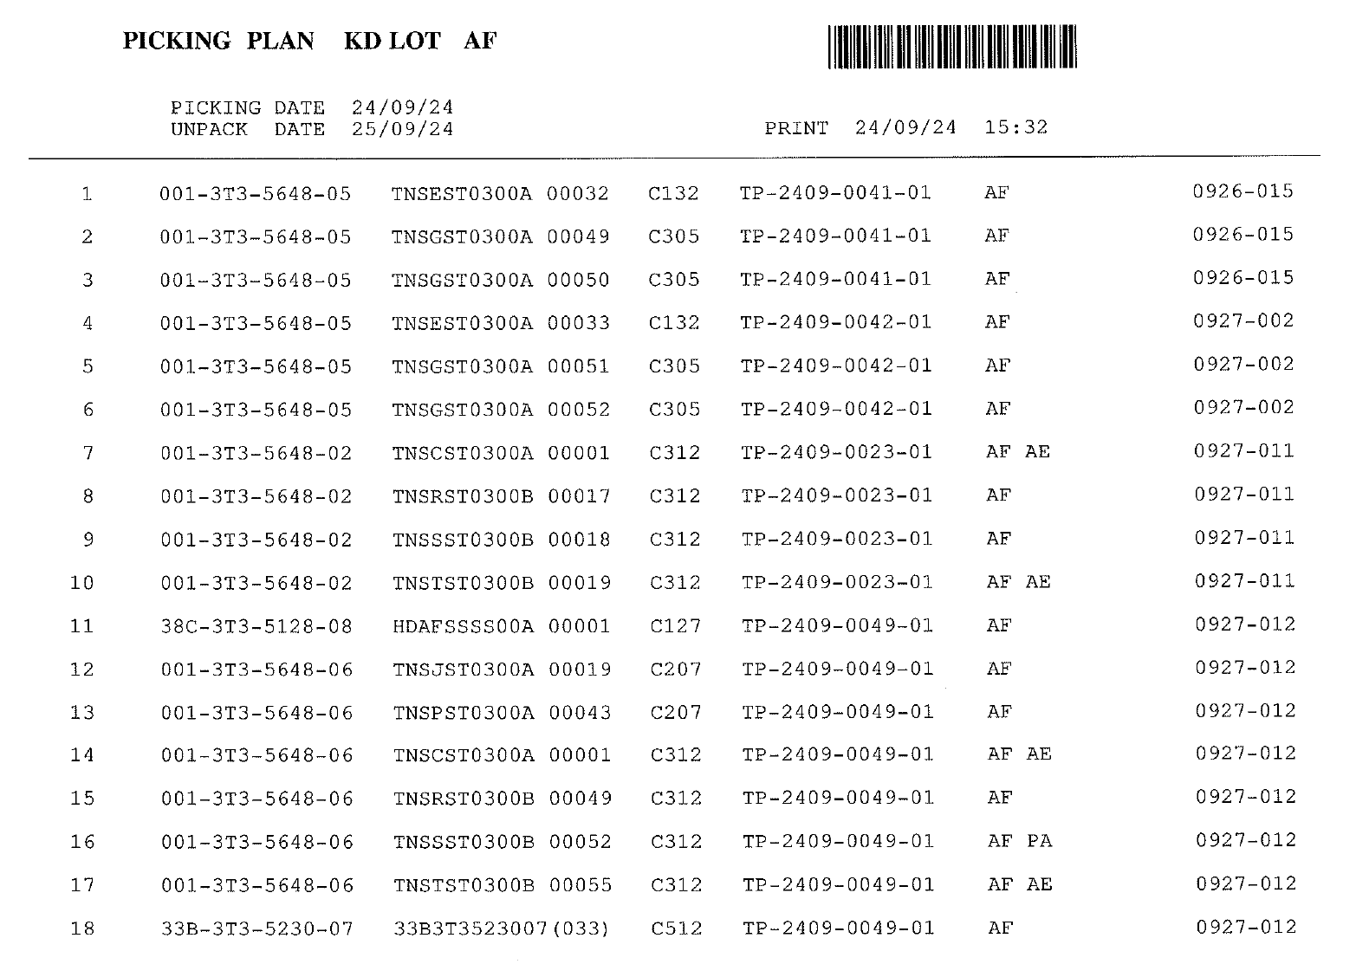
3. Document information
3.8. Picking Plan
แผนล่วงหน้าก่อน Unpack 1 วันเพื่อยกมาไว้ที่จุด picked items
ระบบใหม่สร้าง Picking Case List ในอนาคตอาจไม่ใช้
ให้รวมงานที่ Case ซ้ำกันเป็นรายการเดียว
เดิม แยก line แต่ให้รวมเป็น list เอกสารเดียว
Print จาก office ระบบต้องใส่ QR code เพื่อให้ forklift ยกตามแผน
ให้ซ่อนรายการเหลือเฉพาะที่ยังไม่ได้ทำใน Handy

Slide 12
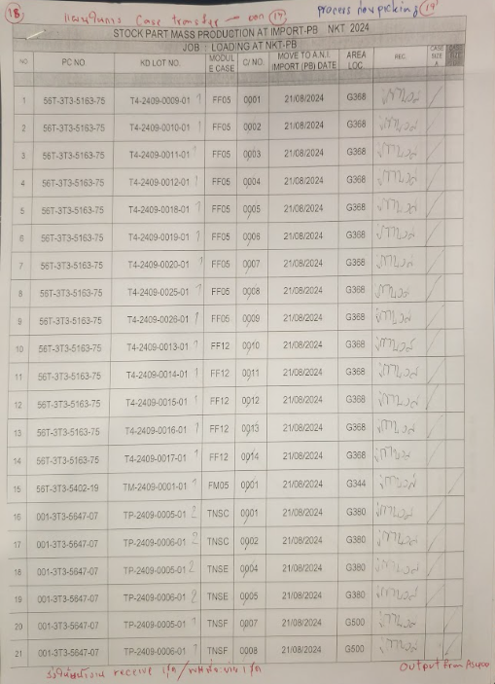

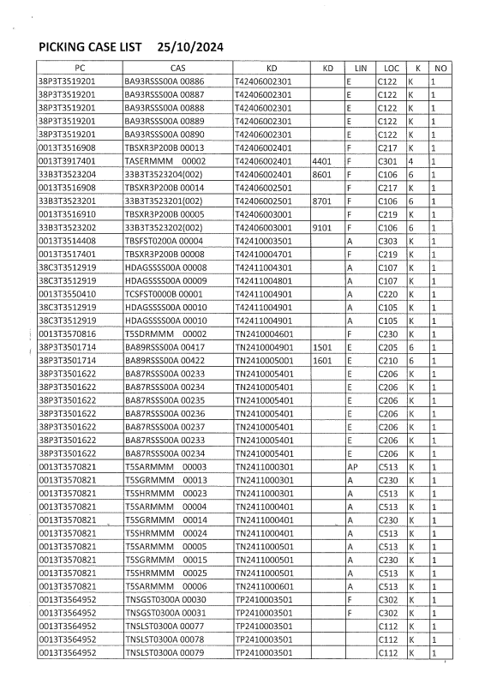
3. Document information
3.9. Case Transfer List
แผนล่วงหน้าก่อน Unpack 2 วันเพื่อยกมาไว้ที่จุด picked items
ระบบใหม่สร้าง Picking Case List ในอนาคตอาจไม่ใช้
ให้รวมงานที่ Case ซ้ำกันเป็นรายการเดียว
เดิม แยก line แต่ให้รวมเป็น list เอกสารเดียว
Print จาก office ระบบต้องใส่ QR code เพื่อให้ forklift ยกตามแผน
ให้ซ่อนรายการเหลือเฉพาะที่ยังไม่ได้ทำใน Handy

Slide 13
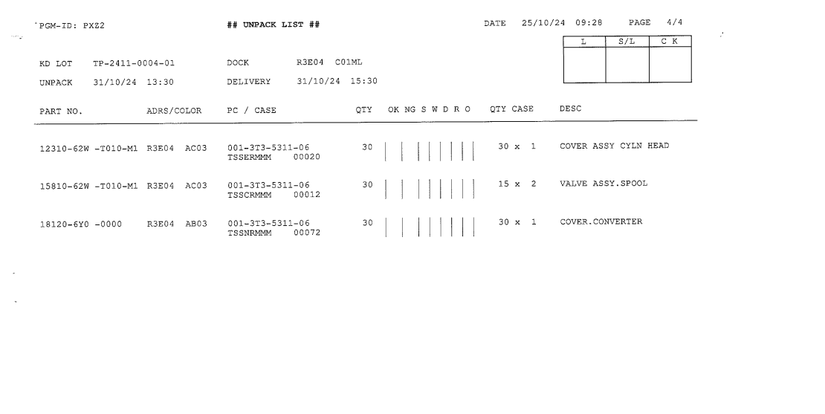
3. Document information
3.10. Unpack List
Line No
E – AE
F – AF
W - WE
ใช้ดู part ใช้กับ Line ขณะ Unpack
ในอนาคต ไม่อยาก print แต่ว่าเบื้องต้นใช้จาก AS400
ดูข้อมูลจาก Handy แทนหรือจอ KD LOT + LINE จาก Weekly plan
แหล่งข้อมูลมาจาก Weekly plan แผนส่ง (22)
Data table monitor
ดูรายการ Unpack ที่หน้างานว่าจะยกมา Unpack
Daily sorting KD lot
JIT sorting delivery time

Slide 14
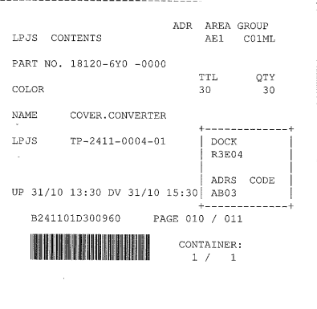
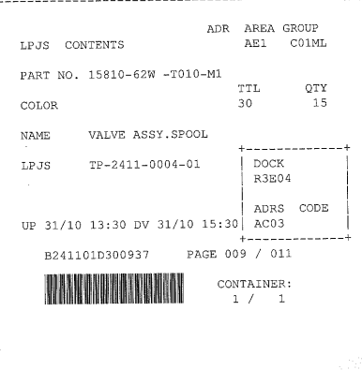
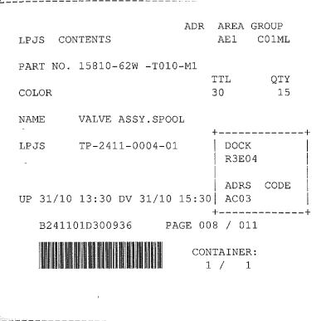
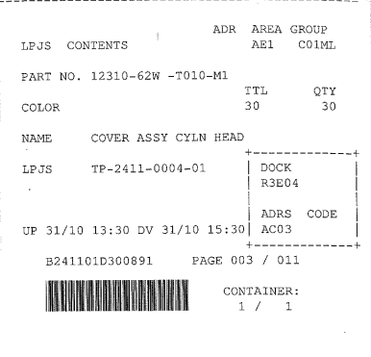
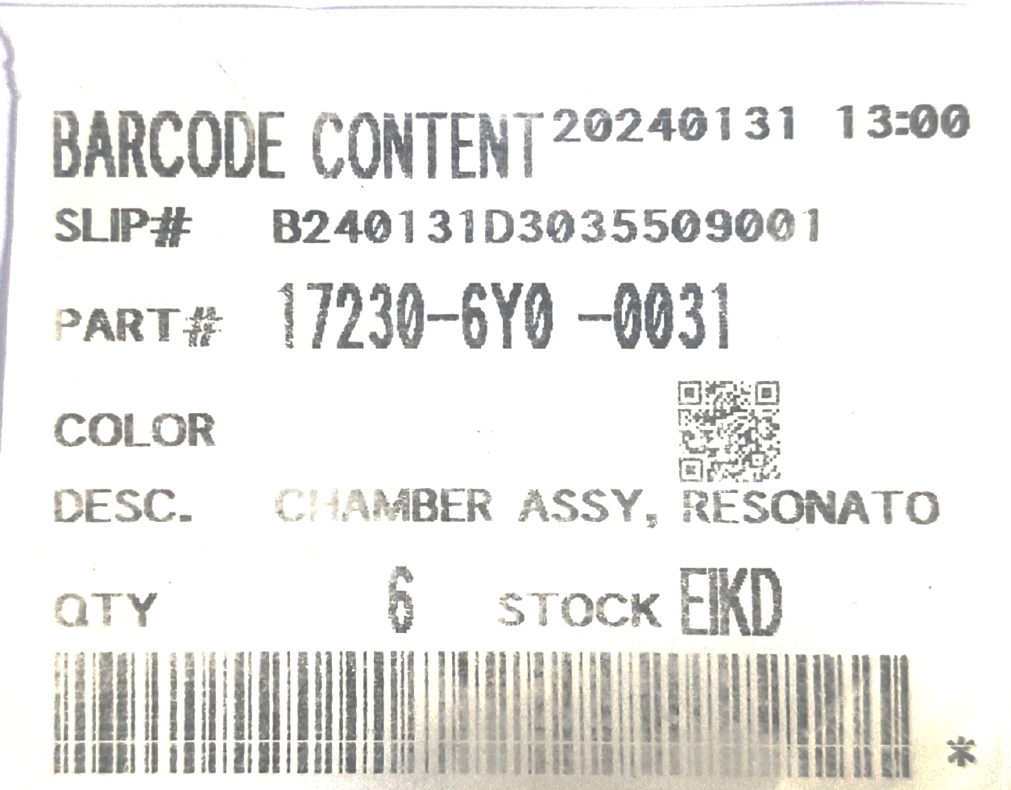
3. Document information
2
3.11. Contents Label ANI
Label นี้ออกโดย mobile printer
*Tomas จะทำการ design แล้วส่งให้ ANI ให้ Honda confirm อีกที
Example contents

Slide 15
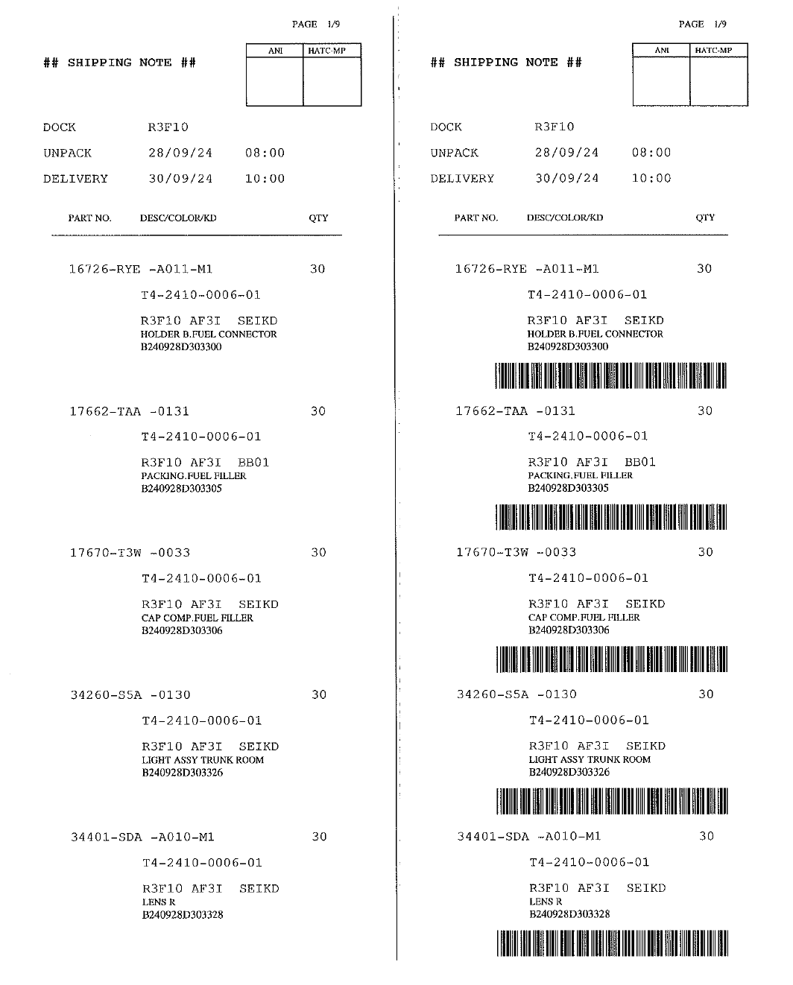
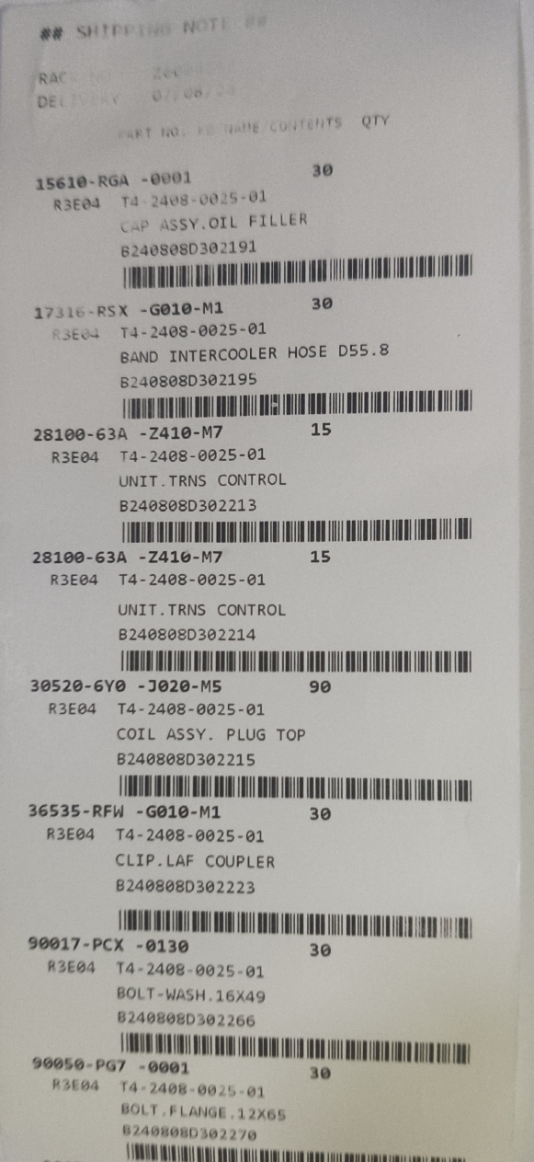
3. Document information
3.12. Shipping Note
ปัจจุบันใช้ด้านซ้าย แต่ต้องการเปลี่ยนไปใช้ tag ใหม่ด้านขวามือแทน
ใช้ SATO label printer ตัวใหญ่เพราะใช้กระดาษเยอะ
ใช้ 5 เครื่อง
Rotation + WE
AE + G9
AF
JIT
MISSION

Slide 16
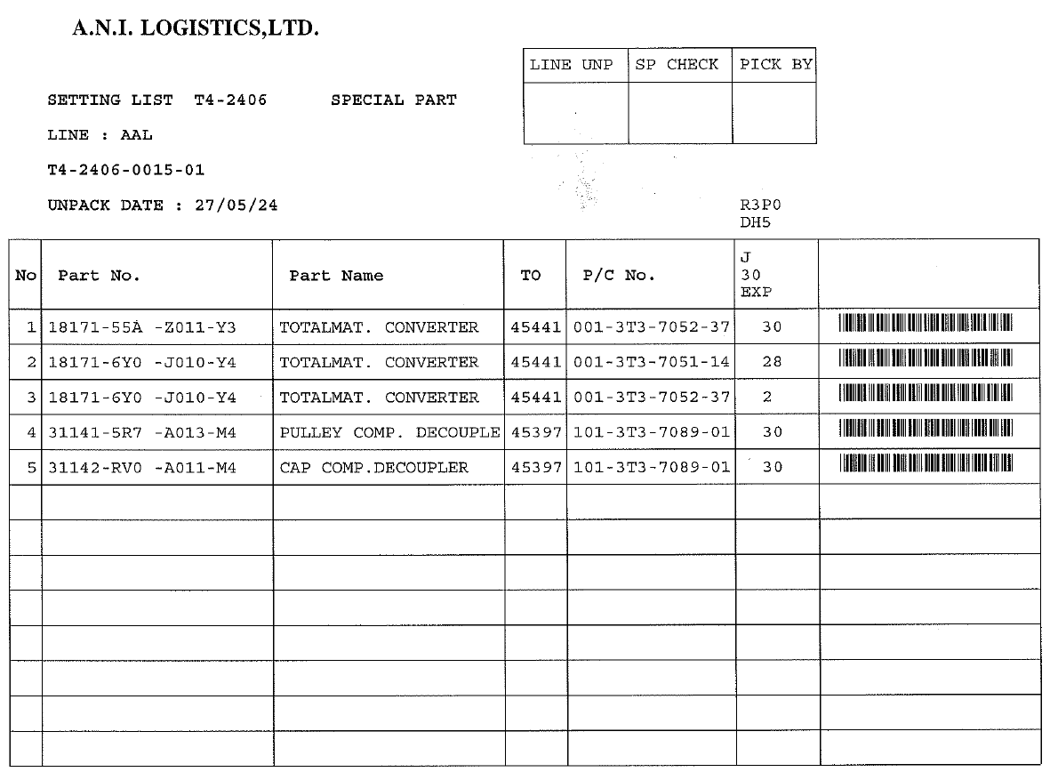
3. Document information
3.13. Setting List
งาน Setting part special สำหรับแผนก Special เท่านั้น
ออกโดย office จาก plan แตกงานก้อนใหญ่

Slide 17
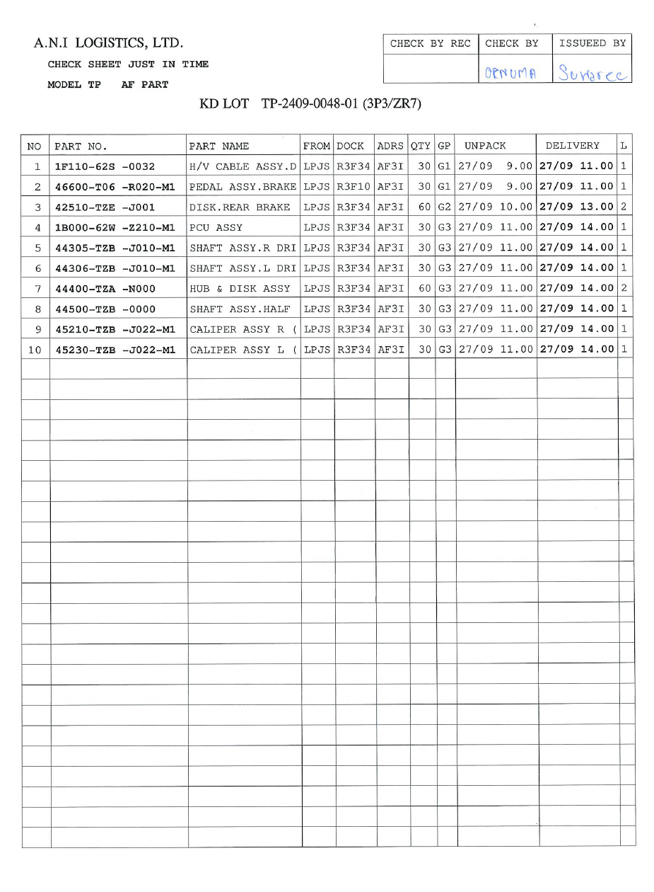
3. Document information
3.14. Check Sheet [Just in time/Daily]
Daily plan แผนส่งล่วงหน้า 1 shift / JIT แผนส่งล่วงหน้า 2 ชม
แผน JIT (part ตัวใหญ่) *G9 part small
ใช้ในขั้นตอน packing
ระบบใหม่ไม่ต้อง print แต่ต้องมีหน้าจอ
dashboard monitor ให้ดูโดยจะใช้ PC *tomas design screen

Slide 18
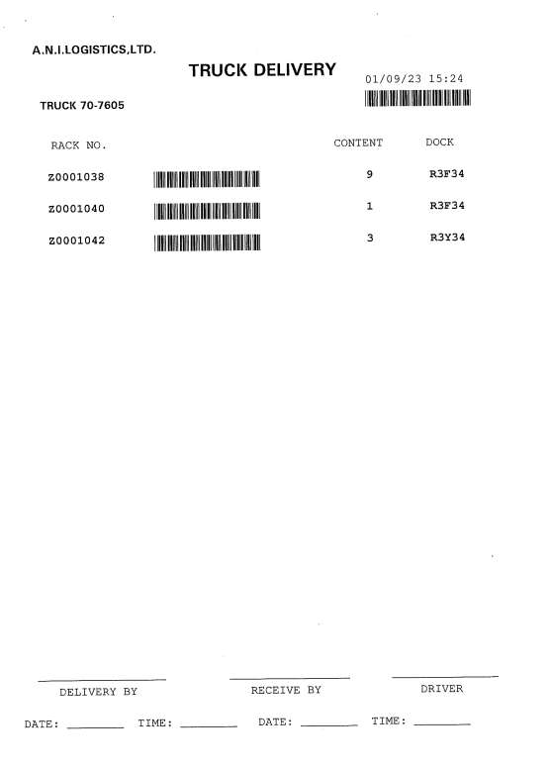
3. Document information
3.15. Truck Delivery
ใช้หลังขั้นตอน Staging เพื่อ loading ขึ้นรถ
สั่งจาก Handy โดยเลือกว่าจะ printer เครื่องไหน
ระบบใหม่ต้อง print ที่หน้างานใช้ printer ทั่วไป
ต้องแยก Printer settings ใน handy
สำหรับการ print งานในแต่ละ function ต่างๆ
ยกเลิกการ print เอกสาร
เพิ่ม process Receive MS(Material Service)
การรับ items ที่ฝั่ง honda
ต้องเพิ่ม Handy อีก 3 เครื่อง AE 1 + [AF+WE 2 (N/S)]
เพิ่มหน้าจอแสดงผล Truck content loading ใน PC *tomas design

Slide 19
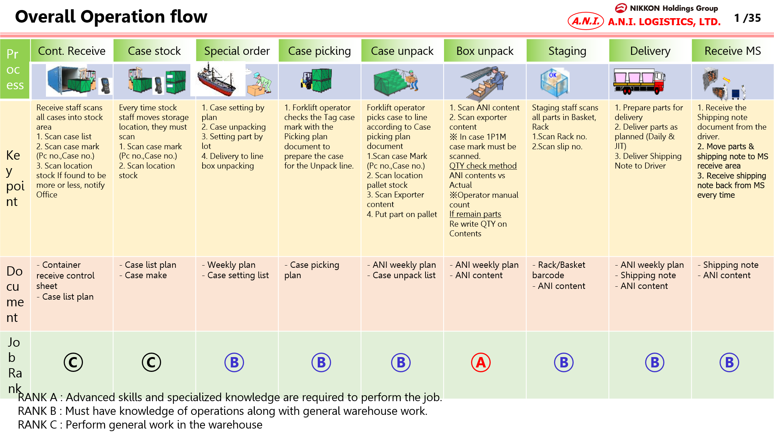
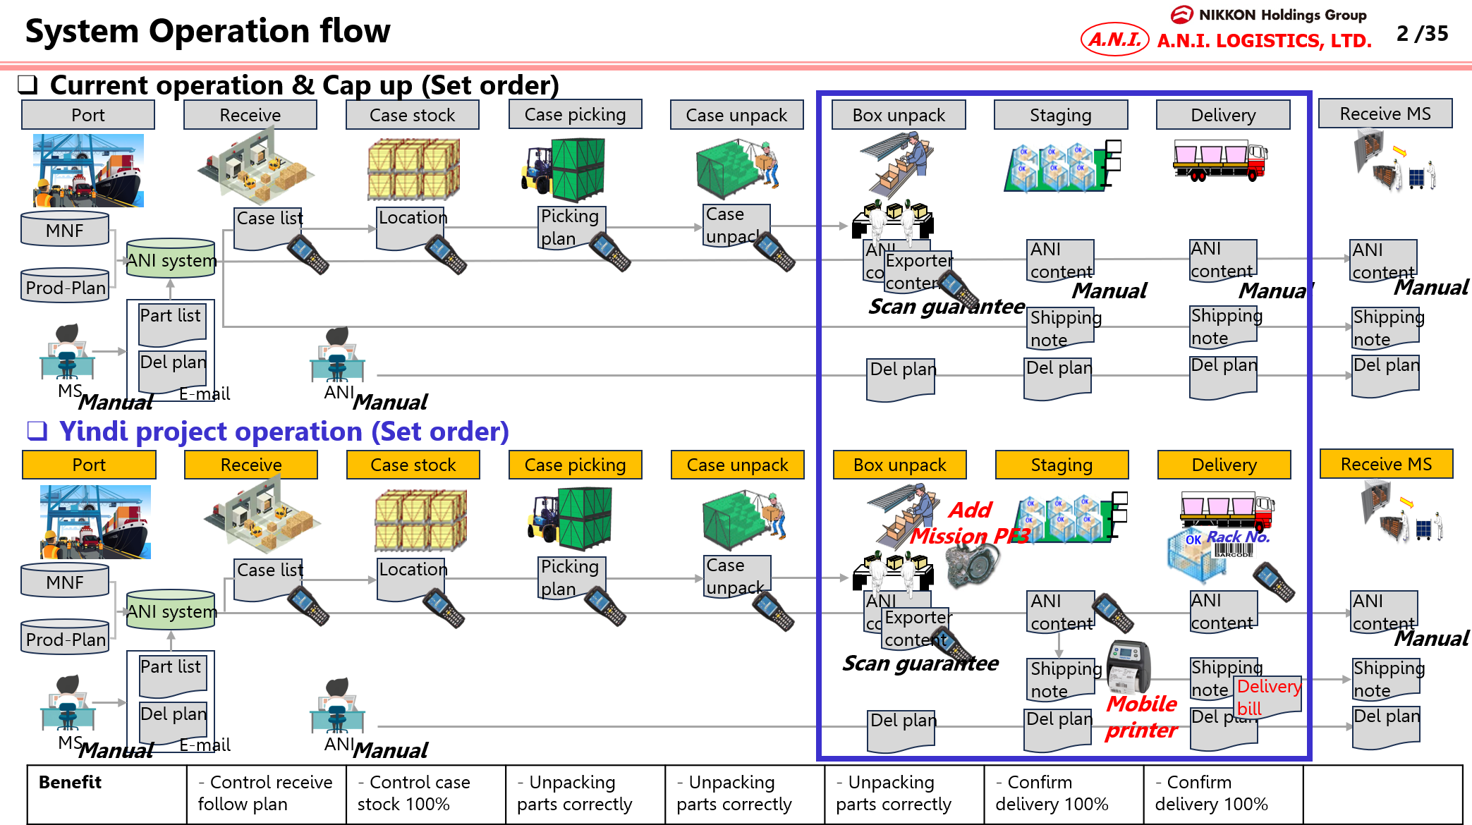
4. Operation flow
4.1. Operation flow
4.1.1. Overall process

Slide 20
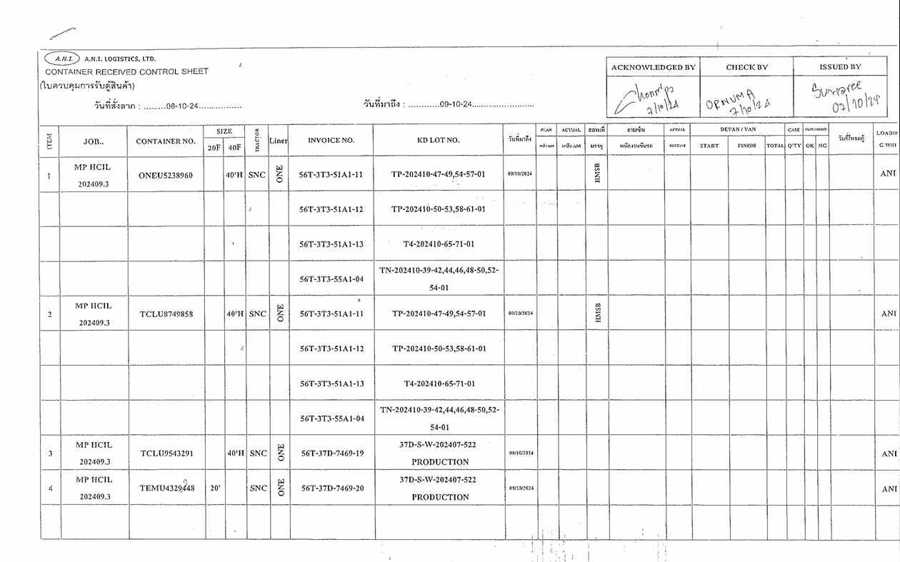
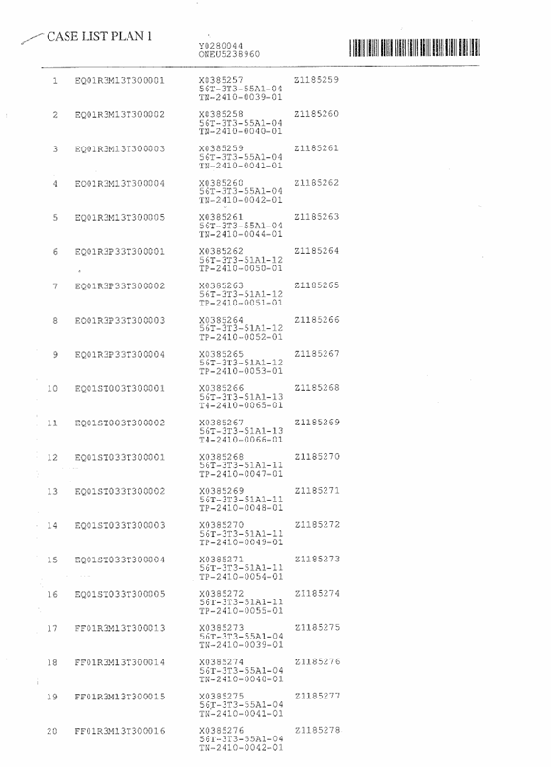
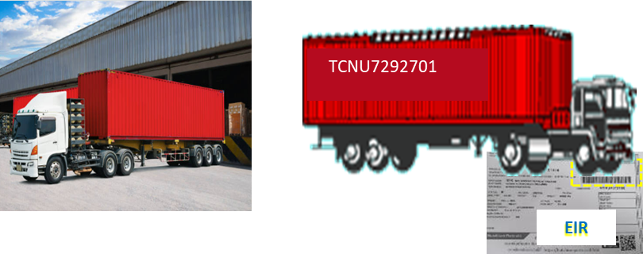
4. Operation flow
4.1. Operation flow
4.1.2. Receive Container process
No. | Detail | Document
1 | รับเอกสารจาก Office Container received control sheet Case list plan
2 | พนักงานทำการตรวจสอบ Container no. ให้ถูกต้องตรงกับเอกสาร Container received control sheet Case list plan
3 | HHT ทำการ log in และเข้าไปที่ Menu Receive >Scan>Case list plan

Slide 21
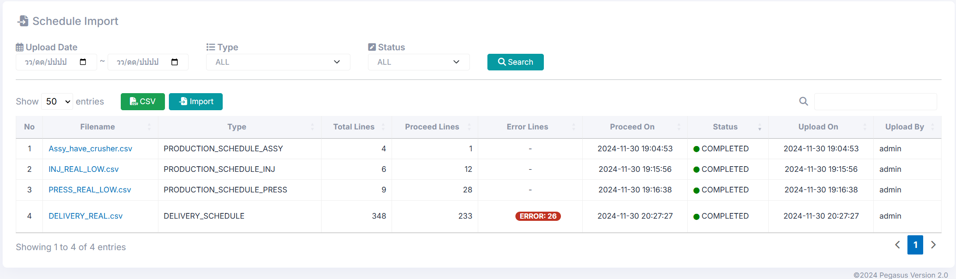
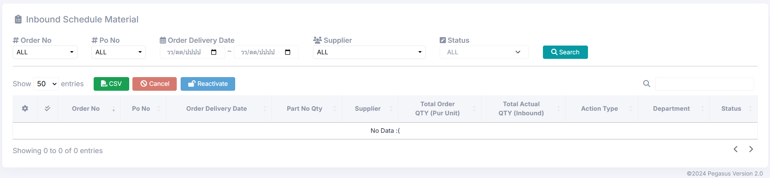

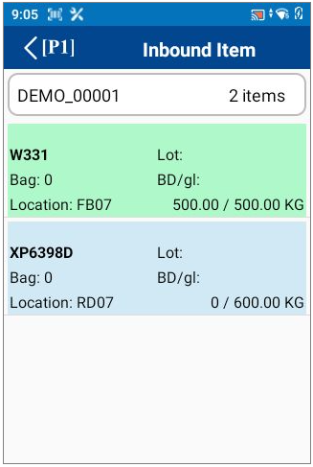


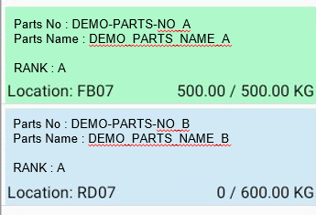

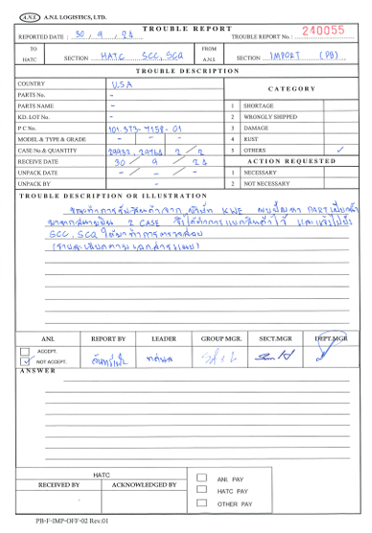
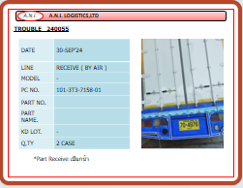
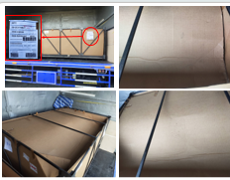
4. Operation flow
4-2. Work Flow Chart
4-2-1. Receive process
ANI - Office
IKD System Pegasus
Receive plan from HONDA
*AS400 will push netfile to shared folder
Auto/Manual Import file
CSV
Verify receive container plan
& issue documents
Receive Container
Date
From
07/Oct/2023
Date
To
07/Oct/2023
Receive container by handy
Except complete
PC No : 33B2T3551135
Container No : Y0279947
20/20 Cases
Trouble Report
PC No : 33B2T3551135
Container No : Y0279947
0/30 Cases
Date
From
07/Oct/2023
Date
To
07/Oct/2023
Trouble report collect function by handy
Except complete
PC No : 33B2T3551135
Container No : Y0279947
20/20 Cases
PC No : 33B2T3551135
Container No : Y0279947
0/30 Cases
Forklift move contents
Trouble report
Pdf
Finish

Slide 22

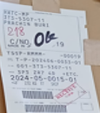
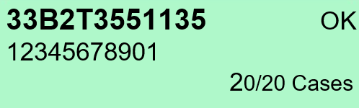
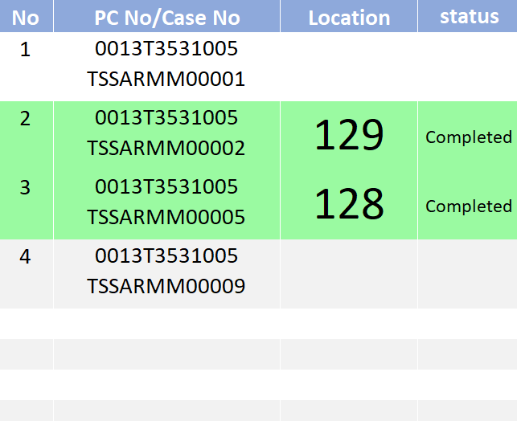
4. Operation flow
4-2. Work Flow Chart
4-2-2. Receive process – Receive Container By Handy
ANI - Office
IKD System Pegasus
Receive container by handy
Start
Receive Container
Date
From
07/Oct/2023
Date
To
07/Oct/2023
Login User ID & enter receive function on handy
Except complete
Use new case list plan document
Show only cont. no
33B2T3551135 OK
12345678901
20/20 Cases
33B2T3551135
12345678901
10/20 Cases
Scan BARCODE case list plan
Special receive case
Manual create plan
Details
- Case no
- Case name
- Receive plan date
- pc no
Scan case mark for verify Pc no., Case no.
Report problem and fix
Enter/Choose
- Case name (scan first 5 digits)
- *Case type (scan)
- **Location ID (move in)
* Alert in case of CASE not found will report to admin to create the new one to CASE Master
** Use PC/Tablet to show the WH map and check the available store and touch the store. It will shows the QR Code which used to scan by Handy.
Is correct?
NO
YES
System will create moving job for forklift
Receive Case
Choose store location on handy and confirm then write it to tag
Date
From
07/Oct/2023
Date
To
07/Oct/2023
Except complete
NO
All done?
Case name : [ V ]
Case type : [ AUTO ]
Location : [ V ]
[ OK ] [ Cancel ]
YES
Finish

Slide 23
4. Operation flow
4-2. Work Flow Chart
4-2-2. Receive process – Trouble Report Collection By Handy
ANI - Office
IKD System Pegasus
Trouble report collect function by handy
Start
Trouble Report - Cont
Date
From
07/Oct/2023
Date
To
07/Oct/2023
Login User ID & enter receive function on handy
Except complete
PC No : 33B2T3551135
Plan No : Y0279947
STATUS: OK
20/20 Items
PC No : 33B2T3551135
Plan No : Y0279947
0/30 Items
Scan BARCODE case list plan
PC No : 33B2T3551135
Plan No : Y0279947
STATUS: NG
20/20 Items
Only received containers are able to make trouble report.
For NG container will change background to Yellow.
Scan case mark for data collect e.g. Pc no., Case no.
Enter NG Reason and take pictures of outside/inside the container
NO
All done?
YES
Finish

Slide 24
4. Operation flow
4-2. Work Flow Chart
4-2-2. Receive process – Trouble Report Collection By Handy
ANI - Office
IKD System Pegasus
Trouble report collect function by handy
Start
Trouble Report - Case
Date
From
07/Oct/2023
Date
To
07/Oct/2023
Login User ID & enter receive function on handy
Except complete
PC No : 33B2T3551135
Plan No : Y0279947
STATUS: OK
20/20 Items
PC No : 33B2T3551135
Plan No : Y0279947
0/30 Items
Scan BARCODE case list plan
PC No : 33B2T3551135
Cont No : Y0279947
STATUS: NG
20/20 Items
Only received containers are able to make case trouble report.
For NG container will change background to Yellow.
Scan case mark for data collect e.g. Pc no., Case no.
Cont No/Receive date/Case no/NG reason/Pictures
Enter NG Reason and take pictures
NO
All done?
YES
Finish

Slide 25
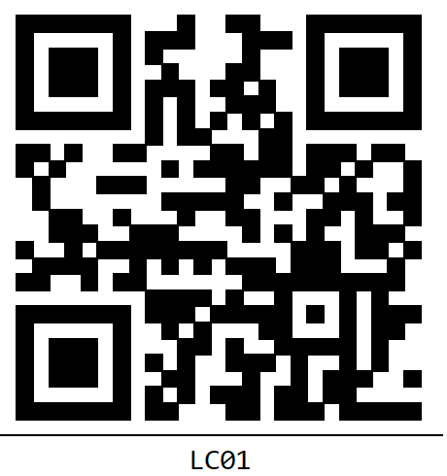
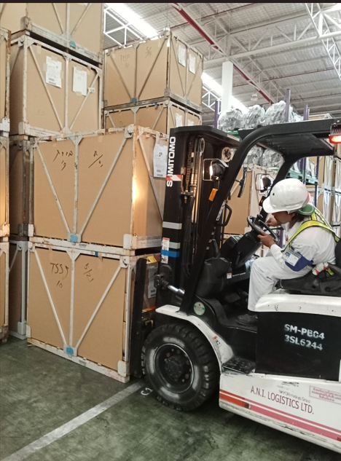
4. Operation flow
4-2. Work Flow Chart
4-2-2. Receive process – Forklift Moving Contents
ANI - Office
IKD System Pegasus
Cancel 2025-01-10
Forklift move contents
Start
Move Case In
Date
From
07/Oct/2023
Date
To
07/Oct/2023
Login User ID & enter receive function on handy
Except complete
33B2T3551135
Y0279947
Location : 218
33B2T3551135
Y0279947
Location : 219
Scan case mark for choose the moving job
Scan the location to confirm move in case.
NO
All done?
YES
Finish

Slide 26
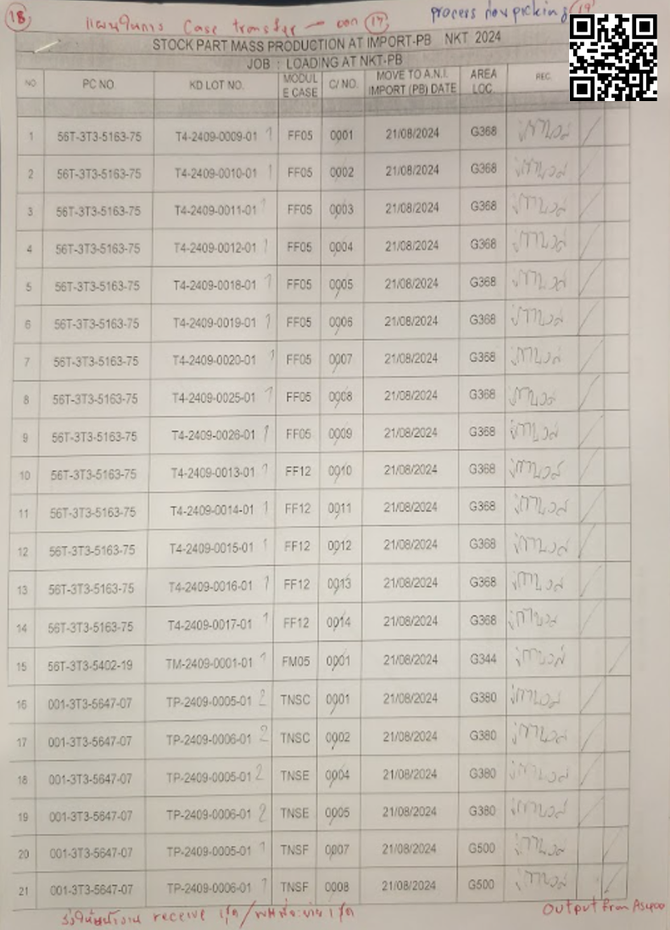
4. Operation flow
4-2. Work Flow Chart
4-2-3. Case Transfer process
ANI - Office
IKD System Pegasus
System will automatically create Case Transfer plan
* After import manifest and delivery plan
1. Automatic check part need and located at branch WH and will create case transfer plan
2. User approves the plan.
3. Operate case transfer
WH
PC NO
Case No
Location
User approves plan
and issues document
Moving Case
Loading case
Date
From
07/Oct/2023
Date
To
07/Oct/2023
Except complete
33B2T3551135
Y0279947
Location : 218
Loading case
33B2T3551135
Y0279947
Location : 219
Issue Delivery Bill
Pdf
Finish

Slide 27
4. Operation flow
4-2. Work Flow Chart
4-2-3. Urgent Case Transfer process (Auto/Manual)
ANI - Office
IKD System Pegasus
System will automatically create urgent Case Transfer plan
while it hasn’t been received to *fixed WH/Manual import urgent plan
*Fixed_WH Check to item master
**Manual import
1. Automatic check part need and located at branch WH and will create case transfer plan
2. User approves the plan.
3. Operate case transfer
WH_From/WH_To
PC NO
Case No
Location_From
User approves plan
and issues document
Moving Case
Loading case
Date
From
07/Oct/2023
Date
To
07/Oct/2023
Except complete
33B2T3551135
Y0279947
Location : 218
Loading case
33B2T3551135
Y0279947
Location : 219
Issue Delivery Bill
Pdf
Finish

Slide 28
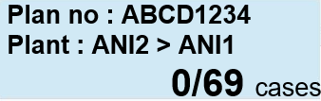

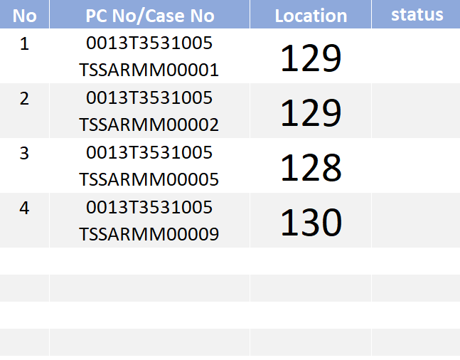
4. Operation flow
4-2. Work Flow Chart
4-2-3. Case Transfer process – Moving Case
ANI - Office
IKD System Pegasus
Moving Case
Start
Moving Case
Date
From
07/Oct/2023
Date
To
07/Oct/2023
Login User ID & enter receive function on handy
Except complete
Plan no : ABCD1234
Plant : ANI2 > ANI1
69/69 cases
Plan no : ABCD1234
Plant : ANI2 > ANI1
0/69 cases
Scan QRCODE case transfer plan
W/H barcode list Master
Scan W/H barcode
Scan case mark for data collect e.g. Pc no., Case no.
Move Case
Date
From
07/Oct/2023
Date
To
07/Oct/2023
Except complete
Move case to loading area
NO
All done?
YES
Finish

Slide 29
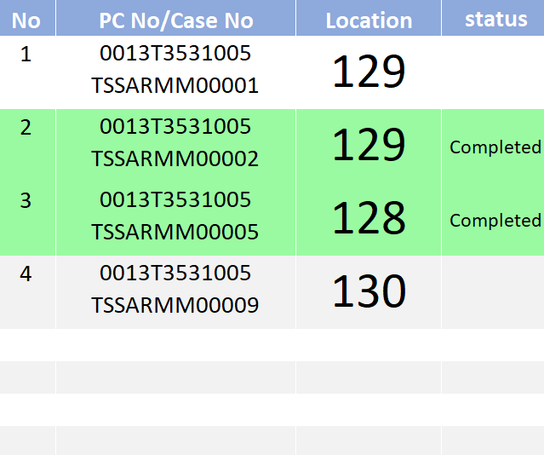
4. Operation flow
4-2. Work Flow Chart
4-2-3. Case Transfer process – Loading Case
ANI - Office
IKD System Pegasus
Loading Case
Start
Loading Case
Date
From
07/Oct/2023
Date
To
07/Oct/2023
Login User ID & enter receive function on handy
Except complete
Plan no : ABCD1234
Plant : ANI2 > ANI1
70-2438 69/69 cases
Plan no : ABCD1234
Plant : ANI2 > ANI1
0/69 cases
Scan QRCODE case transfer plan
Scan Truck no
Truck no tag label
Move case to truck
Loading Case
Scan case mark for data collect e.g. Pc no., Case no.
Plan no : ABCD1234
Plant : ANI2 > ANI1
70-2439 2/69 cases
Date
From
07/Oct/2023
Date
To
07/Oct/2023
Except complete
Move case to truck
NO
All done?
Print Bill
YES
Print Delivery Bill
Finish

Slide 30
4. Operation flow
4-2. Work Flow Chart
4-2-4. Case Transfer Receive process
ANI - Office
IKD System Pegasus
Start
Case Transfer Receive
Date
From
07/Oct/2023
Date
To
07/Oct/2023
Login User ID & enter receive function on handy
Except complete
Plan no : ABCD1234
From : ANI2
70-2438 69/69 cases
Plan no : ABCD1234
From : ANI2
70-2439 0/69 cases
Scan BARCODE case list plan
Scan case mark for verify Pc no., Case no.
Report problem and fix
Is correct?
NO
YES
System will create moving job for forklift
Receive Case
Choose store location on handy and confirm then write it to tag
Date
From
07/Oct/2023
Date
To
07/Oct/2023
Except complete
NO
All done?
Location : [ V ]
[ OK ] [ Cancel ]
YES
4-2-2. Forklift move contents
Finish

Slide 31
4. Operation flow
4-2. Work Flow Chart
4-2-5. Case Picking process
ANI - Office
IKD System Pegasus
Linkage to HONDA via AS400
Auto/Manual Box Unpack plan file
CSV
Verify picking plan and issues Picking Case List document
Case Picking
Case Picking
Date
From
07/Oct/2023
Date
To
07/Oct/2023
Except complete
Y0279897
GAOU6576421
20/20 Items
Y0279898
GAOU6576421
0/20 Items
Issue Daily Picked report
Pdf
Waiting for example report
Finish

Slide 32
4. Operation flow
4-2. Work Flow Chart
4-2-5. Case Picking process – Case Picking
ANI - Office
IKD System Pegasus
Case Picking
Start
Case Picking
Date
From
07/Oct/2023
Date
To
07/Oct/2023
Login User ID & enter receive function on handy
Except complete
Y0279897
GAOU6576421
20/20 Items
Y0279898
GAOU6576421
0/20 Items
Scan QRCODE case list plan
Scan W/H location QRCODE
Scan case mark for data collect e.g. Pc no., Case no.
Move case to unpack area
NO
All done?
YES
Finish

Slide 33
4. Operation flow
4-2. Work Flow Chart
4-2-6. Box Unpack process
ANI - Office
IKD System Pegasus
Linkage to HONDA via AS400
Auto/Manual Box Unpack plan file
CSV
Verify Box Unpack plan and issue documents e.g. Unpack list and contents label
Box Unpack
Box Unpack
Date
From
07/Oct/2023
Date
To
07/Oct/2023
Except complete
TN-2409-0008-01
DOCK: R3W18
20/20 Items
TN-2409-0008-01
DOCK: R3W18
0/2 Items
Issue Check Sheet Just in time report
Pdf
Finish

Slide 34
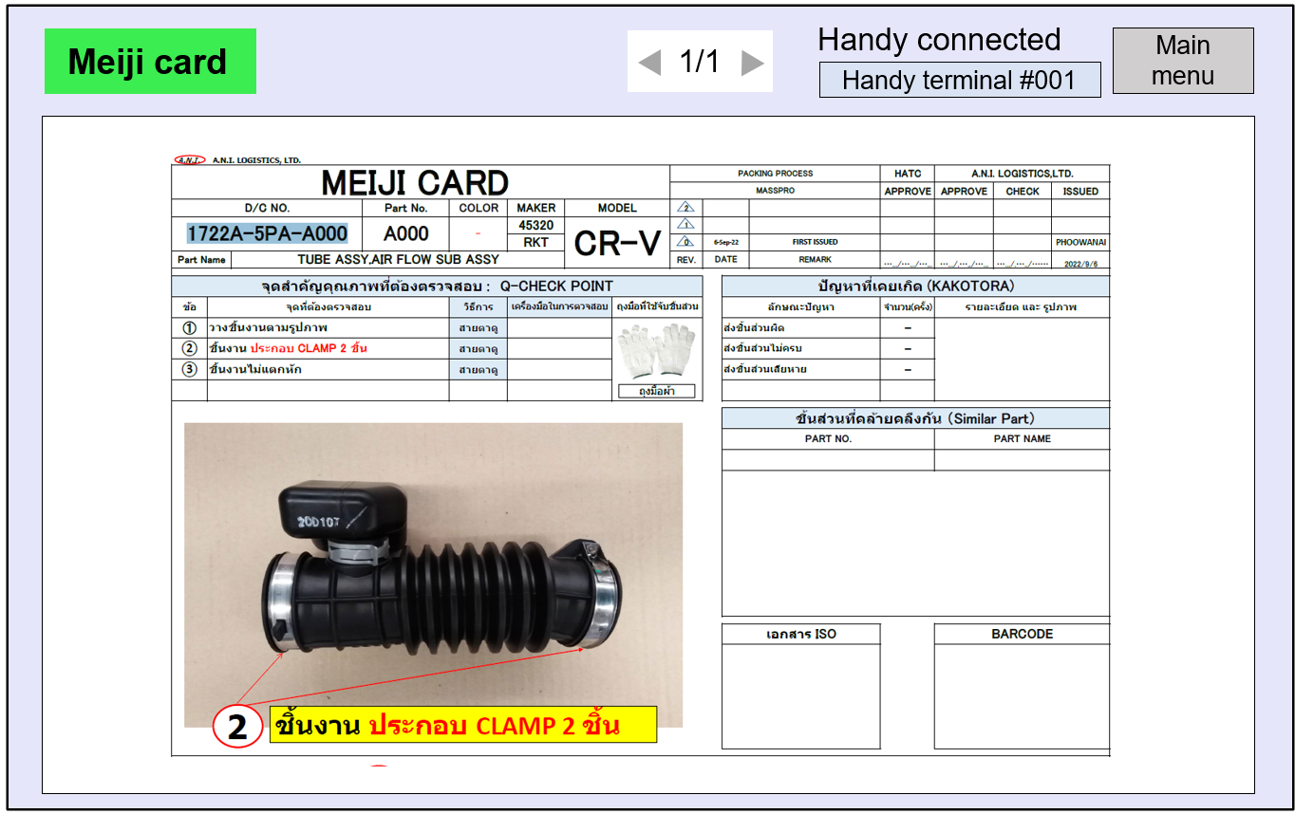
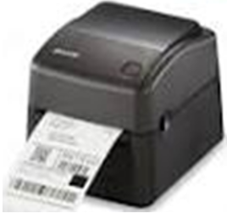
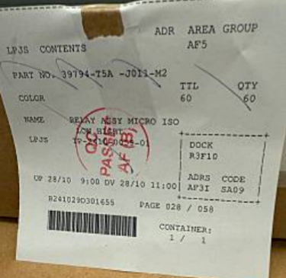
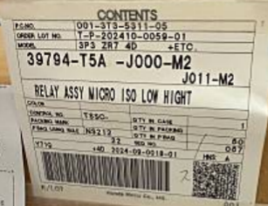
4. Operation flow
4-2. Work Flow Chart
4-2-6. Box Unpack process – Box Unpack
ANI - Office
IKD System Pegasus
Box Unpack
Start
Box Unpack
Date
From
07/Oct/2023
Date
To
07/Oct/2023
Login User ID & enter receive function on handy
Except complete
TN-2409-0008-01
DOCK: R3W18
20/20 Items
TN-2409-0008-01
DOCK: R3W18
0/2 Items
Unbox the package
Scan the Unpack list plan
Scan case mark for data collect e.g. Pc no., Case no.
Print JIT Contents label ANI, paste if needs
Show Meiji card on tablet
Scan Exporter label and contents label ANI, compare check
Is NG?
YES
Collect NG report
(unmatched lot_no|pc_no|case_no)
NO
Is Block?
YES
Collect Block report
(unmatched color|part_no)
NO
NO
All done?
Report problem and fix
YES
Finish

Slide 35
4. Operation flow
4-2. Work Flow Chart
4-2-7. Staging/Delivery process
ANI - Office
IKD System Pegasus
Linkage to HONDA via AS400
Auto/Manual import HATC file
CSV
Verify Staging and Delivery plan
Rack Entry
Truck Entry
Issue Result report
Pdf
Waiting for example report
Finish

Slide 36



4. Operation flow
4-2. Work Flow Chart
4-2-7. Staging/Delivery process – Rack Entry
ANI - Office
IKD System Pegasus
Rack Entry
Start
Rack Entry
Date
From
07/Oct/2023
Date
To
07/Oct/2023
Login User ID & enter receive function on handy
Except complete
TN-2409-0008-01
RACK: 307
20/20 Items
TN-2409-0008-01
RACK:
0/15 Items
Manual or automatic by scan the Contents label ANI
Scan BARCODE label RACK no
Scan the other contents label ANI
NO
All done?
YES
Move all parts to RACK
Issue Shipping Note document
Finish

Slide 37
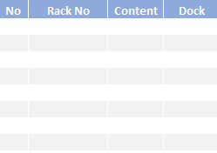


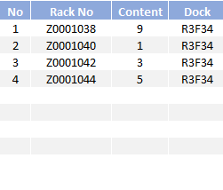

4. Operation flow
4-2. Work Flow Chart
4-2-7. Staging/Delivery process – Truck Entry
ANI - Office
IKD System Pegasus
Truck Entry
Start
Truck Entry
Truck No
70-1787
Login User ID & enter receive function on handy
Scan the Truck BARCODE
Clear[P3]
Confirm[P4]
Truck Entry
Truck No
70-1787
Scan the Rack BARCODE
NO
All done?
Clear[P3]
Confirm[P4]
YES
Move all rack to the truck
Issue Truck Delivery document
Finish

Slide 38
4. Operation flow
2
4-2. Work Flow Chart
4-2-8. Special process
ANI - Office
IKD System Pegasus
Receive plan from HONDA
Auto/Manual Import file
CSV
Verify receive container plan
& issue documents
Receive & Stock
ROBBING
Case Picking
Box Unpack
Robbing process
ปัจจุบันใส่ข้อมูล robbing เพื่อบันทึกแต่ไม่ได้ตัดข้อมูล จาก case stock จริง
ระบบใหม่ต้องการให้นำ case ออกจาก stock
ต้องเตือนตอนนำเข้าแผนส่ง ว่า part ถูก rob ไปแล้ว อะไรบ้าง เพื่อเป็นข้อมูลให้ทาง Honda ว่าหา part แทน
สร้าง Robbing Report
Repack
Putaway
Picking
Unpack Line
Staging
Delivery
Finish

Slide 39
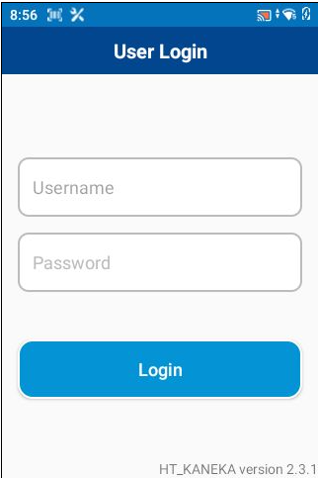
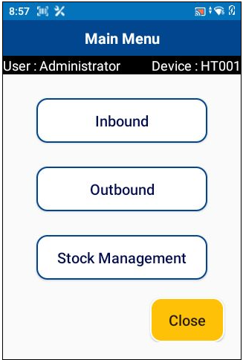
5. System functional specifications
5-1. Handy terminal screen image
Handy terminal function / screen image
1.User Login
2.Main Menu
3.Receive Container
4.Case Transfer
<[P1]
<[P1]
Receive Container
<[P1]
Case Transfer
Receive Container
Receive Container
Moving Case
Trouble Report
Trouble Report
Loading Case
Case Transfer
Move Case In
Case Transfer Receive
Case Picking
Box Unpack
Staging/Delivery
5.Receive Container
6.Trouble Report
7.Move Case In
8.Moving Case
Receive Container
Trouble Report
Move Case In
Moving Case
Date
From
07/Oct/2023
Date
To
07/Oct/2023
Date
From
07/Oct/2023
Date
To
07/Oct/2023
Date
From
07/Oct/2023
Date
To
07/Oct/2023
Date
From
07/Oct/2023
Date
To
07/Oct/2023
Except complete
Except complete
Except complete
Except complete
PC No : 33B2T3551135
Plan No : Y0279947
20/20 Items
PC No : 33B2T3551135
Plan No : Y0279947
20/20 Items
33B2T3551135
Y0279947
Location : 218
Plan no : ABCD1234
Plant : ANI2 > ANI1
69/69 case
PC No : 33B2T3551135
Plan No : Y0279947
0/30 Items
PC No : 33B2T3551135
Plan No : Y0279947
0/30 Items
33B2T3551135
Y0279947
Location : 219
Plan no : ABCD1234
Plant : ANI2 > ANI1
0/69 case
9.Loading Case
10.Case Transfer Receive
11.Case Picking
12.Box Unpack
Loading Case
Case Transfer Receive
Case Picking
Box Unpack
Date
From
07/Oct/2023
Date
To
07/Oct/2023
Date
From
07/Oct/2023
Date
To
07/Oct/2023
Date
From
07/Oct/2023
Date
To
07/Oct/2023
Date
From
07/Oct/2023
Date
To
07/Oct/2023
Except complete
Except complete
Except complete
Except complete
Plan no : ABCD1234
Plant : ANI2 > ANI1
Truck no : 1 69/69 case
Plan no : ABCD1234
From : ANI2
Truck no : 1 69/69 case
Y0279897
GAOU6576421
20/20 Items
TN-2409-0008-01
DOCK: R3W18
20/20 Items
Plan no : ABCD1234
Plant : ANI2 > ANI1
Truck no : 2 0/69 case
Plan no : ABCD1234
From : ANI2
Truck no : 2 0/69 case
Y0279898
GAOU6576421
0/20 Items
TN-2409-0008-01
DOCK: R3W18
0/2 Items

Slide 40
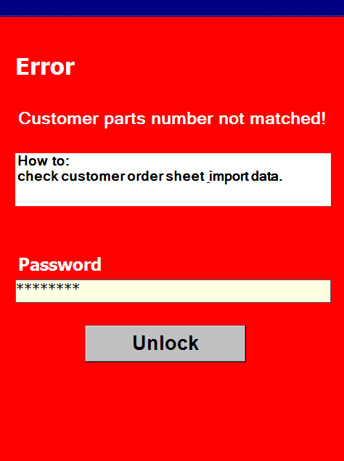
5. System functional specifications
5-1. Handy terminal screen image
Handy terminal function / screen image
13.Staging/Delivery
14.Main Menu
15.Receive Container
16.NG Lock screen
<[P1]
Case Transfer
Rack Entry
Truck Entry
Date
From
07/Oct/2023
Date
To
07/Oct/2023
Truck No
70-1787
Rack Entry
Except complete
Truck Entry
TN-2409-0008-01
RACK: 307
20/20 Items
TN-2409-0008-01
RACK:
0/15 Items
Clear[P3]
Confirm[P4]

Slide 41


5. System functional specifications
5-2. Tablet screen image
Tablet function / screen image
User Login
User ID
Handy terminal
▼
Main menu
Handy terminal
Handy terminal #001
Meiji card
Logout

Slide 42

5. System functional specifications
5-2. Tablet screen image – Meiji card
Tablet function / screen image
Meiji card tablet display
Meiji card
1/1
Handy connected
Main menu
Handy terminal #001
Waiting scan from Handy terminal
Meiji card display loaded
Meiji card
1/1
Handy connected
Main menu
Handy terminal #001
Waiting scan

Slide 43




5. System functional specifications
5-3. PC application screen image
PC function / screen image
User Login
Main menu
Schedule
Production Schedule
Log history
Schedule
Production Schedule Detail
Import Transaction
Item Master
Department Master
Location Master
Name Master
User Credential Master
Package Type Master
Authority Master
Calendar Master
Master
Supplier Master
Pending Reason Master
Customer Master

Slide 44

5. System functional specifications
5-10. Dashboard
Example

Slide 45
6. Q&A

Slide 46
7. Sign off
We hereby acknowledge and agree the above-mentioned blueprint requirements.
Any changes required after the sign off for this blueprint will be addressed through the change request process.
A.N.I. LOGISTICS, LTD.
Sign:
Name:
Title:
Date:
TOMAS TECH CO.,LTD.
Sign:
Name:
Title:
Date:
## END OF BLUEPRINT##

