Slide 1
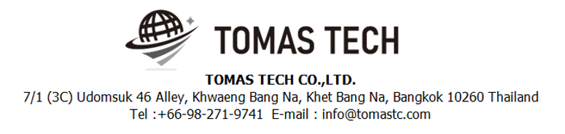
Version 03/Jan/2025
Confidential
Warehouse management system specifications
Documentation EN Blueprint for NKI
Blueprint
R2
Made for: PT NIPPON KONPO INDONESIA.
By: TOMAS TECH CO.,LTD.

Slide 2
Revision History
Date | Version | File name | Details
30/Dec/2024 | R1 | Warehouse management system specifications Documentation EN Blueprint for NKI | First edition
03/Jan/2025 | R2 | Warehouse management system specifications Documentation EN Blueprint for NKI | Second edition
2

Slide 3
■Contents
1. Overview
2. Overall configuration diagram
3. Document image
3-1. Importing Files
3-1-1. Purchase Order
3-1-2. Production Plan
3-1-3. DO Sheet (Delivery Order)
3-2. KANBAN information
3-3. Location Tag
3-4. Labeling
4. Schedule
4-1. Work Flow Chart
4-1-1. CSV file import process
4-1-2. Warehouse Inbound/Incoming process
4-1-3. Goods Receive Process
4-1-4. Picking Process (Part Store)
4-2. Stock management
4-3. Outbound
4-4. Master management
5. System functional specifications
5-1. Handy terminal function
5-2. Handy terminal function Inbound
5-3. Handy terminal function Outbound
5-4. Handy terminal function Stock Management
5-5. PC operation flow Basic
5-6. PC operation flow Schedule
5-7. PC operation flow Inbound
5-8. PC operation flow Outbound
5-9. PC operation flow Stock management
5-10. PC operation flow Master management
6. Q&A
7. Sign off

Slide 4
1. Overview
Introduced Warehouse Management system to NKI.
The system specifications for introduction are described in this document.

Slide 5




2. Overall configuration diagram
Represents a configuration diagram of the stock management system. It is a configuration image of hardware and documents.
Overall configuration diagram image
Handy terminal BT-A500 × 6
WIFI
RECEIVE
PICKING
SHIPPING
Pegasus Server
Report
Receive Report (Dunlop format) - daily
Picking Sheet
Delivery Check Sheet
Picking List
Delivery Part Tag(UPC)
Delivery Bill
NG Report
Transactions Input
Receive Plan
Order Plan
Plan data (IN/OUT)
Actual data (IN/OUT)
Master Data
1. Item master
2. Location master
3. Customer
4. Supplier
5. NG Reason
6. etc.
Part stock report (chart)
Request chart layout from user

Slide 6
2. Overall configuration diagram
Network diagram
NKI office
Lan cable
Pegasus
Server
Cloud
Wi-Fi
Client pc
USB cable
AC220V*1
Switching hub
Access Point
AC220V*1
AC220V*1
Handy terminal#1
Handy terminal#6
AC220V*2
Label printer #1
Client pc
AC220V*1
NKI Warehouse

Slide 7
2. Overall configuration diagram
Hardware diagram
NKI office
Lan cable
Pegasus
Server
Cloud
Wi-Fi
Client pc
USB cable
AC220V*1
Switching hub
Access Point
AC220V*1
AC220V*1
Handy terminal#1
Handy terminal#6
AC220V*2
Label printer #1
Client pc
AC220V*1
NKI Warehouse

Slide 8
3. Document image
3-1. Importing Files
Item | File name | Type | Remarks
Inbound / Material Receive | Inbound data.xlsx | Receive Plan
Outbound / Delivery / Production plan | LIST-PREPARED-BAN-DO-REPLACEMENT(国内向け出荷データ) .xlsx | Delivery Plan
 | 輸出品 出荷指示書(Export Delivery Order).xlsx | Delivery Plan
Master / Report / Other | Item code list | Customer

Slide 9
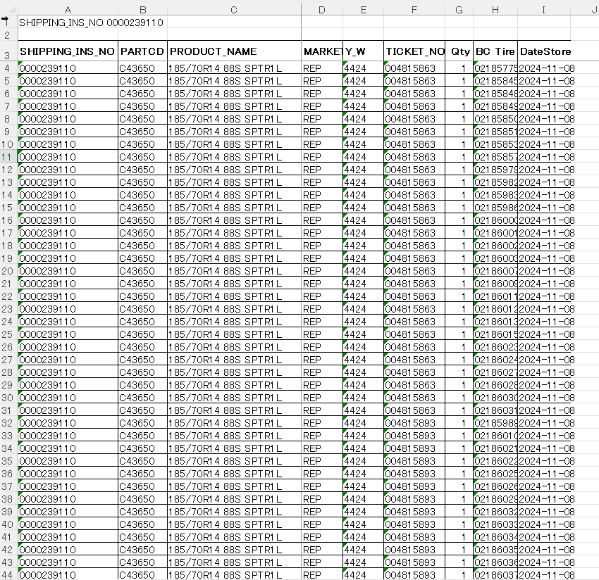
3. Document image
3-1-1. Inbound schedule ( Receive Plan )
NKI ⇒Pegasus
2
Convert from Excel to CSV on the NKI side and import it into Pegasus.
“Market” is not used

Slide 10
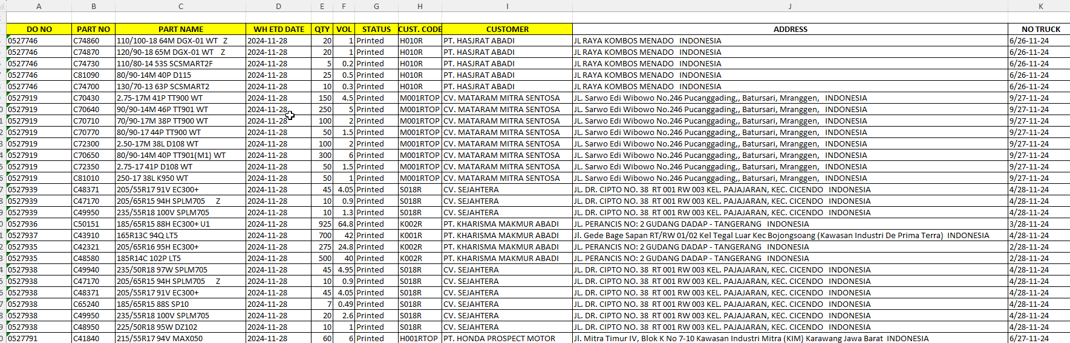
3. Document image
3-1-2. LIST-PREPARED-BAN-DO-REPLACEMENT(国内向け出荷データ) .xlsx
NKI ⇒Pegasus
2
Convert from Excel to CSV on the NKI side and import it into Pegasus.
“Market” is not used
CSVデータとして受領をする。
NKI様にてCSVを取り込む。
20241230
BC Tireは8桁 4輪、2輪含めて。
●CSV変換手順を別途連絡をする。
★MarketについてはNKI様確認。WMS側で制御をする必要があるのかOE,REP,EXPORT
★ WH ETD DATE 出荷予定日 →データ受領、実出荷のタイミングを確認。
★ VOL 重量？立米？ 必要か否かを確認
★ Status 不明
★ CUST CODE
★ No TRUCK , TRUCKER、DELIVERY ADDRESS IDを確認。
★プロダクトweekの指定が必要か否か。

Slide 11
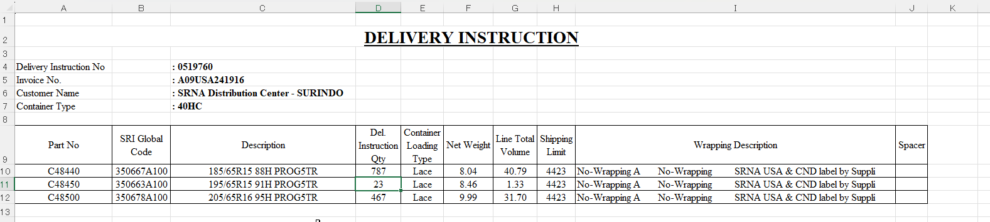
3. Document image
3-1-3.輸出品 出荷指示書(Export Delivery Order).xlsx
NKI ⇒Pegasus
2
Convert from Excel to CSV on the NKI side and import it into Pegasus.
“Market” is not used
CSVデータとして受領をする。
NKI様にてCSVを取り込む。
20241230
BC Tireは8桁 4輪、2輪含めて。
Del. Instruction Qty 出荷数量
Container Loading Type 積込方。Loading listに表示をする。
Shipping Limit プロダクトweekが指示周期以降の製品 4423 <= 4423,4523
Wrapping Description Loading listに表示をする。
●CSV変換手順を別途連絡をする。
★MarketについてはNKI様確認。WMS側で制御をする必要があるのかOE,REP,EXPORT
★出荷日の情報を付与する
★インボイスNoは不要。
★シート毎にCSVファイルを分けていただく。
★Wrapping Description

Slide 12
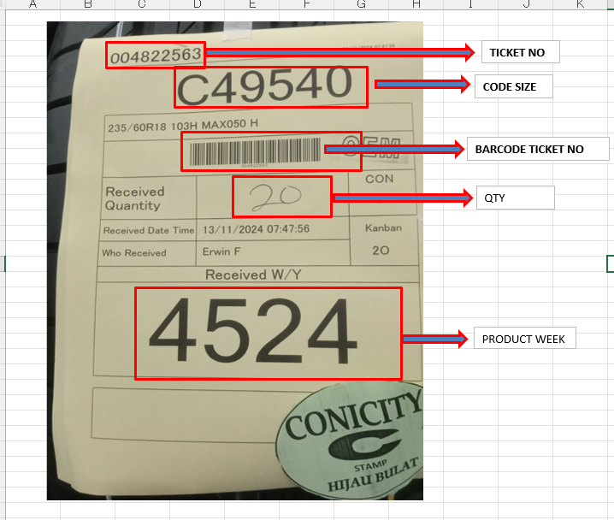
3. Document image
3-1-4. Ticket
NKI
CODE SIZE = Parts no
originalチケットは保管用、再発行は払い出し用。払い出し用フォーマットは、originalフォームと異なる。了承済。
同じチケットNo内に、複数のParts noは存在しない。
★チケットサイズはA4 1ページ分。

Slide 13

3. Document image
3-1-5. Re-print Ticket Size A4
NKI
2
004822563
Printed Data Time : 13/11/2024 07:47:56
C49540
235/60R18 103H MAC050 H
Received
Quantity
004822563
20
29.5mm
Received Data Time
13/11/2024 07:47:45
Who
Received
Erwin F
Received W/Y
4524
21 mm

Slide 14


3. Document image
3-1-6. Product label
NKI
4-wheel vehicle
Two-wheeled vehicle

Slide 15

3. Document image
3-1-7. Picking List
Pegasus

Slide 16
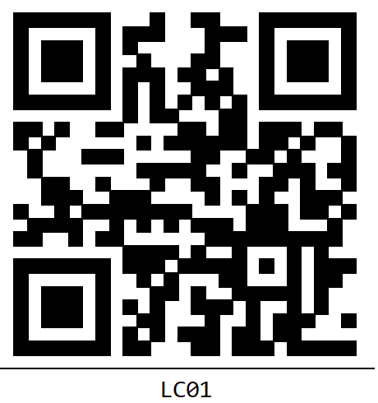
3. Document image
3-2. Location Tag
Font : Consolas
60mm
55mm
Item definition
LOCATION CODE : Location ID
QR information
[LOCATION CODE]
LOCATION CODE : Location ID

Slide 17
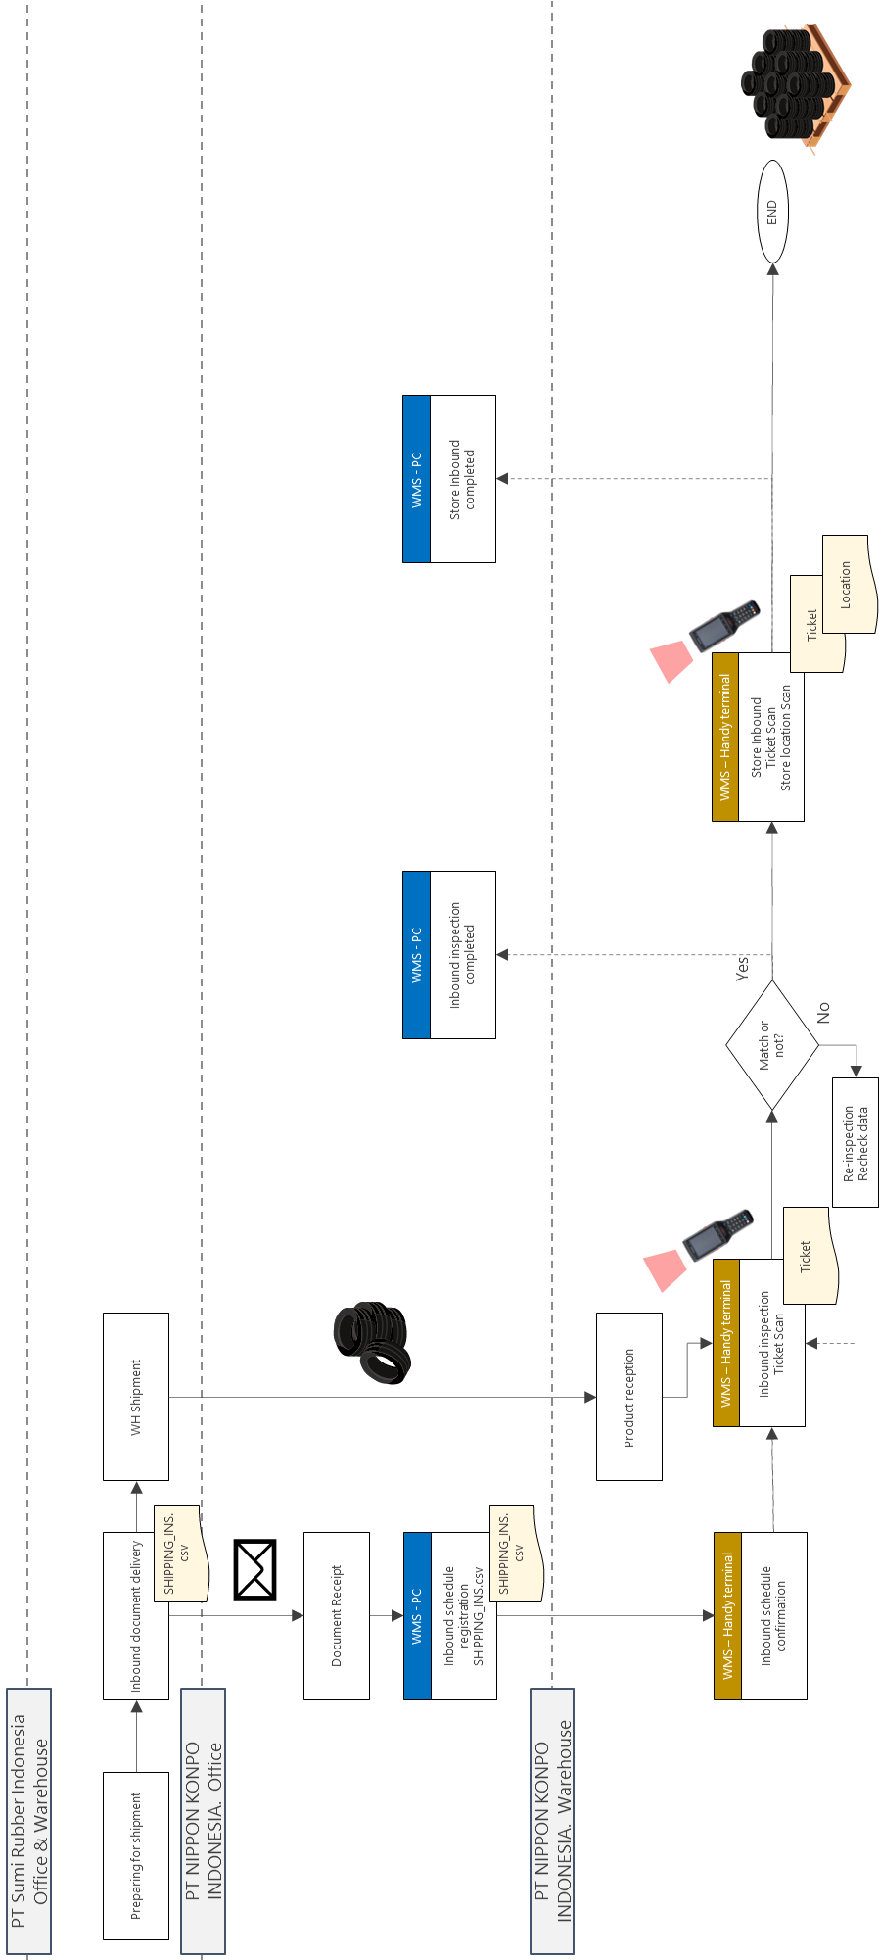
4. Operation flow
4-1. Inbound Operation Flow

Slide 18
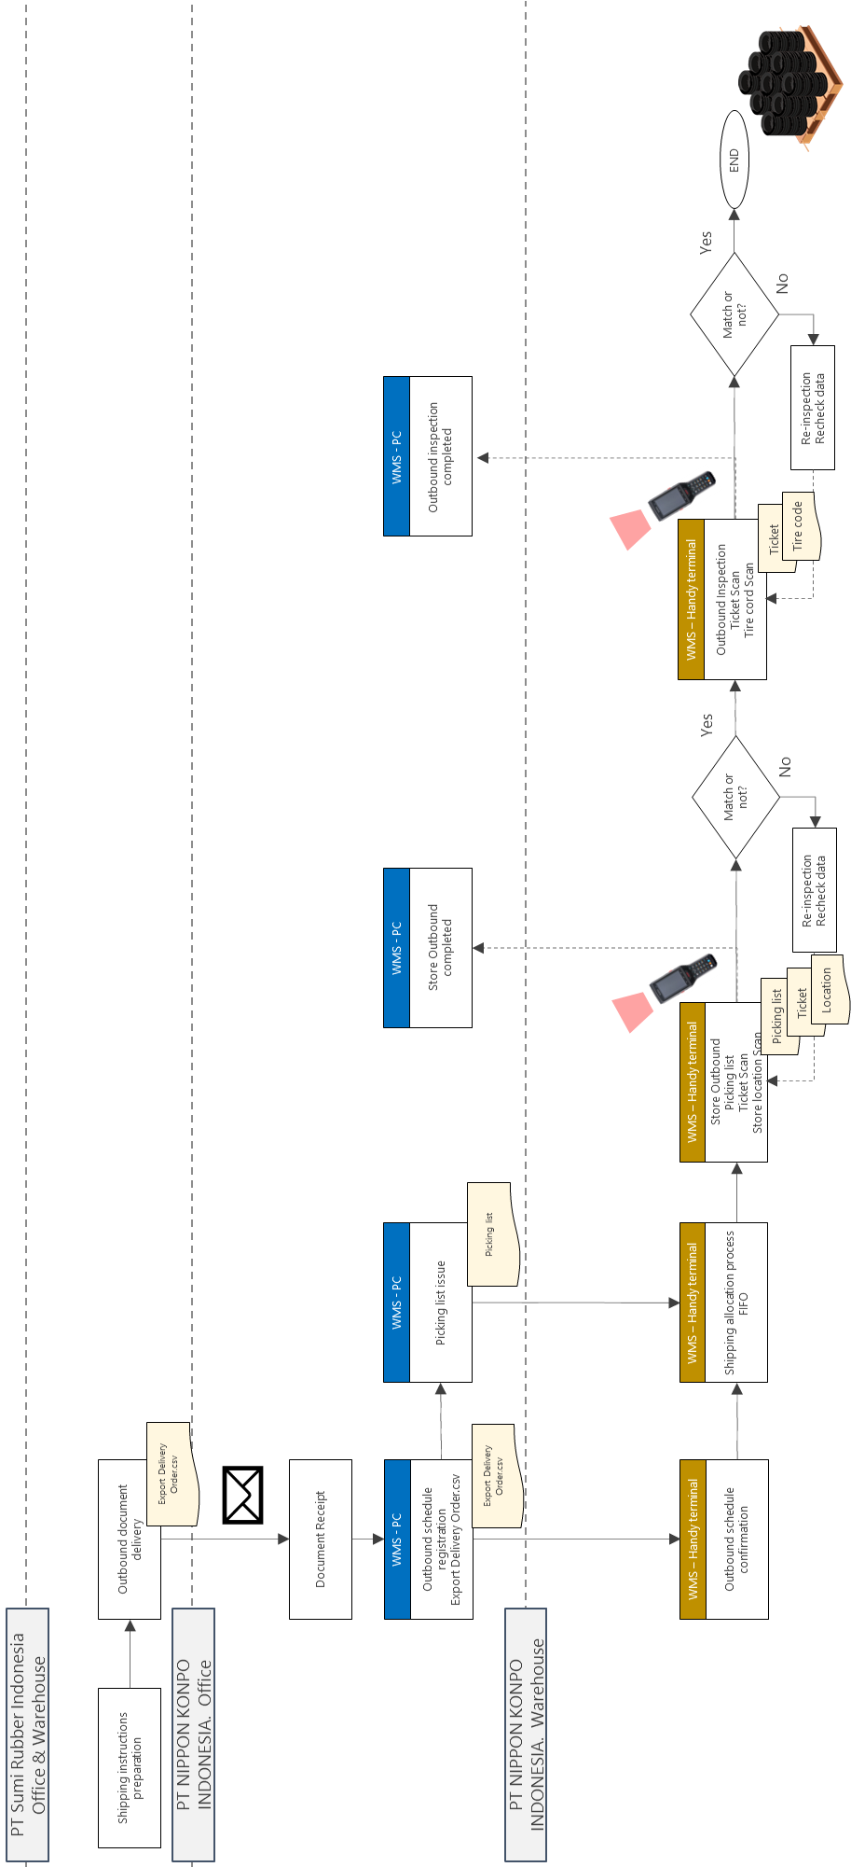
4. Operation flow
4-2. Outbound Operation Flow -Overseas shipping-

Slide 19

4. Operation flow
4-2. Outbound Operation Flow -Domestic Shipping-

Slide 20
4. Operation flow
4-3. Outbound Operation Flow -Overseas shipping-

Slide 21
4. Operation flow
4-1. Inbound
Manage inbound status using the following 5 steps.
Schedule registered
Inbound QC working
Cancel
Inbound QC Completed
Inbound Rack working
Inbound Rack Completed
Inbound QC
Inbound QC Completed
Inbound Rack working
Inbound Rack Completed

Slide 22
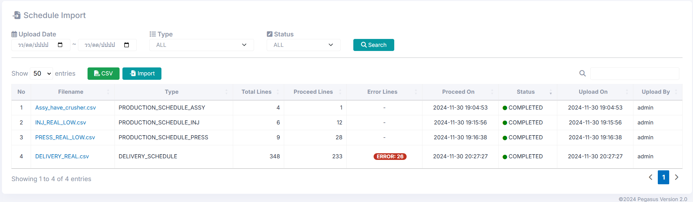
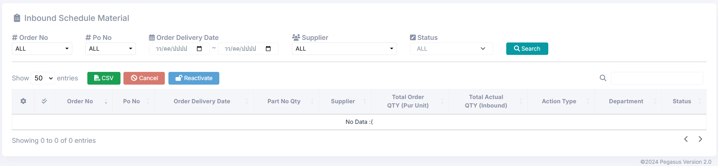

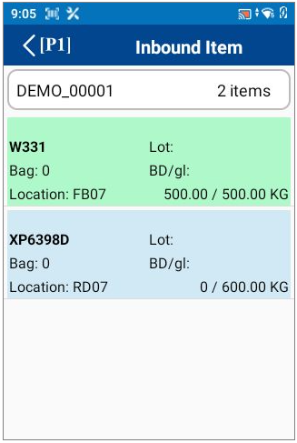


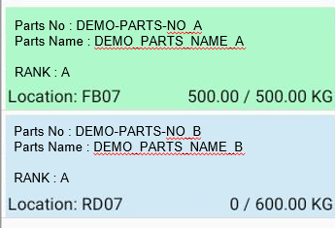
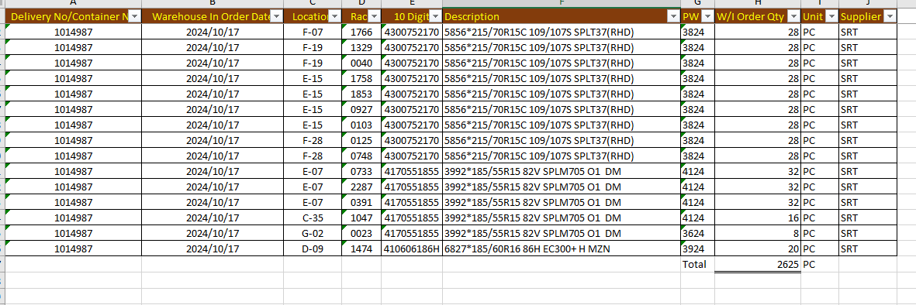
4. Operation flow
2
4-1. Work Flow Chart
4-1-1. Receive process
NKI
Warehouse Management System Pegasus
Received the email RECEIVE PLAN
Import file or Input data
CSV
Verify and prepare tire week tags
Inbound QC
Date
From
07/Oct/2023
Date
To
07/Oct/2023
Except complete
QC inspects received items by handy
Order No : 1014488
Parts No : 4170551955
Parts Name : 195/55R15 85V SPLM705 02 JP DM
Tire week/ Lot no : 37241
200/200 Pcs
Order No : 1014488
Parts No : 4104751880
Parts Name : 185/60R15 84H SP2030 T O MZN
Tire week/ Lot no :
0/320 Pcs
Export report and send to Dunlop
CSV
Finish

Slide 23
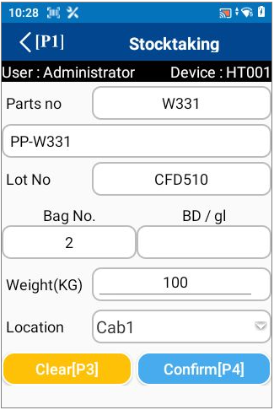



4. Operation flow
2
4-1. Work Flow Chart
4-1-2. QC inspects received items by handy
NKI
Warehouse Management System Pegasus
QC inspects received items by handy
Start
Check receive documents and tire week
Inbound QC
Date
From
07/Oct/2023
Date
To
07/Oct/2023
Except complete
Choose the receive schedule on handy
Order No : 1014488
Parts No : 4170551955
Parts Name : 195/55R15 85V SPLM705 02 JP DM
Tire week/ Lot no : 37241
200/200 Pcs
Order No : 1014488
Parts No : 4104751880
Parts Name : 185/60R15 84H SP2030 T O MZN
Tire week/ Lot no :
0/320 Pcs
NO
QC pass?
YES
Inbound QC
Install to Rack?
4104751880
NO
185/60R15 84H SP2030 T O MZN
Plan :
320 pcs
2023-09-28
320
Qty
200
Qty
3724
YES
Tire week :
Act Qty
~
Act Qty
1A000
1A319
Scan/Choose NG location_id
Scan/Choose Rack no
Scan/Choose floor location_id
Serial no :
Leader ID :
Anucha
Scan tire week tag, paste and move to NG location
Scan tire week tag, paste and move to rack
Scan tire week tag, paste and move to floor location
Enter qty (omitted to use the default that equal to plan)
Scan 1st QR tag and the last QR tag to confirm lot
Scan officer ID to leader confirm
All done?
NO
YES
Finish

Slide 24
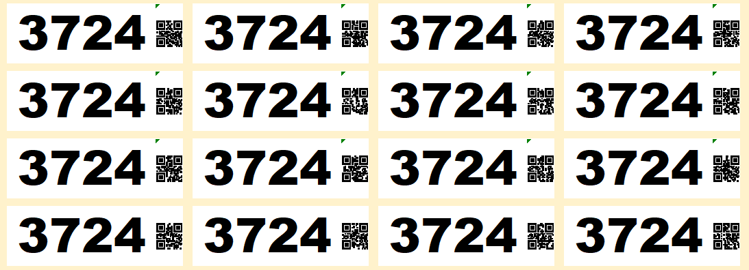



4. Operation flow
2
4-1. Work Flow Chart
4-1-3. Inbound Rack process
NKI
Warehouse Management System Pegasus
Inbound Rack
Date
From
07/Oct/2023
Date
To
07/Oct/2023
Except complete
Start
Order No : 1014488
Parts No : 4170551955
Parts Name : 195/55R15 85V SPLM705 02 JP DM
Tire week/ Lot no : 37241
Location: A1-10,A1-11 200/200 Pcs
Order No : 1014488
Parts No : 4104751880
Parts Name : 185/60R15 84H SP2030 T O MZN
Tire week/ Lot no : 37241
Location: 0/320 Pcs
Scan the Rack no or Choose the Inbound Rack job in handy
Inbound Store
Move and scan Rack no and the location id to confirm
4104751880
185/60R15 84H SP2030 T O MZN
2023-09-28
Tire week :
3724
Qty
~
Qty
200
Serial no :
1A000
1A099
Qty :
/320
Act Qty
All done?
NO
Act Qty
100
Pcs
Location :
A1-10-1
YES
Finish

Slide 25
4. Operation flow
4-2. Stock management
NKI
Warehouse Management System Pegasus
Change Location
HT : Change Location
Stock taking
HT : Stock taking
Stock check
HT : Stock Check

Slide 26
4. Operation flow
4-3. Outbound
Manage inbound status using the following 5 steps.
Schedule registered
Picking working
Picking Completed
Shipping working
Cancel
Shipping Completed
Picking working
Picking Completed
Shipping working
Shipping Completed

Slide 27
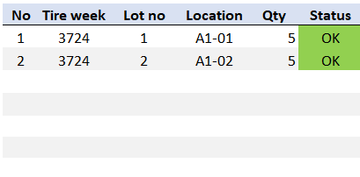
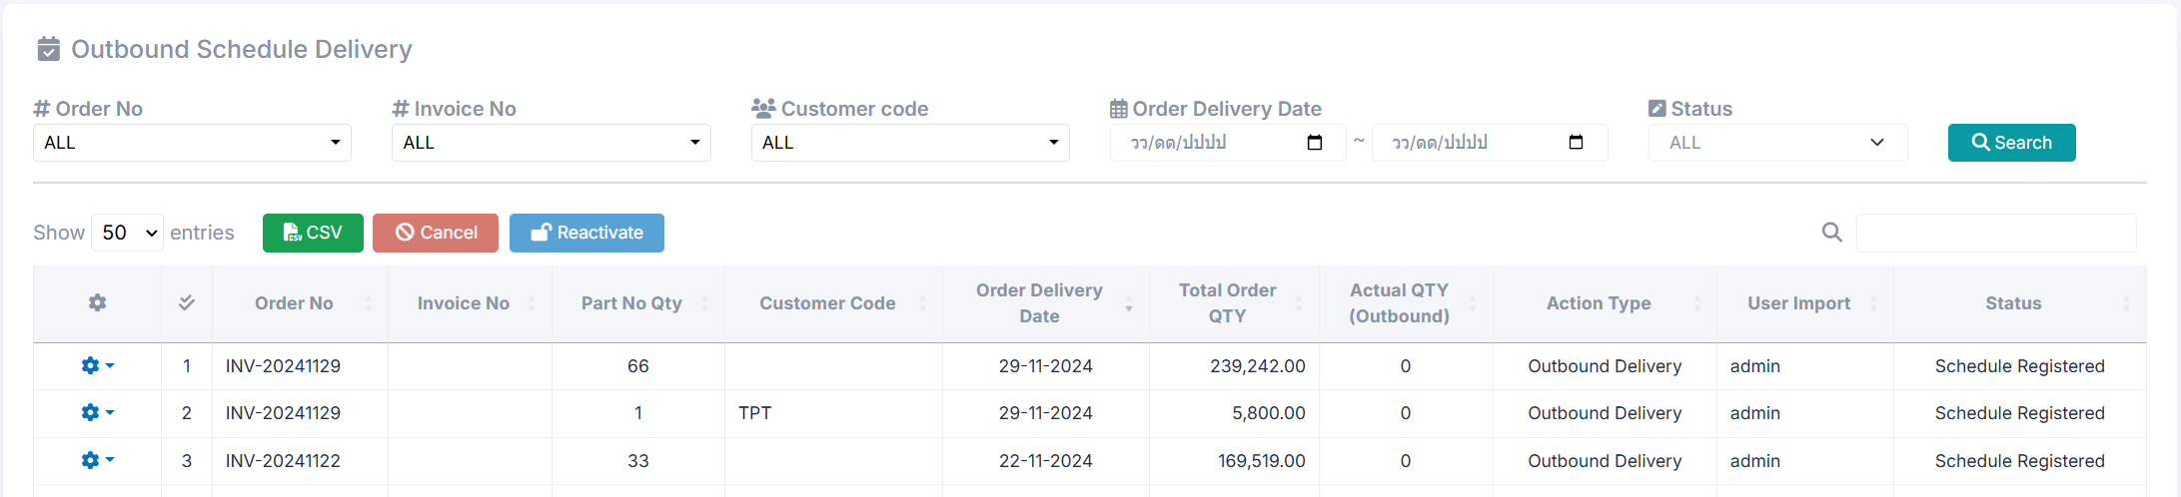
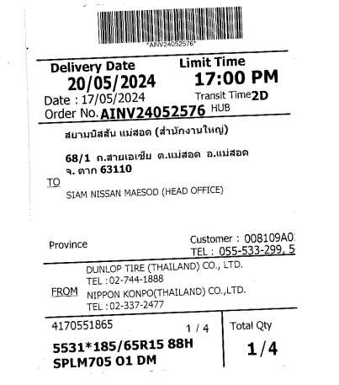

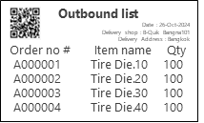
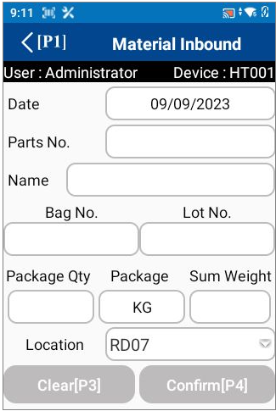
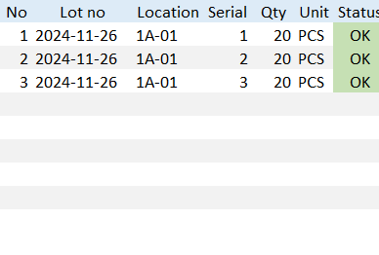

4. Operation flow
2
4-3. Outbound
4-3-1. Outbound Picking process
NKI
Production Management System Pegasus
Received the email ORDER PLAN
Outbound Picking
Import file or Input data
4170551955
195/55R15 85V SPLM705 O2 JP DM
Customer :
161028
Print[P2]
2023-09-28
CSV
Qty
200
Qty
Act Qty
Act Qty
10/10
Verify and confirm picking work
Print documents
Picking list
Delivery Check list
Delivery Bill
Picking work by handy
Outbound Picking
Date
From
07/Oct/2023
Date
To
07/Oct/2023
Except complete
Order No : INV24102844
Parts No : 4170551955
Parts Name : 195/55R15 85V SPLM705 02 JP DM
Tire week : 3724
Lot no :
Location: 2/2 Pcs
Enter qty (omitted to use the default that equal to plan)
Scan 1st QR tag and the last QR tag to confirm lot
Scan officer ID to leader confirm
Move the items to loading area
Order No : INV24102845
Parts No : 4104751860
Parts Name : 185/60R15 84H SP2030 T O MZN
Tire week : 3724
Lot no : 1,2
Location: A1-01,A1-02 0/10 Pcs
Outbound Detail
Shipping work by handy
Outbound Shipping
Parts No
DEMO-PARTS-NO_B
Date
From
07/Oct/2023
Date
To
07/Oct/2023
Parts Name
DEMO-PARTS-NO_B
Except complete
RD05
RD06
DEMO_PARTS_NAME_B
Order No : INV24102844
Parts No : 4170551955
Parts Name : 195/55R15 85V SPLM705 02 JP DM
Tire week : 3724
Lot no :
Location: 2/2 Pcs
Box No
Lot No
Plan
2023-09-10
2023-09-11
0001
Lot No
Qty
Finish
Order No : INV24102845
Parts No : 4104751860
Parts Name : 185/60R15 84H SP2030 T O MZN
Tire week : 3724
Lot no : 1,2
Location: A1-01,A1-02 0/10 Pcs
2
PCS
20
Confirm[P4]

Slide 28
4. Operation flow
4-3. Outbound
4-3-2. Picking work by handy
NKI
Production Management System Pegasus
Picking work by handy
Start
Check and scan the Picking list documents
Scan QR code / Choose the outbound schedule on handy
NO
From Rack?
YES
Entire Floor?
NO
NO
Entire Rack?
YES
YES
Scan Floor no and confirm
Scan tire label
Scan Rack no and confirm
Transfer all items to loading area
Transfer tire to loading area
Transfer rack to loading area
All done?
NO
YES
Finish

Slide 29
4. Operation flow
4-4. Master management
NKI
Production Management System Pegasus
Item master
PC : Item master
Location master
PC : Location master
User master
PC : User master
User credential master
PC : User Credential
Authority master
PC : Authority Master
Name master
PC : Name Master

Slide 30
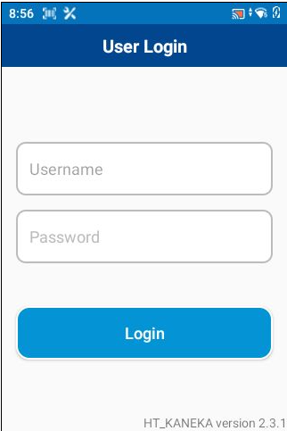
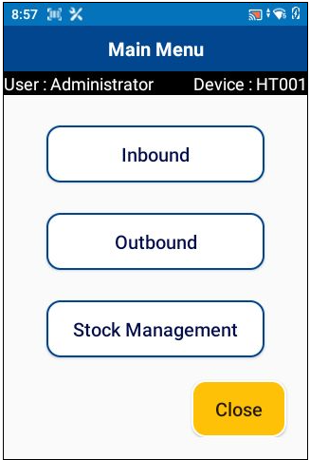
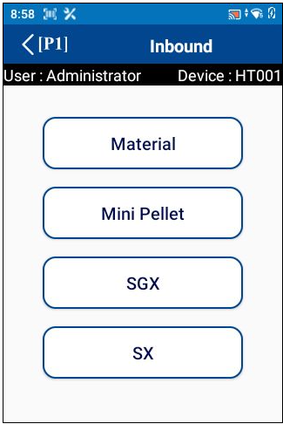
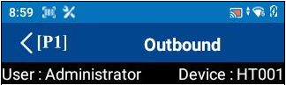

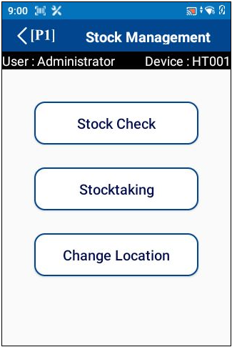
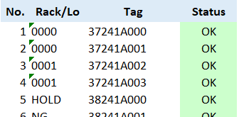
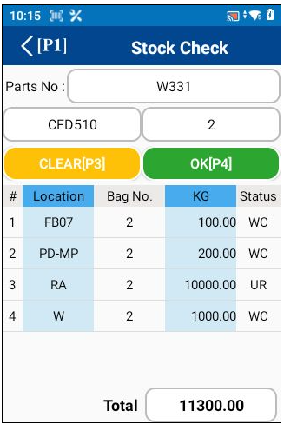
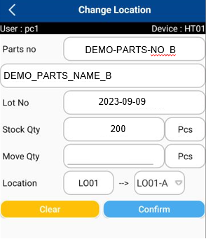

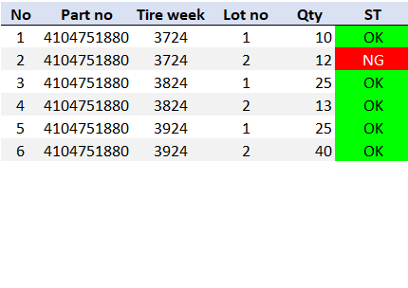
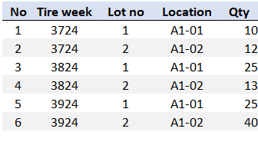
5. System functional specifications
2
5-1. Handy terminal function
1. User Login
2. Main menu
3. Inbound menu
4. Outbound menu
Schedule Label
Outbound Picking
Inbound QC
Label Manual
Outbound Shipping
Inbound Rack
Inbound Manual
Inbound
5. Stock management menu
6. Inbound QC
7. Inbound QC Detail
8. Inbound Rack
TICKET_NO
4104751880
Inbound QC
Inbound QC
Inbound Rack
Date
From
07/Oct/2023
Date
To
07/Oct/2023
Ticket No
004815863
Date
From
07/Oct/2023
Date
To
07/Oct/2023
Except complete
Actual / Plan :
320 / 320 pcs
Complete
Except complete
SHIPPING_INS_NO: 1014488
TICKET_NO : 004815863
Parts No : 4170551955
Parts Name : 195/55R15 85V SPLM705 02 JP DM
Tire week/ Lot no : 3724
200/200 Pcs
2023-09-28
SHIPPING_INS_NO: 1014488
TICKET_NO : 004815863
Parts No : 4170551955
Parts Name : 195/55R15 85V SPLM705 02 JP DM
Tire week/ Lot no : 3724
200/200 Pcs
Qty
Parts no
BC Tire
Qty
200
SHIPPING_INS_NO: 1014488
TICKET_NO : 00481587
Parts No : 4170551953
Parts Name : 195/55R15 85V SPLM705 02 JP DM
Tire week/ Lot no : 3724
0/220 Pcs
Qty
1
1
1
1
SHIPPING_INS_NO: 1014488
TICKET_NO : 00481587
Parts No : 4170551953
Parts Name : 195/55R15 85V SPLM705 02 JP DM
Tire week/ Lot no : 3724
0/220 Pcs
Act Qty
Act Qty
9. Inbound Rack Detail
10. Stock check
11. Stock taking
12. Change location
Inbound Rack
4104751880
Location
DEMO-PARTS-NO_B
Ticket no :
Tire week:
A1-01
Ticket No
004815863
DEMO_PARTS_NAME_B
Ticket No
2023-09-28
2023-09-09
2023-09-28
Qty
200
RD07
Qty
Location
Qty
200
Location :
A-00
Qty
Act Qty
Act Qty
Qty
11 PCS
Act Qty
Total Qty:
Act Qty
300
Act Qty
300
棚入れ後に引き当て可能。
受け入れ時は引き当てをしない。
125
★棚卸方法について、確認をしていただく。

Slide 31






5. System functional specifications
2
5-1. Handy terminal function
13. Outbound Picking
13. Outbound Picking Detail
14. Outbound Shipping
15. Outbound Shipping Detail
Outbound Picking
Outbound Picking
Outbound Shipping
Outbound Shipping
SCHEDULE
MANUAL
Date
From
07/Oct/2023
Date
To
07/Oct/2023
4170551955
Date
From
07/Oct/2023
Date
To
07/Oct/2023
DO No
4170551955
Except complete
DO No
INV24102845
Except complete
INV24102845
SCHEDULE
MANUAL
DO No: INV24102844
Location: A1-01,A1-02 2/2Pcs
2023-09-28
DO No: INV24102844
Location: A1-01,A1-02 2/2Pcs
195/55R15 85V SPLM705 O2 JP DM
2023-09-28
Qty
200
Qty
200
DO No: INV24102845
Location: A1-01,A1-02 0/2Pcs
Qty
DO No: INV24102845
Location: A1-01,A1-02 0/2Pcs
Qty
QC Check
PHOTO
Act Qty
Act Qty
Act Qty
Act Qty
10/10
10/10
品番で指示。
古いチケットNoがあればエラーとする。
ﾊﾟｰﾂNoとTire week
ロケーションは1つのみの表示。WMS側で指示をするような形となる。

Slide 32
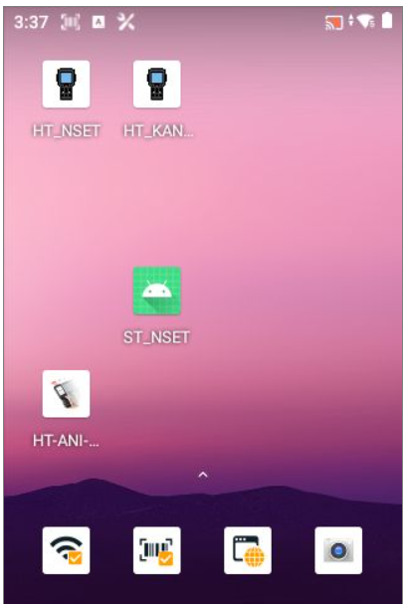

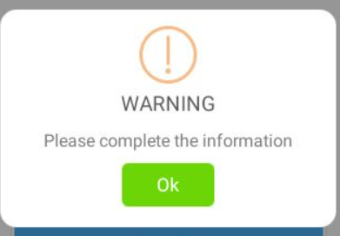
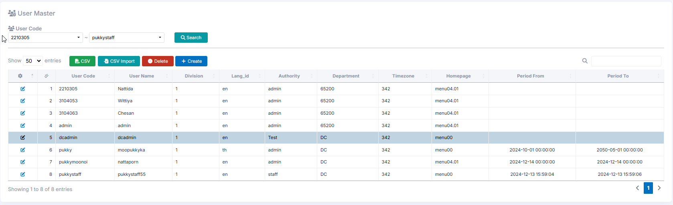
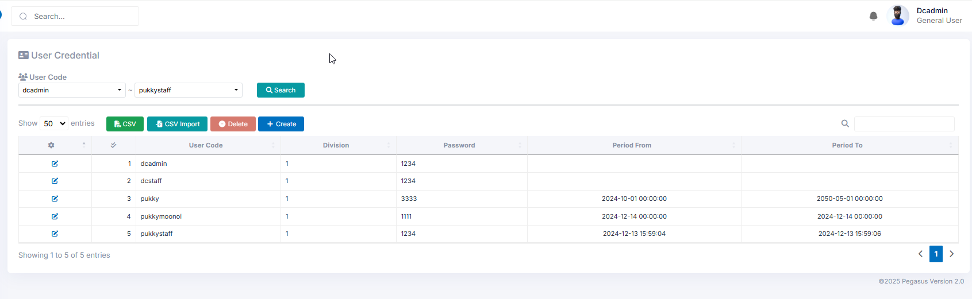
5. System functional specifications
5-1. Handy terminal function
5-1-1. User Login
This is the screen that transitions after icon app click from home screen.
User name: Information is referenced from the User master.
Enter the User code of User master.
If it enter a code that does not exist, an error screen will be displayed. *1
Pass word: Information is referenced from the User credential master.
The User code of User master is linked to the User code of User credential master. User credential Enter the master password.
If it enter a code that does not exist, an error screen will be displayed. *1
Login button: If the information is correct, it will be redirected to the Main menu.
*1: Display screen when information is incorrect
OK button: Close this screen. Return to the previous process.
User master
User credential master

Slide 33
5. System functional specifications
5-1. Handy terminal function
5-1-2. Main menu
This is the screen that transitions after logging in from User Login.
Inbound button: Transitions to the Inbound screen.
Outbound button: Transitions to the Outbound screen.
Stock Management button: Transitions to the Stock Management screen.
Close button: Closes the application.
admin
1234

Slide 34
5. System functional specifications
5-2. Handy terminal function Inbound
5-2-1. Inbound QC
This is the screen that transitions after select inbound from Main menu.
Inbound QC button: Transitions to the Inbound QC screen.
Inbound Rack button: Transitions to the Inbound Rack screen.
< (P1): Back to Main menu
Schedule Label
Inbound QC
Label Manual
Inbound Rack
Inbound Manual

Slide 35
5. System functional specifications
5-2. Handy terminal function Inbound
5-2-2. Inbound Item
Inbound QC
This is the screen that transitions after select Inbound Schedule from Inbound.
Date from: Select the start of the target date. Default is today's date. Search ORDER DELIVERY DATE
Date to: Select the end of the target date. Default is today's date. Search ORDER DELIVERY DATE
Except complete: If checked, the completed status Item list will not be displayed from the Item list. Default is unchecked.
Order list : Display a list that matches the condition.
Shipping ins no : ORDER NO from inbound schedule
Ticket No : Ticket no from inbound schedule
Part No.: PART NUMBER from inbound schedule
Part Name: PART NAME from inbound schedule
Tire week : Lot no from inbound schedule
Item quantity: Number of items that have been processed
Status color: Green - Completed, Dark Blue - Working, Light Blue - Not Started.
< (P1): Back to Main menu
Date
From
07/Oct/2023
Date
To
07/Oct/2023
Schedule Label
Except complete
Inbound QC
SHIPPING_INS_NO: 1014488
TICKET_NO : 004815863
Parts No : 4170551955
Parts Name : 195/55R15 85V SPLM705 02 JP DM
Tire week/ Lot no : 3724
200/200 Pcs
Label Manual
Inbound Rack
SHIPPING_INS_NO: 1014488
TICKET_NO : 00481587
Parts No : 4170551953
Parts Name : 195/55R15 85V SPLM705 02 JP DM
Tire week/ Lot no : 3724
0/220 Pcs
Inbound Manual

Slide 36
5. System functional specifications
5-2. Handy terminal function Inbound
5-2-3. Inbound QC Detail
Inbound QC
Inbound QC
This is the screen that transitions after select order information from Inbound screen.
Ticket no : Ticket no from Scan data
Part No.: Part number from inbound schedule
BC Tire: BC Tire no from inbound schedule
Qty: Quantity of received item
Status : Depend on update status
Clear[P3]: Clear input contents
Confirm[P4]: Confirmation processing. Normal end: Completion of registration *1. Warning: Warning screen display *2
< (P1): Back to Main menu
Date
From
07/Oct/2023
Date
To
07/Oct/2023
Ticket No
004815863
Except complete
Actual / Plan :
0 / 320 pcs
-
SHIPPING_INS_NO: 1014488
TICKET_NO : 004815863
Parts No : 4170551955
Parts Name : 195/55R15 85V SPLM705 02 JP DM
Tire week/ Lot no : 3724
200/200 Pcs
2023-09-28
Qty
Parts no
BC Tire
Qty
200
SHIPPING_INS_NO: 1014488
TICKET_NO : 00481587
Parts No : 4170551953
Parts Name : 195/55R15 85V SPLM705 02 JP DM
Tire week/ Lot no : 3724
0/220 Pcs
Qty
1
1
1
1
Act Qty
Act Qty
Inbound QC
Scan Ticket no and move to Inbound QC screen
Inbound QC
Date
From
07/Oct/2023
Date
To
07/Oct/2023
Ticket No
004815863
Except complete
Actual / Plan :
0 / 320 pcs
-
SHIPPING_INS_NO: 1014488
TICKET_NO : 004815863
Parts No : 4170551955
Parts Name : 195/55R15 85V SPLM705 02 JP DM
Tire week/ Lot no : 3724
200/200 Pcs
2023-09-28
Qty
Parts no
BC Tire
Qty
200
SHIPPING_INS_NO: 1014488
TICKET_NO : 00481587
Parts No : 4170551953
Parts Name : 195/55R15 85V SPLM705 02 JP DM
Tire week/ Lot no : 3724
0/220 Pcs
Qty
1
1
1
1
Act Qty
Act Qty
Select target inbound schedule by hand manual
Inbound QC
Inbound QC
Scan ticket no
Inbound QC
Date
From
07/Oct/2023
Date
To
07/Oct/2023
Ticket No
004815863
Ticket No
004815863
Except complete
Actual / Plan :
0 / 320 pcs
-
Actual / Plan :
0 / 320 pcs
-
SHIPPING_INS_NO: 1014488
TICKET_NO : 004815863
Parts No : 4170551955
Parts Name : 195/55R15 85V SPLM705 02 JP DM
Tire week/ Lot no : 3724
200/200 Pcs
2023-09-28
2023-09-28
Qty
Parts no
BC Tire
Qty
200
Qty
Qty
Parts no
BC Tire
Qty
200
SHIPPING_INS_NO: 1014488
TICKET_NO : 00481587
Parts No : 4170551953
Parts Name : 195/55R15 85V SPLM705 02 JP DM
Tire week/ Lot no : 3724
0/220 Pcs
Qty
1
1
1
1
Act Qty
1
1
1
1
Act Qty
Act Qty
Act Qty

Slide 37

5. System functional specifications
5-2. Handy terminal function Inbound
5-2-3. Inbound QC Detail
Inbound QC
Inbound QC
Ticket No
004815863
Ticket No
004815863
Actual / Plan :
0 / 320 pcs
-
Actual / Plan :
320 / 320 pcs
Confirmed
2023-09-28
2023-09-28
Qty
Parts no
BC Tire
Qty
200
Qty
Qty
Parts no
BC Tire
Qty
200
1
1
1
1
Qty
1
1
1
1
INFORMATION
Act Qty
Operation completed!
Act Qty
Act Qty
Act Qty
Scan wrong ticket no
Inbound QC
Ticket No
004815863
Actual / Plan :
0 / 320 pcs
-
2023-09-28
Qty
Parts no
BC Tire
Qty
200
Qty
1
1
1
1
Ticket No do not match
Act Qty
Act Qty
NG
Inbound QC
Ticket No
004815863
Actual / Plan :
0 / 320 pcs
-
2023-09-28
Qty
Parts no
BC Tire
Qty
200
Qty
1
1
1
1
Insufficient information
Act Qty
Act Qty
NG
Inbound QC
Scan wrong ticket no
Date
From
07/Oct/2023
Date
To
07/Oct/2023
Except complete
SHIPPING_INS_NO: 1014488
TICKET_NO : 004815863
Parts No : 4170551955
Parts Name : 195/55R15 85V SPLM705 02 JP DM
Tire week/ Lot no : 3724
200/200 Pcs
SHIPPING_INS_NO: 1014488
TICKET_NO : 00481587
Parts No : 4170551953
Parts Name : 195/55R15 85V SPLM705 02 JP DM
Tire week/ Lot no : 3724
0/220 Pcs
Ticket No do not match
NG

Slide 38
5. System functional specifications
5-2. Handy terminal function Inbound
5-2-4. Inbound Rack
Inbound Rack
This is the screen that transitions after select Inbound Schedule from Inbound.
Date from: Select the start of the target date. Default is today's date. Search ORDER DELIVERY DATE
Date to: Select the end of the target date. Default is today's date. Search ORDER DELIVERY DATE
Except complete: If checked, the completed status Item list will not be displayed from the Item list. Default is unchecked.
Order list : Display a list that matches the condition.
Shipping ins no : ORDER NO from inbound schedule
Ticket No : Ticket no from inbound schedule
Part No.: PART NUMBER from inbound schedule
Part Name: PART NAME from inbound schedule
Tire week : Lot no from inbound schedule
Item quantity: Number of items that have been processed
Status color: Green - Completed, Dark Blue - Working, Light Blue - Not Started.
< (P1): Back to Main menu
07/Oct/2023
Date
To
07/Oct/2023
Schedule Label
Except complete
Inbound QC
SHIPPING_INS_NO: 1014488
TICKET_NO : 004815863
Parts No : 4170551955
Parts Name : 195/55R15 85V SPLM705 02 JP DM
Tire week/ Lot no : 3724
200/200 Pcs
Label Manual
Inbound Rack
SHIPPING_INS_NO: 1014488
TICKET_NO : 00481587
Parts No : 4170551953
Parts Name : 195/55R15 85V SPLM705 02 JP DM
Tire week/ Lot no : 3724
0/220 Pcs
Inbound Manual

Slide 39
5. System functional specifications
5-2. Handy terminal function Inbound
5-2-5. Inbound Rack Detail
Inbound Rack
Inbound Rack
This is the screen that transitions after select order information from Inbound screen.
Ticket no : Ticket no from Scan data
Location No.: Location no from Scan data
Qty: Quantity of received item
Status : Depend on update status
Clear[P3]: Clear input contents
Confirm[P4]: Confirmation processing. Normal end: Completion of registration *1. Warning: Warning screen display *2
< (P1): Back to Main menu
07/Oct/2023
Date
To
07/Oct/2023
Ticket no :
Except complete
004815863
SHIPPING_INS_NO: 1014488
TICKET_NO : 004815863
Parts No : 4170551955
Parts Name : 195/55R15 85V SPLM705 02 JP DM
Tire week/ Lot no : 3724
200/200 Pcs
2023-09-28
Qty
200
Qty
SHIPPING_INS_NO: 1014488
TICKET_NO : 00481587
Parts No : 4170551953
Parts Name : 195/55R15 85V SPLM705 02 JP DM
Tire week/ Lot no : 3724
0/220 Pcs
Location :
A-00
Act Qty
Act Qty
11 PCS
Total Qty:
Inbound Rack
Scan Ticket no and move to Inbound QC screen
07/Oct/2023
Date
To
07/Oct/2023
Inbound Rack
Except complete
Ticket no :
SHIPPING_INS_NO: 1014488
TICKET_NO : 004815863
Parts No : 4170551955
Parts Name : 195/55R15 85V SPLM705 02 JP DM
Tire week/ Lot no : 3724
200/200 Pcs
004815863
2023-09-28
Qty
200
SHIPPING_INS_NO: 1014488
TICKET_NO : 00481587
Parts No : 4170551953
Parts Name : 195/55R15 85V SPLM705 02 JP DM
Tire week/ Lot no : 3724
0/220 Pcs
Qty
Location :
-
Act Qty
Act Qty
10 PCS
Total Qty:
Select target inbound schedule by hand manual
Inbound Rack
Inbound Rack
Scan ticket no
Inbound Rack
Date
From
07/Oct/2023
Date
To
07/Oct/2023
Ticket no :
Ticket no :
Except complete
-
004815863
SHIPPING_INS_NO: 1014488
TICKET_NO : 004815863
Parts No : 4170551955
Parts Name : 195/55R15 85V SPLM705 02 JP DM
Tire week/ Lot no : 3724
200/200 Pcs
2023-09-28
2023-09-28
Qty
200
Qty
Qty
Qty
200
SHIPPING_INS_NO: 1014488
TICKET_NO : 00481587
Parts No : 4170551953
Parts Name : 195/55R15 85V SPLM705 02 JP DM
Tire week/ Lot no : 3724
0/220 Pcs
Location :
-
Location :
-
Act Qty
Act Qty
Act Qty
0 PCS
Act Qty
10 PCS
Total Qty:
Total Qty:

Slide 40
5. System functional specifications
5-2. Handy terminal function Inbound
5-2-5. Inbound Rack Detail
Inbound Rack
Scan location code
Inbound Rack
Ticket no :
Ticket no :
004815863
004815863
2023-09-28
A-00-00-11
2023-09-28
Qty
200
Qty
200
Qty
Qty
Location :
A-00-00-11
Location :
-
INFORMATION
Act Qty
Operation completed!
Act Qty
Act Qty
Act Qty
10 PCS
Total Qty:
10 PCS
Total Qty:
Inbound Rack
Ticket no :
004815863
2023-09-28
Qty
200
Insufficient information
Qty
Location :
-
NG
Act Qty
Act Qty
10 PCS
Total Qty:

Slide 41
5. System functional specifications
5-3. Handy terminal function Outbound
5-3-1. Outbound
This is the screen that transitions after select outbound from Main menu.
Outbound Picking: Transitions to the Work Outbound screen.
Outbound Shipping: Transitions to the Production Outbound screen.
< (P1): Back to Main menu
Outbound Picking
Outbound Shipping
Inbound

Slide 42
5. System functional specifications
5-3. Handy terminal function Outbound
5-3-2. Outbound Picking
Outbound Picking
This is the screen that transitions after select outbound schedule from Outbound menu.
Date from: Select the start of the target date. Default is today's date. Search ORDER DELIVERY DATE
Date to: Select the end of the target date. Default is advance 7 days date. Search ORDER DELIVERY DATE
Except complete: If checked, the completed status Item list will not be displayed from the Item list. Default is unchecked.
Order list : Display a list that matches the condition.
DO no : ORDER NO
Location: *Display assigned location information. If there are multiple items, display multiple items.
Item quantity: Number of items that have been processed "/" ORDER QTY(PER UNIT)
Status color: Green - Completed, Dark Blue - Working, Light Blue - Not Started.
< (P1): Back to Main menu
Date
From
07/Oct/2023
Date
To
07/Oct/2023
Outbound Picking
Except complete
DO No: INV24102844
Location: A1-01,A1-02 2/2Pcs
Outbound Shipping
DO No: INV24102845
Location: A1-01,A1-02 0/2Pcs
Inbound

Slide 43
5. System functional specifications
5-3. Handy terminal function Outbound
5-3-3. Outbound Picking
This is the screen that transitions after select order information from Outbound item.
Date : Today’s date
DO No.: DO No from scan data
Parts No :Parts no from inbound schedule
Tire week:
Location Plan::*Displays a list of Lot no that are recommended for picking after reservation. If there are multiple items, display multiple items.
Ticket No: *Displays the tire week specified by FIFO.
Qty: *Display the picked quantity
Status : If it is complete, it is displayed as OK. If it is different, it is displayed as NG.
Clear[P3]: Reset to the initial data
Confirm[P4]: Confirmation processing. Normal end: Completion of registration *1. Warning: Warning screen display *2
< (P1): Back to Main menu
Outbound Picking
Outbound Picking
Date
From
07/Oct/2023
Date
To
07/Oct/2023
DO No
4170551955
Except complete
INV24102845
DO No: INV24102844
Location: A1-01,A1-02 2/2Pcs
2023-09-28
Qty
200
DO No: INV24102845
Location: A1-01,A1-02 0/2Pcs
Qty
Act Qty
Act Qty
0/10
Scan picking list move to outbound screen
Outbound Picking
Outbound Picking
Date
From
07/Oct/2023
Date
To
07/Oct/2023
DO No
4170551955
Except complete
INV24102845
DO No: INV24102844
Location: A1-01,A1-02 2/2Pcs
2023-09-28
Qty
200
DO No: INV24102845
Location: A1-01,A1-02 0/2Pcs
Qty
Act Qty
Act Qty
0/30
Select target outbound schedule by hand manual
Outbound Picking
Outbound Picking
Date
From
07/Oct/2023
Date
To
07/Oct/2023
DO No
4170551955
Except complete
INV24102845
DO No: INV24102844
Location: A1-01,A1-02 2/2Pcs
2023-09-28
Qty
200
DO No: INV24102845
Location: A1-01,A1-02 0/2Pcs
Qty
Act Qty
Act Qty
0/30

Slide 44
5. System functional specifications
5-3. Handy terminal function Outbound
5-3-3. Outbound Picking
Outbound Picking
Scan Ticket no and move to outbound QC screen
Outbound Picking
DO No
4170551955
INV24102845
DO No
4170551955
INV24102845
2023-09-28
2023-09-28
Qty
200
Qty
Qty
200
Act Qty
Qty
Act Qty
Act Qty
Act Qty
0/30
10/30
Outbound Picking
DO No
4170551955
INV24102845
2023-09-28
INFORMATION
Qty
200
Operation completed!
Qty
Act Qty
Act Qty
30/30
Outbound Picking
DO No
4170551955
INV24102845
2023-09-28
Insufficient information
Qty
200
Qty
NG
Act Qty
Act Qty
10/30

Slide 45
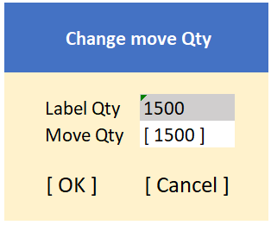
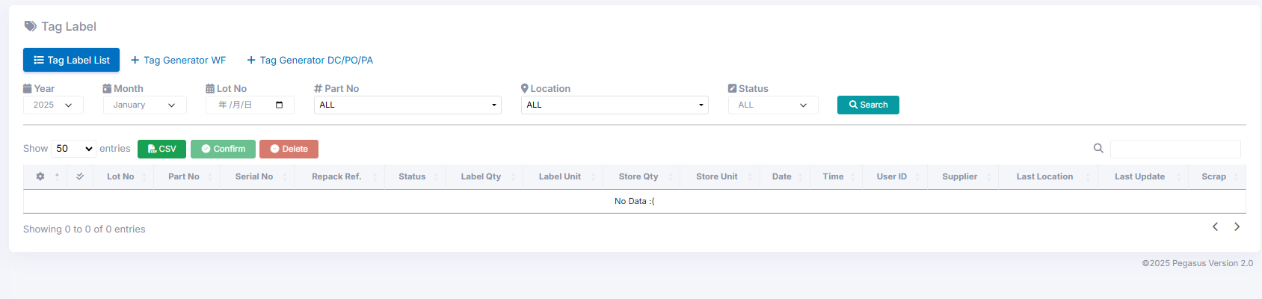
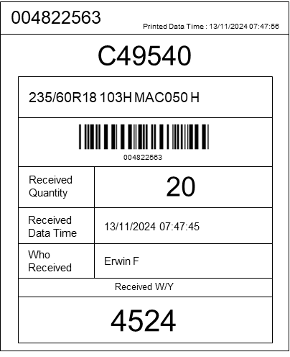
5. System functional specifications
5-3. Handy terminal function Outbound
5-3-3. Outbound Picking
Outbound Picking
DO No
4170551955
If the Parts No. or Tire Week differs from the Plan, it is not acceptable.
INV24102845
2023-09-28
The part numbers are different.
Qty
200
Qty
NG
Act Qty
Act Qty
30/30
Outbound Picking
DO No
4170551955
If the Parts No. or Tire Week differs from the Plan, it is not acceptable.
INV24102845
2023-09-28
Tire Week is different.
Qty
200
Qty
NG
Act Qty
Act Qty
30/30
Original label is qty 12 pcs
When next scan, Original label must be 2pcs
Outbound Picking
DO No
4170551955
Change Qty
Change Qty
INV24102845
2023-09-28
Qty:
12
/10
Qty:
10
/10
INFORMATION
Print the label from PC.
Qty
200
Qty
OK
Cancel
OK
Cancel
Act Qty
Act Qty
30/30
10
For Outbound label

Slide 46
5. System functional specifications
5-3. Handy terminal function Outbound
5-3-4. Outbound Shipping
Outbound Shipping
This is the screen that transitions after select outbound schedule from Outbound menu.
Date from: Select the start of the target date. Default is today's date. Search ORDER DELIVERY DATE
Date to: Select the end of the target date. Default is advance 7 days date. Search ORDER DELIVERY DATE
Except complete: If checked, the completed status Item list will not be displayed from the Item list. Default is unchecked.
Order list : Display a list that matches the condition.
DO no : ORDER NO
Location: *Display assigned location information. If there are multiple items, display multiple items.
Item quantity: Number of items that have been processed "/" ORDER QTY(PER UNIT)
Status color: Green - Completed, Dark Blue - Working, Light Blue - Not Started.
< (P1): Back to Main menu
Date
From
07/Oct/2023
Date
To
07/Oct/2023
Outbound Picking
Except complete
DO No: INV24102844
Location: A1-01,A1-02 2/2Pcs
Outbound Shipping
DO No: INV24102845
Location: A1-01,A1-02 0/2Pcs
Inbound

Slide 47
5. System functional specifications
5-3. Handy terminal function Outbound
5-3-3. Outbound Shipping
This is the screen that transitions after select order information from Outbound item.
Date : Today’s date
DO No.: DO No from scan data
Parts No :Parts no from inbound schedule
Tire week:
Location Plan::*Displays a list of Lot no that are recommended for picking after reservation. If there are multiple items, display multiple items.
Ticket No: *Displays the tire week specified by FIFO.
Qty: *Display the picked quantity
Status : If it is complete, it is displayed as OK. If it is different, it is displayed as NG.
Clear[P3]: Reset to the initial data
Confirm[P4]: Confirmation processing. Normal end: Completion of registration *1. Warning: Warning screen display *2
< (P1): Back to Main menu
Outbound Shipping
Outbound Shipping
Date
From
07/Oct/2023
Date
To
07/Oct/2023
DO No
4170551955
Except complete
INV24102845
DO No: INV24102844
Location: A1-01,A1-02 2/2Pcs
2023-09-28
Qty
200
DO No: INV24102845
Location: A1-01,A1-02 0/2Pcs
Qty
Act Qty
Act Qty
0/10
Scan picking list move to outbound screen
Outbound Shipping
Outbound Shipping
Date
From
07/Oct/2023
Date
To
07/Oct/2023
DO No
4170551955
Except complete
INV24102845
DO No: INV24102844
Location: A1-01,A1-02 2/2Pcs
2023-09-28
Qty
200
DO No: INV24102845
Location: A1-01,A1-02 0/2Pcs
Qty
Act Qty
Act Qty
0/30
Select target outbound schedule by hand manual
Outbound Shipping
Outbound Shipping
Date
From
07/Oct/2023
Date
To
07/Oct/2023
DO No
4170551955
Except complete
INV24102845
DO No: INV24102844
Location: A1-01,A1-02 2/2Pcs
2023-09-28
Qty
200
DO No: INV24102845
Location: A1-01,A1-02 0/2Pcs
Qty
Act Qty
Act Qty
0/30

Slide 48
5. System functional specifications
5-3. Handy terminal function Outbound
5-3-3. Outbound Shipping
Outbound Shipping
Scan BC tire code
Outbound Picking
DO No
4170551955
INV24102845
DO No
4170551955
INV24102845
2023-09-28
2023-09-28
Qty
200
Qty
Qty
200
Act Qty
Qty
Act Qty
Act Qty
Act Qty
0/30
1/30
Outbound Picking
DO No
4170551955
INV24102845
2023-09-28
INFORMATION
Qty
200
Operation completed!
Qty
Act Qty
Act Qty
30/30
Outbound Picking
DO No
4170551955
INV24102845
2023-09-28
Insufficient information
Qty
200
Qty
NG
Act Qty
Act Qty
10/30

Slide 49
5. System functional specifications
5-3. Handy terminal function Outbound
5-3-3. Outbound Picking
Outbound Picking
DO No
4170551955
If the BC Tire differs from the Plan, it is not acceptable.
INV24102845
2023-09-28
The BC Tire numbers are different.
Qty
200
Qty
NG
Act Qty
Act Qty
30/30

Slide 50
5. System functional specifications
5-4. Handy terminal function Stock Management
5-4-1. Stock management
This is the screen that transitions after select Stock management from Main menu.
Stock Check button: Transitions to the Stock Check screen.
Stocktaking button: Transitions to the Stocktaking screen.
Change Location button: Transitions to the Change Location screen.
< (P1): Back to Main menu

Slide 51
5. System functional specifications
5-4. Handy terminal function Stock Management
5-4-2. Stock Check
This is the screen that transitions after select Stock check from Stock management menu.
Parts No: No initial value information, List selection from Item master* Can be changed manually or scan label
Lot No: No initial value information.* Can be changed manually or scan label
Location : No initial value information
Qty Box : No initial value information
Qty : No initial value information
Total : No initial value information
Clear[P3]: Clear input contents
OK[P4]: Confirmation processing. Search data.
< (P1): Back to Main menu
Tire week:
4104751880
125
Tire week:
4104751880
125
*2: Display screen when information is incorrect
OK button: Close this screen. Return to the previous process.
Tire week:
125

Slide 52
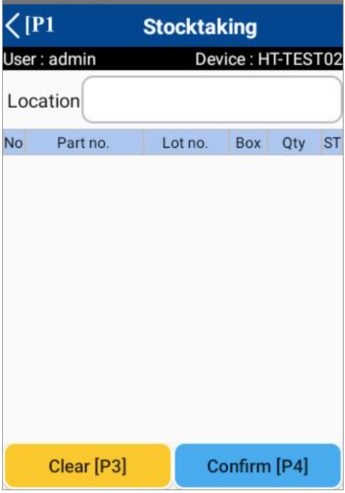
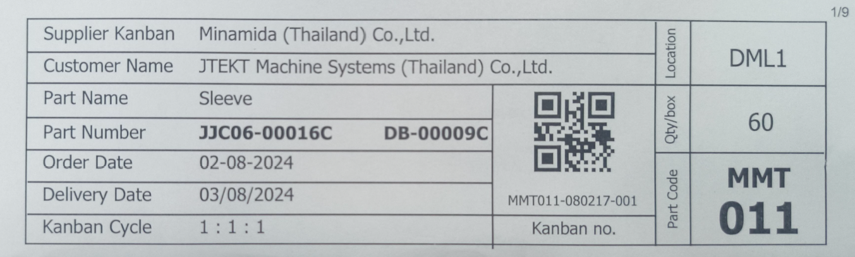
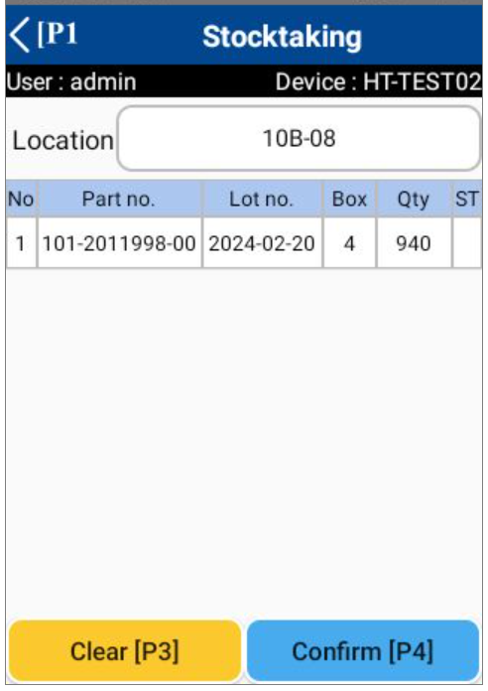
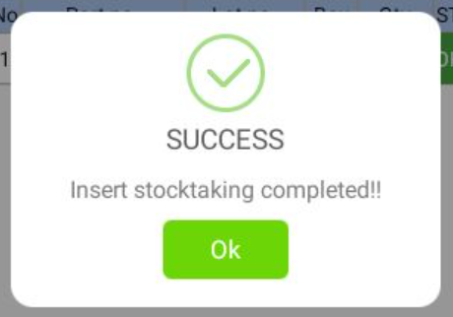
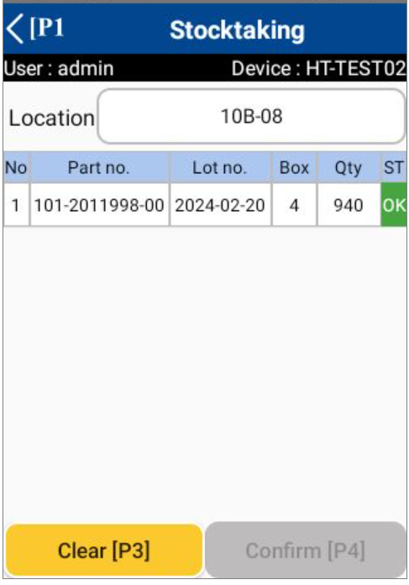
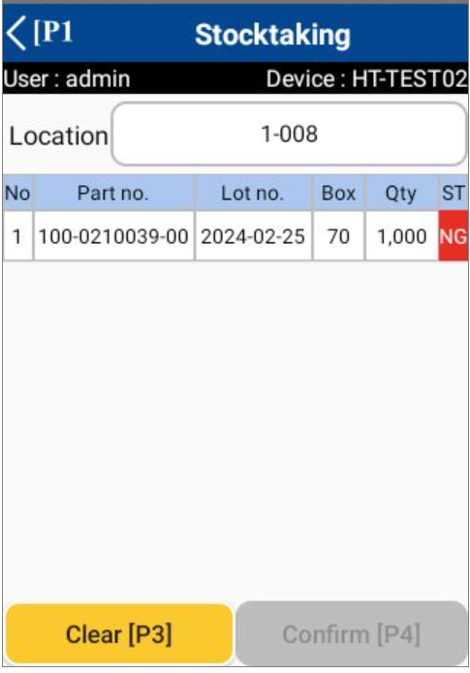
5. System functional specifications
5-4. Handy terminal function Stock Management
5-4-3. Stocktaking
This is the screen that transitions after select Stocktaking from Stock management menu.
Parts No: No initial value information, List selection from Item master* Can be changed manually or scan label
Lot No: No initial value information.* Can be changed manually or scan label
Location : No initial value information .* Can be changed manually or scan label
Qty : System quantity, No initial value information *The quantity in the system will be displayed.
Act ถty : Actual quantity, No initial value information
Clear[P3]: Clear input contents
Confirm[P4]: Confirmation processing.
< (P1): Back to Main menu
808-0210031-00
Label 1 piece
Lot 2024-02-03
Instructions
Scan location
Scan label
Current stock information will be shown on screen.
Click “Confirm” to apply the information.
In the case of NG, the item was rescanned.
Success dialog will show if the data saving completed.

Slide 53
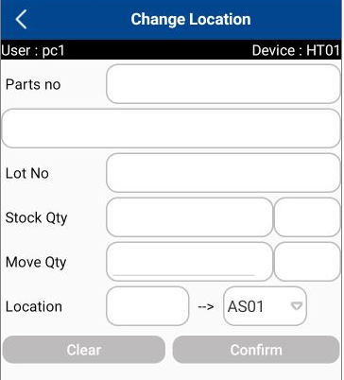
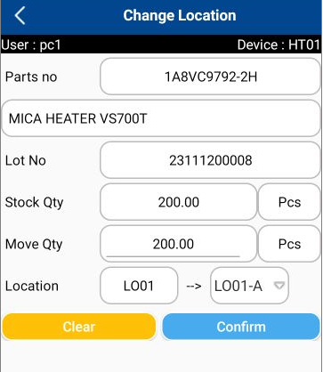
5. System functional specifications
5-4. Handy terminal function Stock Management
5-4-4. Change Location
This is the screen that transitions after select Change Location from Stock management menu.
Parts No: No initial value information, List selection from Item master* Can be changed manually or scan label
Lot No: No initial value information.* Can be changed manually or scan label
Qty : No initial value information Can be changed manually or scan label
Old Location : No initial value information .* Can be changed scan label
New Location : No initial value information .* Can be changed manually or scan label
Clear[P3]: Clear input contents
Confirm[P4]: Confirmation processing.
< (P1): Back to Main menu
1
All pack change location
DEMO-PARTS-NO_B
DEMO-PARTS-NO_B
DEMO-PARTS-NO_B
Box no = 1
Qty per box = 200pcs
Label 1 piece
Lot 2023-09-09
DEMO_PARTS_NAME_B
DEMO-PARTS-NO_B
Box no = 1
Qty per box = 200pcs
Label 1 piece
Lot 2023-09-09
* Scan the same label
DEMO_PARTS_NAME_B
2023-09-09
2023-09-09
200
200
200
DEMO-PARTS-NO_B
DEMO-PARTS-NO_B
DEMO-PARTS-NO_B
Box no = 1
Qty per box = 200pcs
Label 1 piece
Lot 2023-09-10
DEMO_PARTS_NAME_B
DEMO-PARTS-NO_B
Box no = 1
Qty per box = 200pcs
Label 1 piece
Lot 2023-09-10
* Scan the same label
DEMO_PARTS_NAME_B
2023-09-09, 2023-09-10
2023-09-09, 2023-09-10
400
400
200
400
Regarding the removal of the scanned label, the user can remove it by scanning the specific label that needs to be removed.
Yes button: Remove an scanned item.
Cancel button: Close the confirmation dialog.
DEMO-PARTS-NO_B
Box no = 1
Qty per box = 200pcs
Label 1 piece
Lot 2023-09-10
DEMO-PARTS-NO_B
Duplicated scan detect!
Click Yes to remove?
DEMO_PARTS_NAME_B
Yes
Cancel
2023-09-09, 2023-09-10
400
200

Slide 54
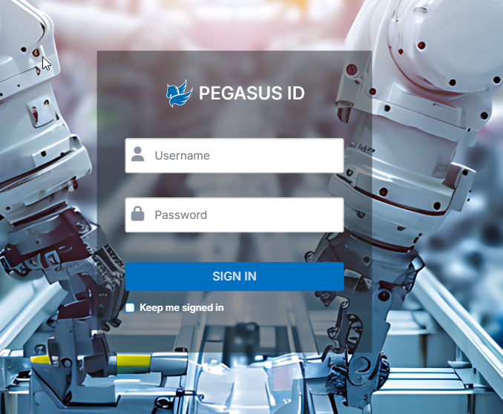
5. System functional specifications
5-5. PC operation flow basic
5-5-1. Login-Menu
** Standard specifics
Prepare user ID and password for NKT.
Please log in with NKT user ID and password.
ID: admin
Pass: 1234

Slide 55
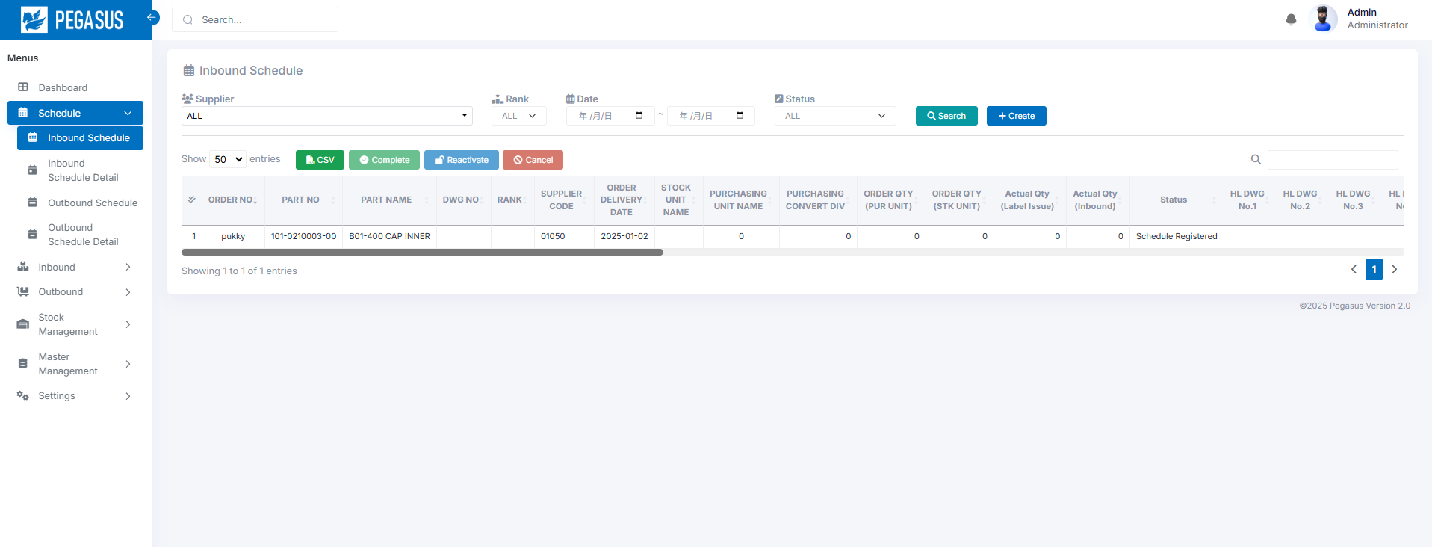
5. System functional specifications
5-5. PC operation flow basic
5-5-2. Main-Menu
** Standard specifics
1
[Schedule]
[Inbound]
[Outbound]
[Stock Management]
[Master Management]
2
3
4
5
Schedule
Inbound Schedule
Inbound Schedule Detail
Inbound
Outbound Schedule
Outbound
Outbound Schedule Detail
Schedule Import
Inbound Inquiry Report
Authority master
Supplier master
Outbound Inquiry Report
Item master
Customer master
Stock Inquiry / report
Name master
Department master
Stock Maintenance
Location master
Stocktaking
User credential master
Stock Maintenance Inquiry / Report
Stock management
User master
Tag label
Change location
Master management

Slide 56
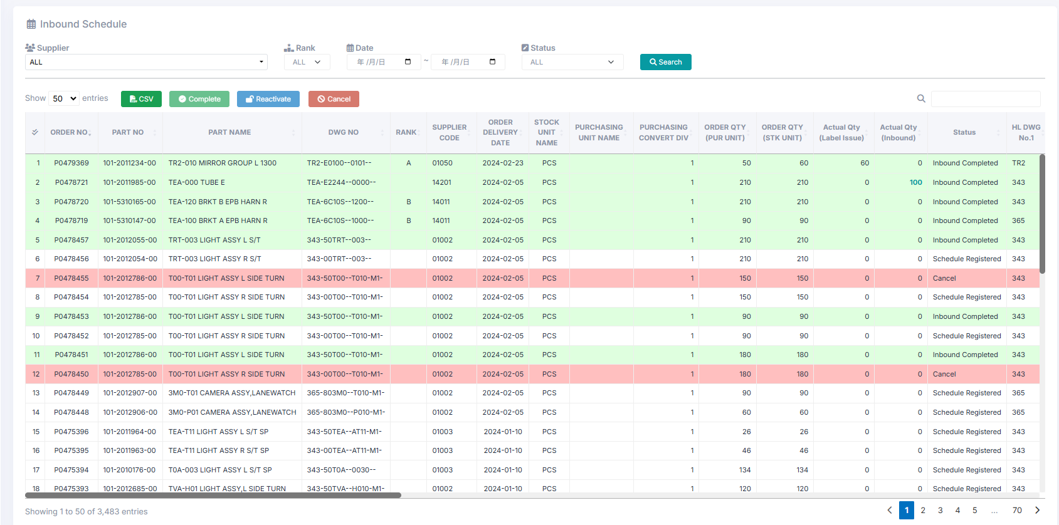
5. System functional specifications
5-6. PC operation flow Schedule
5-6-1. Inbound Schedule
Display items need to be changed
Cancel button It can change the status to Cancel.
CSV import button It can import CSV files manually.
Add button It can register as many schedules as it manually select.
Search button Search using the entered conditions.
Clear button Initializes and clears the entered conditions.
Status management
Schedule registered
Inbound working
Inbound Completed
Cancel

Slide 57
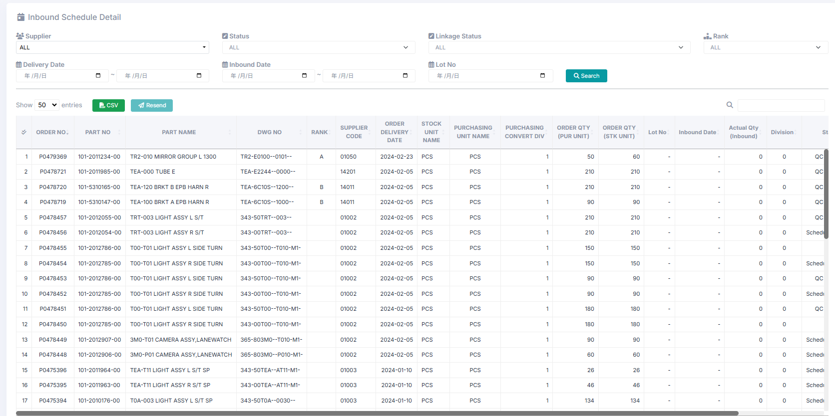
5. System functional specifications
5-6. PC operation flow Schedule
5-6-2. Inbound Schedule Detail
Display items need to be changed
Cancel button It can change the status to Cancel.
CSV import button It can import CSV files manually.
Add button It can register as many schedules as it manually select.
Search button Search using the entered conditions.
Clear button Initializes and clears the entered conditions.
Status management
Schedule registered
Inbound working
Inbound Completed
Cancel

Slide 58

5. System functional specifications
5-6. PC operation flow Schedule
5-6-3. Outbound Schedule
Display items need to be changed
Cancel button It can change the status to Cancel.
CSV import button It can import CSV files manually.
Add button It can register as many schedules as it manually select.
Search button Search using the entered conditions.
Clear button Initializes and clears the entered conditions.
Status management
Schedule registered
Outbound working
Outbound Completed
Cancel

Slide 59

5. System functional specifications
5-6. PC operation flow Schedule
5-6-4. Outbound Schedule Detail
Display items need to be changed
Cancel button It can change the status to Cancel.
CSV import button It can import CSV files manually.
Add button It can register as many schedules as it manually select.
Search button Search using the entered conditions.
Clear button Initializes and clears the entered conditions.
Status management
Schedule registered
Outbound working
Outbound Completed
Cancel

Slide 60

5. System functional specifications
5-6. PC operation flow Schedule
5-6-5. Schedule import
Inbound file
Inbound 1 format
Outbound 2 format
Outbound file

Slide 61

5. System functional specifications
5-7. PC operation flow Inbound
5-7-1. Inbound
** Standard specifics
CSV Export button Export all recodes for CSV file
PDF Export button Export all recodes for CSV file
Search button Search using the entered conditions.
Clear button Initializes and clears the entered conditions.

Slide 62

5. System functional specifications
5-8. PC operation flow Outbound
5-8-1. Outbound
** Standard specifics
CSV Export button Export all recodes for CSV file
PDF Export button Export all recodes for CSV file
Search button Search using the entered conditions.
Clear button Initializes and clears the entered conditions.

Slide 63

5. System functional specifications
5-9. PC operation flow Stock management
5-9-1. Stock Inquiry Report
** Standard specifics
CSV Export button Export all recodes for CSV file
PDF Export button Export all recodes for CSV file
Search button Search using the entered conditions.
Clear button Initializes and clears the entered conditions.

Slide 64

5. System functional specifications
5-9. PC operation flow Stock management
5-9-2. Stock Maintenance
** Standard specifics
Register Register input data.
Remove Zero Qty Remove all zero qty records.
Add Add the blank record for input the new data.
Search button Search using the entered conditions.
Clear button Initializes and clears the entered conditions.

Slide 65

5. System functional specifications
5-9. PC operation flow Stock management
5-9-3. Stocktaking
** Standard specifics
Save button Register input data
Confirm button Confirm the current input data
Delete button Delete selected records
Recheck button Change the status to RECHECK
Start button Initial data for current month (start the new data record)
CSV Output button Export the CSV file
Search button Search using the entered conditions.
Clear button Initializes and clears the entered conditions.

Slide 66

5. System functional specifications
5-9. PC operation flow Stock management
5-9-5. Stock Maintenance Inquiry / Report
** Standard specifics
CSV Export button Export all recodes for CSV file
PDF Export button Export all recodes for CSV file
Search button Search using the entered conditions.
Clear button Initializes and clears the entered conditions.

Slide 67


5. System functional specifications
5-9. PC operation flow Stock management
5-9-6. Tag label
004822563
Printed Data Time : 13/11/2024 07:47:56
C49540
235/60R18 103H MAC050 H
Received
Quantity
004822563
20
Received Data Time
29.5mm
13/11/2024 07:47:45
Who
Received
Erwin F
Received W/Y
4524
21 mm
CSV Export button Export all recodes for CSV file
PDF Export button Export all recodes for CSV file
Search button Search using the entered conditions.
Clear button Initializes and clears the entered conditions.

Slide 68

5. System functional specifications
5-10. PC operation flow Master management
5-10-1. Item master
** Standard specifics
CSV Import button Import selected CSV file
CSV Export button Export all recodes for CSV file
Delete button Delete selected records
Search button Search using the entered conditions.
Clear button Initializes and clears the entered conditions.

Slide 69

5. System functional specifications
5-10. PC operation flow Master management
5-10-2. Packing Standard master
** Standard specifics
CSV Import button Import selected CSV file
CSV Export button Export all recodes for CSV file
Delete button Delete selected records
Search button Search using the entered conditions.
Clear button Initializes and clears the entered conditions.

Slide 70

5. System functional specifications
5-10. PC operation flow Master management
5-10-3. Name Master
** Standard specifics
CSV Import button Import selected CSV file
CSV Export button Export all recodes for CSV file
Delete button Delete selected records
Search button Search using the entered conditions.
Clear button Initializes and clears the entered conditions.

Slide 71

5. System functional specifications
5-10. PC operation flow Master management
5-10-4. Location master
** Standard specifics
CSV Import button Import selected CSV file
CSV Export button Export all recodes for CSV file
Delete button Delete selected records
Search button Search using the entered conditions.
Clear button Initializes and clears the entered conditions.

Slide 72

5. System functional specifications
5-10. PC operation flow Master management
5-10-5. User master
** Standard specifics
CSV Import button Import selected CSV file
CSV Export button Export all recodes for CSV file
Delete button Delete selected records
Search button Search using the entered conditions.
Clear button Initializes and clears the entered conditions.

Slide 73

5. System functional specifications
5-10. PC operation flow Master management
5-10-6. User Credential master
** Standard specifics
CSV Import button Import selected CSV file
CSV Export button Export all recodes for CSV file
Delete button Delete selected records
Search button Search using the entered conditions.
Clear button Initializes and clears the entered conditions.

Slide 74

5. System functional specifications
5-10. PC operation flow Master management
5-10-7. Authority Master
** Standard specifics
CSV Import button Import selected CSV file
CSV Export button Export all recodes for CSV file
Delete button Delete selected records
Search button Search using the entered conditions.
Clear button Initializes and clears the entered conditions.

Slide 75
6. Q&A

Slide 76
7. Sign off
We hereby acknowledge and agree the above-mentioned blueprint requirements.
Any changes required after the sign off for this blueprint will be addressed through the change request process.
PT NIPPON KONPO INDONESIA.
Sign:
Name:
Title:
Date:
TOMAS TECH CO.,LTD.
Sign:
Name:
Title:
Date:
## END OF BLUEPRINT##

