Slide 1
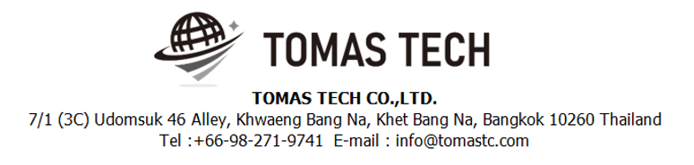
Version 09/Sep/2024
Confidential
Andon system specifications
Documentation EN Blueprint for JATH
Blueprint
R3
Made for: jtekt automotive (thailand) co. Ltd.
By: TOMAS TECH CO.,LTD.

Slide 2
Revision History
Date | Version | File name | Details
19/Aug/2024 | R1 | Andon system specifications Documentation EN Blueprint for JATH Blueprint | First edition
09/Sep/2024 | R2 | Andon system specifications Documentation EN Blueprint for JATH Blueprint | Second edition
20/Sep/2024 | R3 | Andon system specifications Documentation EN Blueprint for JATH Blueprint | Third edition
 | R4 | Andon system specifications Documentation EN Blueprint for JATH Blueprint | 4th edition
11/Nov/2024 | R5 | Andon system specifications Documentation EN Blueprint for JATH Blueprint | 5th edition

Slide 3
■Contents
1. Overview
2. Overall configuration diagram
3. Electrical drawing diagram
4. Specification machine
5. System Features ( Get Requirements from JATH )
6. Installation Requirements
7. Q&A
8. Sign off

Slide 4
1. Overview
Enhancing Production Efficiency:
The Andon system helps monitor and track the real-time status of machines, which reduces unplanned downtime by providing immediate alerts when problems occur. This allows the team to respond and resolve issues quickly.
Quick Problem Notification and Resolution:
The Andon system can notify of irregular events or problems occurring in machines, such as stoppages, errors, or situations requiring team intervention, enabling immediate problem resolution.
Improving Communication Between Teams:
The Andon system enhances communication between production and maintenance teams by notifying and sharing information simultaneously, facilitating coordination and quicker problem resolution.
Data Collection for Process Analysis and Improvement:
The system can record detailed data on machine operation and downtime. This data can be used for analysis to improve production processes, reduce machine failures, and enhance product quality in the long term.
Increasing Workplace Safety:
By providing clear and timely alerts about machine problems and status, the Andon system helps reduce the risk of accidents related to malfunctioning equipment.
Supporting Decision-Making with Data:
Managers and executives can use the data collected from the Andon system to make strategic decisions, such as planning machine maintenance, improving production processes, or managing resources efficiently.
Supporting Lean Manufacturing Concepts:
The Andon system aligns with lean manufacturing principles by reducing waste, minimizing non-value-added time, and making the production process more efficient through continuous monitoring and improvement.

Slide 5
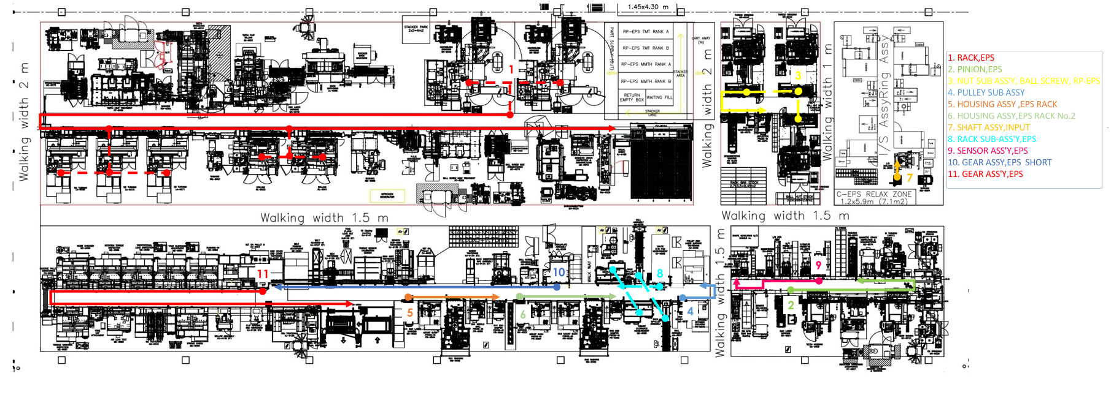
R3
2. Overall configuration diagram
Line layout

Slide 6
R3
2. Overall configuration diagram
PLC Control layout
PLC 1
PLC 2
PLC 3-2
PLC 3-1

Slide 7
R3
2. Overall configuration diagram
Network rack position
G17
R1
C17
R2
G12
R5
E12
R4
B12
R3

Slide 8
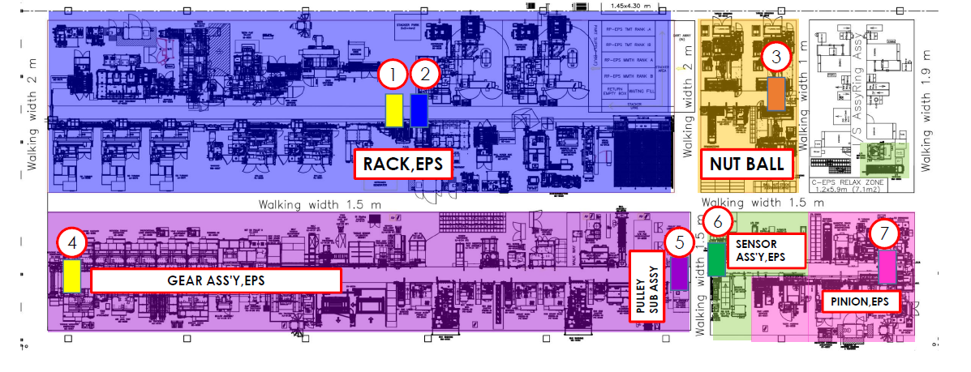
R5
2. Overall configuration diagram
Display position

Slide 9

R5
2. Overall configuration diagram [ MACHINING GROUP ]
Overall configuration diagram (Hardware configuration)
Client pc for Andon system
Client pc for Traceability system
DC 24 V Cable
AC 220 V Cable
Ethernet Lan cable
S/W Hub *1
I/O Wiring
KV-8000
KV-XD02
KV-XLE02
PLC System PLC 1
Andon display 1
Andon display 2
S/W Hub *1
Ethernet S/W Hub *2
S/W R1-SW1 *3
S/W R1-SW2 *3
S/W R1-SW3 *3
S/W R1-SW4 *3
S/W R1-SW5 *3
GR-9037
HT-9005
RL-9001
WM-9059
Link Hub R1-SW1
GR-9038
ME-9070
WM-9058
KJ-9133
Link Hub R1-SW2
LA-9068
LA-9069
ME-9071
GR-9037.2
Link Hub R1-SW3
MX-9019
LA-9070
HT-9006
GR-9037.3
Link Hub R1-SW4
MI-9001
LA-9071
ME-9072
GR-9038.2
Link Rack R2-SW1
BH-9010
WM-9057
MX-9020
GR-9038.3
Link PC Rack
WM-9056
RL-9000
ME-9073
LA-9068.1
Link Rack R5-SW4
Link HUB R1-SW5
Link HUB R1-SW5
Link HUB R1-SW5
Link HUB R1-SW5
Position installation hub and separate group machine Location G17 *High 2.5M.
*1 Internal hub for Andon system
*2 Moxa hub EDS-P510A-8PoE-2GT
*3 S/W for machine group

Slide 10
2. Overall configuration diagram [ MACHINING GROUP ]
IP address ledger - for lower level (Machine distribution)≫Class C
Upper address registration line name : MACHINING GROUP |  |  | Upper IP address : 10.118.2.21
Usable IP address range : 192.168.100.1 to 192.168.101.255 |  |  | Subnet mask : 255.255.254.0
192.168.100.※※
IP Address | PC Port (Other node port no.) | Machine | Manufacturing | PLC Type | Machine no. | Remarks
192.168.100.0
192.168.100.1 |  | Material stocker(In) | Shinwa | Nano10GX | GR-9037 | 1st Line
192.168.100.2 |  | Centerless Grinding | JMS | - | ↑ | ↑
192.168.100.3 |  | Material stocker(Out) | Shinwa | Nano10GX | ↑ | ↑
192.168.100.4 |  | Material stocker(In) | Shinwa | Nano10GX | GR-9038 | ↑
192.168.100.5 |  | Centerless Grinding | JMS | - | ↑ | ↑
192.168.100.6 |  | Material stocker(Out) | Shinwa | Nano10GX | ↑ | ↑
192.168.100.7 |  | Material stocker(In) | Shinwa | Nano10GX | LA-9068 | ↑
192.168.100.8 |  | Ends Machining | Muratec | FANUC+MITSUBISHI | ↑ | ↑
192.168.100.9 |  | DMC Laser Marking | KANDA |  | MX-9019 | ↑
192.168.100.10 |  | Teeth Flats Milling | OKK +KANDA | FANUC | MI-9001 | ↑
192.168.100.11 |  | Teeth Broaching (Robot) | NACHI | FANUC | BH-9010 | ↑
192.168.100.12 |  | Teeth Broaching | NACHI | FANUC | ↑ | ↑
192.168.100.13 |  | Washing | KANDA |  | WM-9056 | ↑
192.168.100.14 |  | Teeth side hardening and tempering | DKK | MITSUBISHI | HT-9005 | ↑
192.168.100.15 |  | Teeth Side Straightening | JFP | Nano10GX | ME-9070 | ↑
192.168.100.16 |  | O.D. Turning Roller Burnishing | DMG MORI | Nano10GX | LA-9069 | ↑
192.168.100.17 |  | O.D. Turning Roller Burnishing | DMG MORI | Nano10GX | LA-9070 | ↑
192.168.100.18 |  | O.D. Turning Roller Burnishing | DMG MORI | Nano10GX | LA-9071 | ↑
192.168.100.19 |  | Washing | JTAP | Nano10GX | WM-9057 | ↑
192.168.100.20 |  | Rolling | JTEKT | SIEMENS | RL-9000 | ↑
192.168.100.21 |  | Rolling | JTEKT | SIEMENS | RL-9001 | ↑
192.168.100.22 |  | Washing | Shinwa |  | WM-9058 | ↑
192.168.100.23 |  | P.C.D. Measurement | FUKUTOKU | MITSUBISHI | ME-9071 | ↑
192.168.100.24 |  | Ball Screw Side Induction Hardening & Induction Tempering | DKK | MITSUBISHI | HT-9006 | ↑
192.168.100.25 |  | Ball Screw Side Straightening | JFP | Nano10GX | ME-9072 | ↑
192.168.100.26 |  | Brushing & Back Side Buffing | Shinwa | MITSUBISHI | MX-9020 | ↑
192.168.100.27 |  | Magnetic Crack Detection Demagnetization | JAPAN ELECTRIC INDUSTRY | Nano10GX | ME-9073 | ↑
192.168.100.28 |  | Washing | I.M.E.(Local) | Nano10GX | WM-9059 | ↑
192.168.100.29 |  | Visual Inspection | JTAP | Nano10GX | KJ-9133 | ↑
192.168.100.30
192.168.100.31
192.168.100.32
192.168.100.33
192.168.100.34
192.168.100.35
192.168.100.36
192.168.100.37
192.168.100.38
192.168.100.39
192.168.100.40
192.168.100.41
192.168.100.42
192.168.100.43
192.168.100.44
192.168.100.45
192.168.100.46
192.168.100.47
192.168.100.48
192.168.100.49
192.168.100.50
192.168.100.51
192.168.100.52
192.168.100.53
192.168.100.54
192.168.100.55
192.168.100.56
Machining Group :
1) Rack,EPS
IP address allocation rules
192.168.100.1~99 For Machine PLC
192.168.100.100-199 Others (dual etc.)
192.168.100.200-249 Network component equipment
192.168.100.250-254 Prohibited to use (area for maintenance)
Request from JATH

Slide 11
2. Overall configuration diagram [ MACHINING GROUP ]
Assigning IP for use in the Andon system
No. | Equipment Name | IP Assign | Use in
1 | PLC KV-8000 | 192.168.100.200 | Main system
2 | KV-XD02 (Port 1) | 192.168.100.201 | Main system
3 | KV-XD02 (Port 2) | 192.168.100.202 | Main system
4 | KV-XLE02 (Port 1) | 192.168.100.203 | Main system
5 | KV-XLE02 (Port 2) | 192.168.100.204 | Main system
6 | PC Client | 192.168.100.210 | PC Client Andon system
7 | Driver display 1 | 192.168.100.220 | For monitoring
8 |  | 192.168.100.230-235 | For Service

Slide 12
R5
2. Overall configuration diagram [ SUB-ASSY GROUP ]
Overall configuration diagram (Hardware configuration)
Client pc for Andon system
Client pc for Traceability system
DC 24 V Cable
AC 220 V Cable
Ethernet Lan cable
S/W Hub *1
I/O Wiring
KV-8000
KV-XD02
KV-XLE02
PLC System PLC 2
Andon display 3
Andon display 6
S/W Hub *1
Ethernet S/W Hub *2
Andon display 7
S/W R2-SW1 *3
S/W R3-SW1 *3
S/W R3-SW2 *3
S/W R3-SW3 *3
GR-9041
MX-9021
ME-9074
PR-9070
GR-9042
GC-9009
WM-9060
PR-9074
GR-9043
HT-9007
PR-9071
Link HUB R3-SW1
WM-9061
GC-9010
PR-9072
Link HUB R3-SW2
ME-9075
GR-9039
PR-9073
Link Rack R4-SW3
PR-9075
GR-9040
ZM-9002
Link Rack PC
WM-9064
LA-9072
ME-9076
Link Rack R1-SW5
Link Hub R3-SW3
Link HUB
R3-SW3
Position installation hub and separate group machine Location G12 *High 2.5M.
Position installation hub and separate group machine Location B12 *High 2.5M.
*1 Internal hub for Andon system
*2 Moxa hub EDS-P510A-8PoE-2GT
*3 S/W for machine group

Slide 13
2. Overall configuration diagram [ SUB-ASSY GROUP ]
Sub-Assy Group :
1) Nut Ball Screw,EPS Rack
2) Pinion,EPS
3) Sensor Assy,EPS
4) Shaft Assy,Input
IP address ledger - for lower level (Machine distribution)≫Class C
Upper address registration line name : SUB-ASSY GROUP |  |  | Upper IP address : 10.118.2.22
Usable IP address range : 192.168.102.1 to 192.168.103.255 |  |  | Subnet mask : 255.255.254.0
192.168.102.※※
IP Address | PC Port (Other node port no.) | Machine | Manufacturing | PLC Type | Machine no. | Remarks
192.168.102.0
192.168.102.1 |  | Thread Grinding | Mitsui seiki |  | GR-9041 | 1st Line
192.168.102.2 |  | Thread Grinding | Mitsui seiki |  | GR-9042 | ↑
192.168.102.3 |  | Thread Grinding | Mitsui seiki |  | GR-9043 | ↑
192.168.102.4 |  | Demagnetizing,Washing,Air Blow | I.M.E.(Local) | Nano10GX | WM-9061 | ↑
192.168.102.5 |  | P.C.D. Measurement | FUKUTOKU-DAIYA |  | ME-9075 | ↑
192.168.102.6 |  | No.1 line spare |  |  |  | ↑
192.168.102.7 |  | ↑ |  |  |  | ↑
192.168.102.8 |  | ↑ |  |  |  | ↑
192.168.102.9 |  | ↑ |  |  |  | ↑
192.168.102.10 |  | ↑ |  |  |  | ↑
192.168.102.11 |  | ↑ |  |  |  | ↑
192.168.102.12 |  | ↑ |  |  |  | ↑
192.168.102.13 |  | ↑ |  |  |  | ↑
192.168.102.14 |  | ↑ |  |  |  | ↑
192.168.102.15 |  | ↑ |  |  |  | ↑
192.168.102.16 |  | ↑ |  |  |  | ↑
192.168.102.17 |  | ↑ |  |  |  | ↑
192.168.102.18 |  | ↑ |  |  |  | ↑
192.168.102.19 |  | ↑ |  |  |  | ↑
192.168.102.20 |  | ↑ |  |  |  | ↑
192.168.102.21 |  | DMC Laser Marking | I.M.E.(Local) | Nano10GX | MX-9021 | ↑
192.168.102.22 |  | Teeth Hobbing | KASHIFUJI |  | GC-9009 | ↑
192.168.102.23 |  | Induction Hardening Induction Tempering | DKK | MITSUBISHI | HT-9007 | ↑
192.168.102.24 |  | Teeth Skiving | KASHIFUJI |  | GC-9010 | ↑
192.168.102.25 |  | O.D. Grinding 1 | JTEKT |  | GR-9039 | ↑
192.168.102.26 |  | O.D. Grinding 2 O.D. Measurement | JTEKT Marposs |  | GR-9040 | ↑
192.168.102.27 |  | I.D. Turning I/D Measurement | Takamaz Marposs |  | LA-9072 | ↑
192.168.102.28 |  | Magnetic Crack Detection Demagnetizing | JAPAN ELECTRIC INDUSTRY |  | ME-9074 | ↑
192.168.102.29 |  | Washing | I.M.E.(Local) | Nano10GX | WM-9060 | ↑
192.168.102.30 |  | No.1 line spare |  |  |  | ↑
192.168.102.31 |  | ↑ |  |  |  | ↑
192.168.102.32 |  | ↑ |  |  |  | ↑
192.168.102.33 |  | ↑ |  |  |  | ↑
192.168.102.34 |  | ↑ |  |  |  | ↑
192.168.102.35 |  | ↑ |  |  |  | ↑
192.168.102.36 |  | ↑ |  |  |  | ↑
192.168.102.37 |  | ↑ |  |  |  | ↑
192.168.102.38 |  | ↑ |  |  |  | ↑
192.168.102.39 |  | ↑ |  |  |  | ↑
192.168.102.40 |  | ↑ |  |  |  | ↑
192.168.102.41 |  | Washing | I.M.E.(Local) | Nano10GX | WM-9064 | ↑
192.168.102.42 |  | Magnet Resin Molding | TOYO |  | IM-9003 | ↑
192.168.102.43 |  | Cooling | Local (TBD) |  | CV-9014 | ↑
192.168.102.44 |  | S/H DMC Laser Marking S/H Dust Seal Press-fit S/H Bearing Press-fit | NDK | Nano10GX | PR-9070 | ↑
192.168.102.45 |  | P/S Bearing Press-fit P/S Ring Crimping | NDK | Nano10GX | PR-9071 | ↑
192.168.102.46 |  | P/S T/B Press-fit | NDK | Nano10GX | PR-9072 | ↑
192.168.102.47 |  | P/S Magnetic Yoke Press-fit Bush Press-fit | NDK | Nano10GX | PR-9073 | ↑
192.168.102.48 |  | I/S Magnetization & T/B O-Ring Assembly & P/S Assembly | NDK | Nano10GX | ZM-9002 | ↑
192.168.102.49 |  | S/A Gap Adjustment & Centering S/A Drill Hole & Pin Press-fit | JMS | Nano10GX | ME-9076 | ↑
192.168.102.50 |  | I/S O-Ring Assembly & I/S Applying Grease S/A Pre Assembly S/A P/S Bearing Press-fit | NDK | Nano10GX | PR-9074 | ↑
IP address allocation rules
192.168.102.1~99 For Machine PLC
192.168.102.100-199 Others (dual etc.)
192.168.102.200-249 Network component equipment
192.168.102.250-254 Prohibited to use (area for maintenance)
Request from JATH

Slide 14
2. Overall configuration diagram [ SUB-ASSY GROUP ]
Assigning IP for use in the Andon system
No. | Equipment Name | IP Assign | Use in
1 | PLC KV-8000 | 192.168.102.200 | Main system
2 | KV-XD02 (Port 1) | 192.168.102.201 | Main system
3 | KV-XD02 (Port 2) | 192.168.102.202 | Main system
4 | KV-XLE02 (Port 1) | 192.168.102.203 | Main system
5 | KV-XLE02 (Port 2) | 192.168.102.204 | Main system
6 | PC Client | 192.168.102.210 | PC Client Andon system
7 | Driver display 1 | 192.168.102.220 | For monitoring
8 |  | 192.168.102.230-235 | For Service

Slide 15
R5
2. Overall configuration diagram [ ASSEMBLY GROUP ]
Overall configuration diagram (Hardware configuration)
Client pc for Andon system
Client pc for Traceability system
DC 24 V Cable
AC 220 V Cable
Ethernet Lan cable
S/W Hub *1
I/O Wiring
KV-8000
KV-XD02
KV-XLE02
PLC System PLC 3-1
KV-8000
KV-XD02
KV-XLE02
PLC System PLC 3-2
Andon display 4
S/W Hub *1
Ethernet S/W Hub *2
PLC System PLC 3-1
S/W R4-SW1 *3
S/W R4-SW2 *3
S/W R4-SW3 *3
ME-9077
PR-9066
AM-9036
PR-9076
MX-9023
AM-9037
AM-9035
PR-9067
ME-9079
MX-9022
PR-9068
ME-9080
PR-9064
WM-9063
Link HUB R4-SW1
WM-9062
PR-9069
Link HUB R4-SW2
PR-9065
ME-9078
Link Rack R5-SW4
Link HUB R4-SW3
Link HUB R4-SW3
Link Rack R3-SW3
Position installation hub and separate group machine Location E12 *High 2.5M.
*1 Internal hub for Andon system
*2 Moxa hub EDS-P510A-8PoE-2GT
*3 S/W for machine group

Slide 16
R5
2. Overall configuration diagram [ ASSEMBLY GROUP ]
Overall configuration diagram (Hardware configuration)
Client pc for Andon system
Client pc for Traceability system
DC 24 V Cable
AC 220 V Cable
Ethernet Lan cable
S/W Hub *1
I/O Wiring
KV-8000
KV-XD02
KV-XLE02
PLC System PLC 3-1
KV-8000
KV-XD02
KV-XLE02
PLC System PLC 3-2
Andon display 5
S/W Hub *1
Ethernet S/W Hub *2
PLC System PLC 3-2
S/W R5-SW1 *3
S/W R5-SW2 *3
S/W R5-SW3 *3
S/W R5-SW4 *3
AM-9038
KJ-9137
ME-9086
KJ-9139
AM-9039
ME-9082
CV-9002
Link HUB R5-SW1
KJ-9134
CV-9001
ME-9087
Link HUB R5-SW2
CV-9000
ME-9083
ME-9089
Link HUB R5-SW3
KJ-9135
ME-9084
AM-9040
Link Rack R1-SW5
ME-9081
ME-9085
ME-9090
Link Rack PC
KJ-9136
ME-9088
KJ-9138
Link Rack R4-SW3
Link HUB R5-SW4
Link HUB R5-SW4
Link HUB R5-SW4
Position installation hub and separate group machine Location G12 *High 2.5M.
*1 Internal hub for Andon system
*2 Moxa hub EDS-P510A-8PoE-2GT
*3 S/W for machine group

Slide 17
2. Overall configuration diagram [ ASSEMBLY GROUP ]
IP address allocation rules
192.168.104.1~99 For Machine PLC
192.168.104.100-199 Others (dual etc.)
192.168.104.200-249 Network component equipment
192.168.104.250-254 Prohibited to use (area for maintenance)
Request from JATH

Slide 18
2. Overall configuration diagram [ ASSEMBLY GROUP ]
Assigning IP for use in the Andon system
No. | Equipment Name | IP Assign | Use in
1 | PLC KV-8000 | 192.168.104.200 | Main system
2 | KV-XD02 (Port 1) | 192.168.104.201 | Main system
3 | KV-XD02 (Port 2) | 192.168.104.202 | Main system
4 | KV-XLE02 (Port 1) | 192.168.104.203 | Main system
5 | KV-XLE02 (Port 2) | 192.168.104.204 | Main system
6 | PC Client | 192.168.104.210 | PC Client Andon system
7 | Driver display 1 | 192.168.104.220 | For monitoring
8 |  | 192.168.104.230-235 | For Service

Slide 19
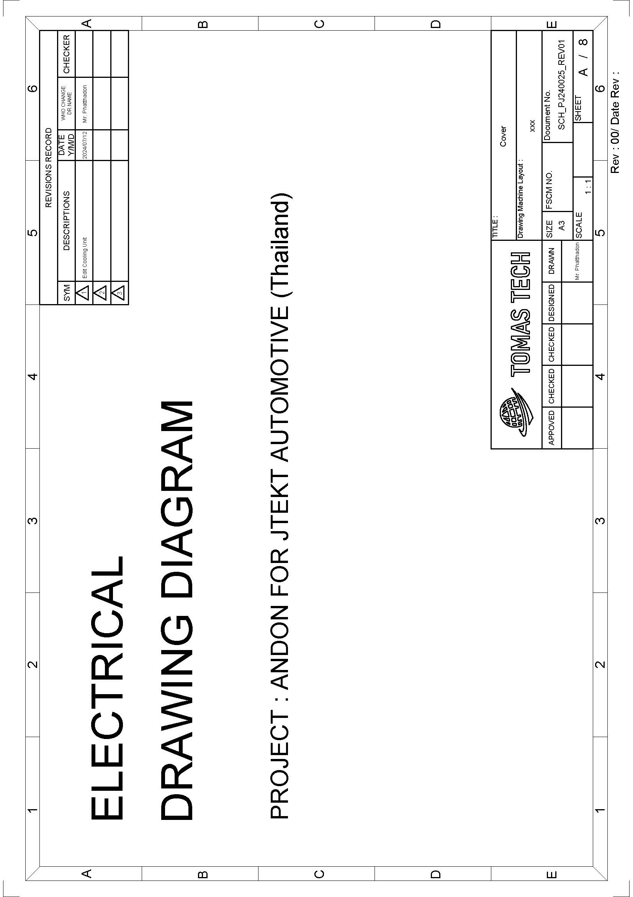
3. Electrical drawing diagram

Slide 20
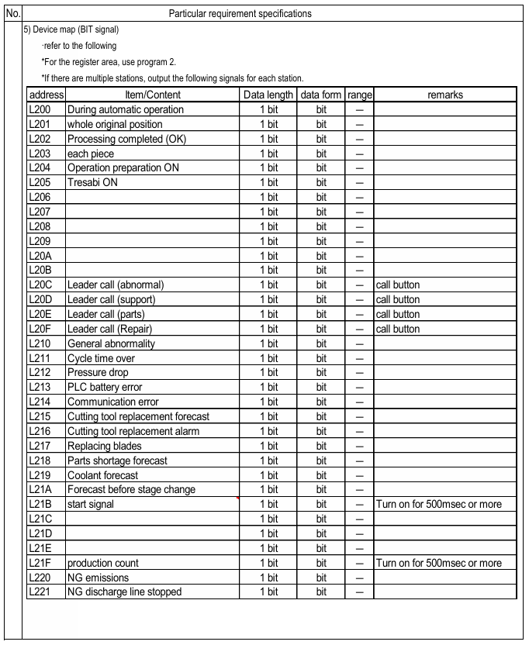
4. Specification machine
Required Machine Status Information for Dashboard:
Operation Status Signal: Signals indicating the machine's operational status, such as Running (Run), Stopped (Stop), and Error.
Start/Stop Signal: Signals used to control the starting or stopping of the machine.
Alarm Signals: Signals that indicate problems or events requiring intervention, such as Overload, High Temperature, or Safety Stop.
Cycle time: Information on the machine's speed or rotations per minute (RPM) for performance measurement.
Quality Signal: Signals indicating the detection of non-standard products or defects from production.

Slide 21
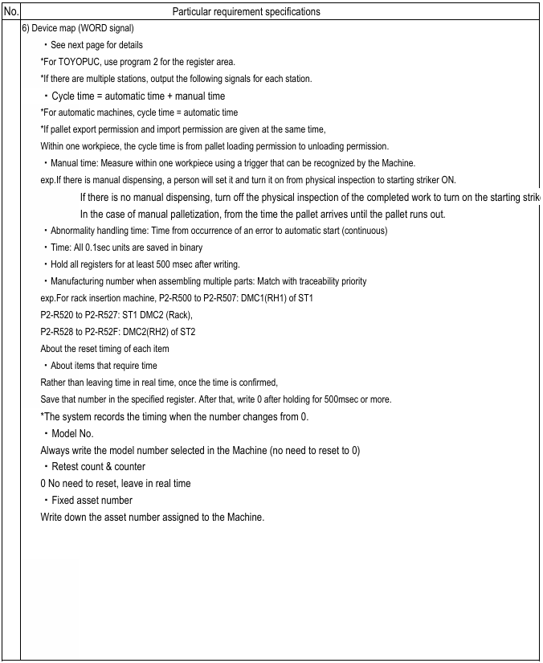
4. Specification machine

Slide 22
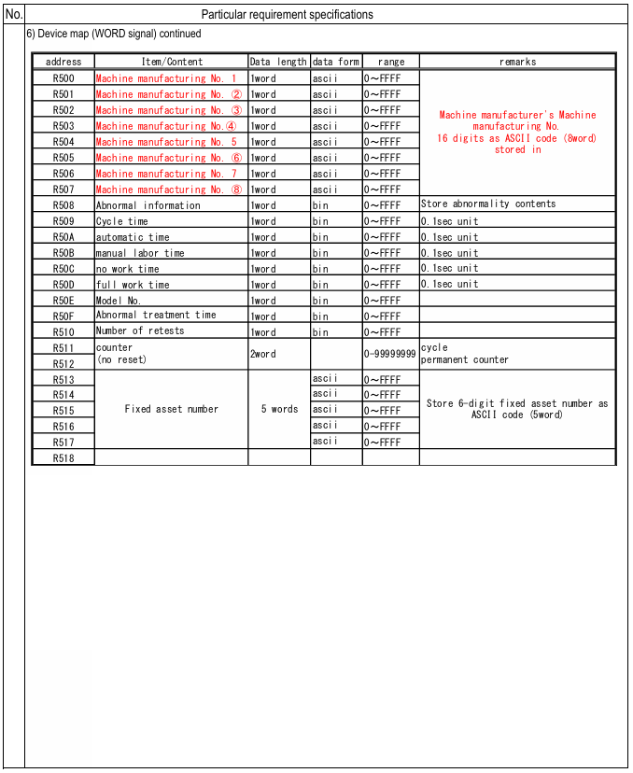
4. Specification machine

Slide 23
5. System Features ( Get Requirements from JATH )
Real-Time Machine Status Panel
  Real-Time monitor machine
  Calling status
  Warning status
Alert Notifications Section
  Error status machine
  Warning status
Machine Performance Summary
  OEE
  Availability
  Performance
  Quality
  OA
  Bekido

Slide 24
5. System Features
Data information from machine ( Bit )

Slide 25
5. System Features
Data information from machine ( Word )

Slide 26
5. System Features
Dashboard operation flow
Andon dashboard system
Main dashboard
Machine dashboard
Time Line Monitor
Setting
Machine dashboard
Main dashboard
Time Line Monitor
Setting model
Setting
Setting machine
Time Line Monitor
Day shift
Night shift
Main dashboard
Time Line Monitor
Machine dashboard
Setting
Authorize
Machine Setting
Authorize
Model Setting
Main dashboard
Line Setting
Main dashboard
Machine dashboard
Working Time Setting
Machine dashboard
Time Line Monitor
Password Setting
Time Line Monitor
Setting
Machine stop/Alarm
Machine downtime status
Y
Machine Stop
Status on
N
Machine downtime status
Y
New status machine downtime
Y
Machine Stop
Status on
N

Slide 27
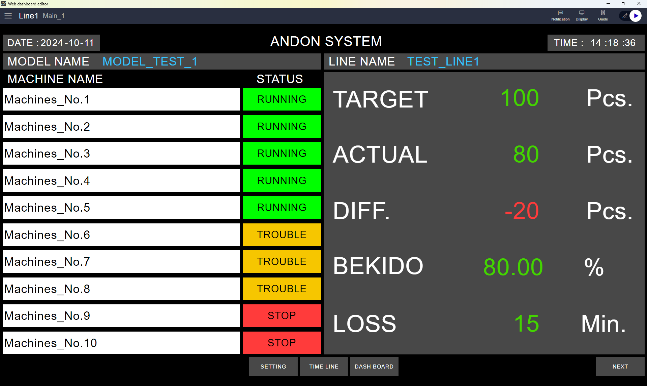
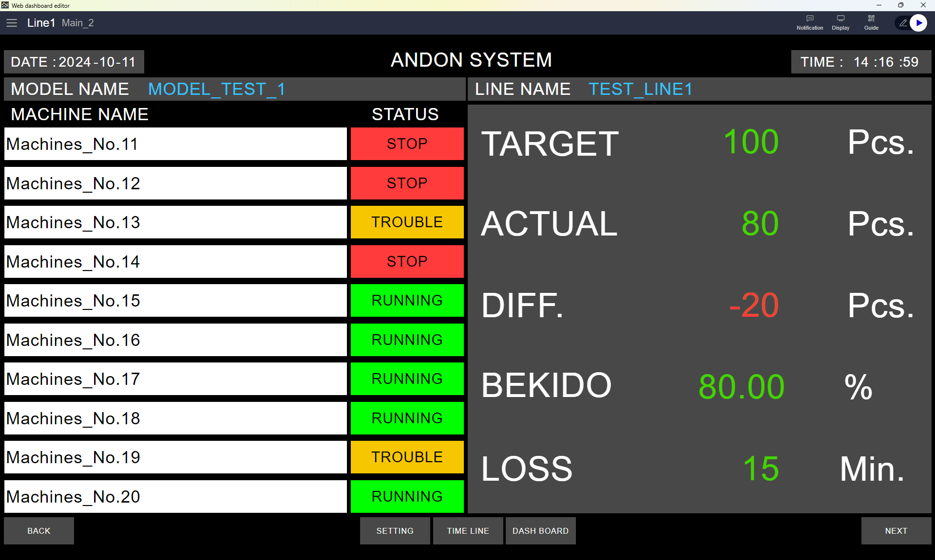
5. System Features
Main dashboard for monitoring machine ( Main display in smart TV )

Slide 28
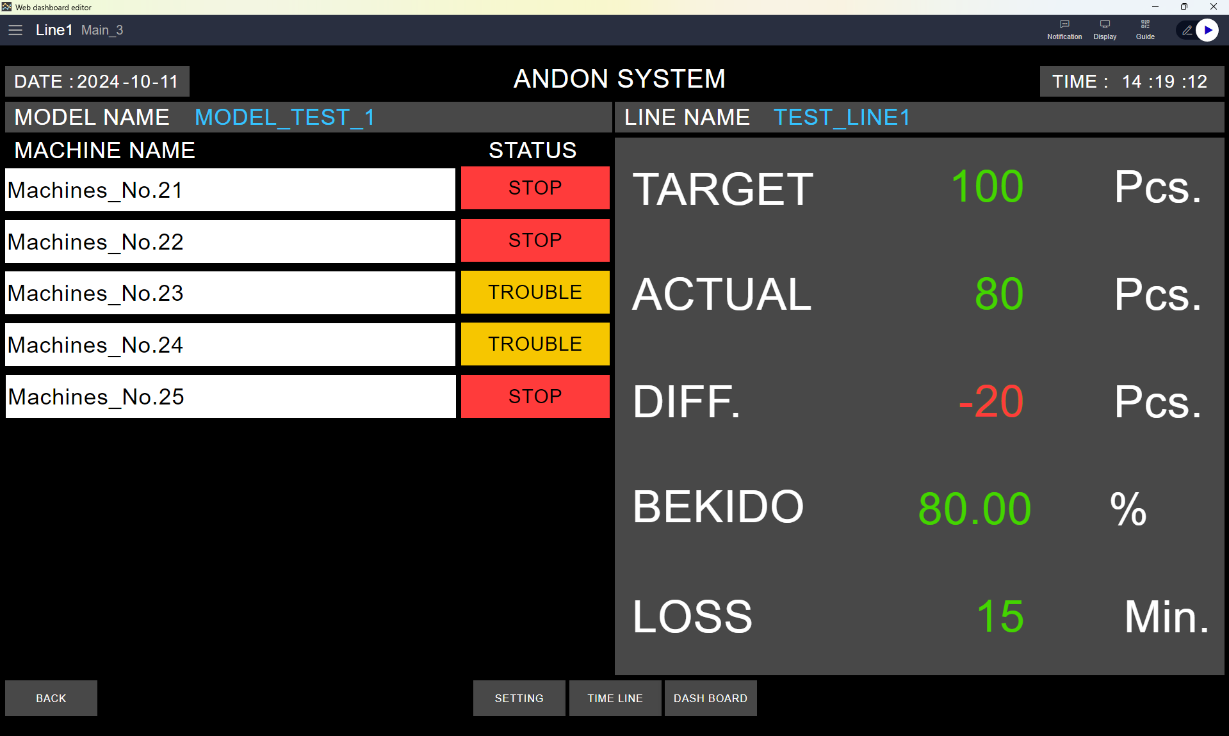
5. System Features
Main dashboard for monitoring machine ( Main display in smart TV )

Slide 29
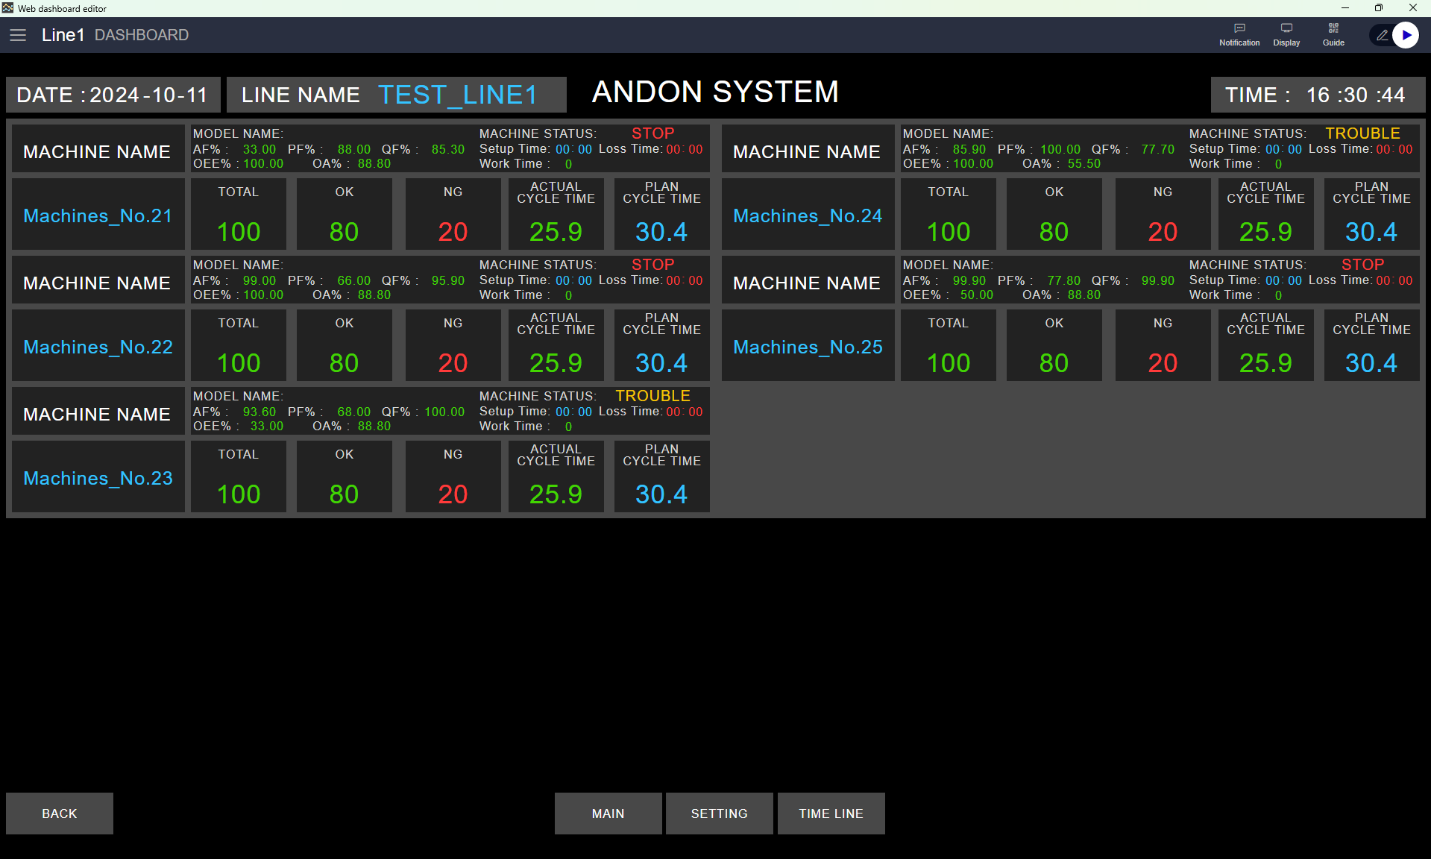
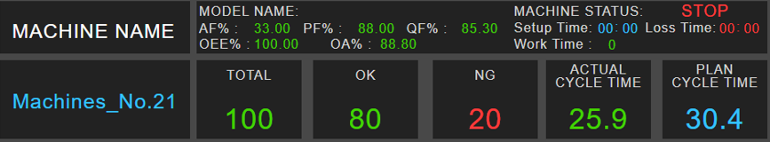
5. System Features
Main dashboard for monitoring machine ( Main display in smart TV )
Status : Model name
Status : Machine
Status : OEE
Status : Setup time
Status : Loss time
Status : Working time
Machine name
Status Target/Plan
Status production

Slide 30
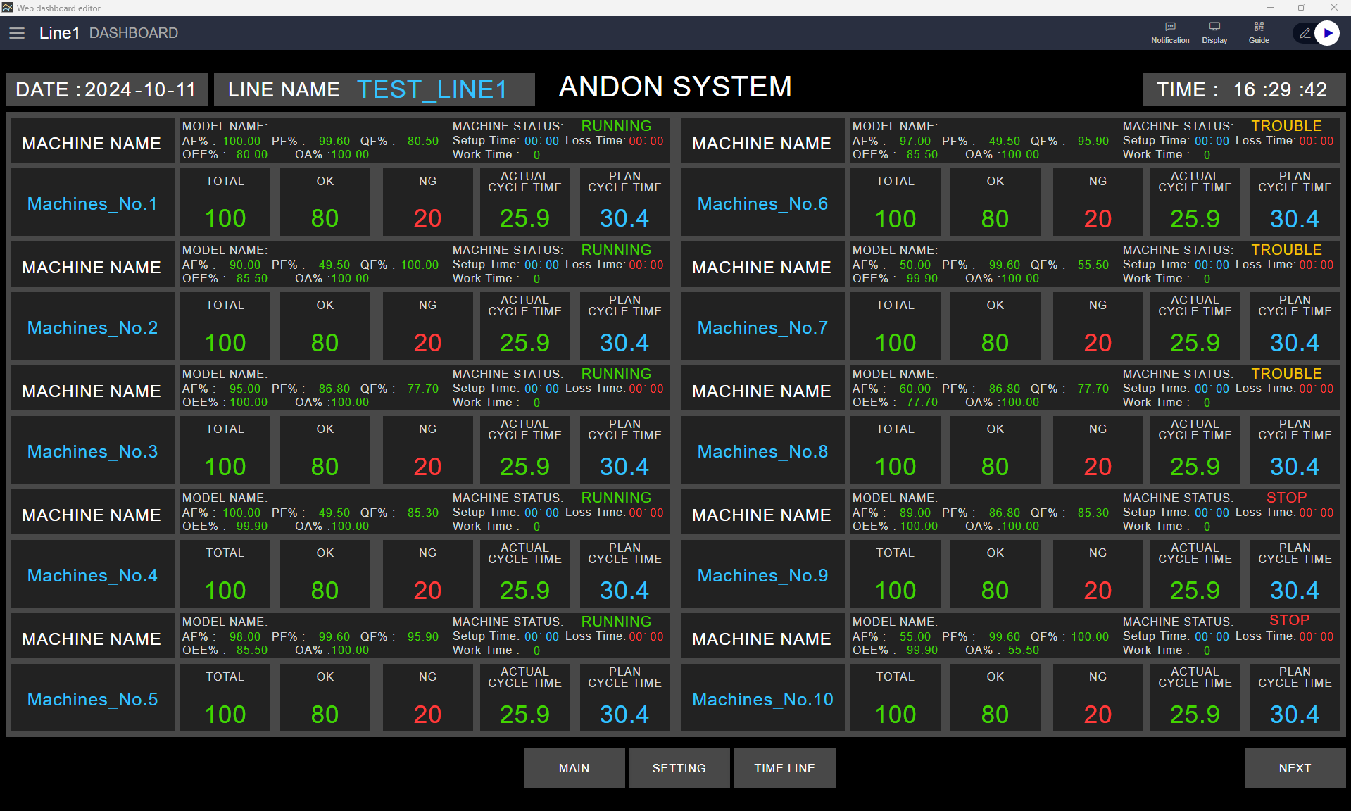
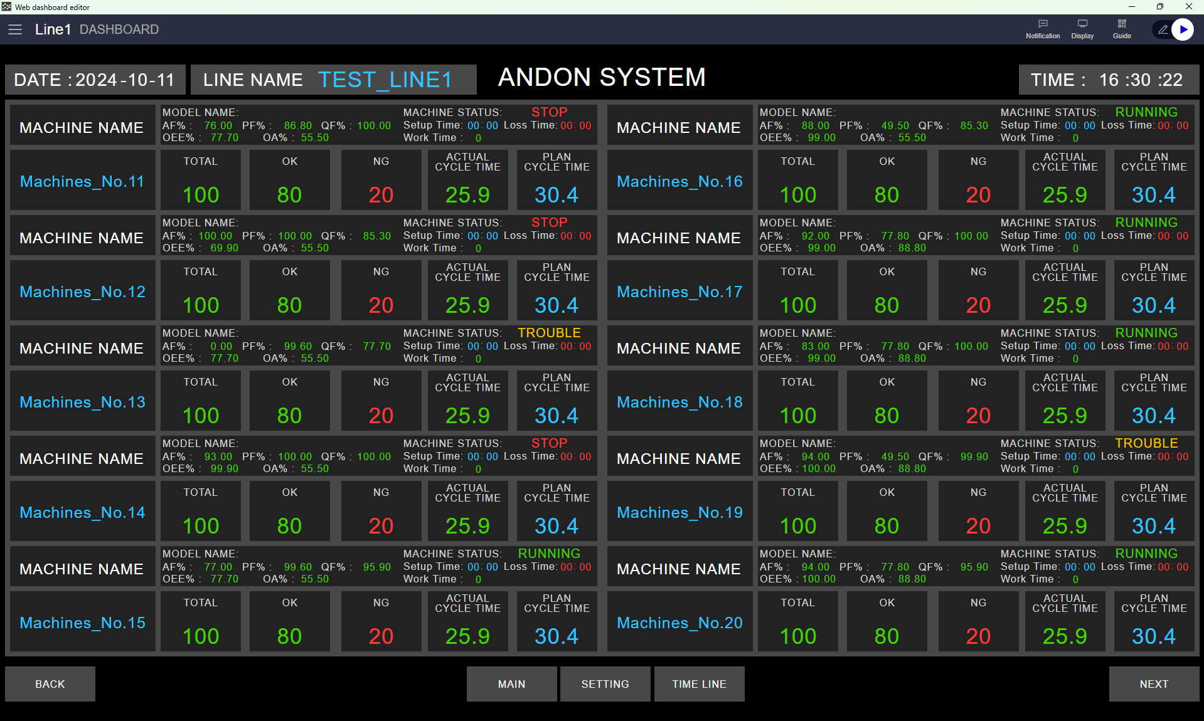
5. System Features
Main dashboard for monitoring machine ( Main display in smart TV )

Slide 31
5. System Features
Main dashboard for monitoring machine ( Main display in smart TV )

Slide 32
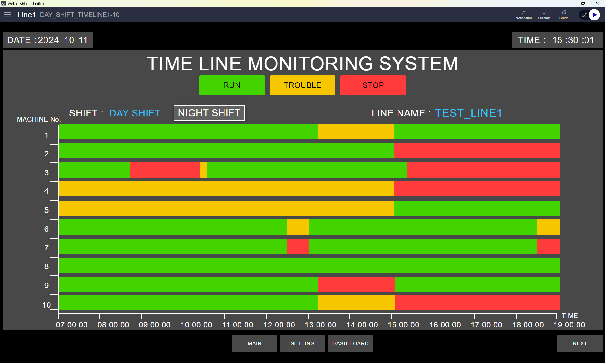
5. System Features
Screen machine detail
Time line status

Slide 33
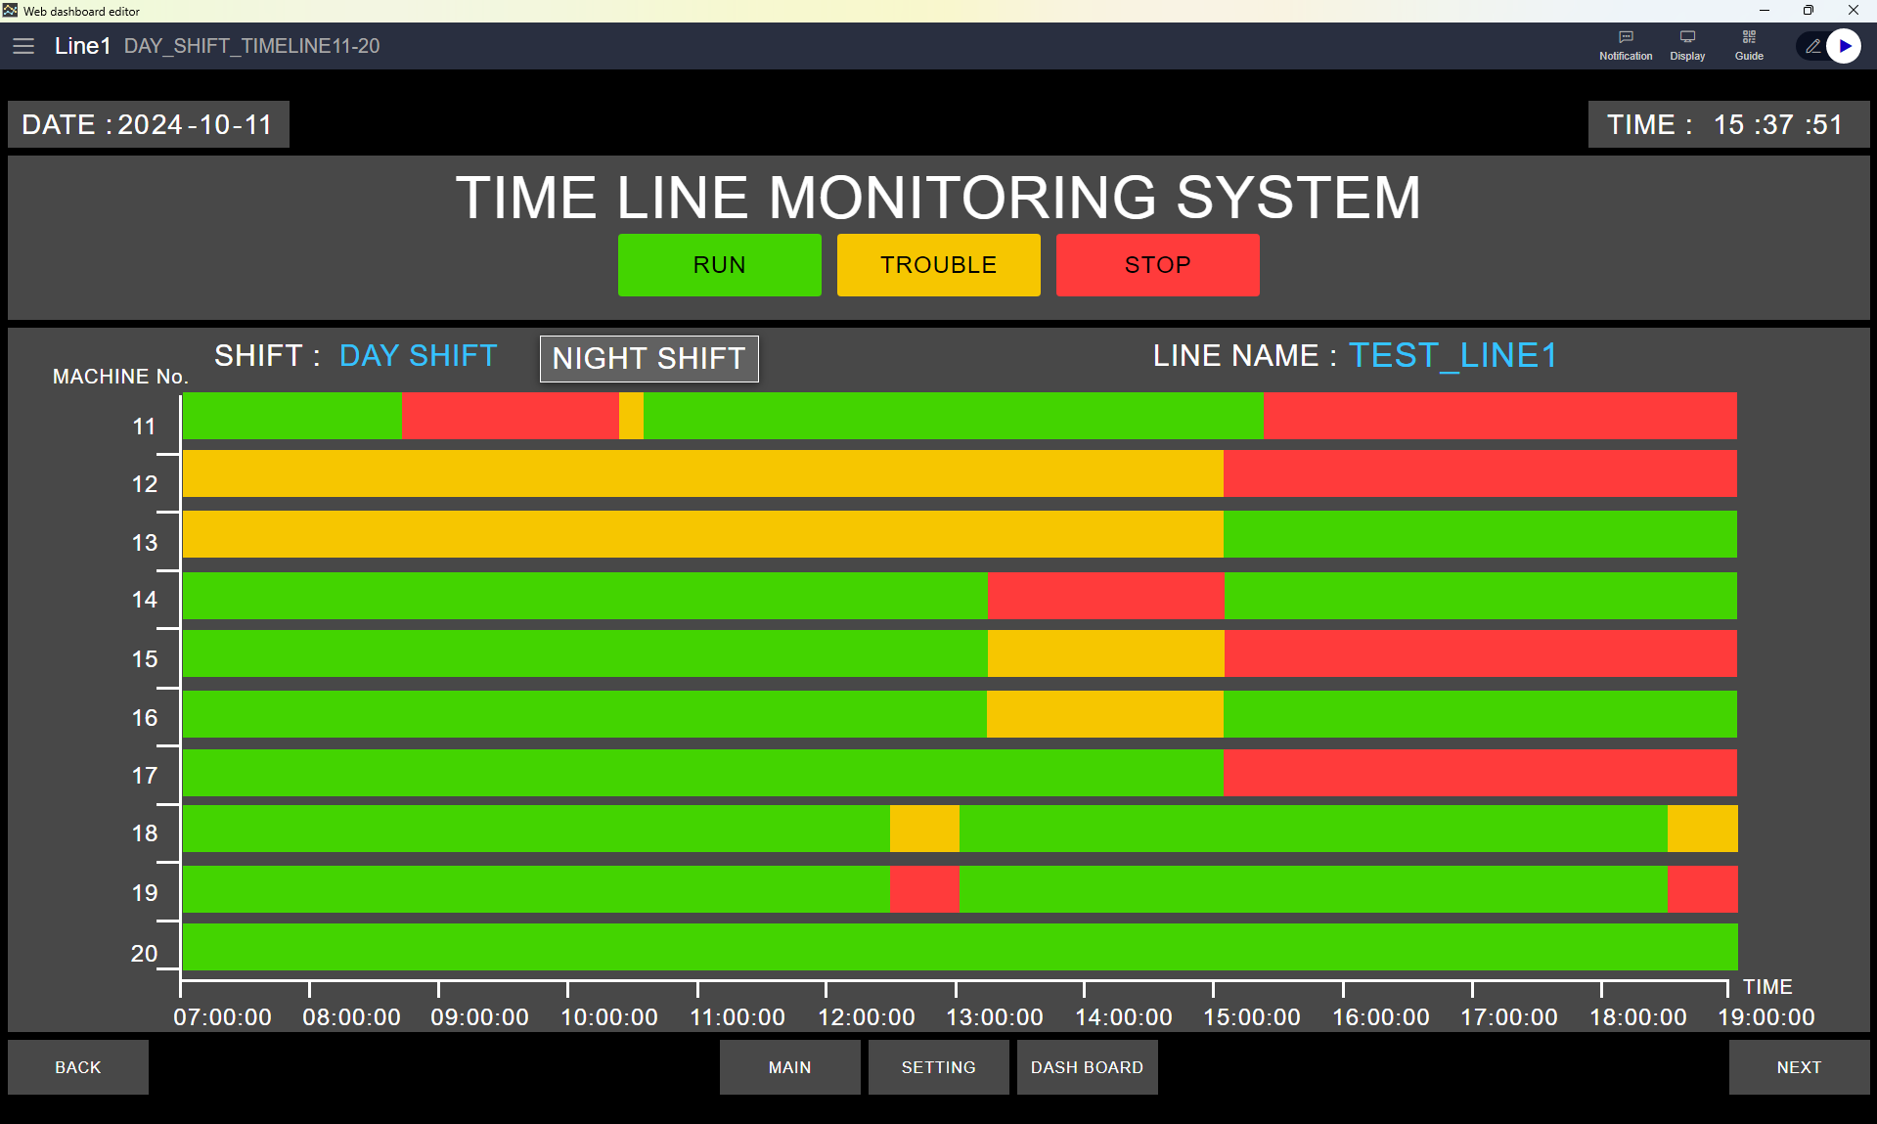
5. System Features
Time line status screen ( Day shift )

Slide 34
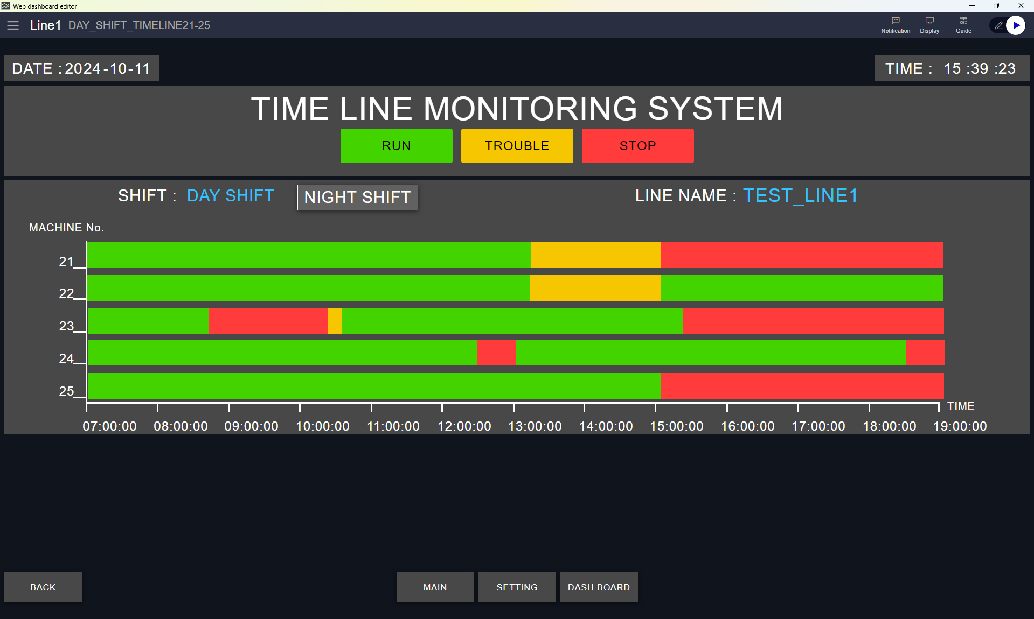
5. System Features
Time line status screen ( Day shift )

Slide 35
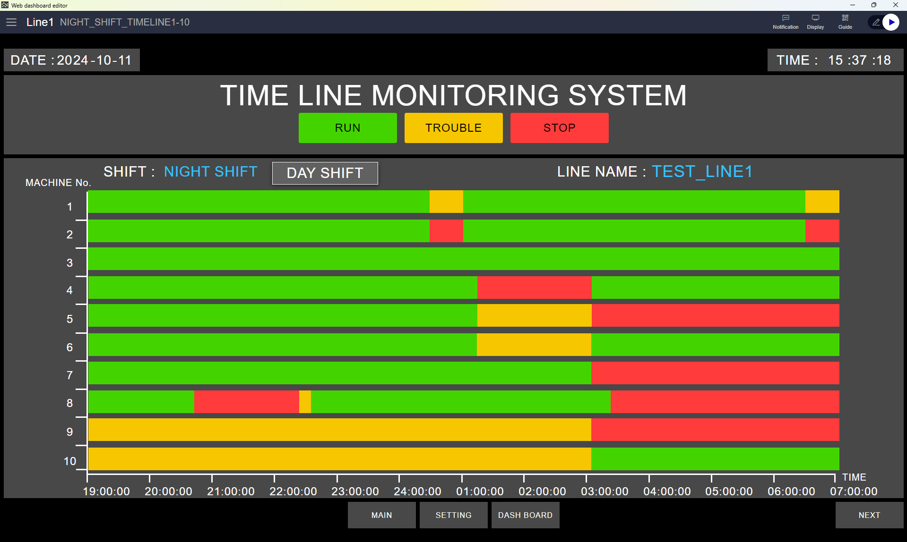
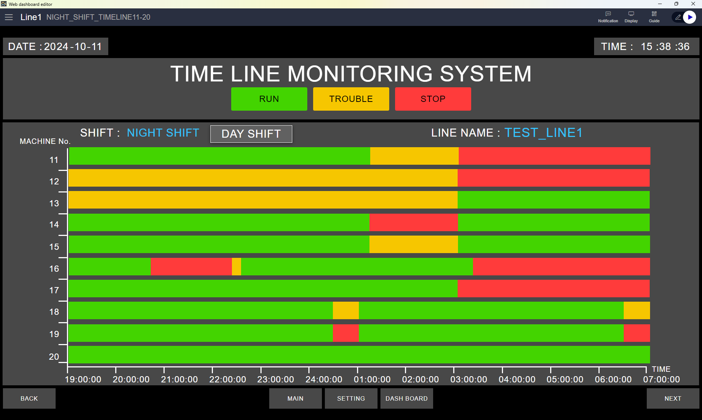
5. System Features
Time line status screen ( Night shift )

Slide 36
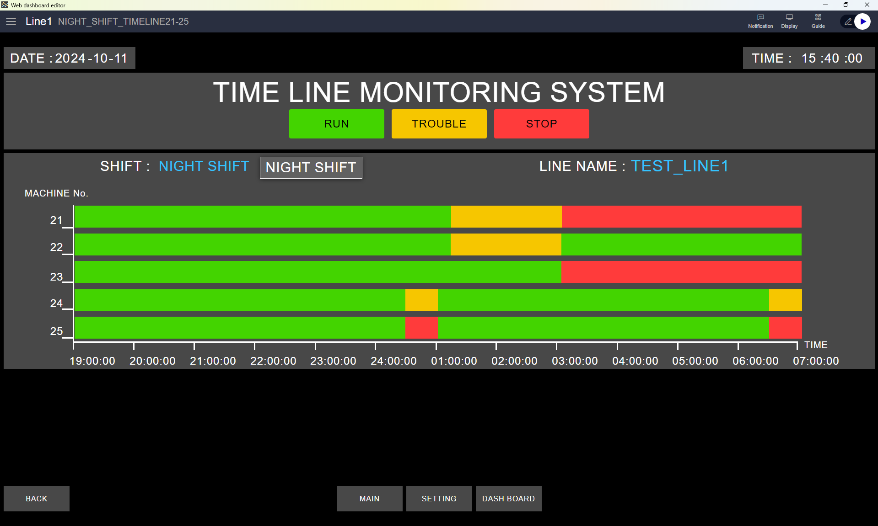
5. System Features
Time line status screen ( Night shift )

Slide 37
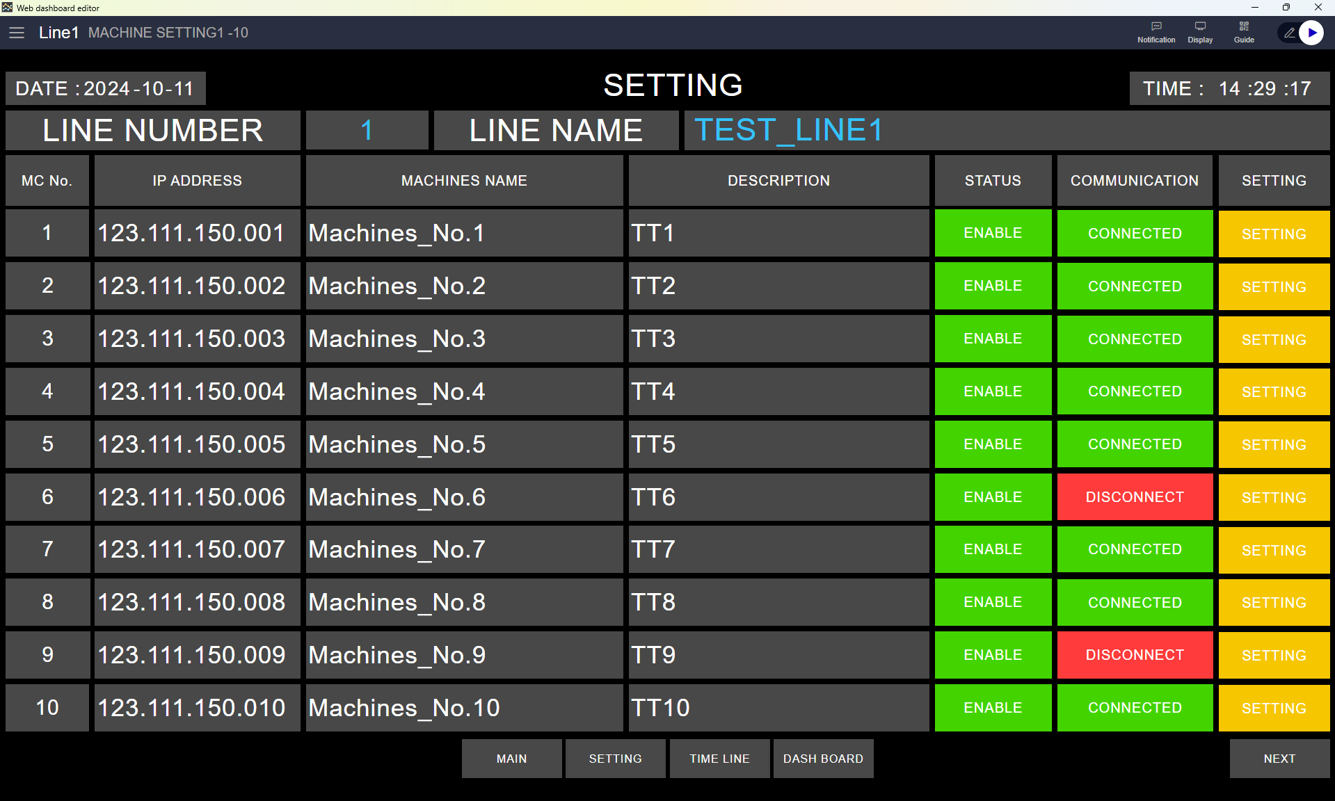
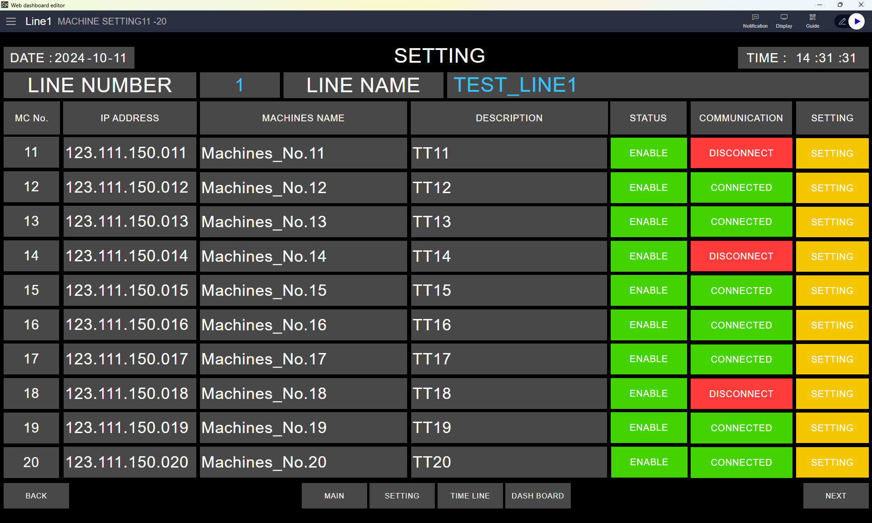
5. System Features
Machine setting

Slide 38
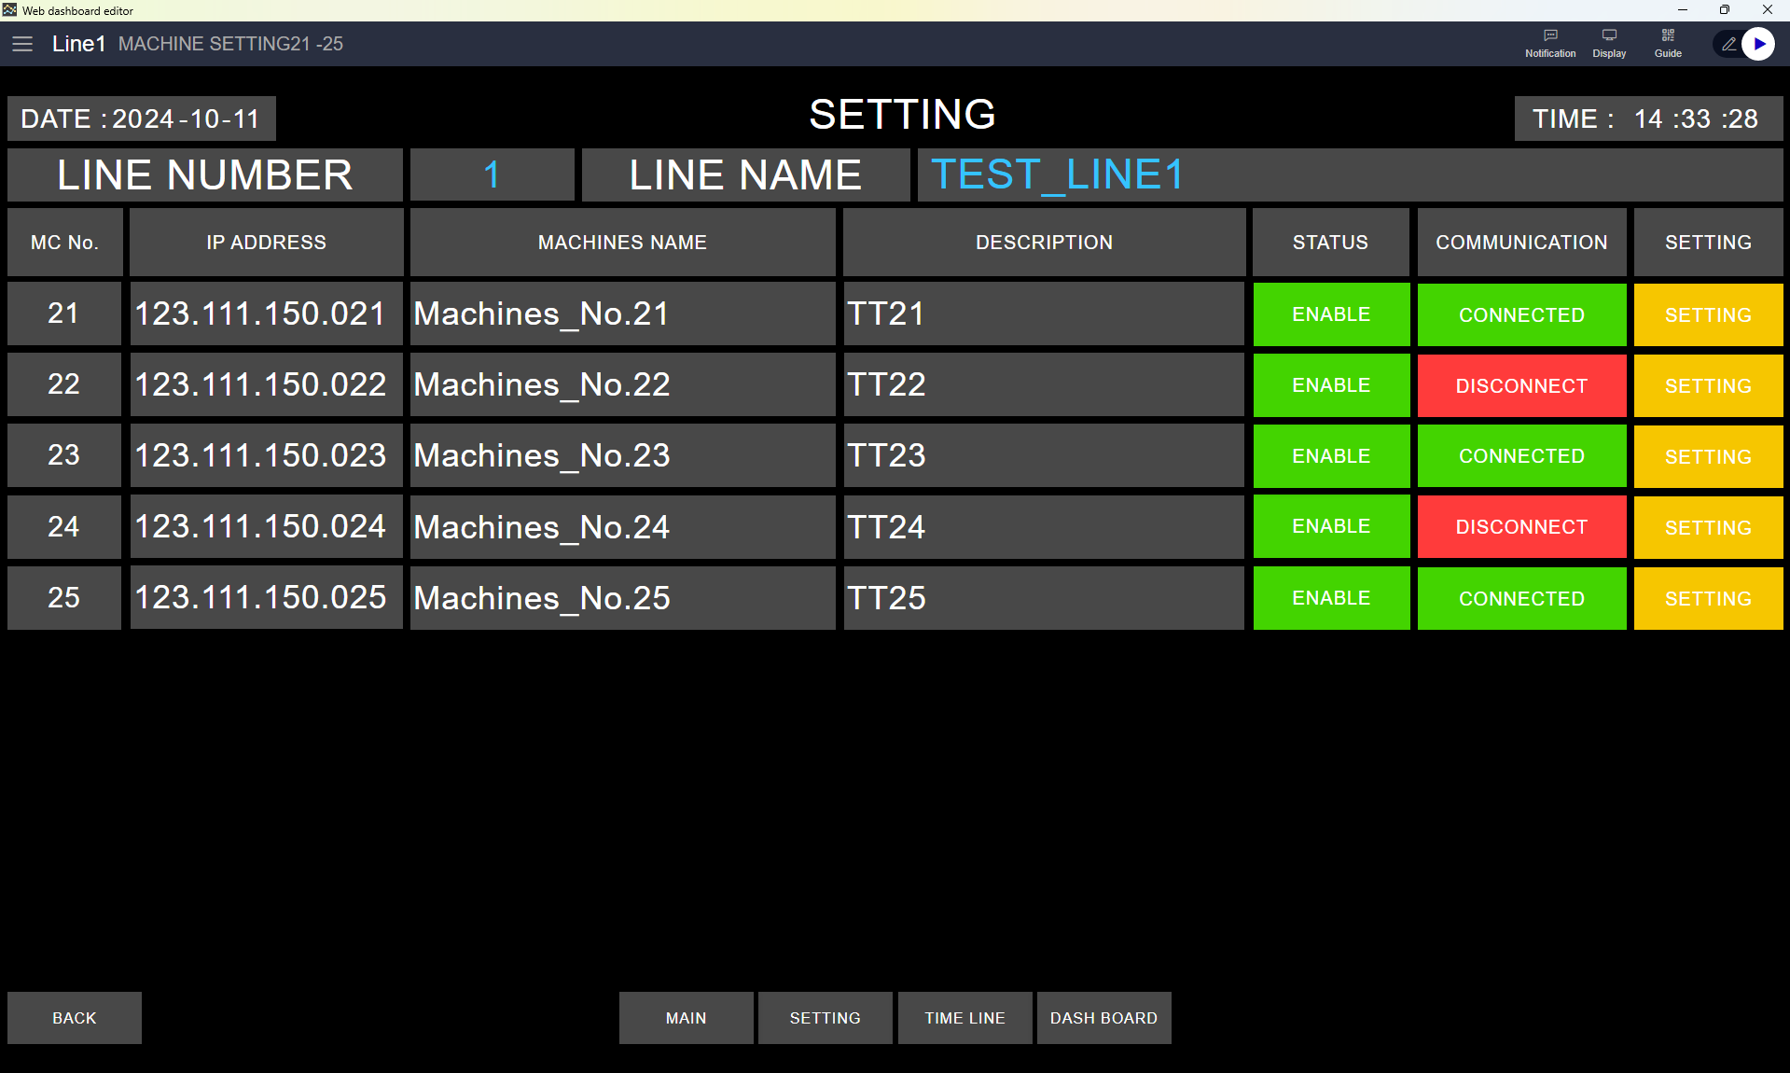
5. System Features
Machine setting

Slide 39
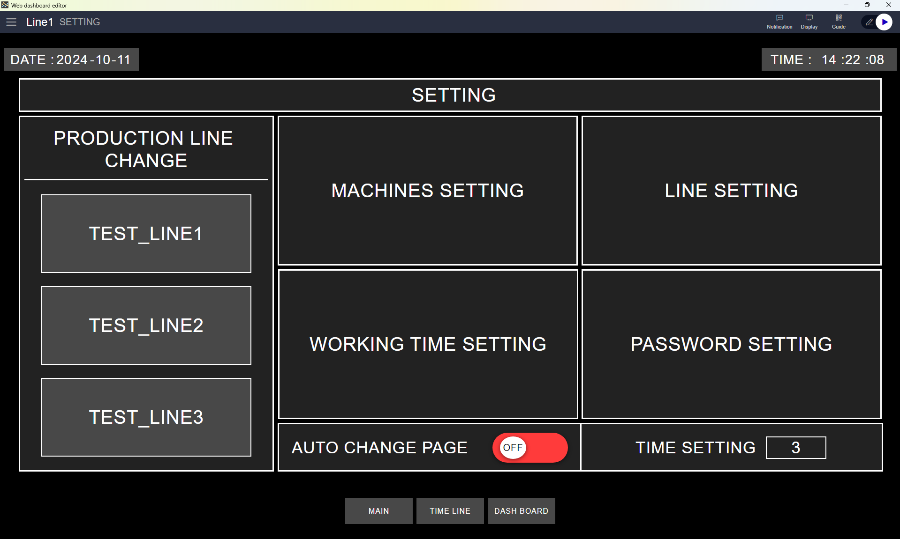
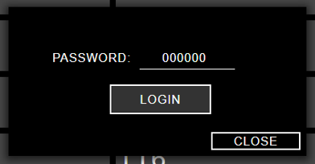
5. System Features
Setting Page

Slide 40
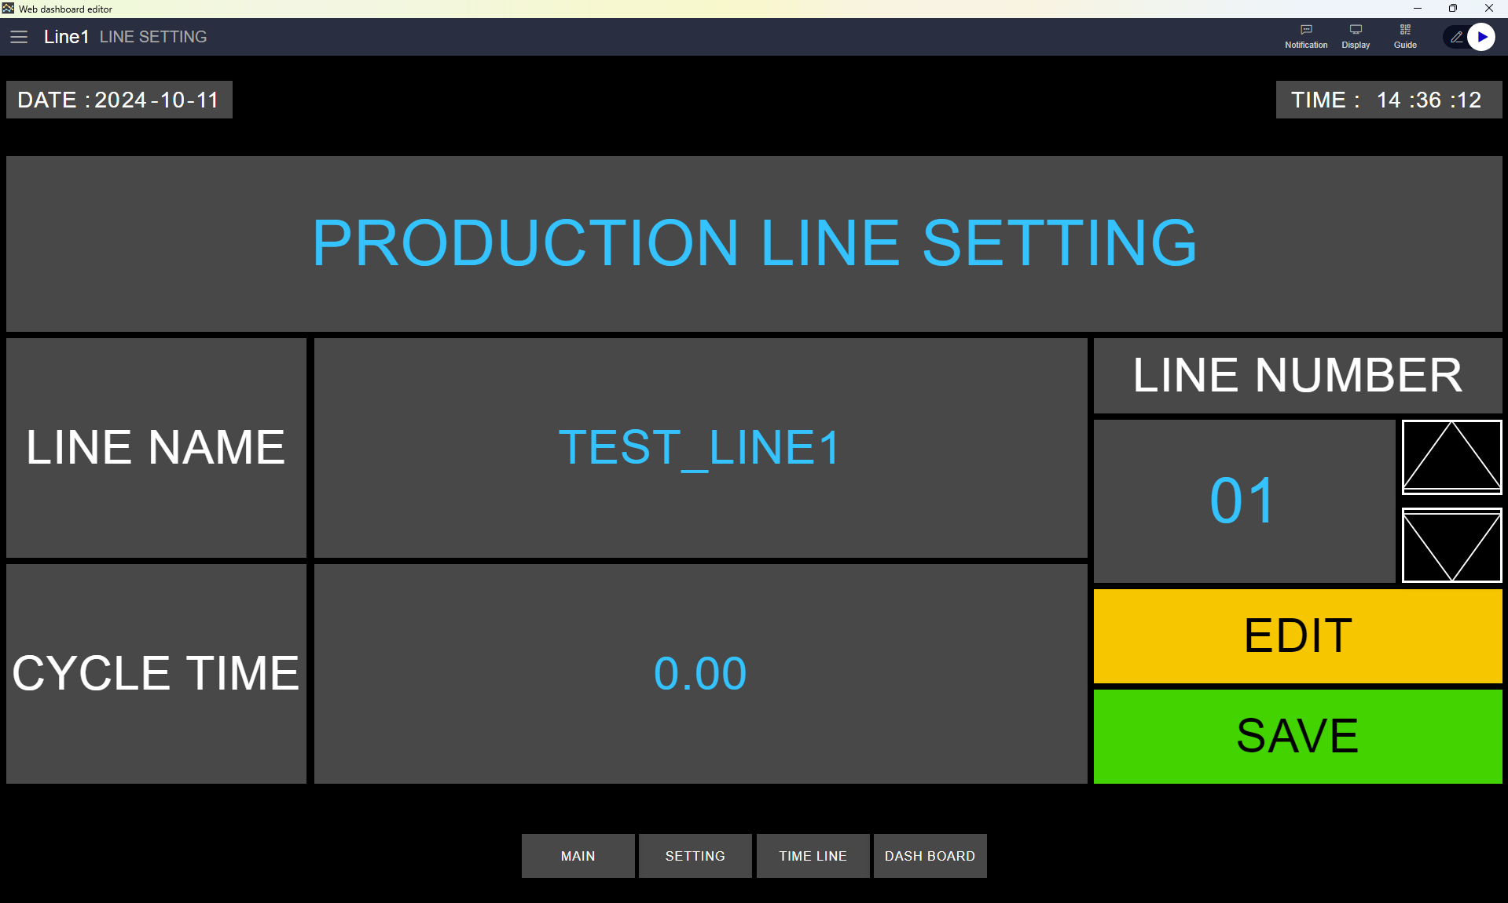
5. System Features
Setting Page

Slide 41
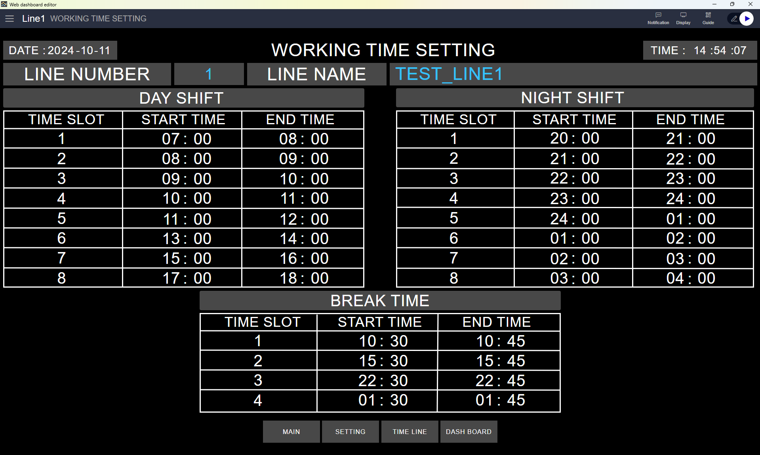
5. System Features
Setting Page

Slide 42
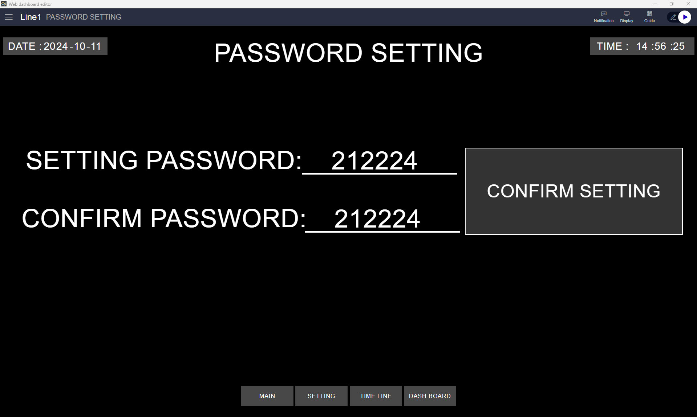
5. System Features
Setting Page

Slide 43
5. System Features
Setting Page
For Change production Line
For Enable mode change main page auto

Slide 44
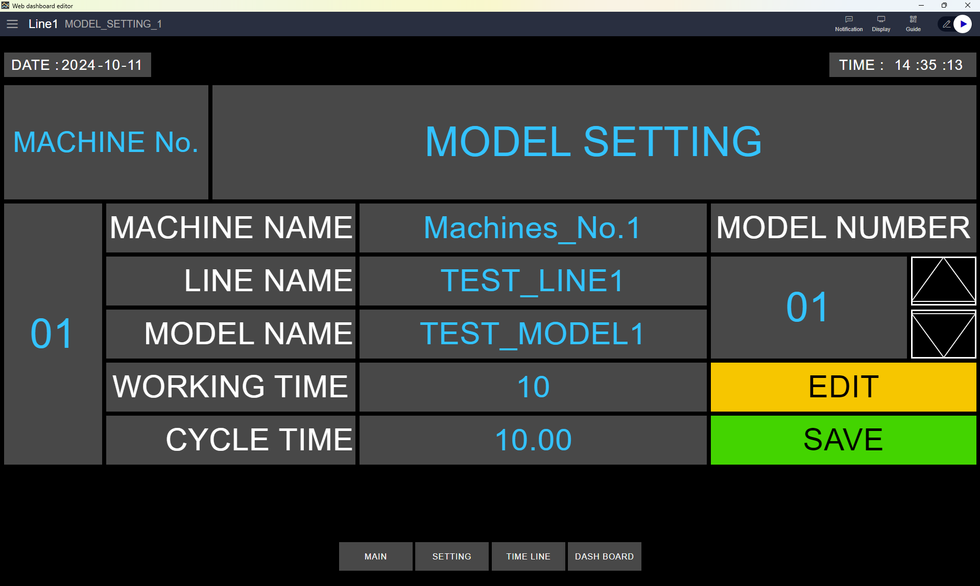
5. System Features
Model setting

Slide 45
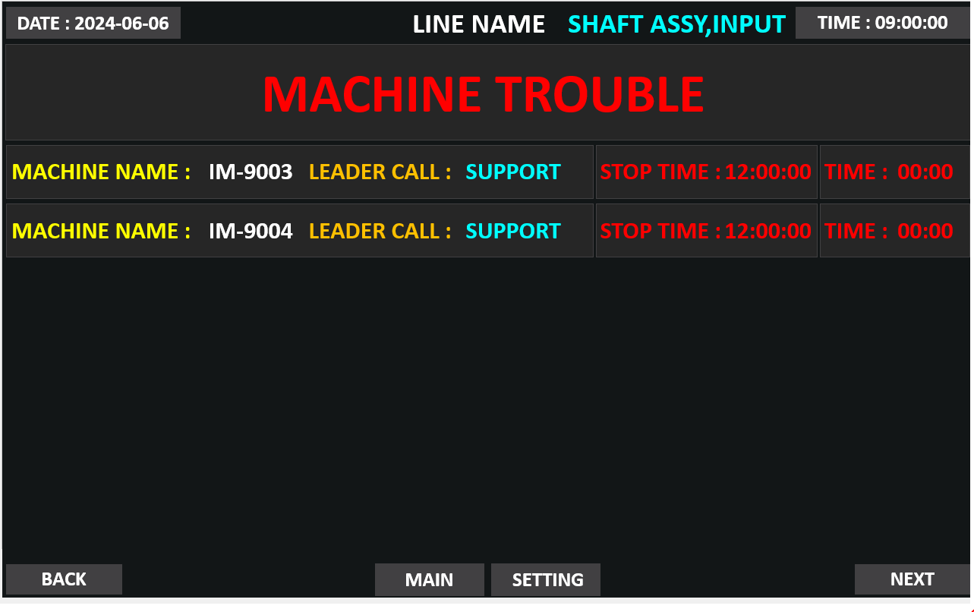
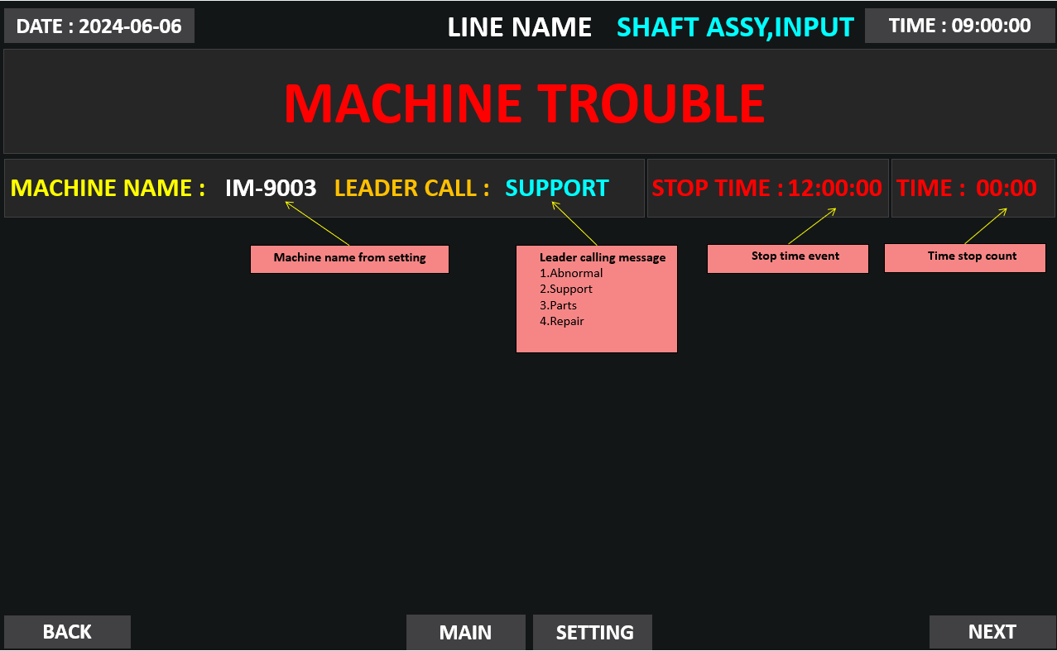
5. System Features
Machine breakdown

Slide 46
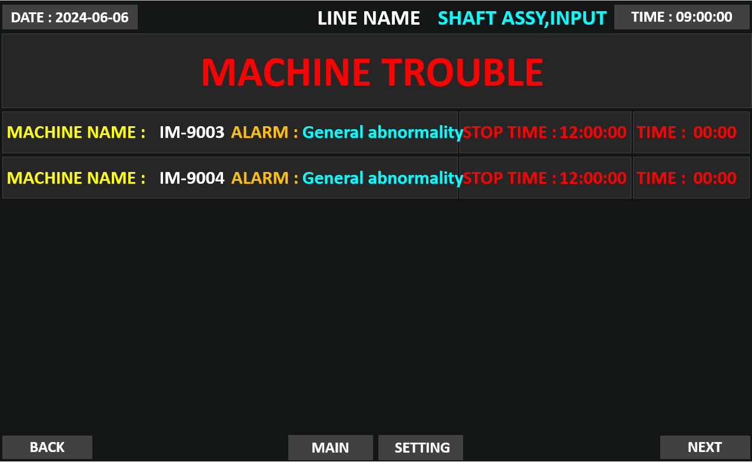
5. System Features
Machine breakdown

Slide 47
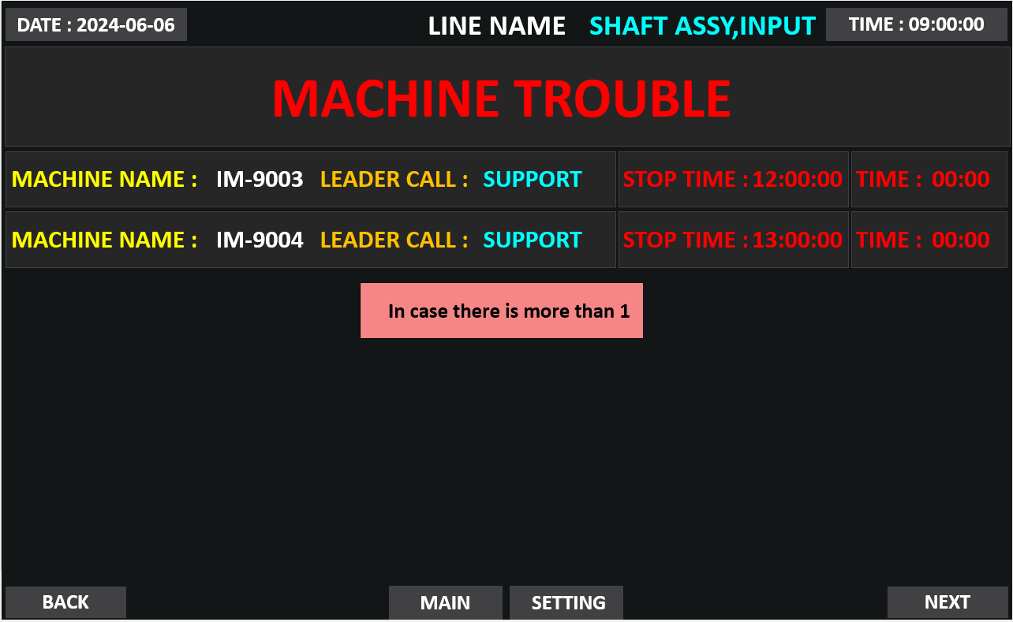
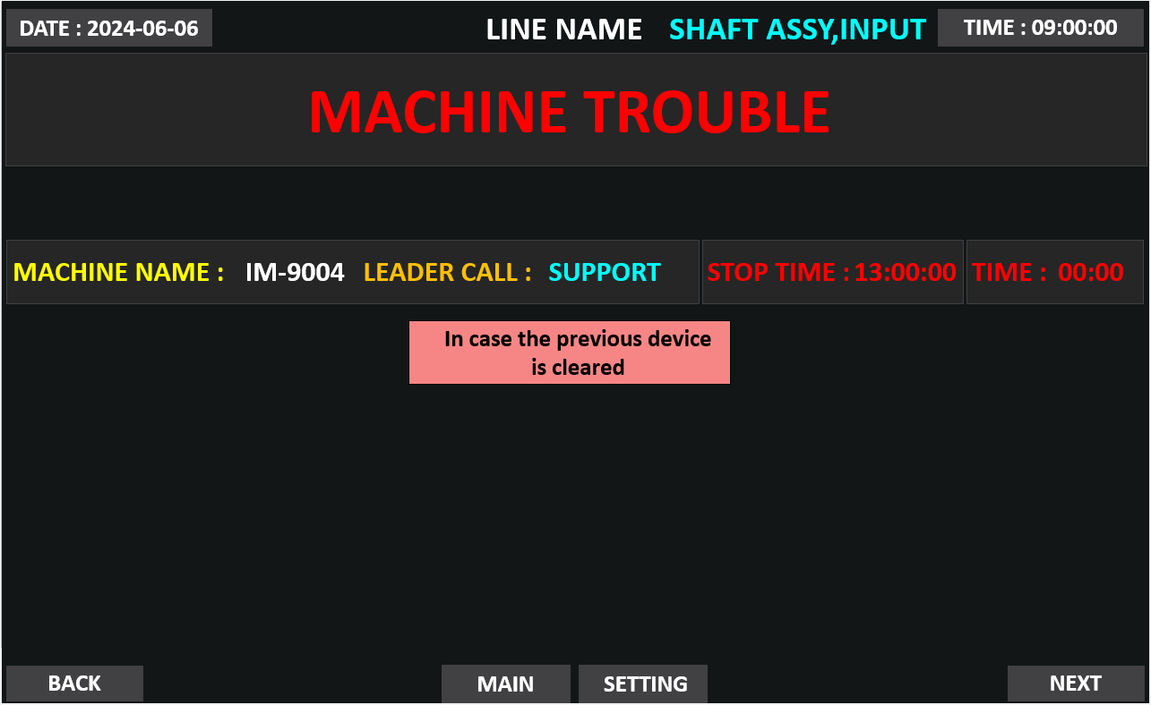
5. System Features
Machine breakdown

Slide 48
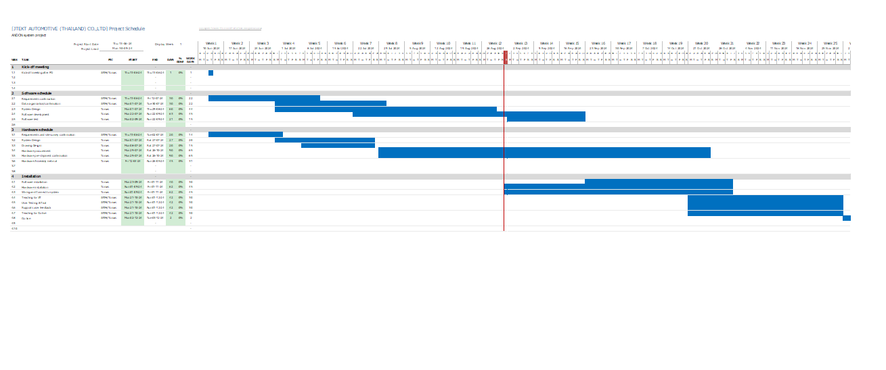
6. Installation Requirements

Slide 49
7. Q&A

Slide 50
8. Sign off
We hereby acknowledge and agree the above-mentioned blueprint requirements.
Any changes required after the sign off for this blueprint will be addressed through the change request process.
jtekt automotive (thailand) Co., Ltd.
Sign:
Name:
Title:
Date:
TOMAS TECH CO.,LTD.
Sign:
Name:
Title:
Date:
## END OF BLUEPRINT##

