Slide 1

Version 3/Dec/2024
Confidential
Q-Gate process system phase1 specifications
Documentation EN Blueprint for ANI
Blueprint
R1
Made for : A.N.I. LOGISTICS, LTD.
By : TOMAS TECH CO.,LTD.

Slide 2
Revision History
Date | Version | File name | Details
3/Dec/2024 | R1 | Q-Gate process system phase1 specifications Documentation EN Blueprint for ANI Blueprint | First edition

Slide 3
■Contents
1. Overview
2. Overall configuration diagram
3. Document information
4. Operation flow
5. System functional specifications
6. Q&A
7. Sign off

Slide 4
1. Overview
Proposal of Process Management System to A.N.I.
By systematizing the Q-Gate work process, we will achieve an improvement in product quality, ensuring that the entire product is delivered without errors.
The objectives of the Quality Gate process in a factory are to ensure that products meet predefined quality standards at specific stages of production, preventing defects from progressing further down the manufacturing line. The key objectives of the Quality Gate process include:
Early Detection of Issues: Identify defects or issues in the production process as early as possible to avoid costly rework or defective products reaching customers.
Ensuring Consistency: Maintain consistent product quality across all units produced by verifying that each step in the manufacturing process meets the required quality standards.
Preventing Waste: Reduce waste by stopping defective products before they go further in the production process, saving both time and resources.
Improved Customer Satisfaction: Ensure the final product meets customer expectations, reducing returns, complaints, and dissatisfaction.
Compliance with Standards: Ensure that products comply with regulatory, safety, and industry standards by adhering to quality control measures at each stage.
Continuous Improvement: Identify trends, recurring issues, or bottlenecks in the manufacturing process that need attention for ongoing improvement.
Traceability and Accountability: Provide traceability of quality checks and testing, making it easier to identify where problems arose and assign responsibility for corrective actions.
The Quality Gate process acts as a checkpoint, confirming that each production phase or batch meets the required quality criteria before moving on to the next stage.

Slide 5
2. Overall configuration diagram
Regarding the CKD process system, consider the following system configuration.
Overall configuration diagram image
Server Room
Fiber optic communication
ANI CKD process server BK
ANI CKD process server
LAN communication
WIFI communication
HATC schedule data
HATC schedule data
System unit
Printing label (New)
Using label (Old)
UPS
UPS
Show document
S/W Hub
A/P *9
TRIM
Q-Gate area
Stock & Staging area
Handy terminal *3
Outer Packing area
Receiving area
Inner packing area
Supplier Part Tag
PANEL
Q-Gate area
Handy terminal *3
Supplier Part Tag

Slide 6
3. Document information
1. ???

Slide 7
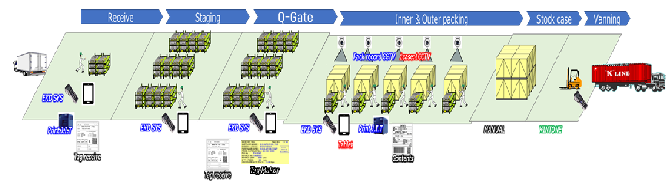
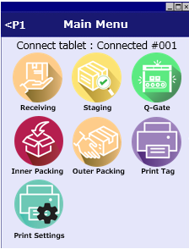
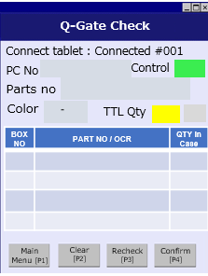
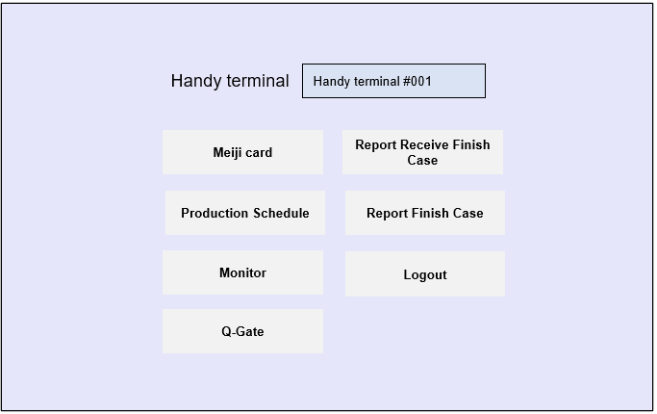
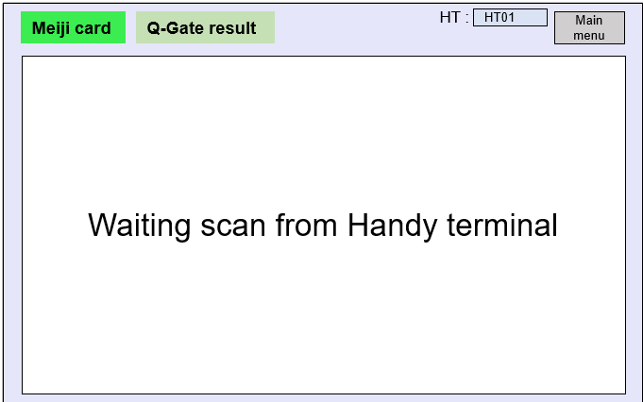
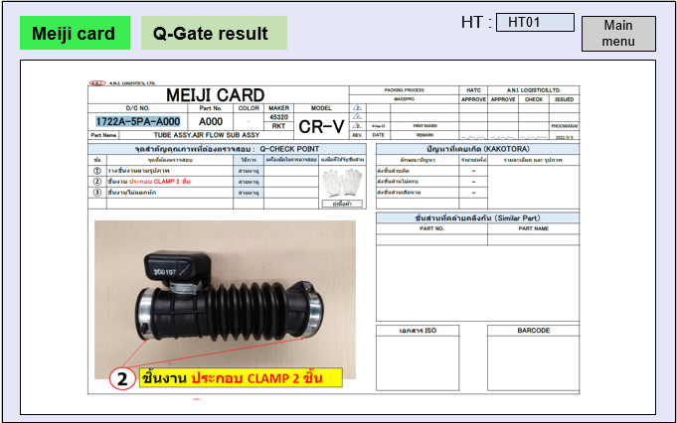
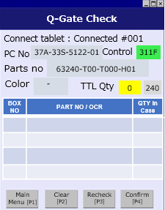
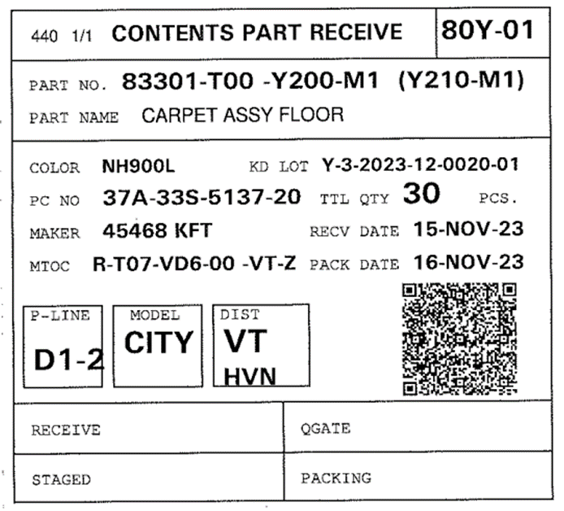

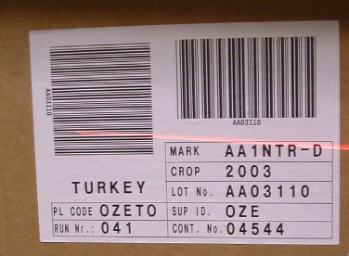
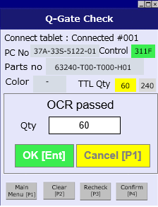
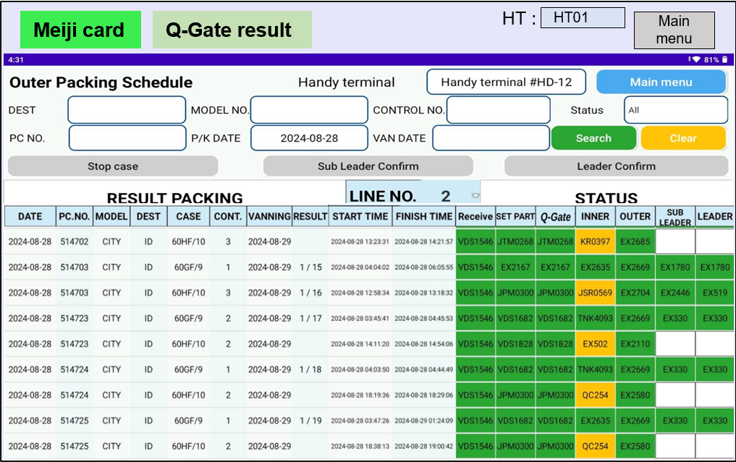
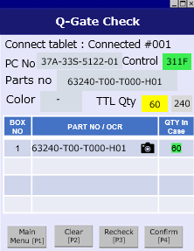
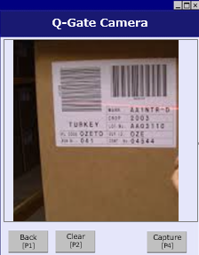
4. Operation flow
4. Operation flow
4-1. Q-Gate process overview
Panel/Trim overall process
Q-Gate process
Instructions
-Scan ID
-Auto user login of handy
-User login Tablet
-Scan tag receive
-Tablet screen display Meiji card
-Handy displays an item detail
-Check the Meiji card
-Handy scans the tag maker and enter its qty.
-Take picture of tag and box.
-Confirm Q-Gate “OK”
-Tablet auto screen display back to the page Q-Gate status according line
Process Locked
Only STAGED status can be entered into the Quality Gate, and the Quality Gate must pass 100% before inner packing.
Staging
Q-Gate
Inner Packing
STAGED
100%
PASS
100%

Slide 8
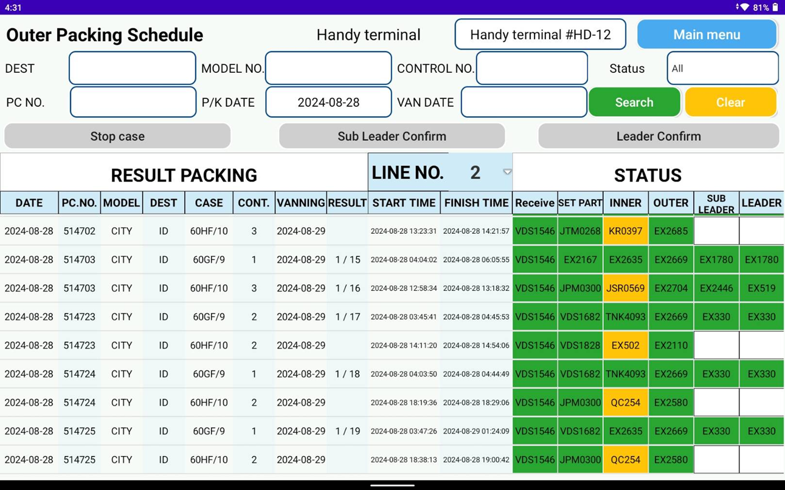
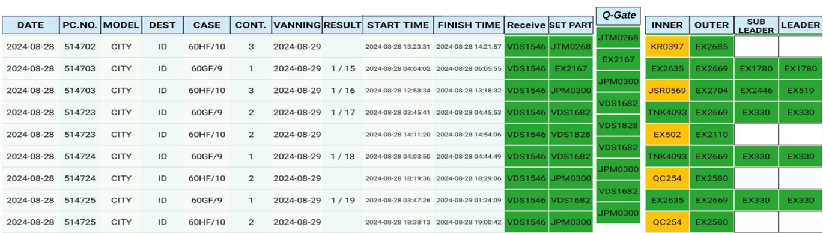
4. Operation flow
4. Operation flow
4-2. Q-Gate process – Tablet status screen
Q-Gate process
Able to display the Q-Gate process status
No | Parts | Color | Date | Checker
1 | 1100A59B Z101 | - | 2024-11-20 20:10 | Winai
2 | 1100A59B Z101 | - | 2024-11-20 20:16 | Winai
3 | 1100A59B Z101 | - | 2024-11-20 20:17 | Winai
4 | 1100A59B Z101 | - | 2024-11-20 20:23 | Winai
5 | 1100A59B Z101 | - | 2024-11-20 21:05 | Chatree

Slide 9
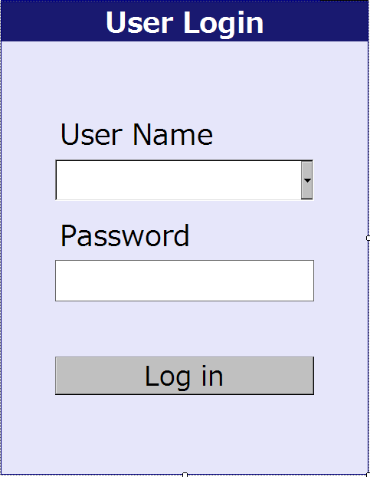
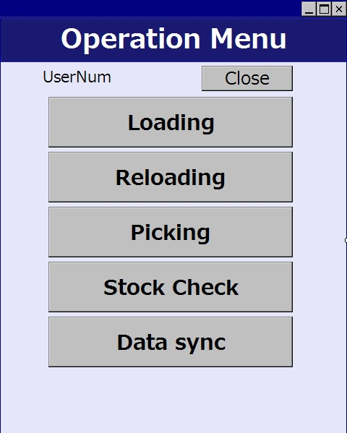








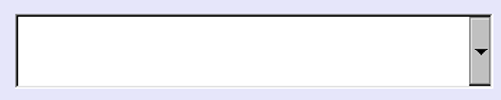







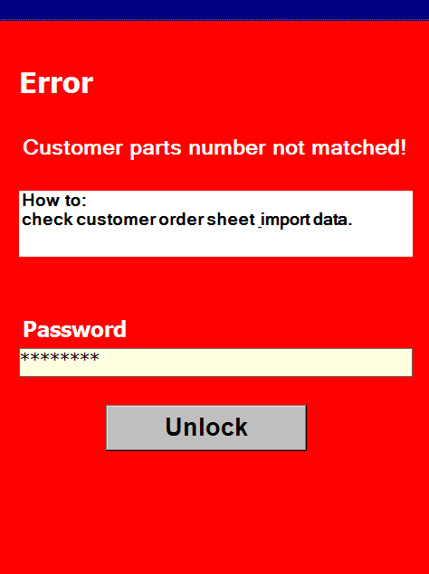

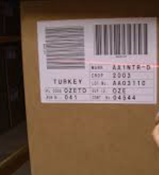
5. System functional specifications
5-1. Handy terminal screen image
Handy terminal function / screen image
1.User Login
2.1.Main Menu
2.2.Main Menu
Main Menu
Main Menu
<P1
<P1
User code
Connect tablet : Connected #001
Connect tablet : Connected #001
Table ID
Receiving Staging Q-Gate
Receive
Finish Case
Move Location
Setup
Finish Case
Inner Packing Outer Packing Print Tag
Vanning
Login
Print Settings
4. Q-Gate Check
5. Q-Gate Check Finished
6. Lock screen
Q-Gate Check
Q-Gate Check
Connect tablet : Connected #001
Connect tablet : Connected #001
PC No
37A-33S-5122-01
Control
311F
PC No
37A-33S-5122-01
Control
311F
Parts no
63240-T00-T000-H01
Parts no
63240-T00-T000-H01
Color
-
TTL Qty
240
Color
-
TTL Qty
180
240
240
BOX NO | PART NO / OCR | QTY in Case
1 | 63240-T00-T000-H01 | 60
2 | 63240-T00-T000-H01 | 60
3 | 63240-T00-T000-H01 | 60
All items Q-Gate check
passed
BOX NO | PART NO / OCR | QTY in Case
1 | 63240-T00-T000-H01 | 60
2 | 63240-T00-T000-H01 | 60
3 | 63240-T00-T000-H01 | 60
4 | 63240-T00-T000-H01 | 60
OK [Ent]
F1
Menu
F1
Menu
F1
Menu
F1
Menu
Main
Menu [P1]
Clear
[P2]
Recheck
[P3]
Confirm
[P4]
F1
Menu
F1
Menu
F1
Menu
F1
Menu
Main
Menu [P1]
Clear
[P2]
Recheck
[P3]
Confirm
[P4]
7. Q-Gate Take Picture
8. Q-Gate Part verify
Q-Gate Camera
Q-Gate Check
All items packing
finished
Connect tablet : Connected #001
PC No
37A-33S-5122-01
Control
311F
Parts no
63240-T00-T000-H01
Color
-
TTL Qty
240
180
OCR passed
BOX NO | PART NO / OCR | QTY in Case
1 | 63240-T00-T000-H01 | 60
2 | 63240-T00-T000-H01 | 60
3 | 63240-T00-T000-H01 | 60
4 | 63240-T00-T000-H01 | 60
Qty
60
OK [Ent]
Cancel [P1]
F1
Menu
F1
Menu
F1
Menu
F1
Menu
F1
Menu
F1
Menu
F1
Menu
Main
Menu [P1]
Clear
[P2]
Recheck
[P3]
Confirm
[P4]
Back
[P1]
Clear
[P2]
Capture
[P4]

Slide 10

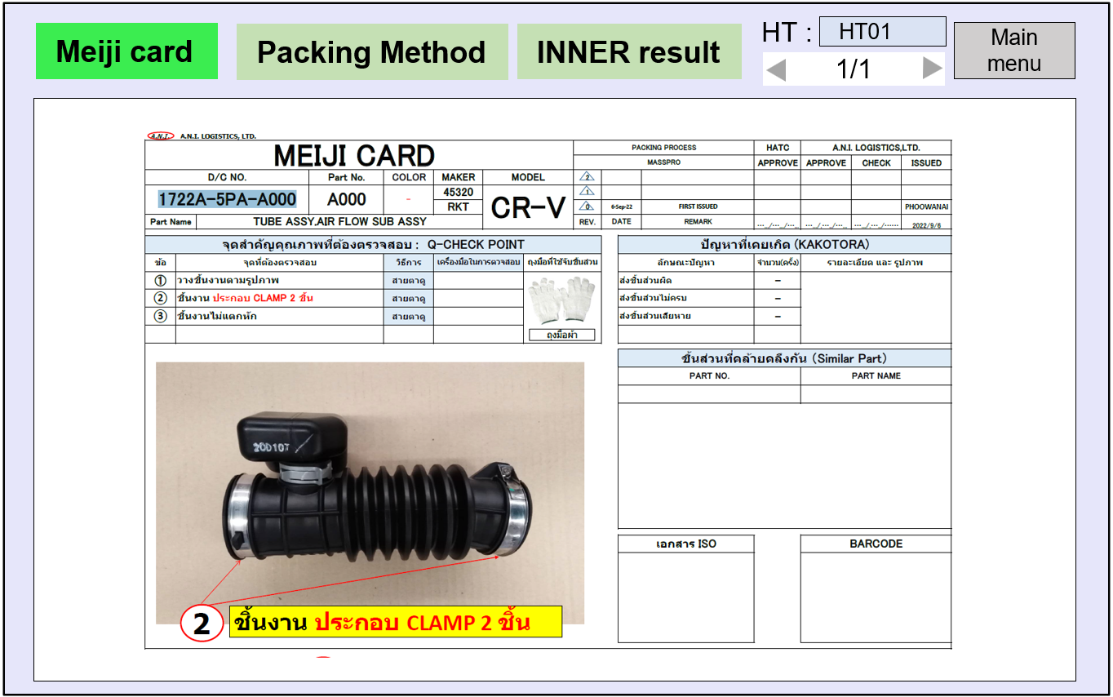
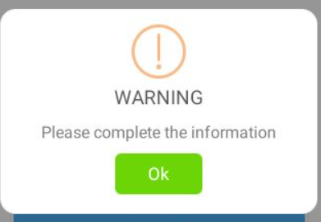

5. System functional specifications
5-1. Handy terminal screen image
5-1-1. Q-Gate check process
Main Menu
Q-Gate Check
This is the screen that transitions after select Inner Packing area[P3] from menu screen.
PC No.: PC number from master plan
Part No.: Part number
Color :Part color
Qty: Quantity of packing item
Control: Control number
Main Menu[P1]: Back to menu screen
Clear[P2]: Clear all input contents
Recheck[P3]: Remove the all OCR check
Confirm[P4]: Confirm the work
<P1
Connect tablet : Connected #001
Connect tablet : Connected #001
PC No
Control
Parts no
Receiving Staging Q-Gate
Color
-
TTL Qty
BOX NO | PART NO / OCR | QTY in Case
Inner Packing Outer Packing Print Tag
F1
Menu
F1
Menu
F1
Menu
F1
Menu
Print Settings
Main
Menu [P1]
Clear
[P2]
Recheck
[P3]
Confirm
[P4]
Step 1. Scan part tag receive.
Q-Gate Check
Step 2. Scan an OCR of
part number.
Connect tablet : Connected #001
* Meiji card PDF will be automatic display on tablet
PC No
37A-33S-5122-01
Control
311F
Parts no
63240-T00-T000-H01
Color
-
TTL Qty
240
0
BOX NO | PART NO / OCR | QTY in Case
F1
Menu
F1
Menu
F1
Menu
F1
Menu
Main
Menu [P1]
Clear
[P2]
Recheck
[P3]
Confirm
[P4]
Q-Gate Check
Q-Gate Camera
Q-Gate Check
Connect tablet : Connected #001
All items packing
finished
Connect tablet : Connected #001
PC No
37A-33S-5122-01
Control
311F
PC No
37A-33S-5122-01
Control
311F
Parts no
63240-T00-T000-H01
Parts no
63240-T00-T000-H01
Color
-
TTL Qty
240
Color
-
TTL Qty
60
0
240
BOX NO | PART NO / OCR | QTY in Case
1 | 63240-T00-T000-H01 | 60
OCR passed
BOX NO | PART NO / OCR | QTY in Case
1 | 63240-T00-T000-H01 | 60
2 | 63240-T00-T000-H01 | 60
3 | 63240-T00-T000-H01 | 60
4 | 63240-T00-T000-H01 | 60
Qty
60
OK [Ent]
Cancel [P1]
INFORMATION
F1
Menu
F1
Menu
F1
Menu
F1
Menu
F1
Menu
F1
Menu
F1
Menu
F1
Menu
Operation completed
Main
Menu [P1]
Clear
[P2]
Recheck
[P3]
Confirm
[P4]
F1
Menu
F1
Menu
F1
Menu
Main
Menu [P1]
Clear
[P2]
Recheck
[P3]
Confirm
[P4]
Back
[P1]
Clear
[P2]
Capture
[P4]

Slide 11

5. System functional specifications
5-1. Handy terminal screen image
5-1-1. Q-Gate check process
Q-Gate Check
Next step -> User able to scan the other supplier tag.
Q-Gate Check
Connect tablet : Connected #001
Connect tablet : Connected #001
PC No
37A-33S-5122-01
Control
311F
PC No
37A-33S-5122-01
Control
311F
Parts no
63240-T00-T000-H01
Parts no
63240-T00-T000-H01
Color
-
TTL Qty
240
Color
-
TTL Qty
60
60
240
BOX NO | PART NO / OCR | QTY in Case
1 | 63240-T00-T000-H01 | 60
OCR passed
BOX NO | PART NO / OCR | QTY in Case
1 | 63240-T00-T000-H01 | 60
2 | 63240-T00-T000-H01 | 60
3 | 63240-T00-T000-H01 | 60
4 | 63240-T00-T000-H01 | 60
Qty
60
OK [Ent]
Cancel [P1]
F1
Menu
F1
Menu
F1
Menu
F1
Menu
F1
Menu
Main
Menu [P1]
Clear
[P2]
Recheck
[P3]
Confirm
[P4]
F1
Menu
Clear
[P2]
F1
Menu
F1
Menu
Main
Menu [P1]
Recheck
[P3]
Confirm
[P4]
Q-Gate Check
Q-Gate Check
Q-Gate Camera
Connect tablet : Connected #001
Connect tablet : Connected #001
All items packing
finished
PC No
37A-33S-5122-01
Control
311F
PC No
37A-33S-5122-01
Control
311F
Parts no
63240-T00-T000-H01
Parts no
63240-T00-T000-H01
Color
-
TTL Qty
240
Color
-
TTL Qty
240
240
120
All items Q-Gate check
passed
BOX NO | PART NO / OCR | QTY in Case
1 | 63240-T00-T000-H01 | 60
2 | 63240-T00-T000-H01 | 60
3 | 63240-T00-T000-H01 | 60
4 | 63240-T00-T000-H01 | 60
BOX NO | PART NO / OCR | QTY in Case
1 | 63240-T00-T000-H01 | 60
2 | 63240-T00-T000-H01 | 60
2 | 63240-T00-T000-H01 | 60
2 | 63240-T00-T000-H01 | 60
OK [Ent]
F1
Menu
F1
Menu
F1
Menu
F1
Menu
F1
Menu
F1
Menu
F1
Menu
F1
Menu
Main
Menu [P1]
Clear
[P2]
Recheck
[P3]
Confirm
[P4]
Main
Menu [P1]
Clear
[P2]
Recheck
[P3]
Confirm
[P4]
F1
Menu
F1
Menu
F1
Menu
Back
[P1]
Clear
[P2]
Capture
[P4]
INFORMATION
Operation completed

Slide 12
5. System functional specifications
5-1. Handy terminal screen image
5-1-1. Q-Gate check process
In case of error – Parts not matched
Q-Gate Check
* User scans not matched parts number.
Connect tablet : Connected #001
PC No
37A-33S-5122-01
Control
311F
Supplier parts number not matched!!
Parts no
63240-T00-T000-H01
Color
-
TTL Qty
240
Check the contents parts number.
180
BOX NO | PART NO / OCR | QTY in Case
1 | 63240-T00-T000-H01 | 60
2 | 63240-T00-T000-H01 | 60
3 | 63240-T00-T000-H01 | 60
F1
Menu
F1
Menu
F1
Menu
F1
Menu
Main
Menu [P1]
Clear
[P2]
Recheck
[P3]
Confirm
[P4]
In case of error – Staging incompleted
Q-Gate Check
* Scan an incompleted staging tag receive.
Connect tablet : Connected #001
PC No
Control
Staging incompleted!!
Parts no
Color
-
TTL Qty
The staging process must be completed.
BOX NO | PART NO / OCR | QTY in Case
F1
Menu
F1
Menu
F1
Menu
F1
Menu
Main
Menu [P1]
Clear
[P2]
Recheck
[P3]
Confirm
[P4]

Slide 13
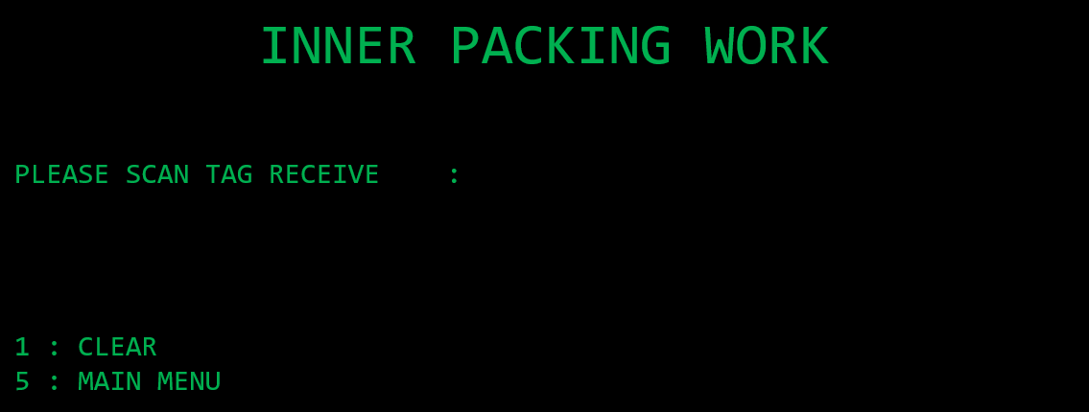
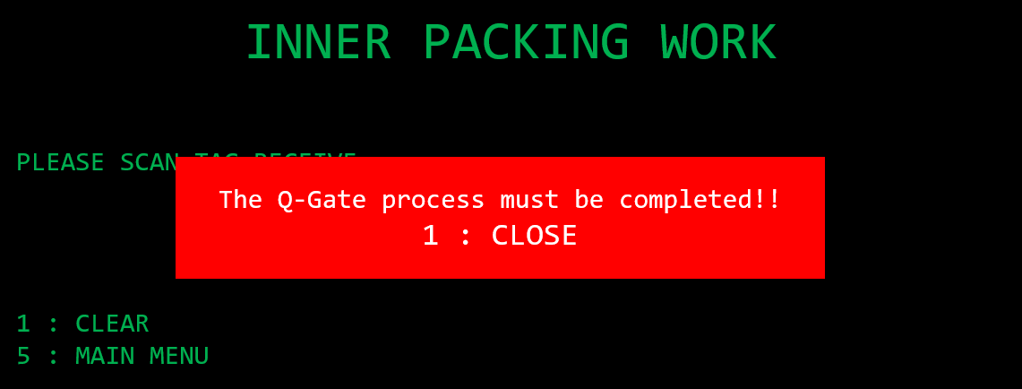

5. System functional specifications
5-1. Handy terminal screen image
5-1-1. Q-Gate check process
In case of error – Q-Gate incompleted
Inner Packing function on PC (Trim)
In case of error – Q-Gate incompleted
Inner Packing function on handy (Panel)
Inner Packing area
* Scan the tag receive that hasn’t passed the Q-Gate process.
Connect tablet : Connected #001
Q-Gate incompleted!!
PC No
Parts no
The Q-Gate process must be completed.
Color
-
Qty
Control
Please open MEIJI CARD.
F1
Menu
F1
Menu
F1
Menu
F1
Menu
Main
Menu [P1]
Clear
[P2]
Pending
[P3]
NG
[P4]

Slide 14
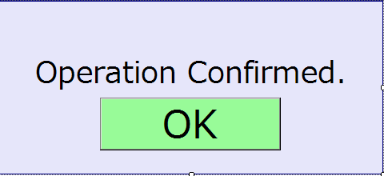

5. System functional specifications
4
5-2. Tablet screen image
5-2-1. Login & Main menu
User Login
User ID
Handy terminal
▼
Main menu
Handy terminal
Handy terminal #001
Meiji card
Report Receive Finish Case
Production Schedule
Report Finish Case
Monitor
Logout
Q-Gate

Slide 15
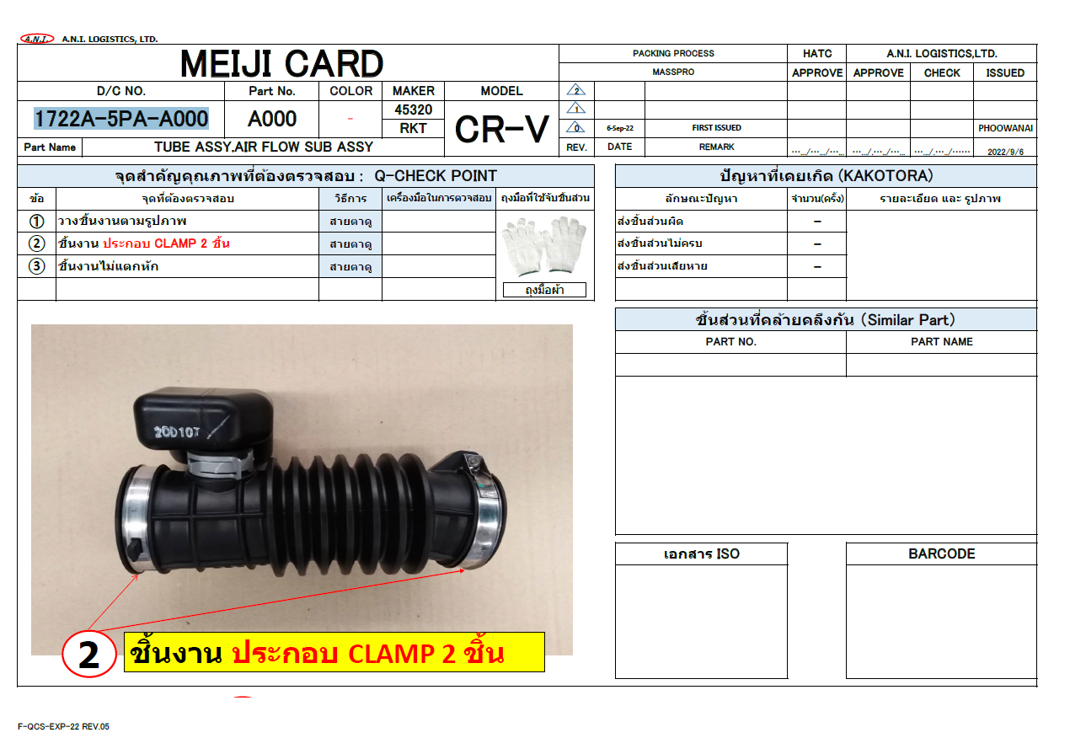
5. System functional specifications
5-2. Tablet screen image
5-2-2. Q-Gate - Meiji card
Meiji card / Packing Method tablet display
Meiji card
Q-Gate result
HT :
HT01
Main menu
Waiting scan from Handy terminal
Meiji card display loaded
Meiji card
Q-Gate result
HT :
HT01
Main menu
Waiting scan

Slide 16
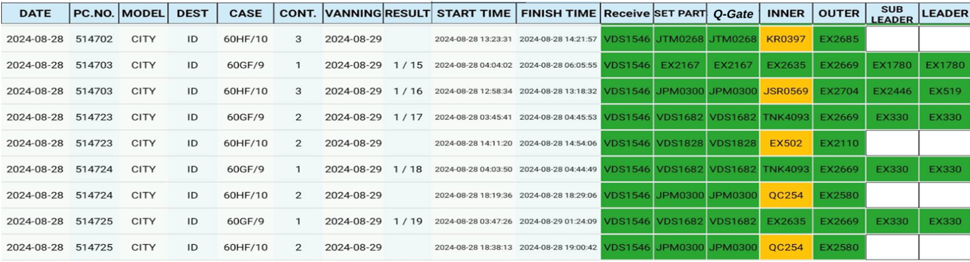
5. System functional specifications
5-2. Tablet screen image
5-2-3. Q-Gate Result
Q-Gate result tablet display
Meiji card
Q-Gate result
HT :
HT01
Main menu
Remark
1. Able to switch back to MEIJI CARD/Q-Gate Status viewer and also show the current preview file.

Slide 17

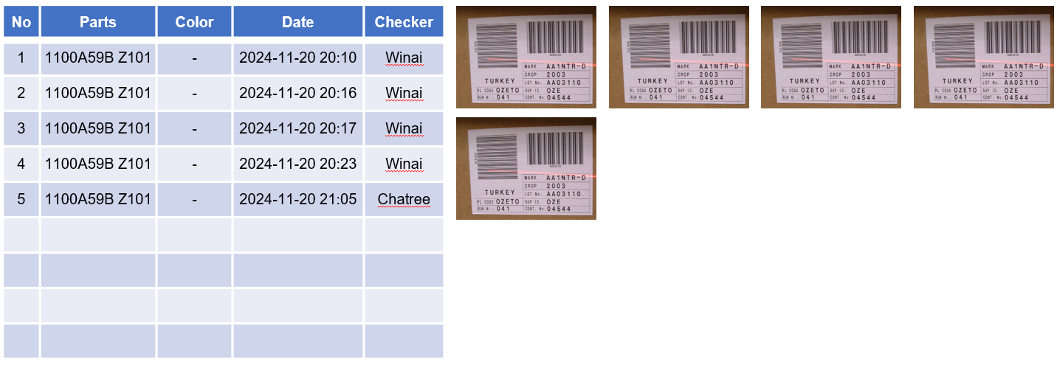
5. System functional specifications
5-2. Tablet screen image
5-2-3. Q-Gate Result
Q-Gate result tablet display
Meiji card
Q-Gate result
HT :
HT01
Main menu
Meiji card
Q-Gate result
HT :
HT01
Main menu
Show all pictures
Able to scroll up/down

Slide 18
5. System functional specifications
5-2. Tablet screen image
5-2-3. Q-Gate Result
Q-Gate result tablet display
Meiji card
Q-Gate result
HT :
HT01
Main menu
Meiji card
Q-Gate result
HT :
HT01
Main menu
Close
Able to move and zoom in/out

Slide 19
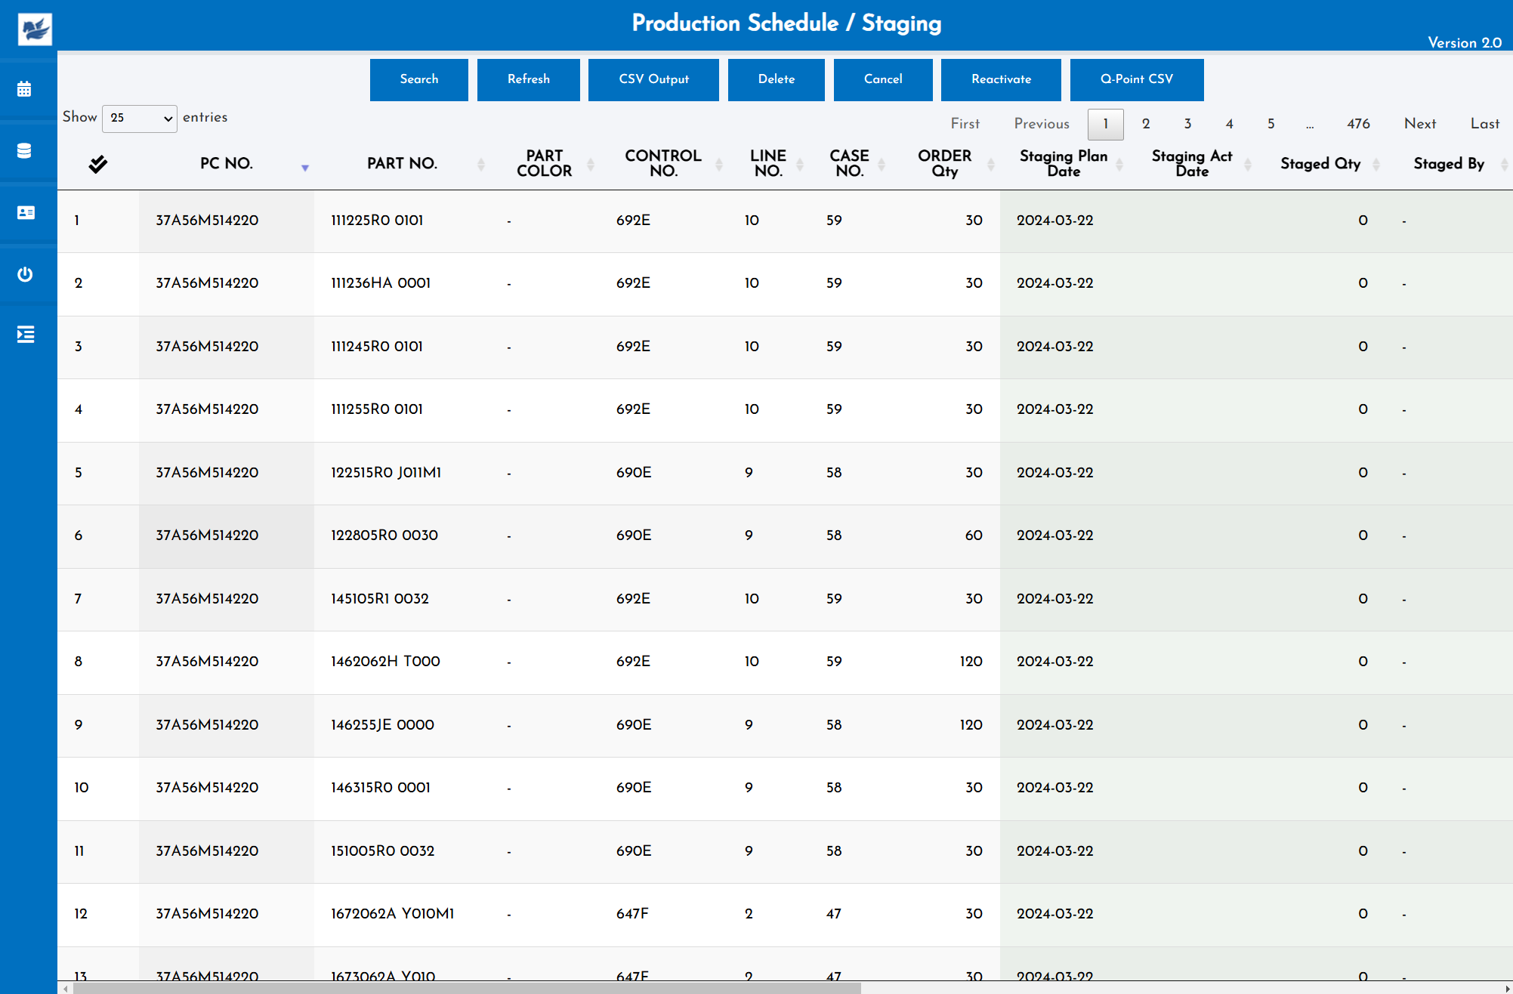
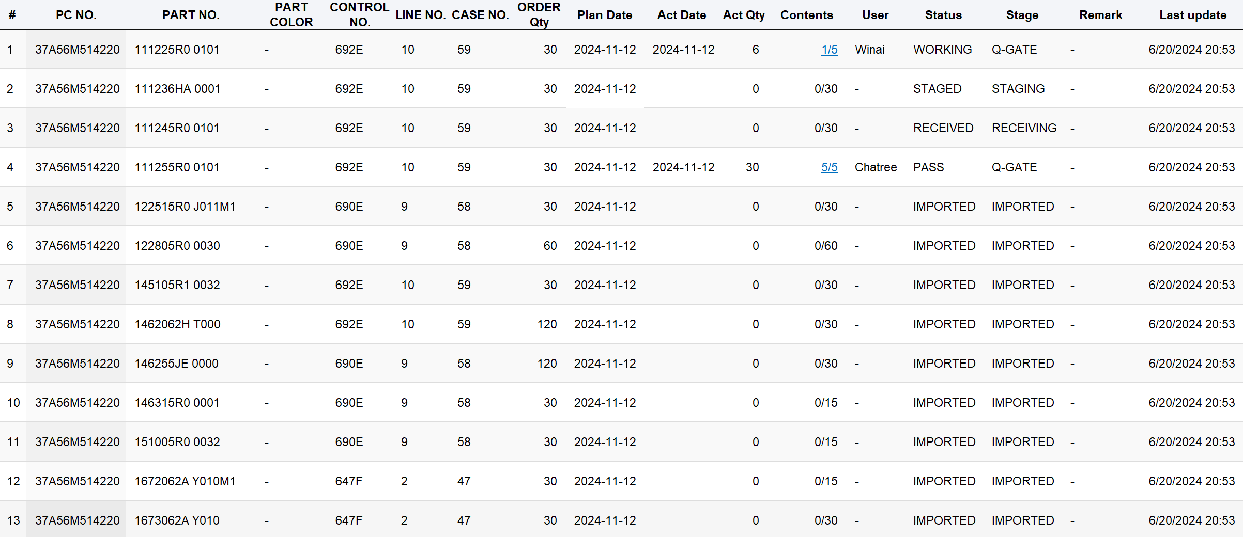
5. System functional specifications
5-3. Web screen image
5-3-1. Q-Gate Schedule
Q-Gate schedule status
Q-Gate
Q-Gate

Slide 20
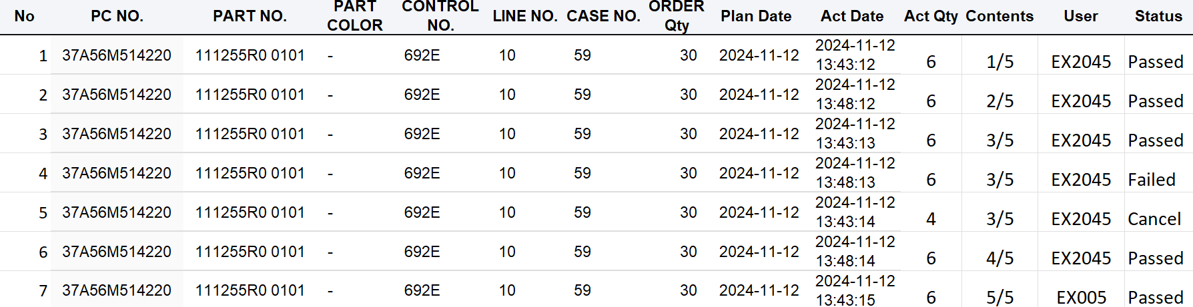
5. System functional specifications
5-3. Web screen image
5-3-1. Q-Gate Schedule
Q-Gate schedule status
Q-Gate
Show details
Q-Gate

Slide 21
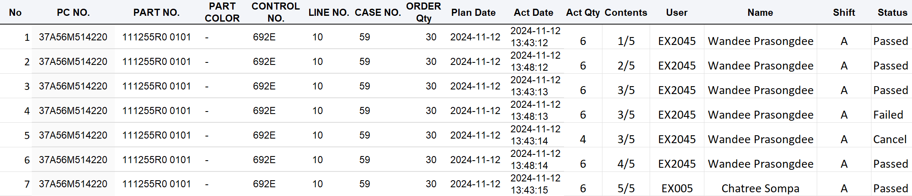
5. System functional specifications
5-3. Web screen image
5-3-1. Q-Gate Schedule
CSV Output
Q-Gate

Slide 22
6. Q&A

Slide 23
7. Sign off
We hereby acknowledge and agree the above-mentioned blueprint requirements.
Any changes required after the sign off for this blueprint will be addressed through the change request process.
A.N.I. LOGISTICS, LTD.
Sign:
Name:
Title:
Date:
TOMAS TECH CO.,LTD.
Sign:
Name:
Title:
Date:
## END OF BLUEPRINT##

