Slide 1
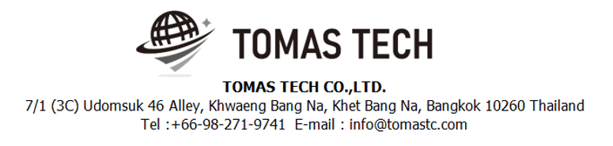
Version 28/Nov/2024
Confidential
Stock management system specifications
Documentation EN Blueprint for MAST
Blueprint
R4
Made for: Minebea AccessSolutions Thai Ltd.
By: TOMAS TECH CO.,LTD.

Slide 2
Revision History
Date | Version | File name | Details
6/Nov/2024 | R1 | Stock management system specifications Documentation EN Blueprint for MAST Blueprint | First edition
16/Nov/2024 | R2 | Stock management system specifications Documentation EN Blueprint for MAST Blueprint | Second edition
22/Nov/2024 | R3 | Stock management system specifications Documentation EN Blueprint for MAST Blueprint | Third edition
28/Nov/2024 | R4 | Stock management system specifications Documentation EN Blueprint for MAST Blueprint
2
3
4

Slide 3
■Contents
1. Overview
2. Overall configuration diagram
3. Document image
3-1. Linkage data
3-1-1. MRP Factory Master
3-1-2. Supplier name information
3-1-3. Item master information
3-1-4. Bucket quantity information
3-1-5. Purchase order information
3-1-6. Delivery instruction information
3-1-7. Inbound information
3-1-8. Outbound information
3-1-9. Inventory information
3-2. Print label information
4. Operation flow
4-1. Inbound
4-2. Stock management
4-3. Outbound
4-4. Master management
5. System functional specifications
5-1. Handy terminal function
5-2. Handy terminal function Inbound
5-3. Handy terminal function Outbound
5-4. Handy terminal function Stock Management
5-5. PC operation flow Basic
5-6. PC operation flow Schedule
5-7. PC operation flow Inbound
5-8. PC operation flow Outbound
5-9. PC operation flow Stock management
5-10. PC operation flow Master management
6. Q&A
7. Sign off

Slide 4
1. Overview
Introduced Stock management system to MAST.
The system specifications for introduction are described in this document.

Slide 5

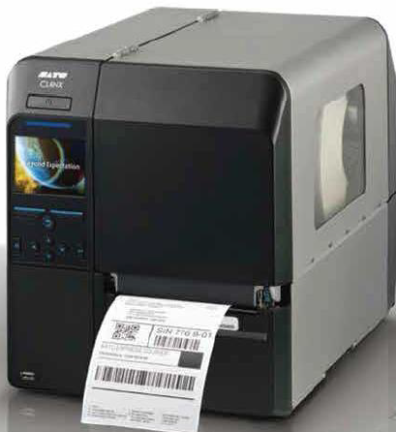



2. Overall configuration diagram
2
Represents a configuration diagram of the stock management system. It is a configuration image of hardware and documents.
Overall configuration diagram image
Inbound
Stock management
Outbound
Inbound label
DC
Label printer × 1
HT × 3
PO
Label printer × 1
HT × 7
Paint
Label printer × 1
HT × 2
LAN cable
LAN cable
LAN cable
Pegasus Server
Implement data linkage between AS400 and PEGASUS stock management system. It is assumed that the linked data are transactions and master data.
Plan data (IN/OUT)
Actual data (IN/OUT)
MAST AS400 server

Slide 6
2. Overall configuration diagram
2
Network diagram
MAS-T office
Lan cable
MAS-T
AS400 server
Pegasus
server
Wi-Fi
Client pc
Switching hub
Access Point
Label printer #1-3
Handy terminal#1
Handy terminal#12
MAS-T Warehouse

Slide 7
2. Overall configuration diagram
2
Hardware diagram
MAS-T office
Lan cable
MAS-T
AS400 server
Pegasus
server
Wi-Fi
Client pc
Switching hub
Access Point
Label printer #1-3
Handy terminal#1
Handy terminal#12
MAS-T Warehouse

Slide 8
3. Document image
3
3-1. Linkage data
Item | File name | Contents
MAS-T⇒Pegasus ・File creation: MAS-T ・Creation timing: Conducted from Monday to Saturday from 6:00 to 23:30 (Creation process executed once every 60 seconds) | FCT86T_yyyyMMddHHmmss.csv | Delivery instruction information *Target: PBTOK.Planned work area=101,104 And PBTOK.Situation CD=‘00’, ‘15’ (Updated date > since last sent date)
 | FCT87T_yyyyMMddHHmmss.csv | Process master
 | FCT88T_yyyyMMddHHmmss.csv | NG Reason master
Pegasus⇒MAS-T ・File creation: Pegasus ・Creation timing: unknown ・AS400 reflection timing: Conducted from Monday to Saturday from 6:00 to 23:30 (Import process executed once every 60 seconds) | FCT93yyyyMMddHHmm.csv | Inbound information Providing information on the results of goods received at Pegasus at any time ⇒MAS-T system received
 | FCT94yyyyMMddHHmm.csv | Outbound information Provide information on the results of deliveries at Pegasus at any time ⇒MAS-T system received
Pegasus⇒MAS-T ・File creation: Pegasus ・Creation timing: unknown ・AS400 reflection timing: Conducted from Monday to Saturday at 21:00 (Import process executed once per day) | FCT95yyyyMMddHHmm.csv | Inventory information Provides inventory information in Pegasus ⇒MAS-T system received
Pegasus⇒MAS-T ・File creation: Pegasus ・Creation timing: unknown ・AS400 reflection timing: Conducted from Monday to Saturday from 6:00 to 23:30 (Import process executed once every 60 seconds) | FCT96yyyyMMddHHmm.csv | NG information Provides NG information in Pegasus ⇒MAS-T system received
11/28 MAS-J黒木様より、ソケイ条件を連携 →11/28までに連携
FCT93と同じ連携タイミング
Same link timing as FCT93

Slide 9
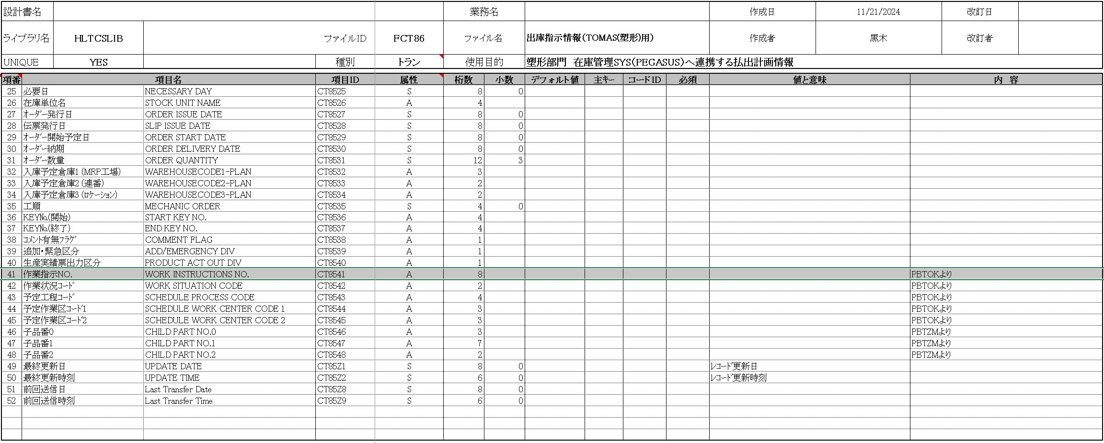
3. Document image
3
3-1-1. Delivery instruction information
MAS-T ⇒Pegasus

Slide 10
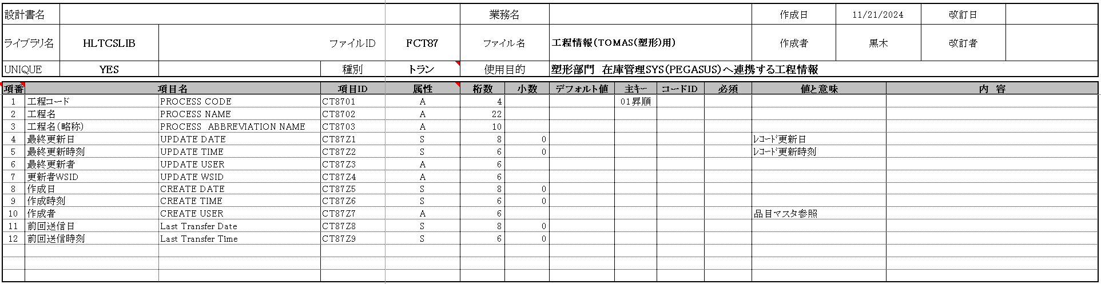
3. Document image
3
3-1-2. Process Master
MAS-T⇒Pegasus

Slide 11
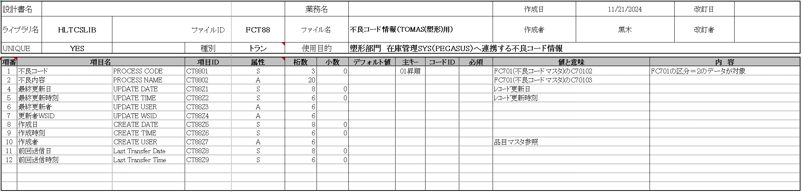
3. Document image
3
3-1-3. NG Reason Master
MAS-T⇒Pegasus

Slide 12
3. Document image
3
2
3-1-4. Inbound information - New
Pegasus⇒MAS-T

Slide 13
3. Document image
3
2
3-1-5. Outbound information - New
Pegasus⇒MAS-T

Slide 14
3. Document image
3
2
3-1-6. Inventory information - New
Pegasus⇒MAS-T

Slide 15
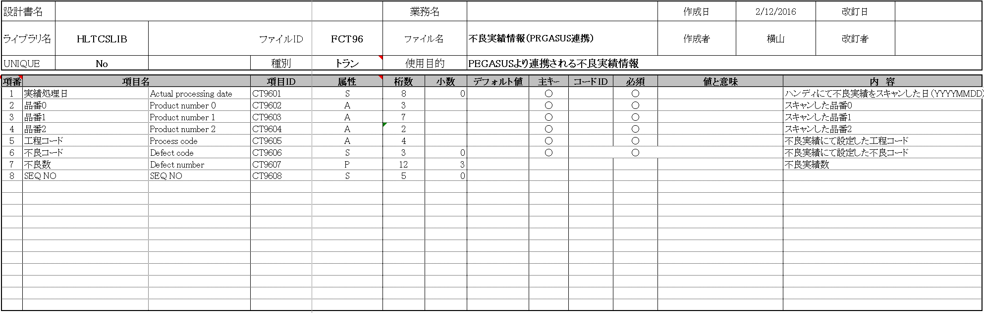
3. Document image
3
2
3-1-7. NG Information
Pegasus⇒MAS-T

Slide 16
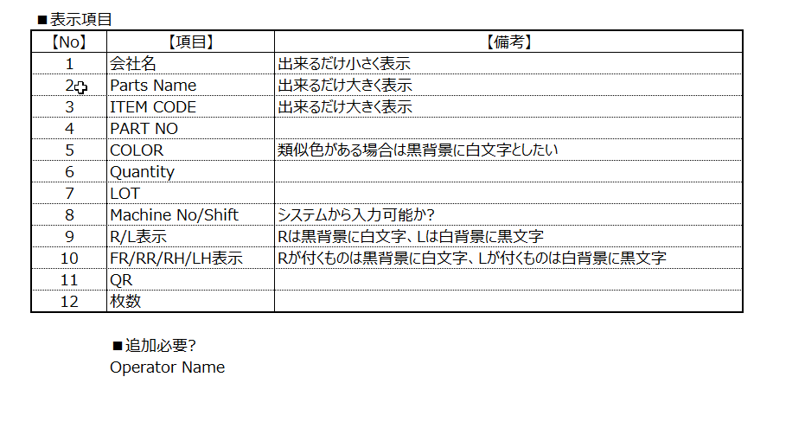
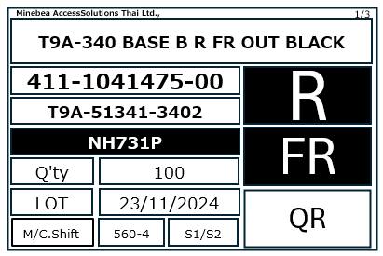


3. Document image
3
3-2. Print label information
Font : Consolas
1
11
2
55mm
3
9
4
10
5
2024-11-28
④5桁目類似色区分(1：類似色あり(反転)、2 : Plating (反転)
ブランク：色反転なし)
2 が入っている場合、Plating に表記を変更する。色記号が入っていても、無視する。
6
7
8
⑤ 端数の場合は反転
⑨⑩
R 反転
L 反転なし
Minebea AccessSolutions Thai Ltd.
85mm
Part No. XXX-XXXXXXX-XX
DWG No. XXX-XXXXX-XXXX-XX-X
Part Name XXXXXXXXX1XXXXXXXXX2XXXXXXXXX3
XXXXXXXXX4XXXXXXXXX5
Model No. / Color
Lot No. : YYYY-MM-DD 0 O
Quantity: XXX,XXX,XXX,1XX.XXX
Box:XXXX
Item definition
1. Part Name : FCT82 - PART NAME(CT8204)
XXXXXXXXX1XXXXXXXXX2XXXXXXXXX3XXXXXXXXX4XXXXXXXXX5
2. Part No. : Input data of parts no - PRAT NO.0 + “-” + PRAT NO.1 + “-” + PRAT NO.2 *1
XXX-XXXXXXX-XX
3. DWG No. : FCT82) - CT8208
XXX-XXXXX-XXXX-XX-X
4. Color : Item master(FCT82) - CT8209 all distils
5th digit: Similar color classification (1: Similar colors (Black inversion), 2: Plating (Black inversion) , Blank: No black inversion)
If 2 is entered, the notation will be changed to Plating. If a color code is entered, it will be ignored.
5. Quantity : Quantity entered on handy terminal *2
In the case of a fraction, black inversion is performed.
6. Lot No. : Today’s date ≒ Date the label was issued YYYY-MM-DD
7. Machine No :
8. Shift :
9. R/L : Item master(FCT82) - CT8257 * R: Black inversion L: No black inversion
10. FR/RR/RH/LH : Item master(FCT82) - CT8242 * Item master(FCT82) - CT8257 R: Black inversion L: No black inversion
11. Page : XXX/XXX
QR information
[System serial No]│[ORDER NO]│[Part No.] │[DWG No.]│[Lot no]│ [Quantity]│[Rank] │[Box serial no]
R
4
⑦M/C . ⑧ Shift についてはMAS-T様にて再検討。
11/29回答をいただく。
[ORDER NO]│[Part No.] │[DWG No.]│[Lot no]│ [Quantity]│[Rank] │[Box serial no]
M1822131│101-2010768-00│T3L-E2250-0001- - │2023-09-09│ 1000.000│A│0001
Up to 6 digits, first 2 digits (FR/RR/RH/LH or blank), 3rd, 4th and 5th digits blank, 6th digit similar color classification (1: similar color exists, blank: no similar color)
4
*1 “-” If the next item is "blank", it will not be displayed.
*2 The number of items entered on the handy terminal. If a fraction appears, display the fraction.
Schedule data allows past and future data to be referenced.
All confirmed data will be able to print labels.
Confirmed data will be linked after about 5 days.
If schedule data is not linked, there is no need to print labels. Return it to the manufacturer.

Slide 17


3. Document image
3
3-2. Print label information
Font : Consolas
1
11
2
55mm
3
9
4
10
5
6
NG
7
8
85mm
85mm
Item definition
1. Part Name : FCT82 - PART NAME(CT8204)
XXXXXXXXX1XXXXXXXXX2XXXXXXXXX3XXXXXXXXX4XXXXXXXXX5
2. Part No. : Input data of parts no - PRAT NO.0 + “-” + PRAT NO.1 + “-” + PRAT NO.2 *1
XXX-XXXXXXX-XX
3. DWG No. : FCT82) - CT8208
XXX-XXXXX-XXXX-XX-X
4. Color : Item master(FCT82) - CT8209 all distils
5th digit: Similar color classification (1: Similar colors (Black inversion), 2: Plating (Black inversion) , Blank: No black inversion)
If 2 is entered, the notation will be changed to Plating. If a color code is entered, it will be ignored.
5. Quantity : Quantity entered on handy terminal *2
In the case of a fraction, black inversion is performed.
6. Lot No. : Today’s date ≒ Date the label was issued YYYY-MM-DD
7. Machine No :
8. Shift :
9. R/L : Item master(FCT82) - CT8257 * R: Black inversion L: No black inversion
10. FR/RR/RH/LH : Item master(FCT82) - CT8242 * Item master(FCT82) - CT8257 R: Black inversion L: No black inversion
11. Page : XXX/XXX
QR information
[System serial No]│[ORDER NO]│[Part No.] │[DWG No.]│[Lot no]│ [Quantity]│[Rank] │[Box serial no]
4
⑦M/C . ⑧ Shift についてはMAS-T様にて再検討。
11/29回答をいただく。
4
*1 “-” If the next item is "blank", it will not be displayed.
*2 The number of items entered on the handy terminal. If a fraction appears, display the fraction.
Schedule data allows past and future data to be referenced.
All confirmed data will be able to print labels.
Confirmed data will be linked after about 5 days.
If schedule data is not linked, there is no need to print labels. Return it to the manufacturer.

Slide 18
4. Operation flow
4-1. Inbound
Manage inbound status using the following 5 steps.
Label Working
Label Completed
Cancel
Inbound working
Inbound Completed

Slide 19
4. Operation flow
4-1. Inbound
MAS-T AS400
Stock Management System Pegasus
Start
Should it be accepted or not?
Yes / No
Yes
No
Print the required number of labels. Manual label printing.
Return to supplier
HT : Label
HT : Inbound
Finish
Require label reprinting?
Yes / No
Yes
No
Print the required number of labels.
HT : Label
Label all boxes.
Finish

Slide 20
4. Operation flow
4-1. Inbound
MAS-T AS400
Stock Management System Pegasus
Start “Goods receipt”
Scan label with handy terminal
HT : Inbound
Scanning required boxes (*5)
Scan location code (*6)(*7)
Link performance files to AS400
Finish

Slide 21
4. Operation flow
4-2. Stock management
MAS-T AS400
Stock Management System Pegasus
Change Location
HT : Change Location
Stock taking
HT : Stock taking
Stock check
HT : Stock Check
Link performance files to AS400
Inventory cooperation

Slide 22
4. Operation flow
4-3. Outbound
Manage inbound status using the following 3 steps.
Schedule registered
Outbound working
Outbound Completed
Cancel

Slide 23
4. Operation flow
4-3.Outbound
MAS-T AS400
Stock Management System Pegasus
Linkage
Delivery instruction
FCT85T
Received
Delivery instruction
FCT85T
Yes
No
BK file manual import (*1)(*2)
AS400 modification required
Yes / No
File import error?
Yes / No
Check error details
Yes
No
Checking the linked data
Yes
Should it be removed or not? (*3)
Yes / No
*1 If there is an import error, set an error flag. Since the import completion flag is not set, it is possible to import the same Order NO / Parts no.
*2 After importing, backup files are stored in the “Normal folder" and the “Error folder".
*3 Allow deletion of linked data. Limited to data before Working status.
No
Disbursement confirmation work
Is it in the plan?
Yes / No
No
Yes
Should it be accepted or not?
Yes / No
Display priority lot by part number/lot number in FIFO.
Yes
No
HT : Outbound Schedule
Enter the part No. and required quantity to enable individual FIFO.
End of outbound work
HT : Outbound
Next #2
Finish

Slide 24
4. Operation flow
4-3.Outbound
MAS-T AS400
Stock Management System Pegasus
Next #2
Start “Dispatch work”
*5 Do not exceed the required number of boxes. Allow partial inventory.
*6 Location code indicates a fixed location. Performs a matching check for matches and mismatches.
*7 Inventory. The results are also linked to AS400.
Scan label with handy terminal
HT : Outbound Schedule
HT : Outbound
Link performance files to AS400
Scanning required boxes (*5)
Scan location code (*6)(*7)
Move to payout area
Finish

Slide 25
4. Operation flow
4-4. Master management
MAS-T AS400
Stock Management System Pegasus
Linkage
MRP factory master
FCT80T
Received
MRP factory master
FCT80T
Linkage
Supplier name information
FCT81T
PC : MRP factory master
Received
Supplier name information
FCT81T
PC : Supplier name Infor
Linkage
Item master information
FCT82T
Received
Item master information
FCT82T
Linkage
Bucket quantity information FCT83T
PC : Item master Infor
Received
Bucket quantity information FCT83T
PC : Bucket quantity Infor
Yes
No
BK file manual import (*1)(*2)
AS400 modification required
Yes / No
File import error?
Yes / No
Check error details
Yes
No
Checking the linked data
Yes
Should it be removed or not? (*3)
Yes / No
*1 If there is an import error, set an error flag. Since the import completion flag is not set, it is possible to import the same Order NO / Parts no.
*2 After importing, backup files are stored in the “Normal folder" and the “Error folder".
*3 Allow deletion of linked data. Limited to data before Working status.
No
Each master maintenance function
Finish

Slide 26
4. Operation flow
4-4. Master management
MAS-T AS400
Stock Management System Pegasus
Location master
PC : Location master
User master
PC : User master
User credential master
PC : User Credential
Authority master
PC : Authority Master
Name master
PC : Name Master
Package type master
PC : Package Type

Slide 27
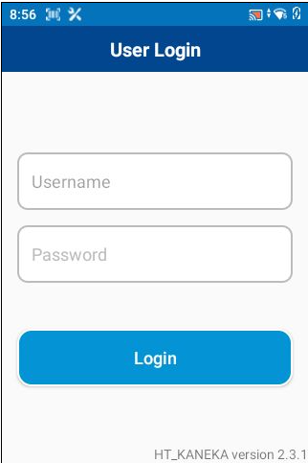
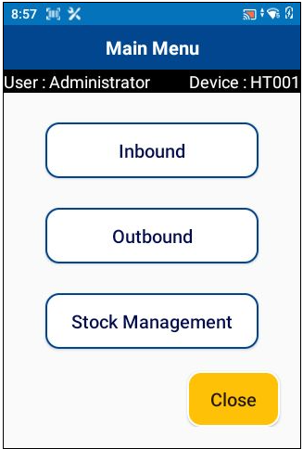
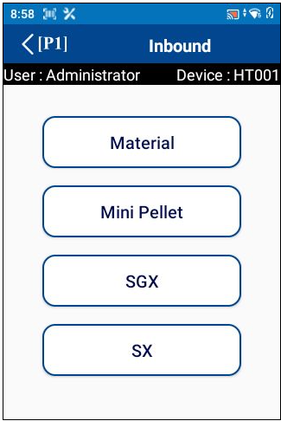
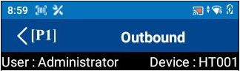









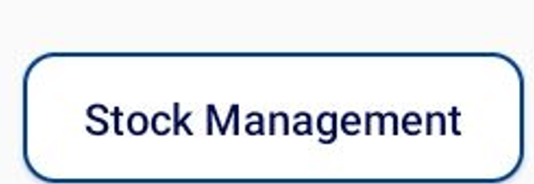



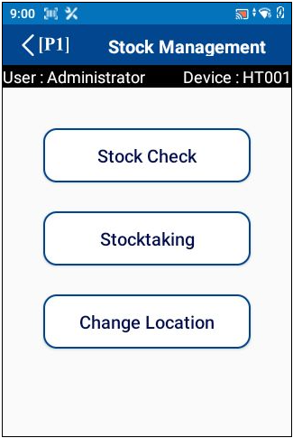
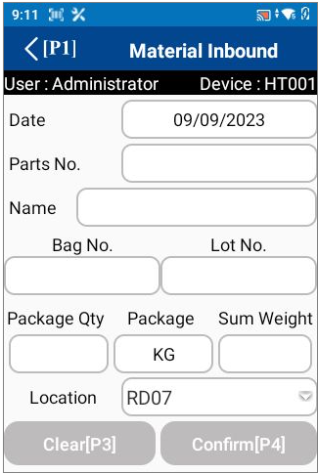
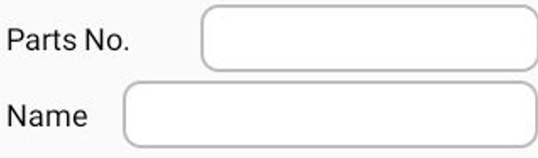
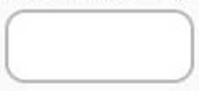

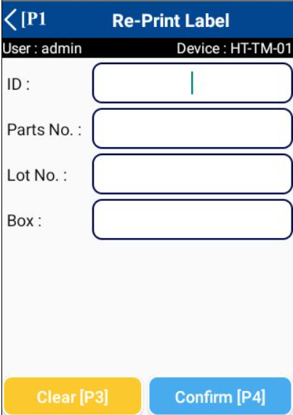
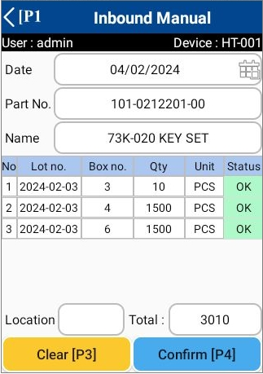
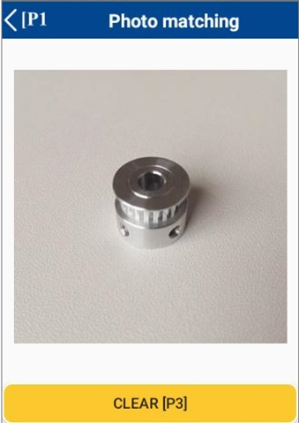
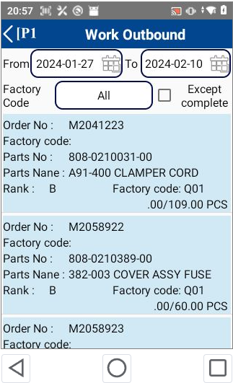

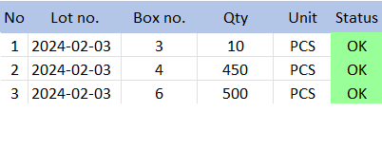
5. System functional specifications
3
5-1. Handy terminal function
1. User Login
2. Main menu
3. Inbound menu
4. Outbound menu
<[P1]
Schedule Label
Inbound
นำเข้าคลัง
Label Manual
พิมพ์ลาเบล
Work Outbound
แผนนำออกคลัง
Schedule Label
Label Manual
SCHEDULE
MANUAL
Inventory Fluctuation
สต็อกผันผวน
Inbound Schedule
Label Manual
Inbound Manual
นำเข้าคลัง
Production Outbound
จัดส่งสินค้า
Inbound Manual
QC Check
นำออกคลัง
Inbound Schedule
SCHEDULE
MANUAL
Photo matching
Outbound Manual
นำออกคลัง
จัดการสต็อก
Inbound Manual
Inbound
Printer Setting
จัดการเครื่องพิมพ์
QC Check
PHOTO
5. Stock management menu
6. Label Menu
7. Label Manual
8. Relabeling
Must be scan QR code of label and can be search parts no
Label Manual
Label Manual
Relabeling
Label Manual
พิมพ์ลาเบล
Parts No
Stock Check
เช็คสต๊อค
Label Manual
Parts Name
Relabeling
แก้ไขลาเบล
Stocktaking
ตรวจสอบคลัง
Relabeling
Model
Mdl/Clr
Order no
Re-Print Label
ทดแทนลาเบล
Color
Qty
Inbound Schedule
Lot No
2023-09-09
Lot No
Qty
ย้ายสต็อกสินค้า
Inbound
Actual total Qty
Qty per Box Old
Qty per Box
Outbound Qty
Clear[P3]
Confirm[P4]
Clear[P3]
Confirm[P4]
9. Re-Print Label
10. Inbound Manual
11. Photo matching
12. Work Outbound
Order No : M2041223
Parts No : 808-0210031-00
Parts Name : A91-400 CLAMPER CORD
Model : FA8
Color : Silver
109.00/109.00 PCS
Mdl/Clr
ABC
Black
Order No : M2058922
Parts No : 808-0210389-00
Parts Name : 382-003 COVER ASSY FUSE
Model : 382
Color : Black
.00/60.00 PCS
Clear[P3]
Confirm[P4]

Slide 28
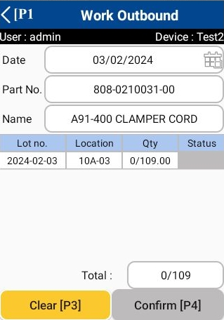
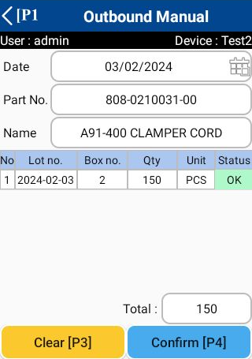
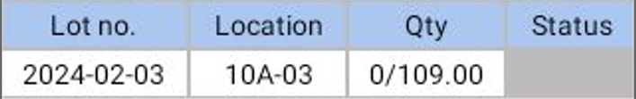
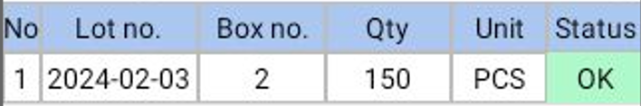
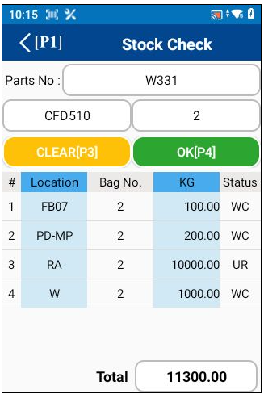
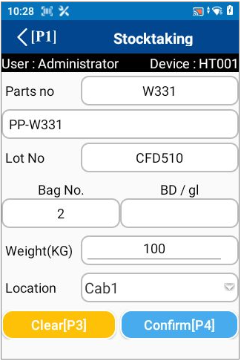
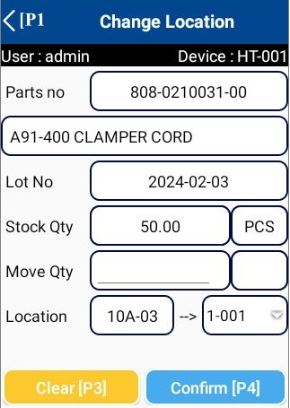
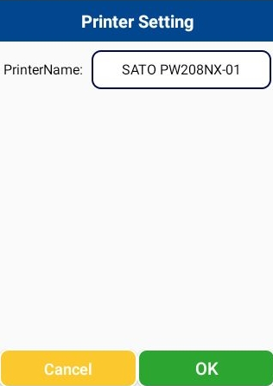
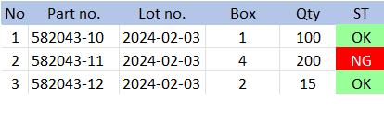

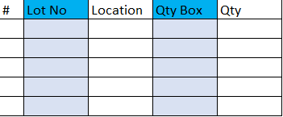

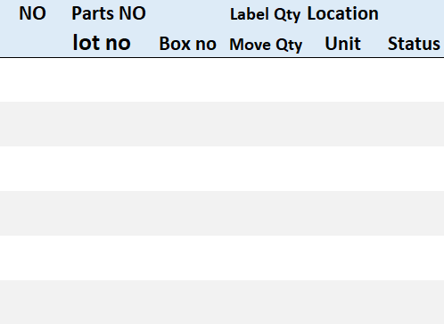
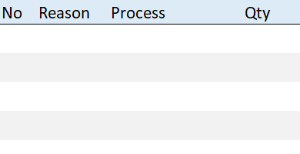

5. System functional specifications
3
5-1. Handy terminal function
13. Work Outbound Detail
14. Production Outbound
15. Production Outbound Detail
16 Outbound Manual
Production Outbound
Production Outbound
Order No : M2041223
Parts No : 808-0210031-00
Parts Name : A91-400 CLAMPER CORD
Model : FA8
Color : Silver
109.00/109.00 PCS
Mdl/Clr
ABC
Black
Mdl/Clr
ABC
Black
Mdl/Clr
ABC
Black
Order No : M2058922
Parts No : 808-0210389-00
Parts Name : 382-003 COVER ASSY FUSE
Model : 382
Color : Black
.00/60.00 PCS
17. Stock Check
18. Stocktaking
19. Change location
20. Printer Setting
Location
DEMO-PARTS-NO_B
Lot No
PC01
DEMO_PARTS_NAME_B
2023-09-09
2023-09-28
Location
RD07
Qty
200
Qty
Qty
Act Qty
Act Qty
300
Act Qty
300
Clear[P3]
Confirm[P4]
Clear[P3]
Confirm[P4]
21. Inventory Fluctuation
22. Transfer in process
23. NG Manual
Inventory Fluctuation
Transfer in process
NG Manual
Transfer in process
เปลี่ยนคลังสินค้า
NG Manual
ตรวจรับ NG
Box No
Mdl/Clr
Qty
Inbound
0
Clear[P3]
Confirm[P4]
Clear[P3]
Add[P2]
Confirm[P4]

Slide 29
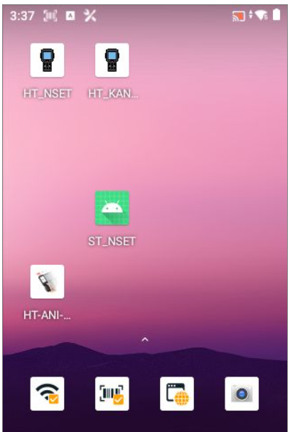

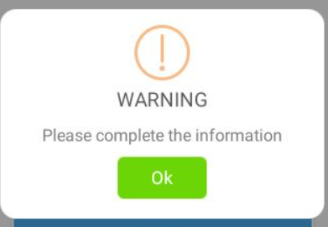
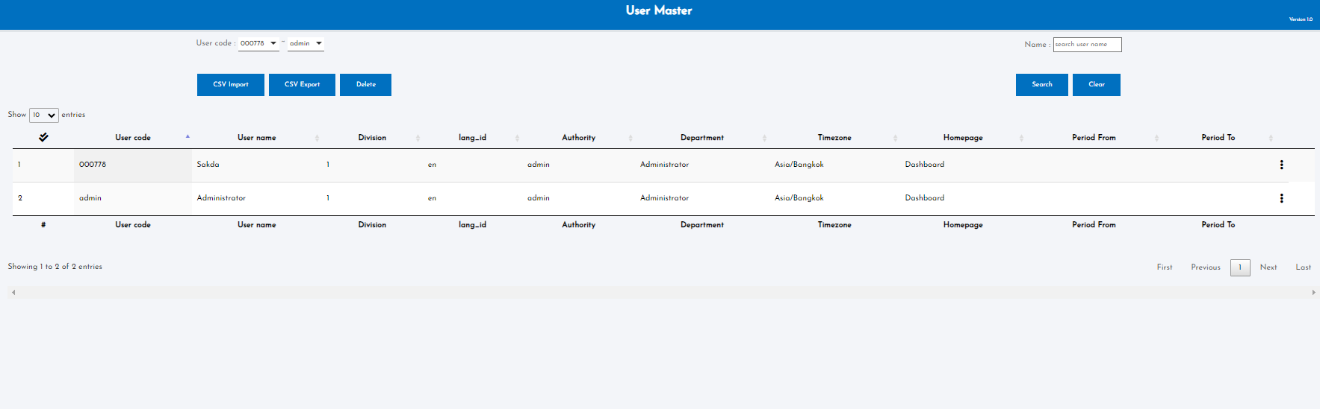
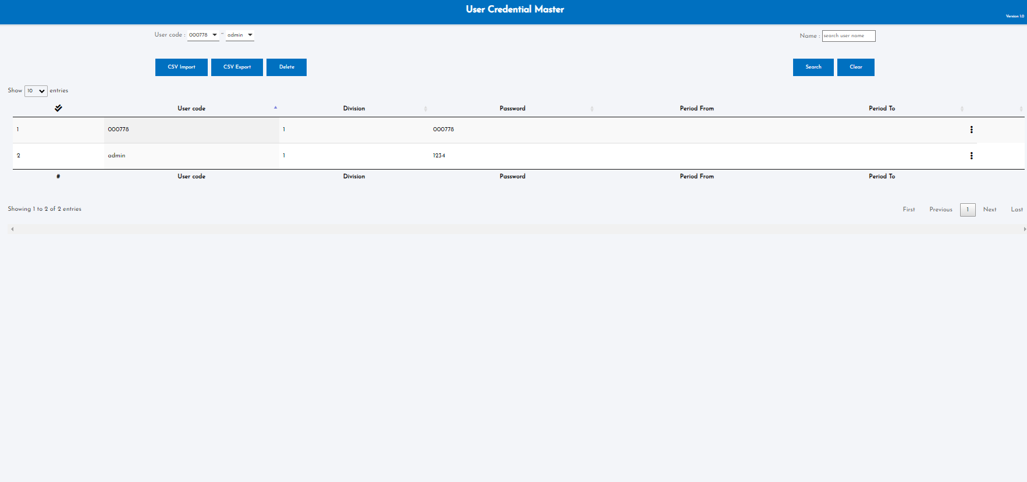
5. System functional specifications
2
5-1. Handy terminal function
5-1-1. User Login
This is the screen that transitions after icon app click from home screen.
User name: Information is referenced from the User master.
Enter the User code of User master.
If it enter a code that does not exist, an error screen will be displayed. *1
Pass word: Information is referenced from the User credential master.
The User code of User master is linked to the User code of User credential master. User credential Enter the master password.
If it enter a code that does not exist, an error screen will be displayed. *1
Login button: If the information is correct, it will be redirected to the Main menu.
*1: Display screen when information is incorrect
OK button: Close this screen. Return to the previous process.
User master
The information about the procurement warehouse will not be visible. Create it as a separate application.
User credential master

Slide 30
5. System functional specifications
2
5-1. Handy terminal function
5-1-2. Main menu
<[P1]
This is the screen that transitions after logging in from User Login.
Inbound button: Transitions to the Inbound screen.
Change Location: Transitions to the Change location screen.
Outbound button: Transitions to the Outbound screen.
Stock Management button: Transitions to the Stock Management screen.
Printer Setting button: Transitions to the Printer Setting screen.
<[P1]: Closes the application.
admin
Inbound
นำเข้าคลัง
1234
Inventory Fluctuation
สต็อกผันผวน
นำออกคลัง
จัดการสต๊อก
Printer Setting
จัดการเครื่องพิมพ์

Slide 31
5. System functional specifications
2
5-1. Handy terminal function
5-1-3. Printer Setting
<[P1]
This is the screen that transitions after select Change Location from Stock management menu.
PrinterName: Printer name* Can be changed manually or scan label
Cancel: Clear input contents
OK: Confirmation processing.
Inbound
นำเข้าคลัง
Inventory Fluctuation
สต็อกผันผวน
นำออกคลัง
จัดการสต๊อก
Printer Setting
จัดการเครื่องพิมพ์

Slide 32



5. System functional specifications
2
5-2. Handy terminal function Inbound
5-2-1. Inbound
<[P1]
This is the screen that transitions after select inbound from Main menu.
Label Manual button: Transitions to the Label screen.
Inbound Manual button: Transitions to the Inbound screen.
< (P1): Back to Main menu
Schedule Label
Inbound
นำเข้าคลัง
Label Manual
พิมพ์ลาเบล
Schedule Label
Label Manual
SCHEDULE
MANUAL
Inventory Fluctuation
สต็อกผันผวน
Inbound Schedule
Label Manual
Inbound Manual
นำเข้าคลัง
Inbound Manual
QC Check
นำออกคลัง
Inbound Schedule
SCHEDULE
MANUAL
Photo matching
จัดการสต๊อก
Inbound Manual
Printer Setting
จัดการเครื่องพิมพ์
QC Check
PHOTO

Slide 33
5. System functional specifications
5-2. Handy terminal function Inbound
5-2-2. Label Manual
Label Manual
This is the screen that transitions after select label manual from Inbound screen.
Label Manual: Transitions to the Label Manual screen.
Relabeling button: Transitions to the Relabeling screen.
Re-Print Label button: Transitions to the Reprint Label screen.
< (P1): Back to Inbound menu
Schedule Label
Label Manual
พิมพ์ลาเบล
Label Manual
พิมพ์ลาเบล
Schedule Label
Label Manual
Label Manual
SCHEDULE
MANUAL
Inbound Schedule
Relabeling
แก้ไขลาเบล
Label Manual
Relabeling
Inbound Manual
นำเข้าคลัง
Inbound Manual
QC Check
Re-Print Label
ทดแทนลาเบล
Inbound Schedule
Inbound Schedule
SCHEDULE
MANUAL
Photo matching
Inbound Manual
Inbound
QC Check
PHOTO

Slide 34
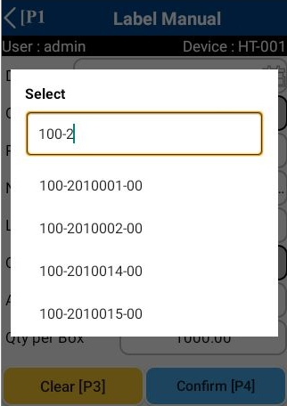
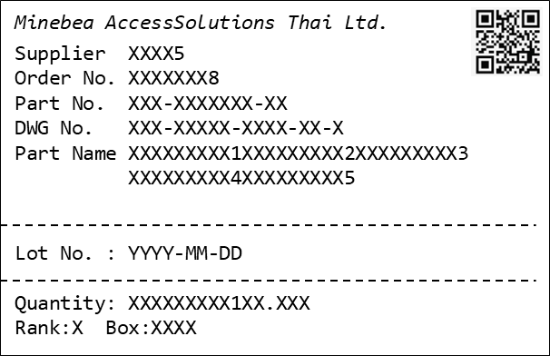
5. System functional specifications
2
5-2. Handy terminal function Inbound
5-2-3. Label Manual
Label Manual
Label Manual
This is the screen that transitions after select label manual from label manual screen.
Date : Today’s date
Part No.: List selection from Item master* Can be changed manually
Part Name :List selection from Item master
Model: Model no * HL DWG NO. PI CT8208 left 3digits
Color: Part Color No * CT8210 all digits
Lot No: Today’s date * Can be changed manually
Qty: No initial value information
Actual total Qty: * Can be changed manually
Qty per Box: * Can be changed manually
Clear[P3]: Clear input contents
Confirm[P4]: Confirmation processing. Normal end: Label printing processing *1. Warning: Warning screen display *2
< (P1): Back to Main menu
Label Manual
พิมพ์ลาเบล
Label Manual
Relabeling
แก้ไขลาเบล
Relabeling
Model
Re-Print Label
ทดแทนลาเบล
Color
Inbound Schedule
Lot No
2023-09-09
Inbound
Actual total Qty
Qty per Box
Label issuance completed successfully
*1: Display screen when information is correct
It will disappear automatically after being displayed. The original screen will be refreshed.
*2: Display screen when information is incorrect
OK button: Close this screen. Return to the previous process.
Label Manual
Label Manual
DEMO-PARTS-NO_B
Model
DEMO_PARTS_NAME_B
Model
Color
ABC
Color
Lot No
Black
Lot No
2023-09-09
2023-09-09
Actual total Qty
Actual total Qty
600.00
Qty per Box
Able to search by scrolling, typing or
scan QR code(normal label) or barcode (only part no).
Qty per Box
10.00
Label Manual
*3: If enter an invalid Qty.
OK button: Close this screen. Return to the previous process.
DEMO-PARTS-NO_B
Qty per box = 10pcs
Label 60pieces
Quantity is in error.
Model
DEMO_PARTS_NAME_B
Color
ABC
Lot No
Black
Allows partial search. If worker enter "DD" during input, only the next candidate will be displayed.
2023-09-09
Display All recode
Display start “DD” recode
Actual total Qty
600.00
DEMO-PARTS-NO_A
DEMO-PARTS-NO_B
DEMO-PARTS-NO_C
DEMO-PARTS-NO_D
DEMO-PARTS-NO_E
DEMO-PARTS-NO_F
DEMO-PARTS-NO_G
DEMO-PARTS-NO_H
DD_ITEM_AAAA
DD_ITEM_AAAA
Qty per Box
10.00

Slide 35
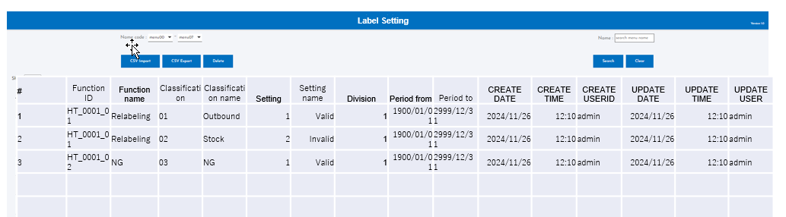
5. System functional specifications
3
5-2. Handy terminal function Inbound
5-2-4. Relabeling
Label Manual
Relabeling
This is the screen that transitions after select Relabeling from label manual screen.
Date : No initial value information
Part No.: No initial value information
Part Name :List selection from Item master
Model: Model no * HL DWG NO. PI CT8208 left 3digits
Color: Part Color No * CT8210 all digits
Lot No: No initial value information
Qty: No initial value information
Qty per Box Old: No initial value information
Outbound Qty: * Can be changed manually
Clear[P3]: Clear input contents
Confirm[P4]: Confirmation processing. Normal end: Label printing processing*1. Warning: Warning screen display *2
< (P1): Back to Main menu
Label Manual
พิมพ์ลาเบล
Parts No
Label Manual
Parts Name
Relabeling
แก้ไขลาเบล
レイアウトを確認 →TT
Relabeling
Mdl / Clr
Model Color
Re-Print Label
ทดแทนลาเบล
Qty
Inbound Schedule
Lot No
Inbound
Qty per Box Old
Outbound Qty
Label issuance completed successfully
*1: Display screen when information is correct
It will disappear automatically after being displayed. The original screen will be refreshed.
*2: Display screen when information is incorrect
OK button: Close this screen. Return to the previous process.
Relabeling
Relabeling
Parts No
Parts No
09/09/2023
Parts Name
DEMO-PARTS-NO_B
Parts Name
Mdl/Clr
DEMO_PARTS_NAME_B
Mdl/Clr
Qty per box = 10pcs
Label 60pieces
ABC
BLACK
Qty
Lot No
2023-09-09
Lot No
Qty
600.00
Qty per Box Old
Qty per Box Old
10.00
Outbound Qty
Outbound Qty
Relabeling
** Printing 2 labels
*3: If Qty per Box Old > Outbound Qty, a warning will be displayed.
OK button: Close this screen. Return to the previous process.
Parts No
09/09/2023
Quantity is in error.
Parts Name
DEMO-PARTS-NO_B
Qty per box = 8pcs
Label 1 piece
*Label for Outbound
Mdl/Clr
DEMO_PARTS_NAME_B
ABC
BLACK
Lot No
2023-09-09
Qty
600.00
Qty per Box Old
10.00
Outbound Qty
8.00
Qty per box = 2pcs
Label 1 piece
*Label for Stock
For each automatically issued label (NG, Outbound, Stock),
the issue status is managed on the master.

Slide 36
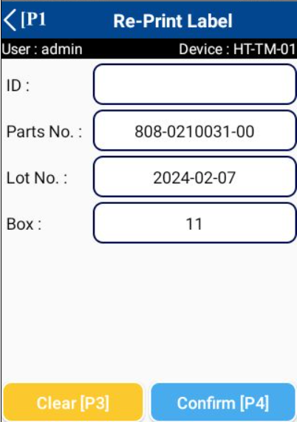
5. System functional specifications
5-2. Handy terminal function Inbound
5-2-5. Re-Print Label
Label Manual
This is the screen that transitions after select Relabeling from label manual screen.
ID : Label identity number
Part No.: No initial value information
Lot No: No initial value information
Box: Box number
Clear[P3]: Clear input contents
Confirm[P4]: Confirmation processing.
< (P1): Back to Main menu
Label Manual
พิมพ์ลาเบล
Label Manual
Relabeling
แก้ไขลาเบล
Relabeling
Re-Print Label
ทดแทนลาเบล
Inbound Schedule
Inbound
Label issuance completed successfully
*1: Display screen when information is correct
It will disappear automatically after being displayed. The original screen will be refreshed.
*2: Display screen when information is incorrect
OK button: Close this screen. Return to the previous process.
** Printing label

Slide 37
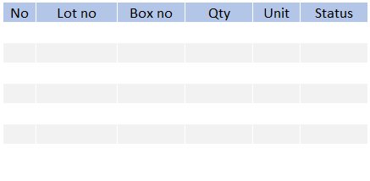
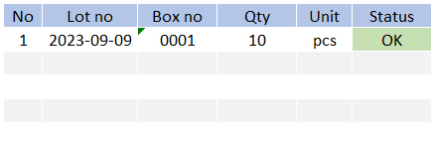
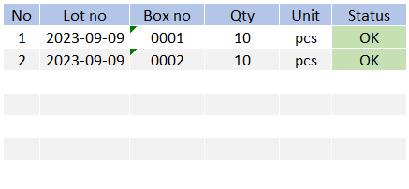
5. System functional specifications
3
5-2. Handy terminal function Inbound
5-2-6. Inbound Manual
Inbound Manual
This is the screen that transitions after select inbound manual from inbound menu.
Date : Today’s date
Part No.: No initial value information * Scan QR data or Can be changed manually
Part Name : No initial value information * Scan QR data or Can be changed manually
Box No: No initial value information * Scan QR data or Can be changed manually
Lot No: No initial value information * Scan QR data or Can be changed manually
Package Qty: No initial value information * Scan QR data or Can be changed manually
Package: No initial value information * Scan QR data or Can be changed manually
Sum Qty: No initial value information * Scan QR data or Can be changed manually
Location: No initial value information * Scan QR data or Can be changed manually
Clear[P3]: Clear input contents
Confirm[P4]: Confirmation processing. Normal end: Completion of registration *1. Warning: Warning screen display *2
< (P1): Back to Main menu
Schedule Label
Label Manual
พิมพ์ลาเบล
Schedule Label
Label Manual
SCHEDULE
MANUAL
レイアウトを確認 →TT
Inbound Schedule
Label Manual
Inbound Manual
นำเข้าคลัง
Inbound Manual
Box No
QC Check
Mdl/Clr
Model Color
Mdl / Clr
Inbound Schedule
SCHEDULE
MANUAL
Qty
Photo matching
Inbound Manual
0
Initial display blank, required input
QC Check
PHOTO
If the lot number on the label is different, update it with the date of receipt.
*1: Display screen when information is correct
It will disappear automatically after being displayed. The original screen will be refreshed.
Inbound Manual
Inbound Manual
Inbound Manual
DEMO-PARTS-NO_B
Qty per box = 10pcs
Label 1 piece
Lot 2023-09-09
DEMO-PARTS-NO_B
DEMO-PARTS-NO_B
Qty per box = 10pcs
Label 1 piece
Lot 2023-09-09
DEMO-PARTS-NO_B
Box No
DEMO_PARTS_NAME_B
Box No
DEMO_PARTS_NAME_B
初期表示：ブランク
→必須入力
Box No
Box No
Box No
Box No
Box No
Box No
Mdl/Clr
1234
Black
Box No
Mdl/Clr
2023-09-09
Mdl/Clr
1234
Black
0001
Qty
0001
2023-09-09
Qty
1
pcs
10
2
pcs
Qty
20
0
10
Scan or select Location code
20
重複スキャン時のエラーを追加する。→ドキュメント上の表示
Inbound Manual
Inbound Manual
DEMO-PARTS-NO_B
Qty per box = 10pcs
Label 1 piece
Lot 2023-09-09
DEMO-PARTS-NO_B
DEMO-PARTS-NO_A
Qty per box = 10pcs
Label 1 piece
Lot 2023-09-09
Parts No does not match scanned last time
Box No
Box No
DEMO_PARTS_NAME_B
Box No
Box No
Mdl/Clr
Box No
*3: If the part number does not match the last scanned part number.
OK button: Close this screen. Return to the previous process.
Mdl/Clr
1234
Black
Duplicated scan label !!
0001
2023-09-09
Qty
0001
2023-09-09
Qty
Qty
1
pcs
Qty
1
pcs
10
10
0
10

Slide 38
5. System functional specifications
3
5-2. Handy terminal function Inbound
5-2-6. Inbound Manual
Inbound Manual
Inbound Manual
DEMO-PARTS-NO_B
Qty per box = 10pcs
Label 1 piece
Lot 2023-09-09
Box no: 1
DEMO-PARTS-NO_B
DEMO-PARTS-NO_B
Qty per box = 10pcs
Label 1 piece
Lot 2023-09-09
Box no: 1
[Same label]
Duplicated scan label !!
Box No
DEMO_PARTS_NAME_B
Box No
Box No
Box No
Box No
Mdl/Clr
Mdl/Clr
1234
Black
*3: Error dialog will be shown once scan the same label.
OK button: Close this screen. Return to the previous process.
0001
2023-09-09
Qty
1
pcs
Qty
10
0
10
1st Label information
DEMO-PARTS-NO_B
Qty per box = 10pcs
Label 1 piece
Lot 2024-11-28
Box no: 1
^{2nd} Label information
DEMO-PARTS-NO_B
Qty per box = 10pcs
Label 1 piece
Lot 2024-11-29
Box no: 1
Inbound Manual
DEMO-PARTS-NO_B
Box No
DEMO_PARTS_NAME_B
If the lot number on the label is different, update it with the date of receipt (Inbound date).
Box No
Box No
Mdl/Clr
1234
Black
0001
2023-09-09
1
pcs
Qty
10
10

Slide 39
5. System functional specifications
3
5-2. Handy terminal function Inbound
5-2-7. Photo matching
Inbound Manual
This is the screen that transitions after select Photo matching from inbound menu.
Clear[P3]: Clear input contents
< (P1): Back to previous screen
DEMO-PARTS-NO_B
Box No
DEMO_PARTS_NAME_B
Box No
Mdl/Clr
1234
Black
0001
2023-09-09
2
pcs
Qty
20
20
Inbound Manual
DEMO-PARTS-NO_B
There are no photos.
Box No
DEMO_PARTS_NAME_B
Mdl/Clr
1234
Black
0001
2023-09-09
0001
2023-09-09
Qty
2
pcs
Qty
2
pcs
20
20
20
** If no photos are registered, the following message will be displayed.

Slide 40
5. System functional specifications
2
5-3. Handy terminal function Inventory Fluctuation
5-3-1. Inventory Fluctuation
<[P1]
Inventory Fluctuation
This is the screen that transitions after select outbound from Main menu.
Transfer in process: Transitions to the Transfer in process screen.
NG Manual: Transitions to the NG Manual screen.
< (P1): Back to Main menu
Inbound
นำเข้าคลัง
Transfer in process
เปลี่ยนคลังสินค้า
Inventory Fluctuation
สต็อกผันผวน
NG Manual
ตรวจรับ NG
นำออกคลัง
จัดการสต๊อก
Inbound
Printer Setting
จัดการเครื่องพิมพ์

Slide 41
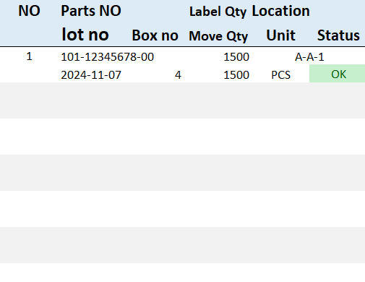
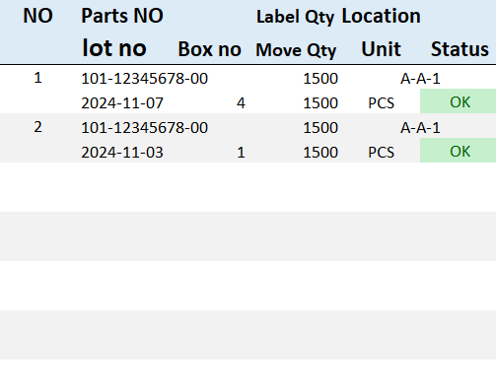
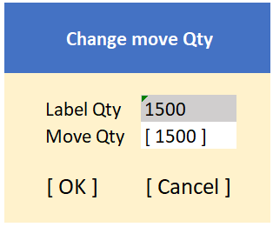
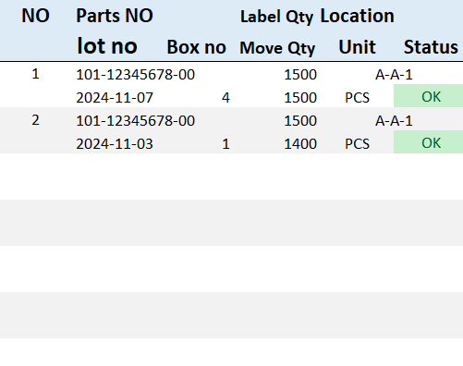
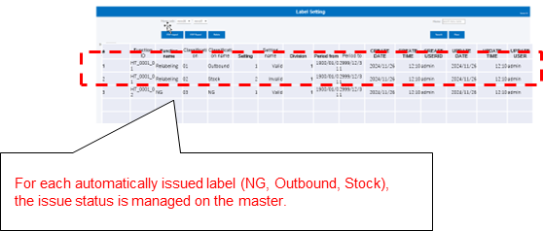
5. System functional specifications
3
5-3. Handy terminal function Inventory Fluctuation
5-3-2. Transfer in process
Inventory Fluctuation
Transfer in process
This is the screen that transitions after select inbound manual from inbound menu.
Part No.: From scan label
Box No: From scan label
Lot No: From scan label
Label Qty: From scan label
Move Qty: Equal to label qty on initial * Can be changed manually
Location: From scan label
Unit: From scan label
Status: From scan label
Location: Destination location to moving to * Scan QR Code or change manually
Total: Summary of scan amount
Clear[P3]: Clear input contents
Confirm[P4]: Confirmation processing. Normal end: Completion of registration *1. Warning: Warning screen display *2
< (P1): Back to Main menu
Transfer in process
เปลี่ยนคลังสินค้า
NG Manual
ตรวจรับ NG
Inbound
初期表示：ブランク
→必須入力
0
Clear[P3]
Confirm[P4]
*1: Scan the tag label of items.
*2: Scan the destination location QR code or change it manually.
Transfer in process
Transfer in process
Transfer in process
DEMO-PARTS-NO_B
Qty per box = 1500pcs
Label 1 piece
Lot 2024-11-07
DEMO-PARTS-NO_B
Qty per box = 1500pcs
Label 1 piece
Lot 2024-11-03
0
3000
0
1500
Clear[P3]
Confirm[P4]
Clear[P3]
Confirm[P4]
Clear[P3]
Confirm[P4]
Transfer in process
Transfer in process
Label Qty:
1500
NG Label
DEMO-PARTS-NO_A
Qty per box = 100pcs
Label 1 piece
Lot 2023-09-09
Move Qty:
1400
OK
Cancel
Functions
1. Keep history for transfer in process
2. Able to click each item to change OK/NG qty
3. Print NG label automatic
3000
2900
Clear[P3]
Confirm[P4]
Clear[P3]
Confirm[P4]

Slide 42



5. System functional specifications
3
5-3. Handy terminal function Inventory Fluctuation
5-3-2. NG Manual
Inventory Fluctuation
NG Manual
This is the screen that transitions after select inbound manual from inbound menu.
Part No.: From scan label
Box No: From scan label
Lot No: From scan label
Label Qty: From scan label
Move Qty: Equal to label qty on initial * Can be changed manually
Location: From scan label
Unit: From scan label
Status: From scan label
Location: Destination location to moving to * Scan QR Code or change manually
Total: Summary of scan amount
Clear[P3]: Clear input contents
Confirm[P4]: Confirmation processing. Normal end: Completion of registration *1. Warning: Warning screen display *2
< (P1): Back to Main menu
Transfer in process
เปลี่ยนคลังสินค้า
NG Manual
ตรวจรับ NG
Box No
レイアウトを確認 →TT
Mdl/Clr
Model Color
Mdl / Clr
Qty
Inbound
Clear[P3]
Add[P2]
Confirm[P4]
*1: Scan the NG tag label of items.
NGスキャン後も、ブランクで表示をする。
NG Manual
Add NG data
NG Manual
DEMO-PARTS-NO_B
Qty per box = 100pcs
Label 1 piece
Lot 2024-11-07
Reason:
Ng reason
Process:
Process 1
DEMO-PARTS-NO_B
Qty:
/100
DEMO-PARTS-NAME-OF_B
NG、Outbound、Stockの各自動発行ラベルについて、
マスタ上で発行可否を管理する。
Box No
OK
Cancel
Box No
Mdl/Clr
Mdl/Clr
123
BLACK
Qty
*2: Choose the NG reason, process and qty then click OK to add the record
Add NG data
Qty
Reason:
Ng reason
Clear[P3]
Add[P2]
Confirm[P4]
Process:
Process 1
Clear[P3]
Add[P2]
Confirm[P4]
Qty:
25
/100
NGスキャン後も、ブランクで表示をする。
OK
Cancel
Functions
1. Allow to scan NG label only
2. Must enter the reason and qty equals to input label qty
3. Allow to scan only 1 pcs.
4. Only display the information while scan an old label (Confirm button disabled)
5. Outbound process and send data to AS400
6. Prevent exceeding the total quantity from the scanned label.
NG Manual
NG Manual
×での削除をして修正をする。
OP imageを追加
DEMO-PARTS-NO_B
Add NG data
DEMO-PARTS-NO_B
NG数量未満での登録はできないようにする。
DEMO-PARTS-NAME-OF_B
Reason:
Ng reason2
DEMO-PARTS-NAME-OF_B
Box No
Box No
Mdl/Clr
123
BLACK
Process:
Process 2
Mdl/Clr
123
BLACK
Qty
Qty:
/75
Qty
Clearの画面イメージを追加
*3: Able to add another NG records by click Add[P2] button
OK
Cancel
*4: Click Confirm[P4] button to save the data
Clear[P3]
Add[P2]
Confirm[P4]
Clear[P3]
Add[P2]
Confirm[P4]

Slide 43
5. System functional specifications
2
5-4. Handy terminal function Outbound
5-4-1. Outbound
<[P1]
This is the screen that transitions after select outbound from Main menu.
Work Outbound: Transitions to the Work Outbound screen.
Production Outbound: Transitions to the Production Outbound screen.
Outbound Manual button: Transitions to the Outbound manual screen.
< (P1): Back to Main menu
Inbound
นำเข้าคลัง
Work Outbound
แผนนำออกคลัง
Inventory Fluctuation
สต็อกผันผวน
Production Outbound
จัดส่งสินค้า
นำออกคลัง
Outbound Manual
นำออกคลัง
จัดการสต๊อก
Inbound
Printer Setting
จัดการเครื่องพิมพ์

Slide 44
5. System functional specifications
2
5-4. Handy terminal function Outbound
5-4-2. Work Outbound
This is the screen that transitions after select outbound schedule from Outbound menu.
Target items: FCT85 –(CT8519, CT8520, CT8521) is not blank
FCT85 CHILD PART NO.0 CT8546
DC：211,261
PO : 231,
Paint : 241
Date from: Select the start of the target date. Default is today's date. Search ORDER DELIVERY DATE(CT8530)
Date to: Select the end of the target date. Default is advance 7 days date. Search ORDER DELIVERY DATE(CT8530)
Factory code: Select factory code. Default is blank. (*FCT85-CT8506)
Except complete: If checked, the completed status Item list will not be displayed from the Item list. Default is unchecked.
Order list : Display a list that matches the condition.
Order no : Delivery instruction(FCT85) - ORDER NO
Part No.: Delivery instruction(FCT85) - PRAT NO.0 + “-” + PRAT NO.1 + “-” + PRAT NO.2
Part Name : Delivery instruction(FCT85) - PART NAME
Model: Model no * HL DWG NO. PI CT8208 left 3digits
Color: Part Color No * CT8210 all digits
Item quantity: Number of items that have been processed "/" Delivery instruction(FCT85) - ORDER QTY(PUR UNIT)
Status color: Green - Completed, Dark Blue - Working, Light Blue - Not Started.
< (P1): Back to Main menu
Work Outbound
แผนนำออกคลัง
Order No : M2041223
Parts No : 808-0210031-00
Parts Name : A91-400 CLAMPER CORD
Model : FA8
Color : Silver
109.00/109.00 PCS
ログインの部門情報でデータを絞り込む
《条件》
塗装の場合：払出計画の子品番０が241
樹脂 ：払出計画の子品番０が231
鋳造 ：払出計画の子品番０が211または261
Production Outbound
จัดส่งสินค้า
Outbound Manual
นำออกคลัง
Order No : M2058922
Parts No : 808-0210389-00
Parts Name : 382-003 COVER ASSY FUSE
Model : 382
Color : Black
.00/60.00 PCS
Inbound

Slide 45
5. System functional specifications
2
5-4. Handy terminal function Outbound
5-4-3. Production Outbound
Production Outbound
This is the screen that transitions after select outbound schedule from Outbound menu.
Target items: FCT85 –(CT8519, CT8520, CT8521) is not blank
FCT85 CHILD PART NO.0 CT8546
DC：211,261
PO : 231,
Paint : 241
Date from: Select the start of the target date. Default is today's date. Search ORDER DELIVERY DATE(CT8530)
Date to: Select the end of the target date. Default is advance 7 days date. Search ORDER DELIVERY DATE(CT8530)
Factory code: Select factory code. Default is blank. (*FCT85-CT8506)
Except complete: If checked, the completed status Item list will not be displayed from the Item list. Default is unchecked.
Order list : Display a list that matches the condition.
Order no : Delivery instruction(FCT85) - ORDER NO
Part No.: Delivery instruction(FCT85) - PRAT NO.0 + “-” + PRAT NO.1 + “-” + PRAT NO.2
Part Name : Delivery instruction(FCT85) - PART NAME
Model: Model no * HL DWG NO. PI CT8208 left 3digits
Color: Part Color No * CT8210 all digits
Item quantity: Number of items that have been processed "/" Delivery instruction(FCT85) - ORDER QTY(PUR UNIT)
Status color: Green - Completed, Dark Blue - Working, Light Blue - Not Started.
< (P1): Back to Main menu
Work Outbound
แผนนำออกคลัง
Order No : M2041223
Parts No : 808-0210031-00
Parts Name : A91-400 CLAMPER CORD
Model : FA8
Color : Silver
109.00/109.00 PCS
ログインの部門情報でデータを絞り込む
《条件》
塗装の場合：払出計画の子品番０が241
樹脂 ：払出計画の子品番０が231
鋳造 ：払出計画の子品番０が211または261
Production Outbound
จัดส่งสินค้า
Outbound Manual
นำออกคลัง
Order No : M2058922
Parts No : 808-0210389-00
Parts Name : 382-003 COVER ASSY FUSE
Model : 382
Color : Black
.00/60.00 PCS
Inbound

Slide 46




5. System functional specifications
3
5-4. Handy terminal function Outbound
5-4-4. Outbound Detail for Work Outbound * Same as Production Outbound
This is the screen that transitions after select order information from Outbound item.
Date : Today’s date
Part No.: Delivery instruction (FCT85) - PRAT NO.0 + “-” + PRAT NO.1 + “-” + PRAT NO.2
Part Name : Delivery instruction (FCT85) - PART NAME
Location Plan :*Display assigned location information. If there are multiple items, display multiple items.
Lot Plan :*Displays a list of Lot no that are recommended for picking after reservation. If there are multiple items, display multiple items.
Model: Model no * HL DWG NO. PI CT8208 left 3digits
Color: Part Color No * CT8210 all digits
Lot No: No initial value information * Scan QR data or Can be changed manually
Package Qty: No initial value information * Scan QR data or Can be changed manually
Package: No initial value information * Scan QR data or Can be changed manually
Sum Qty: No initial value information * Scan QR data or Can be changed manually
Location: The initial value is referenced from the Location master. No initial value information. If there is no link, display blank.* Scan QR data or Can be changed manually
Clear[P3]: Clear input contents
Confirm[P4]: Confirmation processing. Normal end: Completion of registration *1. Warning: Warning screen display *2
< (P1): Back to Main menu
Outbound Detail
Order No : M2041223
Parts No : 808-0210031-00
Parts Name : A91-400 CLAMPER CORD
Model : FA8
Color : Silver
109.00/109.00 PCS
Parts No
808-0210389-00
Parts Name
382-003 COVER ASSY FUSE
Mdl/Clr
RD05
RD06
Lot No
Plan
2023-09-10
2023-09-11
220(Outbound QTY)
100 → SCAN (use an old label)
120
100 → SCAN (use an old label)
20
100 → REPACK
PRINT
LABEL 1 → 80pcs (Force print)
LABEL 2 → 20pcs (YES/NO)
Location
Plan
ABC
Black
レイアウトを確認 →TT
Box No
Lot No
Model Color
Order No : M2058922
Parts No : 808-0210389-00
Parts Name : 382-003 COVER ASSY FUSE
Model : 382
Color : Black
.00/60.00 PCS
Box no
Qty
Mdl / Clr
払出可能ロケーションを設定する。PC,DC,Paintで各工程でロケーションを設定する。→Pegasus側の完成品ロケーションの項目を追加する。
推奨ロケーションに払い出し対象のロケーションが表示された場合、ロケーション部分を赤く表示する。スキャン時にエラーを表示する。
Outbound Detail
Outbound Detail
Outbound Detail
Outbound Detail
Parts No
808-0210389-00
DEMO-PARTS-NO_B
Qty per box = 10pcs
Label 1 piece
Lot 2023-09-10
Label serial : 0001
Parts No
DEMO-PARTS-NO_B
DEMO-PARTS-NO_B
Qty per box = 10pcs
Label 1 piece
Lot 2023-09-10
Label serial : 0002
Parts No
DEMO-PARTS-NO_B
Parts No
DEMO-PARTS-NO_B
DEMO-PARTS-NO_B
DEMO-PARTS-NO_B
DEMO-PARTS-NO_B
Parts Name
382-003 COVER ASSY FUSE
Parts Name
DEMO_PARTS_NAME_B
Parts Name
DEMO_PARTS_NAME_B
Parts Name
DEMO_PARTS_NAME_B
RD05
RD06
2023-09-10
2023-09-11
Mdl/Clr
RD05
RD06
2023-09-10
2023-09-11
RD05
RD06
2023-09-10
2023-09-11
ABC
Black
Lot No
Plan
Location
Plan
Lot No
Plan
Mdl/Clr
ABC
Black
Mdl/Clr
ABC
Black
Lot No
Plan
Location
Plan
Model
RD05
RD06
2023-09-10
2023-09-11
ABC
Black
Box No
Lot No
Box No
Lot No
Box No
Lot No
Box No
Lot No
Plan
0001
2023-09-10
2023-09-10
Box no
Box no
0001
Lot No
Qty
Qty
Qty
0001
2023-09-10
1
PCS
10
2
PCS
20
1A-03
Qty
0/20
10/20
20/20
2
PCS
20
20/20
Outbound Detail
Outbound Detail
Parts No
808-0210389-00
DEMO-PARTS-NO_B
Qty per box = 10pcs
Label 1 piece
Lot 2023-09-10
Label serial : 0001
Parts No
DEMO-PARTS-NO_B
DEMO-PARTS-NO_A
Qty per box = 10pcs
Label 1 piece
Lot 2023-09-10
Label serial : 0002
Parts No does not match Plan
DEMO-PARTS-NO_B
Parts Name
382-003 COVER ASSY FUSE
Parts Name
DEMO_PARTS_NAME_B
RD05
RD06
2023-09-10
2023-09-11
Mdl/Clr
RD05
RD06
2023-09-10
2023-09-11
ABC
Black
Mdl/Clr
ABC
Lot No
Plan
Location
Plan
Lot No
Plan
Location
Plan
Black
Box No
Box No
Lot No
Lot No
*3: When Parts No does not match the Plan.
OK button: Close this screen. Return to the previous process.
0001
2023-09-10
Box no
Qty
Box no
Qty
1
PCS
10
0/20
10/20

Slide 47

5. System functional specifications
3
5-4. Handy terminal function Outbound
5-4-4. Outbound Detail for Work Outbound * Same as Production Outbound
Outbound Detail
Outbound Detail
Outbound Detail
Parts No
DEMO-PARTS-NO_B
DEMO-PARTS-NO_B
Qty per box = 10pcs
Label 1 piece
Lot 2023-09-10
Label serial : 0001
Parts No
DEMO-PARTS-NO_B
DEMO-PARTS-NO_B
Qty per box = 10pcs
Label 1 piece
Lot 2023-09-11
Label serial : 0002
Parts No
DEMO-PARTS-NO_B
DEMO-PARTS-NO_B
DEMO-PARTS-NO_B
Parts Name
382-003 COVER ASSY FUSE
Parts Name
DEMO_PARTS_NAME_B
Parts Name
DEMO_PARTS_NAME_B
RD05
RD06
Mdl/Clr
RD05
RD06
2023-09-10
2023-09-11
2023-09-10
2023-09-11
Location
Plan
ABC
Black
RD05
RD06
2023-09-10
2023-09-11
Mdl/Clr
RD05
RD06
2023-09-10
2023-09-11
Lot No
Plan
Lot No
Plan
ABC
Black
Mdl/Clr
ABC
Black
Lot No
Plan
Location
Plan
Location
Plan
Box No
Box No
Lot No
Box No
Lot No
Box no
0002
Lot No
2023-09-11
Box no
0001
Qty
Box no
Qty
Qty
1
PCS
10
2
PCS
20
0/50
10/50
20/50
Outbound Detail
Outbound Detail
Is it okay if the lot differs from the recommended lot?
Parts No
DEMO-PARTS-NO_B
DEMO-PARTS-NO_B
Qty per box = 10pcs
Label 1 piece
Lot 2023-09-10
Label serial : 0001
Parts No
DEMO-PARTS-NO_B
DEMO-PARTS-NO_B
Qty per box = 10pcs
Label 1 piece
Lot 2023-09-13
Label serial : 0002
Yes
No
DEMO-PARTS-NO_B
Parts Name
382-003 COVER ASSY FUSE
Parts Name
DEMO_PARTS_NAME_B
*4: Is it okay if the lot differs from the recommended lot?
Yes button: Completed processing as partial goods receipt.
No button: Close this screen. Return to the previous process.
RD05
RD06
2023-09-10
2023-09-11
Mdl/Clr
RD05
RD06
Lot No
Plan
2023-09-10
2023-09-11
Mdl/Clr
ABC
Lot No
Plan
Location
Plan
ABC
Black
Location
Plan
Black
Box No
Box No
Lot No
0001
2023-09-10
Box no
Lot No
Qty
Box no
Qty
1
PCS
10
0/50
10/50
Outbound Detail
Outbound Detail
DEMO-PARTS-NO_B
Qty per box = 601pcs
Label 1 piece
Lot 2023-09-10
Label serial : 0001
Is it okay if the lot differs from the recommended Qty?
3
Parts No
DEMO-PARTS-NO_B
Parts No
RD05
RD06
DEMO-PARTS-NO_B
Yes
No
Lot No
Plan
DEMO-PARTS-NO_B
DEMO-PARTS-NO_B
少ない場合、多い場合両方許容する
Both low and high numbers are acceptable
Parts Name
DEMO_PARTS_NAME_B
Parts Name
DEMO_PARTS_NAME_B
*5: If Sum Qty ＞ Plan total Qty, a warning will be displayed.
Yes button: Completed processing as partial goods receipt.
No button: Close this screen. Return to the previous process.
The planned quantity has been exceeded.
Mdl/Clr
0001
Lot No
2023-09-10
2023-09-11
Mdl/Clr
RD05
RD06
2023-09-10
2023-09-11
Location
Plan
ABC
Black
ABC
Black
Box No
Lot No
Plan
Box No
0002
Lot No
2023-09-11
Box no
2
PCS
Qty
1
PCS
601
20
RF05
20/50
20/50

Slide 48

5. System functional specifications
3
5-4. Handy terminal function Outbound
5-4-4. Outbound Detail for Work Outbound * Same as Production Outbound
Outbound Detail
Outbound Detail
Quantity is small. Proceed with the process?
Parts No
DEMO-PARTS-NO_B
DEMO-PARTS-NO_B
Qty per box = 599pcs
Label 1 piece
Lot 2023-09-10
Label serial : 0001
Parts No
DEMO-PARTS-NO_B
Yes
No
DEMO-PARTS-NO_B
Parts Name
382-003 COVER ASSY FUSE
Parts Name
DEMO_PARTS_NAME_B
*6 If Sum Qty ＜ Plan total Qty, a warning will be displayed.
Yes button: Completed processing as partial goods receipt.
No button: Close this screen. Return to the previous process.
.
Mdl/Clr
RD05
RD06
Lot No
Plan
2023-09-10
2023-09-11
RD05
RD06
Lot No
Plan
2023-09-10
2023-09-11
Location
Plan
ABC
Black
Mdl/Clr
ABC
Black
Box No
Location
Plan
Lot No
Box No
Lot No
Box no
0001
2023-09-10
Qty
Box no
Qty
1
PCS
599
RF05
0/50
10/20
Outbound Detail
Outbound Detail
Is it okay if the lot differs from the recommended location?
Parts No
DEMO-PARTS-NO_B
DEMO-PARTS-NO_B
Qty per box = 600pcs
Label 1 piece
Lot 2023-09-09
Label serial : 0001
Location: 1A-03
Parts No
DEMO-PARTS-NO_B
Yes
No
Parts Name
382-003 COVER ASSY FUSE
DEMO-PARTS-NO_B
RD05
RD06
2023-09-10
2023-09-11
Parts Name
DEMO_PARTS_NAME_B
*7: Is it okay if the lot differs from the recommended location?
Yes button: Completed processing as partial goods receipt.
No button: Close this screen. Return to the previous process.
.
Mdl/Clr
ABC
Lot No
Plan
RD05
RD06
2023-09-10
2023-09-11
Location
Plan
Black
Location
Plan
Lot No
Plan
Box No
Box No
Box no
Lot No
Is it okay if the lot differs from the recommended location?
Lot No
0001
2023-09-10
Qty
Box no
Yes
No
Qty
0/50
1
PCS
600
RF07
10/20

Slide 49

5. System functional specifications
3
5-4. Handy terminal function Outbound
5-4-4. Outbound Detail for Work Outbound * Same as Production Outbound
Outbound Detail
Outbound Detail
Repack the package?
Parts No
DEMO-PARTS-NO_B
DEMO-PARTS-NO_B
Qty per box = 600pcs
Label 1 piece
Lot 2023-09-11
Label serial : 0001
Location: 12-001
Parts No
DEMO-PARTS-NO_B
Yes
No
DEMO-PARTS-NO_B
DEMO-PARTS-NO_B
Parts Name
DEMO_PARTS_NAME_B
Parts Name
DEMO_PARTS_NAME_B
*8: Repack the package?
Yes button: Completed processing as partial goods receipt.
No button: Close this screen. Return to the previous process.
Mdl/Clr
RD05
RD06
Lot No
Plan
2023-09-10
2023-09-11
Location
Plan
ABC
Black
Box No
Lot No
Repack the package?
0001
2023-09-10
Box no
PCS
Qty
Yes
No
1
600
1
PCS
600
20/50
RF07
RF07
10/20
20/50
Outbound Detail
Do you want to print the new 30Pcs label?
Yes
No
Parts No
DEMO-PARTS-NO_B
DEMO-PARTS-NO_B
Qty per box = 600-30 → 570pcs
Label 1 piece
Lot 2023-09-11
Label serial : 0002(new Serial)
Location: 12-001
*9 Do you want to print the new 30pcs label?
Yes button: Print the new label of outbound package.
No button: Close this screen. Return to the previous process.
Parts Name
DEMO-PARTS-NO_B
DEMO_PARTS_NAME_B
Mdl/Clr
RD05
RD06
Lot No
Plan
2023-09-10
2023-09-11
ABC
Black
Box No
Lot No
0001
2023-09-10
PCS
Qty
1
600
50/50
RF07
Do you want to print the new 30Pcs label?
DEMO-PARTS-NO_B
Qty per box = 30pcs
Label 1 piece
Lot 2023-09-11
Label serial : 0003(new Serial)
Yes
No
NG、Outbound、Stockの各自動発行ラベルについて、
マスタ上で発行可否を管理する。
For each automatically issued label (NG, Outbound, and Stock),manage whether it can be issued or not on the master.
3
Outbound Detail
Parts No
DEMO-PARTS-NO_B
Parts Name
DEMO-PARTS-NO_B
This is not an available location for payment.
RD05
RD06
DEMO_PARTS_NAME_B
Model
ABC
2023-09-10
2023-09-11
Black
Box No
Lot No
Plan
Lot No
0001
2023-09-10
*3: When Parts No does not match the Plan.
OK button: Close this screen. Return to the previous process.
1A-03
Qty
2
PCS
20
Set "Available locations for delivery" in the location master. Set available locations for delivery at each process in PC, DC and Paint. →Add an "FG" location item on the Pegasus side.
If the location to be delivered is displayed in the recommended locations, the location part will be displayed in red. An error will be displayed when scanning.
20/20

Slide 50

5. System functional specifications
3
5-4. Handy terminal function Outbound
5-4-4. Outbound Detail for Work Outbound * Same as Production Outbound
Outbound Detail
Outbound Detail
Parts No
DEMO-PARTS-NO_B
DEMO-PARTS-NO_B
Plan Qty = 50 pcs
Qty per box = 10 pcs
Label 1 piece
Lot 2023-09-10
Box serial 0001
Parts No
DEMO-PARTS-NO_B
DEMO-PARTS-NO_B
Plan Qty = 50 pcs
Qty per box = 10 pcs
Label 1 piece
Lot 2023-09-10
Box serial 0001
DEMO-PARTS-NO_B
Parts Name
382-003 COVER ASSY FUSE
Parts Name
DEMO_PARTS_NAME_B
Mdl/Clr
RD05
RD06
Lot No
Plan
2023-09-10
2023-09-11
This Box no has been scanned.
Mdl/Clr
RD05
RD06
Lot No
Plan
2023-09-10
2023-09-11
ABC
Black
Location
Plan
ABC
Black
Box No
Box No
0001
Lot No
2023-09-10
Continue Delete
Box no
Lot No
Qty
Box no
Qty
1
PCS
600
RF07
0/50
10/50
*10:When scanning the same Box No.
Continue button : Return to the screen before scanning. Qty is not added.
Delete button : Delete the Box No. of the target serial. Minus Qty.
Outbound Detail
Order No : M2041223
Parts No : 808-0210031-00
Parts Name : A91-400 CLAMPER CORD
Model : FA8
Color : Silver
109.00/109.00 PCS
DEMO-PARTS-NO_B
Qty per box = 10pcs
Label 1 piece
Lot 2023-09-10
Label serial : 0001
Parts No
DEMO-PARTS-NO_B
DEMO-PARTS-NO_B
Parts Name
DEMO_PARTS_NAME_B
Mdl/Clr
RD05
RD06
2023-09-10
2023-09-11
ABC
Black
Location
Plan
Lot No
Plan
Box No
Lot No
0001
2023-09-10
Order No : M2058922
Parts No : 808-0210389-00
Parts Name : 382-003 COVER ASSY FUSE
Model : 382
Color : Black
.00/60.00 PCS
Box no
Qty
1
PCS
600
RF07
10/600
This label was not found.
If it scan the label from the Inbound item screen, it will jump to the corresponding page.
If there is no data on the list, "This label was not found." is displayed.
OK
*10: This label was not found.
OK button: Close this screen. Return to the previous process.
.

Slide 51



5. System functional specifications
3
5-4. Handy terminal function Outbound
5-4-5. Outbound Manual
This is the screen that transitions after select order information from Outbound item.
Date : Today’s date
Part No.: No initial value information * Scan QR data or Can be changed manually
Part Name : No initial value information * Scan QR data or Can be changed manually
Location Plan : None
Lot Plan : None
Model: Model no * HL DWG NO. PI CT8208 left 3digits
Color: Part Color No * CT8210 all digits
Lot No: No initial value information * Scan QR data or Can be changed manually
Package Qty: No initial value information * Scan QR data or Can be changed manually
Package: No initial value information * Scan QR data or Can be changed manually
Sum Qty: No initial value information * Scan QR data or Can be changed manually
Location: No initial value information. If there is no link, display blank.* Scan QR data or Can be changed manually
Clear[P3]: Clear input contents
Confirm[P4]: Confirmation processing. Normal end: Completion of registration *1. Warning: Warning screen display *2
< (P1): Back to Main menu
Outbound Manual
Work Outbound
แผนนำออกคลัง
Parts No
Parts Name
Lot No
Plan
レイアウトを確認 →TT
Mdl/Clr
Location
Plan
Production Outbound
จัดส่งสินค้า
Box No
Model Color
Box no
Lot No
Mdl / Clr
Outbound Manual
นำออกคลัง
Qty
Inbound
Outbound Manual
Outbound Manual
払出可能ロケーションを設定する。PC,DC,Paintで各工程でロケーションを設定する。→Pegasus側の完成品ロケーションの項目を追加する。
スキャン時にエラーを表示する。
Set the location where items can be sent. Set locations for each process in PC, DC and Paint. →Add an item for the location of finished products on the Pegasus side.Show an error when scanning.
DEMO-PARTS-NO_B
Qty per box = 10pcs
Label 1 piece
Lot 2023-09-10
Label serial : 0001
Parts No
DEMO-PARTS-NO_B
DEMO-PARTS-NO_B
Qty per box = 10pcs
Label 1 piece
Lot 2023-09-10
Label serial : 0002
DEMO-PARTS-NO_B
DEMO-PARTS-NO_B
DEMO-PARTS-NO_B
Parts Name
DEMO_PARTS_NAME_B
Parts Name
DEMO_PARTS_NAME_B
Mdl/Clr
RD05
RD06
Lot No
Plan
2023-09-10
2023-09-11
RD05
RD06
2023-09-10
2023-09-11
Location
Plan
ABC
Black
Mdl/Clr
ABC
Black
Box No
Box No
Lot No
Plan
Lot No
Lot No
0001
2023-09-10
2023-09-10
Box no
Qty
0001
Qty
1
PCS
10
2
PCS
20
10
20
Outbound Manual
NG、Outbound、Stockの各自動発行ラベルについて、
マスタ上で発行可否を管理する。
Manage whether or not to issue each automatically issued label (NG, Outbound and Stock) on the master.
DEMO-PARTS-NO_B
Qty per box = 10pcs
Label 1 piece
Lot 2023-09-10
Label serial : 0001
Parts No
DEMO-PARTS-NO_B
DEMO-PARTS-NO_B
Qty per box = 10pcs
Label 1 piece
Lot 2023-09-10
Label serial : 0001
DEMO-PARTS-NO_B
Parts Name
DEMO_PARTS_NAME_B
Mdl/Clr
RD05
RD06
Lot No
Plan
2023-09-10
2023-09-11
This Box no has been scanned.
Location
Plan
ABC
Black
Box No
Lot No
Continue Delete
0001
2023-09-10
Box no
Qty
1
PCS
10
10

Slide 52

5. System functional specifications
3
5-4. Handy terminal function Outbound
5-4-5. Outbound Manual
3
Outbound Detail
Parts No
DEMO-PARTS-NO_B
Parts Name
DEMO-PARTS-NO_B
This is not an available location for payment.
レイアウトを確認 →TT
RD05
RD06
DEMO_PARTS_NAME_B
Model
ABC
2023-09-10
2023-09-11
Black
Box No
Lot No
Plan
Model Color
Lot No
Mdl / Clr
0001
2023-09-10
*3: When Parts No does not match the Plan.
OK button: Close this screen. Return to the previous process.
1A-03
Qty
2
PCS
20
Set "Available locations for delivery" in the location master. Set available locations for delivery at each process in PC, DC and Paint. →Add an "FG" location item on the Pegasus side.
If the location to be delivered is displayed in the recommended locations, the location part will be displayed in red. An error will be displayed when scanning.
20/20
払出可能ロケーションを設定する。PC,DC,Paintで各工程でロケーションを設定する。→Pegasus側の完成品ロケーションの項目を追加する。
スキャン時にエラーを表示する。
Set the location where items can be sent. Set locations for each process in PC, DC and Paint. →Add an item for the location of finished products on the Pegasus side.Show an error when scanning.
NG、Outbound、Stockの各自動発行ラベルについて、
マスタ上で発行可否を管理する。
Manage whether or not to issue each automatically issued label (NG, Outbound and Stock) on the master.

Slide 53
5. System functional specifications
2
5-5. Handy terminal function Stock Management
5-5-1. Stock management
<[P1]
This is the screen that transitions after select Stock management from Main menu.
Stock Check button: Transitions to the Stock Check screen.
Stocktaking button: Transitions to the Stocktaking screen.
< (P1): Back to Main menu
Inbound
นำเข้าคลัง
Stock Check
เช็คสต๊อค
Inventory Fluctuation
สต็อกผันผวน
Stocktaking
ตรวจสอบคลัง
นำออกคลัง
ย้ายสต็อกสินค้า
จัดการสต๊อก
Printer Setting
จัดการเครื่องพิมพ์

Slide 54

5. System functional specifications
3
5-5. Handy terminal function Stock Management
5-5-2. Stock Check
This is the screen that transitions after select Stock check from Stock management menu.
Parts No: No initial value information, List selection from Item master* Can be changed manually or scan label
Lot No: No initial value information.* Can be changed manually or scan label
Location : No initial value information
Qty Box : No initial value information
Qty : No initial value information
Total : No initial value information
Clear[P3]: Clear input contents
OK[P4]: Confirmation processing. Search data.
< (P1): Back to Main menu
Stock Check
เช็คสต๊อค
Lot No :
Lot No
Lot noを追加する。
任意項目とする。
Add Lot no.This is an optional field.
Stocktaking
ตรวจสอบคลัง
Change Location
ย้ายสต็อกสินค้า
*2: Display screen when information is incorrect
OK button: Close this screen. Return to the previous process.
Lot No :
Lot No
Lot No :
DEMO-PARTS-NO_B
Qty per box = 10pcs
Label 1 piece
Lot 2023-09-09
Lot No :
DEMO-PARTS-NO_B
Lot No :
DEMO-PARTS-NO_B
Lot No
Lot No
Lot No
400.00

Slide 55




5. System functional specifications
3
5-5. Handy terminal function Stock Management
5-5-3. Stocktaking
This is the screen that transitions after select Stocktaking from Stock management menu.
Location : No initial value information .* Can be changed manually or scan location tag
Parts No: No initial value information, List selection from Item master* Can be displayed by scan label
Lot No: Show the lot no of items. No initial value information.* Can be displayed by scan label
Box: Box number or serial number. No initial value information.* Display box no from scan label
Qty : Show the qty from scanned label. No initial value information
ST: Show status after collect the data. OK or NG once the data has already been kept.
Clear[P3]: Clear input contents
Confirm[P4]: Confirmation processing.
< (P1): Back to Main menu
Stock Check
เช็คสต๊อค
Stocktaking
ตรวจสอบคลัง
ย้ายสต็อกสินค้า
LC01
Step 1: Scan the location tag
DEMO-PARTS-NO_B
Qty per box = 100pcs
Label 1 piece
Lot 2024-11-22
Box no. 3
[Collected]
LC01
LC01
LC01
DEMO-PARTS-NO_B
Qty per box = 100pcs
Label 2 pieces
Lot 2024-11-22
Box no. 1, 2
Step 2: Scan the tag label

Slide 56


5. System functional specifications
2
5-5. Handy terminal function Stock Management
5-5-4. Change Location
This is the screen that transitions after select Change Location from Stock management menu.
Parts No: No initial value information, List selection from Item master* Can be changed manually or scan label
Lot No: No initial value information.* Can be changed manually or scan label
Qty : No initial value information Can be changed manually or scan label
Old Location : No initial value information .* Can be changed scan label
New Location : No initial value information .* Can be changed manually or scan label
Clear[P3]: Clear input contents
Confirm[P4]: Confirmation processing.
< (P1): Back to Main menu
Stock Check
เช็คสต๊อค
Stocktaking
ตรวจสอบคลัง
ย้ายสต็อกสินค้า
1
All pack change location
DEMO-PARTS-NO_B
DEMO-PARTS-NO_B
DEMO-PARTS-NO_B
Box no = 1
Qty per box = 200pcs
Label 1 piece
Lot 2023-09-09
DEMO_PARTS_NAME_B
DEMO-PARTS-NO_B
Box no = 1
Qty per box = 200pcs
Label 1 piece
Lot 2023-09-09
* Scan the same label
DEMO_PARTS_NAME_B
2023-09-09
2023-09-09
200
200
200
DEMO-PARTS-NO_B
DEMO-PARTS-NO_B
50.00
DEMO-PARTS-NO_B
Box no = 1
Qty per box = 200pcs
Label 1 piece
Lot 2023-09-10
DEMO_PARTS_NAME_B
DEMO-PARTS-NO_B
Box no = 1
Qty per box = 200pcs
Label 1 piece
Lot 2023-09-10
* Scan the same label
DEMO_PARTS_NAME_B
2023-09-09, 2023-09-10
2023-09-09
400
400
200
400
Regarding the removal of the scanned label, the user can remove it by scanning the specific label that needs to be removed.
Yes button: Remove an scanned item.
Cancel button: Close the confirmation dialog.
DEMO-PARTS-NO_B
Duplicated scan detect!
Click Yes to remove?
DEMO-PARTS-NO_B
Box no = 1
Qty per box = 200pcs
Label 1 piece
Lot 2023-09-10
DEMO_PARTS_NAME_B
Yes
Cancel
2023-09-09, 2023-09-10
400
200

Slide 57
5. System functional specifications
2
5-5. Handy terminal function Stock Management
5-5-4. Change Location
This is the screen that transitions after select Change Location from Stock management menu.
Parts No: No initial value information, List selection from Item master* Can be changed manually or scan label
Lot No: No initial value information.* Can be changed manually or scan label
Qty : No initial value information Can be changed manually or scan label
Old Location : No initial value information .* Can be changed scan label
New Location : No initial value information .* Can be changed manually or scan label
Clear[P3]: Clear input contents
Confirm[P4]: Confirmation processing.
< (P1): Back to Main menu
Stock Check
เช็คสต๊อค
Stocktaking
ตรวจสอบคลัง
ย้ายสต็อกสินค้า
2
Partial change location
DEMO-PARTS-NO_B
DEMO-PARTS-NO_B
DEMO-PARTS-NO_B
Qty per box = 200pcs
Label 1 piece
Lot 2023-09-09
Serial 0001
DEMO_PARTS_NAME_B
DEMO_PARTS_NAME_B
2023-09-09
2023-09-09
200
200
120
50.00
DEMO-PARTS-NO_B
Qty per box = 80pcs
Label 1 piece
Lot 2023-09-09
Location: LO01
Serial 0002(new serial)
DEMO-PARTS-NO_B
Qty per box = 120pcs
Label 1 piece
Lot 2023-09-09
Location: LO01-A
Serial 0003(new serial)

Slide 58


5. System functional specifications
2
5-6. PC operation flow basic
5-6-1. Login-Menu
Prepare user ID and password for MAS-T.
Please log in with MAS-T user ID and password.
ID: admin
Pass: 1234
Menu permissions will be managed separately for the Procurement/Warehouse and three Production departments.
Transaction menu permissions will be separated by department.
The master will have the same menu.
admin

Slide 59

5. System functional specifications
3
5-6. PC operation flow basic
5-6-2. Main-Menu
1
[Schedule]
[WF]
[DC,PO,PA]
[Inbound]
[Outbound]
[Stock Management]
[Master Management]
2
Admin権限でないとWF側をみえないようにする
Make the WF side invisible unless you have Admin privileges
3
4
5
Inbound Schedule
Schedule
Submenu of WH and production
Outbound Schedule
Inbound
Outbound Schedule
Detail
Outbound
Inbound Inquiry Report
Outbound Inquiry Report
MRP factory master
User credential master
Supplier name information
Authority master
Inventory linkage
Item master information
Item master
Stock Inquiry / report
Bucket quantity
Name master
Stock Maintenance
Location master
Package type master
Change Location
User master
NG Reason master
Stocktaking
Stock management
Process master
Label setting
NG Inquiry/Report
Pinch list
Stock Maintenance Inquiry / Report
Traceability Report
Master management
Pinch list

Slide 60



5. System functional specifications
5-6. PC operation flow Schedule
5-6-3. Outbound Schedule
Order No
-
Outbound Schedule
Status
Part No
-
Delivery date
-
ORDER NO. | PART NO | PART NAME | ORDER DELIVERY DATE | ORDER QUANTITY | Actual Qty (Outbound) | Division | Status
M1821773 | 104-0210507-00 | MEG-000 BODY | 20231019 | 144 | 0 | 0 | Schedule registered
M1821774 | 104-0212079-00 | 84K-200 COVER | 20231019 | 1200 | 0 | 0 | Schedule registered
M1821796 | 104-0212497-00 | K0G-0D0 SMART KEY SET | 20231020 | 10 | 5 | 1 | Outbound working
M1821797 | 104-0212703-00 | K1B-0C0 SMART KEY SET | 20231020 | 1 | 1 | 1 | Outbound completed
M1821798 | 104-0212635-00 | K2L-030 SMART KEY SET | 20231020 | 1 | 1 | 1 | Outbound completed
M1821826 | 100-0210046-00 | ZF5-J00 SW ASSY START MAG | 20231026 | 24 | 24 | 1 | Outbound completed
M1821827 | 100-0210084-00 | 27K-000 COVER CABLE | 20231026 | 4 | 4 | 2 | Outbound completed
M1821828 | 100-0210176-00 | H20-L00 SW ASSY START MAG | 20231026 | 4 | 0 | 0 | Cancel
Can be scroll
ORDER NO. | PART NO | PART NAME | ORDER DELIVERY DATE | ORDER QUANTITY | Actual Qty (Outbound) | Division | Status | ORDER DEADLINE CODE | COMPLETE CODE | ORDER SITUATION CODE | PRODUCT NO | ITEM TYPE | ARRANGEMENT DIVISION | ITEM LT | SAFETY LT | HL DWG NO.1 | HL DWG NO.2 | HL DWG NO.3 | HL DWG NO.4 | HL DWG NO.5 | PRODUCT NO.1 | PRODUCT NO.2 | PRODUCT NO.3 | CUSTOMER PART NO PI | PART COLOR NO. | FACTORY DIVISION | NECESSARY DAY | STOCK UNIT NAME | ORDER ISSUE DATE | SLIP ISSUE DATE | ORDER START DATE | WAREHOUSECODE1-PLAN | WAREHOUSECODE2-PLAN | WAREHOUSECODE3-PLAN | MECHANIC ORDER | START KEY NO. | END KEY NO. | COMMENT FLAG | ADD/EMERGENCY DIV | PRODUCT ACT OUT DIV | WORK INSTR. NO. | WORK SITUATION CODE | SCHEDULE PROCESS CODE | SCHEDULE WORK CENTER CODE 1 | SCHEDULE WORK CENTER CODE 2 | CHILD PART NO.0 | CHILD PART NO.1 | CHILD PART NO.2 | UPDATE DATE | UPDATE TIME | LAST TRANSFER DATE | LAST TRANSFER TIME
M1821773 | 104-0210507-00 | MEG-000 BODY | 20231019 | 144 | 0 | 0 | Schedule registered |  |  | 10 |  | 1 | 4 | 0 | 0 | MEG | 45321 | 0001 |  |  |  |  |  |  |  | A | 20231019 | PCS | 20231019 | 20231019 | 20231019 | 101 | 02 | 01 | 1 |  |  |  | 1 |  | W7084124 | 15 | 9998 | 101 | 993 | 101 | 0210507 | 00 | 20231020 | 35426 | 20231020 | 60139
M1821774 | 104-0212079-00 | 84K-200 COVER | 20231019 | 1200 | 0 | 0 | Schedule registered |  |  | 10 |  | 1 | 4 | 0 | 0 | 84K | 43351 | 2000 |  |  |  |  |  |  |  | A | 20231019 | PCS | 20231019 | 20231019 | 20231019 | 101 | 02 | 01 | 1 |  |  |  | 1 |  | W7084125 | 15 | 9998 | 101 | 993 | 101 | 0212079 | 00 | 20231020 | 35426 | 20231020 | 60139
M1821796 | 104-0212497-00 | K0G-0D0 SMART KEY SET | 20231020 | 10 | 5 | 1 | Outbound working |  |  | 10 |  | 1 | 4 | 0 | 0 | K0G | 23043 | 0D00 |  |  |  |  |  |  |  | A | 20231020 | PCS | 20231019 | 20231019 | 20231020 | 101 | 02 | 01 | 1 |  |  |  | 1 |  | W7084126 | 15 | 9998 | 101 | 993 | 101 | 0212497 | 00 | 20231020 | 35426 | 20231020 | 60139
M1821797 | 104-0212703-00 | K1B-0C0 SMART KEY SET | 20231020 | 1 | 1 | 1 | Inbound completed |  |  | 10 |  | 1 | 4 | 0 | 0 | K1B | 23040 | 0C00 |  |  |  |  |  |  |  | A | 20231020 | PCS | 20231019 | 20231019 | 20231020 | 101 | 02 | 01 | 1 |  |  |  | 1 |  | W7084127 | 15 | 9998 | 101 | 993 | 101 | 0212703 | 00 | 20231020 | 35426 | 20231020 | 60139
M1821798 | 104-0212635-00 | K2L-030 SMART KEY SET | 20231020 | 1 | 1 | 1 | Inbound completed |  |  | 10 |  | 1 | 4 | 0 | 0 | K2L | 23041 | 0300 |  |  |  |  |  |  |  | A | 20231020 | PCS | 20231019 | 20231019 | 20231020 | 101 | 02 | 01 | 1 |  |  |  | 1 |  | W7084128 | 15 | 9998 | 101 | 993 | 101 | 0212635 | 00 | 20231020 | 35426 | 20231020 | 60139
M1821826 | 100-0210046-00 | ZF5-J00 SW ASSY START MAG | 20231026 | 24 | 24 | 1 | Inbound completed |  |  | 10 | 00VYP3A271 | 1 | 2 | 0 | 1 | ZF5 | 22000 | J003 |  |  | TH | 0210046 | 100 | 35850-ZF5 -V012-M1 |  | A | 20231027 | PCS | 20231019 | 20231019 | 20231025 | 100 | 01 | 01 | 1 |  |  |  |  |  |  | 00 | 9998 | 104 | 999 | 104 | 0210046 | 00 | 20231020 | 33434 | 20231020 | 60139
M1821827 | 100-0210084-00 | 27K-000 COVER CABLE | 20231026 | 4 | 4 | 2 | Inbound completed |  |  | 10 | 00HAZ3A271 | 1 | 2 | 0 | 1 | 27K | H2121 | 0000 |  |  | AH | 0210084 | 000 | 35191-K27-V01 |  | A | 20231027 | PCS | 20231019 | 20231019 | 20231025 | 100 | 01 | 01 | 1 |  |  |  |  |  |  | 00 | 9998 | 104 | 999 | 104 | 0210084 | 00 | 20231020 | 33434 | 20231020 | 60139
M1821828 | 100-0210176-00 | H20-L00 SW ASSY START MAG | 20231026 | 4 | 0 | 0 | Cancel |  |  | 10 | 00AYS3A271 | 1 | 2 | 0 | 1 | H20 | 22000 | L004 |  |  | AH | 0210176 | 000 | 35850-KR3-870 |  | A | 20231027 | PCS | 20231019 | 20231019 | 20231025 | 100 | 01 | 01 | 1 |  |  |  |  |  |  | 00 | 9998 | 104 | 999 | 104 | 0210176 | 00 | 20231020 | 33434 | 20231020 | 60139
Can be scroll
Cancel button It can change the status to Cancel.
CSV import button It can import CSV files manually.
Add button It can register as many schedules as it manually select.
Search button Search using the entered conditions.
Clear button Initializes and clears the entered conditions.
Status management
Schedule registered
Outbound working
Outbound Completed
Cancel

Slide 61
5. System functional specifications
5-6. PC operation flow Schedule
5-6-3. Outbound Schedule
Order No
-
Outbound Schedule
Status
Part No
-
Delivery date
-
ORDER NO. | PART NO | PART NAME | ORDER DELIVERY DATE | ORDER QUANTITY | Actual Qty (Outbound) | Division | Status
M1821773 | 104-0210507-00 | MEG-000 BODY | 20231019 | 144 | 0 | 0 | Schedule registered
M1821774 | 104-0212079-00 | 84K-200 COVER | 20231019 | 1200 | 0 | 0 | Schedule registered
M1821796 | 104-0212497-00 | K0G-0D0 SMART KEY SET | 20231020 | 10 | 10 | 1 | Outbound working
M1821797 | 104-0212703-00 | K1B-0C0 SMART KEY SET | 20231020 | 1 | 1 | 1 | Outbound completed
M1821798 | 104-0212635-00 | K2L-030 SMART KEY SET | 20231020 | 1 | 1 | 1 | Outbound completed
M1821826 | 100-0210046-00 | ZF5-J00 SW ASSY START MAG | 20231026 | 24 | 24 | 1 | Outbound completed
M1821827 | 100-0210084-00 | 27K-000 COVER CABLE | 20231026 | 4 | 4 | 2 | Outbound completed
M1821828 | 100-0210176-00 | H20-L00 SW ASSY START MAG | 20231026 | 4 | 0 | 0 | Cancel
If the actual quantity is included, it will be possible to jump to the “Outbound schedule detail” screen.
If there is a quantity, please add a link. If the quantity is not included, do not link.
“Inbound detail schedule” narrows down the conditions by order number and part no.
If actual results are included, Actual Qty can be checked.
Order No
-
Outbound Schedule Detail
-
Status
M1821827
M1821827
Delivery date
-
Outbound date
Part No
100-0210084-00
-
100-0210084-00
Lot No
-
Linkage Status
Resend
ORDER NO. | PART NO | PART NAME | ORDER DELIVERY DATE | ORDER QUANTITY | Lot No | Outbound Date | Actual Qty (Outbound) | Division | Status | Linkage Status
M1821827 | 100-0210084-00 | 27K-000 COVER CABLE | 20231026 | 4 | 2023-10-26 | 20231026 | 2 | 1 | Outbound completed | Already linked 2023/10/29 21:00:00
M1821827 | 100-0210084-00 | 27K-000 COVER CABLE | 20231026 | 4 | 2023-10-27 | 20231027 | 2 | 1 | Outbound completed | Already linked 2023/10/29 21:00:00
Separate divisions in case of different Lot No. and Inbound date.
If they have the same Lot No. and Inbound date, they will have the same Division.
Lot No Date Div
2023-10-20 2023-10-20 1
2023-10-20 2023-10-21 2
2023-10-21 2023-10-20 3
2023-10-21 2023-10-21 4

Slide 62
5. System functional specifications
5-6. PC operation flow Schedule
5-6-4. Outbound Schedule Detail
Order No
-
Outbound Schedule Detail
-
Status
Delivery date
-
Outbound date
Part No
-
Lot No
-
Linkage Status
Resend
ORDER NO. | PART NO | PART NAME | ORDER DELIVERY DATE | ORDER QUANTITY | Lot No | Outbound Date | Actual Qty (Outbound) | Division | Status | Linkage Status
M1821773 | 104-0210507-00 | MEG-000 BODY | 20231019 | 144 | 0 | - | 0 | 0 | Schedule registered | Not applicable 2023/10/29 21:00:00
M1821774 | 104-0212079-00 | 84K-200 COVER | 20231019 | 1200 | 0 | - | 0 | 0 | Schedule registered | Not applicable 2023/10/29 21:00:00
M1821796 | 104-0212497-00 | K0G-0D0 SMART KEY SET | 20231020 | 10 | 2023-10-20 | 20231020 | 5 | 1 | Outbound working | Not applicable 2023/10/29 21:00:00
M1821797 | 104-0212703-00 | K1B-0C0 SMART KEY SET | 20231020 | 1 | 2023-10-20 | 20231020 | 1 | 1 | Outbound completed | Already linked 2023/10/29 21:00:00
M1821798 | 104-0212635-00 | K2L-030 SMART KEY SET | 20231020 | 1 | 2023-10-20 | 20231020 | 1 | 1 | Outbound completed | Not applicable 2023/10/29 21:00:00
M1821826 | 100-0210046-00 | ZF5-J00 SW ASSY START MAG | 20231026 | 24 | 2023-10-26 | 20231026 | 24 | 1 | Outbound completed | Not linked 2023/10/29 21:00:00
M1821827 | 100-0210084-00 | 27K-000 COVER CABLE | 20231026 | 4 | 2023-10-26 | 20231026 | 4 | 1 | Outbound completed | Already linked 2023/10/29 21:00:00
M1821828 | 100-0210176-00 | H20-L00 SW ASSY START MAG | 20231026 | 4 | 2023-10-26 | 20231026 | 4 | 2 | Cancel | Not applicable 2023/10/29 21:00:00
Search button Search using the entered conditions.
Clear button Initializes and clears the entered conditions.
Resend button If "Linkage Error" occurs in the status, it is possible to create and resend the CSV again.
Status management *Can not change status this screen
Schedule registered
Outbound working
Outbound Completed
Cancel
Not applicable
The data is not in stock.
Not linked
The data is in stock, but Sending procedure not completed
Already linked
The data is in stock, and Sending procedure completed
Linkage Error
An error occurred during linkage data.

Slide 63


5. System functional specifications
5-7. PC operation flow Inbound
5-7-1. Inbound
** Standard specifics
CSV Export button Export all recodes for CSV file
PDF Export button Export all recodes for CSV file
Search button Search using the entered conditions.
Clear button Initializes and clears the entered conditions.

Slide 64
5. System functional specifications
5-8. PC operation flow Outbound
5-8-1. Outbound
** Standard specifics
CSV Export button Export all recodes for CSV file
PDF Export button Export all recodes for CSV file
Search button Search using the entered conditions.
Clear button Initializes and clears the entered conditions.

Slide 65

5. System functional specifications
5-9. PC operation flow Stock management
5-9-1. Stock Inquiry Report
-
Inventory linkage
Warehouse1
Lot No
-
Linkage Status
Part No
-
Location ID
-
Resend
WAREHOUSE 1 | WAREHOUSE 2 | WAREHOUSE 3 | PART NO | PART NAME | Lot No | Stock Qty | Linkage date | Location ID | STOCK UNIT NAME | Linkage Status
101 | 02 | 01 | 104-0210507-00 | MEG-000 BODY | 0 | 10,000 | 20231028 | A-01-01-01 | PCS | Not applicable 2023/10/29 21:00:00
101 | 02 | 01 | 104-0212079-00 | 84K-200 COVER | 0 | 10,000 | 20231028 | A-01-01-01 | PCS | Not applicable 2023/10/29 21:00:00
101 | 02 | 01 | 104-0212497-00 | K0G-0D0 SMART KEY SET | 2023-10-20 | 10,000 | 20231028 | A-01-01-01 | PCS | Not applicable 2023/10/29 21:00:00
101 | 02 | 01 | 104-0212703-00 | K1B-0C0 SMART KEY SET | 2023-10-20 | 10,000 | 20231028 | A-01-01-01 | PCS | Already linked 2023/10/29 21:00:00
101 | 02 | 01 | 104-0212635-00 | K2L-030 SMART KEY SET | 2023-10-20 | 10,000 | 20231028 | A-01-01-01 | PCS | Not applicable 2023/10/29 21:00:00
100 | 01 | 01 | 100-0210046-00 | ZF5-J00 SW ASSY START MAG | 2023-10-26 | 10,000 | 20231028 | A-01-01-01 | PCS | Not linked 2023/10/29 21:00:00
100 | 01 | 01 | 100-0210084-00 | 27K-000 COVER CABLE | 2023-10-26 | 10,000 | 20231028 | A-01-01-01 | PCS | Already linked 2023/10/29 21:00:00
100 | 01 | 01 | 100-0210176-00 | H20-L00 SW ASSY START MAG | 2023-10-26 | 10,000 | 20231028 | A-01-01-01 | PCS | Not applicable 2023/10/29 21:00:00
Search button Search using the entered conditions.
Clear button Initializes and clears the entered conditions.
Resend button If "Linkage Error" occurs in the status, it is possible to create and resend the CSV again.
Status management *Can not change status this screen
Not applicable
The data is not in stock. (status=0)
Not linked
The data is in stock, but Sending procedure not completed (status=1)
Already linked
The data is in stock, and Sending procedure completed (status=2)
Linkage Error
An error occurred during linkage data. (status=3)

Slide 66
5. System functional specifications
5-9. PC operation flow Stock management
5-9-2. Stock Inquiry Report
** Standard specifics
WF側とPD側の両方が参照可能
Both WF and PD sides can be referenced
CSV Export button Export all recodes for CSV file
PDF Export button Export all recodes for CSV file
Search button Search using the entered conditions.
Clear button Initializes and clears the entered conditions.

Slide 67

5. System functional specifications
5-9. PC operation flow Stock management
5-9-3. Stock Maintenance
** Standard specifics
WF側とPD側の両方が参照可能
Both WF and PD sides can be referenced
Save Register input data.
Search button Search using the entered conditions.
Clear button Initializes and clears the entered conditions.

Slide 68

5. System functional specifications
5-9. PC operation flow Stock management
5-9-4. Change Location
** Standard specifics
Register button Register input data.
Search button Search using the entered conditions.
Clear button Initializes and clears the entered conditions.

Slide 69

5. System functional specifications
5-9. PC operation flow Stock management
5-9-5. Stocktaking
** Standard specifics
Confirm button Register input data
Delete button Delete selected records
Search button Search using the entered conditions.
Clear button Initializes and clears the entered conditions.

Slide 70

5. System functional specifications
5-9. PC operation flow Stock management
5-9-6. Stock Maintenance Inquiry / Report
** Standard specifics
WF側とPD側の両方が参照可能
Both WF and PD sides can be referenced
CSV Export button Export all recodes for CSV file
PDF Export button Export all recodes for CSV file
Search button Search using the entered conditions.
Clear button Initializes and clears the entered conditions.

Slide 71


5. System functional specifications
3
5-9. PC operation flow Stock management
5-9-7. NG Inquiry / Report
NG Inquiry / Report
CSV Export button Export all recodes for CSV file
PDF Export button Export all recodes for CSV file
Search button Search using the entered conditions.
Clear button Initializes and clears the entered conditions.

Slide 72
5. System functional specifications
3
5-9. PC operation flow Stock management
5-9-8. Traceability Report
Traceability Report
ID | Division | Outbound date | Label ID | Order No | FG PART NO | FG PART NAME | Color No | Model | Location | Qty | Label ID | Division | Inbound date | Inbound Worker ID | Outbound date | Outbound Worker ID | OK Qty | NG Qty | Status
1 | DC | 2024-02-14 10:00 | 00099 | 000000001 | 101-0211083-00 | MGP-200 BODY CAP | Black | MGPPP | FG0001 | 100.00 | 00099 | 0001 | 2024/12/11 11:00:00 | admin | 2024/12/11 11:00:00 | admin | 25 | 0 | Working
2 | DC | 2024-02-14 10:00 | 00099 | 000000001 | 101-0211083-00 | MGP-200 BODY CAP | Black | MGPPP | FG0001 | 100.00 | 00099 | 0001 | 2024/12/11 11:00:00 | admin | 2024/12/11 11:00:00 | admin | 25 | 0 | Completed
3 | DC | 2024-02-14 10:00 | 00099 | 000000001 | 101-0211083-00 | MGP-200 BODY CAP | Black | MGPPP | FG0001 | 100.00 | 00099 | 0001 | 2024/12/11 11:00:00 | admin | 2024/12/11 11:00:00 | admin | 25 | 0 | Completed
4 | DC | 2024-02-14 10:00 | 00099 | 000000001 | 101-0211083-00 | MGP-200 BODY CAP | Black | MGPPP | FG0001 | 100.00 | 00099 | 0001 | 2024/12/11 11:00:00 | admin | 2024/12/11 11:00:00 | admin | 100 | 0 | Completed
5 | DC | 2024-02-14 10:00 | 00099 | 000000001 | 101-0211083-00 | MGP-200 BODY CAP | Black | MGPPP | FG0001 | 100.00 | 00005 | 0001 | 2024/12/11 11:00:00 | admin | 2024/12/11 11:00:00 | admin | 100 | 0 | Completed
6 | PC | 2024-02-14 10:00 | 00098 | 000000002 | 101-0211083-00 | MGP-300 BODY CAP | Green | MGPPP | FG0002 | 100.00 | 00005 | 0001 | 2024/12/11 11:00:00 | admin | 2024/12/11 11:00:00 | admin | 100 | 0 | Completed
7 | PC | 2024-02-14 10:00 | 00098 | 000000002 | 101-0211083-00 | MGP-300 BODY CAP | Green | MGPPP | FG0002 | 100.00 | 00005 | 0001 | 2024/12/11 11:00:00 | admin | 2024/12/11 11:00:00 | admin | 25 | 0 | Completed
8 | PC | 2024-02-14 10:00 | 00098 | 000000002 | 101-0211083-00 | MGP-300 BODY CAP | Green | MGPPP | FG0002 | 100.00 | 00005 | 0001 | 2024/12/11 11:00:00 | admin | 2024/12/11 11:00:00 | admin | 25 | 0 | Canceled
CSV Export button Export all recodes for CSV file
PDF Export button Export all recodes for CSV file
Search button Search using the entered conditions.
Clear button Initializes and clears the entered conditions.

Slide 73

5. System functional specifications
5-10. PC operation flow Master management
5-10-1. MRP Factory master
Factory code
-
MRP Factory master
Customer code
-
FACTORY CODE | FACTORY NAME | FACTORY ABBREVIATION NAME | FACTORY DIVISION | CUSTOMER CODE | FACTORY CLASSIFICATION | PRODUCT LABEL FACTORY SIGN | LAST UPDATE DAY | LAST UPDATE TIME | LAST RENEWER ID | UPDATE WSID | MAKER DATE | CREATION TIME | MAKER ID | LAST TRANSFER DATE | LAST TRANSFER TIME
100 | PACKING DELIVERY | P DELIVERY | A |  | 0 | A | 20110209 | 85030 | 211346 | TR006 | 0 | 0 |  | 20161010 | 133000
101 | WARE HOUSE PARTS | WHP | A |  | 0 | A | 20100729 | 113155 | 011058 | JP190A | 20100729 | 113155 | 011058 | 20161010 | 133000
102 | EXPORT DELIVERY | EXPORT DEL | A |  | 0 | A | 20100729 | 113225 | 011058 | JP190A | 20100729 | 113225 | 011058 | 20161010 | 133000
103 | EXPORT SHIPMENT | EXPORT SHI | A |  | 0 | A | 20100729 | 113246 | 011058 | JP190A | 20100729 | 113246 | 011058 | 20161010 | 133000
211 | ZDC | ZDC | A |  | 0 | A | 20100730 | 113158 | 011058 | JP190 | 20100730 | 113158 | 011058 | 20161010 | 133000
221 | MG DC | MG DC | A |  | 0 | A | 20100730 | 113241 | 011058 | JP190 | 20100730 | 113241 | 011058 | 20161010 | 133000
231 | PO | PO | A |  | 0 | A | 20100729 | 180533 | 011058 | JP190 | 20100729 | 180533 | 011058 | 20161010 | 133000
241 | PAINT | PAINT | A |  | 0 | A | 20100730 | 114931 | 204175 | JP190 | 20100730 | 114931 | 204175 | 20161010 | 133000
251 | KEY PROCESS | K/P | A |  | 0 | A | 20100730 | 120035 | 204175 | JP190 | 20100730 | 120035 | 204175 | 20161010 | 133000
311 | 2R KEY SET | 2R K/S | A |  | 0 | A | 20100730 | 120123 | 204175 | JP190 | 20100730 | 120123 | 204175 | 20161010 | 133000
401 | 4R KEY SET | 4R K/S | A |  | 0 | A | 20100730 | 120506 | 204175 | JP190 | 20100730 | 120506 | 204175 | 20161010 | 133000
411 | 4R HANDLE ASSY | 4R O/H | A |  | 0 | A | 20100730 | 120614 | 204175 | JP190 | 20100730 | 120614 | 204175 | 20161010 | 133000
412 | 4R TALL GATE SWITCH | 4R TALL | A |  | 0 | A | 20140114 | 104458 | 204175 | PD007 | 20140114 | 104458 | 204175 | 20161010 | 133000
421 | 4R MIRROR ASSY | 4R D/M | A |  | 0 | A | 20100730 | 120653 | 204175 | JP190 | 20100730 | 120653 | 204175 | 20161010 | 133000
422 | 4R BRACKET SUBASSY | 4R BRK | A |  | 0 | A | 20130207 | 83206 | 204175 | PD007A | 20130207 | 83206 | 204175 | 20161010 | 133000
423 | 4R ACTUATOR | 4R ACT | A |  | 0 | A | 20130207 | 83240 | 204175 | PD007A | 20130207 | 83240 | 204175 | 20161010 | 133000
431 | 4R WS | 4R WS | A |  | 0 | A | 20100729 | 171213 | 011058 | JP190A | 20100729 | 171213 | 011058 | 20161010 | 133000
801 | B.V.K PLATING CO.,LTD | B.V.K | A | 02010 | 1 | A | 20110505 | 101210 | 204175 | PD007A | 20100730 | 120948 | 204175 | 20161010 | 133000
802 | BESTEX(THAILAND)CO.,LTD | BESTEX | A | 02200 | 1 | A | 20100730 | 121224 | 204175 | JP190 | 20100730 | 121224 | 204175 | 20161010 | 133000
803 | EZP LTD.,PART. | EZP | A | 05021 | 1 | A | 20100730 | 122541 | 011058 | JP190A | 20100730 | 122541 | 011058 | 20161010 | 133000
804 | MIYOSHI HI-TECH CO.,LTD | MIYOSHI | A | 13051 | 1 | A | 20100730 | 121545 | 204175 | JP190 | 20100730 | 121545 | 204175 | 20161010 | 133000
805 | SWS LOGISTICS & MARKET | SWS | A | 19200 | 1 | A | 20100730 | 121624 | 204175 | JP190 | 20100730 | 121624 | 204175 | 20161010 | 133000
806 | TAKSIN PLASTIC CO.,LTD | TAKSIN | A | 20010 | 1 | A | 20100730 | 121727 | 204175 | JP190 | 20100730 | 121727 | 204175 | 20161010 | 133000
807 | TANABE (THAILAND) CO.,LTD | TANABE | A | 20050 | 1 | A | 20100730 | 121810 | 204175 | JP190 | 20100730 | 121810 | 204175 | 20161010 | 133000
808 | THAI CHIEW CHARN INDUSTRY | TCC | A | 20150 | 1 | A | 20100730 | 122006 | 204175 | JP190 | 20100730 | 122006 | 204175 | 20161010 | 133000
809 | SUMMIT HARNESS PUBLIC | SUMMIT | A | 20500 | 1 | A | 20100730 | 122045 | 204175 | JP190 | 20100730 | 122045 | 204175 | 20161010 | 133000
810 | ZIP METAL WORKSFACTORY | ZIP METAL | A | 33000 | 1 | A | 20100730 | 122128 | 204175 | JP190 | 20100730 | 122128 | 204175 | 20161010 | 133000
811 | SKB TECH. (THAILAND) CO., LTD | SKB | A | 19202 | 1 | A | 20110505 | 92437 | 204175 | PD007 | 20110505 | 92437 | 204175 | 20161010 | 133000
812 | STD.PRODUCTION CO.,LTD | STD.PRODUC | A | 19006 | 1 | A | 20110528 | 95515 | 204175 | PD007A | 20110528 | 95515 | 204175 | 20161010 | 133000
813 | OGAWA ASIA CO.,LTD | OGAWA | A | 15010 | 1 | A | 20110603 | 93544 | 204175 | PD007A | 20110603 | 93544 | 204175 | 20161010 | 133000
814 | KAWABE PRECISION (THAILAND) | KAWABE | A | 11010 | 1 | A | 20120601 | 104901 | 204175 | PD007 | 20120601 | 104901 | 204175 | 20161010 | 133000
815 | YIC ASIA PACIFIC CORPORATION LIMITED | YIC | A | 30012 | 1 | A | 20120707 | 103746 | 204175 | PD007A | 20120707 | 103746 | 204175 | 20161010 | 133000
816 | SHIRAISHI (THAILAND) CO.,LTD | SHIRAISHI | A | 19009 | 1 | A | 20121217 | 95528 | 204175 | PD007A | 20121217 | 95354 | 204175 | 20161010 | 133000
817 | NANO MIRROR INDUSTRY CO.,LTD | NANO | A | 14300 | 1 | A | 20130403 | 95038 | 204175 | PD007A | 20130403 | 95038 | 204175 | 20161010 | 133000
818 | UMC THAI | UMC THAI | A | 21012 | 1 | A | 20160511 | 151340 | 212425 | NM016 | 20150520 | 134553 | 212425 | 20161010 | 133000
819 | SEKISUT THAI | SEKISUI | A | 19205 | 1 | A | 20160511 | 152540 | 212425 | NM016 | 20160511 | 152540 | 212425 | 20161010 | 133000
104 | ETG | ETG | A |  | 0 | A | 20211110 | 90742 | 209158 | TH112A | 20170523 | 93847 | 011058 | 20211110 | 91213
261 | CHROMATE PLATING | CHROMATE | A |  | 0 | A | 20180129 | 143205 | 213500 | NM014 | 20180129 | 143107 | 213500 | 20180129 | 143234
402 | 4R LOCK STRG ESL | 4R ESL | A |  | 0 | A | 20181005 | 141555 | 211357 | NM003 | 20181005 | 141555 | 211357 | 20181005 | 141618
820 | AMPAS AUTO MIRROR CO.,LTD. | AMPAS AUTO | A | 01050 | 1 | A | 20200218 | 120018 | 218008 | TH107 | 20200218 | 120018 | 218008 | 20200218 | 120042
413 | 4R UNIT ASSY KICK SENSOR | 4R KICK | A |  | 0 | A | 20220108 | 165955 | 213500 | TH112 | 20220108 | 165955 | 213500 | 20220108 | 170003
CSV Import button Import selected CSV file
CSV Export button Export all recodes for CSV file
Delete button Delete selected records
Search button Search using the entered conditions.
Clear button Initializes and clears the entered conditions.

Slide 74
5. System functional specifications
5-10. PC operation flow Master management
5-10-2. Supplier name information
Customer code
-
Supplier name information
Supplier code
-
CUSTOMER CODE | PERSON-IN-CHARGE NAME | SECTION-IN-CHARGE NAME | TELEPHONE NO. | FAX NO. | ORDERING CYCLE | SUPPLYER CODE | SUPPLYER NAME | LAST UPDATE DAY | LAST UPDATE TIME | LAST RENEWER ID | UPDATE WSID | MAKED DATE | MAKED TIME | MAKER ID | LAST TRANSFER DATE | LAST TRANSFER TIME
01001 |  |  | 0-2-326-0641 | 0-2326-1550 | 1 | 01001 | THAI HONDA MANUFACTURING CO.,LTD | 20110616 | 85525 | 204189 | PU002 | 20110616 | 85525 | 204189 | 20161010 | 133000
01002 |  |  | 0-3533-1001 | 0-3522-6651 | 1 | 01002 | HONDA AUTOMOBILE (THAILAND)CO.,LTD | 20110128 | 92821 | 204189 | PU002A | 20110128 | 92821 | 204189 | 20161010 | 133000
01003 |  |  | 0-3857-1001-9 | 0-3857-1100 | 1 | 01003 | ASIAN HONDA MOTOR CO.,LTD | 20110616 | 85518 | 204189 | PU002 | 20110506 | 61052 | 085040 | 20161010 | 133000
01004 | MS.SAOWALAK |  | 66 38 954995 | 66 38 667440 | 2 | 01004 | GENERAL MOTORS (THAILAND) LIMITED | 20110722 | 134903 | 204189 | PU002 | 20110722 | 134903 | 204189 | 20161010 | 133000
01005 | MS. S.H.LIM |  | 604-4388202 | - | 1 | 01005 | ARMSTRONG AUTO PARTS SDN.BHD. | 20131101 | 93236 | 204189 | PU023A | 20130806 | 145119 | 210320 | 20161010 | 133000
01006 | K. NATTAKARN | SALES | 08-6652966-7 | 02-6652869 | 3 | 01006 | ALPS ELECTRIC (THAILAND) CO., LTD. | 20131130 | 110448 | 210320 | PU009A | 20131130 | 110448 | 210320 | 20161010 | 133000
01010 | MS.PEERAYA | SALE | 0-2599-1361-4 | 0-2599-1365 | 3 | 01010 | ABLE PROGRESS INDUSTRY CO.,LTD | 20101016 | 141712 | 207254 | PU012 | 20100915 | 115012 | 204189 | 20161010 | 133000
01050 | MS.YUPAPORN | SALE | 0-2323-3322 | 0-27092575 | 3 | 01050 | AMPAS AUTO MIRROR CO.,LTD | 20101016 | 141913 | 207254 | PU012 | 20100915 | 115105 | 204189 | 20161010 | 133000
01100 | AUBPAKIT | SALE | 035-350-720 | 035-350-716 | 3 | 01100 | ASAHIKASI PLASICS (THAILAND)CO.,LTD. | 20101016 | 141923 | 207254 | PU012 | 20100915 | 120238 | 204189 | 20161010 | 133000
01101 | DR.JONGJIT |  | 02-231-2346-9 | 02-231-2488-9 | 3 | 01101 | ALCONIX (THAILAND)LTD. | 20120924 | 130914 | 204189 | PU002 | 20120924 | 130914 | 204189 | 20161010 | 133000
02010 | MS.WANPEN | SALE | 0-2750-2161-2 | 0-2316-8652 | 3 | 02010 | B.V.K. PLATING CO.,LTD. | 20101016 | 142009 | 207254 | PU012 | 20100729 | 140622 | 011058 | 20161010 | 133000
02050 | MS.PAVINEE | SALE | 035-341420-3 | 035-314418-9 | 3 | 02050 | BRAKELITE SHOJI (THAILAND)CO.,LTD | 20101016 | 133833 | 207254 | PU012 | 20100916 | 113155 | 204189 | 20161010 | 133000
02100 | MS.NAPAPORN | SALE | 0-23373078-84 | 0-2337-3590 | 3 | 02100 | BANGKOK DIECASTING AND INJECTION CO.,LTD. | 20100915 | 120845 | 204189 | PU002 | 20100915 | 120845 | 204189 | 20161010 | 133000
02200 | MS.SAYPIN/MS.SUCHADA | PRODUCTION CONTORL | 035-330940-2 | 035-226547 | 3 | 02200 | BESTEX(THAILAND)CO.,LTD. | 20101016 | 142211 | 207254 | PU012 | 20100729 | 140628 | 011058 | 20161010 | 133000
02201 | K.ANG CHEE DEK | SALE | 65-6756-9210 | 65-6757-7510 | 3 | 02201 | FUKUI BYORA SINGAPORE PTE.LTD. | 20120508 | 190436 | 210320 | PU004A | 20120508 | 190436 | 210320 | 20170919 | 133234
03050 | MS.SOMJIT | SALE | 0-2892-4775 | 0-28924775 | 3 | 03050 | CENTURY INOAC CO.,LTD. | 20100915 | 121349 | 204189 | PU002 | 20100915 | 121349 | 204189 | 20161010 | 133000
03051 | MS.JARUNEE | SALE | 038-454106-13 | 038-454105 | 3 | 03051 | COMPLETE AUTO RUBBER MANUFACTURING CO.,LTD | 20101016 | 142531 | 207254 | PU012 | 20100915 | 121512 | 204189 | 20161010 | 133000
03052 | MS.YUWADEE | SALE | 038-465398 | 038-465398 | 3 | 03052 | CAMPLAS (THAILAND) CO.,LTD. | 20101016 | 142439 | 207254 | PU012 | 20100915 | 121146 | 204189 | 20161010 | 133000
03053 | MS.CANDY GUO |  | 8657384755033 | 8657384755035 | 3 | 03053 | CFTC PRECISION (JIA-XING) LIMITED | 20110815 | 101921 | 204189 | PU002 | 20110815 | 101921 | 204189 | 20161010 | 133000
04001 | RATANAPORN |  | 02-749-2377-8 | 02-743-480-1 | 3 | 04001 | DAIKYO INTERNATIONAL (THAILAND)_CO.,LTD | 20110805 | 101529 | 204189 | PU002 | 20110803 | 160846 | 204189 | 20161010 | 133000
04002 | MR.GORYOBARA HIROYUKI |  |  |  | 3 | 04002 | DYNACAST (SINGAPORE) PTE.LTD. | 20160928 | 120841 | 210320 | PU009A | 20160928 | 120841 | 210320 | 20161010 | 133000
05010 | MS.SODJUKON | SALE | 035-741-555 | 035-741556 | 3 | 05010 | ECF PRECISION (THAILAND)CO.,LTD | 20101016 | 142651 | 207254 | PU012 | 20100915 | 121627 | 204189 | 20161010 | 133000
05021 | MR.THANUCHAI | SALE | 0-2706-3216 | 0-2706-3219 | 2 | 05021 | EZP LTD.,PART. | 20101016 | 142723 | 207254 | PU012 | 20100730 | 122505 | 011058 | 20161010 | 133000
05050 | MS.SURANATE | SALE | 038-468110-9 | 038-465517-8 | 3 | 05050 | E&H PRECISION (THAILAND) CO.,LTD. | 20101016 | 142604 | 207254 | PU012 | 20100915 | 121545 | 204189 | 20161010 | 133000
05051 | MS.POONISA | SALE | 035-741670-5 | 035-741676 | 3 | 05051 | EMHART TEKNOLOGIES (THAILAND) CO.,LTD. | 20101016 | 142757 | 207254 | PU012 | 20100729 | 140633 | 011058 | 20161010 | 133000
CSV Import button Import selected CSV file
CSV Export button Export all recodes for CSV file
Delete button Delete selected records
Search button Search using the entered conditions.
Clear button Initializes and clears the entered conditions.

Slide 75
5. System functional specifications
5-10. PC operation flow Master management
5-10-3. Item master information
Part No
-
Item master information
HL DWG NO. PI
-
PART NO | PRAT NO.0 | PRAT NO.1 | PRAT NO.2 | PART NAME | DRAWING PART NAME | MODEL/MATERIAL/SIZE | ASSET CLASSIFICATION | HL DWG NO. PI | PART COLOR NO. | ITEM TYPE | ARRANGEMENT DIVISION | ORDER PLAN CODE | DAY OF THE WEEK | SUM QTY | SUM PERIOD | S-STOCK FOR MPR | SAFETY LT | STANDARD STOCK DIV | STANDARD STOCK | MAX ORDER QTY(ADV) | MIN ORDER QTY(PUR) | DAY OF WEEK(PUR) | SUM QTY(PUR) | SUM PERIOD(PUR) | ITEM LT(PUR) | SAFETY LT(PUR) | WAREHOUSE 1 | WAREHOUSE 2 | WAREHOUSE 3 | STOCK UNIT NAME | STORAGE DIVISION | INV UNIT | INV COEFFICIENT | PROVISION CLASS | ORDER CYCLE | WORK REMIT STYLE | LOT MANAGEMENT FLAG | ITEM DIVISION | INDIVIDUAL ORDER DIV | TYPE1/2 DIV | IMPORTANT PART DIVISION | COMMENT | EFFECTIVE DATE | EXPIRATION DATE | KEY TYPE | MODEL NUMBER | SUPPLIER CODE1 | SUPPLIER CODE2 | SUPPLIER CODE3 | SUPPLIER CODE4 | SUPPLIER CODE5 | PURCHASE CONV FACTOR | PURCHASE CONV FACTOR | PURCHASE CONV FACTOR | PURCHASE CONV FACTOR | PURCHASE CONV FACTOR | QC CHECK | CREATE DATE | UPDATE DATE | CREATE TIME | UPDATE TIME | UPDATE USERID | UPDATE WSID | CREATE USERID | LAST TRANSFER DATE | LAST TRANSFER TIME
100-0200738-00 | 100 | 0200738 | 00 | MJE-000 KIT 1KEY BODY PARTS | KIT 1KEY BODY PARTS (WAVE) |  |  | MJE-42305-0001-D |  | 1 | 1 | B |  | 1 | 0 | 0 | 1 | 0 | 0 | 0 | 0 |  | 0 | 0 | 0 | 0 | 100 | 01 | 01 | PCS | C | PCS | 1 |  | 0 | 1 |  | 03 |  |  |  |  | 20131129 | 99999999 |  |  |  |  |  |  |  | 0 | 0 | 0 | 0 | 0 |  | 20131129 | 20140204 | 151624 | 84703 | 213500 |  | 213500 | 20170628 | 95010
100-0201287-00 | 100 | 0201287 | 00 | KCZ-010 HOLDER ASSY HELMET | HOLDER ASSY HELMET |  |  | KCZ-46000-0101-K1 |  | 1 | 1 | B |  | 1 | 0 | 0 | 0 | 0 | 0 | 0 | 0 |  | 0 | 0 | 0 | 0 | 100 | 01 | 01 | PCS | C | PCS | 1 |  | 0 | 1 |  | 03 |  |  |  |  | 20151015 | 99999999 |  |  |  |  |  |  |  | 0 | 0 | 0 | 0 | 0 |  | 20151015 | 2081027 | 112005 | 134500 | 025107 | JP180 | 213500 | 20181031 | 143017
100-0210003-00 | 100 | 0210003 | 00 | B01-400 CAP INNER | CAP INNER |  |  | B01-20431-4000 |  | 1 | 1 | B |  | 1 | 0 | 0 | 1 | 0 | 0 | 0 | 0 |  | 0 | 0 | 0 | 0 | 100 | 01 | 01 | PCS | C | PCS | 1 |  | 0 | 1 |  | 03 |  |  |  |  | 20111123 | 99999999 |  |  |  |  |  |  |  | 0 | 0 | 0 | 0 | 0 |  | 20111123 | 20131029 | 103842 | 122113 | 203134 |  | 204175 | 20170628 | 95010
100-0210004-00 | 100 | 0210004 | 00 | K38-100 TUMBLER DISK I | TUMBLER DISK I |  |  | K38-40422-1005 |  | 1 | 1 | B |  | 12000 | 0 | 0 | 1 | 0 | 0 | 0 | 0 |  | 0 | 0 | 0 | 0 | 100 | 01 | 01 | PCS | C | PCS | 1 |  | 0 | 1 |  | 03 |  |  |  |  | 20140923 | 99999999 |  |  |  |  |  |  |  | 0 | 0 | 0 | 0 | 0 | B | 20140923 | 20180807 | 163658 | 112027 | 217013 | NM018 | 213500 | 20180807 | 112101
100-0210007-00 | 100 | 0210007 | 00 | A30-000 SPRING LOCK | SPRING LOCK |  |  | A30-21423-0008 |  | 1 | 1 | B |  | 10000 | 0 | 0 | 1 | 0 | 0 | 0 | 0 |  | 0 | 0 | 0 | 0 | 100 | 01 | 01 | PCS | C | PCS | 1 |  | 0 | 1 |  | 03 |  |  |  |  | 20130830 | 99999999 |  |  |  |  |  |  |  | 0 | 0 | 0 | 0 | 0 | A | 20130830 | 20131112 | 161306 | 151502 | 213500 |  | 213500 | 20170628 | 95010
100-0210008-00 | 100 | 0210008 | 00 | B50-900 RING-E | RING-E |  |  | B50-20439-9001 |  | 1 | 1 | B |  | 500 | 0 | 0 | 1 | 0 | 0 | 0 | 0 |  | 0 | 0 | 0 | 0 | 100 | 01 | 01 | PCS | C | PCS | 1 |  | 0 | 1 |  | 03 |  |  |  |  | 20111124 | 99999999 |  |  |  |  |  |  |  | 0 | 0 | 0 | 0 | 0 | B | 20111124 | 20131029 | 95144 | 122131 | 203134 |  | 204175 | 20170628 | 95010
100-0210010-00 | 100 | 0210010 | 00 | A96-410 COVER BODY | COVER BODY |  |  | A96-20323-4100 |  | 1 | 1 | B |  | 200 | 0 | 0 | 1 | 0 | 0 | 0 | 0 |  | 0 | 0 | 0 | 0 | 100 | 01 | 01 | PCS | C | PCS | 1 |  | 0 | 1 |  | 03 |  |  |  |  | 20150209 | 99999999 |  |  |  |  |  |  |  | 0 | 0 | 0 | 0 | 0 | B | 20150209 | 20150209 | 160116 | 160116 | 213500 |  | 213500 | 20170628 | 95010
100-0210014-00 | 100 | 0210014 | 00 | B50-400 BALL CONTACT | BALL CONTACT |  |  | B50-2053A-4000 |  | 1 | 1 | B |  | 0 | 0 | 0 | 1 | 0 | 0 | 0 | 0 |  | 0 | 0 | 0 | 0 | 100 | 01 | 01 | PCS | C | PCS | 1 |  | 0 | 1 |  | 03 |  |  |  |  | 20131015 | 99999999 |  |  |  |  |  |  |  | 0 | 0 | 0 | 0 | 0 | B | 20131015 | 20131029 | 111235 | 122139 | 203134 |  | 213500 | 20170628 | 95010
100-0210015-00 | 100 | 0210015 | 00 | A96-410 BAR COMP LOCK | BAR COMP LOCK |  |  | A96-20340-4100 |  | 1 | 1 | B |  | 0 | 0 | 0 | 1 | 0 | 0 | 0 | 0 |  | 0 | 0 | 0 | 0 | 100 | 01 | 01 | PCS | C | PCS | 1 |  | 0 | 1 |  | 03 |  |  |  |  | 20150209 | 99999999 |  |  |  |  |  |  |  | 0 | 0 | 0 | 0 | 0 | A | 20150209 | 20150210 | 160458 | 93935 | 213500 |  | 213500 | 20170628 | 95010
100-0210016-00 | 100 | 0210016 | 00 | A31-000 SPRING A CONTACT | SPRING A CONTACT (SPG CLICK) |  |  | A31-21532-0004 |  | 1 | 1 | B |  | 5000 | 0 | 0 | 1 | 0 | 0 | 0 | 0 |  | 0 | 0 | 0 | 0 | 100 | 01 | 01 | PCS | C | PCS | 1 |  | 0 | 1 |  | 03 |  |  |  |  | 20111123 | 99999999 |  |  |  |  |  |  |  | 0 | 0 | 0 | 0 | 0 | B | 20111123 | 20151217 | 165301 | 95410 | 212425 |  | 204175 | 20170628 | 95010
100-0210017-00 | 100 | 0210017 | 00 | I94-J10 SW ASSY STMG 31800-310 | SW ASSY START MAG (31800-31C00) |  |  | I94-22011-J100 |  | 1 | 1 | B |  | 1 | 0 | 0 | 1 | 0 | 0 | 0 | 0 |  | 0 | 0 | 0 | 0 | 100 | 01 | 01 | PCS | C | PCS | 1 |  | 0 | 1 |  | 03 |  |  |  |  | 20110506 | 99999999 |  |  |  |  |  |  |  | 0 | 0 | 0 | 0 | 0 | B | 20110506 | 20150518 | 84249 | 155219 | 213500 |  | 204175 | 20170628 | 95010
100-0210018-00 | 100 | 0210018 | 00 | A80-400 PLATE CONTACT | PLATE CONTACT |  |  | A80-20534-4004 |  | 1 | 1 | B |  | 500 | 0 | 0 | 1 | 0 | 0 | 0 | 0 |  | 0 | 0 | 0 | 0 | 100 | 01 | 01 | PCS | C | PCS | 1 |  | 0 | 1 |  | 03 |  |  |  |  | 20111028 | 99999999 |  |  |  |  |  |  |  | 0 | 0 | 0 | 0 | 0 |  | 20111028 | 20150511 | 163233 | 110345 | 212425 |  | 204175 | 20170628 | 95010
100-0210019-00 | 100 | 0210019 | 00 | A80-410 PLATE PUSH | PLATE PUSH |  |  | A80-2052B-4104 |  | 1 | 1 | B |  | 1000 | 0 | 0 | 1 | 0 | 0 | 0 | 0 |  | 0 | 0 | 0 | 0 | 100 | 01 | 01 | PCS | C | PCS | 1 |  | 0 | 1 |  | 03 |  |  |  |  | 20131015 | 99999999 |  |  |  |  |  |  |  | 0 | 0 | 0 | 0 | 0 | B | 20131015 | 20181116 | 115917 | 165522 | 209158 | NM018A | 213500 | 20181116 | 165626
100-0210021-00 | 100 | 0210021 | 00 | A80-410 PIN CONTROL | PIN CONTROL |  |  | A80-20327-4100 |  | 1 | 1 | B |  | 1000 | 0 | 0 | 1 | 0 | 0 | 0 | 0 |  | 0 | 0 | 0 | 0 | 100 | 01 | 01 | PCS | C | PCS | 1 |  | 0 | 1 |  | 03 |  |  |  |  | 20160804 | 99999999 |  |  |  |  |  |  |  | 0 | 0 | 0 | 0 | 0 | A | 20160804 | 20160804 | 152957 | 152957 | 213500 |  | 213500 | 20170628 | 95010
100-0210027-00 | 100 | 0210027 | 00 | F74-000 CAP INNER | CAP INNER |  |  | F74-21431-0002 |  | 1 | 1 | B |  | 500 | 0 | 0 | 1 | 0 | 0 | 0 | 0 |  | 0 | 0 | 0 | 0 | 100 | 01 | 01 | PCS | C | PCS | 1 |  | 0 | 1 |  | 03 |  |  |  |  | 20160804 | 99999999 |  |  |  |  |  |  |  | 0 | 0 | 0 | 0 | 0 | B | 20160804 | 20160804 | 152307 | 152307 | 213500 |  | 213500 | 20170628 | 95010
100-0210028-00 | 100 | 0210028 | 00 | K36-200 COVER INNER CAP | COVER INNER CAP |  |  | K36-41432-2006 |  | 1 | 1 | B |  | 1000 | 0 | 0 | 1 | 0 | 0 | 0 | 0 |  | 0 | 0 | 0 | 0 | 100 | 01 | 01 | PCS | C | PCS | 1 |  | 0 | 1 |  | 03 |  |  |  |  | 20111228 | 99999999 |  |  |  |  |  |  |  | 0 | 0 | 0 | 0 | 0 | B | 20111228 | 20131029 | 120704 | 135157 | 203134 |  | 204175 | 20170628 | 95010
100-0210029-00 | 100 | 0210029 | 00 | K05-000 SPRING RETURN | SPRING RETURN |  |  | K05-40434-0006 |  | 1 | 1 | B |  | 5000 | 0 | 0 | 1 | 0 | 0 | 0 | 0 |  | 0 | 0 | 0 | 0 | 100 | 01 | 01 | PCS | C | PCS | 1 |  | 0 | 1 |  | 03 |  |  |  |  | 20111228 | 99999999 |  |  |  |  |  |  |  | 0 | 0 | 0 | 0 | 0 | B | 20111228 | 20131029 | 120709 | 135204 | 203134 |  | 204175 | 20170628 | 95010
100-0210030-00 | 100 | 0210030 | 00 | K05-000 SHAFT COVER | SHAFT COVER |  |  | K05-40433-0003 |  | 1 | 1 | B |  | 1 | 0 | 0 | 1 | 0 | 0 | 0 | 0 |  | 0 | 0 | 0 | 0 | 100 | 01 | 01 | PCS | C | PCS | 1 |  | 0 | 1 |  | 03 |  |  |  |  | 20111228 | 99999999 |  |  |  |  |  |  |  | 0 | 0 | 0 | 0 | 0 |  | 20111228 | 20131112 | 120713 | 134514 | 213500 |  | 204175 | 20170628 | 95010
100-0210032-00 | 100 | 0210032 | 00 | GT4-400 COVER BODY | COVER BODY |  |  | GT4-20323-4000 |  | 1 | 1 | B |  | 200 | 0 | 0 | 1 | 0 | 0 | 0 | 0 |  | 0 | 0 | 0 | 0 | 100 | 01 | 01 | PCS | C | PCS | 1 |  | 0 | 1 |  | 03 |  |  |  |  | 20160804 | 99999999 |  |  |  |  |  |  |  | 0 | 0 | 0 | 0 | 0 | B | 20160804 | 20160804 | 152947 | 152947 | 213500 |  | 213500 | 20170628 | 95010
100-0210033-00 | 100 | 0210033 | 00 | A80-410 SPRING PUSH | SPRING PUSH |  |  | A80-2052A-4100 |  | 1 | 1 | B |  | 500 | 0 | 0 | 1 | 0 | 0 | 0 | 0 |  | 0 | 0 | 0 | 0 | 100 | 01 | 01 | PCS | C | PCS | 1 |  | 0 | 1 |  | 03 |  |  |  |  | 20111228 | 99999999 |  |  |  |  |  |  |  | 0 | 0 | 0 | 0 | 0 |  | 20111228 | 20131029 | 120650 | 135217 | 203134 |  | 204175 | 20170628 | 95010
100-0210035-00 | 100 | 0210035 | 00 | F57-000 SPRING CONTACT B | SPRING CONTACT B (SPRING CLICK) |  |  | F57-21533-0009 |  | 1 | 1 | B |  | 1 | 0 | 0 | 1 | 0 | 0 | 0 | 0 |  | 0 | 0 | 0 | 0 | 100 | 01 | 01 | PCS | C | PCS | 1 |  | 0 | 1 |  | 03 |  |  |  |  | 20131015 | 99999999 |  |  |  |  |  |  |  | 0 | 0 | 0 | 0 | 0 |  | 20131015 | 20230824 | 111650 | 153307 | 213500 | TH105A | 213500 | 20230824 | 153354
100-0210036-00 | 100 | 0210036 | 00 | B38-400 PLATE CONTACT | PLATE CONTACT |  |  | B38-20534-4000 |  | 1 | 1 | B |  | 1000 | 0 | 0 | 1 | 0 | 0 | 0 | 0 |  | 0 | 0 | 0 | 0 | 100 | 01 | 01 | PCS | C | PCS | 1 |  | 0 | 1 |  | 03 |  |  |  |  | 20131015 | 99999999 |  |  |  |  |  |  |  | 0 | 0 | 0 | 0 | 0 |  | 20131015 | 20131029 | 112304 | 135233 | 203134 |  | 213500 | 20170628 | 95010
100-0210037-00 | 100 | 0210037 | 00 | F99-300 SPRING CONTACT | SPRING CONTACT |  |  | F99-20532-3000 |  | 1 | 1 | B |  | 1 | 0 | 0 | 1 | 0 | 0 | 0 | 0 |  | 0 | 0 | 0 | 0 | 100 | 01 | 01 | PCS | C | PCS | 1 |  | 0 | 1 |  | 03 |  |  |  |  | 20131015 | 99999999 |  |  |  |  |  |  |  | 0 | 0 | 0 | 0 | 0 |  | 20131015 | 20131029 | 115431 | 135240 | 203134 |  | 213500 | 20170628 | 95010
100-0210038-00 | 100 | 0210038 | 00 | KVB-400 PLATE GROUP TERMINAL | PLATE GROUP TERMINAL |  |  | KVB-20600-4000 |  | 1 | 1 | B |  | 0 | 0 | 0 | 1 | 0 | 0 | 0 | 0 |  | 0 | 0 | 0 | 0 | 100 | 01 | 01 | PCS | C | PCS | 1 |  | 0 | 1 |  | 03 |  |  |  |  | 20150326 | 99999999 |  |  |  |  |  |  |  | 0 | 0 | 0 | 0 | 0 | A | 20150326 | 20150326 | 91229 | 91229 | 213500 |  | 213500 | 20170628 | 95010
100-0210039-00 | 100 | 0210039 | 00 | G95-L00 SW ASSY START MAG | SW ASSY START MAG |  |  | G95-22000-L007 |  | 1 | 1 | B |  | 1 | 0 | 0 | 1 | 0 | 0 | 0 | 0 |  | 0 | 0 | 0 | 0 | 100 | 01 | 01 | PCS | C | PCS | 1 |  | 0 | 1 |  | 03 |  |  |  |  | 20110712 | 99999999 |  |  |  |  |  |  |  | 0 | 0 | 0 | 0 | 0 | A | 20110712 | 20131029 | 122305 | 135246 | 203134 |  | 204175 | 20170628 | 95010
100-0210040-00 | 100 | 0210040 | 00 | A80-400 SPRING CONTACT | SPRING CONTACT |  |  | A80-20532-4000 |  | 1 | 1 | B |  | 5000 | 0 | 0 | 1 | 0 | 0 | 0 | 0 |  | 0 | 0 | 0 | 0 | 100 | 01 | 01 | PCS | C | PCS | 1 |  | 0 | 1 |  | 03 |  |  |  |  | 20111228 | 99999999 |  |  |  |  |  |  |  | 0 | 0 | 0 | 0 | 0 | B | 20111228 | 20131029 | 120659 | 135253 | 203134 |  | 204175 | 20170628 | 95010
100-0210041-00 | 100 | 0210041 | 00 | KW3-300 KEY COMP | KEY COMP |  |  | KW3-20120-3007 |  | 1 | 1 | B |  | 1 | 0 | 0 | 1 | 0 | 0 | 0 | 0 |  | 0 | 0 | 0 | 0 | 100 | 01 | 01 | PCS | C | PCS | 1 |  | 0 | 1 |  | 03 |  |  |  |  | 20110712 | 99999999 |  |  |  |  |  |  |  | 0 | 0 | 0 | 0 | 0 | B | 20110712 | 20220705 | 114650 | 172831 | 209158 | TH112 | 204175 | 20220705 | 173131
100-0210042-00 | 100 | 0210042 | 00 | G40-300 TUMBLER DISK I | TUMBLER DISK |  |  | G40-20422-3000 |  | 1 | 1 | B |  | 500 | 0 | 0 | 1 | 0 | 0 | 0 | 0 |  | 0 | 0 | 0 | 0 | 100 | 01 | 01 | PCS | C | PCS | 1 |  | 0 | 1 |  | 03 |  |  |  |  | 20160804 | 99999999 |  |  |  |  |  |  |  | 0 | 0 | 0 | 0 | 0 |  | 20160804 | 20160804 | 152351 | 152351 | 213500 |  | 213500 | 20170628 | 95010
100-0210043-00 | 100 | 0210043 | 00 | G40-300 TUMBLER DISK II | TUMBLER DISK |  |  | G40-20422-3000 |  | 1 | 1 | B |  | 500 | 0 | 0 | 1 | 0 | 0 | 0 | 0 |  | 0 | 0 | 0 | 0 | 100 | 01 | 01 | PCS | C | PCS | 1 |  | 0 | 1 |  | 03 |  |  |  |  | 20160804 | 99999999 |  |  |  |  |  |  |  | 0 | 0 | 0 | 0 | 0 |  | 20160804 | 20160804 | 152852 | 152852 | 213500 |  | 213500 | 20170628 | 95010
100-0210044-00 | 100 | 0210044 | 00 | G40-300 TUMBLER DISK III | TUMBLER DISK |  |  | G40-20422-3000 |  | 1 | 1 | B |  | 500 | 0 | 0 | 1 | 0 | 0 | 0 | 0 |  | 0 | 0 | 0 | 0 | 100 | 01 | 01 | PCS | C | PCS | 1 |  | 0 | 1 |  | 03 |  |  |  |  | 20160804 | 99999999 |  |  |  |  |  |  |  | 0 | 0 | 0 | 0 | 0 |  | 20160804 | 20160804 | 152902 | 152902 | 213500 |  | 213500 | 20170628 | 95010
100-0210046-00 | 100 | 0210046 | 00 | ZF5-J00 SW ASSY START MAG | SW ASSY START MAG |  |  | ZF5-22000-J003 |  | 1 | 1 | B |  | 1 | 0 | 0 | 1 | 0 | 0 | 0 | 0 |  | 0 | 0 | 0 | 0 | 100 | 01 | 01 | PCS | C | PCS | 1 |  | 0 | 1 |  | 03 |  |  |  |  | 20110712 | 99999999 |  |  |  |  |  |  |  | 0 | 0 | 0 | 0 | 0 | A | 20110712 | 20160928 | 134009 | 141801 | 213500 |  | 204175 | 20170628 | 95010
100-0210051-00 | 100 | 0210051 | 00 | KPK-L00 SW SUB SET START MAG | SW SUB SET START MAG |  |  | KPK-22012-L000 |  | 1 | 1 | B |  | 1 | 0 | 0 | 1 | 0 | 0 | 0 | 0 |  | 0 | 0 | 0 | 0 | 100 | 01 | 01 | PCS | C | PCS | 1 |  | 0 | 1 |  | 03 |  |  |  |  | 20110429 | 99999999 |  |  |  |  |  |  |  | 0 | 0 | 0 | 0 | 0 |  | 20110429 | 20131029 | 185409 | 135311 | 203134 |  | 204175 | 20170628 | 95010
100-0210052-00 | 100 | 0210052 | 00 | KPP-L00 SW SUB SET START MAG | SW SUB SET START MAG |  |  | KPP-22011-L000 |  | 1 | 1 | B |  | 1 | 0 | 0 | 1 | 0 | 0 | 0 | 0 |  | 0 | 0 | 0 | 0 | 100 | 01 | 01 | PCS | C | PCS | 1 |  | 0 | 1 |  | 03 |  |  |  |  | 20110429 | 99999999 |  |  |  |  |  |  |  | 0 | 0 | 0 | 0 | 0 |  | 20110429 | 20131029 | 185730 | 135317 | 203134 |  | 204175 | 20170628 | 95010
CSV Import button Import selected CSV file
CSV Export button Export all recodes for CSV file
Delete button Delete selected records
Search button Search using the entered conditions.
Clear button Initializes and clears the entered conditions.
Item master information
Item master
Data linked to Item master information using the stored procedure function is also linked to Item master. If the part number is the same, use Update, and if the part number is different, use Insert.

Slide 76

5. System functional specifications
5-10. PC operation flow Master management
5-10-4. Item master
** Standard specifics
CSV Import button Import selected CSV file
CSV Export button Export all recodes for CSV file
Delete button Delete selected records
Search button Search using the entered conditions.
Clear button Initializes and clears the entered conditions.

Slide 77
5. System functional specifications
5-10. PC operation flow Master management
5-10-5. Bucket quantity
Part No
-
Bucket quantity
PART NO | PART NO.0 | PART NO.1 | PART NO.2 | PACKING QTY | UPDATE DATE | UPDATE TIME | UPDATE USER | UPDATE WSID | CREATE DATE | CREATE TIME | CREATE USERID | LAST TRANSFER DATE | LAST TRANSFER TIME
101-0210002-00 | 101 | 0210002 | 00 | 35 | 0 | 0 |  |  | 0 | 0 |  | 20161207 | 84320
101-0210003-00 | 101 | 0210003 | 00 | 200 | 0 | 0 |  |  | 0 | 0 |  | 20161207 | 84320
101-0210004-00 | 101 | 0210004 | 00 | 12000 | 0 | 0 |  |  | 0 | 0 |  | 20161207 | 84320
101-0210005-00 | 101 | 0210005 | 00 | 12000 | 0 | 0 |  |  | 0 | 0 |  | 20161207 | 84320
101-0210006-00 | 101 | 0210006 | 00 | 12000 | 0 | 0 |  |  | 0 | 0 |  | 20161207 | 84320
101-0210007-00 | 101 | 0210007 | 00 | 10000 | 0 | 0 |  |  | 0 | 0 |  | 20161207 | 84320
101-0210008-00 | 101 | 0210008 | 00 | 1000 | 0 | 0 |  |  | 0 | 0 |  | 20161207 | 84320
101-0210010-00 | 101 | 0210010 | 00 | 1400 | 0 | 0 |  |  | 0 | 0 |  | 20161207 | 84320
101-0210011-00 | 101 | 0210011 | 00 | 500 | 0 | 0 |  |  | 0 | 0 |  | 20161207 | 84320
101-0210012-00 | 101 | 0210012 | 00 | 2000 | 0 | 0 |  |  | 0 | 0 |  | 20161207 | 84320
101-0210013-00 | 101 | 0210013 | 00 | 5000 | 0 | 0 |  |  | 0 | 0 |  | 20161207 | 84320
101-0210014-00 | 101 | 0210014 | 00 | 1000 | 0 | 0 |  |  | 0 | 0 |  | 20161207 | 84320
101-0210016-00 | 101 | 0210016 | 00 | 50000 | 0 | 0 |  |  | 0 | 0 |  | 20161207 | 84320
101-0210017-00 | 101 | 0210017 | 00 | 70 | 0 | 0 |  |  | 0 | 0 |  | 20161207 | 84320
101-0210018-00 | 101 | 0210018 | 00 | 5000 | 0 | 0 |  |  | 0 | 0 |  | 20161207 | 84320
101-0210019-00 | 101 | 0210019 | 00 | 10000 | 0 | 0 |  |  | 0 | 0 |  | 20161207 | 84320
101-0210020-00 | 101 | 0210020 | 00 | 1000 | 0 | 0 |  |  | 0 | 0 |  | 20161207 | 84320
101-0210021-00 | 101 | 0210021 | 00 | 5000 | 0 | 0 |  |  | 0 | 0 |  | 20161207 | 84320
101-0210022-00 | 101 | 0210022 | 00 | 1000 | 0 | 0 |  |  | 0 | 0 |  | 20161207 | 84320
101-0210023-00 | 101 | 0210023 | 00 | 3000 | 0 | 0 |  |  | 0 | 0 |  | 20161207 | 84320
101-0210024-00 | 101 | 0210024 | 00 | 1000 | 0 | 0 |  |  | 0 | 0 |  | 20161207 | 84320
101-0210025-00 | 101 | 0210025 | 00 | 1000 | 0 | 0 |  |  | 0 | 0 |  | 20161207 | 84320
101-0210026-00 | 101 | 0210026 | 00 | 1000 | 0 | 0 |  |  | 0 | 0 |  | 20161207 | 84320
101-0210027-00 | 101 | 0210027 | 00 | 5000 | 0 | 0 |  |  | 0 | 0 |  | 20161207 | 84320
101-0210028-00 | 101 | 0210028 | 00 | 1000 | 0 | 0 |  |  | 0 | 0 |  | 20161207 | 84320
CSV Import button Import selected CSV file
CSV Export button Export all recodes for CSV file
Delete button Delete selected records
Search button Search using the entered conditions.
Clear button Initializes and clears the entered conditions.
Bucket quantity
Packing type master
Data linked to bucket quantity using the stored procedure function is also linked to Packing type master. If the part number is the same, use Update, and if the part number is different, use Insert.

Slide 78

5. System functional specifications
5-10. PC operation flow Master management
5-10-6. Packing type master
** Standard specifics
CSV Import button Import selected CSV file
CSV Export button Export all recodes for CSV file
Delete button Delete selected records
Search button Search using the entered conditions.
Clear button Initializes and clears the entered conditions.

Slide 79

5. System functional specifications
3
5-10. PC operation flow Master management
5-10-7. Location master
項目を追加する。
→完成品ロケーションか否かをチェックできるようにする。
ロケーションマスタは調達とソケイで分ける
CSV Import button Import selected CSV file
CSV Export button Export all recodes for CSV file
Delete button Delete selected records
Search button Search using the entered conditions.
Clear button Initializes and clears the entered conditions.

Slide 80
5. System functional specifications
5-10. PC operation flow Master management
5-10-8. User master
** Standard specifics
CSV Import button Import selected CSV file
CSV Export button Export all recodes for CSV file
Delete button Delete selected records
Search button Search using the entered conditions.
Clear button Initializes and clears the entered conditions.

Slide 81
5. System functional specifications
5-10. PC operation flow Master management
5-10-9. User Credential master
** Standard specifics
CSV Import button Import selected CSV file
CSV Export button Export all recodes for CSV file
Delete button Delete selected records
Search button Search using the entered conditions.
Clear button Initializes and clears the entered conditions.

Slide 82

5. System functional specifications
5-10. PC operation flow Master management
5-10-10. Authority Master
** Standard specifics
CSV Import button Import selected CSV file
CSV Export button Export all recodes for CSV file
Delete button Delete selected records
Search button Search using the entered conditions.
Clear button Initializes and clears the entered conditions.

Slide 83

5. System functional specifications
5-10. PC operation flow Master management
5-10-11. Name Master
** Standard specifics
CSV Import button Import selected CSV file
CSV Export button Export all recodes for CSV file
Delete button Delete selected records
Search button Search using the entered conditions.
Clear button Initializes and clears the entered conditions.

Slide 84

5. System functional specifications
3
5-10. PC operation flow Master management
5-10-12. NG Reason Master
NG Reason Master
CSV Import button Import selected CSV file
CSV Export button Export all recodes for CSV file
Delete button Delete selected records
Search button Search using the entered conditions.
Clear button Initializes and clears the entered conditions.

Slide 85

5. System functional specifications
3
5-10. PC operation flow Master management
5-10-13. Process Master
Process Master
CSV Import button Import selected CSV file
CSV Export button Export all recodes for CSV file
Delete button Delete selected records
Search button Search using the entered conditions.
Clear button Initializes and clears the entered conditions.
ラベル発行機能
トレーサビリティ情報管理
Label issuing function
Traceability information management

Slide 86
5. System functional specifications
3
5-10. PC operation flow Master management
5-10-14. Label Setting
Label Setting
# | Function ID | Function name | Classification | Classification name | Setting | Setting name | Division | Period from | Period to | CREATE DATE | CREATE TIME | CREATE USERID | UPDATE DATE | UPDATE TIME | UPDATE USER
1 | HT_0001_01 | Relabeling | 01 | Outbound | 1 | Valid | 1 | 1900/01/01 | 2999/12/31 | 2024/11/26 | 12:10 | admin | 2024/11/26 | 12:10 | admin
2 | HT_0001_01 | Relabeling | 02 | Stock | 2 | Invalid | 1 | 1900/01/01 | 2999/12/31 | 2024/11/26 | 12:10 | admin | 2024/11/26 | 12:10 | admin
3 | HT_0001_02 | NG | 03 | NG | 1 | Valid | 1 | 1900/01/01 | 2999/12/31 | 2024/11/26 | 12:10 | admin | 2024/11/26 | 12:10 | admin
4 | HT_0001_03 | Outbound Manual | 04 | Outbound | 1 | Valid | 1 | 1900/01/01 | 2999/12/31 | 2024/11/26 | 12:10 | admin | 2024/11/26 | 12:10 | admin
5 | HT_0001_03 | Outbound Manual | 04 | Stock | 2 | Invalid | 1 | 1900/01/01 | 2999/12/31 | 2024/11/26 | 12:10 | admin | 2024/11/26 | 12:10 | admin
6 | HT_0001_04 | Production Outbound | 05 | Outbound | 1 | Valid | 1 | 1900/01/01 | 2999/12/31 | 2024/11/26 | 12:10 | admin | 2024/11/26 | 12:10 | admin
7 | HT_0001_04 | Production Outbound | 05 | Stock | 2 | Invalid | 1 | 1900/01/01 | 2999/12/31 | 2024/11/26 | 12:10 | admin | 2024/11/26 | 12:10 | admin
CSV Import button Import selected CSV file
CSV Export button Export all recodes for CSV file
Delete button Delete selected records
Search button Search using the entered conditions.
Clear button Initializes and clears the entered conditions.
ラベル発行機能
トレーサビリティ情報管理
Label issuing function
Traceability information management

Slide 87


5. System functional specifications
3
5-10. PC operation flow Master management
5-10-15. Tag label
Must be change item
And add csv import function

Slide 88
6. Q&A

Slide 89
7. Sign off
We hereby acknowledge and agree the above-mentioned blueprint requirements.
Any changes required after the sign off for this blueprint will be addressed through the change request process.
Minebea AccessSolutions Thai Ltd.
Sign:
Name:
Title:
Date:
TOMAS TECH CO.,LTD.
Sign:
Name:
Title:
Date:
## END OF BLUEPRINT##

