Slide 1
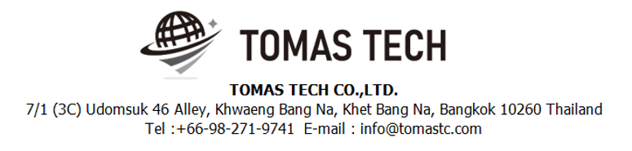
Version 24/Oct/2024
Confidential
EDI system phase 1
Specifications Documentation EN for NSET
Blueprint
R5
Made for : NIDEC TECHNO MOTOR (Thailand) Co.,Ltd.
By : TOMAS TECH CO.,LTD.

Slide 2
Revision History
Date | Version | File name | Details
5/Oct/2024 | R1 | EDI system specifications Documentation EN | First edition
11/Oct/2024 | R2 | EDI system specifications Documentation EN | Second edition
15/Oct/2024 | R3 | EDI system specifications Documentation EN | Third edition
22/Oct/2024 | R4 | EDI system specifications Documentation EN | Fourth edition
25/Oct/2024 | R5 | EDI system specifications Documentation EN | Fifth edition
2
3
4
5

Slide 3
■Contents
1. Overview
2. Overall configuration diagram
3. Label
4. Database information
5. API Documentation
6. System functional specifications
7. Q&A
8. Sign off

Slide 4
1. Overview
■ Objectives
Provided the label/tag printing and management system to vendor/supplier.
■ Possible cause
■ Countermeasures

Slide 5
2. Overall configuration diagram
2
System flow diagram
Overall configuration diagram image
NSET MS Server 2019
NSET database MS SQL 2014
NST_XXX
Sync data service
(Called by DB trigger)
Micro service
NSET Cloud Server
EDI System
Postgres DB server
Linkage Data API
Web User Interface
System
Backend
NST_EDI

Slide 6
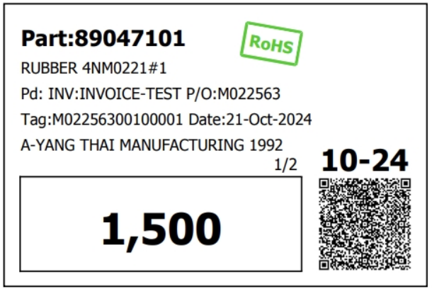
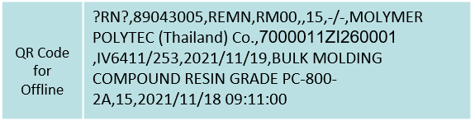

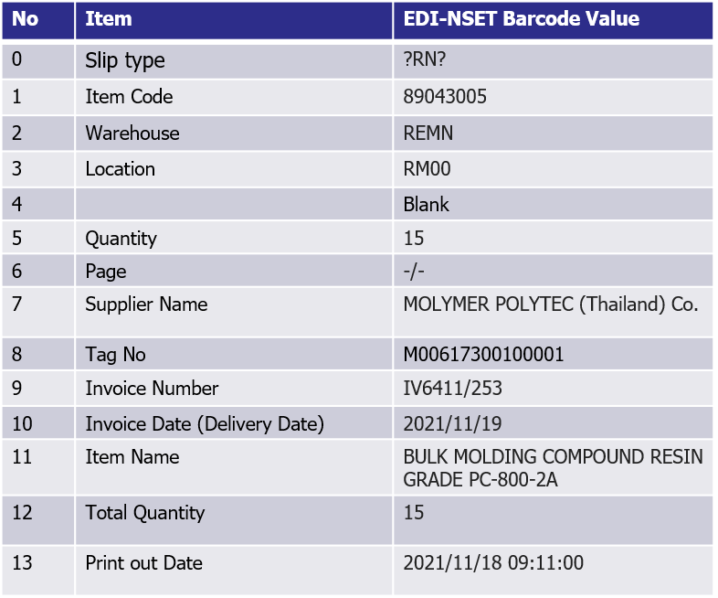
3. Label
5
Tag:M02256300100001

Slide 7
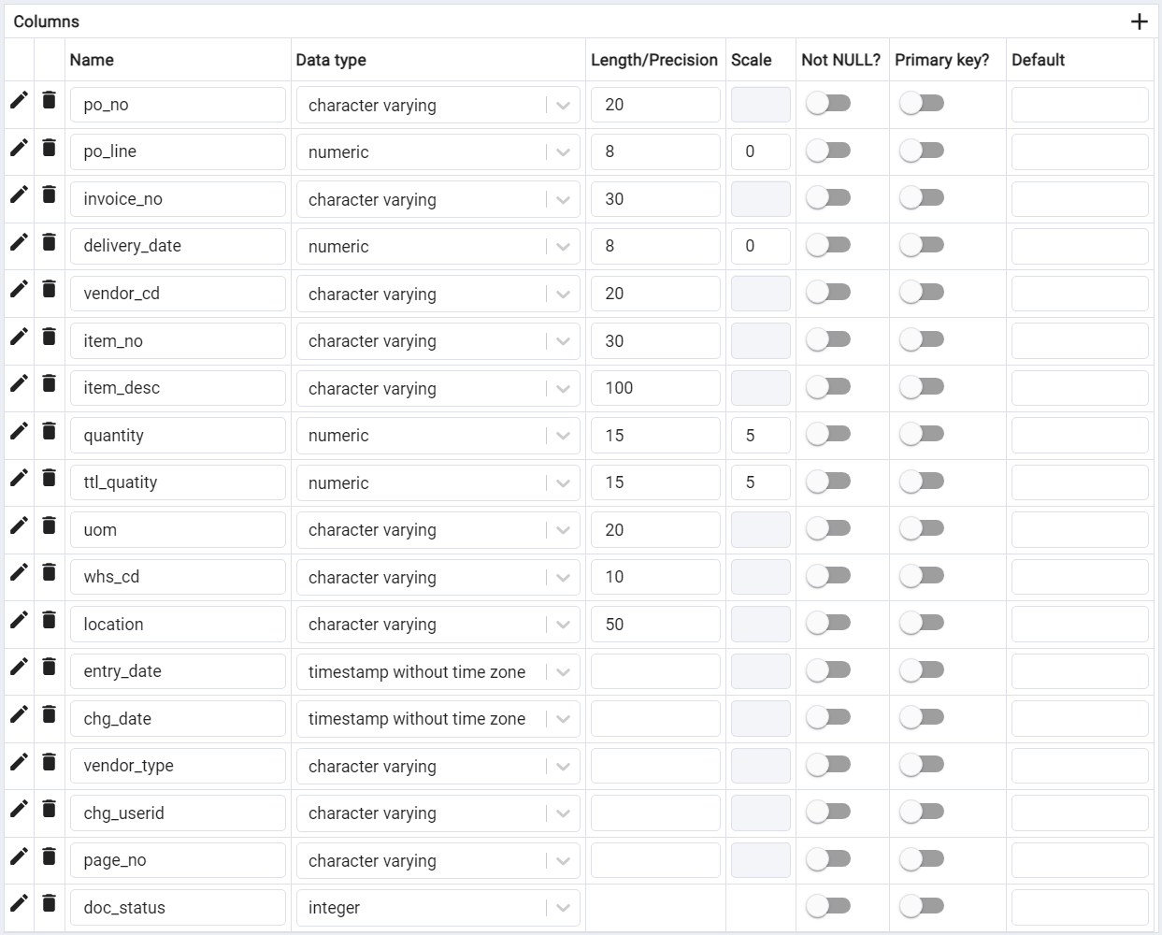
4. Database information
2
System： | PM | Table Layout |  |  | Create | Version
Area： | - |  |  |  | 2024/10/10 | 1
Table Name: | nst_rn_transaction |  | 1/1 |  |  |  | Create by：
Description: | RN Transactions |  |  |  |  |  | Update by：
Remark
The system should check for duplicate Invoice Numbers before showing the confirmation dialog to cancel the document.
Nidec will further use the received data from the EDI system.
5

Slide 8
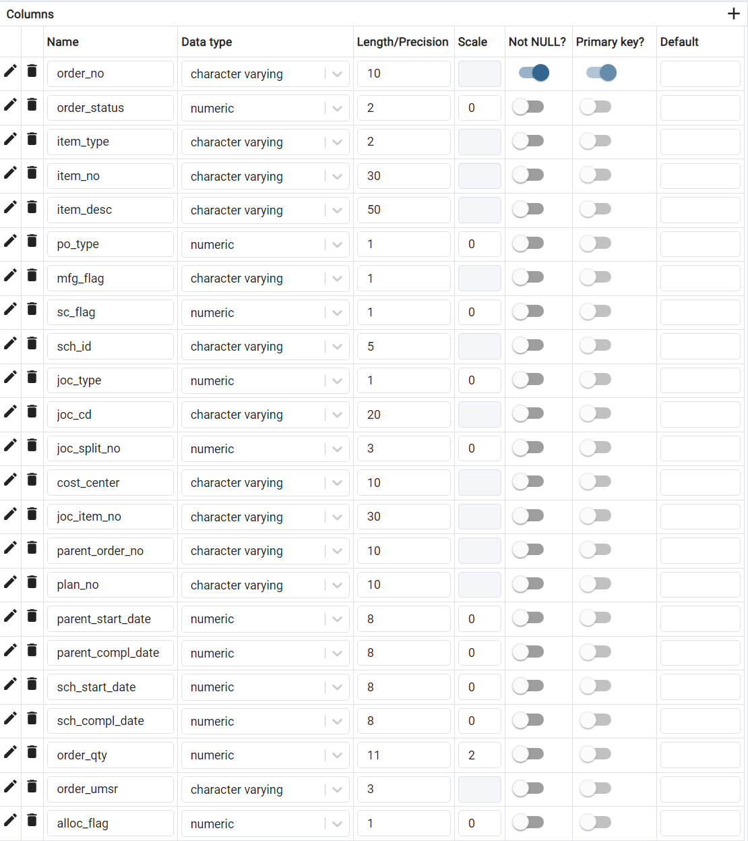
4. Database information
2
System： | PM | Table Layout |  |  | Create | Version
Area： | - |  |  |  | 2024/10/10 | 1
Table Name: | pur_order |  | 1/4 |  |  |  | Create by：
Description: | Purchase order |  |  |  |  |  | Update by：

Slide 9
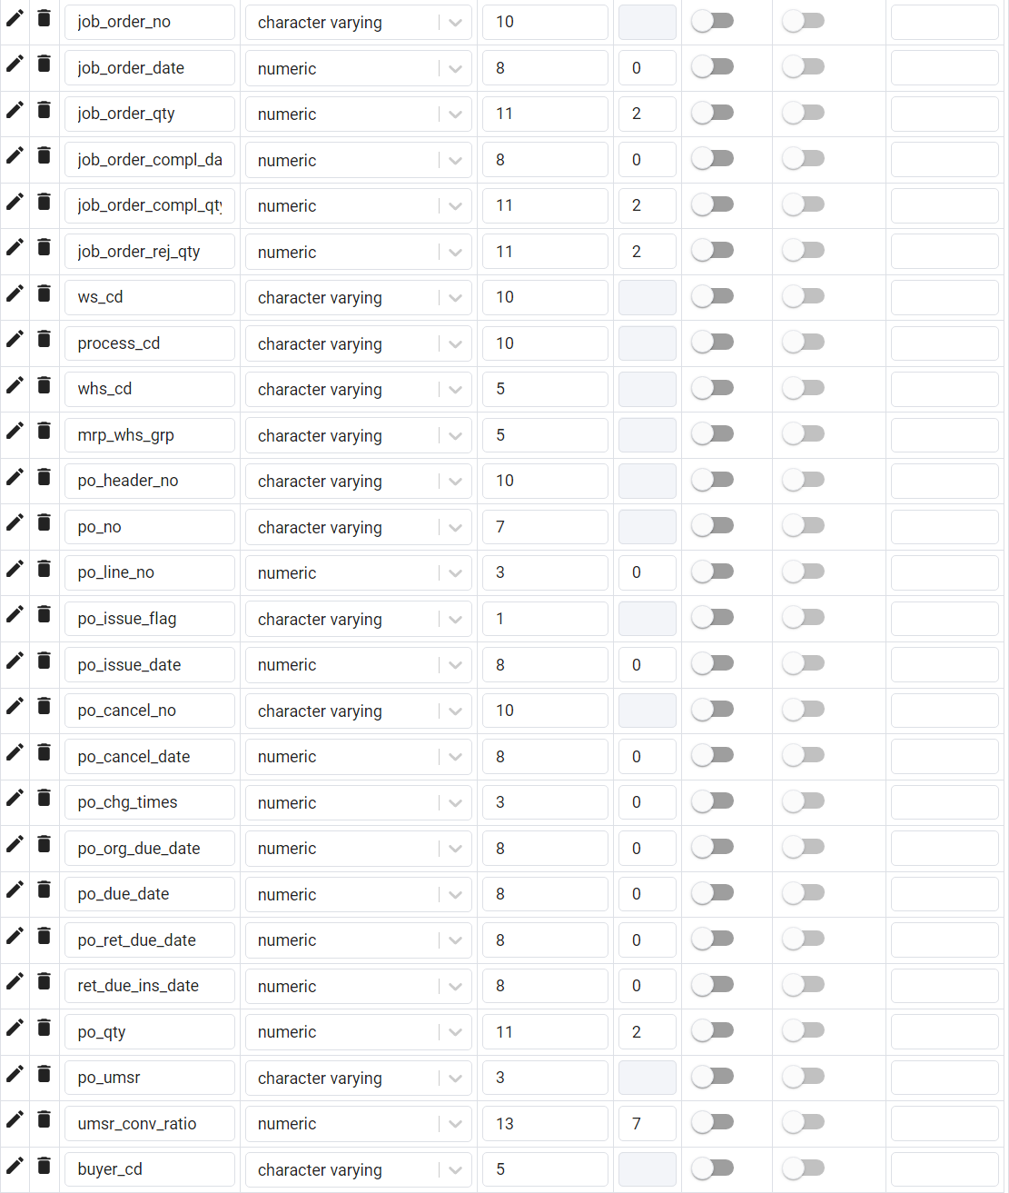
4. Database information
2
System： | PM | Table Layout |  |  | Create | Version
Area： | - |  |  |  | 2024/10/10 | 1
Table Name: | pur_order |  | 2/4 |  |  |  | Create by：
Description: | Purchase order |  |  |  |  |  | Update by：

Slide 10
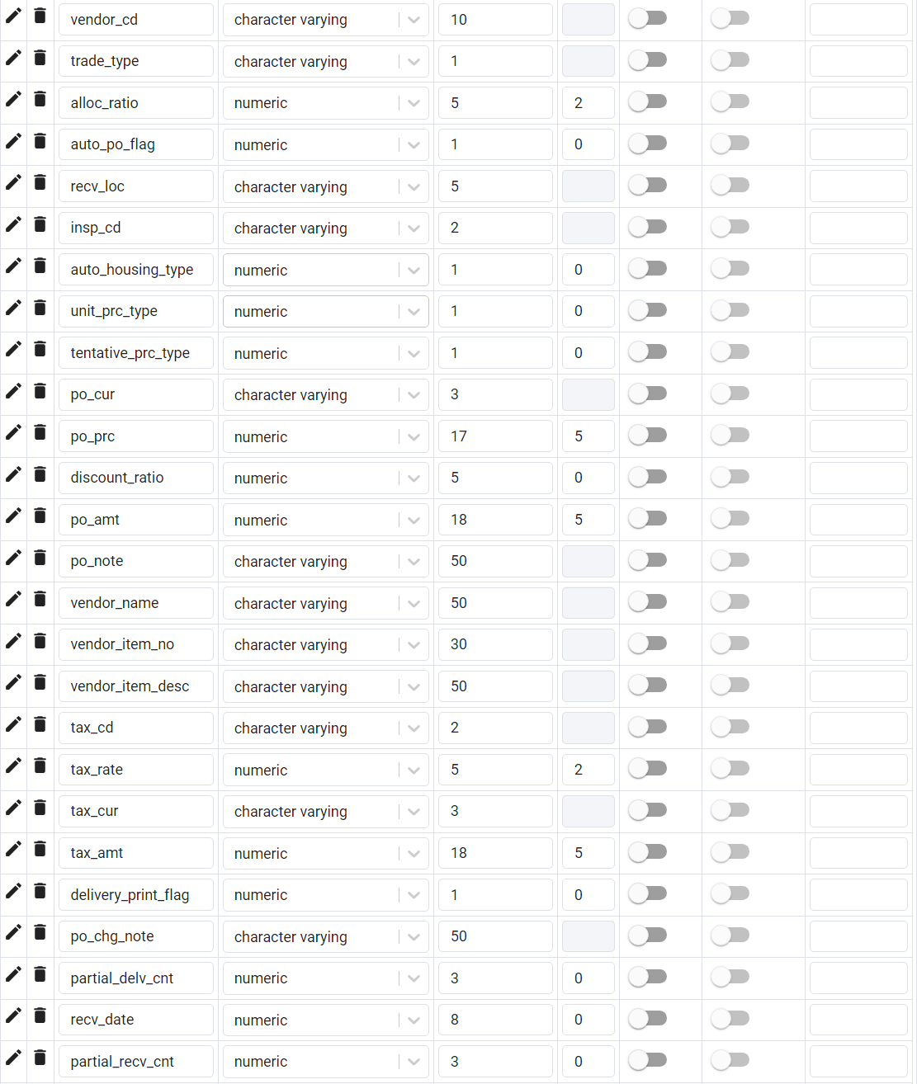
4. Database information
2
System： | PM | Table Layout |  |  | Create | Version
Area： | - |  |  |  | 2024/10/10 | 1
Table Name: | pur_order |  | 3/4 |  |  |  | Create by：
Description: | Purchase order |  |  |  |  |  | Update by：

Slide 11
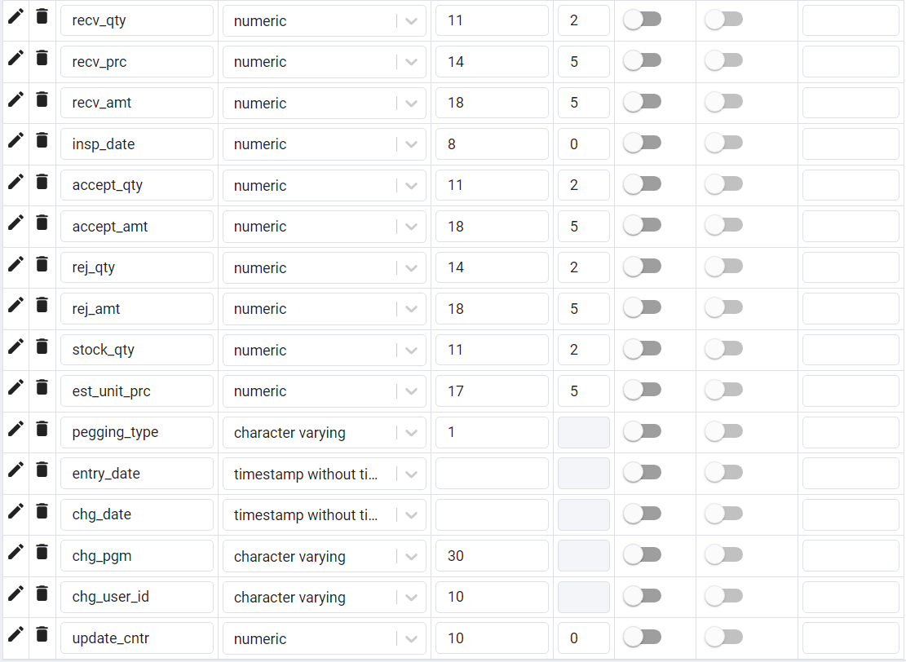
4. Database information
2
System： | PM | Table Layout |  |  | Create | Version
Area： | - |  |  |  | 2024/10/10 | 1
Table Name: | pur_order |  | 4/4 |  |  |  | Create by：
Description: | Purchase order |  |  |  |  |  | Update by：

Slide 12
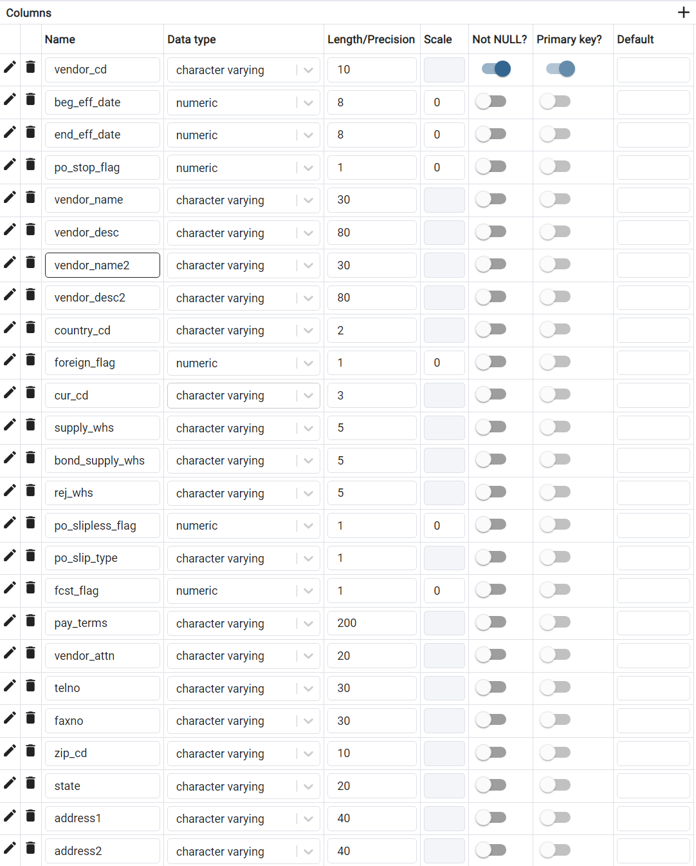
4. Database information
2
System： | PM | Table Layout |  |  | Create | Version
Area： | - |  |  |  | 2024/10/10 | 1
Table Name: | vendor_master |  | 1/3 |  |  |  | Create by：
Description: | Vendor master |  |  |  |  |  | Update by：

Slide 13
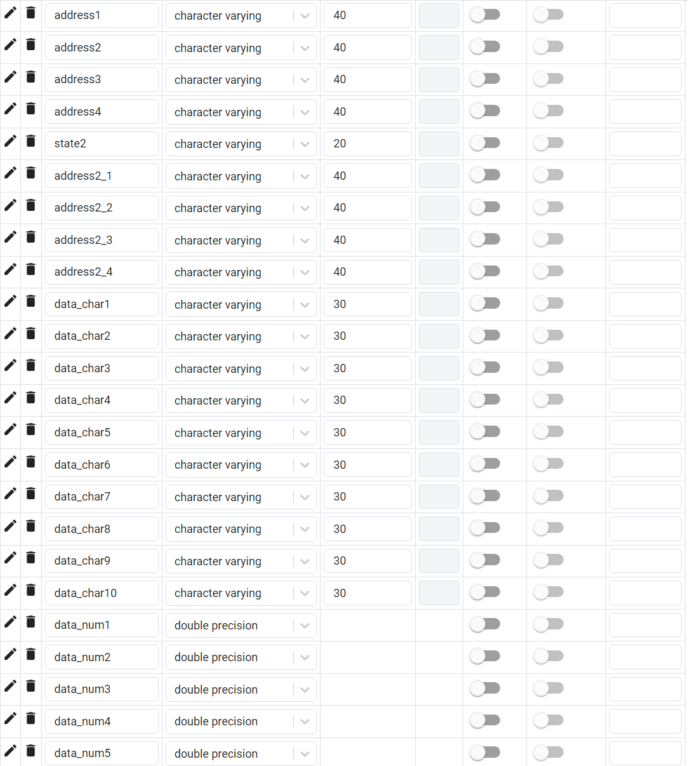
4. Database information
2
System： | PM | Table Layout |  |  | Create | Version
Area： | - |  |  |  | 2024/10/10 | 1
Table Name: | vendor_master |  | 2/3 |  |  |  | Create by：
Description: | Vendor master |  |  |  |  |  | Update by：

Slide 14
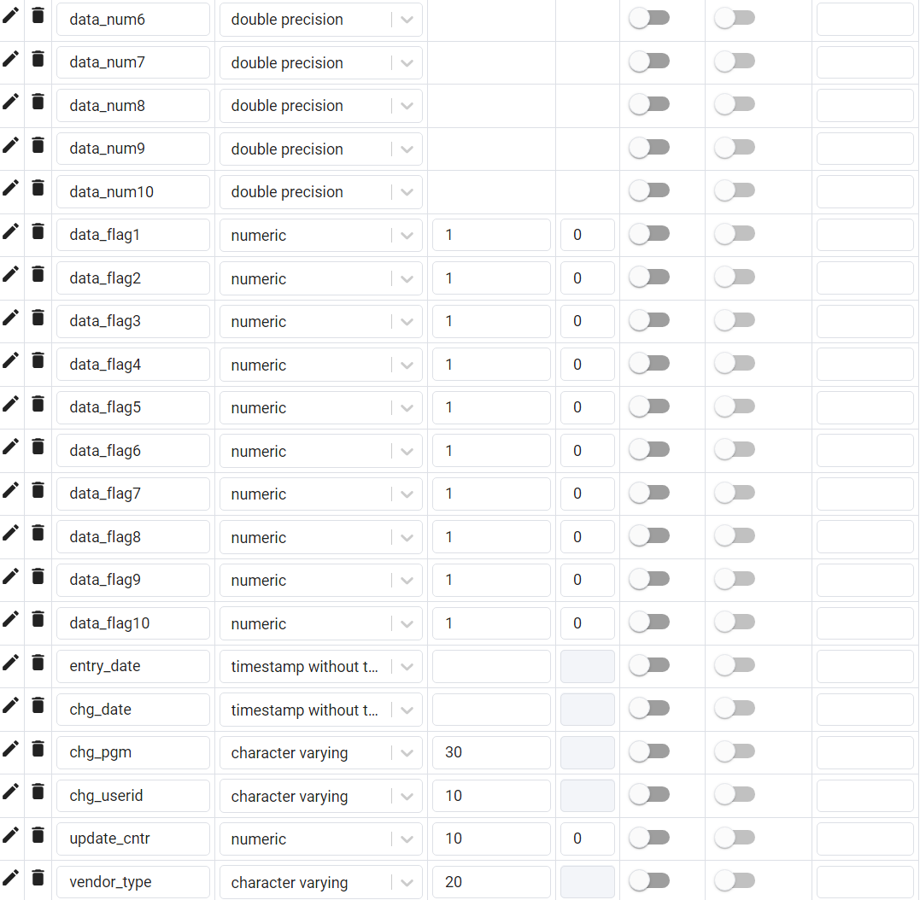
4. Database information
2
System： | PM | Table Layout |  |  | Create | Version
Area： | - |  |  |  | 2024/10/10 | 1
Table Name: | vendor_master |  | 3/3 |  |  |  | Create by：
Description: | Vendor master |  |  |  |  |  | Update by：

Slide 15
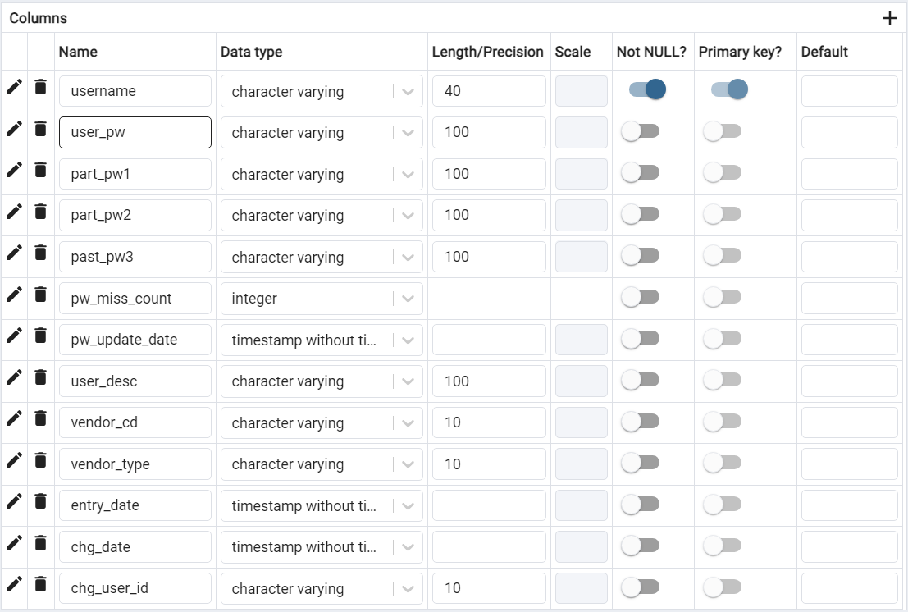
4. Database information
4
System： | PM | Table Layout |  |  | Create | Version
Area： | - |  |  |  | 2024/10/10 | 1
Table Name: | user_master |  | 1/1 |  |  |  | Create by：
Description: | User master |  |  |  |  |  | Update by：
Remark
1.Should be at least 8 characters long
2.Should be mix of upper and lower case letters and numbers
3.Should be contain special characters (@,#,% …)
4.Password is expire every 3 month
5.Prevent to create a new password with the old last 3 passwords.
5

Slide 16
5. API Documentation
2
5-1. Purchase orders
API provides endpoints for creating and updating purchase orders to EDI system
Authentication
All API requests require an API key for authentication. The API key must be included in the request headers as follows:
Authorization Api-key : {API_KEY} (Put key on header)
Base URL https://xxxxxx/api/purchase_orders
DEMO API key b7f63e7d41a84db5f6c3a4f245cba89e
Endpoints
Create or update Purchase orders in table “pur_order” to EDI system.
Method: POST
URL: /create_update
Request
HTTP
POST /purchase_orders/create_update Authorization Api-key : {API_KEY} (Put key on header)
Response
Success status : 200 OK
JSON
{ "status": "OK", "affected_rows": "15", "message": "Create or update purchase order successfully" }
Error status : 401 [Authentication fail]
JSON
{ "status": "ERROR", "message": "Authentication fail“ }

Slide 17
5. API Documentation
2
5-1. Purchase orders
Response
Error status : 400 [Purchase order not found]
JSON
{ "status": "ERROR", "message": "Purchase order not found" }
Error status : 400 [Failed to create or update Purchase order]
JSON
{ "status": "ERROR", "message": "Failed to create or update Purchase order" }
Example format json
The JSON file must contain an array named “rows”, and the format of the JSON file should match the example below. It should allow for adding more than one row of data in a single transmission.
JSON
{ "rows": [ { "order_no": "A168687052", "order_status": "25", ” item_type”: “52” ….. }, { "order_no": "A168687053", "order_status": ”25", ” item_type”: ”52” ….. } ] }

Slide 18
5. API Documentation
2
5-1. Purchase orders
Column
The list of columns required for submitting data for the “pur_order” table.
No | column_name | data_type | maximum_length | format
1 | order_no | character varying | 10
2 | order_status | numeric | NULL
3 | item_type | character varying | 2
4 | item_no | character varying | 30
5 | item_desc | character varying | 50
6 | po_type | numeric | NULL
7 | mfg_flag | character varying | 1
8 | sc_flag | numeric | NULL
9 | sch_id | character varying | 5
10 | joc_type | numeric | NULL
11 | joc_cd | character varying | 20
12 | joc_split_no | numeric | NULL
13 | cost_center | character varying | 10
14 | joc_item_no | character varying | 30
15 | parent_order_no | character varying | 10
16 | plan_no | character varying | 10
17 | parent_start_date | date | NULL | Y-m-d
18 | parent_compl_date | date | NULL | Y-m-d
19 | sch_start_date | date | NULL | Y-m-d
20 | sch_compl_date | date | NULL | Y-m-d
21 | order_qty | numeric | NULL
22 | order_umsr | character varying | 3
23 | alloc_flag | numeric | NULL
24 | job_order_no | character varying | 10
25 | job_order_date | date | NULL | Y-m-d
26 | job_order_qty | numeric | NULL
27 | job_order_compl_date | date | NULL | Y-m-d
28 | job_order_compl_qty | numeric | NULL
29 | job_order_rej_qty | numeric | NULL
30 | ws_cd | character varying | 10

Slide 19
5. API Documentation
2
5-1. Purchase orders
Column
The list of columns required for submitting data for the “pur_order” table.
No | column_name | data_type | maximum_length | format
31 | process_cd | character varying | 10
32 | whs_cd | character varying | 5
33 | mrp_whs_grp | character varying | 5
34 | po_header_no | character varying | 10
35 | po_no | character varying | 7
36 | po_line_no | numeric | NULL
37 | po_issue_flag | character varying | 1
38 | po_issue_date | numeric | NULL
39 | po_cancel_no | character varying | 10
40 | po_cancel_date | date | NULL | Y-m-d
41 | po_chg_times | numeric | NULL
42 | po_org_due_date | date | NULL | Y-m-d
43 | po_due_date | date | NULL | Y-m-d
44 | po_ret_due_date | date | NULL | Y-m-d
45 | ret_due_ins_date | date | NULL | Y-m-d
46 | po_qty | numeric | NULL
47 | po_umsr | character varying | 3
48 | umsr_conv_ratio | numeric | NULL
49 | buyer_cd | character varying | 5
50 | vendor_cd | character varying | 10
51 | trade_type | character varying | 1
52 | alloc_ratio | numeric | NULL
53 | auto_po_flag | numeric | NULL
54 | recv_loc | character varying | 5
55 | insp_cd | character varying | 2
56 | auto_housing_type | numeric | NULL
57 | unit_prc_type | numeric | NULL
58 | tentative_prc_type | numeric | NULL
59 | po_cur | character varying | 3
60 | po_prc | numeric | NULL

Slide 20
5. API Documentation
2
5-1. Purchase orders
Column
The list of columns required for submitting data for the “pur_order” table.
No | column_name | data_type | maximum_length | format
61 | discount_ratio | numeric | NULL
62 | po_amt | numeric | NULL
63 | po_note | character varying | 50
64 | vendor_name | character varying | 50
65 | vendor_item_no | character varying | 30
66 | vendor_item_desc | character varying | 50
67 | tax_cd | character varying | 2
68 | tax_rate | numeric | NULL
69 | tax_cur | character varying | 3
70 | tax_amt | numeric | NULL
71 | delivery_print_flag | numeric | NULL
72 | po_chg_note | character varying | 50
73 | partial_delv_cnt | numeric | NULL
74 | recv_date | date | NULL | Y-m-d
75 | partial_recv_cnt | numeric | NULL
76 | recv_qty | numeric | NULL
77 | recv_prc | numeric | NULL
78 | recv_amt | numeric | NULL
79 | insp_date | date | NULL | Y-m-d
80 | accept_qty | numeric | NULL
81 | accept_amt | numeric | NULL
82 | rej_qty | numeric | NULL
83 | rej_amt | numeric | NULL
84 | stock_qty | numeric | NULL
85 | est_unit_prc | numeric | NULL
86 | pegging_type | character varying | 1
87 | entry_date | timestamp without time zone | NULL
88 | chg_date | timestamp without time zone | NULL
89 | chg_pgm | character varying | 30
90 | chg_user_id | character varying | 10
91 | update_cntr | numeric | NULL

Slide 21
5. API Documentation
2
5-2. Vendors
API provides endpoints for creating and updating vendors to EDI system
Authentication
All API requests require an API key for authentication. The API key must be included in the request headers as follows:
Authorization Api-key : {API_KEY} (Put key on header)
Base URL https://xxxxxx/api/vendors
DEMO API key b7f63e7d41a84db5f6c3a4f245cba89e
Endpoints
Create or update Purchase orders in table “vendor_master” to EDI system.
Method: POST
URL: /create_update
Request
HTTP
POST /vendors/create_update Authorization Api-key : {API_KEY} (Put key on header)
Response
Success status : 200 OK
JSON
{ "status": "OK", "affected_rows": "15", "message": "Create or update purchase order successfully" }
Error status : 401 [Authentication fail]
JSON
{ "status": "ERROR", "message": "Authentication fail“ }

Slide 22
5. API Documentation
2
5-2. Vendors
Response
Error status : 400 [Vender not found]
JSON
{ "status": "ERROR", "message": "Vender not found" }
Error status : 400 [Failed to create or update Vender]
JSON
{ "status": "ERROR", "message": "Failed to create or update Vender" }
Example format json
The JSON file must contain an array named “rows”, and the format of the JSON file should match the example below. It should allow for adding more than one row of data in a single transmission.
JSON
{ "rows": [ { "vendor_cd": "6000000", "beg_eff_date": ”2029-04-01", ”end_eff_date”: NULL ….. }, { "vendor_cd": "6000001", "beg_eff_date": ” 2016-01-01", ”end_eff_date”: NULL ….. } ] }

Slide 23
5. API Documentation
2
5-2. Vendors
Column
The list of columns required for submitting data for the “vendor_master” table.
No | column_name | data_type | maximum_length | format
1 | vendor_cd | character varying | 10
2 | beg_eff_date | date | NULL | Y-m-d
3 | end_eff_date | date | NULL | Y-m-d
4 | po_stop_flag | numeric | NULL
5 | vendor_name | character varying | 30
6 | vendor_desc | character varying | 80
7 | vendor_name2 | character varying | 30
8 | vendor_desc2 | character varying | 80
9 | country_cd | character varying | 2
10 | foreign_flag | numeric | NULL
11 | cur_cd | character varying | 3
12 | supply_whs | character varying | 5
13 | bond_supply_whs | character varying | 5
14 | rej_whs | character varying | 5
15 | po_slipless_flag | numeric | NULL
16 | po_slip_type | character varying | 1
17 | fcst_flag | numeric | NULL | Y-m-d
18 | pay_terms | character varying | 200 | Y-m-d
19 | vendor_attn | character varying | 20 | Y-m-d
20 | telno | character varying | 30 | Y-m-d
21 | faxno | character varying | 30
22 | zip_cd | character varying | 10
23 | state | character varying | 20
24 | address1 | character varying | 40
25 | address2 | character varying | 40 | Y-m-d
26 | address3 | character varying | 40
27 | address4 | character varying | 40 | Y-m-d
28 | state2 | character varying | 20
29 | address2_1 | character varying | 40
30 | address2_2 | character varying | 40

Slide 24
5. API Documentation
2
5-2. Vendors
Column
The list of columns required for submitting data for the “vendor_master” table.
No | column_name | data_type | maximum_length | format
31 | address2_3 | character varying | 40
32 | address2_4 | character varying | 40
33 | data_char1 | character varying | 30
34 | data_char2 | character varying | 30
35 | data_char3 | character varying | 30
36 | data_char4 | character varying | 30
37 | data_char5 | character varying | 30
38 | data_char6 | character varying | 30
39 | data_char7 | character varying | 30
40 | data_char8 | character varying | 30 | Y-m-d
41 | data_char9 | character varying | 30
42 | data_char10 | character varying | 30 | Y-m-d
43 | data_num1 | double precision | NULL | Y-m-d
44 | data_num2 | double precision | NULL | Y-m-d
45 | data_num3 | double precision | NULL | Y-m-d
46 | data_num4 | double precision | NULL
47 | data_num5 | double precision | NULL
48 | data_num6 | double precision | NULL
49 | data_num7 | double precision | NULL
50 | data_num8 | double precision | NULL
51 | data_num9 | double precision | NULL
52 | data_num10 | double precision | NULL
53 | data_flag1 | numeric | NULL
54 | data_flag2 | numeric | NULL
55 | data_flag3 | numeric | NULL
56 | data_flag4 | numeric | NULL
57 | data_flag5 | numeric | NULL
58 | data_flag6 | numeric | NULL
59 | data_flag7 | numeric | NULL
60 | data_flag8 | numeric | NULL

Slide 25
5. API Documentation
2
5-2. Vendors
Column
The list of columns required for submitting data for the “vendor_master” table.
No | column_name | data_type | maximum_length | format
61 | data_flag9 | numeric | NULL
62 | data_flag10 | numeric | NULL
63 | entry_date | timestamp without time zone | NULL
64 | chg_date | timestamp without time zone | NULL
65 | chg_pgm | character varying | 30
66 | chg_userid | character varying | 10
67 | update_cntr | numeric | NULL
68 | vendor_type | character varying | 20

Slide 26
5. API Documentation
3
5-3. Users
API provides endpoints for creating and updating vendors to EDI system
Authentication
All API requests require an API key for authentication. The API key must be included in the request headers as follows:
Authorization Api-key : {API_KEY} (Put key on header)
Base URL https://xxxxxx/api/users
DEMO API key b7f63e7d41a84db5f6c3a4f245cba89e
Endpoints
Create or update Purchase orders in table “user_master” to EDI system.
Method: POST
URL: /create_update
Request
HTTP
POST /users/create_update Authorization Api-key : {API_KEY} (Put key on header)
Response
Success status : 200 OK
JSON
{ "status": "OK", "affected_rows": "15", "message": "Create or update User successfully" }
Error status : 401 [Authentication fail]
JSON
{ "status": "ERROR", "message": "Authentication fail“ }

Slide 27
5. API Documentation
3
5-3. Users
Response
Error status : 400 [User not found]
JSON
{ "status": "ERROR", "message": ”User not found" }
Error status : 400 [Failed to create or update User]
JSON
{ "status": "ERROR", "message": "Failed to create or update User" }
Error status : 401 [Failed to update Password]
5
JSON
{ "status": "ERROR", "message": "Failed to update because the password is the same as the most recent one." }

Slide 28
5. API Documentation
3
5-3. Users
Example format json
The JSON file must contain an array named “rows”, and the format of the JSON file should match the example below. It should allow for adding more than one row of data in a single transmission.
JSON
{ "rows": [ { ”username": ”USER1", ”user_pw": “Ab1234567@” ”part_pw1”: NULL ….. }, { "username": ”USER2", "user_pw": “Us2-3457” ”part_pw1”: “Us2-3456” ….. } ] }
5

Slide 29
5. API Documentation
4
5-3. Users
Column
The list of columns required for submitting data for the “user_master” table.
No | column_name | data_type | maximum_length | format
1 | username | character varying | 40
2 | user_pw | character varying | 100
3 | part_pw1 | character varying | 100
4 | part_pw2 | character varying | 100
5 | part_pw3 | character varying | 100
6 | pw_miss_count | integer
7 | pw_update_date | timestamp without time zone
8 | user_desc | character varying | 100
9 | vendor_cd | character varying | 10
10 | vendor_type | character varying | 10
11 | entry_date | timestamp without time zone | NULL
12 | chg_date | timestamp without time zone | NULL
13 | chg_user_id | character varying | 10
5

Slide 30
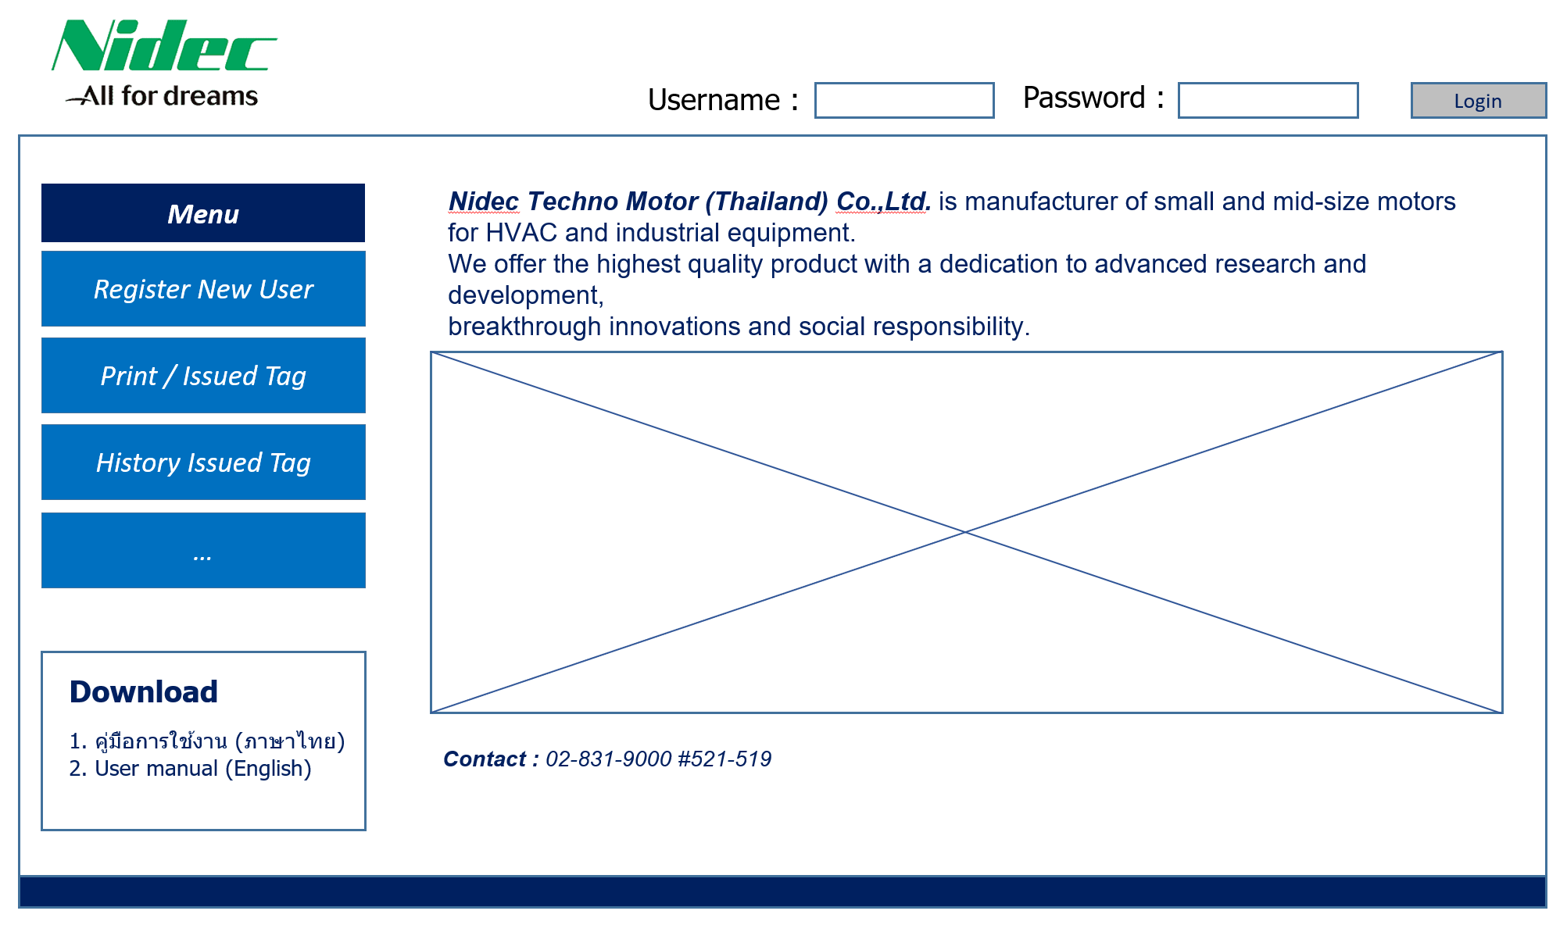

6. System functional specifications
6-1. Web screen image
Web function / screen flow
Home page screen

Slide 31
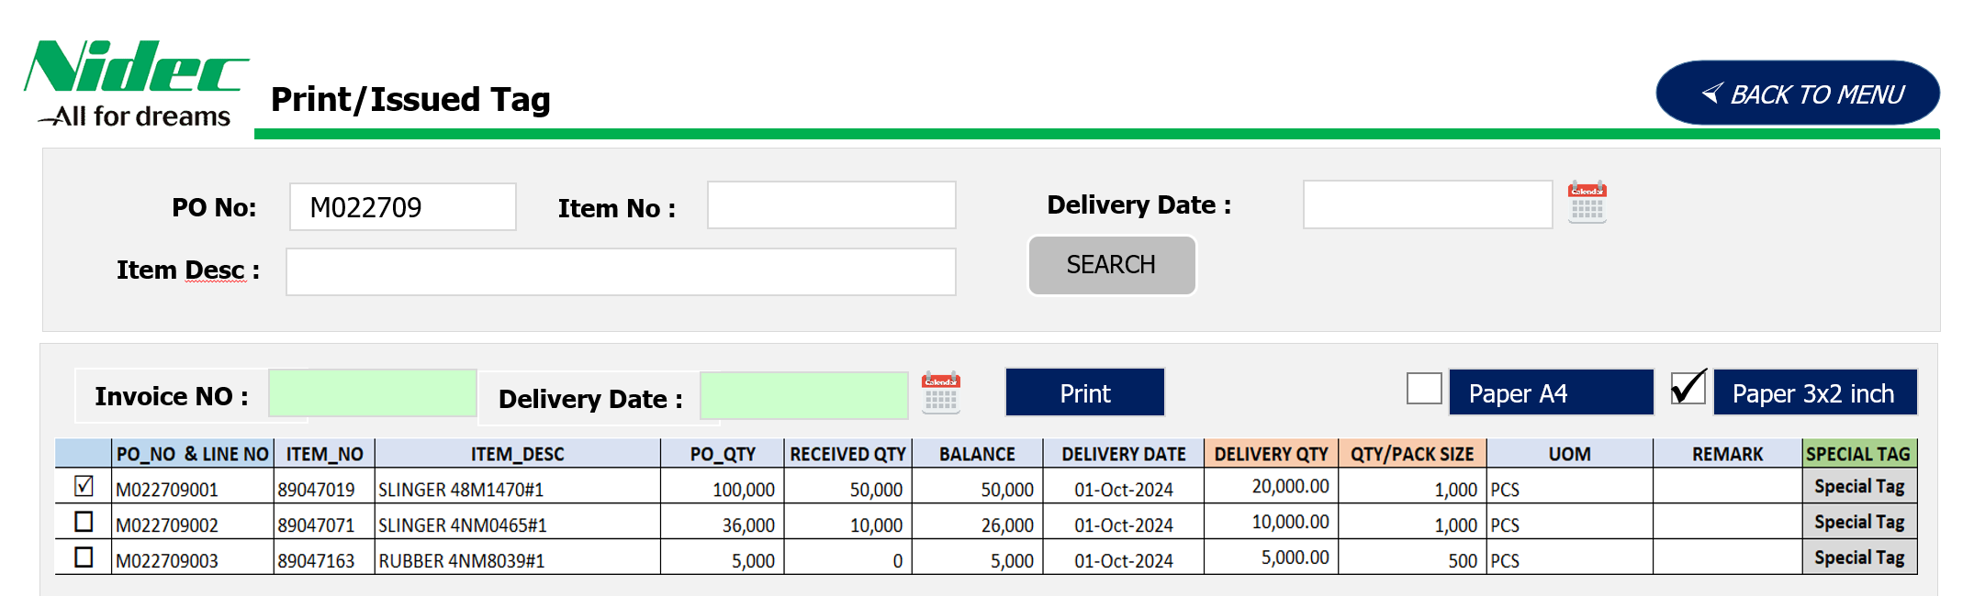

6. System functional specifications
6-1. Web screen image
Web function / screen flow
Print / Issued Tag
Enter Invoice No and Delivery Date
Select an either one of paper print size.
5
0123456789
01-Oct-2024
Update
Print
PO NO (7 digit)
& PO line No (3 digit)
User input quantity
for delivery
Link from table
(PURCHASE_MASTER)
but user can edit and used pack size from last time.
Choose an item to print
Remark
Item for search, user can search by wildcard character
Condition : Order_Status =25 only
User input “Invoice No” and “Delivery Date”
User select paper type for print.
User can change “QTY/PACK SIZE” and this data load from last time transaction.
If some raw material item need to click “Special tag” function for input quantity by label.
If user want to print , user will to select (check box) and click print by item. *** ขอคำแนะนำค่ะ ที่ให้เลือกปริ้นที่ละรายการเพราะว่า บางรายการจำนวนการส่งเยอะเมื่อคำนวณจำนวนลาเบลอาจจะเยอะซึ่งอาจจะทำให้ระบบช้าถ้าเลือกพร้อมกันทั้งหมด แต่ก็อยากให้ผู้ใช้งานสะดวก เท่าที่เชค max สุดของการส่งภายในประเทศอยู่ประมาณ 15 รายการต่อ Invoice ค่ะ ส่วนจำนวนลาเบลยอะสุดจะเป็น BMC =1,500 ลาเบล ต่อ invoice ต่อ item ถ้าการเลือกปริ้นที่ละรายการดีแล้ว รบกวนระบบตรวจสอบว่าถ้า user เลือกมากกว่า 1 รายการแล้วจำนวนลาเบลทั้งหมดไม่เกินเท่าไหร่ที่น่าจะไม่ส่งผลการ generate tag number และ บันทึก ทำให้ระบบช้า หากจำนวนเกิน limit ให้ระบบแจ้งเตือนให้ปริ้นที่ละรายการค่ะ
If press “Print” button , please change name to “Re-Print” because not generate tag number.
Delivery qty can’t key in more than balance qty.
About sorting, sorting by user item search
The user must update the invoice number and the delivery date first.
If the user wants to print labels, they must select the items to be printed, choose the paper size, and click print.
5

Slide 32
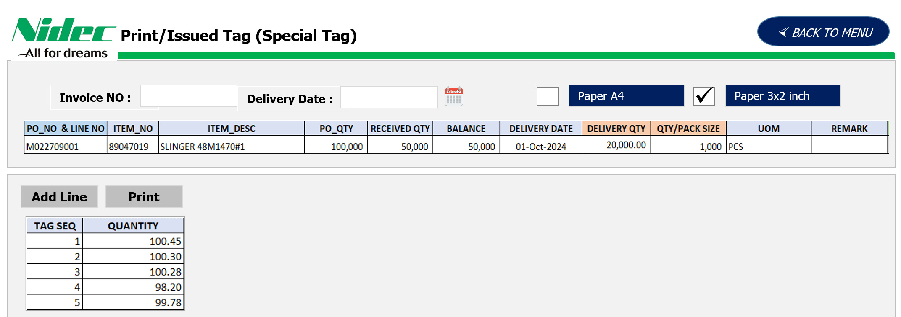
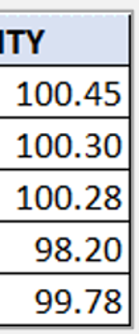

6. System functional specifications
6-1. Web screen image
Web function / screen flow
Print / Issued Tag (Special Tag)
Enter Invoice No
Select an either one of paper print size.
0123456789
01-Oct-2024
Print
Add more tag
The amount display as the summary of below amount of all tags.
Link from table
(PURCHASE_MASTER)
but user can edit and used pack size from last time.
Edit
Remove
The total amount must be less or equal to the remaining balance qty.
Print all tags and save data e.g Invoice No.
Remark
User input “Invoice No” and “Delivery Date”
User select paper type for print.
User can change “QTY/PACK SIZE” and this data load from last time transaction.
User can add line for key in quantity by label and quantity can’t more then “Delivery Qty” column
If press “Print” button , please change name to “Re-Print” because not generate tag number.
Delivery qty can’t key in more than balance qty.

Slide 33
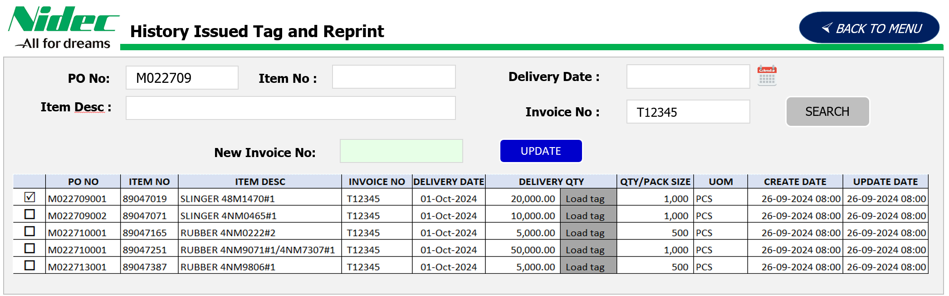
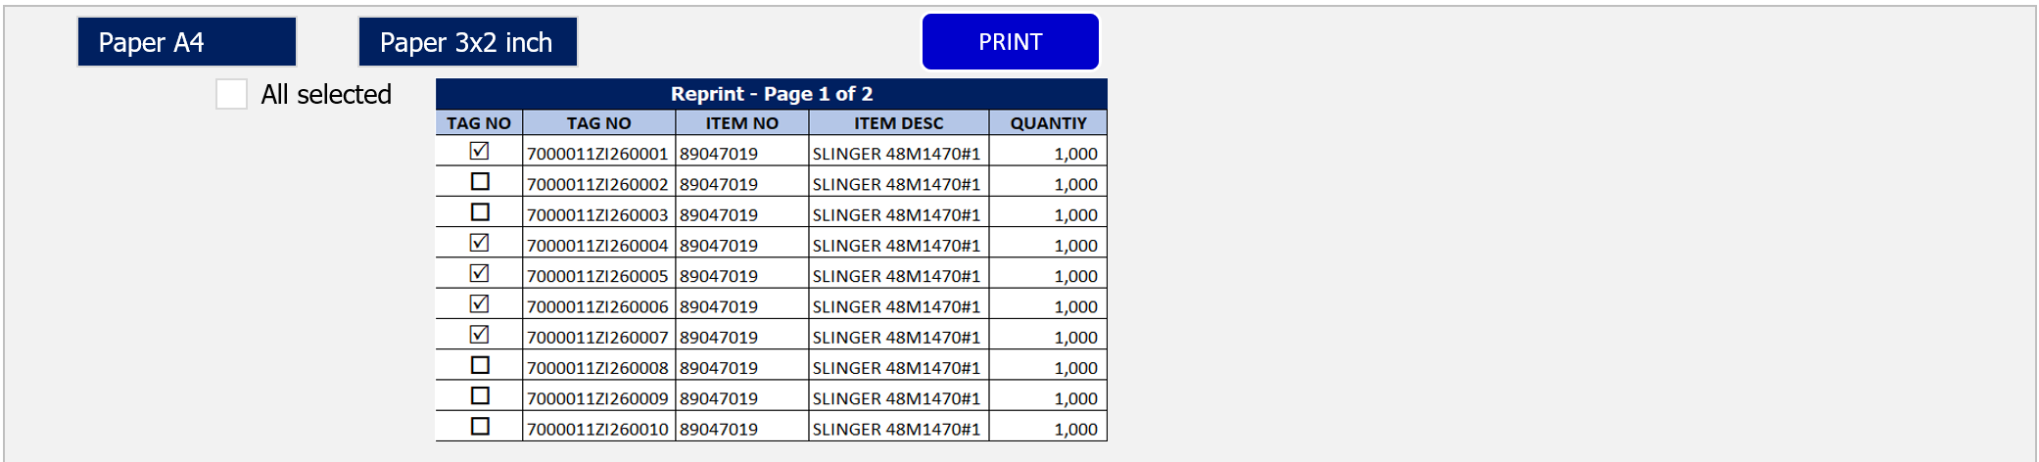
6. System functional specifications
6-1. Web screen image
Web function / screen flow
History Issued Tag / Reprint
Enter Invoice No
Update Invoice No to selected items
0123456789
01-Oct-2024
Unselect/Select all
0123456789
Update
Add more tag
Link from table
(PURCHASE_MASTER)
but user can edit and used pack size from last time.
Edit
Remove
Reprint
The total amount must be less or equal to the remaining balance qty.
Print all tags
Remark
Item for search ,user can search by wildcard character
If user not search by invoice number and user want to change invoice too, so user must be select one item for get invoice into “Invoice No” field. If it is blank can’t update.
If updated invoice ,so the system updated “Update date” column also.
About reprint, user can select by item or all item for print out by tag number.
About sorting, sorting by user item search

Slide 34
7. Q&A

Slide 35
8. Sign off
We hereby acknowledge and agree the above-mentioned blueprint requirements.
Any changes required after the sign off for this blueprint will be addressed through the change request process.
Nidec Techno Motor (Thailand) Co.,Ltd.
Sign:
Name:
Title:
Date:
TOMAS TECH CO.,LTD.
Sign:
Name:
Title:
Date:
## END OF BLUEPRINT##

