Slide 1
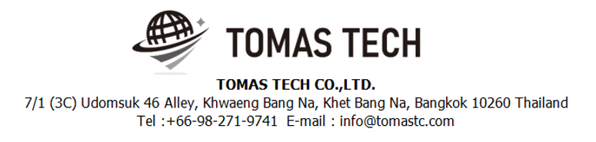
Version 18/Dec/2024
Confidential
Stock management system specifications
Documentation EN Blueprint for TBFST
Blueprint
R8
Made for: Toyota Boshoku Filtration System(Thailand) Co., Ltd.
By: TOMAS TECH CO.,LTD.

Slide 2
Revision History
Date | Version | File name | Details
25/Jul/2024 | R1 | Stock management system specifications Documentation EN Blueprint for TBFST Blueprint | First edition
19/Aug/2024 | R2 | Stock management system specifications Documentation EN Blueprint for TBFST Blueprint | Second edition
2/Sep/2024 | R3 | Stock management system specifications Documentation EN Blueprint for TBFST Blueprint | Third edition
8/Oct/2024 | R4 | Stock management system specifications Documentation EN Blueprint for TBFST Blueprint | Fourth edition
4/Nov/2024 | R5 | Stock management system specifications Documentation EN Blueprint for TBFST Blueprint | Fifth edition
22/Nov/2024 | R6 | Stock management system specifications Documentation EN Blueprint for TBFST Blueprint | Sixth edition
15/Nov/2024 | R7 | Stock management system specifications Documentation EN Blueprint for TBFST Blueprint | Seventh edition
18/Nov/2024 | R8 | Stock management system specifications Documentation EN Blueprint for TBFST Blueprint | Eighth edition
2
3
4
5
6
7
8

Slide 3
■Contents
1. Overview
2. Overall configuration diagram
3. Document image
4. Operation flow
5. System functional specifications
5-1. Handy terminal function
5-2. Handy terminal function Inbound
5-3. Handy terminal function Outbound
5-2. Handy terminal function Stock Management
5-5. PC operation flow
5-5-1. Login-Menu
5-5-2. Main-Menu
5-5-3. Schedule
5-5-4. Inbound
5-5-5. Outbound
5-5-6. Stock Inquiry Report
5-5-7. Stock Maintenance
5-5-8. Stocktaking
5-5-9. Stock Maintenance Inquiry / Report
5-5-10. NG Reason master
5-5-11. Supplier master
5-5-12. Item master
5-5-13. Location master
5-5-14. User master
5-5-15. User Credential master
5-5-16. Authority Master
5-5-17. Name Master
5-5-18. Packing Standard Master
5-5-19. Customer Master
5-5-20. Department Master
6. Q&A
7. Sign off

Slide 4
1. Overview
Introduced Stock management system to TBFST.
The system specifications for introduction are described in this document.

Slide 5
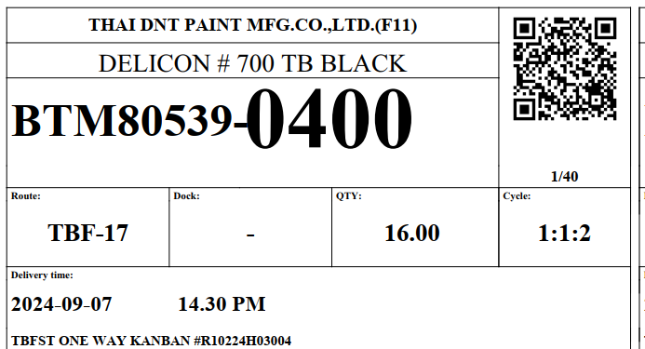
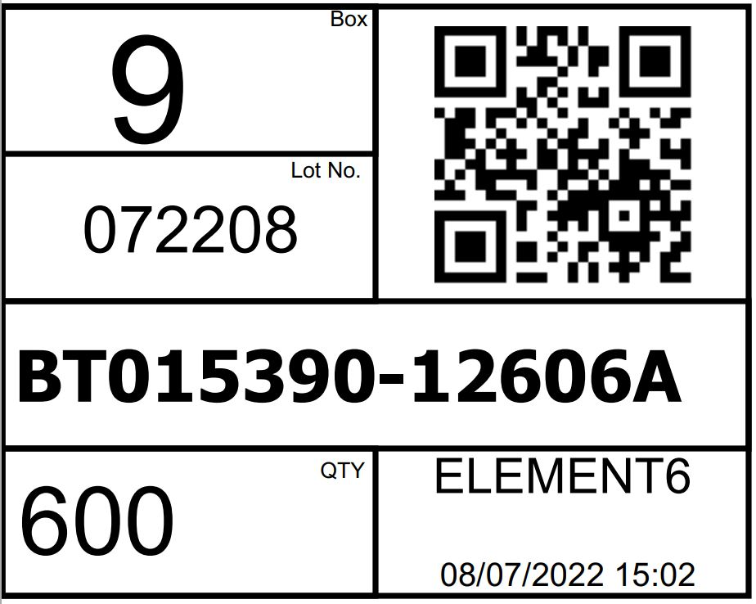
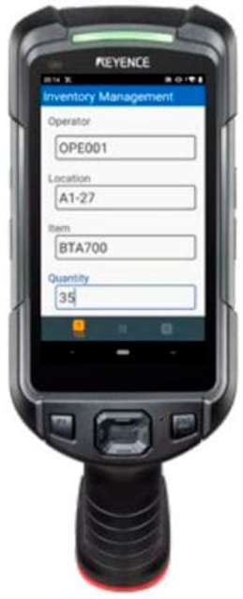


2. Overall configuration diagram
Represents a configuration diagram of the stock management system. It is a configuration image of hardware and documents.
Overall configuration diagram image
Receive & Inspection
Create Label
RM Inbound
Stock Management
Outbound Inspection
Outbound
Delivery
4
Handy terminal × 6
2
WIFI
Pegasus Server
SyteLine / TBFST
PO/PDS Line
Supplier DO
Customer DO
Production Schedule
Plan data (IN/OUT)
Actual data (IN/OUT)
ERP

Slide 6
2. Overall configuration diagram
Network diagram
TBFST office
Lan cable
DB
Middle tier
Pegasus
server
Wi-Fi
4
Client pc
Switching hub
Access Point
2
Handy terminal#1
Handy terminal#6
TBFST Warehouse

Slide 7
2. Overall configuration diagram
Hardware diagram
TBFST office
Lan cable
DB
Middle tier
Pegasus
server
Wi-Fi
4
Client pc
AC220V*1
Switching hub
Access Point
2
Handy terminal#1
Handy terminal#6
Charger #1
Charger #6
AC220V*6
TBFST Warehouse

Slide 8
3. Document image
8
3-1. Linkage data
Item | File name/Page no | Remarks
Inbound / Material Receive | Page 12 | 3-1-4. PO/PDS Line
 | Page 9 | 3-1-1. PS – Production Schedule (FG Inbound)
 | Page 24 | 3-1-20. Part Delivery Sheet (used to start process Receipt Material)
 | Page 23 | 3-1-19. RMA Return view table
Outbound / Delivery / Production plan | Page 10 | 3-1-2. CO (used to mapped to loading container)
 | Page 20 | 3-1-12. Loading Container – FG transfer, POKAYOKE
Master / Report / Other | Page 13 | Item master
 | Page 14 | Location master
 | Page 15 | Department master
 | Page 16 | Customer master
 | Page 17 | Supplier master
 | Page 18 | User master
 | Page 19 | Packing standard
 |  | NG Reason
 | Page 11 | BOM
 | Page 22 | Carton master

Slide 9
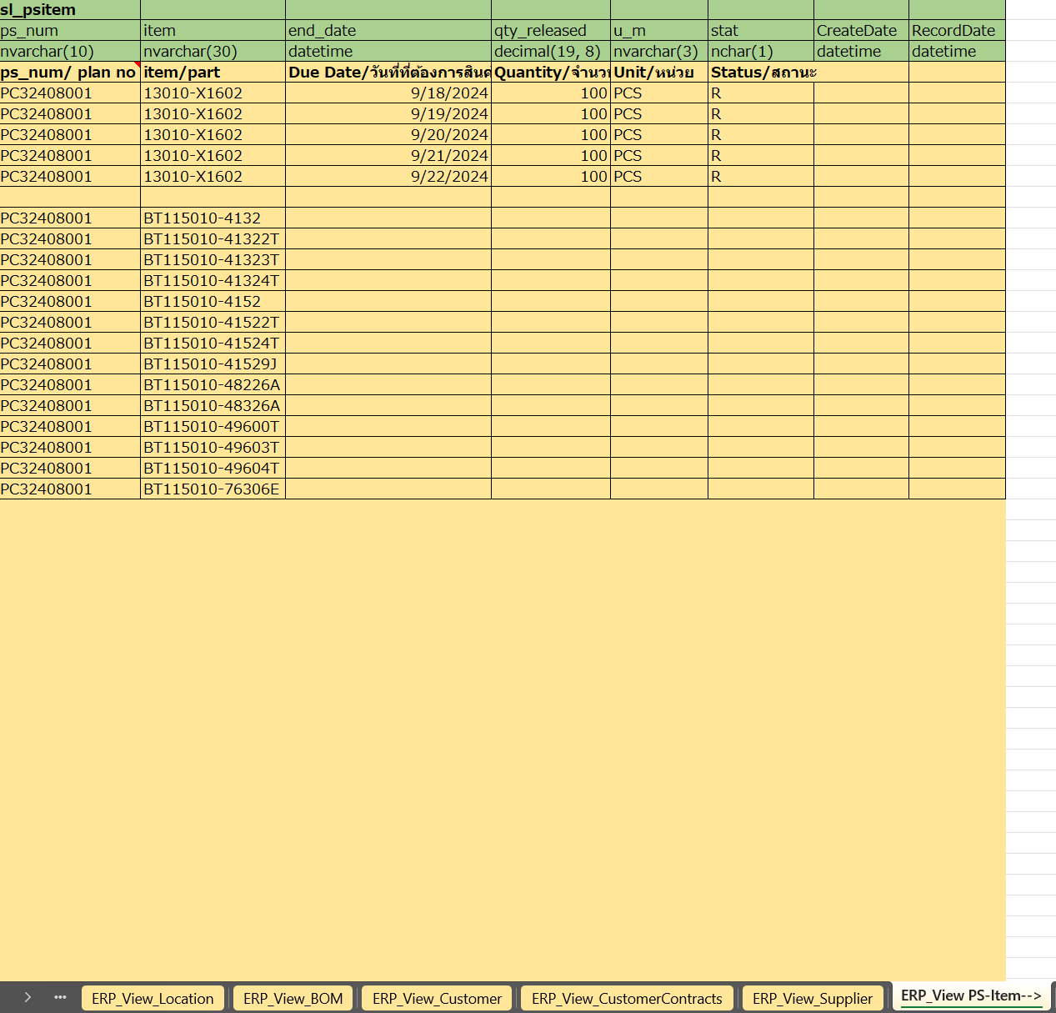
3. Document image
5
3-1-1. Production Schedule - PS
Syteline will create view table on middle DB tier
SYTELINE ⇒Pegasus
PS Item
* Used to generate FG Inbound schedule

Slide 10
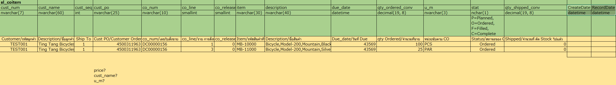
3. Document image
8
3-1-2. CO
Syteline will create view table on middle DB tier
SYTELINE ⇒Pegasus

Slide 11
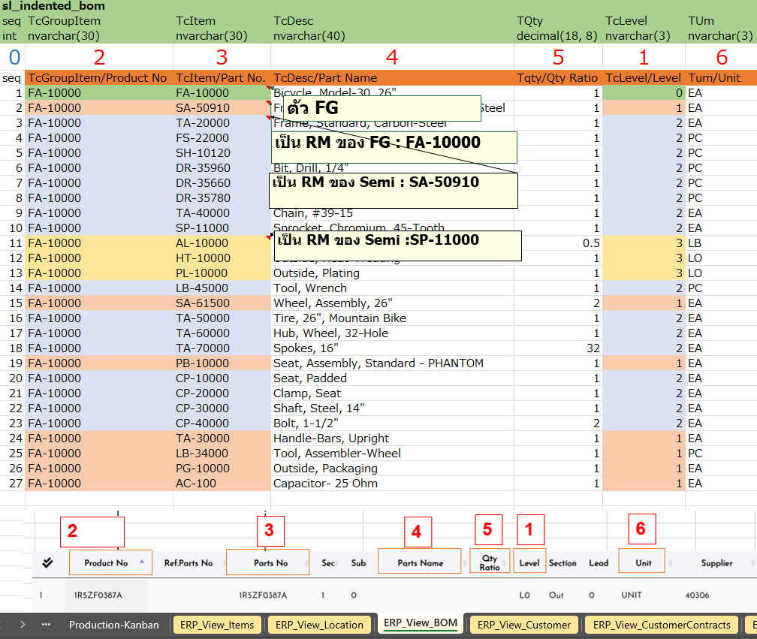
3. Document image
3-1-3. BOM master
Syteline will create view table on middle DB tier
SYTELINE ⇒Pegasus

Slide 12
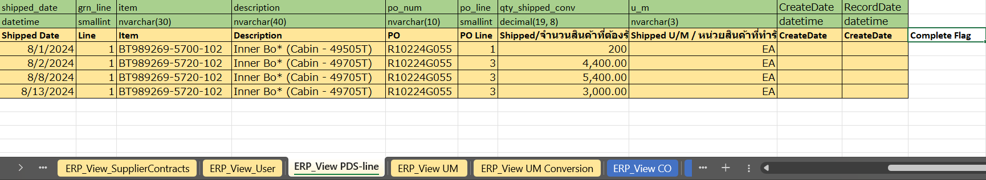
3. Document image
8
3-1-4. PO/PDS Line
Syteline will create view table on middle DB tier
SYTELINE ⇒Pegasus
PO/PDS Line
* Used to generate Material Receive and QC Check schedule
Descriptions
Item | Description | Remarks
Vendor | Vendor ID
Name | Vendor Name
GRN | PDS No
Status | Status of data | “I” (In process) status will be process on WMS
Date | Date created
Shipped Date | Shipped date
Line | Line no
Item | Part no
Description | Part name
PO | PO number
PO Line | PO line
Shipped | Plan qty
Shipped U/M | Unit of material
Complete Flag | Used to set completion of schedule

Slide 13
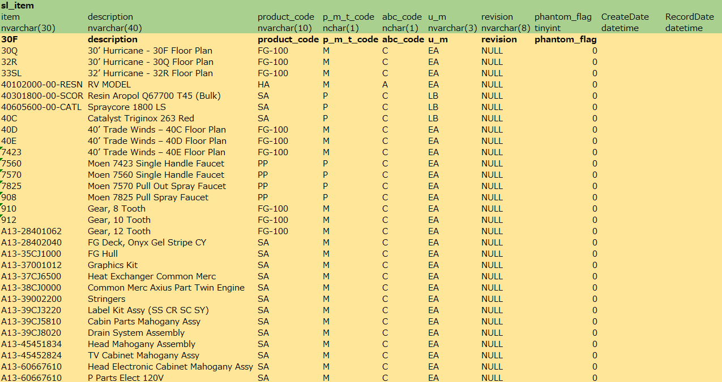
3. Document image
5
3-1-5. Item master
SYTELINE
⇒Pegasus

Slide 14
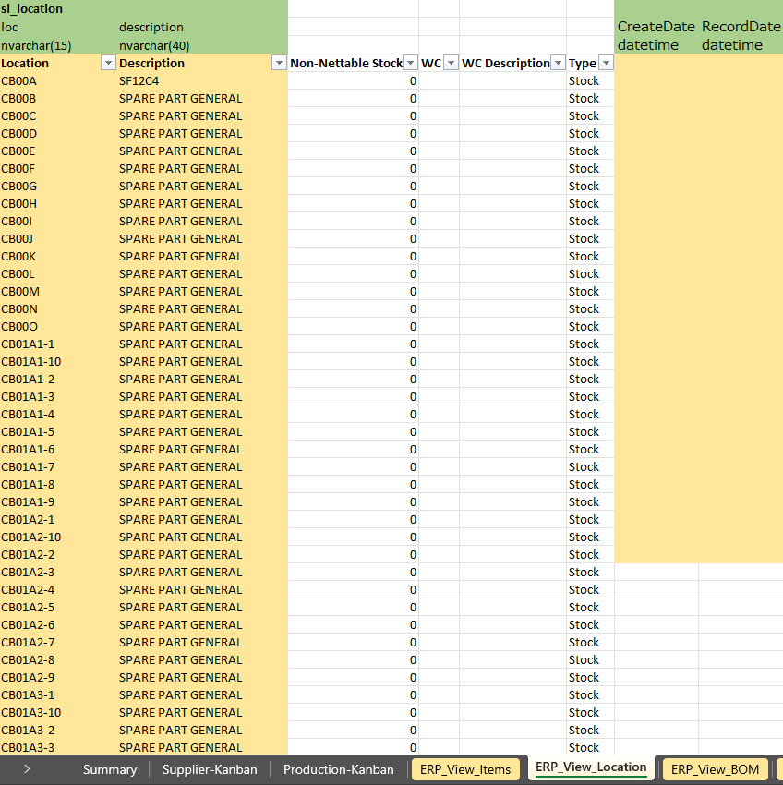
3. Document image
5
3-1-6. Location master
SYTELINE ⇒Pegasus

Slide 15
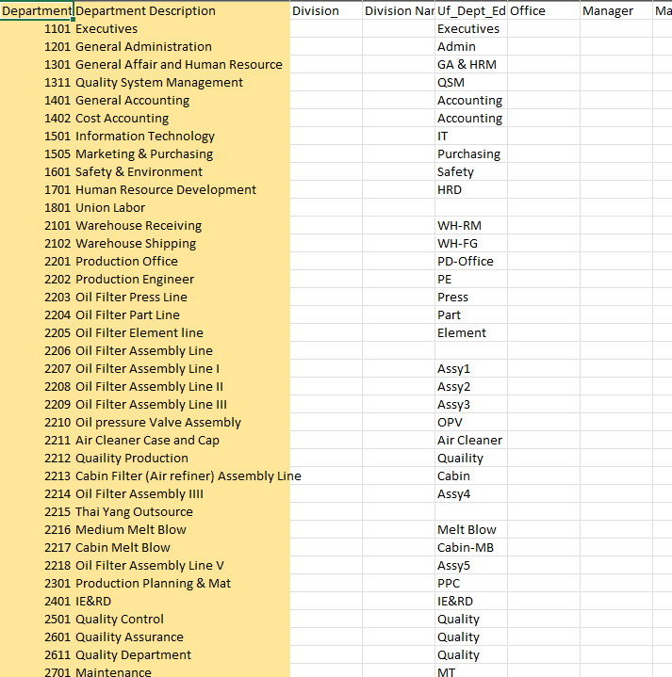
3. Document image
3-1-7. Department master
TBFST ⇒Pegasus

Slide 16
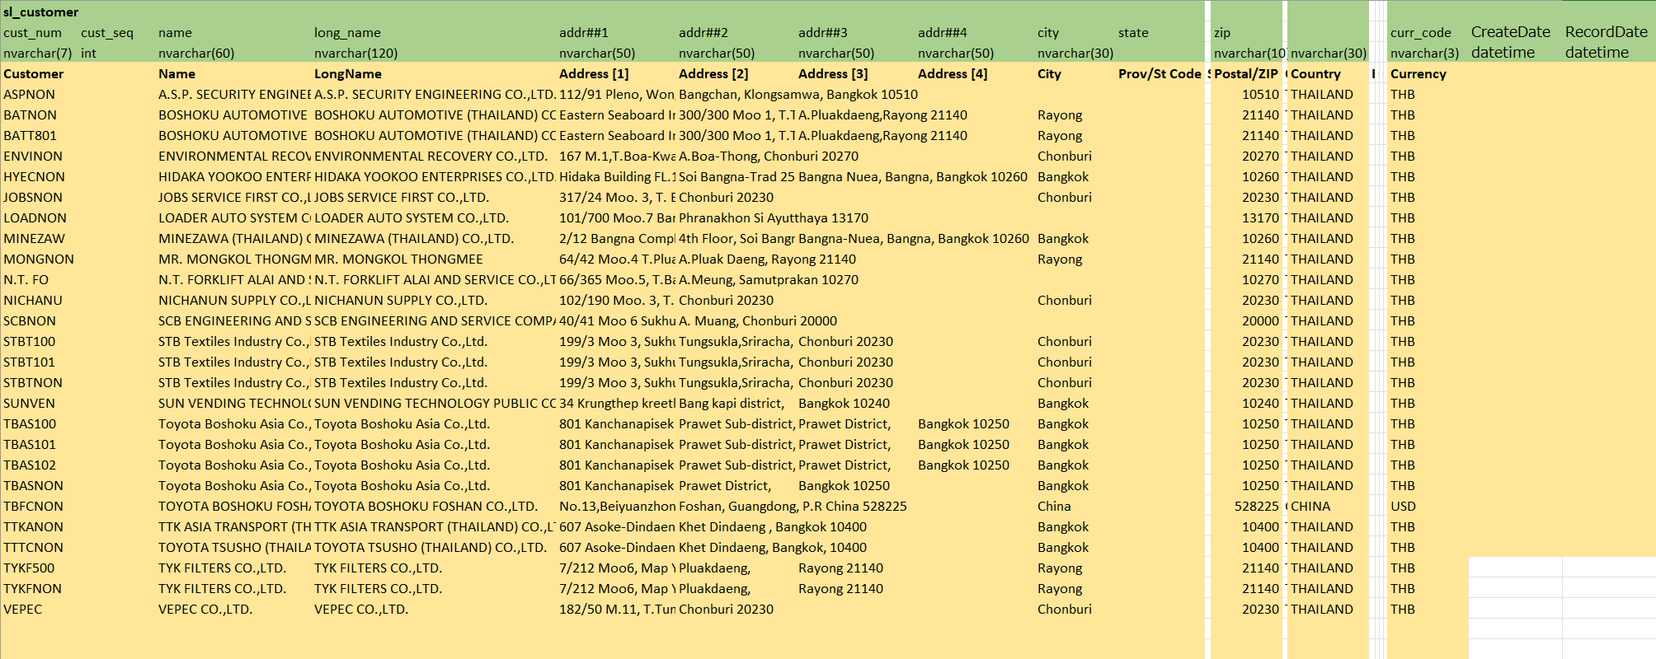
3. Document image
5
3-1-8. Customer master
SYTELINE ⇒Pegasus

Slide 17
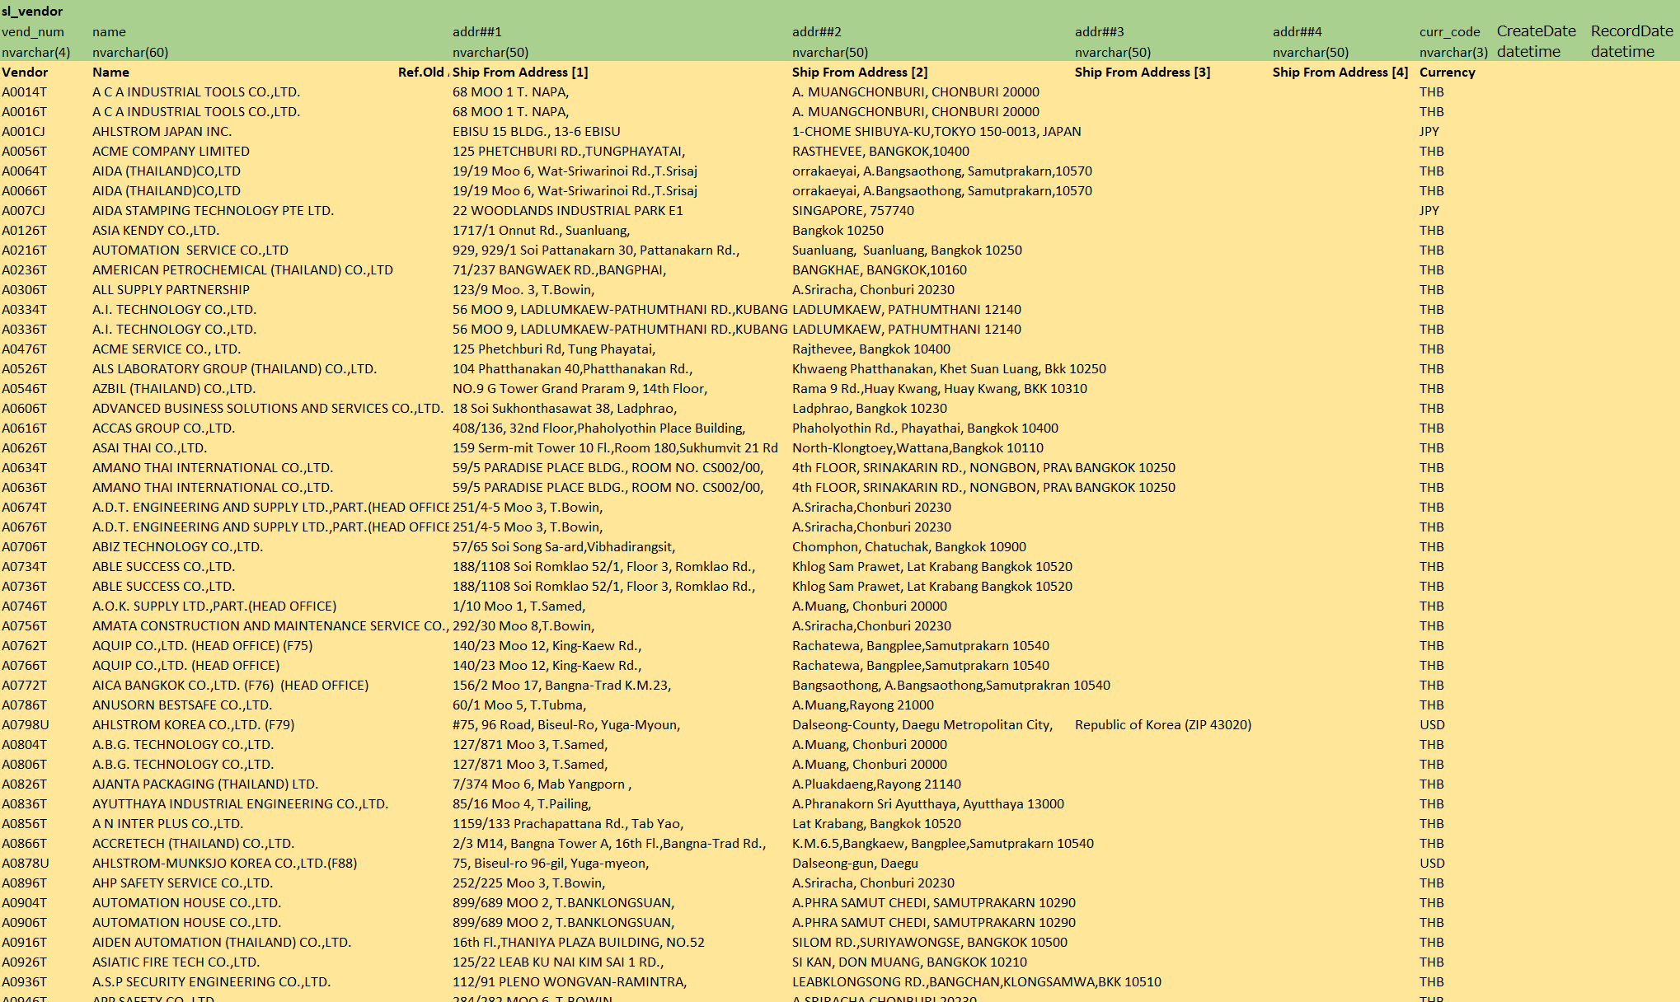
3. Document image
5
3-1-9. Supplier master
SYTELINE ⇒Pegasus

Slide 18
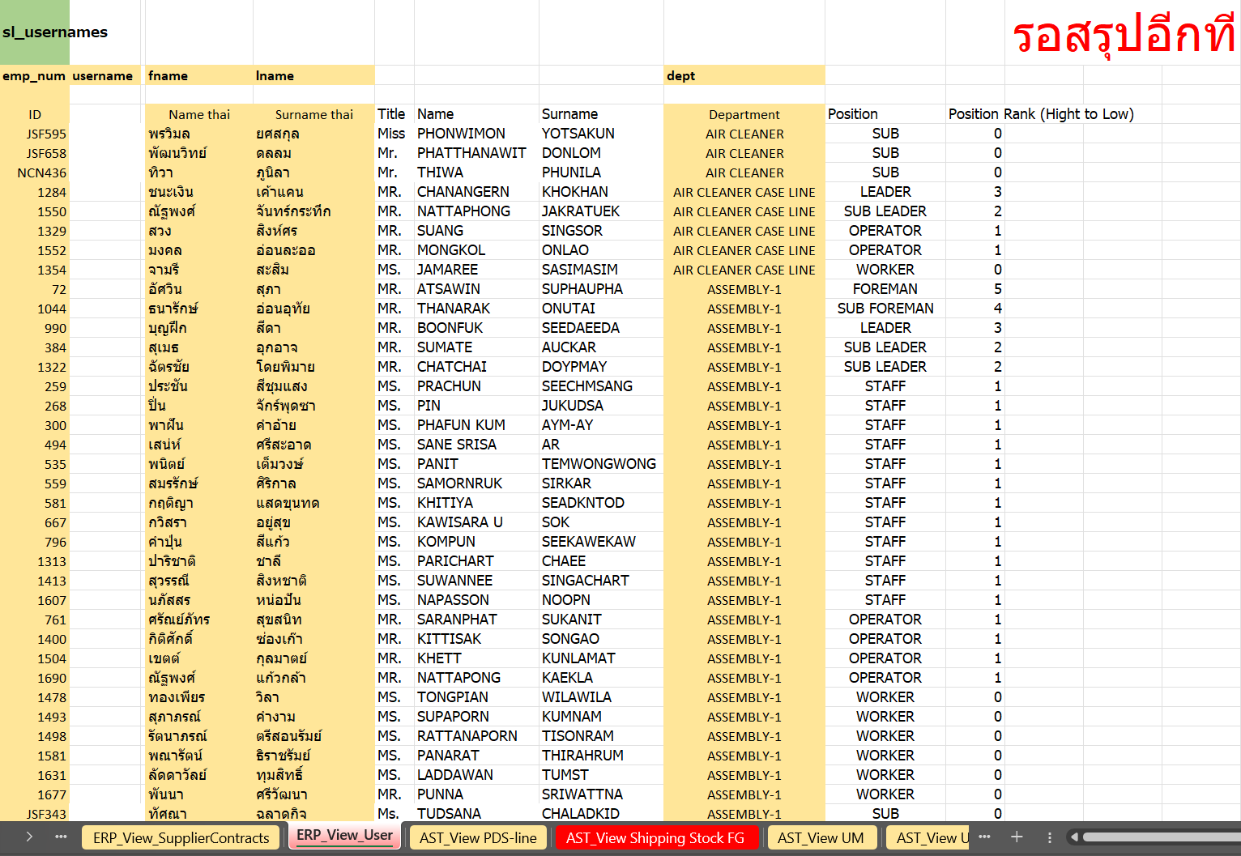
3. Document image
7
3-1-10. User master
SYTELINE ⇒ Pegasus

Slide 19
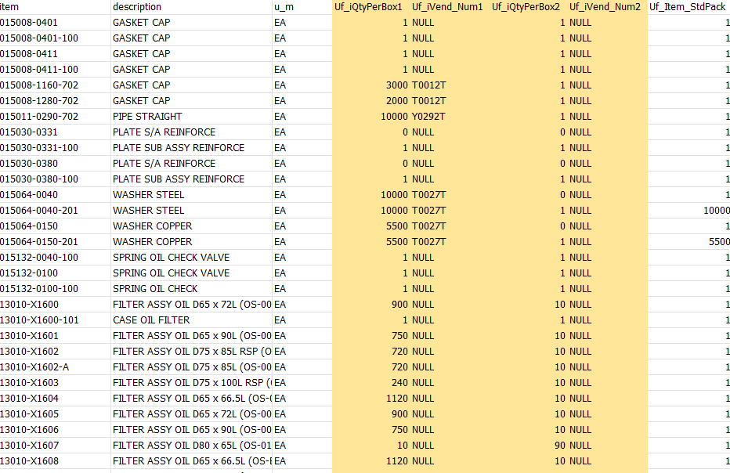
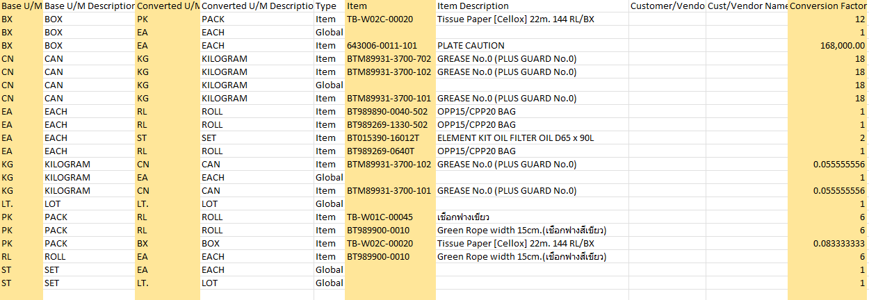
3. Document image
3-1-11. Packing Standard master
SYTELINE ⇒Pegasus
Standard pack
Unit of measure conversion

Slide 20
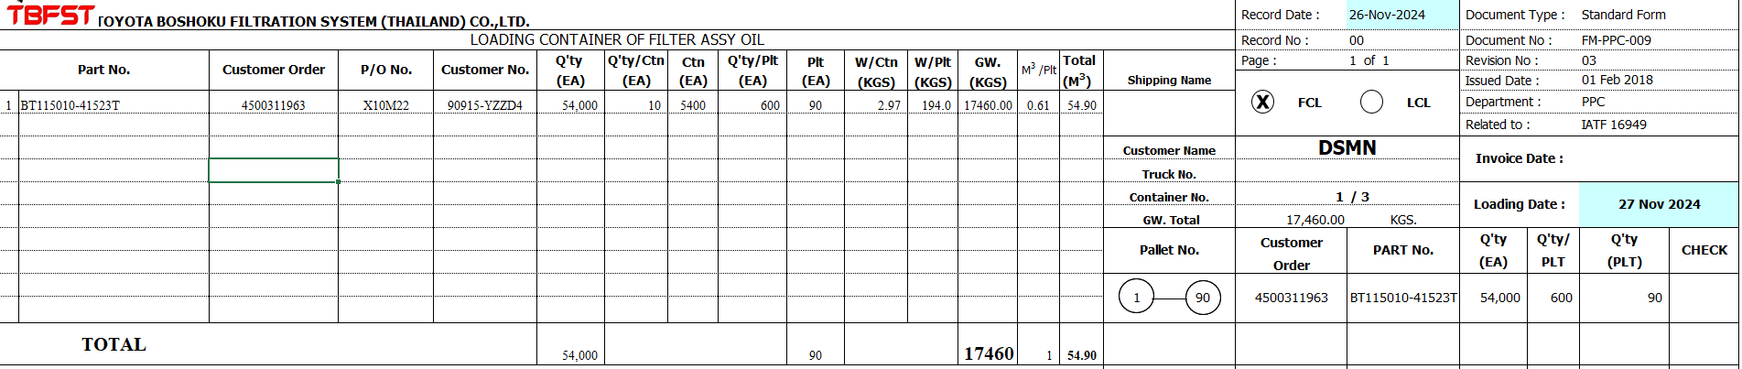
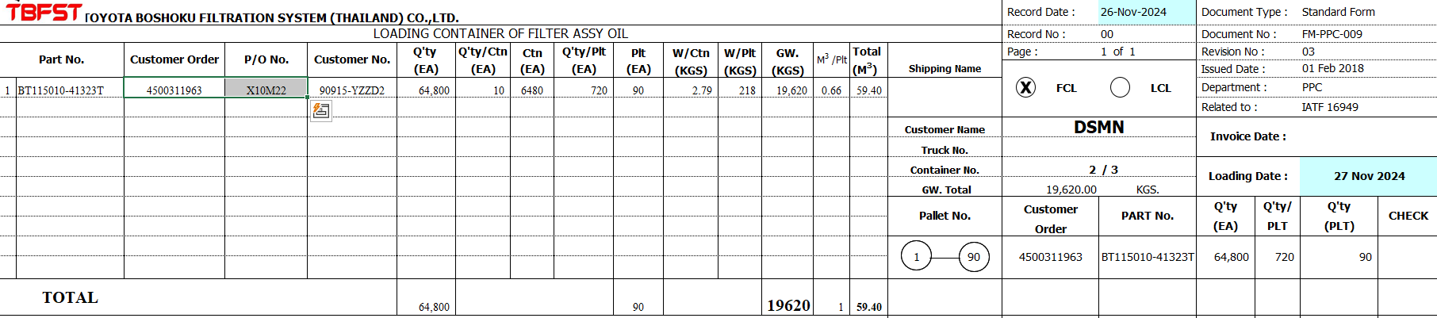
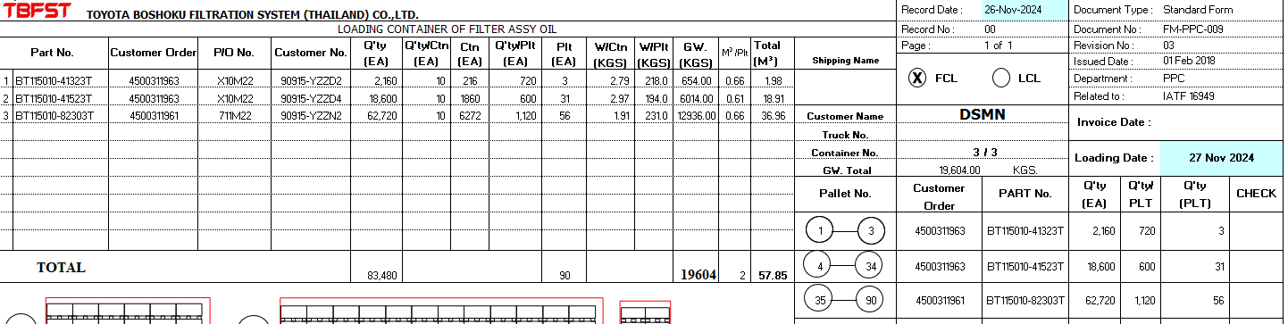
3. Document image
8
3-1-12. Loading Container – FG transfer, POKAYOKE
TBFST ⇒Pegasus
Loading Container
Import loading container to generate the FG transfer to loading area and POKAYOKE
Conditions :
There are linked CO(3-1-2) data and loading container import items which will allowed to create
FG transfers and POKAYOKE schedules only.

Slide 21
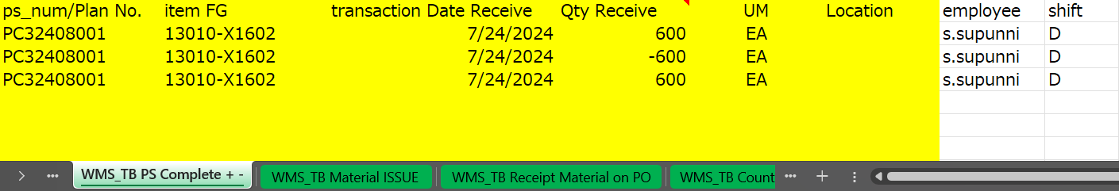
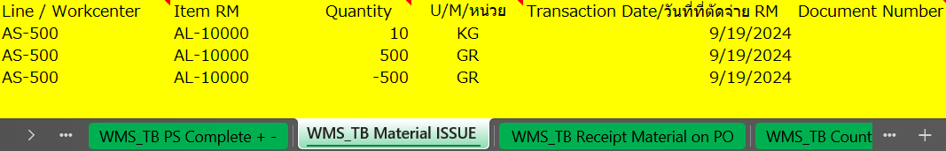
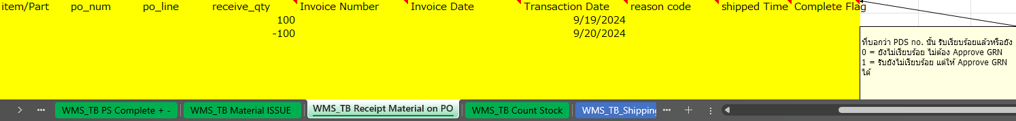
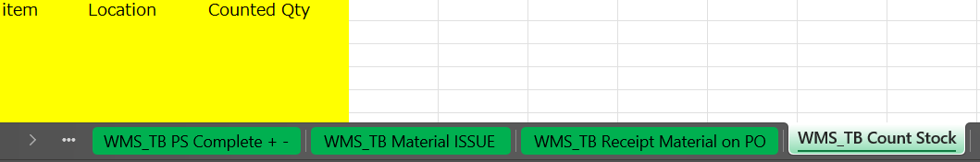
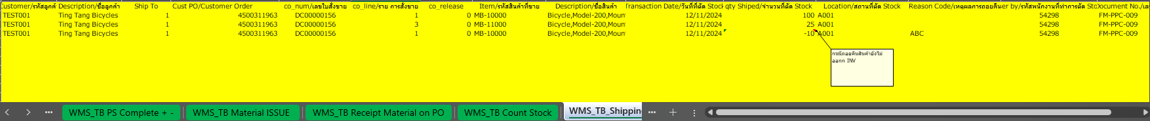
3. Document image
8
3-1-13. PS Complete (FG Inbound) => WMS_TB PS Complete
Pegasus ⇒ SYTELINE
3-1-14. Material Issue => WMS_TB Material ISSUE
Pegasus ⇒ SYTELINE
3-1-15. Receipt Material => WMS_TB Receipt Material on PO
Pegasus ⇒ SYTELINE
3-1-16. Stock count => WMS_TB Count Stock
Pegasus ⇒ SYTELINE
3-1-17. FG Outbound => WMS_TB_Shipping FG
Pegasus ⇒ SYTELINE

Slide 22
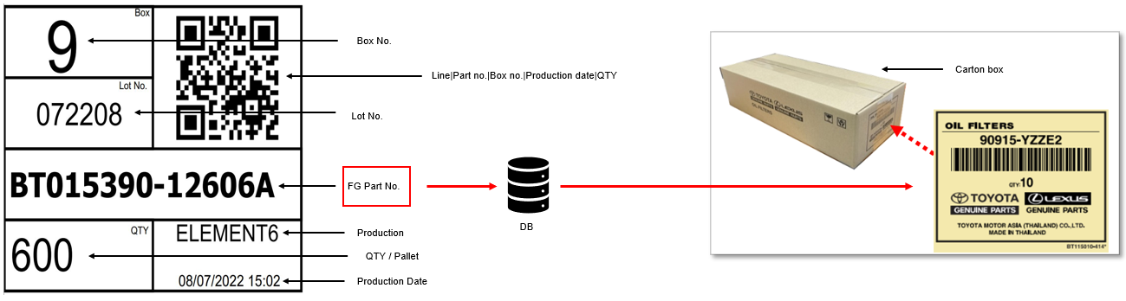
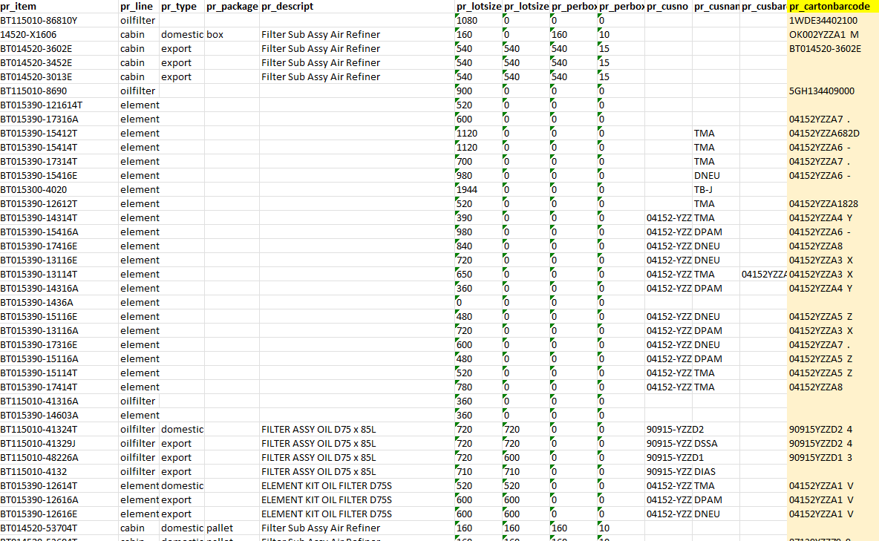
3. Document image
8
3-1-18 Carton barcode master
TBFST ⇒Pegasus
Carton barcode comparison
Carton barcode master data

Slide 23
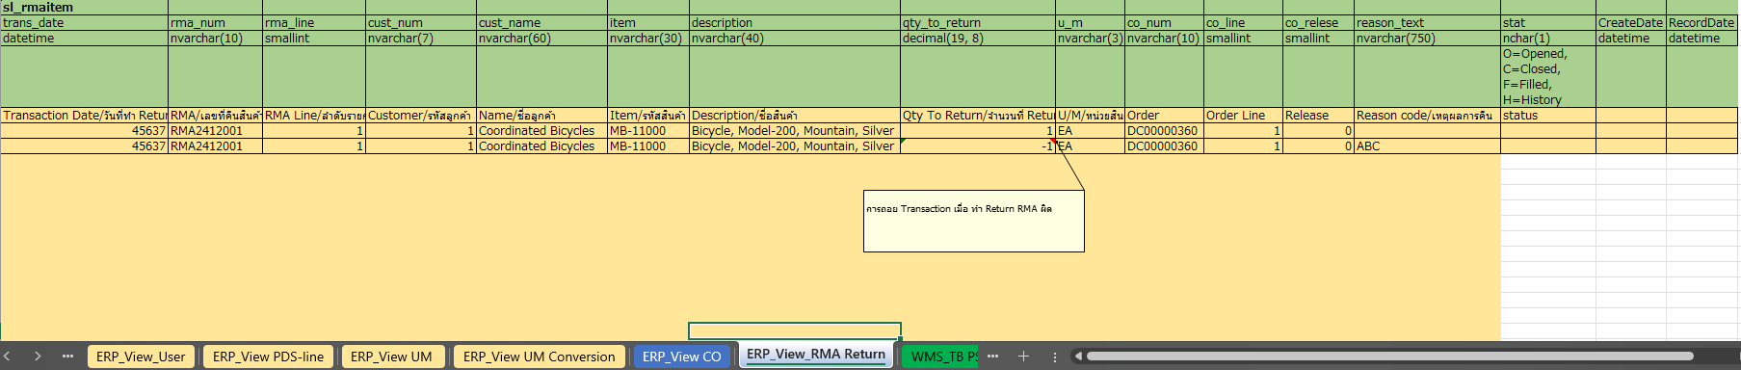
3. Document image
8
3-1-19. RMA Return view table
SYTELINE ⇒Pegasus
RMA Return
Retrieve the RMA return data from ERP to generate the FG inbound schedule,
where items are received into the warehouse (WH).

Slide 24
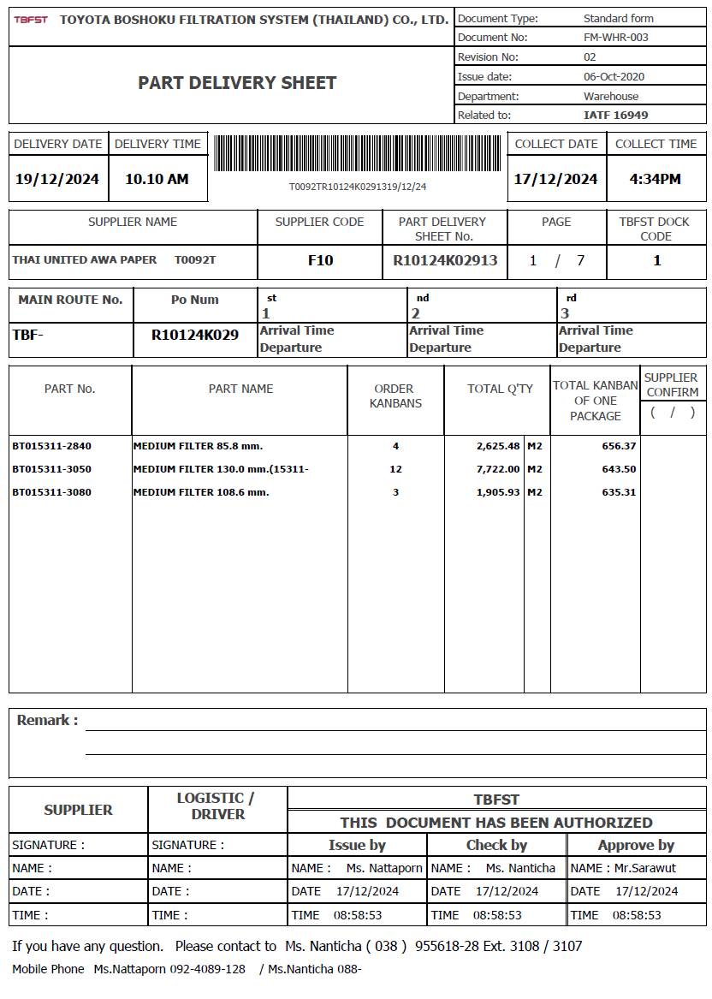
3. Document image
8
3-1-20. Part Delivery Sheet
TBFST ⇒Pegasus

Slide 25
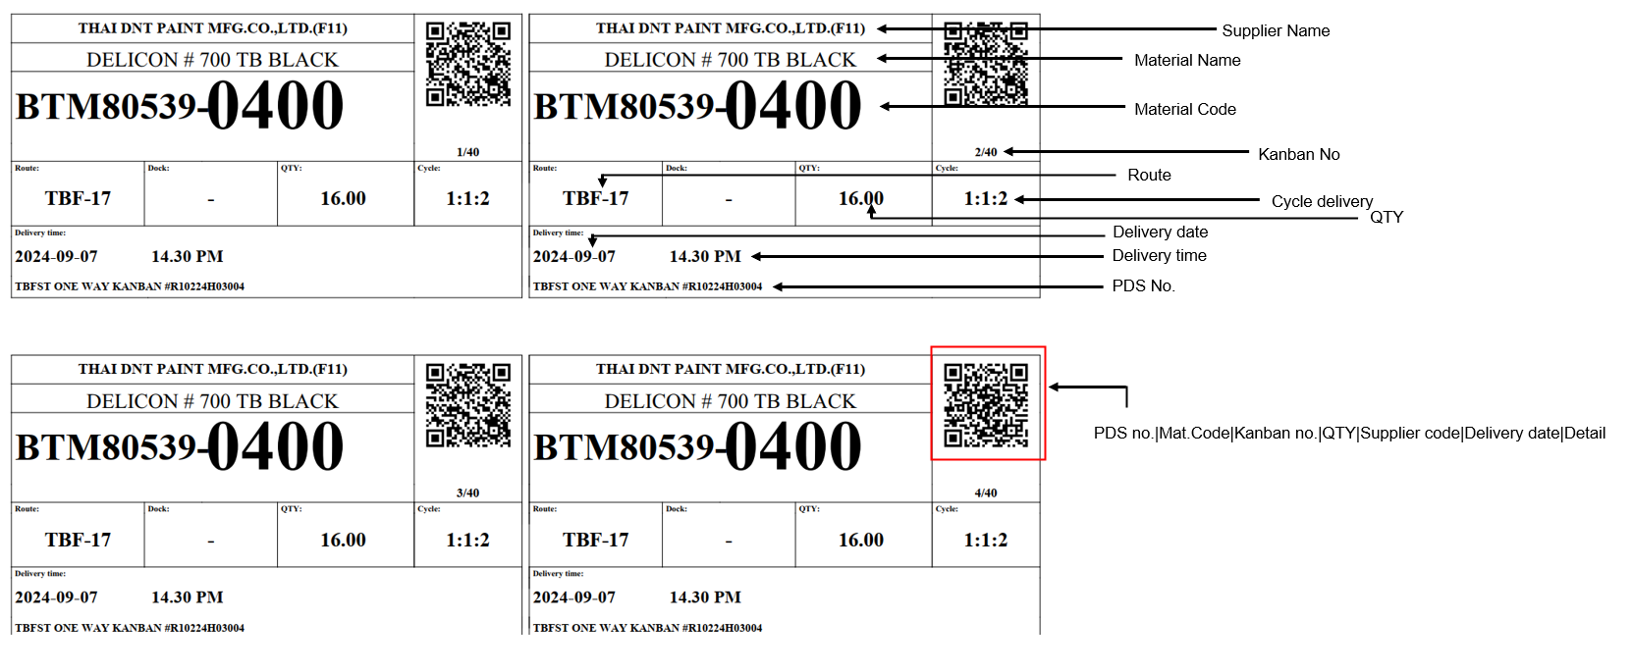

3. Document image
6
3-2-1. Supplier KANBAN
QR Code format:
PDS no.|Mat.Code|Kanban no.|QTY|Supplier code|Delivery date|Detail
Example:
R10224H03004|BTM80539-0400-102|4|16.00|T0102T|2024-09-07|medium

Slide 26
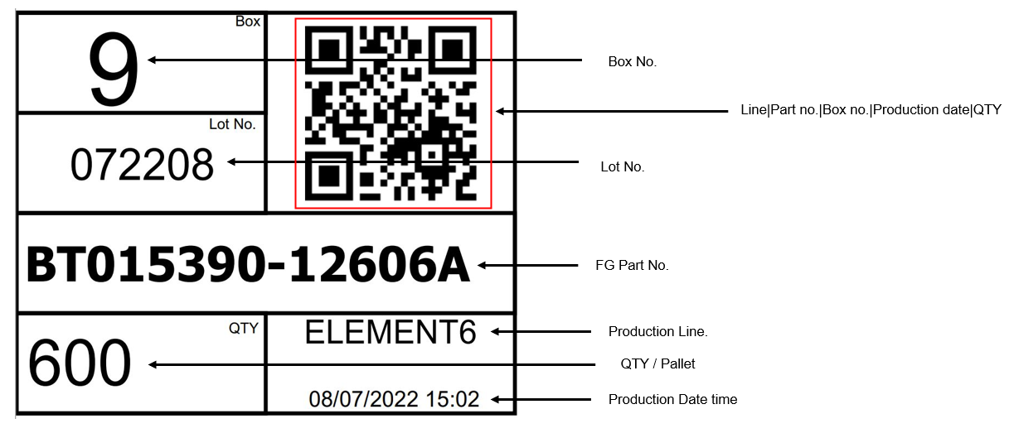
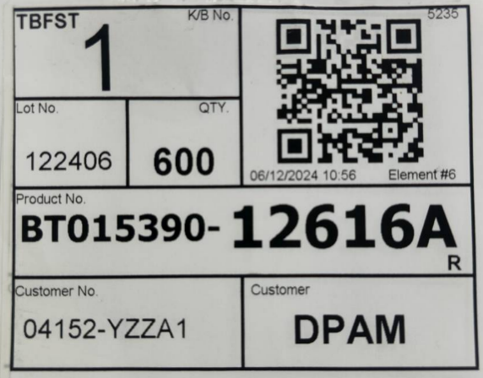
3. Document image
7
3-2-2. Production KANBAN
QR Code format:
Line|Part no.|Box no.|Production date|QTY
Example:
e6|12606A|9|08072022|600
2024-12-15:
New format layout

Slide 27
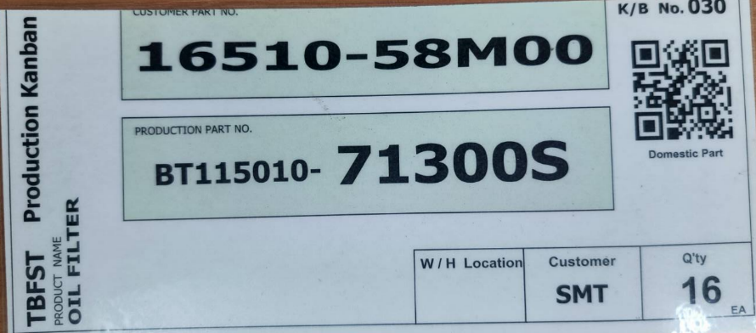

3. Document image
7
3-2-3. Production KANBAN (reused KANBAN)
QR Code format:
[Customer P/N – 11digits][Production P/N – 15digits][Qty]-[K/B No.]
Example:
16510-58M000BT115010-71300S016-030

Slide 28
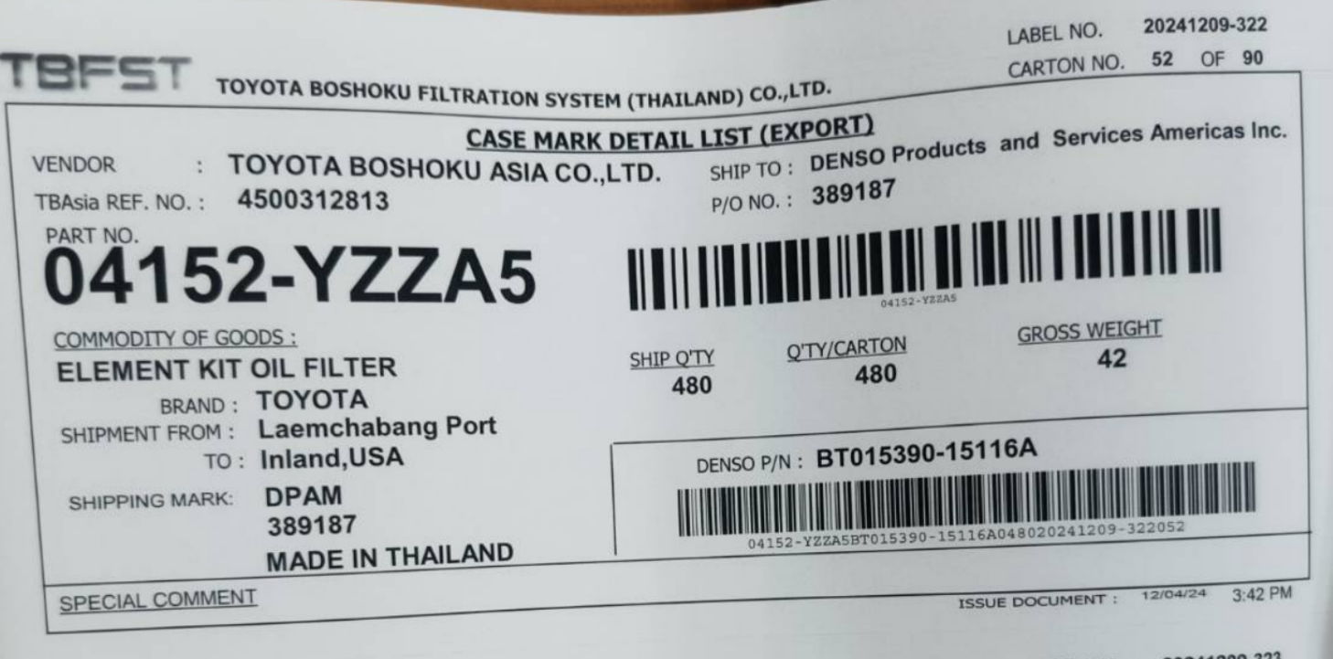
3. Document image
7
3-2-4. Customer KANBAN (Case mark)

Slide 29
4. Operation flow
8
4-1. RM – Materials Receive (PDS Line from ERP)
ERP
Stock Management System Pegasus
Send/Resend PDS Line
Middle Tier
DB
Read PDS Line
Report error details
Data OK?
Yes / No
No
Yes
Acceptance work
/ Create RM schedule
Next #1

Slide 30
4. Operation flow
8
4-1. RM – Materials Receive (Continue)
ERP
Stock Management System Pegasus
Next #1
พี่อ๋อ นันทิชา
Scan PDS sheet to start receiving process
No
Individual scan mode?
Yes/No
Yes
No
Request leader permission?
Yes/No
Scan all
the KANBAN tag.
Confirm and move to QC area
Yes
Scan 1st tag and move to QC area
Enter lot size
and total amount
Confirm and move to QC area
Return Materials
No
QC Inspection
Yes / No
Yes
Confirm RM transactions on web
QC Confirm and move to storage location
Feedback RM result
Get RM result
Middle Tier
DB

Slide 31
4. Operation flow
8
4-2. Temporary FG Inbound
ERP
Stock Management System Pegasus
Start
Scan Production KANBAN
Scan box barcode due to matching the parts no and carton barcode
Is Matched?
Yes / No
No
Yes
Yes
Is more KANBAN?
Yes / No
No
Scan temporary location ID (lane location) & confirm
Finish

Slide 32
4. Operation flow
8
4-3. FG Inbound (Inbound to FG store)
ERP
Stock Management System Pegasus
Start
Check actual part no and FG inbound work
No
Found FG Inbound work?
Yes / No
Yes
Move item to store & Scan FG store location ID
Enter item qty amount
Feedback PS result
Confirm PS transactions on web
Get PS result
Middle Tier
DB
Is more Inbound work?
Yes / No
Yes
No
Finish

Slide 33
4. Operation flow
8
4-3. FG Transfer / POKAYOKE (preparing schedule)
TBFST
Stock Management System Pegasus
Start
Preparing Loading Container Excel(CSV)
Import with Pegasus
Yes
File import error?
Yes / No
Check error details
No
Checking the import detail
No
Confirm work?
Yes
Acceptance work
Finish

Slide 34
4. Operation flow
8
4-4. FG Transfer
TBFST
Stock Management System Pegasus
Start
Check FG transfer work in handy
No
Found FG transfer work?
Yes / No
Yes
Go to location & scan store location ID then move items out
System will choose the oldest package from specific location
Is more transfer work?
Yes / No
Yes
No
Confirm FG transfer schedule on web
Finish

Slide 35
4. Operation flow
8
4-5. POKAYOKE
TBFST
Stock Management System Pegasus
Start
Check POKAYOKE work in handy
No
Found POKAYOKE work?
Yes / No
Yes
Check KANBAN
Scan production KANBAN & customer KANBAN
No
Is matched?
Yes / No
Yes
Yes
Replace production KANBAN with customer KANBAN
Is more POKAYOKE work?
Yes / No
No
Feedback FG Outbound result
Confirm FG Outbound transactions on web
Get FG Outbound result
Middle Tier
DB
Finish

Slide 36
4. Operation flow
8
4-6. Material Issue
TBFST
Stock Management System Pegasus
Start
Receive order to material issue
No
Is KANBAN mode?
Yes / No
Yes
Material Issue Manual mode process
Material Issue KANBAN process
Is more work?
Yes / No
Yes
No
Finish

Slide 37
4. Operation flow
8
4-6. Material Issue – Manual mode
TBFST
Stock Management System Pegasus
Start
Scan parts barcode
Enter the PS No
Enter/Adjust the quantity
System will get the oldest package (FIFO) due to designate quantity
Is more work?
Yes / No
Yes
No
Scan barcode line(destination line)
Confirm & move designate items out
System will generate material issue slip
Finish

Slide 38
4. Operation flow
8
4-6. Material Issue – KANBAN mode
TBFST
Stock Management System Pegasus
Start
Enter the PS No
Scan KANBAN
Is more KANBAN?
Yes / No
Yes
No
Scan barcode line(destination line)
Confirm
System will generate material issue slip
Finish

Slide 39
4. Operation flow
8
4-6. Material Issue – Confirm/Cancel Material Issue Slip
TBFST
Stock Management System Pegasus
Start
Check Material Issue Slip in handy
No
Found waiting to confirm slip?
Yes / No
Yes
Click and visual check the items and slip details
Confirm or Cancel the slip
Is more slip?
Yes / No
Yes
No
Feedback Material Issue result
Confirm Material Issue Slip on web
Get Material Issue result
Middle Tier
DB
Finish

Slide 40
4. Operation flow
8
4-7. RMA Return – Prepare data from ERP
ERP
Stock Management System Pegasus
Start
Send/Resend RMA Return
Middle Tier
DB
ERP_View_RMA Return
Read RMA Return
Report error details
Data OK?
Yes / No
No
Yes
Acceptance work
/ Create Receipt Material schedule
End

Slide 41
4. Operation flow
8
4-8. Return Material
ERP
Stock Management System Pegasus
พี่อ๋อ นันทิชา
Start
Enter “Return Material” and
Scan KANBAN
Yes
Is More KANBAN?
Yes / No
No
Scan barcode line
(source location)
Confirm and move material to WH store
System will automatically create Return Mat schedule
Feedback Material Issue rollback result
Confirm Return Mat schedule on web
Get Material Issue result
Middle Tier
DB
Is more Return material work?
Yes / No
Yes
No
Finish

Slide 42
4. Operation flow
8
4-7. Master management
TBFST
Stock Management System Pegasus
Location master
PC : Location master
User master
PC : User master
User credential master
PC : User Credential
Authority master
PC : Authority Master
Name master
PC : Name Master
Packing Standard master
PC : Packing Standard
Bill of Materials
PC : Bill of Materials
NG Reason master
PC : Name Master
Carton barcode master
PC : Packing Standard
Department master
PC : Bill of Materials

Slide 43
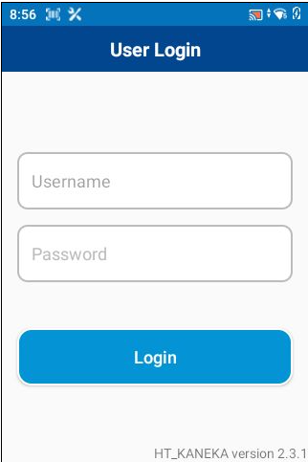
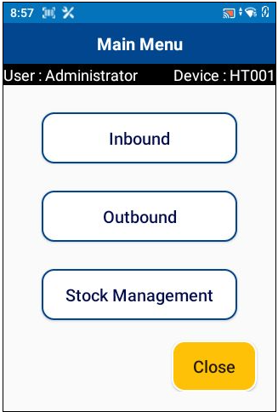
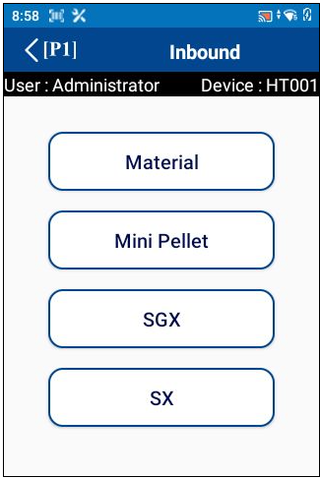
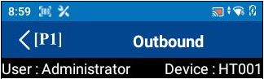













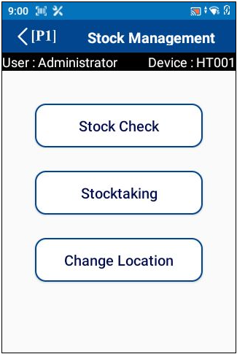
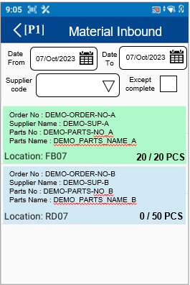
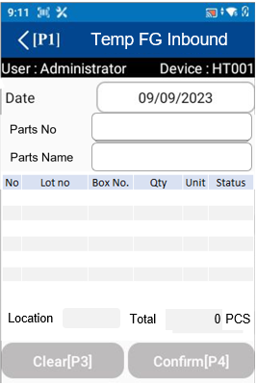
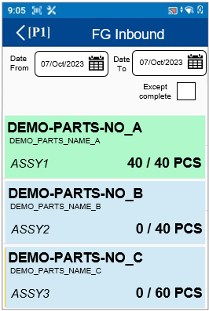
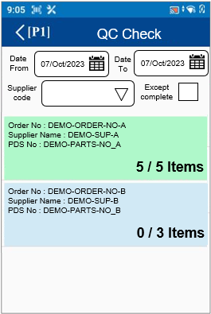
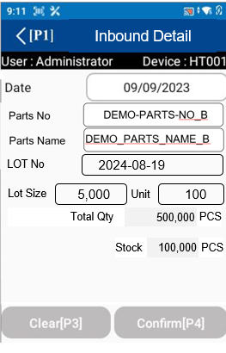
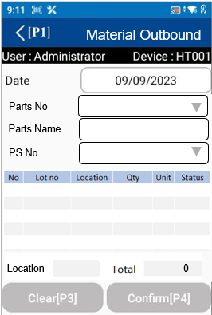
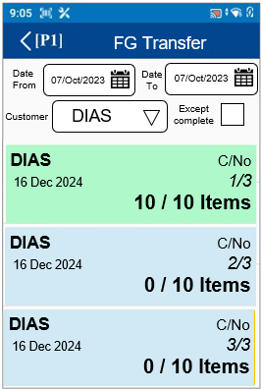
5. System functional specifications
8
5-1. Handy terminal function
1. User Login
2. Main menu
3. Inbound menu
4. Outbound menu
Material
Inbound
Supplier FG Inbound
Temp FG
Inbound
Material
Outbound
FG
Transfer
POKAYOKE
Sell
WIP
Supplier FG Inbound
FG
Inbound
Return
Material
Inbound Schedule
QC
Check
Simple
Inbound
Material
Issue Slip
Simple
Outbound
Inbound
5. Stock management menu
6. Material Inbound
7. Temp FG Inbound
8. FG Inbound
9. QC Check
10. Simple Inbound
11. Material Outbound
12. FG Transfer

Slide 44
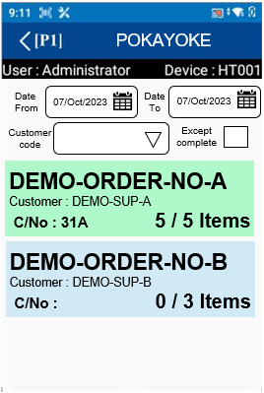
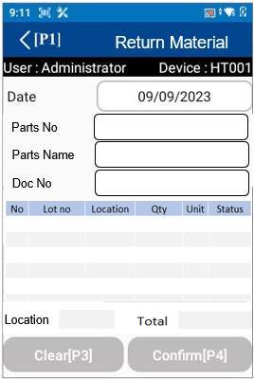
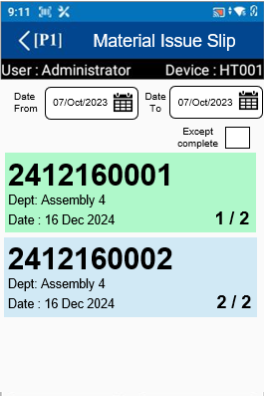
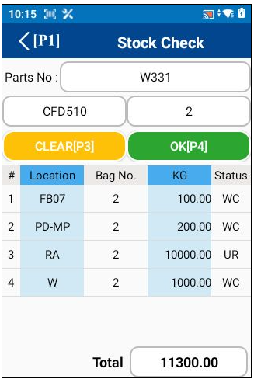
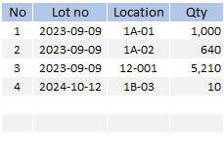


5. System functional specifications
5-1. Handy terminal function
13. POKAYOKE
14. Return Material
15. Material Issue Slip
16. Stock check
Lot No:
DEMO-PARTS-NO_B
6,860
17. Stock taking
18. Change location

Slide 45





5. System functional specifications
5-1. Handy terminal function
5-1-1. User Login
This is the screen that transitions after icon app click from home screen.
User name: Information is referenced from the User master.
Enter the User code of User master.
If it enter a code that does not exist, an error screen will be displayed. *1
Pass word: Information is referenced from the User credential master.
The User code of User master is linked to the User code of User credential master. User credential Enter the master password.
If it enter a code that does not exist, an error screen will be displayed. *1
Login button: If the information is correct, it will be redirected to the Main menu.
*1: Display screen when information is incorrect
OK button: Close this screen. Return to the previous process.
User master
User credential master

Slide 46
5. System functional specifications
5-1. Handy terminal function
5-1-2. Main menu
This is the screen that transitions after logging in from User Login.
Inbound button: Transitions to the Inbound screen.
Outbound button: Transitions to the Outbound screen.
Stock Management button: Transitions to the Stock Management screen.
Close button: Closes the application.
admin
1234

Slide 47
5. System functional specifications
7
5-2. Handy terminal function Inbound
5-2-1. Inbound
This is the screen that transitions after select inbound from Main menu.
Material Inbound button: Transitions to the Material Inbound screen.
Supplier FG Inbound button: Transitions to the Supplier FG Inbound screen.
Pokayoke button: Transitions to the Pokayoke screen.
Temp FG Inbound button: Transitions to the Temp FG Inbound screen.
FG Inbound button: Transitions to the FG Inbound screen.
QC Check button: Transitions to the QC Check screen.
Simple Inbound button: Transitions to the Simple Inbound screen.
< (P1): Back to Main menu
Material
Inbound
Supplier FG Inbound
Temp FG
Inbound
Supplier FG Inbound
FG
Inbound
QC
Check
Simple
Inbound

Slide 48




5. System functional specifications
8
5-2. Handy terminal function Inbound
5-2-2. Material Inbound *Same as “Supplier FG Inbound”
Material Inbound
This is the screen that transitions after select Inbound Schedule from Inbound.
Date from: Select the start of the target date. Default is today's date. Search ORDER DELIVERY DATE
Date to: Select the end of the target date. Default is today's date. Search ORDER DELIVERY DATE
PDS No: Able to scan PDS sheet to find the schedule.
Except complete: If checked, the completed status Item list will not be displayed from the Item list. Default is unchecked.
Order no : ORDER NO
Supplier name : SUPPLIER CODE
Part No.: PART NUMBER
Part Name: PART NAME
Location: Fixed location of each Item linked to Item master
Item quantity: Number of items that have been processed
Status color: Green - Completed, Dark Blue - Working, Light Blue - Not Started.
< (P1): Back to Main menu
Date
From
07/Oct/2023
Date
To
07/Oct/2023
PDS No
Except complete
Material
Inbound
Supplier FG Inbound
Temp FG
Inbound
Order No : DEMO-ORDER-NO-A
Supplier Name : DEMO-SUP-A
Parts No : DEMO-PARTS-NO_A
Parts Name : DEMO_PARTS_NAME_A
Supplier FG Inbound
20 / 20 PCS
Order No : DEMO-ORDER-NO-B
Supplier Name : DEMO-SUP-B
Parts No : DEMO-PARTS-NO_B
Parts Name : DEMO_PARTS_NAME_B
FG
Inbound
QC
Check
Simple
Inbound
0 / 50 PCS
PDS sheet
Able to scan the PDS sheet to enter the receive process automatically
2024-12-16:
There are two receiving types of Material Inbound.
All_at_once : Scan all KANBAN packs.
Individual : Manual enter total pack quantity.
Conditions :
1.Collect receiving type information on which is the reception was conducted (Individual/All_at_once)
2.Lot size standard – display n/total
3.Able to over/under received plan
3.1 In case of received qty >= Plan, show the complete only.
3.2 In case of received qty < Plan
a. Medium/Steel Coil able to set pending or complete
b. Others – shows pending only
4.Detect and prevent scanning the same KANBAN

Slide 49





5. System functional specifications
8
5-2. Handy terminal function Inbound
5-2-3. Material Inbound *Same as “Supplier FG Inbound” - Inbound Detail
Material Inbound
Inbound Detail
This is the screen that transitions after select order information from Inbound screen.
Mode: All at once/Individual(default). *Click to change mode
Part No.: Part number
PDS No.: PDS number
Total: The total number from plan
Lot No: From KANBAN delivery date
Qty: Quantity of received item
Unit: Receive unit will be loaded from schedule * Able to over/under the plan qty
Location : The location of items will be stored.* Use the location_fix_id (item master) and cannot change
Clear[P3]: Clear input contents
Confirm[P4]: Confirmation processing. Normal end: Completion of registration *1. Warning: Warning screen display *2
< (P1): Back to Main menu
Date
From
07/Oct/2023
Date
To
07/Oct/2023
All at once
Individual
Supplier
code
Except complete
BTM80539-0400
Order No : DEMO-ORDER-NO-A
Supplier Name : DEMO-SUP-A
Parts No : DEMO-PARTS-NO_A
Parts Name : DEMO_PARTS_NAME_A
PDS No
Total
480
PCS
QR Code format:
PDS no.|Mat.Code|Kanban no.|QTY|Supplier code|Delivery date|Detail
Example:
R10224H03004|BTM80539-0400-102|4|16.00|T0102T|2024-09-07|medium
20 / 20 PCS
R10224G05501
0
Order No : DEMO-ORDER-NO-B
Supplier Name : DEMO-SUP-B
Parts No : DEMO-PARTS-NO_B
Parts Name : DEMO_PARTS_NAME_B
0 / 50 PCS
Q01
Stock PCS
Location
100,000
Clear[P3]
Confirm[P4]
Inbound Detail
Show current total stock information.
Show
- PDS
- Order no (PO number)
Inbound Detail
Change mode
Change the mode, the data will be lost!!
All at once
Individual
All at once
Individual
BTM80539-0400
BTM80539-0400
Confirm to change mode?
PDS No
Total
480
PCS
PDS No
Total
480
PCS
R10224G05501
0
R10224G05501
16.00
Yes[P1]
Cancel[P2]
(Step.1)
Scan KANBAN for receive inspection with PO and record LOT
Q01
Stock PCS
Location
100,000
Q01
Stock PCS
Clear[P3]
Confirm[P4]
Location
100,000
In case of NG
Detect and prevent scan duplicated KANBAN
In case of NG
Detect and prevent scan multiple parts / PDS / Lot no
Clear[P3]
Confirm[P4]
Individual
Individual scan
Scan KANBAN 1 by 1 to complete the total amount
Inbound Detail
Inbound Detail
All at once
Individual
All at once
Individual
BTM80539-0400
BTM80539-0400
PDS No
Total
480
PCS
PDS No
Total
480
PCS
R10224G05501
16.00
R10224G05501
480.00
INFORMATION
Operation completed
Q01
Stock PCS
Q01
Stock PCS
Location
100,000
Location
100,000
Clear[P3]
Confirm[P4]
Clear[P3]
Confirm[P4]

Slide 50

5. System functional specifications
8
5-2. Handy terminal function Inbound
5-2-3. Material Inbound *Same as “Supplier FG Inbound” - Inbound Detail
All at once
Enter total unit
Enter the total unit number after scan step 1
Confirm
Inbound Detail
Inbound Detail
Use All at once
mode?
All at once
Individual
All at once
Individual
user
LEADER01
BTM80539-0400
BTM80539-0400
WARNING
password
*********
PDS No
Lot No
PDS No
Lot No
INFORMATION
R10224G05501
2024-08-19
R10224G05501
2024-08-19
Operation completed
OK[P2]
Clear[P3]
Lot Size
Unit
Lot Size
Unit
16.00
1
16.00
30
Yes[P1]
Cancel[P2]
Total Receive
Total Receive
Leader confirm
Enter or scan the leader id due to requests permission to use this mode
16.00
/480
480.00
/480
PCS
PCS
Q01
Stock PCS
Q01
Stock PCS
Location
100,000
Location
100,000
Clear[P3]
Confirm[P4]
Clear[P3]
Confirm[P4]
Over the plan
Inbound Detail
All at once
Individual
BTM80539-0400
INFORMATION
PDS No
Lot No
Operation completed
R10224G05501
2024-08-19
Lot Size
Unit
16.00
31
Total Receive
496.00
/480
PCS
Q01
Stock PCS
Location
100,000
Clear[P3]
Confirm[P4]
Under the plan
Inbound Detail
All at once
Individual
Completed or Pending?
(Step.2)
Click the Confirm[P4] to complete the operation
BTM80539-0400
Steel coil / Medium
Completed[P1]
Pending[P2]
PDS No
Lot No
INFORMATION
R10224G05501
2024-08-19
Operation completed
Lot Size
Unit
INFORMATION
16.00
29
Operation completed
Total Receive
Others
464.00
/480
PCS
Pending to Receive?
Q01
Stock PCS
Location
100,000
Yes[P1]
Cancel[P2]
Clear[P3]
Confirm[P4]

Slide 51
5. System functional specifications
7
5-2. Handy terminal function Inbound
5-2-4. QC Check
QC Check
This is the screen that transitions after select QC Schedule from Inbound.
Date from: Select the start of the target date. Default is today's date. Search ORDER DELIVERY DATE
Date to: Select the end of the target date. Default is today's date. Search ORDER DELIVERY DATE
Supplier code: Select supplier code. Or do a scan. Default is blank. Search SUPPLIER CODE
Except complete: If checked, the completed status Item list will not be displayed from the Item list. Default is unchecked.
Order no : ORDER NO
Supplier name : SUPPLIER CODE
PDS No.: PDS NUMBER
< (P1): Back to Main menu
Date
From
07/Oct/2023
Date
To
07/Oct/2023
Supplier
code
Except complete
Material
Inbound
Supplier FG Inbound
Temp FG
Inbound
Order No : DEMO-ORDER-NO-A
Supplier Name : DEMO-SUP-A
PDS No : DEMO-PARTS-NO_A
5 / 5 Items
Supplier FG Inbound
FG
Inbound
QC
Check
Simple
Inbound
Order No : DEMO-ORDER-NO-B
Supplier Name : DEMO-SUP-B
PDS No : DEMO-PARTS-NO_B
0 / 3 Items
(Step.2)
Enter GOOD / NG amount
Box No : 1 Total: 20 PCS
LOT
2024-08-19
OK
Cancel
INFORMATION
Operation completed

Slide 52




5. System functional specifications
7
5-2. Handy terminal function Inbound
5-2-4. QC Check
QC Check
QC Check Detail
This is the screen that transitions after select order information from Inbound screen.
PDS.: PDS number
PO No: Order no
Part No: Part number of items
NG/PASS: Quantity of NG and PASS
Unit: Receive unit will be loaded from schedule
Status: The status of QC Check
Location : The location of NG where items will be moved in. No initial value information.* The NG location will be loaded only.
Clear[P3]: Clear input contents
Confirm[P4]: Confirmation processing. Normal end: Completion of registration *1. Warning: Warning screen display *2
< (P1): Back to Main menu
Date
From
07/Oct/2023
Date
To
07/Oct/2023
PDS No
123456789ABC
Supplier
code
Except complete
PO No
12345
Order No : DEMO-ORDER-NO-A
Supplier Name : DEMO-SUP-A
PDS No : DEMO-PARTS-NO_A
5 / 5 Items
Order No : DEMO-ORDER-NO-B
Supplier Name : DEMO-SUP-B
PDS No : DEMO-PARTS-NO_B
0 / 3 Items
NG01
Location
0/50
Location
Total
Confirm[P4]
QC Check Detail
QC Check Detail
PDS No
123456789ABC
No NG entry
Click the confirm button
PDS No
123456789ABC
Status
Display the inspection result
PO No
12345
PO No
12345
(Step.2)
Enter GOOD / NG amount
INFORMATION
NG Location
No need to confirm the location while no NG entry
Box No : 1 Total: 20 PCS
Operation completed
NG01
NG01
LOT
2024-08-19
0/50
Location
Location
Location
Total
0/50
Confirm[P4]
Location
Total
OK
Cancel
Disable button
Disable while saved
QC Check Detail
BTM80539-0400
GOOD
1000
PCS
PDS No
123456789ABC
NG
0
PCS
PO No
12345
Select NG Reason
QC Check Detail
Total: 1,000 PCS
OK
Cancel
PDS No
123456789ABC
PO No
12345
Confirm location
Scan the QR code to confirm location
BTM80539-0400
NG01
995
Location
0/50
GOOD
PCS
Location
Total
NG
5
PCS
Confirm[P4]
Dirty skin
Total: 1,000 PCS
NG01
Location
0/50
OK
Cancel
Location
Total
INFORMATION
In case of NG
Enter NG amount
Clear[P3]
Confirm[P4]
Operation completed

Slide 53


5. System functional specifications
7
5-2. Handy terminal function Inbound
5-2-4. QC Check
QC Check Detail
QC Check Detail
PDS No
123456789ABC
PDS No
123456789ABC
PO No
12345
PO No
12345
INFORMATION
Operation completed
NG01
Location
NG01
0/50
Location
Total
0/50
Location
Confirm[P4]
Location
Total
Clear[P3]
Clear[P3]
Confirm[P4]
Add new input data.
1.Enter LOT Supplier (QC)
2.NG Reason (load from master)
Addition NG entry
Able to add NG entry to any QC schedule
QC Check Detail
14526-X1600-101
QC Check Detail
GOOD
2500
PCS
123456789ABC
NG
0
PCS
123456789ABC
(Step.2)
Enter GOOD / NG amount
PDS No
12345
Select NG Reason
PDS No
12345
PO No
Total: 2,500 PCS
PO No
Box No : 1 Total: 20 PCS
OK
Cancel
GOOD
20
PCS
NG
0
PCS
INFORMATION
Select NG Reason
14526-X1600-101
Operation completed
LOT
2024-08-19
NG01
GOOD
2450
PCS
NG01
OK
Cancel
Location
Location
0/50
0/50
Location
Total
NG
50
PCS
Location
Total
Clear[P3]
Confirm[P4]
Dirty skin
Clear[P3]
Confirm[P4]
Total: 2,500 PCS
OK
Cancel
QC Check Detail
Clear[P3]
Revoke the last changed
* Reload the current QC check details
QC Check Detail
PDS No
123456789ABC
PDS No
123456789ABC
PO No
12345
PO No
12345
Click Yes[P1] to clear?
NG01
Yes[P1]
Cancel[P2]
NG01
Location
Location
0/50
0/50
Location
Total
Location
Total
Confirm[P4]
INFORMATION
Clear[P3]
Confirm[P4]
Operation completed

Slide 54






5. System functional specifications
7
5-2. Handy terminal function Inbound
5-2-5. Temporary FG Inbound - Inbound Detail
This is the screen that transitions after select order information from Inbound screen.
Part No.: Part number
Part Name :PART NAME
Lot No: Today date YYYY-MM-DD will be default
Qty: Quantity of received item
Unit: Receive unit will be loaded from schedule
Total Qty: Will be loaded from schedule
Location : The WIP store lane will be loaded from the Location master. No initial value information.* The location control will be identified in QR Code
Clear[P3]: Clear input contents
Confirm[P4]: Confirmation processing. Normal end: Completion of registration *1. Warning: Warning screen display *2
< (P1): Back to Main menu
Temp FG Inbound
Material
Inbound
Supplier FG Inbound
Temp FG
Inbound
Supplier FG Inbound
FG
Inbound
QC
Check
Simple
Inbound
Total PCS
Location
0
(Step.1)
Scan WIP label for moving Goods to WIP Store lane
Export items 1KANBAN / 1OUTER (CARTON)
In case of NG
Box barcode doesn’t matched
Temp FG Inbound
Temp FG Inbound
(Step.2)
Scan Box Barcode due to data verification
* Refer to page 24 – carton mater compare
In case of NG
Detect and prevent scan duplicated KANBAN
Total PCS
Total PCS
Location
0
Location
20
Temp FG Inbound
Temp FG Inbound
NG
In case of NG
Must be enter the leader user and password to unlock the screen
user
LEADER01
password
*********
(Step.3)
Scan the destination location (end of production line)
OK[P2]
Clear[P3]
Total PCS
W01
20
Total PCS
Location
W01
20
Location
Confirm[P4]
Clear[P3]
INFORMATION
Operation completed

Slide 55

5. System functional specifications
7
5-2. Handy terminal function Inbound
5-2-6. FG Inbound
FG Inbound
This is the screen that transitions after select Inbound Schedule from Inbound.
Date from: Select the start of the target date. Default is today's date. Search ORDER DELIVERY DATE
Date to: Select the end of the target date. Default is today's date. Search ORDER DELIVERY DATE
Except complete: If checked, the completed status Item list will not be displayed from the Item list. Default is unchecked.
Part No.: PART NUMBER
Part Name: PART NAME
Location: Temporary Line Location.
Item quantity: Number of items that have been processed
Status color: Green - Completed, Dark Blue - Working, Light Blue - Not Started.
< (P1): Back to Main menu
Date
From
07/Oct/2023
Date
To
07/Oct/2023
Except complete
Material
Inbound
Supplier FG Inbound
Temp FG
Inbound
DEMO-PARTS-NO_A
DEMO_PARTS_NAME_A
ASSY1 40 / 40 PCS
Supplier FG Inbound
Order No : DEMO-ORDER-NO-B
Customer Name : DEMO-SUP-B
Parts No : DEMO-PARTS-NO_B
Parts Name : DEMO_PARTS_NAME_B
FG
Inbound
QC
Check
Simple
Inbound
DEMO-PARTS-NO_B
DEMO_PARTS_NAME_B
ASSY2 0 / 40 PCS
0 / 50 PCS
Order No : DEMO-ORDER-NO-A
Customer Name : DEMO-SUP-A
Parts No : DEMO-PARTS-NO_A
Parts Name : DEMO_PARTS_NAME_A
DEMO-PARTS-NO_C
DEMO_PARTS_NAME_C
ASSY3 0 / 60 PCS
Location: XX01
40 / 20 PCS
In case of NG
Location not scan
In case of NG
Enter an invalid qty
Date
From
FG Inbound
FG Inbound Detail
(Step.1)
Scan WH location
FG Inbound Detail
07/Oct/2023
Date
To
07/Oct/2023
Except complete
DEMO-PARTS-NO_A
DEMO_PARTS_NAME_A
ASSY1 40 / 40 PCS
Location :
Location :
Order No : DEMO-ORDER-NO-B
Customer Name : DEMO-SUP-B
Parts No : DEMO-PARTS-NO_B
Parts Name : DEMO_PARTS_NAME_B
ASSY2 =>
ASSY2 =>
FG01
DEMO-PARTS-NO_B
DEMO_PARTS_NAME_B
ASSY2 0 / 40 PCS
Qty :
Qty :
(Step.2)
Enter amount number
0 / 50 PCS
/ 40 PCS
30
/ 40 PCS
Order No : DEMO-ORDER-NO-A
Customer Name : DEMO-SUP-A
Parts No : DEMO-PARTS-NO_A
Parts Name : DEMO_PARTS_NAME_A
DEMO-PARTS-NO_C
DEMO_PARTS_NAME_C
ASSY3 0 / 60 PCS
Confirm[P4]
Location: XX01
40 / 20 PCS
In case of NG
Must be enter the leader user and password to unlock the screen
FG Inbound Detail
FG Inbound Detail
Date
From
FG Inbound
07/Oct/2023
Date
To
07/Oct/2023
NG
Except complete
user
DEMO-PARTS-NO_A
DEMO_PARTS_NAME_A
ASSY1 40 / 40 PCS
INFORMATION
Location :
LEADER01
Location :
Operation completed
password
ASSY2 =>
ASSY2 =>
*********
Order No : DEMO-ORDER-NO-B
Customer Name : DEMO-SUP-B
Parts No : DEMO-PARTS-NO_B
Parts Name : DEMO_PARTS_NAME_B
Qty :
Clear[P3]
Qty :
DEMO-PARTS-NO_B
DEMO_PARTS_NAME_B
ASSY2 30 / 40 PCS
OK[P2]
/ 10 PCS
/ 10 PCS
0 / 50 PCS
Order No : DEMO-ORDER-NO-A
Customer Name : DEMO-SUP-A
Parts No : DEMO-PARTS-NO_A
Parts Name : DEMO_PARTS_NAME_A
DEMO-PARTS-NO_C
DEMO_PARTS_NAME_C
ASSY3 0 / 60 PCS
Location: XX01
40 / 20 PCS

Slide 56
5. System functional specifications
7
5-2. Handy terminal function Inbound
5-2-7. Simple Inbound - Inbound Detail
Inbound Detail
This is the screen that transitions after select order information from Inbound screen.
Part No.: Part number
Part Name :PART NAME
Lot No: From KANBAN delivery date
Qty: Quantity of received item
Unit: Receive unit will be loaded from schedule
Total Qty: Will be loaded from schedule
Location : The allowed location and free location will be loaded from the Location master. No initial value information.* The location control will be identified in QR Code
Clear[P3]: Clear input contents
Confirm[P4]: Confirmation processing. Normal end: Completion of registration *1. Warning: Warning screen display *2
< (P1): Back to Main menu
Material
Inbound
Supplier FG Inbound
Temp FG
Inbound
LOT No
2024-08-19
Supplier FG Inbound
Lot Size
5,000
Unit
100
Total Qty PCS
FG
Inbound
QC
Check
Simple
Inbound
500,000
Stock PCS
Location
100,000
Inbound Detail
Inbound Detail
LOT No
LOT No
2024-08-19
Show current total stock information.
Lot Size
Unit
(Step.1)
Scan KANBAN for receive inspection with PO and record LOT
Lot Size
5,000
Unit
100
Total Qty PCS
Total Qty PCS
Stock PCS
500,000
Stock PCS
Location
Location
100,000
Inbound Detail
(Step.2)
Scan QC area barcode
The “Confirm[P4]” button will be enabled.
LOT No
2024-08-19
Lot Size
5,000
Unit
100
Total Qty PCS
500,000
Stock PCS
Q01
100,000
Location
Clear[P3]
Confirm[P4]
INFORMATION
(Step.3)
Click the Confirm[P4] to complete the operation
Operation completed

Slide 57
5. System functional specifications
7
5-3. Handy terminal function Outbound
5-3-1. Outbound
This is the screen that transitions after select outbound from Main menu.
Material Outbound: Transitions to the Material Outbound screen.
FG Transfer: Transitions to the FG Transfer screen.
POKAYOKE: Transitions to the POKAYOKE screen.
Return Material: Transitions to the Return Material screen.
< (P1): Back to Main menu
Material
Outbound
FG
Transfer
POKAYOKE
Return
Material
Inbound Schedule
Material
Issue Slip
Simple
Outbound
Inbound

Slide 58





5. System functional specifications
8
5-3. Handy terminal function Outbound
5-3-2. Material Outbound
This is the screen that transitions after select order information from Outbound item.
Date : Today’s date
Part No.: Part no list loaded from master. * Scan KANBAN QR data or item barcode/QR code(manual)
Part Name : Display part name while part no has been selected.
PS No : PS number list loaded from schedule table.
Lot No: No initial value information * Scan QR data or Can be changed manually
Location: No initial value information. If there is no link, display blank.* Scan barcode line. For example SA|AS01
Clear[P3]: Clear input contents
Confirm[P4]: Confirmation processing. Normal end: Completion of registration *1. Warning: Warning screen display *2
< (P1): Back to Main menu
Material Outbound
Parts No
Material
Outbound
FG
Transfer
POKAYOKE
Parts Name
PS No
Box No
Lot No
Return
Material
Inbound Schedule
Simple
Outbound
Box no
Qty
This function will issue the material issue slip.
There are 2 type
Manual (before picking)
Scan KANBAN (after item used at end line)
Stock will be deducted and sending data to ERP at web confirm(final step).
Material
Issue Slip
Inbound
Location
0
KANBAN mode
Production staff will shop for materials themselves.
The user will be able to scan the KANBAN, where they will automatically get the details from the tag.
(Step.1)
Scan KANBAN tag
In case of NG
Prevent scan duplicated or invalid tag(not in store)
Material Outbound
Material Outbound
DEMO-PARTS-NO_B
Qty per box = 10pcs
Label 1 piece
Lot 2023-09-10
Label serial : 0001
Parts No
DEMO-PARTS-NO_B
DEMO-PARTS-NO_B
Qty per box = 10pcs
Label 1 piece
Lot 2023-09-10
Label serial : 0002
Parts No
DEMO-PARTS-NO_B
DEMO-PARTS-NO_B
Parts Name
DEMO-PARTS-NO_B
Parts Name
DEMO_PARTS_NAME_B
PS No
DEMO_PARTS_NAME_B
PS No
123456789
Box No
123456789
Box No
Lot No
Lot No
0001
2023-09-10
0001
2023-09-10
(Step.2) *Mandatory
PS No
Able to partial search from drop down list
Box no
Qty
Qty
1
PCS
10
Source location
Load from item master location_fix_id
2
PCS
20
Location
10
AS01
20
Location
Confirm[P4]
Clear[P3]
Confirm[P4]
(Step.3) *Mandatory
Destination location
Scan barcode line.
For example SA|AS01
Clear[P3]
Conditions:
1. This step will create the MATERIAL ISSUE SLIP plan while it is completed.
2. Slip no format should be <BARCODE LINE><YYMMDDNNNN>
BARCODE LINE : From scan
YYMMDDNNNN : DATE(YYMMDD) + Running number 4 digits
3. Material Issue Slip details
- Part no
- Qty
- Date
- PS_NO
- Destination Location ID
Slip no : 2412160001
Dept: Assembly 4
Date : 16 Dec 2024
1 / 2
Slip no : 2412160002
Dept: Assembly 4
Date : 16 Dec 2024
2 / 2

Slide 59

5. System functional specifications
8
5-3. Handy terminal function Outbound
5-3-2. Material Outbound
This is the screen that transitions after select order information from Outbound item.
Date : Today’s date
Part No.: Part no list loaded from master. * Scan KANBAN QR data or item barcode/QR code(manual)
Part Name : Display part name while part no has been selected.
PS No : PS number list loaded from schedule table.
Lot No: No initial value information * Scan QR data or Can be changed manually
Location: No initial value information. If there is no link, display blank.* Scan barcode line. For example SA|AS01
Clear[P3]: Clear input contents
Confirm[P4]: Confirmation processing. Normal end: Completion of registration *1. Warning: Warning screen display *2
< (P1): Back to Main menu
Material Outbound
Parts No
Material
Outbound
FG
Transfer
POKAYOKE
Parts Name
PS No
Box No
Lot No
Inbound Schedule
Box no
Qty
This function will issue the material issue slip.
There are 2 type
Manual (before picking)
Scan KANBAN (after item used at end line)
Stock will be deducted and sending data to ERP at web confirm(final step).
Return
Material
Material
Issue Slip
Simple
Outbound
Inbound
Location
0
MANUAL mode
WH staff will shop for materials themselves.
The user will be able to choose parts and quantity directly.
(Step.2)
QTY
Amount entry dialog will be display automatically while part selected
Or click the total input box which is enable in this mode
(Step.1)
Parts no
Choose or scan parts barcode
(Step.3) *Mandatory
PS No
Able to partial search from drop down list
Material Outbound
BTM80539-0400
Material Outbound
QTY
PCS
Parts No
BTM80539-0400
20
Parts No
BTM80539-0400
BTM80539-0400
Qty per box = 10pcs
Label 1 piece
Lot 2023-09-10
Label serial : 0001
DEMO-PARTS-NO_B
Parts Name
DEMO-PARTS-NO_B
Parts Name
DEMO_PARTS_NAME_B
OK
Cancel
PS No
DEMO_PARTS_NAME_B
PS No
Box No
123456789
Box No
Lot No
In case of NG
Prevent to add QTY without part selected
Stock FIFO
Outbound items list will be loaded automatically
0001
2023-09-10
PCS
Qty
(Step.4) *Mandatory
Destination location
Scan barcode line.
For example SA|AS01
2
20
Location
0
AS01
20
Location
Confirm[P4]
Clear[P3]
Material Outbound
Material Outbound
BTM80539-0400
Lot 2023-09-10 box 2
BTM80539-0400
QTY
PCS
BTM80539-0400
Parts Name
DEMO-PARTS-NO_B
0
DEMO-PARTS-NO_B
PS No
DEMO_PARTS_NAME_B
Parts Name
DEMO_PARTS_NAME_B
INFORMATION
Box No
123456789
PS No
123456789
Operation completed
Lot No
OK
Cancel
Box No
2023-09-10
Lot No
0001
Qty
0001
2023-09-10
PCS
20
Delete
User is able to enter zero(0) qty to delete an item.
PCS
Qty
2
2
20
AS01
20
AS01
10
Location
Confirm[P4]
Location
Clear[P3]
Clear[P3]
Confirm[P4]

Slide 60
5. System functional specifications
8
5-3. Handy terminal function Outbound
5-3-3. Material Issue Slip
Production staff will confirm the material issue slip while items shopped.
Material Issue Slip
This is the screen that transitions after select MATERIAL ISSUE SLIP from Outbound.
Date from: Select the start of the target date. Default is today's date. Search ORDER DELIVERY DATE
Date to: Select the end of the target date. Default is today's date. Search ORDER DELIVERY DATE
Except complete: If checked, the completed status Item list will not be displayed from the Item list. Default is unchecked.
Slip No : SLIP NUMBER
Dept : Department Name
Date : Issue date
Serial No : Amount of serial / total number
< (P1): Back to Main menu
Material Issue Slip
Date
From
07/Oct/2023
Date
To
07/Oct/2023
Except complete
Material
Outbound
FG
Transfer
POKAYOKE
2412160001
Dept: Assembly 4
Date : 16 Dec 2024 1 / 2
Return
Material
Inbound Schedule
Simple
Outbound
2412160002
Dept: Assembly 4
Date : 16 Dec 2024 2 / 2
Material
Issue Slip
Inbound
CONFIRM slip
Material Issue Slip
Material Issue Slip
Display the material issue only
Material Issue Slip
Material Issue Slip
Material Issue Slip
Date
From
07/Oct/2023
Date
To
07/Oct/2023
Parts No
Date
From
07/Oct/2023
Date
To
07/Oct/2023
Except complete
BTM80539-0400
Except complete
Parts Name
DEMO-PARTS-NO_B
INFORMATION
2412160001
Dept: Assembly 4
Date : 16 Dec 2024 1 / 2
PS No
DEMO_PARTS_NAME_B
Operation completed
2412160001
Dept: Assembly 4
Date : 16 Dec 2024 1 / 2
Box No
123456789
Lot No
2412160002
Dept: Assembly 4
Date : 16 Dec 2024 2 / 2
0001
2023-09-10
2412160002
Dept: Assembly 4
Date : 16 Dec 2024 2 / 2
PCS
Qty
2
20
(Step.1)
Confirm the slip
Click the Confirm[P4] button
AS01
20
Location
Confirm[P4]
Cancel[P3]
CANCEL slip
Material Issue Slip
Material Issue Slip
Material Issue Slip
Material Issue Slip
Material Issue Slip
Date
From
07/Oct/2023
Date
To
07/Oct/2023
Parts No
Confirm to cancel slip?
Date
From
07/Oct/2023
Date
To
07/Oct/2023
Except complete
BTM80539-0400
Yes[P1]
Cancel[P2]
Except complete
2412160001
Dept: Assembly 4
Date : 16 Dec 2024 1 / 2
Parts Name
DEMO-PARTS-NO_B
PS No
DEMO_PARTS_NAME_B
2412160001
Dept: Assembly 4
Date : 16 Dec 2024 1 / 2
Box No
123456789
Lot No
2412160002
Dept: Assembly 4
Date : 16 Dec 2024 2 / 2
0001
2023-09-10
2412160002
Dept: Assembly 4
Date : 16 Dec 2024 2 / 2
PCS
Qty
2
20
INFORMATION
AS01
20
Operation completed
Location
Confirm[P4]
Cancel[P3]
(Step.1)
Cancel the slip
Click the Cancel[P3] button

Slide 61
5. System functional specifications
7
5-3. Handy terminal function Outbound
5-3-4. FG Transfer
FG Transfer
This is the screen that transitions after select Inbound Schedule from Inbound.
Date from: Select the start of the target date. Default is today's date. Search ORDER DELIVERY DATE
Date to: Select the end of the target date. Default is today's date. Search ORDER DELIVERY DATE
Customer name: Select customer. Default is blank. Search CUSTOMER NAME
Except complete: If checked, the completed status Item list will not be displayed from the Item list. Default is unchecked.
Customer Name: CUSTOMER NAME
C/No: Container Number
Delivery Date: DELIVERY DATE
Item quantity: Number of items that have been processed
Status color: Green - Completed, Dark Blue - Working, Light Blue - Not Started.
< (P1): Back to Main menu
Date
From
07/Oct/2023
Date
To
07/Oct/2023
Customer
DIAS
Except complete
Material
Outbound
FG
Transfer
POKAYOKE
DIAS C/No
16 Dec 2024 1/3
10 / 10 Items
Order No : DEMO-ORDER-NO-B
Customer Name : DEMO-SUP-B
Parts No : DEMO-PARTS-NO_B
Parts Name : DEMO_PARTS_NAME_B
Return
Material
Inbound Schedule
DIAS C/No
16 Dec 2024 2/3
0 / 10 Items
Material
Issue Slip
Simple
Outbound
0 / 50 PCS
Inbound
Order No : DEMO-ORDER-NO-A
Customer Name : DEMO-SUP-A
Parts No : DEMO-PARTS-NO_A
Parts Name : DEMO_PARTS_NAME_A
DIAS C/No
16 Dec 2024 3/3
0 / 10 Items
Location: XX01
40 / 20 PCS

Slide 62




5. System functional specifications
7
5-3. Handy terminal function Outbound
5-3-4. FG Transfer
FG Transfer
FG Transfer Detail
This is the screen that transitions after select order information from Inbound screen.
Customer : Customer name
Cont. No: Container number
Production No: Production number
Part No.: Part number
Lot No: Lot number
Loc: Location (from FIFO)
Qty: Quantity of received item
Unit: Item unit will be loaded from schedule
Total Qty: Will be loaded from schedule
Clear[P3]: Clear input contents
Confirm[P4]: Confirmation processing. Normal end: Completion of registration *1. Warning: Warning screen display *2
< (P1): Back to Main menu
Date
From
07/Oct/2023
Date
To
07/Oct/2023
DIAS
Except complete
Customer
DIAS C/No
16 Dec 2024 1/3
10 / 10 Items
DIAS
Cont. No
2/3
Production No
Prod-0001
Order No : DEMO-ORDER-NO-B
Customer Name : DEMO-SUP-B
Parts No : DEMO-PARTS-NO_B
Parts Name : DEMO_PARTS_NAME_B
DIAS C/No
16 Dec 2024 2/3
0 / 1 Items
0 / 50 PCS
Order No : DEMO-ORDER-NO-A
Customer Name : DEMO-SUP-A
Parts No : DEMO-PARTS-NO_A
Parts Name : DEMO_PARTS_NAME_A
DIAS C/No
16 Dec 2024 3/3
0 / 1 Items
Total PCS
0/1800
Location: XX01
40 / 20 PCS
Guide line FIFO
FG Transfer Detail
FG Transfer Detail
Customer
From PS
Customer
DIAS
DIAS
Cont. No
Cont. No
2/3
2/3
Production No
Production No
Prod-0001
Prod-0001
(Step.1)
Scan location ID
System will outbound an oldest items lot automatically
Total PCS
Total PCS
600/1800
0/1800
Clear[P3]
Confirm[P4]
(**Optional Step)
Scan other Location label
FG Transfer Detail
FG Transfer Detail
Customer
Customer
DIAS
DIAS
Cont. No
Cont. No
2/3
2/3
Production No
Production No
Prod-0001
Prod-0001
Total PCS
Total PCS
1800/1800
600/1800
Clear[P3]
Confirm[P4]
Clear[P3]
Confirm[P4]
INFORMATION
(Step.2)
Push Confirm[P4] to apply the operation
Operation completed

Slide 63
5. System functional specifications
8
5-3. Handy terminal function Outbound
5-3-5. Return Material
This is the screen that transitions after select order information from Outbound item.
Date : Today’s date
Part No.: No initial value information * Scan QR data or Can be changed manually
Part Name : No initial value information * Scan QR data or Can be changed manually
Location Plan : None
Lot Plan : None
Box No: No initial value information * Scan QR data or Can be changed manually
Lot No: No initial value information * Scan QR data or Can be changed manually
Total Qty: No initial value information * Scan QR data or Can be changed manually
Location: No initial value information. If there is no link, display blank.* Scan QR data or Can be changed manually
Clear[P3]: Clear input contents
Confirm[P4]: Confirmation processing. Normal end: Completion of registration *1. Warning: Warning screen display *2
< (P1): Back to Main menu
Return Material
Parts No
Material
Outbound
FG
Transfer
POKAYOKE
Parts Name
Doc No
Return
Material
Inbound Schedule
Box no
Lot No
Qty
Material
Issue Slip
Simple
Outbound
Inbound
Location
Return Material
Return Material
DEMO-PARTS-NO_B
Qty per box = 10pcs
Label 1 piece
Lot 2023-09-10
Label serial : 0001
Parts No
DEMO-PARTS-NO_B
DEMO-PARTS-NO_B
Qty per box = 10pcs
Label 1 piece
Lot 2023-09-10
Label serial : 0002
Parts No
DEMO-PARTS-NO_B
DEMO-PARTS-NO_B
Parts Name
DEMO-PARTS-NO_B
Parts Name
DEMO_PARTS_NAME_B
DEMO_PARTS_NAME_B
Doc No
202408190001
Doc No
202408190001
Lot No
Lot No
0001
2023-09-10
0001
2023-09-10
Box no
Qty
Add new row data:
Doc no: YYYYMMDD<running no>
Qty
Destination location get from last store location of supplier KANBAN.
*Keep last location of RM store for return mat
1
PCS
10
2
PCS
20
Location
10
F01
20
Location
Confirm[P4]
Clear[P3]
Scan barcode line
SA|xxxx
Conditions:
1. Send receipt material data to ERP referred to 3-1-15
2. Create RETURN MATERIAL schedule
2.1 Used to confirm on web site and send data to ERP table 3-1-15
2.2 Slip No format RM-SAXXXX-YYMMDDNNNN

Slide 64
5. System functional specifications
8
5-3. Handy terminal function Outbound
5-3-6. POKAYOKE
POKAYOKE
This is the screen that transitions after select POKAYOKE from Outbound.
Date from: Select the start of the target date. Default is today's date. Search ORDER DELIVERY DATE
Date to: Select the end of the target date. Default is today's date. Search ORDER DELIVERY DATE
Customer code: Select customer code. Default is blank. Search CUSTOMER CODE
Except complete: If checked, the completed status Item list will not be displayed from the Item list. Default is unchecked.
Order no : ORDER NO
Customer name : CUSTOMER CODE
Qty : Amount of actual / total number
< (P1): Back to Main menu
Date
From
07/Oct/2023
Date
To
07/Oct/2023
Material
Outbound
FG
Transfer
Customer
code
Except complete
POKAYOKE
DEMO-ORDER-NO-A
Customer : DEMO-SUP-A
C/No : 31A 5 / 5 Items
Return
Material
Inbound Schedule
DEMO-ORDER-NO-B
Customer : DEMO-SUP-B
C/No : 0 / 3 Items
Material
Issue Slip
Simple
Outbound
Inbound

Slide 65




5. System functional specifications
8
5-3. Handy terminal function Outbound
5-3-6. POKAYOKE
POKAYOKE
This is the screen that transitions after select order information from Inbound screen.
Part No.: Part number
Part Name :PART NAME
Lot No: Today date YYYY-MM-DD will be default
Qty: Quantity of received item
Unit: Receive unit will be loaded from schedule
Total Qty: Will be loaded from schedule
Location : The WIP store lane will be loaded from the Location master. No initial value information.* The location control will be identified in QR Code
Clear[P3]: Clear input contents
Confirm[P4]: Confirmation processing. Normal end: Completion of registration *1. Warning: Warning screen display *2
< (P1): Back to Main menu
PO No
389187
Cust Name
DENSO Product and Services
Container No
31A
(Step.3)
POKAYOKE matching
Scan customer KANBAN to comfirm the POKAYOKE matching.
The STATUS will be change to OK.
POKAYOKE
(Step.2)
Scan WIP label for moving Goods to WIP Store lane
POKAYOKE
PO No
389187
PO No
389187
Cust Name
DENSO Product and Services
Cust Name
DENSO Product and Services
Container No
31A
Container No
31A
(Step.1)
Enter container number
In case of NG
Detect and prevent scan duplicated KANBAN
Confirm[P4]
POKAYOKE
POKAYOKE
PO No
389187
NG
In case of NG
Must be enter the leader user and password to unlock the screen
Cust Name
DENSO Product and Services
Container No
31A
INFORMATION
user
LEADER01
Operation completed
password
*********
OK[P2]
Clear[P3]
(Step.4)
Click the Confirm[P4] to complete the operation
Total PCS
Confirm[P4]
Clear[P3]
20

Slide 66
5. System functional specifications
8
5-3. Handy terminal function Outbound
5-3-7. Simple Outbound - Outbound Detail
Outbound Detail
This is the screen that transitions after select order information from Inbound screen.
Part No.: Part number
Part Name :PART NAME
Lot No: From KANBAN delivery date
Total Qty: Will be loaded from schedule
Location : The location of KANBAN. No initial value information.* The location control will be identified in QR Code
Clear[P3]: Clear input contents
Confirm[P4]: Confirmation processing. Normal end: Completion of registration *1. Warning: Warning screen display *2
< (P1): Back to Main menu
Material
Outbound
FG
Transfer
POKAYOKE
Box No
Lot No
Total Qty
0
Return
Material
Inbound Schedule
PCS
Material
Issue Slip
Simple
Outbound
Inbound
Location
Stock PCS
Outbound Detail
Outbound Detail
BT015390-12606A
Box No
Lot No
Box No
Lot No
Total Qty
9
072208
0
Total Qty
(Step.1)
Scan KANBAN
600.00
Show current total stock information.
PCS
PCS
Stock PCS
NG01
Stock PCS
Location
Location
100,000
Clear[P3]
Confirm[P4]
INFORMATION
Operation completed

Slide 67
5. System functional specifications
5-4. Handy terminal function Stock Management
5-4-1. Stock management
This is the screen that transitions after select Stock management from Main menu.
Stock Check button: Transitions to the Stock Check screen.
Stocktaking button: Transitions to the Stocktaking screen.
Change Location button: Transitions to the Change Location screen.
< (P1): Back to Main menu

Slide 68

5. System functional specifications
5-4. Handy terminal function Stock Management
5-4-2. Stock Check
This is the screen that transitions after select Stock check from Stock management menu.
Parts No: No initial value information, List selection from Item master* Can be changed manually or scan label
Lot No: No initial value information.* Can be changed manually or scan label
Location : No initial value information
Qty Box : No initial value information
Qty : No initial value information
Total : No initial value information
Clear[P3]: Clear input contents
OK[P4]: Confirmation processing. Search data.
< (P1): Back to Main menu
Lot No
Qty
*2: Display screen when information is incorrect
OK button: Close this screen. Return to the previous process.
Qty
4
DEMO-PARTS-NO_B
DEMO-PARTS-NO_B
DEMO-PARTS-NO_B
Qty per box = 10pcs
Label 1 piece
Lot 2023-09-09
6,850
6,860

Slide 69




5. System functional specifications
8
5-4. Handy terminal function Stock Management
5-4-3. Stocktaking
This is the screen that transitions after select Stocktaking from Stock management menu.
Location : No initial value information .* Can be changed manually or scan location tag
Parts No: No initial value information, List selection from Item master* Can be displayed by scan label
Lot No: Show the lot no of items. No initial value information.* Can be displayed by scan label
Box: Box number or serial number. No initial value information.* Display box no from scan label
Qty : Show the qty from scanned label. No initial value information
ST: Show status after collect the data. OK or NG once the data has already been kept.
Clear[P3]: Clear input contents
Confirm[P4]: Confirmation processing.
< (P1): Back to Main menu
LC01
Step 1: Scan the location tag
LC01
LC01
LC01
In case of NG
Detect and prevent scan duplicated KANBAN
or collected
Step 2: Scan the tag label

Slide 70


5. System functional specifications
8
5-4. Handy terminal function Stock Management
5-4-4. Change Location
This is the screen that transitions after select Change Location from Stock management menu.
Parts No: No initial value information, List selection from Item master* Can be changed manually or scan label
Lot No: No initial value information.* Can be changed manually or scan label
Qty : No initial value information Can be changed manually or scan label
Old Location : No initial value information .* Can be changed scan label
New Location : No initial value information .* Can be changed manually or scan label
Clear[P3]: Clear input contents
Confirm[P4]: Confirmation processing.
< (P1): Back to Main menu
1
All pack change location
DEMO-PARTS-NO_B
DEMO-PARTS-NO_B
DEMO_PARTS_NAME_B
DEMO_PARTS_NAME_B
2023-09-09
2023-09-09
200
200
* Scan the same label
200
DEMO-PARTS-NO_B
DEMO-PARTS-NO_B
DEMO_PARTS_NAME_B
DEMO_PARTS_NAME_B
2023-09-09, 2023-09-10
2023-09-09, 2023-09-10
400
400
* Scan the next label
200
* Scan the same label
400
Regarding the removal of the scanned label, the user can remove it by scanning the specific label that needs to be removed.
Yes button: Remove an scanned item.
Cancel button: Close the confirmation dialog.
DEMO-PARTS-NO_B
Duplicated scan detect!
Click Yes to remove?
DEMO_PARTS_NAME_B
Yes
Cancel
2023-09-09, 2023-09-10
400
* Scan the old label
200

Slide 71


5. System functional specifications
5-5. PC operation flow
5-5-1. Login-Menu
Prepare user ID and password.
Please log in user ID and password.
ID: admin
Pass: 1234
admin

Slide 72

5. System functional specifications
8
5-5. PC operation flow
5-5-2. Main-Menu
1
[Schedule]
[Inbound]
[Outbound]
[Inbound]
[Outbound]
[Stock Management]
[Master Management]
2
3
4
5
ERP and Stock Confirmation
- PS Complete
- Receipt Material
- Show QC Check Status (*Mandatory)
- Must pass QC before confirm stock&ERP
- Material Issue Slip
- FG Outbound
Inbound
Inbound Schedule
PS Complete
(FG Inbound)
Inbound schedule
Receipt Material
Outbound schedule
Outbound
Outbound Schedule
Material Issue Slip
Inbound Inquiry Report
Return Material
FG Outbound
Outbound Inquiry Report
Inbound Inquiry Report
Outbound Inquiry Report
Return Material
Please refer to 5-3-5 Return Material which created by handheld backend function
Supplier master
Authority master
Stock Inquiry / report
Item master
Name master
Stock Maintenance
Stock management
Customer master
Packing Standard
Stocktaking
Location master
NG Reason
Stock Maintenance Inquiry / Report
User master
BOM
User credential master
Department
Master management

Slide 73

5. System functional specifications
8
5-5. PC operation flow
5-5-3. Schedule
** Standard specifics
Action detail
- PS Complete (FG Inbound)
- Receipt Material
Remark
1. Able to manage the schedule e.g. confirmation/cancel/reactivate.
2. Confirm schedule, stock qty and send data to each interface tables on ERP.
3. User have to confirm the schedule after RM Inbound on handy.
4. User must input INVOICE NO/INVOICE DATE and send back to ERP.
5. Send default NGReason code only for send back to ERP.
6. Add new column transaction date(actual receive shift date) to INBOUND Table that will be set on inbound event. 8.30-20.30 (day shift)/20.30-8.29 (night shift)

Slide 74

5. System functional specifications
8
5-5. PC operation flow
5-5-3. Schedule – PS Complete
** Standard specifics
Inbound Schedule Detail - PS Complete
Remark
1. Show the deep details e.g. actual qty and related KANBAN details
2. Able to confirm stock qty and insert data to WMS_TB_PS_Complete table.

Slide 75
5. System functional specifications
8
5-5. PC operation flow
5-5-3. Schedule – Receipt Material
** Standard specifics
Inbound Schedule Detail – Receipt Material
Remark
Show the deep details e.g. actual qty, QC check and related GOOD/NG KANBAN details
Able to collect the supplier lot no in web site.
Must pass the QC check before confirmation.
Able to confirm stock qty and insert data to WMS_TB_Receipt_material table.

Slide 76

5. System functional specifications
8
5-5. PC operation flow
5-5-3. Schedule – Outbound Schedule
** Standard specifics
Action detail
- Material Issue Slip
- FG Outbound
Remark
1. Able to manage the schedule e.g. confirmation/cancel/reactivate.
2. Confirm schedule, stock qty and send data to each interface tables on ERP.
3. User have to confirm the schedule after FG outbound on handy.
4. Able to enter the additional data e.g. container number that requested from ERP.

Slide 77

5. System functional specifications
8
5-5. PC operation flow
5-5-3. Schedule – Material Issue Slip
** Standard specifics
Outbound Schedule Detail – Material Issue Slip
Remark
1. Show the deep details e.g. actual qty and related KANBAN details
2. Able to confirm stock qty (deduct the material qty from PD store) and insert data to WMS_TB_Material_ISSUE table.

Slide 78
5. System functional specifications
8
5-5. PC operation flow
5-5-3. Schedule – FG Outbound
** Standard specifics
Outbound Schedule Detail – FG Outbound
Remark
1. Show the deep details e.g. actual qty and related KANBAN details
2. Able to confirm stock qty and insert data to WMS_TB_Shipping FG table.

Slide 79
5. System functional specifications
8
5-5. PC operation flow
5-5-3. Schedule – Return Material
** Standard specifics
Outbound Schedule Detail – Return Material
Remark
1. Show the deep details e.g. actual qty and related KANBAN details
2. Able to confirm stock qty and insert data to WMS_TB Receipt Material table.

Slide 80


5. System functional specifications
5-5. PC operation flow
5-5-4. Inbound
** Standard specifics

Slide 81
5. System functional specifications
5-5. PC operation flow
5-5-5. Outbound
** Standard specifics

Slide 82

5. System functional specifications
5-5. PC operation flow
5-5-6. Stock Inquiry Report
4
** Standard specifics
Add Summary Column to display the total qty.

Slide 83

5. System functional specifications
5-5. PC operation flow
5-5-7. Stock Maintenance
4
** Standard specifics
Load from reason code master
Add new column for department ID
Dept

Slide 84



5. System functional specifications
5-5. PC operation flow
5-5-8. Stocktaking
4
** Standard specifics
Change the summary stocktaking to input box for compare
1960.00
1080.00

Slide 85

5. System functional specifications
5-5. PC operation flow
5-5-9. Stock Maintenance Inquiry / Report
** Standard specifics

Slide 86

5. System functional specifications
5-5. PC operation flow
5-5-10. NG Reason master
** Standard specifics
NG Reason Master

Slide 87

5. System functional specifications
5-5. PC operation flow
5-5-11. Supplier master
** Standard specifics

Slide 88

5. System functional specifications
5-5. PC operation flow
5-5-12. Item master
** Standard specifics
Conditions :
1. Collect the material type e.g. steel coil/ medium which is used to separates the material receiving instructions. Referred to 5-2-2. Material Inbound

Slide 89

5. System functional specifications
5-5. PC operation flow
5-5-13. Location master
** Standard specifics

Slide 90
5. System functional specifications
5-5. PC operation flow
5-5-14. User master
** Standard specifics

Slide 91
5. System functional specifications
5-5. PC operation flow
5-5-15. User Credential master
** Standard specifics

Slide 92

5. System functional specifications
5-5. PC operation flow
5-5-16. Authority Master
** Standard specifics

Slide 93

5. System functional specifications
5-5. PC operation flow
5-5-17. Name Master
** Standard specifics

Slide 94

5. System functional specifications
5-5. PC operation flow
5-5-18. Packing Standard Master
** Standard specifics
CSV Import button Import selected CSV file
CSV Export button Export all recodes for CSV file
Delete button Delete selected records
Search button Search using the entered conditions.
Clear button Initializes and clears the entered conditions.

Slide 95

5. System functional specifications
5-5. PC operation flow
5-5-19. Customer master
** Standard specifics

Slide 96

5. System functional specifications
8
5-5. PC operation flow
5-5-20. Department master
** Standard specifics

Slide 97
6. Q&A

Slide 98
7. Sign off
We hereby acknowledge and agree the above-mentioned blueprint requirements.
Any changes required after the sign off for this blueprint will be addressed through the change request process.
Toyota Boshoku Filtration System(Thailand) Co., Ltd.
Sign:
Name:
Title:
Date:
TOMAS TECH CO.,LTD.
Sign:
YN2-TECH (THAILAND) CO.,LTD.
Sign:
Name:
Name:
Title:
Title:
Date:
Date:
## END OF BLUEPRINT##

