Slide 1
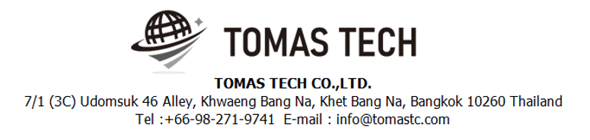
Version 28/Nov/2024
Confidential
EDI system phase 1
System Manual Documentation EN for NSET
Blueprint
R1
Made for : NIDEC TECHNO MOTOR (Thailand) Co.,Ltd.
By : TOMAS TECH CO.,LTD.

Slide 2
Revision History
Date | Version | File name | Details
28/Nov/2024 | R1 | EDI system System Manual Documentation EN | First edition

Slide 3
■Contents
1. Overview
2. Overall configuration diagram
3. Document image
3.1 Dashboard
3.2 Print/Issues Tag
3.3 Print/Issued Tag (Special Tag)
3.4 History Issued Tag and Reprint
4. Operation flow
5. Q&A
6. Sign off

Slide 4
1. Overview
Introduced EDI system to NSET.
The system specifications for introduction are described in this document.

Slide 5
2. Overall configuration diagram
System flow diagram
Overall configuration diagram image
NSET MS Server 2019
NSET database MS SQL 2014
NST_XXX
Sync data service
(Called by DB trigger)
Micro service
NSET Cloud Server
EDI System
Postgres DB server
Linkage Data API
Web User Interface
System
Backend
NST_EDI

Slide 6
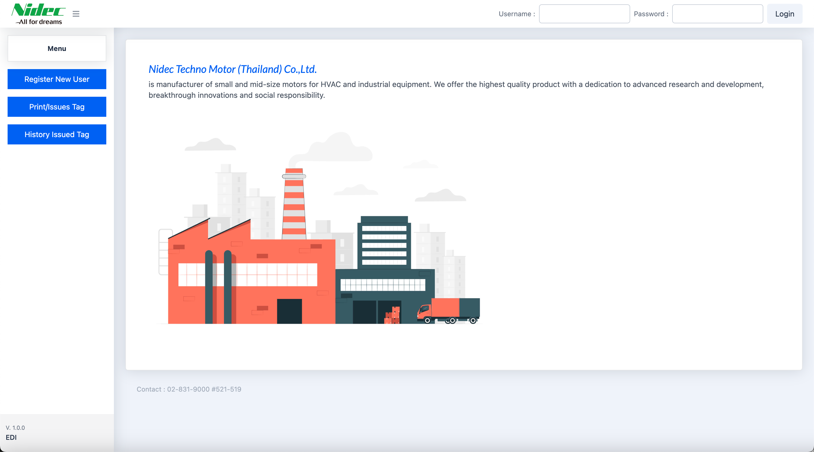
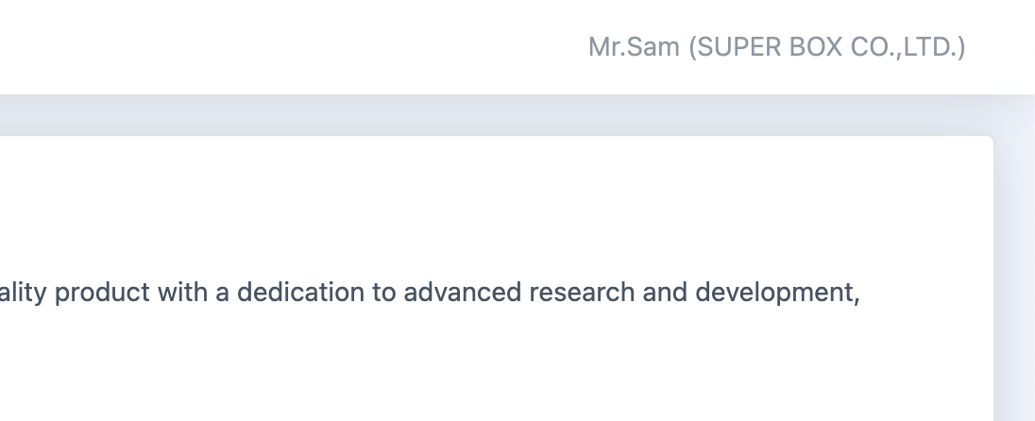
3. Document image
3.1 Dashboard
The dashboard consists of three sections.
Login
Site Menu
Main content
1
2
3
After the user logs into the system, the tab at the top right will display the username and the Vendor name.
Username
Vendor name

Slide 7
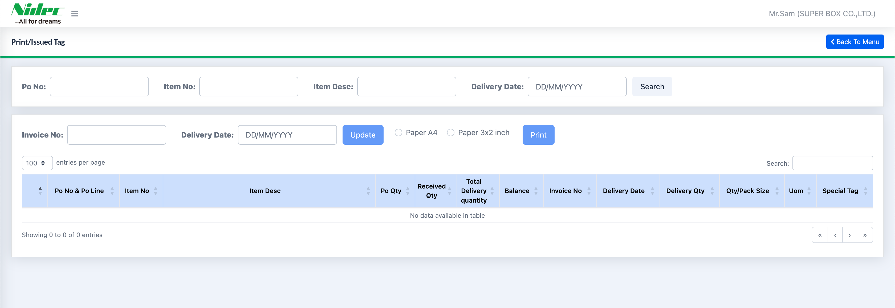
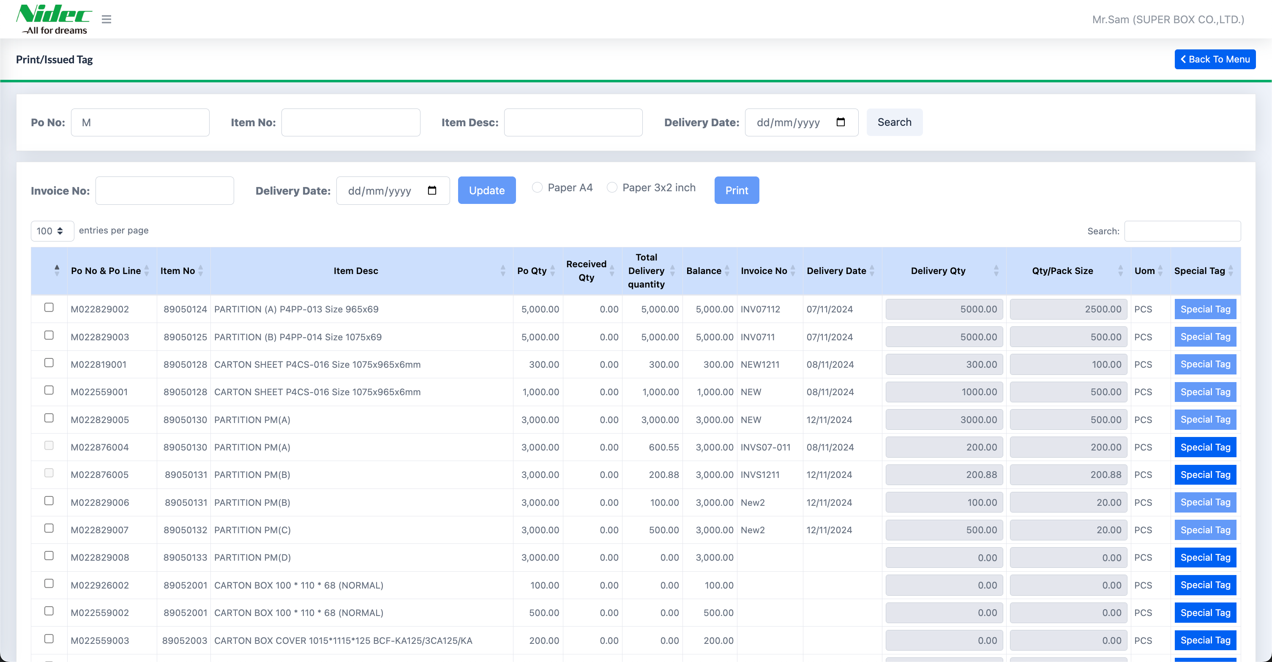
3. Document image
3.2 Print/Issues Tag
Print/Issues Tag consists of three sections
Search for information
Update the Invoice number, Delivery Date, and print labels in A4 and 3x2 inch sizes
Display section for information after searching
Return to the Dashboard
1
2
3
Print/Issue Tag: After clicking Search, the data that meets the criteria will be displayed.
Po Qty = pur_order.po_qty
Received Qty = pur_order.recv_qty, which will be updated once NIDEC receives the data.
Total Delivery Quantity = The total quantity delivered, calculated as the sum of all Delivery Qty.
Balance = (Po Qty - Received Qty).

Slide 8
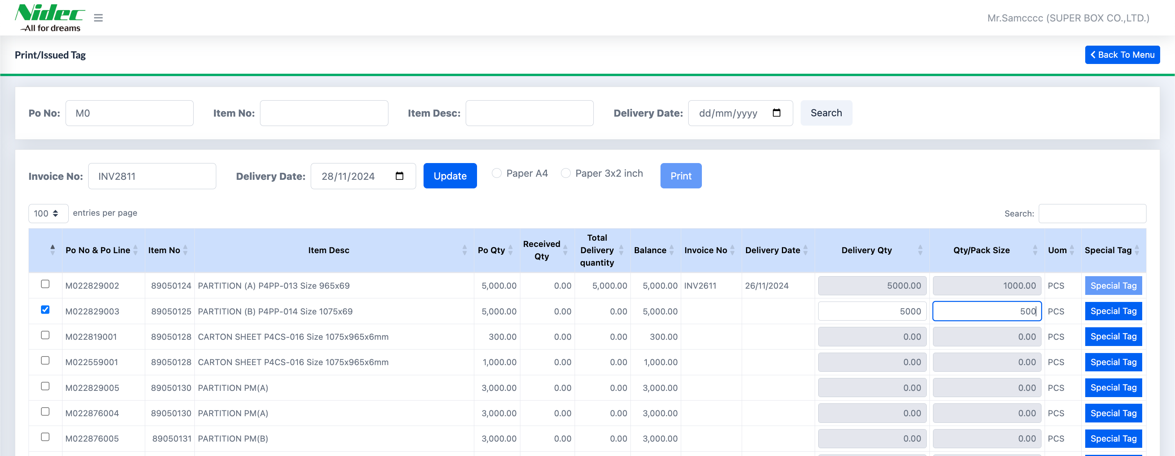
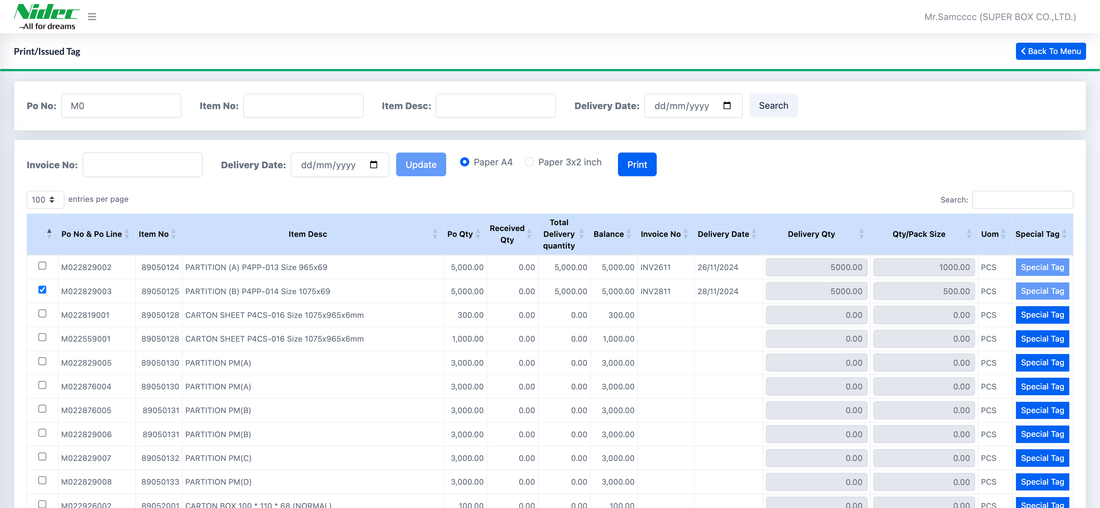
3. Document image
3.2 Print/Issues Tag
Issues Tag
Select the item to issue the tag
Enter the Invoice number, Delivery Date, and the quantity to be delivered, input the Pack size
Click the "Update" button to update the information
2
3
1
2
Print Tag
Select the item to print the tag
Select the tag size you want to print
Click the "Print" button to print the tag
2
3
1
The "Special Tag" button allows the customer to choose whether the item should be a special tag. If the item has already had a label printed in the "Print/Issue Tag" page, the "Special Tag" button will be disabled.

Slide 9
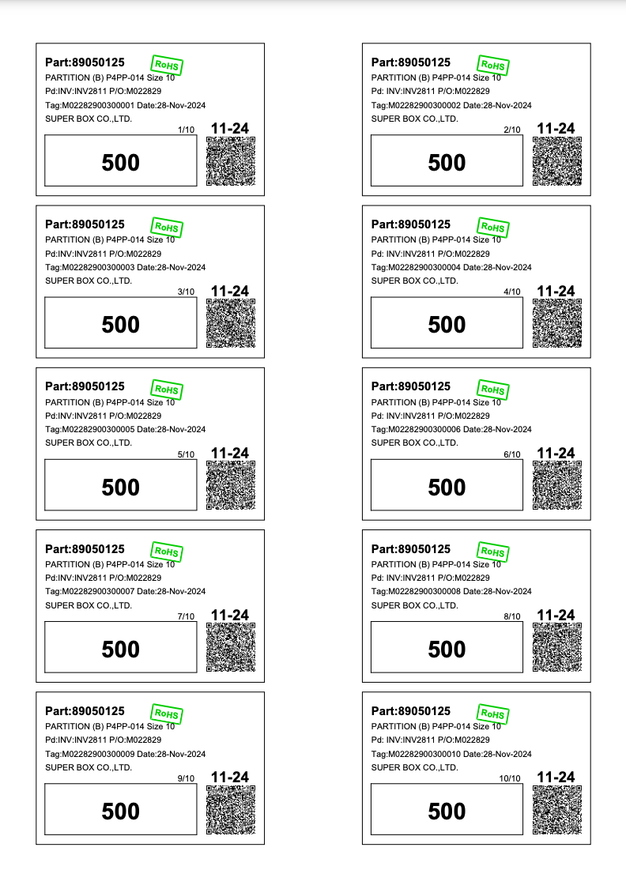
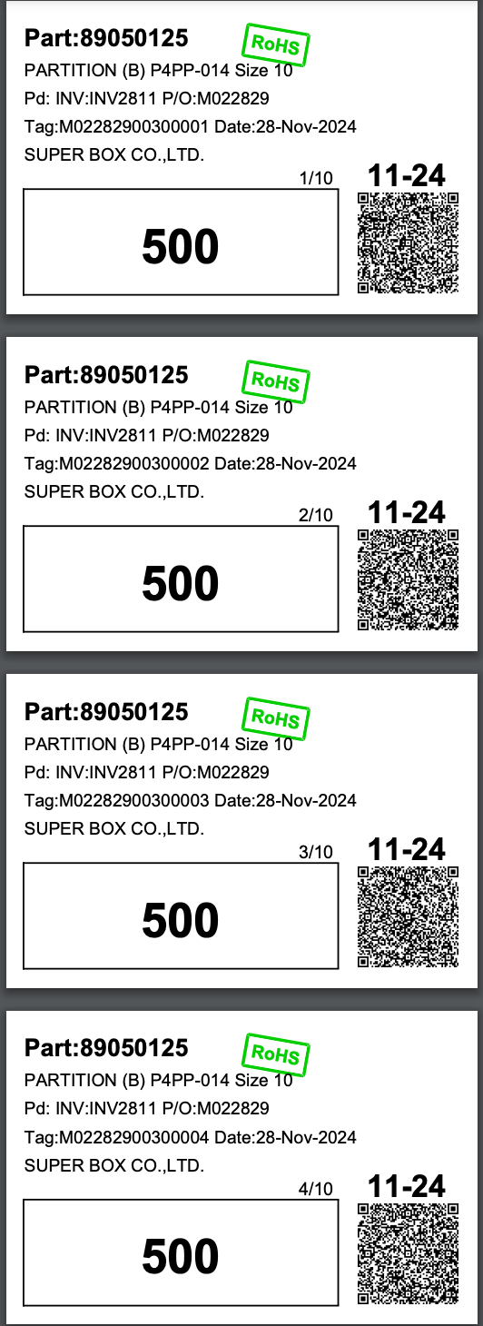
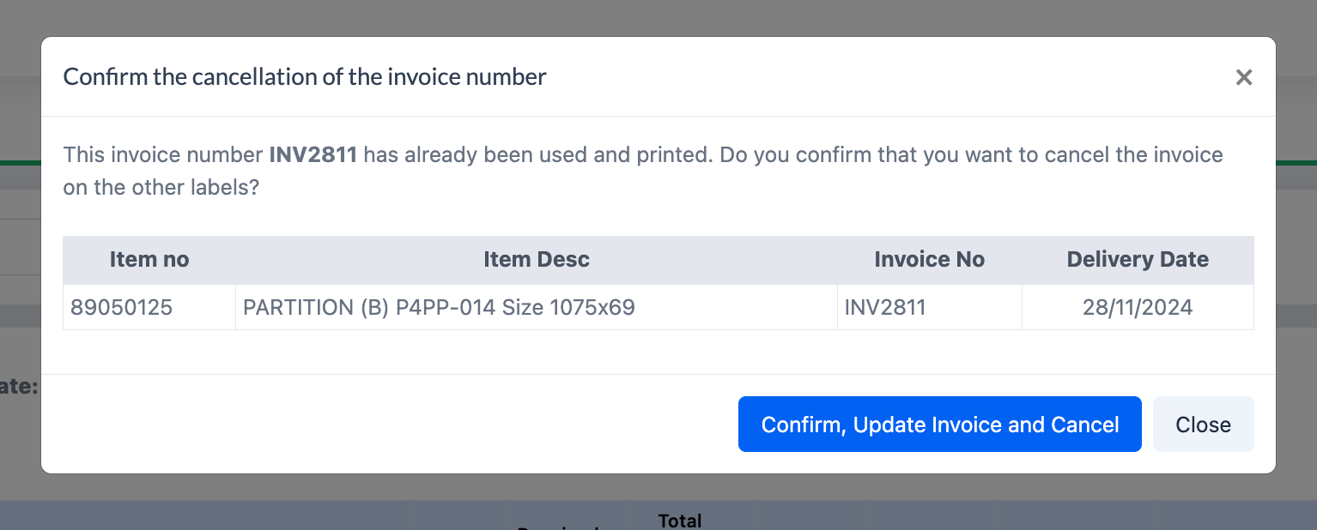
3. Document image
3.2 Print/Issues Tag
The format for printing tags in two sizes
A4 Size Tag
3x2 Inch Tag
1
2
If the customer updates the Invoice number to one that already exists in the system, the system will display a notification asking for confirmation from the customer. The message will confirm whether they want to update this Invoice number and cancel the Invoice number for other items that have already been assigned this number.

Slide 10
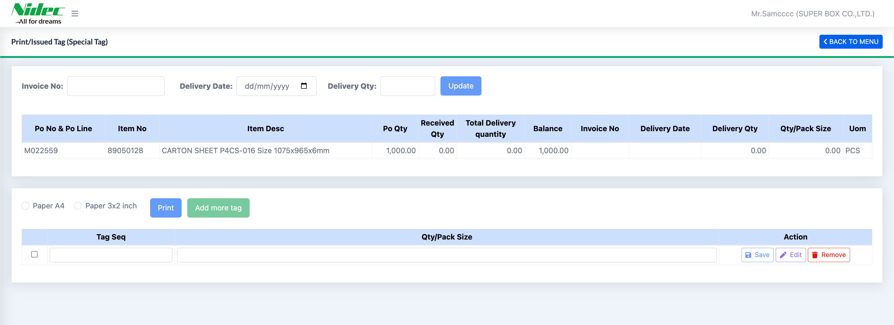
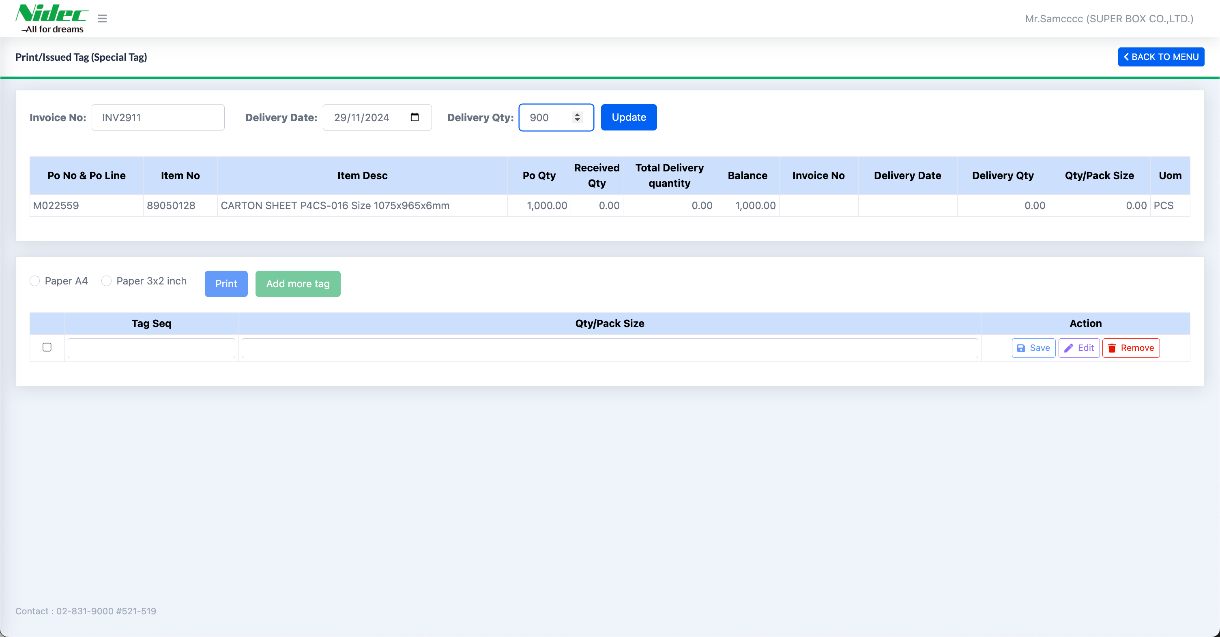
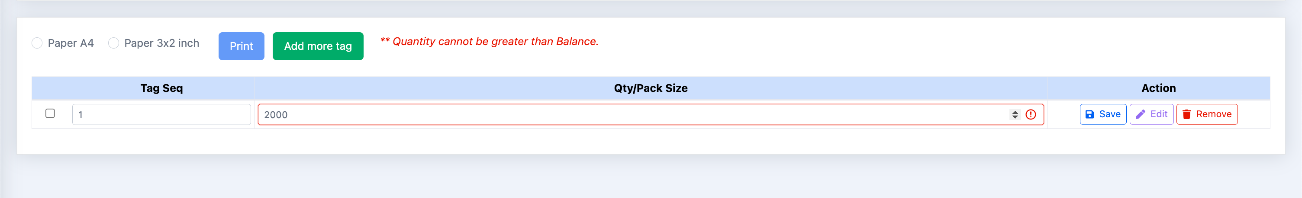
3. Document image
3.3 Print/Issued Tag (Special Tag)
Print/Issues Tag (Special Tag) consists of three sections
The section for updating information on Invoice No, Delivery Date, and Delivery Qty
Purchase Order Information
Customer Delivery Tag Information
1
2
3
Issues Tag
Fill in the Invoice No, Delivery Date, and Delivery Qty, then click the Update button.
Add a Tag by entering the Tag Seq and Qty/Pack Size, then click the Save button
1
2
If the customer wants to add more Tags, click the green “Add more tag” button. The Input field will appear at the end of the table, Customers can add Tag information until the total of the Tags does not exceed the Balance of the purchase order. If the entered delivery quantity exceeds the available balance, the system will notify the user and prevent saving the Tag information.

Slide 11
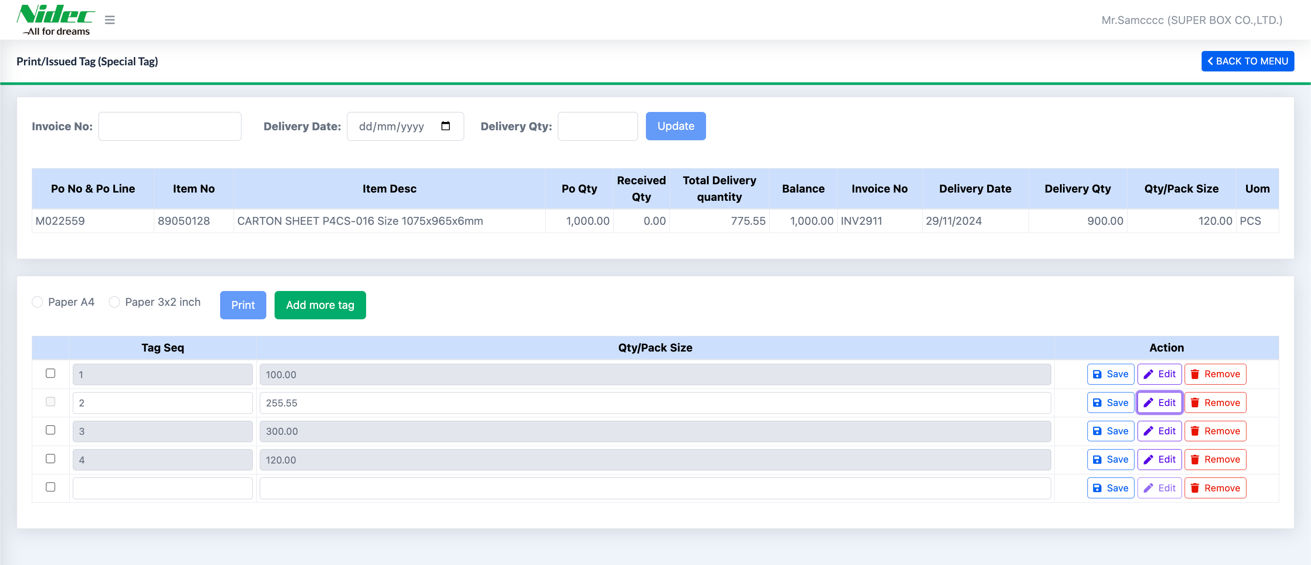
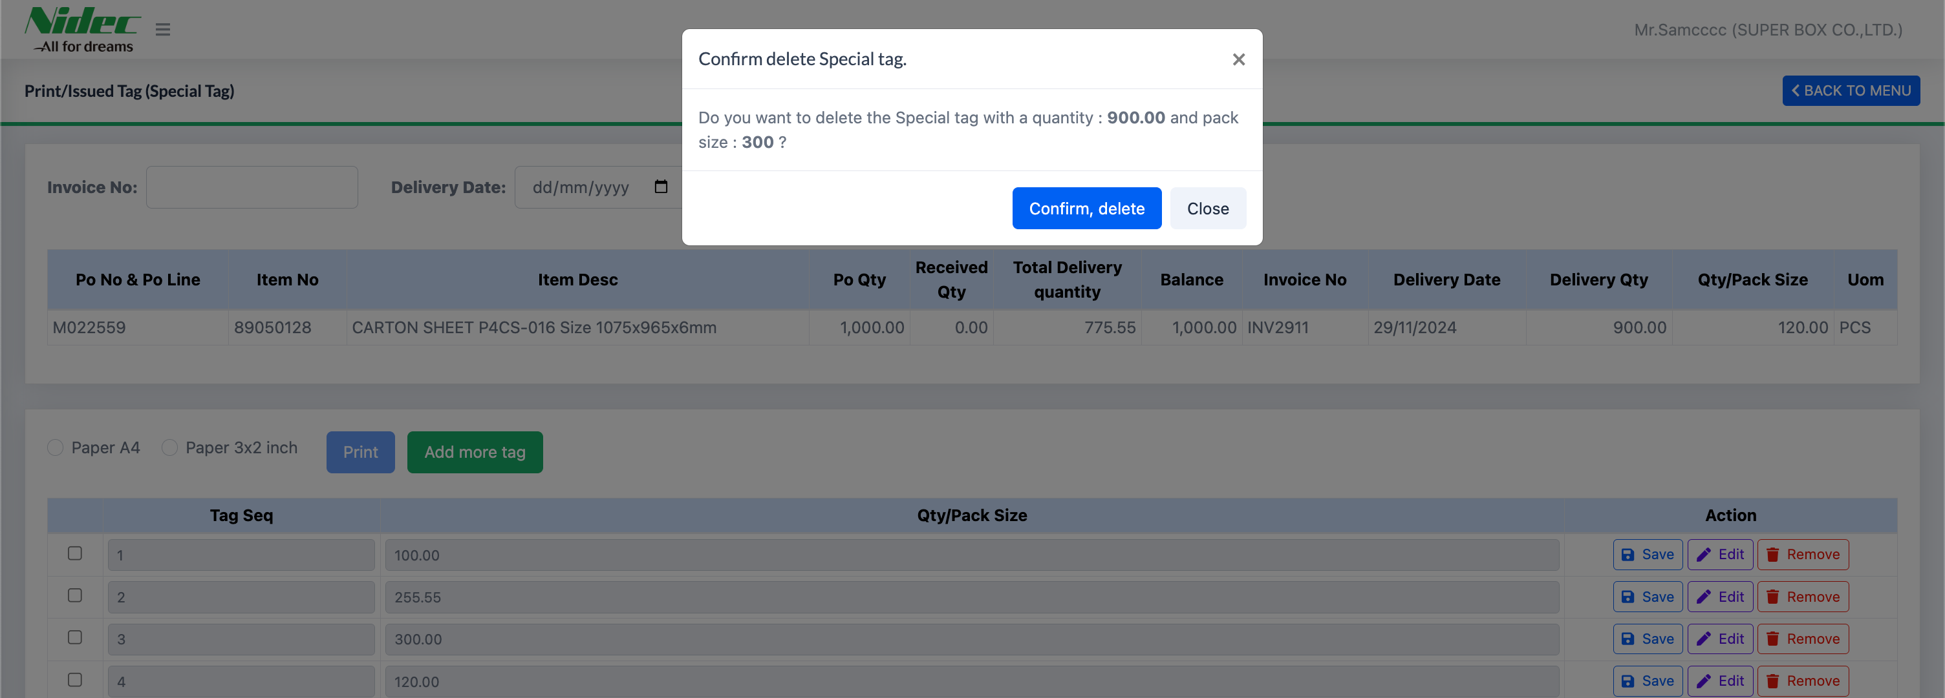
3. Document image
3.3 Print/Issued Tag (Special Tag)
Edit Tag/Remove Tag
If you want to edit a Tag, you can click the edit button of the Tag row you want to modify. The input fields will then be enabled, allowing you to make changes. After that, click the Save button to update the information
1
If you want to delete a Tag, you can click the Remove button of the Tag row you want to delete. A popup will appear asking you to confirm the deletion
2
After clicking the Confirm button, the deleted Tag in the database will have its status changed to "Cancel," and the system will recalculate the Total Delivery quantity.

Slide 12
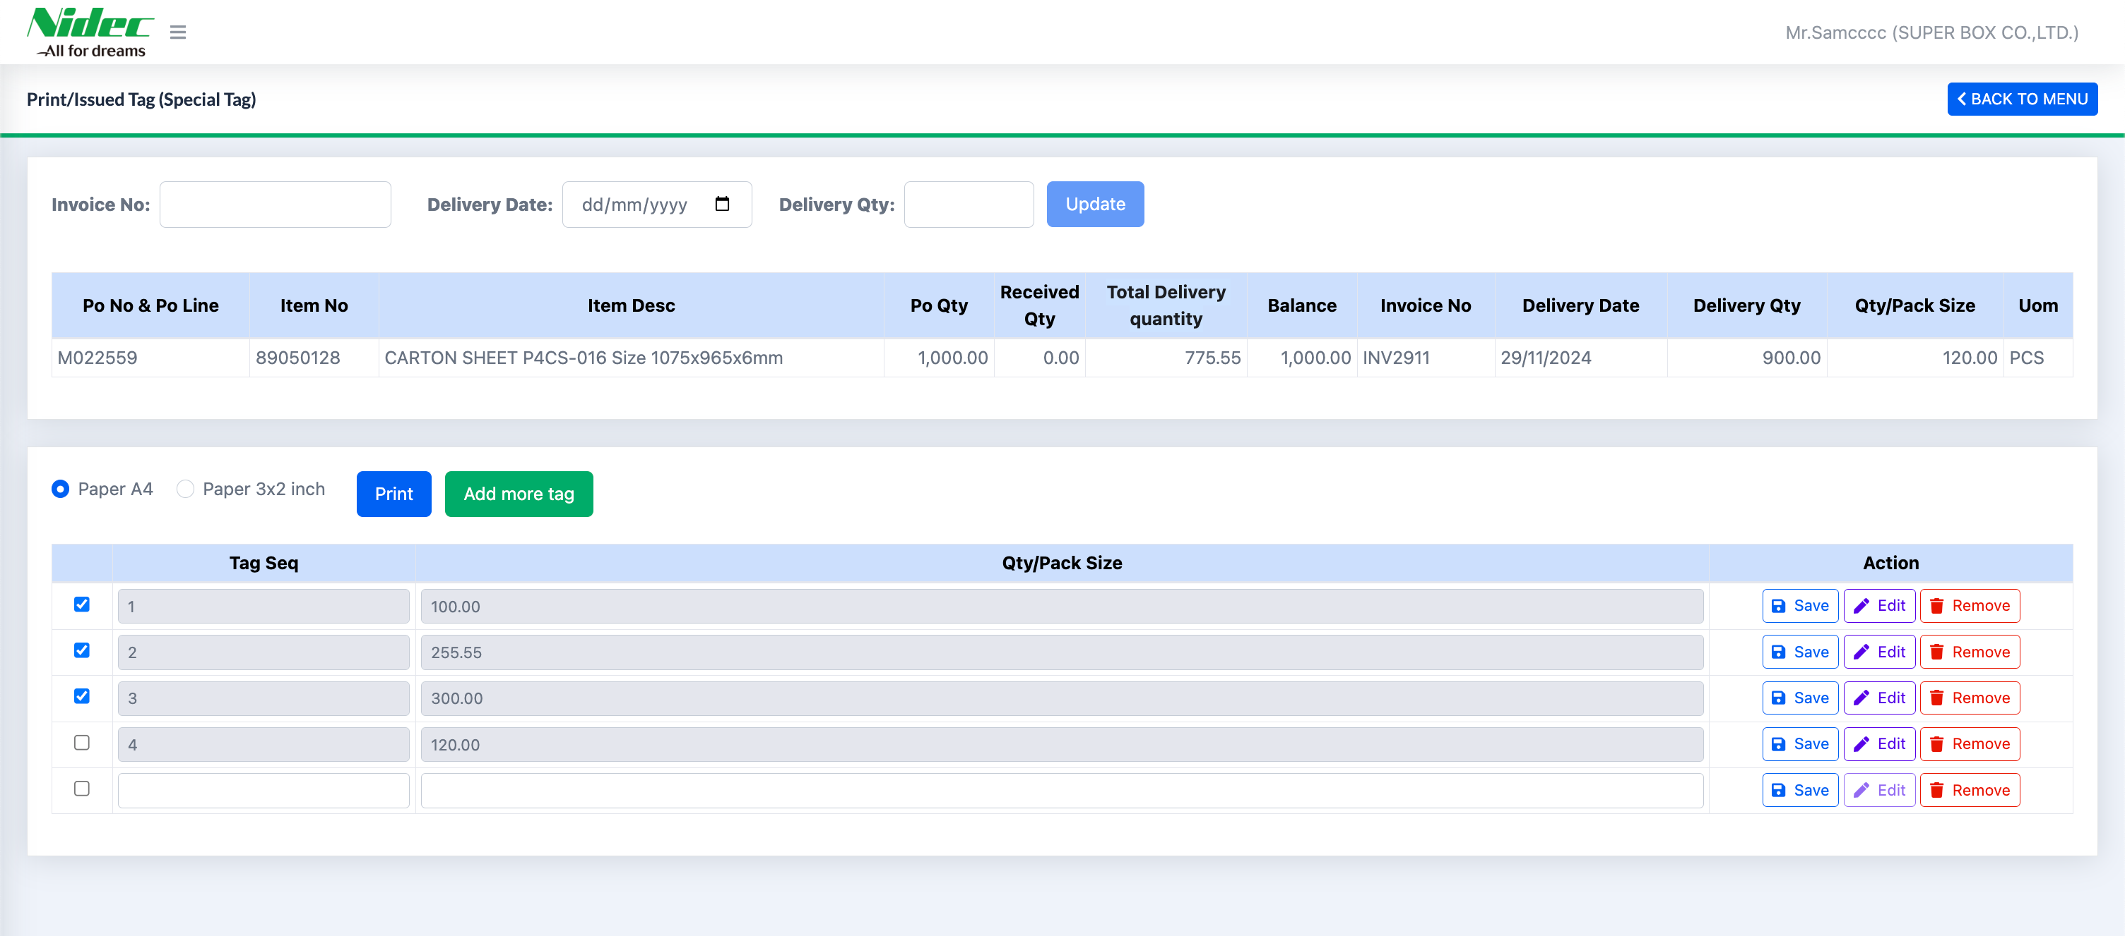
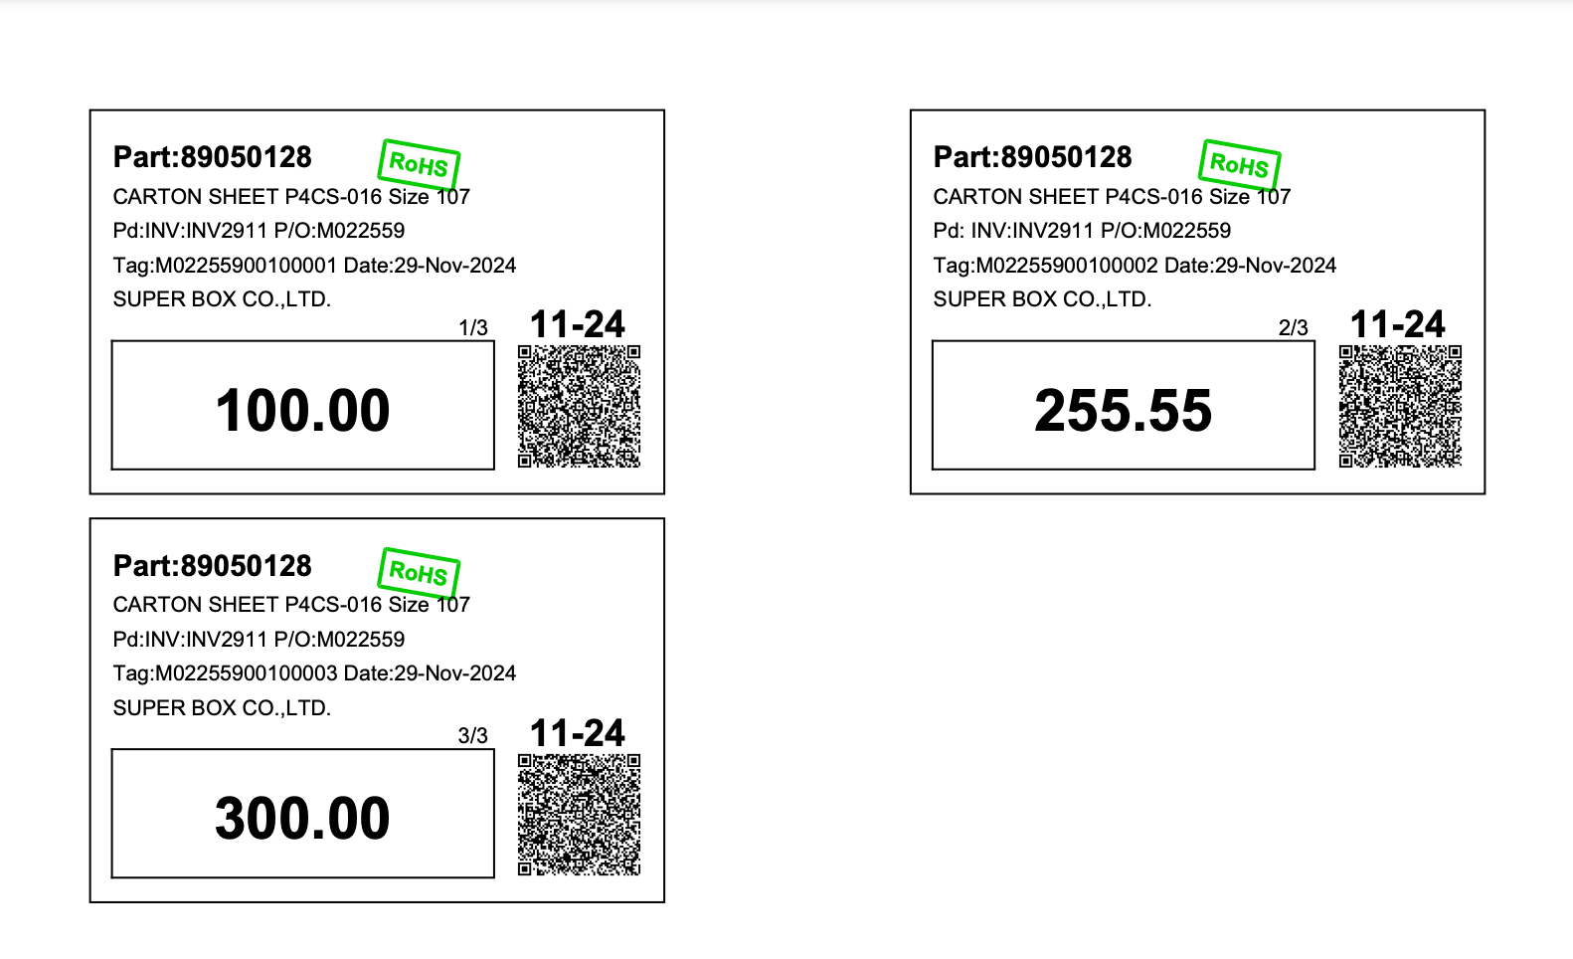
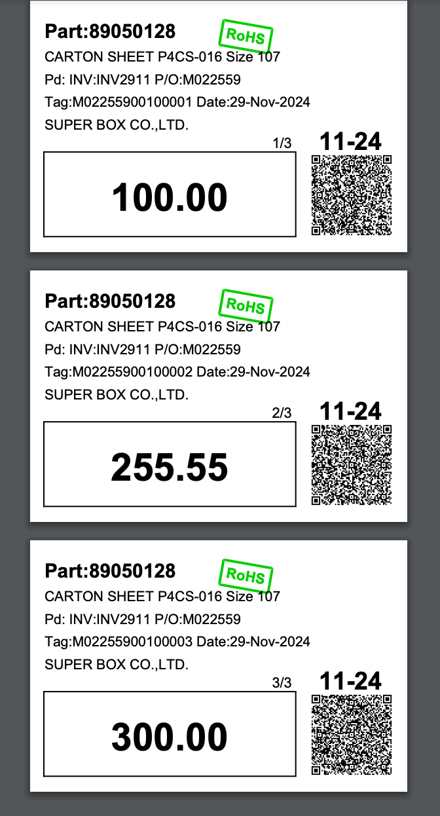
3. Document image
3.3 Print/Issued Tag (Special Tag)
Print Tag
Select the item to print the tag
Select the tag size you want to print
Click the "Print" button to print the tag
2
3
1
The format for printing tags in two sizes
A4 Size Tag
3x2 Inch Tag
1
2

Slide 13
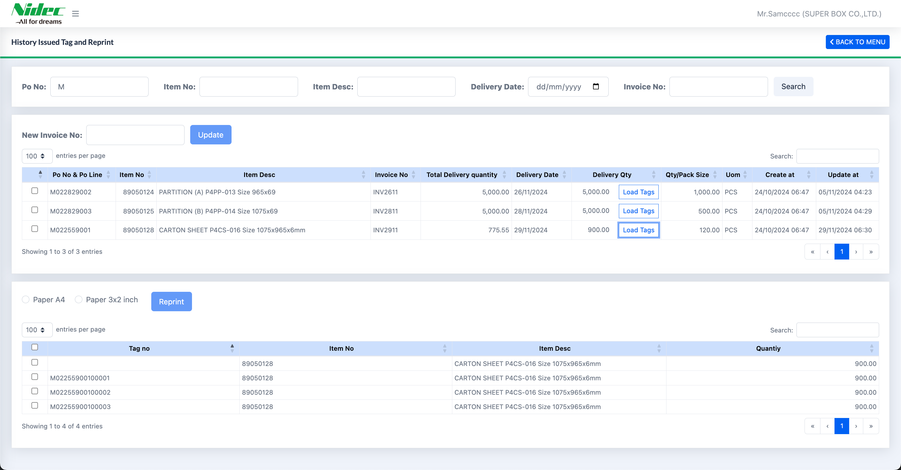
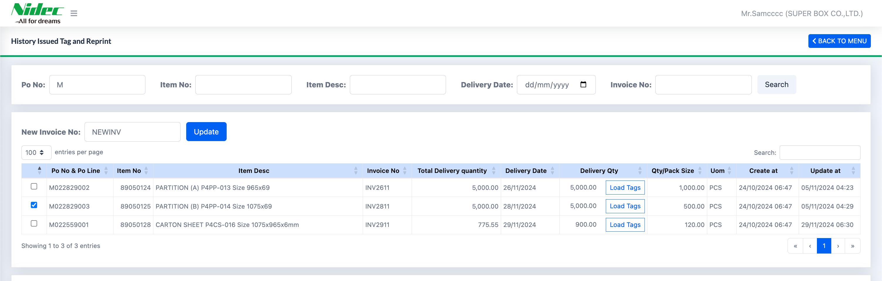
3. Document image
3.4 History Issued Tag and Reprint
History Issues Tag (Special Tag) consists of three sections
Search for information
The section displaying the information after searching and updating the new Invoice No
The section displaying the information after clicking the “Load tags” button
1
2
3
Update New Invoice
Select the items that need to be updated with the new Invoice number
Enter the new Invoice number
Click the Update button to update the information
2
3
1

Slide 14
3. Document image
3.4 History Issued Tag and Reprint
If the customer updates the Invoice number to one that already exists in the system, the system will display a notification asking for confirmation from the customer. The message will confirm whether they want to update this Invoice number and cancel the Invoice number for other items that have already been assigned this number.
Load Tag
Select the items for which you want to view the Tags
Display all Tags after clicking the "Load tags" button
1
2

Slide 15
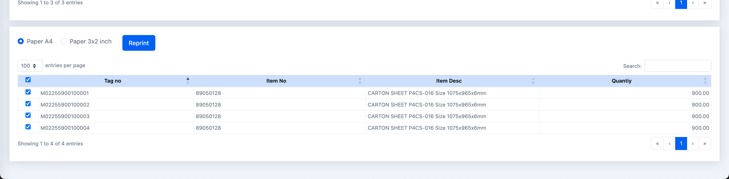
3. Document image
3.4 History Issued Tag and Reprint
Print Tag
Select the item to print the tag
Select the tag size you want to print
Click the "Print" button to print the tag
2
3
1
The format for printing tags in two sizes
A4 Size Tag
3x2 Inch Tag
1
2

Slide 16
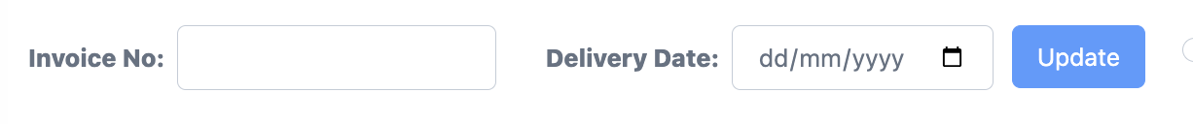
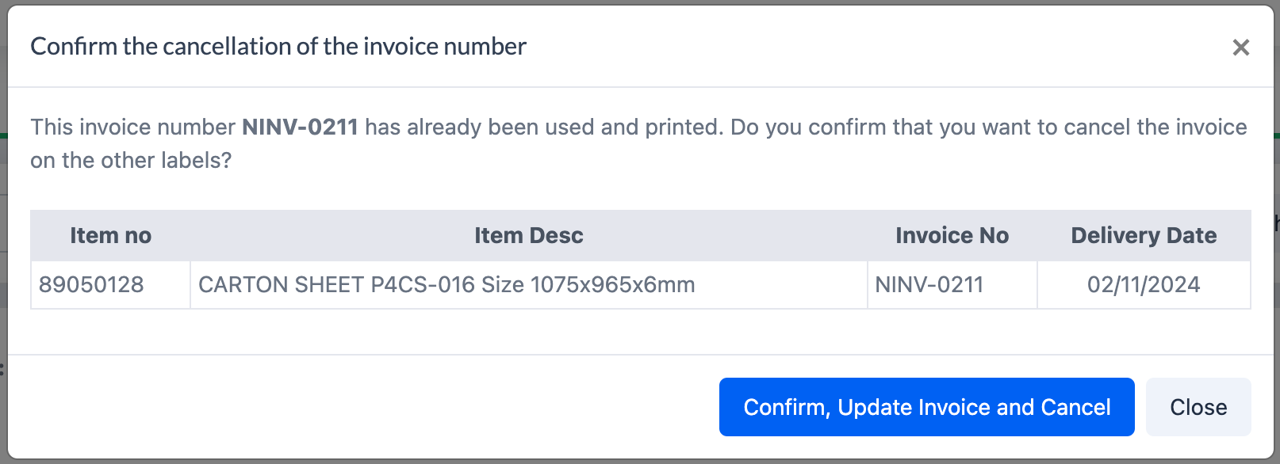
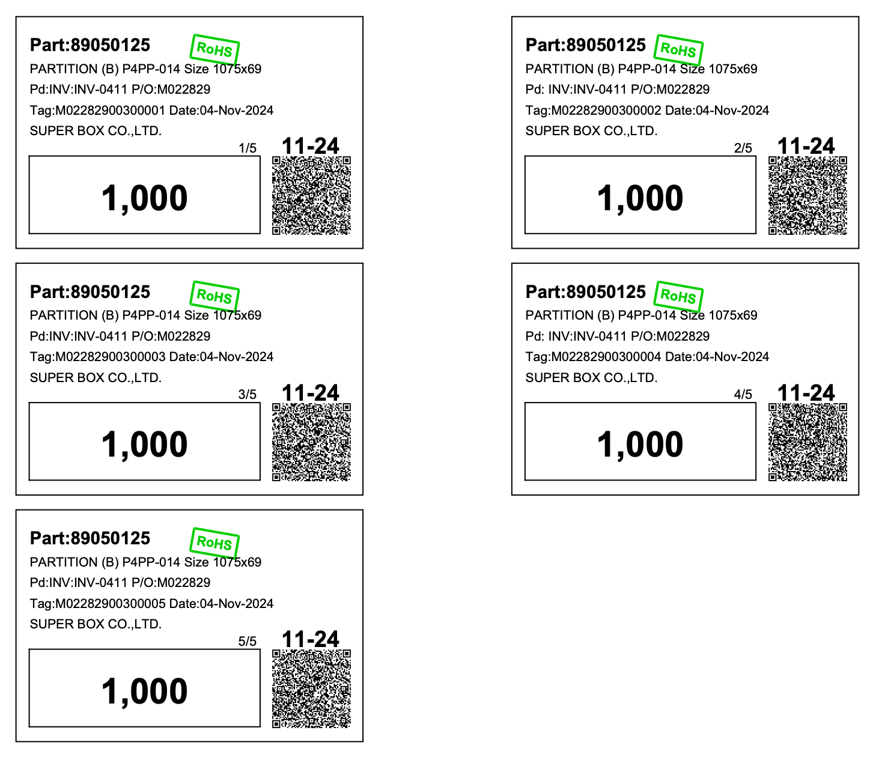
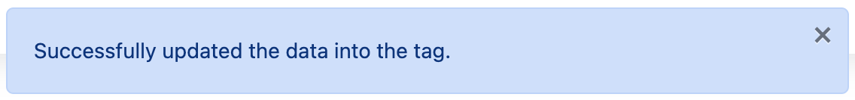
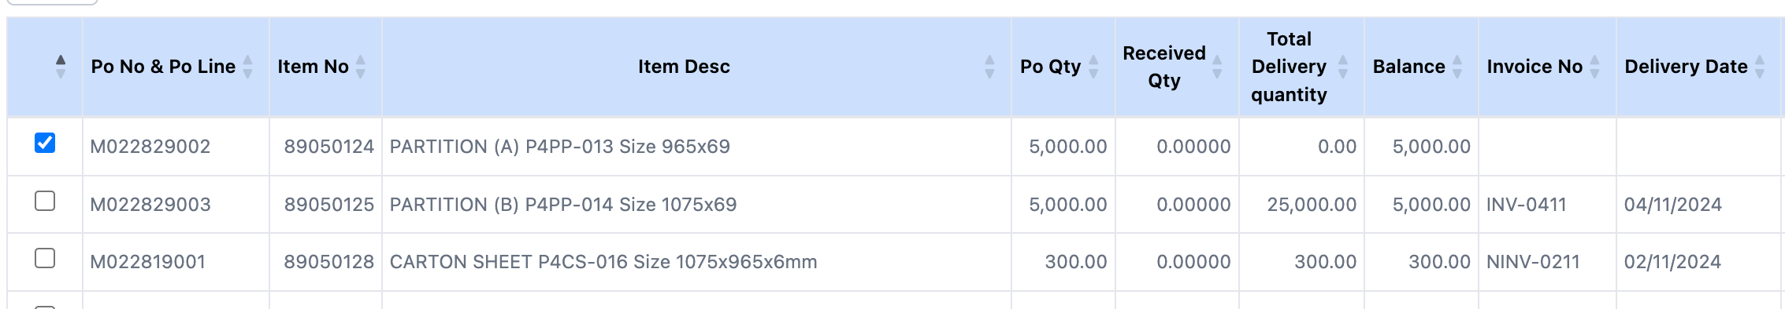
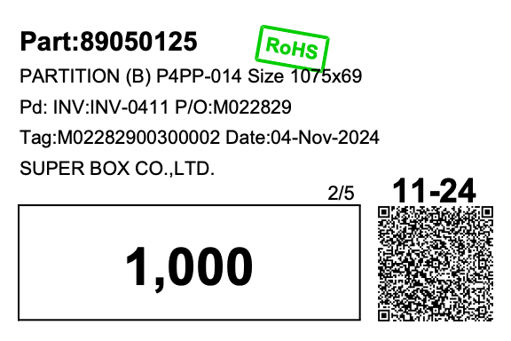
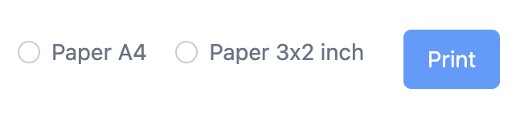
4. Operation flow
Print/Issues Tag : Flow for Updating data, and Printing Labels
A popup appears for the customer to confirm
updating the invoice number.
Start
Select item, Input Invoice No, Delivery Date, Delivery Qty, Delivery Pack size
Click “Update”
Example size A4
The invoice number is duplicate in the system (False).
Is the invoice number duplicate in the system?
The invoice number is not duplicate in the system (True)
Successfully updated the data into the tag.
Do you want to print the label?
Example size 3x2'
Select the item to print the label
Is there an invoice number and delivery date?
There is no invoice number or delivery date
There is an invoice number and delivery date
Select label size
Print Label
End

Slide 17
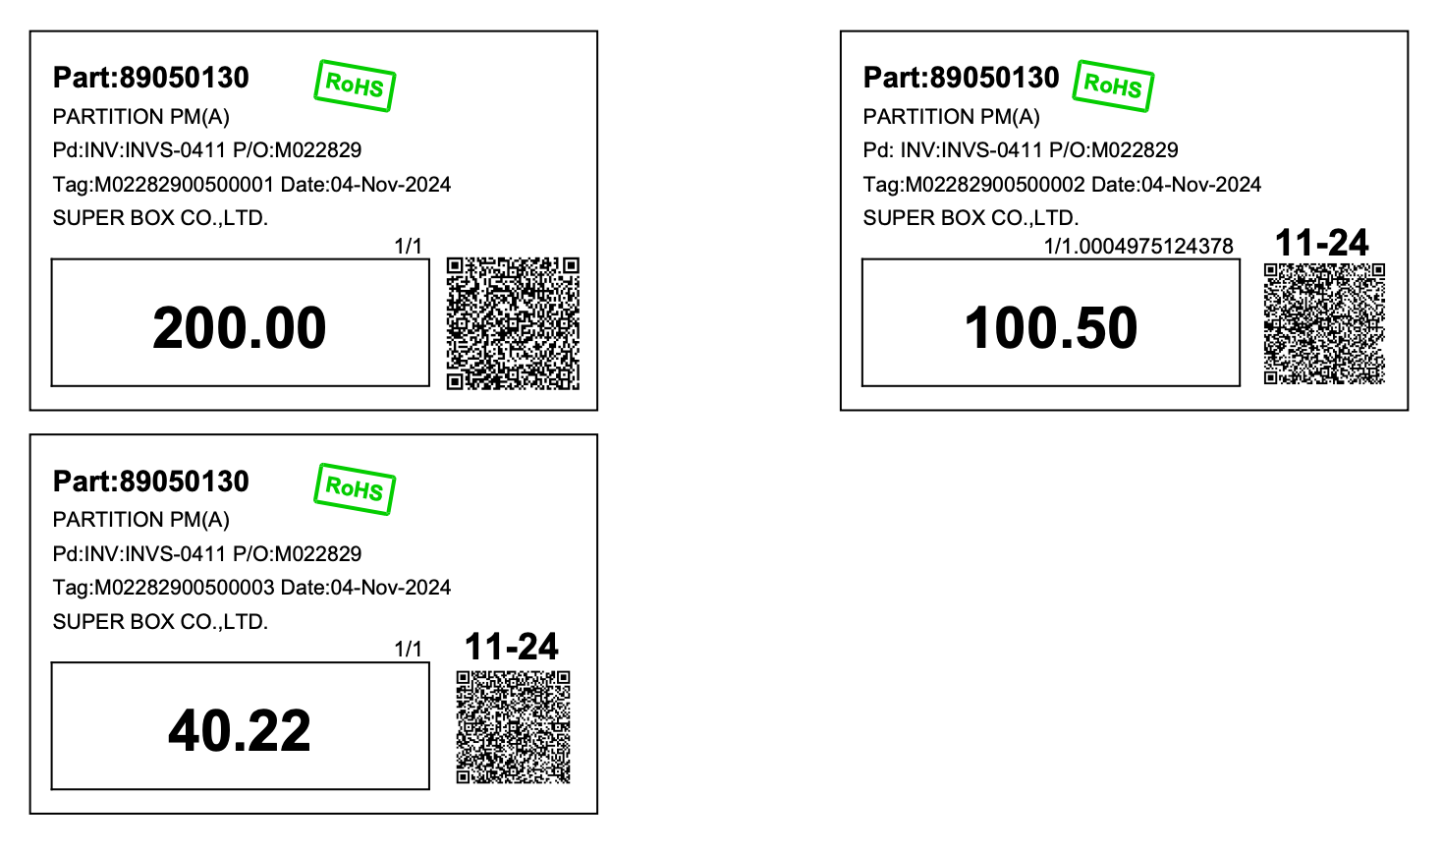
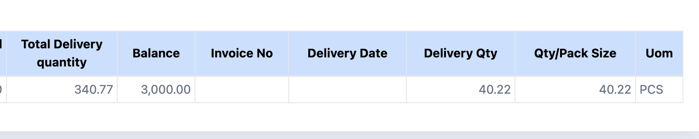
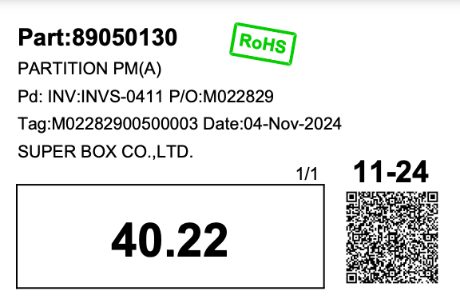
4. Operation flow
Print/Issues Tag (Special Tag) : Flow for Updating data, and Printing Labels
Start
Do you want to add
a tag?
A
Add special tag.
Input Invoice No, Delivery Date, Delivery Qty
Click “Update”
The invoice number is duplicate in the system (False).
Is the invoice number duplicate in the system?
Example size A4
The invoice number is not duplicate in the system (True)
Successfully updated the data into the tag.
Do you want to print the label?
Example size 3x2'
Select the item to print the label
Is there an invoice number and delivery date?
There is no invoice number or delivery date
There is an invoice number and delivery date
Select label size
Print Label
End

Slide 18
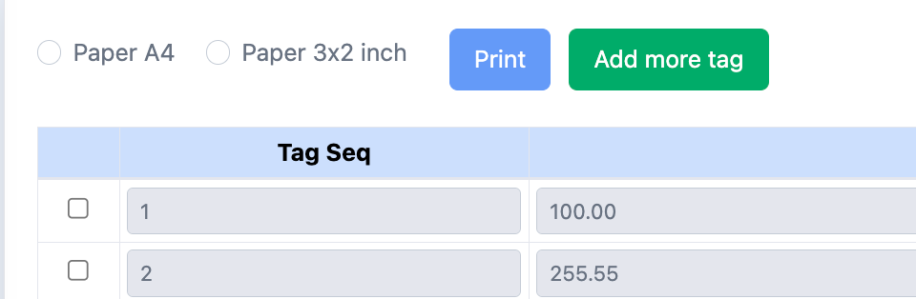
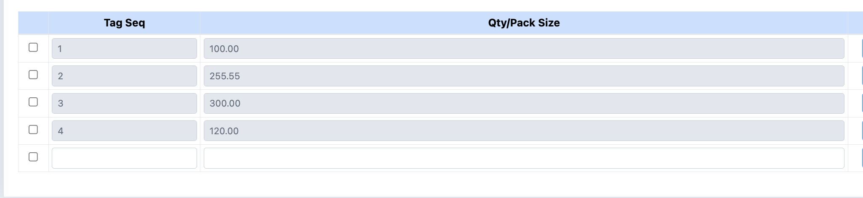
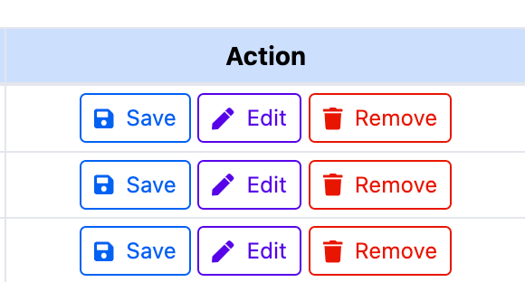
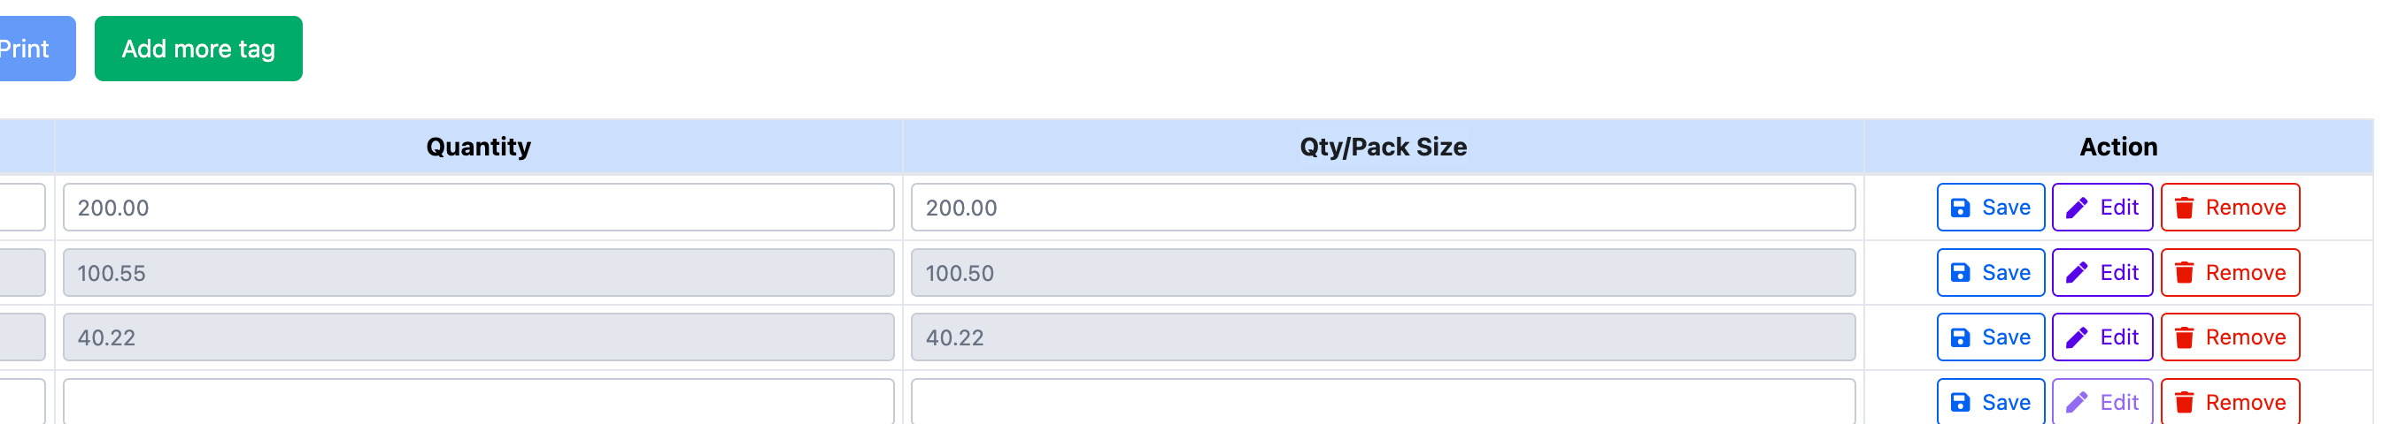
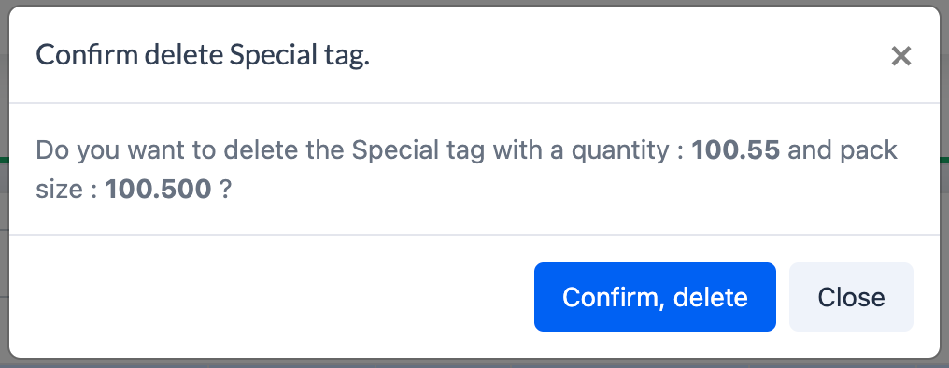
4. Operation flow
Special Tag : Flow for adding
A
Click the
'Add more tag' button
Input Tag seq, Qty/Pack Size
Click ‘Save’ button
Special Tag : Flow for edit
Start
Click the 'Edit' button of the tag you want to modify
After clicking 'Edit' for the tag you want, the row for that tag
will be enabled for data editing
Edit the Seq and Qty/Pack Size as needed
Click ‘Save’ button
End
Special Tag : Flow for delete
Start
Click the 'Remove' button of the tag you want to delete
Is the tag data already in the database?
There is data in
the database (True)
There is no data in the database (False)
Confirm deletion
End

Slide 19
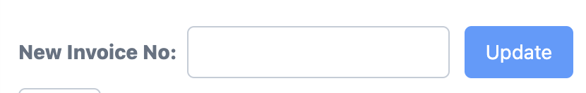
4. Operation flow
History Issued Tag and Reprint : Flow for Updating data, and Printing Labels
A popup appears for the customer to confirm
updating the invoice number.
Start
Select item, Input New Invoice No
Click “Update”
Example size A4
The invoice number is duplicate in the system (False)
Is the invoice number duplicate in the system?
The invoice number is not duplicate in the system (True)
Successfully updated the data into the tag.
Do you want to print the label?
No
Example size 3x2'
Yes
Click ’Load Tags’
Select the item to print the label
Select label size
Print Label
End

Slide 20
5. Q&A

Slide 21
6. Sign off
We hereby acknowledge and agree the above-mentioned blueprint requirements.
Any changes required after the sign off for this blueprint will be addressed through the change request process.
NIDEC TECHNO MOTOR (THAILAND) CO., LTD.
Sign:
Name:
Title:
Date:
TOMAS TECH CO.,LTD.
Sign:
Name:
Title:
Date:
## END OF BLUEPRINT##

