Slide 1
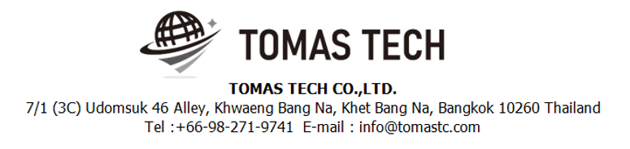
Version 31/Oct/2024
Confidential
Pegasus System Manual Document
Documentation EN Blueprint for TMC
Phase1
Made for: Thaimetaltech Ltd.
By: TOMAS TECH CO.,LTD.

Slide 2

Introduction
This manual explains each handy terminal, how to set it up with a PC, how to check the operation, and how to communicate with a PC.
Please read before starting work.
For safe use of this device
To use this device correctly and safely, be sure to observe the following safety precautions when operating this device. TOMAS TECH cannot be held responsible or warranted for any damage caused by using the product in violation of these precautions.
◆How to read the symbols
In this manual, the items to be observed in order to use the device safely are classified as follows.
Danger
If you ignore the information on this label and handle it incorrectly, there is a risk of death or serious injury.
Warning
This indicates the contents that may cause injury if the contents of this display are ignored and the product is handled improperly.
Caution
It indicates that property damage may occur if the product is handled improperly, ignoring the contents of this display.
The symbol represents a "caution" that it should be aware of.
The symbol represents an "instruction" that it must execute.
The symbol represents a "prohibition" that must not be done.
The symbols represent the "information" needed to deepen your understanding of this book.
The symbol represents "prohibited handling" by anyone other than a service person.
The symbol indicates that grounding is required during installation.
Reference
Indicates chapters to refer to and other manual references.

Slide 3
For safe use
◆General caution
In the unlikely event that this device breaks down, take sufficient safety measures to prevent various damages before use.
Please note that we cannot guarantee the function and performance of products that are used or modified outside the specifications shown in the specifications.
Do not disassemble this device unnecessarily. There is a risk of failure or damage.
Do not allow the device to get wet with water. It may lead to damage to this device.
Please use within the environmental conditions of this device. In addition, even within environmental conditions, equipment may be damaged in an environment where condensation forms due to sudden temperature changes.
Do not drop the device or hit it with strong force. Also, if the wiring from this device is likely to be subject to excessive impact, consider how to protect the wiring. It may lead to damage to this device and other devices.
Do not operate the device in a place with flammable or explosive gas or vapor. It is very dangerous to use this device in such an environment.
When using this device in combination with other devices, the functions and performance may not be satisfactory depending on the usage conditions and environment, so please consider carefully before using.
Caution
◆For proper use
When installing this device, turn off the power of the device. Do not short-circuit each wiring or terminal.
When installing this device, be sure to perform protective grounding to prevent electric shock.
Be sure to check that the power supply voltage of the device matches the voltage of the power supply before turning on the device.
Only our customer service or equivalent handlers should install this equipment.
To supply power to this device, connect it via a protection circuit such as a switchboard breaker or an earth leakage breaker.
Since this device is an electronic device, when installing various devices, investigate the installation environment (primary power supply system noise, drive device system noise, electrostatic discharge noise, etc.) and take countermeasures. It may cause system malfunction or damage to various devices.
Caution

Slide 4
Revision History
Date | Version | File name | Details
31/Oct/2024 | R1 | Stock management Manual Document Documentation EN Blueprint for TMC_R1 | Last edition phase 1

Slide 5
■Contents
1. Overview
2. Overall configuration diagram
2-1-1. Login screen
2-2-1. Inbound Schedule Material
2-2-2. Inbound Schedule Production
2-2-3. Inbound Schedule Detail
2-2-4. Outbound Schedule Delivery
2-2-5. Outbound Schedule Detail
2-2-6. Production Assembly Fg
2-2-7. Production Assembly Sdi
2-2-8. Parts Reqeust
2-2-9. Pokayoke
2-2-10. Schedule Import
2.3-1. Inbound Inquiry Report
2.4-1. Outbound Inquiry Report
2.5-1. Stock Inquiry Report
2.5-2. Stock Maintenance
2.5-3. Stocktaking
2.5-4. Stock Maintenance Report
2.5-5. Label Status Master
2.6-1. Item Master
2.6-2. Bill Of Materials
2.6-3. Supplier master
2.6-4. Location Master
2-6-5. Packing Standard Master
2-6-6. Department Master
2-6-7. User Master
2-6-8. User Credential Master
3. Configuration file storage
4. Q&A
5. Contact information

Slide 6
1. Overview
We propose a stock management system to Minebea AccessSolutions Thai Ltd.. In the current operation, we aim to improve work efficiency and work accuracy by replacing the work managed by paper and whiteboard with a system. The expected effects of introducing an inventory management system are as follows.
1. Work efficiency and work accuracy can be improved by supporting work at the handy terminal at the time of warehousing and warehousing. In addition, the inventory status can be grasped in real time.
2. By managing the ordering points, it is possible to eliminate excess inventory and out of stock.
3. By managing the materials and goods tracking, it is able to trace back to find material lot numbers, suppliers, and processes when found problematic products.

Slide 7
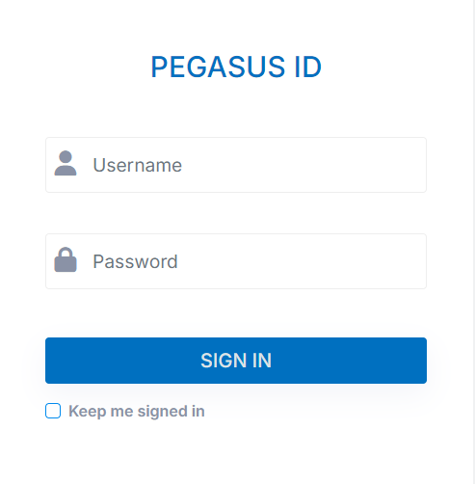
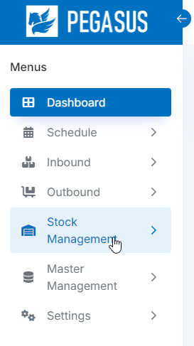
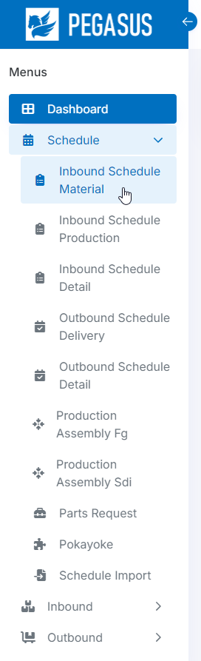
2. Handheld functions
2-1-1. Login screen.
1. Open the browser of the website below on your PC to access
the link to use on the Cloud.
URL : http://192.168.1.197/tmc/pegasus/
2. Enter Username and Password.
3. Click Sing In
4. Once logged in successfully You will find a menu on the left-hand side of the system. which will have the main menu and various submenus
Main menu
Sub menu

Slide 8
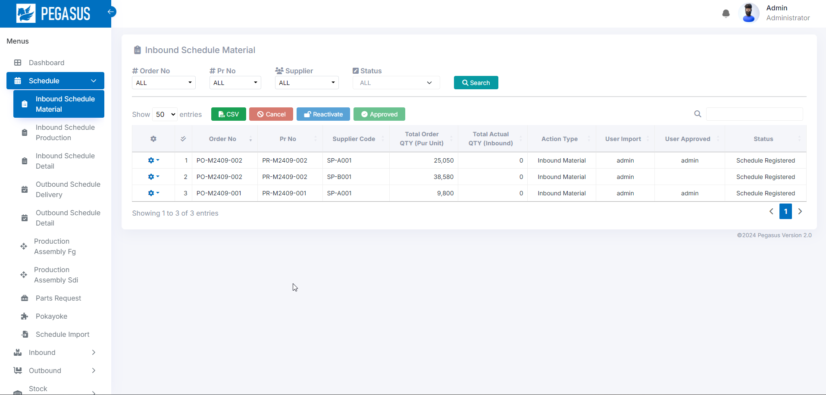
2. Handheld functions
2-1-2. Home Page.
Once logged in successfully You will find a menu on the left-hand side of the system. which will have the main menu and various submenus
Home page after this will be logged in.
Main menu
Sub menu

Slide 9
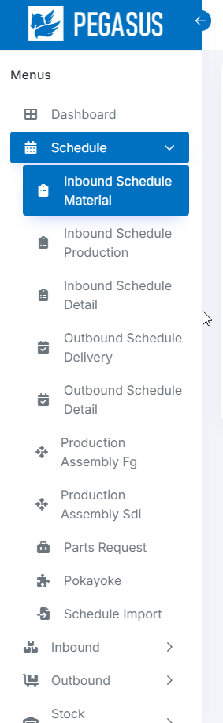
2. Handheld functions
2-2-1. Schedule Menu.
The Schedule menu has 10 submenus.
- Inbound Schedule Material.
- Inbound Schedule Production.
- Inbound Schedule Detail.
- Outbound Schedule Delivery.
- Outbound Schedule Detail.
- Production Assembly FG
- Production Assembly SDI
- Parts Request
- Pokayoke
- Schedule Import

Slide 10
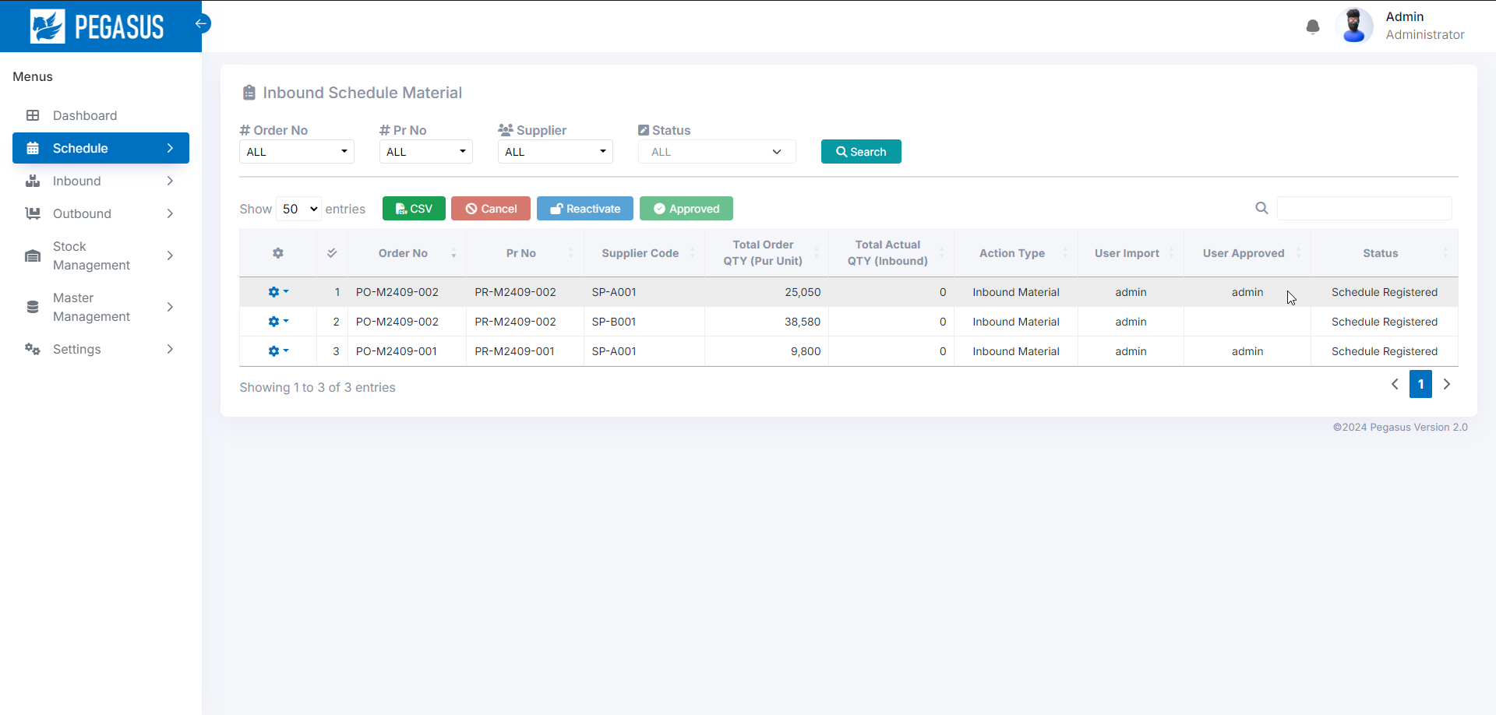

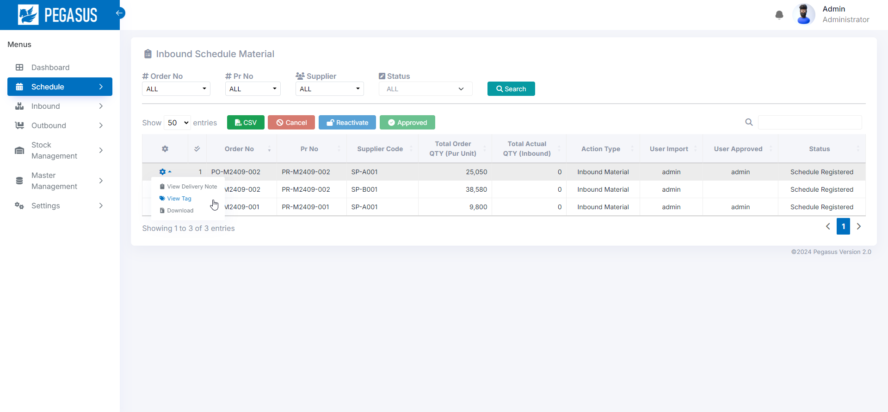
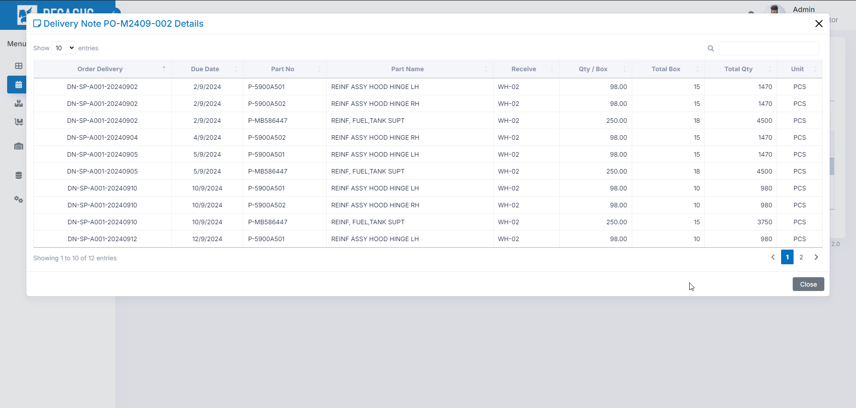
2. Handheld functions
2-2-2. Inbound Schedule Material.
View data and manage all Inbound Schedule Material.
Inbound Schedule Material page.
When you arrive at this page, Click the “Search” button to search and display the desired information.
• Search: A function for searching for information as specified in each option.

Slide 11
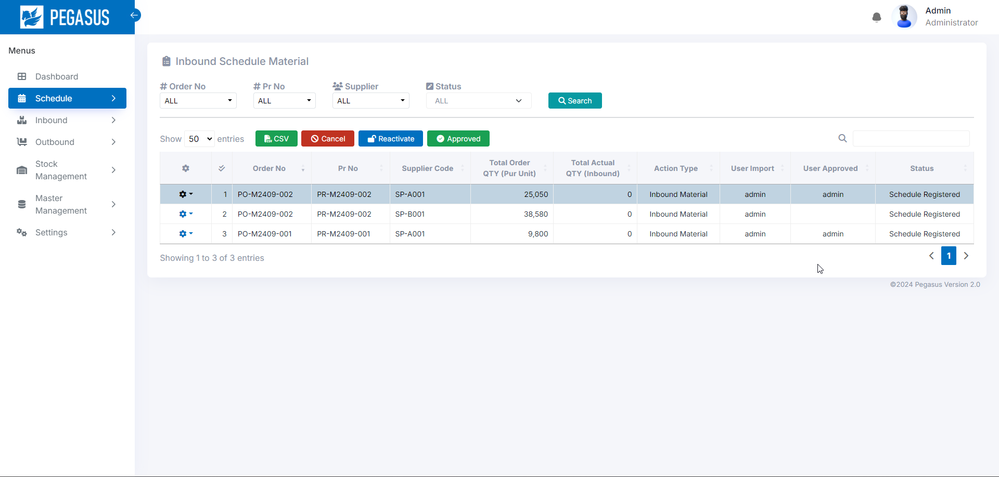
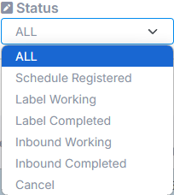
2. Handheld functions
2-2-2. Inbound Schedule.
Inbound Schedule Material page.
Status management :
Cancel

Slide 12
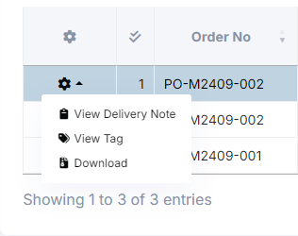
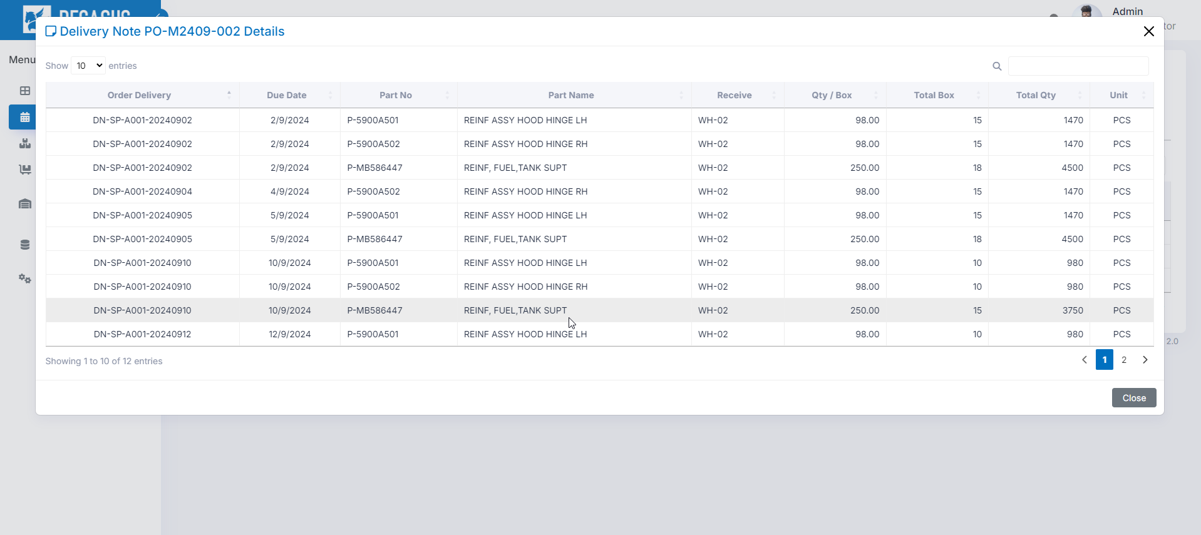
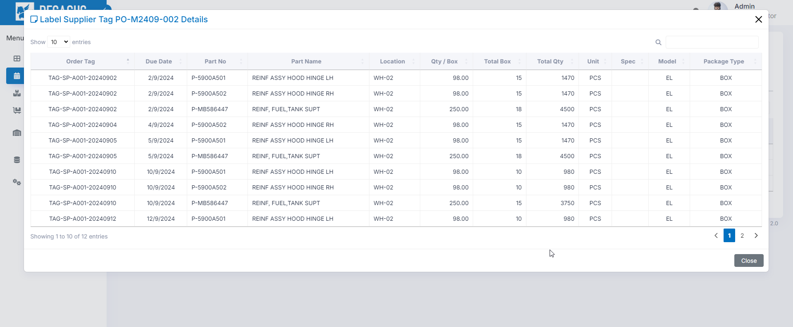
2. Handheld functions
2-2-2. Inbound Schedule.
Action -> View Delivery Noted :
Action -> View Tag :

Slide 13
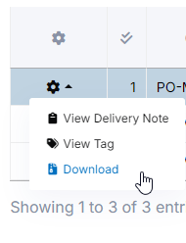
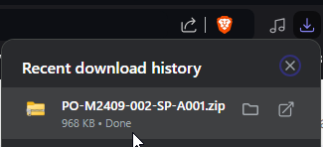
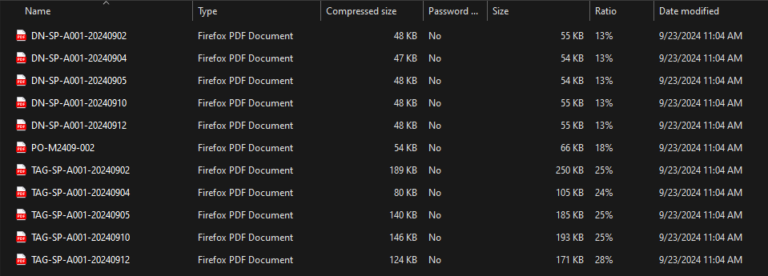
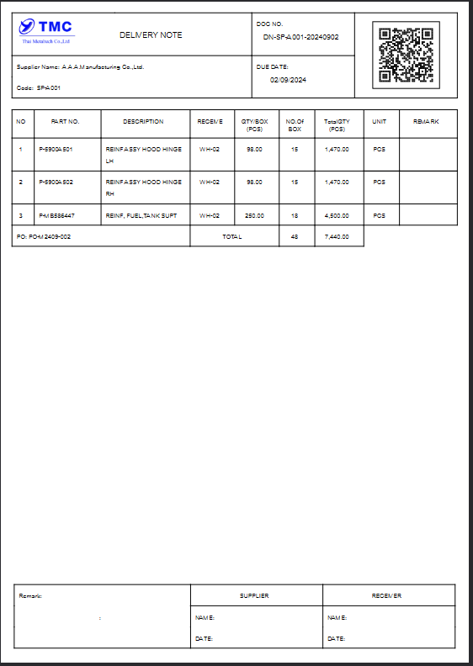
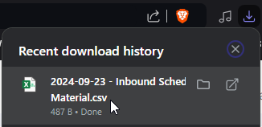
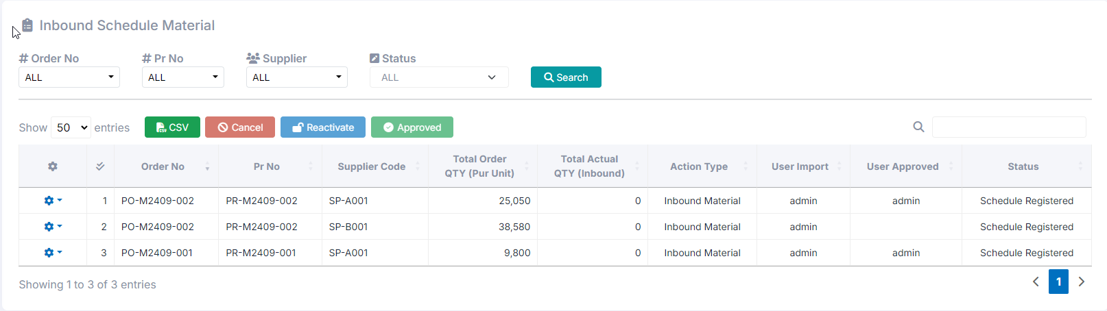
2. Handheld functions
2-2-2. Inbound Schedule.
• Action -> Download : download Tag label.
• CSV Output: Export data as a CSV file.
It will export data from the current page.

Slide 14
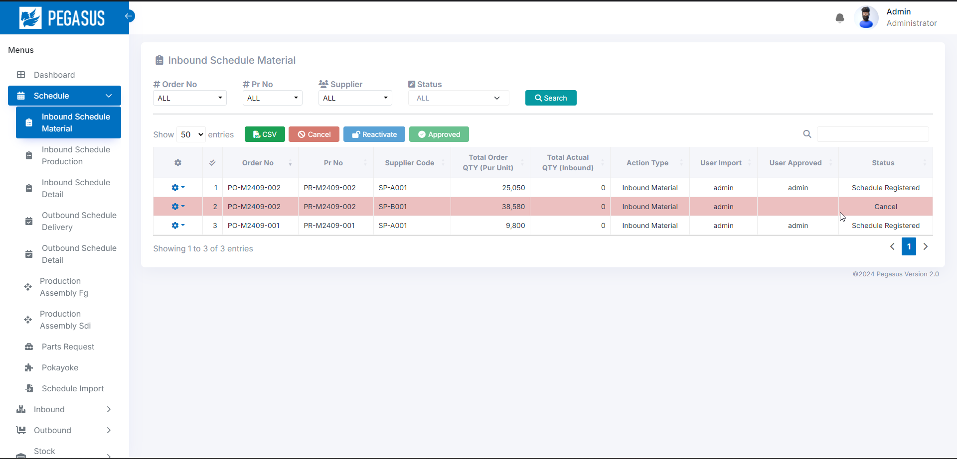
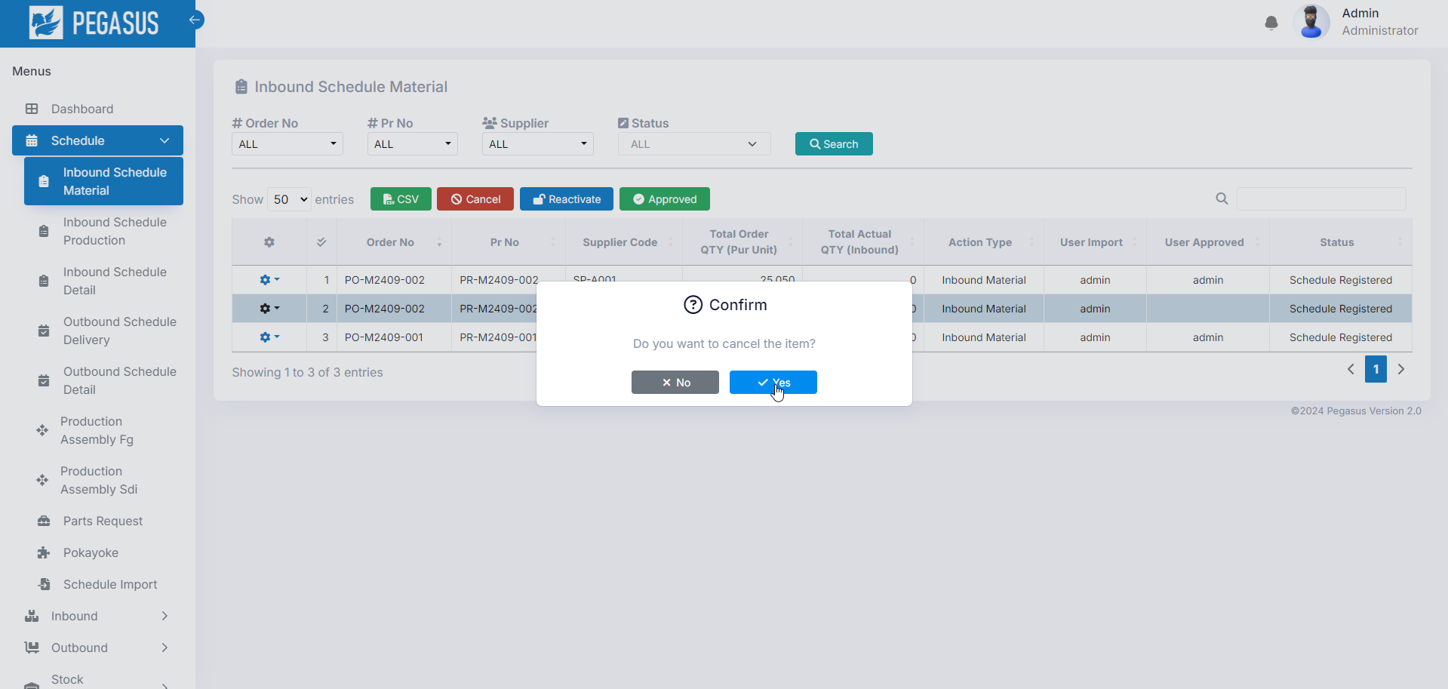
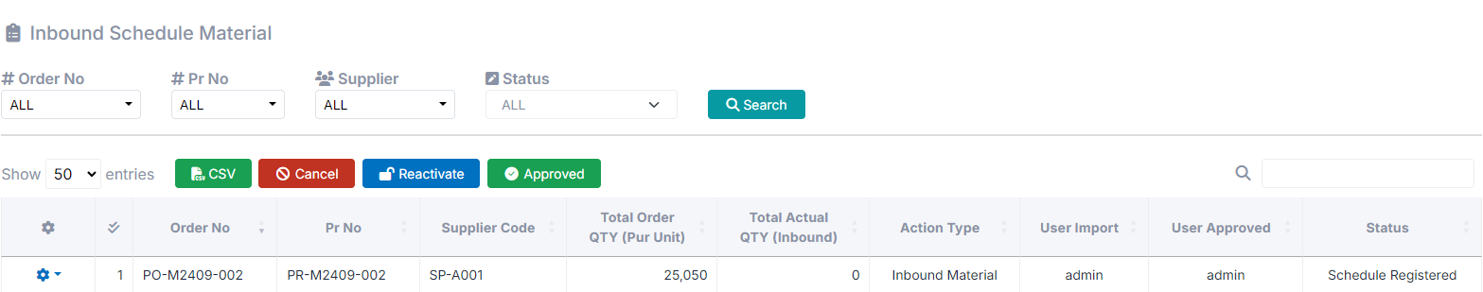
2. Handheld functions
2-2-2. Inbound Schedule.
• Cancel: Select an item from the row below. and click “cancel”
to change the status to cancel.
*can change status only: Schedule Registered.
• Reactivate: Select an item from the row below. and click “Reactivate”
to change the cancel status to reactivate status .

Slide 15
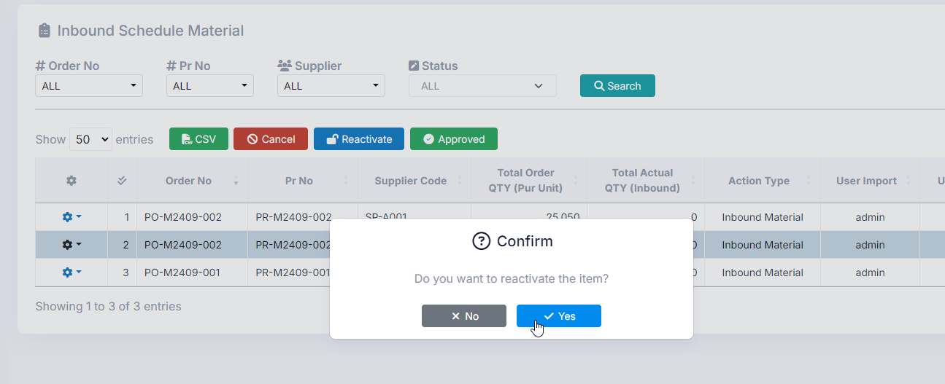
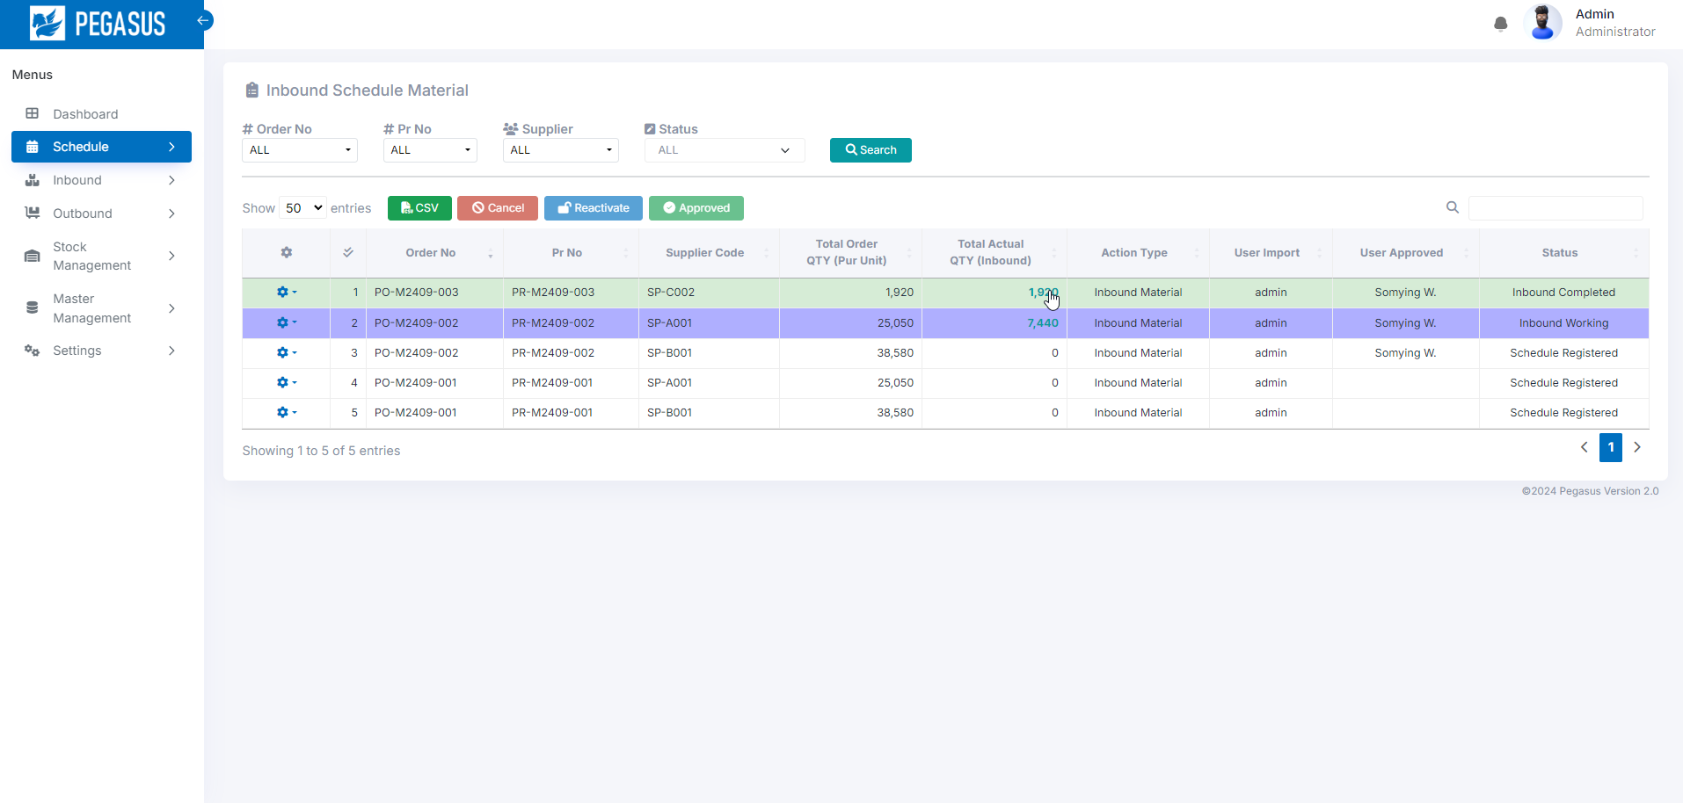
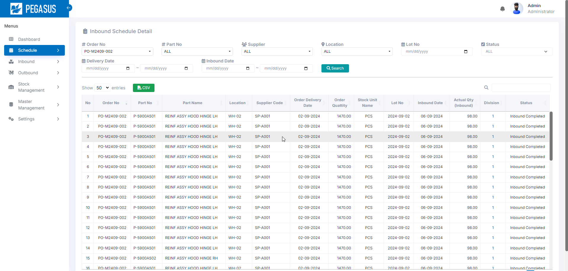
2. Handheld functions
2-2-2. Inbound Schedule.
*Status can be changed from the menu symbol. on the back of each item.
If the actual quantity is included, it will be possible to jump to the “Inbound schedule detail” screen.
Inbound Schedule page
Inbound Schedule Detail page

Slide 16
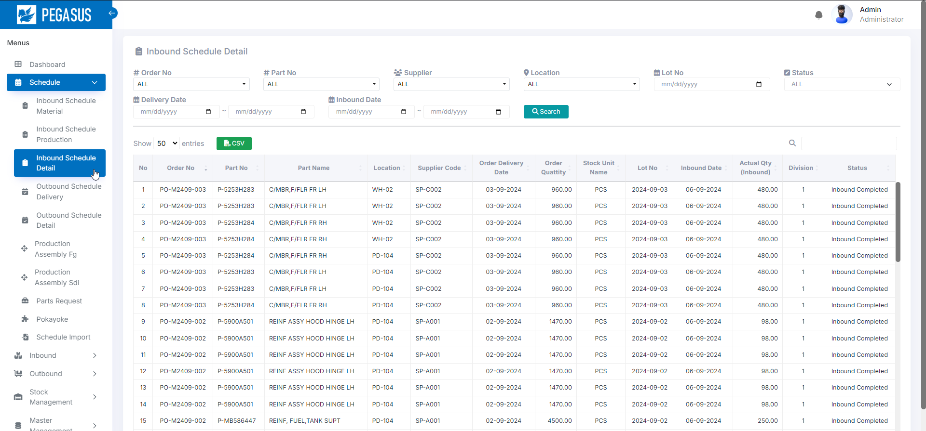
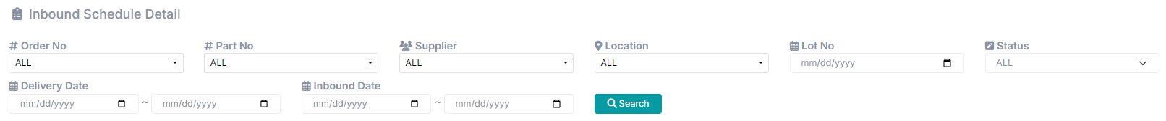
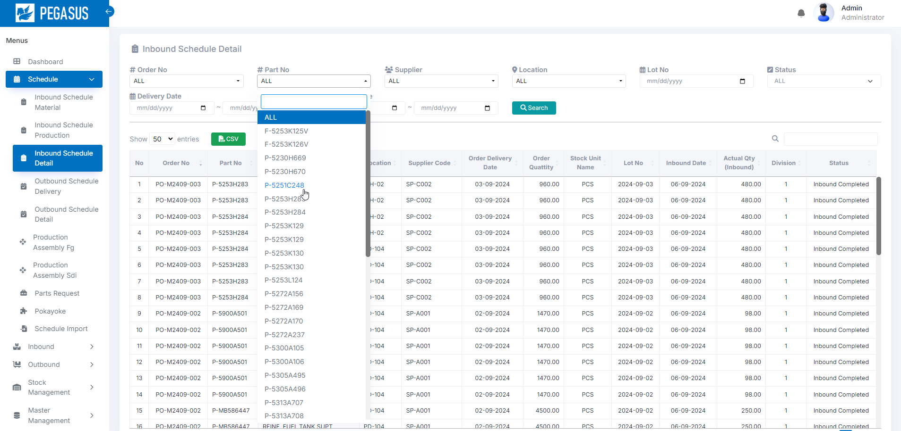
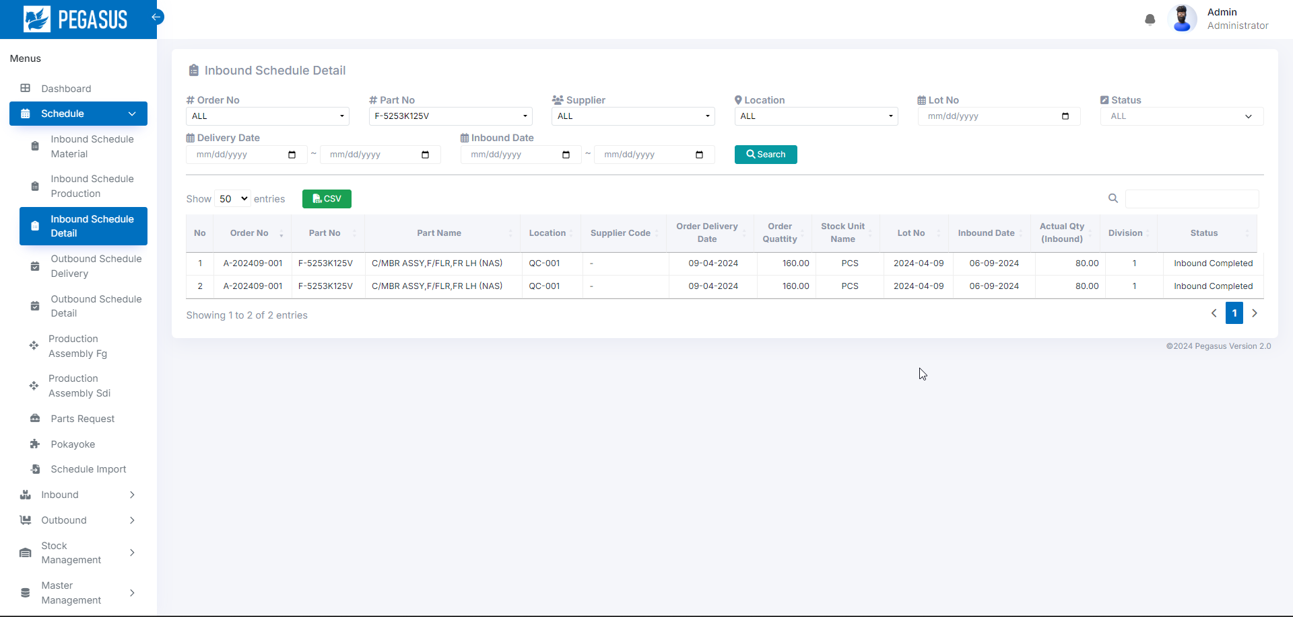
2. Handheld functions
2-2-3. Inbound Schedule Detail.
View data all Inbound Schedule Detail.
Inbound Schedule Detail page
When you arrive at this page, Click the “Search” button to search and display the desired information.
• Search: A function for searching for information as specified in each option.

Slide 17
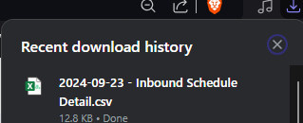

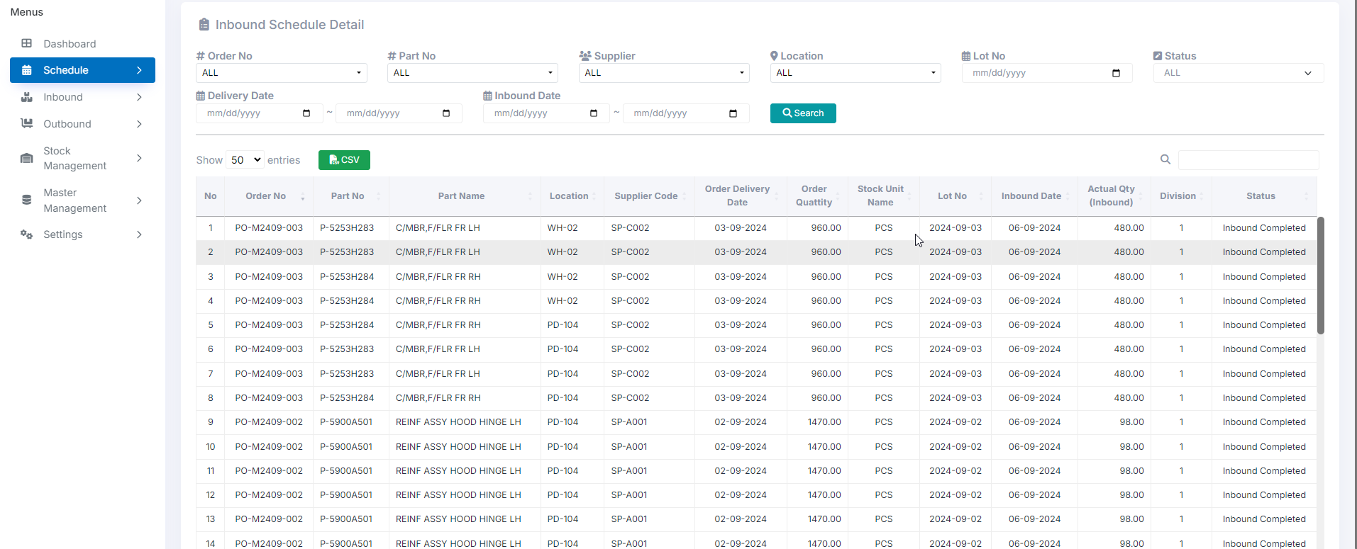
2. Handheld functions
2-2-3. Inbound Schedule Detail
• CSV Output: Export data as a CSV file.
It will export data from the current page.

Slide 18
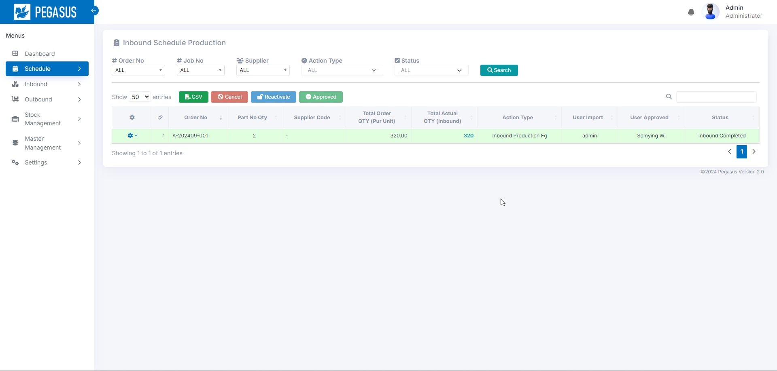
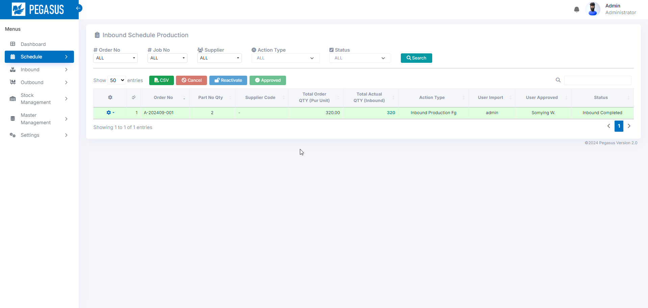
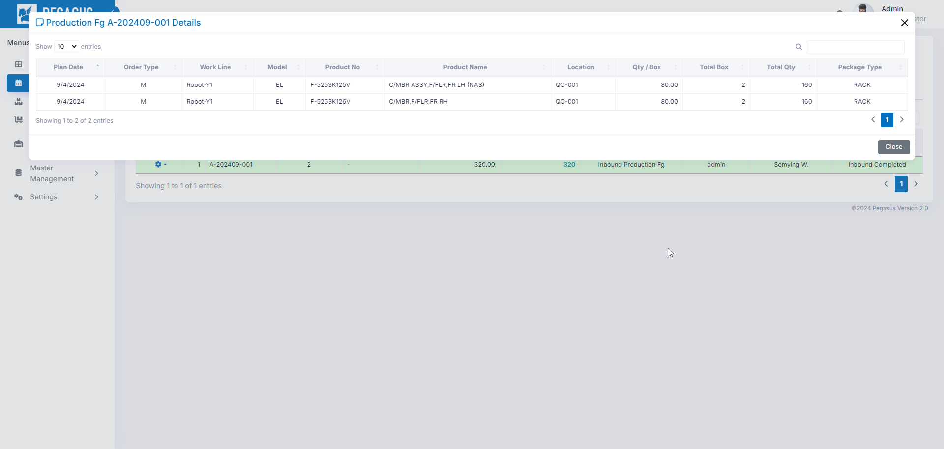
2. Handheld functions
2-2-3. Inbound Schedule Production.
View data and manage all Inbound Schedule Production.
Inbound Schedule Production page.
When you arrive at this page, Click the “Search” button to search and display the desired information.
• Search: A function for searching for information as specified in each option.

Slide 19
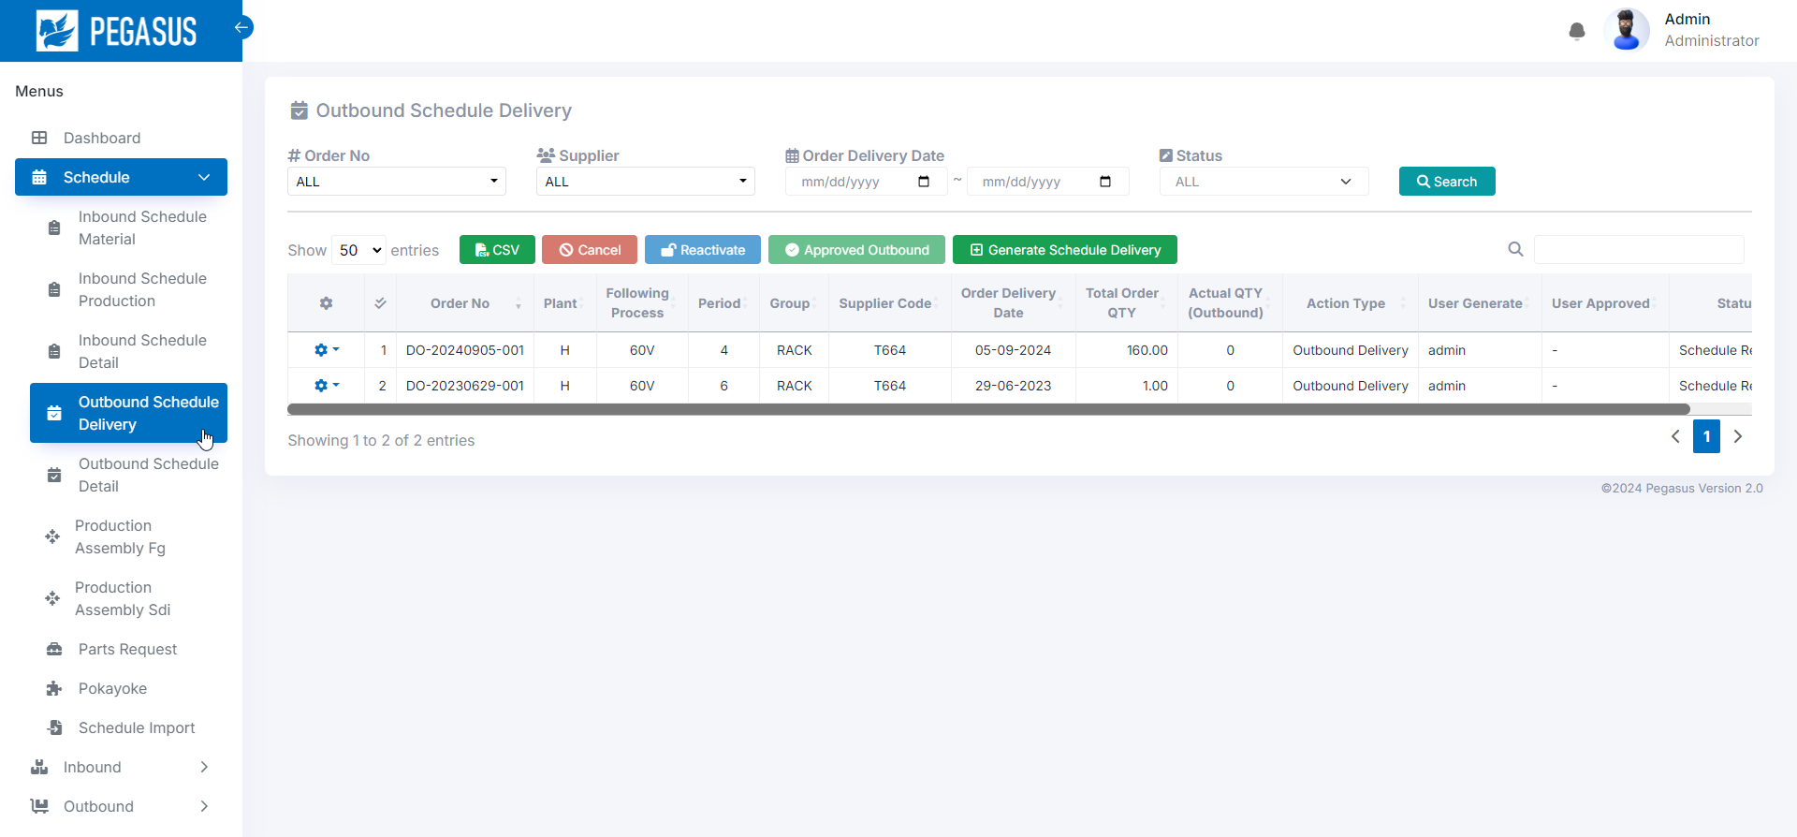
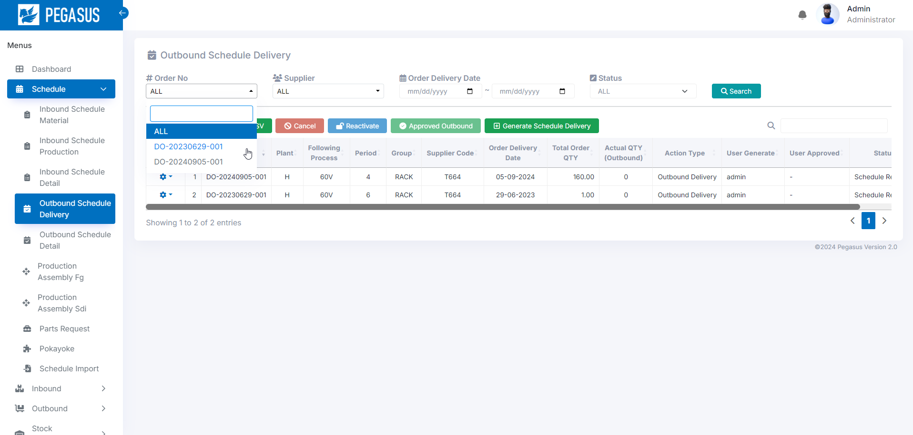
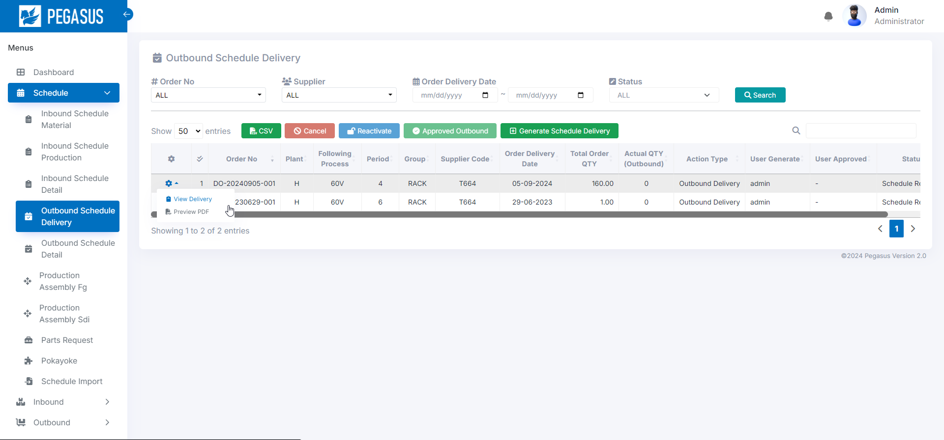
2. Handheld functions
2-2-4. Outbound Schedule Delivery.
View data and manage all Outbound Schedule Delivery.
Outbound Schedule page.
When you arrive at this page, Click the “Search” button to search and display the desired information.
• Search: A function for searching for information as specified in each option.
• Action View Delivery And Preview PDF : A function for details option.

Slide 20
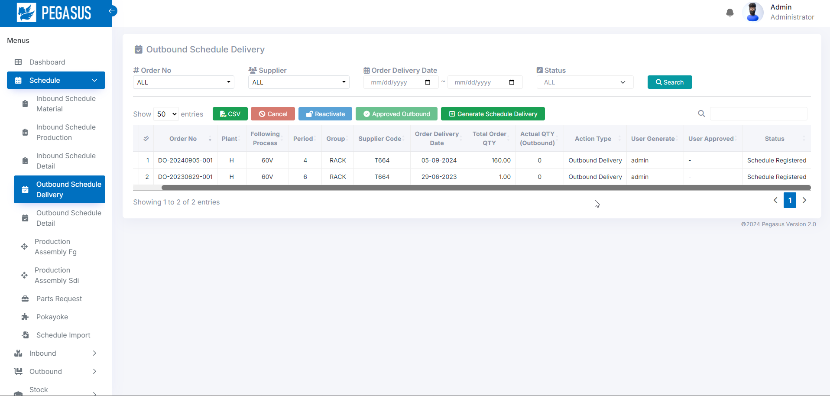
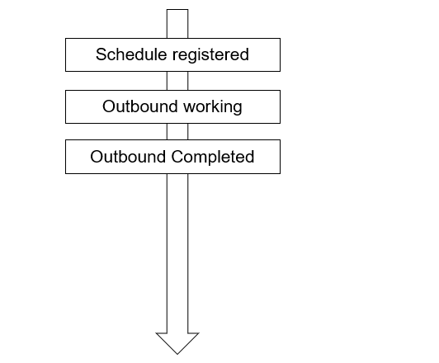
2. Handheld functions
2-2-4. Outbound Schedule Delivery.
Outbound Schedule Delivery page
Status management :
Cancel

Slide 21
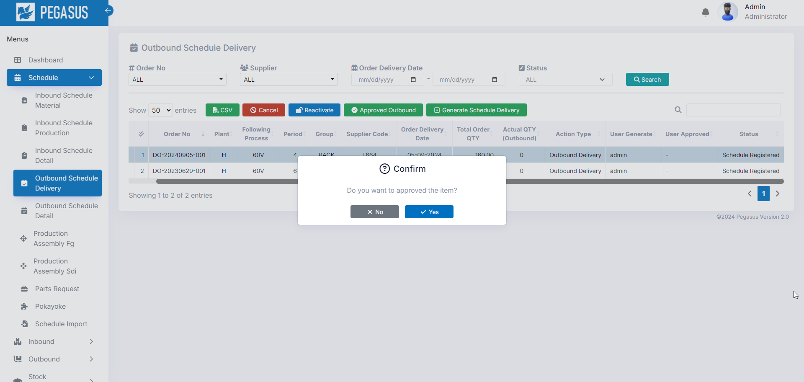
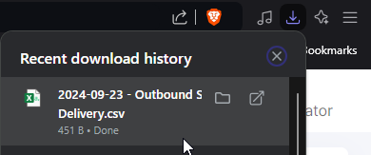
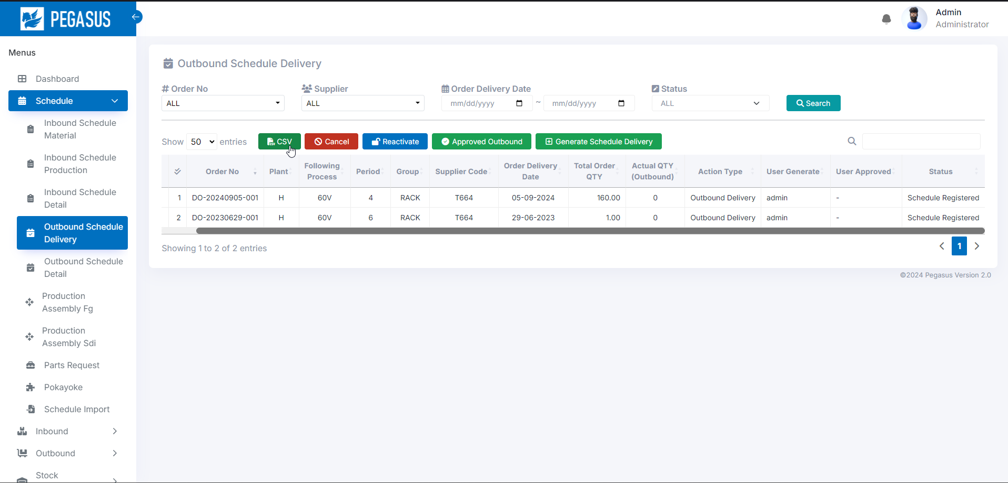
2. Handheld functions
2-2-4. Outbound Schedule.
• Approved Outbound: Manual Confirm Outbound Fg.
• CSV Output: Export data as a CSV file.
It will export data from the current page.

Slide 22


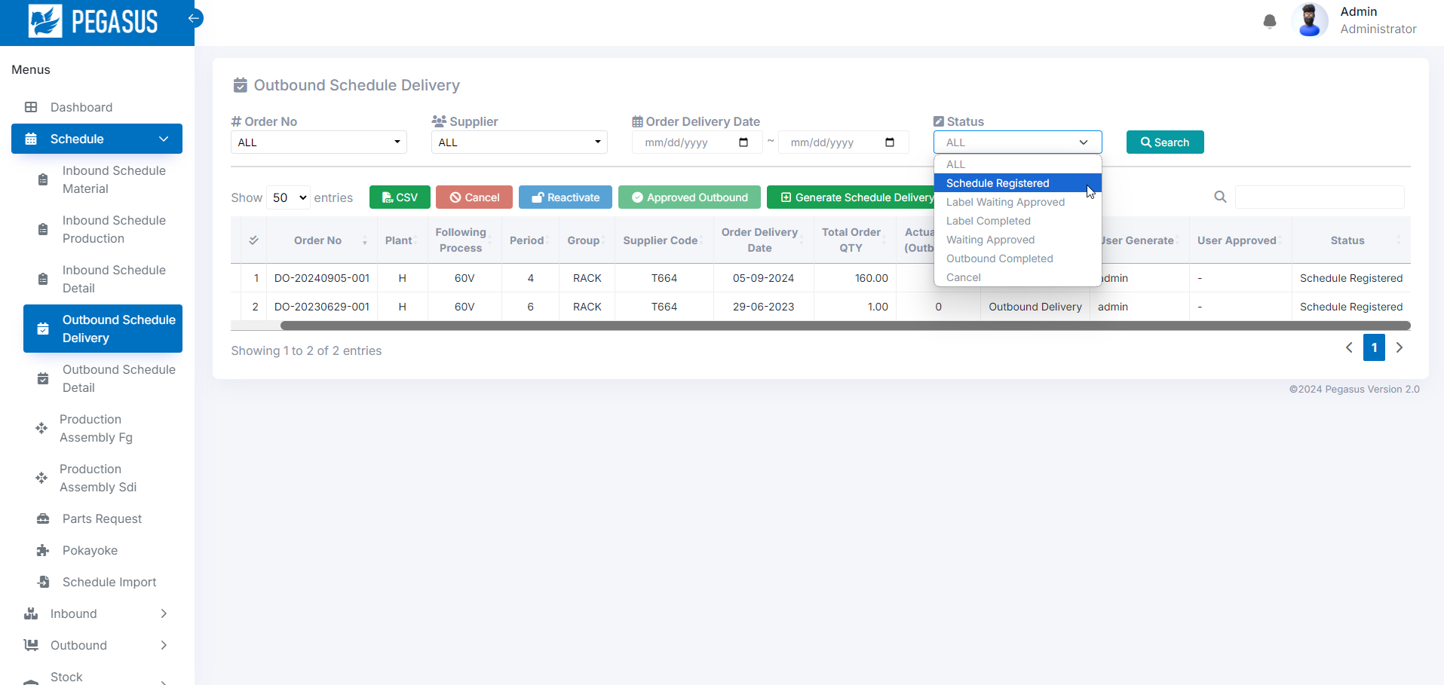
2. Handheld functions
2-2-4. Outbound Schedule Delivery.
• Cancel: Select an item from the row below. and click “cancel”
to change the status to cancel.
*can change status only: Schedule Registered.
• Reactivate: Select an Order No from the row below. and click “Reactivate”
to change the cancel status to reactivate status .

Slide 23
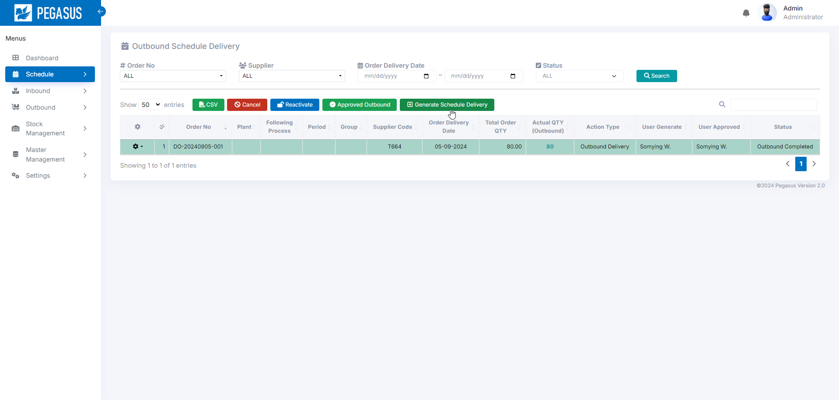
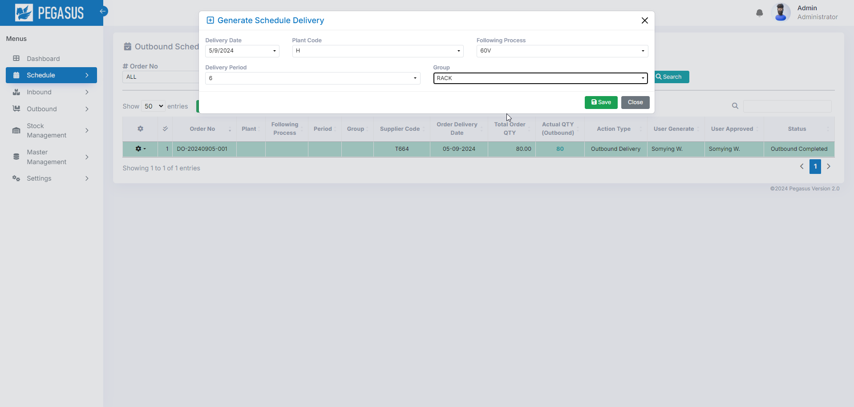
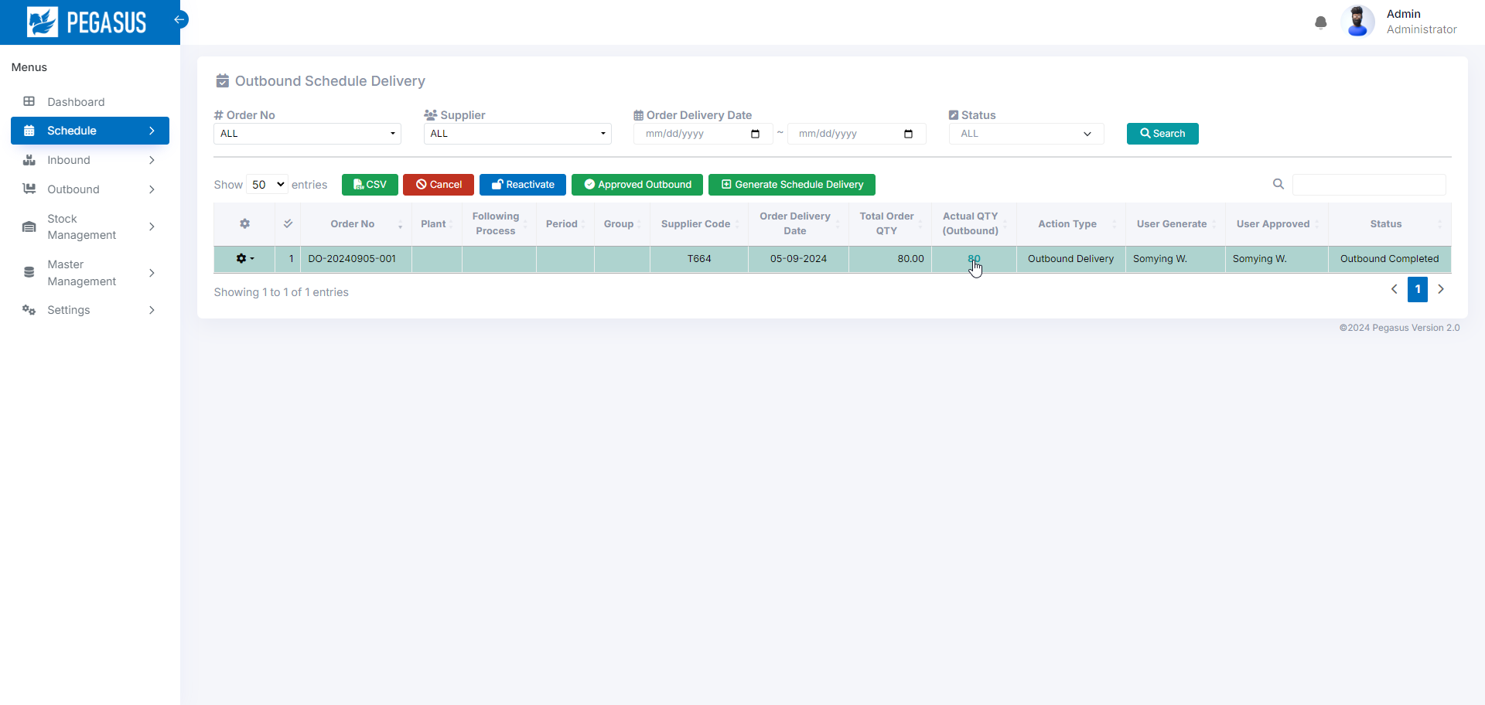
2. Handheld functions
2-2-4. Outbound Schedule Delivery.
• Generate Schedule Delivery: Gen Schedule From Data In Import Delivery.
If the actual quantity is included, it will be possible to jump to the “Outbound schedule detail” screen.
Outbound Schedule Delivery page.

Slide 24
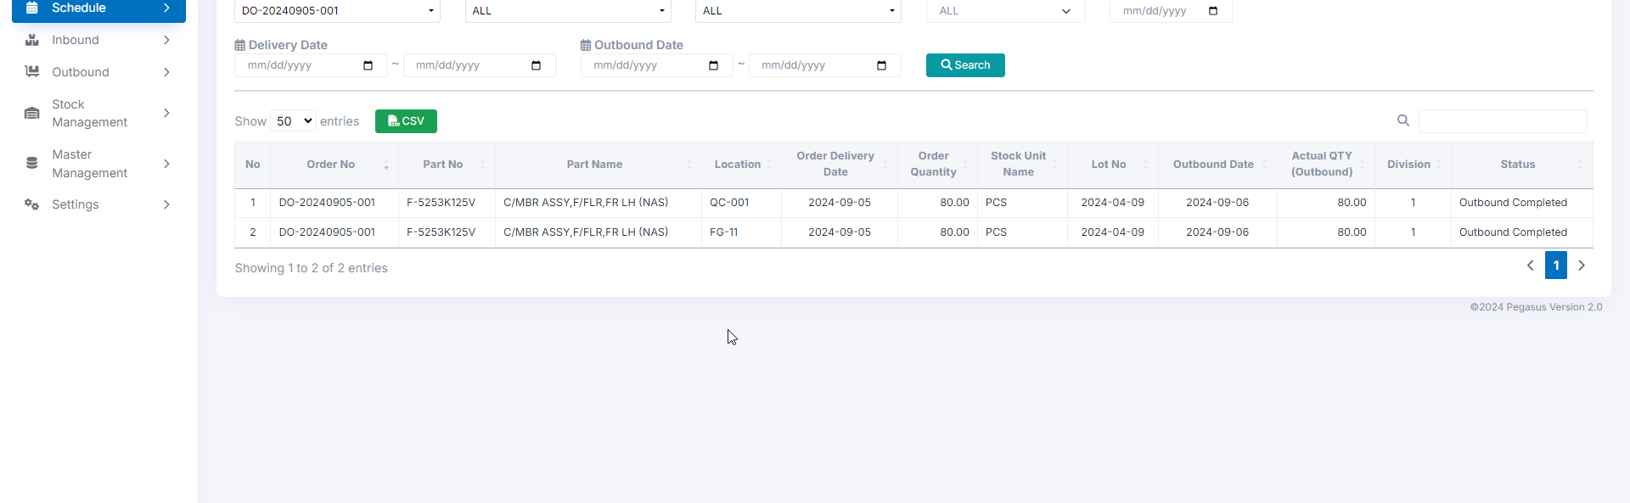
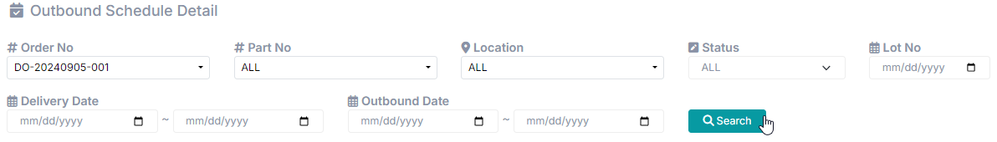

2. Handheld functions
2-2-5. Outbound Schedule Detail.
View data all Outbound Schedule Detail
Outbound Schedule Detail page
When you arrive at this page, Click the “Search” button to search and display the desired information.
• Search: A function for searching for information as specified in each option.

Slide 25
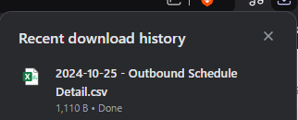

2. Handheld functions
2-2-5. Outbound Schedule Detail.
• CSV Output: Export data as a CSV file.
It will export data from the current page.

Slide 26




2. Handheld functions
2-2-6. Production Assembly Fg.
• Search And View Detail Production Fg
Dropdown Detail: List Production Inbound Type Fg

Slide 27


2. Handheld functions
2-2-6. Production Assembly Fg.
Dropdown Detail: List Material Inbound Type Fg
Material Inbound Detail For Production Fg
2-2-7. Production Assembly Sdi.
• Search: A function for searching for information as specified in each option.

Slide 28
2. Handheld functions
2-2-6. Production Assembly Fg.
Dropdown Detail: List Material Inbound Type Fg
Material Inbound Detail For Production Fg
2-2-7. Production Assembly Sdi.
• Search: A function for searching for information as specified in each option.

Slide 29


2. Handheld functions
2-2-7. Production Assembly sdi.
Dropdown Detail: List Production Inbound Type Sdi
Dropdown Detail: List Material Inbound Type Sdi

Slide 30



2. Handheld functions
2-2-8. Parts Request.
• Search: A function for searching for information as specified in each option.
Dropdown Detail: List Parts Request.

Slide 31


2. Handheld functions
2-2-9. Pokayoke.
• Search: A function for searching for information as specified in each option.

Slide 32




2. Handheld functions
2-2-10. Schedule Import.
• Search: A function for searching for information as specified in each option.
Button Import: Click to Import Schedule.
Button Type: Choose Type Schedule Import.

Slide 33



2. Handheld functions
2-3-1. Inbound Inquiry Report.
• CSV Output: Export data as a CSV file.
• Search: A function for searching for information as specified in each option.
It will export data from the current page.

Slide 34


2. Handheld functions
2-4-1. Outbound Inquiry Report.
• CSV Output: Export data as a CSV file.
• Search: A function for searching for information as specified in each option.
It will export data from the current page.

Slide 35

2. Handheld functions
2-5. Stock Management Menu.
The Stock Management menu has 5 submenus.
- Stock Inquiry Report.
- Stocktaking.
- Stock Maintenance.
- Stock Maintenance Inquiry / Report.
- Tag Label.

Slide 36



2. Handheld functions
2-5-1. Stock Inquiry Report.
View data stock report.
Stock Inquiry Report page.
• Search: A function for searching for information as specified in each option.

Slide 37



2. Handheld functions
2-5-2. Stock Maintenance
View data stock maintenance report.
Stock Inquiry Report page.
• Search: A function for searching for information as specified in each option.

Slide 38


2. Handheld functions
2-5-3. Stocktaking
View data Stocktaking report.
Stock Inquiry Report page.
• Select : Select the item to confirm.
Press confirm to confirm the item.

Slide 39



2. Handheld functions
2-5-4. Stock Maintenance Report
View data Stock Maintenance Report report.
Stock Maintenance Inquiry Report page.

Slide 40



2. Handheld functions
2-5-5. Tag Label
View data LabelStatus Master.
Tag Label page.
Search: A function for searching for information as specified in each option.
Status management :
PRINTED
IN_WH
IN_STORE
OUT_STORE

Slide 41

2. Handheld functions
2-6. Stock Management Menu.
The Master Management menu has 8 submenus.
- Item Master.
- Bill Of Materials.
- Location master
- Supplier Master.
- Packing Standard
- Department Master
- User master
- User Credential master

Slide 42




2. Handheld functions
2-6-1. Item master
View data Item master report.
Item Master page.
Export : Press Export the csv file and edit data and Csv Import data.
Add Item.
Edit Item.

Slide 43




2. Handheld functions
2-6-2. Bill of Materials
View data bill of materials.
Bill of Materials page.
Export : Press Export the csv file and edit data and Csv Import data.
Add Bill Of Materials.
Edit Bill Of Materials.

Slide 44




2. Handheld functions
2-6-3. Location Master
View data Location Master.
Location Master page.
Export : Press Export the csv file and edit data and Csv Import data.

Slide 45




2. Handheld functions
2-6-4. Supplier Master
View data Supplier Master.
Supplier Master page.
Search: A function for searching for information as specified in each option.
Export : Press Export the csv file and edit data and Csv Import data.

Slide 46




2. Handheld functions
2-6-5. Packing Standard Master
View data Packing Standard Master.
Packing Standard Master page.
Search: A function for searching for information as specified in each option.
Export : Press Export the csv file and edit data and Csv Import data.

Slide 47




2. Handheld functions
2-6-6. Department Master
View data Department Master.
Department Master page.
Search: A function for searching for information as specified in each option.
Export : Press Export the csv file and edit data and Csv Import data.

Slide 48




2. Handheld functions
2-6-7. User Master
View data User Master.
User Master page.
Search: A function for searching for information as specified in each option.
Export : Press Export the csv file and edit data and Csv Import data.

Slide 49




2. Handheld functions
2-6-8. User Credential Master
View data User Credential Master.
User Credential Master page.

Slide 50
3. Configuration file storage
Input data:
1. Employee information
2. Product list

Slide 51
4. Q&A
# | Date | Question | By | Date | Answer | By
1
2
3
4
5

Slide 52
5. Contact information
The contents of this specification and manual are subject to change without notice. Copying or copying part or all of the manual without the written permission of TOMAS TECH is prohibited, regardless of its form.
If you have any questions, concerns, or questions regarding the specifications of this system and the contents of the manual, please contact us by phone or e-mail. Tel: +66 (0) 2 336 0574 E-mail: info@tomastc.com
Item | Description
1. Service time | 8 hours x 5 days (8:00 -17:00 Monday to Friday)
2. Onsite Hardware Maintenance | -
3. Onsite System Maintenance | -
4. Response after receive a call | On-line support within 24 hours / On-site support within 48 hours
5. Remote service | Yes
6. Phone service | Yes
7. Email service | Yes

