Slide 1
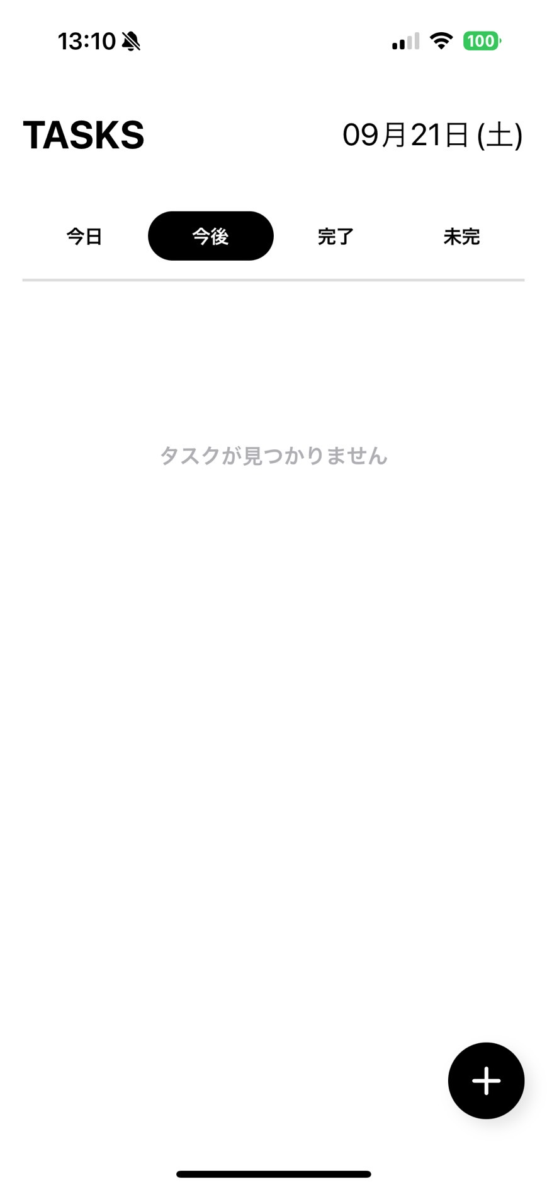


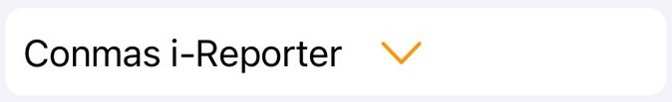

┃Login
2
Login screen
Close > Close the application
Settings > Set the device IP address, set the cloud device *Details not yet determined
CONECT TO > Select the server. Use the Settings button to register the list. Use the Settings button to enable server registration.
USER ID > Enter manually or scan QR code
PASS WORD > Enter manually or scan QR code
LANGEAGE > ENGLISH, THAI, JAPANESE
Login screen
Close > Close the application
Settings > Set the device IP address, set the cloud device *Details not yet determined
CONECT TO > Select the server. Use the Settings button to register the list. Use the Settings button to enable server registration.
USER ID > Enter manually or scan QR code
PASS WORD > Enter manually or scan QR code
Location> Can be select from Location master data
LANGEAGE > ENGLISH, THAI, JAPANESE
Close
Close
Calling system
For Callee
Calling system
For Caller
Connect To *
Connect To *
＞
＞
User ID *
User ID *
admin
admin
Password *
Password *
●●●●●●●
●●●●●●●
Language *
Location *
ENGLISH
＞
ENGINE LINE / CNC OP20
＞
Language *
ENGLISH
＞

Slide 2


┃Setting
<Common>
2
Settings
Close
Mode
Callee
＞
Callee
Caller
NFC
OFF
＞
ON
OFF
Logout
Submit

Slide 3
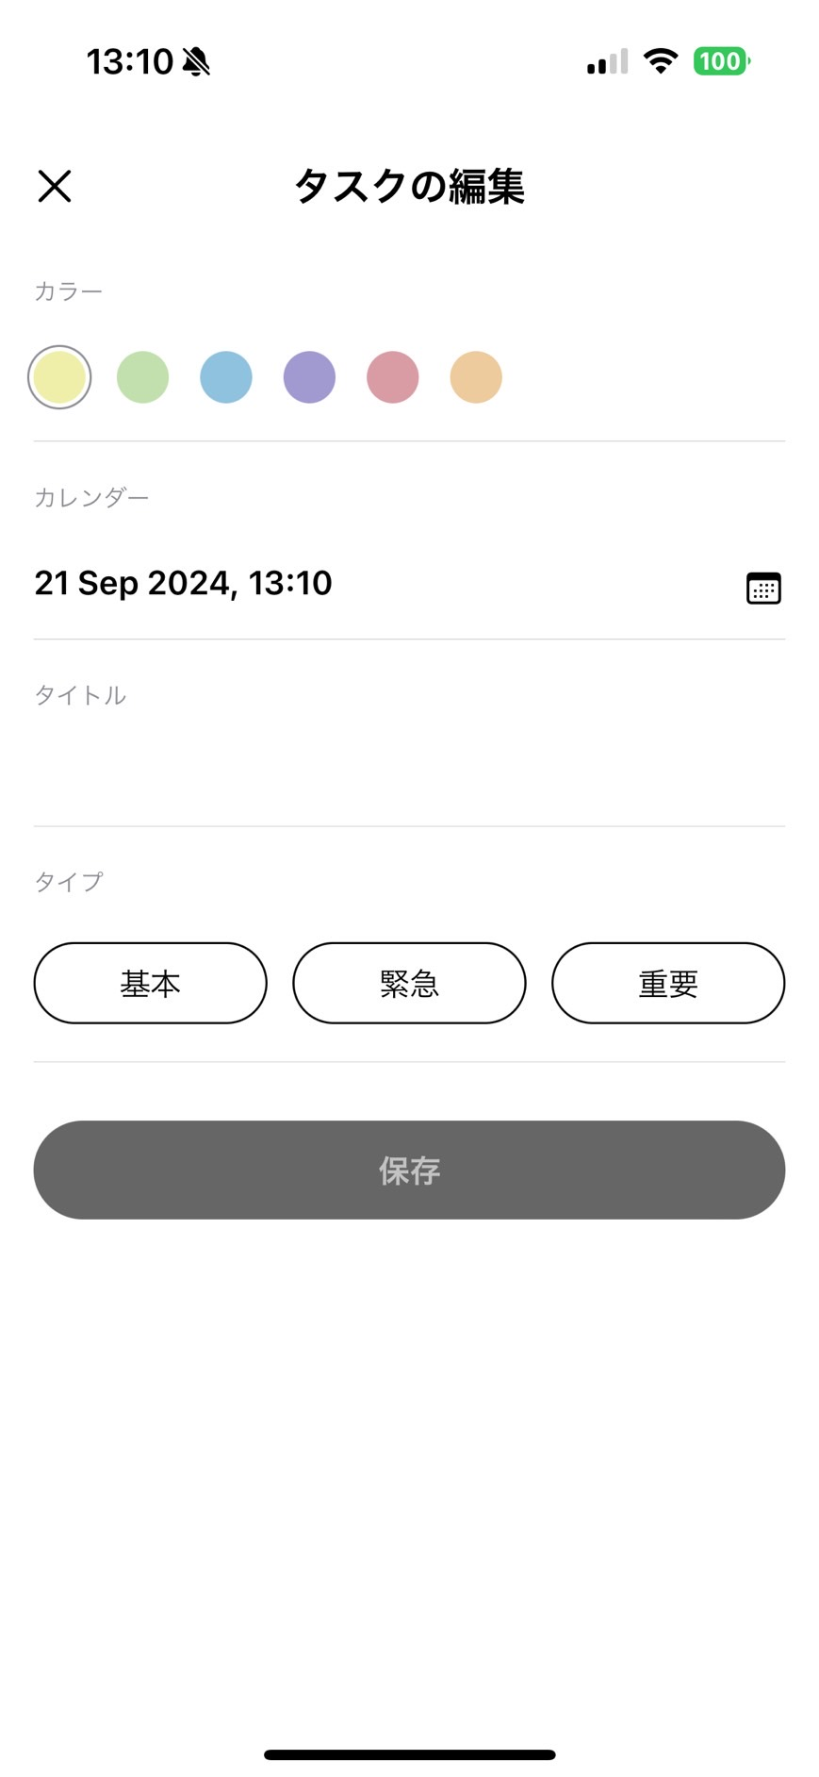
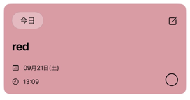





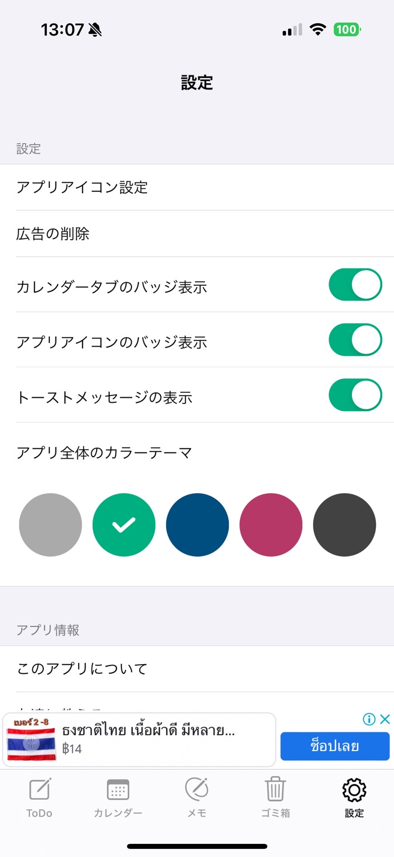





┃Tasks
<Callee>
Calling system
21-Sep-2024 Sat
Calling system
21-Sep-2024 Sat
Task Modification
Task Modification
Update status *
Update status *
ENGINE LINE / CNC OP20
Not responding
＞
Not responding
Available
Not available
Support needed
Response pending
Available
＞
Incident : Machine Breakdown
Comment :
Status : Not responding
Caller : Kittisak
Nominate : Soraya
Responder : *******
Elapsed time : 00:01:02
Comment
Comment
No notification.
Up to 30 characters
Up to 30 characters
21-Sep-2024 Sat 13:09:00
Login
Submit
Submit
Submit
Call
Sound and vibration
Not active with “Not responding”
Active without “Not responding”
Tasks
All
Schedule
Dashboard
Setting
Tasks
All
Schedule
Dashboard
Setting

Slide 4
┃Tasks Not available
<Callee>
Task Modification
Calling system
21-Sep-2024 Sat
Task Modification
Update status *
Update status *
Not available
＞
ENGINE LINE / CNC OP20
Not available
＞
Not responding
Available
Not available
Support needed
Response pending
Incident : Machine Breakdown
Comment :
Status : Not available
Caller : Kittisak
Nominate : Soraya
Responder : Soraya
Elapsed time : 00:01:02
Comment
Comment
Up to 30 characters
Up to 30 characters
21-Sep-2024 Sat 13:09:00
Submit
Submit
Submit
Submit
Active without “Not responding”
Active without “Not responding”
Tasks
All
Schedule
Dashboard
Setting

Slide 5
┃Tasks Support needed
<Callee>
Task Modification
Calling system
21-Sep-2024 Sat
Task Modification
Update status *
Update status *
Support needed
＞
ENGINE LINE / CNC OP20
Support needed
＞
Not responding
Available
Not available
Support needed
Response pending
Incident : Machine Breakdown
Comment :
Status : Support needed
Caller : Kittisak
Nominate : Soraya
Responder : Soraya
Elapsed time : 00:01:02
Comment
Comment
Up to 30 characters
Up to 30 characters
21-Sep-2024 Sat 13:09:00
Submit
Submit
Submit
Submit
Active without “Not responding”
Active without “Not responding”
Tasks
All
Schedule
Dashboard
Setting

Slide 6
┃Tasks Response pending
<Callee>
Task Modification
Calling system
21-Sep-2024 Sat
Task Modification
Update status *
Update status *
Response pending
＞
ENGINE LINE / CNC OP20
Response pending
＞
Not responding
Available
Not available
Support needed
Response pending
Incident : Machine Breakdown
Comment :
Status : Response pending
Caller : Kittisak
Nominate : Soraya
Responder : Soraya
Elapsed time : 00:01:02
Comment
Comment
Up to 30 characters
Up to 30 characters
21-Sep-2024 Sat 13:09:00
Submit
Submit
Submit
Submit
Active without “Not responding”
Active without “Not responding”
Tasks
All
Schedule
Dashboard
Setting

Slide 7
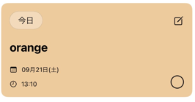

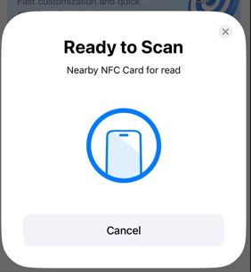


┃Tasks Available
<Callee>
Task Modification
Calling system
21-Sep-2024 Sat
Task Modification
Task Modification
Update status *
Update status *
Update status
Available
＞
ENGINE LINE / CNC OP20
Gray out
Available
＞
Incident : Machine Breakdown
Comment :
Status : Available
Caller : Kittisak
Nominate : Soraya
Responder : Soraya
Elapsed time : 00:01:02
Available
＞
Comment
Smart card recognition
Smart card recognition
The necessity is determined by the master settings.
Gray out if not needed
Up to 30 characters
21-Sep-2024 Sat 13:09:00
Presumed cause *
Presumed cause
Submit
Cause - Master registration possible
Coolant trouble
Cutting tool trouble
Jig trouble
Facility door trouble
Cylinder trouble
Air trouble
Emergency error
Robot arm trouble
Other
Submit
＞
Operator human error
＞
Active without “Not responding”
Comment
Comment
Up to 30 characters
Up to 30 characters
The necessity is determined by the master settings.
Gray out if not needed
Submit
If "Smart card recognition" and "Presumed cause" are not entered, they will be grayed out.
If NFC is not set, it will not be displayed.
Tasks
All
Schedule
Dashboard
Setting

Slide 8
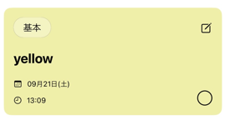
┃Tasks Available
<Callee>
Task Modification
Calling system
21-Sep-2024 Sat
Task Modification
Update status *
Incident - Master registration possible
Coolant trouble
Cutting tool trouble
Jig trouble
Facility door trouble
Cylinder trouble
Air trouble
Emergency error
Robot arm trouble
Other
Update status *
Available
＞
ENGINE LINE / CNC OP20
Gray out
Gray out
Available
＞
Incident : Machine Breakdown
Comment :
Status : Available
Caller : Kittisak
Nominate : Soraya
Responder : Soraya
Elapsed time : 00:01:02
Incident
Smart card recognition
＞
Cause *
Presumed cause *
21-Sep-2024 Sat 13:09:00
＞
Cause - Master registration possible
Operator human error
Maintenance worker human error
Omission of regular maintenance items
Equipment lifespan
Maintenance part lifespan
Other
Operator human error
＞
Response details *
Comment
＞
Comment
Response details - Master registration possible
Equipment restart
Resetting conditions
Cutting tool replacement
Air pressure change
Part replacement inside equipment
Part replacement outside equipment
Other
Up to 30 characters
Up to 30 characters
Submit
If "Smart card recognition" and "Presumed cause" are not entered, they will be grayed out.
If “Incident" , “Cause" and “Response details” are not entered, they will be grayed out.
Tasks
All
Schedule
Dashboard
Setting

Slide 9
┃Tasks Available
<Callee>
If NFC is not set, it will not be displayed.
Task Modification
Task Modification
Calling system
21-Sep-2024 Sat
Incident - Master registration possible
Coolant trouble
Cutting tool trouble
Jig trouble
Facility door trouble
Cylinder trouble
Air trouble
Emergency error
Robot arm trouble
Other
Update status *
Update status
Available
＞
Available
＞
Incident *
Incident
The necessity is determined by the master settings.
Gray out if not needed
Coolant trouble
＞
Coolant trouble
＞
Cause *
Cause
No notification.
Operator human error
＞
Cause - Master registration possible
Operator human error
Maintenance worker human error
Omission of regular maintenance items
Equipment lifespan
Maintenance part lifespan
Other
Operator human error
＞
Response details *
Response details
Equipment restart
＞
Equipment restart
＞
Comment
Response details - Master registration possible
Equipment restart
Resetting conditions
Cutting tool replacement
Air pressure change
Part replacement inside equipment
Part replacement outside equipment
Other
Comment
Up to 30 characters
Up to 30 characters
The necessity is determined by the master settings.
Gray out if not needed
If NFC is not set, it will not be displayed.
If “Incident" , “Cause" and “Response details” are not entered, they will be grayed out.
If “Incident" , “Cause" and “Response details” are not entered, they will be grayed out.
Tasks
All
Schedule
Dashboard
Setting

Slide 10

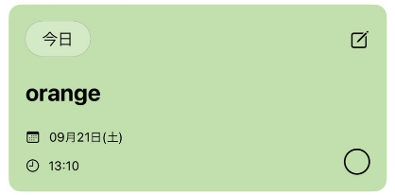

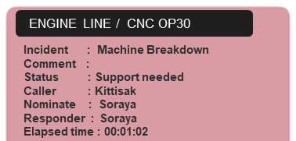


┃All
<Common>
Group A
Machine OP10
Machine OP20
Machine OP30
Soraya
Kittisak
Nongnut
Calling system
21-Sep-2024 Sat
Natapong
Kolawat
ENGINE LINE / CNC OP20
ENGINE LINE / CNC OP10
Incident : Machine Breakdown
Comment :
Status : Support needed
Caller : Kittisak
Nominate : Soraya
Responder : Soraya
Elapsed time : 00:01:02
Incident :
Comment :
Status :
Caller :
Nominate :
Responder :
Elapsed time :
21-Sep-2024 Sat 13:09:00
ENGINE LINE / CNC OP20
ENGINE LINE / CNC OP20
Incident : Machine Breakdown
Comment :
Status : Support needed
Caller : Kittisak
Nominate : Soraya
Responder : Soraya
Elapsed time : 00:01:02
Incident :
Comment :
Status :
Caller :
Nominate :
Responder :
Elapsed time :
Kittisak
Nongnut
Natapong
Kolawat
Soraya
Just for reference
Group A
Group B
21-Sep-2024 Sat 13:09:00
Tasks
All
Schedule
Dashboard
Setting

Slide 11

┃Schedule
<Callee>
Calling system
21-Sep-2024 Sat
Calling system
21-Sep-2024 Sat
ENGINE LINE / CNC OP20
Incident : Regular maintenance
Comment :
Status : Not responding
Caller : Kittisak
Nominate : Soraya
Responder : ********
Elapsed time :
Future reservation schedule
No action required yet.
Scheduled information from the caller
28-Sep-2024 Sat 13:00:00
No notification.
ENGINE LINE / CNC OP20
Incident : Regular maintenance
Comment :
Status : Not responding
Caller : Kittisak
Nominate : Soraya
Responder : ********
Elapsed time :
Just for reference
Just for reference
30-Sep-2024 Sat 13:00:00
Tasks
All
Schedule
Dashboard
Setting
Tasks
All
Schedule
Dashboard
Setting

Slide 12
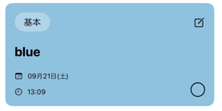

┃Dashboard
<Common>
Calling system
21-Sep-2024 Sat
Cases handled (Overall)
Cases handled (Individual)
8h
12h
24h
1w
1m
ENGINE LINE / CNC OP20
Cases handled
(Overall)
Cases handled
(Individual)
ENGINE LINE / CNC OP20
Incident : Machine Breakdown
Comment :
Status : Available
Caller : Kittisak
Nominate : Natapon
Responder : Natapon
Elapsed time : 00:01:02
Incident : Machine Breakdown
Comment :
Status : Available
Caller : Kittisak
Nominate : Soraya
Responder : Soraya
Elapsed time : 00:01:02
24 posts
24 posts
"Cases handled" will be clickable.
Dispatch time
(Overall)
Dispatch time
(Individual)
21-Sep-2024 Sat 13:10:00
21-Sep-2024 Sat 13:10:00
24 min
24 min
ENGINE LINE / CNC OP20
ENGINE LINE / CNC OP20
Incident : Machine Breakdown
Comment :
Status : Available
Caller : Kittisak
Nominate : Nozaki
Responder : Nozaki
Elapsed time : 00:01:02
Incident : Machine Breakdown
Comment :
Status : Available
Caller : Kittisak
Nominate : Soraya
Responder : Soraya
Elapsed time : 00:01:02
Waiting time
(Overall)
Waiting time
(Individual)
24 min
24 min
Arrival time
(Overall)
Arrival time
(Individual)
21-Sep-2024 Sat 13:05:00
21-Sep-2024 Sat 13:05:00
24 min
24 min
ENGINE LINE / CNC OP20
ENGINE LINE / CNC OP20
Incident : Machine Breakdown
Comment :
Status : Available
Caller : Kittisak
Nominate : Soraya
Responder : Soraya
Elapsed time : 00:01:02
Incident : Machine Breakdown
Comment :
Status : Available
Caller : Kittisak
Nominate : Soraya
Responder : Soraya
Elapsed time : 00:01:02
Response time
(Overall)
Response time
(Individual)
24 min
24 min
21-Sep-2024 Sat 13:00:00
21-Sep-2024 Sat 13:00:00
Tasks
All
Schedule
Dashboard
Setting

Slide 13

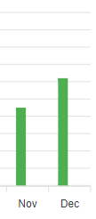
┃Dashboard
<Common>
Calling system
21-Sep-2024 Sat
Dispatch time (Overall)
Dispatch time (Individual)
8h
12h
24h
1w
1m
21-Sep-2024 Sat
21-Sep-2024 Sat
Cases handled
(Overall)
Cases handled
(Individual)
24 posts
24 posts
“Dispatch time" will be clickable.
Dispatch time
(Overall)
Dispatch time
(Individual)
24 min
24 min
Waiting time
(Overall)
Waiting time
(Individual)
24 min
24 min
min
08:00
12:00
16:00
20:00
24:00
04:00
min
08:00
12:00
16:00
20:00
24:00
04:00
Arrival time
(Overall)
Arrival time
(Individual)
24 min
24 min
Response time
(Overall)
Response time
(Individual)
24 min
24 min
Tasks
All
Schedule
Dashboard
Setting

Slide 14
┃Dashboard
<Common>
Calling system
21-Sep-2024 Sat
Waiting time (Overall)
Waiting time (Individual)
8h
12h
24h
1w
1m
21-Sep-2024 Sat
21-Sep-2024 Sat
Cases handled
(Overall)
Cases handled
(Individual)
24 posts
24 posts
“Waiting time" will be clickable.
Dispatch time
(Overall)
Dispatch time
(Individual)
24 min
24 min
Waiting time
(Overall)
Waiting time
(Individual)
24 min
24 min
min
08:00
12:00
16:00
20:00
24:00
04:00
min
08:00
12:00
16:00
20:00
24:00
04:00
Arrival time
(Overall)
Arrival time
(Individual)
24 min
24 min
Response time
(Overall)
Response time
(Individual)
24 min
24 min
Tasks
All
Schedule
Dashboard
Setting

Slide 15
┃Dashboard
<Common>
Calling system
21-Sep-2024 Sat
Arrival time (Overall)
Arrival time (Individual)
8h
12h
24h
1w
1m
21-Sep-2024 Sat
21-Sep-2024 Sat
Cases handled
(Overall)
Cases handled
(Individual)
24 posts
24 posts
“Arrival time" will be clickable.
Dispatch time
(Overall)
Dispatch time
(Individual)
24 min
24 min
Waiting time
(Overall)
Waiting time
(Individual)
24 min
24 min
min
08:00
12:00
16:00
20:00
24:00
04:00
min
08:00
12:00
16:00
20:00
24:00
04:00
Arrival time
(Overall)
Arrival time
(Individual)
24 min
24 min
Response time
(Overall)
Response time
(Individual)
24 min
24 min
Tasks
All
Schedule
Dashboard
Setting

Slide 16
┃Dashboard
<Common>
Calling system
21-Sep-2024 Sat
Response time (Overall)
Response time (Individual)
8h
12h
24h
1w
1m
21-Sep-2024 Sat
21-Sep-2024 Sat
Cases handled
(Overall)
Cases handled
(Individual)
24 posts
24 posts
“Response time" will be clickable.
Dispatch time
(Overall)
Dispatch time
(Individual)
24 min
24 min
Waiting time
(Overall)
Waiting time
(Individual)
24 min
24 min
min
08:00
12:00
16:00
20:00
24:00
04:00
min
08:00
12:00
16:00
20:00
24:00
04:00
Arrival time
(Overall)
Arrival time
(Individual)
24 min
24 min
Response time
(Overall)
Response time
(Individual)
24 min
24 min
Tasks
All
Schedule
Dashboard
Setting

Slide 17
┃Dashboard
<Common>
Calling system
21-Sep-2024 Sat
Calling system
21-Sep-2024 Sat
Dispatch time (Overall)
8h
12h
1w
1m
8h
12h
24h
1w
1m
21-Sep-2024 Sat
24h
12h
Cases handled
(Overall)
Cases handled
(Individual)
Cases handled
(Overall)
Cases handled
(Individual)
24 posts
24 posts
“12h" will be clickable.
13 posts
4 posts
Dispatch time
(Overall)
Dispatch time
(Individual)
Dispatch time
(Overall)
Dispatch time
(Individual)
24 min
24 min
5 min
2 min
Waiting time
(Overall)
Waiting time
(Individual)
Waiting time
(Overall)
Waiting time
(Individual)
24 min
24 min
10 min
3 min
min
08:00
10:00
12:00
14:00
16:00
18:00
20:00
Arrival time
(Overall)
Arrival time
(Individual)
Arrival time
(Overall)
Arrival time
(Individual)
24 min
24 min
2 min
0.5 min
Response time
(Overall)
Response time
(Individual)
Response time
(Overall)
Response time
(Individual)
24 min
24 min
1 min
1 min
Tasks
All
Schedule
Dashboard
Setting
Tasks
All
Schedule
Dashboard
Setting

Slide 18
┃Dashboard
<Common>
Calling system
21-Sep-2024 Sat
Calling system
21-Sep-2024 Sat
Dispatch time (Overall)
8h
12h
1w
1m
8h
12h
24h
1w
1m
24h
8h
21-Sep-2024 Sat
Cases handled
(Overall)
Cases handled
(Individual)
Cases handled
(Overall)
Cases handled
(Individual)
24 posts
24 posts
“8h" will be clickable.
13 posts
4 posts
Dispatch time
(Overall)
Dispatch time
(Individual)
Dispatch time
(Overall)
Dispatch time
(Individual)
24 min
24 min
5 min
2 min
Waiting time
(Overall)
Waiting time
(Individual)
Waiting time
(Overall)
Waiting time
(Individual)
24 min
24 min
10 min
3 min
min
08:00
10:00
12:00
14:00
17:00
Arrival time
(Overall)
Arrival time
(Individual)
Arrival time
(Overall)
Arrival time
(Individual)
24 min
24 min
2 min
0.5 min
Response time
(Overall)
Response time
(Individual)
Response time
(Overall)
Response time
(Individual)
24 min
24 min
1 min
1 min
Tasks
All
Schedule
Dashboard
Setting
Tasks
All
Schedule
Dashboard
Setting

Slide 19
┃Dashboard
<Common>
Calling system
21-Sep-2024 Sat
Calling system
21-Sep-2024 Sat
Dispatch time (Overall)
8h
12h
24h
1w
1m
8h
12h
24h
1w
1m
15-Sep-2024 Sun –
21-Sep-2024 Sat
1w
Cases handled
(Overall)
Cases handled
(Individual)
Cases handled
(Overall)
Cases handled
(Individual)
24 posts
24 posts
“1w" will be clickable.
13 posts
4 posts
Dispatch time
(Overall)
Dispatch time
(Individual)
Dispatch time
(Overall)
Dispatch time
(Individual)
24 min
24 min
5 min
2 min
Waiting time
(Overall)
Waiting time
(Individual)
Waiting time
(Overall)
Waiting time
(Individual)
24 min
24 min
10 min
3 min
min
21-Sep
12:00
16:00
20:00
24:00
21-Sep
Arrival time
(Overall)
Arrival time
(Individual)
Arrival time
(Overall)
Arrival time
(Individual)
24 min
24 min
2 min
0.5 min
Response time
(Overall)
Response time
(Individual)
Response time
(Overall)
Response time
(Individual)
24 min
24 min
1 min
1 min
Tasks
All
Schedule
Dashboard
Setting
Tasks
All
Schedule
Dashboard
Setting

Slide 20
┃Dashboard
<Common>
Calling system
21-Sep-2024 Sat
Calling system
21-Sep-2024 Sat
Dispatch time (Overall)
8h
12h
1w
1m
8h
12h
24h
1w
1m
22-Aug-2024 Thu –
21-Sep-2024 Sat
24h
1m
Cases handled
(Overall)
Cases handled
(Individual)
Cases handled
(Overall)
Cases handled
(Individual)
24 posts
24 posts
“1m" will be clickable.
13 posts
4 posts
Dispatch time
(Overall)
Dispatch time
(Individual)
Dispatch time
(Overall)
Dispatch time
(Individual)
24 min
24 min
5 min
2 min
Waiting time
(Overall)
Waiting time
(Individual)
Waiting time
(Overall)
Waiting time
(Individual)
24 min
24 min
10 min
3 min
min
08:00
10:00
12:00
14:00
17:00
Arrival time
(Overall)
Arrival time
(Individual)
Arrival time
(Overall)
Arrival time
(Individual)
24 min
24 min
2 min
0.5 min
Response time
(Overall)
Response time
(Individual)
Response time
(Overall)
Response time
(Individual)
24 min
24 min
1 min
1 min
Tasks
All
Schedule
Dashboard
Setting
Tasks
All
Schedule
Dashboard
Setting

Slide 21


┃Setting
<Common>
2
Settings
Calling system
21-Sep-2024 Sat
Close
Mode
Callee
Not active / Gray out
＞
NFC
OFF
Not active / Gray out
＞
No notification.
Logout
Submit
Tasks
All
Schedule
Dashboard
Setting

Slide 22
┃Tasks
<Caller>
2
Calling system
21-Sep-2024 Sat
Calling system
21-Sep-2024 Sat
ENGINE LINE / CNC OP20
Incident : Machine Breakdown
Comment :
Status : Not responding
Caller : Kittisak
Nominate : Soraya
Responder : *******
Elapsed time : 00:01:02
No notification.
Allow reference only
21-Sep-2024 Sat 13:09:00
Login
Call
Sound and vibration
＋
＋
Tasks
All
Call
Dashboard
Setting
Tasks
All
Call
Dashboard
Setting

Slide 23

┃Call
<Caller>
2
Calling system
21-Sep-2024 Sat
Making a call
Making a call
Nominate - Master registration possible
Kittisak
Soraya
Group A
Group B
…
Nominate
Nominate *
＞
Kittisak
＞
Incident
Incident *
＞
Coolant trouble
＞
Incident - Master registration possible
Coolant trouble
Cutting tool trouble
Jig trouble
Facility door trouble
Cylinder trouble
Air trouble
Emergency error
Robot arm trouble
Other
Login
Comment
Comment
Up to 30 characters
Up to 30 characters
Schedule
Schedule
Schedule
Submit
28-Sep-2024 Sat 13:00:00
Not active with must enter “Nominate” and “Incident”.
Schedule allows you to input reservations. By selecting the date and time, you can call it at a future date. Not required
＋
If "Smart card recognition" and "Presumed cause" are not entered, they will be grayed out.
Tasks
All
Call
Dashboard
Setting

Slide 24
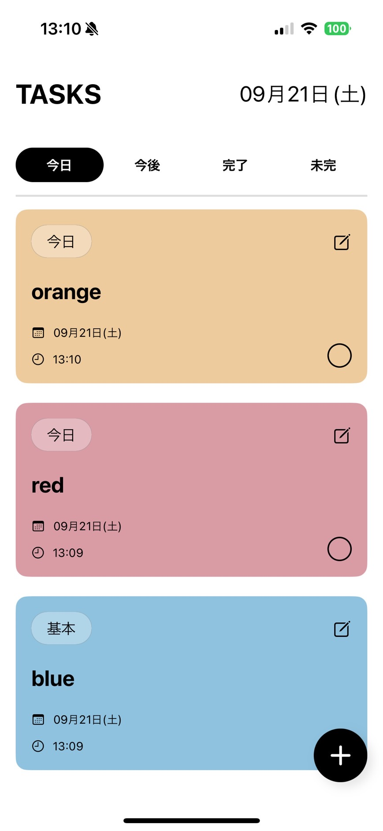
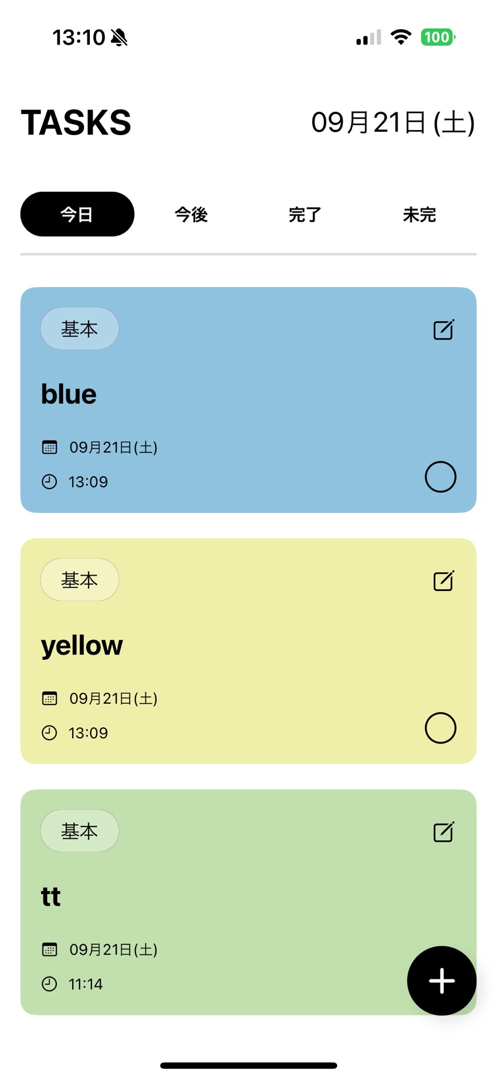
┃Image

