Slide 1
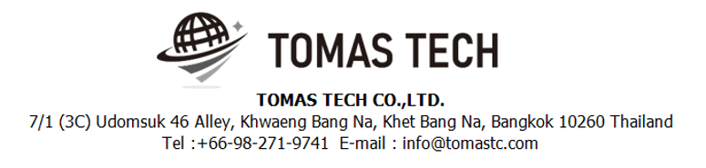
Version 10/Oct/2024
Confidential
CKD process system phase4 specifications
Documentation EN Blueprint for ANI
Blueprint
R3
Made for : A.N.I. LOGISTICS, LTD.
By : TOMAS TECH CO.,LTD.

Slide 2
Revision History
Date | Version | File name | Details
23/Sep/2024 | R1 | CKD process system phase3 specifications Documentation EN Blueprint for ANI Blueprint | First edition
4/Oct/2024 | R2 | CKD process system phase3 specifications Documentation EN Blueprint for ANI Blueprint | Second edition
10/Oct/2024 | R3 | CKD process system phase3 specifications Documentation EN Blueprint for ANI Blueprint | Third edition
2
3

Slide 3
■Contents
1. Overview
2. Overall configuration diagram
3. Document information
4. Operation flow
5. System functional specifications
6. Q&A
7. Sign off

Slide 4
1. Overview
Proposal of Process Management System to A.N.I.
By systematizing the CKD work process, we will realize “Improvement of quality", “Improvement of work efficiency", “Visualization of work", “Paperless" and “Traceability management".
Advantages of introducing the system
By scanning and verifying the visual confirmation work with a handy terminal, it is possible to prevent check mistakes by workers and expect "improvement of quality".
By acquiring the cycle time of the packing work, it becomes possible to analyze by process, worker, and control number, and "improvement of work efficiency" can be expected.
By creating a system, on-site managers, office managers, and people in charge of other processes will be able to grasp the work status, realizing "visualization of work". By visualizing the on-site situation, it is possible to manage the progress of the Material Stock process, which can be expected to improve work efficiency.
By enabling the necessary information to be viewed on PCs, handy terminals, tablets, and TV displays, it is possible to realize "paperless" by digitizing forms.
"Traceability management" can be realized because it is possible to take pictures of the actual product and the product as well as the result of verification by the handy terminal.

Slide 5
2. Overall configuration diagram
Regarding the CKD process system, consider the following system configuration.
Overall configuration diagram image
Server Room
Fiber optic communication
ANI CKD process server BK
ANI CKD process server
LAN communication
WIFI communication
HATC schedule data
HATC schedule data
System unit
Printing label (New)
Using label (Old)
UPS
UPS
Show document
TV 75” for monitor *2
S/W Hub
A/P *9
Receiving area
Stock & Staging area
Inner packing area
Outer Packing area
Handy terminal *3
Tablet *3
Label printer for Tag receive *1
Handy terminal * 21
Tablet *21
Label printer for Content label *7
Parts contents tag receive
Parts contents tag receive
Parts contents tag receive
Contents label
Meiji card for Tablet
Meiji card for Tablet
Contents label
Packing check sheet
Meiji card for Tablet
Case mark
Bolt area
Small area
Handy terminal *4
Tablet *4
Label printer for Content label *4
Handy terminal *6
Tablet *6
Label printer for Content label *6
Packing method for Tablet
Inner panel area
Vanning area
Re finish area
Handy terminal *5
Tablet *5
Label printer for Content label *5
Handy terminal *4
Tablet *4
Handy terminal *1
Tablet *1

Slide 6
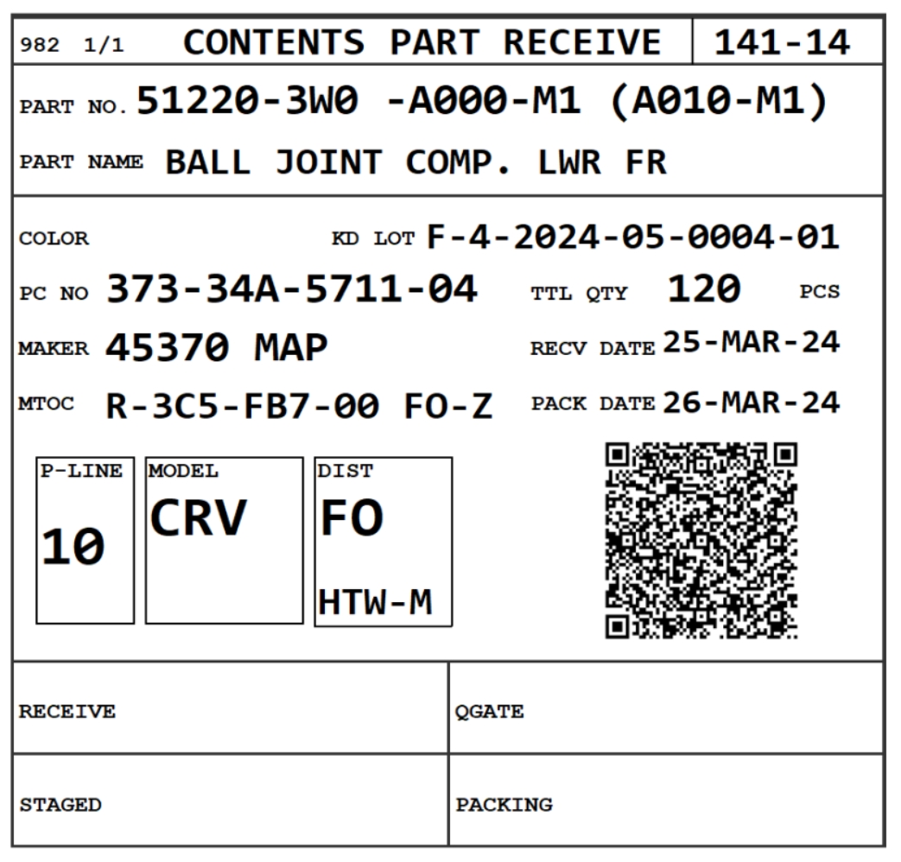
3. Document information
3. Document information
3.1 Contents Part Receive
3
Add “SC” (special characteristic) icon to tag receive label regarding “sc_flag” column equals to 1 from Item master and ProductionScheduleTagReceive.
SC

Slide 7
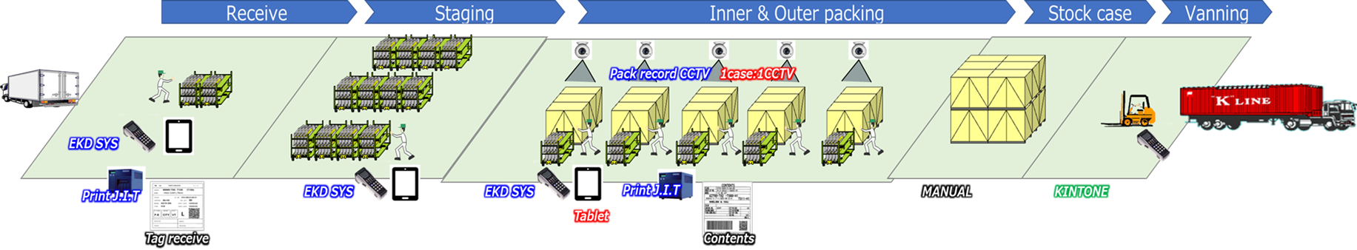
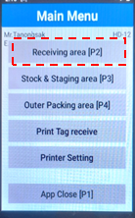
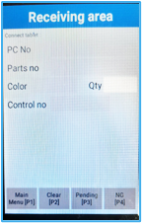
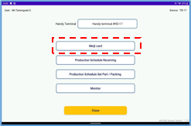
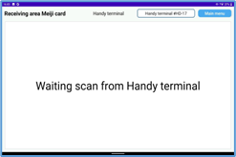
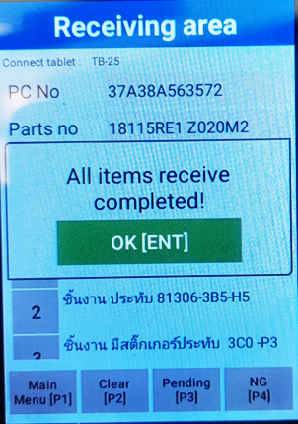
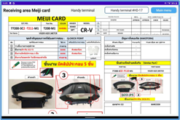
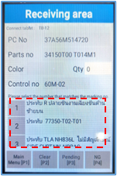
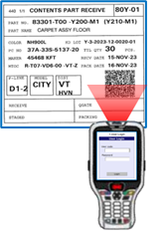
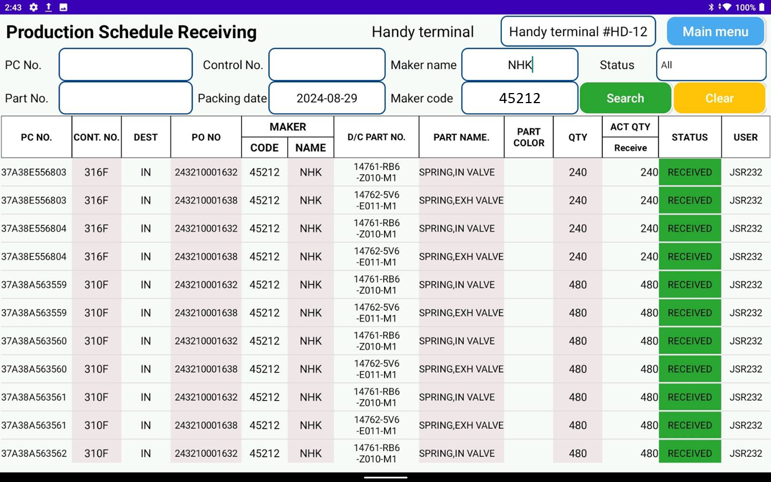
4. Operation flow
4. Operation flow
4-1. Panel area overall process / Receive process
Panel overall process
Receive process (enhanced concept)
Instructions
-Scan ID
-Auto user login of handy
-User login Tablet
-Scan tag receive
-Tablet screen display Meiji card
-Handy screen display detail scan and
Q-Point check
-Check Q-Point with part
-Confirm Q-Point
-Confirm receive “OK”
-Tablet auto screen display back to the page receive status according maker

Slide 8
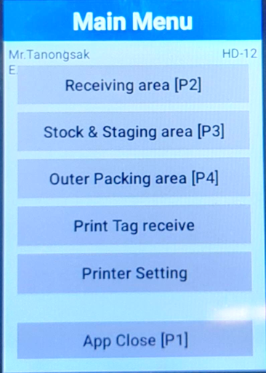
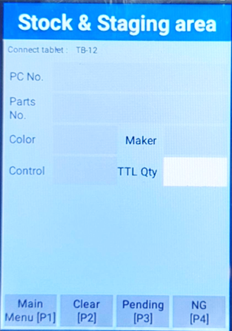
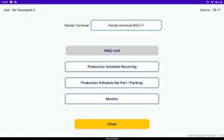
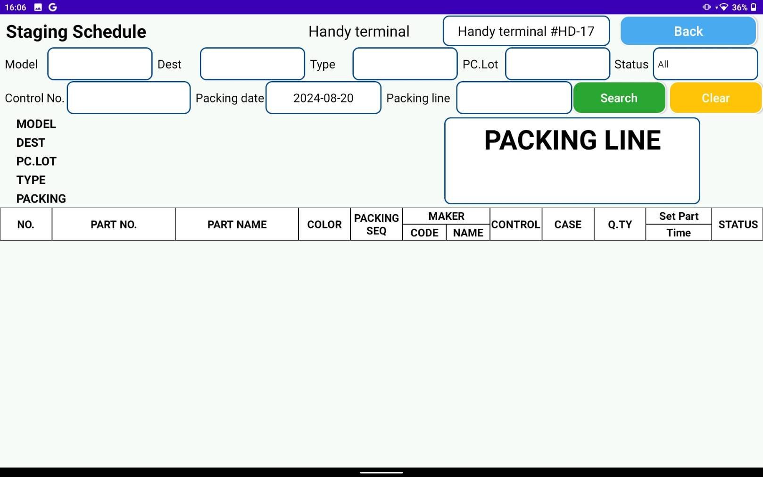
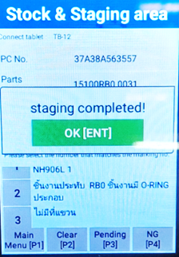
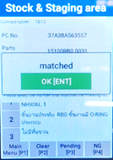
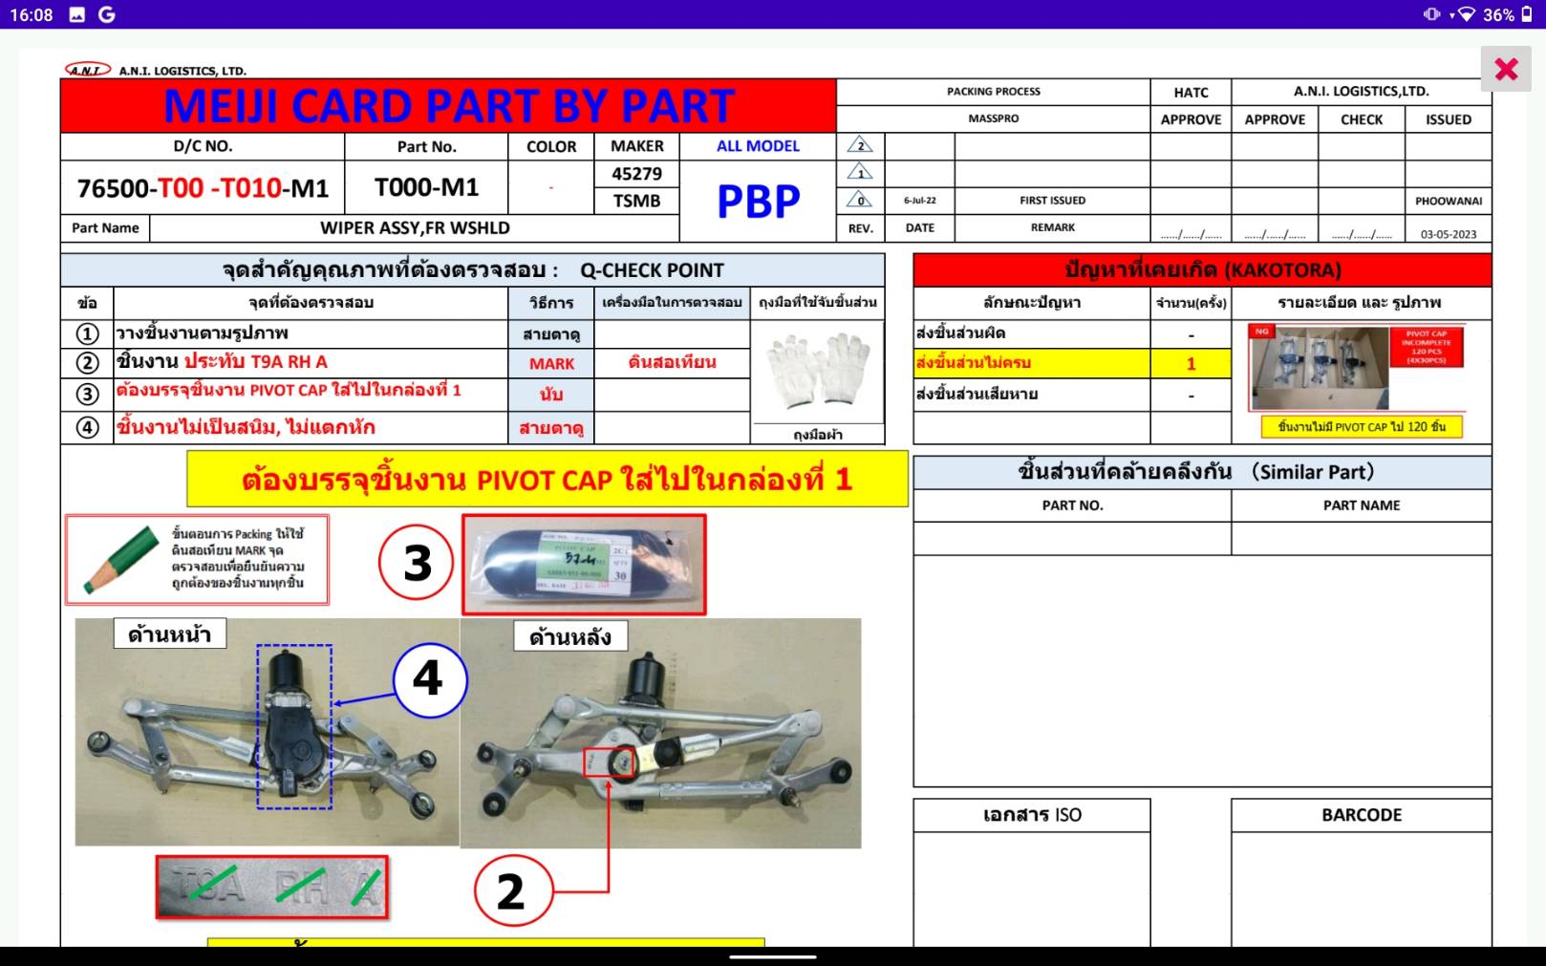
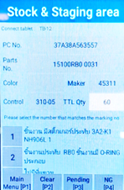
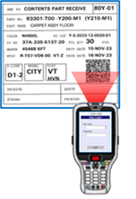
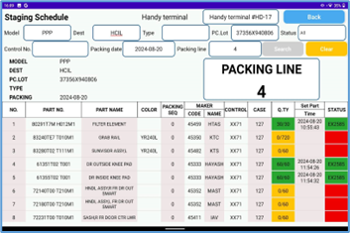
4. Operation flow
4. Operation flow
4-2. Panel area – Staging process
Staging process (enhanced concept)
Instructions
-Scan ID
-Auto user login of handy
-User login Tablet
-Scan tag receive
-Tablet screen display Meiji card
-Handy screen display detail scan and
Q-Point check
-Check Q-Point with part
-Confirm Q-Point
-Confirm staging “OK”
-Tablet auto screen display back to the page control line status

Slide 9
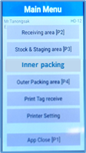
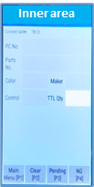
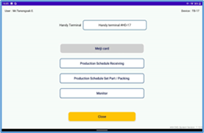
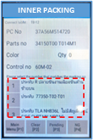
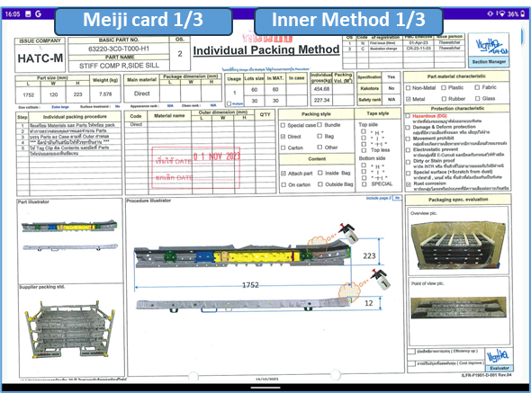
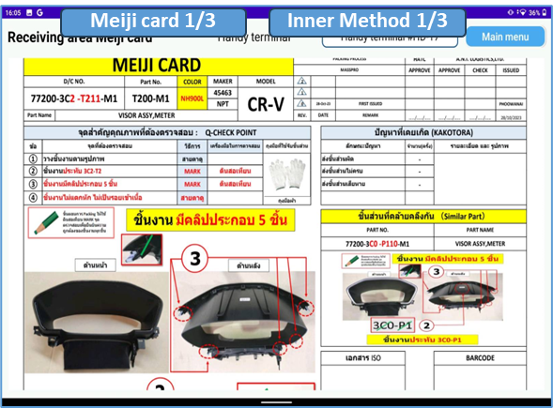
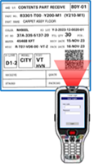

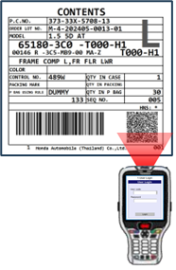
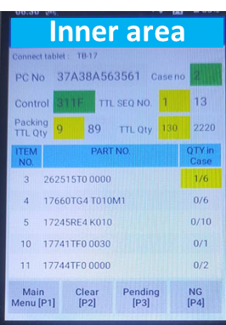
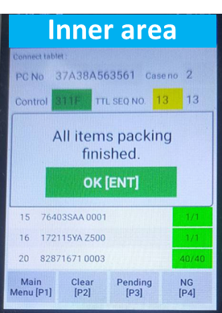
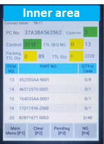

4. Operation flow
4. Operation flow
4-3. Panel, Bolt, Small – Inner Packing Process
Inner Packing process of line Panel, Bolt, Small (enhanced concept)
Instructions
-Scan ID
-Auto user login of handy
-User login Tablet
-Scan Area ID
-Scan QR Code tag receive
-Tablet screen display Meiji card
-Touch screen of tablet to switch check inner method or Meiji card
-Handy screen display detail scan and
Q-Point check
-Check Q-Point with part
-Confirm Q-Point
-Confirm print contents packing
-Confirm print “OK”
-Screen display detail of part for inner
-Scan QR-Code content after inner part finish
-Confirm “OK” after scan inner finish

Slide 10
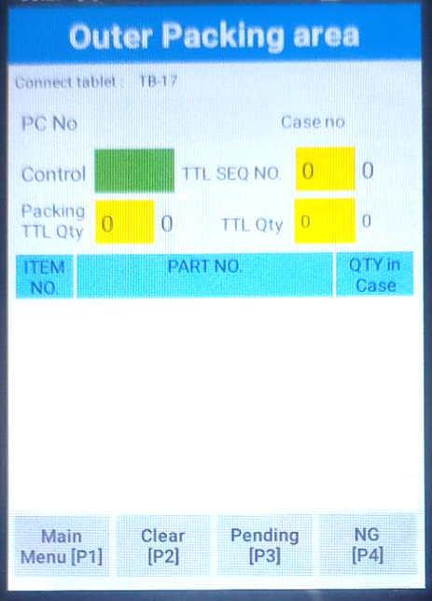
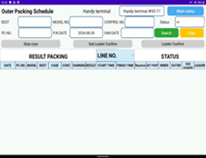
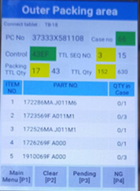
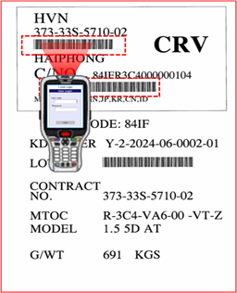

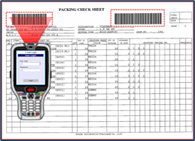
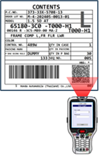
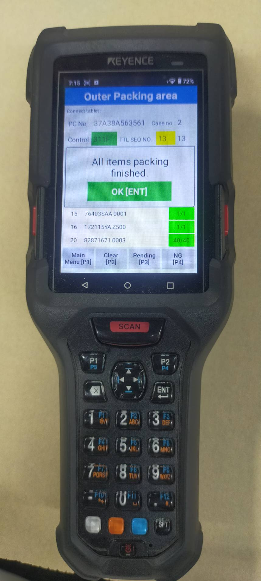
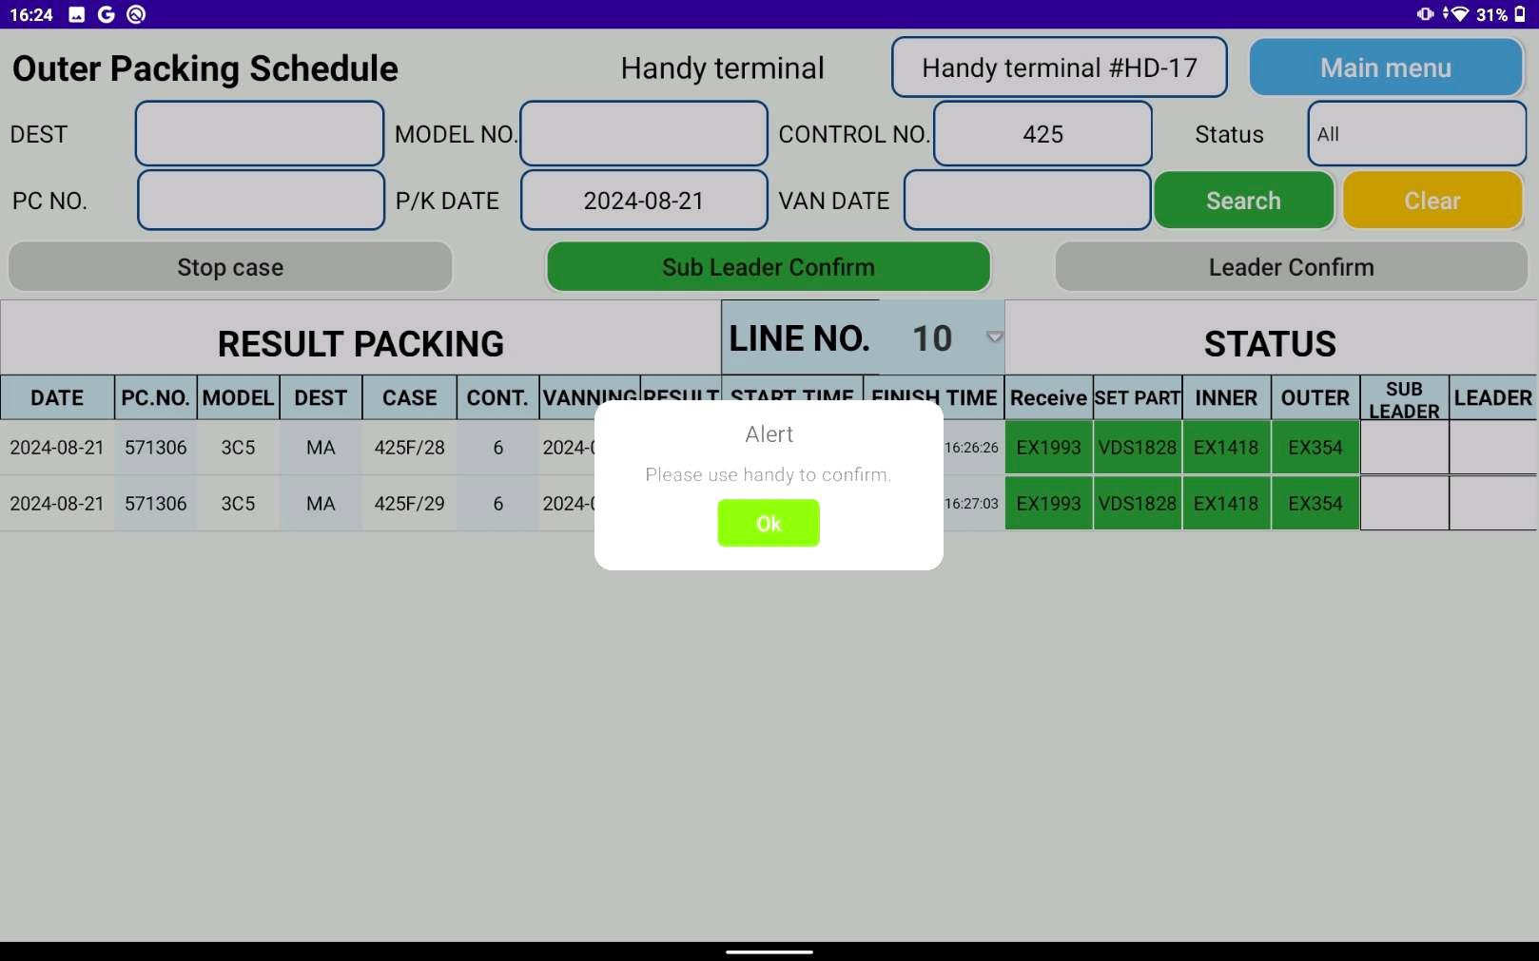
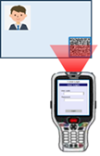
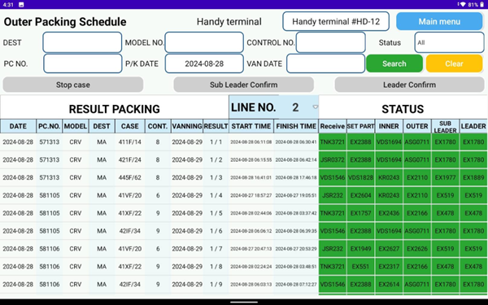
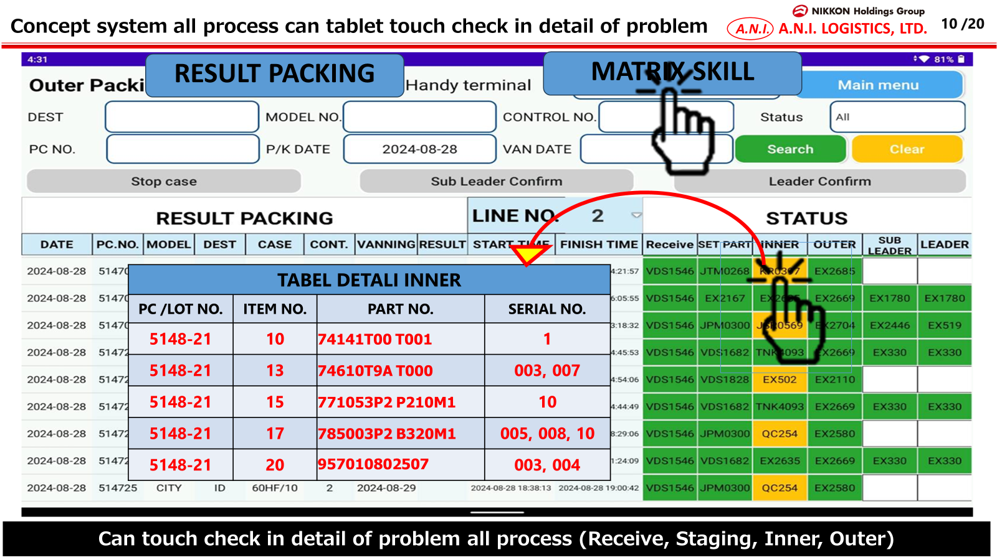
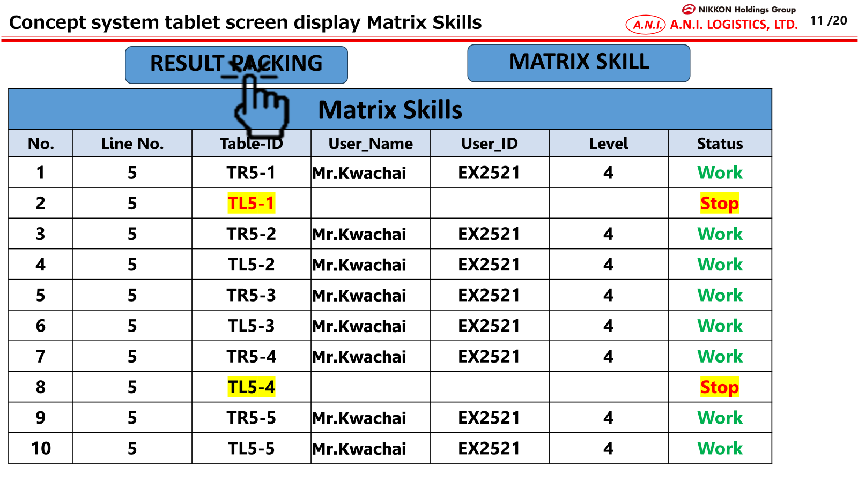
4. Operation flow
4. Operation flow
4-4. Panel area – Outer Packing Process
Outer Packing process (enhanced concept)
Instructions
-Scan ID
-Auto user login of handy
-User login Tablet
-Scan barcode of check sheet 2 point
-Scan barcode of case mark 2 point
-Screen display detail of part for outer
-Outer Scan QR Code count Q’ty contents
-Tablet screen status outer
-White = Not scan
-Yellow = Scan not complete
-Green = Scan complete
-Red = Stop case
-Sub-leader scan ID confirm outer case
-Leader scan ID confirm finish case
***New Function
-Tablet touch check in detail of the problem
-Tablet screen display matrix skills of operator packing
Sub
leader
Leader

Slide 11
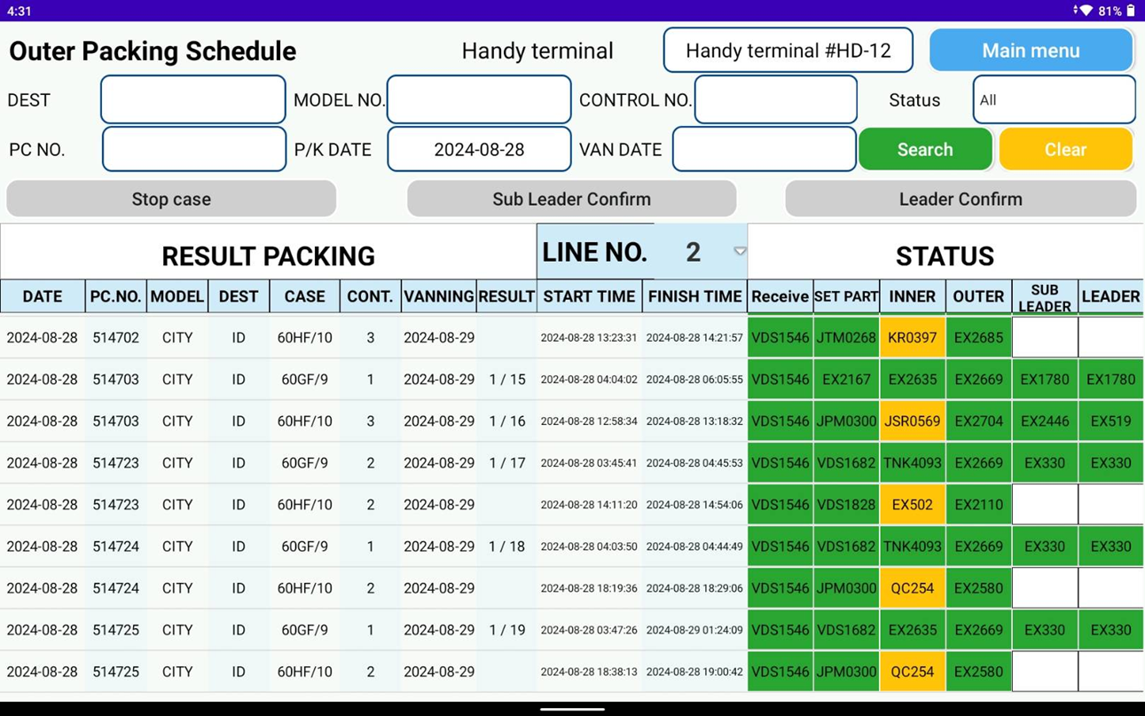

4. Operation flow
4. Operation flow
4-4. Panel area – Outer Packing Process
Outer Packing process (enhanced concept)
Able to click at the cell to display the deep details problem of all process
TABEL DETAIL INNER
PC /LOT NO. | ITEM NO. | PART NO. | SERIAL NO.
5148-21 | 10 | 74141T00 T001 | 1
5148-21 | 13 | 74610T9A T000 | 003, 007
5148-21 | 15 | 771053P2 P210M1 | 10
5148-21 | 17 | 785003P2 B320M1 | 005, 008, 10
5148-21 | 20 | 957010802507 | 003, 004

Slide 12
4. Operation flow
4. Operation flow
4-4. Panel area – Outer Packing Process
Outer Packing process (enhanced concept)
Able to display the matric skill by clicking at the “MATRIX SKILL” menu
Matrix Skills
No. | Line No. | Table-ID | User Name | User ID | Level | Status
1 | 5 | TR5-1 | Mr.Kwanchai | EX2521 | 4 | Work
2 | 5 | TL5-1 |  |  |  | Stop
3 | 5 | TR5-2 | Mr.Kwanchai | EX2521 | 4 | Work
4 | 5 | TL5-2 | Mr.Kwanchai | EX2521 | 4 | Work
5 | 5 | TR5-3 | Mr.Kwanchai | EX2521 | 4 | Work
6 | 5 | TL5-3 | Mr.Kwanchai | EX2521 | 4 | Work
7 | 5 | TR5-4 | Mr.Kwanchai | EX2521 | 4 | Work
8 | 5 | TL5-4 |  |  |  | Stop
9 | 5 | TR5-5 | Mr.Kwanchai | EX2521 | 4 | Work
10 | 5 | TL5-5 | Mr.Kwanchai | EX2521 | 4 | Work
PANEL
TRIM

Slide 13
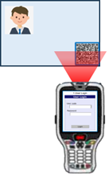
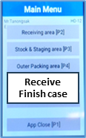
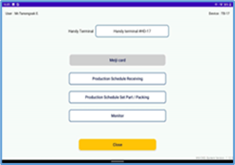
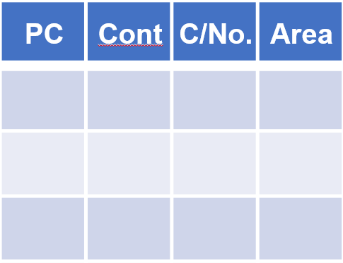







4. Operation flow
4. Operation flow
4-5. Stock Finish Case
Stock Finish Case – all area process
Instructions
-Scan ID
-Auto user login of handy
-Select menu stock finish case on handy
-Handy screen display stock finish case
-User login Tablet and connect handy
-Select menu finish case
-Tablet screen display detail of finish case
-Scan case mark
-Handy screen display detail finish case
-Scan ID area keep stock finish case
-Confirm area “OK” handy
-Move finish case place on area
-Tablet auto screen display detail of stock finish case
-Next scan case mark
Function search
-Can use search manual
System protect
-PC NO., Lot No., C/No., Control No. mistake
-Container No
-Skip step process receive finish case
PC | Cont | C/No. | Area
571002 | 84IFR | 21 | A01
Stock Finish Case
Stock Finish Case
PC/NO : …
Dest : …
CONT NO : …
C/No : …
KD Lot : …
MODEL : …
Stock Finish Case
Stock Finish Case
Cancel[P1]
Save[P2]
Stock Finish Case
Stock Area
Stock Finish Case
PC/NO : 571002
Dest : ID
CONT NO : 84IFR
C/No : 21
KD Lot : Y-2-2024-06-0002-01
MODEL : CRV
A01
PC/NO : 571002
Dest : ID
CONT NO : 84IFR
C/No : 21
KD Lot : Y-2-2024-06-0002-01
MODEL : CRV
Cancel[P1]
Save[P2]
Cancel[P1]
Save[P2]

Slide 14


4. Operation flow
4. Operation flow
4-6. Set Up Finish Case
Set Up Finish Case – all area process
Instructions
-Scan ID
-Auto user login of handy
-Select menu receive case on handy
-Handy scree display receive case
-User login Tablet and connect handy
-Select menu finish case
-Tablet screen display detail of finish case
-Scan ID area receive
-Scan case mark
-Handy scree display detail receive case
-Confirm receive finish case on handy
-Tablet auto screen display detail of case
-Move finish case
-Scan area ID
Function search
-Can use search manual
System protect
-PC NO., Lot No., C/No., Control No. mistake
-Container No
-Skip step process stock finish case
PC | Cont | C/No. | Area
571002 | 84IFR | 21 | A01
Set Up Finish Case
Set Up Finish Case
PC/NO : …
Dest : …
CONT NO : …
C/No : …
KD Lot : …
MODEL : …
Set Up Finish Case
Set Up Finish Case
Cancel[P1]
Save[P2]
Set Up Finish Case
PC/NO : 571002
Dest : ID
CONT NO : 84IFR
C/No : 21
KD Lot : Y-2-2024-06-0002-01
MODEL : CRV
Cancel[P1]
Confirm[P2]
Set Up Finish Case
PC/NO : 571002
Dest : ID
CONT NO : 84IFR
C/No : 21
KD Lot : Y-2-2024-06-0002-01
MODEL : CRV
Cancel[P1]
Confirm[P2]

Slide 15



4. Operation flow
4. Operation flow
4-7. Vanning Finish Case
Vanning Finish Case – all area process
Instructions
-Scan ID
-Auto user login of handy
-Select menu vanning on handy
-Handy scree display vanning
-User login Tablet and connect handy
-Select menu vanning
-Tablet screen display detail of vanning
-Scan ID area dock vanning
-Scan case mark
-Handy scree display detail vanning case
-Confirm vanning case on handy
-Tablet auto screen display detail of case
-Move finish case Truck to vanning
Function search
-Can use search manual
System protect
-PC NO., Lot No., C/No., Control No. mistake
-Container No
-Skip step process set up finish case
PC | Cont | C/No. | Container no
571002 | 80OF | 12 | 3
571002 | 80OF | 12 | 3
Vanning
Vanning Case
PC/NO : …
Dest : …
CONT NO : …
C/No : …
KD Lot : …
MODEL : …
Vanning
Vanning Case
Cancel[P1]
Save[P2]
Vanning
Dock Vanning
PC/NO : 571002
Dest : ID
CONT NO : 80OF
C/No : 12
KD Lot : Y-2-2024-06-0002-01
MODEL : CRV
Cancel[P1]
Confirm[P2]
Vanning
PC/NO : 571002
Dest : ID
CONT NO : 84IFR
C/No : 21
KD Lot : Y-2-2024-06-0002-01
MODEL : CRV
Cancel[P1]
Confirm[P2]

Slide 16


4. Operation flow
4. Operation flow
4-8. Other
Receive CSV report

Slide 17









5. System functional specifications
5-1. Handy terminal screen image
Handy terminal function / screen image
1.User Login
2.Main Menu
3.Inner Packing area
Main Menu
Inner Packing area
User code
Receiving area [P1]
Connect tablet : Connected #001
PC No
37A-33S-5122-01
Table ID
Stock & Staging area [P2]
Parts no
63240-T00-T000-H01
Inner Packing area [P3]
Color
-
Qty
30
Outer Packing area [P4]
Control
312F
Print Tag receive
Please open MEIJI CARD.
Login
App Close
F1
Menu
F1
Menu
F1
Menu
F1
Menu
Main
Menu [P1]
Clear
[P2]
Pending
[P3]
NG
[P4]
4.Inner Q-Point Check
5. Inner Items display
2
6. Inner Finished
Inner Packing area
Inner Packing area
Inner Packing area
Connect tablet : Connected #001
Connect tablet : Connected #001
Connect tablet : Connected #001
Color
-
Qty
30
PC No
37A-33S-5122-01
Case no
22
PC No
37A-33S-5122-01
Case no
22
All items packing
finished
Control
Control
311F
TTL Seq no
11
12
Control
311F
TTL Seq no
12
12
312F
Packing
TTL Qty
TTL Qty
Packing
TTL Qty
36
TTL Qty
Please select the number that matches the marking no.
35
36
230
240
36
240
240
ITEM NO | PART NO | QTY in Case
1 | 711013C0 0200AA | 30/30
2 | 71234555 0923BB | 0/10
3 | 172115YA Z500 | 1/1
4 | 82871671 0003 | 40/40
ITEM NO | PART NO | QTY in Case
1 | 711013C0 0200AA | 30/30
2 | 71234555 0923BB | 10/10
3 | 172115YA Z500 | 1/1
4 | 82871671 0003 | 40/40
1
２OD10T
OK [Ent]
2
２OD11T
３
２OD12T
4
２OD13T
F1
Menu
F1
Menu
F1
Menu
F1
Menu
F1
Menu
F1
Menu
F1
Menu
F1
Menu
F1
Menu
F1
Menu
Clear
[P2]
F1
Menu
F1
Menu
Main
Menu [P1]
Clear
[P2]
Pending
[P3]
NG
[P4]
Main
Menu [P1]
Clear
[P2]
Pending
[P3]
NG
[P4]
Main
Menu [P1]
Pending
[P3]
NG
[P4]

Slide 18


5. System functional specifications
5-1. Handy terminal screen image
5-1-1. Login screen
3
Support multiple user login
There is only 1st user will be kept to transaction data e.g. receiving, staging and packing
User code
User code
EX2521
EX2521
Table ID
EX445
Table ID
Login
Login
Matrix skills will able to show the multiple users that work at the same table or handy.
Matrix Skills
No. | Line No. | Table-ID | User Name | User ID | Level | Status
1 | 5 | TR5-1 | Mr.Kwanchai | EX2521 | 4 | Work
2 | 5 | TR5-1 | Mr.Supat | EX445 | 3 | Work
3 | 5 | TR5-2 | Mr.A | EX1234 | 4 | Work
4 | 5 | TL5-2 | Mr.B | EX122 | 4 | Work
5 | 5 | TR5-3 | Mr.C | EX143 | 4 | Work
6 | 5 | TL5-3 | Mr.D | EX15 | 4 | Work
7 | 5 | TR5-4 | Mr.E | EX221 | 4 | Work
8 | 5 | TL5-4 |  |  |  | Stop
9 | 5 | TR5-5 | Mr.F | EX21 | 4 | Work
10 | 5 | TL5-5 | Mr.G | EX252 | 4 | Work
PANEL
TRIM

Slide 19



5. System functional specifications
5-1. Handy terminal screen image
5-1-1. Special Characteristic Item
3
Receiving / Staging / Inner packing(Panel)
Receiving area
Stock & Staging area
Connect tablet : Connected #001
PC No
37A-33S-5122-01
PC No
37A-33S-5122-01
Parts no
63240-T00-T000-H01
Parts no
63240-T00-T000-H01
Color
-
Maker
88A-11
SC item found!!
Leader can work only
SC item found!!
Leader can work only
Color
-
Control
88A-11
TTL Qty
30
Control
OK [ENT]
２OD10T
88A-11
1
OK [ENT]
TTL Qty
30
2
２OD11T
３
２OD12T
The SC (special characteristic) item can be process by leader only.
Stop working when it is found that the current user is not a leader level.
２OD13T
F1
Menu
4
Main
Menu [P1]
F1
Menu
F1
Menu
F1
Menu
Main
Menu [P1]
Clear
[P2]
F1
Menu
F1
Menu
Back
[P4]
Pending
[P3]
Complete
[P4]
Inner Packing area
Connect tablet : Connected #001
User code
PC No
37A-33S-5122-01
EX2521
Parts no
63240-T00-T000-H01
SC item found!!
Leader can work only
Table ID
Color
-
Qty
30
Control
OK [ENT]
312F
Please open MEIJI CARD.
F1
Menu
F1
Menu
F1
Menu
F1
Menu
Login
Main
Menu [P1]
Clear
[P2]
Pending
[P3]
NG
[P4]
Inner packing(Trim)
Inner packing work screen
Login screen
SC item found!!
Leader can work only.
1 : CLOSE

Slide 20








5. System functional specifications
5-1. Handy terminal screen image
5-1-1. Inner Packing
2
Main Menu
Inner Packing area
This is the screen that transitions after select Inner Packing area[P3] from menu screen.
PC No.: PC number from master plan
Part No.: Part number
Color :Part color
Qty: Quantity of packing item
Control: Control number
Q-Point: Show random Q-Point check
Main Menu[P1]: Back to menu screen
Clear[P2]: Clear input contents
Pending[P3]: Set PENDING status
NG[P4]: Set NG status
Receiving area [P1]
Connect tablet : Connected #001
PC No
Stock & Staging area [P2]
Parts no
Inner Packing area [P3]
Color
-
Qty
Outer Packing area [P4]
Control
Print Tag receive
Please open MEIJI CARD.
App Close
F1
Menu
F1
Menu
F1
Menu
F1
Menu
Main
Menu [P1]
Clear
[P2]
Pending
[P3]
NG
[P4]
Inner Packing area
Inner Packing area
Connect tablet : Connected #001
Connect tablet : Connected #001
PC No
PC No
37A-33S-5122-01
Parts no
Parts no
63240-T00-T000-H01
Color
-
Qty
Color
-
Qty
30
* In case of the contents label have already printed. The Reprint confirmation dialog will be appear.
Control
Control
312F
Please open MEIJI CARD.
Please open MEIJI CARD.
F1
Menu
F1
Menu
F1
Menu
F1
Menu
F1
Menu
F1
Menu
F1
Menu
F1
Menu
Main
Menu [P1]
Clear
[P2]
Pending
[P3]
NG
[P4]
Main
Menu [P1]
Clear
[P2]
Pending
[P3]
NG
[P4]
Confirm to Reprint?
Yes[P1]
Cancel[P2]
* Meiji card and packing methods PDF will be automatic display on tablet
* In case of the user chooses the wrong answer.
Inner Packing area
Incorrect!!
Connect tablet : Connected #001
OK[Ent]
Color
-
Qty
30
* Automatic JIT printing
Control
312F
Please select the number that matches the marking no.
1
２OD10T
2
２OD11T
INFORMATION
３
２OD12T
Operation completed
4
２OD13T
F1
Menu
F1
Menu
F1
Menu
F1
Menu
Main
Menu [P1]
Clear
[P2]
Pending
[P3]
NG
[P4]

Slide 21

5. System functional specifications
5-1. Handy terminal screen image
5-1-1. Inner Packing
2
Inner Packing area
Inner Packing area
Connect tablet : Connected #001
Connect tablet : Connected #001
PC No
37A-33S-5122-01
Case no
22
PC No
37A-33S-5122-01
Case no
22
Control
311F
TTL Seq no
2
12
Control
311F
TTL Seq no
2
12
Packing
TTL Qty
36
TTL Qty
Packing
TTL Qty
TTL Qty
15
67
240
15
36
67
240
ITEM NO | PART NO | QTY in Case
1 | 711013C0 0200AA | 27/30
2 | 71234555 0923BB | 0/10
3 | 172115YA Z500 | 1/1
4 | 82871671 0003 | 40/40
ITEM NO | PART NO | QTY in Case
1 | 711013C0 0200AA | 30/30
2 | 71234555 0923BB | 0/10
3 | 172115YA Z500 | 1/1
4 | 82871671 0003 | 40/40
F1
Menu
F1
Menu
F1
Menu
F1
Menu
F1
Menu
F1
Menu
F1
Menu
F1
Menu
Main
Menu [P1]
Clear
[P2]
Pending
[P3]
NG
[P4]
Main
Menu [P1]
Clear
[P2]
Pending
[P3]
NG
[P4]
Inner Packing area
Inner Packing area
Connect tablet : Connected #001
Connect tablet : Connected #001
PC No
37A-33S-5122-01
Case no
22
PC No
37A-33S-5122-01
Case no
22
All items packing
finished
Control
311F
TTL Seq no
11
12
Control
311F
TTL Seq no
12
12
Packing
TTL Qty
TTL Qty
Packing
TTL Qty
36
TTL Qty
35
36
230
240
36
240
240
ITEM NO | PART NO | QTY in Case
1 | 711013C0 0200AA | 30/30
2 | 71234555 0923BB | 0/10
3 | 172115YA Z500 | 1/1
4 | 82871671 0003 | 40/40
ITEM NO | PART NO | QTY in Case
1 | 711013C0 0200AA | 30/30
2 | 71234555 0923BB | 10/10
3 | 172115YA Z500 | 1/1
4 | 82871671 0003 | 40/40
OK [Ent]
F1
Menu
F1
Menu
F1
Menu
F1
Menu
F1
Menu
F1
Menu
F1
Menu
F1
Menu
Main
Menu [P1]
Clear
[P2]
Pending
[P3]
NG
[P4]
Main
Menu [P1]
Clear
[P2]
Pending
[P3]
NG
[P4]
Inner Packing area
Connect tablet : Connected #001
PC No
Parts no
Color
-
Qty
Control
Please open MEIJI CARD.
F1
Menu
F1
Menu
F1
Menu
F1
Menu
Main
Menu [P1]
Clear
[P2]
Pending
[P3]
NG
[P4]

Slide 22

5. System functional specifications
2
5-2. Tablet screen image
Tablet function / screen image
User Login
User ID
Handy terminal
▼
Main menu
Handy terminal
Handy terminal #001
Meiji card
Stock Finish Case
Production Schedule
Move Finish Case
Monitor
Set up Finish Case
Logout
Vanning

Slide 23
5. System functional specifications
5-2. Tablet screen image
Tablet function / screen image
Production Schedule (all area)
Production Schedule
Handy terminal
Handy terminal #001
Main menu
Contract No. (PC No.)
Control No. (PC No.)
Status
Part No.
Packing date
Search
Status
Imported
Received – completed on receiving area
Staged – completed on staging area
Inner Packed – completed on inner pack area
Outer Packed – completed on outer pack area
Cancel
Stop case
Working
NG
Current State
Imported
Receiving
Staging
Inner Packing
Outer Packing
Completed

Slide 24

5. System functional specifications
5-2. Tablet screen image – Meiji card / Packing Method
Tablet function / screen image
Meiji card / Packing Method tablet display
Meiji card
Packing Method
1/1
Handy connected
Main menu
Handy terminal #001
Waiting scan from Handy terminal
Meiji card display loaded
Meiji card
Packing Method
1/1
Handy connected
Main menu
Handy terminal #001
Waiting scan

Slide 25

5. System functional specifications
5-2. Tablet screen image – Meiji card / Packing Method
Tablet function / screen image
Meiji card / Packing Method tablet display
Meiji card
Packing Method
1/1
Handy connected
Main menu
Handy terminal #001
Waiting scan from Handy terminal
Packing Method display loaded
Meiji card
Packing Method
1/3
Handy connected
Main menu
Handy terminal #001
Waiting scan

Slide 26




5. System functional specifications
5-3. PC application screen image
PC function / screen image
User Login
Main menu
Schedule
Production Schedule Receive
2
Log history
Schedule
Matrix Skills
3
Production Schedule Staging
Production Schedule Outer Packing
Production Schedule Inner Packing
Production Schedule Vanning Finish case
Item Master
Department Master
Location Master
Name Master
Master
User Credential Master
Package Type Master
Authority Master
Calendar Master
Supplier Master
Pending Reason Master
Customer Master

Slide 27

5. System functional specifications
3
5-3. PC application screen image
PC function / screen image
Item master
Modify item master add new column sc_flag

Slide 28



5. System functional specifications
3
5-3. PC application screen image
PC function / screen image
Q-point details report
Receiving / Staging / INNER Packing
Q-Point CSV
Part Color:
Add new button “Q-Point CSV” to export the Q-Point check activities report
PC No, Part no, color and control no are automatic loaded and mandatory.
RECEIVING Q-POINT CHECK DETAIL REPORT
STAGING Q-POINT CHECK DETAIL REPORT
INNER PACKING Q-POINT CHECK DETAIL REPORT
There are exported reports separated from each web RECEIVING, STAGING and INNER PACKING.
Download all Q-Point check activities detail and timestamp.

Slide 29
5. System functional specifications
3
5-3. PC application screen image
PC function / screen image
Matrix Skills page
Matrix Skills
No. | Line No. | Table-ID | User Name | User ID | Level | Status
1 | 5 | TR5-1 | Mr.Kwanchai | EX2521 | 4 | Work
2 | 5 | TL5-1 |  |  |  | Stop
3 | 5 | TR5-2 | Mr.Kwanchai | EX2521 | 4 | Work
4 | 5 | TL5-2 | Mr.Kwanchai | EX2521 | 4 | Work
5 | 5 | TR5-3 | Mr.Kwanchai | EX2521 | 4 | Work
6 | 5 | TL5-3 | Mr.Kwanchai | EX2521 | 4 | Work
7 | 5 | TR5-4 | Mr.Kwanchai | EX2521 | 4 | Work
8 | 5 | TL5-4 |  |  |  | Stop
9 | 5 | TR5-5 | Mr.Kwanchai | EX2521 | 4 | Work
10 | 5 | TL5-5 | Mr.Kwanchai | EX2521 | 4 | Work
PANEL
TRIM

Slide 30


5. System functional specifications
2
5-3. PC application screen image
PC function / screen image
Schedule Receive
1. Add function search by part No. and can CSV file Only output items Day and month type.
Schedule Staging
1. Separate page display of staging process.
2. Add function search by part No. and can CSV file Only output items Day and month type.

Slide 31


5. System functional specifications
2
5-3. PC application screen image
PC function / screen image
Schedule Inner Packing
1. Separate page display of Inner process.
2. Add function search by part No. and can CSV file Only output items Day and month type.
Schedule Outer Packing
1. Add column Handy scan No.
2. Separate page display of Outer process.
3. Add function search by part No. and can CSV file Only output items Day and month type.

Slide 32


5. System functional specifications
2
5-3. PC application screen image
PC function / screen image
Schedule Vanning Finish case
Schedule Vanning Finish case CSV report

Slide 33


5. System functional specifications
2
5-3. PC application screen image
PC function / screen image
Packing monthly summary report
Packing daily summary report

Slide 34

5. System functional specifications
2
5-3. PC application screen image
PC function / screen image
Dashboard
Packing summary report

Slide 35

5. System functional specifications
5-10. CSV Report
2
CSV Report adjustments
RECEIVING REPORT
STAGING REPORT

Slide 36


5. System functional specifications
5-10. CSV Report
2
CSV Report adjustments
INNER PACKING REPORT
OUTER PACKING REPORT

Slide 37
6. Q&A

Slide 38
7. Sign off
We hereby acknowledge and agree the above-mentioned blueprint requirements.
Any changes required after the sign off for this blueprint will be addressed through the change request process.
A.N.I. LOGISTICS, LTD.
Sign:
Name:
Title:
Date:
TOMAS TECH CO.,LTD.
Sign:
Name:
Title:
Date:
## END OF BLUEPRINT##

