Slide 1
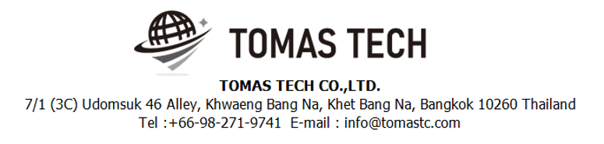
Version 8/Oct/2024
Confidential
Stock management system specifications
Documentation EN Blueprint for TBFST
Blueprint
R4
Made for: Toyota Boshoku Filtration System(Thailand) Co., Ltd.
By: TOMAS TECH CO.,LTD.

Slide 2
Revision History
Date | Version | File name | Details
25/Jul/2024 | R1 | Stock management system specifications Documentation EN Blueprint for TBFST Blueprint | First edition
19/Aug/2024 | R2 | Stock management system specifications Documentation EN Blueprint for TBFST Blueprint | Second edition
2/Sep/2024 | R3 | Stock management system specifications Documentation EN Blueprint for TBFST Blueprint | Third edition
8/Oct/2024 | R4 | Stock management system specifications Documentation EN Blueprint for TBFST Blueprint | Fourth edition
2
3
4

Slide 3
■Contents
1. Overview
2. Overall configuration diagram
3. Document image
3-1. Linkage data
3-1-1. Production Schedule - PS
3-1-2. Customer DO
3-1-3. Supplier DO
3-1-4. PO
3-1-5. Item master
3-2. Print label information
4. Operation flow
4-1. RM
4-2. WIP
4-3. FG
4-4. Delivery
4-5. Sell WIP
4-6. RM – Receive FG
4-7. Master management
5. System functional specifications
5-1. Handy terminal function
5-2. Handy terminal function Inbound
5-3. Handy terminal function Outbound
5-2. Handy terminal function Stock Management
5-5. PC operation flow
5-5-1. Login-Menu
5-5-2. Main-Menu
5-5-3. Schedule
5-5-4. Inbound
5-5-5. Outbound
5-5-6. Stock Inquiry Report
5-5-7. Stock Maintenance
5-5-8. Stocktaking
5-5-9. Stock Maintenance Inquiry / Report
5-5-10. NG Reason master
5-5-11. Supplier master
5-5-12. Item master
5-5-13. Location master
5-5-14. User master
5-5-15. User Credential master
5-5-16. Authority Master
5-5-17. Name Master
5-5-18. Packing Standard Master
5-5-19. Customer Master
6. Q&A
7. Sign off

Slide 4
1. Overview
Introduced Stock management system to TBFST.
The system specifications for introduction are described in this document.

Slide 5
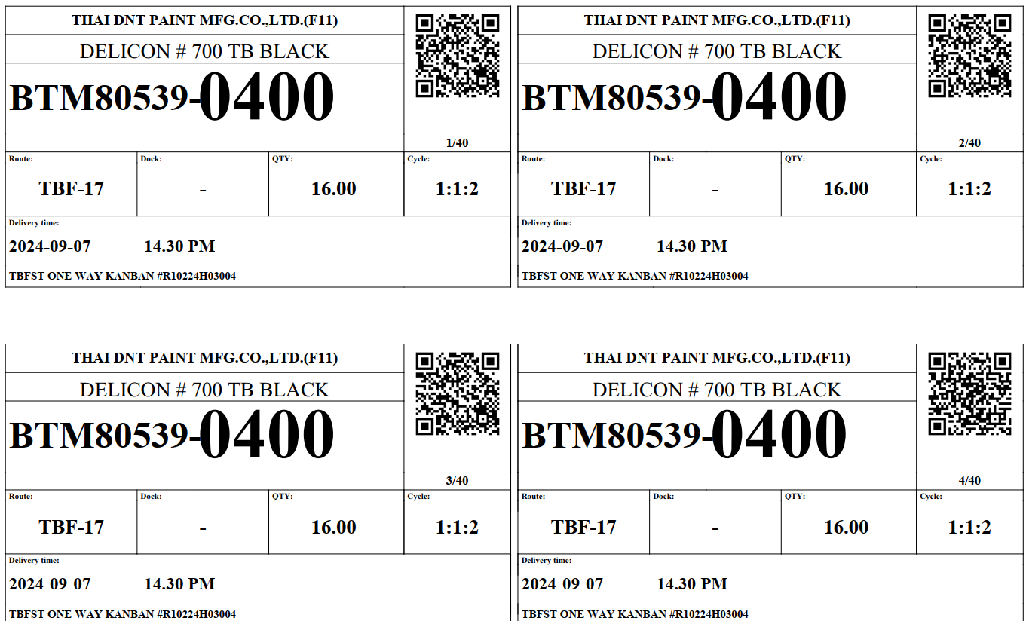
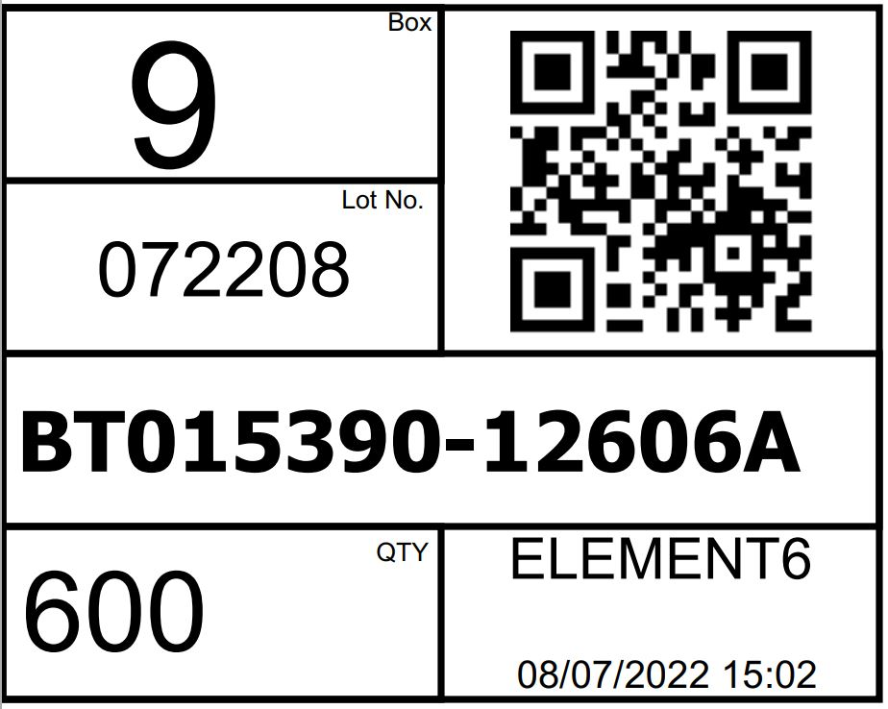
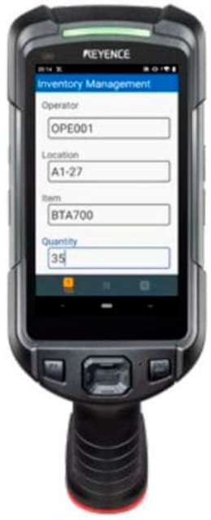


2. Overall configuration diagram
Represents a configuration diagram of the stock management system. It is a configuration image of hardware and documents.
Overall configuration diagram image
Receive & Inspection
Create Label
RM Inbound
Stock Management
Outbound Inspection
Outbound
Delivery
4
Handy terminal × 6
2
WIFI
Pegasus Server
SyteLine / TBFST
PO/PDS Line
Supplier DO
Customer DO
Production Schedule
Plan data (IN/OUT)
Actual data (IN/OUT)
ERP

Slide 6
2. Overall configuration diagram
Network diagram
TBFST office
Lan cable
DB
Middle tier
Pegasus
server
Wi-Fi
4
Client pc
Switching hub
Access Point
2
Handy terminal#1
Handy terminal#6
TBFST Warehouse

Slide 7
2. Overall configuration diagram
Hardware diagram
TBFST office
Lan cable
DB
Middle tier
Pegasus
server
Wi-Fi
4
Client pc
AC220V*1
Switching hub
Access Point
2
Handy terminal#1
Handy terminal#6
Charger #1
Charger #6
AC220V*6
TBFST Warehouse

Slide 8
3. Document image
3
4
3-1. Linkage data
Item | File name/Page no | Remarks
Inbound / Material Receive | Page 13 | PO/PDS Line
 | Need to confirm with K.SAM | The list of KANBAN for material receive.
Outbound / Delivery / Production plan | Page 10 | Customer DO
 | Page 11 Need to confirm with ERP | Supplier DO
 | Page 9 Need to confirm with ERP | PS – Production Schedule
Master / Report / Other | Page 13 | Item master
 | Page 14 | Location master
 | Page 15 | Department master
 | Page 16 | Customer master
 | Page 17 | Supplier master
 | Page 18 | User master
 | Page 19 | Packing standard
 | Need to confirm with K.SAM | NG Reason
 | Need to confirm with ERP | BOM

Slide 9
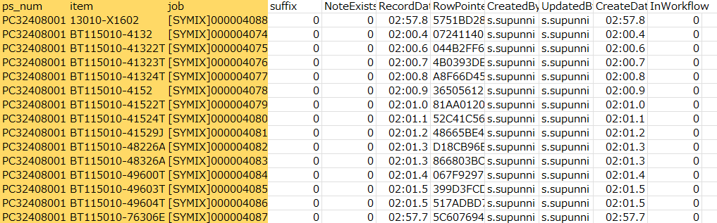
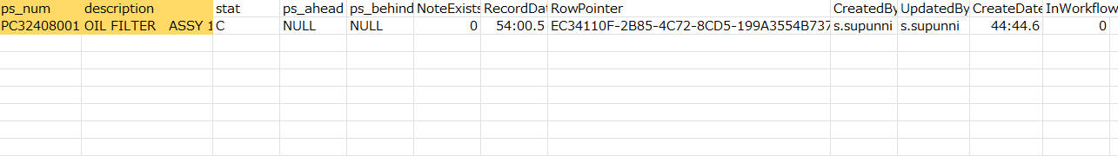
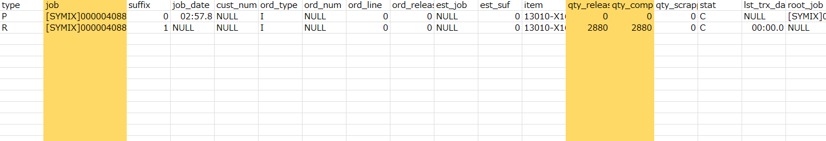
3. Document image
4
3-1-1. Production Schedule - PS
SYTELINE ⇒Pegasus
PS Item
PS Header
PS Job

Slide 10
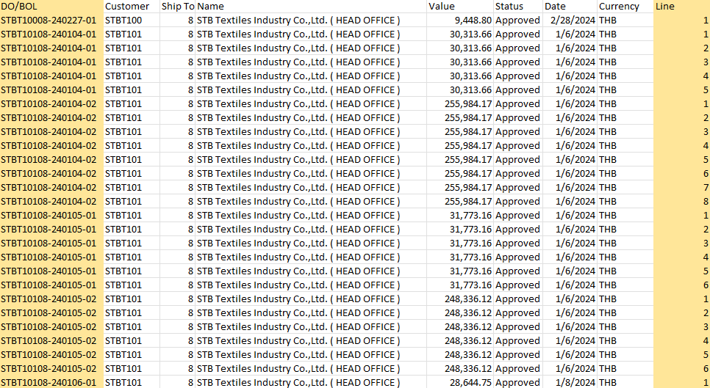
3. Document image
4
3-1-2. Customer DO
SYTELINE ⇒Pegasus

Slide 11
3. Document image
4
3-1-3. Supplier DO
SYTELINE ⇒Pegasus

Slide 12
3. Document image
4
3-1-4. PO/PDS Line
SYTELINE ⇒Pegasus
Syteline will create view table on middle DB tier
Descriptions
Item | Description | Remarks
Vendor | Vendor ID
Name | Vendor Name
GRN | PDS No
Status | Status of data | “I” (In process) status will be process on WMS
Date | Date created
Shipped Date | Shipped date
Line | Line no
Item | Part no
Description | Part name
PO | PO number
PO Line | PO line
Shipped | Plan qty
Shipped U/M | Unit of material
Received | Actual qty | Send back
Received U/M | Unit of received material | Send back
Data keying
Send back data

Slide 13
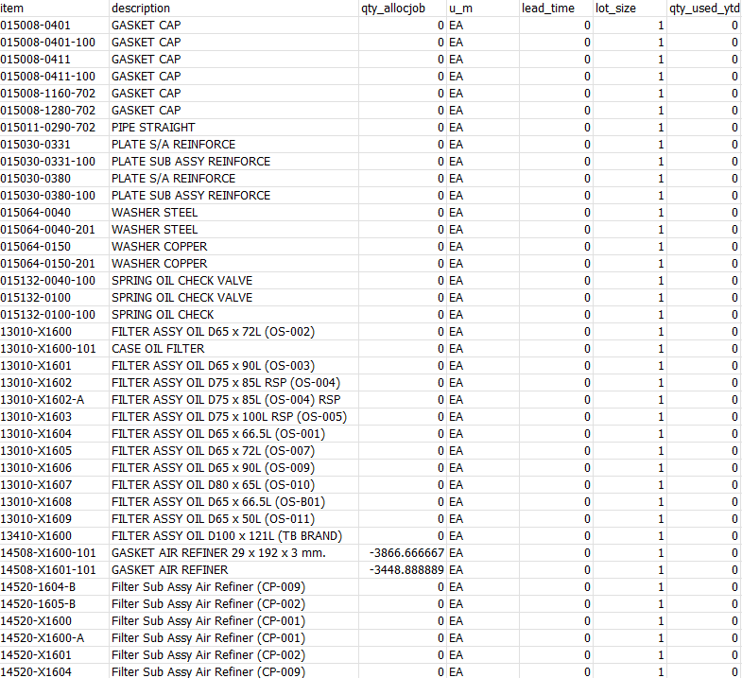
3. Document image
4
3-1-5. Item master
TBFST ⇒Pegasus

Slide 14
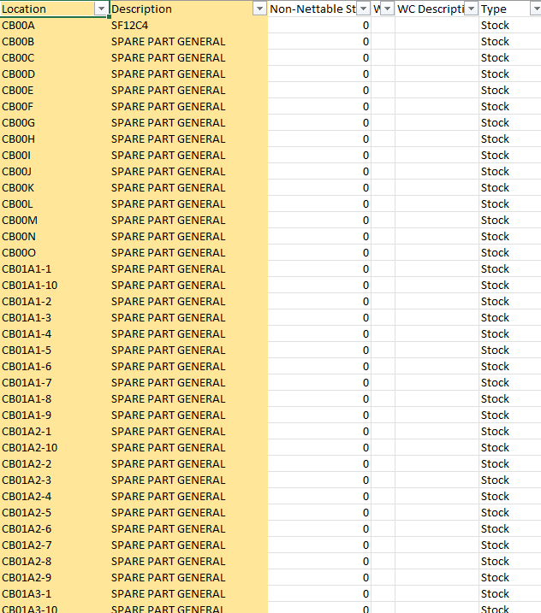
3. Document image
3-1-6. Location master
TBFST ⇒Pegasus

Slide 15
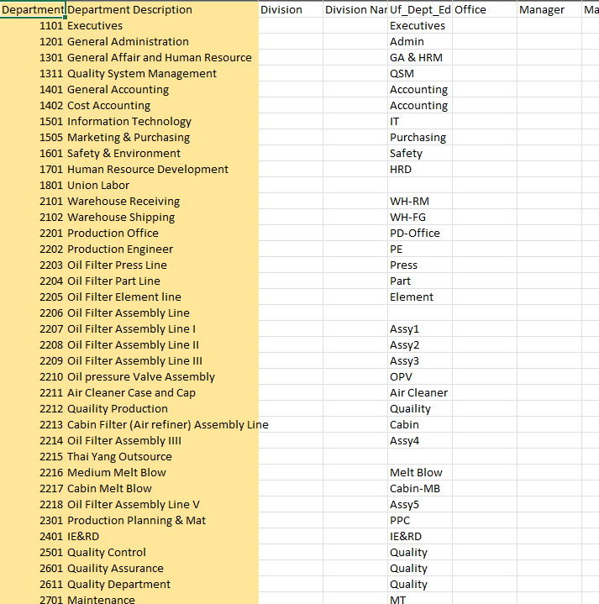
3. Document image
3-1-7. Department master
TBFST ⇒Pegasus

Slide 16
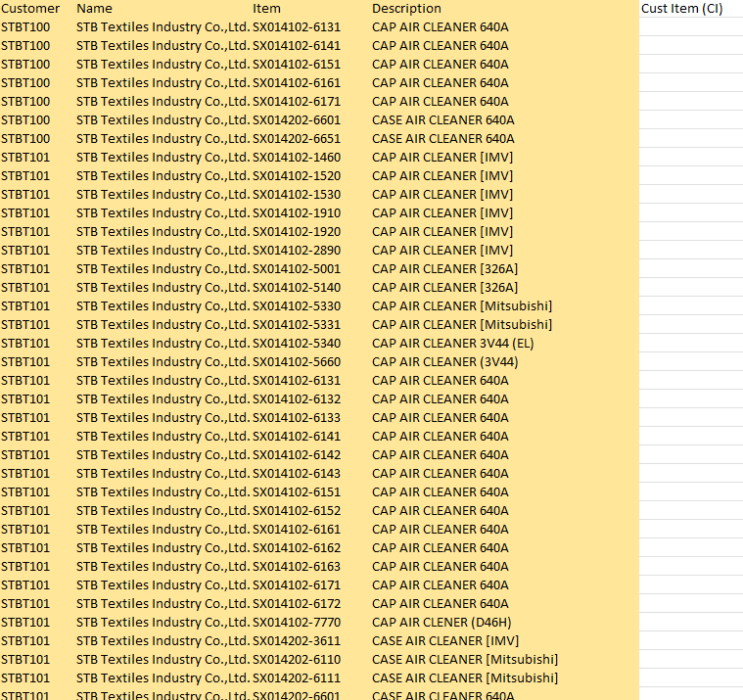
3. Document image
3-1-8. Customer master
TBFST ⇒Pegasus

Slide 17
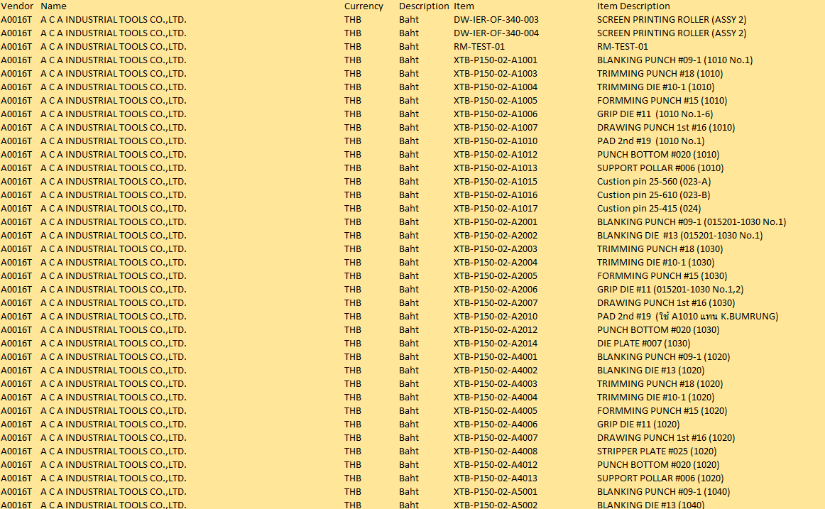
3. Document image
3-1-9. Supplier master
TBFST ⇒Pegasus

Slide 18
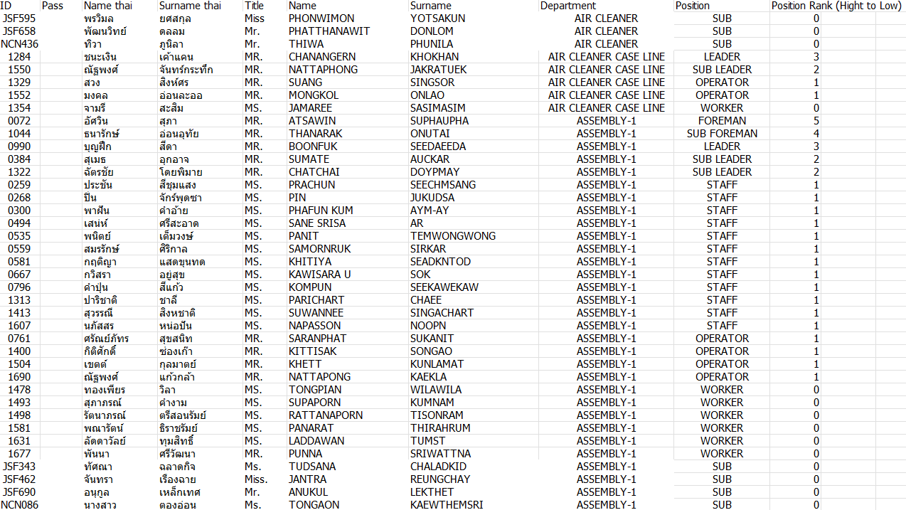
3. Document image
3-1-10. User master
TBFST ⇒Pegasus

Slide 19
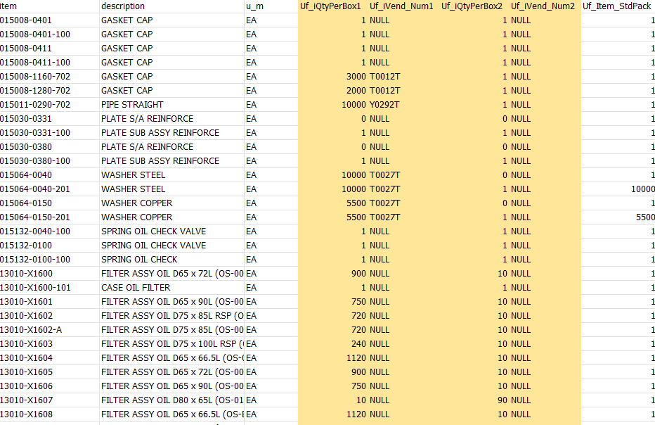
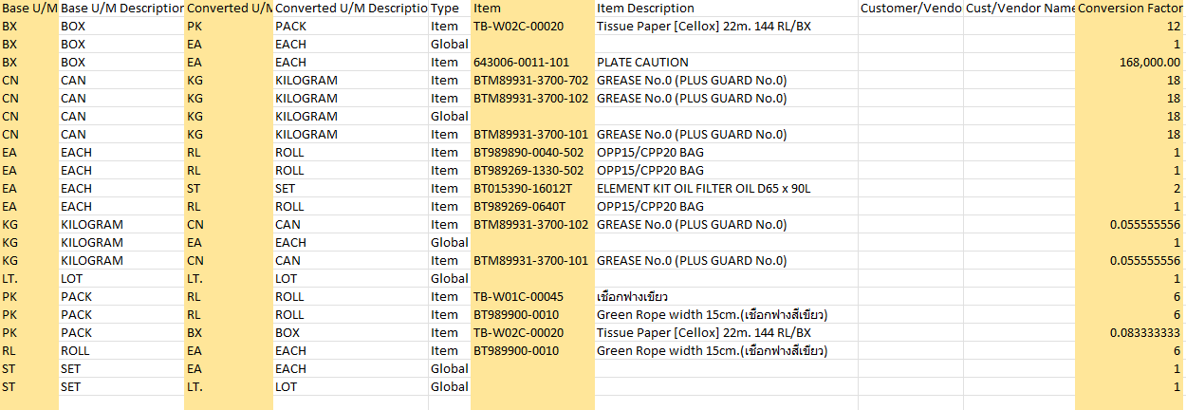
3. Document image
3-1-11. Packing Standard master
TBFST ⇒Pegasus
Standard pack
Unit of measure conversion

Slide 20
4. Operation flow
4-1. RM – Materials Receive (PO from ERP)
ERP
Stock Management System Pegasus
Send/Resend PDS Line
Middle Tier
DB
Need to confirm flow with K.Golf
Read PDS Line
Report error details
Data OK?
Yes / No
No
Yes
Acceptance work
/ Create RM schdule
Next #1

Slide 21
4. Operation flow
4-1. RM – Materials Receive (Continue)
ERP
Stock Management System Pegasus
Next #1
Linkage
Purchase Order
Material Receive
Move to temporary RM area
May import KANBAN list for material receive
User needs to scan only one KANBAN label and confirm all KANBAN lot.
2
Scan the KANBAN tag.
Confirm and move to QC area
BK file manual import (*1)(*2)
File import error?
Yes / No
QC Inspection
Yes / No
Check error details
Yes
Return Materials
No
No
Checking the linked data
Yes
Confirm RM transactions on web
QC Confirm and move to storage location
Yes
Should it be removed or not? (*3)
Yes / No
*1 If there is an import error, set an error flag. Since the import completion flag is not set, it is possible to import the same Order NO / Parts no.
*2 After importing, backup files are stored in the “Normal folder" and the “Error folder".
*3 Allow deletion of linked data. Limited to data before Working status.
No
Feedback RM result
Acceptance work
Get RM result
Middle Tier
DB

Slide 22
4. Operation flow
4-2. WIP - Outbound RM
ERP
Stock Management System Pegasus
Process the outbound items from Picking List / Materials return List
The system will automatically created an Outbound / Inbound transactions at source and destination (manual select) locations
2
Scan an item KANBAN & Move items to destination area
Where to get the destination data location?
Referred to PS
How to separate for common part?
Let user select the destination location in HT.
User must scan the source location on picking.
The qty will be specified in KANBAN.
Is Finished?
Yes / No
No
Yes
Finish

Slide 23
4. Operation flow
4-3. FG – PS-WIP/FG Production Sc(CSV import)
TBFST
Stock Management System Pegasus
Linkage WIP/FG
Production Schedule
Received
PS-FG
Inbound from ERP
Need to confirm flow with K.Golf
Yes
No
BK file manual import (*1)(*2)
Modification required
Yes / No
File import error?
Yes / No
Check error details
Yes
No
Checking the linked data
Yes
Should it be removed or not? (*3)
Yes / No
*1 If there is an import error, set an error flag. Since the import completion flag is not set, it is possible to import the same Order NO / Parts no.
*2 After importing, backup files are stored in the “Normal folder" and the “Error folder".
*3 Allow deletion of linked data. Limited to data before Working status.
No
Acceptance work
Next #1

Slide 24
4. Operation flow
4-3. FG – Supplier FG Inbound (Continue)
ERP
Stock Management System Pegasus
Move WIP Goods to WIP Store lane
(Transfer WIP func.
on Handy)
Process FG/WIP Inbound items from Production Schedule
The system will automatically deduct the related materials stock at production store regarding to BOM qty data.
???
Send Inventory updated to ERP
Scan the prepared WIP/FG label.
Move an item to lane location area and confirm.
2
Is Finished?
Yes / No
No
Need to check BOM for deduct materials stock.
Yes
Finish

Slide 25
4. Operation flow
4-4. Delivery – Picking Inspection /QC
TBFST
Stock Management System Pegasus
Linkage
Loading Container / Delivery Order
To Customer
Received CSV
Loading Container / Delivery Order
To Customer from TBFST
Need to confirm flow with K.Golf
Yes
No
BK file manual import (*1)(*2)
Modification required
Yes / No
File import error?
Yes / No
Check error details
Yes
No
Checking the linked data
Yes
Should it be removed or not? (*3)
Yes / No
*1 If there is an import error, set an error flag. Since the import completion flag is not set, it is possible to import the same Order NO / Parts no.
*2 After importing, backup files are stored in the “Normal folder" and the “Error folder".
*3 Allow deletion of linked data. Limited to data before Working status.
No
Acceptance work
Next #1

Slide 26
4. Operation flow
4-4. Delivery – Picking Inspection /QC (Continue)
ERP
Stock Management System Pegasus
Process Inspection/QC Outbound items from DO Picking List
2
Scan the FG KANBAN.
Move an item to loading area and confirm.
Need to check the web page for schedule confirmation.
Enter container number. Able to enter multiple number delimiter by comma(,).
Send result to ERP
Schedule updated
Stock counting
NG/Return result
Schedule Confirmation
on Web console
Is Finished?
Yes / No
No
Yes
Finish

Slide 27
4. Operation flow
4-5. Sell WIP – Picking WIP Inspection
TBFST
Stock Management System Pegasus
Linkage
Loading /Delivery Order
To Supplier
Received
Loading /Delivery Order
To Supplier
Need to confirm flow with K.Golf
Yes
No
BK file manual import (*1)(*2)
Modification required
Yes / No
File import error?
Yes / No
Check error details
Yes
No
Checking the linked data
Yes
Should it be removed or not? (*3)
Yes / No
*1 If there is an import error, set an error flag. Since the import completion flag is not set, it is possible to import the same Order NO / Parts no.
*2 After importing, backup files are stored in the “Normal folder" and the “Error folder".
*3 Allow deletion of linked data. Limited to data before Working status.
No
Acceptance work
Next #1

Slide 28
4. Operation flow
4-5. Sell WIP – Picking WIP Inspection (Continue)
ERP
Stock Management System Pegasus
2
Process
Outbound items from DO Picking List
Must move WIP to FG before sell.
Picking WIP items from FG Store.
Send Inventory updated to ERP
Scan the prepared KANBAN.
Move an item to loading area and confirm.
Is Finished?
Yes / No
No
Yes
Finish

Slide 29
4. Operation flow
4-6. RM – Receive FG
ERP
Stock Management System Pegasus
Process
Inspection / QC and
Inbound items from PO
User may confirm the concept flow.
FG Receive
Move to temporary RM area
Scan the KANBAN tag. Move to QC area
Return FG
No
QC Inspection
Yes / No
Yes
QC Confirm and move to FG storage area
Send result to ERP
Receive RM process information
Is Finished?
Yes / No
No
Yes
Finish

Slide 30
4. Operation flow
4-7. Master management
TBFST
Stock Management System Pegasus
Location master
PC : Location master
User master
PC : User master
User credential master
PC : User Credential
Authority master
PC : Authority Master
Name master
PC : Name Master
Packing Standard master
PC : Packing Standard
Bill of Materials
PC : Bill of Materials

Slide 31
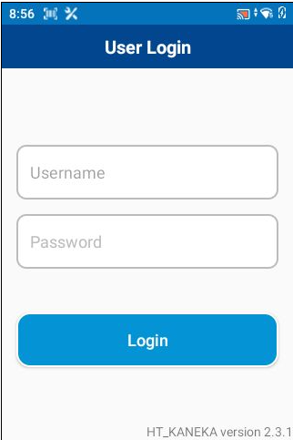
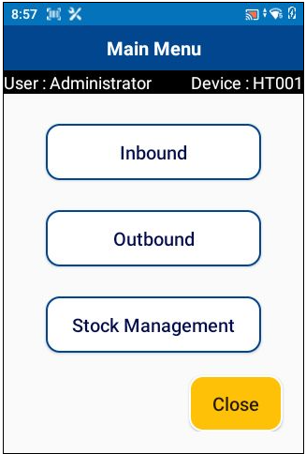
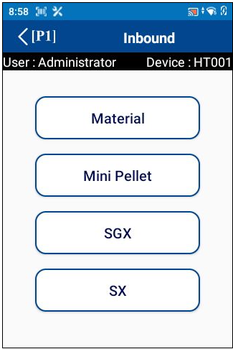
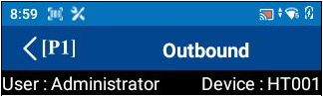











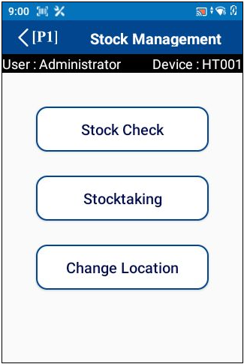
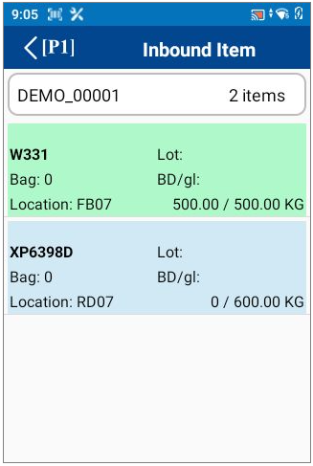
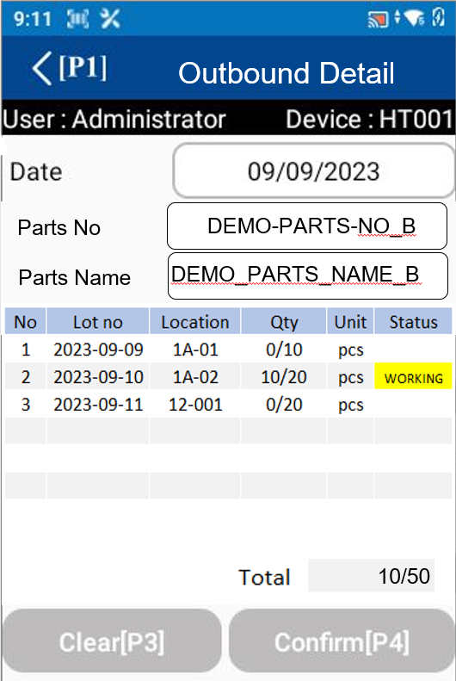
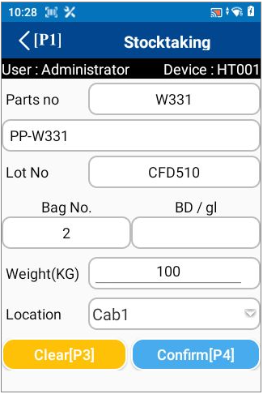


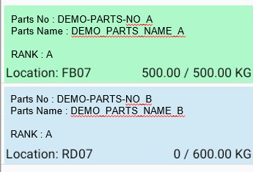



5. System functional specifications
5-1. Handy terminal function
1. User Login
2. Main menu
3. Inbound menu
3
4. Outbound menu
Material
Inbound
Supplier FG Inbound
Pokayoke
Material
Outbound
FG
Outbound
Sell
WIP
Supplier FG Inbound
Temp FG
Inbound
FG
Inbound
QC
Check
Return
Material
Inbound Schedule
Inbound
Simple
Inbound
5. Stock management menu
6. Inbound Item
7. Inbound Detail
8. QC Check
2
Date
From
Inbound Item
Inbound Detail
QC Check
07/Oct/2023
Date
To
07/Oct/2023
DEMO-PARTS-NO_B
Supplier
code
Except complete
DEMO_PARTS_NAME_B
Order No : DEMO-ORDER-NO-A
Supplier Name : DEMO-SUP-A
Parts No : DEMO-PARTS-NO_A
Parts Name : DEMO_PARTS_NAME_A
Lot No
2023-09-28
PDS No
123456789ABC
Qty
2024-12-25
PO No
12345
Qty
0
PCS
Order No : DEMO-ORDER-NO-B
Supplier Name : DEMO-SUP-B
Parts No : DEMO-PARTS-NO_B
Parts Name : DEMO_PARTS_NAME_B
2024-08-19
Qty
200
LOT No
NG
0
PCS
Act Qty
Lot Size
5,000
100
Act Qty
Unit
Total 0/600 PCS
Total Receive PCS
500,000
Stock PCS
Q01
100,000
Location
Confirm[P4]
Clear[P3]
9. Outbound Item
10. Outbound Detail
Outbound Item
Date
From
07/Oct/2023
Date
To
07/Oct/2023
Except complete
Order No : DEMO-ORDER-NO-A
Parts No : DEMO-PARTS-NO_A
Parts Name : DEMO_PARTS_NAME_A
Lot no : 20231225, 20240118
Order No : DEMO-ORDER-NO-B
Parts No : DEMO-PARTS-NO_B
Parts Name : DEMO_PARTS_NAME_B
Lot no : 20231225, 20240118

Slide 32
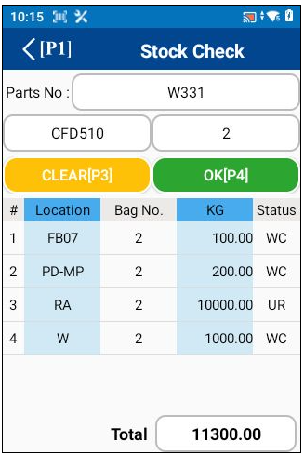
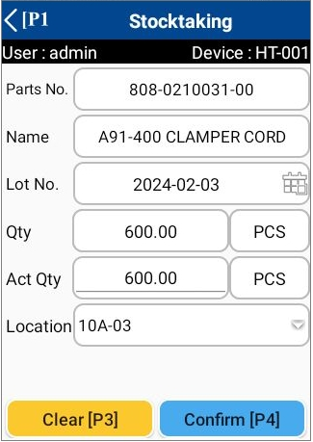
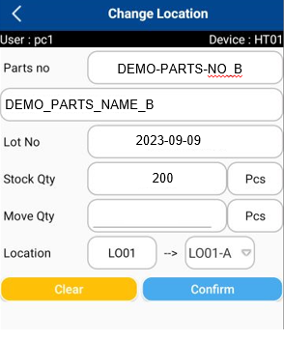
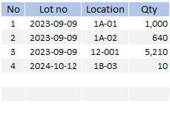
5. System functional specifications
5-1. Handy terminal function
11. Stock check
12. Stock taking
13. Change location
Lot No:
DEMO-PARTS-NO_B
6,860

Slide 33
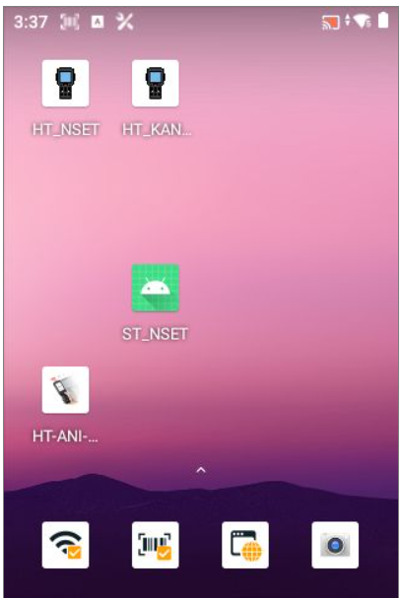

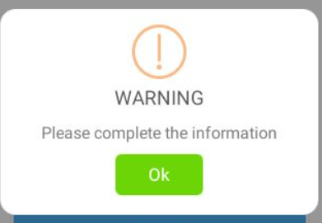
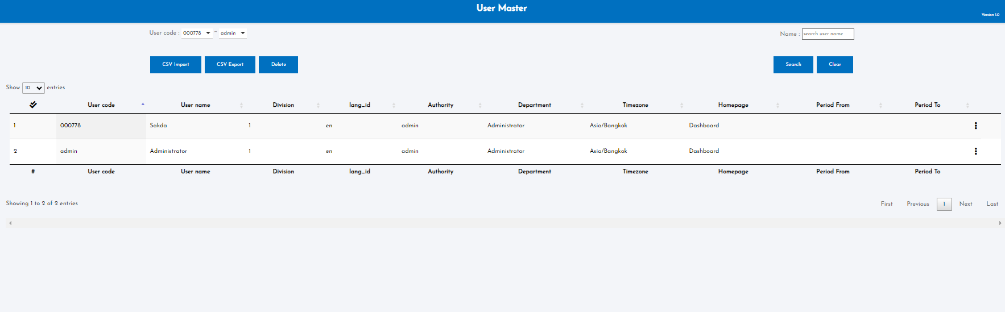
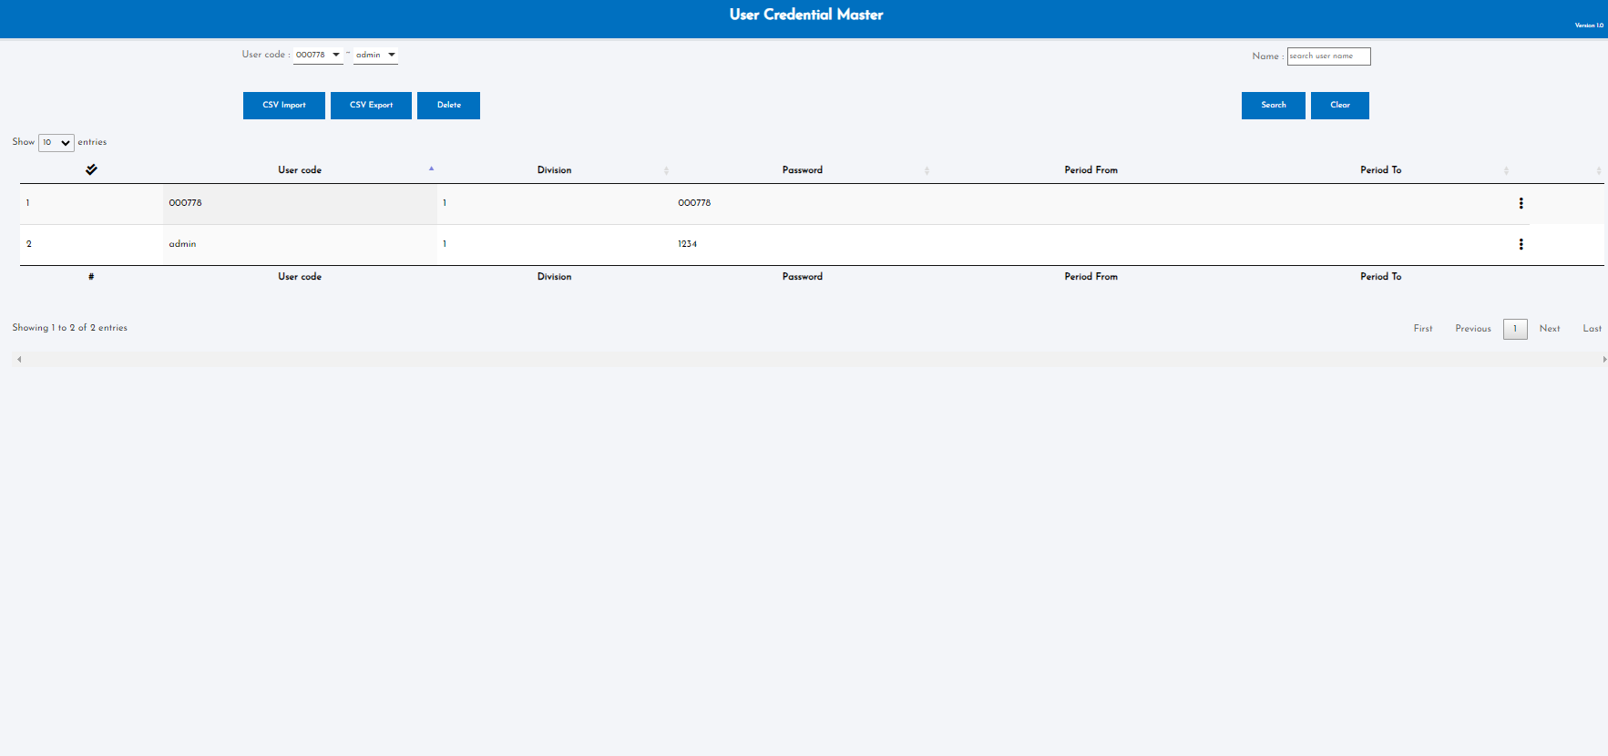
5. System functional specifications
5-1. Handy terminal function
5-1-1. User Login
This is the screen that transitions after icon app click from home screen.
User name: Information is referenced from the User master.
Enter the User code of User master.
If it enter a code that does not exist, an error screen will be displayed. *1
Pass word: Information is referenced from the User credential master.
The User code of User master is linked to the User code of User credential master. User credential Enter the master password.
If it enter a code that does not exist, an error screen will be displayed. *1
Login button: If the information is correct, it will be redirected to the Main menu.
*1: Display screen when information is incorrect
OK button: Close this screen. Return to the previous process.
User master
User credential master

Slide 34
5. System functional specifications
5-1. Handy terminal function
5-1-2. Main menu
This is the screen that transitions after logging in from User Login.
Inbound button: Transitions to the Inbound screen.
Outbound button: Transitions to the Outbound screen.
Stock Management button: Transitions to the Stock Management screen.
Close button: Closes the application.
admin
1234

Slide 35
5. System functional specifications
5-2. Handy terminal function Inbound
5-2-1. Inbound
3
This is the screen that transitions after select inbound from Main menu.
Material Inbound button: Transitions to the Material Inbound screen.
Supplier FG Inbound button: Transitions to the Supplier FG Inbound screen.
Pokayoke button: Transitions to the Pokayoke screen.
Temp FG Inbound button: Transitions to the Temp FG Inbound screen.
FG Inbound button: Transitions to the FG Inbound screen.
QC Check button: Transitions to the QC Check screen.
Simple Inbound button: Transitions to the Simple Inbound screen.
< (P1): Back to Main menu
Material
Inbound
Supplier FG Inbound
Pokayoke
Supplier FG Inbound
Temp FG
Inbound
FG
Inbound
QC
Check
Simple
Inbound

Slide 36
5. System functional specifications
5-2. Handy terminal function Inbound
5-2-2. Material Inbound *Same as “Supplier FG Inbound”
3
Material Inbound
This is the screen that transitions after select Inbound Schedule from Inbound.
Date from: Select the start of the target date. Default is today's date. Search ORDER DELIVERY DATE
Date to: Select the end of the target date. Default is today's date. Search ORDER DELIVERY DATE
Supplier code: Select supplier code. Or do a scan. Default is blank. Search SUPPLIER CODE
Except complete: If checked, the completed status Item list will not be displayed from the Item list. Default is unchecked.
Order list : Display a list that matches the condition.
Order no : ORDER NO
Supplier name : SUPPLIER CODE
Part No.: PART NUMBER
Part Name: PART NAME
Location: Fixed location of each Item linked to Item master
Item quantity: Number of items that have been processed
Status color: Green - Completed, Dark Blue - Working, Light Blue - Not Started.
< (P1): Back to Main menu
Date
From
07/Oct/2023
Date
To
07/Oct/2023
Supplier
code
Except complete
Material
Inbound
Supplier FG Inbound
Pokayoke
Order No : DEMO-ORDER-NO-A
Supplier Name : DEMO-SUP-A
Parts No : DEMO-PARTS-NO_A
Parts Name : DEMO_PARTS_NAME_A
Supplier FG Inbound
20 / 20 PCS
Temp FG
Inbound
FG
Inbound
QC
Check
Order No : DEMO-ORDER-NO-B
Supplier Name : DEMO-SUP-B
Parts No : DEMO-PARTS-NO_B
Parts Name : DEMO_PARTS_NAME_B
0 / 50 PCS
Simple
Inbound

Slide 37


5. System functional specifications
5-2. Handy terminal function Inbound
5-2-3. Material Inbound *Same as “Supplier FG Inbound” - Inbound Detail
2
Material Inbound
Inbound Detail
This is the screen that transitions after select order information from Inbound screen.
Part No.: Part number
Part Name :PART NAME
Lot No: From KANBAN delivery date
Qty: Quantity of received item
Unit: Receive unit will be loaded from schedule
Total Qty: Will be loaded from schedule
Location : The allowed location and free location will be loaded from the Location master. No initial value information.* The location control will be identified in QR Code
Clear[P3]: Clear input contents
Confirm[P4]: Confirmation processing. Normal end: Completion of registration *1. Warning: Warning screen display *2
< (P1): Back to Main menu
Date
From
07/Oct/2023
Date
To
07/Oct/2023
Supplier
code
Except complete
Order No : DEMO-ORDER-NO-A
Supplier Name : DEMO-SUP-A
Parts No : DEMO-PARTS-NO_A
Parts Name : DEMO_PARTS_NAME_A
PDS No
123456789ABC
20 / 20 PCS
PO No
12345
Order No : DEMO-ORDER-NO-B
Supplier Name : DEMO-SUP-B
Parts No : DEMO-PARTS-NO_B
Parts Name : DEMO_PARTS_NAME_B
LOT No
20240819
0 / 50 PCS
Lot Size
5,000
Unit
100
Total Receive PCS
500,000
Stock PCS
Location
100,000
Inbound Detail
Show current total stock information.
Show
- PDS
- Order no (PO number)
Inbound Detail
PDS No
123456789ABC
PDS No
123456789ABC
PO No
12345
(Step.1)
Scan KANBAN for receive inspection with PO and record LOT
PO No
12345
LOT No
LOT No
2024-08-19
Lot Size
Unit
Lot Size
5,000
Unit
100
Total Receive PCS
Total Receive PCS
Stock PCS
500,000
100,000
Stock PCS
Total PCS
100,000
Location
0/50
Location
Location
Inbound Detail
PDS No
123456789ABC
(Step.2)
Scan QC area barcode
The “Confirm[P4]” button will be enabled.
PO No
12345
LOT No
2024-08-19
Lot Size
5,000
Unit
100
Total Receive PCS
500,000
Stock PCS
Q01
100,000
Location
Confirm[P4]
Clear[P3]
INFORMATION
(Step.3)
Click the Confirm[P4] to complete the operation
Operation completed

Slide 38
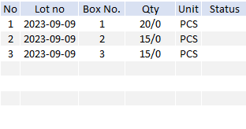
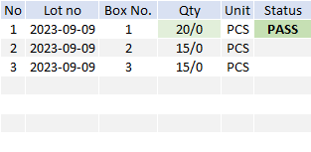
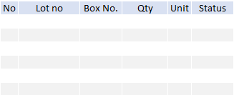
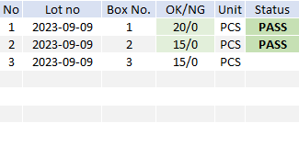
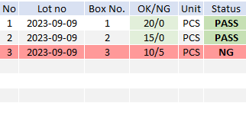
5. System functional specifications
5-2. Handy terminal function Inbound
5-2-4. Material Inbound *Same as “Supplier FG Inbound” - QC Check
2
QC Check
QC Check Detail
This is the screen that transitions after select order information from Inbound screen.
Part No.: Part number
Part Name :PART NAME
Lot No: Today date YYYY-MM-DD will be default
Qty: Quantity of received item
Unit: Receive unit will be loaded from schedule
Total Qty: Will be loaded from schedule
Location : The allowed location and free location will be loaded from the Location master. No initial value information.* The location control will be identified in QR Code
Clear[P3]: Clear input contents
Confirm[P4]: Confirmation processing. Normal end: Completion of registration *1. Warning: Warning screen display *2
< (P1): Back to Main menu
Date
From
07/Oct/2023
Date
To
07/Oct/2023
Supplier
code
Except complete
Order No : DEMO-ORDER-NO-A
Supplier Name : DEMO-SUP-A
Parts No : DEMO-PARTS-NO_A
Parts Name : DEMO_PARTS_NAME_A
20 / 20 PCS
Order No : DEMO-ORDER-NO-B
Supplier Name : DEMO-SUP-B
Parts No : DEMO-PARTS-NO_B
Parts Name : DEMO_PARTS_NAME_B
0 / 50 PCS
0/50
Location
Total
Add new input data.
1.Enter LOT Supplier (QC)
2.NG Reason (load from master)
QC Check Detail
(Step.2)
Enter GOOD / NG amount
QC Check Detail
Box No : 1 Total: 20 PCS
Display the inspection result
GOOD
20
PCS
NG
0
PCS
(Step.1)
Touch to inspect a focus item
Select NG Reason
(Step.3)
Scan RM location barcode
The “Confirm[P4]” button will be enabled.
LOT
2024-08-19
OK
Cancel
0/50
20/50
Location
Total
RM01
Total
Location
Confirm[P4]
Clear[P3]
QC Check Detail
In case of NG
Enter GOOD / NG amount
QC Check Detail
Box No : 1 Total: 20 PCS
GOOD
10
PCS
NG
5
PCS
Dirty skin
LOT
2024-08-19
OK
Cancel
INFORMATION
RM01
35/50
RM01
50/50
Operation completed
Location
Total
Location
Total
Clear[P3]
Confirm[P4]
Clear[P3]
Confirm[P4]

Slide 39
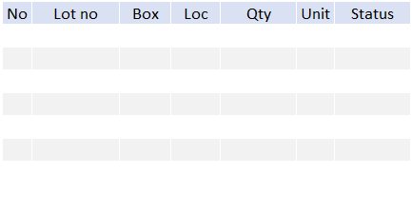
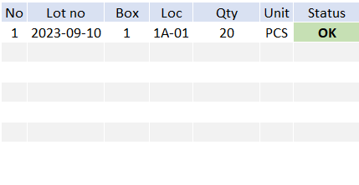
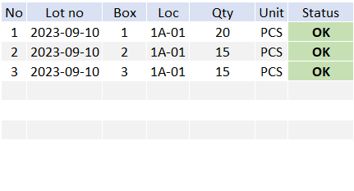
5. System functional specifications
5-2. Handy terminal function Inbound
5-2-5. POKAYOKE - Inbound Detail
3
This is the screen that transitions after select order information from Inbound screen.
Part No.: Part number
Part Name :PART NAME
Lot No: Today date YYYY-MM-DD will be default
Qty: Quantity of received item
Unit: Receive unit will be loaded from schedule
Total Qty: Will be loaded from schedule
Location : The WIP store lane will be loaded from the Location master. No initial value information.* The location control will be identified in QR Code
Clear[P3]: Clear input contents
Confirm[P4]: Confirmation processing. Normal end: Completion of registration *1. Warning: Warning screen display *2
< (P1): Back to Main menu
POKAYOKE
Material
Inbound
Supplier FG Inbound
Pokayoke
Supplier FG Inbound
Temp FG
Inbound
FG
Inbound
QC
Check
Total PCS
Location
0
Simple
Inbound
Move location to each list that it is production line location
This location can be get from KANBAN
Customer KANBAN
POKAYOKE
POKAYOKE
(Step.2)
POKAYOKE matching
Scan customer KANBAN to comfirm the POKAYOKE matching.
The STATUS will be change to OK.
If not matched:
Lock screen call leader to unlock.
(Step.1)
Scan WIP label for moving Goods to WIP Store lane
Total PCS
Total PCS
0
20
Confirm[P4]
INFORMATION
(Step.3)
Click the Confirm[P4] to complete the operation
Operation completed
In case of NG
Must be enter the leader user and password to unlock the screen
POKAYOKE
NG
(**Optional Step)
Scan other KANBAN tag
user
LEADER01
POKAYOKE
password
*********
OK[P2]
Clear[P3]
Total PCS
Clear[P3]
20
Total PCS
50
Clear[P3]
Confirm[P4]

Slide 40
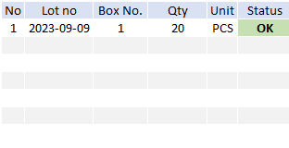
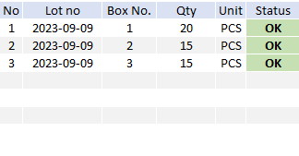
5. System functional specifications
5-2. Handy terminal function Inbound
5-2-5. Temporary FG Inbound - Inbound Detail
3
This is the screen that transitions after select order information from Inbound screen.
Part No.: Part number
Part Name :PART NAME
Lot No: Today date YYYY-MM-DD will be default
Qty: Quantity of received item
Unit: Receive unit will be loaded from schedule
Total Qty: Will be loaded from schedule
Location : The WIP store lane will be loaded from the Location master. No initial value information.* The location control will be identified in QR Code
Clear[P3]: Clear input contents
Confirm[P4]: Confirmation processing. Normal end: Completion of registration *1. Warning: Warning screen display *2
< (P1): Back to Main menu
Temp FG Inbound
Material
Inbound
Supplier FG Inbound
Pokayoke
Supplier FG Inbound
Temp FG
Inbound
FG
Inbound
QC
Check
Total PCS
Location
0
Simple
Inbound
Temp FG Inbound
Temp FG Inbound
(Step.1)
Scan WIP label for moving Goods to WIP Store lane
Total PCS
Total PCS
Location
0
Location
20
Temp FG Inbound
(**Optional Step)
Scan other KANBAN tag
Temp FG Inbound
(Step.2)
Scan the destination location
Total PCS
W01
20
W01
Total PCS
Location
Confirm[P4]
Location
50
Clear[P3]
INFORMATION
Clear[P3]
Confirm[P4]
(Step.3)
Click the Confirm[P4] to complete the operation
Operation completed

Slide 41
5. System functional specifications
5-2. Handy terminal function Inbound
5-2-6. FG Inbound
3
FG Inbound
This is the screen that transitions after select Inbound Schedule from Inbound.
Date from: Select the start of the target date. Default is today's date. Search ORDER DELIVERY DATE
Date to: Select the end of the target date. Default is today's date. Search ORDER DELIVERY DATE
Supplier code: Select supplier code. Or do a scan. Default is blank. Search SUPPLIER CODE
Except complete: If checked, the completed status Item list will not be displayed from the Item list. Default is unchecked.
Order list : Display a list that matches the condition.
Order no : ORDER NO
Supplier name : SUPPLIER CODE
Part No.: PART NUMBER
Part Name: PART NAME
Location: Fixed location of each Item linked to Item master
Item quantity: Number of items that have been processed
Status color: Green - Completed, Dark Blue - Working, Light Blue - Not Started.
< (P1): Back to Main menu
Date
From
07/Oct/2023
Date
To
07/Oct/2023
Customer
code
Except complete
Material
Inbound
Supplier FG Inbound
Pokayoke
Order No : DEMO-ORDER-NO-A
Customer Name : DEMO-SUP-A
Parts No : DEMO-PARTS-NO_A
Parts Name : DEMO_PARTS_NAME_A
Supplier FG Inbound
20 / 20 PCS
Temp FG
Inbound
FG
Inbound
QC
Check
Order No : DEMO-ORDER-NO-B
Customer Name : DEMO-SUP-B
Parts No : DEMO-PARTS-NO_B
Parts Name : DEMO_PARTS_NAME_B
0 / 50 PCS
Order No : DEMO-ORDER-NO-A
Customer Name : DEMO-SUP-A
Parts No : DEMO-PARTS-NO_A
Parts Name : DEMO_PARTS_NAME_A
Simple
Inbound
Location: XX01
40 / 20 PCS

Slide 42
5. System functional specifications
5-2. Handy terminal function Inbound
5-2-6. FG Inbound - Inbound Detail
FG Inbound
FG Inbound Detail
This is the screen that transitions after select order information from Inbound screen.
Part No.: Part number
Part Name :PART NAME
Lot No: Today date YYYY-MM-DD will be default
Qty: Quantity of received item
Unit: Receive unit will be loaded from schedule
Total Qty: Will be loaded from schedule
Location : The WIP store lane will be loaded from the Location master. No initial value information.* The location control will be identified in QR Code
Clear[P3]: Clear input contents
Confirm[P4]: Confirmation processing. Normal end: Completion of registration *1. Warning: Warning screen display *2
< (P1): Back to Main menu
Date
From
07/Oct/2023
Date
To
07/Oct/2023
Customer
code
Except complete
Order No : DEMO-ORDER-NO-A
Customer Name : DEMO-SUP-A
Parts No : DEMO-PARTS-NO_A
Parts Name : DEMO_PARTS_NAME_A
Production No
20 / 20 PCS
Prod-0001
Order No : DEMO-ORDER-NO-B
Customer Name : DEMO-SUP-B
Parts No : DEMO-PARTS-NO_B
Parts Name : DEMO_PARTS_NAME_B
From PS
0 / 50 PCS
Total PCS
Location
0/50
FG Inbound Detail
FG Inbound Detail
Production No
Production No
Prod-0001
Prod-0001
(Step.1)
Scan PD KANBAN for moving FG from WIP to FG store
Total PCS
Total PCS
Location
0/50
Location
0/50
FG Inbound Detail
(**Optional Step)
Scan other KANBAN label
FG Inbound Detail
Production No
Prod-0001
Production No
(Step.2)
Scan FG store barcode
The “Confirm[P4]” button will be enabled.
Prod-0001
F01
Total PCS
Location
20/50
F01
Total PCS
Clear[P3]
Confirm[P4]
Location
50/50
INFORMATION
Clear[P3]
Confirm[P4]
(Step.3)
Click the Confirm[P4] to complete the operation
Operation completed

Slide 43
5. System functional specifications
5-2. Handy terminal function Inbound
5-2-3. Simple Inbound - Inbound Detail
2
3
This is the screen that transitions after select order information from Inbound screen.
Part No.: Part number
Part Name :PART NAME
Lot No: From KANBAN delivery date
Qty: Quantity of received item
Unit: Receive unit will be loaded from schedule
Total Qty: Will be loaded from schedule
Location : The allowed location and free location will be loaded from the Location master. No initial value information.* The location control will be identified in QR Code
Clear[P3]: Clear input contents
Confirm[P4]: Confirmation processing. Normal end: Completion of registration *1. Warning: Warning screen display *2
< (P1): Back to Main menu
Inbound Detail
Material
Inbound
Supplier FG Inbound
Pokayoke
LOT No
2024-08-19
Supplier FG Inbound
Lot Size
5,000
Unit
100
Total Qty PCS
Temp FG
Inbound
FG
Inbound
QC
Check
500,000
Stock PCS
Location
100,000
Simple
Inbound
Inbound Detail
Inbound Detail
LOT No
LOT No
2024-08-19
Show current total stock information.
Lot Size
Unit
(Step.1)
Scan KANBAN for receive inspection with PO and record LOT
Lot Size
5,000
Unit
100
Total Qty PCS
Total Qty PCS
Stock PCS
500,000
Stock PCS
Location
Location
100,000
Inbound Detail
(Step.2)
Scan QC area barcode
The “Confirm[P4]” button will be enabled.
LOT No
2024-08-19
Lot Size
5,000
Unit
100
Total Qty PCS
500,000
Stock PCS
Q01
100,000
Location
Clear[P3]
Confirm[P4]
INFORMATION
(Step.3)
Click the Confirm[P4] to complete the operation
Operation completed

Slide 44
5. System functional specifications
5-3. Handy terminal function Outbound
5-3-1. Outbound
This is the screen that transitions after select outbound from Main menu.
Material Outbound: Transitions to the Material Outbound screen.
FG Outbound: Transitions to the FG Outbound screen.
Sell WIP: Transitions to the Sell WIP screen.
Return Material: Transitions to the Return Material screen.
< (P1): Back to Main menu
Material
Outbound
FG
Outbound
Sell
WIP
Return
Material
Inbound Schedule
Inbound

Slide 45
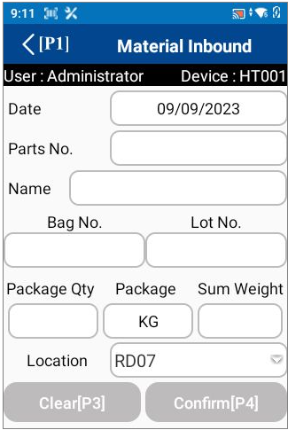
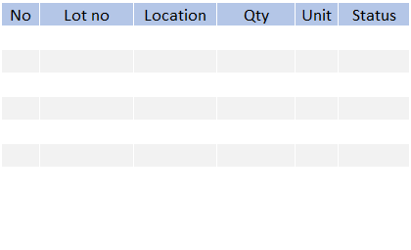

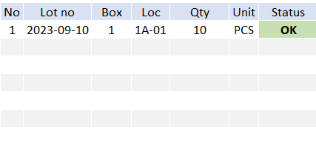
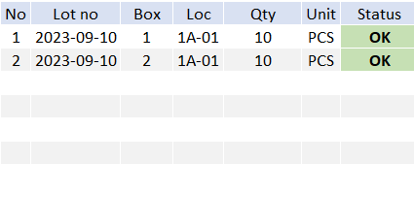
5. System functional specifications
5-3. Handy terminal function Outbound
5-3-2. Material Outbound
3
This is the screen that transitions after select order information from Outbound item.
Date : Today’s date
Part No.: No initial value information * Scan QR data or Can be changed manually
Part Name : No initial value information * Scan QR data or Can be changed manually
Lot No: No initial value information * Scan QR data or Can be changed manually
Location: No initial value information. If there is no link, display blank.* Scan QR data or Can be changed manually
Clear[P3]: Clear input contents
Confirm[P4]: Confirmation processing. Normal end: Completion of registration *1. Warning: Warning screen display *2
< (P1): Back to Main menu
Material Outbound
Parts No
Material Outbound
Material
Outbound
FG
Outbound
Sell
WIP
4
Parts Name
PS No
Date
From
07/Oct/2023
Date
To
07/Oct/2023
Box No
Lot No
Part
no
Except complete
Return
Material
Inbound Schedule
Box no
Qty
Order No : OUTBOUND NO 1
Inbound
0
20 / 20 ITEMS
Location
Order No : OUTBOUND NO 2
1 / 2 ITEMS
Date
From
Material Outbound
07/Oct/2023
Date
To
07/Oct/2023
Part
no
Except complete
ORDER NO: OUTBOUND NO 2
PART NO :
PART NAME :
Material Outbound
Material Outbound
20 / 20 PCS
ORDER NO: OUTBOUND NO 2
PART NO :
PART NAME :
DEMO-PARTS-NO_B
Qty per box = 10pcs
Label 1 piece
Lot 2023-09-10
Label serial : 0001
Parts No
DEMO-PARTS-NO_B
DEMO-PARTS-NO_B
Qty per box = 10pcs
Label 1 piece
Lot 2023-09-10
Label serial : 0002
Parts No
DEMO-PARTS-NO_B
DEMO-PARTS-NO_B
Parts Name
DEMO-PARTS-NO_B
0 / 50 PCS
4
Parts Name
DEMO_PARTS_NAME_B
PS No
DEMO_PARTS_NAME_B
PS No
123456789
Box No
123456789
Box No
Lot No
Lot No
0001
2023-09-10
0001
2023-09-10
Box no
Qty
Able to scan or manual input PS NO
*Mandatory
Qty
1
PCS
10
2
PCS
20
Location
10
F01
20
Location
Confirm[P4]
Clear[P3]
Scan destination location to move the items

Slide 46
5. System functional specifications
5-3. Handy terminal function Outbound
5-3-2. Return Material
This is the screen that transitions after select order information from Outbound item.
Date : Today’s date
Part No.: No initial value information * Scan QR data or Can be changed manually
Part Name : No initial value information * Scan QR data or Can be changed manually
Location Plan : None
Lot Plan : None
Box No: No initial value information * Scan QR data or Can be changed manually
Lot No: No initial value information * Scan QR data or Can be changed manually
Total Qty: No initial value information * Scan QR data or Can be changed manually
Location: No initial value information. If there is no link, display blank.* Scan QR data or Can be changed manually
Clear[P3]: Clear input contents
Confirm[P4]: Confirmation processing. Normal end: Completion of registration *1. Warning: Warning screen display *2
< (P1): Back to Main menu
Return Material
Parts No
Return Material
Material
Outbound
FG
Outbound
Sell
WIP
Parts Name
Date
From
07/Oct/2023
Date
To
07/Oct/2023
Doc No
Part
no
Except complete
Return
Material
Inbound Schedule
Box no
Lot No
Qty
Order No : OUTBOUND NO 1
Inbound
20 / 20 ITEMS
Location
Order No : OUTBOUND NO 2
1 / 2 ITEMS
Date
From
Return Material
07/Oct/2023
Date
To
07/Oct/2023
Part
no
Except complete
ORDER NO: OUTBOUND NO 2
PART NO :
PART NAME :
Return Material
Return Material
20 / 20 PCS
ORDER NO: OUTBOUND NO 2
PART NO :
PART NAME :
DEMO-PARTS-NO_B
Qty per box = 10pcs
Label 1 piece
Lot 2023-09-10
Label serial : 0001
Parts No
DEMO-PARTS-NO_B
DEMO-PARTS-NO_B
Qty per box = 10pcs
Label 1 piece
Lot 2023-09-10
Label serial : 0002
Parts No
DEMO-PARTS-NO_B
DEMO-PARTS-NO_B
Parts Name
DEMO-PARTS-NO_B
0 / 50 PCS
Parts Name
DEMO_PARTS_NAME_B
DEMO_PARTS_NAME_B
Doc No
202408190001
Doc No
202408190001
Lot No
Lot No
0001
2023-09-10
0001
2023-09-10
Box no
Qty
Add new row data:
Doc no: YYYYMMDD<running no>
Qty
1
PCS
10
2
PCS
20
Location
10
F01
20
Location
Confirm[P4]
Destination location get from last store location of supplier KANBAN.
*Keep last location of RM store for return mat
Clear[P3]
Scan source location to move the items

Slide 47
5. System functional specifications
5-3. Handy terminal function Outbound
5-3-3. FG Outbound *Same as “Sell WIP”
3
This is the screen that transitions after select order information from Outbound item.
Date : Search by From date and To date
Customer Code : Search plan by customer code.
Except complete : Not show the completed job if checked.
Part No.: Display the Part No from plan.
Part Name : Display the Part Name from plan.
Customer Name : Display the customer name from plan.
Total Qty: Display the total actual/plan amount.
< (P1): Back to Main menu
Date
From
FG Outbound
07/Oct/2023
Date
To
07/Oct/2023
Customer
code
Except complete
Material
Outbound
FG
Outbound
Sell
WIP
Order No : DEMO-ORDER-NO-A
Customer Name : DEMO-SUP-A
Parts No : DEMO-PARTS-NO_A
Parts Name : DEMO_PARTS_NAME_A
20 / 20 PCS
Return
Material
Inbound Schedule
Order No : DEMO-ORDER-NO-B
Customer Name : DEMO-SUP-B
Parts No : DEMO-PARTS-NO_B
Parts Name : DEMO_PARTS_NAME_B
Inbound
0 / 50 PCS

Slide 48
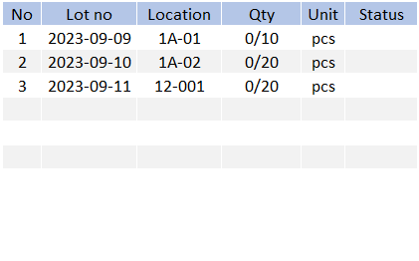
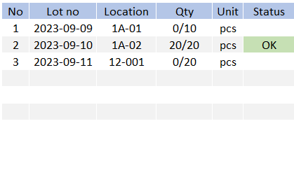
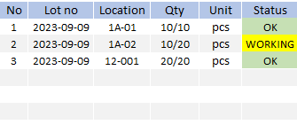

5. System functional specifications
5-3. Handy terminal function Outbound
5-3-3. Outbound Detail for FG Outbound * Same as Sell WIP
This is the screen that transitions after select order information from Outbound item.
Date : Today’s date
Part No.: PART NUMBER
Part Name : PART NAME
Location Plan :*Display assigned location information. If there are multiple items, display multiple items.
Lot Plan :*Displays a list of Lot no that are recommended for picking after reservation. If there are multiple items, display multiple items.
Lot No: No initial value information * Scan QR data or Can be changed manually
Package Qty: No initial value information * Scan QR data or Can be changed manually
Package: No initial value information * Scan QR data or Can be changed manually
Sum Qty: No initial value information * Scan QR data or Can be changed manually
Location: The initial value is referenced from the Location master. No initial value information. If there is no link, display blank.* Scan QR data or Can be changed manually
Clear[P3]: Reset to the initial data
Confirm[P4]: Confirmation processing. Normal end: Completion of registration *1. Warning: Warning screen display *2
< (P1): Back to Main menu
Date
From
FG Outbound
Outbound Detail
07/Oct/2023
Date
To
07/Oct/2023
Customer
code
Except complete
Parts No
DEMO-PARTS-NO_B
Order No : DEMO-ORDER-NO-A
Customer Name : DEMO-SUP-A
Parts No : DEMO-PARTS-NO_A
Parts Name : DEMO_PARTS_NAME_A
Parts Name
DEMO_PARTS_NAME_B
220(Outbound QTY)
100 → SCAN (use an old label)
120
100 → SCAN (use an old label)
20
100 → REPACK
PRINT
LABEL 1 → 80pcs (Force print)
LABEL 2 → 20pcs (YES/NO)
Location
Plan
RD05
RD06
Lot No
Plan
2023-09-10
2023-09-11
20 / 20 PCS
Box No
Lot No
Order No : DEMO-ORDER-NO-B
Customer Name : DEMO-SUP-B
Parts No : DEMO-PARTS-NO_B
Parts Name : DEMO_PARTS_NAME_B
Box no
Qty
0 / 50 PCS
0/50
Operation completed
Outbound Detail
Outbound Detail
Parts No
DEMO-PARTS-NO_B
Parts No
DEMO-PARTS-NO_B
DEMO-PARTS-NO_B
Parts Name
DEMO-PARTS-NO_B
Parts Name
DEMO_PARTS_NAME_B
RD05
RD06
DEMO_PARTS_NAME_B
Parts No does not match Plan
Location
Plan
RD05
RD06
Lot No
Plan
2023-09-10
2023-09-11
DEMO-PARTS-NO_B
Enter QTY = 20pcs
Label 1 piece
Lot 2023-09-10
Box No
Lot No
Plan
2023-09-10
2023-09-11
Box No
Lot No
Box no
Lot No
0001
2023-09-10
Qty
PCS
Qty
2
20
INFORMATION
0/50
20/50
Operation completed!
Confirm[P4]
Parts No does not match Plan
Outbound Detail
Outbound Detail
*3: When Parts No does not match the Plan.
OK button: Close this screen. Return to the previous process.
Parts No
DEMO-PARTS-NO_B
Parts No
DEMO-PARTS-NO_B
DEMO-PARTS-NO_B
Parts Name
DEMO-PARTS-NO_B
Parts Name
DEMO_PARTS_NAME_B
RD05
RD06
DEMO_PARTS_NAME_B
Location
Plan
RD05
RD06
Lot No
Plan
2023-09-10
2023-09-11
DEMO-PARTS-NO_B
Enter QTY = 10pcs
Label 1 piece
Lot 2023-09-10
Box No
Lot No
Plan
2023-09-10
2023-09-11
Box No
Lot No
Box no
Lot No
0001
2023-09-10
Qty
PCS
Qty
2
20
INFORMATION
40/50
50/50
All items completed!
Confirm[P4]

Slide 49

5. System functional specifications
5-3. Handy terminal function Outbound
5-3-3. Outbound Detail for FG Outbound * Same as Sell WIP
* Scan the other items not included in the FIFO plan
Outbound Detail
Outbound Detail
Parts No
DEMO-PARTS-NO_B
Parts No
DEMO-PARTS-NO_B
INFORMATION
220(Outbound QTY)
100 → SCAN (use an old label)
120
100 → SCAN (use an old label)
20
100 → REPACK
PRINT
LABEL 1 → 80pcs (Force print)
LABEL 2 → 20pcs (YES/NO)
DEMO-PARTS-NO_B
DEMO-PARTS-NO_B
All items completed!
Parts Name
DEMO_PARTS_NAME_B
Parts Name
DEMO_PARTS_NAME_B
Location
Plan
RD05
RD06
Lot No
Plan
2023-09-10
2023-09-11
DEMO-PARTS-NO_B
Enter QTY = 10pcs
Label 1 piece
Lot 2024-10-12
RD05
RD06
Lot No
Plan
2023-09-10
2023-09-11
Box No
Lot No
Box No
Box no
Lot No
Qty
0001
2023-09-10
PCS
Qty
40/50
2
20
50/50
Confirm[P4]
* All status should be changed to OK while the outbound items have already completed
Operation completed
Parts No does not match Plan
Parts No does not match Plan
*3: When Parts No does not match the Plan.
OK button: Close this screen. Return to the previous process.

Slide 50
5. System functional specifications
5-4. Handy terminal function Stock Management
5-4-1. Stock management
This is the screen that transitions after select Stock management from Main menu.
Stock Check button: Transitions to the Stock Check screen.
Stocktaking button: Transitions to the Stocktaking screen.
Change Location button: Transitions to the Change Location screen.
< (P1): Back to Main menu

Slide 51

5. System functional specifications
5-4. Handy terminal function Stock Management
5-4-2. Stock Check
This is the screen that transitions after select Stock check from Stock management menu.
Parts No: No initial value information, List selection from Item master* Can be changed manually or scan label
Lot No: No initial value information.* Can be changed manually or scan label
Location : No initial value information
Qty Box : No initial value information
Qty : No initial value information
Total : No initial value information
Clear[P3]: Clear input contents
OK[P4]: Confirmation processing. Search data.
< (P1): Back to Main menu
Lot No
Qty
*2: Display screen when information is incorrect
OK button: Close this screen. Return to the previous process.
Qty
4
DEMO-PARTS-NO_B
DEMO-PARTS-NO_B
DEMO-PARTS-NO_B
Qty per box = 10pcs
Label 1 piece
Lot 2023-09-09
6,850
6,860

Slide 52

5. System functional specifications
5-4. Handy terminal function Stock Management
5-4-3. Stocktaking
This is the screen that transitions after select Stocktaking from Stock management menu.
Parts No: No initial value information, List selection from Item master* Can be changed manually or scan label
Lot No: No initial value information.* Can be changed manually or scan label
Location : No initial value information .* Can be changed manually or scan label
Qty : System quantity, No initial value information *The quantity in the system will be displayed.
Act Qty : Actual quantity, No initial value information
Clear[P3]: Clear input contents
Confirm[P4]: Confirmation processing.
< (P1): Back to Main menu
4
INFORMATION
Operation completed!
808-0210031-00
Label 1 piece
Lot 2024-02-03
Auto insert the KANBAN item qty
Period time
RM : daily / weekly / monthly
FG : weekly / monthly

Slide 53


5. System functional specifications
5-4. Handy terminal function Stock Management
5-4-4. Change Location
This is the screen that transitions after select Change Location from Stock management menu.
Parts No: No initial value information, List selection from Item master* Can be changed manually or scan label
Lot No: No initial value information.* Can be changed manually or scan label
Qty : No initial value information Can be changed manually or scan label
Old Location : No initial value information .* Can be changed scan label
New Location : No initial value information .* Can be changed manually or scan label
Clear[P3]: Clear input contents
Confirm[P4]: Confirmation processing.
< (P1): Back to Main menu
1
All pack change location
4
DEMO-PARTS-NO_B
DEMO-PARTS-NO_B
DEMO_PARTS_NAME_B
DEMO_PARTS_NAME_B
2023-09-09
2023-09-09
200
200
DEMO-PARTS-NO_B
Label 1 piece
Lot 2023-09-09
DEMO-PARTS-NO_B
Label 1 piece
Lot 2023-09-09
* Scan the same label
200
50.00

Slide 54


5. System functional specifications
5-5. PC operation flow
5-5-1. Login-Menu
Prepare user ID and password for MAS-T.
Please log in with MAS-T user ID and password.
ID: admin
Pass: 1234
admin

Slide 55

5. System functional specifications
5-5. PC operation flow
5-5-2. Main-Menu
1
[Schedule]
[Inbound]
[Outbound]
[Stock Management]
[Master Management]
2
3
4
5
Inbound Schedule
Inbound schedule
Outbound Schedule
Outbound schedule
Inbound Inquiry Report
Inbound Inquiry Report
Outbound Inquiry Report
Outbound Inquiry Report
Stock Inquiry / report
Stock Maintenance
Stock management
Supplier master
Authority master
Stocktaking
Item master
Name master
Stock Maintenance Inquiry / Report
Customer master
Packing Standard
Location master
NG Reason
User master
BOM
User credential master
4
Master management

Slide 56

5. System functional specifications
5-5. PC operation flow
5-5-3. Schedule
** Standard specifics
4
Remark
1. Confirm and send data to ERP.
2. User have to confirm the schedule after RM Inbound on handy.
3. User must input INVOICE NO/INVOICE DATE and send back to ERP.
4. Send default NGReason code only for send back to ERP.
5. Add new column transaction date(actual receive shift date) to INBOUND Table that will be set on inbound event. 8.30-20.30 (day shift)/20.30-8.29 (night shift)

Slide 57

5. System functional specifications
5-5. PC operation flow
5-5-3. Schedule
** Standard specifics
4
Remark
1. Confirm and send data to ERP.
2. User have to confirm the schedule after FG outbound on handy.
3. Must input container number on Remark column.

Slide 58


5. System functional specifications
5-5. PC operation flow
5-5-4. Inbound
** Standard specifics

Slide 59
5. System functional specifications
5-5. PC operation flow
5-5-5. Outbound
** Standard specifics

Slide 60

5. System functional specifications
5-5. PC operation flow
5-5-6. Stock Inquiry Report
4
** Standard specifics
Add Summary Column to display the total qty.

Slide 61

5. System functional specifications
5-5. PC operation flow
5-5-7. Stock Maintenance
4
** Standard specifics
Load from reason code master
Add new column for department ID
Dept

Slide 62



5. System functional specifications
5-5. PC operation flow
5-5-8. Stocktaking
4
** Standard specifics
Change the summary stocktaking to input box for compare
1960.00
1080.00

Slide 63

5. System functional specifications
5-5. PC operation flow
5-5-9. Stock Maintenance Inquiry / Report
** Standard specifics

Slide 64

5. System functional specifications
5-5. PC operation flow
5-5-10. NG Reason master
** Standard specifics
NG Reason Master

Slide 65

5. System functional specifications
5-5. PC operation flow
5-5-11. Supplier master
** Standard specifics

Slide 66

5. System functional specifications
5-5. PC operation flow
5-5-12. Item master
** Standard specifics

Slide 67

5. System functional specifications
5-5. PC operation flow
5-5-13. Location master
** Standard specifics

Slide 68
5. System functional specifications
5-5. PC operation flow
5-5-14. User master
** Standard specifics

Slide 69
5. System functional specifications
5-5. PC operation flow
5-5-15. User Credential master
** Standard specifics

Slide 70

5. System functional specifications
5-5. PC operation flow
5-5-16. Authority Master
** Standard specifics

Slide 71

5. System functional specifications
5-5. PC operation flow
5-5-17. Name Master
** Standard specifics

Slide 72

5. System functional specifications
5-5. PC operation flow
5-5-18. Packing Standard Master
** Standard specifics
CSV Import button Import selected CSV file
CSV Export button Export all recodes for CSV file
Delete button Delete selected records
Search button Search using the entered conditions.
Clear button Initializes and clears the entered conditions.

Slide 73

5. System functional specifications
5-5. PC operation flow
5-5-19. Customer master
** Standard specifics

Slide 74
6. Q&A

Slide 75
7. Sign off
We hereby acknowledge and agree the above-mentioned blueprint requirements.
Any changes required after the sign off for this blueprint will be addressed through the change request process.
Toyota Boshoku Filtration System(Thailand) Co., Ltd.
Sign:
Name:
Title:
Date:
TOMAS TECH CO.,LTD.
Sign:
YN2-TECH (THAILAND) CO.,LTD.
Sign:
Name:
Name:
Title:
Title:
Date:
Date:
## END OF BLUEPRINT##

