Slide 1
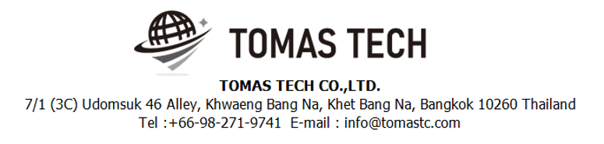
Version 15/July/2024
Confidential
Check Sheet Application
Documentation EN Blueprint
Blueprint
Made for: DENSO (THAILAND) CO., LTD.
By: TOMAS TECH CO.,LTD.

Slide 2
Revision History
Date | Version | File name | Details
15/July/2024 | R1 | Check Sheet Application Documentation EN Blueprint | First edition

Slide 3
■Contents
1. Overview
2. Overall configuration diagram
3. Overall flow diagram
3-1. Login flow
3-2. Check and Input : Machine condition check flow diagram
3-3. Check and Input : x-R chart flow diagram
3-4. Check and Input : Jig condition check flow
3-5. Check and Input : Changing point record flow diagram
3-6. Check Result/Approve: Machine condition check flow diagram
3-7. Check Result/Approve: x-R chart flow diagram
3-8. Check Result/Approve: Jig check flow diagram
3-9. Check Result/Approve: Changing point record flow diagram
3-10. Approval flow diagram
4. Overall ER diagram
4-1. Master data ER-diagram
4-2. User permission ER-diagram
4-3. Transaction ER-diagram
5. Operation approval flow

Slide 4
1. Overview
Introduced Check sheet application to Denso.
The system specifications for introduction are described in this document.

Slide 5
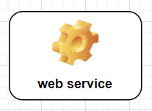

2. Overall configuration diagram
Represents a configuration diagram of the Check sheet application. It is a configuration image of documents.
Overall configuration diagram image
Check and input
Check result
Approval
Web Application
(IIS)
DB Server

Slide 6
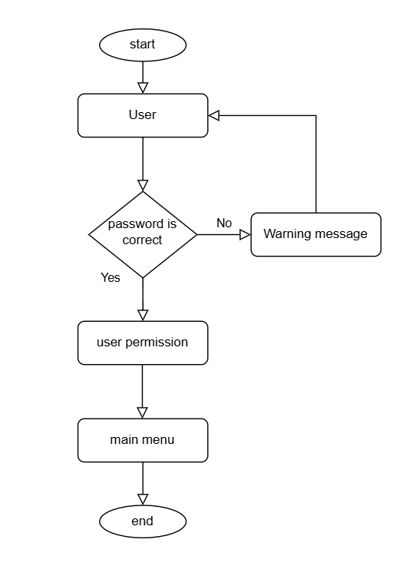
3. Overall flow diagram
Represents flow diagram of the check sheet application.
3-1. Login flow diagram image

Slide 7
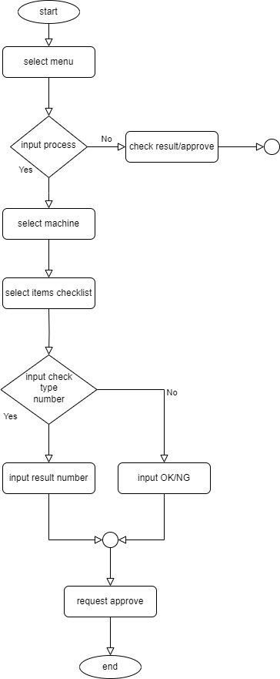
3. Overall flow diagram
Represents flow diagram of the check sheet application.
3-2. Check and Input : Machine condition check flow diagram image

Slide 8

3. Overall flow diagram
Represents flow diagram of the check sheet application.
3-3. Check and Input : x-R chart flow diagram image

Slide 9
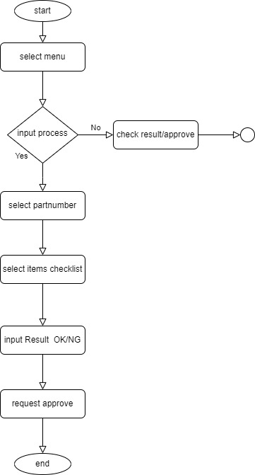
3. Overall flow diagram
Represents flow diagram of the check sheet application.
3-4. Check and Input : Jig condition check flow diagram image

Slide 10
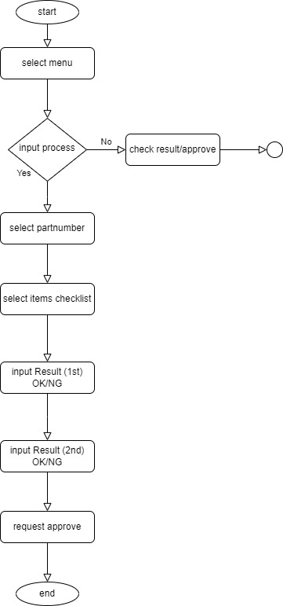
3. Overall flow diagram
Represents flow diagram of the check sheet application.
3-5. Check and Input : Changing point record flow diagram image

Slide 11
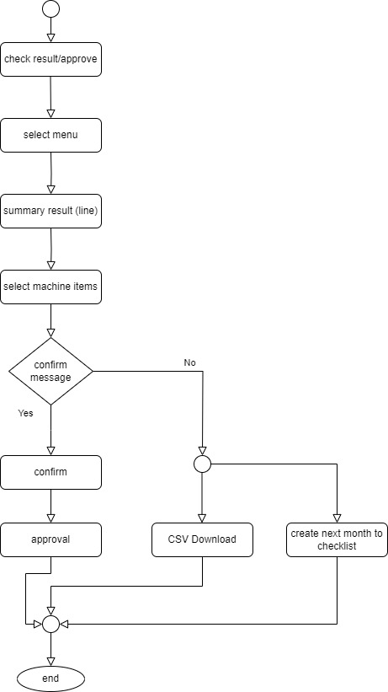
3. Overall flow diagram
Represents flow diagram of the check sheet application.
3-6. Check Result/Approve: Machine condition check flow diagram image

Slide 12
3. Overall flow diagram
Represents flow diagram of the check sheet application.
3-7. Check Result/Approve: x-R chart flow diagram image

Slide 13
3. Overall flow diagram
Represents flow diagram of the check sheet application.
3-8. Check Result/Approve: Jig check flow diagram image

Slide 14
3. Overall flow diagram
Represents flow diagram of the check sheet application.
3-9. Check Result/Approve: Changing point record flow diagram image

Slide 15
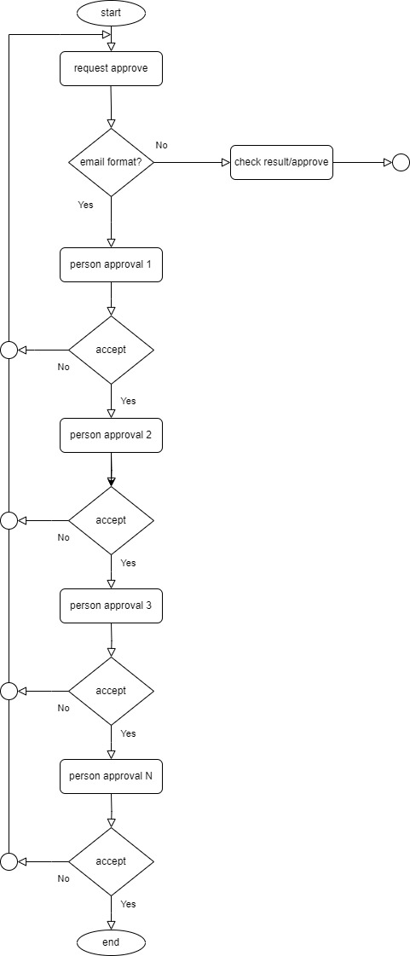
3. Overall flow diagram
Represents flow diagram of the check sheet application.
3-10. Approval flow diagram image

Slide 16
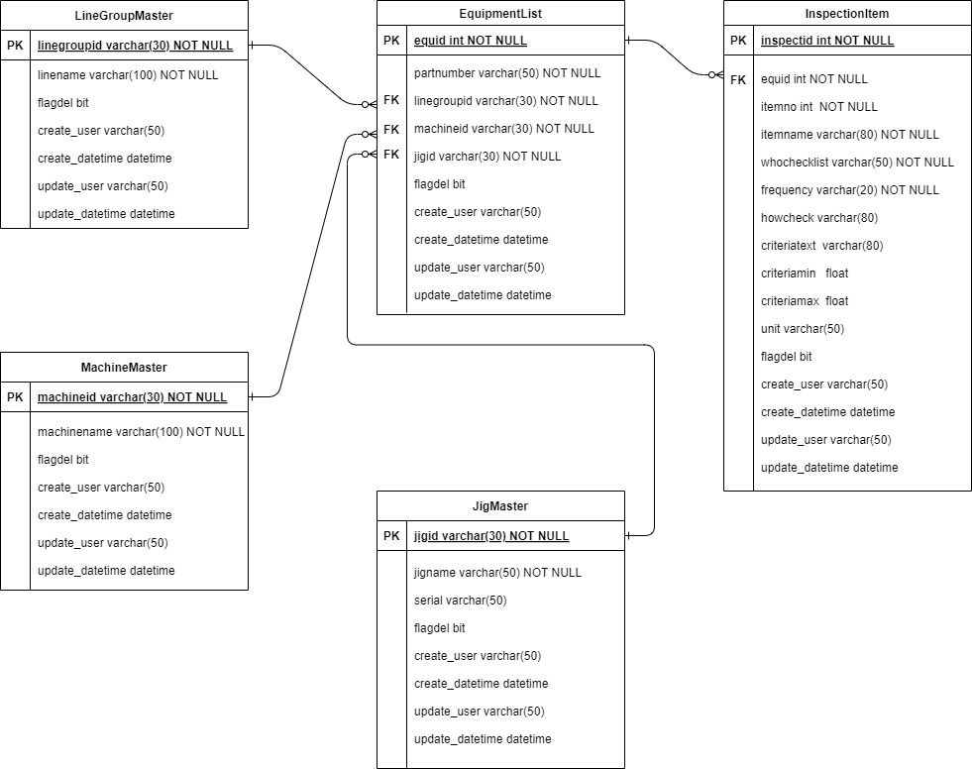
4. Overall ER diagram
Represents ER-diagram of the check sheet application.
4-1. Master data ER-diagram image

Slide 17
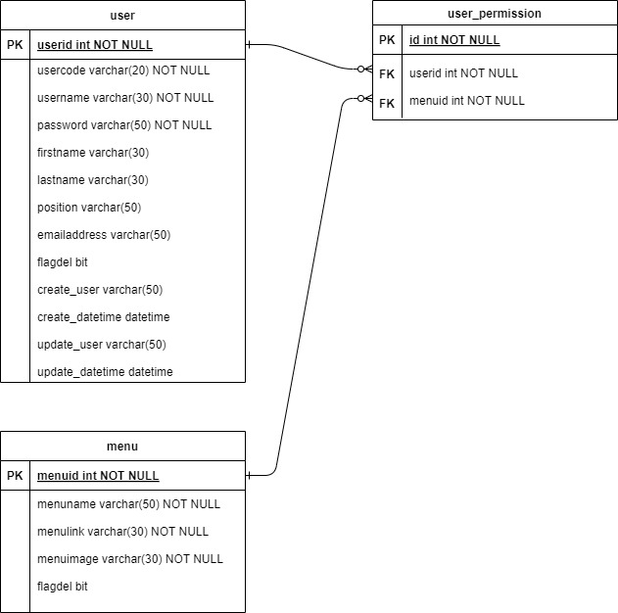
4. Overall ER diagram
Represents ER-diagram of the check sheet application.
4-2. User permission ER-diagram image

Slide 18
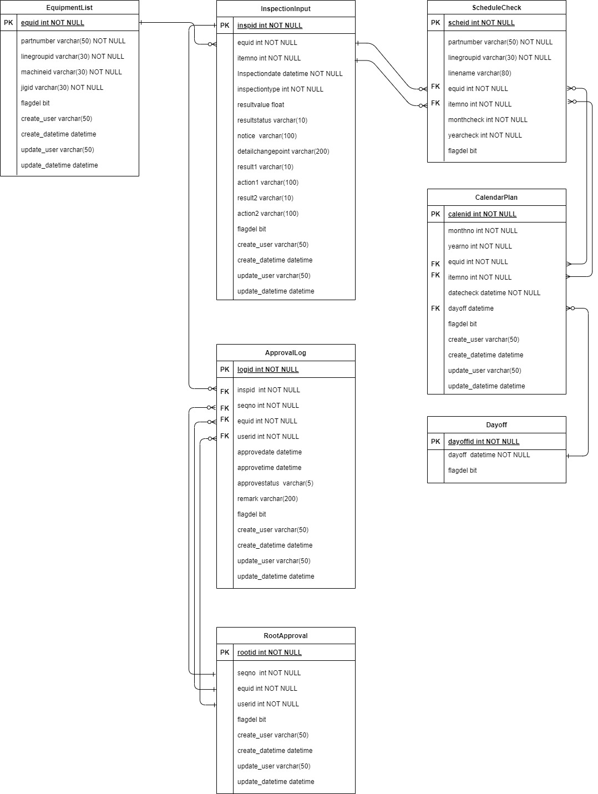
4. Overall ER diagram
Represents ER-diagram of the check sheet application.
4-3. Transaction ER-diagram image

Slide 19
5. Operation approval flow
Check sheet application approval flow
Check and Input
Status Using
#1 Input checklist data
Status Not Using
Person sign (1)
1
#1 Input checklist data
#2 Confirm message
Check and Input Data
#3 Check items data (Approved)
#1 InspectionInput
#4 Check items data (Reject)
Person Sign (2)
#1 Input checklist data
Root Approval
#2 Confirm message
#2 RootApproval
#3 User
#3 Check items data (Approved)
#4 Check items data (Reject)
Person Sign (3)
Log Approval
#1 Input checklist data
#12 ApprovalLog
#2 Confirm message
#3 Check items data (Approved)
#4 Check items data (Reject)
Person Sign (N)
#1 Input checklist data
#2 Confirm message
#3 Check items data (Approved)
#4 Check items data (Reject)
The red frame shows the table for keep data.
19

