Slide 1
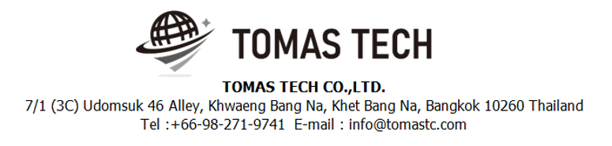
Version 12/Oct/2023
Confidential
Handy Terminal Direct Labor system
Specifications Documentation EN for NTMT
Blueprint
R1
Made for : NIDEC TECHNO MOTOR (Thailand) Co., Ltd.
By : TOMAS TECH CO.,LTD.

Slide 2
Revision History
Date | Version | File name | Details
12/Oct/2023 | R1 | Handy Terminal Direct Labor system Specifications Documentation EN for NTMT | First edition

Slide 3
■Contents
1. Overview
2. Overall configuration diagram
3. Document information
4. System functional specifications
5. Q&A
6. Sign off

Slide 4
1. Overview
Direct Labor system. Work efficiency and work accuracy can be improved with Handy Terminal support.
1. Can choose to have workers work according to the set plan.
2. Able to collect and record Worker entry-exit information accurately, precisely, This allows the information to be used efficiently.

Slide 5
2. Overall configuration diagram
Link with the NTMT database.
Overall configuration diagram image
NTMT MS Server 2019
NTMT database MS SQL 2014
NST_DIRECT_EMPLOYEE_MASTER
NST_MANPOWER_ALLOC_PLAN
NST_ACTUAL_PLAN
Handy terminal App

Slide 6
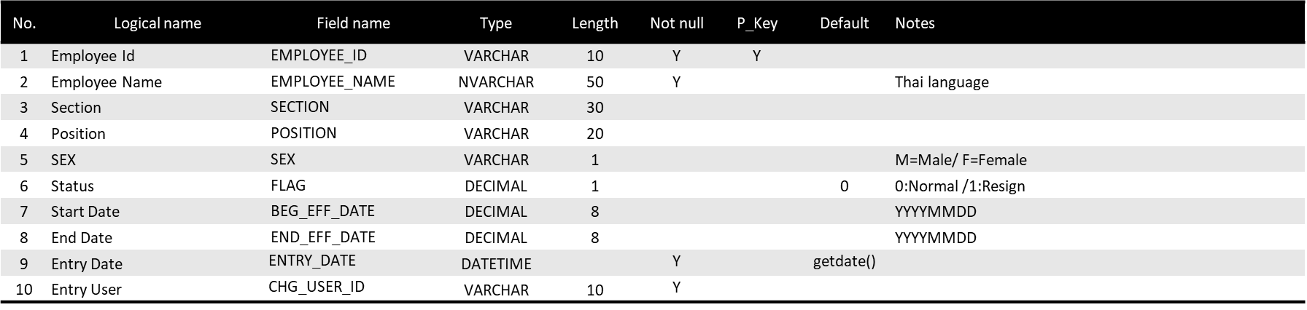
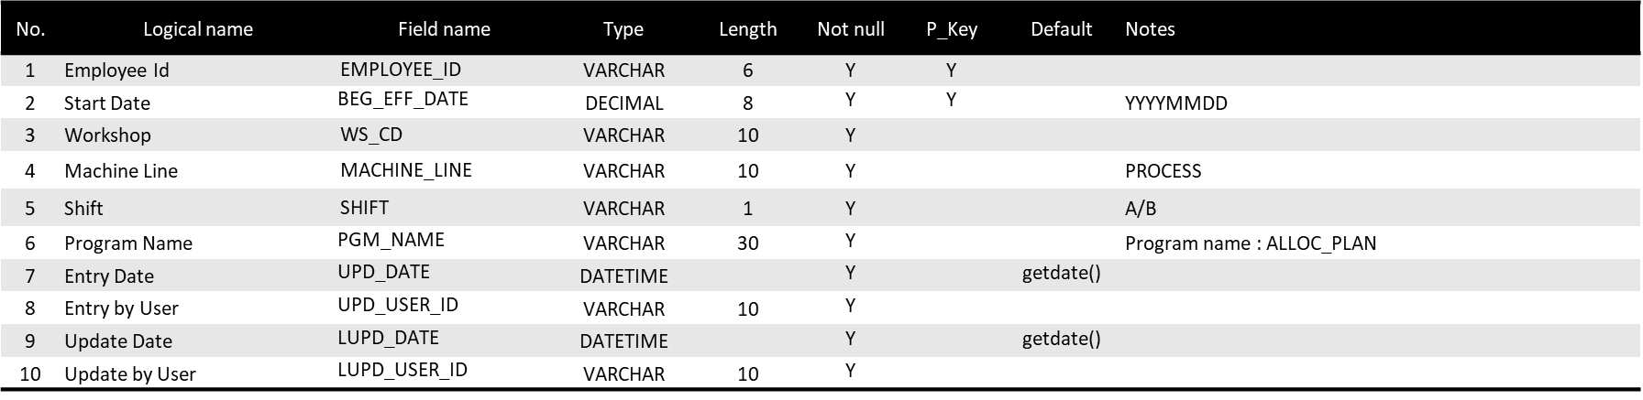
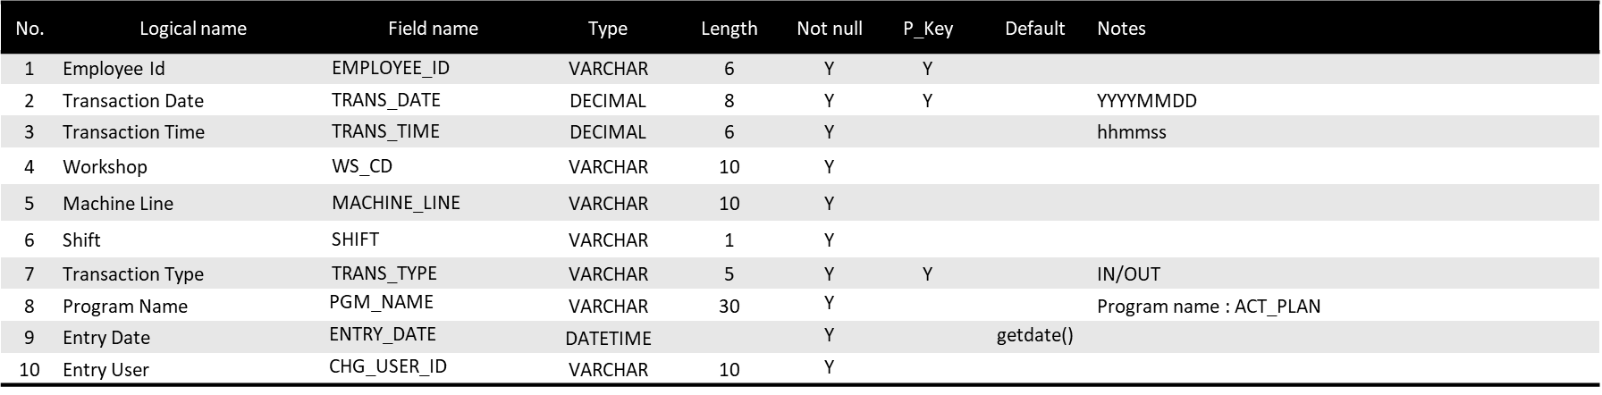
3. Document information
1. Database information

Slide 7
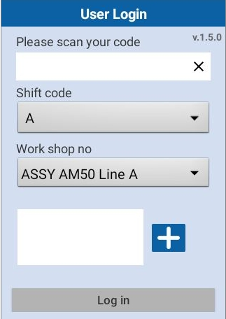
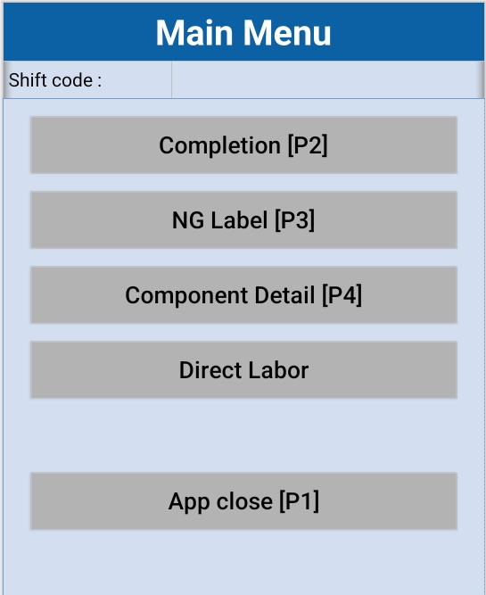
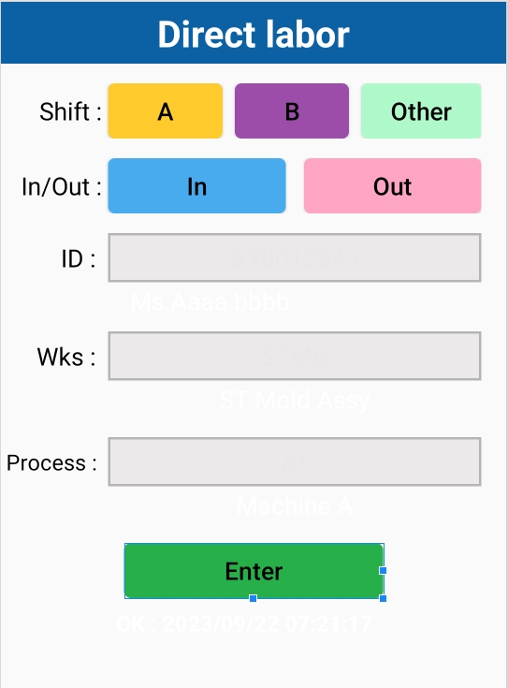
4. System functional specifications
4-1. Handy terminal function
Handy terminal function / screen image
1.User Login
2.Main Menu
3. Direct Labor

Slide 8

4. System functional specifications
4-1. Handy terminal function
Handy terminal function / screen flow
Step Login:
1.Scan user id.
2.Select shift code
3.Select work shop no.
4.Click button
5.Click button login

Slide 9
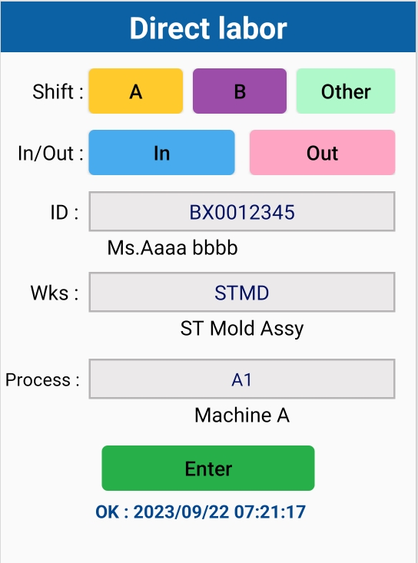
4. System functional specifications
4-1. Handy terminal function
Handy terminal function / screen flow
Direct Labor
Click the button to
select the desired shift.
Click the button to
select In / Out.
Scan or manual key user id.
Select workshop list
If there are no list,
they can be filled manual
Select process list
If there are no list,
they can be filled manual
If the data is filled in completely, Click the Enter button to save data.
The system will notify you.
OK : 2023/09/22 07:21:17
Condition:
- When you record Out, but the system doesn't find it when you In.
Can save data but will notify: No data found In.

Slide 10
5. Q&A

Slide 11
6. Sign off
We hereby acknowledge and agree the above-mentioned blueprint requirements.
Any changes required after the sign off for this blueprint will be addressed through the change request process.
NIDEC TECHNO MOTOR (Thailand) Co., Ltd.
Sign:
Name:
Title:
Date:
TOMAS TECH CO.,LTD.
Sign:
Name:
Title:
Date:
## END OF Direct Labor System

