Slide 1
production IoT

Slide 2
Machine monitoring

Slide 3
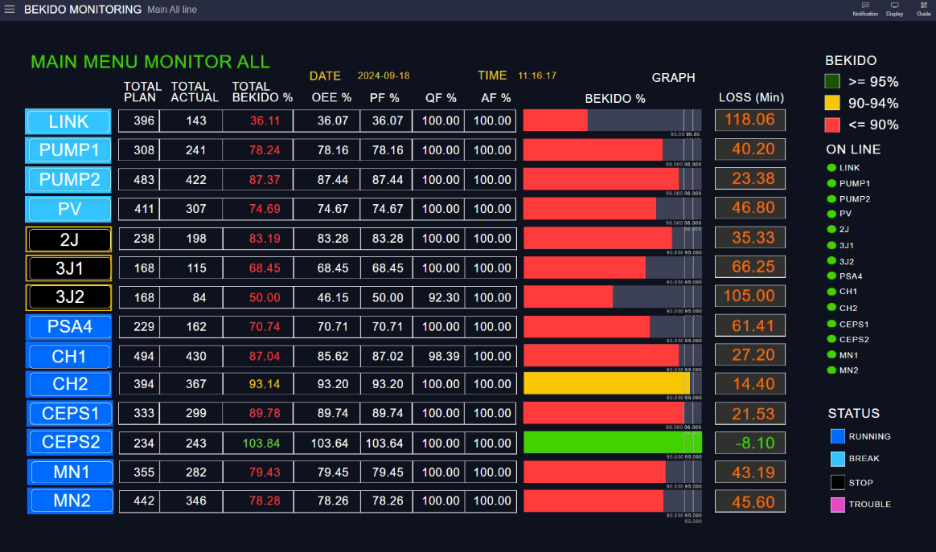
| Main overall monitoring screen

Slide 4
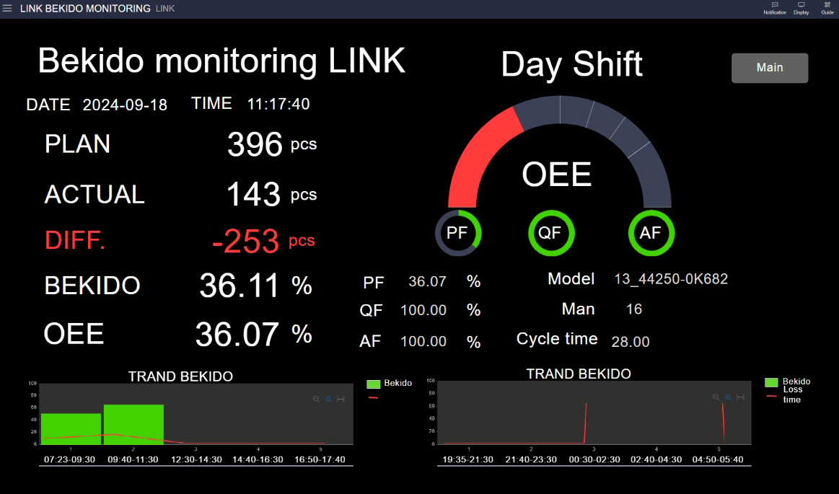
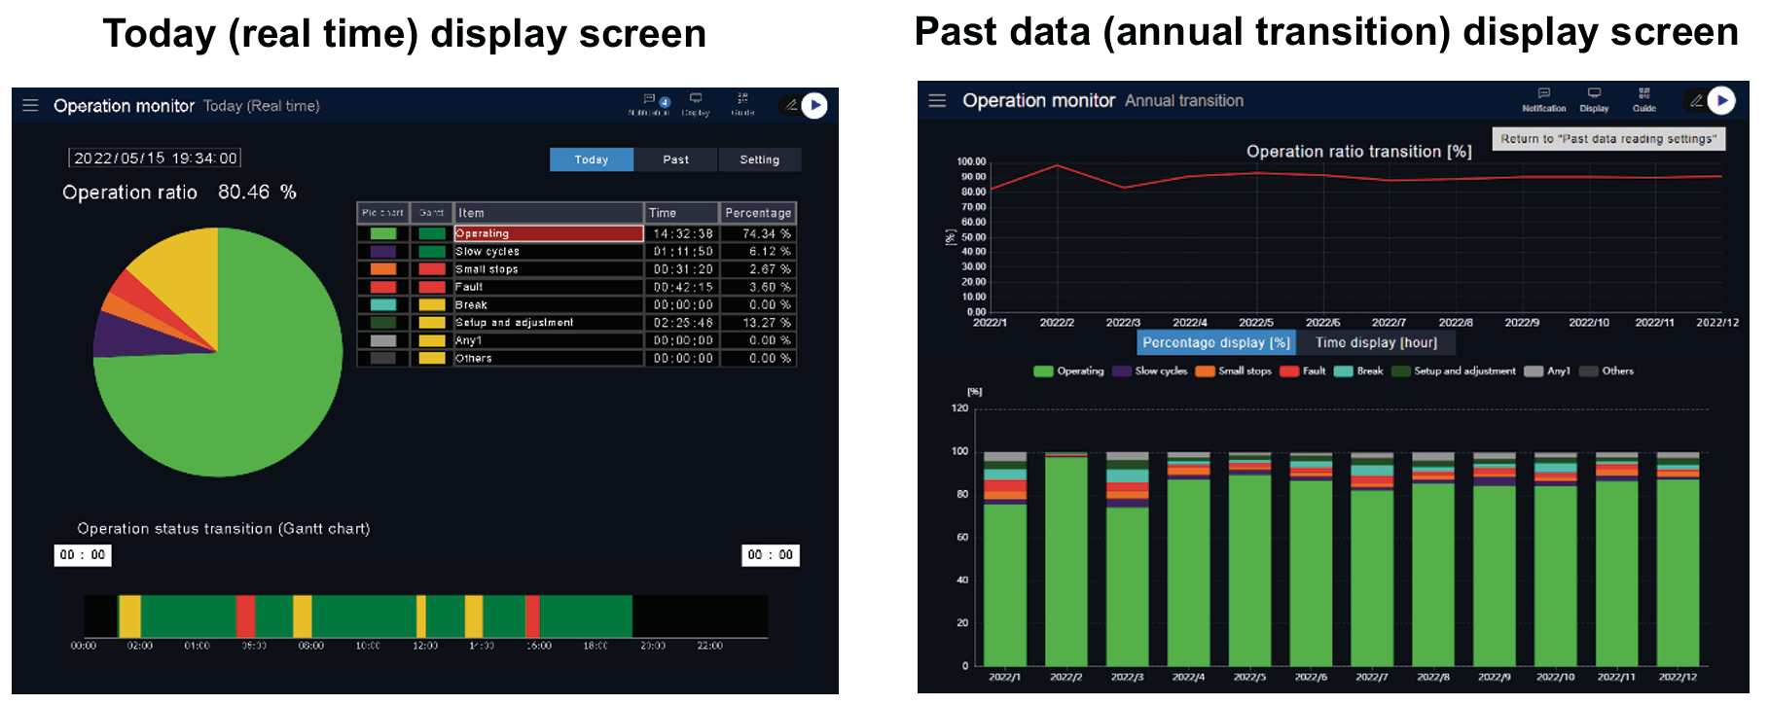
| Production line screen

Slide 5
| Production line screen

Slide 6
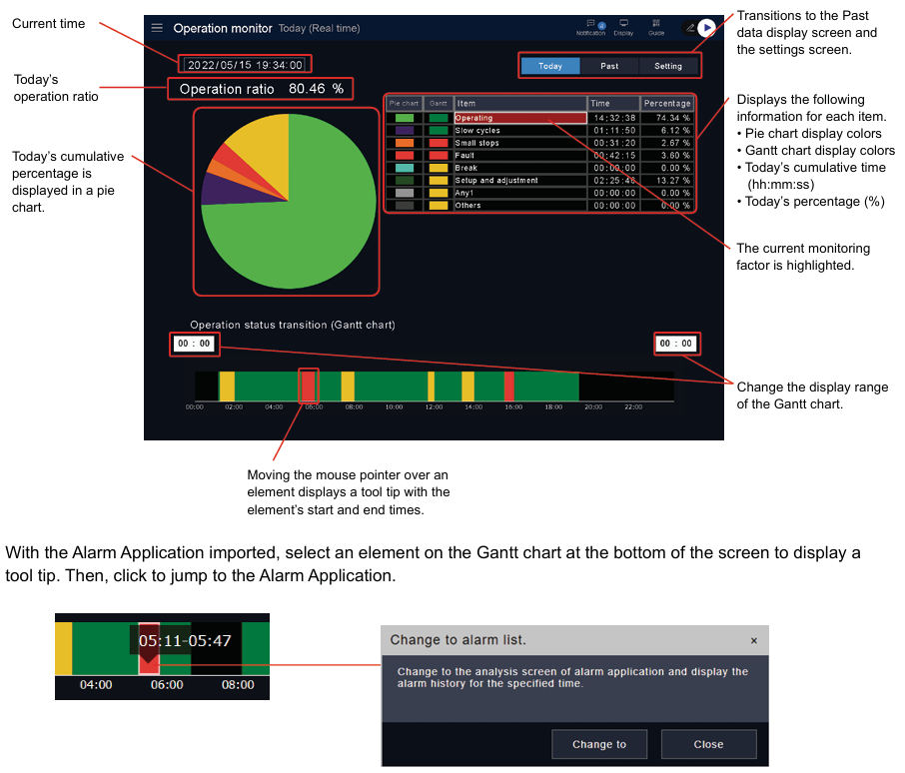
| Production line screen

Slide 7
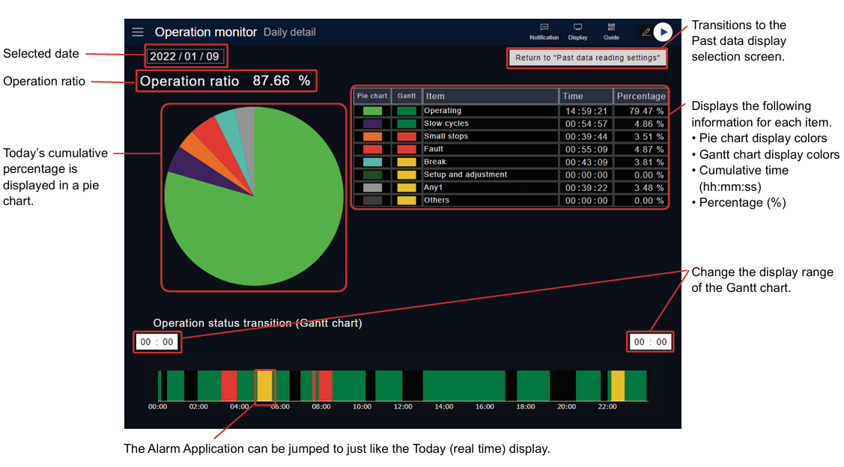
| Production line screen

Slide 8
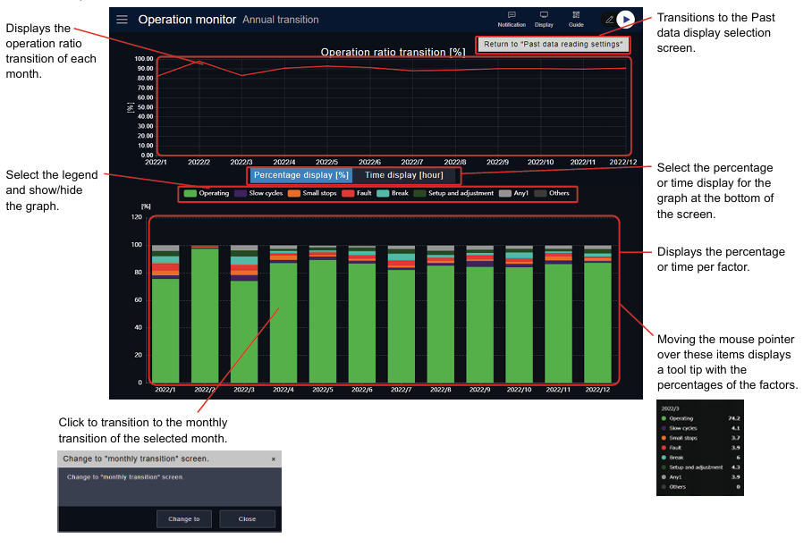
| Production line screen ( Weekly )

Slide 9
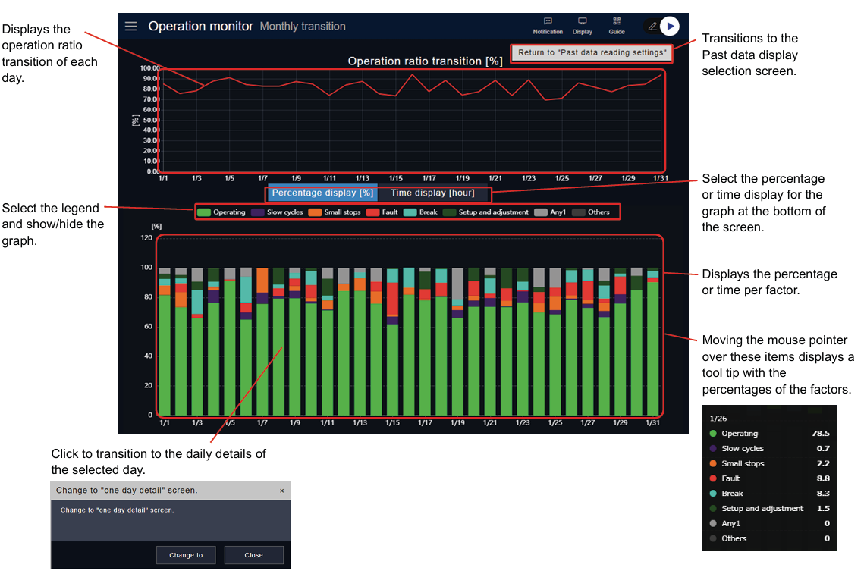
| Production line screen ( Monthly )

Slide 10
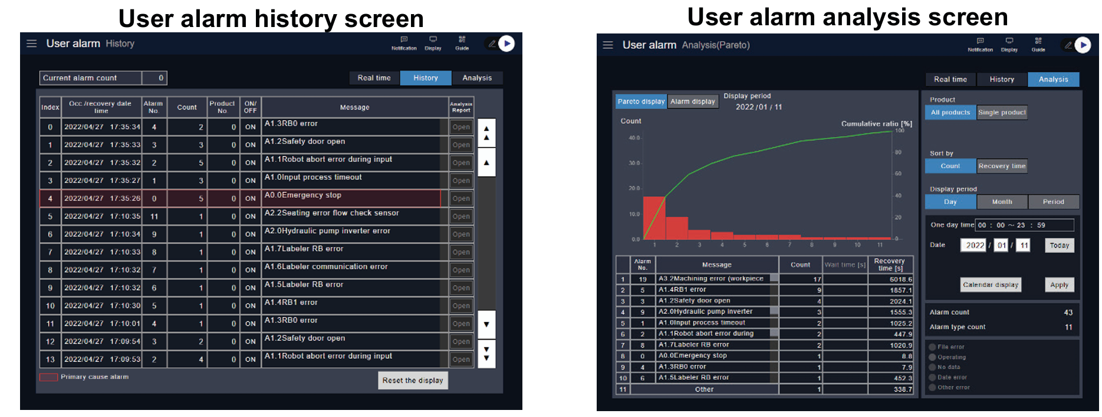
| Alarm screen

Slide 11
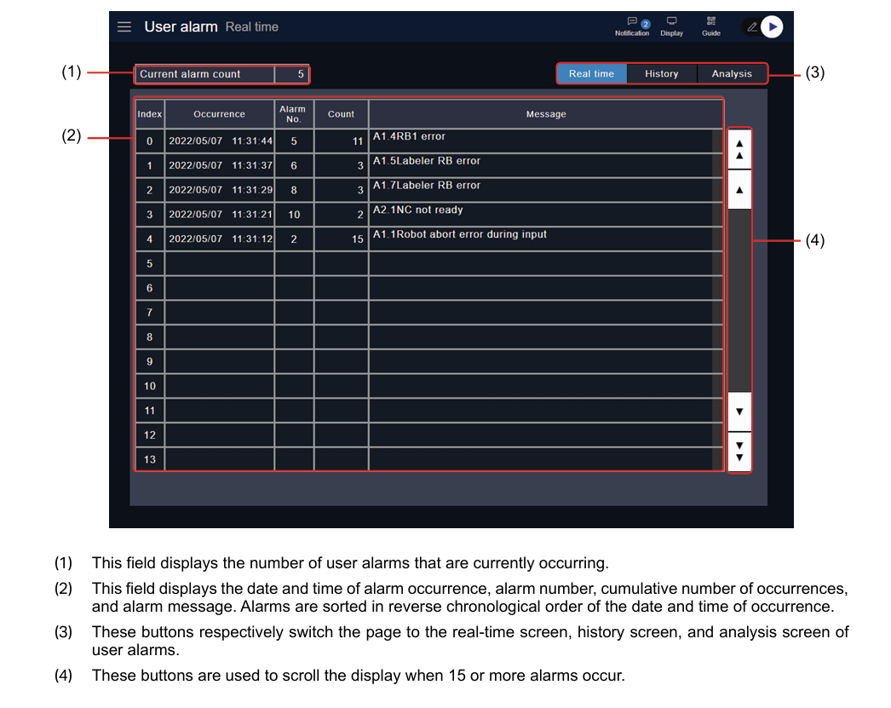
| Realtime monitor screen
No need

Slide 12
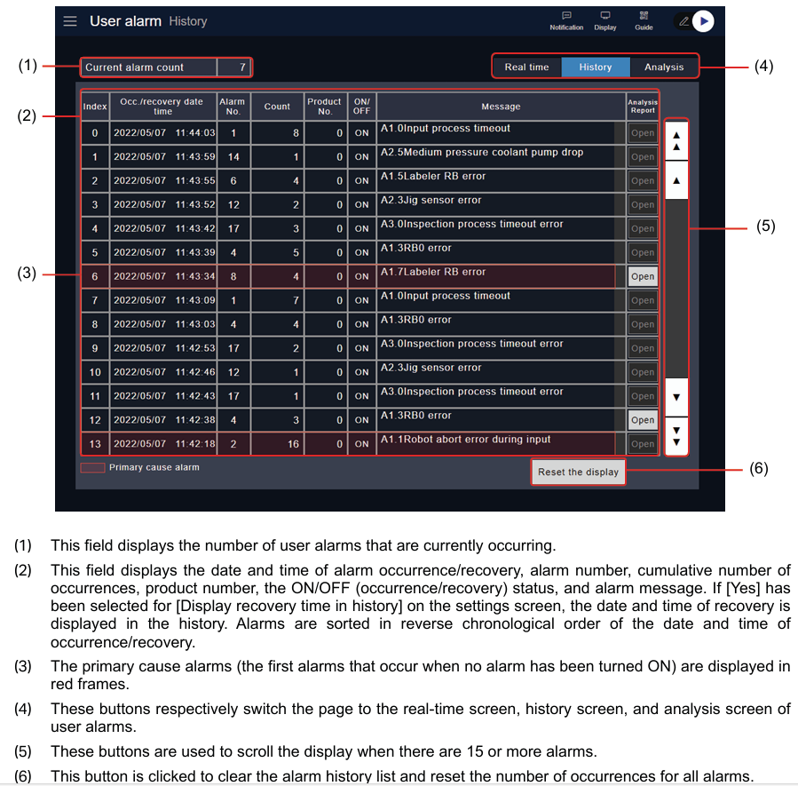
| History monitor screen

Slide 13
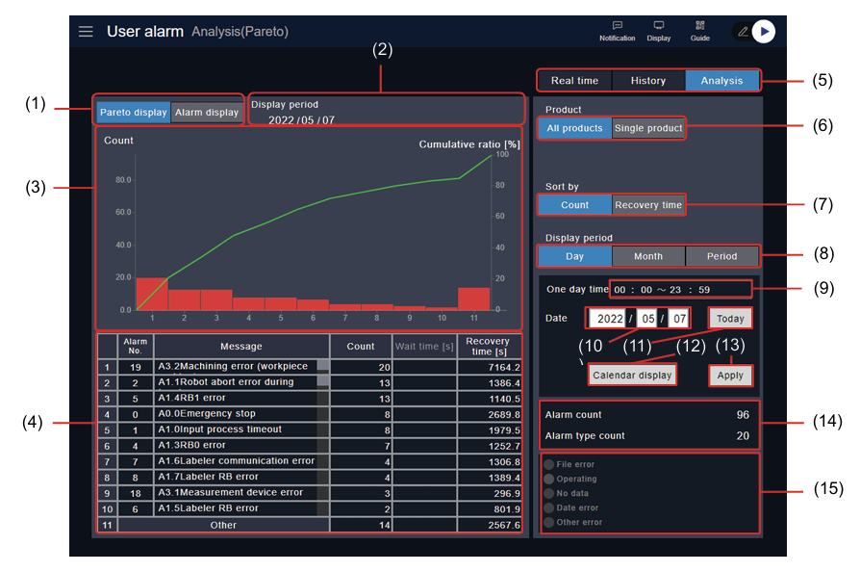
| Alarm analysis screen
*Please add menu for export alarm history by date time

Slide 14
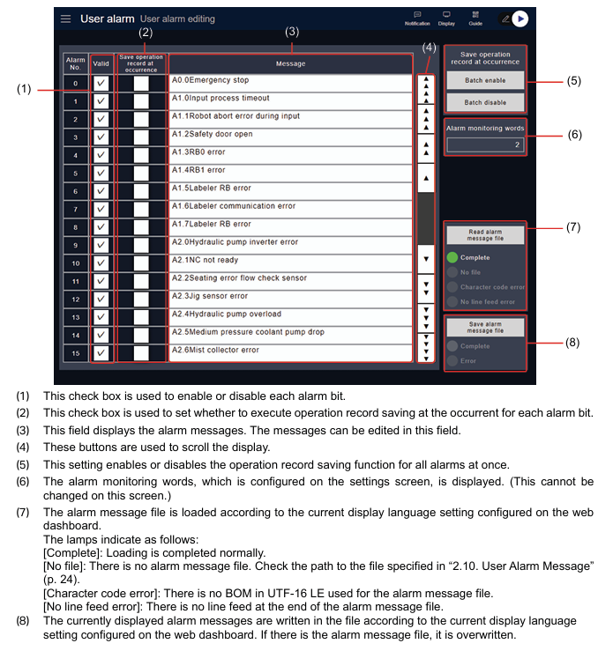
| Alarm setting screen

Slide 15
Infrastructure IoT

Slide 16
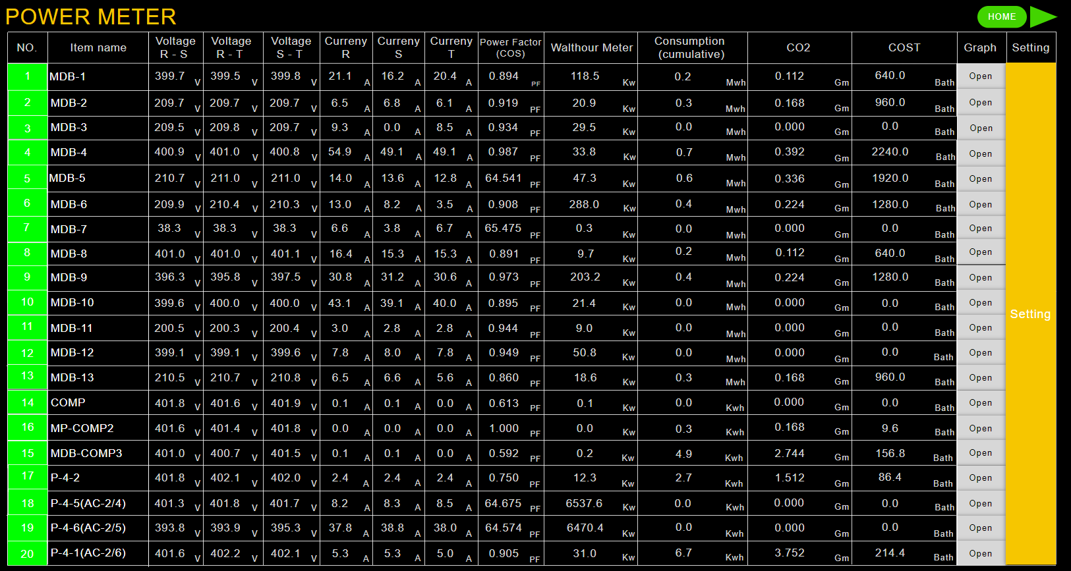
Date from
Date to
Factory
Power meter no
Export csv

Slide 17
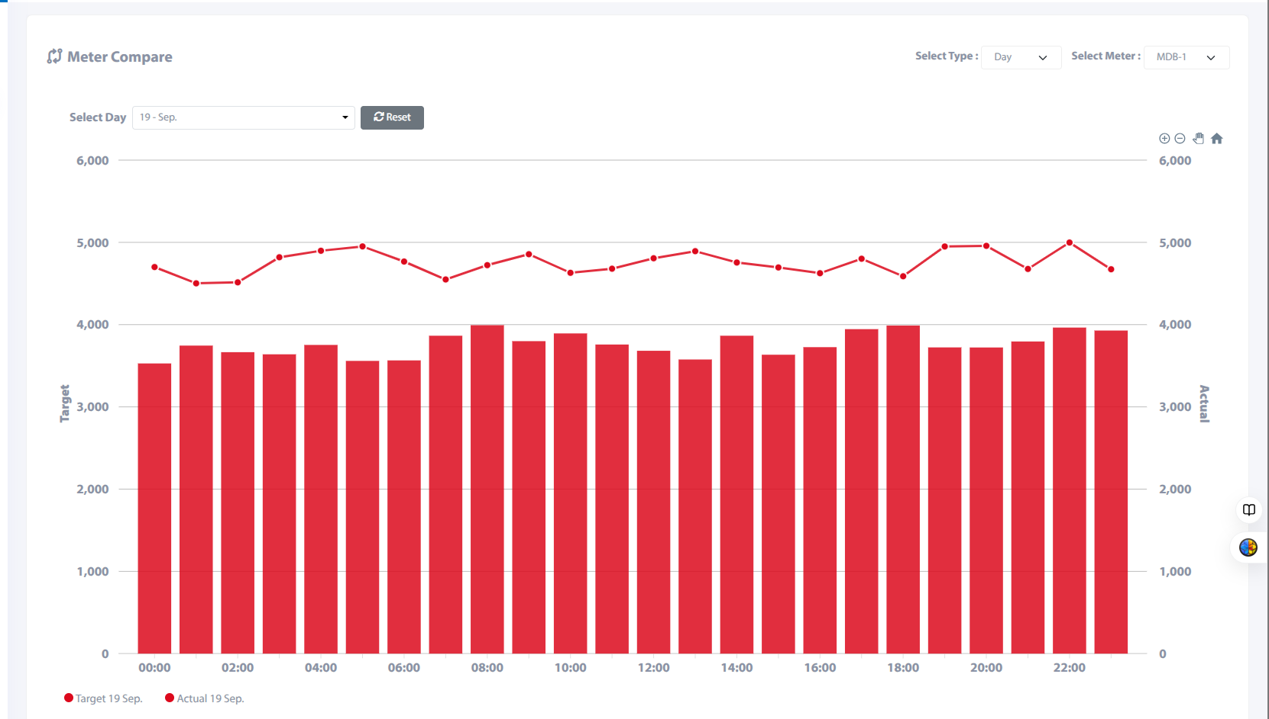
Power meter
Date
Power meter no
Export csv
Day/ week/ month/year

Slide 18
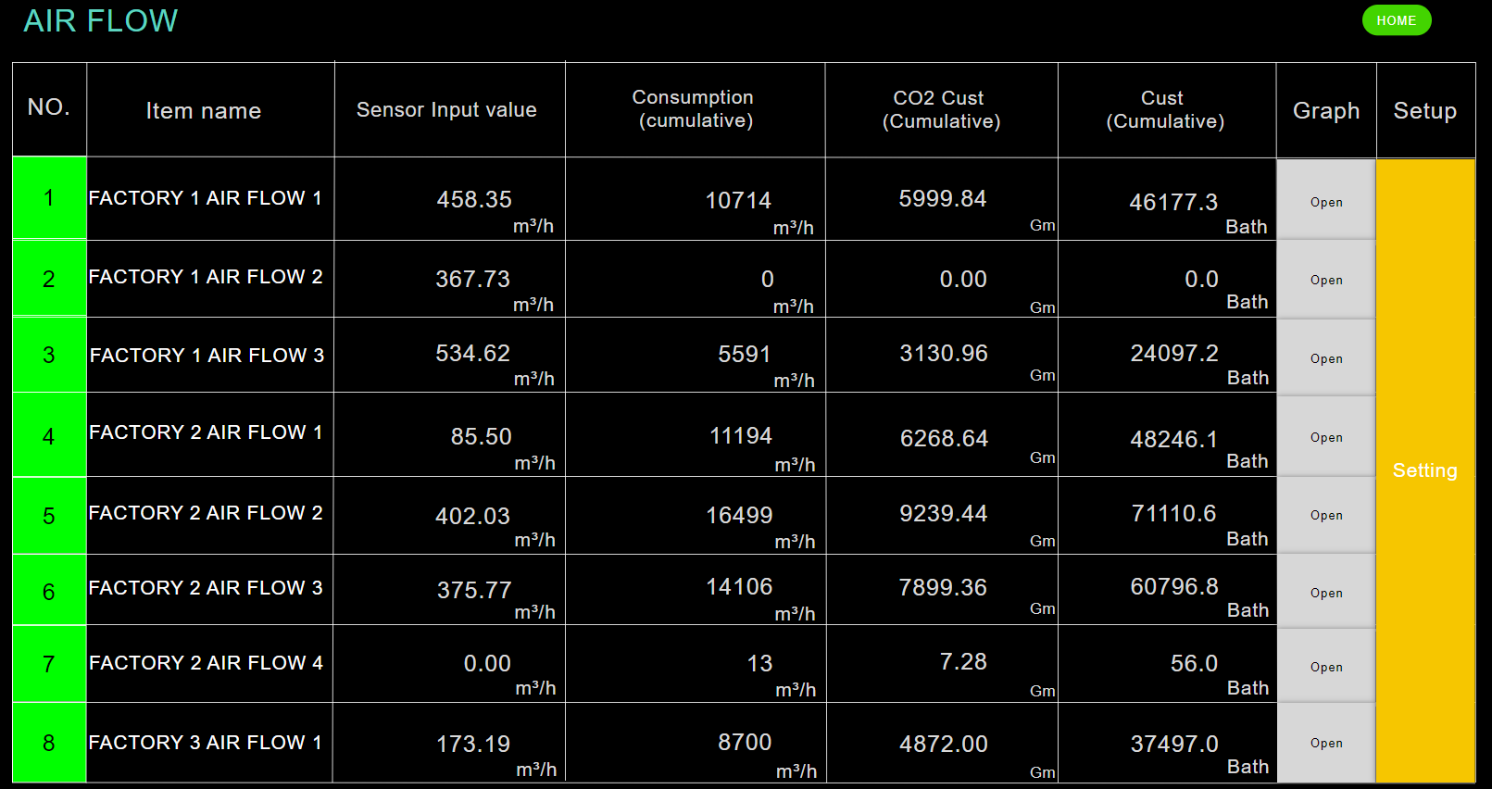
Date from
Date to
Factory
Air flow no
Export csv

Slide 19
Air flow
Date
Air flow no
Export csv
Day/ week/ month/year

Slide 20
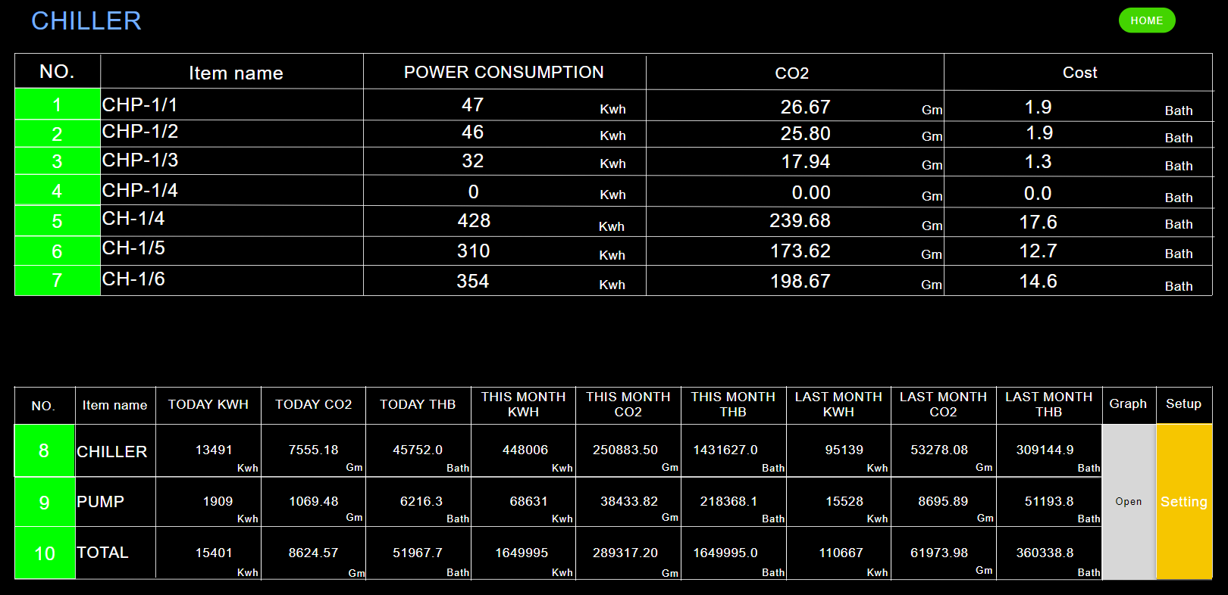
Date from
Date to
Factory
Chiller no
Export csv

Slide 21
Chiller
Date
Chiller no
Export csv
Day/ week/ month/year

Slide 22
reference
https://tom-demo-01.proen.app.ruk-com.cloud/ntn/
Regarding DB data, CSV data will be received from K. Panupon and K. boy.

