Slide 1
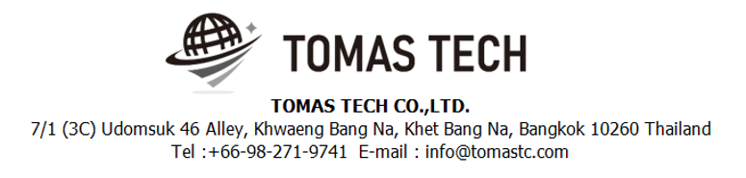
Version 19/Aug/2024
Confidential
Power meter monitoring web application
Documentation EN Blueprint
Blueprint
Made for: OTICS(THAILAND)CO., LTD.
By: TOMAS TECH CO.,LTD.

Slide 2
Revision History
Date | Version | File name | Details
19/Aug2024 | R1 | Power meter monitoring web application Documentation EN Blueprint | First edition

Slide 3
■Contents
1. Overview
2. Overall configuration diagram
3. Document image
3-1. Login
3-2. Receive and Manage log data
3-3. Log data
3-4. Summary data
3-5. Export data
3-6 Dashboard data
3-7. User data
3-8. Config connect to server
4. Q&A
5. Sign off

Slide 4
1. Overview
Introduced Power meter monitoring web application to OTICS.
The system specifications for introduction are described in this document.

Slide 5

2. Overall configuration diagram
Represents a configuration diagram of the Power meter monitoring web application system. It is a configuration image of documents.
Overall configuration diagram image
Receive and Manage log data
Summary data
Export data to dashboard and excel format
DB Server

Slide 6
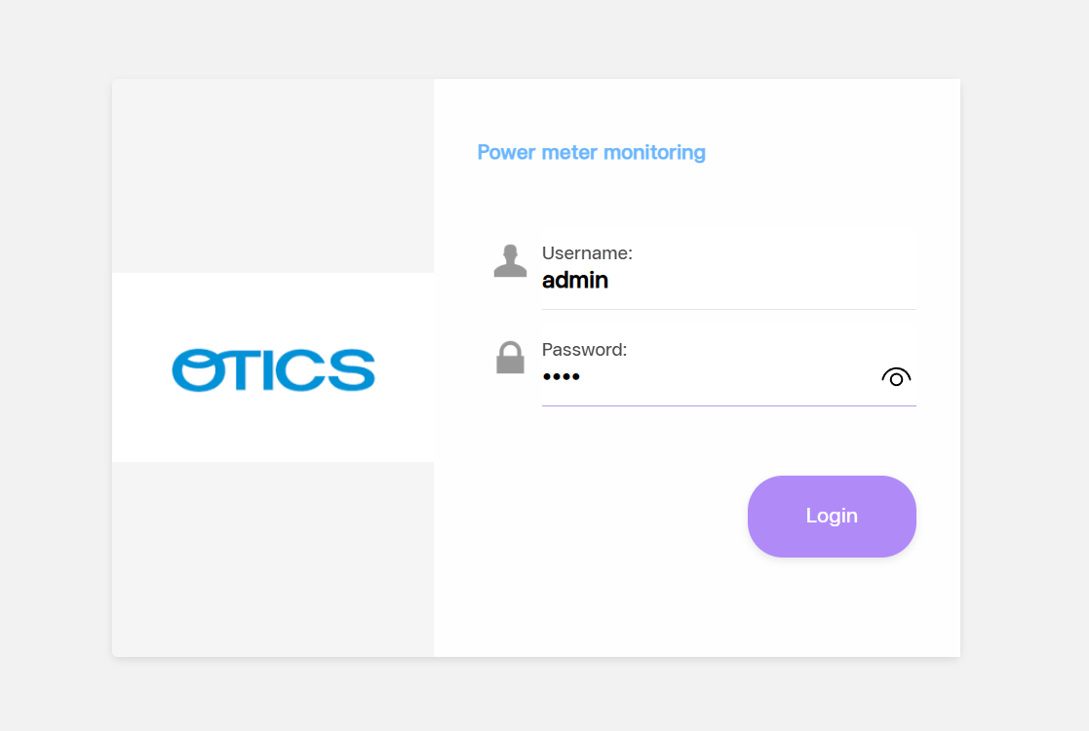
3. Document image
3-1. Login
1
2
The first login is the default username ‘admin’
2. The first login is the default password ‘1234’

Slide 7
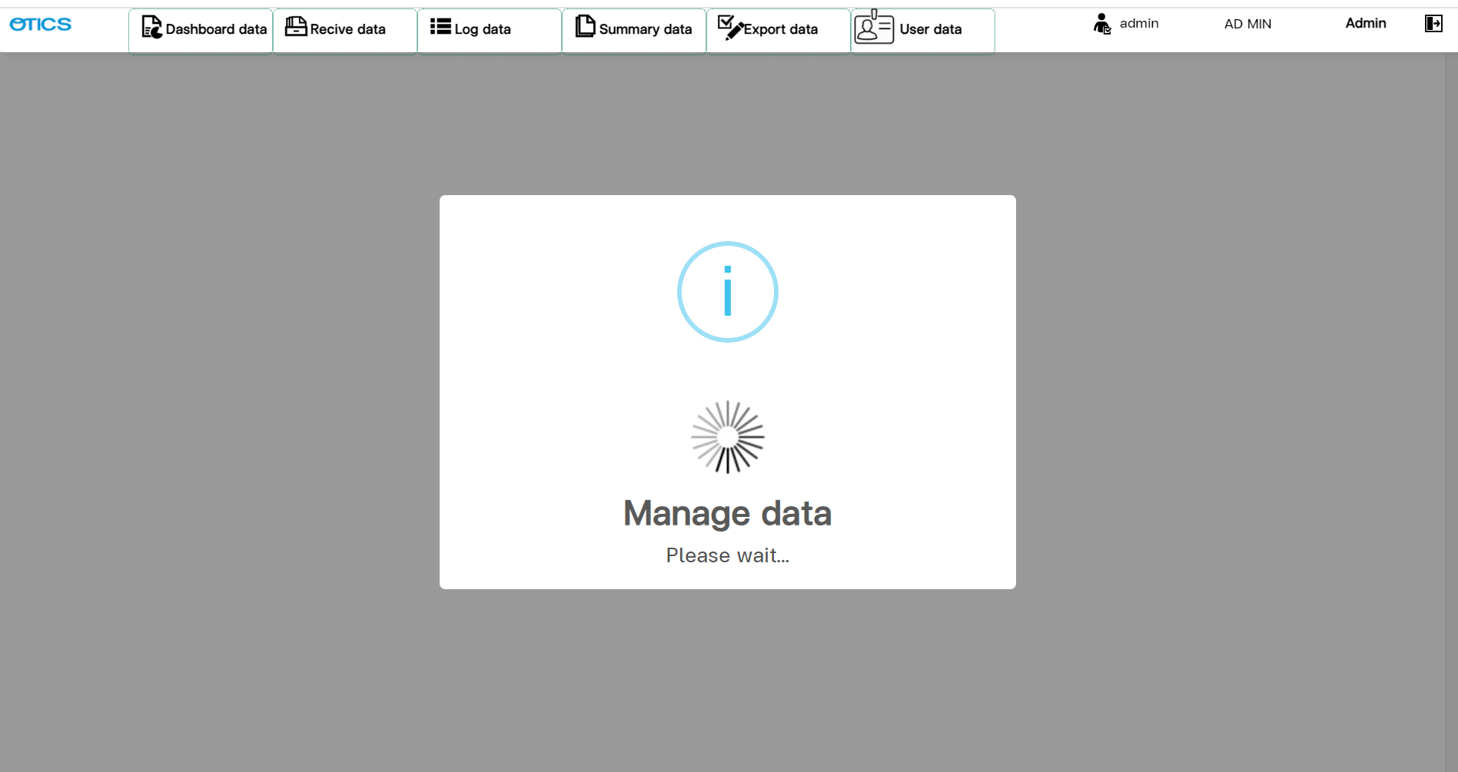
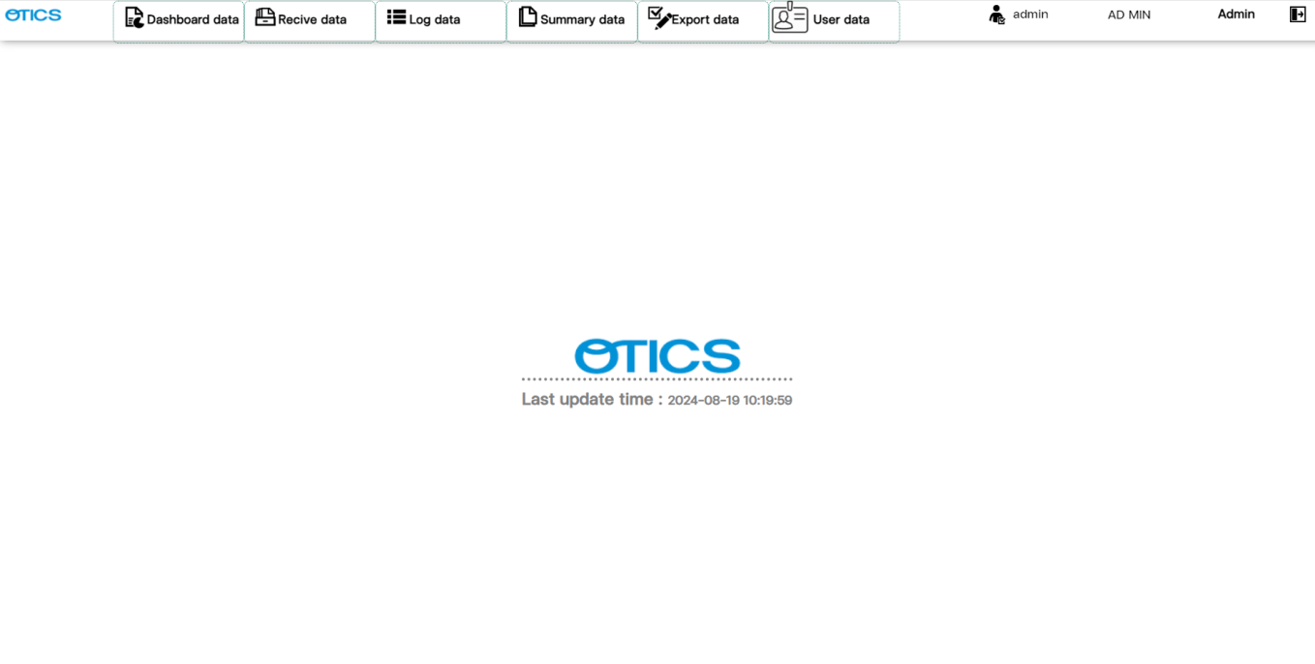
3. Document image
3-2. Receive and Manage log data
2
3
4
1
5
Menu Receive data.
Show cost summary information on dashboard.
Shows recorded data in a 60 minute period section.
Show cost summary information divided by month.
Show last time have been receive data.

Slide 8
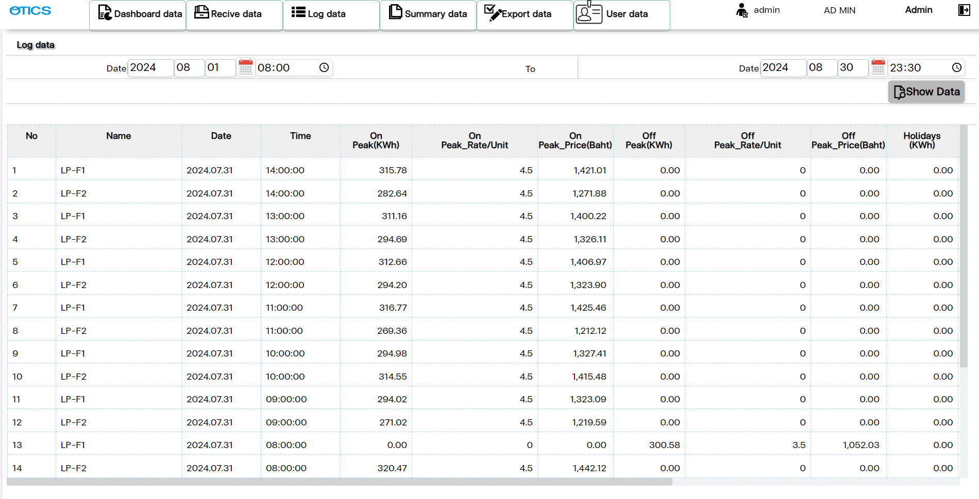
3. Document image
3-3. Log data
1
2
4
5
3
Menu Log data.
Specify start date and time.
Specify the end date and time.
Calculate the value by subtracting the current hour's value from the previous hour's value.
The value is calculated by subtracting the current hour's value from the previous hour's value and multiplying by the cost rate.

Slide 9
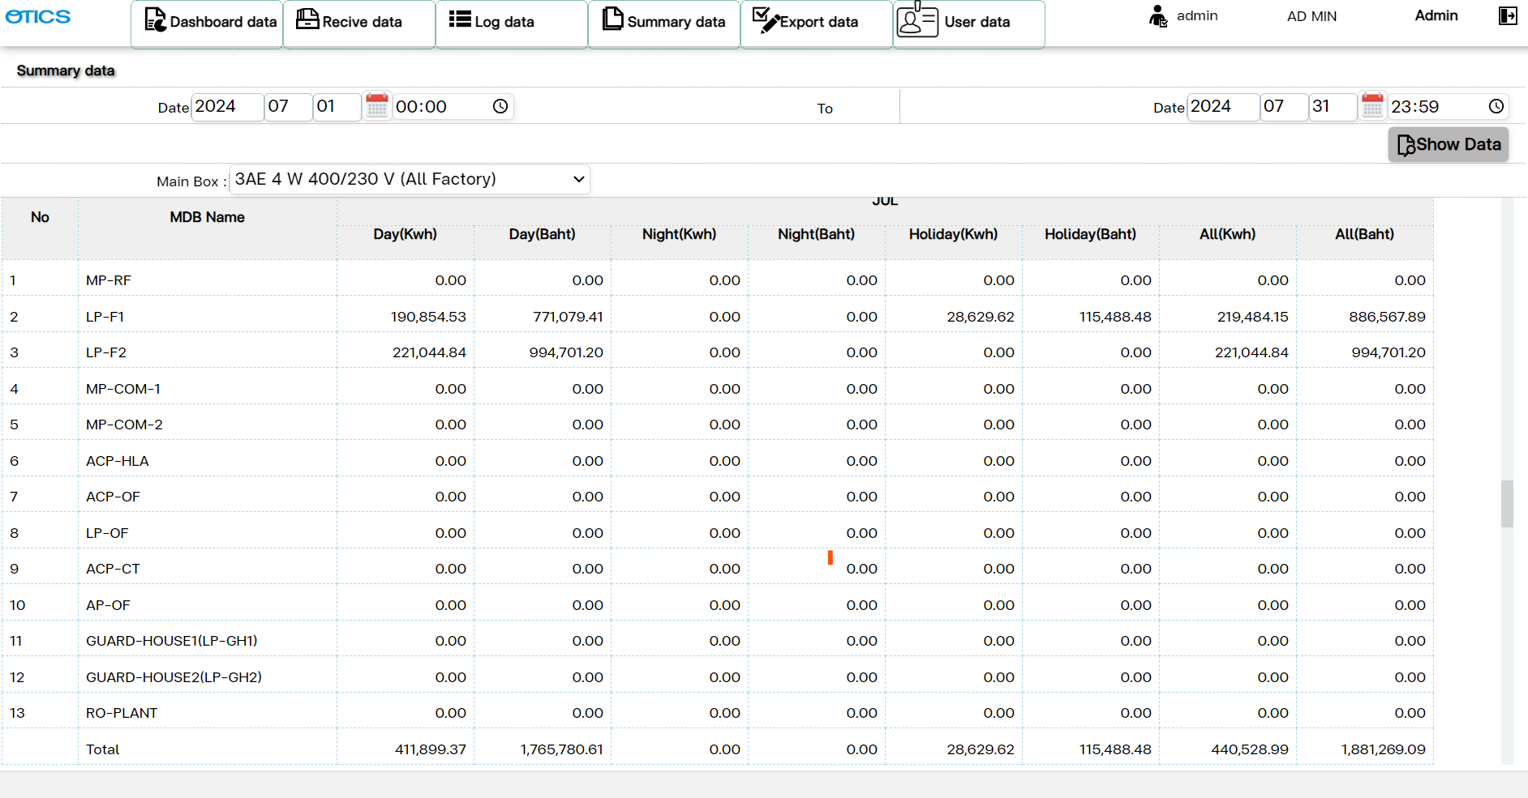
3. Document image
3-4. Summary data
1
2
3
Menu Summary data.
Specify start date and time.
Specify the end date and time.

Slide 10
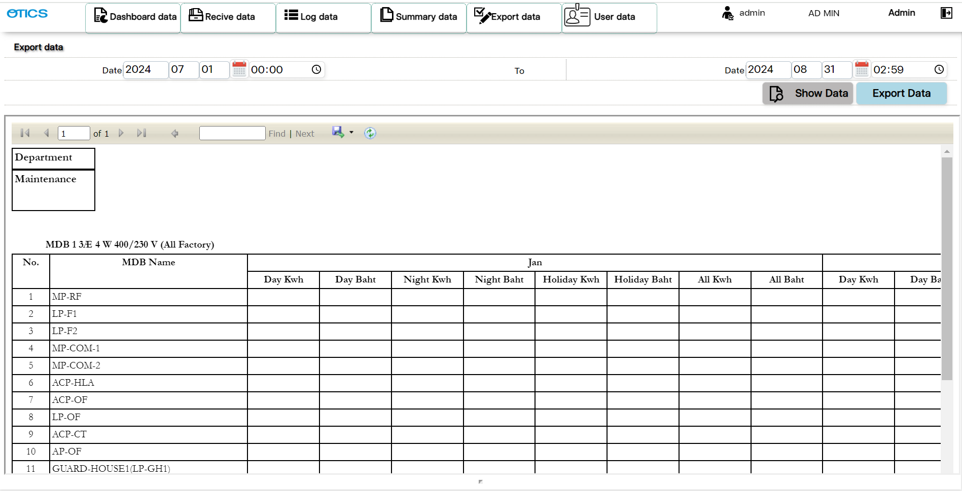
3. Document image
3-5. Export data
2
1
3
4
Menu Export data.
Specify start date and time.
Specify the end date and time.
Display summary data in Excel format and save file to PC server, folder name Excel log.

Slide 11
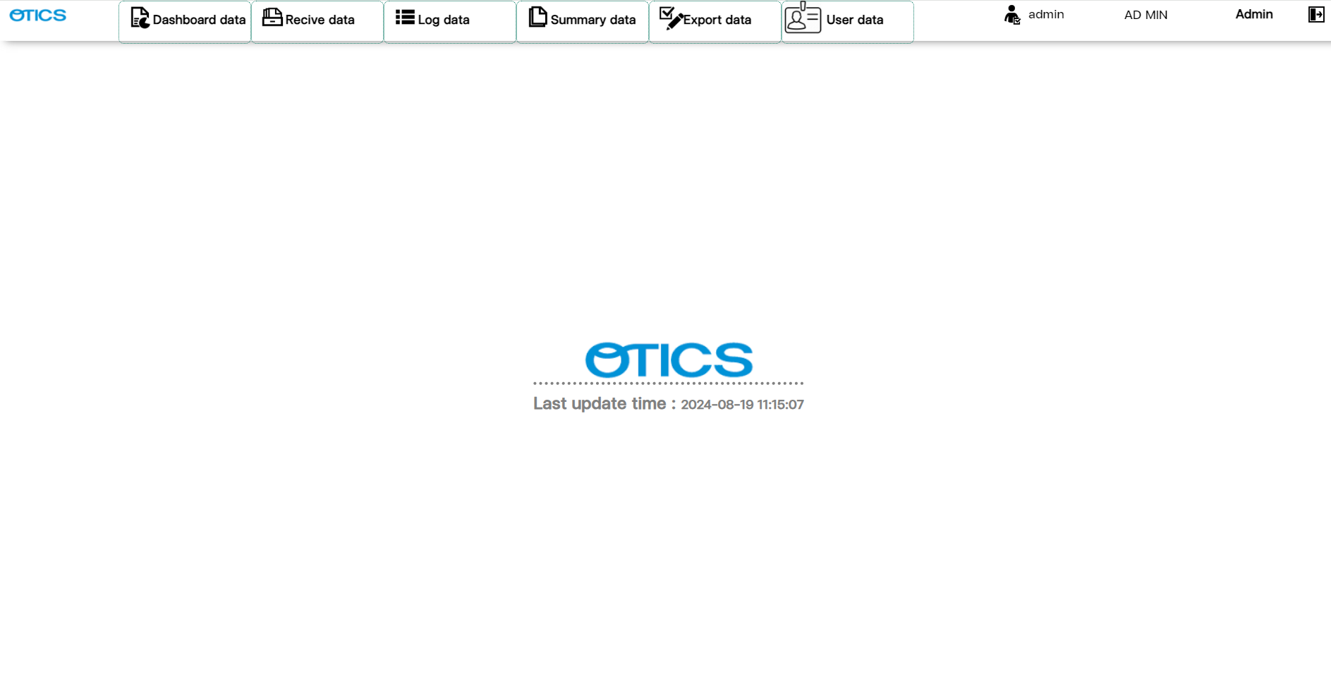
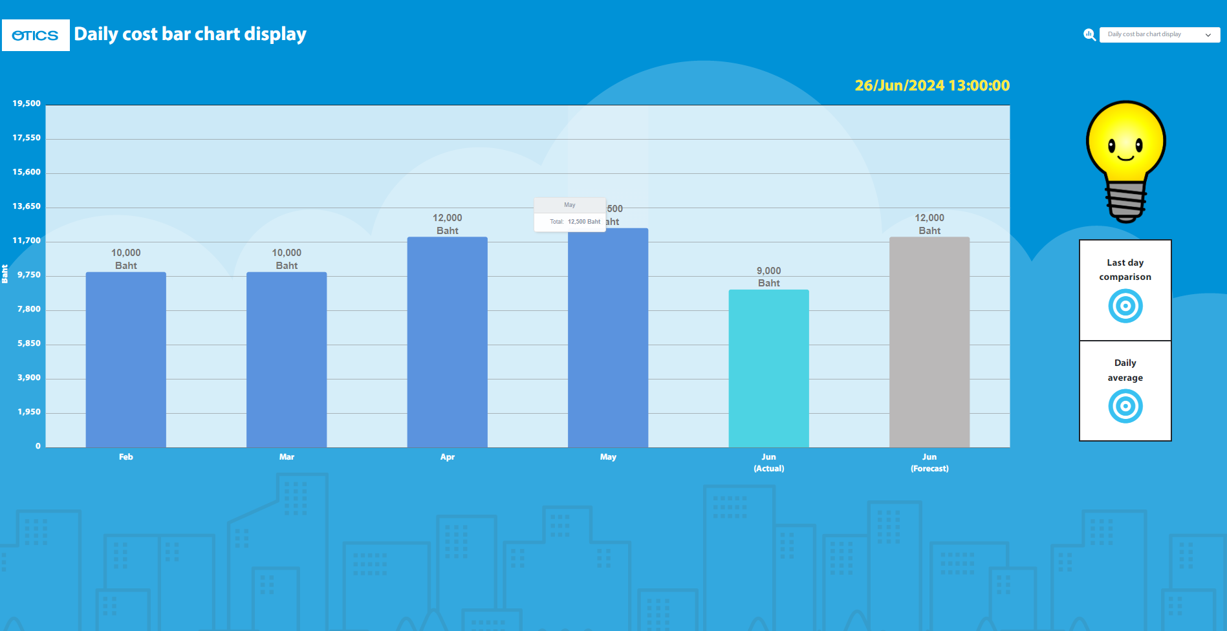
3. Document image
3-6. Dashboard data
1
When you click on the Dashboard menu, there will be a screen showing graphs.

Slide 12
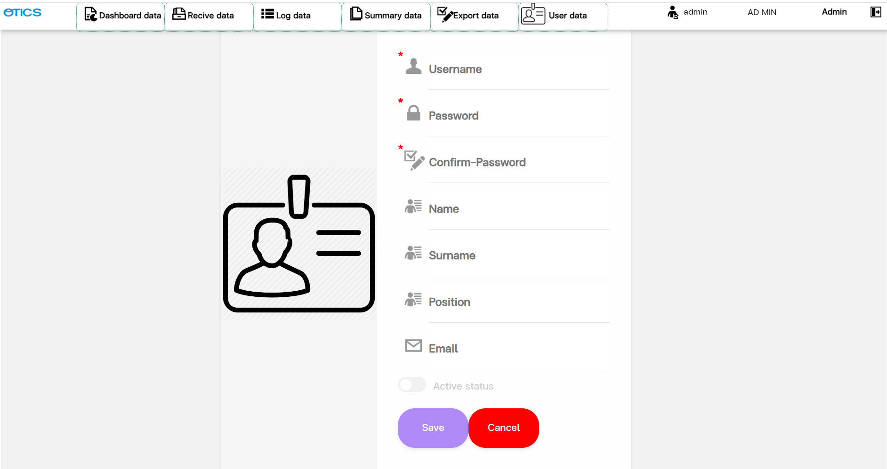
3. Document image
3-7. User data
1
5
2
3
4
Menu User data.
Set status as active or inactive
Save or edit user profile.
Clear items in a form.
Logout.

Slide 13
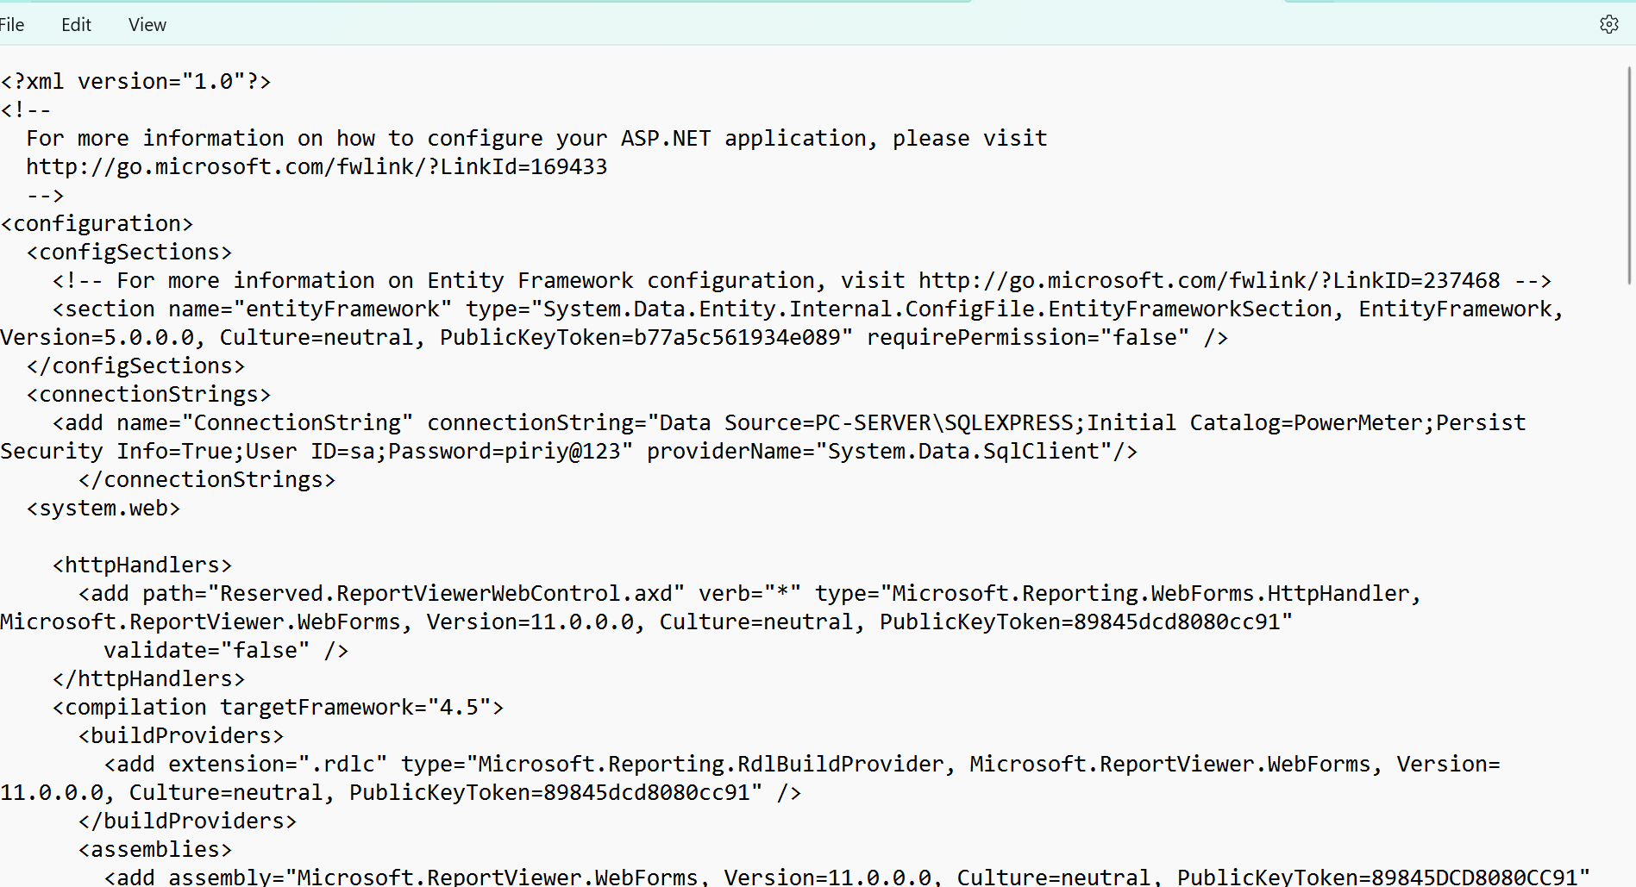
3. Document image
3-8. Config connect to server
1
ConnectionString: It ‘s point to PowerMeter database. (file name is Web.config)

Slide 14
4. Q&A

Slide 15
5. Sign off
We hereby acknowledge and agree the above-mentioned blueprint requirements.
Any changes required after the sign off for this blueprint will be addressed through the change request process.
OTICS(Thailand)Co., Ltd.
Sign:
Name:
Title:
Date:
TOMAS TECH CO.,LTD.
Sign:
Name:
Title:
Date:
## END OF BLUEPRINT##

