Slide 1
Infrastructure IoT project meeting Date : 13/06/24 Made for JATH
TOMAS TECH Co., Ltd.

Slide 2
| Meeting agenda
Update progress work 09/06/24
Installation plan 15/06/24 – 16/06/24
Shutdown air and power plan

Slide 3
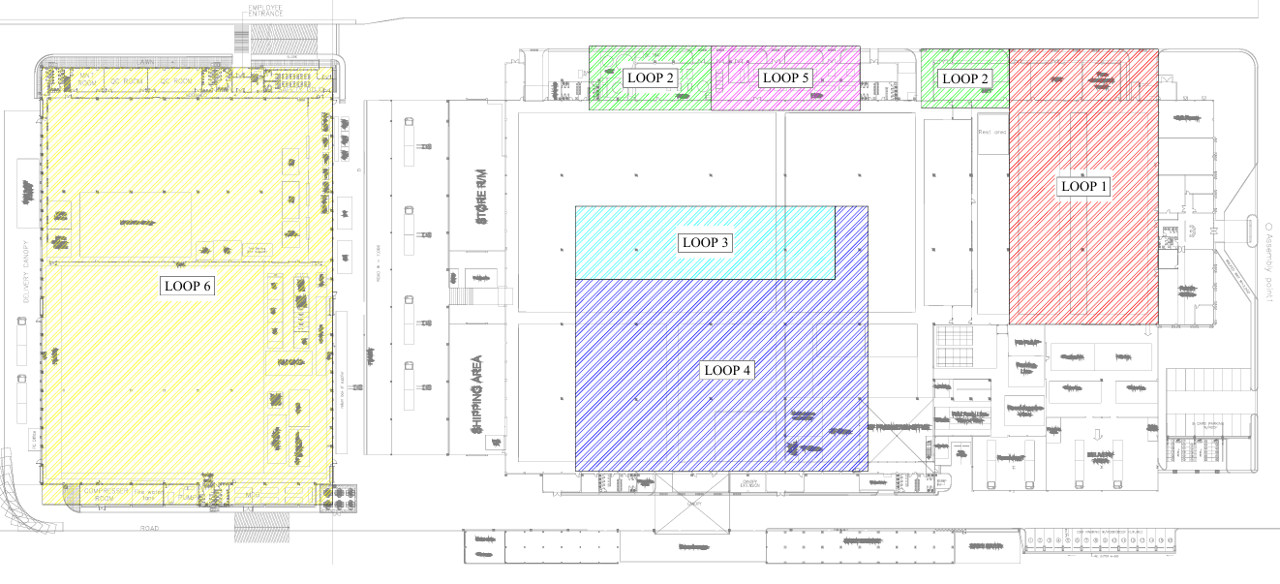
| Power meter installation overall ( 02/06/24 – 03/06/24 )
100%
90%
95%
100%
90%
90%

Slide 4
| Power meter installation overall ( 09/06/24 )
100%
Air flow sensor 75%
95%
97%
100%
90%
97%

Slide 5
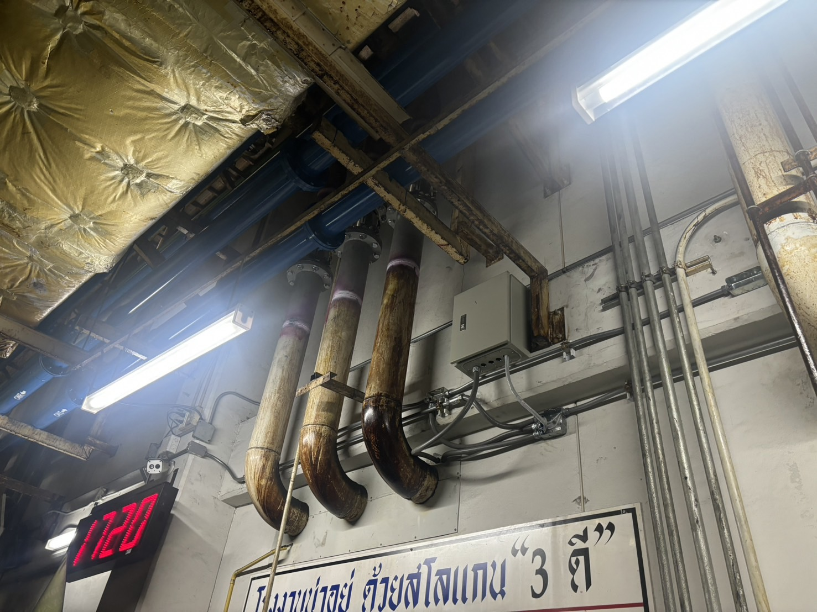
| Air flow installation ( Installation )

Slide 6
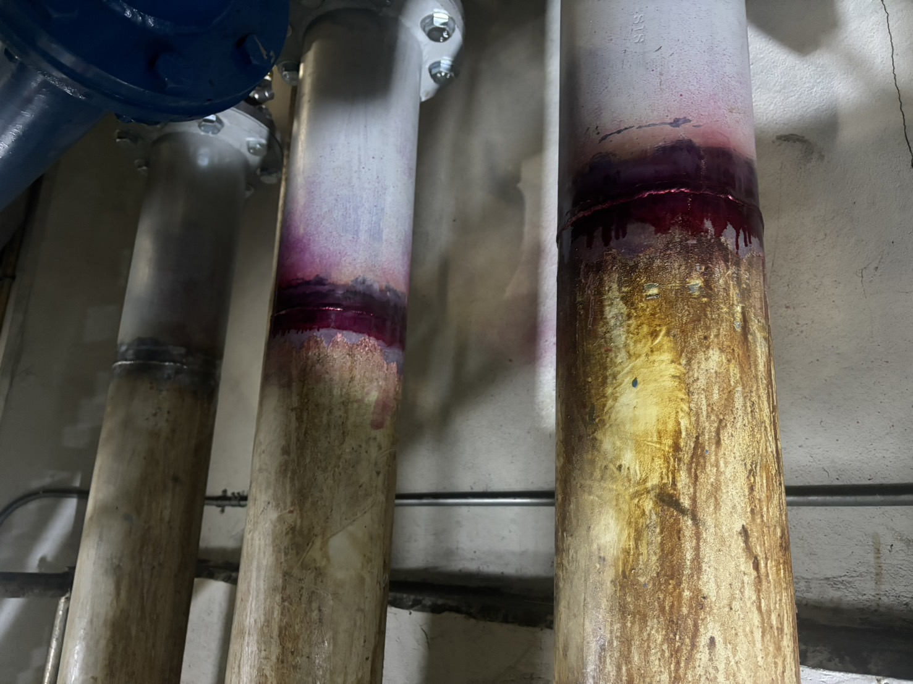
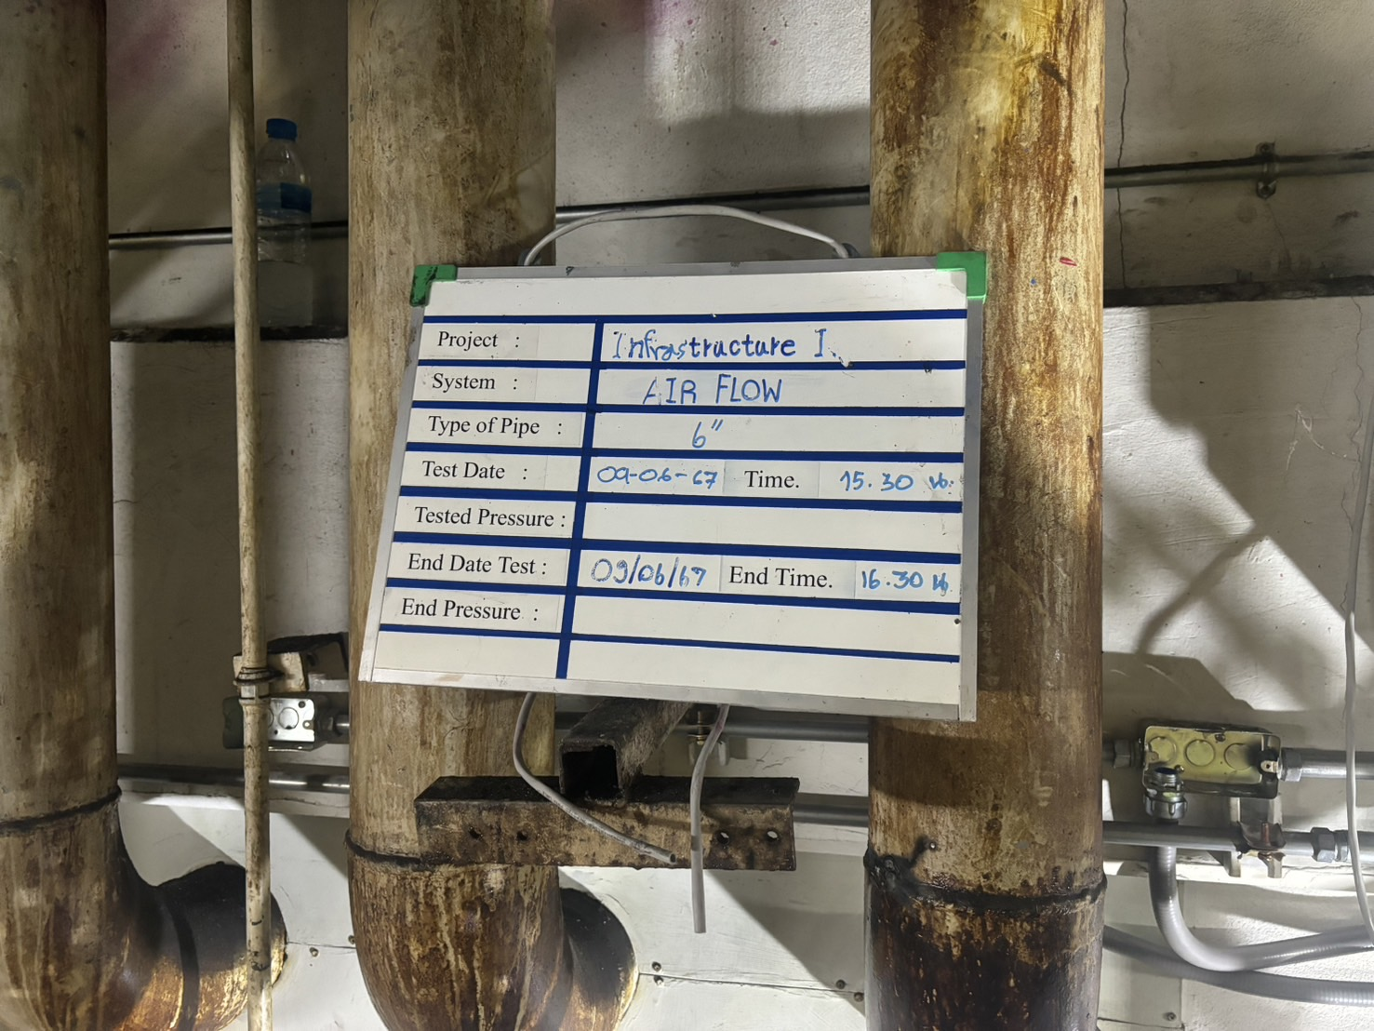
| Air flow installation ( Welding and check leak )

Slide 7
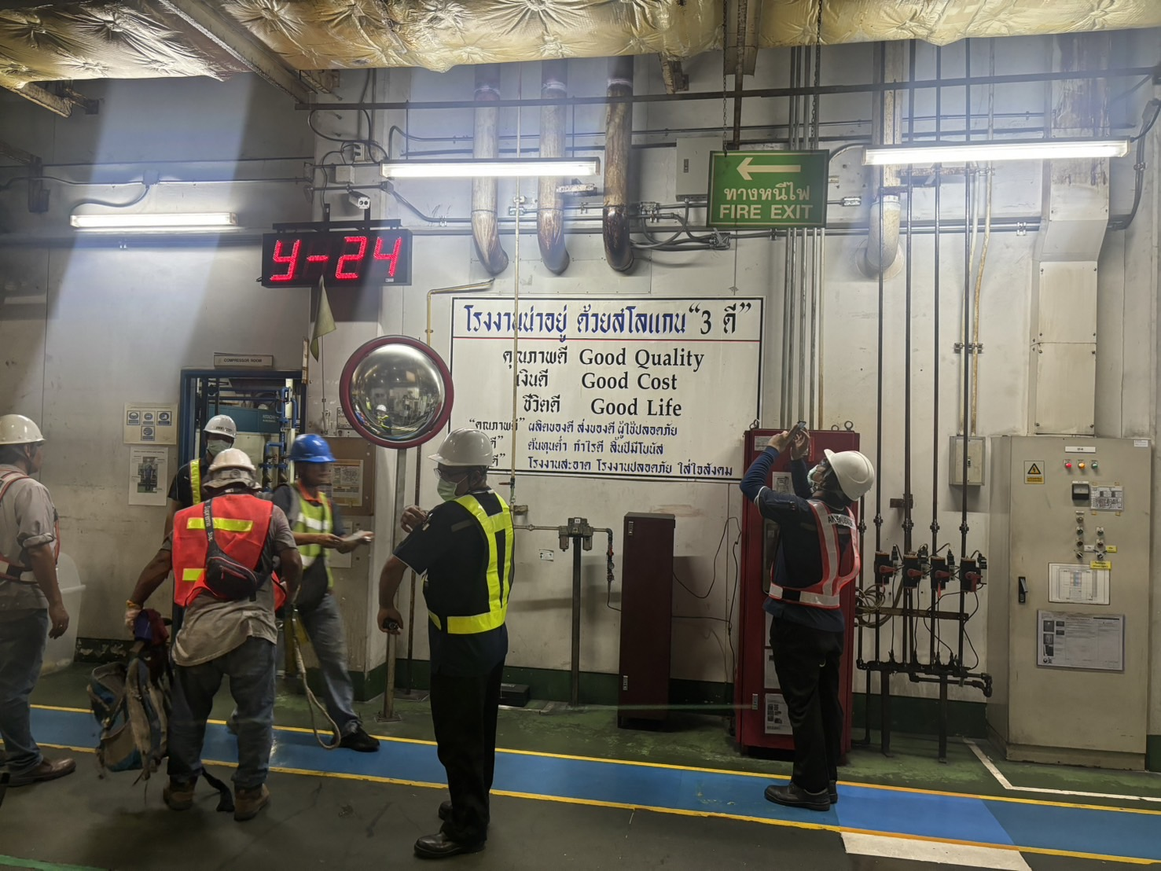
| Air flow installation ( After system on )

Slide 8
| Installation plan 15/06/24 change to 16/06/24
Loop 3,4 request
1. Newton phase
2. Request power off
* LINE + Newton Tab from P8
- P7-1 (P8-8)
- P7-2 (P8-9)
- P7-3 (P8-10)
P7-4 (P8-10)
P7-5 (P8-6)
P7-6 (P8-6)
P7-7 (P8-6)
- P7-8 ( P8-8 )
- P8-11 <> P8-7 ( Newton )
P8-13 <> P8-8 ( Newton )

Slide 9
| Installation plan 16/06/24
Working 15-16

Slide 10
Request and comment by JATH

Slide 11
Thank you for join meeting
By TOMAS TECH TEAM

