Slide 1
Infrastructure IoT project meeting Date : 27/06/24 Made for JATH
TOMAS TECH Co., Ltd.

Slide 2
| Meeting agenda
Update progress work 23/06/24
Installation plan 01/07/24 - 05/07/24
Update transformer installation
Shutdown air and power plan

Slide 3
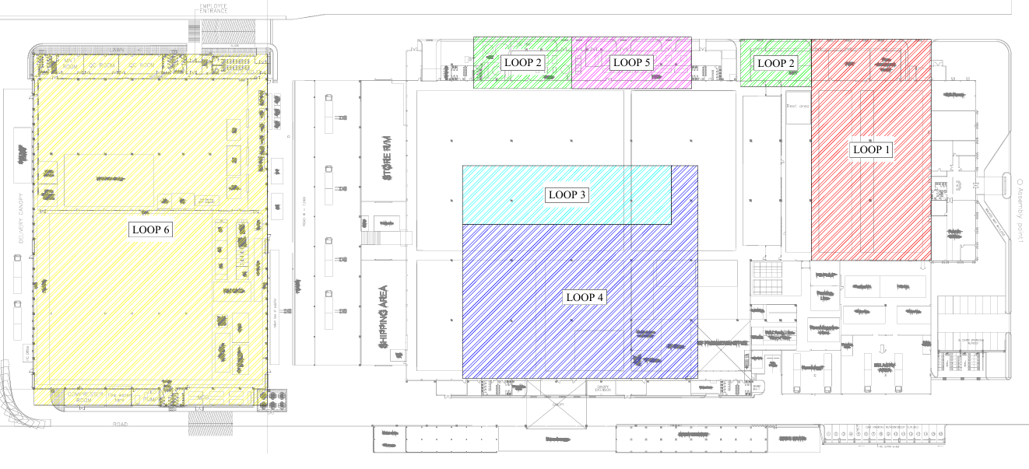
| Power meter installation overall ( 15/06/24 – 16/06/24 )
100%
Air flow sensor 75%
100%
97%
100%
97%
97%

Slide 4
| Power meter installation overall (23/06/24 )
100%
100%
100%
100%
97%
100%
QC Room
Install in Shutdown factory

Slide 5
| Installation plan 01/07/24 – 05/07/24 ( setting power meter and communication test )

Slide 6
Request and comment by JATH

Slide 7
Thank you for join meeting
By TOMAS TECH TEAM

