Slide 1
Infrastructure IoT project meeting Date : 20/06/24 Made for JATH
TOMAS TECH Co., Ltd.

Slide 2
| Meeting agenda
Update progress work 15/06/24 – 16/06/24
Installation plan 23/06/24
Confirmation about Transformer installation
Shutdown air and power plan

Slide 3
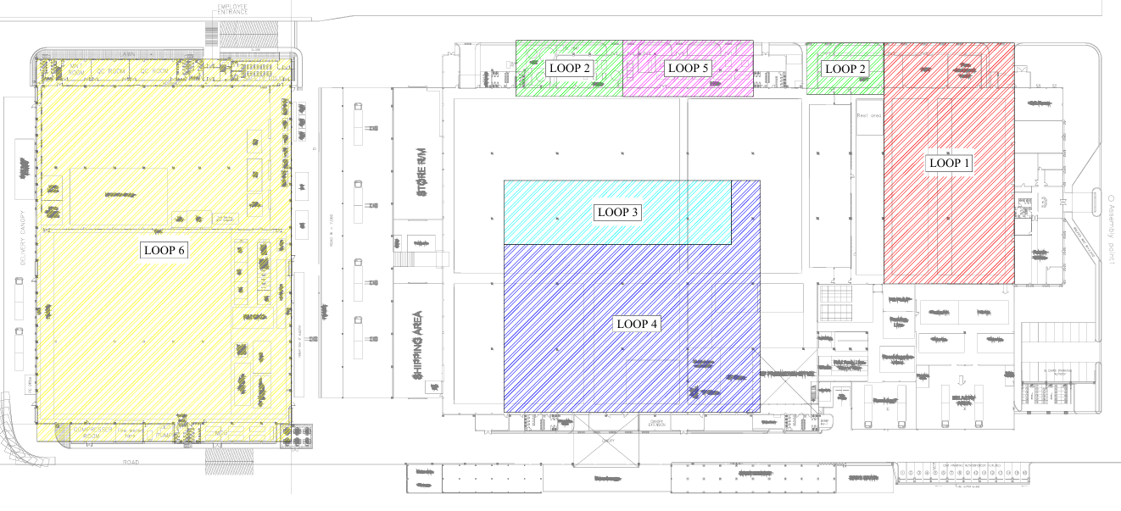
| Power meter installation overall ( 09/06/24 )
100%
Air flow sensor 75%
95%
97%
100%
90%
97%

Slide 4
| Power meter installation overall ( 15/06/24 – 16/06/24 )
100%
Air flow sensor 75%
100%
97%
100%
97%
97%

Slide 5
| Installation plan 23/06/24
Loop 3,4 request
1. Newton phase
2. Request power off
- P7-1 ( Install transformer )
- P7-2 ( Install transformer )
- P7-3 ( Install transformer )
- P7-4 ( Install transformer )
- P7-5 ( Install transformer )
- P7-6 ( Install transformer )
- P7-7 ( Install transformer )
- P7-8 ( Install transformer )
- P8-11 <> P8-7 ( Newton )
- P8-13 <> P8-8 ( Newton )

Slide 6
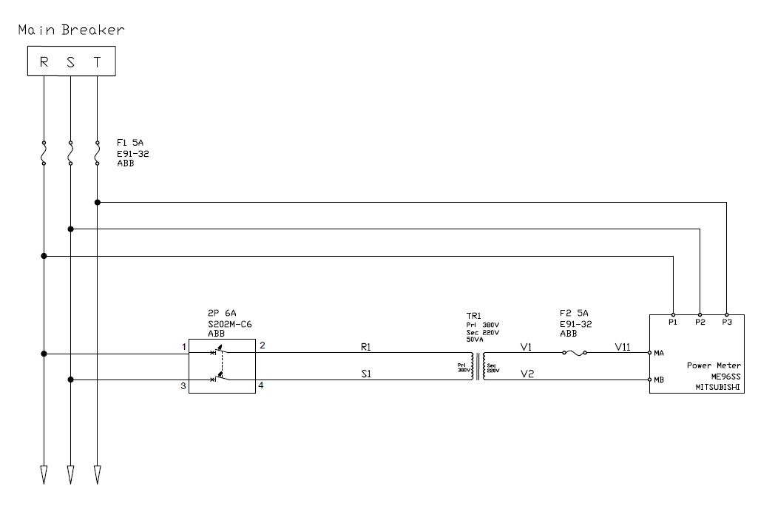
| Concept installation transformer

Slide 7
| Installation plan 23/06/24 ( setting power meter and communication test )

Slide 8
Request and comment by JATH

Slide 9
Thank you for join meeting
By TOMAS TECH TEAM

