Slide 1
Infrastructure IoT project meeting
Date : 06/06/24
Made for JATH
TOMAS TECH Co., Ltd.

Slide 2
| Meeting agenda
Update progress work 01/06/24 – 02/06/24
Installation plan 09/06/24
Prepare installation 08/06/24

Slide 3
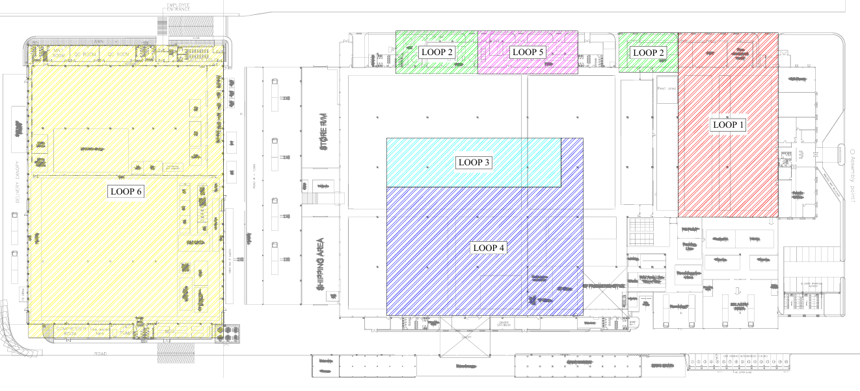
| Installation plan 01/06/24

Slide 4
| Installation plan 02/06/24

Slide 5
| Power meter installation overall ( 27/05/24 )
100%
100%
90%
95%
100%
75%
70%

Slide 6
| Power meter installation overall ( 02/06/24 – 03/06/24 )
100%
100%
90%
95%
100%
90%
90%

Slide 7
Installation Plan 09/06/24 ( Shutdown plant )
TOMAS TECH Co., Ltd.

Slide 8
Person in charge of infrastructure project Date : 09/06/24 working time 07:00 – 19:00
TOMAS TECH TEAM
CT Wiring and connect to power meter
Control master box installation
Chiller room
Flow meter installation
[ Factory 2 ]
K.Konlawat ( Loop 2,3,4 )
K.Santi Loop 6,MDB room
K.Nattapol
K.Nattapol
Team A ( 4 Person )
Team B ( 4 Person )
Team C ( 4 Person )
Team D
Team E

Slide 9
Working area point 09/06/24

Slide 10
| Prepare scaffolding before installation
Generator for Lighting
Generator for welding installation point
Installation scaffolding

Slide 11
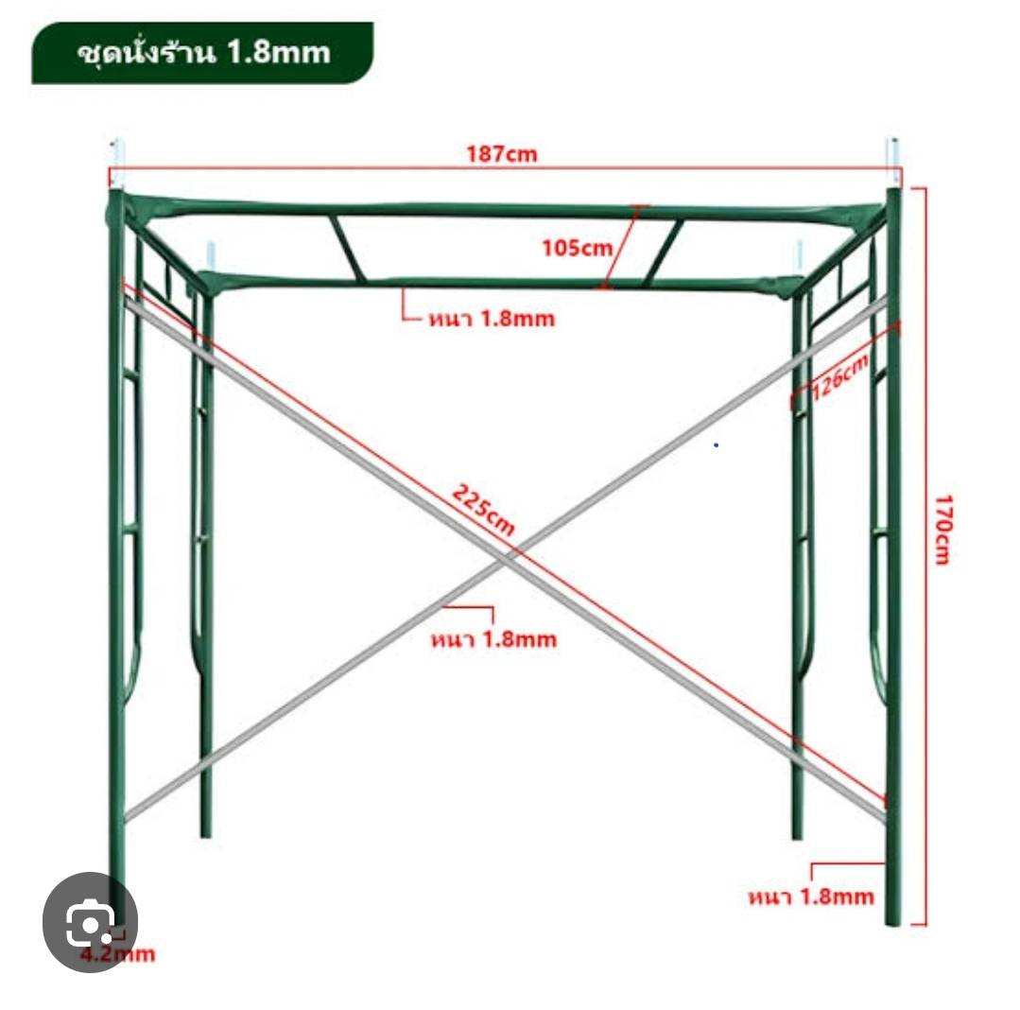
| Scaffolding dimension ( 3 Floor )
ระยะความสูงต่อ 1 ชั้น

Slide 12
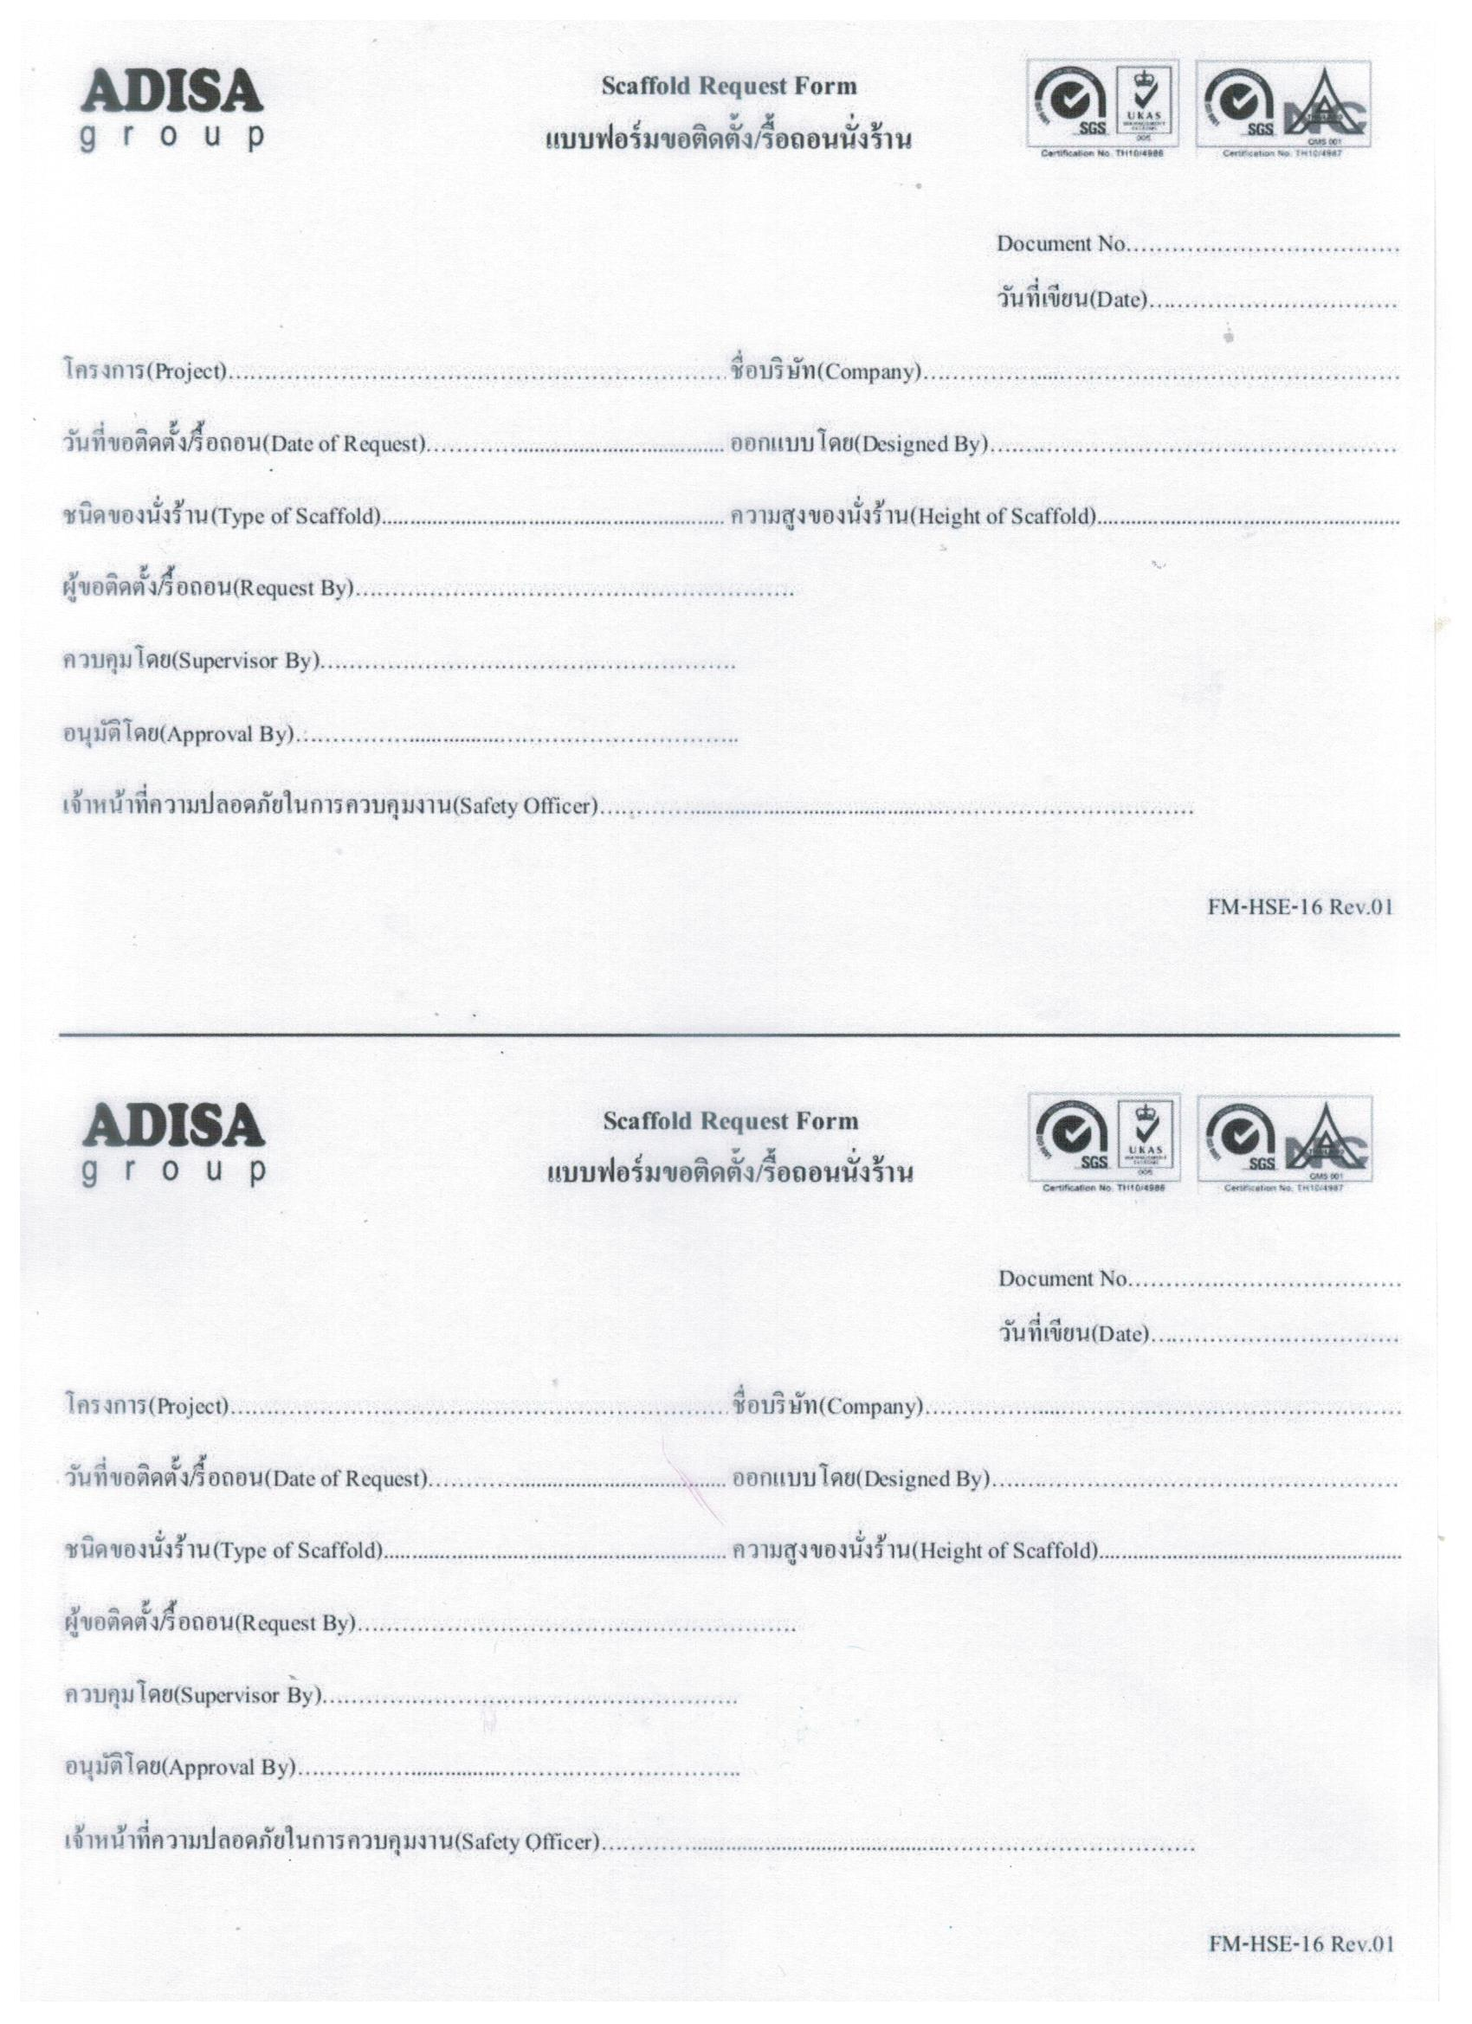
| Scaffolding request from

Slide 13
| Master control box installation confrim

Slide 14
Request and comment by JATH

Slide 15
Thank you for join meeting
By TOMAS TECH TEAM

