Slide 1
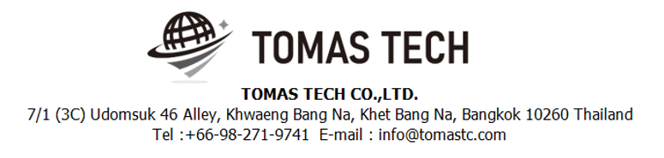
Version 24/Jun/2024
Confidential
How to use Redmine
Manual EN
R8
By: TOMAS TECH CO.,LTD.

Slide 2
Revision History
Date | Version | File name | Details
01/Oct/2023 | R1 | How to use Redmine Manual EN | First edition
02/Oct/2023 | R2 | How to use Redmine Manual EN | Second edition
06/Oct/2023 | R3 | How to use Redmine Manual EN | Third edition
11/Oct/2023 | R4 | How to use Redmine Manual EN | 4th edition
28/Nov/2023 | R5 | How to use Redmine Manual EN | 5th edition
02/May/2024 | R6 | How to use Redmine Manual EN | 6th edition
04/May/2024 | R7 | How to use Redmine Manual EN | 7th edition
24/Jun/2024 | R8 | How to use Redmine Manual EN | 8th edition
4
5
6
7
8

Slide 3
Contents
1. Overview
2. What is need to prepare
3. Operation method

Slide 4
1. Overview
It will explain how to operate Redmine.
There are three purposes for using Redmine.
1. Utilization as asset management for source code, documents, etc.
2. Schedule management
3. Man-hour management

Slide 5
2. What is need to prepare
Downloading a browser such as Firefox or Microsoft Edge
Link URL to use : https://node25444-tom-demo-01.proen.app.ruk-com.cloud/redmine/
3. ID/Password of each user
ID is each staff email address. Password information will be communicated separately.
8

Slide 6
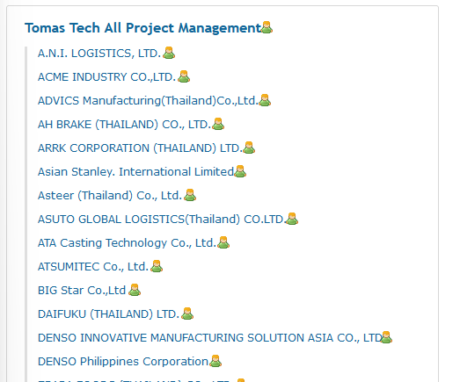
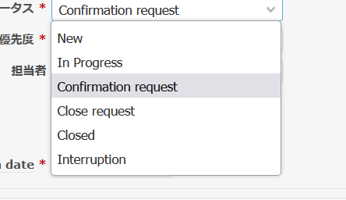
3. Operation method
How to manage projects
Manage the project as follows.
Scope of work for Nozaki & Kittisak regarding additions , updates and closing
Main project
Tomas Tech All Project Management
Customer hierarchy
“Customer name”
Project hierarchy
“[Project No]Project name”
7
Task ticket hierarchy
“Task name” *1
Tracker : Project progress work, Problem-Bug, Sales support
“Task name” *2
Tracker : Sales support
Scope of work for each staff member regarding additions and updates
4
*1 In the case of a project after PO has been received, it will be linked to the project to which the PJ number is linked.
*2 If PO is not received, link it to each customer's PJ. Tracker: Sales support only. As soon as the PO is received and a PJ ticket with PJ No. is created, the target ticket will be moved.
Status operation
New
Scope of work for each staff member regarding additions and updates
In progress
Confirmation request
Close request
Closed
Scope of work for Kittisak regarding additions , updates to Close request
Interruption
Scope of work for Nozaki regarding additions , updates and closing

Slide 7
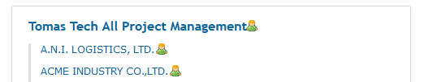
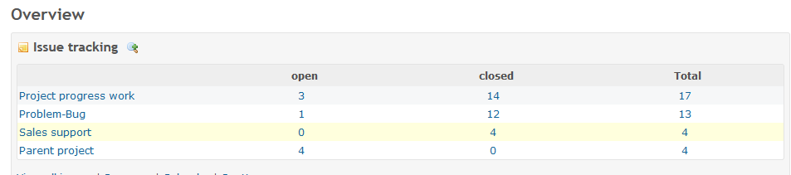
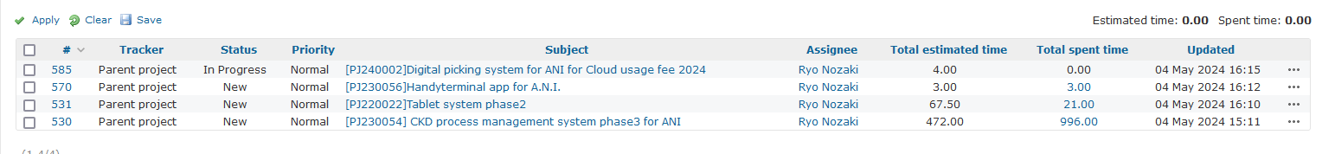
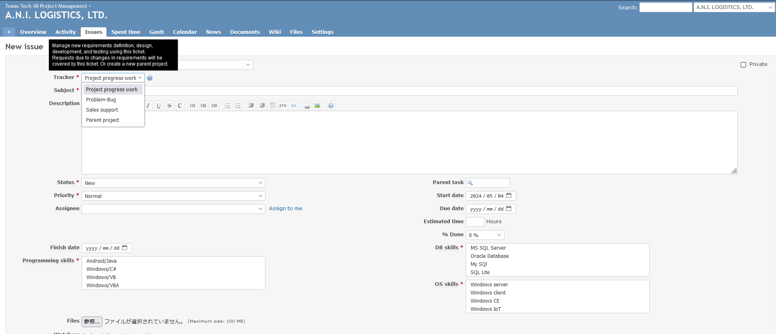
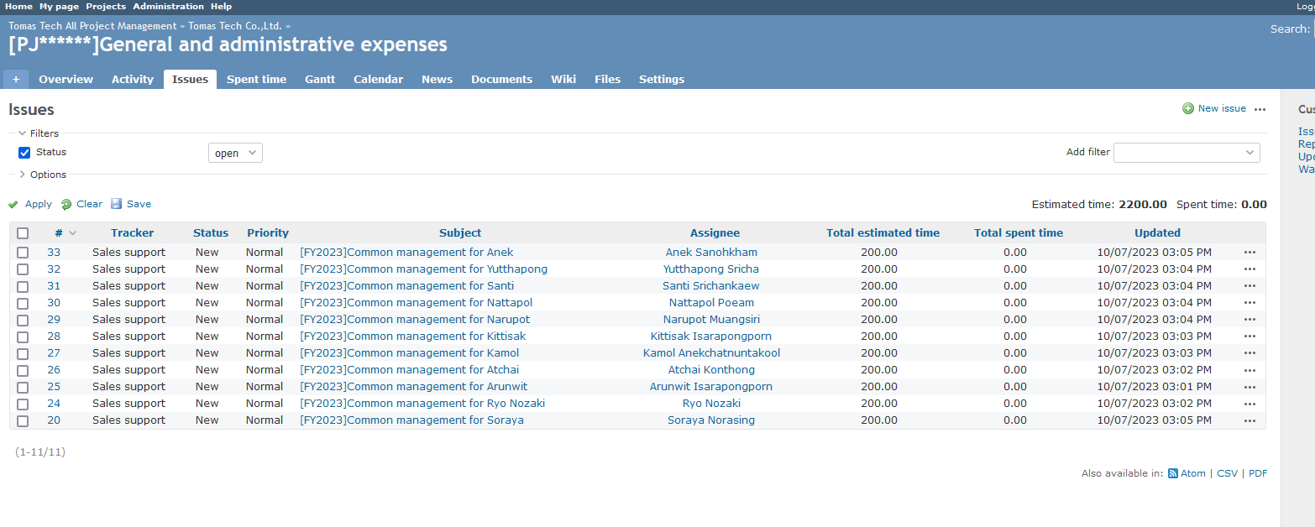
3. Operation method
2. How to add a task ticket
7
Project : Specify parent project
Tracker :
【Project progress work】 Manage new requirements definition, design, development, and testing using this ticket. Requests due to changes in requirements will be covered by this ticket. Or create a new parent project.
【Problem-Bug】 If a problem occurs after the project is released, manage it with this ticket.
【Sales support】 Sales support work. Work that mainly occurs before receiving a project order is assigned to this ticket.
Subject: Briefly describe the work. Ex) Development of stock management function for BT-A500 handy terminal
Description: Please describe the work content.
Ex) Developing an Android application for Keyence's BT-A500. The number of screens is assumed to be 10. Assumes the print issue command function via Ethernet communication with a label printer.
**[Sauce code] : Please be sure to enter the link of the sauce code stored in MS Teams.
**Use this for tasks not related to the project. [PJ******]General and administrative expenses.
**If the Tracker type is "Problem-Bug", enter it as follows.
“Problem” It became impossible to scan some QR codes on the Inbound screen of the handy terminal.
“Cause” The 10th to 15th digits of the scan string were entered as blank spaces.
“Solution” The program has been modified so that it does not import data from 10th to 15th digits when scanning.
Status: Initial filing is “New”
Priority: change each time
Assignee: Fill in the person in charge
Parent task: Not required
Start date: Work start date
Due Date: Expected work completion date
Estimated time: Time required for work
% Done: Work progress rate
Programing skills
DB skills
OS skills
Finish date: Work completion date
7

Slide 8
3. Operation method
■ Project progress work
For Project progress work, the ticket structure is as follows.
[Requirement definition]
[Internal Design]
[Coding]
[Installation&On-site support]
EX)
[Requirement definition] Customer interview
[Internal Design] DB and various functions, man-hour calculation
[Coding] Inner packing screen function C#
[Installation&On-site support] CKD process management system phase3 for ANI
Each ticket requires these deliverables.
[Requirement definition]
A-1. Requirements definition material
http://node25444-tom-demo-01.proen.app.ruk-com.cloud:11447/issues/10
[Internal Design]
A-2. Development schedule
http://node25444-tom-demo-01.proen.app.ruk-com.cloud:11447/issues/96?issue_count=11&issue_position=10&next_issue_id=10&prev_issue_id=97
[Coding]
A-3. Source code
http://node25444-tom-demo-01.proen.app.ruk-com.cloud:11447/issues/105
[Installation&On-site support]
A-4. Wiring diagram
http://node25444-tom-demo-01.proen.app.ruk-com.cloud:11447/issues/8
A-5. Infrastructure setting list
http://node25444-tom-demo-01.proen.app.ruk-com.cloud:11447/issues/8
■ Project progress work
B-1. Source code
http://node25444-tom-demo-01.proen.app.ruk-com.cloud:11447/issues/15
■ Sales support
No special specification
5

Slide 9
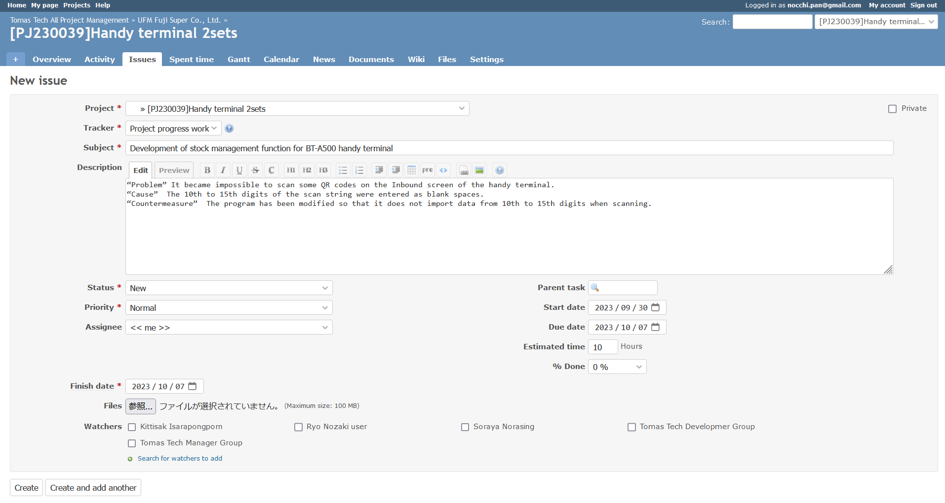
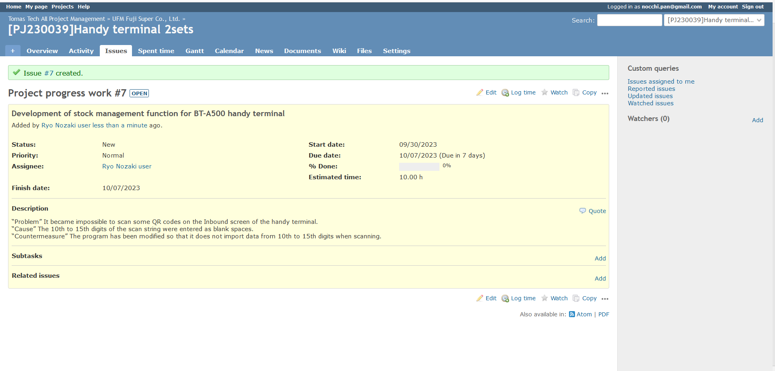
3. Operation method
2. How to add a task ticket
Push create button

Slide 10
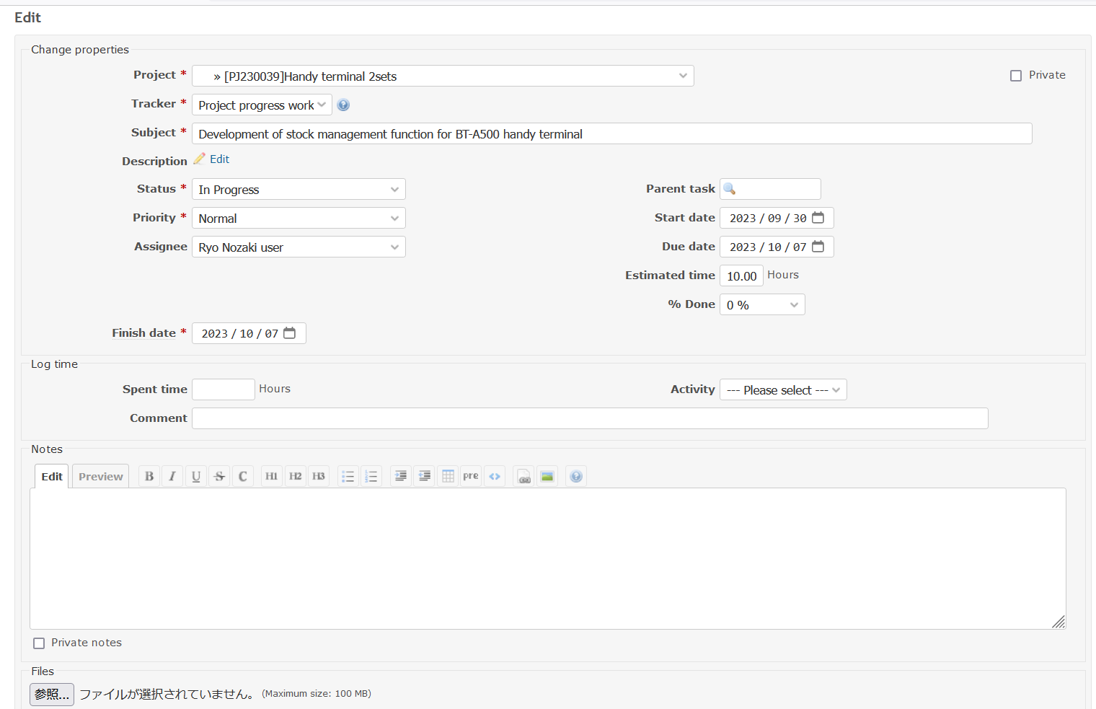
3. Operation method
3. When starting task
Change status

Slide 11
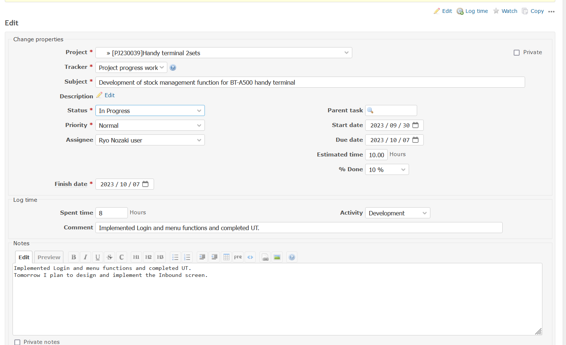
3. Operation method
4. When working task (Please perform this task every day.)
6
% Done : Change the percentage depending on your progress rate.
Spent time : Fill out the time used for work that day.
Activity : Select at “Development”, ”Meeting”, ”Make document” , ”Design”, ”Installation”
Comment : Fill out the "contents to be carried out on the day"
Note : Fill out the "contents to be carried out on the day" and "plans for the next day."
Implemented Login and menu functions and completed UT.
Tomorrow I plan to design and implement the Inbound screen.

Slide 12
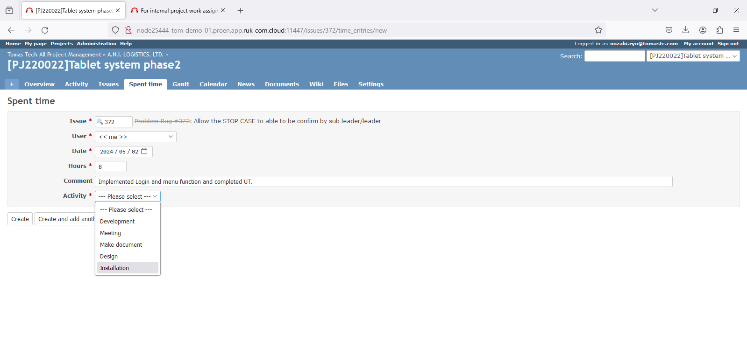
3. Operation method
4. When working task (Please perform this task every day.)
6
Spent time : Fill out the time used for work that day.
Activity : Select at “Development”, ”Meeting”, ”Make document” , ”Design”, ”Installation” , ”Taking Day off”
Comment : Fill out the "contents to be carried out on the day"
Note : Fill out the "contents to be carried out on the day" and "plans for the next day."
Implemented Login and menu functions and completed UT.
Tomorrow I plan to design and implement the Inbound screen.

Slide 13
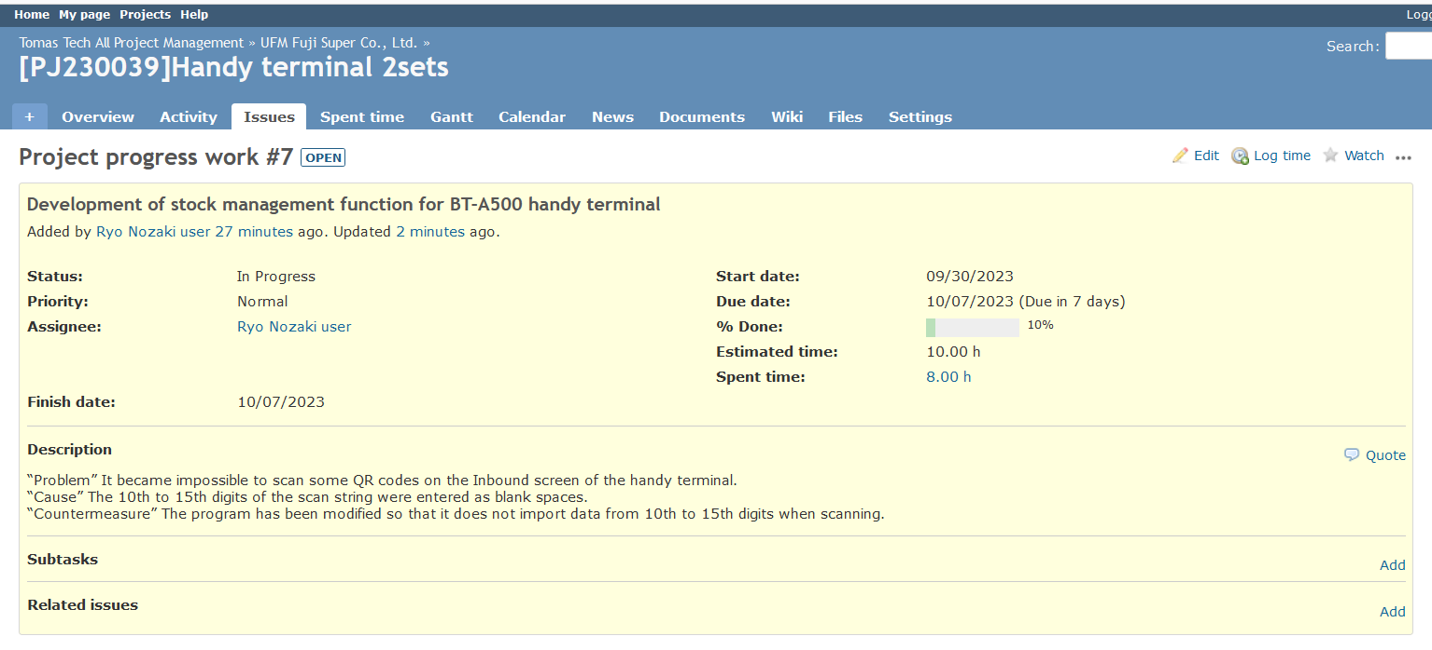
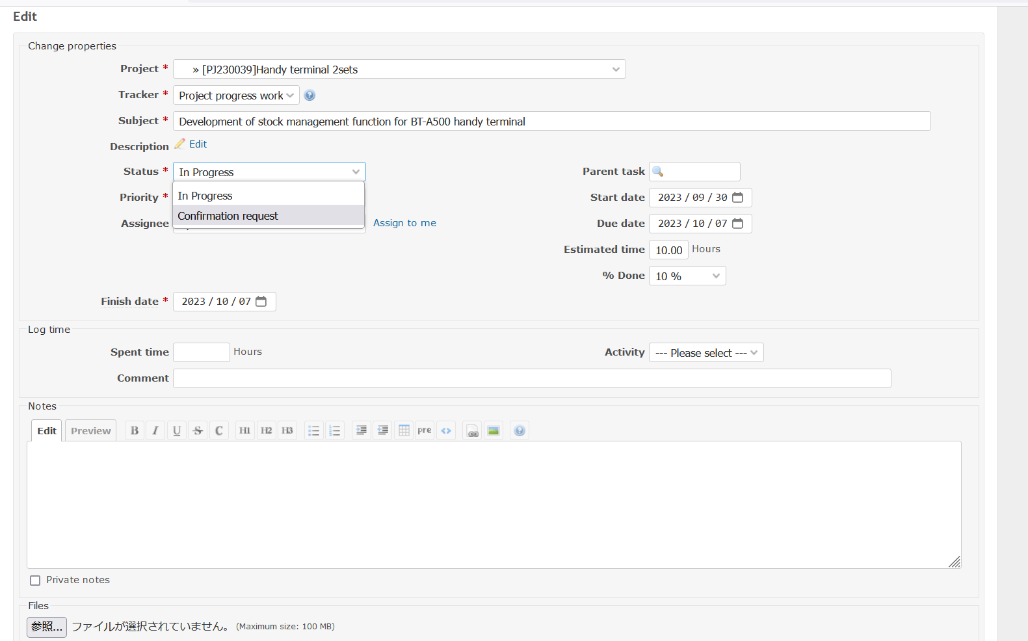
3. Operation method
5. When the work is completed
Change status to “Confirmation request”
Change progress to 100%
Fill out actual finish date

Slide 14
3. Operation method
5. When the work is completed
1. Redmine project launch
1-1. Creating a Main project / Purpose: Management of each company /PIC : Project manager / Timing: As needed
1-2. Creating a Company project / Purpose: Management of each project / PIC : Project manager / Timing: As needed
1-3. Creating a task / Management of each task / PIC : Each staff / Timing: Assigned timing, when a problem occurs
2. Source code and spec document management
Management to team cloud / Paste the link URL in 1-3
2-1. Source code / All project sauce codes and databases related to program creation
2-2. Project schedule(*1), Development-Installation schedule(*2) / All project sauce codes and databases related to program creation
2-3. Document management for ToDoList(*3), Specifications(*4), Infrastructure settings list(*5), Manuals(*6)
** If the total person-month of the project is 10 person-days or less, anything other than No. 4 & 5 is optional.

Slide 15
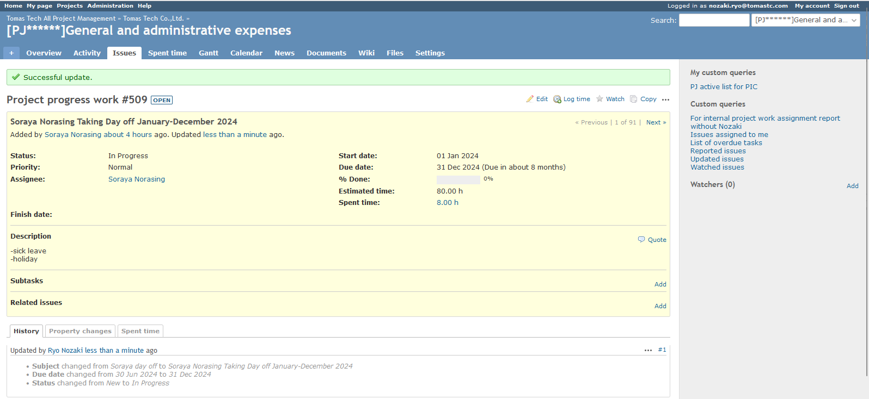
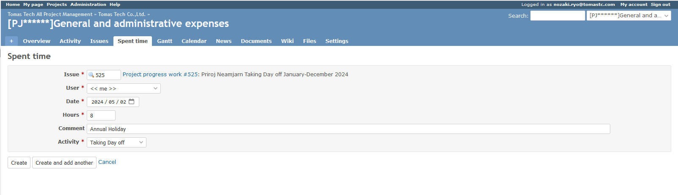
3. Operation method
6. When taking leave
If you will be taking vacation between January and December 2024, please set the Log time on the ticket with your name.
Activity : Select at ”Taking Day off”
If you are taking a day off, please select "Taking Day off" as the Log time activity.
Please also enter a comment about the reason for your leave.
Reason)
- Annual Holiday
- Sick Leave
- Business Leave
6

