Slide 1
Company rule 02-May-2024 update
TOMAS TECH CO.,LTD.

Slide 2
Contents
Company rule
1-1. Weekly meeting
1-2. Schedule management
1-3. Meeting Minutes
1-4. Technical regular meeting
1-5. Project management
1-6. Transportation expense rules
1-7. Travel allowance & Accommodation fees
1-99. Other rules
9
10
9

Slide 3
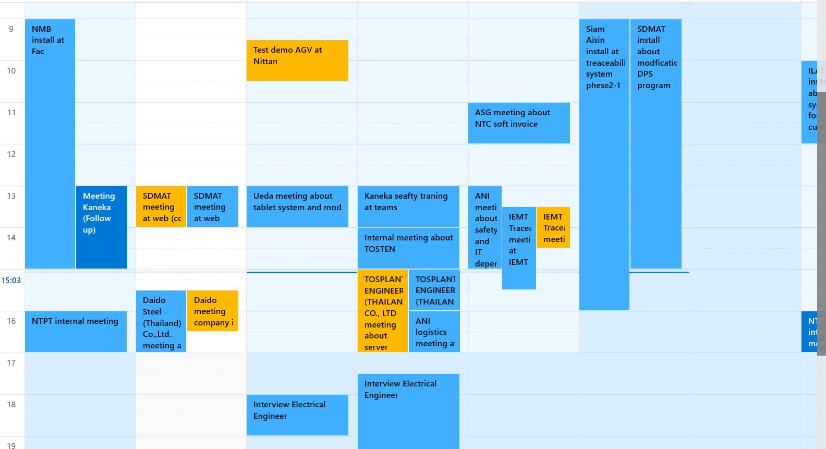
1-1. Monthly meeting & Weekly meeting
1.Overview
Hold regular Meetings.
2. Meeting
Weekly : Every Monday 08:15 Start 08:45 Fin: MS Teams
https://teams.microsoft.com/l/meetup-join/19%3a4OsVjOUiVLJbl2eI48B3Ksl2Hnz7K-BpnWoy-xYV0f81%40thread.tacv2/1664154797805?context=%7b%22Tid%22%3a%221581cc7a-3f7e-407b-a64b-1d8fff9333af%22%2c%22Oid%22%3a%22060cdeff-6f5c-4d70-9ec0-ba80da110752%22%7d
* 1 week schedule confirmation : Please update your schedule.

Slide 4
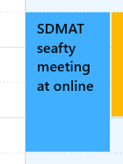
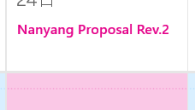
1-2. Schedule management
1.Overview
Rules for going out. Describe where to go, who to meet, and what to do in the Schedule.
Please provide information about the tasks you are doing.
2.How to write
2-1-1. Record information with customers. “Company name”, “Customer name”, “Agenda", "Place"
Ex1) IEMT Mr. Kongkit meeting about traceability system at IEMT.
Ex2) IEMT Mr. Kongkit online meeting about traceability system at MS teams.
2-1-2. For tasks, please include “[Task]” , “Project customer name", “Project name", “Task name", and “Progress".
*Please make settings for each hour.
Ex1) [Task] IEMT traceability system for MC27 programming 3/5 *Day 3 of 5 days. 100% done in 5 days.
Ex2) [Task] IEMT traceability system for MC27 Making proposal 1/2
2-2. Leave early, be late, holiday.
*Be late , Go home early *Report in advance by talking or telephone
*Holiday ( Write the reason. Ex: Annual Leave , Sick Leave etc.) *Report in advance by talking or telephone
2-3. Weekly meeting Input by the week before. Reminder from K.Nook every Friday at 09:00
4. Absence
In case of absence, contact Nozaki before the start of the meeting.
〇
×

Slide 5
1-2. Schedule management
How the calendar works. Please share calendars using each Apple ID. *Please share settings with everyone.
Here's how to share your calendar:
https://photos.app.goo.gl/WrSnVRgNqhQCm2Am8
Recommended applications for PC and iPhone
PC
https://apps.microsoft.com/store/detail/one-calendar/9WZDNCRDR0SF?hl=th-th&gl=th
https://apps.microsoft.com/store/detail/my-calendar/9WZDNCRDCR1W?hl=th-th&gl=th
iPhone
https://www.fsi.co.jp/solution/refills/english/index.html
nozaki.ryo@tomastc.com
nocchi.pan@gmail.com
anek.s@tomastc.com
arunwit.i@tomastc.com
kittisak.i@tomastc.com
nongnut.t@tomastc.com
soraya.n@tomastc.com
kamol.a@tomastc.com
nattapol.p@tomastc.com
narupot.m@tomastc.com
santi.s@tomastc.com
panupong.r@tomastc.com
pornpimon.j@tomastc.com
tanawan.w@tomastc.com
jidapha.m@tomastc.com
thanthima.p@tomastc.com
ronnagon.k@tomastc.com
teeradon.y@tomastc.com
phatthadon.i@tomastc.com
konlawat.s@tomastc.com
priroj.n@tomastc.com
kuroda.saki@tomastc.com

Slide 6
1-3. Meeting Minutes for sales
1.Overview
Describe how to record Meeting Minutes and calling list for each day.
2. Target person
Sales representative
3.How to write
①“Customer” : Select from the sheet "list memo". If not in the list, add the official name.
②“Visit date” : Record the date of visit.
③“Start” : Record the time when the meeting started.
④“Finish” : Record the time when the meeting finished.
⑤“Customer name” : Record the name of the customer who did the meeting.
⑥“Visitor” : Record your name.
⑦“Agenda” : Record the agenda. Ex) Cutting tool first meeting , Delivery
⑧“Minutes” : Record the agenda. Record customer information on a 5W1H basis. (When, Where, Who, What, Why, How)
⑨“Next Action” : Record what you need to do next. Ex) Create and submit a quote about OSG V –XPM-EDS 10
4.How to operation
Record by 09:00 the next day of the meeting date. * Recorded in English.
①
②
③
④
⑤
⑥
⑦
⑧
⑨

Slide 7
1-4. Technical regular meeting
1.Overview
Technical regular meeting for Application team
Hold regular Meetings. Every Monday, Wednesday, Friday 16:50-17:00
https://teams.microsoft.com/l/meetup-join/19:meeting_ZDUwYTk1NjQtODNmNy00MDNkLWFiZjgtMDY3MDM2N2EwZmM1@thread.v2/0?context=%7B%22Tid%22:%22ebd760b5-c884-4486-ae39-ee726b7876a8%22,%22Oid%22:%22fa636b6d-b609-415a-91e3-52741451ff6f%22%7D
2. Meeting
1) Confirmation of the progress of projects for each person in charge
2) Check for technical issues
3. Participant
Kittisak​ * Organizer
Each engineer position
R.Nozaki *Sometimes
4. Output
Recording of minutes for each meeting in English PIC Kittisak
Create and share line groups
5. Absence
In case of absence, contact K.Kittisak and CEO before the start of the meeting.

Slide 8
1-4. Technical regular meeting
1.Overview
Technical regular meeting for IoT team
Hold regular Meetings. Every Tuesday, Thuesday, Friday 16:50-17:00
https://teams.microsoft.com/l/meetup-join/19:meeting_ZDUwYTk1NjQtODNmNy00MDNkLWFiZjgtMDY3MDM2N2EwZmM1@thread.v2/0?context=%7B%22Tid%22:%22ebd760b5-c884-4486-ae39-ee726b7876a8%22,%22Oid%22:%22fa636b6d-b609-415a-91e3-52741451ff6f%22%7D
2. Meeting
1) Confirmation of the progress of projects for each person in charge
2) Check for technical issues
3. Participant
Nattapol​ * Organizer
Each engineer position
R.Nozaki *Sometimes
4. Output
Recording of minutes for each meeting in English PIC Nattapol
Create and share line groups
5. Absence
In case of absence, contact K. Nattapol and CEO before the start of the meeting.

Slide 9
1-5. Project management
1. Redmine project launch
1-1. Creating a Main project / Purpose: Management of each company /PIC : Project manager / Timing: As needed
1-2. Creating a Company project / Purpose: Management of each project / PIC : Project manager / Timing: As needed
1-3. Creating a task / Management of each task / PIC : Each staff / Timing: Assigned timing, when a problem occurs
2. Source code and spec document management
Management to team cloud / Paste the link URL in 1-3
2-1. Source code / All project sauce codes and databases related to program creation
2-2. Project schedule(*1), Development-Installation schedule(*2) / All project sauce codes and databases related to program creation
2-3. Document management for ToDoList(*3), Specifications(*4), Infrastructure settings list(*5), Manuals(*6)
** If the total person-month of the project is 10 person-days or less, anything other than No. 4 & 5 is optional.
Document sample
*1 https://docs.google.com/spreadsheets/d/1I6i--AxljJuiCPE9aYtRQvPkjgli4q4G/edit?usp=sharing&ouid=115890458727315108555&rtpof=true&sd=true
*2 https://docs.google.com/spreadsheets/d/1rfZiRcl7rzNezepQV4qhpw-JUei0tEYu/edit?usp=sharing&ouid=115890458727315108555&rtpof=true&sd=true
*3 https://docs.google.com/spreadsheets/d/1sTTYwCJ6ucJE-Srli2DVliAbI3_tWmmM/edit?usp=sharing&ouid=115890458727315108555&rtpof=true&sd=true
*4 https://docs.google.com/presentation/d/1ri5oVPTH8N3uAbysEnkGC7D8sic8dWTR/edit?usp=sharing&ouid=115890458727315108555&rtpof=true&sd=true
*5 https://docs.google.com/spreadsheets/d/1sk6YiEIUiWa6yx781NPZwtZjf09XkBUz/edit?usp=sharing&ouid=115890458727315108555&rtpof=true&sd=true
*6 https://docs.google.com/presentation/d/1sCzyo8r6KYLggxIQagyKlE0apQY0iCJ_/edit?usp=sharing&ouid=115890458727315108555&rtpof=true&sd=true

Slide 10
1-5. Project management
3. How to use Redmine.
See Attachment

Slide 11




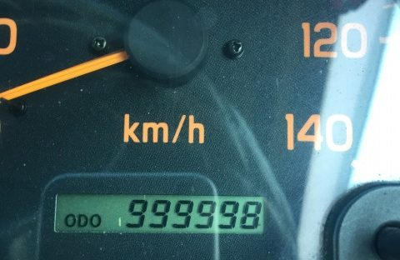


1-6. Transportation expense rules
9
1.Overview
The rules for using a private car at the customer from the company, at the customer at the company, at home at the customer, and at the customer at home are specified. *If company cars can be used, priority is given to using company cars. This payment rule applies when traveling from work or home to a customer's location using your own four-wheeled vehicle or two-wheeled vehicle. It doesn't apply to anything else. This operational rule must start from May 1, 2024.
2.How to operation
2-1. The calculation 4 wheel vehicle is 5 THB (Maintenance of Car 2Baht/km , Gasoline Fee 3Baht/km) per km.
The calculation 2 wheel vehicle is 2 THB (Maintenance of Car 1Baht/km , Gasoline Fee 1Baht/km) per km.
2-2. If a company car is available, give priority to using the company car. Also, if you are heading to the same location on the same day, try to go in one car. If these two conditions cannot be met, please obtain permission from company CEO.
2-3. Transportation expenses will be due and paid three times a month.
Deadline on the 10th of every month → Payment on the 15th of every month
Deadline on the 20th of every month → Payment on the 25th of every month
Deadline on the last day of the month → Payment on the 05th(Next month) of every month
2-4. Take a picture of the meter at the start and end points. Please send the photo to the account manager ( Nongnut ) at the time of expense settlement. If you do not have a photo, company will calculate the shortest distance when the Start Point and Goal Point are marked on Google Maps. In that case, it is mandatory to submit a Google map screen capture.
2-5. If applicant wish to go directly between Home and your company, please obtain permission from the company CEO in advance before 12h your starting. Please send information to Company group line (TOMAS TECH). If permission is not obtained, the distance will be calculated by subtracting the distance from the office to the home. Like Ex2.
2-6. If applicant receive a warning about consulting with the CEO, it will be difficult to provide transportation expenses.
2-7. If an applicant makes a false report, transportation expenses will be suspended or disciplinary action will be taken.
2-8. In addition, if you use high speed, m-Flow, etc., you will be required to submit the original receipt.
Example description
Ex1 ) This pattern goes from Home to the company and from the company to the customer.
Ex2 ) If you wish to go directly between Home and your company, please obtain permission from the company CEO in advance before 12h your starting. Please send information to Company group line (TOMAS TECH). If permission is not obtained, the distance will be calculated by subtracting the distance from the office to the home.
10
10
Ex1) Start (1)15km + Finish (2)15km = 30km
Application route and Required documents
1. Transportation expense bill_R1.xlsx
2. Meter photo : 1 application 4 sheets
2-1. Start → Destination Start Point
2-2. Start → Destination Goal Point
2-3. Destination → Start Start Point
2-4. Destination → Start Goal Point
Ex2) Start(1) 20km+Finish (2) 20km = 40km – 20km = 20km
If you wish to go directly between Home and your company, please obtain permission from the company CEO in advance before 12h your starting. If permission is not obtained, the distance will be calculated by subtracting the distance from the office to the home.
Your home
Location
Company
Location
Customer
Location
Photo 3
Photo 2
Not supported
Photo 1
Photo 2
(2) 20km
(1) 20km
(1)10km
10km
(2)10km
Photo 4
10km
Photo 4
Photo 3
Applicant
Accountant
Authorizer
Photo 1

Slide 12
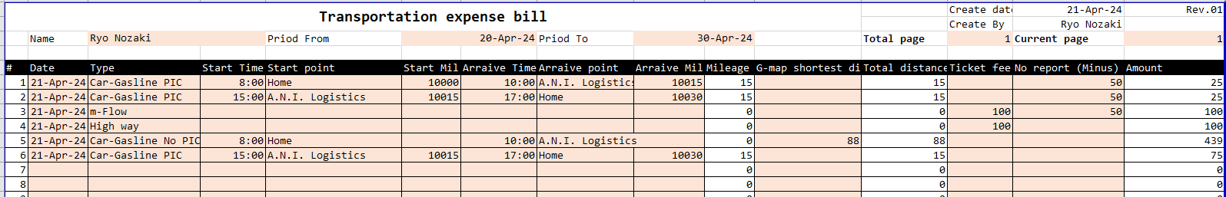
1-6. Transportation expense rules
9
2-7. Application format must be use same form
Date : Please fill out using car date
Type : Choose which type
Car-Gasline PIC : Using car and have taken picture / Bike-Gasline PIC : Using bike and have taken picture / Car-Gasline No PIC : Using car and have not taken picture
Bike-Gasline No PIC : Using bike and have not taken picture / m-Flow : Using m-Flow / High way : Using High way

Slide 13
1-7. Travel allowance & Accommodation fees
9

Slide 14
1-99. Other rules
Please use ".zip" for compressed files.
".rar" is prohibited.
Regarding how to order drinks when customers come, they will be able to order from the link below.
https://tom-demo-01.proen.app.ruk-com.cloud/drink-order/

