Slide 1
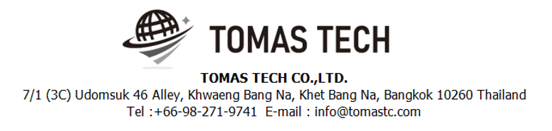
Version 26/Feb/2024
Confidential
Real-time Shopper System specifications
Documentation EN Blueprint for DNPH
Blueprint
R6
Made for: DENSO Philippines Corporation.
By: Meiji (Thailand) Co.,Ltd. / TOMAS TECH CO.,LTD.

Slide 2
Revision History
Date | Version | File name | Details
05/Oct/2023 | R1 | Real-time Shopper System specifications Documentation EN Blueprint for DNPH Blueprint | First edition
09/Oct/2023 | R2 | Real-time Shopper System specifications Documentation EN Blueprint for DNPH Blueprint | Second edition
06/Jan/2024 | R3 | Real-time Shopper System specifications Documentation EN Blueprint for DNPH Blueprint | Third edition
09/Jan/2024 | R4 | Real-time Shopper System specifications Documentation EN Blueprint for DNPH Blueprint | 4th edition
13/Feb/2024 | R5 | Real-time Shopper System specifications Documentation EN Blueprint for DNPH Blueprint | 5th edition
26/Feb/2024 | R6 | Real-time Shopper System specifications Documentation EN Blueprint for DNPH Blueprint | 6th edition Split the installation phase into 2 phases. Specify phase 1.
２
3
4
5
6

Slide 3
■Contents
1. Overview
2. Overall configuration diagram
3. Document image
3-1. Linkage data
3-1-1. CMS Link data format
    3-1-2. E-Kanban Link data format
    3-1-3. Production Line parts sensor Link data format
    3-1-4. Production Line FG sensor Link data format
    3-1-5. Shopper AGV Station Sensor Link data format
    3-1-6. Cycle time master for Transport work linkage data format
  3-2. Utilize QR Traceability System and CMS Data
4. Operation flow
4-1. Data linkage
    4-1-1. CMS data linkage data registration
    4-1-2. CMS data linkage data Delete
    4-1-3. E-Kanban data linkage registration schedule
    4-1-4. E-Kanban data linkage Delete schedule
    4-1-5. Production Line parts sensor data registration
    4-1-6. Production Line parts sensor data Delete
    4-1-7. Production Line FG sensor data registration
    4-1-8. Production Line FG sensor data Delete
    4-1-9. Shopper AGV Station Sensor data registration
    4-1-10. Shopper AGV Station sensor data Delete
    4-1-11. Cycle time master for Transport work linkage data registration
    4-1-12. Cycle time master for Transport work data linkage data Delete
4-2. Pre-production preparation operations
4-2-1. Kanban scan registration
4-3. During production operation
4-3-1. Kitting work instructions
    4-3-2. Shopper work instructions for parts
    4-3-3. Shopper work instructions for FG
5. System functional specifications
5-1. Smart watch operation flow
5-2. PC operation flow
6. Q&A
7. Sign off

Slide 4
1. Overview
Provide Real Time shopper system to DNPH.
This document is a detailed summary of the specifications.

Slide 5


2. Overall configuration diagram
Represents a configuration diagram of the Real-Time shopper system. It is a configuration image of hardware and documents.
Overall configuration diagram image
Kitting area
Shopper station (New)
Production Line
FG sensor × N
Parts sensor × N
Smart watch × 50
Display × 2
PC & Scanner× 9
I/O
I/O
WIFI or
Ethernet
WIFI or
Ethernet
WIFI
PLC
KDDI server
Production
Plan data
Pegasus Server

Slide 6

2. Overall configuration diagram
Network diagram
DNPH office
Lan cable
KDDI server
Pegasus
server
Wi-Fi
Client pc
I/O
Switching hub
Switching hub
Access Point
Access Point
PLC
Display driver#1
Display driver#2
Smart watch #1
Smart watch #50
Display #1
Display #2
Various sensors
  Respond with a hardware list 52units of MAC addresses to DNPH by January 31, 2024.
3
DNPH Factory

Slide 7

3. Document image
3-1. Linkage data phase#2
# | Linkage flow | Contents | File name | Method | Timing
1 | KDDI→ Pegasus | Andon 1.5 CMS data (Operation status data) linkage |  | DB linkage | Each time
2 |  | Cycle time master for Transport work (New function) |  | DB linkage | Once a day
3 | Pegasus → KDDI | Smart watch performance log |  | DB linkage | Each time
5 | DNPH(E-Kanban) →Pegasus | E-Kanban data (Production schedule data) linkage |  | DB linkage | Once a day
6 |  | E-Log System linkage |  | DB linkage | Each time
7 | DNPH(E-Kanban) →Pegasus | WACS System |  | DB linkage | Each time
8 | KAU→ Pegasus | Production Line parts sensor (N points) |  | DB linkage | Each time
9 |  | Production Line FG sensor (N points) |  | DB linkage | Each time
 |  | Shopper AGV Station Sensor (9 points) |  | CSV linkage | Each time
06/Jan/2024
Unnecessary
3
4
4
4
4
4
4
06/Jan/2024
Unnecessary
3
  About linking methods and file types in red
3

Slide 8
3. Document image
3-1. Linkage data phase#1
6
# | Linkage flow | Contents | File name | Method | Timing
1 | KDDI→ Pegasus | Andon 1.5 CMS data (Operation status data) linkage |  | DB linkage | Each time
2 |  | Cycle time master for Transport work (New function) |  | DB linkage | Once a day
3 | Pegasus → KDDI | Smart watch performance log |  | DB linkage | Each time
5 | DNPH(E-Kanban) →Pegasus | E-Kanban data (Production schedule data) linkage |  | DB linkage | Once a day
6 |  | E-Log System linkage |  | DB linkage | Each time
7 | DNPH(E-Kanban) →Pegasus | WACS System |  | DB linkage | Each time
8 | KAU→ Pegasus | Production Line parts sensor (N points) |  | DB linkage | Each time
9 |  | Production Line FG sensor (N points) |  | DB linkage | Each time
 |  | Shopper AGV Station Sensor (9 points) |  | CSV linkage | Each time
06/Jan/2024
Unnecessary
06/Jan/2024
Unnecessary
  About linking methods and file types in red
3

Slide 9
3. Document image
3-1-1. Andon 1.5 CMS data format
KDDI ⇒Pegasus
06/Jan/2024
Unnecessary
3

Slide 10
3. Document image
3-1-2. Cycle time master for Transport work data format
KDDI ⇒Pegasus

Slide 11
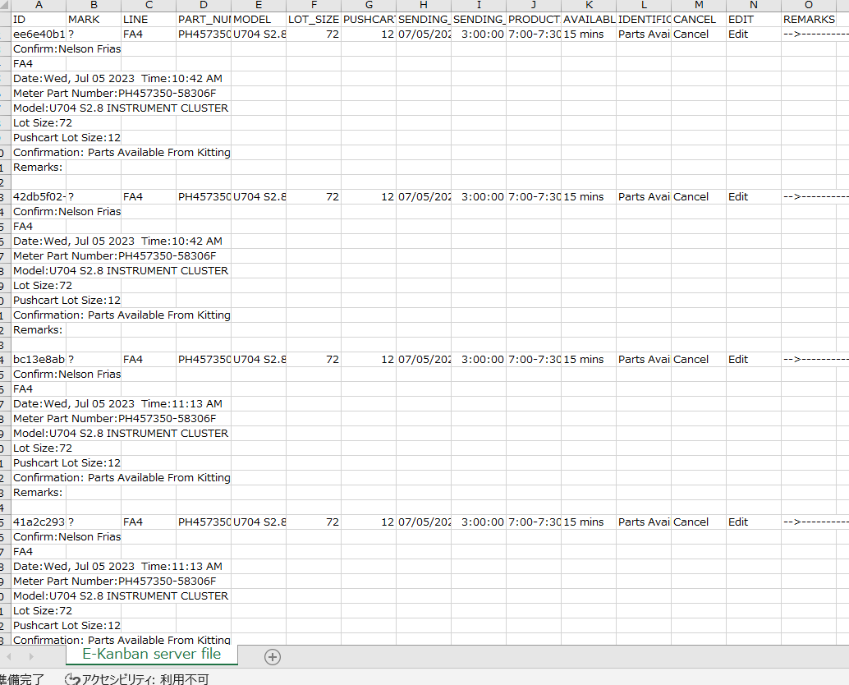
3. Document image
3-1-3. E-Kanban data format
DNPH ⇒Pegasus

Slide 12
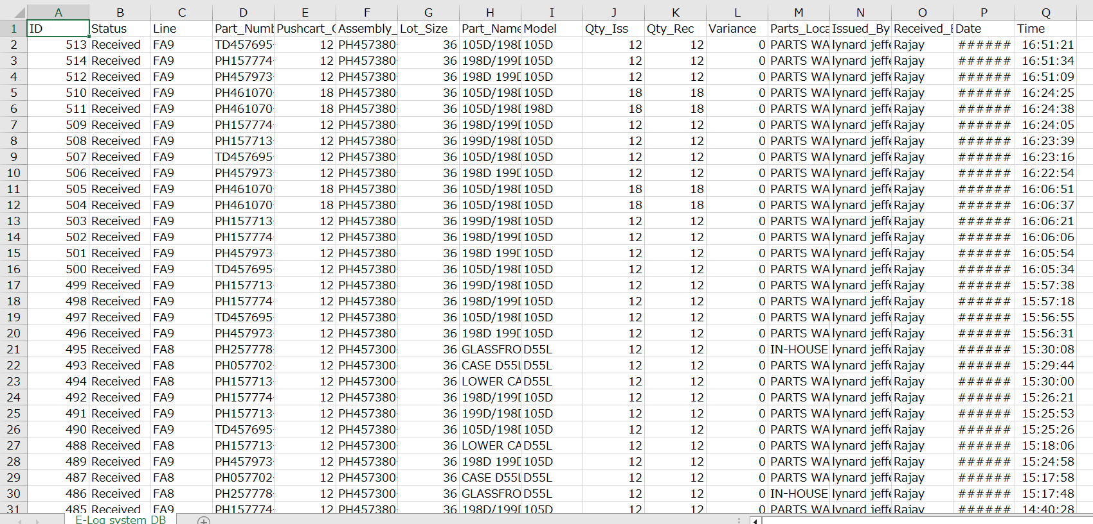
3. Document image
3-1-4. E-Log system data format
DNPH ⇒Pegasus

Slide 13
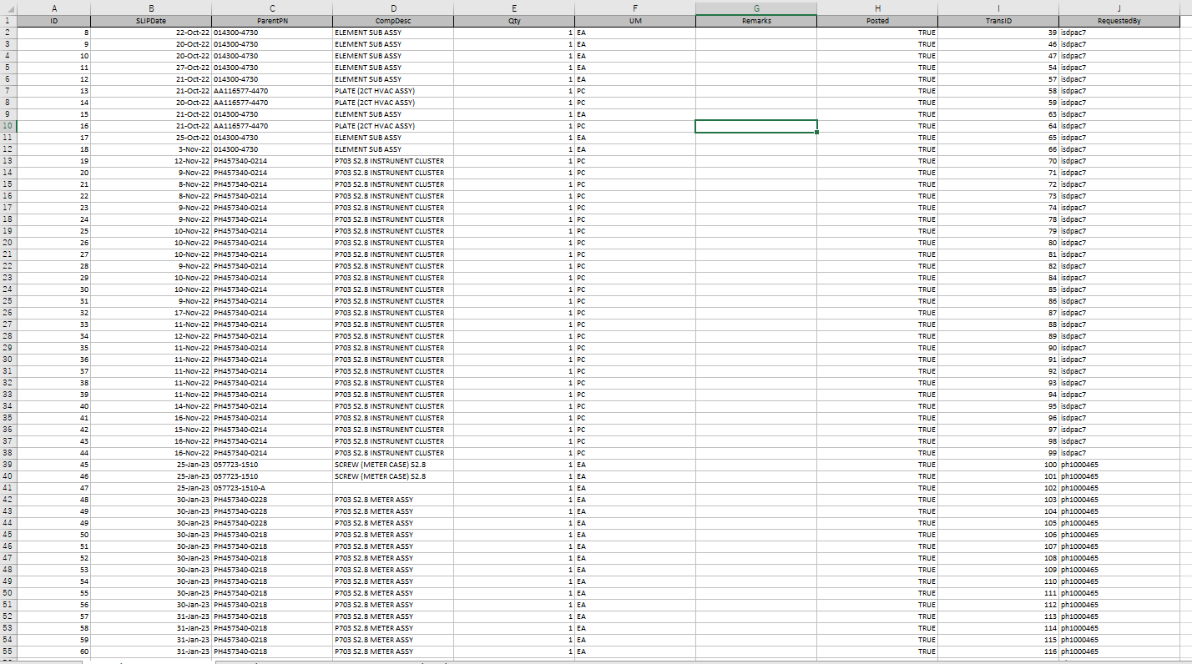
3. Document image
3-1-5-1. WACS system data format With ParentRN
DNPH ⇒Pegasus
  About the differences between the three types of files
3

Slide 14
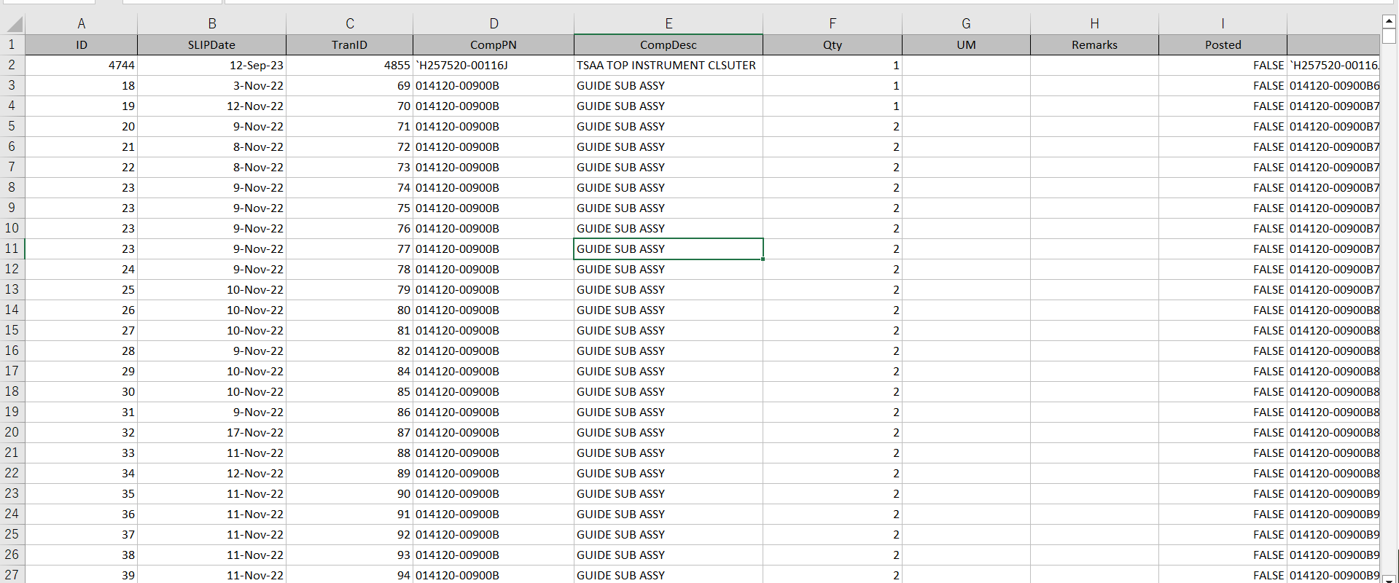
3. Document image
3-1-5-2. WACS system data format With ComponentPN
DNPH ⇒Pegasus
  About the differences between the three types of files
3

Slide 15
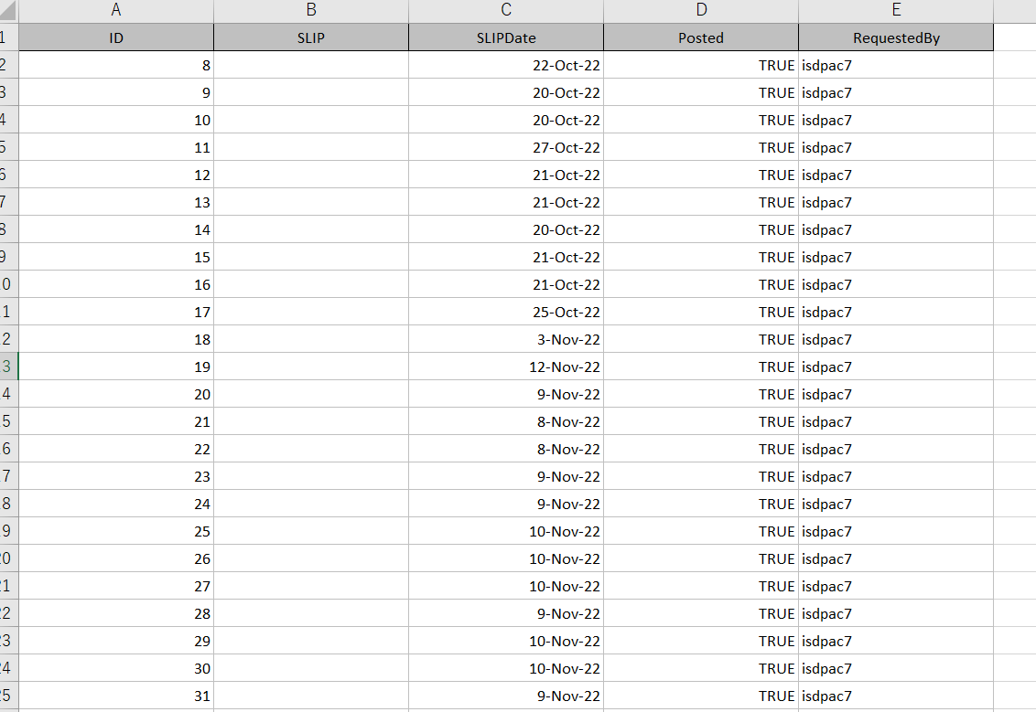
3. Document image
3-1-5-3. WACS system data format With SlipPN
DNPH ⇒Pegasus
  About the differences between the three types of files
3

Slide 16
3. Document image
3-1-6. Production Line parts sensor Link data format
KAU ⇒Pegasus

Slide 17
3. Document image
3-1-7. Production Line FG sensor Link data format
KAU ⇒Pegasus

Slide 18
3. Document image
3-1-5. Shopper AGV Station Sensor Link data format
KAU ⇒Pegasus
06/Jan/2024
Unnecessary
3

Slide 19
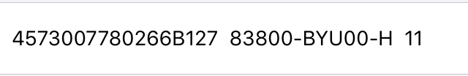
3. Document image
3-2. Utilize QR Traceability System and CMS Data
QR Tracesability Data
06/Jan/2024
Unnecessary
3
Parts No
Serial No.
Prod. Date.
Customer P/No.
QR information
[Parts No]│[Serial No.] │[Prod. Date.]│[Customer P/No]
Parts No :
Serial No. :
Prod Date. :
Customer P/No. :
**Check QR code data format.

Slide 20
4. Operation flow
4-1. Data linkage
4-1-1-1. Andon 1.5 CMS data registration
KDDI
Pegasus
06/Jan/2024
Unnecessary
3
Linkage of production schedule data for the day
Received
Operating status data
Data To Be Utilize
<Sample>
Line - FA6
Model - 3M0A
Part Number - PH257580-5854
CT-Cycle Time – 75.0 sec.
OR-Operation Ratio – 85%
Yes
No
BK file manual import (*1)(*2)
Modification required
Yes / No
File import error?
Yes / No
Check error details
Yes
No
Checking the linked data
Operation status link app
Finish
*1 If there is an import error, set an error flag. Since the import completion flag is not set, it is possible to import the same Date / Line / Parts No.
*2 After importing, backup files are stored in the “Normal folder" and the “Error folder".

Slide 21
4. Operation flow
4-1. Data linkage
4-1-1-2. Andon 1.5 CMS data Delete
KDDI
Pegasus
06/Jan/2024
Unnecessary
3
Linkage of production schedule data for the day
Received
Operating status data
Data To Be Utilize
<Sample>
Line - FA6
Model - 3M0A
Part Number - PH257580-5854
CT-Cycle Time – 75.0 sec.
OR-Operation Ratio – 85%
Yes
No
BK file manual import (*1)(*2)
Modification required
Yes / No
File import error?
Yes / No
Check error details
Yes
No
Checking the linked data
Turn on operation status deletion
Operation status link app
Finish
*1 If there is an import error, set an error flag. Since the import completion flag is not set, it is possible to import the same Serial no / Parts no.
*2 After importing, backup files are stored in the “Normal folder" and the “Error folder".

Slide 22
4. Operation flow
4-1. Data linkage
4-1-2-1. Cycle time master for Transport work linkage data registration
KDDI
Pegasus
Linkage of CT transport work data for the day
Received
CT transport work data
Yes
No
BK file manual import (*1)(*2)
Modification required
Yes / No
File import error?
Yes / No
Check error details
Yes
No
Checking the linked data
Master link app
Finish
*1 If there is an import error, set an error flag. Since the import completion flag is not set, it is possible to import the same Date / Line / Parts No.
*2 After importing, backup files are stored in the “Normal folder" and the “Error folder".

Slide 23
4. Operation flow
4-1. Data linkage
4-1-2-2. Cycle time master for Transport work data linkage data Delete
KDDI
Pegasus
Linkage of CT transport work data for the day
Received
CT transport work data
Yes
No
BK file manual import (*1)(*2)
Modification required
Yes / No
File import error?
Yes / No
Check error details
Yes
No
Checking the linked data
Turn on operation status deletion
Master link app
Finish
*1 If there is an import error, set an error flag. Since the import completion flag is not set, it is possible to import the same Serial no / Parts no.
*2 After importing, backup files are stored in the “Normal folder" and the “Error folder".

Slide 24
4. Operation flow
4-1. Data linkage
4-1-3-1. E-Kanban data linkage registration schedule
DNPH
Pegasus
Linkage of production schedule data for the day
Received
Production schedule data
Data To Be Utilize
<Sample>
Line - FA6
Model - 3M0A
Part Number - PH257580-5854
Lot Size/Qty – 30
Pushcart Lot - 10
Sending Date – 2023-07-06
Sending Time – 04:30:00
Production Time – 08:30 – 9:00 AM
Yes
No
BK file manual import (*1)(*2)
Modification required
Yes / No
File import error?
Yes / No
Check error details
Yes
No
Checking the linked data
Schedule link app
Remove data
Yes
Should it be removed or not? (*3)
Yes / No
No
*1 If there is an import error, set an error flag. Since the import completion flag is not set, it is possible to import the same Serial no / Parts no.
*2 After importing, backup files are stored in the “Normal folder" and the “Error folder".
*3 Allow deletion of linked data. Limited to data before Working status.
Instruction priority calculation
(Update)
Finish

Slide 25
4. Operation flow
4-1. Data linkage
4-1-3-2. E-Kanban data linkage Delete schedule
DNPH
Pegasus
Linkage of production schedule data for the day
Received
Production schedule data
Data To Be Utilize
<Sample>
Line - FA6
Model - 3M0A
Part Number - PH257580-5854
Lot Size/Qty – 30
Pushcart Lot - 10
Sending Date – 2023-07-06
Sending Time – 04:30:00
Production Time – 08:30 – 9:00 AM
Yes
No
BK file manual import (*1)(*2)
Modification required
Yes / No
File import error?
Yes / No
Check error details
Yes
No
Checking the linked data
Turn on schedule deletion
Schedule link app
Remove data
Yes
Should it be removed or not? (*3)
Yes / No
No
*1 If there is an import error, set an error flag. Since the import completion flag is not set, it is possible to import the same Serial no / Parts no.
*2 After importing, backup files are stored in the “Normal folder" and the “Error folder".
*3 Allow deletion of linked data. Limited to data before Working status.
Instruction priority calculation
(Update)
Finish

Slide 26
4. Operation flow
4-1. Data linkage
4-1-4-1. E-Log System data linkage registration schedule
DNPH
Pegasus
Linkage of production schedule data for the day
Received
Production schedule data
Yes
No
BK file manual import (*1)(*2)
Modification required
Yes / No
File import error?
Yes / No
Check error details
Yes
No
Checking the linked data
Schedule link app
Remove data
Yes
Should it be removed or not? (*3)
Yes / No
No
*1 If there is an import error, set an error flag. Since the import completion flag is not set, it is possible to import the same Serial no / Parts no.
*2 After importing, backup files are stored in the “Normal folder" and the “Error folder".
*3 Allow deletion of linked data. Limited to data before Working status.
Instruction priority calculation
(Update)
Finish

Slide 27
4. Operation flow
4-1. Data linkage
4-1-4-2. E-Log System data linkage Delete schedule
DNPH
Pegasus
Linkage of production schedule data for the day
Received
Production schedule data
Yes
No
BK file manual import (*1)(*2)
Modification required
Yes / No
File import error?
Yes / No
Check error details
Yes
No
Checking the linked data
Turn on schedule deletion
Schedule link app
Remove data
Yes
Should it be removed or not? (*3)
Yes / No
No
*1 If there is an import error, set an error flag. Since the import completion flag is not set, it is possible to import the same Serial no / Parts no.
*2 After importing, backup files are stored in the “Normal folder" and the “Error folder".
*3 Allow deletion of linked data. Limited to data before Working status.
Instruction priority calculation
(Update)
Finish

Slide 28
4. Operation flow
4-1. Data linkage
4-1-5-1. WACS System data linkage registration schedule
DNPH
Pegasus
Linkage of production schedule data for the day
Received
Production schedule data
Yes
No
BK file manual import (*1)(*2)
Modification required
Yes / No
File import error?
Yes / No
Check error details
Yes
No
Checking the linked data
Schedule link app
Remove data
Yes
Should it be removed or not? (*3)
Yes / No
No
*1 If there is an import error, set an error flag. Since the import completion flag is not set, it is possible to import the same Serial no / Parts no.
*2 After importing, backup files are stored in the “Normal folder" and the “Error folder".
*3 Allow deletion of linked data. Limited to data before Working status.
Instruction priority calculation
(Update)
Finish

Slide 29
4. Operation flow
4-1. Data linkage
4-1-5-2. WACS System data linkage Delete schedule
DNPH
Pegasus
Linkage of production schedule data for the day
Received
Production schedule data
Yes
No
BK file manual import (*1)(*2)
Modification required
Yes / No
File import error?
Yes / No
Check error details
Yes
No
Checking the linked data
Turn on schedule deletion
Schedule link app
Remove data
Yes
Should it be removed or not? (*3)
Yes / No
No
*1 If there is an import error, set an error flag. Since the import completion flag is not set, it is possible to import the same Serial no / Parts no.
*2 After importing, backup files are stored in the “Normal folder" and the “Error folder".
*3 Allow deletion of linked data. Limited to data before Working status.
Instruction priority calculation
(Update)
Finish

Slide 30
4. Operation flow
4-1. Data linkage
4-1-6-1. Production Line parts sensor data registration
KAU
Pegasus
Linkage of production Line parts sensor data for the day
Received
Production Line parts sensor data
Yes
No
BK file manual import (*1)(*2)
Modification required
Yes / No
File import error?
Yes / No
Check error details
Yes
No
Checking the linked data
I/O status link app
Finish
*1 If there is an import error, set an error flag. Since the import completion flag is not set, it is possible to import the same Date / Line / Parts No.
*2 After importing, backup files are stored in the “Normal folder" and the “Error folder".

Slide 31
4. Operation flow
4-1. Data linkage
4-1-6-2. Production Line parts sensor data Delete
KAU
Pegasus
Linkage of production Line parts sensor data for the day
Received
Production Line parts sensor data
Yes
No
BK file manual import (*1)(*2)
Modification required
Yes / No
File import error?
Yes / No
Check error details
Yes
No
Checking the linked data
Turn on operation status deletion
I/O status link app
Finish
*1 If there is an import error, set an error flag. Since the import completion flag is not set, it is possible to import the same Serial no / Parts no.
*2 After importing, backup files are stored in the “Normal folder" and the “Error folder".

Slide 32
4. Operation flow
4-1. Data linkage
4-1-7-1. Production Line FG sensor data registration
KAU
Pegasus
Linkage of production Line FG sensor data for the day
Received
Production Line FG sensor data
Yes
No
BK file manual import (*1)(*2)
Modification required
Yes / No
File import error?
Yes / No
Check error details
Yes
No
Checking the linked data
I/O status link app
Finish
*1 If there is an import error, set an error flag. Since the import completion flag is not set, it is possible to import the same Date / Line / Parts No.
*2 After importing, backup files are stored in the “Normal folder" and the “Error folder".

Slide 33
4. Operation flow
4-1. Data linkage
4-1-7-2. Production Line FG sensor data Delete
KAU
Pegasus
Linkage of production Line FG sensor data for the day
Received
Production Line FG sensor data
Yes
No
BK file manual import (*1)(*2)
Modification required
Yes / No
File import error?
Yes / No
Check error details
Yes
No
Checking the linked data
Turn on operation status deletion
I/O status link app
Finish
*1 If there is an import error, set an error flag. Since the import completion flag is not set, it is possible to import the same Serial no / Parts no.
*2 After importing, backup files are stored in the “Normal folder" and the “Error folder".

Slide 34
4. Operation flow
4-1. Data linkage
4-1-9. Shopper AGV Station Sensor data registration
KAU
Pegasus
06/Jan/2024
Unnecessary
3
Linkage of production Line FG sensor data for the day
Received
Production Line FG sensor data
Yes
No
BK file manual import (*1)(*2)
Modification required
Yes / No
File import error?
Yes / No
Check error details
Yes
No
Checking the linked data
I/O status link app
Finish
*1 If there is an import error, set an error flag. Since the import completion flag is not set, it is possible to import the same Date / Line / Parts No.
*2 After importing, backup files are stored in the “Normal folder" and the “Error folder".

Slide 35
4. Operation flow
4-1. Data linkage
4-1-10. Shopper AGV Station sensor data Delete
KAU
Pegasus
06/Jan/2024
Unnecessary
3
Linkage of AGV Station Line FG sensor data for the day
Received
Production Line FG sensor data
Yes
No
BK file manual import (*1)(*2)
Modification required
Yes / No
File import error?
Yes / No
Check error details
Yes
No
Checking the linked data
Turn on operation status deletion
I/O status link app
Finish
*1 If there is an import error, set an error flag. Since the import completion flag is not set, it is possible to import the same Serial no / Parts no.
*2 After importing, backup files are stored in the “Normal folder" and the “Error folder".

Slide 36
4. Operation flow
4-2. Pre-production preparation operations
4-2-1. E-Kanban registration
3
DNPH
Pegasus
Kanban preparation
E-Kanban preparation
N-1
Import E-Kanban information at DNPH database
Linkage data from
E-Kanban system database of DNPH
E-Kanban linkage data
Registration App
Scan the target kanban with the app
Linkage data from
E-Kanban system database of DNPH
Change status
E-Kanban linkage data
Registration App

Slide 37
4. Operation flow
4-3. During production operation
4-3-1. Kitting work instructions phase#1
DNPH
Pegasus
This cannot be realized because there is no E-Kanban data.
26/Feb/2024
6

Slide 38
4. Operation flow
4-3. During production operation
4-3-1. Kitting work instructions phase#2
6
DNPH
Pegasus
Start & Wait
Instruction priority calculation
(Update)
Kitting display App
Receiving trigger from Shopper ST
Instructions from the top schedule
(Select) *1
Display status change
Directed
Kitting smart watch App
Press Start button
Working
Display status change
Working
Move to buffer ST
Press End button
Kitting Completed
Display status change
Kitting Completed
Scan Kanban by E-Log system
E-Log linkage data
Registration App
Linkage E-log system data from DNPH database
AGV start action
Display status change
Work Completed
No
Is today's schedule complete?
Yes / No
Kitting display App
Yes
Finish
*1 After issuing a schedule instruction, the corresponding ID will be excluded from recalculation targets. Changes are not allowed.

Slide 39
4. Operation flow
4-3. During production operation
4-3-2. Shopper work instructions for parts phase#1
6
3
DNPH
Pegasus
Start & Wait
Parts sensor linkage data
Registration App
Production Line parts sensor OFF by KAU
Linkage parts sensor data from KAU DB
Shopper display App
Work instructions from each LINE
Display status change
Directed
Shopper smart watch App
Press Start button
Working
Display status change
Working
Sending trigger to Kitting ST
Press End button
Shopper Completed
Display status change
Shopper Completed
Production Line parts sensor ON by KAU
Linkage parts sensor data from KAU CSV
Display status change
Work Completed
Parts sensor linkage data
Registration App
No
Is today's schedule complete?
Yes / No
Yes
*1 After issuing a schedule instruction, the corresponding ID will be excluded from recalculation targets. Changes are not allowed.
Finish

Slide 40
4. Operation flow
4-3. During production operation
4-3-2. Shopper work instructions for parts phase#2
6
3
DNPH
Pegasus
Start & Wait
Parts sensor linkage data
Registration App
Production Line parts sensor OFF by KAU
Linkage parts sensor data from KAU DB
Shopper display App
Instructions from the top schedule
(Select) *1
Display status change
Directed
Shopper smart watch App
Press Start button
Working
Display status change
Working
Sending trigger to Kitting ST
Press End button
Shopper Completed
Display status change
Shopper Completed
Production Line parts sensor ON by KAU
Linkage parts sensor data from KAU CSV
Display status change
Work Completed
Parts sensor linkage data
Registration App
Instruction priority calculation
(Update)
No
Is today's schedule complete?
Yes / No
Yes
*1 After issuing a schedule instruction, the corresponding ID will be excluded from recalculation targets. Changes are not allowed.
Finish

Slide 41
4. Operation flow
4-3. During production operation
4-3-3. Shopper work instructions for FG phase#1
6
3
DNPH
Pegasus
Start & Wait
FG sensor linkage data
Registration App
Production Line FG sensor OFF by KAU
Linkage FG sensor data from KAU DB
Instructions from the top schedule
(Select) *1
Shopper smart watch App
Press Start button
Working
Press End button
Shopper Completed
Production Line FG sensor ON by KAU
Linkage FG sensor data from KAU CSV
FG sensor linkage data
Registration App
No
Is today's schedule complete?
Yes / No
Yes
Finish

Slide 42
4. Operation flow
4-3. During production operation
4-3-3. Shopper work instructions for FG phase#2
6
3
DNPH
Pegasus
Start & Wait
FG sensor linkage data
Registration App
Production Line FG sensor OFF by KAU
Linkage FG sensor data from KAU DB
Instructions from the top schedule
(Select) *1
Shopper smart watch App
Press Start button
Working
Press End button
Shopper Completed
Production Line FG sensor ON by KAU
Linkage FG sensor data from KAU CSV
FG sensor linkage data
Registration App
No
Is today's schedule complete?
Yes / No
Yes
Finish

Slide 43
4. Operation flow
4-4. Priority determination
4-4-1. Kitting work instructions phase#2
3
1. Various conditions
# | Key item | Description | Judgement | Remark
1 | Receiving trigger from Shopper ST | The production line is in operation | Yes or No
2 | CMS data linkage data | Manage transport cycle time for all parts. “Smart watch free” Qty < “Receiving trigger from Shopper ST” Qty | Yes or No | Prioritize parts with short transport cycle times. Judgments are made at the same timing within 10-30 seconds.
2. Flow chart
Start
*1 Waiting time can be changed in the master setting.
“Smart watch free Qty”
<
“Receiving trigger”
Yes / No
Yes
No
Wait 10 to 30 seconds
*1
Picking instruction for ST order with trigger
Is there only one trigger?
Yes / No
Yes
Picking instruction for ST order with trigger
No
Does this item have a short cycle time?
Yes / No
Yes
Picking instruction for ST order with trigger
Select the Item with the shortest cycle time
Picking instruction for ST order with trigger
Finish

Slide 44
4. Operation flow
4-4. Priority determination
4-4-1. Kitting work instructions phase#1
6
Not applicable
26/Feb/2024

Slide 45

4. Operation flow
4-4. Priority determination
4-4-1. Kitting work instructions phase#2
２
3. Notification method
Step 0 : Number of workers
Step 0 : Priority among workers
Smart watch
Smart watch
Smart watch
Worker A
Worker B
Worker C
Worker A
Worker B
Worker C
Step 0 : Original data linked from E-Kanban
1 | 2 | 3 | 4 | 5 | 6 | 7 | 8 | 9 | 10
Model A 30/30 Line1 #1 | Model B 30/30 Line2 #2 | Model C 30/30 Line3 #3 | Model D 30/30 Line4 #4 | Model E 30/30 Line5 #5 | Model F 30/30 Line6 #6 | Model G 30/30 Line7 #7 | Model H 30/30 Line8 #8 | Model J 30/30 Line1 #9 | Model K 30/30 Line1 #10

Slide 46
4. Operation flow
4-4. Priority determination
4-4-1. Kitting work instructions phase#2
3
3. Notification method
Step 1 : Select Pattern #1
Start
“Smart watch free Qty”
<
“Receiving trigger”
Yes / No
Yes
No
Wait 10 to 30 seconds
*1
Picking instruction for ST order with trigger
Is there only one trigger?
Yes / No
Yes
Picking instruction for ST order with trigger
No
Does this item have a short cycle time?
Yes / No
Yes
Picking instruction for ST order with trigger
Select the Item with the shortest cycle time
Picking instruction for ST order with trigger
Finish
1 | 2 | 3 | 4 | 5 | 6 | 7 | 8 | 9 | 10
Model A 30/30 Line1 #1 | Model B 30/30 Line2 #2 | Model C 30/30 Line3 #3 | Model D 30/30 Line4 #4 | Model E 30/30 Line5 #5 | Model F 30/30 Line6 #6 | Model G 30/30 Line7 #7 | Model H 30/30 Line8 #8 | Model J 30/30 Line1 #9 | Model K 30/30 Line1 #10
Before
Smart watch
Smart watch
Smart watch
Worker A
Worker B
Worker C
Trigger
Line 1
After
Smart watch
Model A 30/30 Line1 #1
Smart watch
Smart watch
Worker A
Worker B
Worker C

Slide 47
4. Operation flow
4-4. Priority determination
4-4-1. Kitting work instructions phase#2
3
3. Notification method
Step 1 : Select Pattern #2
Start
“Smart watch free Qty”
<
“Receiving trigger”
Yes / No
Yes
No
Wait 10 to 30 seconds
*1
Picking instruction for ST order with trigger
Is there only one trigger?
Yes / No
Yes
Picking instruction for ST order with trigger
No
Does this item have a short cycle time?
Yes / No
Yes
Picking instruction for ST order with trigger
Select the Item with the shortest cycle time
Picking instruction for ST order with trigger
Finish
1 | 2 | 3 | 4 | 5 | 6 | 7 | 8 | 9 | 10
Model A 30/30 Line1 #1 | Model B 30/30 Line2 #2 | Model C 30/30 Line3 #3 | Model D 30/30 Line4 #4 | Model E 30/30 Line5 #5 | Model F 30/30 Line6 #6 | Model G 30/30 Line7 #7 | Model H 30/30 Line8 #8 | Model J 30/30 Line1 #9 | Model K 30/30 Line1 #10
Before
Smart watch
Smart watch
Smart watch
Worker A
Worker B
Worker C
Trigger
Line 1
Line 2
Line 5
After
Smart watch
Model A 30/30 Line1 #1
Smart watch
Model B 30/30 Line2 #2
Smart watch
Model E 30/30 Line5 #5
Worker A
Worker B
Worker C

Slide 48
4. Operation flow
4-4. Priority determination
4-4-1. Kitting work instructions phase#2
3
3. Notification method
Step 2 : Select Pattern #3
Start
“Smart watch free Qty”
<
“Receiving trigger”
Yes / No
Yes
No
Wait 10 to 30 seconds
*1
Picking instruction for ST order with trigger
Is there only one trigger?
Yes / No
Yes
Picking instruction for ST order with trigger
No
Does this item have a short cycle time?
Yes / No
Yes
Picking instruction for ST order with trigger
Select the Item with the shortest cycle time
Picking instruction for ST order with trigger
Finish
1 | 2 | 3 | 4 | 5 | 6 | 7 | 8 | 9 | 10
Model A 30/30 Line1 #1 | Model B 30/30 Line2 #2 | Model C 30/30 Line3 #3 | Model D 30/30 Line4 #4 | Model E 30/30 Line5 #5 | Model F 30/30 Line6 #6 | Model G 30/30 Line7 #7 | Model H 30/30 Line8 #8 | Model J 30/30 Line1 #9 | Model K 30/30 Line1 #10
Before
Smart watch
Model A 30/30 Line1 #1
Smart watch
Model B 30/30 Line2 #2
Smart watch
Worker A
Worker B
Worker C
Trigger
Line 3
After
Smart watch
Model A 30/30 Line1 #1
Smart watch
Model B 30/30 Line2 #2
Smart watch
Model C 30/30 Line3 #3
Worker A
Worker B
Worker C

Slide 49
4. Operation flow
4-4. Priority determination
4-4-1. Kitting work instructions phase#2
3
3. Notification method
Step 2 : Select Pattern #4
Start
“Smart watch free Qty”
<
“Receiving trigger”
Yes / No
Yes
No
Wait 10 to 30 seconds
*1
Picking instruction for ST order with trigger
Is there only one trigger?
Yes / No
Yes
Picking instruction for ST order with trigger
No
Does this item have a short cycle time?
Yes / No
Yes
Picking instruction for ST order with trigger
Select the Item with the shortest cycle time
Picking instruction for ST order with trigger
Finish
1 | 2 | 3 | 4 | 5 | 6 | 7 | 8 | 9 | 10
Model A 30/30 Line1 #1 | Model B 30/30 Line2 #2 | Model C 30/30 Line3 #3 | Model D 30/30 Line4 #4 | Model E 30/30 Line5 #5 | Model F 30/30 Line6 #6 | Model G 30/30 Line7 #7 | Model H 30/30 Line8 #8 | Model J 30/30 Line1 #9 | Model K 30/30 Line1 #10
Before
Smart watch
Model A 30/30 Line1 #1
Smart watch
Model B 30/30 Line2 #2
Smart watch
CT Model C = 100s
Worker A
Worker B
Worker C
CT Model D = 80s
Trigger
Line 3
Line 4
After
Smart watch
Model A 30/30 Line1 #1
Smart watch
Model B 30/30 Line2 #2
Smart watch
Model D 30/30 Line4 #4
Worker A
Worker B
Worker C

Slide 50
4. Operation flow
4-4. Priority determination
4-4-1. Kitting work instructions phase#2
3
3. Notification method
Step 2 : Select Pattern #4
1 | 2 | 3 | 4 | 5 | 6 | 7 | 8 | 9 | 10
Model A 30/30 Line1 #1 | Model B 30/30 Line2 #2 | Model C 30/30 Line3 #3 | Model D 30/30 Line4 #4 | Model E 30/30 Line5 #5 | Model F 30/30 Line6 #6 | Model G 30/30 Line7 #7 | Model H 30/30 Line8 #8 | Model J 30/30 Line1 #9 | Model K 30/30 Line1 #10
Before
Smart watch
Model A 30/30 Line1 #1
Smart watch
Model B 30/30 Line2 #2
Smart watch
CT Model C = 100s
Worker A
Worker B
Worker C
CT Model D = 80s
Trigger
Line 3
Line 4
After step2
Smart watch
Model A 30/30 Line1 #1
Smart watch
Model B 30/30 Line2 #2
Smart watch
Model D 30/30 Line4 #4
Worker A
Worker B
Worker C
Trigger
Line 3
After step2.5
Smart watch
Model A 30/30 Line1 #1
Smart watch
Smart watch
Model D 30/30 Line4 #4
Worker A
Worker B
Worker C
Trigger
Line 3
After step3
Smart watch
Model A 30/30 Line1 #1
Smart watch
Model C 30/30 Line3 #3
Smart watch
Model D 30/30 Line4 #4
Worker A
Worker B
Worker C

Slide 51
4. Operation flow
4-4. Priority determination
4-4-2. Shopper work instructions for parts phase#1
6
1. Various conditions
# | Key item | Description | Judgement | Remark
1 | Receiving trigger from Parts sencer | The production line is in operation | Yes or No
2 | CMS data linkage data | Manage production cycle time for all parts. “Smart watch free” Qty < “Receiving trigger from Shopper ST” Qty | Yes or No | Prioritize parts with short production cycle times. Judgments are made at the same timing within 10-30 seconds.
2. Flow chart
Start
“Smart watch free Qty”
<
“Receiving trigger”
Yes / No
Yes
No
Picking instruction for ST order with trigger
Is there only one trigger?
Yes / No
Yes
Picking instruction for order with trigger
No
No
Wait until smartwatch becomes free. Return to "Start".
Finish

Slide 52
4. Operation flow
4-4. Priority determination
4-4-2. Shopper work instructions for parts phase#1
6
3. Notification method
Step 0 : Number of workers
Step 0 : Priority among workers
Smart watch
Smart watch
Smart watch
Worker A
Worker B
Worker C
Worker A
Worker B
Worker C
Step 0 : Original data linked from E-Kanban
1 | 2 | 3 | 4 | 5 | 6 | 7 | 8 | 9 | 10
Model A 30/30 Line1 #1 | Model B 30/30 Line2 #2 | Model C 30/30 Line3 #3 | Model D 30/30 Line4 #4 | Model E 30/30 Line5 #5 | Model F 30/30 Line6 #6 | Model G 30/30 Line7 #7 | Model H 30/30 Line8 #8 | Model J 30/30 Line1 #9 | Model K 30/30 Line1 #10
Not applicable
26/Feb/2024

Slide 53
4. Operation flow
4-4. Priority determination
4-4-2. Shopper work instructions for parts phase#2
6
3
1. Various conditions
# | Key item | Description | Judgement | Remark
1 | Receiving trigger from Parts sencer | The production line is in operation | Yes or No
2 | CMS data linkage data | Manage production cycle time for all parts. “Smart watch free” Qty < “Receiving trigger from Shopper ST” Qty | Yes or No | Prioritize parts with short production cycle times. Judgments are made at the same timing within 10-30 seconds.
2. Flow chart
Start
*1 Waiting time can be changed in the master setting.
“Smart watch free Qty”
<
“Receiving trigger”
Yes / No
Yes
No
Wait 10 to 30 seconds
*1
Picking instruction for ST order with trigger
Is there only one trigger?
Yes / No
Yes
Picking instruction for ST order with trigger
No
Does this item have a short cycle time?
Yes / No
Yes
Picking instruction for ST order with trigger
No
Wait until smartwatch becomes free. Return to "Start".
Finish

Slide 54
4. Operation flow
4-4. Priority determination
4-4-2. Shopper work instructions for parts phase#2
6
２
3. Notification method
Step 0 : Number of workers
Step 0 : Priority among workers
Smart watch
Smart watch
Smart watch
Worker A
Worker B
Worker C
Worker A
Worker B
Worker C
Step 0 : Original data linked from E-Kanban
1 | 2 | 3 | 4 | 5 | 6 | 7 | 8 | 9 | 10
Model A 30/30 Line1 #1 | Model B 30/30 Line2 #2 | Model C 30/30 Line3 #3 | Model D 30/30 Line4 #4 | Model E 30/30 Line5 #5 | Model F 30/30 Line6 #6 | Model G 30/30 Line7 #7 | Model H 30/30 Line8 #8 | Model J 30/30 Line1 #9 | Model K 30/30 Line1 #10

Slide 55
4. Operation flow
4-4. Priority determination
4-4-2. Shopper work instructions for parts phase#2
6
3
3. Notification method
Step 1 : Select Pattern #1
Start
“Smart watch free Qty”
<
“Receiving trigger”
Yes / No
Yes
No
Wait 10 to 30 seconds
*1
Picking instruction for ST order with trigger
Is there only one trigger?
Yes / No
Yes
Picking instruction for ST order with trigger
No
Does this item have a short cycle time?
Yes / No
Yes
Picking instruction for ST order with trigger
No
Wait until smartwatch becomes free. Return to "Start".
Finish
1 | 2 | 3 | 4 | 5 | 6 | 7 | 8 | 9 | 10
Model A 30/30 Line1 #1 | Model B 30/30 Line2 #2 | Model C 30/30 Line3 #3 | Model D 30/30 Line4 #4 | Model E 30/30 Line5 #5 | Model F 30/30 Line6 #6 | Model G 30/30 Line7 #7 | Model H 30/30 Line8 #8 | Model J 30/30 Line1 #9 | Model K 30/30 Line1 #10
Before
Smart watch
Smart watch
Smart watch
Worker A
Worker B
Worker C
Trigger
Line 1
After
Smart watch
Model A 30/30 Line1 #1
Smart watch
Smart watch
Worker A
Worker B
Worker C

Slide 56
4. Operation flow
4-4. Priority determination
4-4-2. Shopper work instructions for parts phase#2
6
3
3. Notification method
Step 1 : Select Pattern #2
Start
“Smart watch free Qty”
<
“Receiving trigger”
Yes / No
Yes
No
Wait 10 to 30 seconds
*1
Picking instruction for ST order with trigger
Is there only one trigger?
Yes / No
Yes
Picking instruction for ST order with trigger
No
Does this item have a short cycle time?
Yes / No
Yes
Picking instruction for ST order with trigger
No
Wait until smartwatch becomes free. Return to "Start".
Finish
1 | 2 | 3 | 4 | 5 | 6 | 7 | 8 | 9 | 10
Model A 30/30 Line1 #1 | Model B 30/30 Line2 #2 | Model C 30/30 Line3 #3 | Model D 30/30 Line4 #4 | Model E 30/30 Line5 #5 | Model F 30/30 Line6 #6 | Model G 30/30 Line7 #7 | Model H 30/30 Line8 #8 | Model J 30/30 Line1 #9 | Model K 30/30 Line1 #10
Before
Smart watch
Smart watch
Smart watch
Worker A
Worker B
Worker C
Trigger
Line 1
Line 2
Line 5
After
Smart watch
Model A 30/30 Line1 #1
Smart watch
Model B 30/30 Line2 #2
Smart watch
Model E 30/30 Line5 #5
Worker A
Worker B
Worker C

Slide 57
4. Operation flow
4-4. Priority determination
4-4-2. Shopper work instructions for parts phase#2
6
3
3. Notification method
Step 2 : Select Pattern #3
Start
“Smart watch free Qty”
<
“Receiving trigger”
Yes / No
Yes
No
Wait 10 to 30 seconds
*1
Picking instruction for ST order with trigger
Is there only one trigger?
Yes / No
Yes
Picking instruction for ST order with trigger
No
Does this item have a short cycle time?
Yes / No
Yes
Picking instruction for ST order with trigger
No
Wait until smartwatch becomes free. Return to "Start".
Finish
1 | 2 | 3 | 4 | 5 | 6 | 7 | 8 | 9 | 10
Model A 30/30 Line1 #1 | Model B 30/30 Line2 #2 | Model C 30/30 Line3 #3 | Model D 30/30 Line4 #4 | Model E 30/30 Line5 #5 | Model F 30/30 Line6 #6 | Model G 30/30 Line7 #7 | Model H 30/30 Line8 #8 | Model J 30/30 Line1 #9 | Model K 30/30 Line1 #10
Before
Smart watch
Model A 30/30 Line1 #1
Smart watch
Model B 30/30 Line2 #2
Smart watch
Worker A
Worker B
Worker C
Trigger
Line 3
After
Smart watch
Model A 30/30 Line1 #1
Smart watch
Model B 30/30 Line2 #2
Smart watch
Model C 30/30 Line3 #3
Worker A
Worker B
Worker C

Slide 58
4. Operation flow
4-4. Priority determination
4-4-2. Shopper work instructions for parts phase#2
6
3
3. Notification method
Step 2 : Select Pattern #4
Start
“Smart watch free Qty”
<
“Receiving trigger”
Yes / No
Yes
No
Wait 10 to 30 seconds
*1
Picking instruction for ST order with trigger
Is there only one trigger?
Yes / No
Yes
Picking instruction for ST order with trigger
No
Does this item have a short cycle time?
Yes / No
Yes
Picking instruction for ST order with trigger
Wait until smartwatch becomes free. Return to "Start".
Finish
1 | 2 | 3 | 4 | 5 | 6 | 7 | 8 | 9 | 10
Model A 30/30 Line1 #1 | Model B 30/30 Line2 #2 | Model C 30/30 Line3 #3 | Model D 30/30 Line4 #4 | Model E 30/30 Line5 #5 | Model F 30/30 Line6 #6 | Model G 30/30 Line7 #7 | Model H 30/30 Line8 #8 | Model J 30/30 Line1 #9 | Model K 30/30 Line1 #10
Before
Smart watch
Model A 30/30 Line1 #1
Smart watch
Model B 30/30 Line2 #2
Smart watch
CT Model C = 100s
Worker A
Worker B
Worker C
CT Model D = 80s
Trigger
Line 3
Line 4
After
Smart watch
Model A 30/30 Line1 #1
Smart watch
Model B 30/30 Line2 #2
Smart watch
Model D 30/30 Line4 #4
Worker A
Worker B
Worker C

Slide 59
4. Operation flow
4-4. Priority determination
4-4-2. Shopper work instructions for parts phase#2
6
3
3. Notification method
Step 3 : Select Pattern #5
1 | 2 | 3 | 4 | 5 | 6 | 7 | 8 | 9 | 10
Model A 30/30 Line1 #1 | Model B 30/30 Line2 #2 | Model C 30/30 Line3 #3 | Model D 30/30 Line4 #4 | Model E 30/30 Line5 #5 | Model F 30/30 Line6 #6 | Model G 30/30 Line7 #7 | Model H 30/30 Line8 #8 | Model J 30/30 Line1 #9 | Model K 30/30 Line1 #10
Before
Smart watch
Model A 30/30 Line1 #1
Smart watch
Model B 30/30 Line2 #2
Smart watch
CT Model C = 100s
Worker A
Worker B
Worker C
CT Model D = 80s
Trigger
Line 3
Line 4
After step2
Smart watch
Model A 30/30 Line1 #1
Smart watch
Model B 30/30 Line2 #2
Smart watch
Model D 30/30 Line4 #4
Worker A
Worker B
Worker C
Trigger
Line 3
After step2.5
Smart watch
Model A 30/30 Line1 #1
Smart watch
Smart watch
Model D 30/30 Line4 #4
Worker A
Worker B
Worker C
Trigger
Line 3
After step3
Smart watch
Model A 30/30 Line1 #1
Smart watch
Model C 30/30 Line3 #3
Smart watch
Model D 30/30 Line4 #4
Worker A
Worker B
Worker C

Slide 60
4. Operation flow
4-4. Priority determination
4-4-3. Shopper work instructions for FG phase#1
6
1. Various conditions
# | Key item | Description | Judgement | Remark
1 | Production Line FG sensor data | Production Line FG sensor is ON | Yes or No
2
3
4
5
2. Flow chart
Start
“Smart watch free Qty”
<=
“Receiving trigger”
Yes / No
Yes
No
Picking instruction for ST order with trigger
Wait until smartwatch becomes free. Return to "Start".
Finish

Slide 61
4. Operation flow
4-4. Priority determination
4-4-3. Shopper work instructions for FG phase#2
6
1. Various conditions
# | Key item | Description | Judgement | Remark
1 | Production Line FG sensor data | Production Line FG sensor is ON | Yes or No
2
3
4
5
2. Flow chart
Start
“Smart watch free Qty”
<=
“Receiving trigger”
Yes / No
Yes
No
Picking instruction for ST order with trigger
Wait until smartwatch becomes free. Return to "Start".
Finish

Slide 62
4. Operation flow
4-4. Priority determination
4-4-3. Shopper work instructions for FG phase#2
6
3
3. Notification method
Step 1 : Select Pattern #1
Start
“Smart watch free Qty”
<=
“Receiving trigger”
Yes / No
Yes
No
Picking instruction for ST order with trigger
Wait until smartwatch becomes free. Return to "Start".
Finish
1 | 2 | 3 | 4 | 5 | 6 | 7 | 8 | 9 | 10
Model A 30/30 Line1 #1 | Model B 30/30 Line2 #2 | Model C 30/30 Line3 #3 | Model D 30/30 Line4 #4 | Model E 30/30 Line5 #5 | Model F 30/30 Line6 #6 | Model G 30/30 Line7 #7 | Model H 30/30 Line8 #8 | Model J 30/30 Line1 #9 | Model K 30/30 Line1 #10
Before
Smart watch
Smart watch
Smart watch
Worker A
Worker B
Worker C
Trigger
Line 1
After
Smart watch
Model A 30/30 Line1 #1
Smart watch
Smart watch
Worker A
Worker B
Worker C

Slide 63
4. Operation flow
4-4. Priority determination
4-4-3. Shopper work instructions for FG phase#2
6
3
3. Notification method
Step 1 : Select Pattern #2
Start
“Smart watch free Qty”
<=
“Receiving trigger”
Yes / No
Yes
No
Picking instruction for ST order with trigger
Wait until smartwatch becomes free. Return to "Start".
Finish
1 | 2 | 3 | 4 | 5 | 6 | 7 | 8 | 9 | 10
Model A 30/30 Line1 #1 | Model B 30/30 Line2 #2 | Model C 30/30 Line3 #3 | Model D 30/30 Line4 #4 | Model E 30/30 Line5 #5 | Model F 30/30 Line6 #6 | Model G 30/30 Line7 #7 | Model H 30/30 Line8 #8 | Model J 30/30 Line1 #9 | Model K 30/30 Line1 #10
Before
Smart watch
Smart watch
Smart watch
Worker A
Worker B
Worker C
Trigger
Line 1
Line 2
Line 5
After
Smart watch
Model A 30/30 Line1 #1
Smart watch
Model B 30/30 Line2 #2
Smart watch
Model E 30/30 Line5 #5
Worker A
Worker B
Worker C

Slide 64
4. Operation flow
4-4. Priority determination
4-4-3. Shopper work instructions for FG phase#2
6
3
3. Notification method
Step 2 : Select Pattern #3
Start
“Smart watch free Qty”
<=
“Receiving trigger”
Yes / No
Yes
No
Picking instruction for ST order with trigger
Wait until smartwatch becomes free. Return to "Start".
Finish
1 | 2 | 3 | 4 | 5 | 6 | 7 | 8 | 9 | 10
Model A 30/30 Line1 #1 | Model B 30/30 Line2 #2 | Model C 30/30 Line3 #3 | Model D 30/30 Line4 #4 | Model E 30/30 Line5 #5 | Model F 30/30 Line6 #6 | Model G 30/30 Line7 #7 | Model H 30/30 Line8 #8 | Model J 30/30 Line1 #9 | Model K 30/30 Line1 #10
Before
Smart watch
Model A 30/30 Line1 #1
Smart watch
Model B 30/30 Line2 #2
Smart watch
Worker A
Worker B
Worker C
Trigger
Line 3
After
Smart watch
Model A 30/30 Line1 #1
Smart watch
Model B 30/30 Line2 #2
Smart watch
Model C 30/30 Line3 #3
Worker A
Worker B
Worker C

Slide 65
4. Operation flow
4-4. Priority determination
4-4-3. Shopper work instructions for FG phase#2
6
3
3. Notification method
Step 2 : Select Pattern #4
Start
“Smart watch free Qty”
<=
“Receiving trigger”
Yes / No
Yes
No
Picking instruction for ST order with trigger
Wait until smartwatch becomes free. Return to "Start".
Finish
1 | 2 | 3 | 4 | 5 | 6 | 7 | 8 | 9 | 10
Model A 30/30 Line1 #1 | Model B 30/30 Line2 #2 | Model C 30/30 Line3 #3 | Model D 30/30 Line4 #4 | Model E 30/30 Line5 #5 | Model F 30/30 Line6 #6 | Model G 30/30 Line7 #7 | Model H 30/30 Line8 #8 | Model J 30/30 Line1 #9 | Model K 30/30 Line1 #10
Before
Smart watch
Model A 30/30 Line1 #1
Smart watch
Model B 30/30 Line2 #2
Smart watch
Worker A
Worker B
Worker C
Trigger1
Line 3
Trigger2
Line 4
After
Smart watch
Model A 30/30 Line1 #1
Smart watch
Model B 30/30 Line2 #2
Smart watch
Model C 30/30 Line3 #3
Worker A
Worker B
Worker C

Slide 66
4. Operation flow
4-4. Priority determination
4-4-3. Shopper work instructions for FG phase#2
6
3
3. Notification method
Step 3 : Select Pattern #5
1 | 2 | 3 | 4 | 5 | 6 | 7 | 8 | 9 | 10
Model A 30/30 Line1 #1 | Model B 30/30 Line2 #2 | Model C 30/30 Line3 #3 | Model D 30/30 Line4 #4 | Model E 30/30 Line5 #5 | Model F 30/30 Line6 #6 | Model G 30/30 Line7 #7 | Model H 30/30 Line8 #8 | Model J 30/30 Line1 #9 | Model K 30/30 Line1 #10
Before
Smart watch
Model A 30/30 Line1 #1
Smart watch
Model B 30/30 Line2 #2
Smart watch
Worker A
Worker B
Worker C
Trigger1
Trigger2
Line 4
After step2
Smart watch
Model A 30/30 Line1 #1
Smart watch
Model B 30/30 Line2 #2
Smart watch
Model C 30/30 Line3 #3
Worker A
Worker B
Worker C
Trigger1
Line 4
Trigger2
After step2.5
Smart watch
Model A 30/30 Line1 #1
Smart watch
Smart watch
Model C 30/30 Line3 #3
Worker A
Worker B
Worker C
Trigger1
Line 4
Trigger2
After step3
Smart watch
Model A 30/30 Line1 #1
Smart watch
Model D 30/30 Line4 #4
Smart watch
Model C 30/30 Line3 #3
Worker A
Worker B
Worker C

Slide 67
4. Operation flow
4-5. Report management
DNPH
Pegasus
Report management
Line graph
PC :Report management Line graph
Report management
Bar graph
PC :Report management bar graph

Slide 68
4. Operation flow
4-6. Master management
DNPH
Pegasus
Location master
PC : Location master
Cycle time master
PC : Cycle time master
User master
PC : User master

Slide 69
5. System functional specifications
5-1. Kitting work instructions phase#1
6
Not applicable
26/Feb/2024

Slide 70
5. System functional specifications
5-1. Kitting work instructions phase#2
5
Start & Wait
Instruction priority calculation
(Update)
Kitting display App
Receiving trigger from Shopper ST
Instructions from the top schedule
(Select) *1
Display status change
Directed
Kitting smart watch App
Press Start button
Working
Display status change
Working
Move to buffer ST
Press End button
Kitting Completed
Display status change
Kitting Completed
Scan Kanban by E-Log system
E-Log linkage data
Registration App
Linkage E-log system data from DNPH database
AGV start action
Display status change
Work Completed
No
Is today's schedule complete?
Yes / No
Kitting display App
Yes
Finish

Slide 71


5. System functional specifications
5-1. Kitting work instructions phese#2
5-1-1. Smart watch operation flow
5
Start & Wait
1
Smart
Watch
Alex / Group A
14:56:00
Mon Sep 19,22
Worker001
1
Receiving trigger from Shopper ST
2
Receipt of instructions
Instructions from the top schedule
(Select) *1
2
Start
Line FA9
Parts PH457380-0553
14:57:00 / 00:00:11
Mon Sep 19,22
Worker001
If the specified time is exceeded
**Allow time to be changed on master
Kitting smart watch App
Start
Press Start button
Working
3
Start
Line FA9
Parts PH457380-0553
15:57:00 / 01:00:01
Mon Sep 19,22
Worker001
3
Press “Start”
Press End button
Kitting Completed
4
Start
Working
Line FA9
Parts PH457380-0553
14:57:00 / 00:01:01
Mon Sep 19,22
Worker001
Finish
Press “Start”
Working
Line FA9
Parts PH457380-0553
14:57:00 / 00:01:01
Mon Sep 19,22
Worker001
If the standard cycle time is exceeded
Finish
4
Press “NO”
Finished?
Line FA9
Parts PH457380-0553
14:57:00 / 00:01:01
Mon Sep 19,22
Worker001
Press “Finish”
YES
NO
Press “YES”
Smart
Watch
Alex / Group A
14:56:00
Mon Sep 19,22
Worker001

Slide 72
5. System functional specifications
5-1. Kitting work instructions phese#2
5-1-2. Kitting display App
5
Display status change
Directed
Kitting Status Display
Date : 10-Apr-2024 | Time : 8:00 | Shift : Day
Line
FA2
FA4
FA5
FA6
FA7
FA8
FA9
AC Panel
# | Parts No. | Model | Lot size | PIC | Status
Now | PH457350-58306F | U704 S2.8 INSTRUMENT CLUSTER | 72 | Worker 1 | Directed
Next | PH457350-58306F | U704 S2.8 INSTRUMENT CLUSTER | 72 | Worker 2 | -
Now | PH457350-58306F | U704 S2.8 INSTRUMENT CLUSTER | 72 | Worker 3 | -
Next | PH457350-58306F | U704 S2.8 INSTRUMENT CLUSTER | 72 | Worker 4 | -
Now | PH457350-58306F | U704 S2.8 INSTRUMENT CLUSTER | 72 | Worker 5 | -
Next | PH457350-58306F | U704 S2.8 INSTRUMENT CLUSTER | 72 | Worker 6 | -
Now | PH457350-58306F | U704 S2.8 INSTRUMENT CLUSTER | 72 | Worker 7 | -
Next | PH457350-58306F | U704 S2.8 INSTRUMENT CLUSTER | 72 | Worker 8 | -
Now | PH457350-58306F | U704 S2.8 INSTRUMENT CLUSTER | 72 | Worker 9 | -
Next | PH457350-58306F | U704 S2.8 INSTRUMENT CLUSTER | 72 | Worker 10 | -
Now | PH457350-58306F | U704 S2.8 INSTRUMENT CLUSTER | 72 | Worker 11 | -
Next | PH457350-58306F | U704 S2.8 INSTRUMENT CLUSTER | 72 | Worker 12 | -
Now | PH457350-58306F | U704 S2.8 INSTRUMENT CLUSTER | 72 | Worker 13 | -
Next | PH457350-58306F | U704 S2.8 INSTRUMENT CLUSTER | 72 | Worker 14 | -
Now | PH457350-58306F | U704 S2.8 INSTRUMENT CLUSTER | 72 | Worker 15 | -
Next | PH457350-58306F | U704 S2.8 INSTRUMENT CLUSTER | 72 | Worker 16 | -
Start
Line FA9
Parts PH457380-0553
14:57:00 / 00:00:11
Mon Sep 19,22
Worker001
Start
Display status change
Working
Kitting Status Display
Date : 10-Apr-2024 | Time : 8:00 | Shift : Day
Line
FA2
FA4
FA5
FA6
FA7
FA8
FA9
AC Panel
# | Parts No. | Model | Lot size | PIC | Status
Now | PH457350-58306F | U704 S2.8 INSTRUMENT CLUSTER | 72 | Worker 1 | Working
Next | PH457350-58306F | U704 S2.8 INSTRUMENT CLUSTER | 72 | Worker 2 | -
Now | PH457350-58306F | U704 S2.8 INSTRUMENT CLUSTER | 72 | Worker 3 | -
Next | PH457350-58306F | U704 S2.8 INSTRUMENT CLUSTER | 72 | Worker 4 | -
Now | PH457350-58306F | U704 S2.8 INSTRUMENT CLUSTER | 72 | Worker 5 | -
Next | PH457350-58306F | U704 S2.8 INSTRUMENT CLUSTER | 72 | Worker 6 | -
Now | PH457350-58306F | U704 S2.8 INSTRUMENT CLUSTER | 72 | Worker 7 | -
Next | PH457350-58306F | U704 S2.8 INSTRUMENT CLUSTER | 72 | Worker 8 | -
Now | PH457350-58306F | U704 S2.8 INSTRUMENT CLUSTER | 72 | Worker 9 | -
Next | PH457350-58306F | U704 S2.8 INSTRUMENT CLUSTER | 72 | Worker 10 | -
Now | PH457350-58306F | U704 S2.8 INSTRUMENT CLUSTER | 72 | Worker 11 | -
Next | PH457350-58306F | U704 S2.8 INSTRUMENT CLUSTER | 72 | Worker 12 | -
Now | PH457350-58306F | U704 S2.8 INSTRUMENT CLUSTER | 72 | Worker 13 | -
Next | PH457350-58306F | U704 S2.8 INSTRUMENT CLUSTER | 72 | Worker 14 | -
Now | PH457350-58306F | U704 S2.8 INSTRUMENT CLUSTER | 72 | Worker 15 | -
Next | PH457350-58306F | U704 S2.8 INSTRUMENT CLUSTER | 72 | Worker 16 | -
Working
Line FA9
Parts PH457380-0553
14:57:00 / 00:01:01
Mon Sep 19,22
Worker001
Finish

Slide 73
5. System functional specifications
5-1. Kitting work instructions phese#2
5-1-2. Kitting display App
5
Display status change
Directed if delay
Kitting Status Display
Date : 10-Apr-2024 | Time : 8:00 | Shift : Day
Line
FA2
FA4
FA5
FA6
FA7
FA8
FA9
AC Panel
# | Parts No. | Model | Lot size | PIC | Status
Now | PH457350-58306F | U704 S2.8 INSTRUMENT CLUSTER | 72 | Worker 1 | Directed ST Over
Next | PH457350-58306F | U704 S2.8 INSTRUMENT CLUSTER | 72 | Worker 2 | -
Now | PH457350-58306F | U704 S2.8 INSTRUMENT CLUSTER | 72 | Worker 3 | -
Next | PH457350-58306F | U704 S2.8 INSTRUMENT CLUSTER | 72 | Worker 4 | -
Now | PH457350-58306F | U704 S2.8 INSTRUMENT CLUSTER | 72 | Worker 5 | -
Next | PH457350-58306F | U704 S2.8 INSTRUMENT CLUSTER | 72 | Worker 6 | -
Now | PH457350-58306F | U704 S2.8 INSTRUMENT CLUSTER | 72 | Worker 7 | -
Next | PH457350-58306F | U704 S2.8 INSTRUMENT CLUSTER | 72 | Worker 8 | -
Now | PH457350-58306F | U704 S2.8 INSTRUMENT CLUSTER | 72 | Worker 9 | -
Next | PH457350-58306F | U704 S2.8 INSTRUMENT CLUSTER | 72 | Worker 10 | -
Now | PH457350-58306F | U704 S2.8 INSTRUMENT CLUSTER | 72 | Worker 11 | -
Next | PH457350-58306F | U704 S2.8 INSTRUMENT CLUSTER | 72 | Worker 12 | -
Now | PH457350-58306F | U704 S2.8 INSTRUMENT CLUSTER | 72 | Worker 13 | -
Next | PH457350-58306F | U704 S2.8 INSTRUMENT CLUSTER | 72 | Worker 14 | -
Now | PH457350-58306F | U704 S2.8 INSTRUMENT CLUSTER | 72 | Worker 15 | -
Next | PH457350-58306F | U704 S2.8 INSTRUMENT CLUSTER | 72 | Worker 16 | -
Start
Line FA9
Parts PH457380-0553
15:57:00 / 01:00:01
Mon Sep 19,22
Worker001
Start
Display status change
Working if delay
Kitting Status Display
Date : 10-Apr-2024 | Time : 8:00 | Shift : Day
Line
FA2
FA4
FA5
FA6
FA7
FA8
FA9
AC Panel
# | Parts No. | Model | Lot size | PIC | Status
Now | PH457350-58306F | U704 S2.8 INSTRUMENT CLUSTER | 72 | Worker 1 | Working ST Over
Next | PH457350-58306F | U704 S2.8 INSTRUMENT CLUSTER | 72 | Worker 2 | -
Now | PH457350-58306F | U704 S2.8 INSTRUMENT CLUSTER | 72 | Worker 3 | -
Next | PH457350-58306F | U704 S2.8 INSTRUMENT CLUSTER | 72 | Worker 4 | -
Now | PH457350-58306F | U704 S2.8 INSTRUMENT CLUSTER | 72 | Worker 5 | -
Next | PH457350-58306F | U704 S2.8 INSTRUMENT CLUSTER | 72 | Worker 6 | -
Now | PH457350-58306F | U704 S2.8 INSTRUMENT CLUSTER | 72 | Worker 7 | -
Next | PH457350-58306F | U704 S2.8 INSTRUMENT CLUSTER | 72 | Worker 8 | -
Now | PH457350-58306F | U704 S2.8 INSTRUMENT CLUSTER | 72 | Worker 9 | -
Next | PH457350-58306F | U704 S2.8 INSTRUMENT CLUSTER | 72 | Worker 10 | -
Now | PH457350-58306F | U704 S2.8 INSTRUMENT CLUSTER | 72 | Worker 11 | -
Next | PH457350-58306F | U704 S2.8 INSTRUMENT CLUSTER | 72 | Worker 12 | -
Now | PH457350-58306F | U704 S2.8 INSTRUMENT CLUSTER | 72 | Worker 13 | -
Next | PH457350-58306F | U704 S2.8 INSTRUMENT CLUSTER | 72 | Worker 14 | -
Now | PH457350-58306F | U704 S2.8 INSTRUMENT CLUSTER | 72 | Worker 15 | -
Next | PH457350-58306F | U704 S2.8 INSTRUMENT CLUSTER | 72 | Worker 16 | -
Working
Line FA9
Parts PH457380-0553
14:57:00 / 00:01:01
Mon Sep 19,22
Worker001
Finish

Slide 74
5. System functional specifications
5-1. Kitting work instructions phese#2
5-1-2. Kitting display App
5
Display status change
Kitting Completed
Kitting Status Display
Date : 10-Apr-2024 | Time : 8:00 | Shift : Day
Line
FA2
FA4
FA5
FA6
FA7
FA8
FA9
AC Panel
# | Parts No. | Model | Lot size | PIC | Status
Now | PH457350-58306F | U704 S2.8 INSTRUMENT CLUSTER | 72 | Worker 1 | Kitting Completed
Next | PH457350-58306 | U705 S2.8 INSTRUMENT CLUSTER | 72 | Worker 2 | -
Now | PH457350-58306F | U704 S2.8 INSTRUMENT CLUSTER | 72 | Worker 3 | -
Next | PH457350-58306F | U704 S2.8 INSTRUMENT CLUSTER | 72 | Worker 4 | -
Now | PH457350-58306F | U704 S2.8 INSTRUMENT CLUSTER | 72 | Worker 5 | -
Next | PH457350-58306F | U704 S2.8 INSTRUMENT CLUSTER | 72 | Worker 6 | -
Now | PH457350-58306F | U704 S2.8 INSTRUMENT CLUSTER | 72 | Worker 7 | -
Next | PH457350-58306F | U704 S2.8 INSTRUMENT CLUSTER | 72 | Worker 8 | -
Now | PH457350-58306F | U704 S2.8 INSTRUMENT CLUSTER | 72 | Worker 9 | -
Next | PH457350-58306F | U704 S2.8 INSTRUMENT CLUSTER | 72 | Worker 10 | -
Now | PH457350-58306F | U704 S2.8 INSTRUMENT CLUSTER | 72 | Worker 11 | -
Next | PH457350-58306F | U704 S2.8 INSTRUMENT CLUSTER | 72 | Worker 12 | -
Now | PH457350-58306F | U704 S2.8 INSTRUMENT CLUSTER | 72 | Worker 13 | -
Next | PH457350-58306F | U704 S2.8 INSTRUMENT CLUSTER | 72 | Worker 14 | -
Now | PH457350-58306F | U704 S2.8 INSTRUMENT CLUSTER | 72 | Worker 15 | -
Next | PH457350-58306F | U704 S2.8 INSTRUMENT CLUSTER | 72 | Worker 16 | -
Working
Line FA9
Parts PH457380-0553
14:57:00 / 00:01:01
Mon Sep 19,22
Worker001
Finish
Press “Finish”
Finished?
Line FA9
Parts PH457380-0553
14:57:00 / 00:01:01
Mon Sep 19,22
Worker001
YES
NO
Press “YES”
Kitting Status Display
Date : 10-Apr-2024 | Time : 8:00 | Shift : Day
Display status change
Work Completed
Line
FA2
FA4
FA5
FA6
FA7
FA8
FA9
AC Panel
# | Parts No. | Model | Lot size | PIC | Status
Now | PH457350-58306 | U705 S2.8 INSTRUMENT CLUSTER | 72 | Worker 2 | -
Next | PH457350-58307 | U706 S2.8 INSTRUMENT CLUSTER | 72 | Worker 1 | -
Now | PH457350-58306F | U704 S2.8 INSTRUMENT CLUSTER | 72 | Worker 3 | Directed
Next | PH457350-58306F | U704 S2.8 INSTRUMENT CLUSTER | 72 | Worker 4 | -
Now | PH457350-58306F | U704 S2.8 INSTRUMENT CLUSTER | 72 | Worker 5 | -
Next | PH457350-58306F | U704 S2.8 INSTRUMENT CLUSTER | 72 | Worker 6 | -
Now | PH457350-58306F | U704 S2.8 INSTRUMENT CLUSTER | 72 | Worker 7 | -
Next | PH457350-58306F | U704 S2.8 INSTRUMENT CLUSTER | 72 | Worker 8 | -
Now | PH457350-58306F | U704 S2.8 INSTRUMENT CLUSTER | 72 | Worker 9 | -
Next | PH457350-58306F | U704 S2.8 INSTRUMENT CLUSTER | 72 | Worker 10 | -
Now | PH457350-58306F | U704 S2.8 INSTRUMENT CLUSTER | 72 | Worker 11 | -
Next | PH457350-58306F | U704 S2.8 INSTRUMENT CLUSTER | 72 | Worker 12 | -
Now | PH457350-58306F | U704 S2.8 INSTRUMENT CLUSTER | 72 | Worker 13 | -
Next | PH457350-58306F | U704 S2.8 INSTRUMENT CLUSTER | 72 | Worker 14 | -
Now | PH457350-58306F | U704 S2.8 INSTRUMENT CLUSTER | 72 | Worker 15 | -
Next | PH457350-58306F | U704 S2.8 INSTRUMENT CLUSTER | 72 | Worker 16 | -
If the screen exits from “Kitting Completed”, delete the schedule. Give work instructions regarding other work.

Slide 75
5. System functional specifications
5-2. Shopper work instructions for parts phase#1
6
Start & Wait
Parts sensor linkage data
Registration App
Production Line parts sensor OFF by KAU
Linkage parts sensor data from KAU DB
Shopper display App
Work instructions from each LINE
Display status change
Directed
Shopper smart watch App
Press Start button
Working
Display status change
Working
Sending trigger to Kitting ST
Press End button
Shopper Completed
Display status change
Shopper Completed
Production Line parts sensor ON by KAU
Linkage parts sensor data from KAU CSV
Display status change
Work Completed
Parts sensor linkage data
Registration App
No
Is today's schedule complete?
Yes / No
Yes
*1 After issuing a schedule instruction, the corresponding ID will be excluded from recalculation targets. Changes are not allowed.
Finish

Slide 76
5. System functional specifications
5-2. Shopper work instructions for parts phase#1
5-2-1. Smart watch operation flow
6
Start & Wait
1
Smart
Watch
Alex / Group A
14:56:00
Mon Sep 19,22
Worker001
Linkage parts sensor data from KAU CSV
1
Instructions from the top schedule
(Select) *1
2
2
Receipt of instructions
Shopper smart watch App
3
Start
Line FA9
Parts PH457380-0553
14:57:00 / 00:00:11
Mon Sep 19,22
Worker001
Press Start button
Working
If the specified time is exceeded
**Allow time to be changed on master
Sending trigger to Kitting ST
Start
Press End button
Shopper Completed
4
Start
Line FA9
Parts PH457380-0553
15:57:00 / 01:00:01
Mon Sep 19,22
Worker001
3
Press “Start”
Linkage parts sensor data from KAU CSV
Start
Parts sensor linkage data
Registration App
Working
Line FA9
Parts PH457380-0553
14:57:00 / 00:01:01
Mon Sep 19,22
Worker001
Finish
Press “Start”
4
Finished?
Line FA9
Parts PH457380-0553
14:57:00 / 00:01:01
Mon Sep 19,22
Worker001
YES
NO
Press “YES”
Smart
Watch
Alex / Group A
14:56:00
Mon Sep 19,22
Worker001

Slide 77
5. System functional specifications
5-2. Shopper work instructions for parts phase#1
5-2-2. Shopper work instructions for parts display App
6
Display status change
Directed
Shopper Work Status Display
Date : 10-Apr-2024 | Time : 8:00 | Shift : Day
Line
FA2
FA4
FA5
FA6
FA7
FA8
FA9
AC Panel
# | Parts No. | Model | Lot size | PIC | Status
Now | - | - | - | Worker 1 | Directed
Next | - | - | - | Worker 2 | -
Now | - | - | - | Worker 3 | -
Next | - | - | - | Worker 4 | -
Now | - | - | - | Worker 5 | -
Next | - | - | - | Worker 6 | -
Now | - | - | - | Worker 7 | -
Next | - | - | - | Worker 8 | -
Now | - | - | - | Worker 9 | -
Next | - | - | - | Worker 10 | -
Now | - | - | - | Worker 11 | -
Next | - | - | - | Worker 12 | -
Now | - | - | - | Worker 13 | -
Next | - | - | - | Worker 14 | -
Now | - | - | - | Worker 15 | -
Next | - | - | - | Worker 16 | -
Start
Line FA9
Parts PH457380-0553
14:57:00 / 00:00:11
Mon Sep 19,22
Worker001
Start
Display status change
Working
Shopper Work Status Display
Date : 10-Apr-2024 | Time : 8:00 | Shift : Day
Line
FA2
FA4
FA5
FA6
FA7
FA8
FA9
AC Panel
# | Parts No. | Model | Lot size | PIC | Status
Now | - | - | - | Worker 1 | Working
Next | - | - | - | Worker 2 | -
Now | - | - | - | Worker 3 | -
Next | - | - | - | Worker 4 | -
Now | - | - | - | Worker 5 | -
Next | - | - | - | Worker 6 | -
Now | - | - | - | Worker 7 | -
Next | - | - | - | Worker 8 | -
Now | - | - | - | Worker 9 | -
Next | - | - | - | Worker 10 | -
Now | - | - | - | Worker 11 | -
Next | - | - | - | Worker 12 | -
Now | - | - | - | Worker 13 | -
Next | - | - | - | Worker 14 | -
Now | - | - | - | Worker 15 | -
Next | - | - | - | Worker 16 | -
Working
Line FA9
Parts PH457380-0553
14:57:00 / 00:01:01
Mon Sep 19,22
Worker001
Finish

Slide 78
5. System functional specifications
5-2. Shopper work instructions for parts phase#1
5-2-2. Shopper work instructions for parts display App
6
Display status change
Directed if delay
Shopper Work Status Display
Date : 10-Apr-2024 | Time : 8:00 | Shift : Day
Line
FA2
FA4
FA5
FA6
FA7
FA8
FA9
AC Panel
# | Parts No. | Model | Lot size | PIC | Status
Now | - | - | - | Worker 1 | Directed ST Over
Next | - | - | - | Worker 2 | -
Now | - | - | - | Worker 3 | -
Next | - | - | - | Worker 4 | -
Now | - | - | - | Worker 5 | -
Next | - | - | - | Worker 6 | -
Now | - | - | - | Worker 7 | -
Next | - | - | - | Worker 8 | -
Now | - | - | - | Worker 9 | -
Next | - | - | - | Worker 10 | -
Now | - | - | - | Worker 11 | -
Next | - | - | - | Worker 12 | -
Now | - | - | - | Worker 13 | -
Next | - | - | - | Worker 14 | -
Now | - | - | - | Worker 15 | -
Next | - | - | - | Worker 16 | -
Start
Line FA9
Parts PH457380-0553
15:57:00 / 01:00:01
Mon Sep 19,22
Worker001
Start

Slide 79
5. System functional specifications
5-2. Shopper work instructions for parts phase#1
5-2-2. Shopper work instructions for parts display App
6
Display status change
Shopper Completed
Shopper Work Status Display
Date : 10-Apr-2024 | Time : 8:00 | Shift : Day
Line
FA2
FA4
FA5
FA6
FA7
FA8
FA9
AC Panel
# | Parts No. | Model | Lot size | PIC | Status
Now | - | - | - | Worker 1 | Kitting Completed
Next | - | - | - | Worker 2 | -
Now | - | - | - | Worker 3 | -
Next | - | - | - | Worker 4 | -
Now | - | - | - | Worker 5 | -
Next | - | - | - | Worker 6 | -
Now | - | - | - | Worker 7 | -
Next | - | - | - | Worker 8 | -
Now | - | - | - | Worker 9 | -
Next | - | - | - | Worker 10 | -
Now | - | - | - | Worker 11 | -
Next | - | - | - | Worker 12 | -
Now | - | - | - | Worker 13 | -
Next | - | - | - | Worker 14 | -
Now | - | - | - | Worker 15 | -
Next | - | - | - | Worker 16 | -
Working
Line FA9
Parts PH457380-0553
14:57:00 / 00:01:01
Mon Sep 19,22
Worker001
Finish
Press “Finish”
Finished?
Line FA9
Parts PH457380-0553
14:57:00 / 00:01:01
Mon Sep 19,22
Worker001
YES
NO
Press “YES”
Shopper Work Status Display
Date : 10-Apr-2024 | Time : 8:00 | Shift : Day
Display status change
Work Completed
Line
FA2
FA4
FA5
FA6
FA7
FA8
FA9
AC Panel
# | Parts No. | Model | Lot size | PIC | Status
Now | - | - | - | Worker 2 | -
Next | - | - | - | Worker 1 | -
Now | - | - | - | Worker 3 | Directed
Next | - | - | - | Worker 4 | -
Now | - | - | - | Worker 5 | -
Next | - | - | - | Worker 6 | -
Now | - | - | - | Worker 7 | -
Next | - | - | - | Worker 8 | -
Now | - | - | - | Worker 9 | -
Next | - | - | - | Worker 10 | -
Now | - | - | - | Worker 11 | -
Next | - | - | - | Worker 12 | -
Now | - | - | - | Worker 13 | -
Next | - | - | - | Worker 14 | -
Now | - | - | - | Worker 15 | -
Next | - | - | - | Worker 16 | -
If the screen exits from “Kitting Completed”, delete the schedule. Give work instructions regarding other work.

Slide 80
5. System functional specifications
5-2. Shopper work instructions for parts phase#2
5
Start & Wait
Parts sensor linkage data
Registration App
Production Line parts sensor OFF by KAU
Linkage parts sensor data from KAU CSV
Shopper display App
Instructions from the top schedule
(Select) *1
Display status change
Directed
Shopper smart watch App
Press Start button
Working
Display status change
Working
Sending trigger to Kitting ST
Press End button
Shopper Completed
Display status change
Shopper Completed
Production Line parts sensor ON by KAU
Linkage parts sensor data from KAU CSV
Display status change
Work Completed
Parts sensor linkage data
Registration App
Instruction priority calculation
(Update)
No
Is today's schedule complete?
Yes / No
Yes
*1 After issuing a schedule instruction, the corresponding ID will be excluded from recalculation targets. Changes are not allowed.
Finish

Slide 81
5. System functional specifications
5-2. Shopper work instructions for parts phase#2
5-2-1. Smart watch operation flow
5
Start & Wait
1
Smart
Watch
Alex / Group A
14:56:00
Mon Sep 19,22
Worker001
Linkage parts sensor data from KAU CSV
1
Instructions from the top schedule
(Select) *1
2
2
Receipt of instructions
Shopper smart watch App
3
Start
Line FA9
Parts PH457380-0553
14:57:00 / 00:00:11
Mon Sep 19,22
Worker001
Press Start button
Working
If the specified time is exceeded
**Allow time to be changed on master
Sending trigger to Kitting ST
Start
Press End button
Shopper Completed
4
Start
Line FA9
Parts PH457380-0553
15:57:00 / 01:00:01
Mon Sep 19,22
Worker001
3
Press “Start”
Linkage parts sensor data from KAU CSV
Start
Parts sensor linkage data
Registration App
Working
Line FA9
Parts PH457380-0553
14:57:00 / 00:01:01
Mon Sep 19,22
Worker001
Finish
Press “Start”
Working
Line FA9
Parts PH457380-0553
14:57:00 / 00:01:01
Mon Sep 19,22
Worker001
If the standard cycle time is exceeded
Finish
4
Press “NO”
Finished?
Line FA9
Parts PH457380-0553
14:57:00 / 00:01:01
Mon Sep 19,22
Worker001
Press “Finish”
YES
NO
Press “YES”
Smart
Watch
Alex / Group A
14:56:00
Mon Sep 19,22
Worker001

Slide 82
5. System functional specifications
5-2. Shopper work instructions for parts phase#2
5-2-2. Shopper work instructions for parts display App
5
Display status change
Directed
Shopper Work Status Display
Date : 10-Apr-2024 | Time : 8:00 | Shift : Day
Line
FA2
FA4
FA5
FA6
FA7
FA8
FA9
AC Panel
# | Parts No. | Model | Lot size | PIC | Status
Now | PH457350-58306F | U704 S2.8 INSTRUMENT CLUSTER | 72 | Worker 1 | Directed
Next | PH457350-58306F | U704 S2.8 INSTRUMENT CLUSTER | 72 | Worker 2 | -
Now | PH457350-58306F | U704 S2.8 INSTRUMENT CLUSTER | 72 | Worker 3 | -
Next | PH457350-58306F | U704 S2.8 INSTRUMENT CLUSTER | 72 | Worker 4 | -
Now | PH457350-58306F | U704 S2.8 INSTRUMENT CLUSTER | 72 | Worker 5 | -
Next | PH457350-58306F | U704 S2.8 INSTRUMENT CLUSTER | 72 | Worker 6 | -
Now | PH457350-58306F | U704 S2.8 INSTRUMENT CLUSTER | 72 | Worker 7 | -
Next | PH457350-58306F | U704 S2.8 INSTRUMENT CLUSTER | 72 | Worker 8 | -
Now | PH457350-58306F | U704 S2.8 INSTRUMENT CLUSTER | 72 | Worker 9 | -
Next | PH457350-58306F | U704 S2.8 INSTRUMENT CLUSTER | 72 | Worker 10 | -
Now | PH457350-58306F | U704 S2.8 INSTRUMENT CLUSTER | 72 | Worker 11 | -
Next | PH457350-58306F | U704 S2.8 INSTRUMENT CLUSTER | 72 | Worker 12 | -
Now | PH457350-58306F | U704 S2.8 INSTRUMENT CLUSTER | 72 | Worker 13 | -
Next | PH457350-58306F | U704 S2.8 INSTRUMENT CLUSTER | 72 | Worker 14 | -
Now | PH457350-58306F | U704 S2.8 INSTRUMENT CLUSTER | 72 | Worker 15 | -
Next | PH457350-58306F | U704 S2.8 INSTRUMENT CLUSTER | 72 | Worker 16 | -
Start
Line FA9
Parts PH457380-0553
14:57:00 / 00:00:11
Mon Sep 19,22
Worker001
Start
Display status change
Working
Shopper Work Status Display
Date : 10-Apr-2024 | Time : 8:00 | Shift : Day
Line
FA2
FA4
FA5
FA6
FA7
FA8
FA9
AC Panel
# | Parts No. | Model | Lot size | PIC | Status
Now | PH457350-58306F | U704 S2.8 INSTRUMENT CLUSTER | 72 | Worker 1 | Working
Next | PH457350-58306F | U704 S2.8 INSTRUMENT CLUSTER | 72 | Worker 2 | -
Now | PH457350-58306F | U704 S2.8 INSTRUMENT CLUSTER | 72 | Worker 3 | -
Next | PH457350-58306F | U704 S2.8 INSTRUMENT CLUSTER | 72 | Worker 4 | -
Now | PH457350-58306F | U704 S2.8 INSTRUMENT CLUSTER | 72 | Worker 5 | -
Next | PH457350-58306F | U704 S2.8 INSTRUMENT CLUSTER | 72 | Worker 6 | -
Now | PH457350-58306F | U704 S2.8 INSTRUMENT CLUSTER | 72 | Worker 7 | -
Next | PH457350-58306F | U704 S2.8 INSTRUMENT CLUSTER | 72 | Worker 8 | -
Now | PH457350-58306F | U704 S2.8 INSTRUMENT CLUSTER | 72 | Worker 9 | -
Next | PH457350-58306F | U704 S2.8 INSTRUMENT CLUSTER | 72 | Worker 10 | -
Now | PH457350-58306F | U704 S2.8 INSTRUMENT CLUSTER | 72 | Worker 11 | -
Next | PH457350-58306F | U704 S2.8 INSTRUMENT CLUSTER | 72 | Worker 12 | -
Now | PH457350-58306F | U704 S2.8 INSTRUMENT CLUSTER | 72 | Worker 13 | -
Next | PH457350-58306F | U704 S2.8 INSTRUMENT CLUSTER | 72 | Worker 14 | -
Now | PH457350-58306F | U704 S2.8 INSTRUMENT CLUSTER | 72 | Worker 15 | -
Next | PH457350-58306F | U704 S2.8 INSTRUMENT CLUSTER | 72 | Worker 16 | -
Working
Line FA9
Parts PH457380-0553
14:57:00 / 00:01:01
Mon Sep 19,22
Worker001
Finish

Slide 83
5. System functional specifications
5-2. Shopper work instructions for parts phase#2
5-2-2. Shopper work instructions for parts display App
5
Display status change
Directed if delay
Shopper Work Status Display
Date : 10-Apr-2024 | Time : 8:00 | Shift : Day
Line
FA2
FA4
FA5
FA6
FA7
FA8
FA9
AC Panel
# | Parts No. | Model | Lot size | PIC | Status
Now | PH457350-58306F | U704 S2.8 INSTRUMENT CLUSTER | 72 | Worker 1 | Directed ST Over
Next | PH457350-58306F | U704 S2.8 INSTRUMENT CLUSTER | 72 | Worker 2 | -
Now | PH457350-58306F | U704 S2.8 INSTRUMENT CLUSTER | 72 | Worker 3 | -
Next | PH457350-58306F | U704 S2.8 INSTRUMENT CLUSTER | 72 | Worker 4 | -
Now | PH457350-58306F | U704 S2.8 INSTRUMENT CLUSTER | 72 | Worker 5 | -
Next | PH457350-58306F | U704 S2.8 INSTRUMENT CLUSTER | 72 | Worker 6 | -
Now | PH457350-58306F | U704 S2.8 INSTRUMENT CLUSTER | 72 | Worker 7 | -
Next | PH457350-58306F | U704 S2.8 INSTRUMENT CLUSTER | 72 | Worker 8 | -
Now | PH457350-58306F | U704 S2.8 INSTRUMENT CLUSTER | 72 | Worker 9 | -
Next | PH457350-58306F | U704 S2.8 INSTRUMENT CLUSTER | 72 | Worker 10 | -
Now | PH457350-58306F | U704 S2.8 INSTRUMENT CLUSTER | 72 | Worker 11 | -
Next | PH457350-58306F | U704 S2.8 INSTRUMENT CLUSTER | 72 | Worker 12 | -
Now | PH457350-58306F | U704 S2.8 INSTRUMENT CLUSTER | 72 | Worker 13 | -
Next | PH457350-58306F | U704 S2.8 INSTRUMENT CLUSTER | 72 | Worker 14 | -
Now | PH457350-58306F | U704 S2.8 INSTRUMENT CLUSTER | 72 | Worker 15 | -
Next | PH457350-58306F | U704 S2.8 INSTRUMENT CLUSTER | 72 | Worker 16 | -
Start
Line FA9
Parts PH457380-0553
15:57:00 / 01:00:01
Mon Sep 19,22
Worker001
Start
Display status change
Working if delay
Shopper Work Status Display
Date : 10-Apr-2024 | Time : 8:00 | Shift : Day
Line
FA2
FA4
FA5
FA6
FA7
FA8
FA9
AC Panel
# | Parts No. | Model | Lot size | PIC | Status
Now | PH457350-58306F | U704 S2.8 INSTRUMENT CLUSTER | 72 | Worker 1 | Working ST Over
Next | PH457350-58306F | U704 S2.8 INSTRUMENT CLUSTER | 72 | Worker 2 | -
Now | PH457350-58306F | U704 S2.8 INSTRUMENT CLUSTER | 72 | Worker 3 | -
Next | PH457350-58306F | U704 S2.8 INSTRUMENT CLUSTER | 72 | Worker 4 | -
Now | PH457350-58306F | U704 S2.8 INSTRUMENT CLUSTER | 72 | Worker 5 | -
Next | PH457350-58306F | U704 S2.8 INSTRUMENT CLUSTER | 72 | Worker 6 | -
Now | PH457350-58306F | U704 S2.8 INSTRUMENT CLUSTER | 72 | Worker 7 | -
Next | PH457350-58306F | U704 S2.8 INSTRUMENT CLUSTER | 72 | Worker 8 | -
Now | PH457350-58306F | U704 S2.8 INSTRUMENT CLUSTER | 72 | Worker 9 | -
Next | PH457350-58306F | U704 S2.8 INSTRUMENT CLUSTER | 72 | Worker 10 | -
Now | PH457350-58306F | U704 S2.8 INSTRUMENT CLUSTER | 72 | Worker 11 | -
Next | PH457350-58306F | U704 S2.8 INSTRUMENT CLUSTER | 72 | Worker 12 | -
Now | PH457350-58306F | U704 S2.8 INSTRUMENT CLUSTER | 72 | Worker 13 | -
Next | PH457350-58306F | U704 S2.8 INSTRUMENT CLUSTER | 72 | Worker 14 | -
Now | PH457350-58306F | U704 S2.8 INSTRUMENT CLUSTER | 72 | Worker 15 | -
Next | PH457350-58306F | U704 S2.8 INSTRUMENT CLUSTER | 72 | Worker 16 | -
Working
Line FA9
Parts PH457380-0553
14:57:00 / 00:01:01
Mon Sep 19,22
Worker001
Finish

Slide 84
5. System functional specifications
5-2. Shopper work instructions for parts phase#2
5-2-2. Shopper work instructions for parts display App
5
Display status change
Kitting Completed
Shopper Work Status Display
Date : 10-Apr-2024 | Time : 8:00 | Shift : Day
Line
FA2
FA4
FA5
FA6
FA7
FA8
FA9
AC Panel
# | Parts No. | Model | Lot size | PIC | Status
Now | PH457350-58306F | U704 S2.8 INSTRUMENT CLUSTER | 72 | Worker 1 | Kitting Completed
Next | PH457350-58306 | U705 S2.8 INSTRUMENT CLUSTER | 72 | Worker 2 | -
Now | PH457350-58306F | U704 S2.8 INSTRUMENT CLUSTER | 72 | Worker 3 | -
Next | PH457350-58306F | U704 S2.8 INSTRUMENT CLUSTER | 72 | Worker 4 | -
Now | PH457350-58306F | U704 S2.8 INSTRUMENT CLUSTER | 72 | Worker 5 | -
Next | PH457350-58306F | U704 S2.8 INSTRUMENT CLUSTER | 72 | Worker 6 | -
Now | PH457350-58306F | U704 S2.8 INSTRUMENT CLUSTER | 72 | Worker 7 | -
Next | PH457350-58306F | U704 S2.8 INSTRUMENT CLUSTER | 72 | Worker 8 | -
Now | PH457350-58306F | U704 S2.8 INSTRUMENT CLUSTER | 72 | Worker 9 | -
Next | PH457350-58306F | U704 S2.8 INSTRUMENT CLUSTER | 72 | Worker 10 | -
Now | PH457350-58306F | U704 S2.8 INSTRUMENT CLUSTER | 72 | Worker 11 | -
Next | PH457350-58306F | U704 S2.8 INSTRUMENT CLUSTER | 72 | Worker 12 | -
Now | PH457350-58306F | U704 S2.8 INSTRUMENT CLUSTER | 72 | Worker 13 | -
Next | PH457350-58306F | U704 S2.8 INSTRUMENT CLUSTER | 72 | Worker 14 | -
Now | PH457350-58306F | U704 S2.8 INSTRUMENT CLUSTER | 72 | Worker 15 | -
Next | PH457350-58306F | U704 S2.8 INSTRUMENT CLUSTER | 72 | Worker 16 | -
Working
Line FA9
Parts PH457380-0553
14:57:00 / 00:01:01
Mon Sep 19,22
Worker001
Finish
Press “Finish”
Finished?
Line FA9
Parts PH457380-0553
14:57:00 / 00:01:01
Mon Sep 19,22
Worker001
YES
NO
Press “YES”
Shopper Work Status Display
Date : 10-Apr-2024 | Time : 8:00 | Shift : Day
Display status change
Work Completed
Line
FA2
FA4
FA5
FA6
FA7
FA8
FA9
AC Panel
# | Parts No. | Model | Lot size | PIC | Status
Now | PH457350-58306 | U705 S2.8 INSTRUMENT CLUSTER | 72 | Worker 2 | -
Next | PH457350-58307 | U706 S2.8 INSTRUMENT CLUSTER | 72 | Worker 1 | -
Now | PH457350-58306F | U704 S2.8 INSTRUMENT CLUSTER | 72 | Worker 3 | Directed
Next | PH457350-58306F | U704 S2.8 INSTRUMENT CLUSTER | 72 | Worker 4 | -
Now | PH457350-58306F | U704 S2.8 INSTRUMENT CLUSTER | 72 | Worker 5 | -
Next | PH457350-58306F | U704 S2.8 INSTRUMENT CLUSTER | 72 | Worker 6 | -
Now | PH457350-58306F | U704 S2.8 INSTRUMENT CLUSTER | 72 | Worker 7 | -
Next | PH457350-58306F | U704 S2.8 INSTRUMENT CLUSTER | 72 | Worker 8 | -
Now | PH457350-58306F | U704 S2.8 INSTRUMENT CLUSTER | 72 | Worker 9 | -
Next | PH457350-58306F | U704 S2.8 INSTRUMENT CLUSTER | 72 | Worker 10 | -
Now | PH457350-58306F | U704 S2.8 INSTRUMENT CLUSTER | 72 | Worker 11 | -
Next | PH457350-58306F | U704 S2.8 INSTRUMENT CLUSTER | 72 | Worker 12 | -
Now | PH457350-58306F | U704 S2.8 INSTRUMENT CLUSTER | 72 | Worker 13 | -
Next | PH457350-58306F | U704 S2.8 INSTRUMENT CLUSTER | 72 | Worker 14 | -
Now | PH457350-58306F | U704 S2.8 INSTRUMENT CLUSTER | 72 | Worker 15 | -
Next | PH457350-58306F | U704 S2.8 INSTRUMENT CLUSTER | 72 | Worker 16 | -
If the screen exits from “Kitting Completed”, delete the schedule. Give work instructions regarding other work.

Slide 85
5. System functional specifications
5-3. Shopper work instructions for FG phase#1
6
Start & Wait
FG sensor linkage data
Registration App
Production Line FG sensor OFF by KAU
Linkage FG sensor data from KAU CSV
Instructions from the top schedule
(Select) *1
Shopper smart watch App
Press Start button
Working
Press End button
Shopper Completed
Production Line FG sensor ON by KAU
Linkage FG sensor data from KAU CSV
FG sensor linkage data
Registration App
No
Is today's schedule complete?
Yes / No
Yes
Finish

Slide 86
5. System functional specifications
5-3. Shopper work instructions for FG phase#1
5-3-1. Smart watch operation flow
6
Start & Wait
1
Smart
Watch
Alex / Group A
14:56:00
Mon Sep 19,22
Worker001
Linkage FG sensor data from KAU CSV
1
Instructions from the top schedule
(Select) *1
2
2
Receipt of instructions
Shopper smart watch App
3
Start
Line FA9
Parts PH457380-0553
14:57:00 / 00:00:11
Mon Sep 19,22
Worker001
Press Start button
Working
If the specified time is exceeded
**Allow time to be changed on master
Sending trigger to Kitting ST
Start
Press End button
Shopper Completed
4
Start
Line FA9
Parts PH457380-0553
15:57:00 / 01:00:01
Mon Sep 19,22
Worker001
3
Press “Start”
Linkage FG sensor data from KAU CSV
Start
FG sensor linkage data
Registration App
Working
Line FA9
Parts PH457380-0553
14:57:00 / 00:01:01
Mon Sep 19,22
Worker001
Finish
Press “Start”
4
Finished?
Line FA9
Parts PH457380-0553
14:57:00 / 00:01:01
Mon Sep 19,22
Worker001
YES
NO
Press “YES”
Smart
Watch
Alex / Group A
14:56:00
Mon Sep 19,22
Worker001

Slide 87
5. System functional specifications
5-3. Shopper work instructions for FG phase#2
5
Start & Wait
FG sensor linkage data
Registration App
Production Line FG sensor OFF by KAU
Linkage FG sensor data from KAU CSV
Instructions from the top schedule
(Select) *1
Shopper smart watch App
Press Start button
Working
Press End button
Shopper Completed
Production Line FG sensor ON by KAU
Linkage FG sensor data from KAU CSV
FG sensor linkage data
Registration App
No
Is today's schedule complete?
Yes / No
Yes
Finish

Slide 88
5. System functional specifications
5-3. Shopper work instructions for FG phase#2
5-3-1. Smart watch operation flow
5
Start & Wait
1
Smart
Watch
Alex / Group A
14:56:00
Mon Sep 19,22
Worker001
Linkage FG sensor data from KAU CSV
1
Instructions from the top schedule
(Select) *1
2
2
Receipt of instructions
Shopper smart watch App
3
Start
Line FA9
Parts PH457380-0553
14:57:00 / 00:00:11
Mon Sep 19,22
Worker001
Press Start button
Working
If the specified time is exceeded
**Allow time to be changed on master
Sending trigger to Kitting ST
Start
Press End button
Shopper Completed
4
Start
Line FA9
Parts PH457380-0553
15:57:00 / 01:00:01
Mon Sep 19,22
Worker001
3
Press “Start”
Linkage FG sensor data from KAU CSV
Start
FG sensor linkage data
Registration App
Working
Line FA9
Parts PH457380-0553
14:57:00 / 00:01:01
Mon Sep 19,22
Worker001
Finish
Press “Start”
Working
Line FA9
Parts PH457380-0553
14:57:00 / 00:01:01
Mon Sep 19,22
Worker001
If the standard cycle time is exceeded
Finish
4
Press “NO”
Finished?
Line FA9
Parts PH457380-0553
14:57:00 / 00:01:01
Mon Sep 19,22
Worker001
Press “Finish”
YES
NO
Press “YES”
Smart
Watch
Alex / Group A
14:56:00
Mon Sep 19,22
Worker001

Slide 89
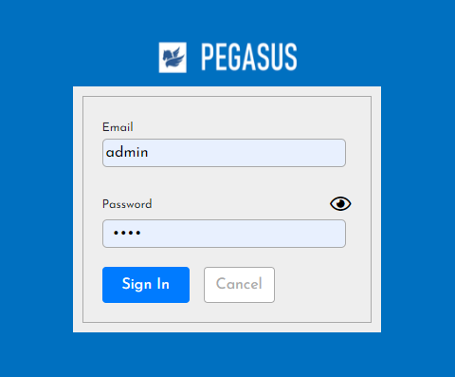

5. System functional specifications
5-4. PC Data confirmation
5-4-1. Login-Menu
5
Prepare user ID and password for DNPH.
Please log in with DNPH user ID and password.
ID: admin
Pass: 1234
admin

Slide 90
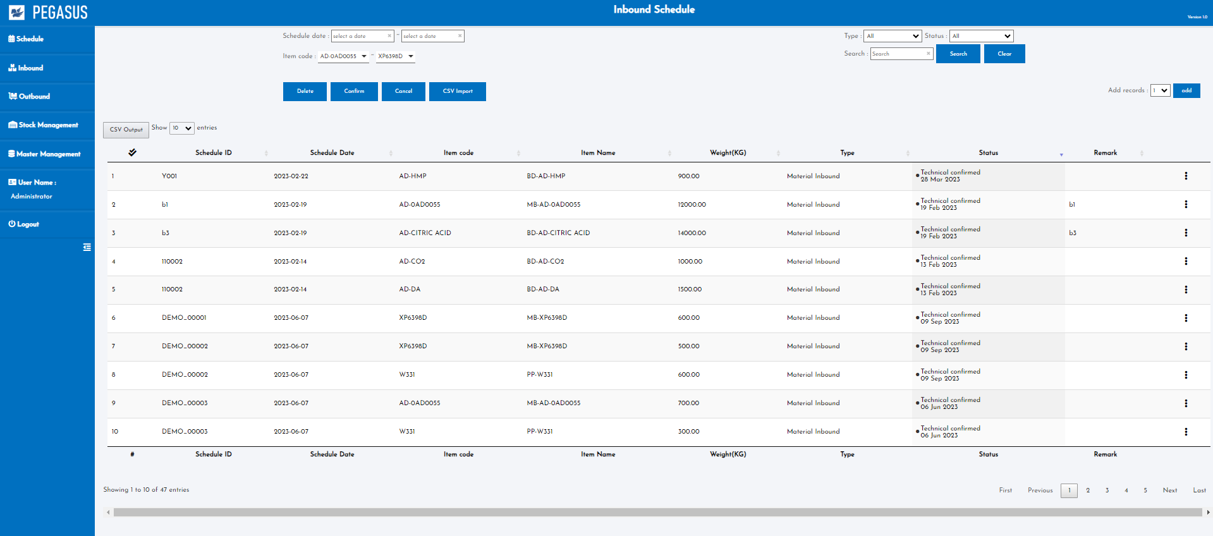
5. System functional specifications
5-4. PC Data confirmation
5-4-2. Main-Menu
5
Data Reference
1
[Data Reference]
[Master Management]
Master Management
2
Smart watch performance log
WACS System
Data Reference
E-Kanban data linkage
Production Line parts sensor
E-Log System linkage
Production Line FG sensor
Preset master
Cycle time master
Name master
Job management
User master
Authority master
Transaction report
User credential master
Master management

Slide 91
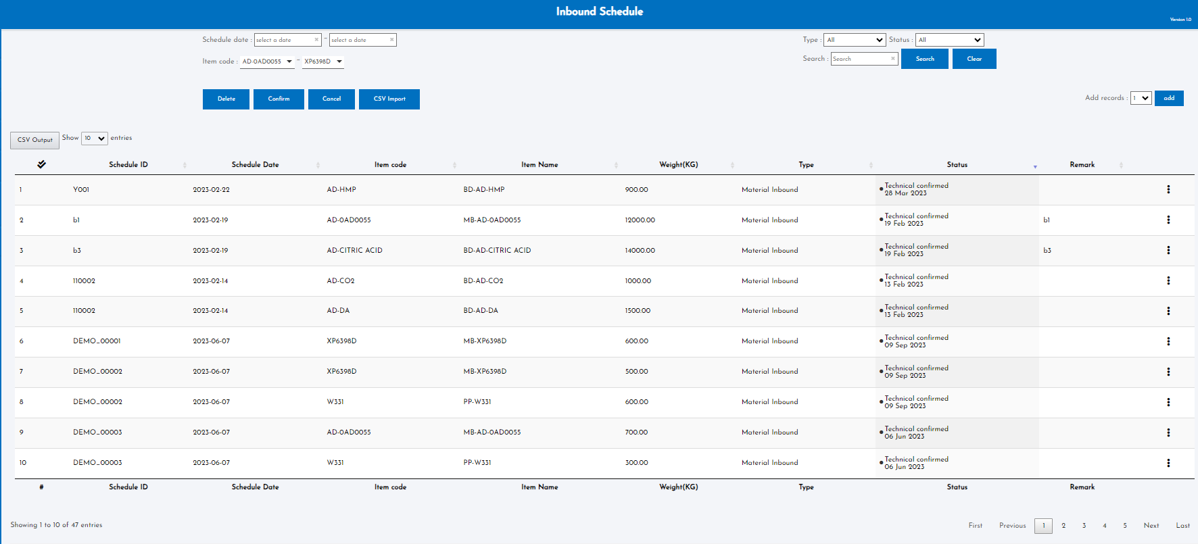


5. System functional specifications
5-4. PC Data confirmation
5-4-3. Smart watch performance log
5
Smart watch performance log
-
Status
Line
-
Model
-
Job scorp
Part No
-
CSV export
PIC
Resend
-
ST Diff
-
Linkage Status
Line | PART NO | Model | Job ID | Job Scorp | PIC | Standad ST | Act ST | ST Diff | Start time | End time | Status | Linkage Status
FA4 | PH457350-58306F | U704 S2.8 INSTRUMENT CLUSTER | ID0001 | Kitting Directed | Worker A | 00:10:00 | 00:10:00 | 0 | 13/Feb/2024 13:00:00 | 13/Feb/2024 13:10:00 | Schedule registered | Not applicable 2023/10/29 21:00:00
FA4 | PH457350-58306F | U704 S2.8 INSTRUMENT CLUSTER | ID0001 | Kitting Work | Worker A | 00:08:00 | 00:10:00 | +2 | 13/Feb/2024 13:00:00 | 13/Feb/2024 13:10:00 | Schedule registered | Not applicable 2023/10/29 21:00:00
FA4 | PH457350-58306F | U704 S2.8 INSTRUMENT CLUSTER | ID0002 | Shopper Parts Directed | Worker A | 00:10:00 | 00:08:00 | -2 | 13/Feb/2024 13:00:00 | 13/Feb/2024 13:10:00 | Working | Not applicable 2023/10/29 21:00:00
FA4 | PH457350-58306F | U704 S2.8 INSTRUMENT CLUSTER | ID0002 | Shopper Parts Work | Worker A | 00:10:00 | 00:10:00 | 0 | 13/Feb/2024 13:00:00 | 13/Feb/2024 13:10:00 | Working | Already linked 2023/10/29 21:00:00
FA4 | PH457350-58306F | U704 S2.8 INSTRUMENT CLUSTER | ID0003 | Shopper FG Directed | Worker A | 00:10:00 | 00:10:00 | 0 | 13/Feb/2024 13:00:00 | 13/Feb/2024 13:10:00 | Completed | Not applicable 2023/10/29 21:00:00
FA4 | PH457350-58306F | U704 S2.8 INSTRUMENT CLUSTER | ID0003 | Shopper FG Work | Worker A | 00:10:00 | 00:10:00 | 0 | 13/Feb/2024 13:00:00 | 13/Feb/2024 13:10:00 | Completed | Not linked 2023/10/29 21:00:00
FA4 | PH457350-58306F | U704 S2.8 INSTRUMENT CLUSTER | ID0004 | Kitting Directed | Worker A | 00:10:00 | 00:10:00 | 0 | 13/Feb/2024 13:00:00 | 13/Feb/2024 13:10:00 | Completed | Already linked 2023/10/29 21:00:00
FA4 | PH457350-58306F | U704 S2.8 INSTRUMENT CLUSTER | ID0004 | Kitting Work | Worker A | 00:10:00 | 00:10:00 | 0 | 13/Feb/2024 13:00:00 | 13/Feb/2024 13:10:00 | Cancel | Not applicable 2023/10/29 21:00:00

Slide 92
5. System functional specifications
5-4. PC Data confirmation
5-4-4. E-Kanban data
5

Slide 93
5. System functional specifications
5-4. PC Data confirmation
5-4-5. E-Log System linkage
5

Slide 94
5. System functional specifications
5-4. PC Data confirmation
5-4-6. WACS System
5

Slide 95
5. System functional specifications
5-4. PC Data confirmation
5-4-7. Production Line parts sensor
5

Slide 96
5. System functional specifications
5-4. PC Data confirmation
5-4-8. Production Line FG sensor
5

Slide 97
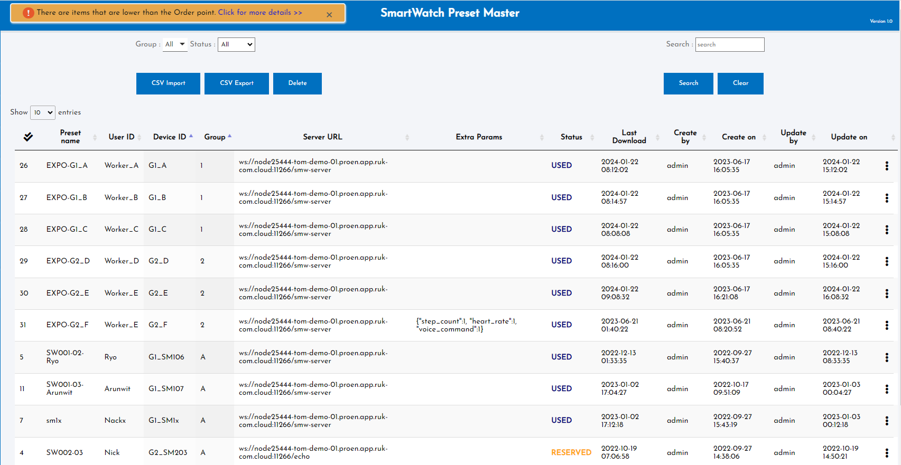
5. System functional specifications
5-5. PC Data confirmation master
5-5-1. Preset master
5
** Standard specifics

Slide 98
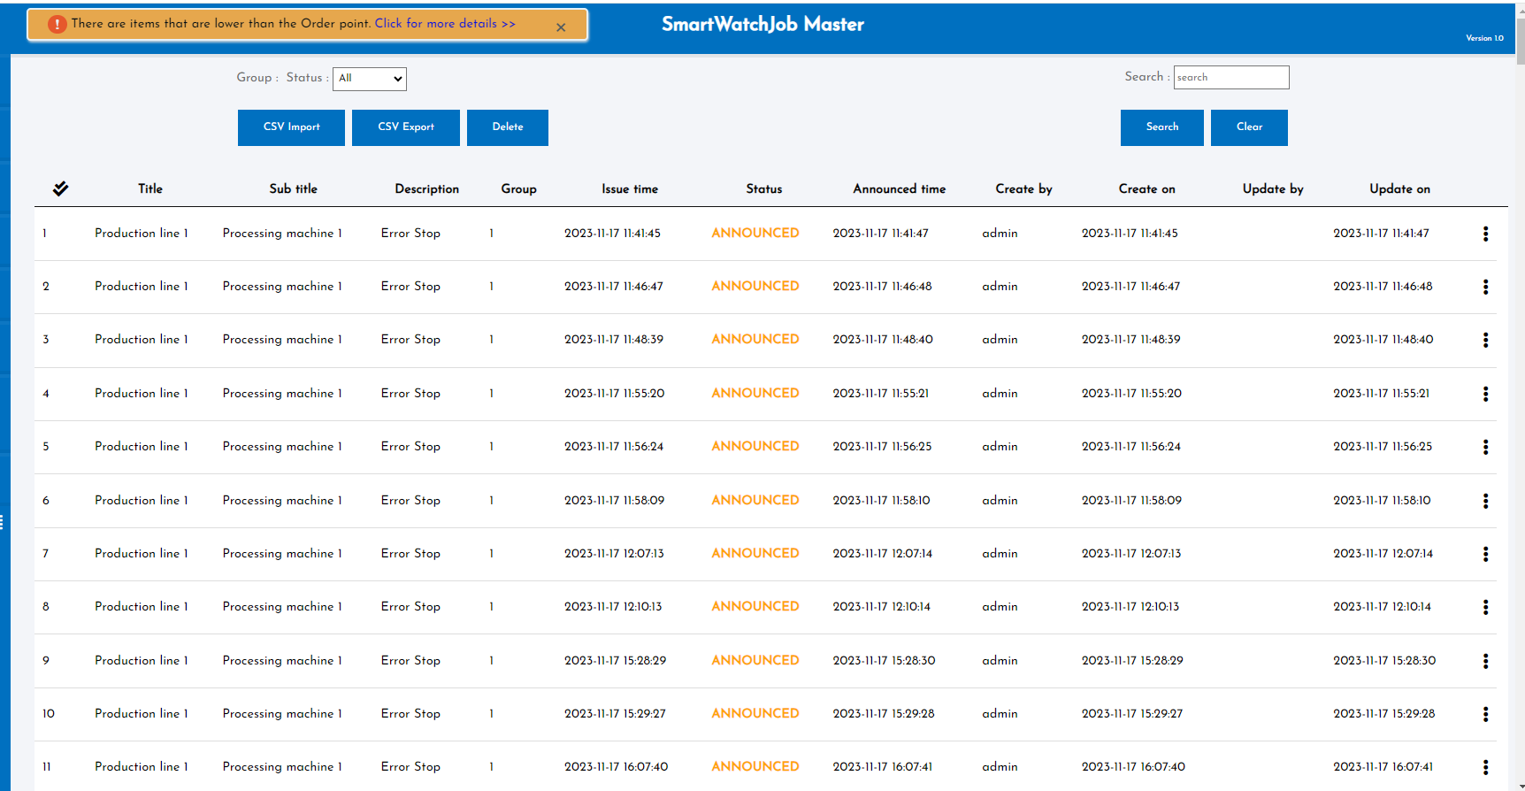
5. System functional specifications
5-5. PC Data confirmation master
5-5-2. Job management
5
** Standard specifics

Slide 99
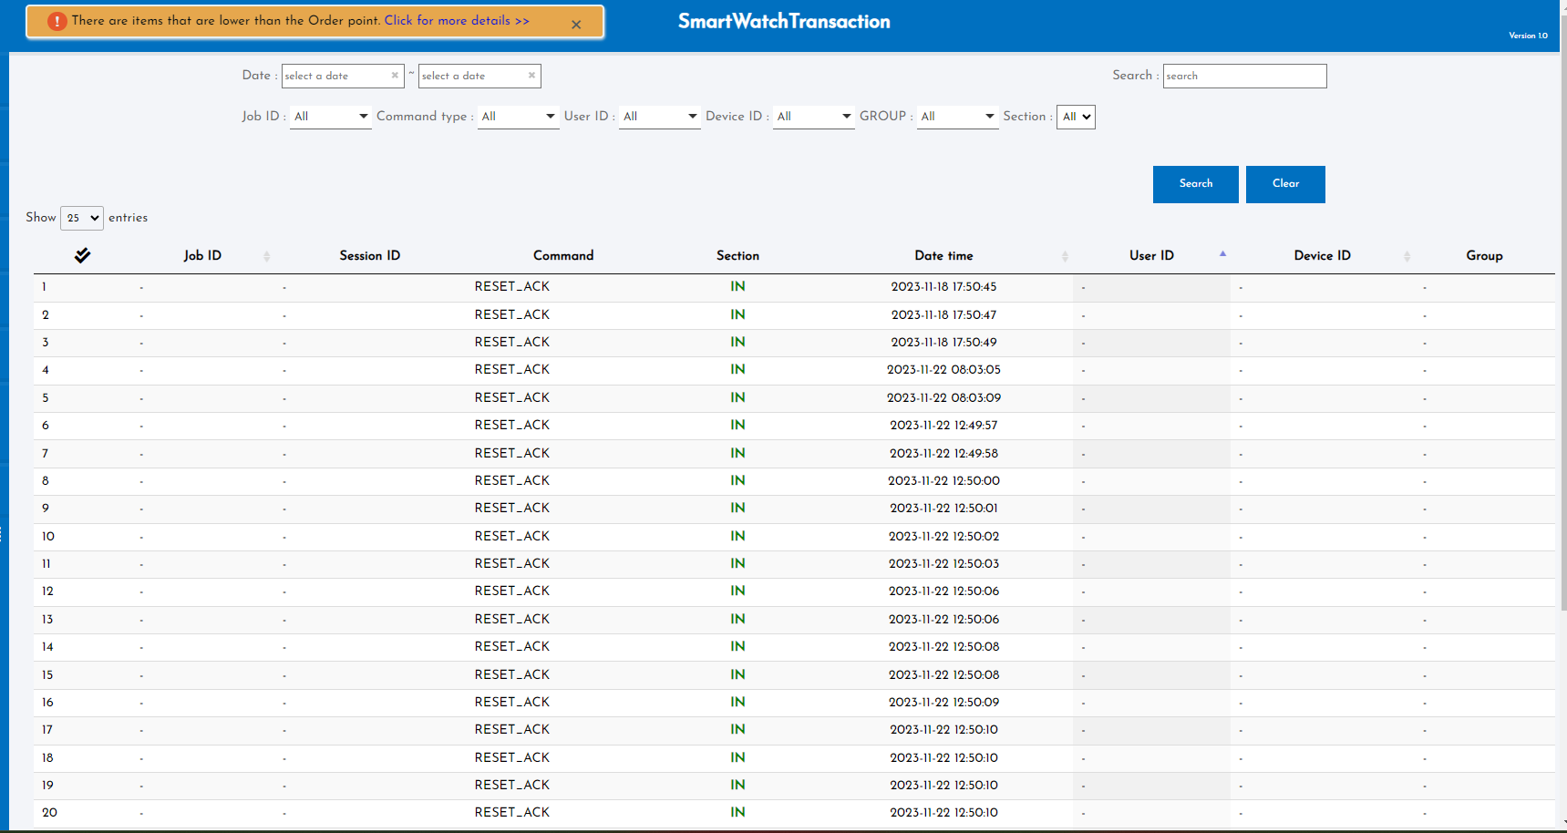
5. System functional specifications
5-5. PC Data confirmation master
5-5-3. Transaction report
5
** Standard specifics

Slide 100
5. System functional specifications
5-5. PC Data confirmation master
5-5-4. Cycle time master
5

Slide 101
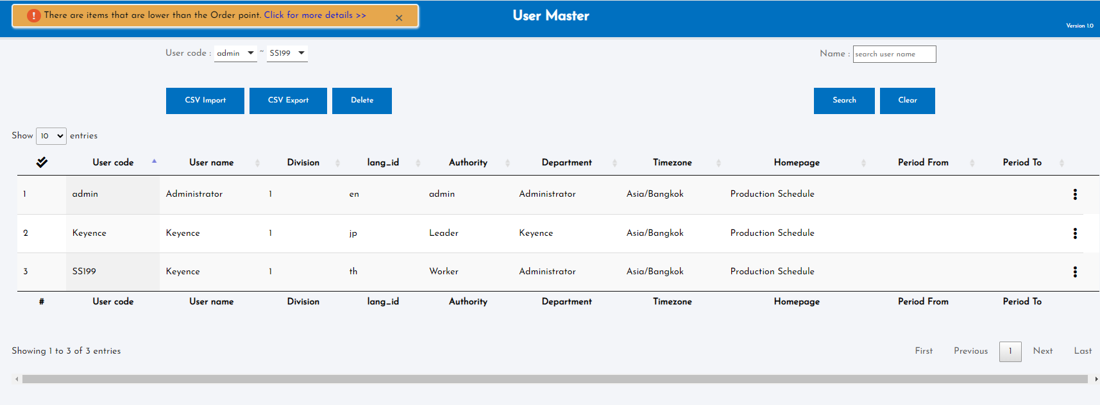
5. System functional specifications
5-5. PC Data confirmation master
5-5-5. User master
5
** Standard specifics

Slide 102
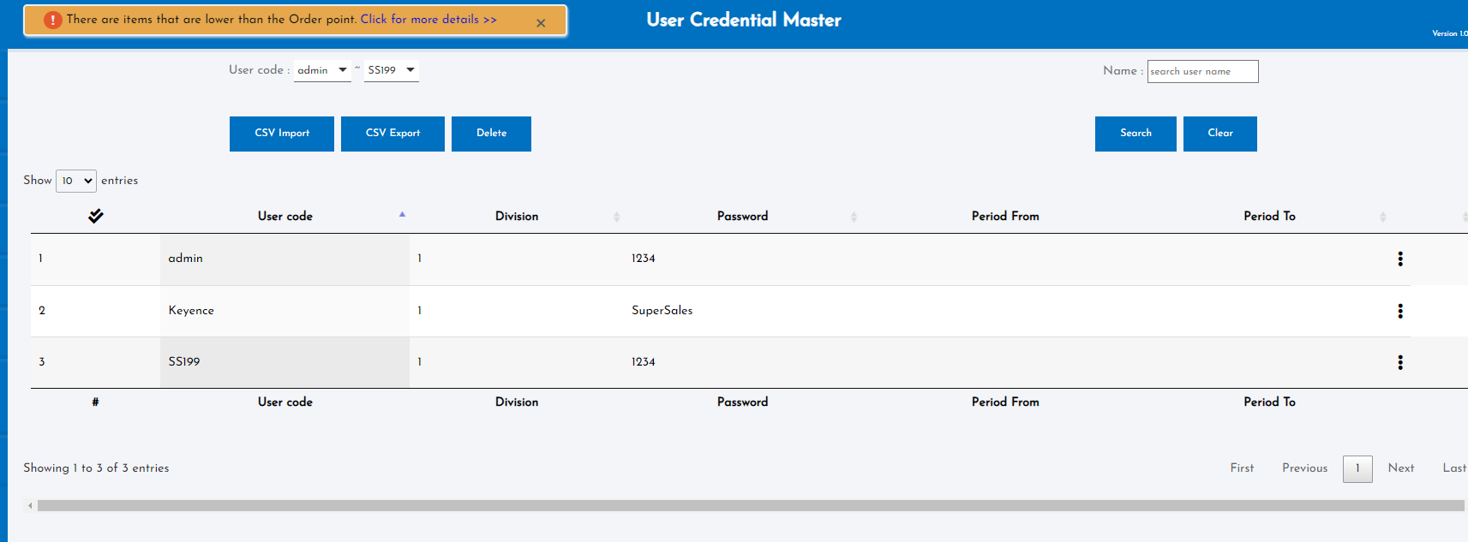
5. System functional specifications
5-5. PC Data confirmation master
5-5-6. User credential master
5
** Standard specifics

Slide 103
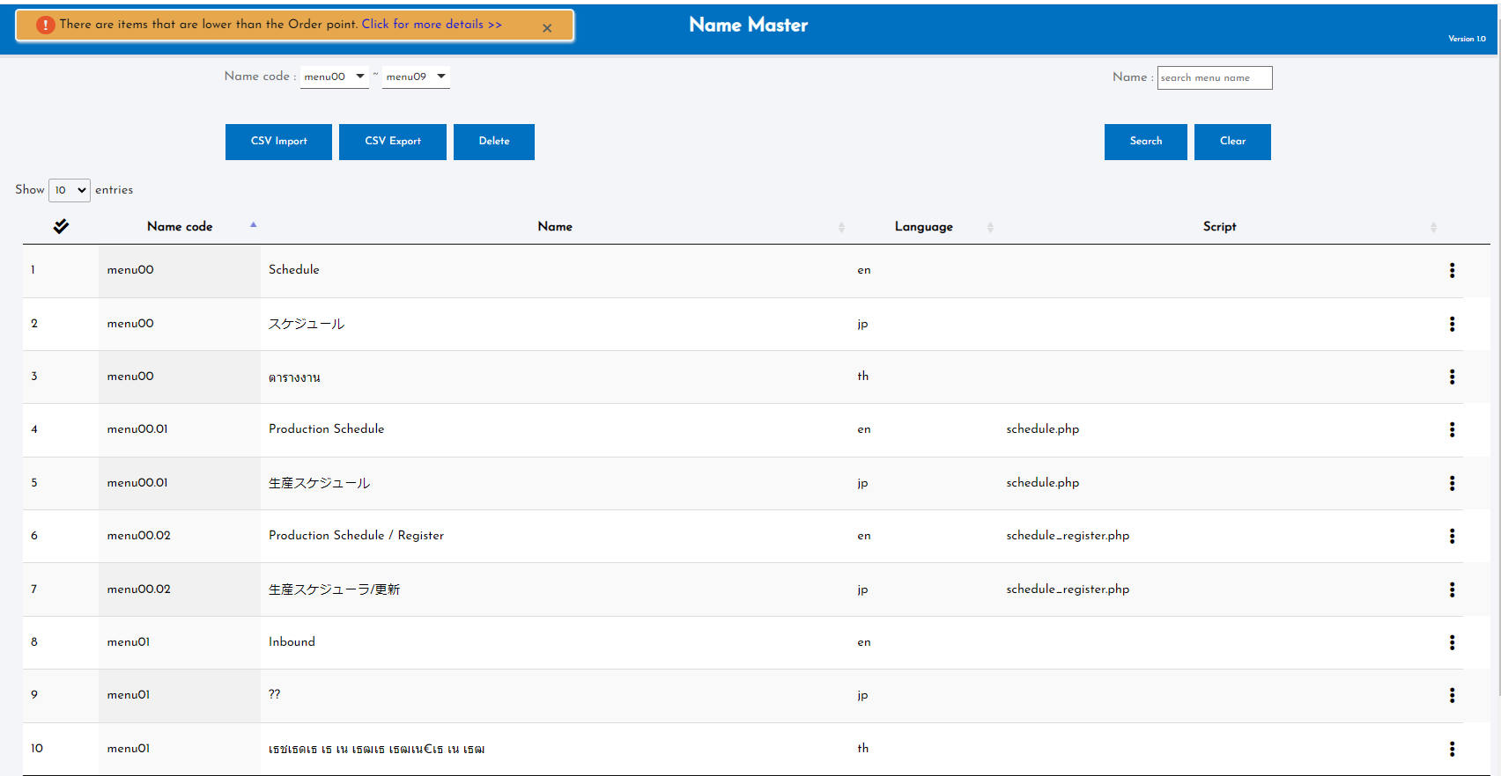
5. System functional specifications
5-5. PC Data confirmation master
5-5-7. Name master
5
** Standard specifics

Slide 104
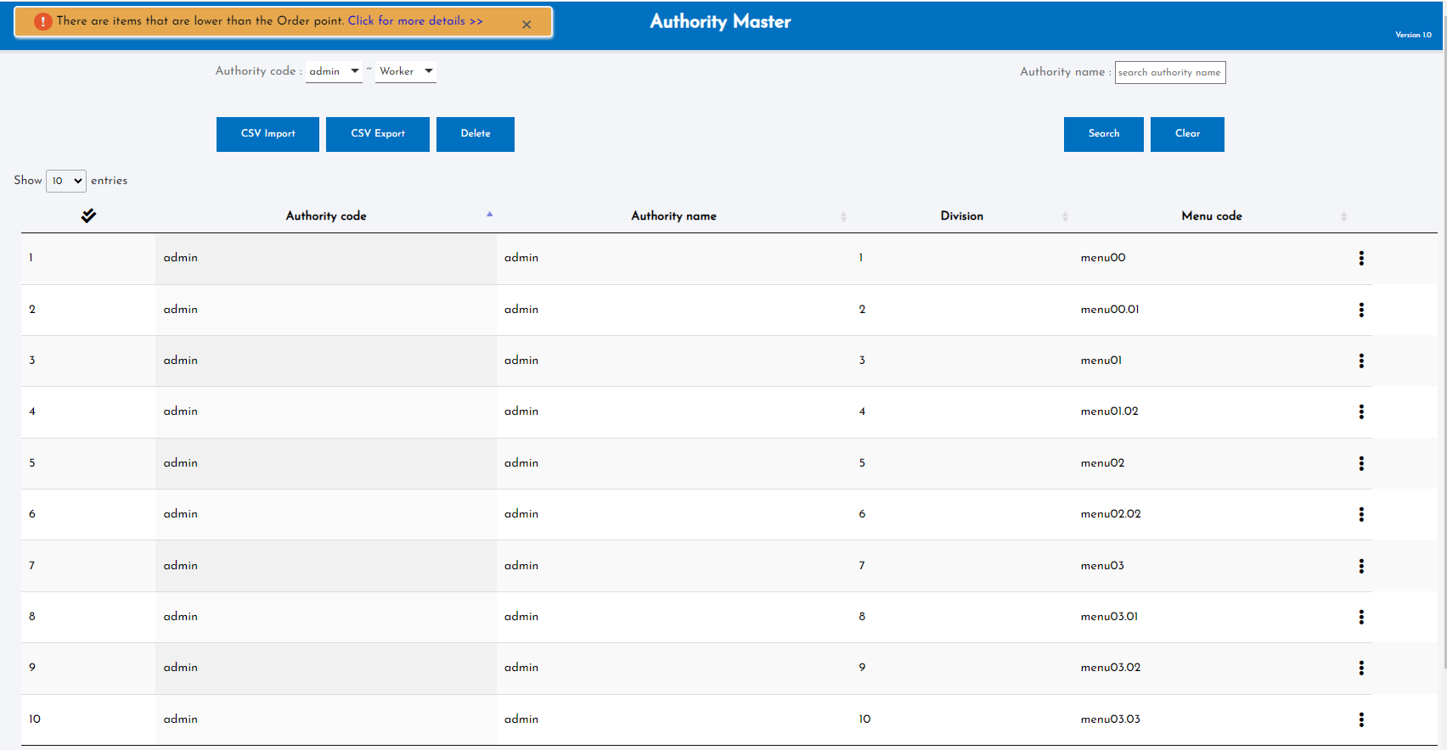
5. System functional specifications
5-5. PC Data confirmation master
5-5-8. Authority master
5
** Standard specifics

Slide 105
6. Q&A

Slide 106
7. Sign off
We hereby acknowledge and agree the above-mentioned blueprint requirements.
Any changes required after the sign off for this blueprint will be addressed through the change request process.
DENSO Philippines Corporation.
Sign:
Meiji (Thailand) Co.,Ltd.
Sign:
Name:
Name:
Title:
Title:
Date:
Date:
TOMAS TECH CO.,LTD.
Sign:
Name:
Title:
Date:
## END OF BLUEPRINT##

