Slide 1
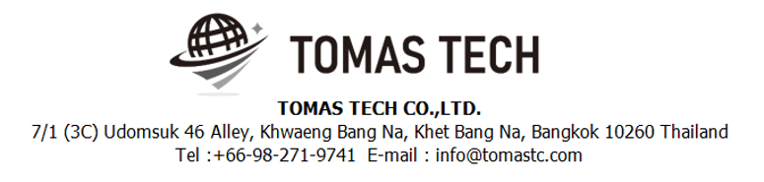
Version 03/Feb/2024
Confidential
Handy Terminal Stock management
Manual Document
Documentation EN Blueprint for MAST
R1
Made for: Minebea AccessSolutions Thai Ltd.
By: TOMAS TECH CO.,LTD.

Slide 2

Introduction
This manual explains each handy terminal, how to set it up with a PC, how to check the operation, and how to communicate with a PC.
Please read before starting work.
For safe use of this device
To use this device correctly and safely, be sure to observe the following safety precautions when operating this device. TOMAS TECH cannot be held responsible or warranted for any damage caused by using the product in violation of these precautions.
◆How to read the symbols
In this manual, the items to be observed in order to use the device safely are classified as follows.
Danger
If you ignore the information on this label and handle it incorrectly, there is a risk of death or serious injury.
Warning
This indicates the contents that may cause injury if the contents of this display are ignored and the product is handled improperly.
Caution
It indicates that property damage may occur if the product is handled improperly, ignoring the contents of this display.
The symbol represents a "caution" that it should be aware of.
The symbol represents an "instruction" that it must execute.
The symbol represents a "prohibition" that must not be done.
The symbols represent the "information" needed to deepen your understanding of this book.
The symbol represents "prohibited handling" by anyone other than a service person.
The symbol indicates that grounding is required during installation.
Reference
Indicates chapters to refer to and other manual references.

Slide 3
For safe use
◆General caution
In the unlikely event that this device breaks down, take sufficient safety measures to prevent various damages before use.
Please note that we cannot guarantee the function and performance of products that are used or modified outside the specifications shown in the specifications.
Do not disassemble this device unnecessarily. There is a risk of failure or damage.
Do not allow the device to get wet with water. It may lead to damage to this device.
Please use within the environmental conditions of this device. In addition, even within environmental conditions, equipment may be damaged in an environment where condensation forms due to sudden temperature changes.
Do not drop the device or hit it with strong force. Also, if the wiring from this device is likely to be subject to excessive impact, consider how to protect the wiring. It may lead to damage to this device and other devices.
Do not operate the device in a place with flammable or explosive gas or vapor. It is very dangerous to use this device in such an environment.
When using this device in combination with other devices, the functions and performance may not be satisfactory depending on the usage conditions and environment, so please consider carefully before using.
Caution
◆For proper use
When installing this device, turn off the power of the device. Do not short-circuit each wiring or terminal.
When installing this device, be sure to perform protective grounding to prevent electric shock.
Be sure to check that the power supply voltage of the device matches the voltage of the power supply before turning on the device.
Only our customer service or equivalent handlers should install this equipment.
To supply power to this device, connect it via a protection circuit such as a switchboard breaker or an earth leakage breaker.
Since this device is an electronic device, when installing various devices, investigate the installation environment (primary power supply system noise, drive device system noise, electrostatic discharge noise, etc.) and take countermeasures. It may cause system malfunction or damage to various devices.
Caution

Slide 4
Revision History
Date | Version | File name | Details
03/Feb/2024 | R1 | Handy Terminal Stock management Manual Document Documentation EN Blueprint for MAST_R1 | First edition

Slide 5
■Contents
Chapter [Page]
1. Overview 4
2. Overall configuration diagram
2-1-1. Login screen 5
2-2-1. Settings mode 6
2-2-2. Settings Information 7
2-3-1. Main menu 8
2-4-1. Inbound menu 9
2-4-2. Schedule Label 10
2-4-3. Schedule Label [Label Detail Screen] 12
2-4-4. Label Manual Menu 14
2-4-5. Label Manual 15
2-4-6. Relabeling 16
2-4-7. Re-Print Label 17
2-4-8. Schedule Inbound 18
2-4-9. Schedule Inbound [Inbound Detail Screen] 20
2-4-10. Inbound Manual 21
2-4-11. QC Menu 22
2-4-12. QC Schedule 23
2-4-13. QC Check Manual 28
2-4-14. Photo matching 31
2-5-1. Outbound menu 32
2-5-2. Outbound Schedule [Work Outbound & Production Outbound] 33
2-5-3. Outbound Manual 37
2-6-1. Stock management Menu 38
2-6-2. Stock Check 39
2-6-3. Stocktaking 40
2-6-4. Change Location 41
2-7-1. Printer Setting 42
3. Configuration file storage 43
4. Q&A 44
5. Contact information 47

Slide 6
1. Overview
We propose a stock management system to Minebea AccessSolutions Thai Ltd.. In the current operation, we aim to improve work efficiency and work accuracy by replacing the work managed by paper and whiteboard with a system. The expected effects of introducing an inventory management system are as follows.
1. Work efficiency and work accuracy can be improved by supporting work at the handy terminal at the time of warehousing and warehousing. In addition, the inventory status can be grasped in real time.
2. By managing the product location, the location can be used effectively. In addition, it is possible to thoroughly implement the FIFO.
3. By managing the ordering points, it is possible to eliminate excess inventory and out of stock.
4. By managing the materials and goods tracking, it is able to trace back to find material lot numbers, suppliers, and processes when found problematic products.

Slide 7
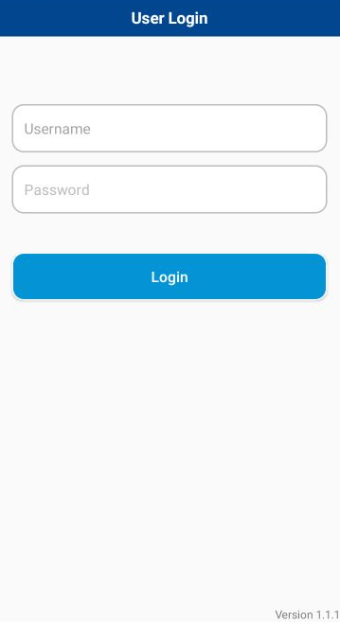
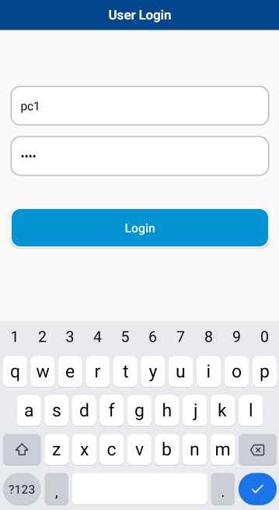
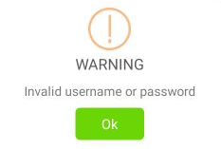
2. Handheld functions
2-1-1. Login screen
Login Instructions
Scan or Click the Username text box.
On-screen keyboard will automatic show up.
Enter the staff ID or Scan the QRcode or Barcode.
Enter the password.
Click “Login”
The warning dialog will be shown if login failed.
!
2.1.2 Example of Staff ID Qrcode or Barcode

Slide 8

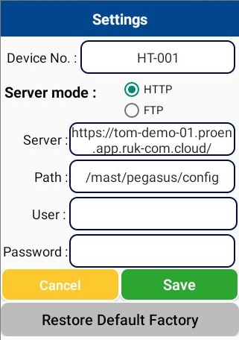
2. Handheld functions
2-2-1. Settings mode
To enter the “Settings” screen.
Tap the upper title “User Login” 7 times.
In case of upgrading new version or restore default settings. User need to enter the information in settings screen.
Instructions
Enter the information to each text box regarding to below table.
Click “Save” to apply the settings and restart the app.
Click “Cancel” to cancel any changed.
Click “Restore Default Factory” to remove all settings.
2

Slide 9
2. Handheld functions
2.2.2 Settings information
No | Item | Description | Example
1. | Device No. | Device name | HT01
2. | Server mode | Communication protocol | HTTP or FTP
3. | Server | URL link to server instance. | https://tom-demo-01.proen.app.ruk-com.cloud
4. | Path | Application web configuration path | /mast/pegasus/config/
5 | User(optional) | Authenticate user account
6 | Password (optional) | Password for login

Slide 10
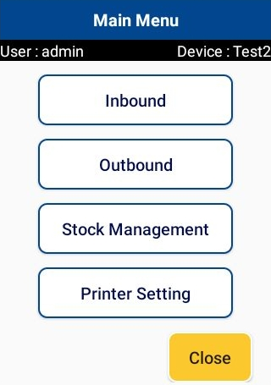
2. Handheld functions
2-3-1. Main menu
Screen name
User name logged in.
Device info.
No | Menu | Description
1. | Inbound | Click to enter Inbound section.
2. | Outbound | Click to enter Outbound section.
3. | Stock Management | Click to Stock management functions.
4. | Printer Setting | Click to Printer Setting functions.
5. | Close | Close the application.

Slide 11
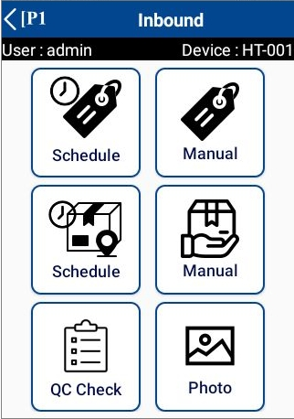
2. Handheld functions
2-4-1. Inbound menu
Click “<” to exit to main menu
1
2
3
4
5
6
No | Menu | Description
 | Schedule Label | Click to enter Schedule Label.
 | Label Manual | Click to enter Label Manual.
 | Inbound Schedule | Click to enter Inbound Schedule
 | Inbound Manual | Click to enter Inbound Manual.
 | QC Check | Click to enter QC Check.
 | Photo | Click to enter photo matching.
1
2
3
4
5
6

Slide 12
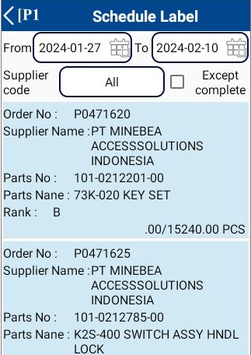
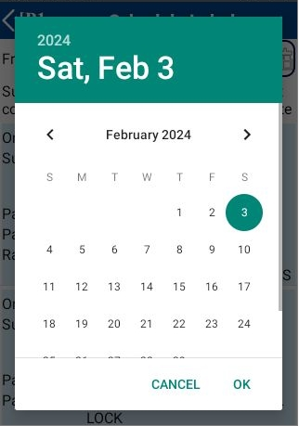

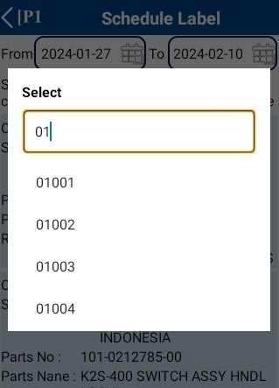



2. Handheld functions
2-4-2. Schedule Label
1. Select the desired information
Date From - To
Date from: Default is previous 7 days.
Date to: Default is advance 7 days.
* Can be changed manually
----------------------------------------------------------------------------------------------------------
Supplier code
Select supplier code or do a scan.
Default is All
----------------------------------------------------------------------------------------------------------
Except complete:
If checked, the completed status Item list will not be displayed from the Item list. Default is unchecked.
Color | Description
 | WORKING
 | COMPLETED
 | NEW

Slide 13
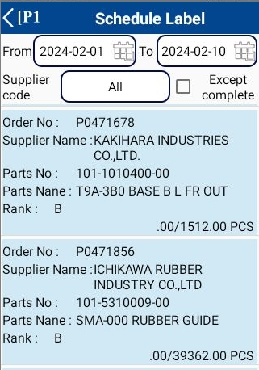
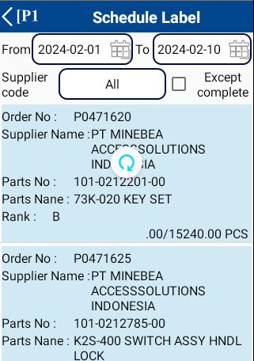
2. Handheld functions
2-4-2. Schedule Label
2. Please pull down the screen to refresh the information.
3. Click an item
Color | Description
 | WORKING
 | COMPLETED
 | NEW
Color status identify

Slide 14
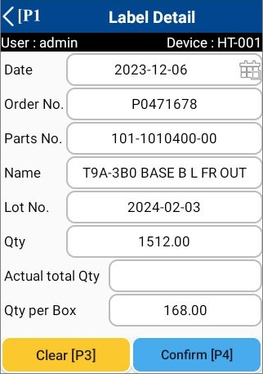
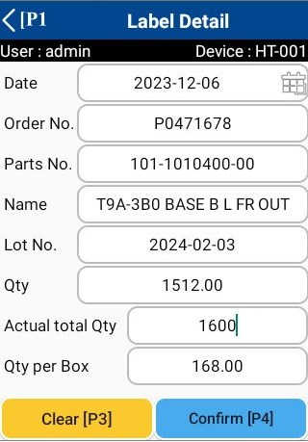
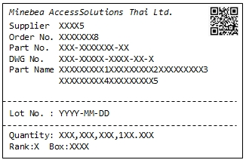
2. Handheld functions
2-4-3. Schedule Label [ Label Detail Screen ]
1. Click an item from schedule list.
* Can be changed manually
* Can be changed manually
2. Enter actual total qty and confirm.
1
When click confirm.
The system will print the label.
2

Slide 15
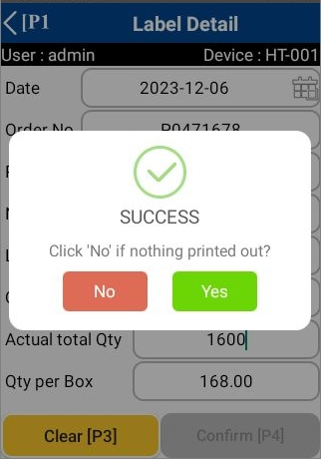
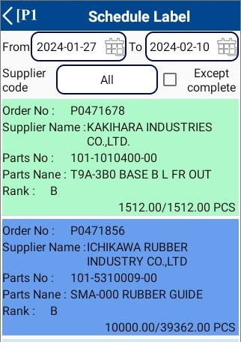
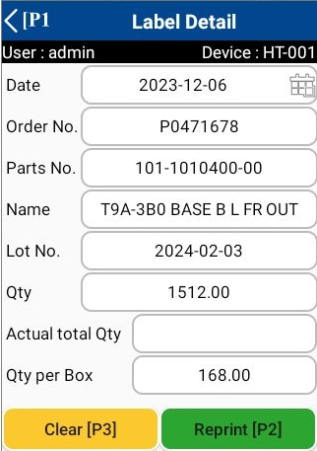
2. Handheld functions
2-4-3. Schedule Label [label Detail Screen]
3. When the system finishes printing the label will notify you.
Click “Yes” when the label is completely printed.
Click “No” if nothing printing out?
Status :
COMPLETED
4. If you click to select a completed item, it can be reprinted.
Enter actual qty

Slide 16
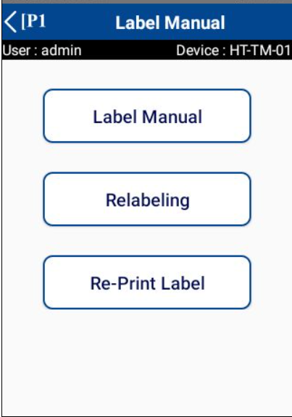
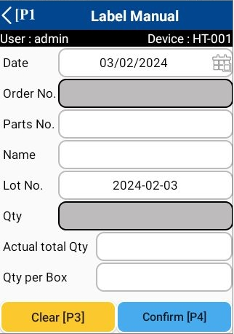
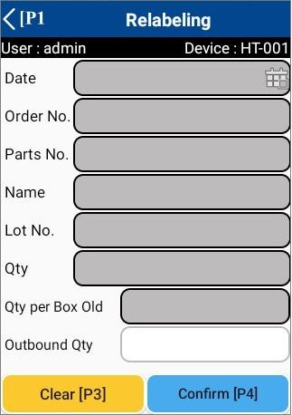
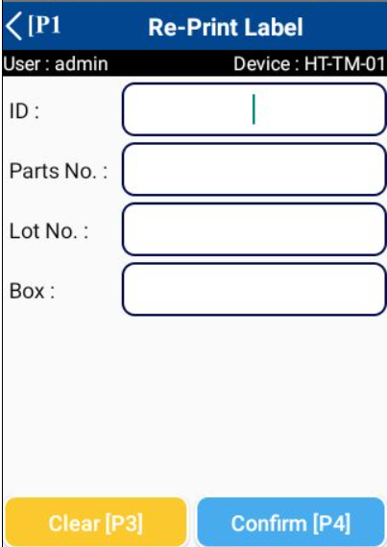
2. Handheld functions
2-4-4. Label Manual Menu
1
2
3
1
Label Manual
2
Relabeling
3
Re-Print Label

Slide 17
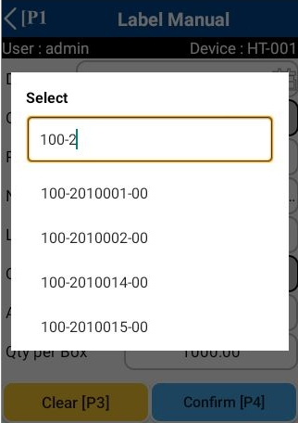
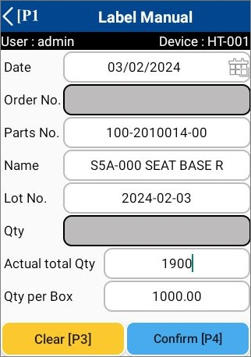
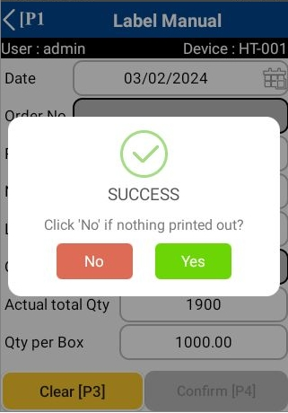
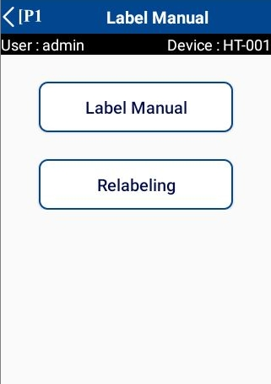
2. Handheld functions
2-4-5. Label Manual
1. Select parts no.
can be search by scrolling or typing.
2. Enter actual total qty and confirm.
1
When click confirm.
The system will print the label.
2
3. When the system finishes printing the label will notify you.
Click “Yes” when the label is completely printed.
Click “No” if nothing printing out?
Notes:
You can search by scrolling or typing.

Slide 18
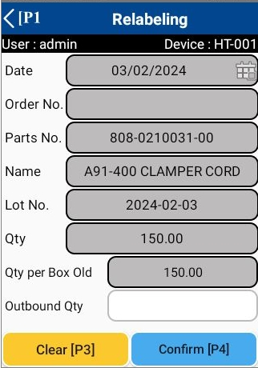
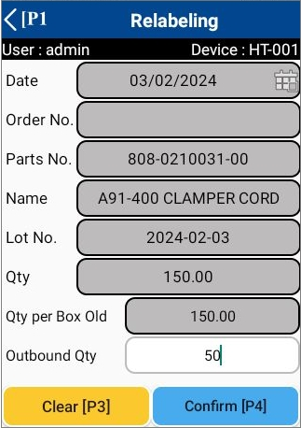
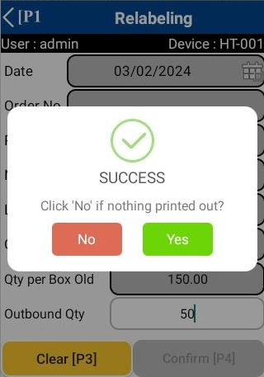
2. Handheld functions
2-4-6. Relabeling
1. Scan label.
2. Enter outbound qty and confirm.
When click confirm.
The system will print the label.
1
2
3. When the system finishes printing the label will notify you.
Click “Yes” when the label is completely printed.
Click “No” if nothing printing out?
Notes:
You can search by scrolling or typing.

Slide 19
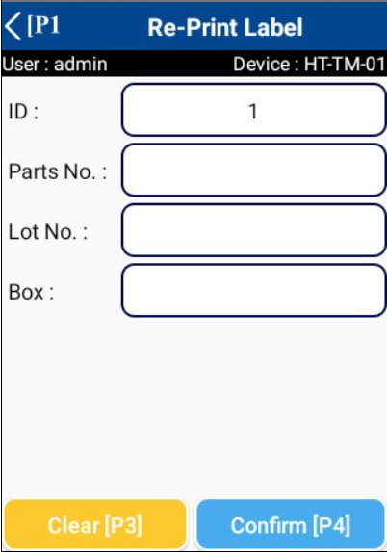
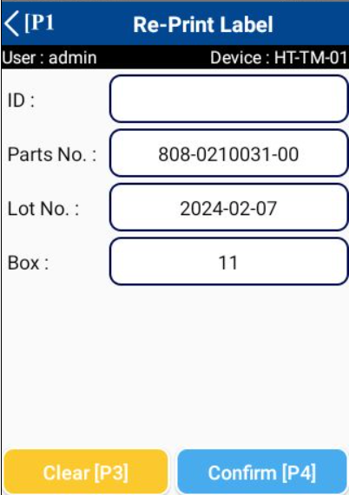
2. Handheld functions
2-4-7. Re-Print Label
Can be done in 2 ways
1). Enter Label ID. → Click “Confirm”.
Print new label
2). Scan Label → Click “Confirm”.
Scan label
Print new label
Notes:
You can search by scrolling or typing.

Slide 20
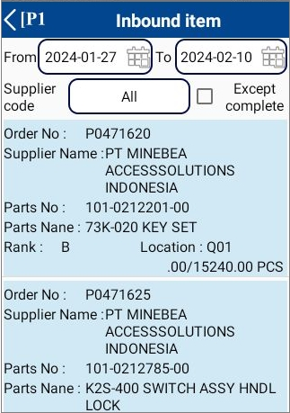
2. Handheld functions
2-4-8. Schedule Inbound
1. Select the desired information
Date From - To
Date from: Default is previous 7 days.
Date to: Default is advance 7 days.
* Can be changed manually
----------------------------------------------------------------------------------------------------------
Supplier code
Select supplier code or do a scan.
Default is All
----------------------------------------------------------------------------------------------------------
Except complete:
If checked, the completed status Item list will not be displayed from the Item list. Default is unchecked.
Color | Description
 | WORKING
 | COMPLETED
 | NEW

Slide 21
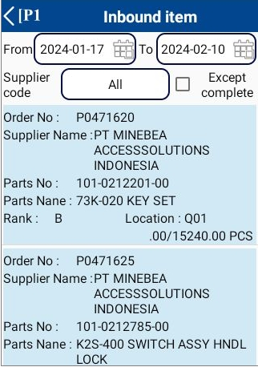
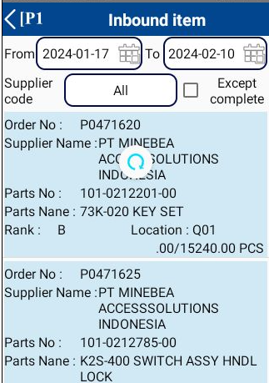
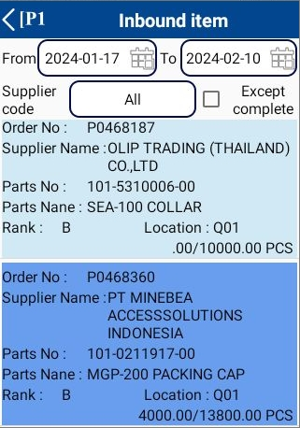
2. Handheld functions
2-4-8. Schedule Inbound
2. Please pull down the screen to refresh the information.
3. Click an item from schedule list or scan label.
Color | Description
 | WORKING
 | COMPLETED
 | NEW
Color status identify

Slide 22
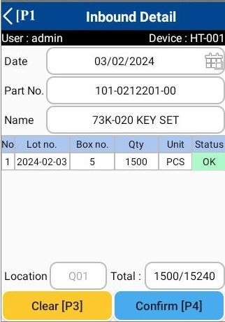
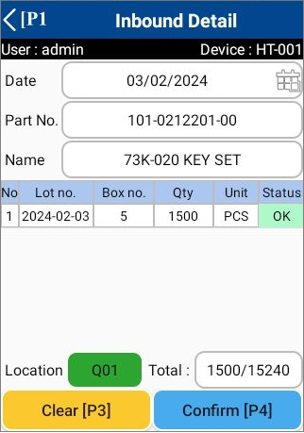

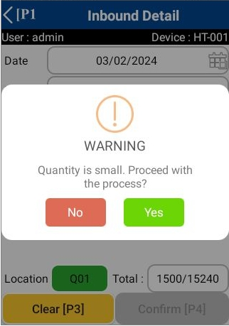
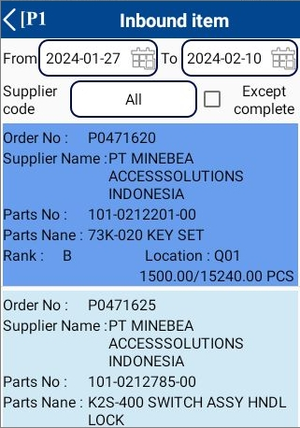
2. Handheld functions
2-4-9. Schedule Inbound [ Inbound Detail Screen ]
1. scan label.
The system will search for
the scanned order no.
and parts no.
2. Scan location and confirm
QR location
If the qty is less than the plan
The system will notify you
to confirm the transaction.
1
2
The system will update the information.

Slide 23
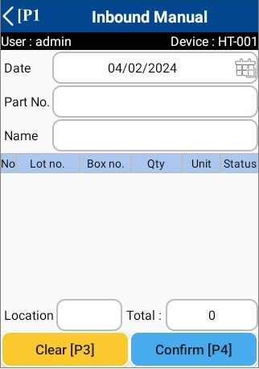
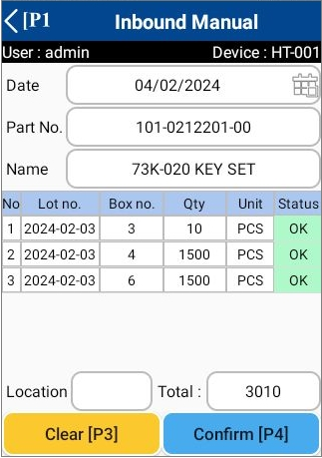
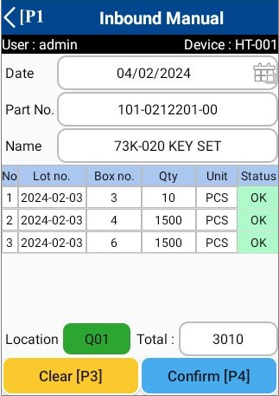
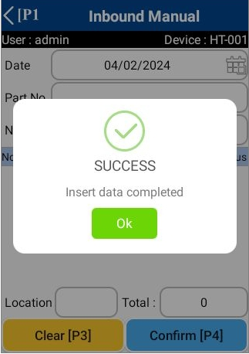
2. Handheld functions
2-4-10. Inbound Manual
1. scan label.
2. scan location and confirm.
QR location
1
2

Slide 24
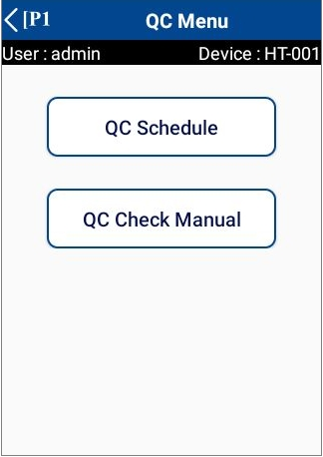
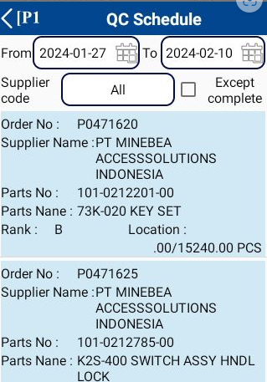
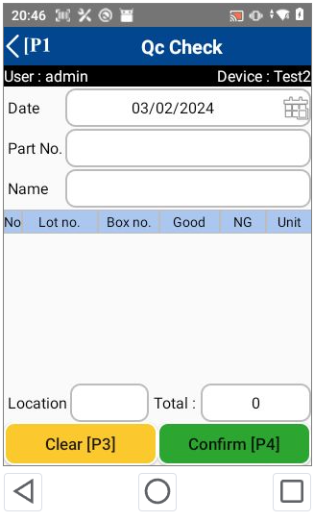

2. Handheld functions
2-4-11. QC Menu
1
2
1
QC Schedule
2
QC Check Manual
Notes:
You can search by scrolling or typing.

Slide 25
2. Handheld functions
2-4-12. QC Schedule
1. Select the desired information
Date From - To
Date from: Default is previous 7 days.
Date to: Default is advance 7 days.
* Can be changed manually
----------------------------------------------------------------------------------------------------------
Supplier code
Select supplier code or do a scan.
Default is All
----------------------------------------------------------------------------------------------------------
Except complete:
If checked, the completed status Item list will not be displayed from the Item list. Default is unchecked.
Color | Description
 | WORKING
 | COMPLETED
 | NEW

Slide 26

2. Handheld functions
2-4-12. QC Schedule
2. Please pull down the screen to refresh the information.
3. Click an item from schedule list or scan label.
Color | Description
 | WORKING
 | COMPLETED
 | NEW
Color status identify

Slide 27
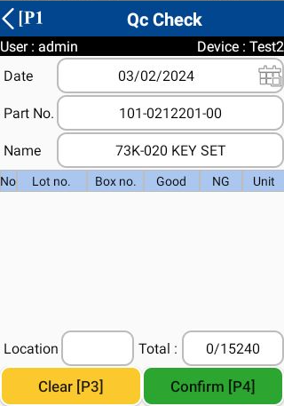
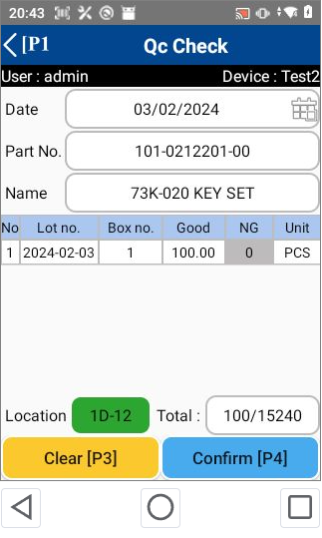

2. Handheld functions
2-4-12. QC Schedule
1. Click an item.
2. Scan label.

Slide 28
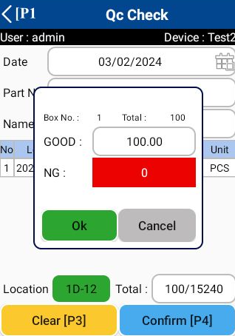
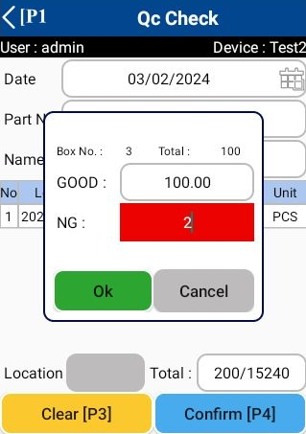

2. Handheld functions
2-4-12. QC Schedule
3. If NG items are detected. Please select row item.
4. Please enter the qty of NG.
repack good items qty = 98
Print new label
1
2
When you click the “OK” button to confirm NG, the system will order a new label to be printed to repack good items.

Slide 29






2. Handheld functions
2-4-12. QC Schedule
After printing the label The system will notify you to confirm print out.
3
NG = 2
5. Scan Location and confirm
QR location
If the qty is less than the plan
The system will notify you
to confirm the transaction.
1
2
The system will update
the information.

Slide 30

2. Handheld functions
2-4-13. QC Check Manual
1. Scan label.
2. If NG items are detected. Please select row item.

Slide 31



2. Handheld functions
2-4-13. QC Check Manual
3. Please enter the qty of NG.
repack good items qty = 120
Print new label
1
2
When you click the “OK” button to confirm NG, the system will order a new label to be printed to repack good items.
After printing the label The system will notify you to confirm print out.
3

Slide 32


2. Handheld functions
2-4-13. QC Check Manual
4. Scan Location and confirm
QR location
If the qty is less than the plan
The system will notify you
to confirm the transaction.
1
2

Slide 33



2. Handheld functions
2-4-14. Photo matching
1. Scan label.
Found photo
photo not found
Notes:
You can search by scrolling or typing.

Slide 34

2. Handheld functions
2-5-1. Outbound menu
No | Menu | Description
1. | Work Outbound | Click to enter Schedule Label.
2. | Production Outbound | Click to enter Outbound Production. Outbound the items to production process.
3. | Outbound Manual | Click to enter Inbound Schedule

Slide 35

2. Handheld functions
2-5-2. Outbound Schedule [ Work Outbound & Production Outbound ]
1. Select the desired information
Date From - To
Date from: Default is today
Date to: Default is advance 7 days.
* Can be changed manually
----------------------------------------------------------------------------------------------------------
Supplier code
Select supplier code or do a scan.
Default is All
----------------------------------------------------------------------------------------------------------
Except complete:
If checked, the completed status Item list will not be displayed from the Item list. Default is unchecked.
Color | Description
 | WORKING
 | COMPLETED
 | NEW

Slide 36

2. Handheld functions
2-5-2. Outbound Schedule [ Work Outbound & Production Outbound ]
2. Please pull down the screen to refresh the information.
Color | Description
 | WORKING
 | COMPLETED
 | NEW
Color status identify
3. Click an item from schedule list or scan label.
FIFO list

Slide 37



2. Handheld functions
2-5-2. Outbound Schedule [ Work Outbound & Production Outbound ]
4. Scan label.
5. Confirm.
If you want to print labels for repack, please click Yes.

Slide 38


2. Handheld functions
2-5-2. Outbound Schedule [ Work Outbound & Production Outbound ]
6. When the system finishes printing the label will notify you.
Click “Yes” when the label is completely printed.
Click “No” if nothing printing out?
The system will update the information.

Slide 39



2. Handheld functions
2-5-3. Outbound Manual
1. Scan label. 2.Confirm

Slide 40

2. Handheld functions
2-6-1. Stock management
No | Menu | Description
1. | Stock Check | Click to enter Stock Check screen.
2. | Stocktaking | Click to enter Stocktaking screen.
3. | Change Location | Click to enter Change Location screen. User able to changes or repack the package.

Slide 41


2. Handheld functions
2-6-2. Stock Check
Instructions
Scan tag label package.
Stock information will be shown on screen table.

Slide 42



2. Handheld functions
2-6-3. Stocktaking
Instructions
Scan tag label package.
Current stock information will be shown on screen.
Edit the actual qty.
Click “Confirm” to apply the information.
Success dialog will show if the data saving completed.

Slide 43



2. Handheld functions
2-6-4. Change Location
No | Menu | Description
Mode 1 | Change location | Scan the tag label twice → Scan the destinate location
Mode 2 | Repack | Scan the label tag once→ Enter the amount you want to move. (move qty < stock qty) → Scan the location

Slide 44





2. Handheld functions
2-7-1. Printer Setting
1. Scan QR code Printer.

Slide 45
3. Configuration file storage
Input data:
1. Employee information
2. Product list

Slide 46
4. Q&A
# | Date | Question | By | Date | Answer | By
1
2
3
4
5

Slide 47
5. Contact information
The contents of this specification and manual are subject to change without notice. Copying or copying part or all of the manual without the written permission of TOMAS TECH is prohibited, regardless of its form.
If you have any questions, concerns, or questions regarding the specifications of this system and the contents of the manual, please contact us by phone or e-mail. Tel: +66 (0) 2 336 0574 E-mail: info@tomastc.com
Item | Description
1. Service time | 8 hours x 5 days (8:00 -17:00 Monday to Friday)
2. Onsite Hardware Maintenance | -
3. Onsite System Maintenance | -
4. Response after receive a call | On-line support within 24 hours / On-site support within 48 hours
5. Remote service | Yes
6. Phone service | Yes
7. Email service | Yes

