Slide 1
Shoe size sorting machine
Made for BIG STAR CO.,LTD.
TOMAS TECH Co., Ltd.
Make by Nattapol ( IoT Engineer )

Slide 2
┃Agenda
► Proposal overview
► Layout machine
► Process flow
► Machine operation monitoring system
► Machine data record

Slide 3
Proposal overview

Slide 4
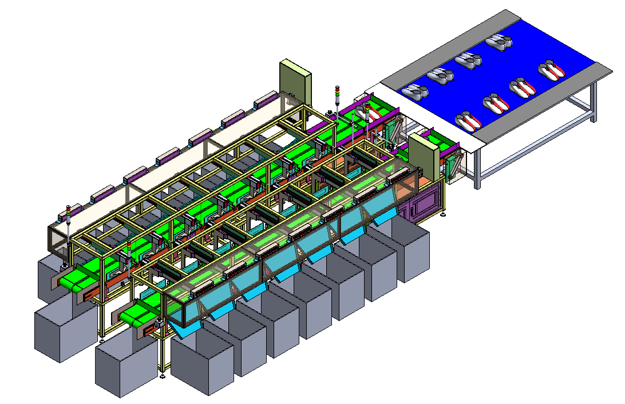
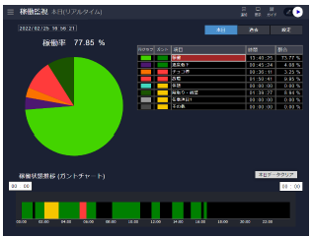


┃Proposal overview
Increased production efficiency : The project focuses on using modern and automated machinery to reduce time in the shoe sizing process and increase efficiency.
Reduce errors : This project will help reduce errors that may occur in the shoe sizing process by using high-precision technology.
Increased product quality : Using machines that can accurately sort shoe sizes increases the quality of the shoes produced.
Reduce production costs : by reducing time and inaccuracy in the shoe production process. We will be able to reduce overall production costs.
Phase1
Phase2
Monitoring system
Controller machine
Data base

Slide 5
Machine overview

Slide 6
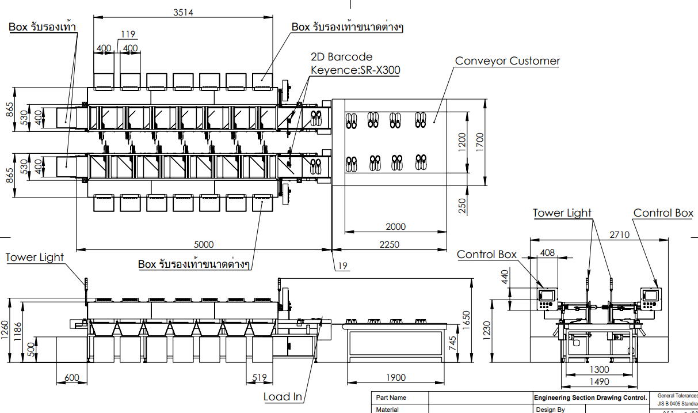
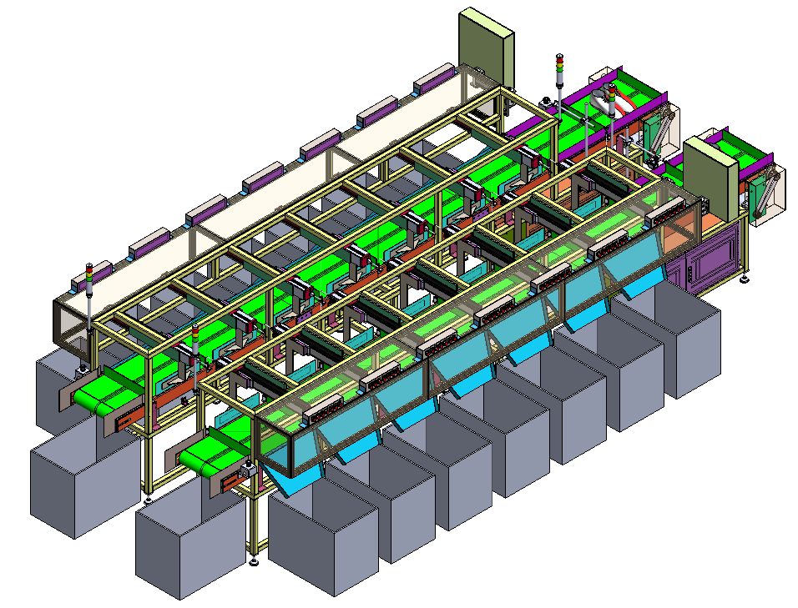
┃Machine overview

Slide 7
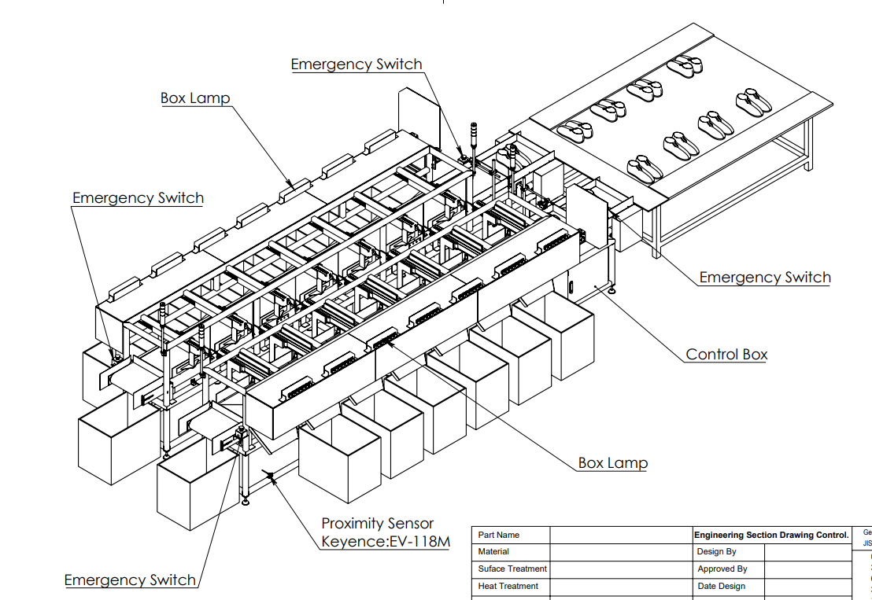
┃Machine overview

Slide 8
Process flow

Slide 9
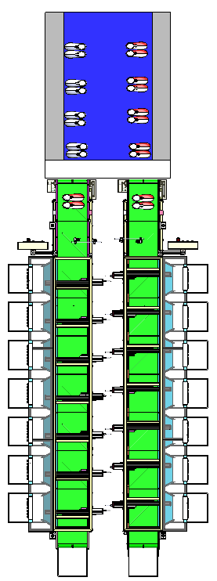
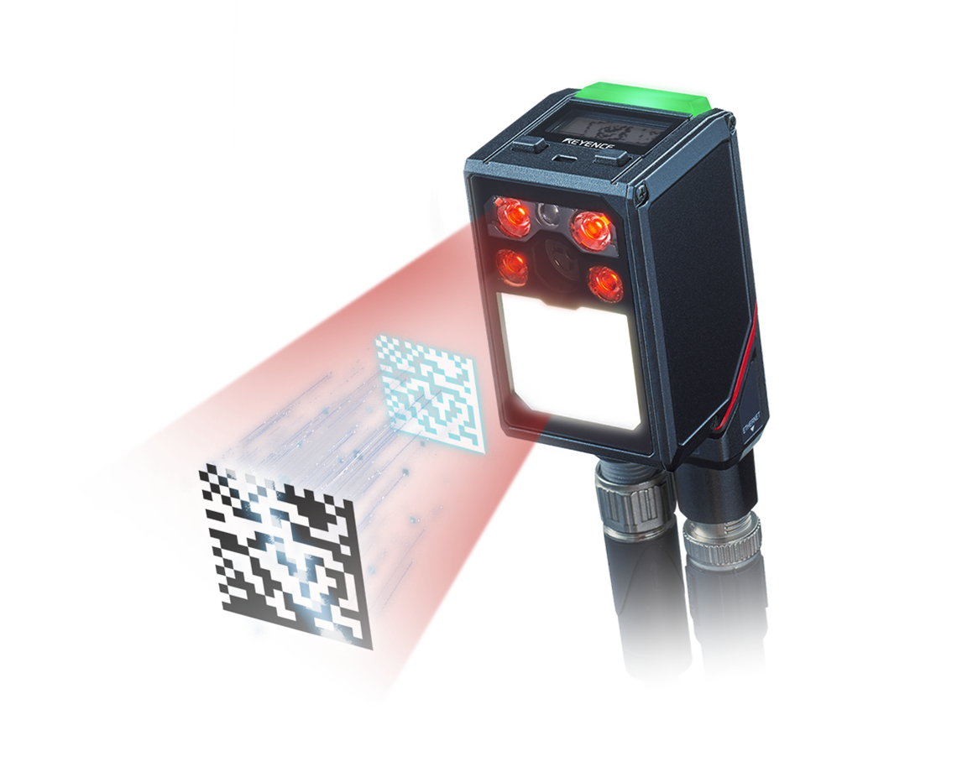

┃Process flow
Unload ( Case OK )
SR-Reader ( STEP2 )
LOAD ( STEP1 )
Transfer ( STEP3 )
AS-IN Current
Unload ( case NG )
Pushing ( STEP4 )
Human loader

Slide 10
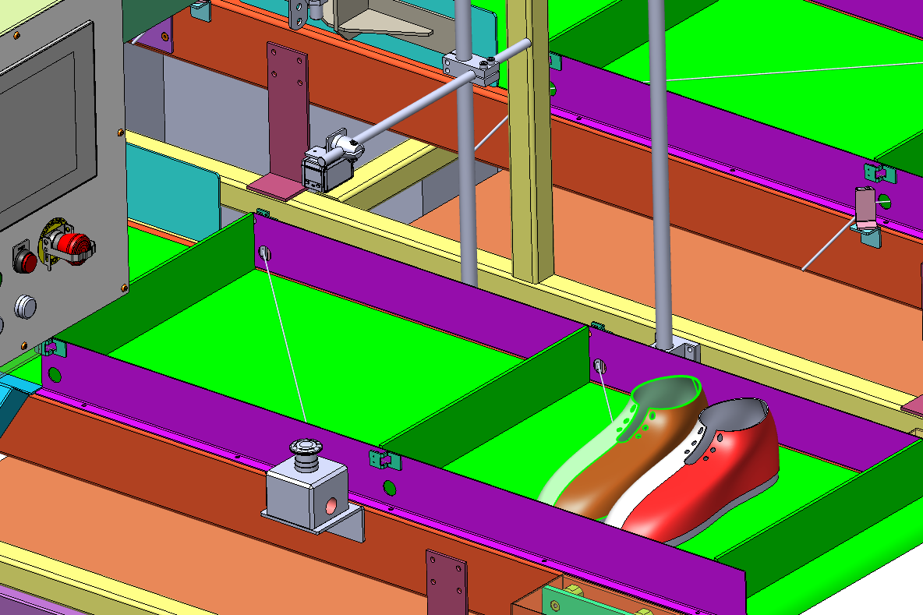
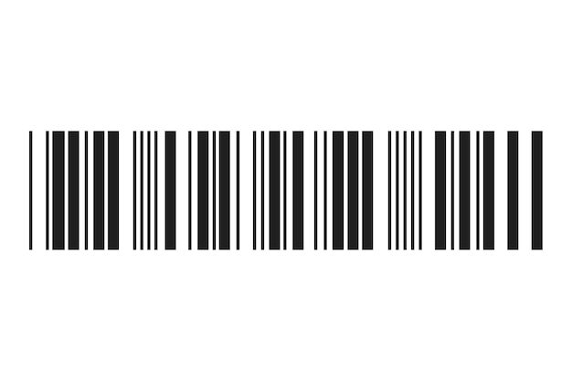

┃Process flow ( Reader )
Scan barcodes from Barcode attached to the workpiece to send for processing and size sorting

Slide 11
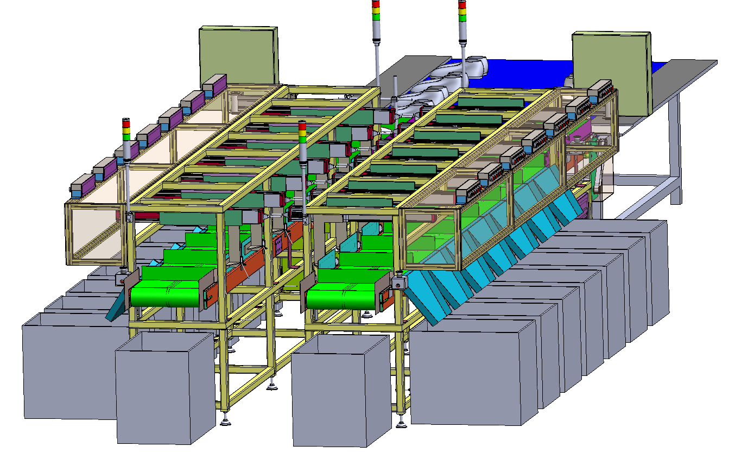
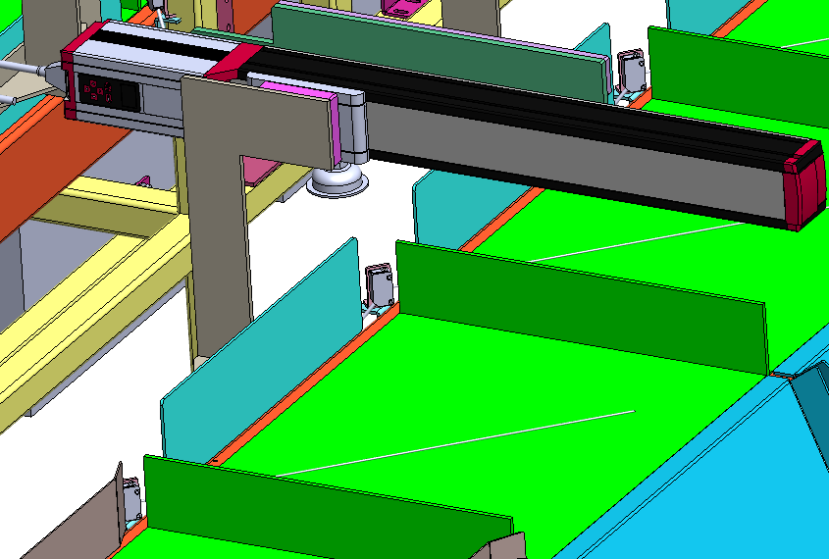
┃Process flow ( Pushing )

Slide 12
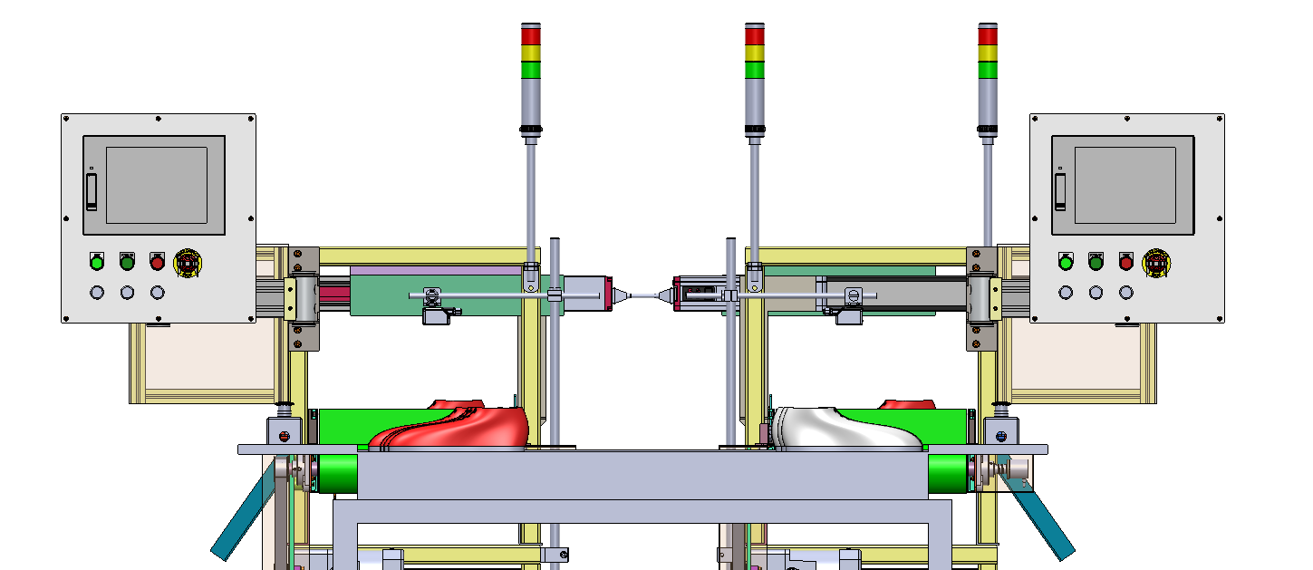
┃Operation panel and status machine
Status machine
- Lamp
- Buzzer
Touch panel operation
- VTW10 ( Keyence )
Button and lamp operation
- Start machine
- Stop machine
- Emergency stop

Slide 13
┃Machine setting parameter
MIAN MENU
Pattern parameter setting
ALARM
Name pattern
B1(Size)
B2(Size)
B3(Size)
B4(Size)
B5(Size)
B6(Size)
Pattern 1
36
37
38
39
40
41
SELECT
Pattern 2
40
41
42
43
44
45
SELECT
Pattern 3
SELECT
Pattern 4
SELECT
Pattern 5
SELECT
Pattern 6
SELECT
Pattern 7
SELECT
Pattern 8
SELECT
Pattern 9
SELECT
Pattern 99
SELECT

Slide 14
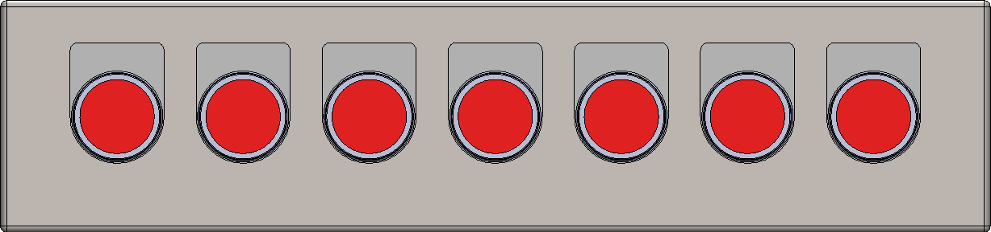
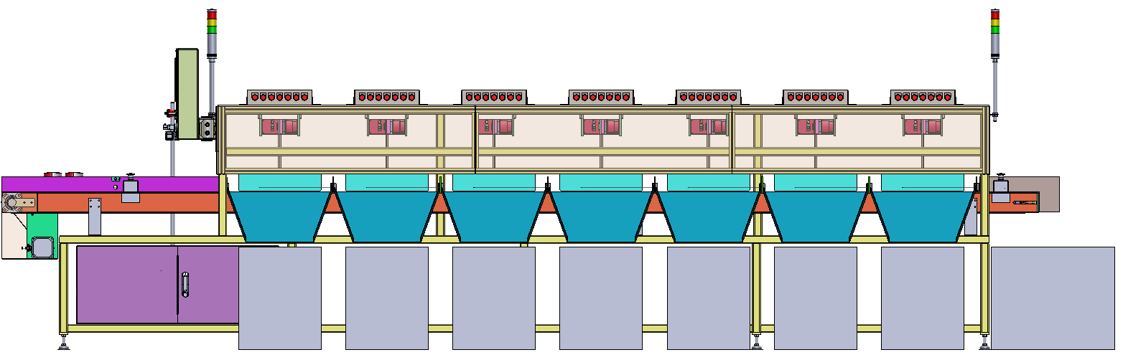
┃Machine setting parameter
SIZE 36
SIZE 37
SIZE 38
SIZE 39
SIZE 40
SIZE 41
SIZE 42

Slide 15
┃Time Chart

Slide 16
Machine operation monitoring system | Phase 2

Slide 17
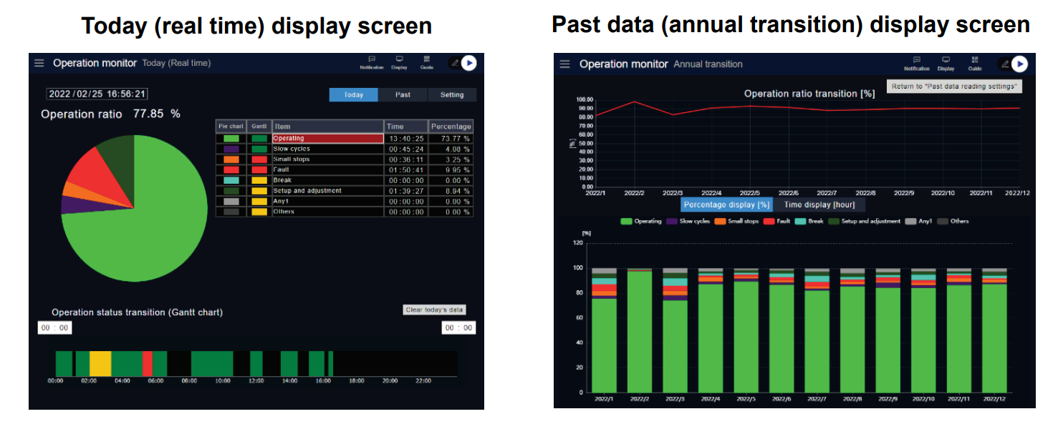
┃Machine operation monitoring system | Phase 2
The Operation Monitor Application uses the KV-XD02 to analyze and display the factors of non-operating equipment from signals for status such as equipment operating and stopped signals.

Slide 18
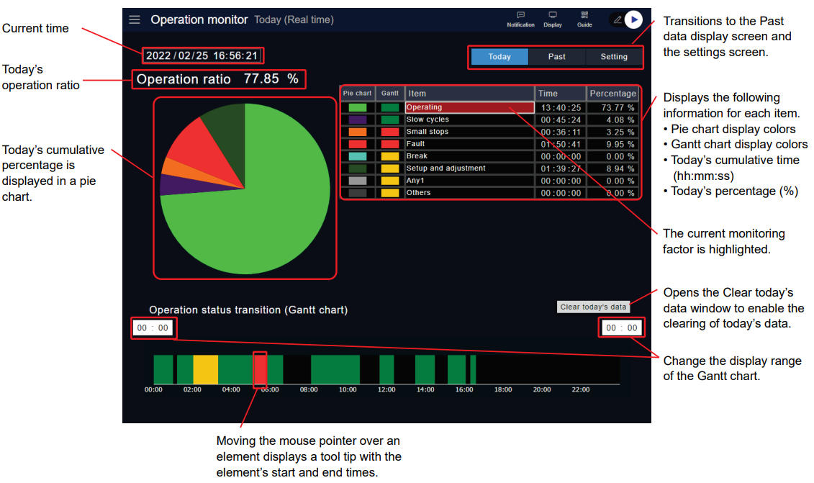
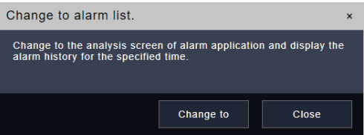
┃Machine operation monitoring system | Phase 2
Today’s operation ratio and the time and percentage for each factor are updated in real time on this screen.
The table of times and percentages on the right side of the screen displays only the enabled items.

Slide 19
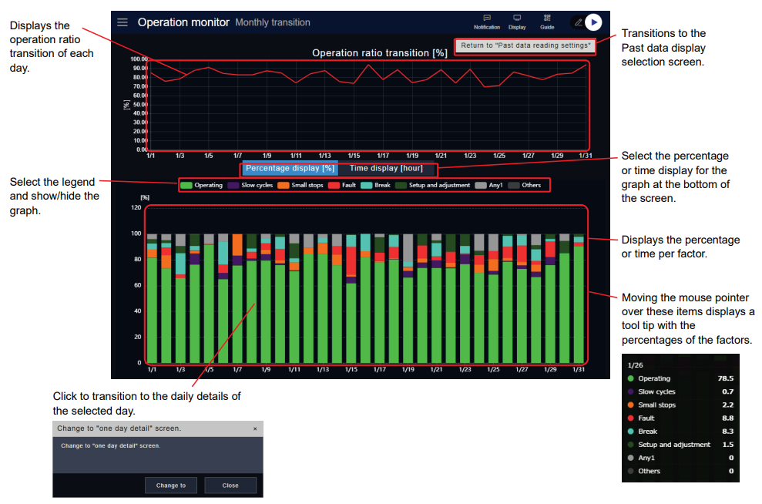
┃Machine operation monitoring system | Phase 2
Monthly transition screen : Displays 31 days worth of daily operation ratios as well as times and percentages for each monitoring factor from the
specified day

Slide 20
┃Machine operation monitoring system | Phase 2
Record production data into the database Basic information
Production Code: [1234567890]
Production date: [2024/01/01 15:30:41]
Number of Shoes Produced: [2000]
Machine
Data base

Slide 21
┃Schedule │ Go live schedule
1. Current situation analysis
We will inspection the current business and the system being used, confirm the requirements, and analyze the customer's current situation. And will make an estimate based on customer requirements.
生産計画
Within sales
2. Requirement definition
Detailed requirement definition will be performed based on the analysis result. Check the detailed requirements so that the system can be implemented in a manner that matches actual operation.
1-4 weeks
3. Design
While a process meeting, we will perform basic design, detailed design, and preparation for transfer based on the requirements.
1-4 weeks
4. Development
/ Test
Perform the test that fits with customer work and start the test.
We will consider a transfer every method for let smooth working process.
8-12 weeks
5. Introduction support
We will have an operation training to introduce the system that is currently being used or work in parallel with the work, and after confirming the usability, etc., And the final acceptance will be continue to process.
4 week
6. Production operation
When start operation. We will provide a long-term support for safe and comfortable system by providing operation maintenance support, information provision, and revision edition.
Min : 20 weeks
Max : 30 weeks

Slide 22

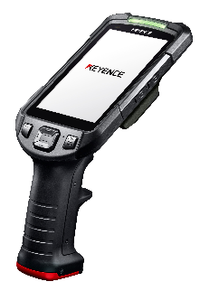
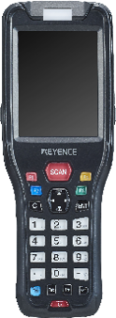
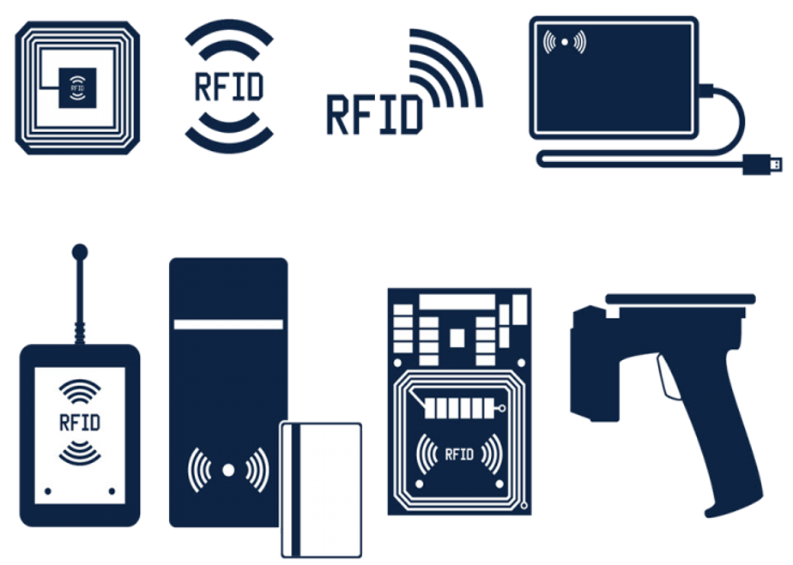
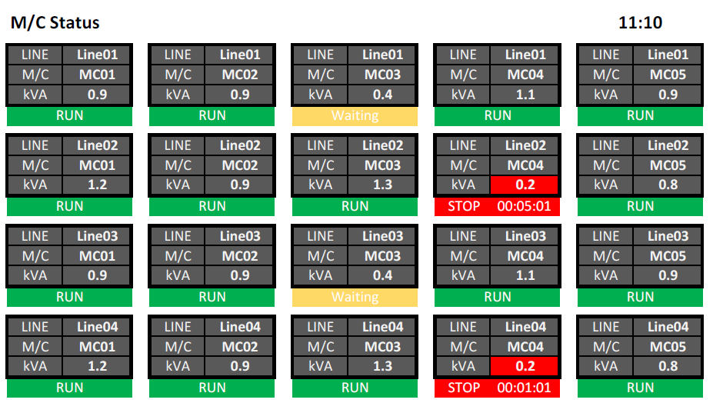



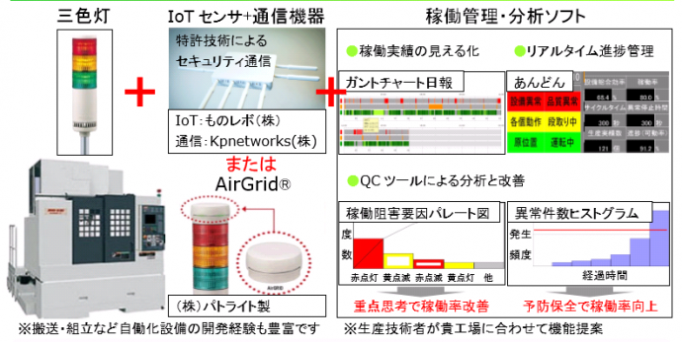
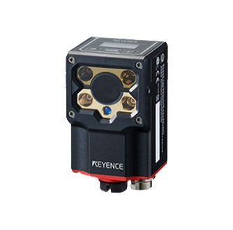
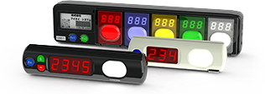
┃ Proposals that only we can make
With a wide range of “Soft" x "Hard" solutions, which is our strength,
We will solve problems in various situations at manufacturing and distribution sites.
Picking System
Handy terminal System / Tablet System
RFID System
Monitoring / Traceability System

Slide 23
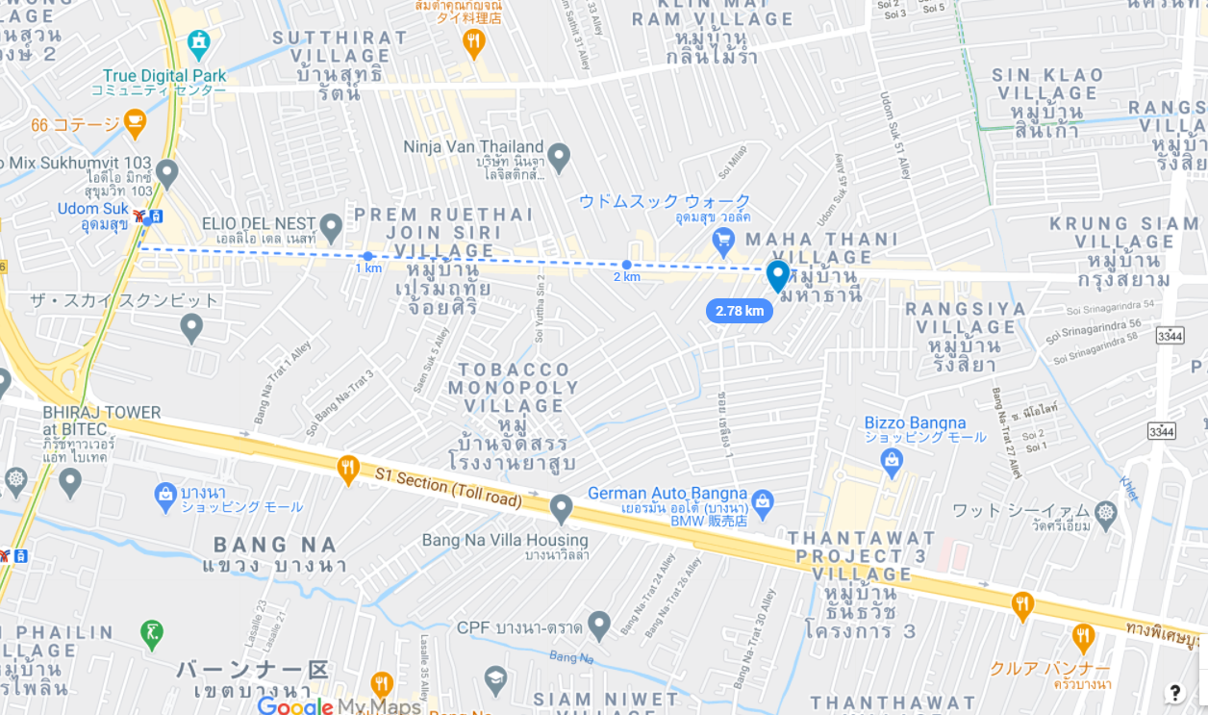


┃Contact
info@tomastc.com
TH/EN: +66-81-012-6064 (Anek)
JP/TH/EN: +66-94-552-3097 (Nozaki)
TOMAS TECH
http://www.tomastc.com
7/1(3C) Soi Sukhumvit 103 (Udomsuk 46) Sukhumvit Bang Na, Bangkok 10260

