Slide 1
Data collection box for JATH
Made for JTKET Machine system Co.,Ltd.
TOMAS TECH Co., Ltd.

Slide 2
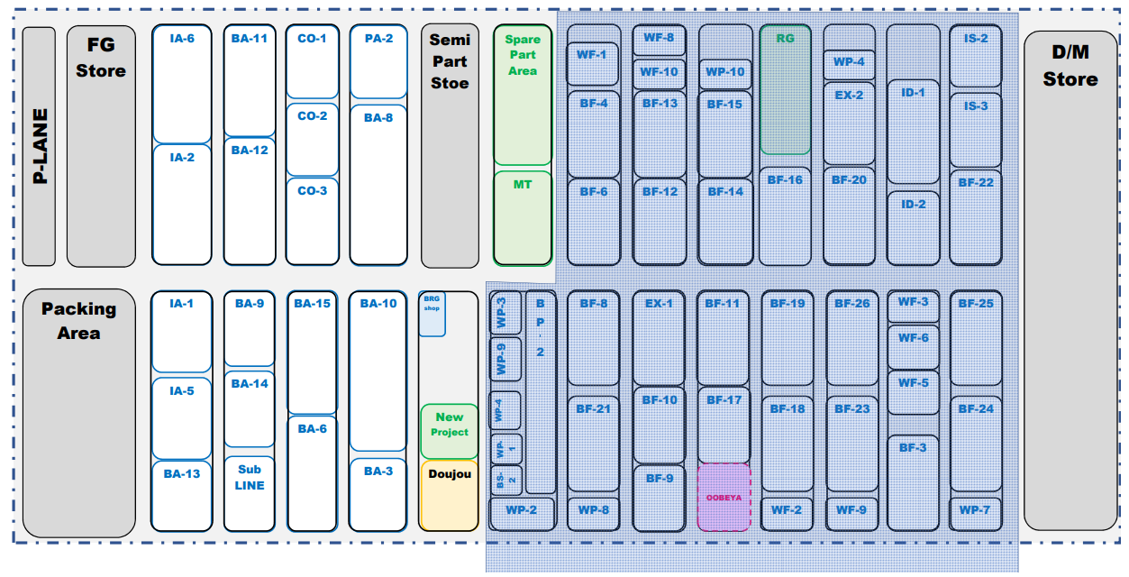
┃System outline
New data collection box + New panel input + Add module Ethernet
TV 43” + Driver display 2 equipment/point
Master Box
HUB 24 port x 2
Panel Box
Zone 1
Zone 2
Server
JATH
Wiring system
I/O Cable
Lan Cable
Scope of work
- Uninstall Board monitor 45 unit (*Estimate)
- Uninstall data collection box 49 Unit
- Install TV Display 30 Unit ( Rack Tomas tech Provide )
- Install Master box 3 Unit ( Box control Tomas tech Provide )
- Install new data collection box and wiring 30 I/O 49 Unit ( Box and wiring diagram Tomas tech Provide )
- Install new panel input box and wiring to terminal 49 unit ( Box Tomas tech Provide )
- Install rack switching hub 3 Unit ( Rack and Hub Tomas tech supply )
- Wiring Lan cable from Hub to Master Unit 3 Point ( Rev. Wiring system
- Wiring Lan cable from Hub to data collection box 49 Unit
- Wiring Lan and power to TV Display 30 Unit
Zone 3
Zone 2

Slide 3

┃System outline for collect data box
Server JATH
Master Box control 1
Master Box control 2
Master Box control 3
Switching Hub 24 Port x2
Switching Hub 24 Port x2
Switching Hub 24 Port x2
Data Box
WF-1
Ethernet
Module
Ethernet
Module
Data Box
BF-14
Data Box
ID-1
Ethernet
Module
Ethernet
Module
Data Box
WF-6
Data Box
BF-19
Ethernet
Module
Ethernet
Module
Data Box
BF-21
Data Box
BF-4
Ethernet
Module
Ethernet
Module
Data Box
RG
Data Box
ID-2
Ethernet
Module
Ethernet
Module
Data Box
WF-5
Data Box
BF-18
Ethernet
Module
Ethernet
Module
Data Box
WP-8
Data Box
BF-6
Ethernet
Module
Ethernet
Module
Data Box
BF-16
Data Box
IS-2
Ethernet
Module
Ethernet
Module
Data Box
BF-3
Data Box
WF-2
Ethernet
Module
Ethernet
Module
Data Box
BP-2
Data Box
WF-8
Ethernet
Module
Ethernet
Module
Data Box
WP-4
Data Box
IS-3
Ethernet
Module
Ethernet
Module
Data Box
BF-26
Data Box
BF-11
Ethernet
Module
Ethernet
Module
Data Box
WP-3
Data Box
WF-10
Ethernet
Module
Ethernet
Module
Data Box
EX-2
Data Box
BF-22
Ethernet
Module
Ethernet
Module
Data Box
BF-23
Data Box
BF-17
Ethernet
Module
Ethernet
Module
Data Box
WP-9
Data Box
BF-13
Ethernet
Module
Ethernet
Module
Data Box
BF-20
Data Box
BF-25
Ethernet
Module
Ethernet
Module
Data Box
WF-9
Data Box
OOBEYA
Ethernet
Module
Ethernet
Module
Data Box
WP-4
Data Box
BF-12
Ethernet
Module
Data Box
BF-24
Ethernet
Module
Data Box
EX-1
Ethernet
Module
Ethernet
Module
Data Box
WP-1
Data Box
WP-10
Ethernet
Module
Data Box
WP-7
Ethernet
Module
Data Box
BF-10
Ethernet
Module
Ethernet
Module
Data Box
BS-2
Data Box
BF-15
Ethernet
Module
Data Box
WF-3
Ethernet
Module
Data Box
BF-9
Ethernet
Module
Ethernet
Module
Data Box
WP-2
Data Box
BF-8
Ethernet
Module

Slide 4
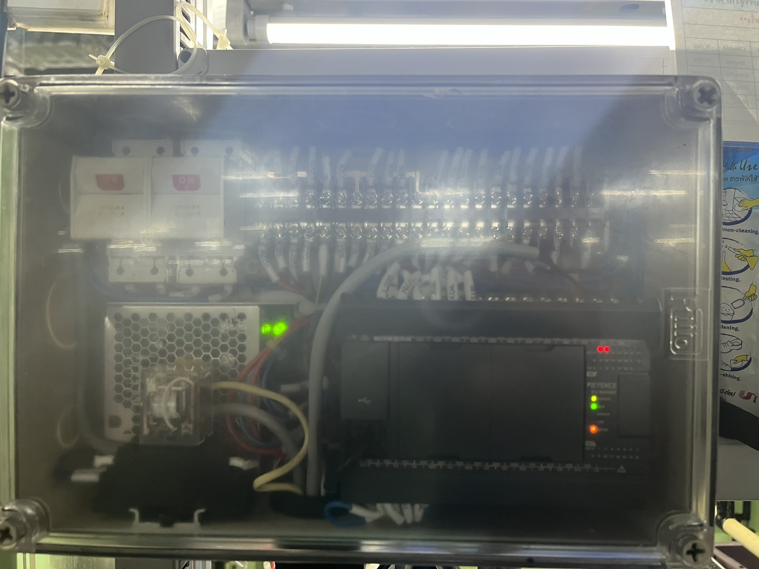
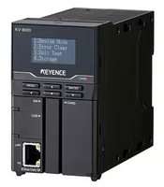
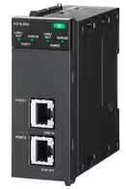
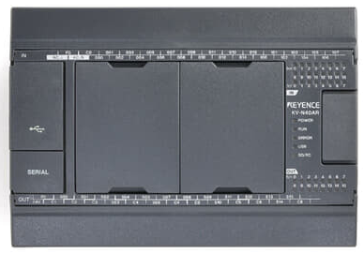


┃Addition device for Collect data box
As-In Current
KV-40AR
Add New
KV-NC1EP
Add New Master collect data
KV-8000 + KV-XLE02
- Addition and installation KV-NC1EP to PLC KV-N40AR 49 Unit
- Change current data box to New data box
- Addition Master PLC for Collect data from data box and communication between server
3 Unit

Slide 5
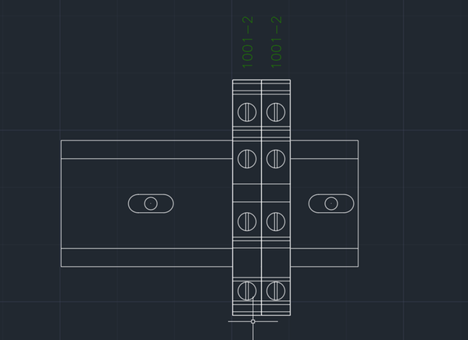
┃Collection data box
CP1
CP1
Power
Supply
PLC KV-N40AR
KV-N1
KV-NC1EP
Terminal for IN/OUT

Slide 6

┃Master box
ELCB
CP1
CP2
UPS
PLC
XLE
XTD
Power on
Front
Side
In side

Slide 7
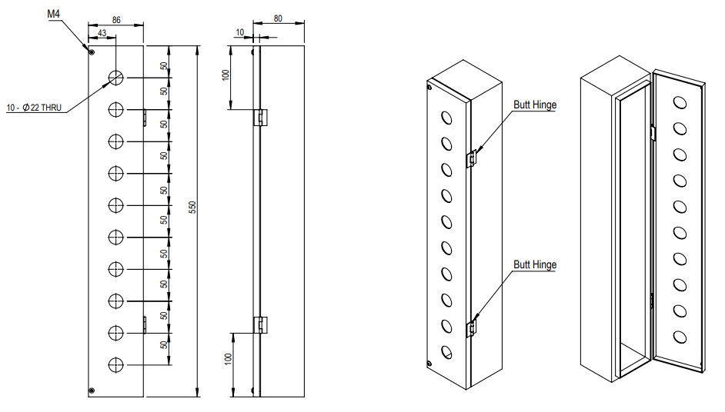
┃Addition panel input data final line

Slide 8
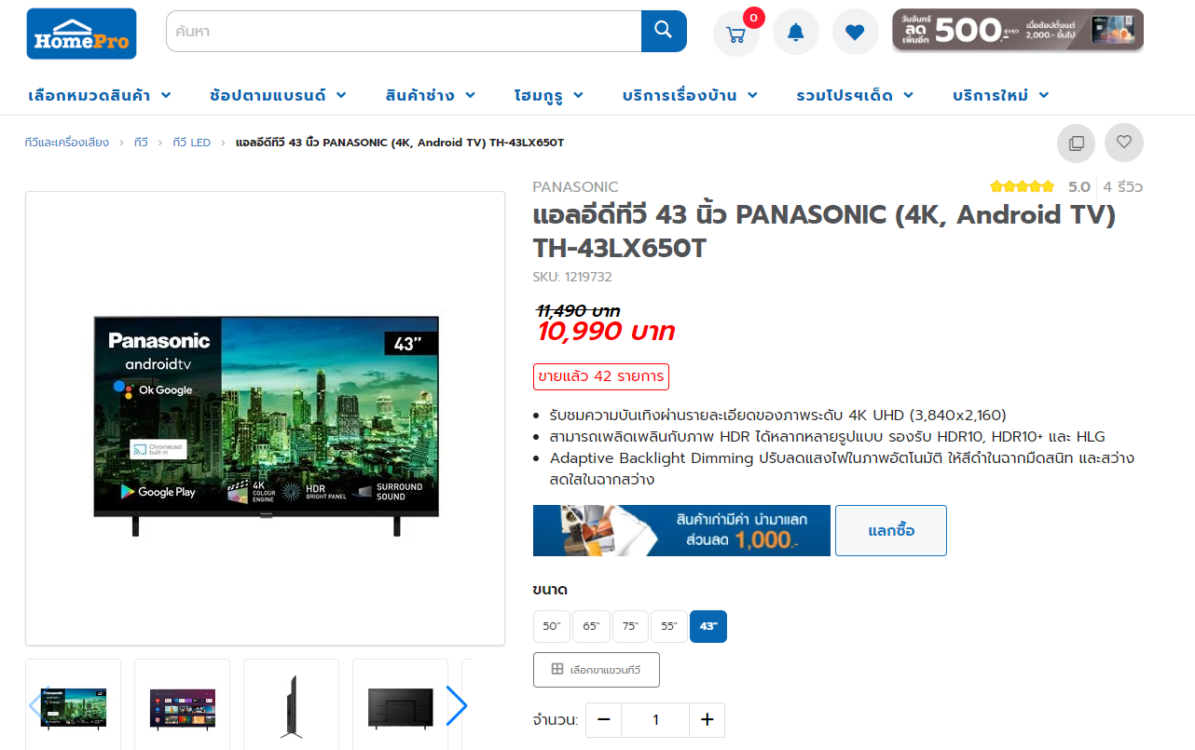
┃TV-Display
https://www.homepro.co.th/p/1219732

Slide 9
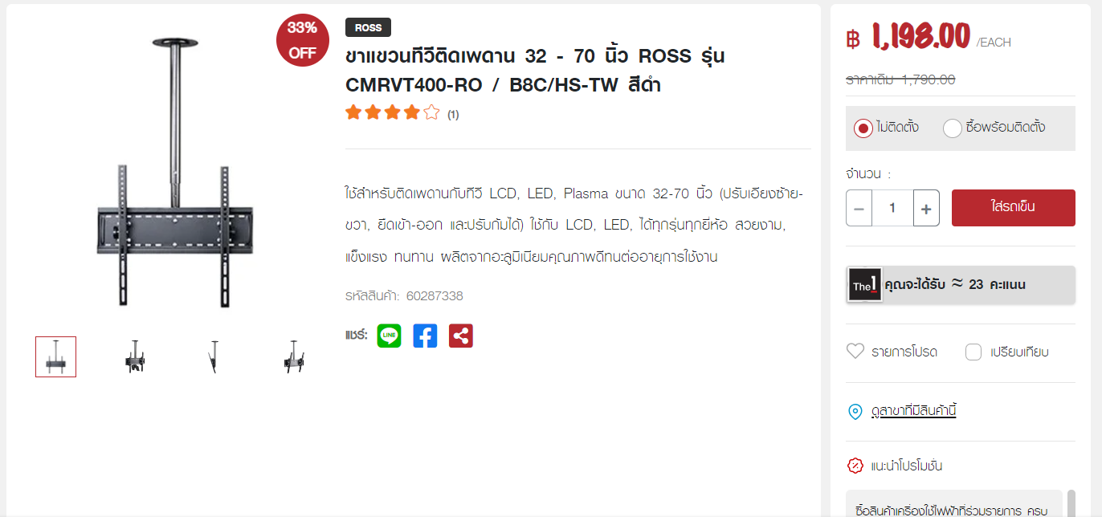
┃TV-Rack
https://www.thaiwatsadu.com/th/product/%E0%B8%82%E0%B8%B2%E0%B9%81%E0%B8%82%E0%B8%A7%E0%B8%99%E0%B8%97%E0%B8%B5%E0%B8%A7%E0%B8%B5%E0%B8%95%E0%B8%B4%E0%B8%94%E0%B9%80%E0%B8%9E%E0%B8%94%E0%B8%B2%E0%B8%99-32---70-%E0%B8%99%E0%B8%B4%E0%B9%89%E0%B8%A7-ROSS-%E0%B8%A3%E0%B8%B8%E0%B9%88%E0%B8%99-CMRVT400-RO-%7C-B8C%7CHS-TW-%E0%B8%AA%E0%B8%B5%E0%B8%94%E0%B8%B3-60287338?gad_source=1&gclid=Cj0KCQiA7aSsBhCiARIsALFvovyToA_0-McQqXG_y__iH_7ZZh6GjzCuQxxCOLu0U7OW71NMu1uoGIwaAsL9EALw_wcB

Slide 10
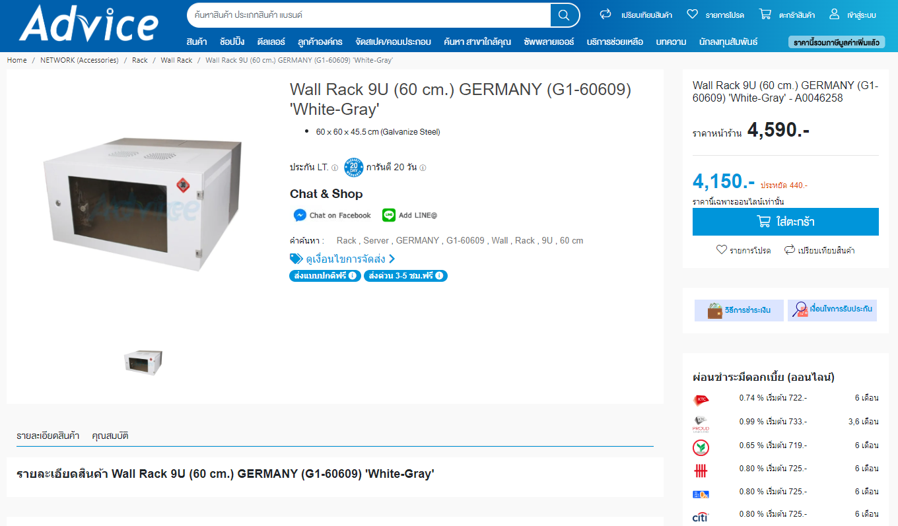
┃Wall Rack
https://www.advice.co.th/product/rack/wall-rack/wall-rack-9u-60-cm-germany-g1-60609-white-gray-?gclid=Cj0KCQiA7aSsBhCiARIsALFvovzKYyeY4jTwDq2SkT9udh0pgUve-eV1ByTBhf1kBrWKQNeCHPn3vs8aAgnaEALw_wcB

Slide 11
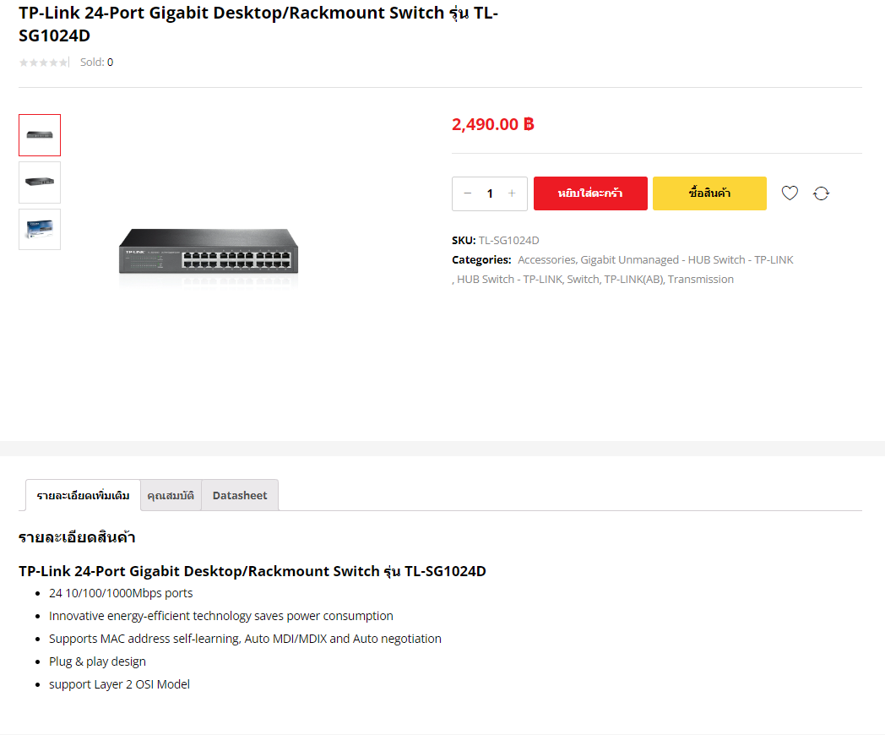
┃TP-Link 24-Port Gigabit Desktop/Rackmount Switch
https://www.abshop.in.th/product/tl-sg1024d/?gad_source=1&gclid=Cj0KCQiA7aSsBhCiARIsALFvovxe0ITM6JDQvlK703DhnChYn6WgG_vXV72SUkIah_kTMHzPAGGNU6oaArQ3EALw_wcB

Slide 12


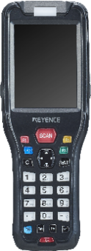
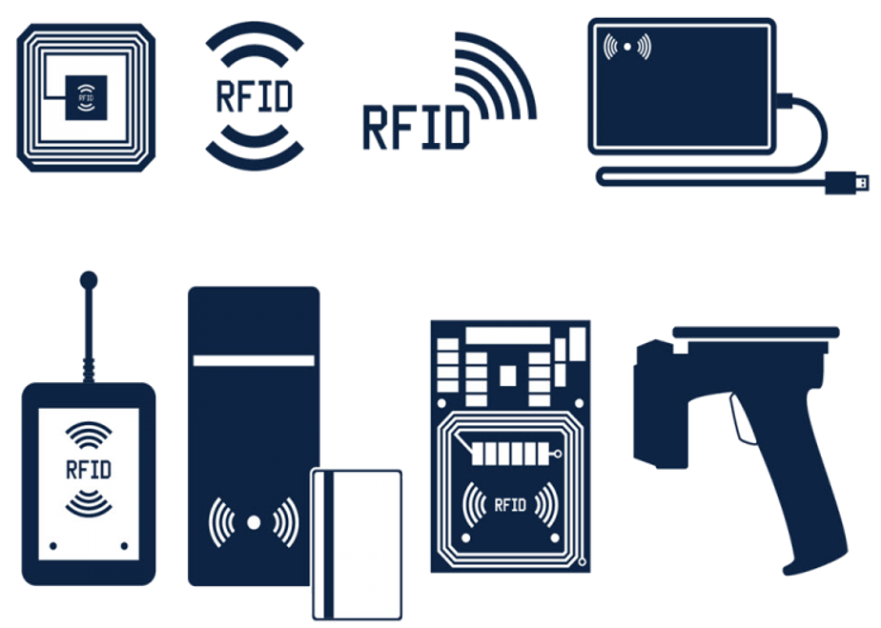
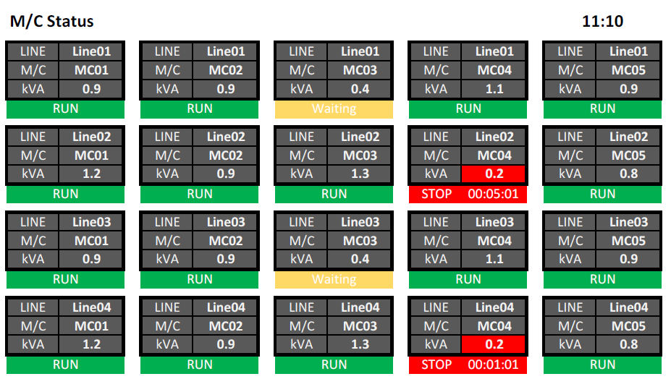


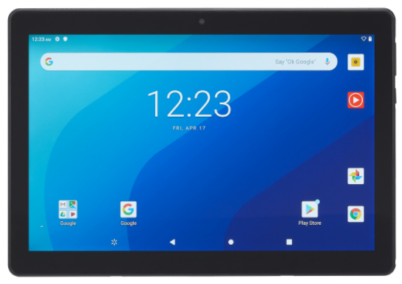
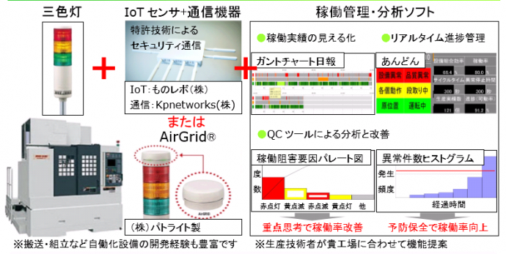
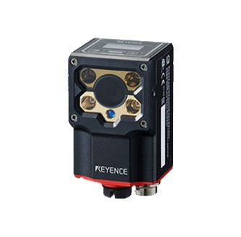
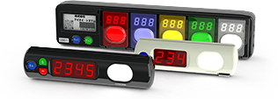
┃ Proposals that only we can make
With a wide range of “Soft" x "Hard" solutions, which is our strength,
We will solve problems in various situations at manufacturing and distribution sites.
Picking System
Handy terminal System / Tablet System
RFID System
Monitoring / Traceability System

Slide 13
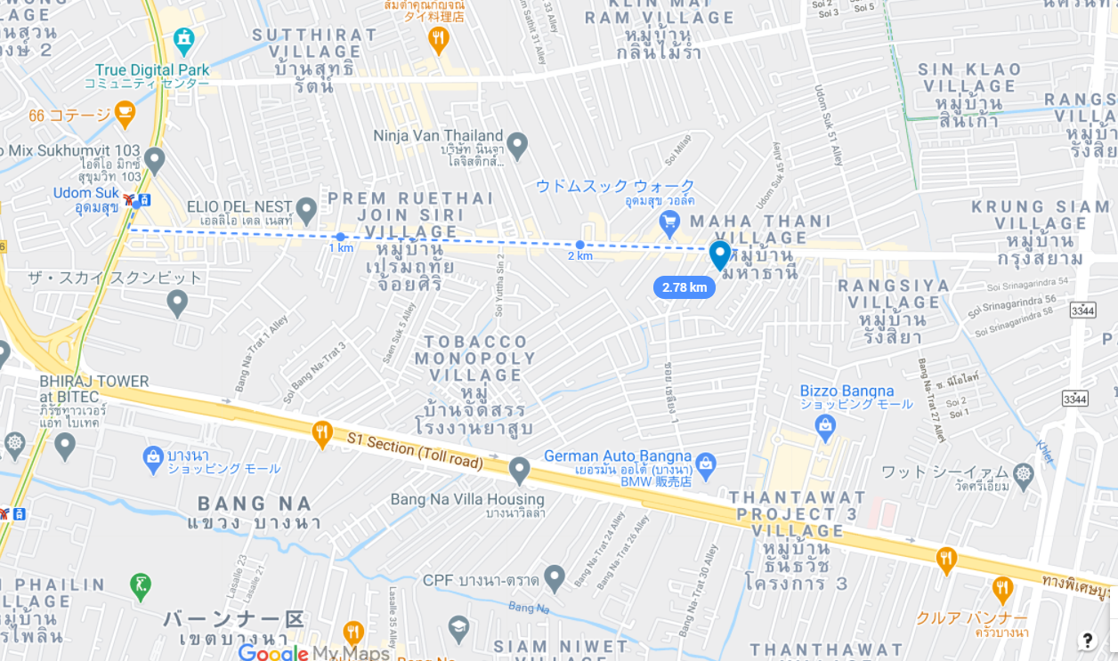


┃Contact
info@tomastc.com
TH: +66-85-995-0178 (Nattapol)
TH/EN: +66-81-012-6064 (Anek)
JP/TH/EN: +66-94-552-3097 (Nozaki)
TOMAS TECH
http://www.tomastc.com
7/1(3C) Soi Sukhumvit 103 (Udomsuk 46) Sukhumvit Bang Na, Bangkok 10260

