Slide 1
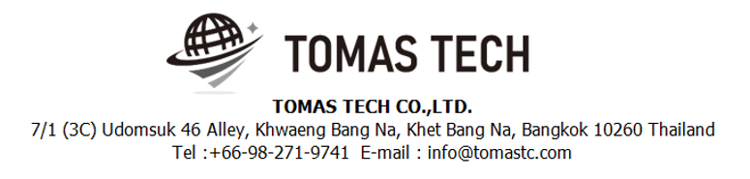
Version 22/Dec/2023
Confidential
CKD process system phase3 specifications
Documentation EN Blueprint for ANI
Blueprint
R7
Made for : A.N.I. LOGISTICS, LTD.
By : TOMAS TECH CO.,LTD.

Slide 2
Revision History
Date | Version | File name | Details
04/Nov/2023 | R1 | CKD process system phase3 specifications Documentation EN Blueprint for ANI Blueprint | First edition
14/Nov/2023 | R2 | CKD process system phase3 specifications Documentation EN Blueprint for ANI Blueprint | Second edition
21/Nov/2023 | R3 | CKD process system phase3 specifications Documentation EN Blueprint for ANI Blueprint | Third edition
29/Nov/2023 | R4 | CKD process system phase3 specifications Documentation EN Blueprint for ANI Blueprint | Fourth edition
06/Dec/2023 | R5 | CKD process system phase3 specifications Documentation EN Blueprint for ANI Blueprint | Fifth edition
13/Dec/2023 | R6 | CKD process system phase3 specifications Documentation EN Blueprint for ANI Blueprint | Sixth edition
22/Dec/2023 | R7 | CKD process system phase3 specifications Documentation EN Blueprint for ANI Blueprint | Seventh edition
2
3
4
5
6
7

Slide 3
■Contents
1. Overview
2. Overall configuration diagram
3. Document information
4. Operation flow
5. System functional specifications
6. Q&A
7. Sign off

Slide 4
1. Overview
Proposal of Process Management System to A.N.I.
By systematizing the CKD work process, we will realize “Improvement of quality", “Improvement of work efficiency", “Visualization of work", “Paperless" and “Traceability management".
Advantages of introducing the system
By scanning and verifying the visual confirmation work with a handy terminal, it is possible to prevent check mistakes by workers and expect "improvement of quality".
By acquiring the cycle time of the packing work, it becomes possible to analyze by process, worker, and control number, and "improvement of work efficiency" can be expected.
By creating a system, on-site managers, office managers, and people in charge of other processes will be able to grasp the work status, realizing "visualization of work". By visualizing the on-site situation, it is possible to manage the progress of the Material Stock process, which can be expected to improve work efficiency.
By enabling the necessary information to be viewed on PCs, handy terminals, tablets, and TV displays, it is possible to realize "paperless" by digitizing forms.
"Traceability management" can be realized because it is possible to take pictures of the actual product and the product as well as the result of verification by the handy terminal.

Slide 5
2. Overall configuration diagram
Regarding the CKD process system, consider the following system configuration.
Overall configuration diagram image
Server Room
Fiber optic communication
ANI CKD process server BK
ANI CKD process server
LAN communication
WIFI communication
HATC schedule data
HATC schedule data
System unit
Printing label (New)
Using label (Old)
UPS
UPS
Show document
TV display for monitor *1
S/W Hub
A/P *9
Receiving area
Stock & Staging area
Inner packing area
Outer Packing area
Handy terminal *7
Tablet for Meiji card *7
Tablet for monitor *5
Label printer for Tag receive *2
Handy terminal *12
Tablet for monitor *12
Client PC & UPS *40
Display *40*2
Printer *40*1
Scanner *40*1
Camera *60*1
S/W Hub * 40
Handy terminal *12
Tablet for monitor *11
TV Display 55inch *1
Parts contents tag receive
Parts contents tag receive
Parts contents tag receive
Contents label
Meiji card for Tablet
Meiji card for Tablet
Contents label
Packing check sheet
Office area
Meiji card for PC
Case mark
PC *2
Label printer for Contents label *2
Packing method for PC
Contents label

Slide 6
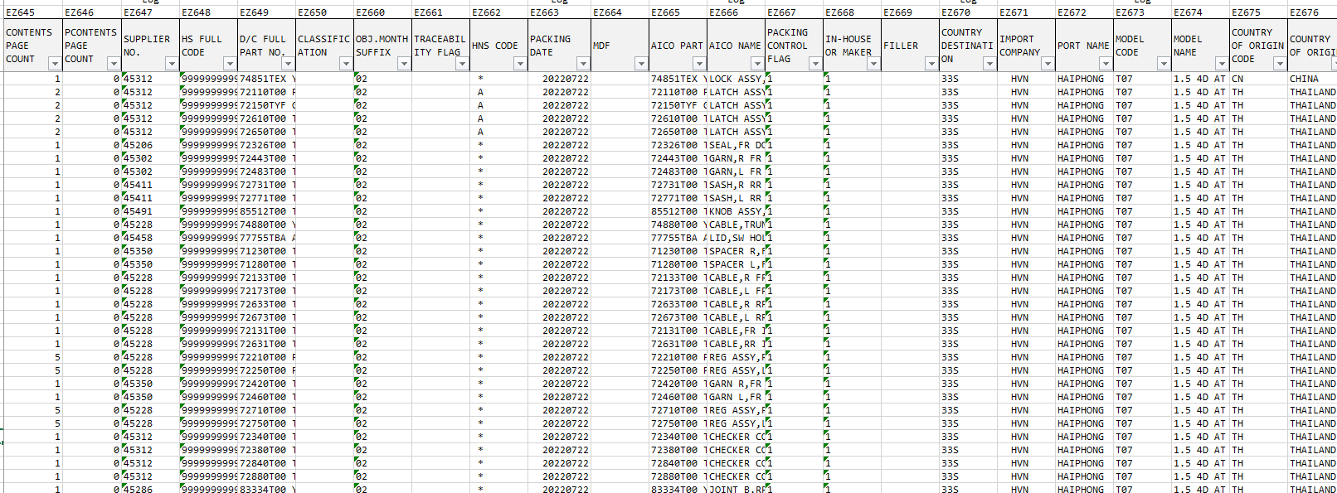
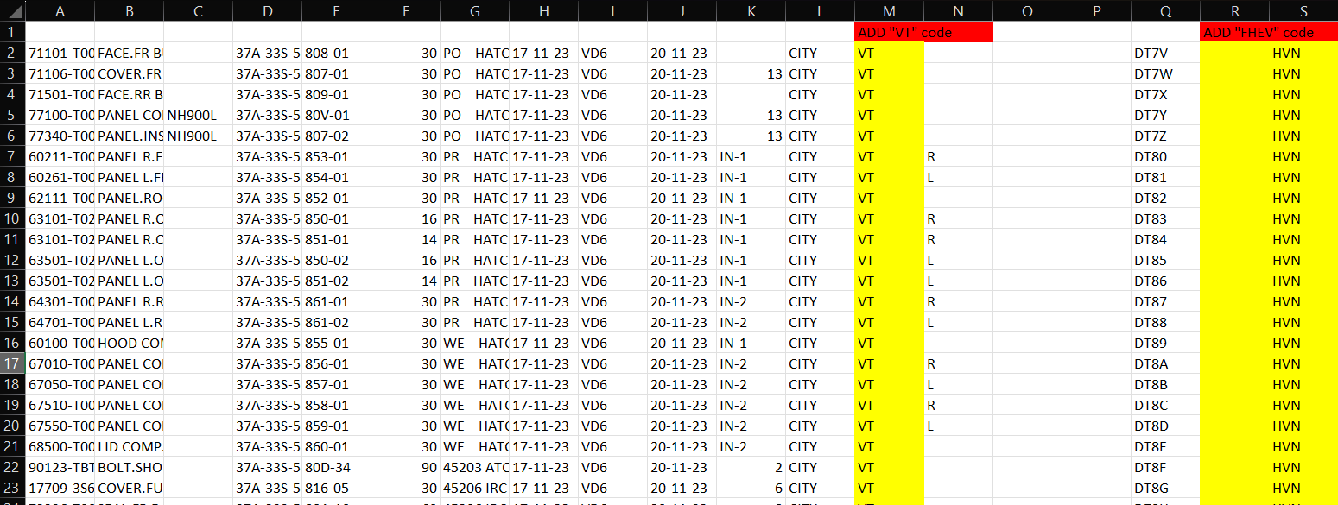
3. Document information
1. HATC Production schedule sheet ‘.txt data’ (Input data)
1-1. New TAG RECEIVE input format
4

Slide 7

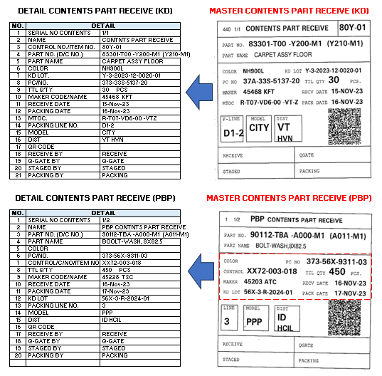
3. Document information
2
2. Parts contents tag receive (Input data)
[NETFILE]4126063 R 202311 R33ST07 37A33S513720 R T07VD600 VT-Z Y3202312002001 80YF R8F3T 80YR8F3T 83301T00 Y200M1 405 0001 0001 30 1 3 28 30 1 10 48.7 125.0 3.7925148 1492 2290 1110 0 0 Y210M1 CARPET ASSY FLOOR NH900L 4875.00 0 1348.69 F .00 3 0 45468 999999999999 83301T00 Y210M1 01 * 20231116 83301T00 Y200M1 CARPET ASSY FLOOR 1 1 33S HVN HAIPHONG T07 1.5 4D AT TH THAILAND HATC KD 11 (16-20).csv 2023-11-15 09:12:00.830 EX2521 NULL NULL
[TAGRECIEVE]2168880 37A33S513720 83301T00 Y210M1 CARPET ASSY FLOOR NH900L 80Y01 NULL 37A-33S-5137-20 83301-T00 -Y200-M1 (Y210-M1) 80Y-01 30 45468 KFT 15/11/23 VD6 16/11/23 D1-2 CITY VT FHEV TAG RECEIVE KD 11 (16-20) r4.csv 2023-11-15 09:03:12.810 EX2521 NULL NULL
Data not found!
4
83301-T00 -Y200-M1 (Y210-M1)CARPET ASSY FLOOR NH900L 37A-33S-5137-2080Y-01 30 45468 KFT 15/11/23VD616/11/23D1-2CITY FHEVVT
4
FHEV
4
CONTENT SERIAL NO
4121529 R 202311 R56XPPP 37356X931103 R MTOC 56X3R2024 01 OO XX17 AFT01 XX17AFT01 46430T9D D000M1 00053 0004 NS222 0 0 1 00001 00001 0 1 598.7 719.0 3.7900000 1492 2290 1110 0 120 D020 HOSE,RR BRAKE (2WD) .07 0 1.00 .00 00001 0 45313 999999999999 46430T9D D020M1 01 1 A 20231114 00A 3 1 HCIL HCIL PIPAVAV PPP XX17-RPPP-00A PPP-HATC 11(11-15).csv 2023-11-03 09:11:03.947 VDS1621 NULL NULL
4121725 R 202311 R56XPPP 37356X931103 R MTOC 56X3R2024 01 OO XX17 AFT01 XX17AFT01 46430T9D D000M1 00167 0003 NS222 0 0 1 00002 00002 0 1 520.9 629.4 3.7900000 1492 2290 1110 0 120 D020 HOSE,RR BRAKE (2WD) .07 0 1.00 .00 00001 0 45313 999999999999 46430T9D D020M1 01 1 A 20231115 00A 3 1 HCIL HCIL PIPAVAV PPP XX17-RPPP-00A PPP-HATC 11(11-15).csv 2023-11-03 09:11:06.010 VDS1621 NULL NULL
4121920 R 202311 R56XPPP 37356X931103 R MTOC 56X3R2024 01 OO XX17 AFT01 XX17AFT01 46430T9D D000M1 00306 0003 NS222 0 0 1 00003 00003 0 1 598.7 719.0 3.7900000 1492 2290 1110 0 120 D020 HOSE,RR BRAKE (2WD) .07 0 1.00 .00 00001 0 45313 999999999999 46430T9D D020M1 01 1 A 20231116 00A 3 1 HCIL HCIL PIPAVAV PPP XX17-RPPP-00A PPP-HATC 11(16-20).csv 2023-11-03 09:12:24.430 VDS1621 NULL NULL
4121726 R 202311 R56XPPP 37356X931103 R MTOC 56X3R2024 01 OO XX17 AFT01 XX17AFT01 46430T9D D000M1 00436 0007 NS222 0 0 1 00002 00002 0 1 520.9 629.4 3.7900000 1492 2290 1110 0 120 D020 HOSE,RR BRAKE (2WD) .07 0 1.00 .00 00001 0 45313 999999999999 46430T9D D020M1 01 1 A 20231115 00A 3 1 HCIL HCIL PIPAVAV PPP XX17-RPPP-00A PPP-HATC 11(11-15).csv 2023-11-03 09:11:06.063 VDS1621 NULL NULL
Add new column ‘SUB_MODEL’ in TAG receive e.g. FHEV
Where to get the SERIAL NO from?
Manual count from packing data.
90112-TBA -A000-M1 (A011-M1)BOLT-WASH,8X82.5 373-56X-9311-03003-018450 45203 ATC 16/11/23PPP17/11/233 XX72HC
4
Where to get it from?
ANI will add the country to new tag receive file.
[NETFILE]4122063 R 202311 R56XPPP 37356X931103 R MTOC 56X3R2024 01 OO XX72 AFT01 XX72AFT01 90112TBA A000M1 00372 0018 NS112 0 0 1 00003 00003 0 3 412.9 568.4 3.7900000 1492 2290 1110 0 150 A011 BOLT-WASH,8X82.5 .03 0 1.00 .00 00003 0 45203 999999999999 90112TBA A011M1 01 * 20231117 00A 3 1 HCIL HCIL PIPAVAV PPP XX72-RPPP-00A PPP-HATC 11(16-20).csv 2023-11-03 09:12:24.733 VDS1621 NULL NULL
[TAGRECIEVE]2166979 37356X931103 90112TBA A011M1 BOLT-WASH.8X82.5 XX72 003-018 373-56X-9311-03 90112-TBA -A000-M1 (A011-M1) XX72 450 45203 ATC 16/11/23 17/11/23 3 PPP HCIL PPP TAG RECEIVE 11 (16-20).csv 2023-11-06 15:59:30.070 EX2521 NULL NULL

Slide 8
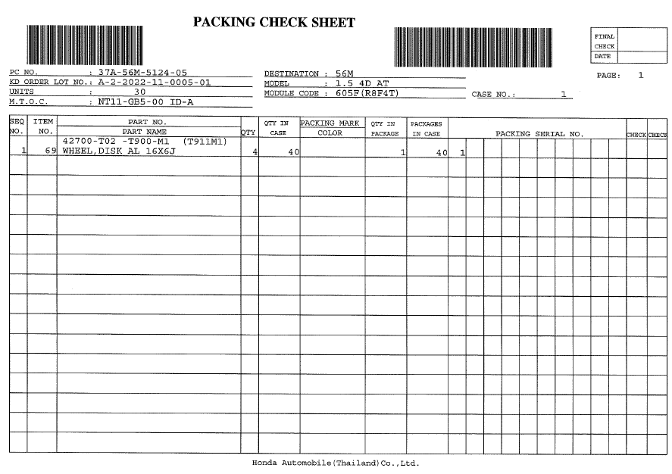
3. Document information
3. Packing check sheet (Input data)
Scan two barcodes.
The contents of the bar code are "PC No." and "Module code".
Scanning this code starts matching.

Slide 9
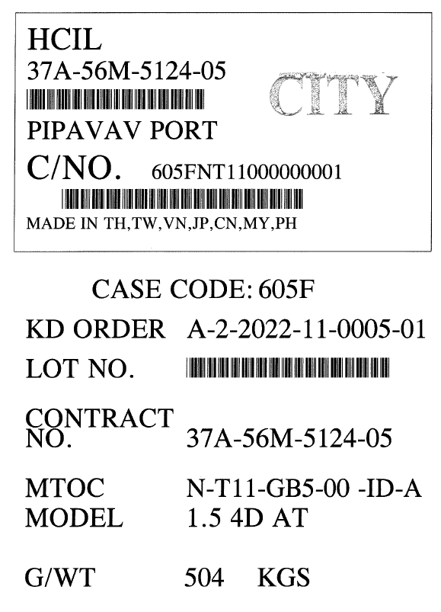
3. Document information
4. Case mark (Input data)
Case marks will also be collated.
Currently, it is used as a confirmation of the log rather than collation.

Slide 10
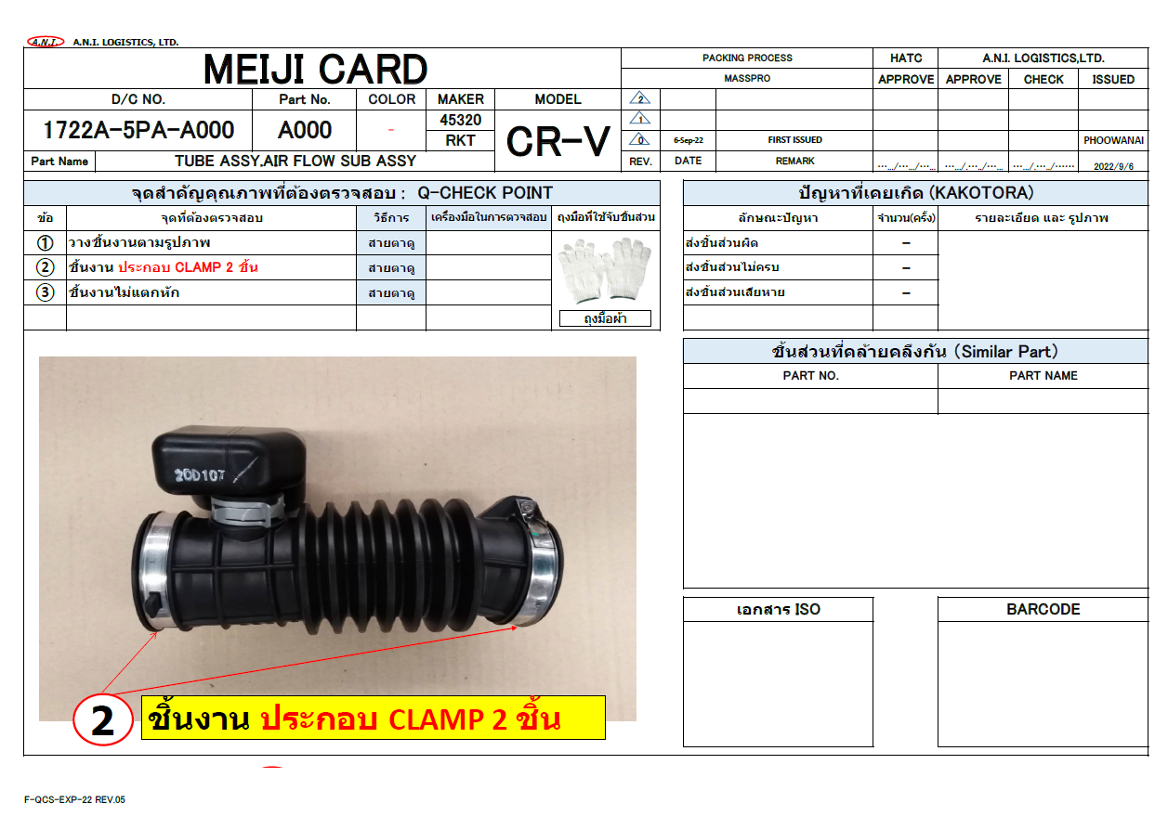

3. Document information
5. Meiji card (Output data)
Meiji card saves by using file name + part name. The save format is to save in PDF format.
There are 3800 types of parts..
Display on tablet and PC.

Slide 11
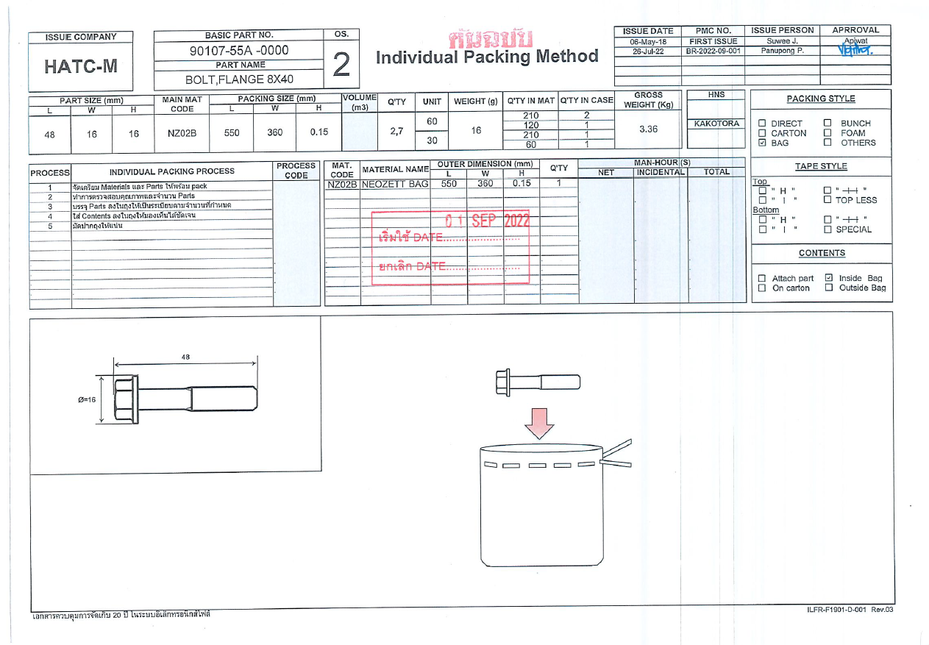

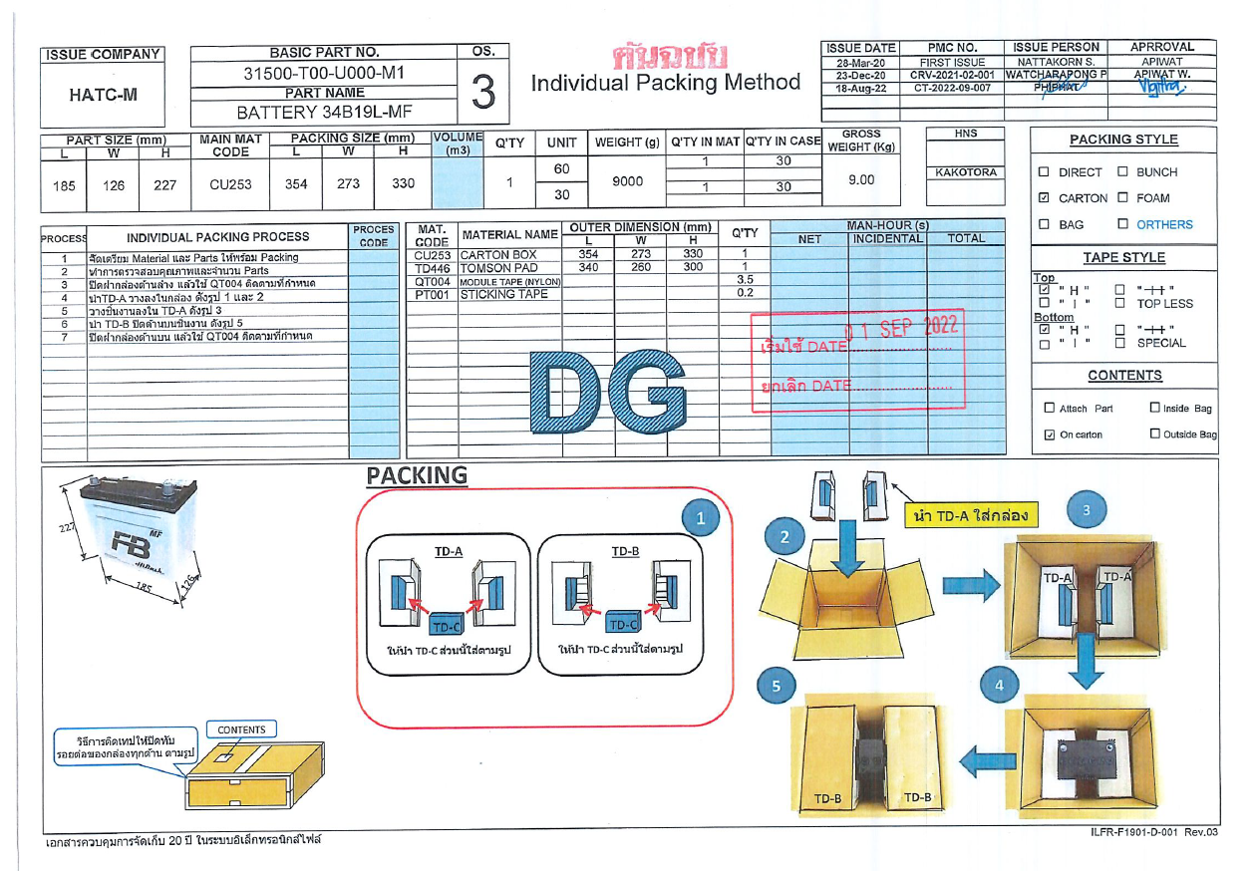
3. Document information
6. Packing method (Output data)
Tomas preferred to use the pattern in the item master settings below. The 1st 2 digits of package type in NET files will be mapped to the file name in the packing process automatically.
INNER_PACKING_METHOD :
<BASIC_PART_NO>_<%PACKAGE_TYPE%>.pdf
Example:
<BASIC_PART_NO>_RT.pdf
<BASIC_PART_NO>_CA.pdf
<BASIC_PART_NO>_PB.pdf
2

Slide 12
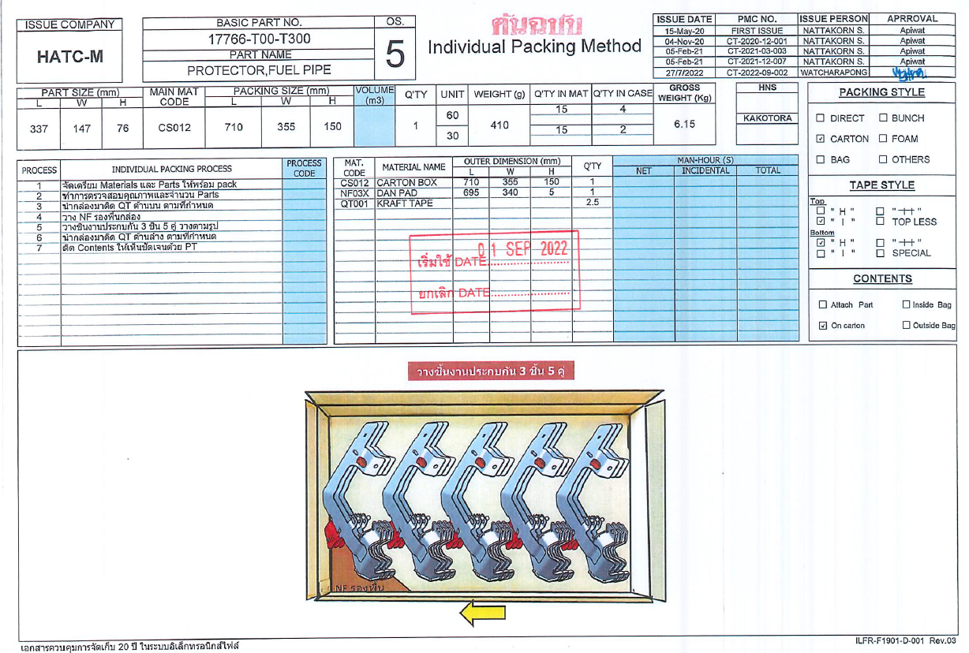
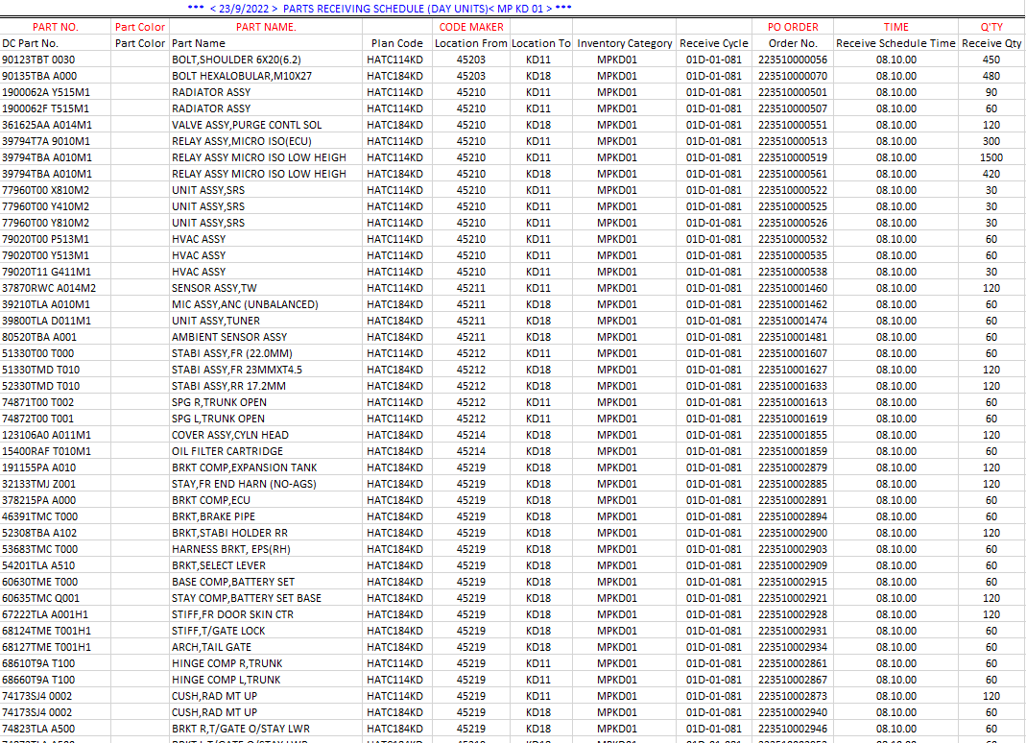
3. Document information
7. Packing method (Output data)
Day units file will be imported 2 days in advance.
This is an example day units excel file.
8. Receiving day unit (Input data)

Slide 13
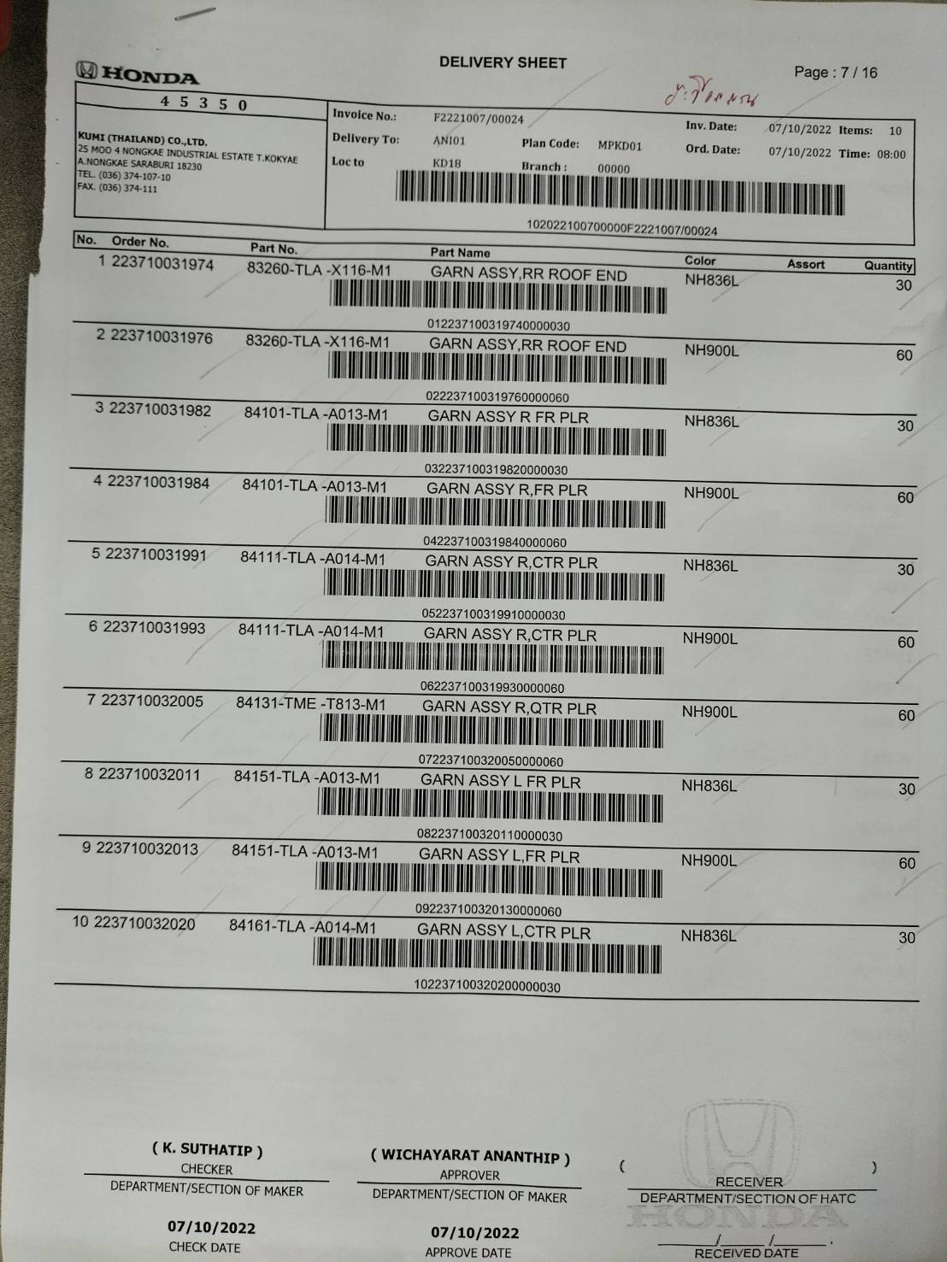
3. Document information
Scan this document together with tag scanning in the receiving process.
8. Delivery Sheet (Input data)
4
Just in time print by handheld.
* Will be design HT function screen for JIT tag label print.
Prevent the just in time reprint.
Able JIT reprint by entering the leader pass code

Slide 14
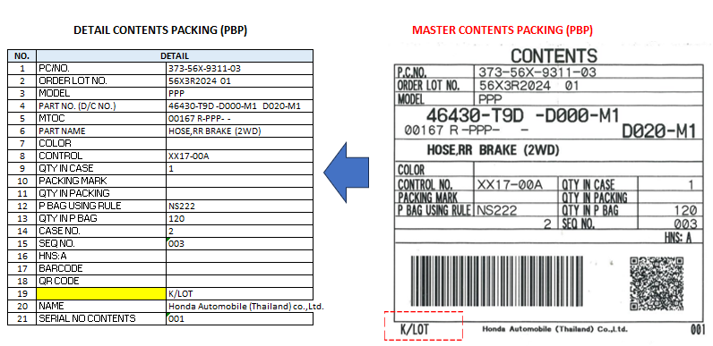
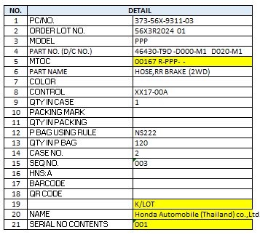

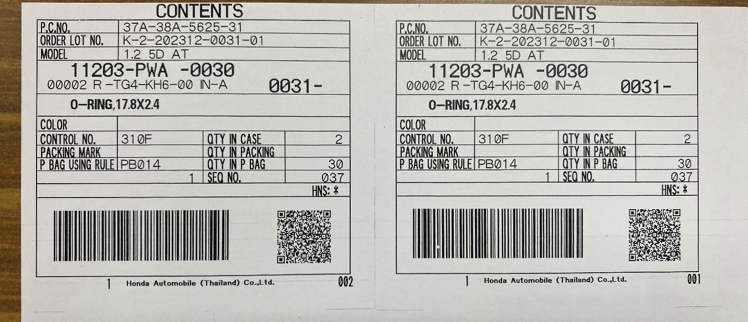
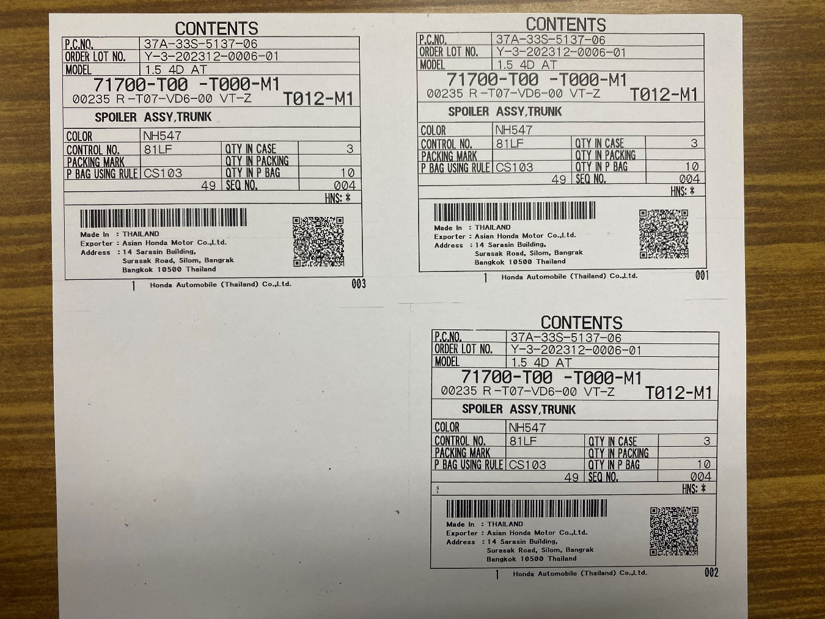
3. Document information
9. Contents label (Output data)
2
Show ‘R-PPP- -’ for PPP
Show data from NET FILE
Show ‘K/LOT’ in PPP only
Check the totally of parts in the same case
3
46430T9D D000M1
R
37356X93110356X3R2024 01 PPP 46430T9D D000M146430T9D D020M100167HOSE,RR BRAKE (2WD) XX1700A NS222 00002000000100000000000120003ANIP 00101 20231115RPPP356X
CONTENT SERIAL NO
4121529 R 202311 R56XPPP 37356X931103 R MTOC 56X3R2024 01 OO XX17 AFT01 XX17AFT01 46430T9D D000M1 00053 0004 NS222 0 0 1 00001 00001 0 1 598.7 719.0 3.7900000 1492 2290 1110 0 120 D020 HOSE,RR BRAKE (2WD) .07 0 1.00 .00 00001 0 45313 999999999999 46430T9D D020M1 01 1 A 20231114 00A 3 1 HCIL HCIL PIPAVAV PPP XX17-RPPP-00A PPP-HATC 11(11-15).csv 2023-11-03 09:11:03.947 VDS1621 NULL NULL
4121725 R 202311 R56XPPP 37356X931103 R MTOC 56X3R2024 01 OO XX17 AFT01 XX17AFT01 46430T9D D000M1 00167 0003 NS222 0 0 1 00002 00002 0 1 520.9 629.4 3.7900000 1492 2290 1110 0 120 D020 HOSE,RR BRAKE (2WD) .07 0 1.00 .00 00001 0 45313 999999999999 46430T9D D020M1 01 1 A 20231115 00A 3 1 HCIL HCIL PIPAVAV PPP XX17-RPPP-00A PPP-HATC 11(11-15).csv 2023-11-03 09:11:06.010 VDS1621 NULL NULL
4121920 R 202311 R56XPPP 37356X931103 R MTOC 56X3R2024 01 OO XX17 AFT01 XX17AFT01 46430T9D D000M1 00306 0003 NS222 0 0 1 00003 00003 0 1 598.7 719.0 3.7900000 1492 2290 1110 0 120 D020 HOSE,RR BRAKE (2WD) .07 0 1.00 .00 00001 0 45313 999999999999 46430T9D D020M1 01 1 A 20231116 00A 3 1 HCIL HCIL PIPAVAV PPP XX17-RPPP-00A PPP-HATC 11(16-20).csv 2023-11-03 09:12:24.430 VDS1621 NULL NULL
4121726 R 202311 R56XPPP 37356X931103 R MTOC 56X3R2024 01 OO XX17 AFT01 XX17AFT01 46430T9D D000M1 00436 0007 NS222 0 0 1 00002 00002 0 1 520.9 629.4 3.7900000 1492 2290 1110 0 120 D020 HOSE,RR BRAKE (2WD) .07 0 1.00 .00 00001 0 45313 999999999999 46430T9D D020M1 01 1 A 20231115 00A 3 1 HCIL HCIL PIPAVAV PPP XX17-RPPP-00A PPP-HATC 11(11-15).csv 2023-11-03 09:11:06.063 VDS1621 NULL NULL
No country of origin information
3
Country of origin information available
HVN only
R
3
[NETFILE]4121725 R 202311 R56XPPP 37356X931103 R MTOC 56X3R2024 01 OO XX17 AFT01 XX17AFT01 46430T9D D000M1 00167 0003 NS222 0 0 1 00002 00002 0 1 520.9 629.4 3.7900000 1492 2290 1110 0 120 D020 HOSE,RR BRAKE (2WD) .07 0 1.00 .00 00001 0 45313 999999999999 46430T9D D020M1 01 1 A 20231115 00A 3 1 HCIL HCIL PIPAVAV PPP XX17-RPPP-00A PPP-HATC 11(11-15).csv 2023-11-03 09:11:06.010 VDS1621 NULL NULL
[LINECONTROL]88202 9311-03 XX17 R8F3T 002 3 9311-03 NO.3.csv 2023-11-08 09:21:40.857 VDS1621 NULL NULL
[TAGRECEIVE]2166659 37356X931103 46430T9D D020M1 HOSE.RR BRAKE (2WD) XX17 002-007 373-56X-9311-03 46430-T9D -D000-M1 (D020-M1) XX17 120 45313 NCRN 14/11/23 15/11/23 3 PPP HCIL PPP TAG RECEIVE 11 (11-15) R3.csv 2023-11-06 13:19:05.903 EX2521 NULL NULL

Slide 15
4. Operation flow
4. Overall operation flow
4-1. ANI CKD process operation flow
Start
1
●Imported
5th Oct 2021
14:00:00
3
●Received
5th Oct 2021
14:00:00
6
●Staged
5th Oct 2021
14:00:00
7
●Inner Packed
5th Oct 2021
14:00:00
8
●Outer Packed
5th Oct 2021
14:00:00
2
Delete
4
5
4
5
4
5
4
5
●Receiving-Pending
5th Oct 2021
14:00:00
●Staging-Pending
5th Oct 2021
14:00:00
●Inner Packing-Pending
5th Oct 2021
14:00:00
●Outer Packing-Pending
5th Oct 2021
14:00:00
5
5
5
5
●Canceled
5th Oct 2021
14:00:00
● Canceled
5th Oct 2021
14:00:00
● Canceled
5th Oct 2021
14:00:00
● Canceled
5th Oct 2021
14:00:00
Receiving area
Stock & Staging area
Inner Packing area
Outer Packing area
Data linkage / data registration
After pressing the "Delete" button on Invoice list screen
If receive processing is executed, change the status to "Received".
It is possible to change the status with a handy terminal.
It is possible to change the status with a PC.
If it has completed moving to the staging area, change the status to “Staged". It can only be changed when the status is “Received".
Change status when Inner Packing is completed , change the status to “Inner Packed“. It can only be changed when the status is “Staged".
Change status when Outer Packing is completed , change the status to “Outer Packed“. It can only be changed when the status is “Inner Packed".

Slide 16
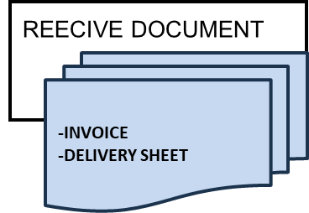
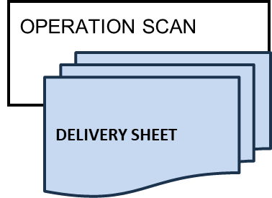

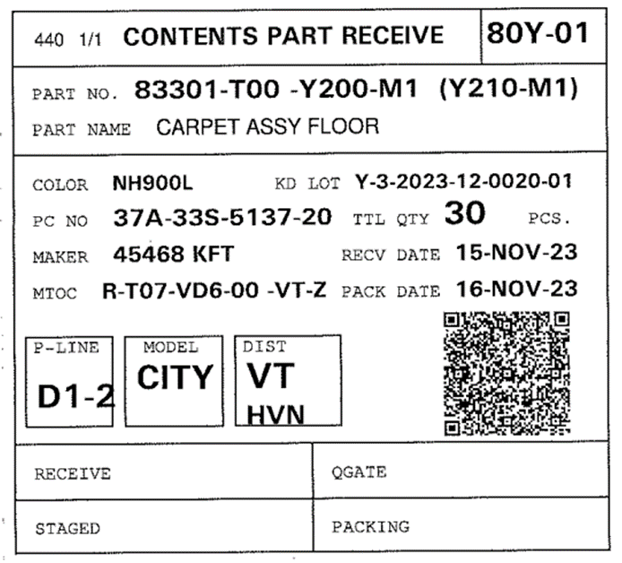
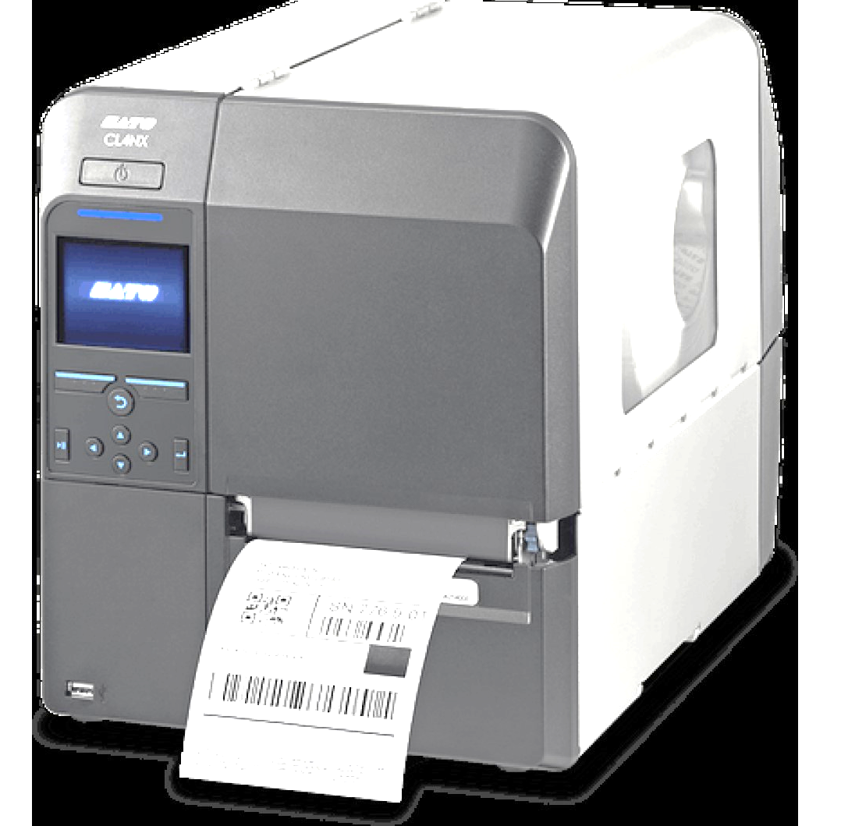

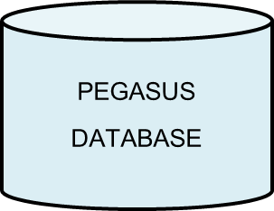
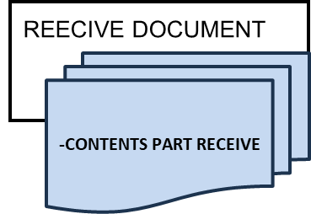
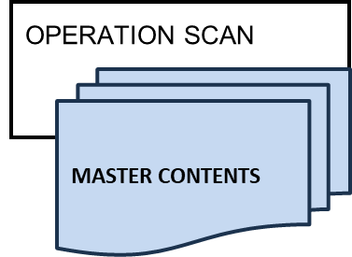
4. Operation flow
4. Overall operation flow
4-2. Receiving operation flow (Enhanced with tag print function)
4
PRINT CONTENTS PART RECEIVE
1.RECEIVE DELIVERY SHEET & INVOICE
2.H/T SELECT MANU PRINT CONTENTS PART RECEIVE
3. SCAN DELIVER SHEET
4.SYSTEM CHECK AND RECORD
5.PRINT CONTENTS PART RECEIVE
NG
OK
SYSTEM PROTECE | SYSTEM RECORD
1.RECEIVE DATE & LOCATION 2.ORDER LOT NO. (PO) 3.PART NO. 4.PART NAME 5.PART COLOR 6.CHECK POINT | 1.OPERATOR RECEIVE 2.RECEIVE DATE 3.RECEIVE TIME 4.CHECK POINT SELECT 5.STATUS RECEIVE
PRINT TAG MAKER TEMPORARY
1.H/T SELECT MANU PRINT TAG MAKER TEMPORARY
2.SCAN CONTENTS PART RECEIVE MASTER
3.PRINT TAG MAKER TEMPORARY
NG
OK

Slide 17
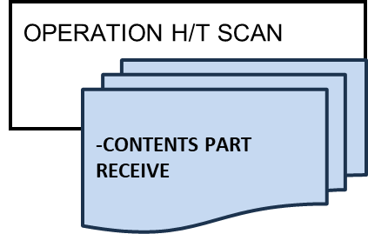

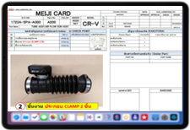

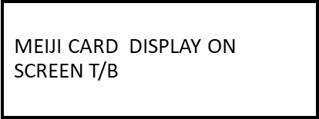




4. Operation flow
4. Overall operation flow
4-3. Staging system operation flow (Enhanced with new operation)
4
STAGING PROCESS
1.H/T SELECT MANU STAGING
2.SCAN CONTENTS PART RECEIVE
-H/T SHOW ITEM FOR STAGING
-IF SCAN WRONG SYSTEM ALARM
3.T/B OPEN MEIJI CARD
4.SELECT Q-POINT ON H/T
5.H/D SHOW STATUS STAGING
6.T/B SHOW STATUS STAGING
SYSTEM PROTECE | SYSTEM RECORD
1.RECEIVE DATE 2.PACKING DATE 3.DEST 4.CONTROL NO. 5.MODEL 6.PART NO. 7.PART NAME 8.PART COLOR 9.CHECK POINT | 1.OPERATOR STAGING 2.STAGING DATE 3.STAGING TIME 4.STATUS STAGING
NG
OK

Slide 18
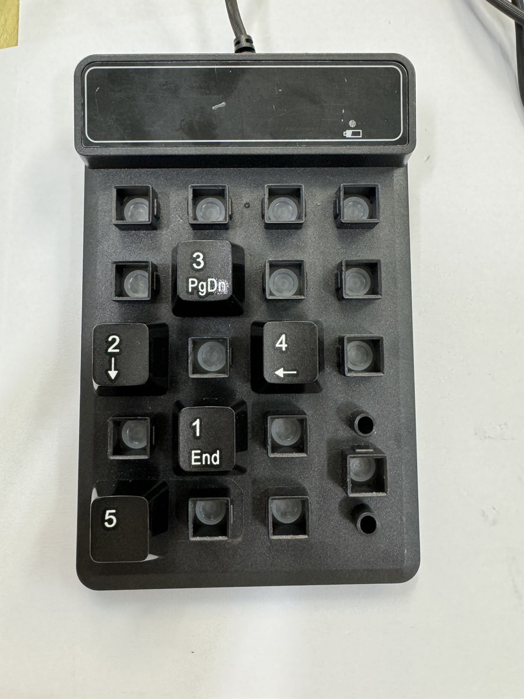
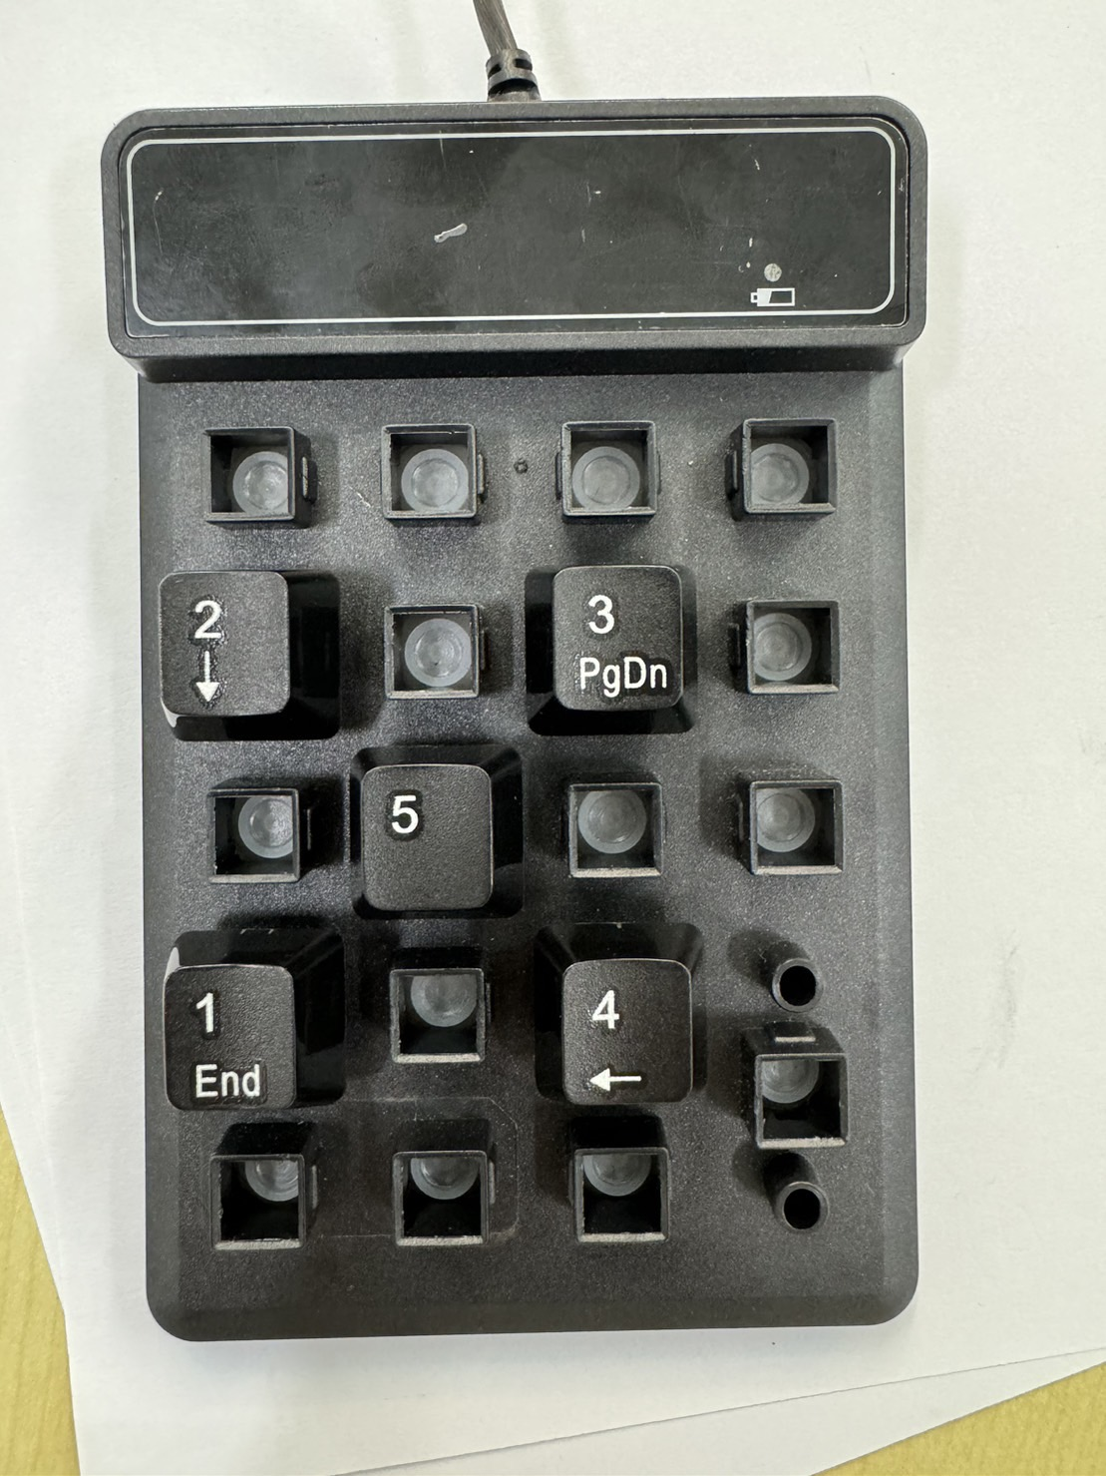

4. Operation flow
4. Overall operation flow
4-4. Inner packing system operation flow
Keyboard operation
Left side desk
Right side desk
Scanning process
2. Scan each QR code in the following process.
1. For all scans, be sure to scan the QR code on Worker’s desk first.
Left side desk
DK0001
Staff ID QR code
Leader QR code
Right side desk
DK0002
Contents label from1
Contents label from2
Tag receive label

Slide 19
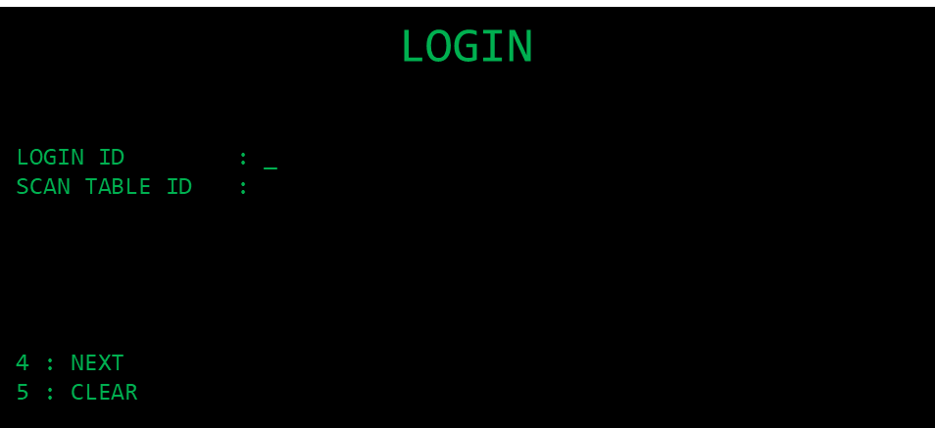
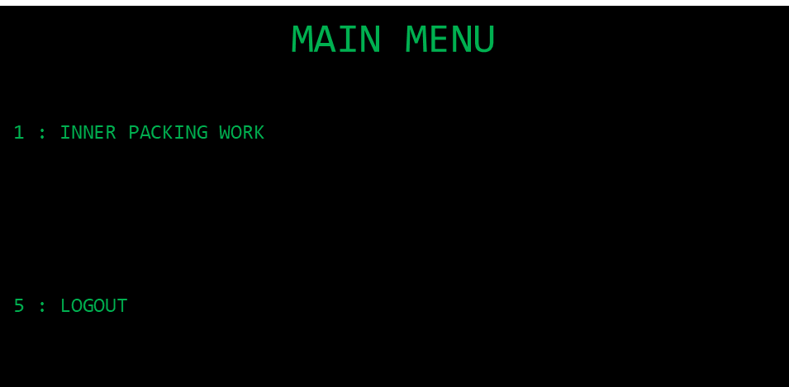
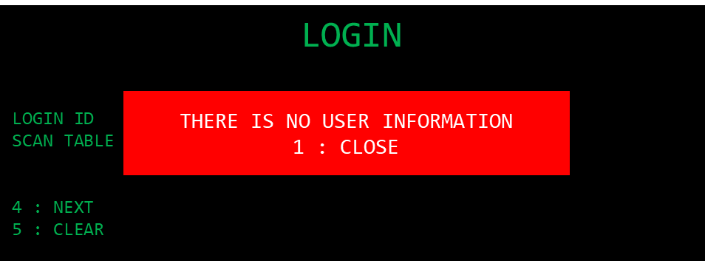
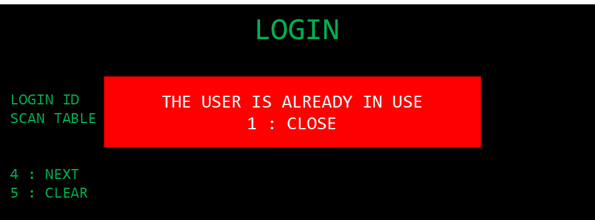
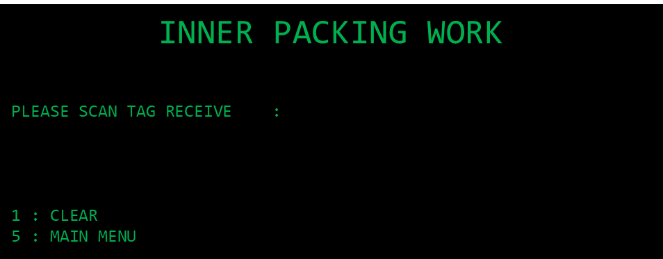


4. Operation flow
4. Overall operation flow
4-4. Inner packing system operation flow
Start
May use the table ID to matching the work?
Waiting for user confirm.
Login screen
3
Select next cursor
4
5
Clear data
5
Login screen error
Main menu
1
1
Inner packing work screen
1
Clear data
5
Scan error
Next #1
1

Slide 20
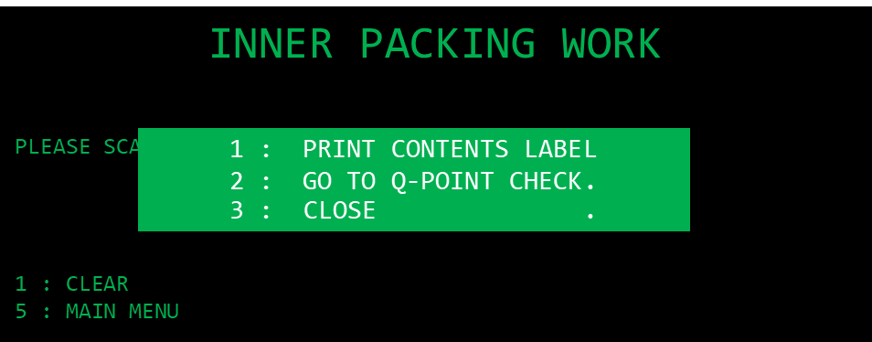
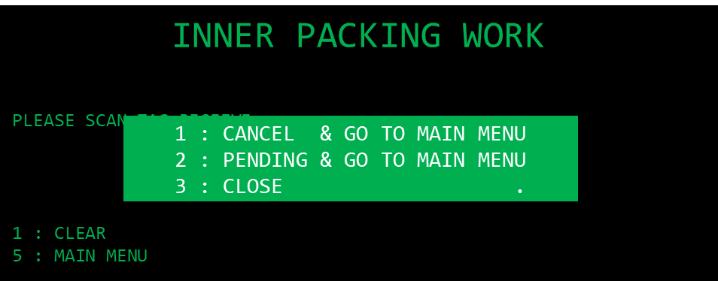
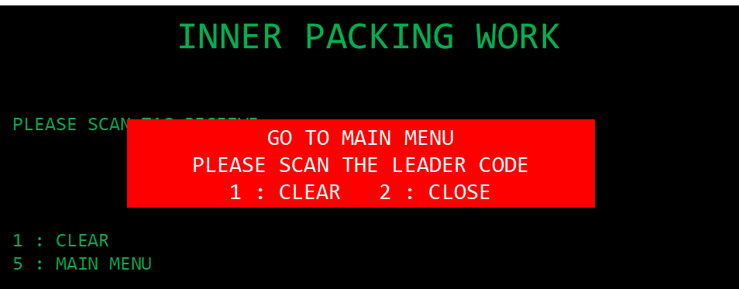


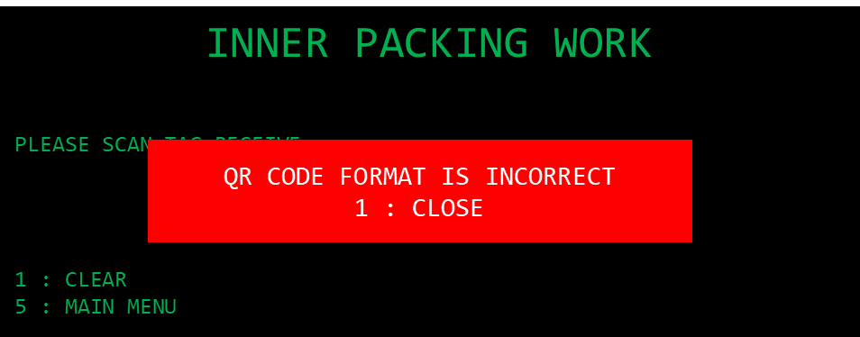

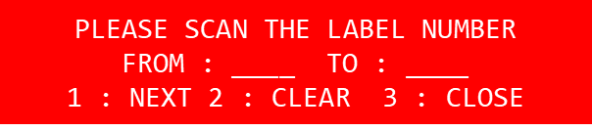
4. Operation flow
4. Overall operation flow
4-4. Inner packing system operation flow
Next
#1
Main menu
Main menu
3
Inner packing work
Inner packing work
1
2
3
1
2
2
Clear data
1
Print label
Q-POINT CHECK
1
2
Scan error
1
1
3
1
2
1
ALL label Re-print
Select next cursor
2
3
Parts of label Re-print
Clear data
It is able to print all tags in 1 time coz there are confirmation process in the packing process.
2

Slide 21

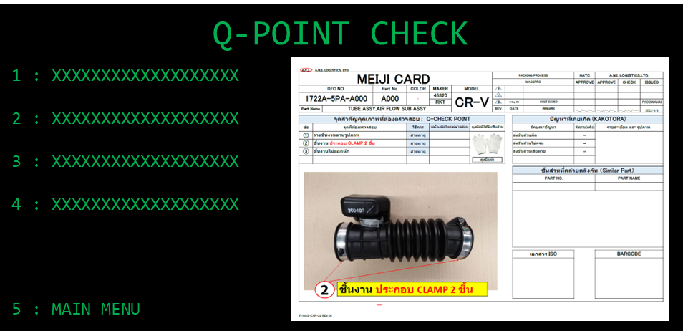

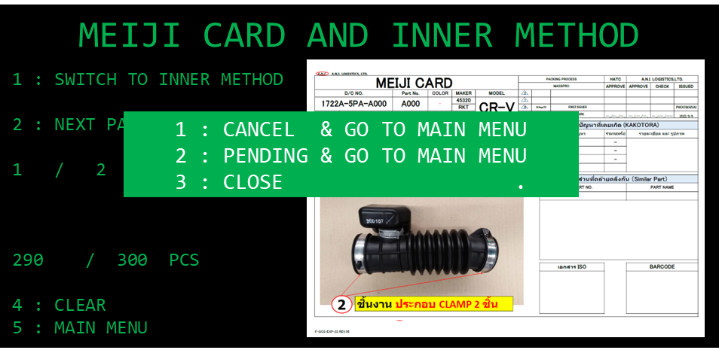
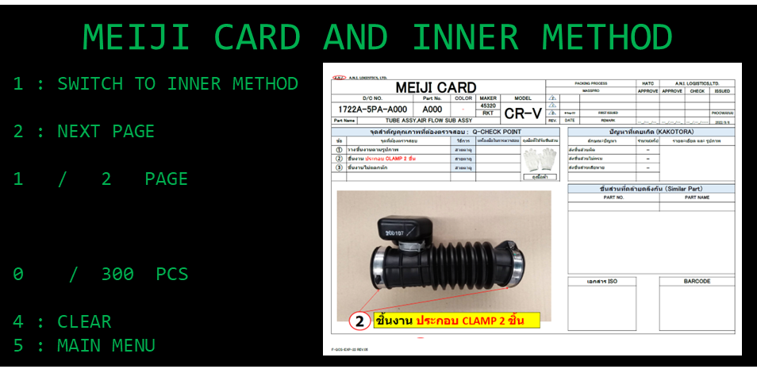
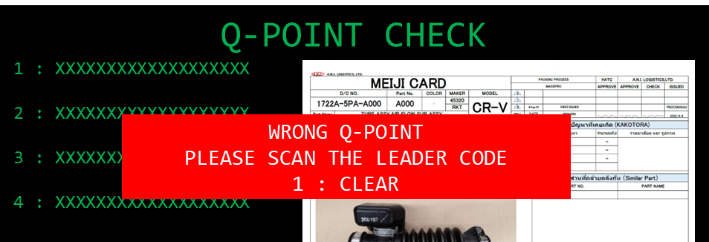
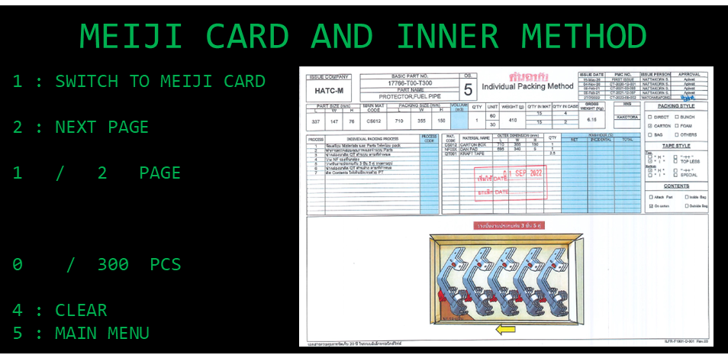
4. Operation flow
4. Overall operation flow
4-4. Inner packing system operation flow
Q-POINT CHECK
1
2
5
1
2
Clear data
Correct
Wrong
Main menu
1
1
2
5
4
Clear data
Clear data
Main menu
1
Next page
Scan

Slide 22






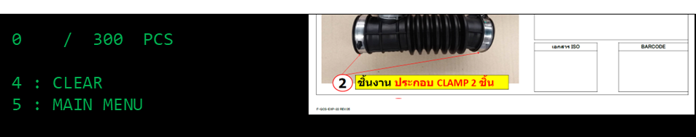
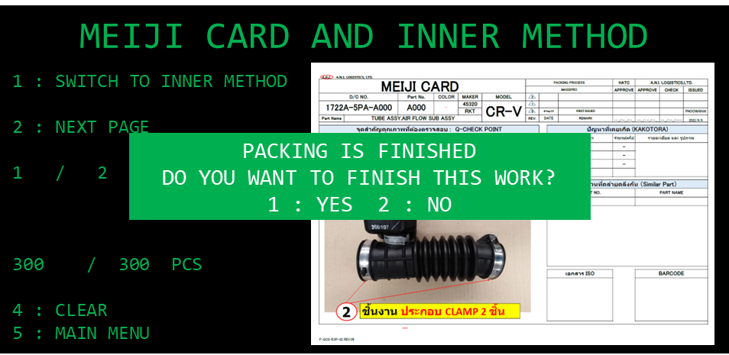
4. Operation flow
4. Overall operation flow
4-4. Inner packing system operation flow
Scan
1
1
2
1
1
2

Slide 23
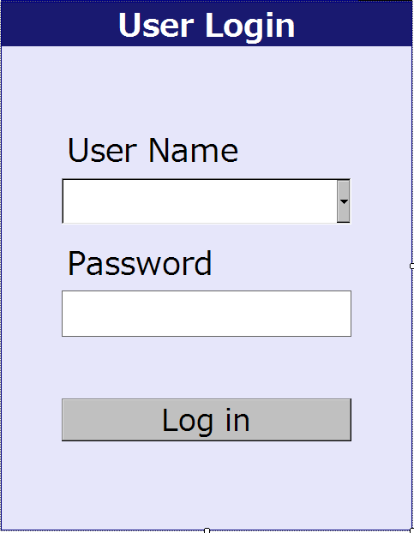
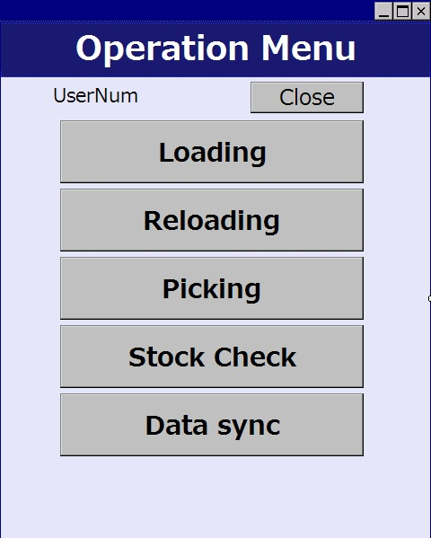


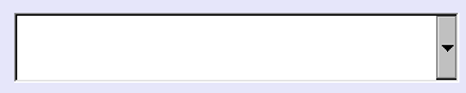


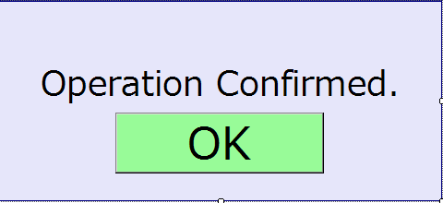
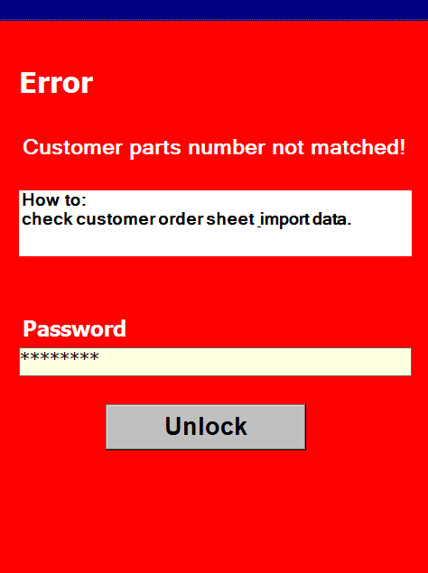
5. System functional specifications
5-1. Handy terminal screen image
Handy terminal function / screen image
1.User Login
2.Main Menu
3.Receiving area matching
Main Menu
Receiving area
User code
Connect tablet : Connected #001
Receiving area [P2]
PC No
37A-33S-5122-01
Password
Stock & Staging area [P3]
Parts no
63240-T00-T000-H01
Color
-
Outer Packing area [P4]
Control
88A-11
Print Tag receive
TTL Qty
30
Login
App Close [P1]
F1
Menu
Main
Menu [P1]
F1
Menu
Back
[P4]
4.Receiving area select
5. Pop-up
6. Select reason
Receiving area
5-1. Pop-up (OK)
6-1. Pending reason
Connect tablet : Connected #001
Please select
the reason for pending.
PC No
37A-33S-5122-01
Matched
OK [ENT]
Parts no
63240-T00-T000-H01
Prepare 4 check point in advance.
It should be the same for each part. User is able to adjust it.
F1
Menu
F1
Menu
Please select the number that matches the marking no.
Close [P1]
Confirm [P4]
1
２OD10T
5-2. Pop-up (NG)
7. Pop-up (No schedule)
2
２OD11T
３
２OD12T
Non-matched
Scan the administrator's QR code.
No schedule
Please scan again.
4
２OD13T
Scan
Check sheet (2 times)
Content label tag
Case mark (for confirmation)
F1
Menu
F1
Menu
F1
Menu
F1
Menu
NG [Scan]
NG [ENT]
Main
Menu [P1]
Clear
[P2]
Pending
[P3]
Back
[P4]
8. Stock & Staging area
9. Outer Packing area
Stock & Staging area
Outer Packing area
PC No
37A-33S-5122-01
PC No
37A-33S-5122-01
Parts no
63240-T00-T000-H01
Module code
605F
Color
-
Maker
88A-11
Case No
1
Control
88A-11
TTL Qty
30
Parts no
42700-T02 –T900-M1
1
２OD10T
Item No.
00069
2
２OD11T
SEQ No.
Serial No.
001
001
３
２OD12T
Qty in Case
Case No
40
1
TTL Qty
40
120
Add checkpoint random on this screen. Information appeared after scan and matching verification with meiji card.
Able to save while working.
4
２OD13T
Completed Qty
1
10
F1
Menu
F1
Menu
Main
Menu [P1]
Clear
[P2]
F1
Menu
F1
Menu
Pending
[P3]
Complete
[P4]
F1
Menu
F1
Menu
Main
Menu [P1]
Clear
[P2]
F1
Menu
F1
Menu
Pending
[P3]
Complete
[P4]

Slide 24

5. System functional specifications
5-1. Handy terminal screen image
Handy terminal function / screen image
9.Print tag
4
10.Print Tag Receive
11.Print Temporary Tag
Print tag
Print Tag Receive
Print Temporary Tag
Connect tablet : Connected #001
Connect tablet : Connected #001
Connect tablet : Connected #001
TAG RECEIVE [P2]
PC No
37A-33S-5122-01
PC No
37A-33S-5122-01
TEMPORARY TAG [P3]
Parts no
63240-T00-T000-H01
Parts no
63240-T00-T000-H01
Color
-
Color
-
Control
88A-11
Control
88A-11
TTL Qty
30
TTL Qty
30
F1
Menu
Main
Menu [P1]
F1
Menu
F1
Menu
Main
Menu [P1]
F1
Menu
Main
Menu [P1]
F1
Menu
Clear
[P2]
Print
[P4]
Clear
[P2]
Print
[P4]
12. Error screen
It's already printed.
If you want to reprint, please enter the reader password
Re-Print
Cancel

Slide 25

5. System functional specifications
5-2. Tablet screen image
Tablet function / screen image
User Login
User ID
▼
Password
Handy terminal
▼
Main menu
Handy terminal
Handy terminal #001
Meiji card
Display only when connected to receiving area handy.
Production Schedule
Monitor
Logout

Slide 26
5. System functional specifications
5-2. Tablet screen image
Tablet function / screen image
Production Schedule (all area)
Production Schedule
Handy terminal
Handy terminal #001
Main menu
Contract No. (PC No.)
Control No. (PC No.)
Status
Part No.
Packing date
Search
Status
Imported
Received – completed on receiving area
Staged – completed on staging area
Inner Packed – completed on inner pack area
Outer Packed – completed on outer pack area
Cancel
Stop case
Working
NG
Current State
Imported
Receiving
Staging
Inner Packing
Outer Packing
Completed

Slide 27

5. System functional specifications
5-2. Tablet screen image – Receiving area
Tablet function / screen image
Receiving area - Meiji card tablet display
Receiving area Meiji card
Handy terminal
Handy terminal #001
Main menu
Waiting scan from Handy terminal
Receiving area - Meiji card tablet display
Receiving area Meiji card
Handy terminal
Handy terminal #001
Main menu
Waiting scan

Slide 28


5. System functional specifications
5-2. Tablet screen image – Receiving area
Tablet function / screen image
DAY UNIT (INPUT DATA PO ORDER)
Receiving Schedule - Monitor
Receiving Schedule
Handy terminal
Handy terminal #001
Main menu
Code maker
Part No.
Part name
Status
Color
Date
PO No
Search

Slide 29

5. System functional specifications
5-2. Tablet screen image – Receiving area
Tablet function / screen image
Receiving Schedule – Monitor
Receiving Schedule
Handy terminal
Handy terminal #001
Main menu
Code maker
STATUS PO ORDER
Status
Color
Part No.
Part name
Date
PO No
Search
Display red font for unscan list.
Change to green font color after scanned the delivery sheet.
Step 1 scan
Part receive tag
The balance will be increase in the real time.
Green color for completed, yellow for working and red for new coming list.

Slide 30



5. System functional specifications
5-2. Tablet screen image – Staging area
2
Tablet function / screen image
Set part operation
Step 1 scan
Part receive tag
Step 2
Meiji card display
3
Display the confirmation dialog while user scans the other control.
Yes => switch control
No => cancel the scan
Step 3
Check point
Step 4
Tablet data display
Stock & Staging area
PC No
37A-33S-5122-01
Parts no
63240-T00-T000-H01
Color
-
Maker
88A-11
Control
88A-11
TTL Qty
30
1
２OD10T
2
２OD11T
３
２OD12T
4
２OD13T
F1
Menu
F1
Menu
Main
Menu [P1]
Clear
[P2]
F1
Menu
F1
Menu
Pending
[P3]
Complete
[P4]

Slide 31

5. System functional specifications
5-2. Tablet screen image
Tablet function / screen image
Outer Packing Schedule - Monitor
Outer Packing Schedule
Handy terminal
Handy terminal #001
Main menu
Code maker
Part No.
Part name
Status
Color
Date
PO No
Search
Stop case
Sub Leader Confirm
Leader Confirm
Material status will be implemented in Phase 2.
Phase 1 is blank.
Able to set status to STOPCASE, SUB_LEADER_CONFIRM and LEADER_CONFIRM by click the designated list and button.
If the login user hasn’t permission, the user/password dialog will be appear to request an allowance.
* SUB_LEADER_CONFIRM can be confirm if OUTER is completed only
** LEADER_CONFIRM can be confirm if SUB_LEADER_CONFIRM has been already confirmed only.
Require access grant
Enter password
▼
**************
OK
Cancel

Slide 32




5. System functional specifications
5-3. PC application screen image
PC function / screen image
User Login
Prevent the concurrent access by the same user.
2
Main menu
Schedule
1
Production Schedule
Log history
Schedule
Production Schedule Detail
2
Item Master
Department Master
Location Master
Name Master
User Credential Master
Package Type Master
Authority Master
Calendar Master
Master
Supplier Master
Pending Reason Master
Customer Master
Prepare 4 check point in advance.
It should be the same for each part. User is able to adjust.

Slide 33



5. System functional specifications
5-3. PC application screen image
PC function / screen image
Production Schedule
Production Schedule
Contract No. (PC No.)
Control No. (PC No.)
Status
Year Month
Part No.
Packing date
Invoice no
Customer
Import
Delete
CP List Export
Invoice date
Invoice
no
IV Type
Order no
Customer code
Customer name
Route
Type
Status
Short Ship
Photo
Add remark to enter the reason while cut part.
Add pending/NG reason column.
User can adjust the DAY UNIT by adding or editing.
Delete
CRITICAL PART CONTROL LIST (EXPORT)

Slide 34
5. System functional specifications
5-3. PC application screen image
PC function / screen image
Production Schedule Detail
Production Schedule Detail
Contract No. (PC No.)
Control No. (PC No.)
Status
Year Month
Part No.
Packing date
Invoice no
Customer
Import
Delete
Invoice date
Invoice
no
IV Type
Order no
Customer code
Customer name
Route
Type
Status
Short Ship
Photo

Slide 35
5. System functional specifications
5-3. PC application screen image
PC function / screen image
Log history
Log history
Contract No. (PC No.)
Control No. (PC No.)
Status
Year Month
Part No.
Packing date
Invoice no
Customer
Import
Delete
Invoice date
Invoice
no
IV Type
Order no
Customer code
Customer name
Route
Type
Status
Short Ship
Photo
Pending Reason master
Pending Reason master
Section
Search
Year Month
Invoice no
Customer
Import
Delete
Invoice date
Invoice
no
IV Type
Order no
Customer code
Customer name
Route
Type
Status
Short Ship
Photo

Slide 36

5. System functional specifications
5-3. PC application screen image
PC function / screen image
Content label printing function
5
Part Color :
Print All receive tag
Print All contents tag
Able to print all of the manual tags in the same PC no.
Print contents tag
 | Print Type | PC NO. | PART NO. | PART COLOR | CONTROL NO. | Model | LINE NO. | CASE NO. | ORDER Qty | Receive Plan Date | Packing Plan Date | S/N | Receive tag | Print By | Print Count | Contents tag | Print By | Print Count | Last update
1 | Manual | 37334A570307 | 1100A59B Z101 | - | 190E | CITY | 13 | 171 | 30 | 2023-07-20 | 2023-07-23 | 1 | - | - | 0 | - | - | 0 | 7/28/2023 0:25
2 | JIT | 37334A570307 | 1100A59B Z101 | - | 190E | CRV | 13 | 170 | 30 | 2023-07-20 | 2023-07-23 | 2 | Reprint | admin | 2 | Reprint | admin | 2 | 7/28/2023 0:25
3 | JIT | 37334A570307 | 1120B64A Z000 | - | 192E | HEV | 12 | 173 | 60 | 2023-07-20 | 2023-07-23 | 3 | Print | admin | 1 | Print | admin | 1 | 7/28/2023 0:25
4 | Manual | 37334A570307 | 1210B6A0 F000 | - | 190E | PPP | 13 | 170 | 30 | 2023-07-20 | 2023-07-23 | 4 | Print | admin | 1 | Print | admin | 1 | 7/28/2023 0:25
5 | Manual | 37334A570307 | 1210B6A0 F000 | - | 190E | PPP | 13 | 171 | 30 | 2023-07-20 | 2023-07-23 | 5 | Reprint | admin | 2 | Reprint | admin | 2 | 7/28/2023 0:25
6 | Manual | 37334A570307 | 122516A0 A011M2 | - | 193E | PPP | 8 | 174 | 60 | 2023-07-20 | 2023-07-23 | 6 | Print | admin | 1 | Print | admin | 1 | 7/28/2023 0:25
7 | Manual | 37334A570307 | 122705PA A002 | - | 193E | PPP | 8 | 174 | 60 | 2023-07-20 | 2023-07-23 | 1 | Reprint | admin | 2 | Reprint | admin | 2 | 7/28/2023 0:25
8 | JIT | 37334A570307 | 123106A0 A011M1 | - | 193E | PPP | 8 | 174 | 60 | 2023-07-20 | 2023-07-23 | 1 | - | - | 0 | - | - | 0 | 7/28/2023 0:25
9 | JIT | 37334A570307 | 131015PA A002 | - | 193E | PPP | 8 | 174 | 240 | 2023-07-20 | 2023-07-23 | 1 | - | - | 0 | - | - | 0 | 7/28/2023 0:25
10 | JIT | 37334A570307 | 1312159B 0042 | - | 194E | PPP | 10 | 175 | 240 | 2023-07-20 | 2023-07-23 | 1 | - | - | 0 | - | - | 0 | 7/28/2023 0:25
Print receive
Print contents
Reprint receive
Reprint contents
Production Schedule / Receiving
Once we have confirmed the printing data, we will start designing.
04/Nov/2023
Requirements summary)
1. There are two types of content label formats. For Taiwan and others.
2. If printing is canceled due to a printing error, it is possible to resume printing from the middle.
Ex) Print 100 sheets. 50 sheets have been printed. An error occurred on the 51st photo.
Allows printing from the 51st to the 100th page.
3.Allows reprinting. For reprinting, it can specify the number of copies using From To.
4. Print with two printers using one computer. The printer is Sato's CL4NX Plus 305dpi STD
5. Limit concurrent user access.
6
1. Add new column about the print type (JIT/Manual) to NET fiile => J/M
2. Create new page for Label print JIT/Manual.
3. Able to print all contents of packing set (PPP).
4. Add [Print all manual] for manual items only except the reprint.
5. Able to filter data Packing_date, PC_NO, Control_No, Parts_no and part_color.
6. Show serial no column.

Slide 37




5. System functional specifications
5-3. PC application screen image
7
PC function / screen image
Print type master
Print type master
Part color :
Model no :
Print contents tag
 | PART NO. | PART COLOR | CONTROL NO. | Model | Print Type | Last update
1 | 1100A59B Z101 | - | 190E | CITY | JIT | 2023-12-12 12:06:00
2 | 1100A59B Z101 | - | 190E | CRV | Manual | 2023-12-12 12:06:00
3 | 1120B64A Z000 | - | 192E | HEV | Manual | 2023-12-12 12:06:00
4 | 1210B6A0 F000 | - | 190E | PPP | Manual | 2023-12-12 12:06:00
5 | 1210B6A0 F000 | - | 190E | PPP | Manual | 2023-12-12 12:06:00
6 | 122516A0 A011M2 | - | 193E | PPP | JIT | 2023-12-12 12:06:00
7 | 122705PA A002 | - | 193E | PPP | Manual | 2023-12-12 12:06:00
8 | 123106A0 A011M1 | - | 193E | PPP | JIT | 2023-12-12 12:06:00
9 | 131015PA A002 | - | 193E | PPP | JIT | 2023-12-12 12:06:00
10 | 1312159B 0042 | - | 194E | PPP | JIT | 2023-12-12 12:06:00
Table master
Table master
Table ID :
Model no :
# | Table ID | Last update
1 | T001 | 2023-12-12 12:06:00
2 | T002 | 2023-12-12 12:06:00
3 | T003 | 2023-12-12 12:06:00
4 | T004 | 2023-12-12 12:06:00
5 | T005 | 2023-12-12 12:06:00
6 | T006 | 2023-12-12 12:06:00
7 | T007 | 2023-12-12 12:06:00
8 | T008 | 2023-12-12 12:06:00
9 | T009 | 2023-12-12 12:06:00
10 | T010 | 2023-12-12 12:06:00

Slide 38
5. System functional specifications
5-4. PC application for Inner packing screen image
5-4-1. Login
PC function / screen image
Login screen
LOGIN
LOGIN ID : _
SCAN TABLE ID :
4 : NEXT
5 : CLEAR
Login screen fill out information
LOGIN
LOGIN ID : EX1234
SCAN TABLE ID : 00001
4 : NEXT
5 : CLEAR
Go to main menu
Login screen fill out information and occur error #1
LOGIN
THERE IS NO USER INFORMATION
1 : CLOSE
LOGIN ID : EX1234
SCAN TABLE ID : 00001
4 : NEXT
5 : CLEAR

Slide 39
5. System functional specifications
5-4. PC application for Inner packing screen image
5-4-1. Login
PC function / screen image
Login screen fill out information and occur error #2
LOGIN
THE USER IS ALREADY IN USE
1 : CLOSE
LOGIN ID : EX1234
SCAN TABLE ID : 00001
4 : NEXT
5 : CLEAR

Slide 40
5. System functional specifications
5-4. PC application for Inner packing screen image
5-4-2. Main menu
PC function / screen image
Main menu screen
MAIN MENU
1 : INNER PACKING WORK
5 : LOGOUT
Push “1”
Go to “INNER PACING WORK”

Slide 41
5. System functional specifications
5-4. PC application for Inner packing screen image
5-4-3. Inner packing work
PC function / screen image
Inner packing work screen
INNER PACKING WORK
PLEASE SCAN TAG RECEIVE :
1 : CLEAR
5 : MAIN MENU
Inner packing work screen fill out information
INNER PACKING WORK
Correct information
#1 Print Contents Label
PLEASE SCAN TAG RECEIVE :
1 : CLEAR
5 : MAIN MENU
1 : PRINT CONTENTS LABEL
2 : GO TO Q-POINT CHECK.
3 : CLOSE .
Correct information
#2 Go to “Q-POINT CHECK”
Inner packing work screen fill out information and error #1
INNER PACKING WORK
PLEASE SCAN TAG RECEIVE :
1 : CLEAR
5 : MAIN MENU
QR CODE FORMAT IS INCORRECT
1 : CLOSE

Slide 42
5. System functional specifications
5-4. PC application for Inner packing screen image
5-4-3. Inner packing work
PC function / screen image
Inner packing work screen Select #1 and #2 and error #2
INNER PACKING WORK
PLEASE SCAN TAG RECEIVE :
1 : CLEAR
5 : MAIN MENU
PACKING HAS ALREADY BEEN COMPLETED
1 : CLOSE
Inner packing work screen Select #1 Print tag receive and error #3
INNER PACKING WORK
PLEASE SCAN TAG RECEIVE :
1 : CLEAR
5 : MAIN MENU
PRINT ERROR
1 : CLOSE
Inner packing work screen Select #1 and #2 and error #4
INNER PACKING WORK
PLEASE SCAN TAG RECEIVE :
1 : CLEAR
5 : MAIN MENU
NO SCHEDULE
1 : CLOSE

Slide 43
5. System functional specifications
5-4. PC application for Inner packing screen image
5-4-3. Inner packing work
PC function / screen image
Inner packing work screen Select #1 Print tag receive and error #5-1
INNER PACKING WORK
PLEASE SCAN TAG RECEIVE :
1 : CLEAR
5 : MAIN MENU
CONTENT LABELS ARE ALREADY PRINTED WOULD YOU LIKE TO REPRINT?
1 : YES 2 : NO
Inner packing work screen Select #1 Print tag receive and error #5-2
INNER PACKING WORK
PLEASE SCAN TAG RECEIVE :
1 : CLEAR
5 : MAIN MENU
RE-PRINT
PLEASE SCAN THE LEADER CODE
1 : CLEAR 2 : CLOSE
Inner packing work screen Select #1 Print tag receive and error #5-3
INNER PACKING WORK
PLEASE SCAN TAG RECEIVE :
1 : CLEAR
5 : MAIN MENU
PLEASE SELECT THE RANGE TO REPRINT
1 : ALL 2 : PART 3 : CLOSE

Slide 44
5. System functional specifications
5-4. PC application for Inner packing screen image
5-4-3. Inner packing work
PC function / screen image
Inner packing work screen Select #1 Print tag receive and error #5-4
INNER PACKING WORK
PLEASE SCAN TAG RECEIVE :
1 : CLEAR
5 : MAIN MENU
PLEASE SCAN THE LABEL NUMBER
FROM : ____ TO : ____
1 : NEXT 2 : CLEAR 3 : CLOSE
Inner packing work screen Already cancel and error #6
Inner packing work screen Already cancel and error #6-1
INNER PACKING WORK
PLEASE SCAN TAG RECEIVE :
1 : CLEAR
5 : MAIN MENU
IT HAS BEEN CANCELLED
DO YOU WANT TO RESTART?
1 : YES 2 : NO
Inner packing work screen Already cancel and error #6-2
INNER PACKING WORK
PLEASE SCAN TAG RECEIVE :
1 : CLEAR
5 : MAIN MENU
RE-WORK
PLEASE SCAN THE LEADER CODE
1 : CLEAR 2 : CLOSE

Slide 45
5. System functional specifications
5-4. PC application for Inner packing screen image
5-4-3. Inner packing work
PC function / screen image
Inner packing work screen push ‘5’ Main menu #1-1
INNER PACKING WORK
PLEASE SCAN TAG RECEIVE :
1 : CLEAR
5 : MAIN MENU
1 : CANCEL & GO TO MAIN MENU
2 : PENDING & GO TO MAIN MENU
3 : CLOSE .
Inner packing work screen push ‘5’ Main menu #1-2
INNER PACKING WORK
PLEASE SCAN TAG RECEIVE :
1 : CLEAR
5 : MAIN MENU
GO TO MAIN MENU
PLEASE SCAN THE LEADER CODE
1 : CLEAR 2 : CLOSE

Slide 46
5. System functional specifications
5-4. PC application for Inner packing screen image
5-4-4. Q-point check
PC function / screen image
Q-point check screen fill out information
Q-POINT CHECK
5 : MAIN MENU
1 : XXXXXXXXXXXXXXXXXXX
2 : XXXXXXXXXXXXXXXXXXX
3 : XXXXXXXXXXXXXXXXXXX
4 : XXXXXXXXXXXXXXXXXXX
Q-point check screen fill out information
Q-POINT CHECK
1 : XXXXXXXXXXXXXXXXXXX
2 : XXXXXXXXXXXXXXXXXXX
3 : XXXXXXXXXXXXXXXXXXX
4 : XXXXXXXXXXXXXXXXXXX
Correct information
Go to “MEIJI & PACKING CARD”
Q-point check screen fill out information and error #1
Q-POINT CHECK
1 : XXXXXXXXXXXXXXXXXXX
2 : XXXXXXXXXXXXXXXXXXX
3 : XXXXXXXXXXXXXXXXXXX
4 : XXXXXXXXXXXXXXXXXXX
WRONG Q-POINT
PLEASE SCAN THE LEADER CODE
1 : CLEAR

Slide 47
5. System functional specifications
5-4. PC application for Inner packing screen image
5-4-5. Meiji card and Inner method
PC function / screen image
Meij card and inner method screen fill out information #1
MEIJI CARD AND INNER METHOD
1 : SWITCH TO INNER METHOD
2 : NEXT PAGE
1 / 2 PAGE
0 / 300 PCS
4 : CLEAR
5 : MAIN MENU
Meij card and inner method screen fill out information #2
MEIJI CARD AND INNER METHOD
1 : SWITCH TO MEIJI CARD
2 : NEXT PAGE
1 / 2 PAGE
0 / 300 PCS
4 : CLEAR
5 : MAIN MENU

Slide 48
5. System functional specifications
5-4. PC application for Inner packing screen image
5-4-5. Meiji card and Inner method
PC function / screen image
Meij card and inner method screen fill out information #3
MEIJI CARD AND INNER METHOD
1 : SWITCH TO INNER METHOD
2 : NEXT PAGE
/ 2 PAGE
0 / 300 PCS
4 : CLEAR
5 : MAIN MENU
Meij card and inner method screen fill out information #4
MEIJI CARD AND INNER METHOD
1 : SWITCH TO MEIJI CARD
2 : NEXT PAGE
/ 2 PAGE
0 / 300 PCS
4 : CLEAR
5 : MAIN MENU

Slide 49
5. System functional specifications
5-4. PC application for Inner packing screen image
5-4-5. Meiji card and Inner method
PC function / screen image
Meij card and inner method screen fill out information #5
MEIJI CARD AND INNER METHOD
1 : SWITCH TO INNER METHOD
2 : NEXT PAGE
1 / 2 PAGE
10 / 300 PCS
4 : CLEAR
5 : MAIN MENU
Meij card and inner method screen fill out information #6
MEIJI CARD AND INNER METHOD
1 : SWITCH TO MEIJI CARD
2 : NEXT PAGE
1 / 2 PAGE
10 / 300 PCS
4 : CLEAR
5 : MAIN MENU

Slide 50
5. System functional specifications
5-4. PC application for Inner packing screen image
5-4-5. Meiji card and Inner method
PC function / screen image
Meij card and inner method screen fill out information #7-1
MEIJI CARD AND INNER METHOD
1 : SWITCH TO INNER METHOD
2 : NEXT PAGE
1 / 2 PAGE
290 / 300 PCS
4 : CLEAR
5 : MAIN MENU
Meij card and inner method screen fill out information #7-2
MEIJI CARD AND INNER METHOD
1 : SWITCH TO INNER METHOD
2 : NEXT PAGE
1 / 2 PAGE
300 / 300 PCS
4 : CLEAR
5 : MAIN MENU
PACKING IS FINISHED
DO YOU WANT TO FINISH THIS WORK?
1 : YES 2 : NO

Slide 51
5. System functional specifications
5-4. PC application for Inner packing screen image
5-4-5. Meiji card and Inner method
PC function / screen image
Meij card and inner method screen push ‘5’ main menu #1-1
MEIJI CARD AND INNER METHOD
1 : SWITCH TO INNER METHOD
2 : NEXT PAGE
1 / 2 PAGE
290 / 300 PCS
4 : CLEAR
5 : MAIN MENU
1 : CANCEL & GO TO MAIN MENU
2 : PENDING & GO TO MAIN MENU
3 : CLOSE .
Meij card and inner method screen push ‘5’ main menu #1-2
MEIJI CARD AND INNER METHOD
1 : SWITCH TO INNER METHOD
2 : NEXT PAGE
1 / 2 PAGE
290 / 300 PCS
4 : CLEAR
5 : MAIN MENU
GO TO MAIN MENU
PLEASE SCAN THE LEADER CODE
1 : CLEAR 2 : CLOSE

Slide 52
5. System functional specifications
5-4. PC application for Inner packing screen image
5-4-5. Meiji card and Inner method
PC function / screen image
Meij card and inner method screen fill out information and occur error #1
MEIJI CARD AND INNER METHOD
1 : SWITCH TO INNER METHOD
2 : NEXT PAGE
1 / 2 PAGE
10 / 300 PCS
4 : CLEAR
5 : MAIN MENU
QR CODE FORMAT IS INCORRECT
1 : CLOSE
Meij card and inner method screen fill out information and occur error #2
MEIJI CARD AND INNER METHOD
1 : SWITCH TO INNER METHOD
2 : NEXT PAGE
1 / 2 PAGE
10 / 300 PCS
4 : CLEAR
5 : MAIN MENU
NO SCHEDULE
1 : CLOSE

Slide 53
5. System functional specifications
5-4. PC application for Inner packing screen image
5-4-5. Meiji card and Inner method
PC function / screen image
Meij card and inner method screen fill out information and occur error #3-1
MEIJI CARD AND INNER METHOD
1 : SWITCH TO INNER METHOD
2 : NEXT PAGE
1 / 2 PAGE
10 / 300 PCS
4 : CLEAR
5 : MAIN MENU
THIS LABEL HAS ALREADY BEEN SCANNED DO YOU WANT TO DELETE THIS LABEL?
1 : YES 2 :NO
Meij card and inner method screen fill out information and occur error #3-2
MEIJI CARD AND INNER METHOD
1 : SWITCH TO INNER METHOD
2 : NEXT PAGE
1 / 2 PAGE
10 / 300 PCS
4 : CLEAR
5 : MAIN MENU
THIS LABEL HAS BEEN REMOVED
1 : CLOSE
0 / 300 PCS
4 : CLEAR
5 : MAIN MENU

Slide 54


5. System functional specifications
5-5. Display dashboard screen image
4
PC function / screen image
Packing Plan Dashboard
BG color identity for finished shift work
It will show 3 days of work as yesterday, today and tomorrow
7

Slide 55



5. System functional specifications
5-7. Deep details report for Outer Schedule
Add the detail report for label scan tracking of specific outer packing work.
PC function / screen image
3
Outer Contents Label Details Report
Case No : [ All [v] ]

Slide 56
5. System functional specifications
5-8. Result report
User requests about the result report data.
PC function / screen image
After hearing the requirements, we will implement the design.
15/Nov/2023

Slide 57




5. System functional specifications
5-9. Label Expense Report
Add the detail report for label scan tracking of specific outer packing work.
PC function / screen image
3
Label Expense Report
Show the below data in the same report
Part receive
Contents label
Referred to net file date
PART RECEIVE
Actual qty
Plan qty
CONTENTS LABEL

Slide 58




5. System functional specifications
5-10. CSV Report
4
CSV Report example
RECEIVING REPORT
STAGING REPORT
INNER PACKING REPORT
OUTER PACKING REPORT

Slide 59
6. Q&A

Slide 60
7. Sign off
We hereby acknowledge and agree the above-mentioned blueprint requirements.
Any changes required after the sign off for this blueprint will be addressed through the change request process.
A.N.I. LOGISTICS, LTD.
Sign:
Name:
Title:
Date:
TOMAS TECH CO.,LTD.
Sign:
Name:
Title:
Date:
## END OF BLUEPRINT##

