Slide 1
Machine data monitoring systems Made for FTS AUTOMOTIVE (THAILAND) CO., LTD.
TOMAS TECH Co., Ltd.

Slide 2


┃ Systems
Monitoring
Lan cable
PLC Link
KV-7500
KV-XL402
KV-8000
KV-XD02
KV-XL402
RS-232
Machine 1
CPU : CS1H-CPU66H
Machine 2
CPU : CS1H-CPU66H

Slide 3
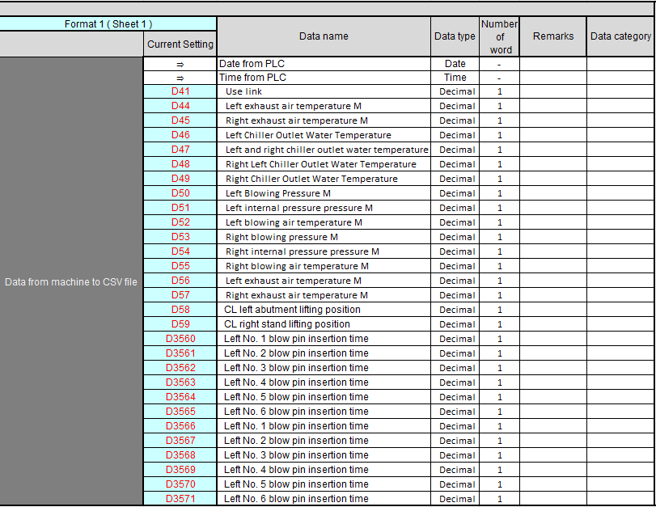
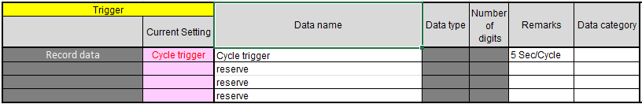
┃ Format data 1
Trigger by

Slide 4
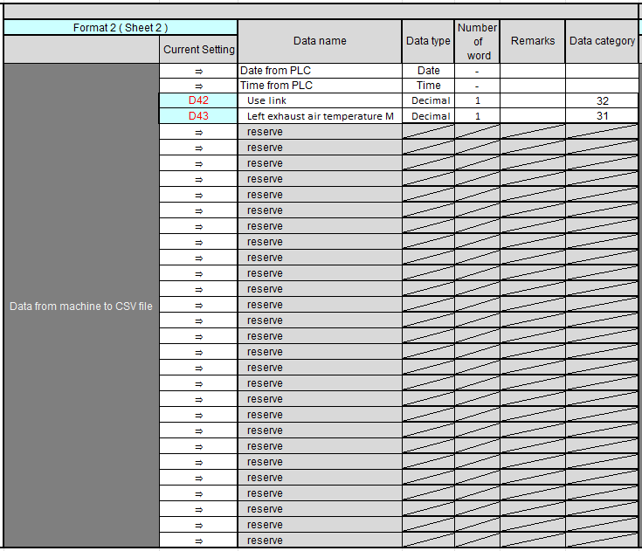
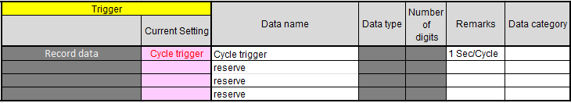
┃ Format data 2
Trigger by

Slide 5
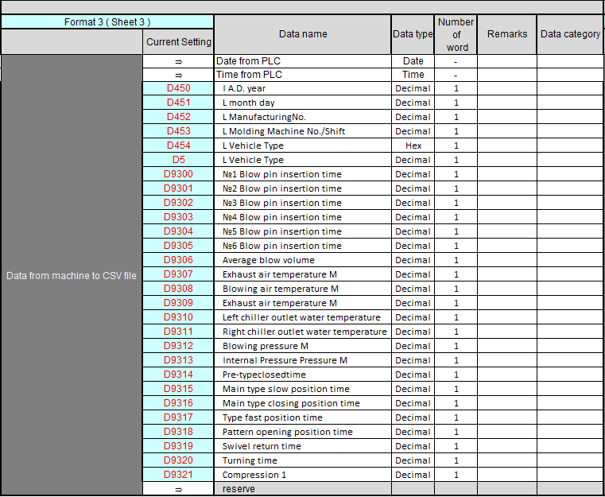
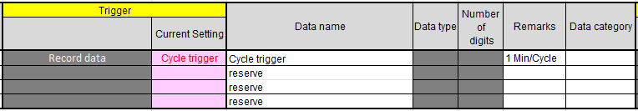
┃ Format data 3
Trigger by

Slide 6
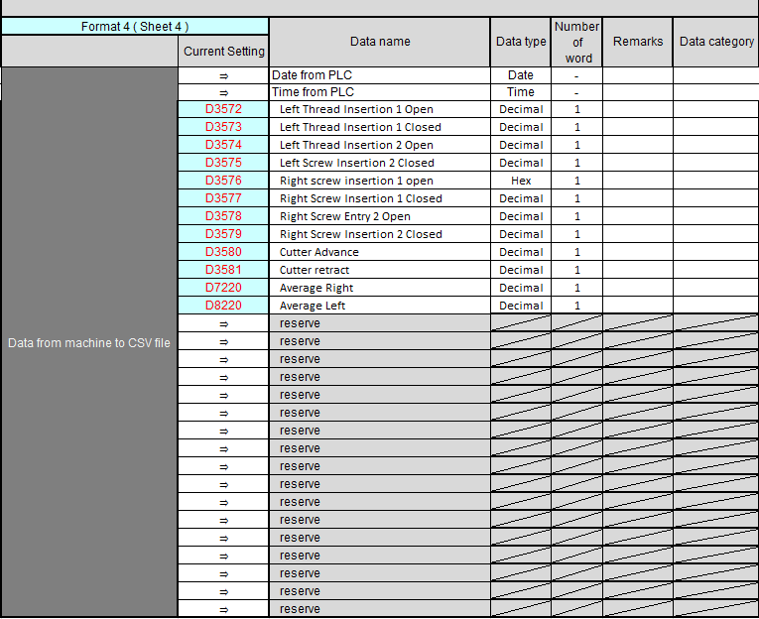

┃ Format data 4
Trigger by

Slide 7
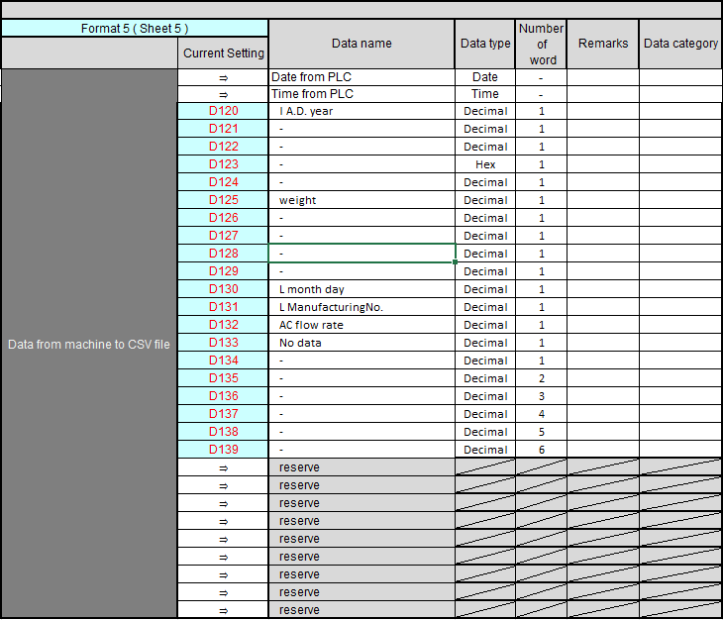
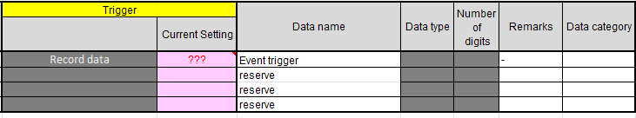
┃ Format data 5
Trigger by

Slide 8
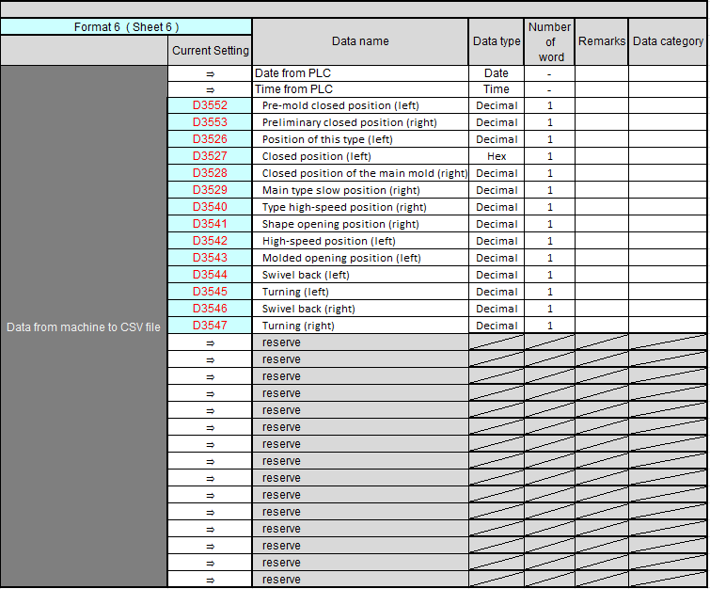
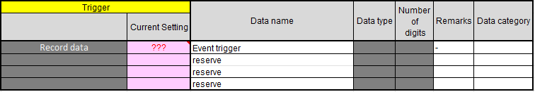
┃ Format data 6
Trigger by

Slide 9
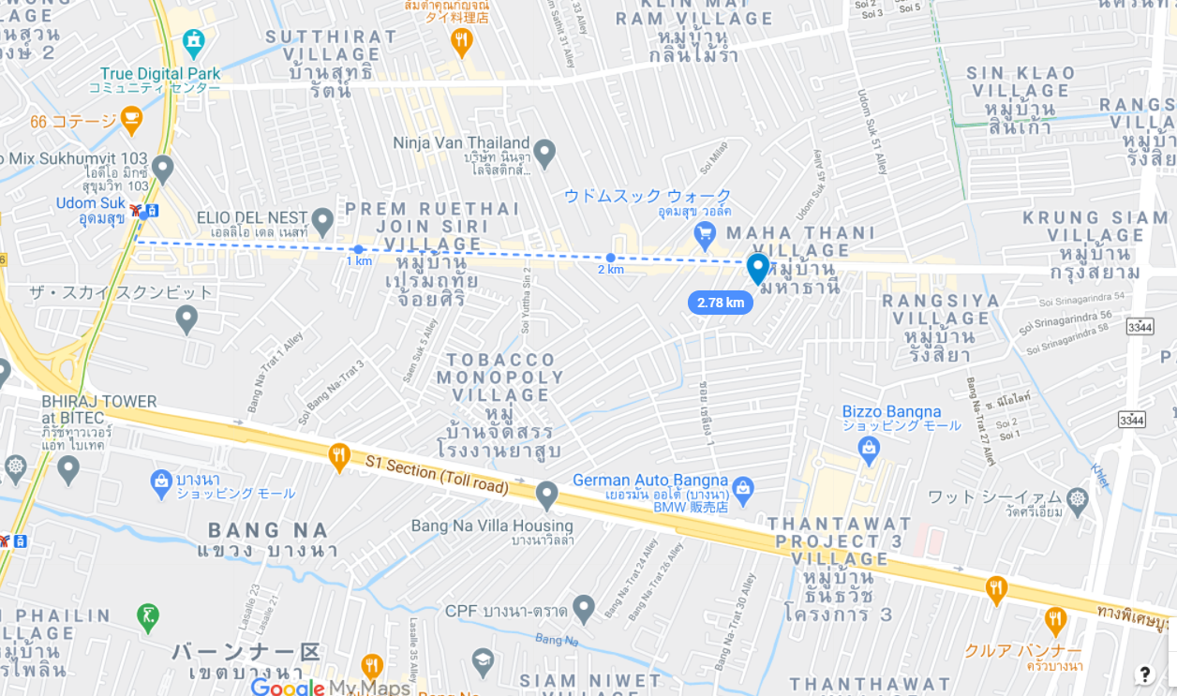


┃Contact
info@tomastc.com
TH/EN: +66-81-012-6064 (Anek)
JP/TH/EN: +66-94-552-3097 (Nozaki)
TOMAS TECH
http://www.tomastc.com
7/1(3C) Soi Sukhumvit 103 (Udomsuk 46) Sukhumvit Bang Na, Bangkok 10260

