Slide 1
Auto labeling machine Made for PANASONIC AUTOMOTIVE SYSTEMS ASIA PACIFIC CO.,LTD.
TOMAS TECH Co., Ltd.
Make by Nattapol ( IoT Engineer )

Slide 2
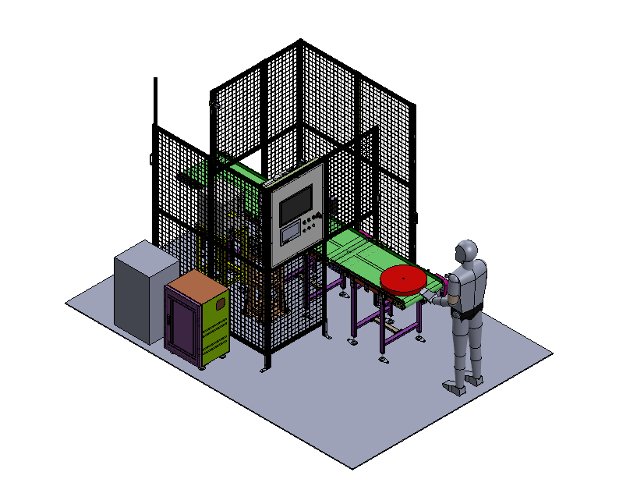
┃Agenda
► Packet material
► Layout machine
► Process flow
► Operation flow

Slide 3
Packet material

Slide 4
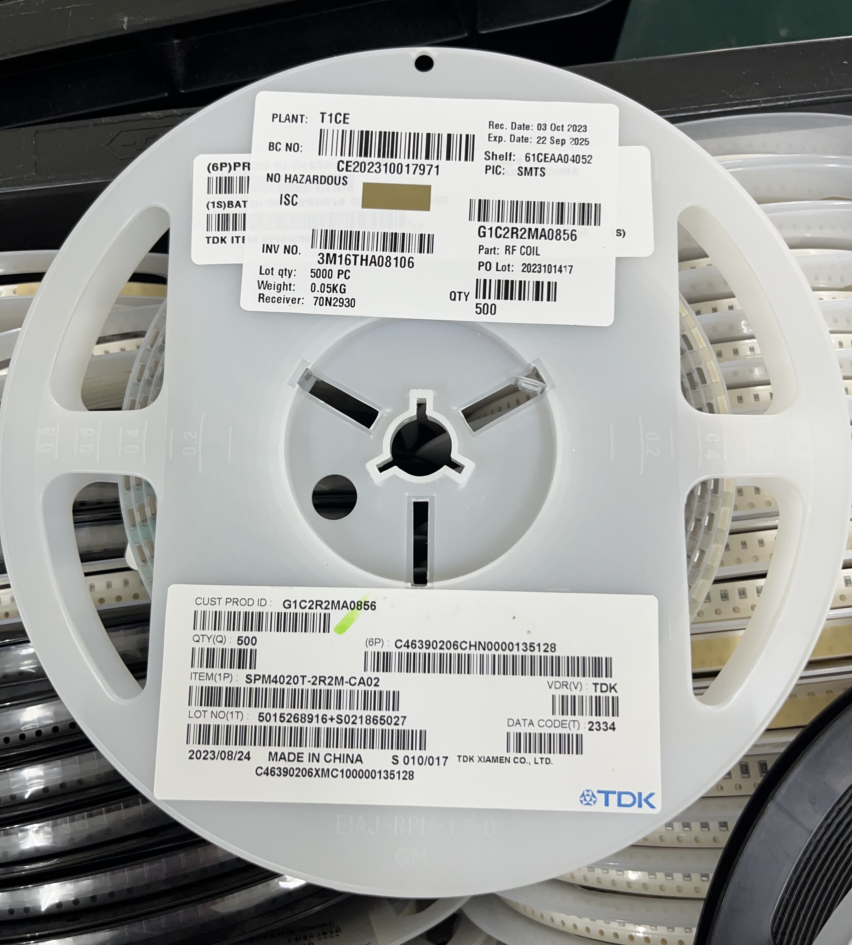
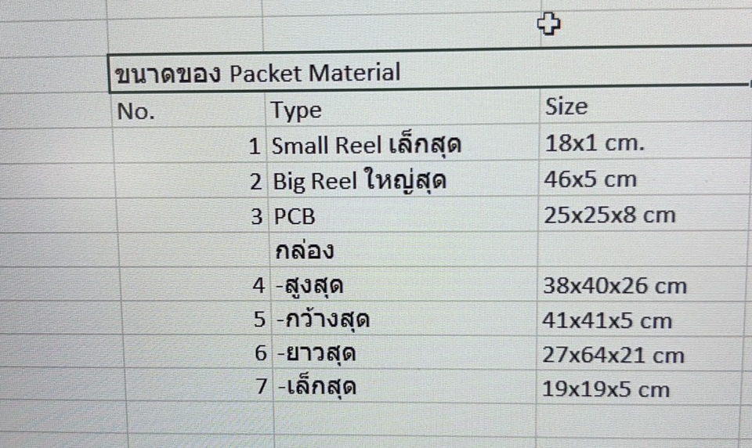
┃Packet material
18 x 1 cm
46 x 5 cm
8 cm
High maximum 26 cm
25 cm
25 cm
Maximum 64 cm
Maximum 41 cm
1. Small Reel
2. Big Reel
3. PCB
4. Box

Slide 5
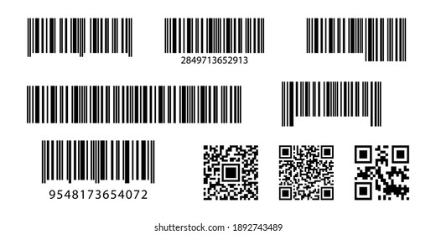

┃Packet material
Packet materials that can participate in the Auto process
Reels
Box or PCB ( label on top )
Label Area

Slide 6
Layout machine

Slide 7
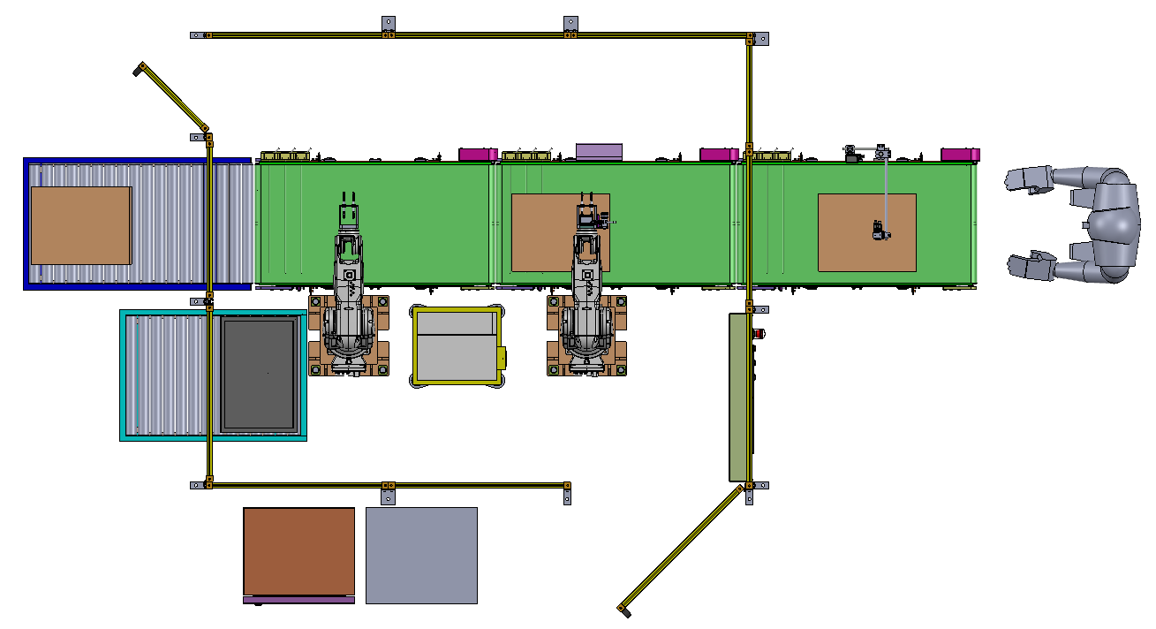
┃Layout machine
Phase 2

Slide 8
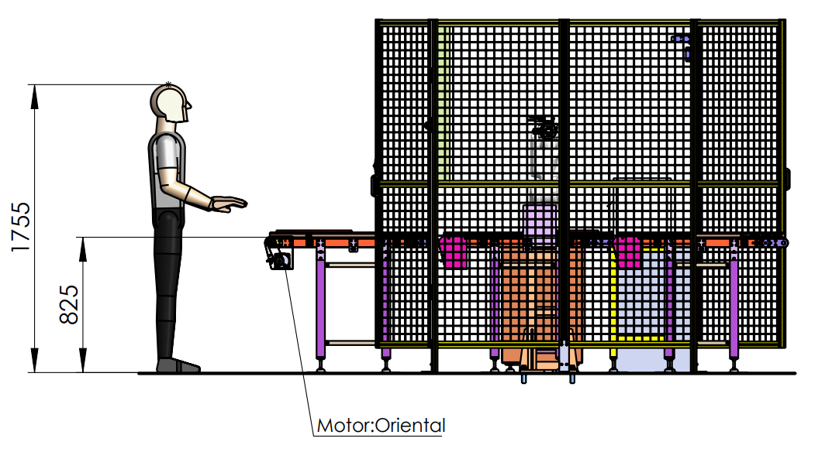
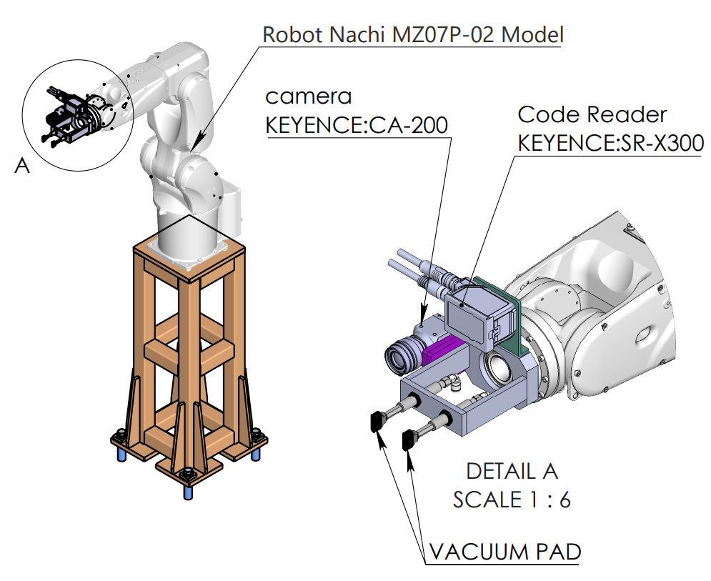
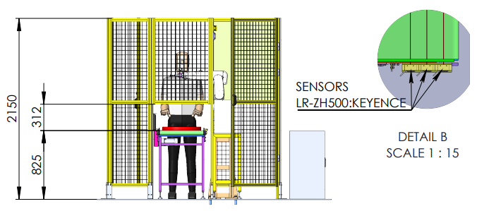
┃Layout machine Phase 1

Slide 9
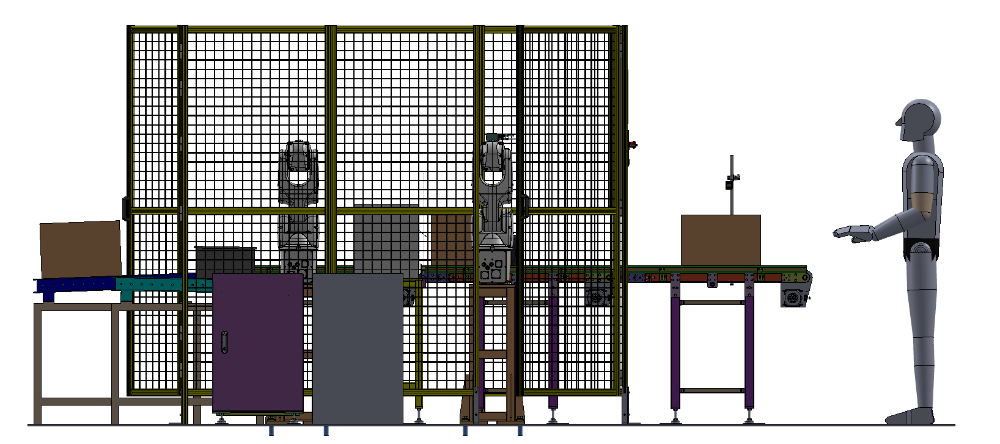
┃Layout machine Phase 2

Slide 10
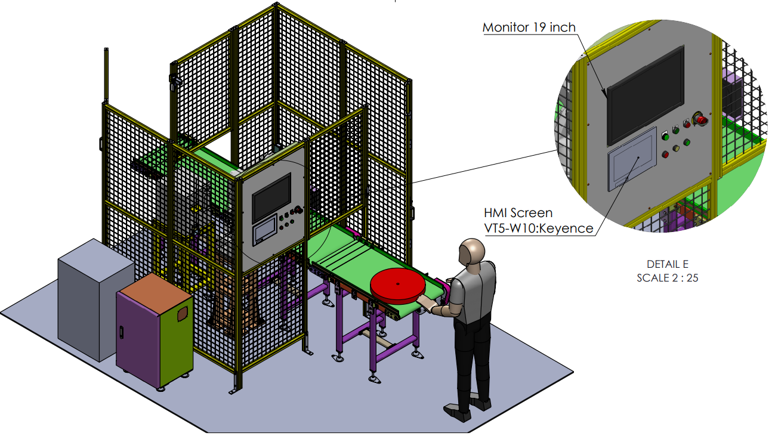
┃Layout machine

Slide 11
Process flow

Slide 12
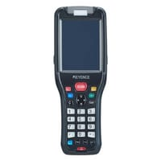
┃Process flow
Phase 1
Phase 2
4
Place the work piece on the first Conveyor, after which the Conveyor will transport the work piece to the second point.
Use SR-Reader *In cases where work cannot be read with SR, Handy will be used instead. scan at work for select model and send the model to the computer to print labels
When the workpiece reaches the third position, the robot will use the camera to take pictures to find the current sticker position. and make an offset from the current position to the position to be pasted
After the sticker is finished, the robot will lift the Z axis and rotate the SR-Reader to read the information after the sticker is finished.
In the case of a model with RFID, information will be written as well.
After data confirmation is complete, the workpiece will be sent to the load-out location.
After the auto labeling process is completed, point number 7 will be the work sorting point. In order to put it in the box, point 8, in the case of the work being Reels, if it is a Box, it will be released to point 6.
2
6
3
1
7
5
8
3
2
4
6

Slide 13
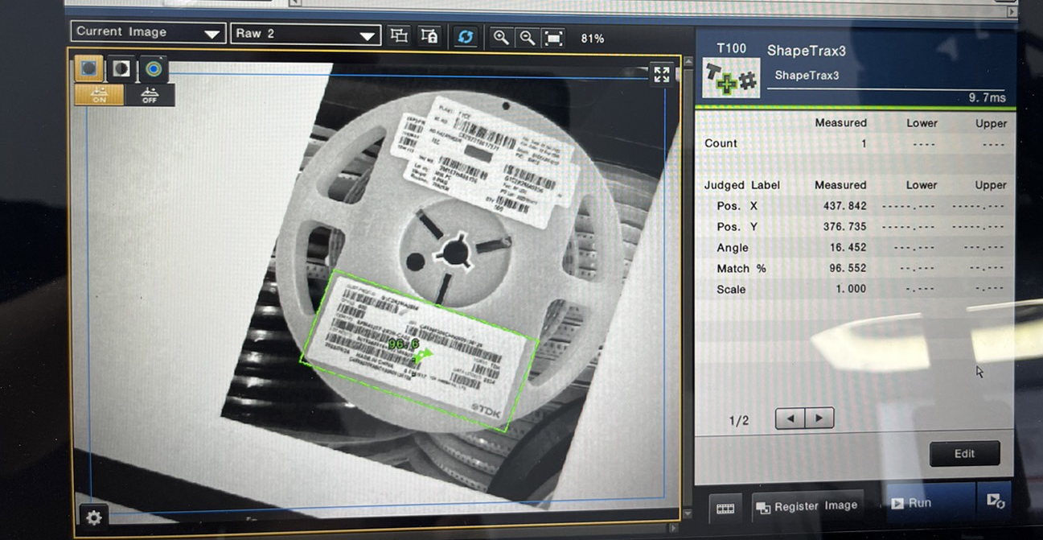
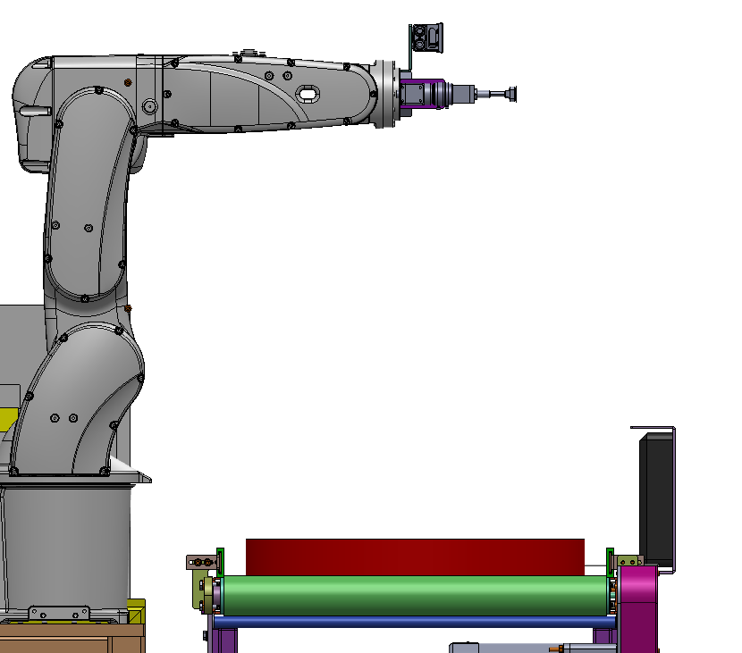
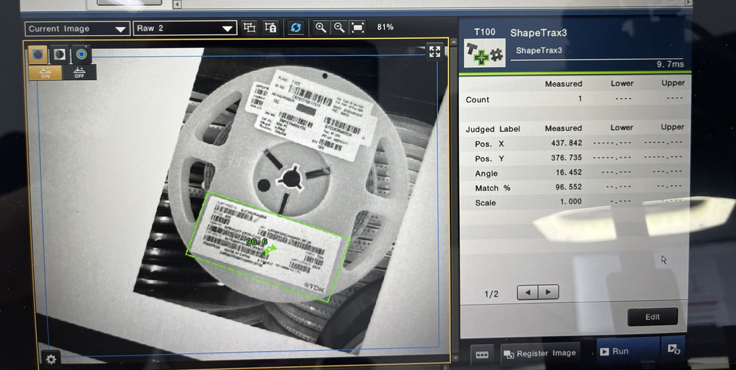
┃Process flow

Slide 14

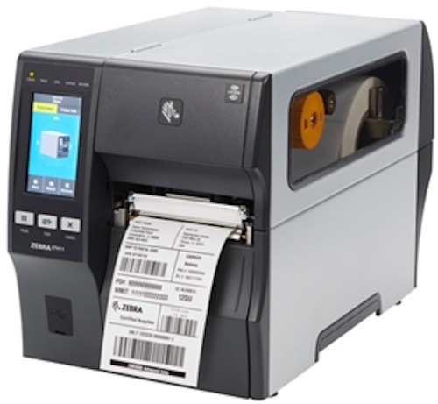
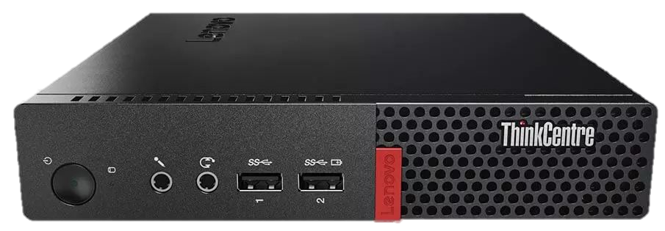
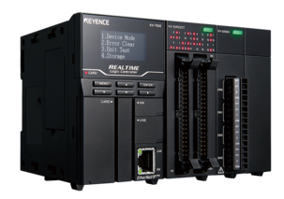
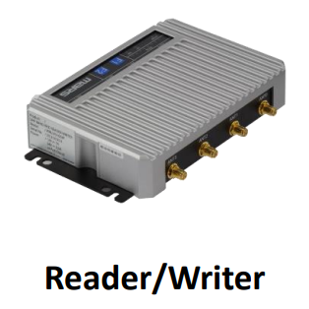
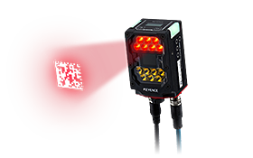
┃Operation flow
Register invoice
Preparing data for INV.Number and INV.Order
Read Part Number
By SR-Reader/Handy send to Barcode system
Auto labeling
By Robot received trigger by sensor
Duplicate check
RFID Read/Writer
PLC SR-Reader read from sticker label send to Barcode systems
PLC Read from RFID and send to RFID systems
Windows App C#
? Protocol
Host Link
Server PASAP
Trigger
Ethernet IP Protocol
Machine systems
Machine

Slide 15

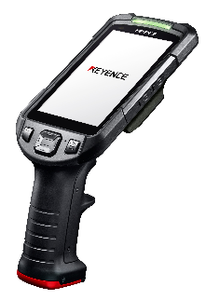
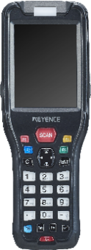
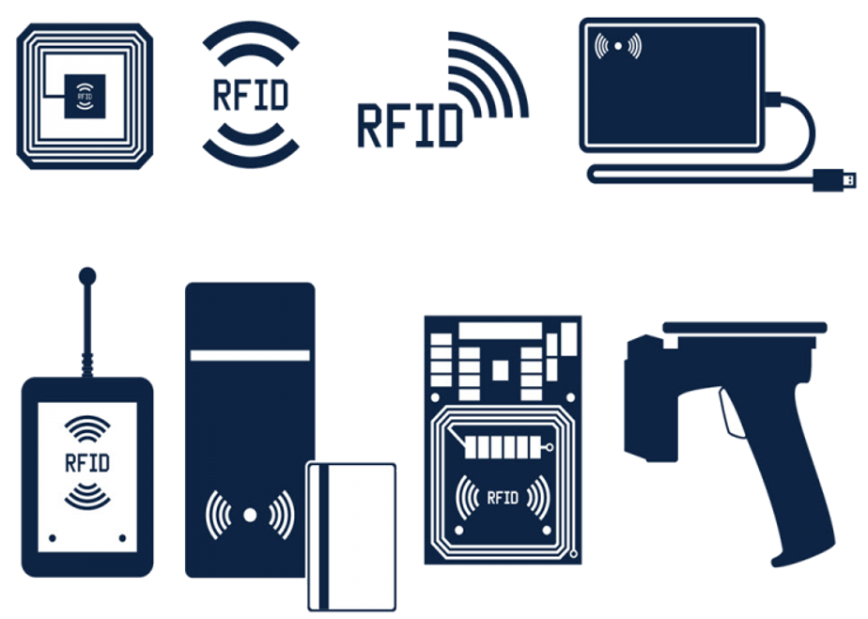
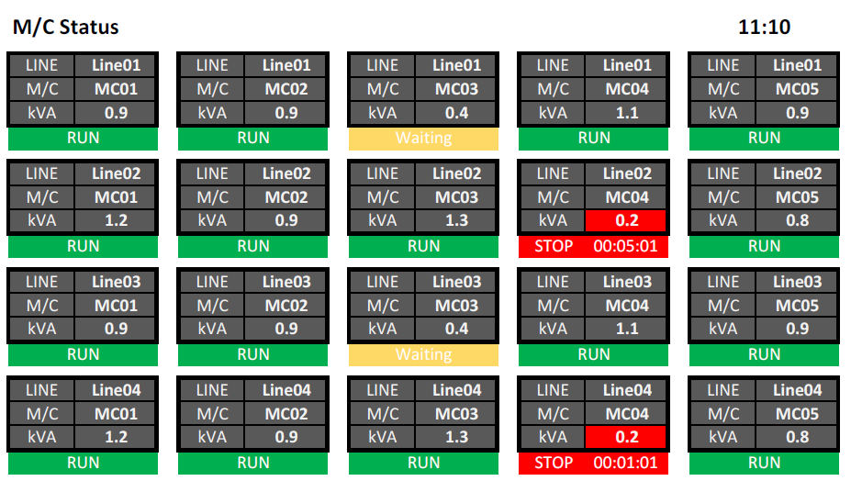
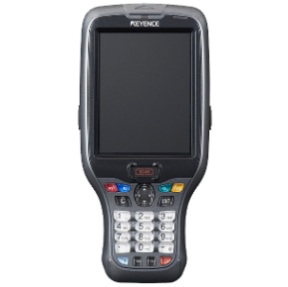

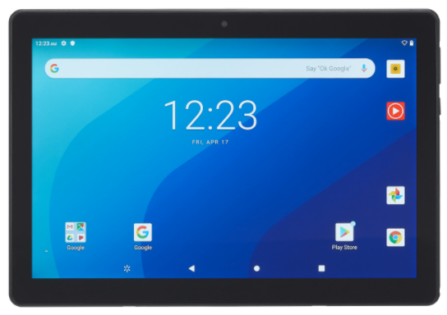
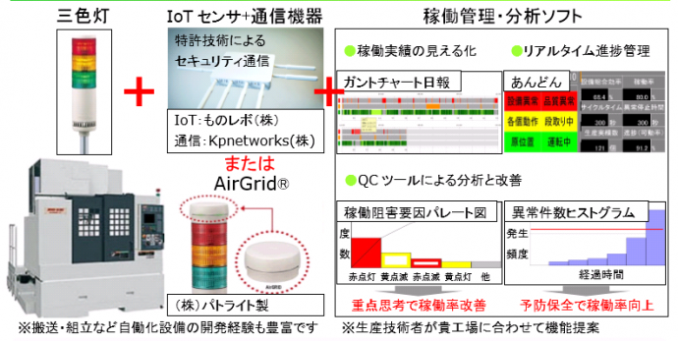
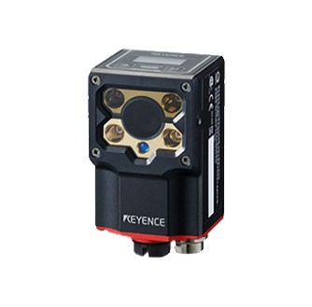
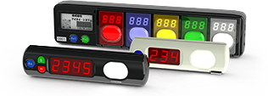
┃ Proposals that only we can make
With a wide range of “Soft" x "Hard" solutions, which is our strength,
We will solve problems in various situations at manufacturing and distribution sites.
Picking System
Handy terminal System / Tablet System
RFID System
Monitoring / Traceability System

Slide 16
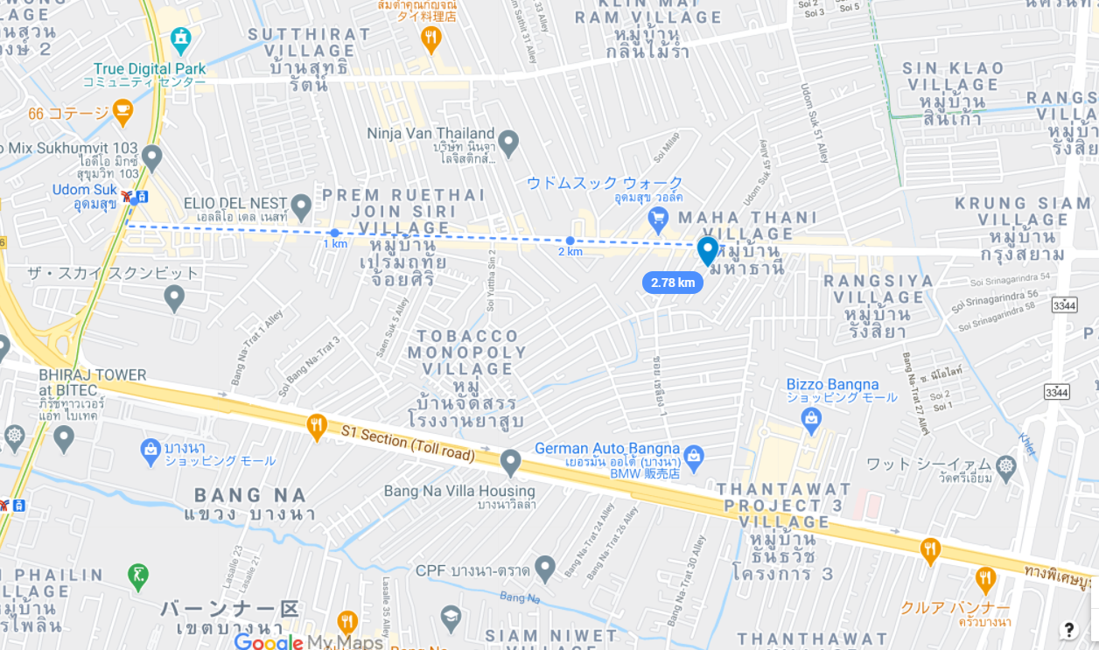


┃Contact
info@tomastc.com
TH/EN: +66-81-012-6064 (Anek)
JP/TH/EN: +66-94-552-3097 (Nozaki)
TOMAS TECH
http://www.tomastc.com
7/1(3C) Soi Sukhumvit 103 (Udomsuk 46) Sukhumvit Bang Na, Bangkok 10260

