Slide 1

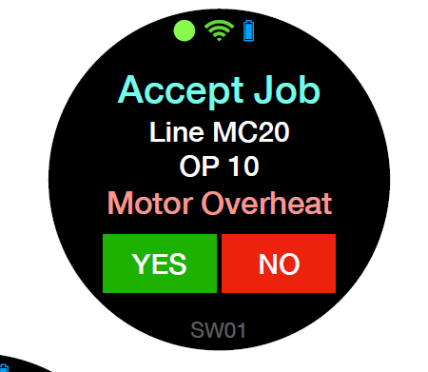
┃Re-notification function
If no one responds or everyone says no, send a reminder.
Master image
When 60 seconds has passed without anyone responding (Time can be changed by the master.)
If everyone said NO.
Call group
Reminder
Waiting time
Group A
Yes or No
60 seconds
・・
・・
・・
・・
NO
NO
NO
NO
A
B
C
D
A
B
C
D
Reminder for Group A
Remainder

Slide 2
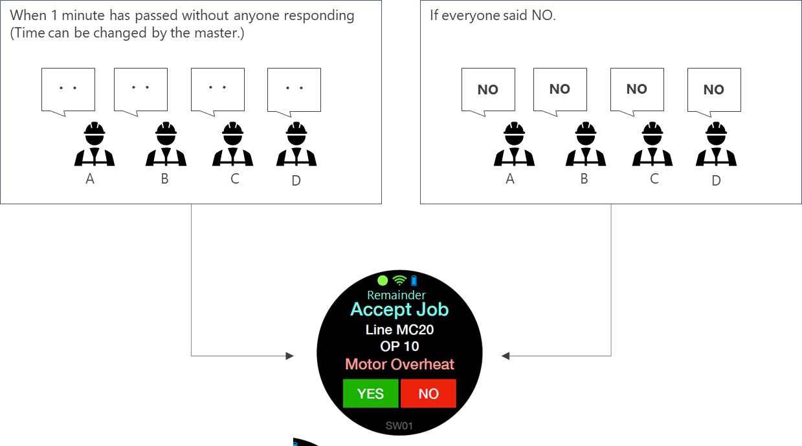
┃Call to another group
If there is no response to the reminder, it will be possible to send a notification to another group that has been set as the master.
Master image
Call group
Reminder
Waiting time
Follow up group
Group A
Yes or No
60 seconds
Group B
Follow up for Group B
Follow up

Slide 3
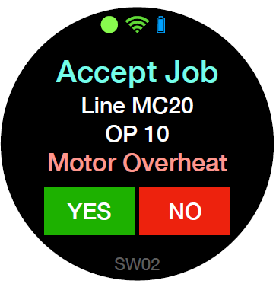
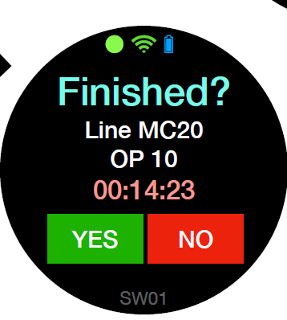
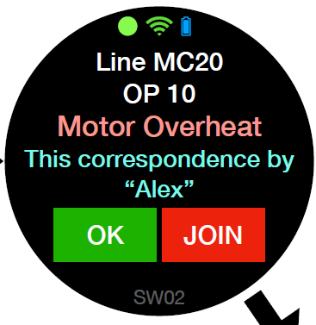
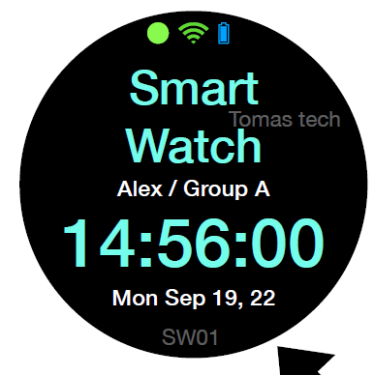
┃Queue management
Manage queues. Make it possible to see and select all notifications on a per-person basis.
It also manages job IDs. Display by linking with Pegasus job.
Added: "New Notification Acquisition"
Decrease: "Completed", "NO"
Get now notice
Get now notice
Get now notice
next page
previous page
Push “NO” button
Push “YES” button
Group A
1st notification 1/1
2nd notification 1/2
3rd notification 1/3
move page to 2/3
move page to 1/3
Push “NO” button
Decrease in number of management cases
Push “YES” button
1/1
1/2
1/3
2/3
1/3
1/3
1/2
1/2
1/2
0001
0001
0001
0002
0001
0001
0002
0002
0002
A
Screen moves button is active
Get now notice
Get now notice
Get now notice
next page
Get now join notice
previous page
Catch finish notice
Group A
1st notification 1/1
2nd notification 1/2
3rd notification 1/3
move page to 2/3
Change screen of JOB ID 0001
move page to 1/3
Catch finish notice
Push “YES” button
1/1
1/2
1/3
2/3
2/3
1/3
1/2
Push “YES” button
0001
0001
0001
0002
0002
0001
0001
2/2
2/2
0003
0003
B
Change screen
Catch finish notice
Group A
Change screen of JOB ID 0003
Catch finish notice
Back to home screen
1/1
1/1
1/1
0003
0003
0003
A
Screen moves button is not active

Slide 4
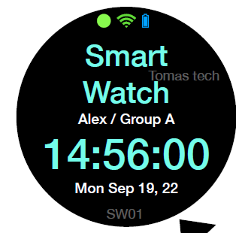
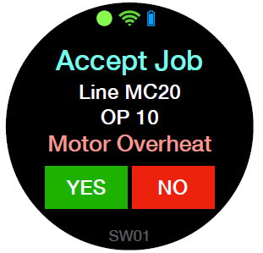
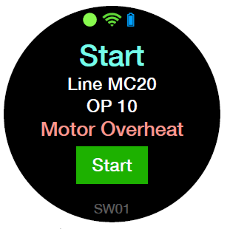
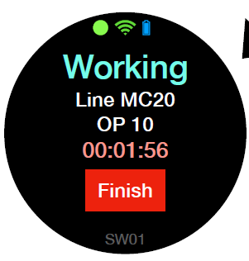
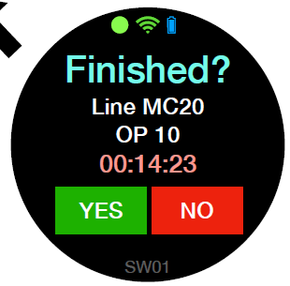
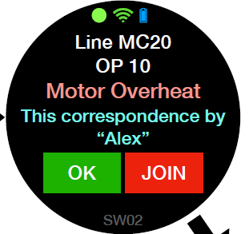
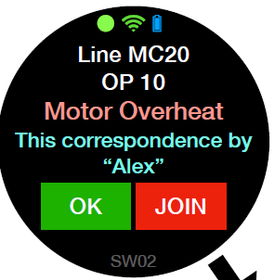
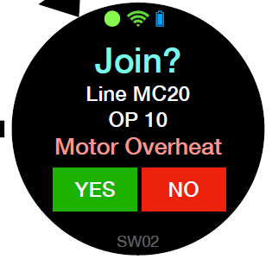
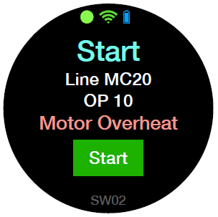
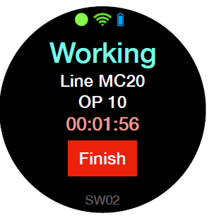
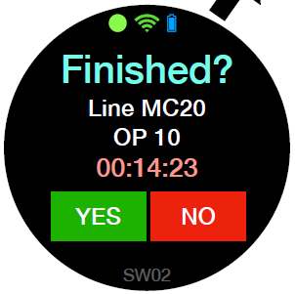
┃Call type master management
The function of whether or not to record and the function of whether or not to perform join can be selected by master management.
Master image
Type | Join | Recode
1 | 〇 | 〇
2 | 〇 | ×
3 | × | 〇
4 | × | ×
Call group
Call type
Reminder
Waiting time
Follow up group
Group A
1 , 2, 3 , 4
Yes or No
60 seconds
Group B
Call type
1
Call type
2
Call type
3
Call type
4

Slide 5
┃Q&A
Can smart watch fix IP?
Note:
NFC function , what can it made for us?

