Slide 1
Drink order system
TOMAS TECH CO.,LTD.

Slide 2
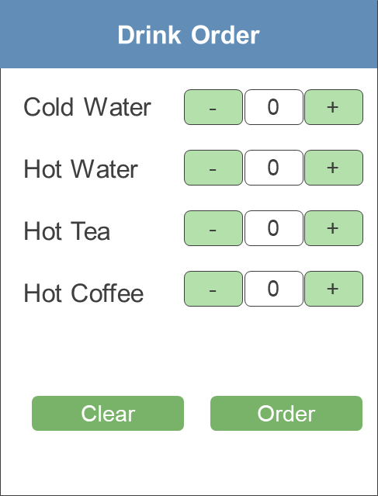
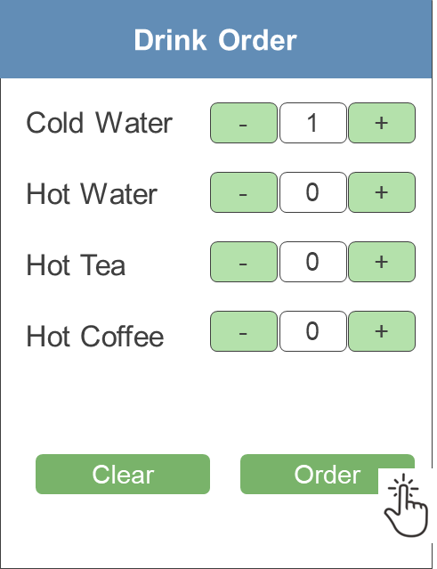
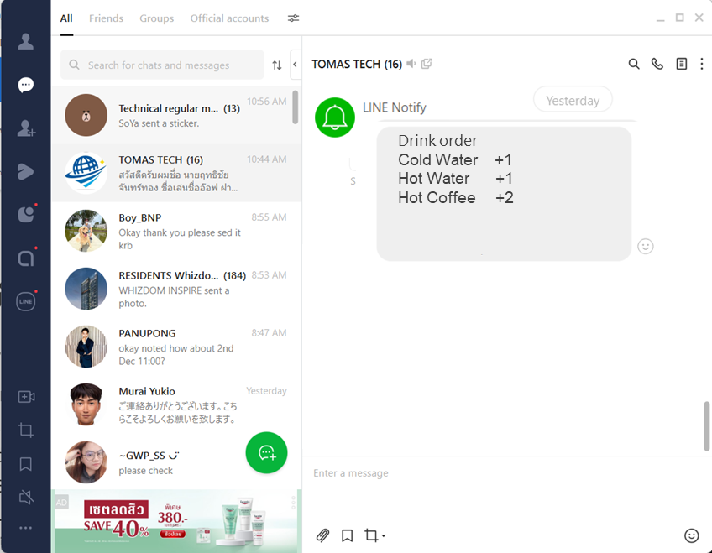


Operation flow
Open browser
At smart phone(Chlome)
2. Select order
3. Push order button
4. Send LINE

Slide 3

Operation flow
Drink Order
Drink Order
Cold Water
Hot Water
Hot Tea
Hot Coffee
-
0
+
Cold Water
Hot Water
Hot Tea
Hot Coffee
-
1
+
-
0
+
-
0
+
-
0
+
-
0
+
-
0
+
-
0
+
Clear
Order
Clear
Order

Slide 4
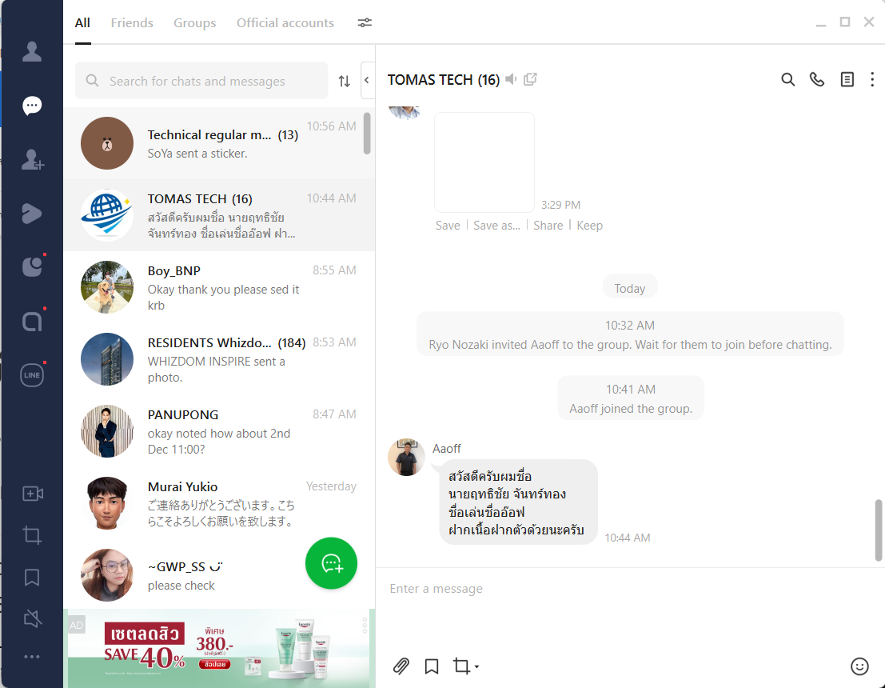

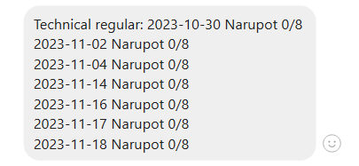
Operation flow
Drink order
Cold Water +1
Hot Water +1
Hot Coffee +2

Slide 5
Change history
Version | Amendments | Modification date
Rev01 | First edition | 19-Nov-2023

