Slide 1
Training demo kit Made for YAMADA SOMBOON CO.,LTD
TOMAS TECH Co., Ltd.

Slide 2
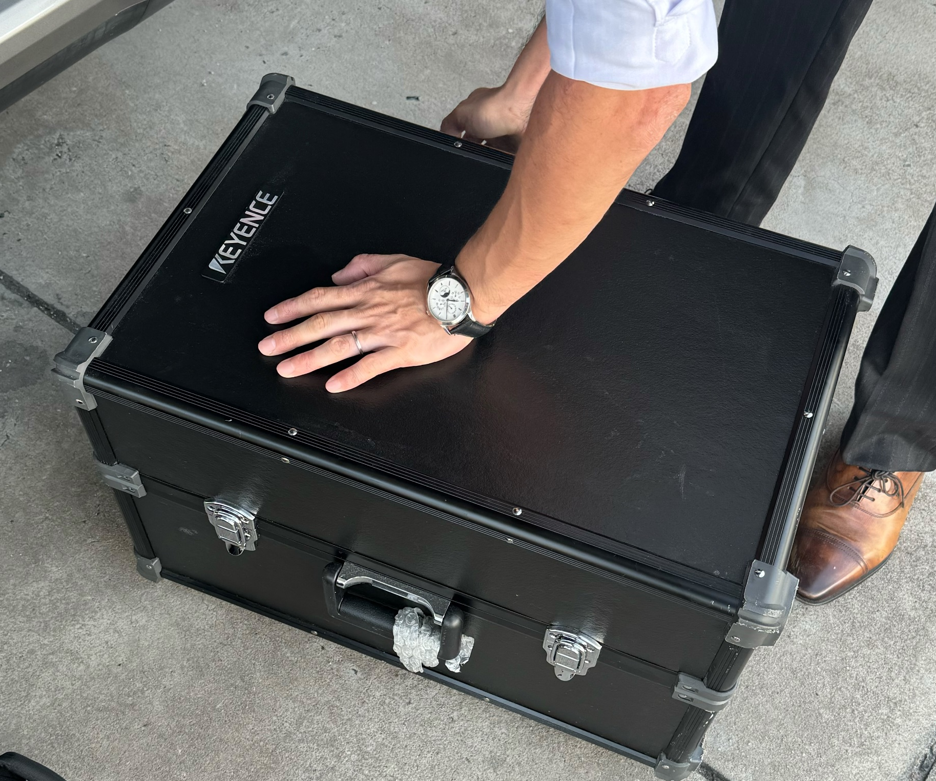
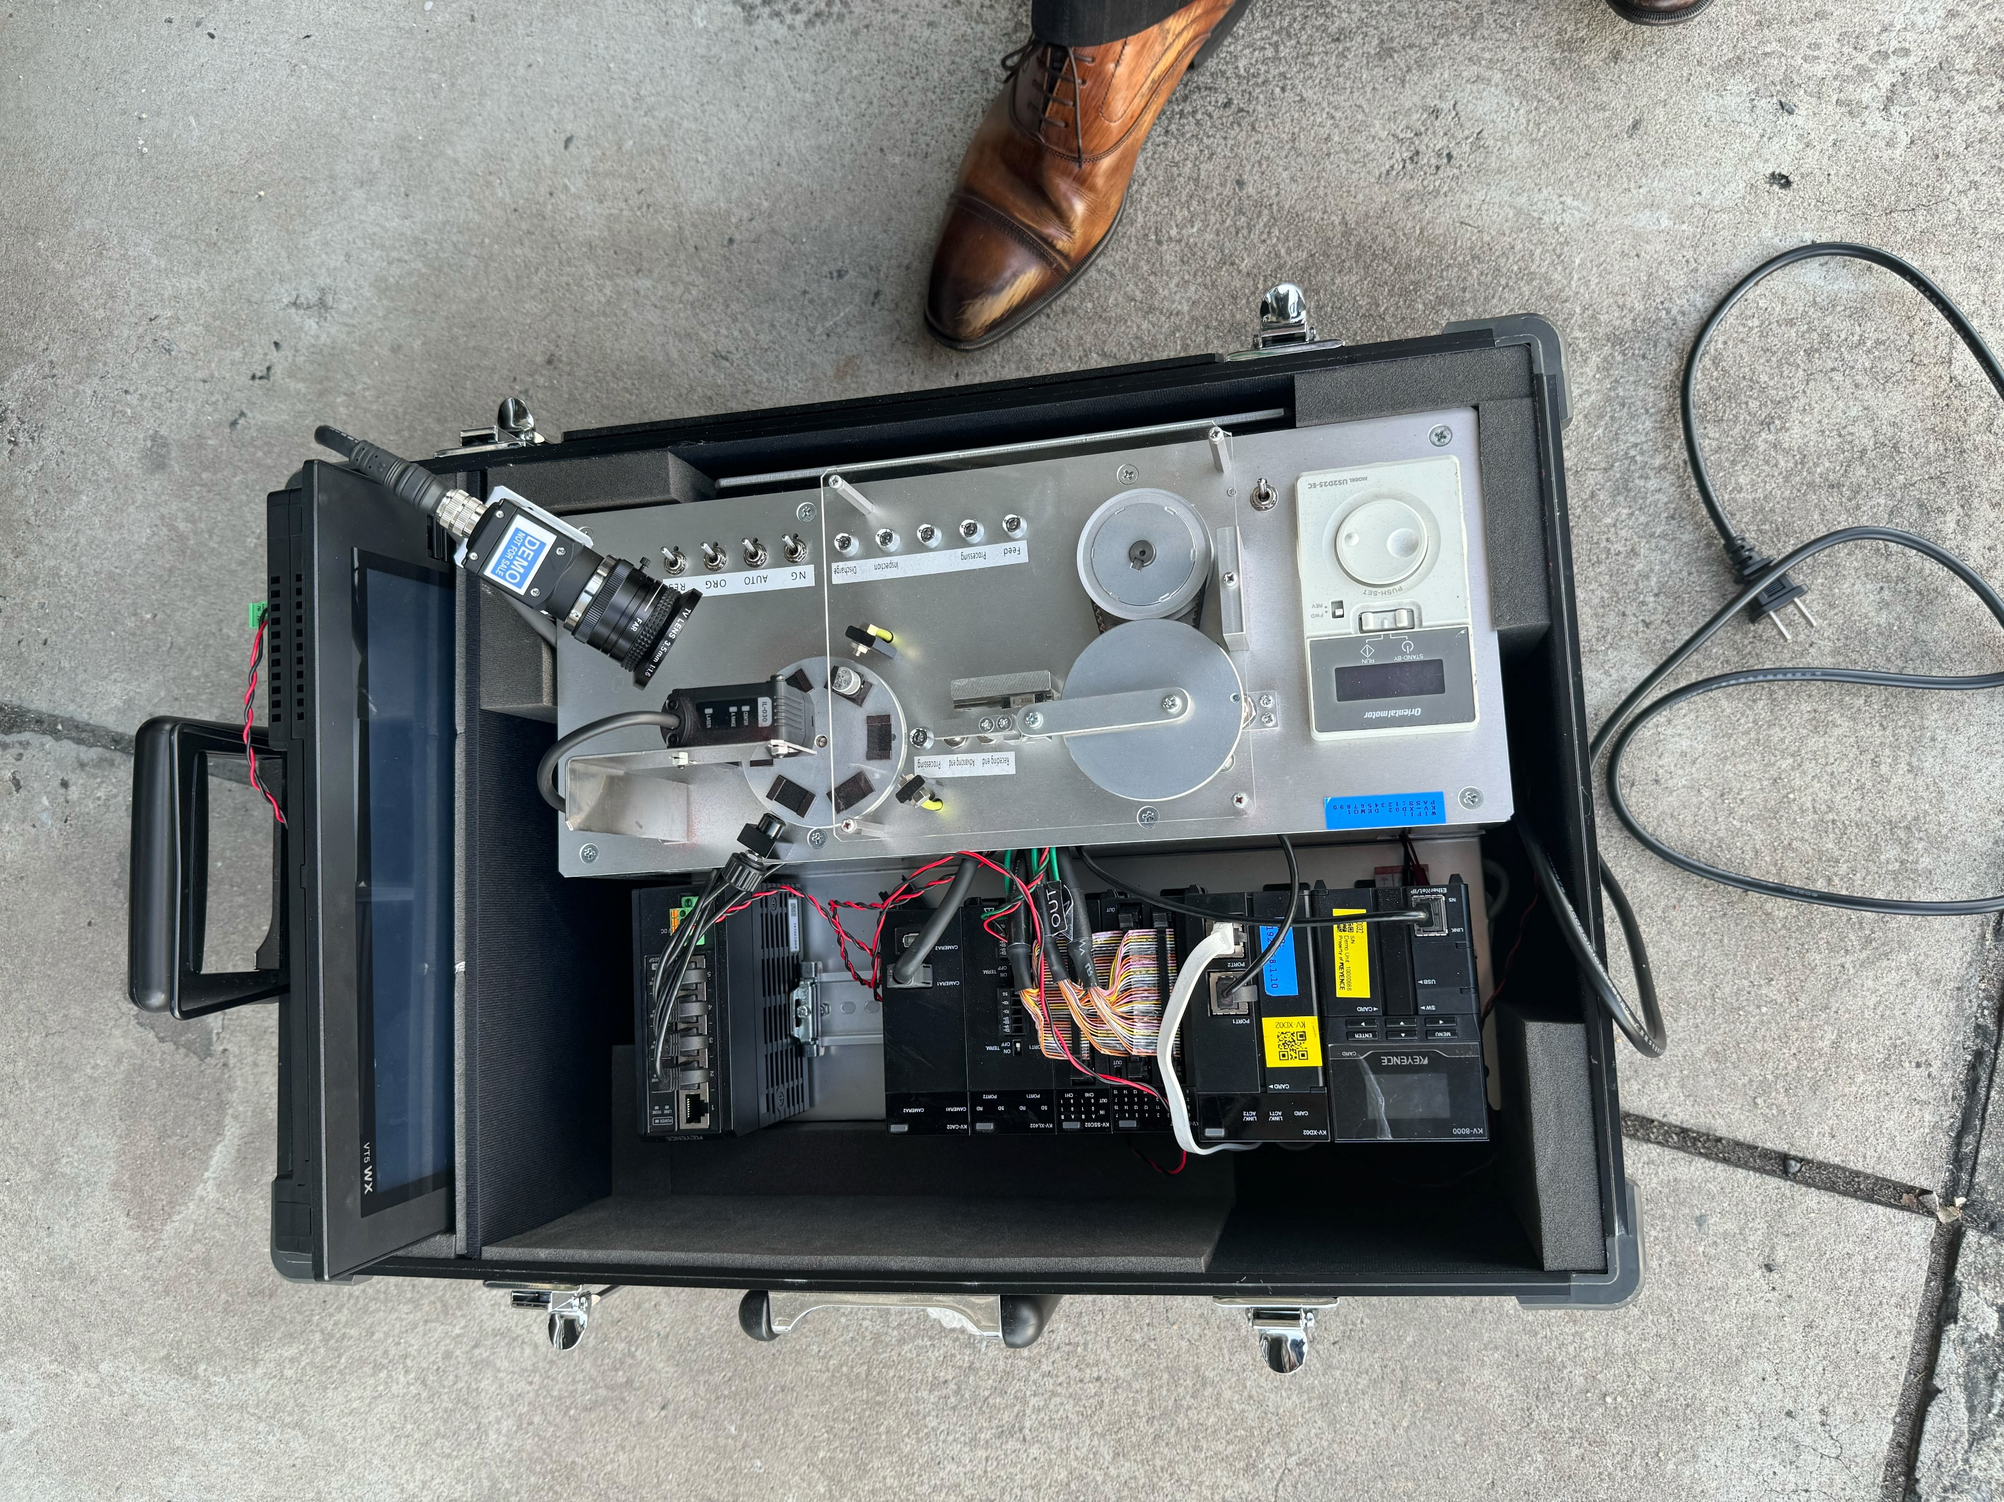
┃Example
Pic.1
Pic.2

Slide 3
┃Part list ( Keyence )
Only the Keyence device, not included with other devices such as the Mechanical part, Motor control unit
Item | Model/Part Number | Quantity | Discription | URL
1 | KV-8000 | 1 | PLC Unit | https://www.keyence.co.th/products/controls/plc-building-block-type/kv-8000/models/kv-8000/?search_dl=1
2 | KV-XD02 | 1 | Data Utilization Unit | https://www.keyence.co.th/products/controls/plc-building-block-type/kv-8000/models/kv-xd02/?search_dl=1
3 | KV-SIR32XT | 1 | I/O Unit ( High speed ) | https://www.keyence.co.th/products/controls/plc-building-block-type/kv-8000/models/kv-sir32xt/?search_dl=1
4 | KV-XH16ML | 1 | Positioning unit | https://www.keyence.co.th/products/controls/plc-building-block-type/kv-8000/models/kv-xh16ml/?search_dl=1
5 | KV-SSC02 | 1 | High speed counter Unit | https://www.keyence.co.th/products/controls/plc-building-block-type/kv-8000/models/kv-ssc02/?search_dl=1
6 | KV-CA02 | 1 | Module Camera Unit | https://www.keyence.co.th/products/controls/plc-building-block-type/kv-8000/models/kv-ca02/?search_dl=1
7 | MS2-H100 | 1 | Power supply Unit | https://www.keyence.co.th/products/controls/other-controls/ms2/models/ms2-h100/?search_dl=1
8 | NE-Q05P | 1 | Swiching Hub Ethernet Unit | https://www.keyence.co.th/products/controls/plc-building-block-type/kv-8000/models/ne-q05p/?search_dl=1
9 | NU-EP1 | 1 | Communication Unit | https://www.keyence.co.th/products/sensor/network-communication/nu/models/nu-ep1/?search_dl=1
10 | FS-N12N | 5 | Amplifier Unit | https://www.keyence.co.th/products/sensor/fiber-optic/fs-n/models/fs-n12n/?search_dl=1
11 | FU-66TZ | 3 | Fiber received Unit | https://www.keyence.co.th/products/sensor/fiber-optic/fu/models/fu-66tz/?search_dl=1
12 | FU-13 | 2 | Regression-reflective | https://www.keyence.co.th/products/sensor/fiber-optic/fu/models/fu-13/?search_dl=1
13 | EZ-8M | 2 |  | https://www.keyence.co.th/products/sensor/proximity/ez/models/ez-8m/?search_dl=1
14 | DL-EP1 | 1 | Communication Unit | https://www.keyence.co.th/products/sensor/network-communication/dl/models/dl-ep1/
15 | IL-1000 | 1 | Amplifier Unit | https://www.keyence.co.th/products/sensor/laser/il/models/il-1000/?search_dl=1
16 | IL-030 | 1 | Analog lazer Sensor | https://www.keyence.co.th/products/sensor/positioning/il/models/il-030/?search_dl=1
17 | OP-87056 | 1 | Cabel Sensor | https://www.keyence.co.th/products/sensor/laser/il/models/op-87056/?search_dl=1
18 | VT5-WX12 | 1 | HMI | https://www.keyence.co.th/products/controls/hmi/vt5/models/vt5-wx12/?search_dl=1
19 | SV-M005AS | 1 | Servo motor | https://www.keyence.co.th/products/controls/motor/sv/models/sv-m005as/
20 | SV-005L2 | 1 | Servo motor
21 | SV-BE3 | 1 | Cabel | https://www.keyence.co.th/products/controls/motor/sv/models/sv-e3/
22 | SV-C3A | 1 | Servo motor | https://www.keyence.co.th/products/controls/motor/sv/models/sv-c3a/
23 | SV-LA5 | 1 | Machatrolink cabel | https://www.keyence.co.th/products/controls/plc-building-block-type/kv-7000/models/sv-la5/
24 | KV-M16G | 1 | Memory Card | https://www.keyence.co.th/products/controls/plc-building-block-type/kv-8000/models/kv-m16g/
25 | KV-CAL03 | 1 | Camera lens | https://www.keyence.co.th/products/controls/plc-building-block-type/kv-8000/models/kv-cal03/?search_dl=1
26 | KV-CAC1H | 1 | Camera | https://www.keyence.co.th/products/controls/plc-building-block-type/kv-8000/models/kv-cac1h/?search_dl=1

Slide 4

┃Bag size
560 mm.
200 mm.
1
350 mm.
2
3
3
200 mm.
Top view
Side view
1
Can hold HMI VT-WX12 Rev.item 18 Page.3
2
The bag can be opened separately.
3
Has a handle for lifting or moving. Rev Pic1,Pic2
There is a bag lock set.

Slide 5
┃Accessories
Please design the IN power 230V plug set to be easy to use and can easily store equipment
Drive shaft set
Turn table set
Cover set
Stand set for Sensor
Stand set for Camera
Speed control
Toggle switch
Lamp
Toggle switch

Slide 6
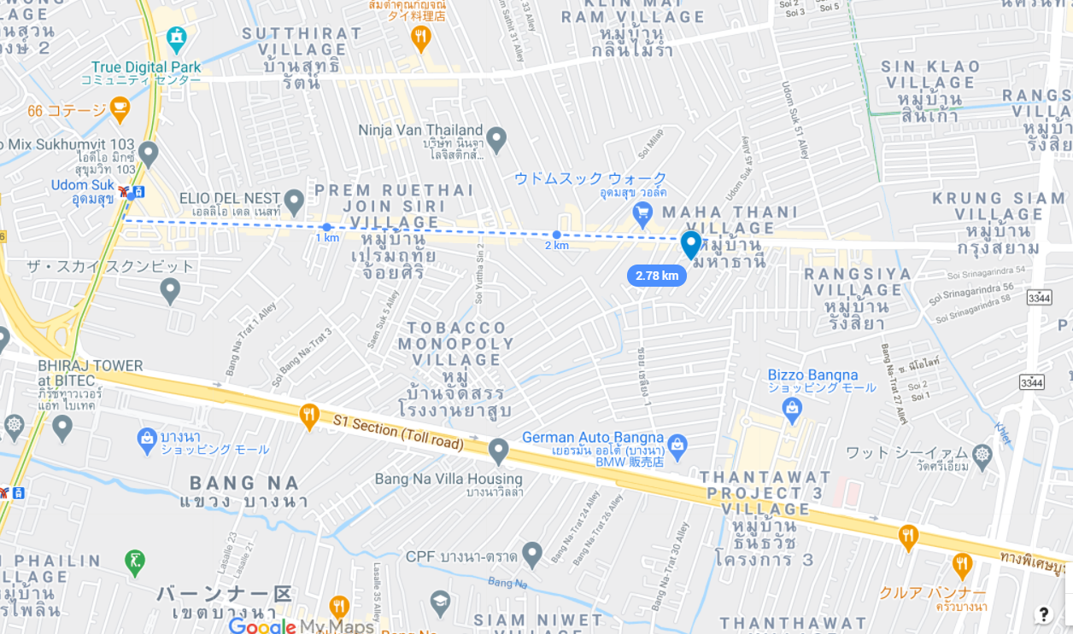


┃Contact
info@tomastc.com
TH/EN: +66-81-012-6064 (Anek)
JP/TH/EN: +66-94-552-3097 (Nozaki)
TOMAS TECH
http://www.tomastc.com
7/1(3C) Soi Sukhumvit 103 (Udomsuk 46) Sukhumvit Bang Na, Bangkok 10260

