Slide 1
Addition program record data to CF-Card Line MC30 OP80
Made for Isuzu Engine Manufacturing (Thailand) Co.,Ltd.
TOMAS TECH Co., Ltd.
Design : Nattapol Po-eam
(IoT Engineer)

Slide 2
┃Agenda
► System configuration
► Definition of each information
► Storage map format

Slide 3
System configuration

Slide 4
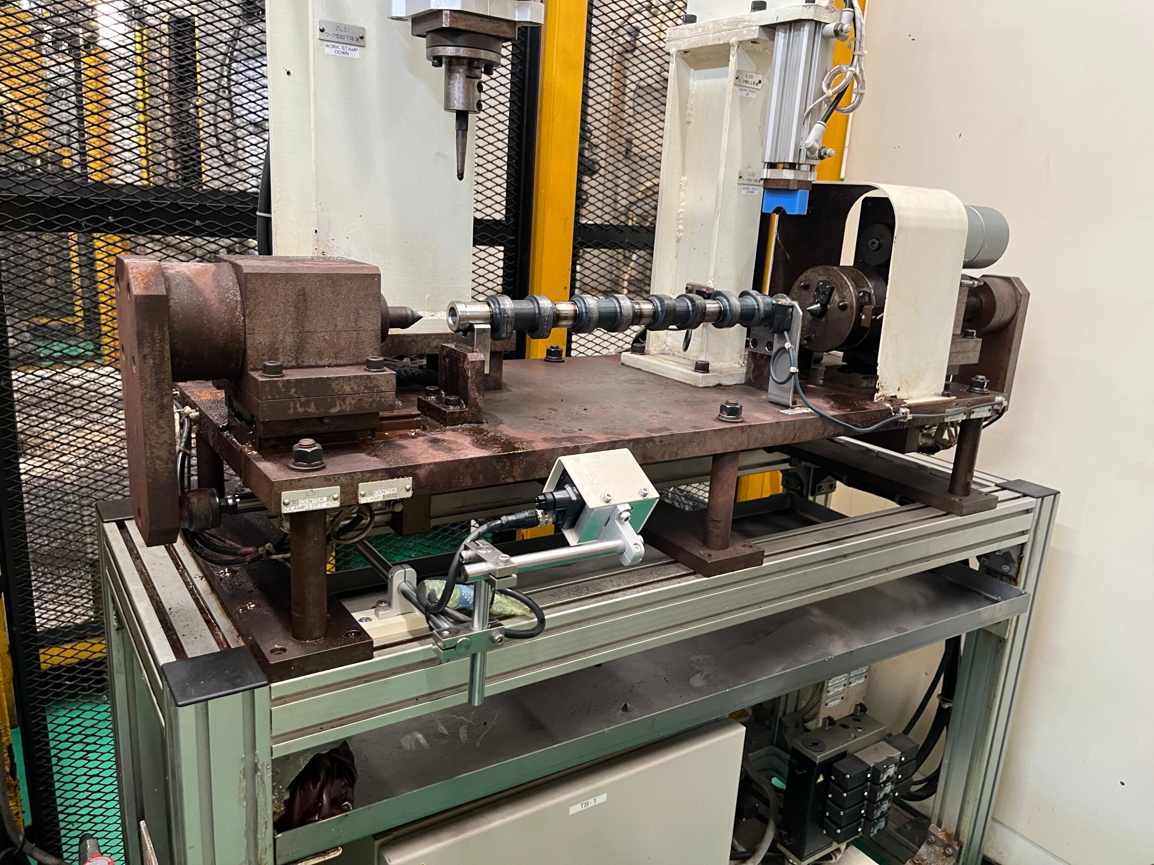
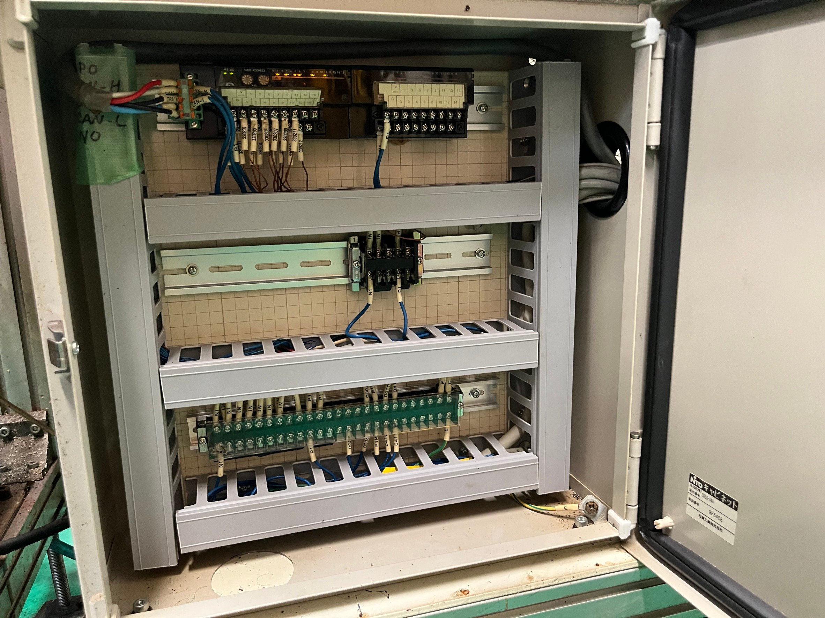
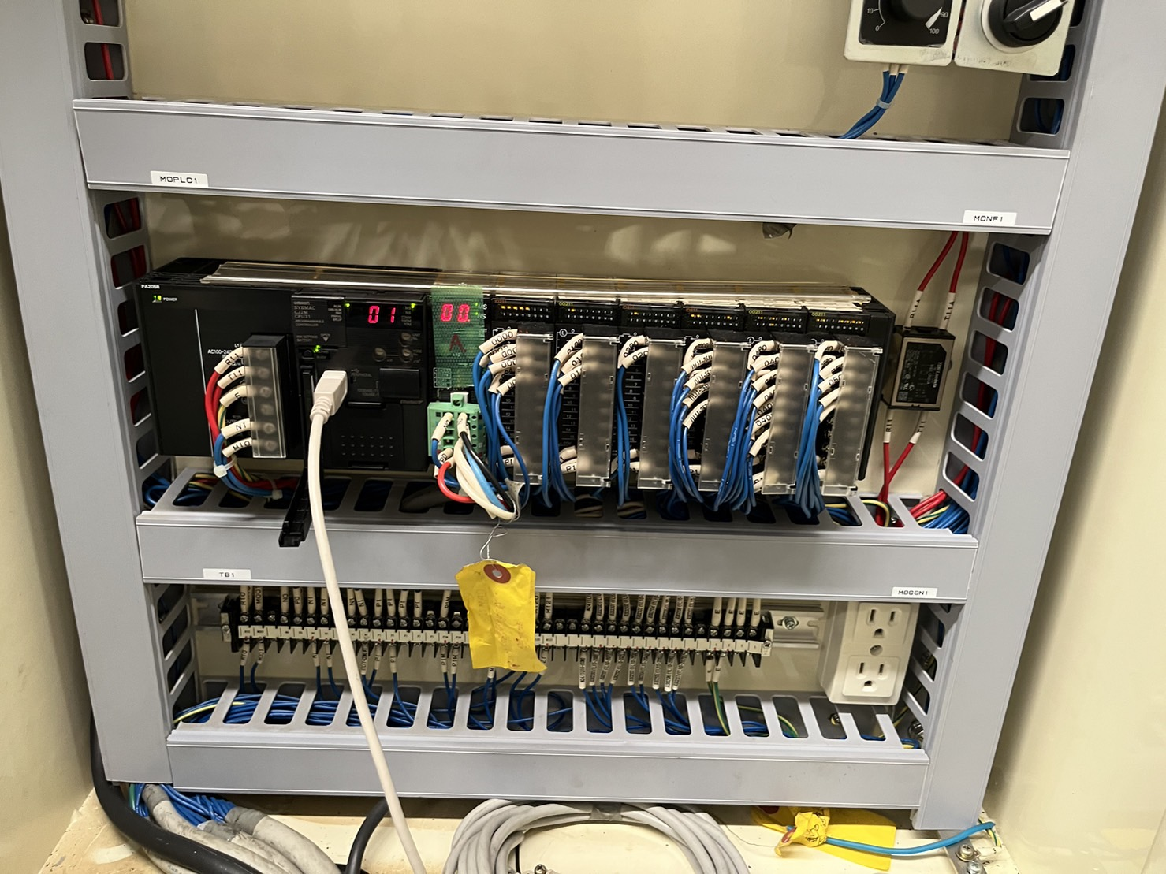
┃System configuration
SRX-300
TB-BOX
Main Control
2
HUB
1
3
Wiring the LAN cable from the main control cabinet by connecting from the Omron CJ2M CPU to the TB-Box cabinet.
Add an Ethernet hub to connect the SRX-300 to the Omron CJ2M CPU.
Connect the SRX-300 LAN cable to the Hub.

Slide 5
Definition of each information

Slide 6
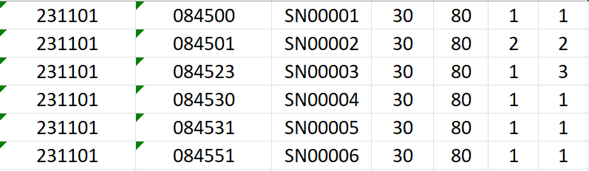
┃Definition of each information
Column format data
1
2
3
4
5
6
7
Date [ 231101 : 23 ( Year ) 11 ( Month ) 01 ( Day ) ]
Time [ 084500 : 08 ( Hr. ) 45 ( Min. ) 00 ( Sec. ) ]
Serial Number [ Ref. Part Number ]
Line MC [ 30 : Line MC30 ]
OP [ 80 : OP-80 ]
Mode [ 1 : Auto , 2 : Manual ]
Event definition [ 1: Start, 2: Stop, 3: Finish process, 4: Alarm

Slide 7
Storage map format

Slide 8
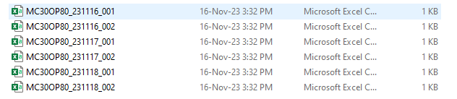
┃Storage map format
CSV Format
MC30OP80_231116_001
Shift : Day shift 08:00 – 17:00 = 001, Day Night 20:00 – 07:00 = 002
Date
Line + OP

Slide 9
Thank you
Design : Nattapol Po-eam

Slide 10


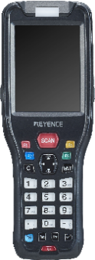
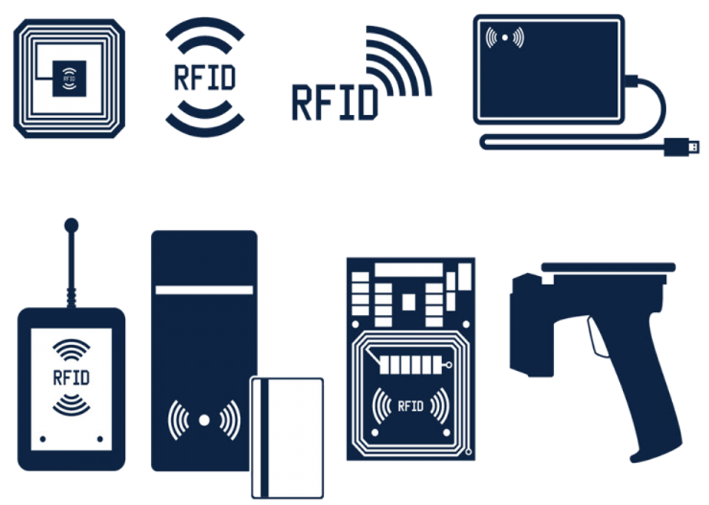
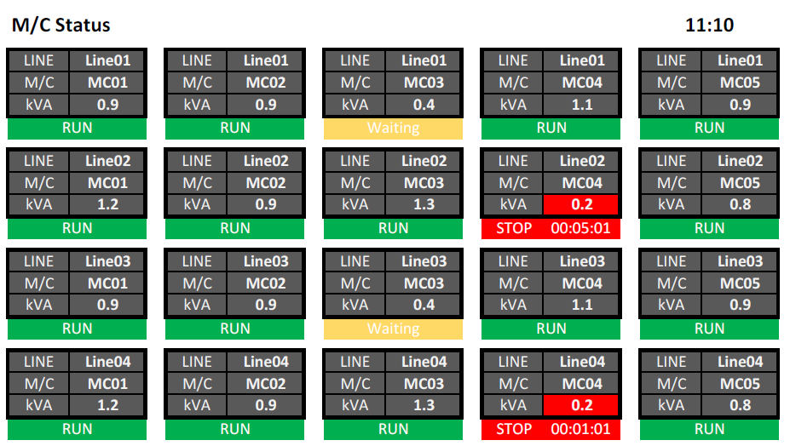


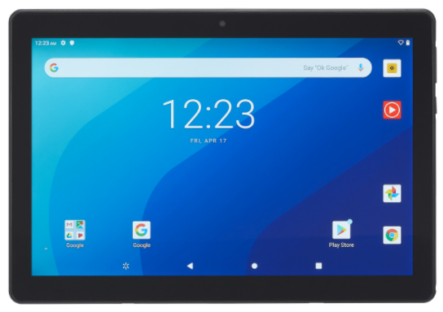
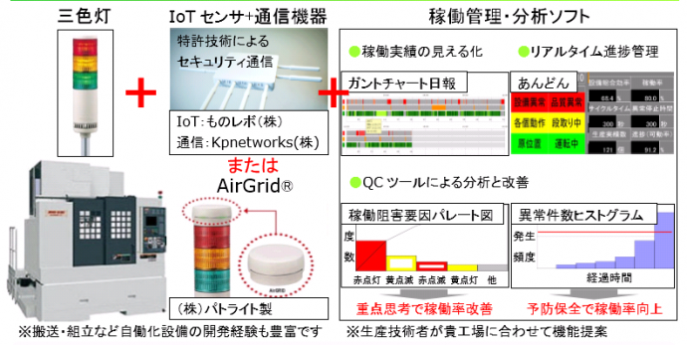
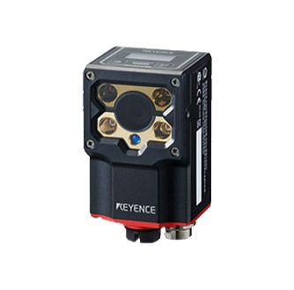
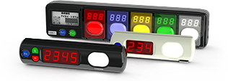
┃ Proposals that only we can make
With a wide range of “Soft" x "Hard" solutions, which is our strength,
We will solve problems in various situations at manufacturing and distribution sites.
Picking System
Handy terminal System / Tablet System
RFID System
Monitoring / Traceability System

Slide 11
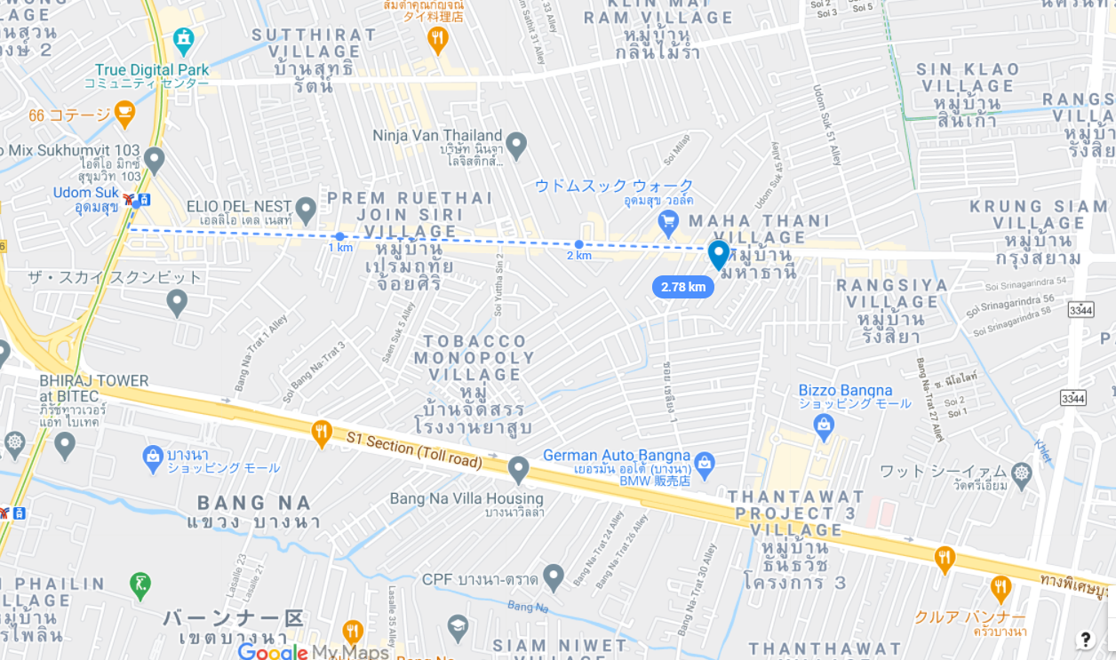


┃Contact
info@tomastc.com
TH/EN: +66-81-012-6064 (Anek)
JP/TH/EN: +66-94-552-3097 (Nozaki)
TOMAS TECH
http://www.tomastc.com
7/1(3C) Soi Sukhumvit 103 (Udomsuk 46) Sukhumvit Bang Na, Bangkok 10260

