Slide 1
Project IOT line notify
Capacity file record sd card
1 IMAGE RECORD ➔ 7 MB
Convert time ➔ 30 Sec / step
Data transfer time ➔ 1 Sec
CSV Record new day new file CSV every time ➔ 00:00

Slide 2
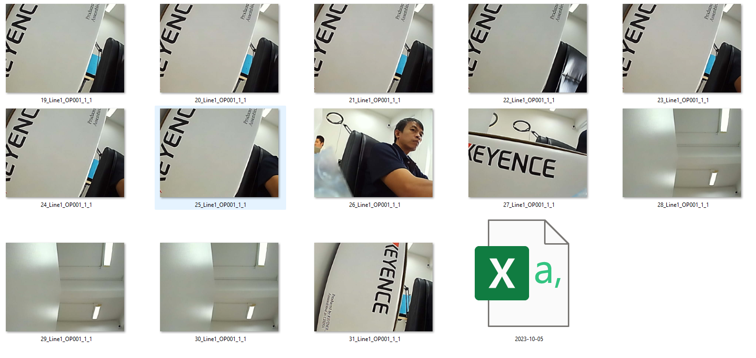
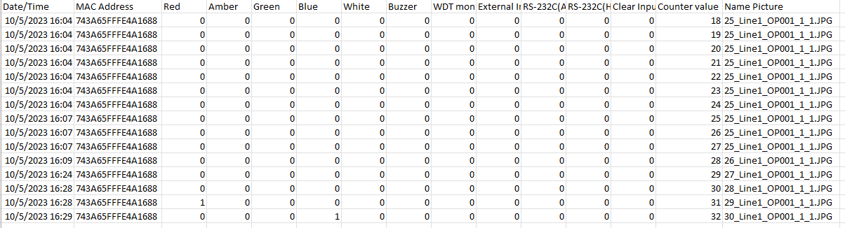
Detail FTP record CSV file

