Slide 1
┃Line notification function
1.1 Notify Line Notify when the patrol light is red.
1.2 Notify Group A if red, Group B if blue. Separate accounts.
2.1 Sending jpeg data at the same time as the error message
2.2 Sending jpeg data with the "Camera No" and "pic" commands
2.3 Capture camera data and send jpeg data from CA01 with ``Camera No'' and ``pic'' commands
3 Distinguish the person in charge from the sender.
4 Send videos. Same as item 2.

Slide 2
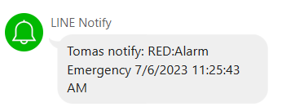
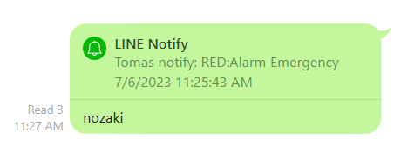


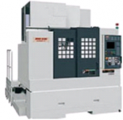



┃Line notification function
Notify the machine equipment side to Line.
１
2
3
An error has occurred in the equipment. Transfer information to the server for line, machine number and error information.
Calling the group in charge Example: Group B
The person who received the Line replies that it can respond.
A
Equipment error occurred
Line: MC20
Machine number: OP10
Error information:
Motor overheat
NO
NO
YES
NO
B
C
6
5
4
By collecting the rush time, response start time, and response completion time, each work time can be recorded as a log.
Press the completion button on Smart Watch. Complete the response.
Workers who answered YES head to the site. Corresponding start.
Fix completed
Fix start
Response time
02-Aug-2022 14:00:00
Start time
02-Aug-2022 14:05:00
Finish time
02-Aug-2022 15:05:00
Arrival time
00:05:00
Fix time
01:00:00

Slide 3

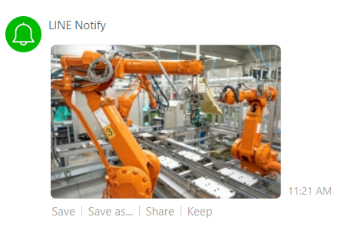
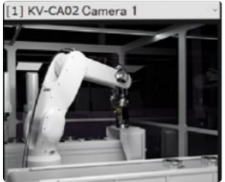
┃Line notification function
Notify the machine equipment side to Line.
１
2
An error has occurred in the equipment. Transfer information to the server for line, machine number and error information.
Photo data request
MC001
PIC
Equipment error occurred
Line: MC20
Machine number: OP10
Error information:
Motor overheat

Slide 4
┃Line maintenance note
Create line maintenance notes.
Detect errors from equipment. Notify the line.
Send and receive automatic messages according to the master settings on the line.
1. Equipment error notification
2. Assignment of personnel
3. Question 【1】
Have you arrived?
3. Answer 【1】
Have you arrived?
Yes

Slide 5
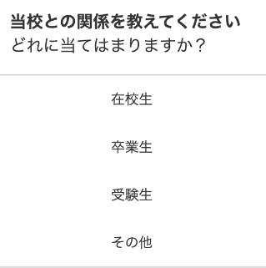

┃Line maintenance note
3. Question 【2】
3. Answer 【2】
What kind of problem?
Please tell me the reason.
What kind of problem?
Please tell me the reason.
Equipment failure
What kind of problem?
Please tell me the reason.
Cutting tools problem
3. Question 【3】
The cutting tool of the equipment is broken.
This is due to the life of the cutting tool.
Human error
Other
Need a repair?
3. Answer 【3】
Have you arrived?
Yes
BOT type
Is it possible to have a conversational type like BOT?
Also, can the wording be changed by the master?
Is it possible to save conversation data in DB?
Choose type
Is it possible to have a conversational type like choose?
Also, can the wording be changed by the master?
Is it possible to save conversation data in DB?
Yes
No
What kind of problem?
Please tell me the reason.
The cutting tool of the equipment is broken.
This is due to the life of the cutting tool.
Need a repair?
Yes

