Slide 1
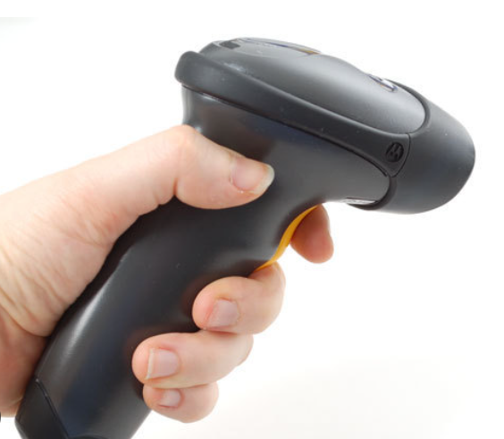
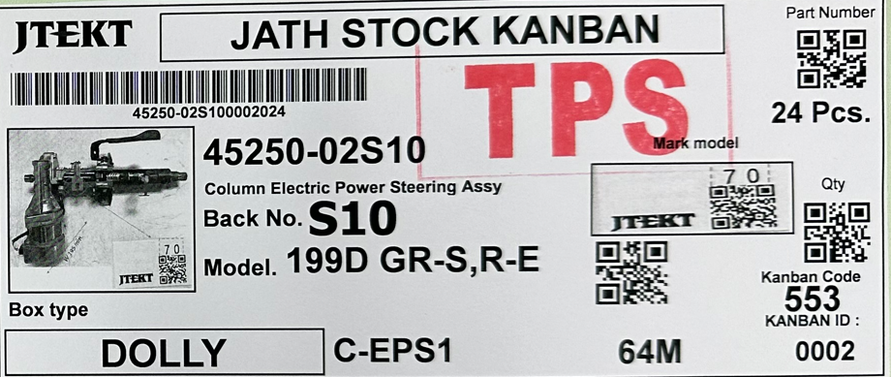
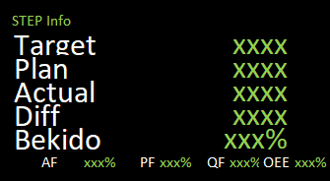
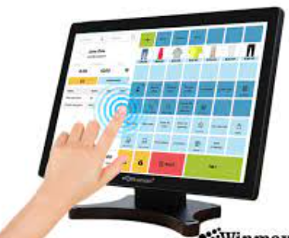

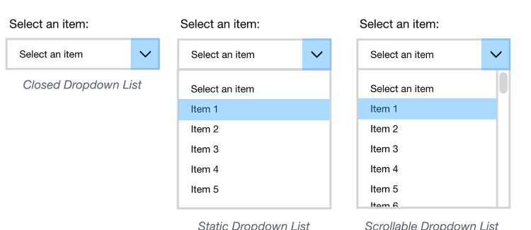
Scan Kanban (part no.)
เก็บข้อมูลจำนวนงานที่ผลิตตาม part no.
*Wait Confirm
Production
+
Information Change over
Monitor in line
Scan KB ทุกครั้งที่มีการเปลี่ยนรุ่น
Final process
Line
touch screen in put data
Summary report *ทำสรุป daily ส่งเมล Auto
touch screen in put data
เลือกข้อมูล dropdown ( Machine Stop , Quality , C/O , retest, Other พิมพ์เพิ่มนอกเหนือจาก dropdown )
*ในอนาคตสามารถเพิ่มหัวข้อเองได้

Slide 2
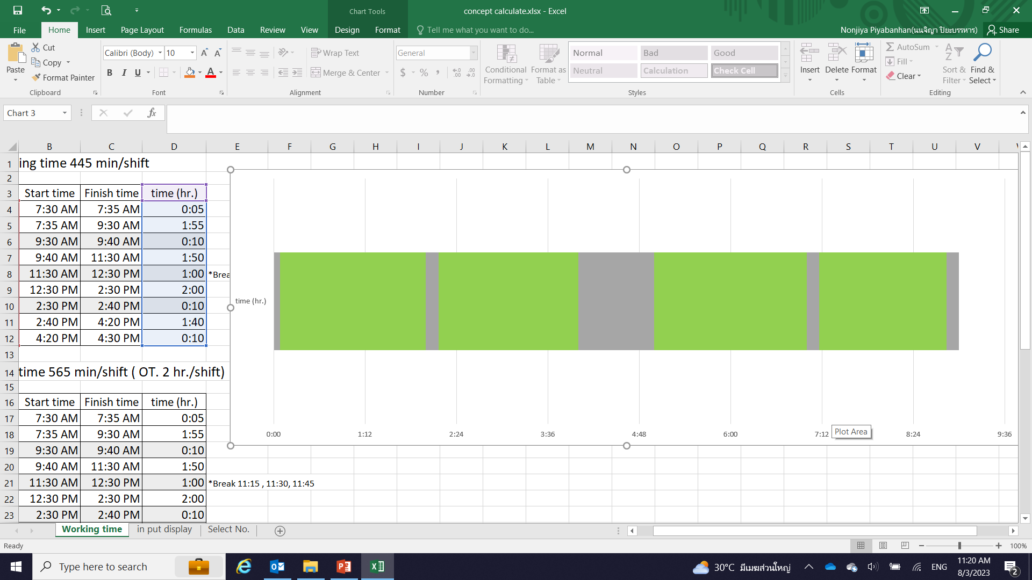
วิธีลงข้อมูล breakdown
Working time STD 445 min/shift
Start 7:35
Break 9:30-9:40
Break 14:30-14:40
5S 16:20 – 16:30
Break
11:15-12:15
11:30-12:30
11:45-12:45
115 min.
110 min.
120 min.
100 min.
สแกนคัมบังทุกครั้งที่มีการเปลี่ยนรุ่น
M/C breakdown
1.งานไม่ออกตาม CT.ที่กำหนด Program alarm ให้ใส่ปัญหา ภายใน 5 นาที
2.Leader ใส่ปัญหาตามตัวเลือก ( real time หรือ ย้อนหลังได้ ภายในกะ)
3.Programจะหยุดเวลาที่ใช้คำนวน breakdown เมื่อมีงานออก
Quality , rework , retest
Change over
Change Tools
Other
touch screen in put data

Slide 3

A
Working Time (Day shift)
Standard working time of JATH
ไม่คำนวน Bekido%
**Lunch time : 11:15-12:15, 11:30-12:30, 11:45-12:45
Subject | No Over time |  | Over time 1 Hrs. |  | Over time 1.5 Hrs. |  | Over time 2 Hrs. |  | Over time 2.5 Hrs.
 | Time | Duration | Time | Duration | Time | Duration | Time | Duration | Time | Duration
Start Working |  | 07:30 |  | 07:30 |  | 07:30 |  | 07:30 |  | 07:30
Morning meeting | 5 min | 7:30 – 7:35 | 5 min | 7:30 – 7:35 | 5 min | 7:30 – 7:35 | 5 min | 7:30 – 7:35 | 5 min | 7:30 – 7:35
Working time | 115 min | 7:35 – 9:30 | 115 min | 7:35 – 9:30 | 115 min | 7:35 – 9:30 | 115 min | 7:35 – 9:30 | 115 min | 7:35 – 9:30
Morning Break | 10 min | 9:30 – 9:40 | 10 min | 9:30 – 9:40 | 10 min | 9:30 – 9:40 | 10 min | 9:30 – 9:40 | 10 min | 9:30 – 9:40
Working time | 110 min | 9:40 – 11:30 | 110 min | 9:40 – 11:30 | 110 min | 9:40 – 11:30 | 110 min | 9:40 – 11:30 | 110 min | 9:40 – 11:30
Lunch time | 60 min | 11:30 – 12:30 | 60 min | 11:30 – 12:30 | 60 min | 11:30 – 12:30 | 60 min | 11:30 – 12:30 | 60 min | 11:30 – 12:30
Working time | 120 min | 12:30 – 14:30 | 120 min | 12:30 – 14:30 | 120 min | 12:30 – 14:30 | 120 min | 12:30 – 14:30 | 120 min | 12:30 – 14:30
Afternoon Break | 10 min | 14:30 – 14:40 | 10 min | 14:30 – 14:40 | 10 min | 14:30 – 14:40 | 10 min | 14:30 – 14:40 | 10 min | 14:30 – 14:40
Working time | 100 min | 14:40 – 16:20 | 110 min | 14:40 – 16:30 | 110 min | 14:40 – 16:30 | 110 min | 14:40 – 16:30 | 110 min | 14:40 – 16:30
Over time break |  |  | 20 min | 16:30 – 16:50 | 20 min | 16:30 – 16:50 | 20 min | 16:30 – 16:50 | 20 min | 16:30 – 16:50
Working time |  |  | 50 min | 16:50 – 17:40 | 80 min | 16:50 – 18:10 | 110 min | 16:50 – 18:40 | 140 min | 16:50 – 19:10
5S | 10 min | 16:20 – 16:30 | 10 min | 17:40 – 17:50 | 10 min | 18:10 – 18:20 | 10 min | 18:40 – 18:50 | 10 min | 19:10 – 19:20
Stop production time |  | 16:30 |  | 17:50 |  | 18:20 |  | 18:50 |  | 19:20
Total time | 540 min |  | 620 min |  | 650 min |  | 680 min |  | 710 min
Total Break time | 95 min |  | 115 min |  | 115 min |  | 115 min |  | 115 min
Total Working time | 445 min |  | 505 min |  | 535 min |  | 565 min |  | 595 min

Slide 4
A
Working Time (Night shift)
ไม่คำนวน Bekido%
Standard working time of JATH
**Lunch time : 23:15-00:15, 23:30-00:30, 23:45-00:45
Subject | No Over time |  | Over time 1 Hrs. |  | Over time 1.5 Hrs. |  | Over time 2 Hrs. |  | Over time 2.5 Hrs.
 | Time | Duration | Time | Duration | Time | Duration | Time | Duration | Time | Duration
Start Working |  | 19:30 |  | 19:30 |  | 19:30 |  | 19:30 |  | 19:30
Morning meeting | 5 min | 19:30 – 19:35 | 5 min | 19:30 – 19:35 | 5 min | 19:30 – 19:35 | 5 min | 19:30 – 19:35 | 5 min | 19:30 – 19:35
Working time | 115 min | 19:35 – 21:30 | 115 min | 19:35 – 21:30 | 115 min | 19:35 – 21:30 | 115 min | 19:35 – 21:30 | 115 min | 19:35 – 21:30
Morning Break | 10 min | 21:30 – 21:40 | 10 min | 21:30 – 21:40 | 10 min | 21:30 – 21:40 | 10 min | 21:30 – 21:40 | 10 min | 21:30 – 21:40
Working time | 110 min | 21:40 – 23:30 | 110 min | 21:40 – 23:30 | 110 min | 21:40 – 23:30 | 110 min | 21:40 – 23:30 | 110 min | 21:40 – 23:30
Lunch time | 60 min | 23:30 – 00:30 | 60 min | 23:30 – 00:30 | 60 min | 23:30 – 00:30 | 60 min | 23:30 – 00:30 | 60 min | 23:30 – 00:30
Working time | 120 min | 00:30 – 02:30 | 120 min | 00:30 – 02:30 | 120 min | 00:30 – 02:30 | 120 min | 00:30 – 02:30 | 120 min | 00:30 – 02:30
Afternoon Break | 10 min | 02:30 – 02:40 | 10 min | 02:30 – 02:40 | 10 min | 02:30 – 02:40 | 10 min | 02:30 – 02:40 | 10 min | 02:30 – 02:40
Working time | 100 min | 02:40 – 04:20 | 110 min | 02:40 – 04:30 | 110 min | 02:40 – 04:30 | 110 min | 02:40 – 04:30 | 110 min | 02:40 – 04:30
Over time break |  |  | 20 min | 04:30 – 04:50 | 20 min | 04:30 – 04:50 | 20 min | 04:30 – 04:50 | 20 min | 04:30 – 04:50
Working time |  |  | 50 min | 04:50 – 05:40 | 80 min | 04:50 – 06:10 | 110 min | 04:50 – 06:40 | 140 min | 04:50 – 07:10
5S | 10 min | 04:20 – 04:30 | 10 min | 05:40 – 05:50 | 10 min | 06:10 – 06:20 | 10 min | 06:40 – 06:50 | 10 min | 07:10 – 07:20
Stop production time |  | 04:30 |  | 05:50 |  | 06:20 |  | 06:50 |  | 07:20
Total time | 540 min |  | 620 min |  | 650 min |  | 680 min |  | 710 min
Total Break time | 95 min |  | 115 min |  | 115 min |  | 115 min |  | 115 min
Total Working time | 445 min |  | 505 min |  | 535 min |  | 565 min |  | 595 min

Slide 5
Calculate Bekido% (OA%)
Break
11:15-12:15
11:30-12:30
11:45-12:45
Start 7:35
Break 9:30-9:40
Break 14:30-14:40
Working time STD
445 min/shift
Meeting,Break,5S
115 min.
110 min.
120 min.
100 min.
Working time
Example.
Part. A
CT. 30 sec.
Operator 10 person.
Part. B
CT. 35 sec.
Operator 9 person.
Part. C
CT. 28 sec.
Operator 10 person.
Part. A
CT. 30 sec.
Operator 10 person.
Actual Output (pcs.)
A = 430 pcs.
B = 160 pcs.
C = 240 pcs.
Total = 830 pcs.
Working time 115 min
10 min
Working time 100 min
Working time 120 min
Working time 100 min
Bekido% =
Actual output (pcs.)x100%
Working time (sec.) / Cycle Time (sec.)
= xx.xx %
Bekido% (A) =
430 pcs. X 100%
= 430 pcs. X 100%
= 95.56%
((115+10+100 min.)x60)/30 sec.
450 pcs.
Bekido% (All) =
(430 + 160 + 240 (pcs.)) x 100%
450 + 171 + 257 (pcs.)
Bekido% (B) =
160 pcs. X 100%
= 160 pcs. X 100%
= 93.56%
= 830 pcs. X 100%
(100 min. x60)/35 sec.
171 pcs.
878 pcs.
Bekido% (C) =
240 pcs. X 100%
= 240 pcs. X 100%
= 94.53%
= 93.38%
(120 min.x60)/28 sec.
257 pcs.

Slide 6
Calculate Productivity (PPLH)
Break
11:15-12:15
11:30-12:30
11:45-12:45
Start 7:35
Break 9:30-9:40
Break 14:30-14:40
Working time STD
445 min/shift
Meeting,Break,5S
115 min.
110 min.
120 min.
100 min.
Working time
Example.
Part. A
CT. 30 sec.
Operator 10 person.
Part. B
CT. 35 sec.
Operator 9 person.
Part. C
CT. 28 sec.
Operator 10 person.
Part. A
CT. 30 sec.
Operator 10 person.
Actual Output (pcs.)
A = 430 pcs.
B = 160 pcs.
C = 240 pcs.
Total = 830 pcs.
Working time 115 min
10 min
Working time 100 min
Working time 120 min
Working time 100 min
PPLH =
Actual Output (pcs.)
= xx.xx (pcs./man*hr.)
No. of operator (person) x Working time(hr.)
PPLH (A) =
430 pcs.
= 430 pcs.
= 11.47 pcs./man*hr.
PPLH (All) =
830 pcs.
10 person. x ((115+10+100 min.)/60)
10 person. x 3.75 hr.
(10 person. x 3.75 hr.)+(9 person. x 1.67 hr.)+ (10 person. x 2 hr.)
PPLH (B) =
160 pcs.
= 160 pcs.
= 10.64 pcs./man*hr.
= 830 pcs.
9 person. x (100 min./60)
9 person. x 1.67 hr.
72.53 man*hr.
PPLH (C) =
240 pcs.
= 240 pcs.
= 12 pcs./man*hr.
= 11.44 pcs./man*hr.
10 person. x (120 min./60)
10 person. x 2 hr.

Slide 7
Calculate Chokko%
Actual output (pcs.)x100%
Working time (sec.) / Cycle Time (sec.)
Chokko% =
= xx.xx %
Direct OK = Direct finish good x 100%
( Direct finish good + rework + NG)
= 100 x 100% = 100 x 100% = 86.95 %
(100 + 10 + 5 ) 115
ปัจจุบัน เราคำนวณแบบซ่อนปัญหา
Chokko% (OK ratio) = (Direct finish good + rework ) x 100%
( Direct finish good + rework + NG)
= (100+10) x 100% = 110 x 100% = 95.65 %
(100 + 10 + 5 ) 115

