Slide 1
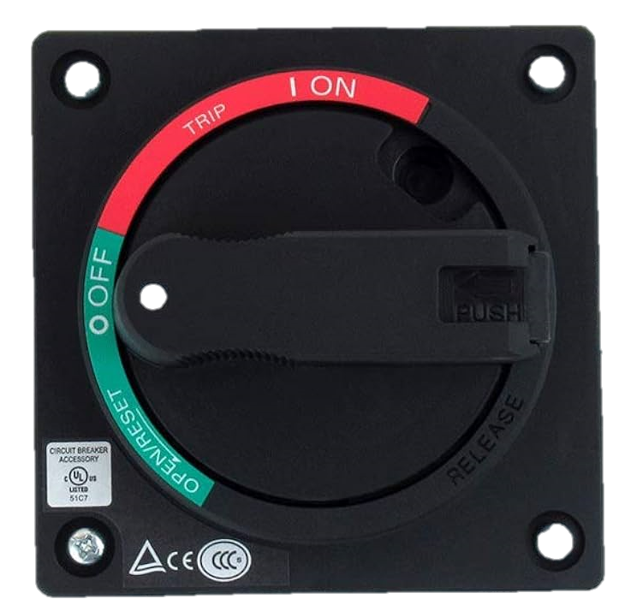
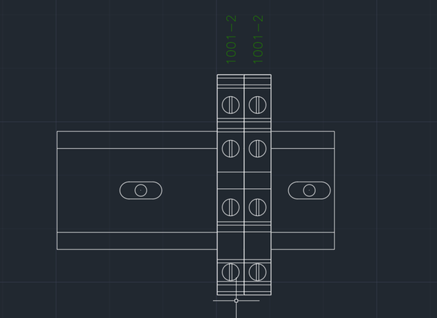

Master box_R1
ELCB
CP1
CP2
UPS
PLC
XD
XTD
VT5-W10
Front
Side
In side

Slide 2
Slave box_R1
ELCB
CP1
CP2
UPS
KV-EP02
NC16EXE
VT5-W10
Front
Side
In side

Slide 3
Master box_R2
ELCB
CP1
CP2
UPS
PLC
XD
XTD
VT5-W10
Front
Side
In side

Slide 4
Slave box_R2
ELCB
CP1
CP2
UPS
KV-EP02
NC16EXE
VT5-W10
Front
Side
In side

