Slide 1
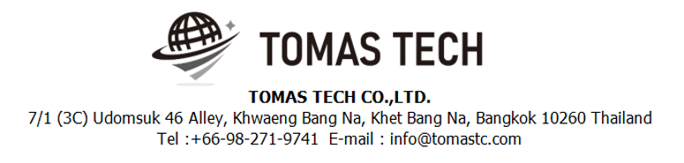
Version 21/June/2023
Confidential
WMS System
Specifications Documentation EN for Ebisu
Blueprint
R1
Made for : EBISU FOODS CO.,LTD.
By : TOMAS TECH CO.,LTD.

Slide 2
Revision History
Date | Version | File name | Details
21/June/2023 | R1 | WMS system Specifications Documentation EN for Ebisu Foods | First edition

Slide 3
■Contents
1. Overview
2. Overall configuration diagram
3. Document information
3-1. Warehouse Management System
3-2. Interface information SAP-WMS
3-3. Format Inbound label (Output data)
3-4. Inbound Operation Diagram
3-5. Outbound Operation Diagram
4. Operation flow
4-1. Work Flow Chart
4-1-1. Data linkage with Ebisu's ERP system and Pegasus
4-1-2. Warehouse Inbound process
4-1-3. Outbound for production process - Preparation
4-1-4. Outbound for production process - Picking
4-1-5. Outbound for production process - Slicing Production
4-1-6. Outbound for production process - Sorting to packing
4-1-7. Outbound for production process - Stock check
4-1-8. Outbound for production process - Location management
4-1-9. Outbound for production process - Stocktaking
5. System functional specifications
5-1. Handy terminal function
5-1-1. Inbound
5-1-2. Outbound
5-1-3. Outbound - Production
5-1-4. Sorting
5-1-5. Stock Management – Stock Check
5-1-6. Stock management – Change Location
5.2 WMS Application
6. Q&A
7. Sign off

Slide 4
1. Overview
We propose a process control system to Ebisu Foods Co Ltd. By scanning and collating the visual confirmation work with label management + handy terminal, it is possible to prevent check mistakes by workers and expect “Improvement of quality".
Giving work instructions to workers with handy terminals, it is possible to expect “Improvement of work efficiency" and prevent dependence on individual skills.
Creating a system, on-site managers, office managers, and people in charge of other processes will be able to grasp the work status, realizing “Visualization of work".
Being able to view the necessary information on a PC or handy terminal, it is possible to realize “Paperless" by digitizing forms.“ Traceability management" and “FIFO” can be realized by confirming the matching result with a handy terminal.
Since it is possible to simplify the performance input to the ERP side, “Improvement of work efficiency" can be realized.

Slide 5



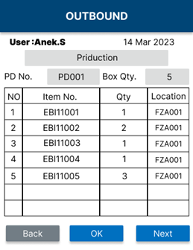








2. Overall configuration diagram
Regarding the Process control system, consider the following system configuration.
Overall configuration diagram image
Inbound
Create label
Move to Store
Picking
Packing
Sorting
Outbound
Create labels
SAP
WMS
Create labels : "Inbound date & time", "Expiry date", "Lot No." "Item No.", "Item Name", "Qty"

Slide 6
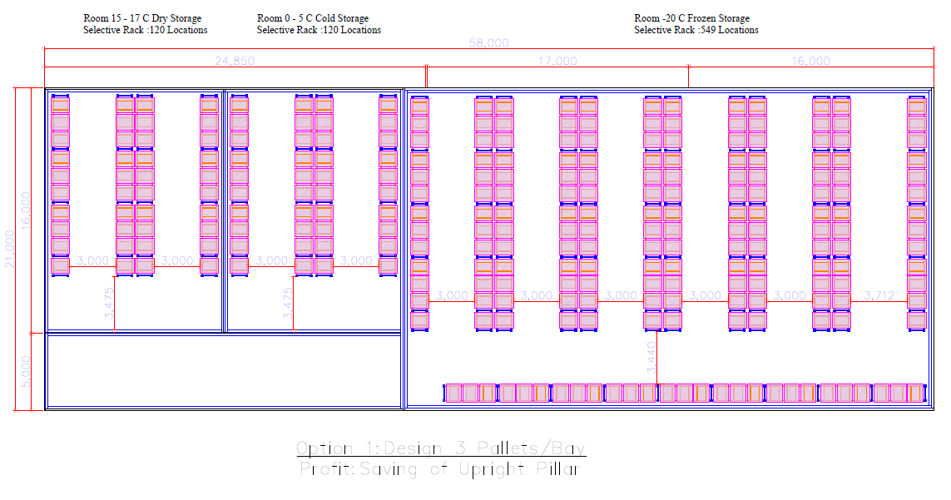
3. Document information
3-1. Warehouse Management System
DRY
COLD
FROZEN
SORTING
3-2. Interface information SAP-WMS
No. of Format Design | SAP Process | WMS Process | Inventory Update
1 | Purchase Order (PO) | Inbound schedule/PO | IN
1.1 | Claim to maker | Outbound update /PO | OUT
1.2 | Maker return back | Inbound update/PO | IN
2 | Sell order ( SO) | Outbound schedule/SO
2.1 | Customer return | Inbound schedule/Customer return | IN
2.2 | Delivery (DO) | Update/SO | OUT
3 | Production Order | Production schedule | IN/OUT
4 | W/H transfer | Stock transfer | IN/OUT
4.1 | Stock Count | Stock Update In/Out | IN/OUT
5 | Issue/Receive Request | Issue/Receive | IN/OUT
6 | Item Master/Supplier/Customer/Employee | Item Master/Supplier/Customer/Employee | IN/OUT
SAP
1.PO
1.2 Return
2.1 Return
4.Transfer
3.Production Order
2.SO
2.2.DO
1.1.Claim
5.Issue
4.Transfer
WMS
WMS - INBOUND
WMS - PRODUCTION
WMS - OUTBOUND

Slide 7
3. Document information
3-3. Format Inbound label (Output data)
Inbound label
QR Code for Offline | 31-10-2022, 31-10-2022, 22021031-0001,164400-59B-0033, Kikkoman soy sauce 400ml,100
No | Item | Ebisu Barcode Value
0 | Inbound date | 31-10-2022
1 | Expiry date | 31-10-2022
2 | Lot No. | 20221031-0001
3 | Item No. | 164400-59B-0033
4 | Item Name | Kikkoman soy sauce 400ml
5 | Qty | 100

Slide 8
3. Document information
3-4. Inbound Operation Diagram
Inbound
From Supplier
From Production
PO From SAP
Create label
PD From SAP
Create label
HT. Scan Product
Frozen
HT. Scan FG
Frozen
Move to Store
Cold
Move to Store
Cold
Update to ERP/PO
Dry
Update to ERP/PD
Dry
3-5. Outbound Operation Diagram
Outbound
To Customer
Frozen
To Production
Frozen
SO rom SAP
Batch Picking FG
Cold
PD From ERP
Picking Mat./PD
Cold
Move to Packing
Dry
Move to production
Dry
Print SO / Set Box
Inbound to FG Store
Scan FG
Update to ERP/PD
Scan SO
Update to ERP/SO

Slide 9
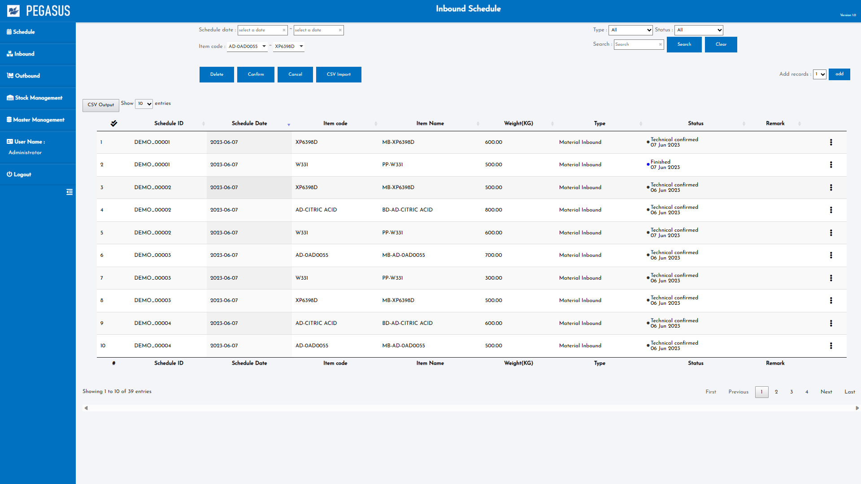
4. Operation flow
4-1. Workflow Chart
4-1-1. Data linkage with Ebisu's ERP system and Pegasus
Officer
Screen
Data linkage is assumed to be linked in both Inbound and Outbound. Receive schedule data from EPR.

Slide 10
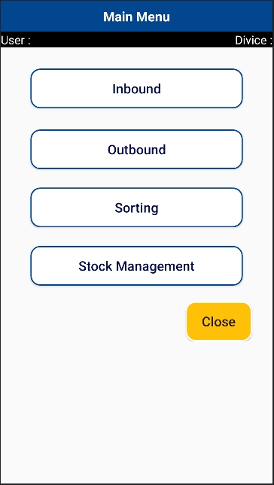
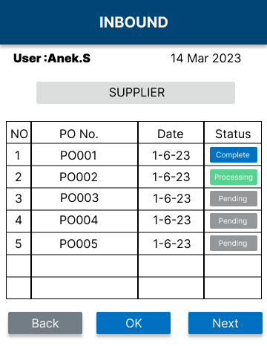
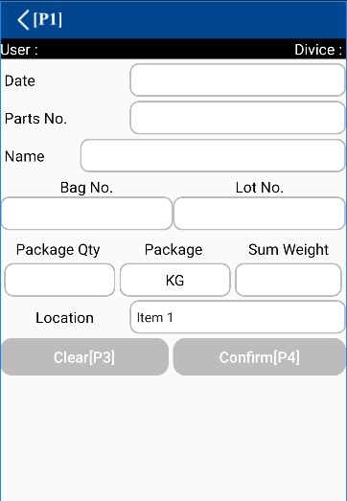
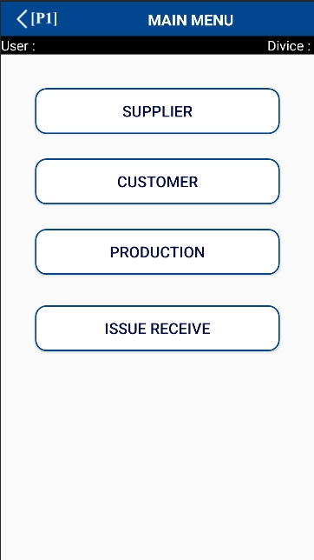
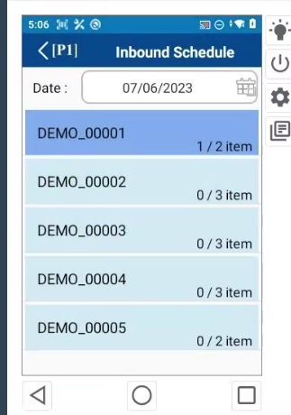
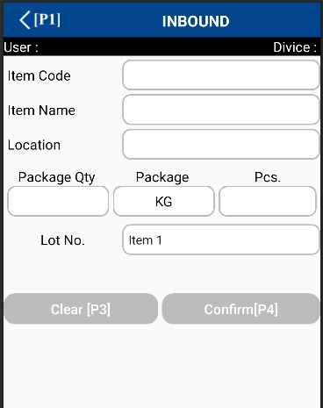

4. Operation flow
4-1. Workflow Chart
4-1-2. Warehouse Inbound process
Officer
Factory staff
Start
No
Check daily job?
Print prepare part label
Yes
Put label to items.
Inbound process check by handy
Inbound
No
All done?
Yes
Place the items to store Frozen, Cold, Dry
Scan the label with a handy terminal
Inbound
EBI11001
MEAT
FZA010
Scan the loading location with a handy terminal
1
CARTON
20
LOT14032023
No
All done?
Yes

Slide 11
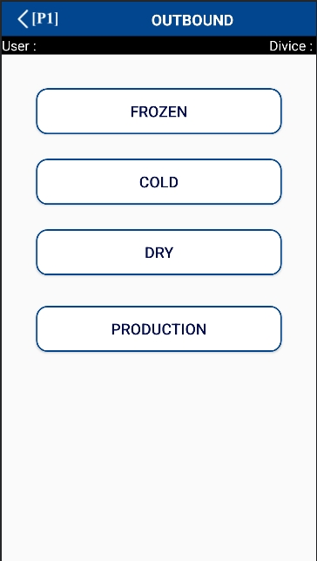
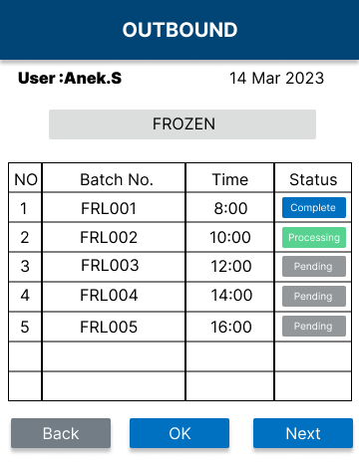
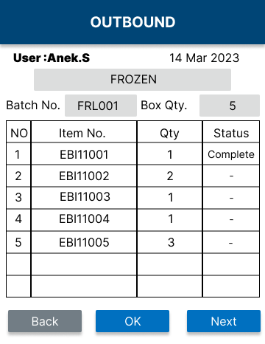
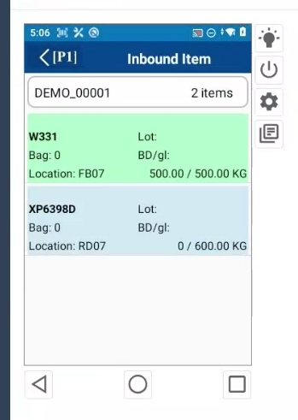
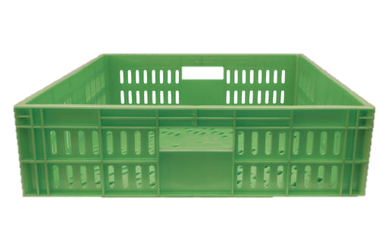
4. Operation flow
4-1. Workflow Chart
4-1-3. Outbound process - Preparation
Officer
Factory staff
Start
No
Check daily job?
Yes
Create a batch picking list
Select area for picking
Picking cart setup
Prepare the cart for picking every area

Slide 12

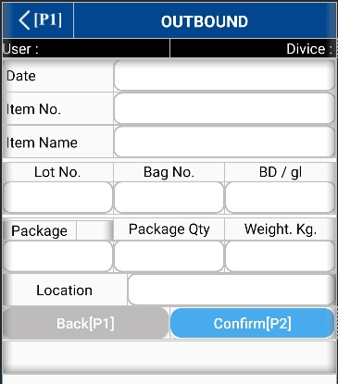
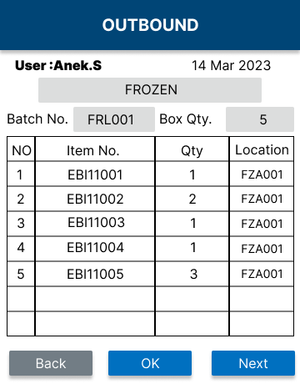
4. Operation flow
4-1. Workflow Chart
4-1-4. Outbound process - Picking
Officer
Factory staff
Start
No
Check daily job?
Yes
scan the location Label code
scan the item label code
No
All done?
20/06/65
C-12345678910
Yes
LOT1042368
MEAT
Continue picking at each location
PACK
10
9.8
FZA101

Slide 13

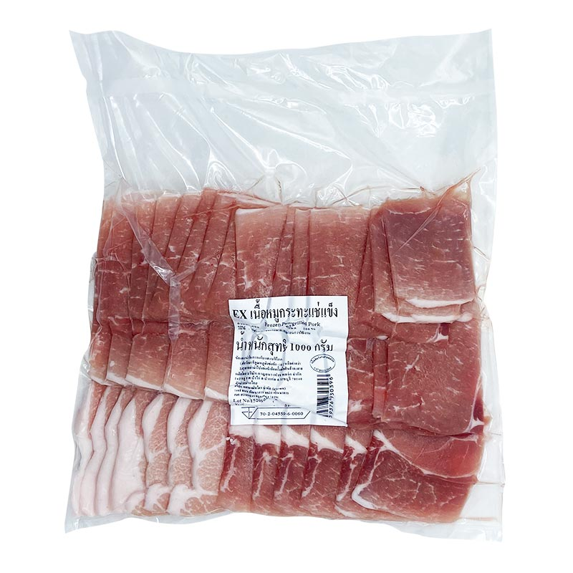
4. Operation flow
4-1. Workflow Chart
4-1-5. Outbound for production process - Slicing Production
Officer
Factory staff
Start
No
Check daily job?
Yes
Slicing meat follow production plan
Picking meat large size form warehouse
Print prepare part label
Slicing meat
Picking 100 kg.
Order 40 kg
Remainder 60 kg
Put label to items.
scanned label item
Inbound-Store

Slide 14

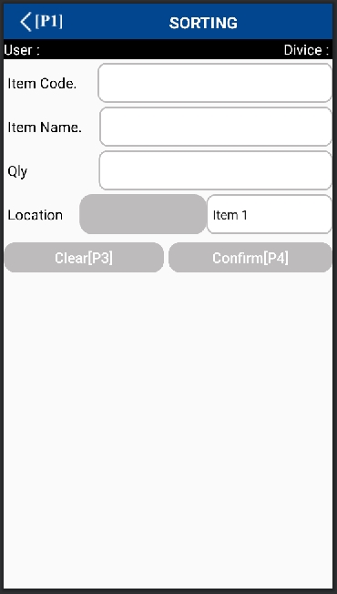
4. Operation flow
4-1. Workflow Chart
4-1-6. Outbound process - Sorting to packing
Officer
Factory staff
Start
No
Check order list?
Yes
Print out Order packing list
Create order packing list
Put paper packing list on each box.
Scan product label on picking cart
All done?
AA001
No
C-12345678910
MEAT
Yes
A11
10
FZA101
put product tot that box

Slide 15
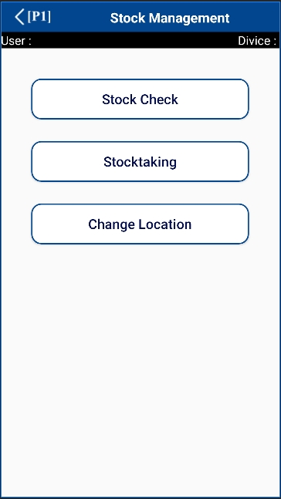
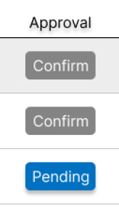
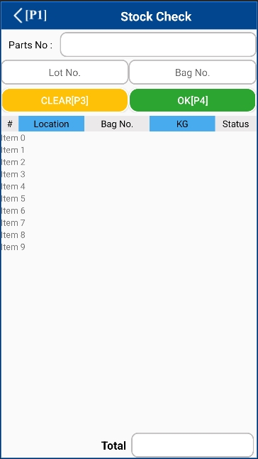
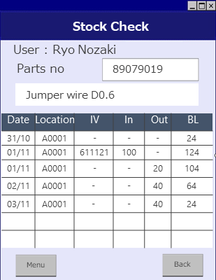
4. Operation flow
4-1. Workflow Chart
4-1-7. Stock Management - Stock check
Officer
Factory staff
Start
Scan product label
confirm on WMS Application.
OK
check the history
Finish
C-12345678910
L6532185200

Slide 16
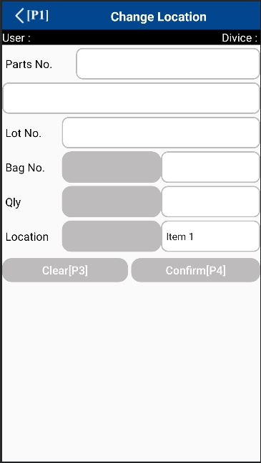
4. Operation flow
4-1. Workflow Chart
4-1-8. Stock Management - Location management
Officer
Factory staff
Start
Scan product label
Change locations, Quantity
OK
Finish
C-12345678910
ground beef A65
L6532185200
Change Quantity
500
200
A11
B23
Change locations

Slide 17
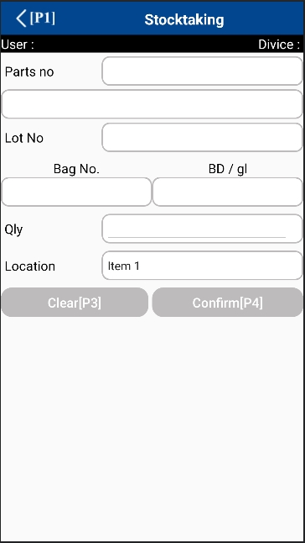
4. Operation flow
4-1. Workflow Chart
4-1-9. Stock Management - Stocktaking
Officer
Factory staff
Start
Scan product label
Input Quantity
OK
Finish
C-12345678910
ground beef A65
L6532185200
200
Input Quantity
B23

Slide 18
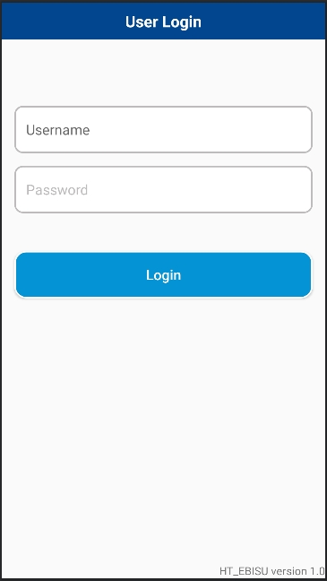
5. System functional specifications
5-1. Handy terminal function
Handy terminal function / screen image
1.User Login
2.Main Menu
3. Inbound
INBOUND
4. Outbound
5. Sorting
6. Stock Management
C-12345678910
MEAT
A11
10
FZA101

Slide 19
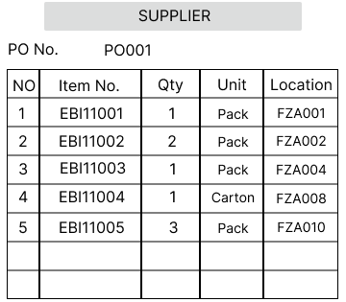
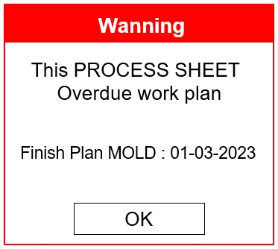
5. System functional specifications
5-1. Handy terminal function
5-1-1. Inbound
Handy terminal function / screen flow
INBOUND
1. Scan Location
2. Scan Item Code
3. Check Package
4. Check Qty.
5. Click “OK”
Good
Adjust according to the menu.
Inbound
Inbound
EBI11001
MEAT
QC Confirm
FG Repack
FZA010
FG Reprint
1
CARTON
20
LOT14032023
NG
Sorry !!
Location does not match

Slide 20
5. System functional specifications
5-1. Handy terminal function
5-1-2. Outbound
Handy terminal function / screen flow
Adjust according to the menu.
Count Box for Item
20/06/65
C-12345678910
QC Confirm
FG Repack
MEAT
LOT1042368
FG Reprint
PACK
10
9.8
FZA101
Good
1. Scan Location
2. Scan Item Code
3. Check Package
4. Check Qty.
5. Input Weight
5. Click “OK”
Input weight. Kg.

Slide 21

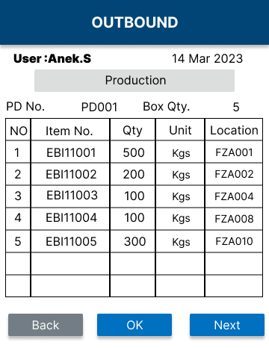
5. System functional specifications
5-1. Handy terminal function
5-1-3. Outbound - Production
Handy terminal function / screen flow
Adjust according to the menu.
Count Box for Item
20/06/65
EBI11001
QC Confirm
FG Repack
MEAT
LOT1042368
FG Reprint
PACK
10
9.8
FZA101
Good
Slicing meat process
-Slicing meat follow production plan.
-Production plan show on handy terminal.
1. Scan Location
2. Scan Item Code
3. Check Package
4. Check Qty.
5. Input Weight
5. Click “OK”
Input weight. Kg.

Slide 22
5. System functional specifications
5-1. Handy terminal function
5-1-4. Sorting
Handy terminal function / screen flow
C-12345678910
MEAT
A11
10
FZA101
QC Confirm
FG Repack
FG Reprint

Slide 23
5. System functional specifications
5-1. Handy terminal function
5-1-5. Stock Management – Stock Check
Handy terminal function / screen flow
C-12345678910
L6532185200
it can check inventory information in real time. Workers can check the history of inbound and outbound on the handy terminal. After check stock already let Approve before confirm on WMS Application.
QC Confirm
FG Repack
FG Reprint

Slide 24
5. System functional specifications
5-1. Handy terminal function
5-1-6. Stock Management – Stock Taking
Handy terminal function / screen flow
C-12345678910
Compare physical inventory and theoretical inventory. Enter the actual shelf quantity on the handy terminal, compare it on the PC side, and display if there is a difference.
ground beef A65
FG Repack
QC Confirm
FG Reprint
L6532185200
200
B23

Slide 25
5. System functional specifications
5-1. Handy terminal function
5-1-7. Stock management – Change Location
Handy terminal function / screen flow
C-12345678910
it can manage location information. it can register, change, delete, and move locations.
ground beef A65
L6532185200
FG Repack
QC Confirm
FG Reprint
500
200
1. Input Qty.
A11
B23
2. Scan location

Slide 26
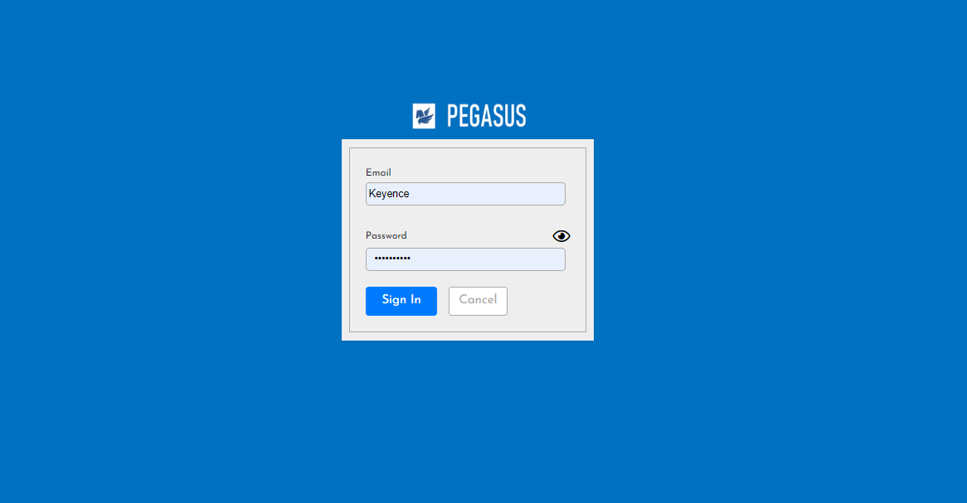
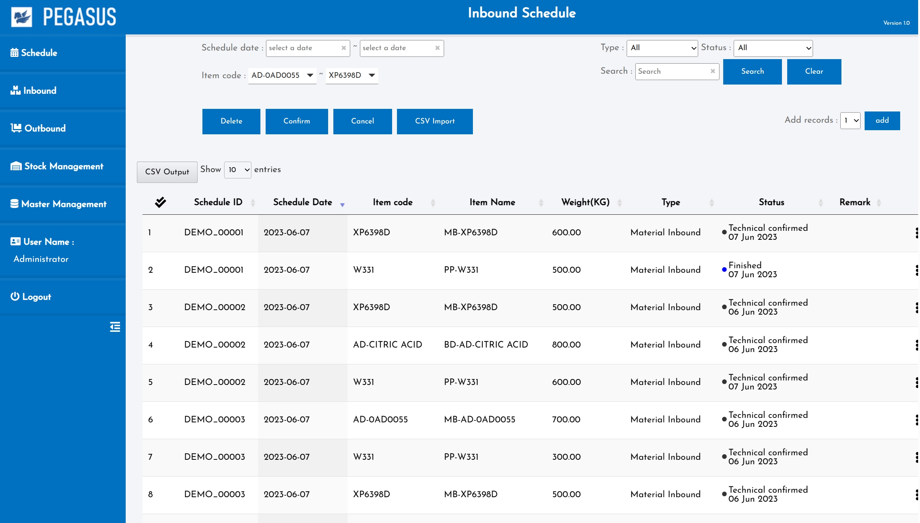
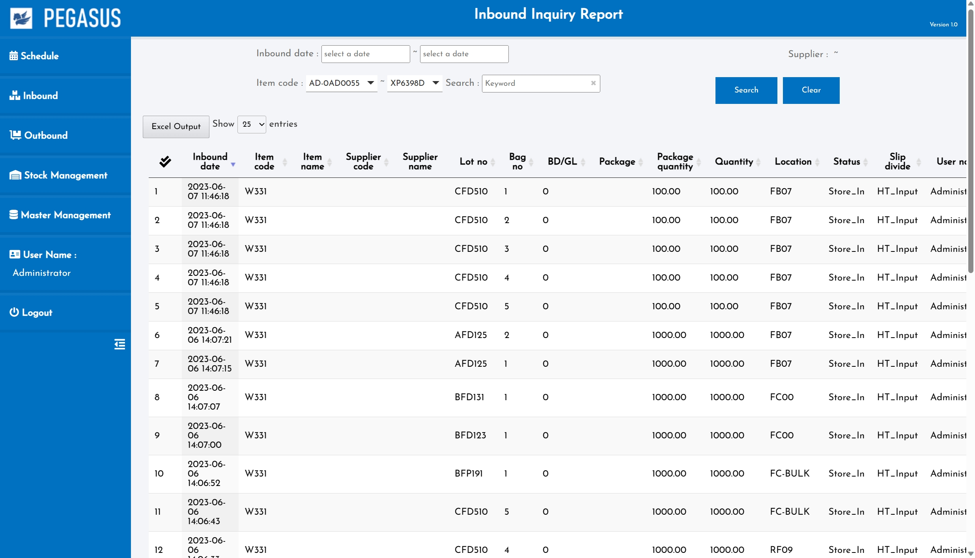

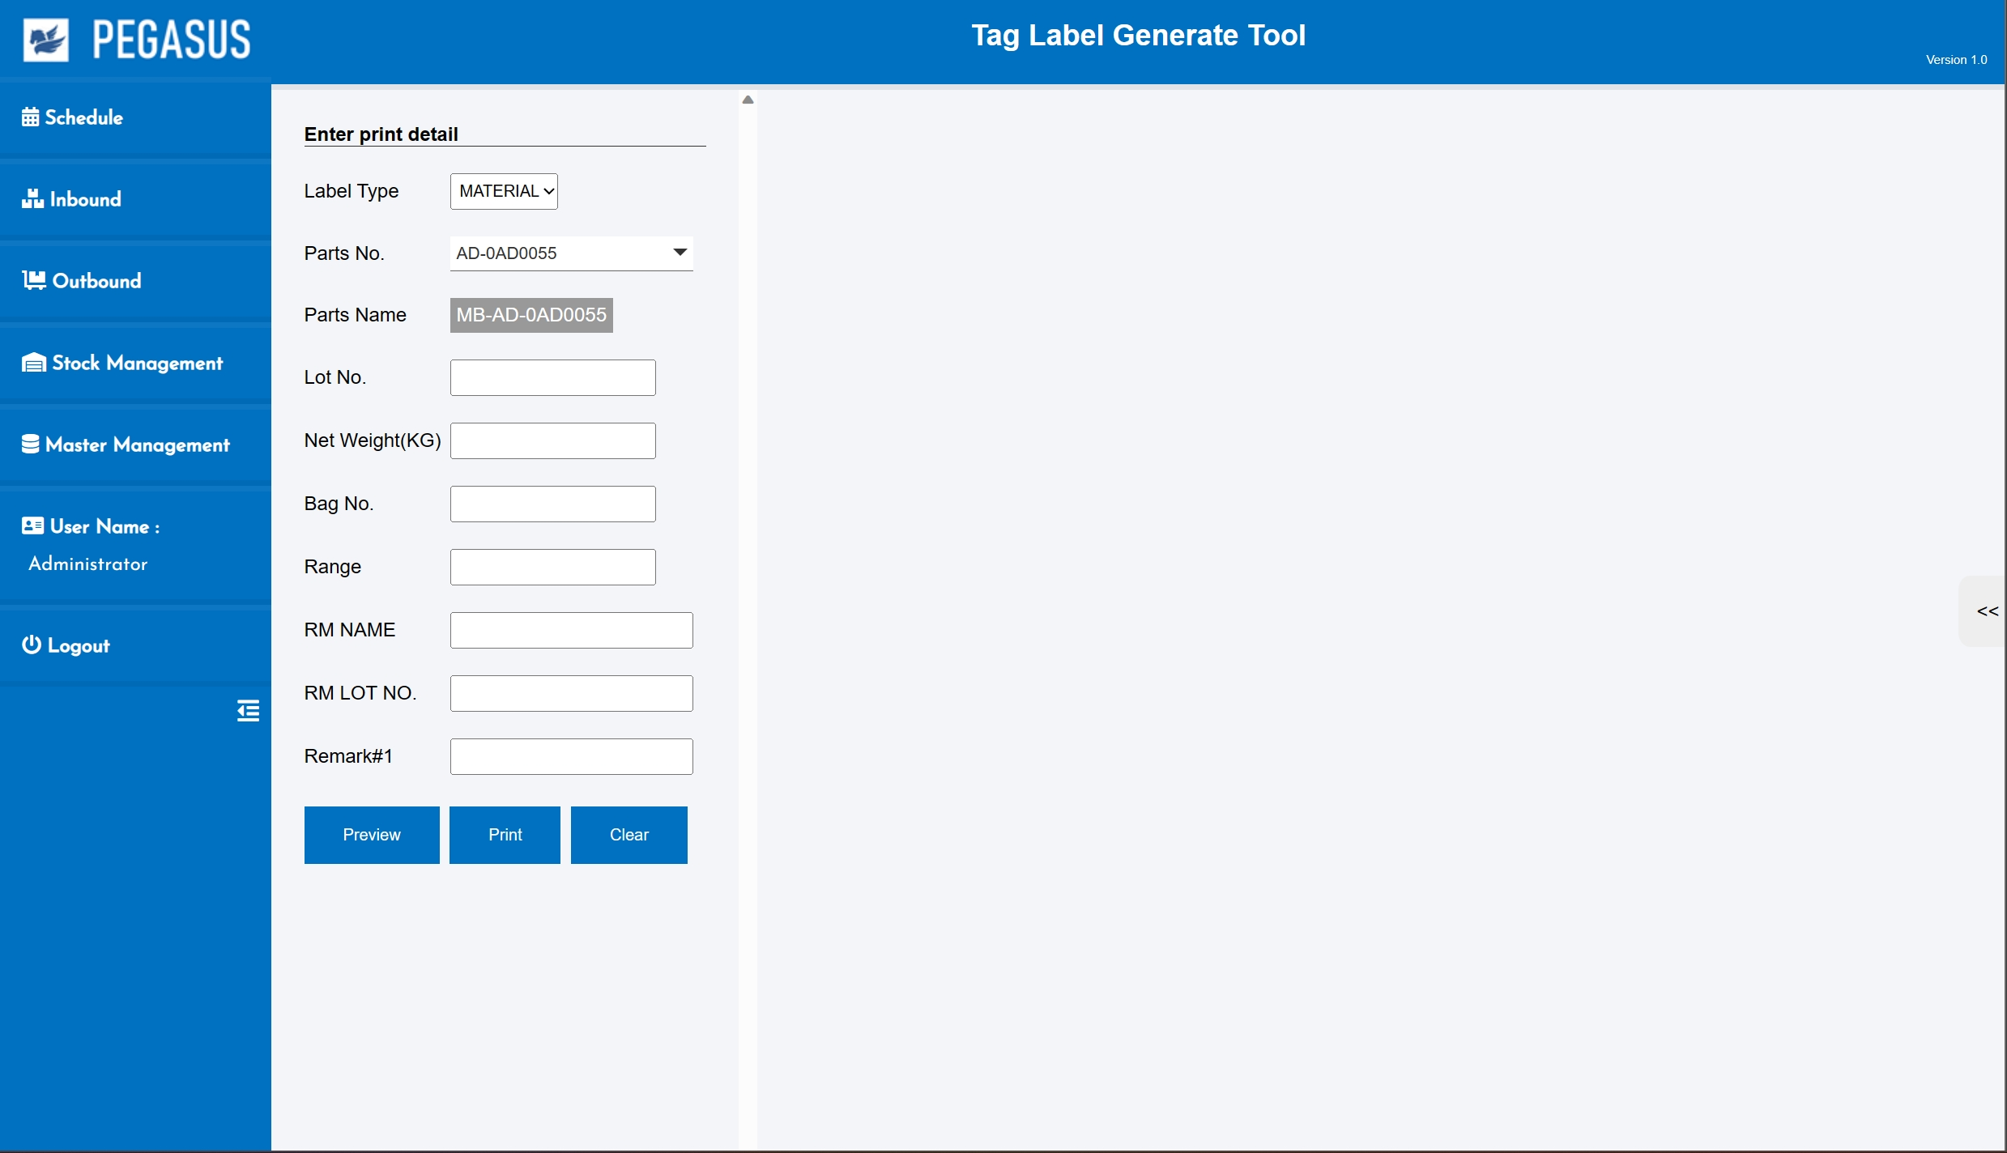
5. System functional specifications
5.2 WMS Application
Pegasus function / screen flow
1.User Login
2. Schedule
3. Inbound Inquiry / Report
4. Outbound Inquiry / Report
5. Create Label
QC Confirm
FG Repack
FG Reprint

Slide 27
5. System functional specifications
5.2 WMS Application
Pegasus function / screen flow
1. Schedule
QC Confirm
FG Repack
FG Reprint

Slide 28
5. System functional specifications
5.2 WMS Application
Pegasus function / screen flow
1. Inbound
QC Confirm
FG Repack
FG Reprint

Slide 29
5. System functional specifications
5-2 WMS Application
Pegasus function / screen flow
1. Outbound
QC Confirm
FG Repack
FG Reprint

Slide 30
5. System functional specifications
5.2 WMS Application
Pegasus function / screen flow
1. Tag Label Generate Tool
QC Confirm
FG Repack
FG Reprint

Slide 31
6. Q&A

Slide 32
7. Sign off
We hereby acknowledge and agree the above-mentioned blueprint requirements.
Any changes required after the sign off for this blueprint will be addressed through the change request process.
Ebisu Foods Co Ltd.
Sign:
Name:
Title:
Date:
TOMAS TECH CO.,LTD.
Sign:
Name:
Title:
Date:
## END OF Goods-Reprint/Repack

